Slide 1
Linkages Between Tropopause Polar Vortices and the Development of Cold Air Outbreaks over Central and Eastern North America
Kevin A. Biernat
Department of Atmospheric and Environmental Sciences
University at Albany, SUNY
Master’s Thesis Seminar
29 November 2017
Research support provided by NSF Grant AGS-1355960

Slide 2
What are Tropopause Polar Vortices (TPVs)?
TPVs are defined as tropopause-based vortices of high-latitude origin and are material features (Pyle et al. 2004; Cavallo and Hakim 2009, 2010, 2012, 2013)
TPV
TPV
(left) Dynamic tropopause (DT) wind speed (every 15 m s⁻¹ starting at 50 m s⁻¹, thick contours) and DT potential temperature (K, thin contours and shading) on 1.5-PVU surface valid 0000 UTC 1 Dec 1991; (right) same as left except DT pressure (hPa, thin contours and shading). Adapted from Fig. 11 in Pyle et al. (2004).

Slide 3
Motivation
TPVs may interact with and strengthen midlatitude jet streams, and act as precursors to intense midlatitude cyclones

Slide 4
Motivation
TPVs may interact with and strengthen midlatitude jet streams, and act as precursors to intense midlatitude cyclones
Arctic air surges that accompany TPVs as they are transported into middle latitudes may lead to widespread cold air outbreaks (CAOs)

Slide 5
Motivation
TPVs may interact with and strengthen midlatitude jet streams, and act as precursors to intense midlatitude cyclones
Arctic air surges that accompany TPVs as they are transported into middle latitudes may lead to widespread cold air outbreaks (CAOs)
CAOs may lead to significant socioeconomic impacts, posing a hazard to society, agriculture, and infrastructure

Slide 6
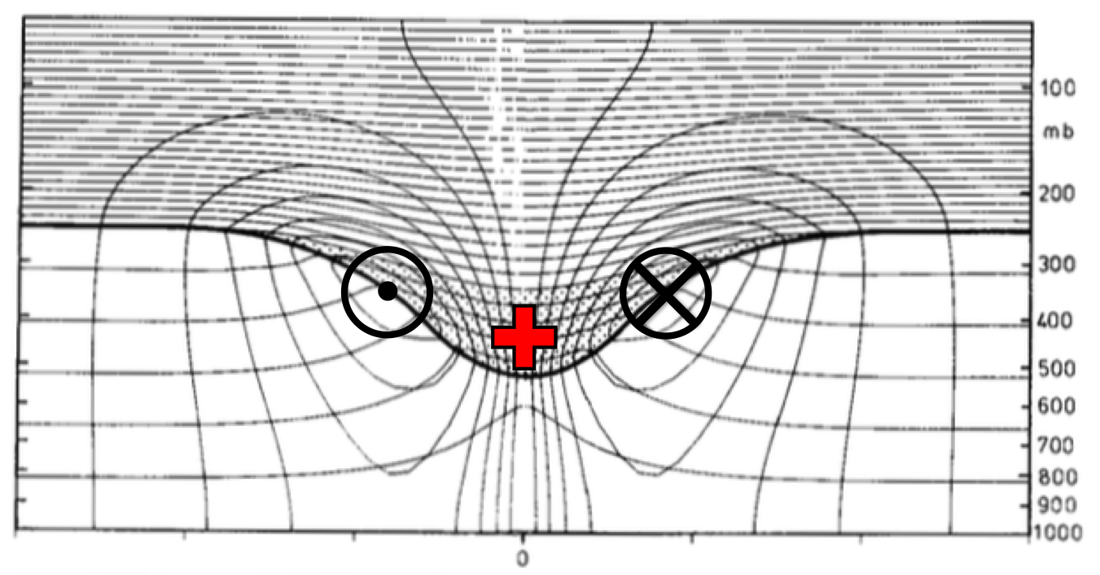
Motivation
Cavallo and Hakim (2010)
Hoskins et al. (1985)
Cross section of circularly symmetric cyclonic flow induced by simple isolated upper-level cyclonic PV anomaly (stippled region and red plus symbol). The thick line represents the tropopause and the solid contours represent potential temperature (every 5 K) and azimuthal wind velocity (every 3 m s⁻¹). Figure 15 and caption adapted from Hoskins et al. (1985, section 3).
Fig. 1.3. Composite west-to-east cross-TPV section of anomalous temperature (K). Thick solid black contour is the composite tropopause, thick dashed black contour is the background tropopause, and thin solid contour is the 0 contour. Figure 9a and adapted caption from Cavallo and Hakim (2010).

Slide 7
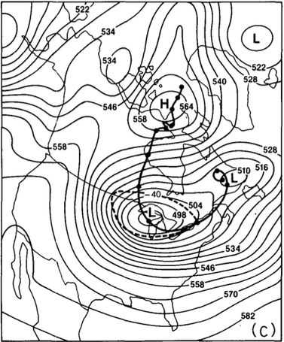
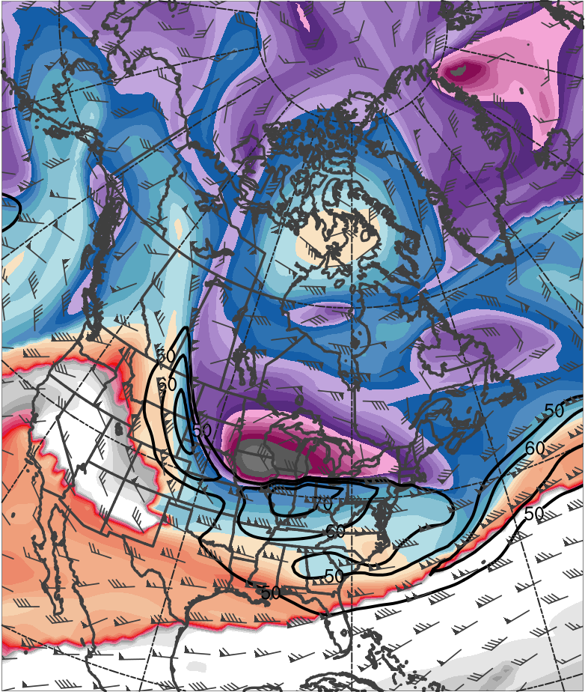
Motivation
Shapiro et al. (1987)
0000 UTC 20 January 1985
378
372
366
360
354
348
342
336
“Polar Vortex”
TPV
330
324
318
312
306
300
294
288
282
276
270
264
258
252
(K)
500-hPa geopotential height (black, every 6 dam) and −40°C isotherm (dashed contour); track of polar vortex from 0000 UTC 12 January to 0000 UTC 24 January 1985 (heavy black). Figure 5 and caption adapted from Shapiro et al. (1987).
Potential temperature (K, shaded), wind speed (black, every 10 m s⁻¹ starting at 50 m s⁻¹), and wind (m s⁻¹, flags and barbs) on 2-PVU surface. Data source: ERA-Interim.

Slide 8
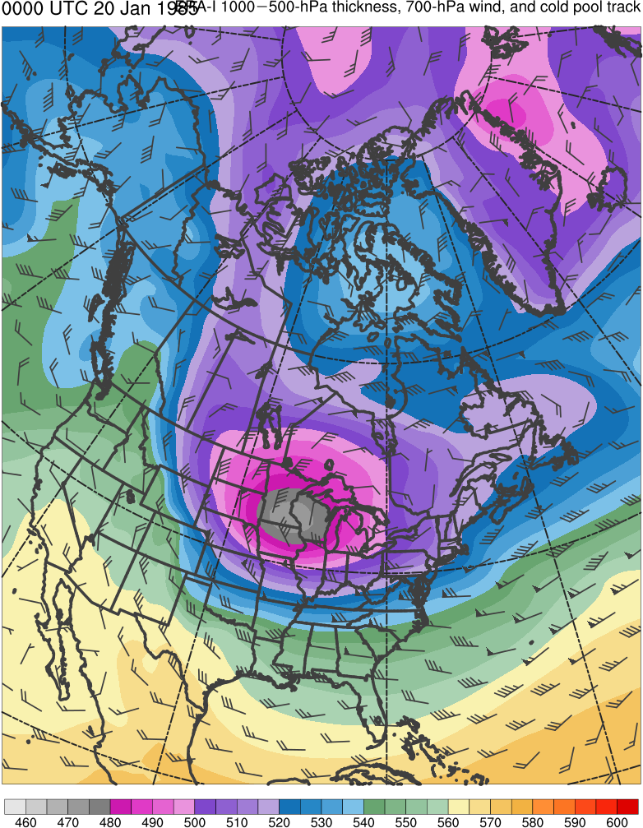
Motivation
Shapiro et al. (1987)
0000 UTC 20 January 1985
600
590
580
570
560
550
“Polar Vortex”
Cold Pool
540
530
520
510
500
490
480
470
460
(dam)
500-hPa geopotential height (black, every 6 dam) and −40°C isotherm (dashed contour); track of polar vortex from 0000 UTC 12 January to 0000 UTC 24 January 1985 (heavy black). Figure 5 and caption adapted from Shapiro et al. (1987).
1000–500-hPa thickness (dam, shaded) and 700-hPa wind (m s⁻¹, flags and barbs). Data source: ERA-Interim.

Slide 9
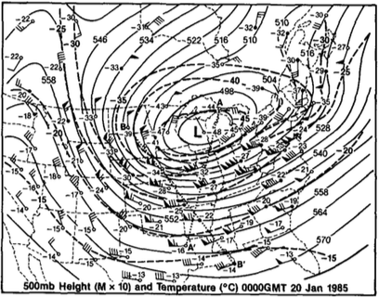
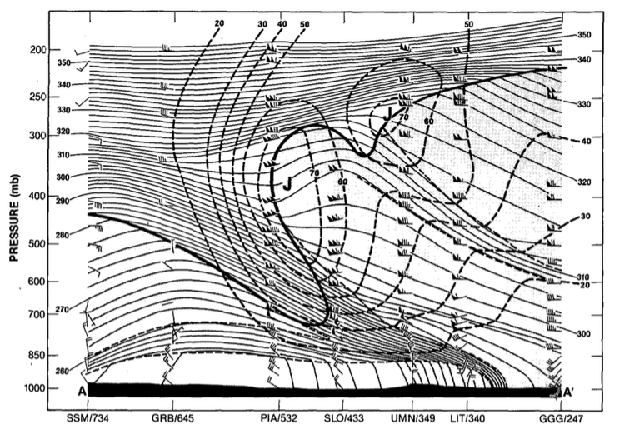
Motivation
Shapiro et al. (1987)
0000 UTC 20 January 1985
A
A’
A
A’
500-hPa geopotential height (dam, solid contours), temperature (°C, dashed contours), and wind (barbs and flags, m s⁻¹). Figure 7 and caption adapted from Shapiro et al. (1987)
Potential temperature (K, thin solid), wind speed (m s⁻¹, heavy dashed contours), and wind (m s⁻¹, barbs and flags) between Sault Sainte Marie, MI and Longview, TX. Heavy solid line is tropopause (10⁻⁷ K s⁻¹ hPa⁻¹ isopleth of PV) and light dashed lines indicate tropospheric frontal and stable layer boundaries. Figure 9 and caption adapted from Shapiro et al. (1987)

Slide 10
Overview of 9–14 January 1982 CAO
According to NOAA NCEI, contributed to cost of 1.7 billion dollars, after 2017 consumer price adjustment, and 85 deaths (https://www.ncdc.noaa.gov/billions/)
Lead to widespread record lows over the central and eastern U.S. (Wagner, 1982)
All-time record low of −32.2°C (−26°F) in Chicago, IL on 10 January 1982
All-time record low of −17.2°C (1°F) in Augusta, GA on 11 January 1982

Slide 11
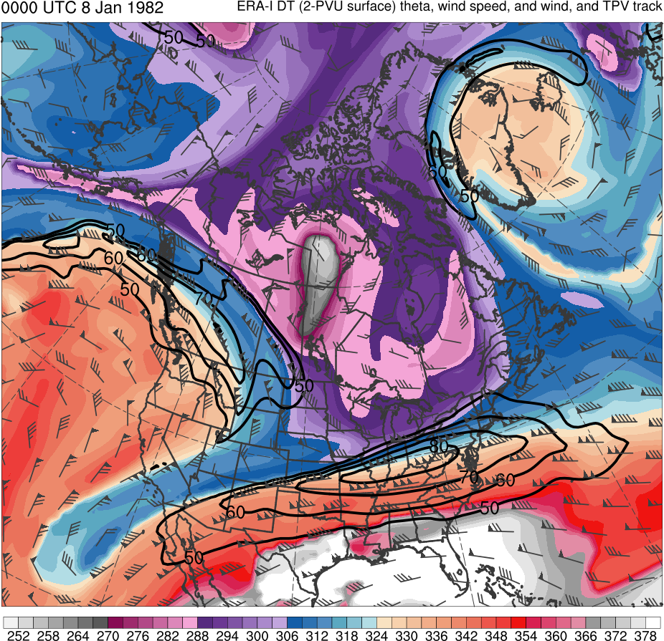
9–14 Jan 1982 CAO
0000 UTC 8 Jan 1982
Data Source: ERA-Interim
TPV
CP
(K)
252
258
264
270
276
282
288
294
300
306
312
318
324
330
336
342
348
354
360
366
372
378
(dam)
460
470
480
490
500
510
520
530
540
550
560
570
580
590
600
Potential temperature (K, shaded), wind speed (black, every 10 m s⁻¹ starting at 50 m s⁻¹), and wind (m s⁻¹, flags and barbs) on 2-PVU surface
1000–500-hPa thickness (dam, shaded) and 700-hPa wind (m s⁻¹, flags and barbs); CP denotes “cold pool”

Slide 12
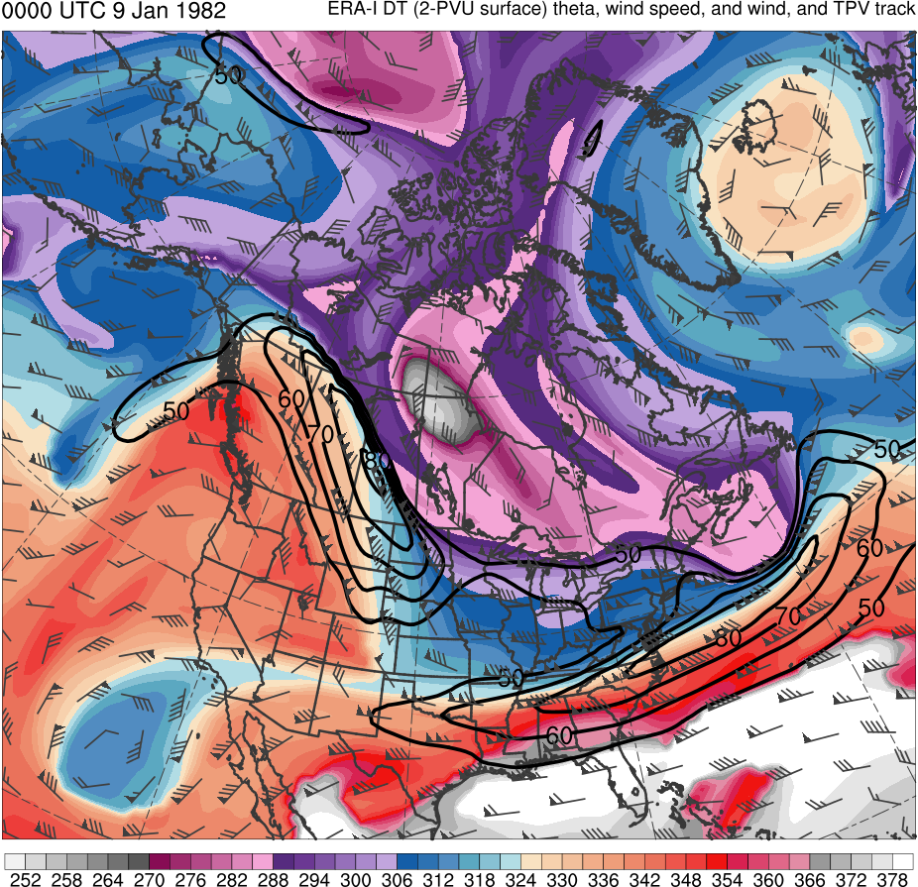
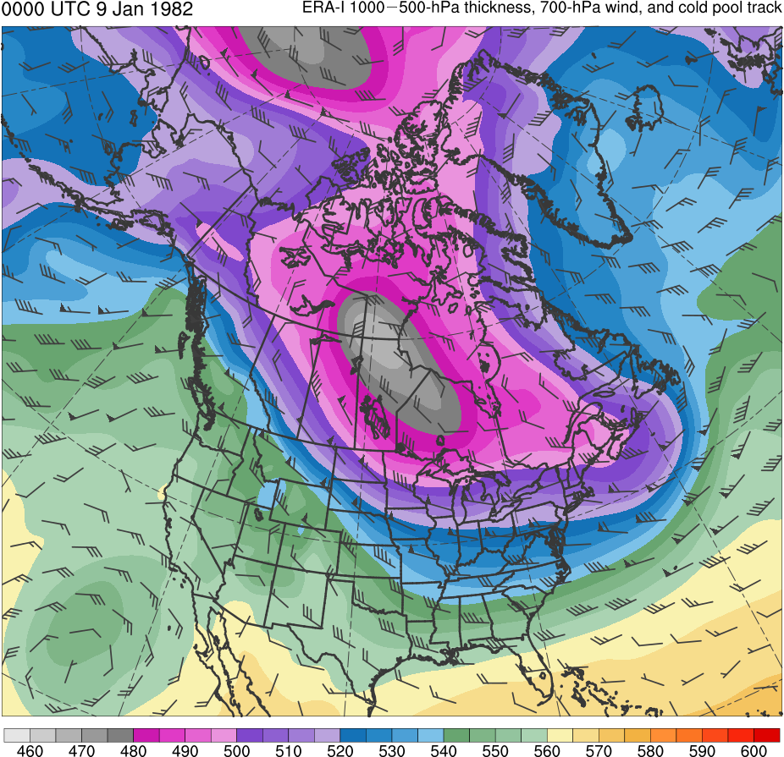
9–14 Jan 1982 CAO
0000 UTC 9 Jan 1982
Data Source: ERA-Interim
TPV
CP
(K)
252
258
264
270
276
282
288
294
300
306
312
318
324
330
336
342
348
354
360
366
372
378
(dam)
460
470
480
490
500
510
520
530
540
550
560
570
580
590
600
Potential temperature (K, shaded), wind speed (black, every 10 m s⁻¹ starting at 50 m s⁻¹), and wind (m s⁻¹, flags and barbs) on 2-PVU surface
1000–500-hPa thickness (dam, shaded) and 700-hPa wind (m s⁻¹, flags and barbs); CP denotes “cold pool”

Slide 13
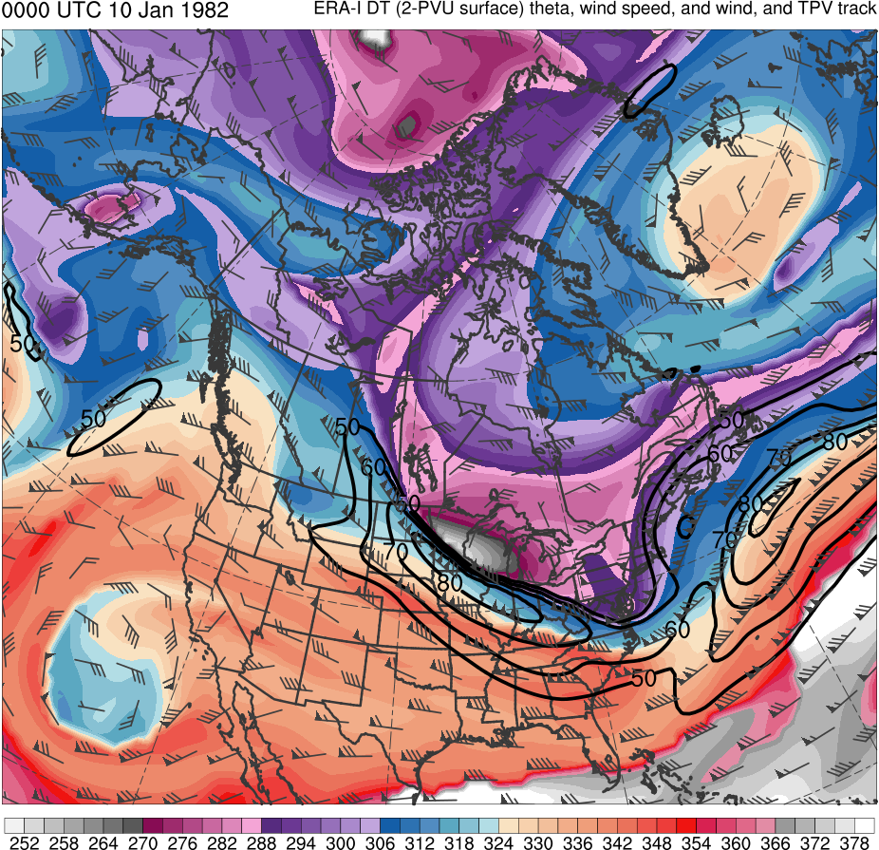
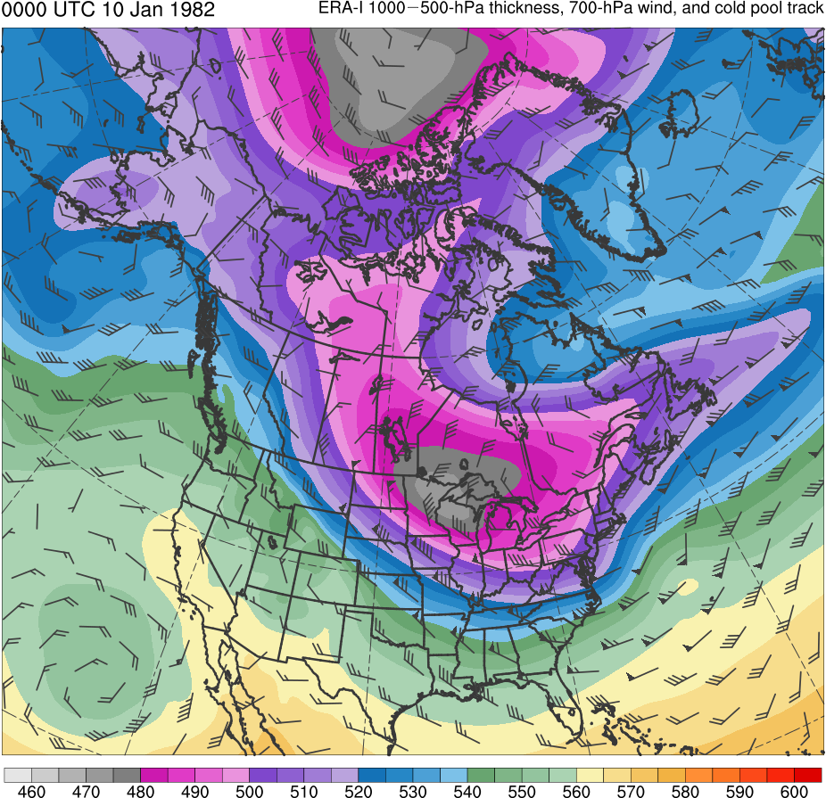
9–14 Jan 1982 CAO
0000 UTC 10 Jan 1982
Data Source: ERA-Interim
CP
TPV
(K)
252
258
264
270
276
282
288
294
300
306
312
318
324
330
336
342
348
354
360
366
372
378
(dam)
460
470
480
490
500
510
520
530
540
550
560
570
580
590
600
Potential temperature (K, shaded), wind speed (black, every 10 m s⁻¹ starting at 50 m s⁻¹), and wind (m s⁻¹, flags and barbs) on 2-PVU surface
1000–500-hPa thickness (dam, shaded) and 700-hPa wind (m s⁻¹, flags and barbs); CP denotes “cold pool”

Slide 14
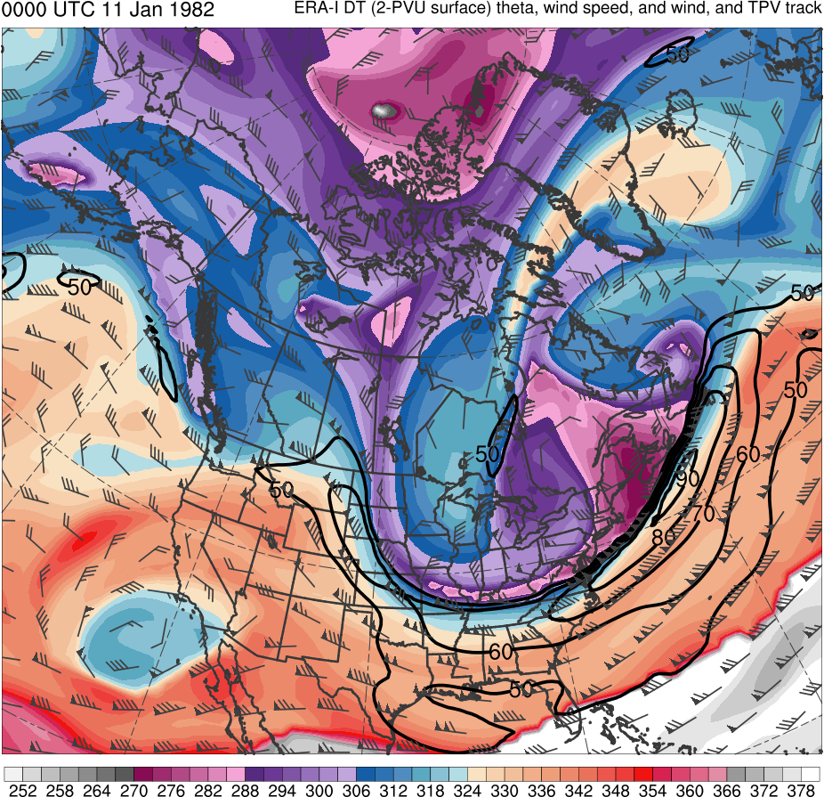
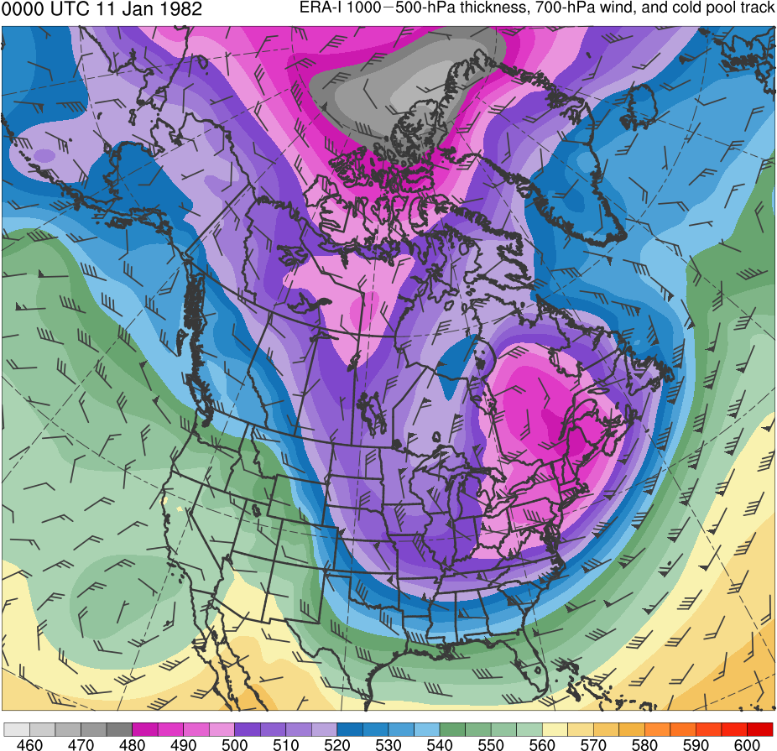
9–14 Jan 1982 CAO
0000 UTC 11 Jan 1982
Data Source: ERA-Interim
TPV
CP
(K)
252
258
264
270
276
282
288
294
300
306
312
318
324
330
336
342
348
354
360
366
372
378
(dam)
460
470
480
490
500
510
520
530
540
550
560
570
580
590
600
Potential temperature (K, shaded), wind speed (black, every 10 m s⁻¹ starting at 50 m s⁻¹), and wind (m s⁻¹, flags and barbs) on 2-PVU surface
1000–500-hPa thickness (dam, shaded) and 700-hPa wind (m s⁻¹, flags and barbs); CP denotes “cold pool”

Slide 15
Research Objectives
Investigate the equatorward transport of TPVs and cold pools to middle latitudes
Investigate the dynamical linkages between TPVs, cold pools, and CAOs

Slide 16
Outline
TPV and cold pool tracking
TPV and cold pool climatologies
Identification of CAOs
Identification of CAOs linked to cold pools
Identification of cold pools associated with TPVs
Identification of CAOs that are linked to cold pools associated with TPVs
Examination of 9–14 January 1982 CAO

Slide 17
TPV Tracking
Data:
0.5° ERA-Interim (Dee et al. 2011)
1979–2015, every 6 h
Utilized TPV tracking algorithm developed by Nicholas Szapiro and Steven Cavallo to identify and track TPVs
Input variables: potential temperature, relative vorticity, and wind on 2-PVU surface
Potential temperature minima on 2-PVU surface tracked spatially and temporally to create TPV tracks
Link for Tracking Algorithm: https://github.com/nickszap/tpvTrack

Slide 18
Cold Pool Tracking
Modified TPV tracking algorithm by changing input variables to identify and track cold pools
Input variables: 1000–500-hPa thickness and thermal vorticity, and 700-hPa wind
1000–500-hPa thickness minima tracked spatially and temporally to create cold pool tracks

Slide 19
Filtering TPV and Cold Pool Tracks
TPVs must last at least 2 days and spend at least 6 h poleward of 60°N (adapted from criteria of Cavallo and Hakim 2010)
Cold pools must last at least 2 days and spend at least 6 h poleward of 60°N
Focus on TPVs and cold pools transported from high latitudes to middle latitudes
Require that TPVs and cold pools in high latitudes move equatorward of 60°N

Slide 20
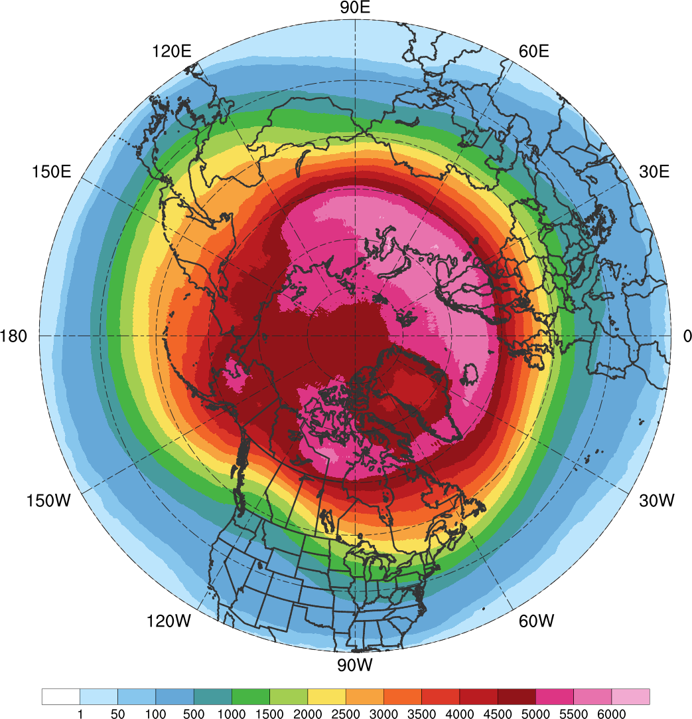
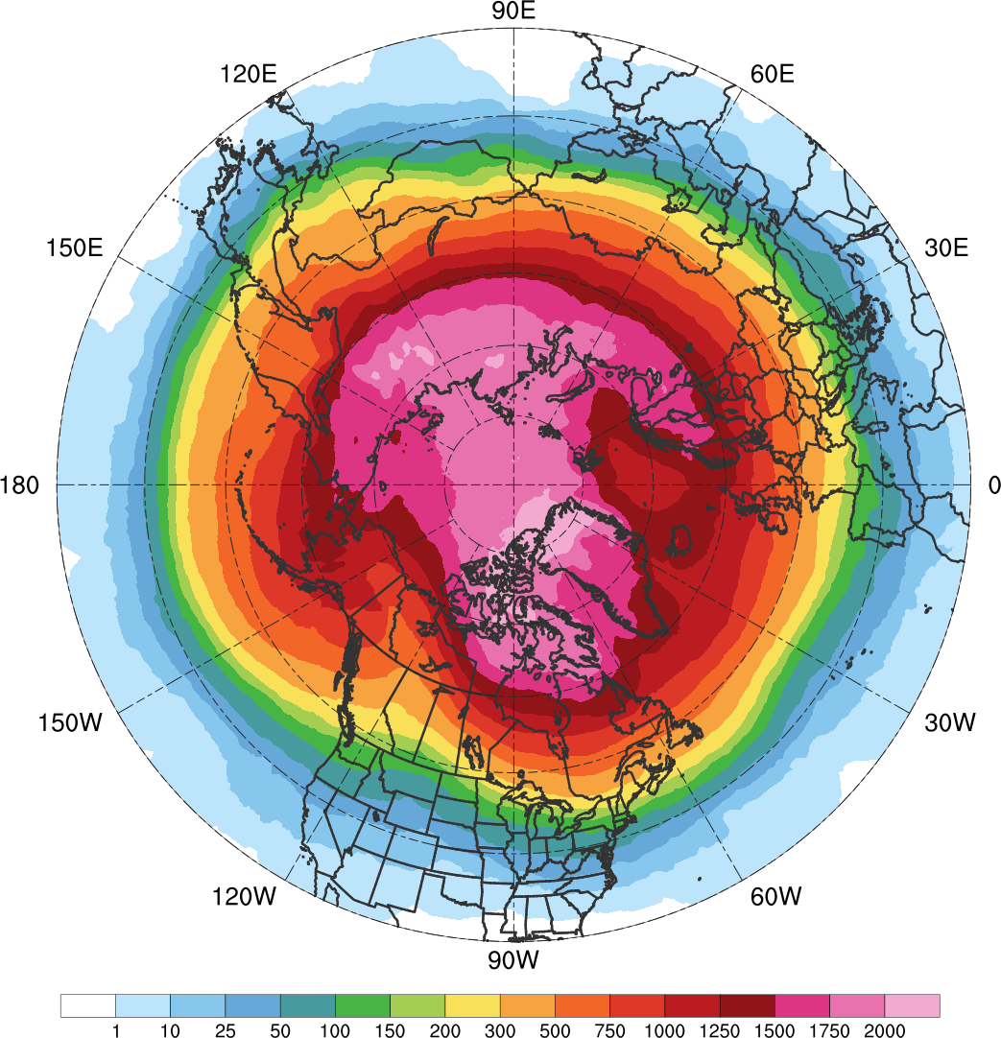
TPV and Cold Pool Track Density
All TPVs
(N = 58,563; avg. of ~1,583 per yr)
All Cold Pools
(N = 23,045; avg. of ~623 per yr)
Total number of unique TPVs (left) and cold pools (right) within 500 km of each grid point (using a 0.5° grid) for all TPVs and cold pools during 1979–2015

Slide 21
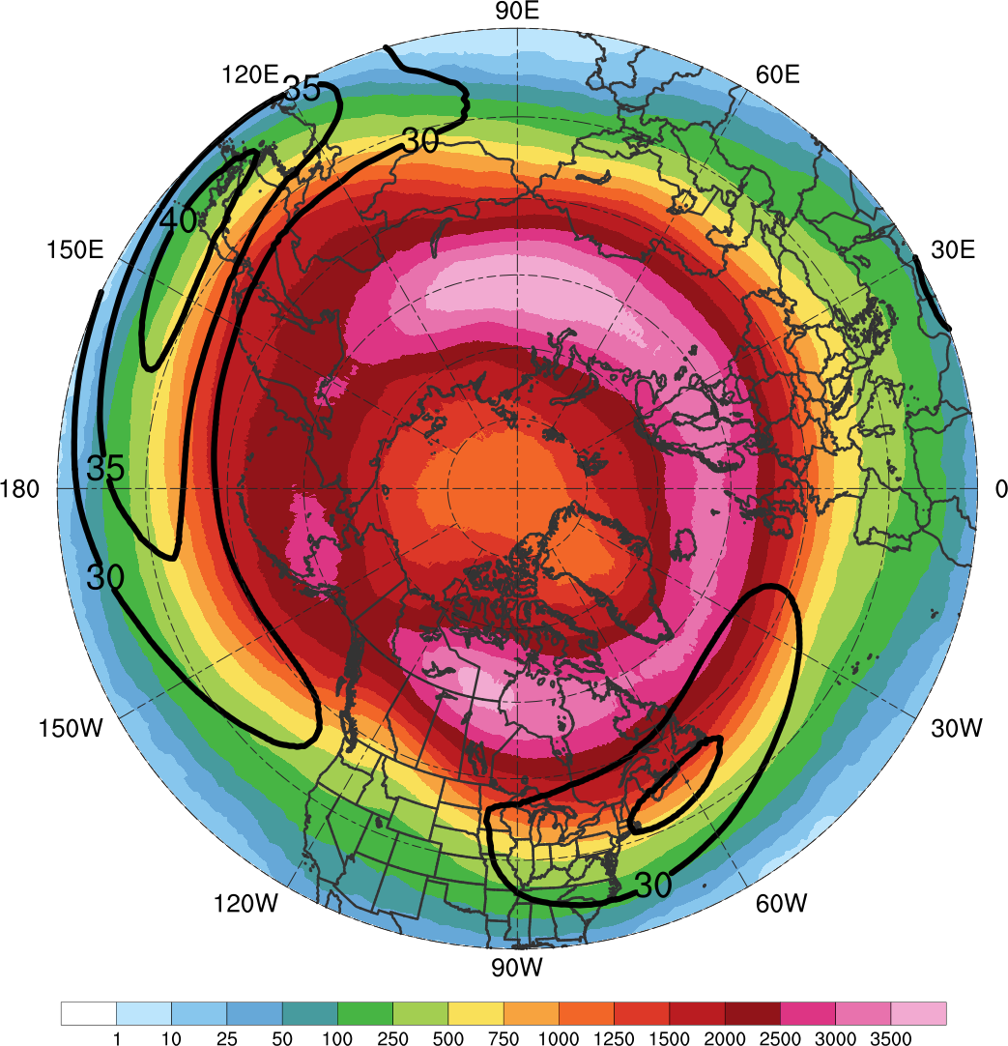
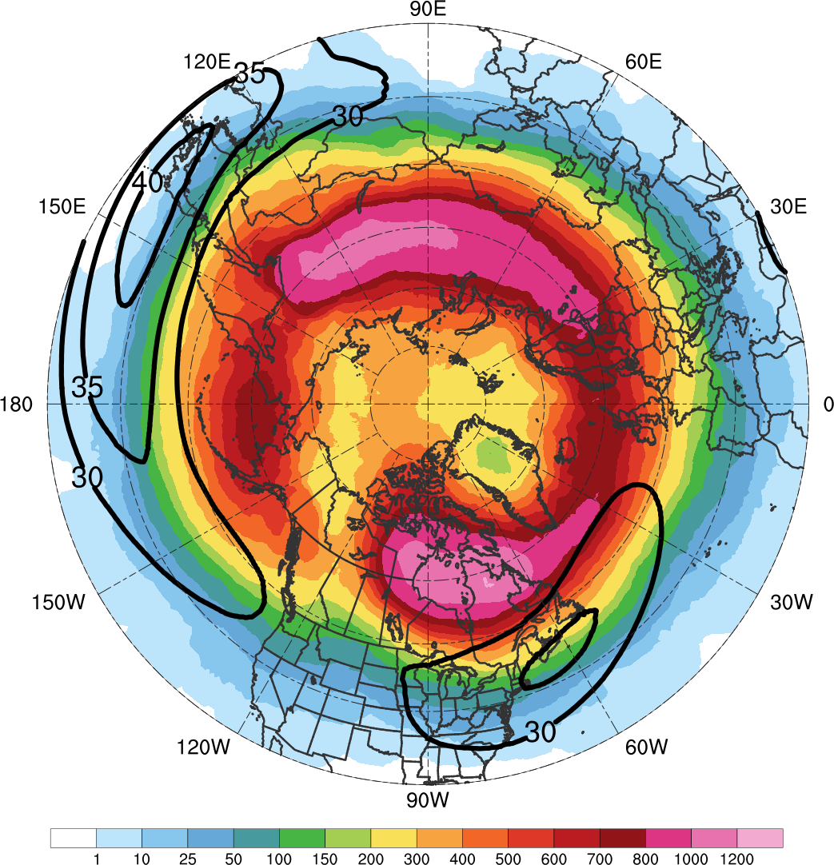
TPV and Cold Pool Track Density
TPVs Transported to Middle Latitudes
(N = 25,085; avg. of ~678 per yr)
Cold Pools Transported to Middle Latitudes
(N = 8,395; avg. of ~227 per yr)
Total number of unique TPVs (left) and cold pools (right) within 500 km of each grid point (using a 0.5° grid) for TPVs and cold pools that move equatorward of 60°N during 1979–2015. Also, 1979–2015 mean wind speed (black, every 5 m s⁻¹ starting at 30 m s⁻¹) on 2-PVU surface

Slide 22
TPV and Cold Pool Track Density
TPVs Transported to Middle Latitudes
(N = 25,085; avg. of ~678 per yr)
Cold Pools Transported to Middle Latitudes
(N = 8,395; avg. of ~227 per yr)
Total number of unique TPVs (left) and cold pools (right) within 500 km of each grid point (using a 0.5° grid) for TPVs and cold pools that move equatorward of 60°N during 1979–2015. Also, 1979–2015 mean wind speed (black, every 5 m s⁻¹ starting at 30 m s⁻¹) on 2-PVU surface

Slide 23
TPV and Cold Pool Track Density
TPVs Transported to Middle Latitudes
(N = 25,085; avg. of ~678 per yr)
Cold Pools Transported to Middle Latitudes
(N = 8,395; avg. of ~227 per yr)
Total number of unique TPVs (left) and cold pools (right) within 500 km of each grid point (using a 0.5° grid) for TPVs and cold pools that move equatorward of 60°N during 1979–2015. Also, 1979–2015 mean wind speed (black, every 5 m s⁻¹ starting at 30 m s⁻¹) on 2-PVU surface

Slide 24
TPV and Cold Pool Track Density
TPVs Transported to Middle Latitudes
(N = 25,085; avg. of ~678 per yr)
Cold Pools Transported to Middle Latitudes
(N = 8,395; avg. of ~227 per yr)
Total number of unique TPVs (left) and cold pools (right) within 500 km of each grid point (using a 0.5° grid) for TPVs and cold pools that move equatorward of 60°N during 1979–2015. Also, 1979–2015 mean wind speed (black, every 5 m s⁻¹ starting at 30 m s⁻¹) on 2-PVU surface

Slide 25
TPV and Cold Pool Track Density
TPVs Transported to Middle Latitudes
(N = 25,085; avg. of ~678 per yr)
Cold Pools Transported to Middle Latitudes
(N = 8,395; avg. of ~227 per yr)
Total number of unique TPVs (left) and cold pools (right) within 500 km of each grid point (using a 0.5° grid) for TPVs and cold pools that move equatorward of 60°N during 1979–2015. Also, 1979–2015 mean wind speed (black, every 5 m s⁻¹ starting at 30 m s⁻¹) on 2-PVU surface

Slide 26
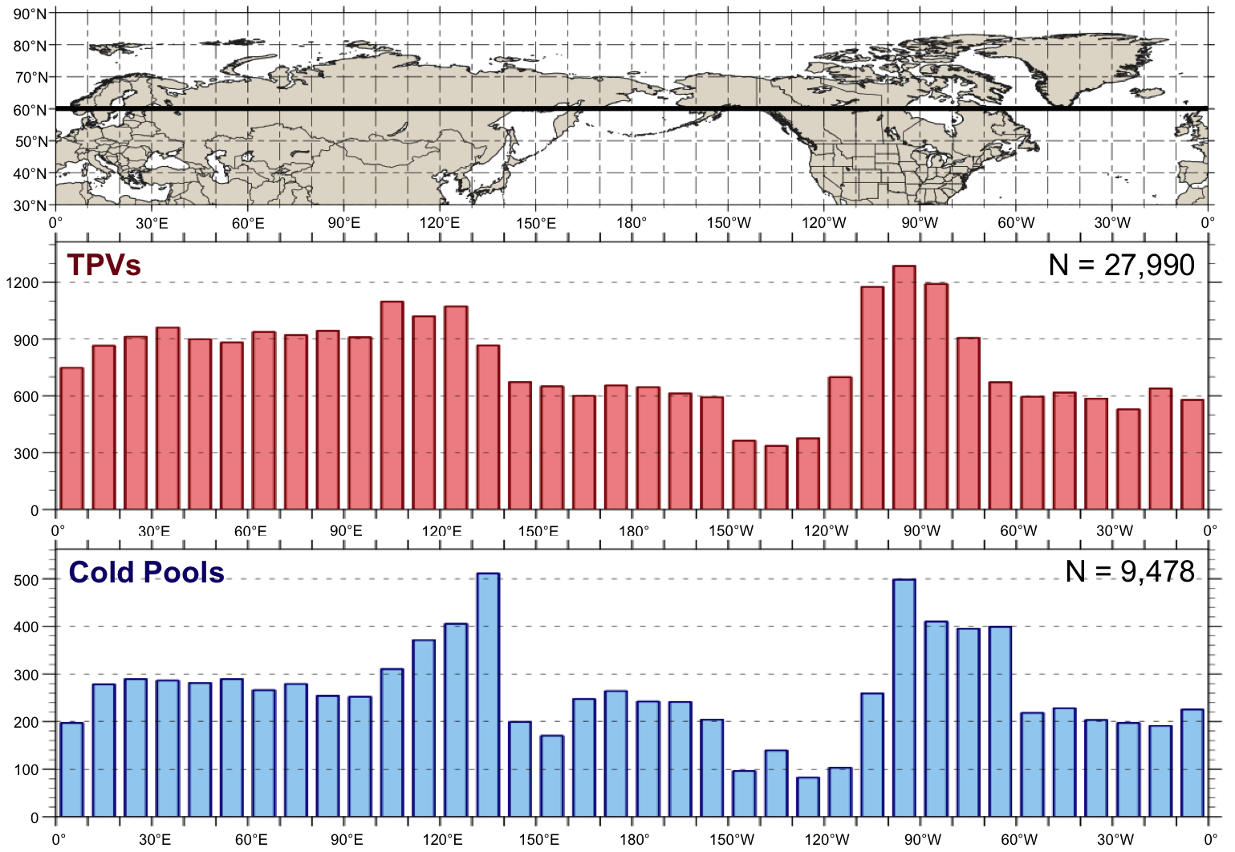
Equatorward Transport of TPVs and Cold Pools
Histograms showing total number of instances in which a TPV (red) and cold pool (blue) is transported equatorward of 60°N (black line on map) for each 10° longitude bin globally during 1979–2015. A TPV and cold pool can be counted more than once if it cross equatorward of 60°N after returning poleward of 60°N

Slide 27
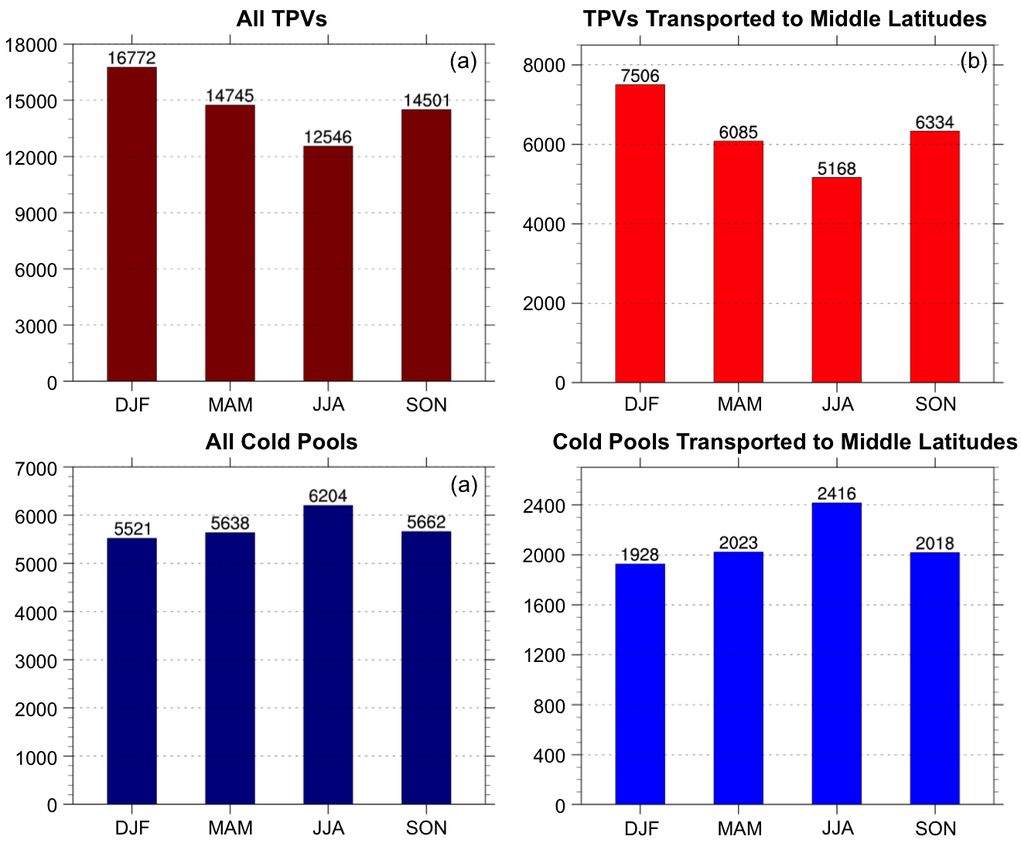
Seasonal Variability
(a) Total number of TPVs per season, (b) total number of TPVs transported to middle latitudes (equatorward of 60°N) per season, (c) total number of cold pools per season, and (d) total number of cold pools transported to middle latitudes (equatorward of 60°N) per season, normalized to a 91.25-day season

Slide 28
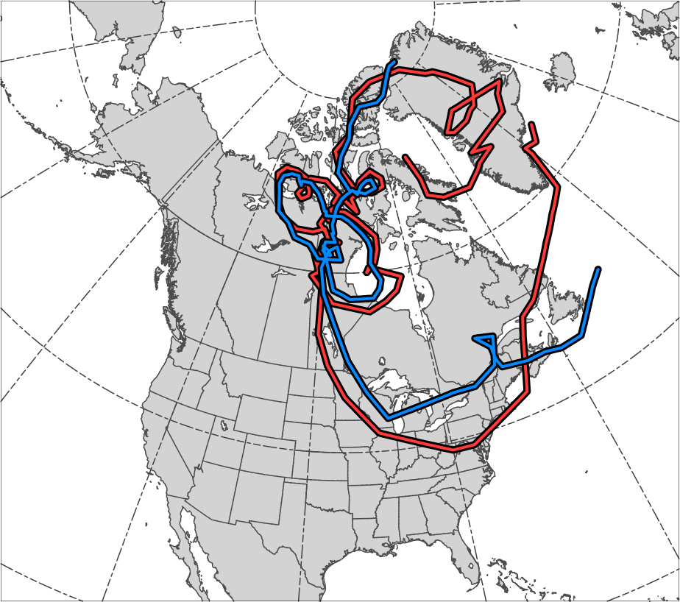
Tracks for Jan 1982 CAO
TPV Track:
Genesis:
0600 UTC 15 Dec 1981
Lysis:
0000 UTC 13 Jan 1982
Lifetime:
~29 days
Cold Pool Track:
Genesis:
1800 UTC 20 Dec 1981
Lysis:
1800 UTC 13 Jan 1982
Lifetime:
~24 days
TPV
Cold
Pool
Genesis
Lysis

Slide 29
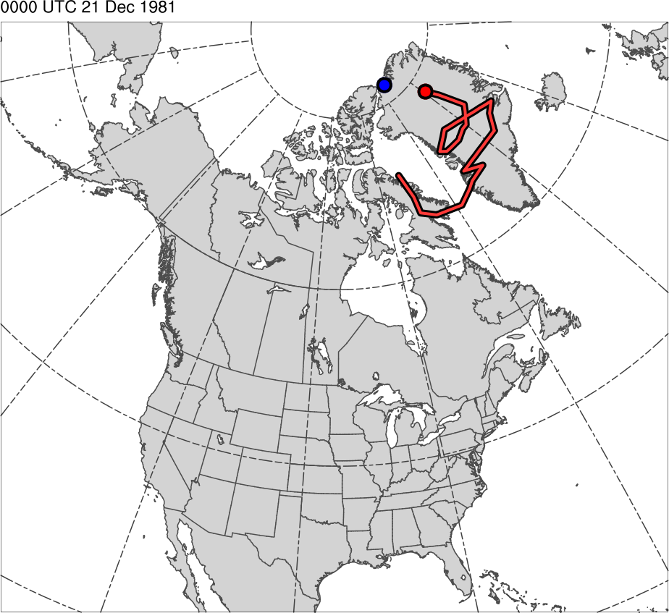
Tracks for Jan 1982 CAO
0000 UTC 21 Dec 1981
TPV Track:
Genesis:
0600 UTC 15 Dec 1981
Lysis:
0000 UTC 13 Jan 1982
Lifetime:
~29 days
Cold Pool Track:
Genesis:
1800 UTC 20 Dec 1981
Lysis:
1800 UTC 13 Jan 1982
Lifetime:
~24 days
TPV
Cold Pool

Slide 30
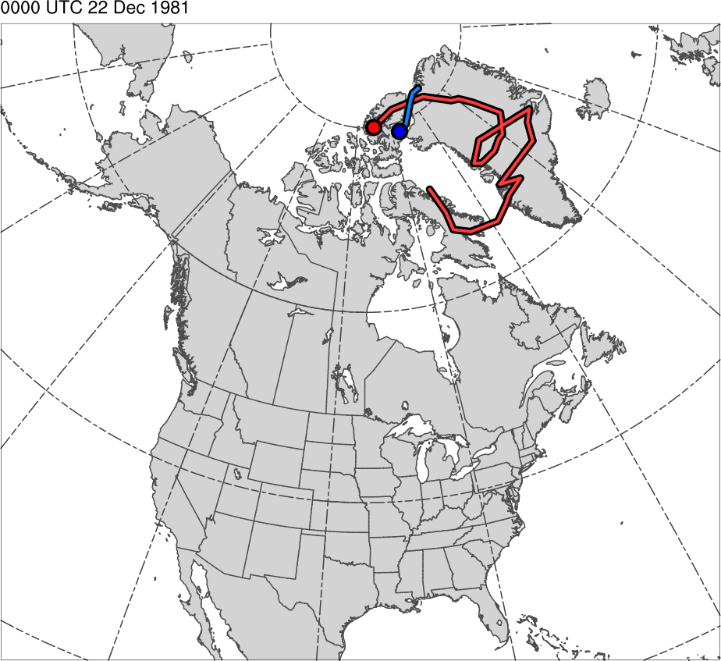
Tracks for Jan 1982 CAO
0000 UTC 22 Dec 1981
TPV Track:
Genesis:
0600 UTC 15 Dec 1981
Lysis:
0000 UTC 13 Jan 1982
Lifetime:
~29 days
Cold Pool Track:
Genesis:
1800 UTC 20 Dec 1981
Lysis:
1800 UTC 13 Jan 1982
Lifetime:
~24 days
TPV
Cold Pool

Slide 31
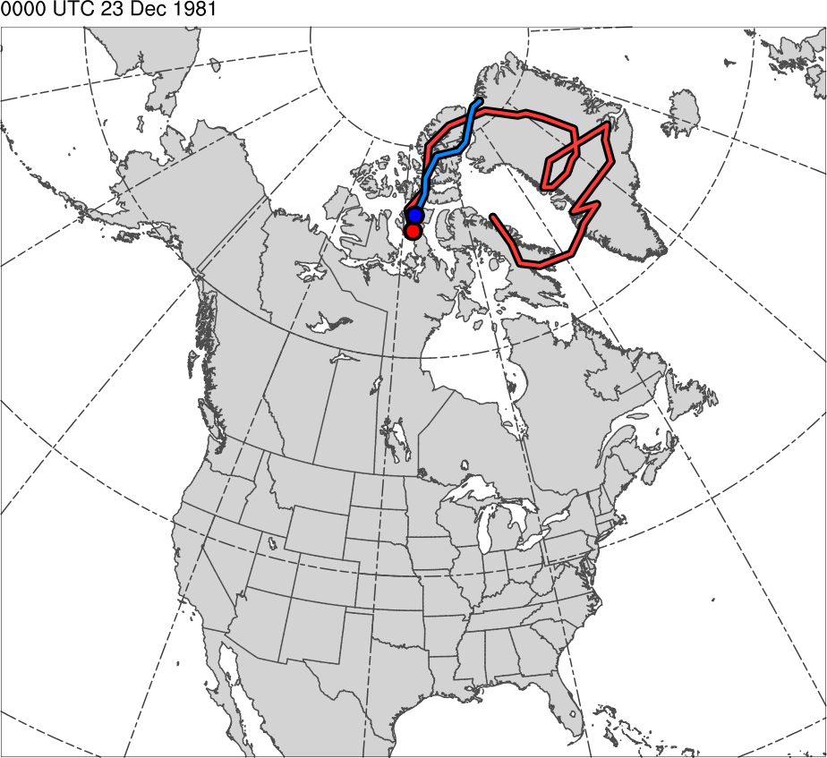
Tracks for Jan 1982 CAO
0000 UTC 23 Dec 1981
TPV Track:
Genesis:
0600 UTC 15 Dec 1981
Lysis:
0000 UTC 13 Jan 1982
Lifetime:
~29 days
Cold Pool Track:
Genesis:
1800 UTC 20 Dec 1981
Lysis:
1800 UTC 13 Jan 1982
Lifetime:
~24 days
TPV
Cold Pool

Slide 32
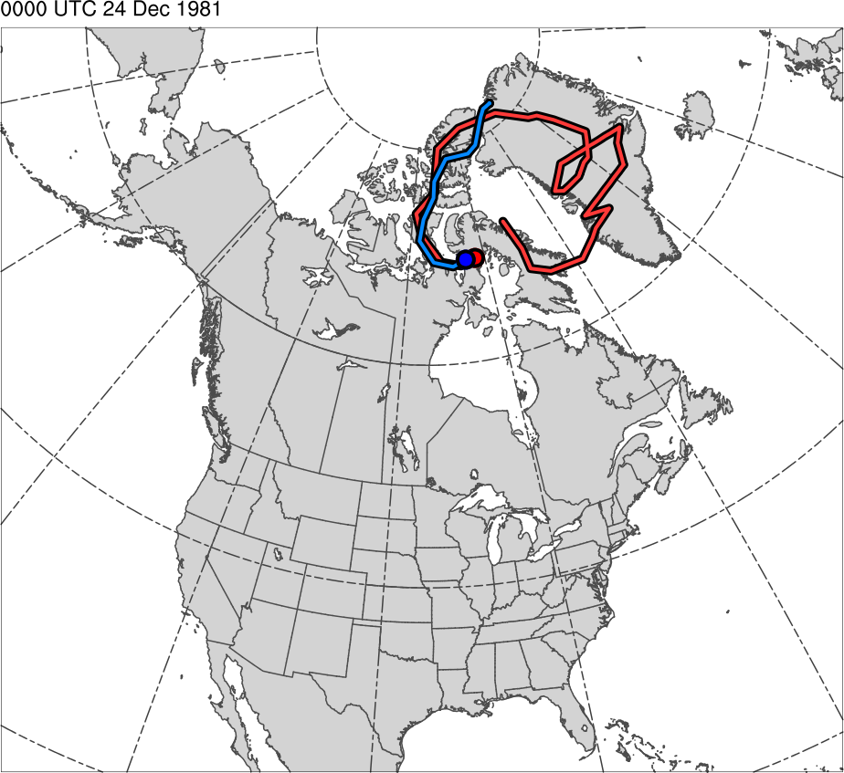
Tracks for Jan 1982 CAO
0000 UTC 24 Dec 1981
TPV Track:
Genesis:
0600 UTC 15 Dec 1981
Lysis:
0000 UTC 13 Jan 1982
Lifetime:
~29 days
Cold Pool Track:
Genesis:
1800 UTC 20 Dec 1981
Lysis:
1800 UTC 13 Jan 1982
Lifetime:
~24 days
TPV
Cold Pool

Slide 33
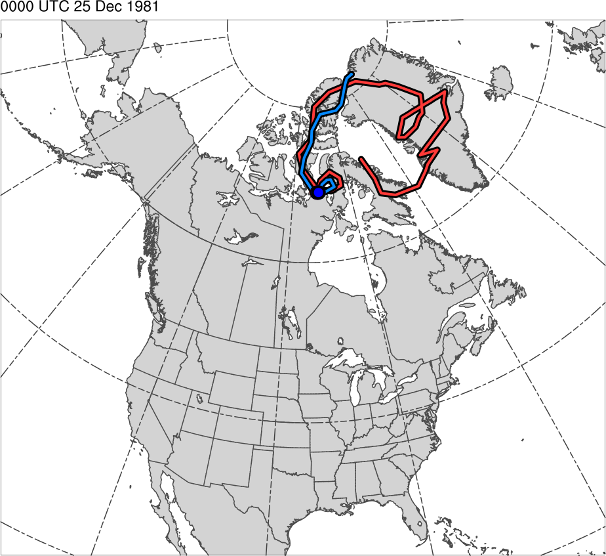
Tracks for Jan 1982 CAO
0000 UTC 25 Dec 1981
TPV Track:
Genesis:
0600 UTC 15 Dec 1981
Lysis:
0000 UTC 13 Jan 1982
Lifetime:
~29 days
Cold Pool Track:
Genesis:
1800 UTC 20 Dec 1981
Lysis:
1800 UTC 13 Jan 1982
Lifetime:
~24 days
TPV
Cold Pool

Slide 34
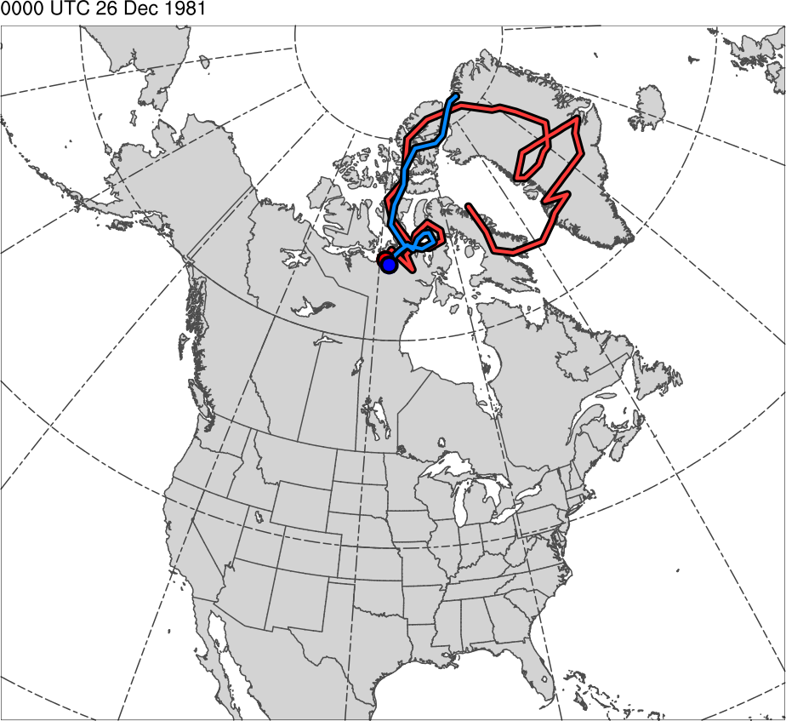
Tracks for Jan 1982 CAO
0000 UTC 26 Dec 1981
TPV Track:
Genesis:
0600 UTC 15 Dec 1981
Lysis:
0000 UTC 13 Jan 1982
Lifetime:
~29 days
Cold Pool Track:
Genesis:
1800 UTC 20 Dec 1981
Lysis:
1800 UTC 13 Jan 1982
Lifetime:
~24 days
TPV
Cold Pool

Slide 35
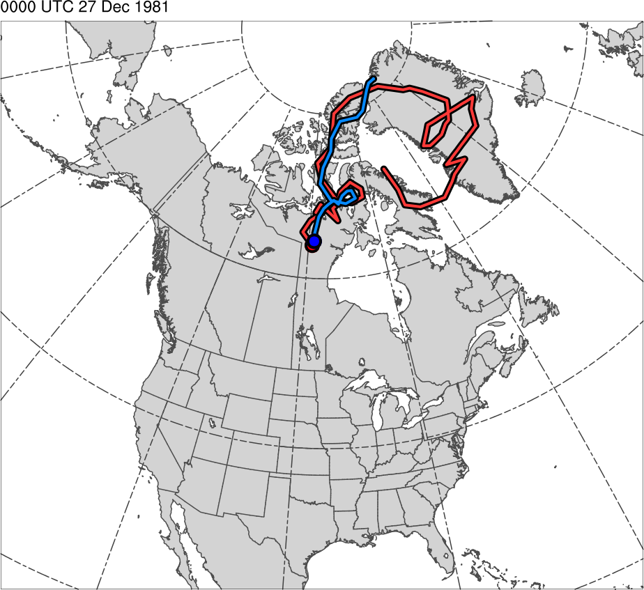
Tracks for Jan 1982 CAO
0000 UTC 27 Dec 1981
TPV Track:
Genesis:
0600 UTC 15 Dec 1981
Lysis:
0000 UTC 13 Jan 1982
Lifetime:
~29 days
Cold Pool Track:
Genesis:
1800 UTC 20 Dec 1981
Lysis:
1800 UTC 13 Jan 1982
Lifetime:
~24 days
TPV
Cold Pool

Slide 36
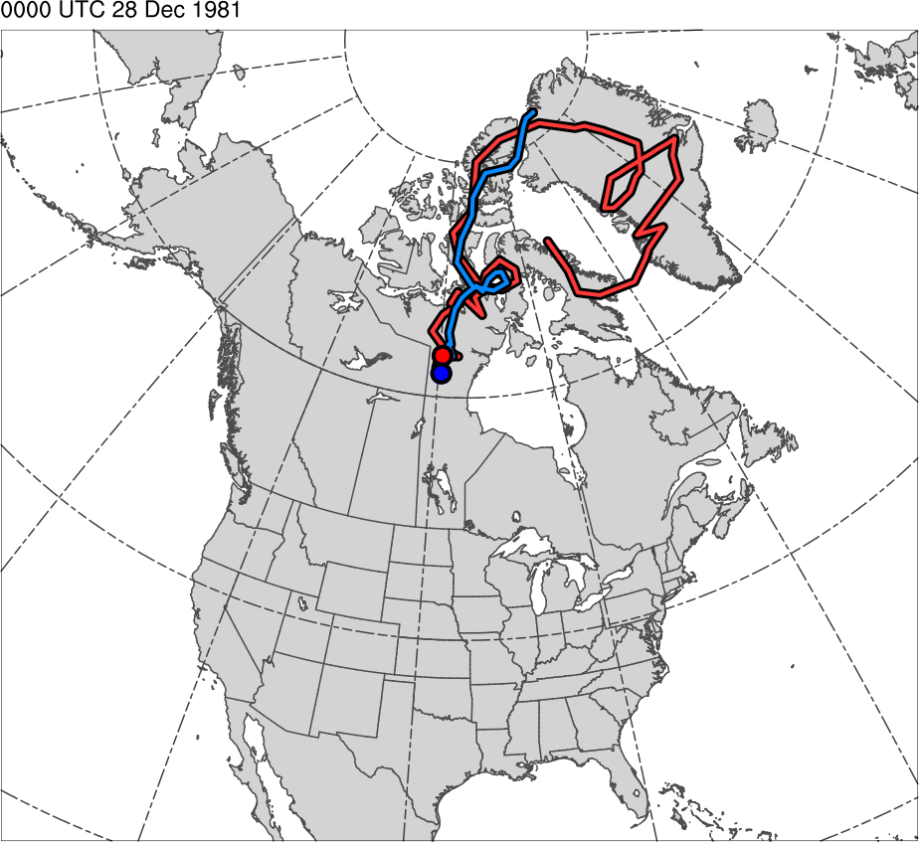
Tracks for Jan 1982 CAO
0000 UTC 28 Dec 1981
TPV Track:
Genesis:
0600 UTC 15 Dec 1981
Lysis:
0000 UTC 13 Jan 1982
Lifetime:
~29 days
Cold Pool Track:
Genesis:
1800 UTC 20 Dec 1981
Lysis:
1800 UTC 13 Jan 1982
Lifetime:
~24 days
TPV
Cold Pool

Slide 37
Tracks for Jan 1982 CAO
0000 UTC 29 Dec 1981
TPV Track:
Genesis:
0600 UTC 15 Dec 1981
Lysis:
0000 UTC 13 Jan 1982
Lifetime:
~29 days
Cold Pool Track:
Genesis:
1800 UTC 20 Dec 1981
Lysis:
1800 UTC 13 Jan 1982
Lifetime:
~24 days
TPV
Cold Pool

Slide 38
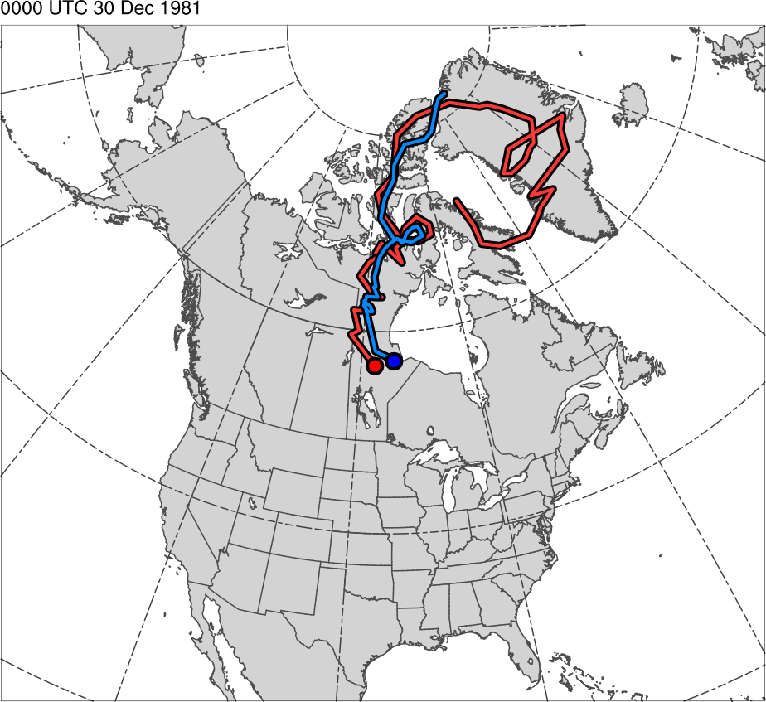
Tracks for Jan 1982 CAO
0000 UTC 30 Dec 1981
TPV Track:
Genesis:
0600 UTC 15 Dec 1981
Lysis:
0000 UTC 13 Jan 1982
Lifetime:
~29 days
Cold Pool Track:
Genesis:
1800 UTC 20 Dec 1981
Lysis:
1800 UTC 13 Jan 1982
Lifetime:
~24 days
TPV
Cold Pool

Slide 39
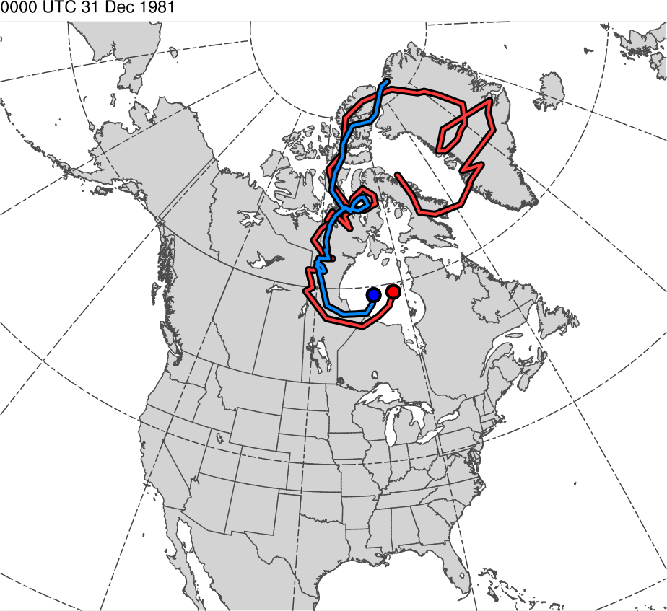
Tracks for Jan 1982 CAO
0000 UTC 31 Dec 1981
TPV Track:
Genesis:
0600 UTC 15 Dec 1981
Lysis:
0000 UTC 13 Jan 1982
Lifetime:
~29 days
Cold Pool Track:
Genesis:
1800 UTC 20 Dec 1981
Lysis:
1800 UTC 13 Jan 1982
Lifetime:
~24 days
TPV
Cold Pool

Slide 40
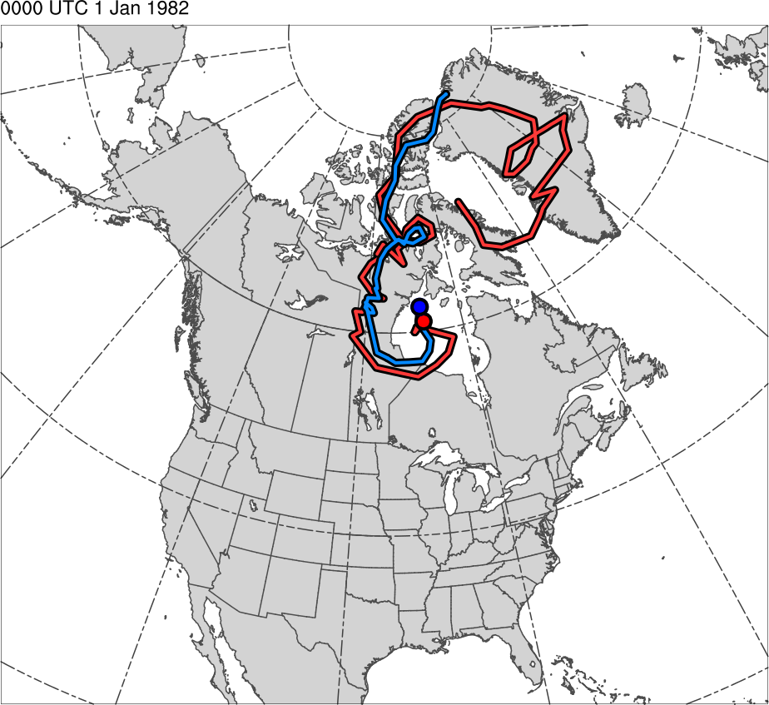
Tracks for Jan 1982 CAO
0000 UTC 1 Jan 1982
TPV Track:
Genesis:
0600 UTC 15 Dec 1981
Lysis:
0000 UTC 13 Jan 1982
Lifetime:
~29 days
Cold Pool Track:
Genesis:
1800 UTC 20 Dec 1981
Lysis:
1800 UTC 13 Jan 1982
Lifetime:
~24 days
TPV
Cold Pool

Slide 41
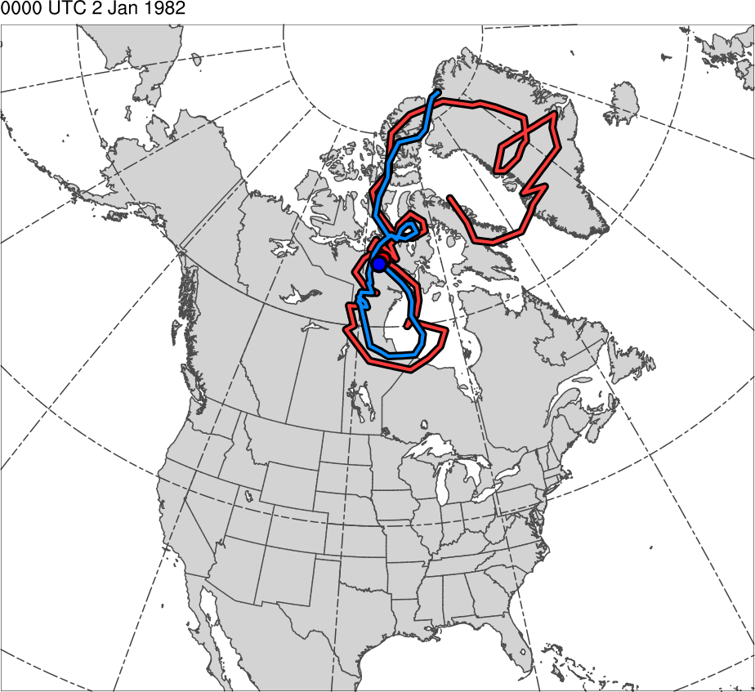
Tracks for Jan 1982 CAO
0000 UTC 2 Jan 1982
TPV Track:
Genesis:
0600 UTC 15 Dec 1981
Lysis:
0000 UTC 13 Jan 1982
Lifetime:
~29 days
Cold Pool Track:
Genesis:
1800 UTC 20 Dec 1981
Lysis:
1800 UTC 13 Jan 1982
Lifetime:
~24 days
TPV
Cold Pool

Slide 42
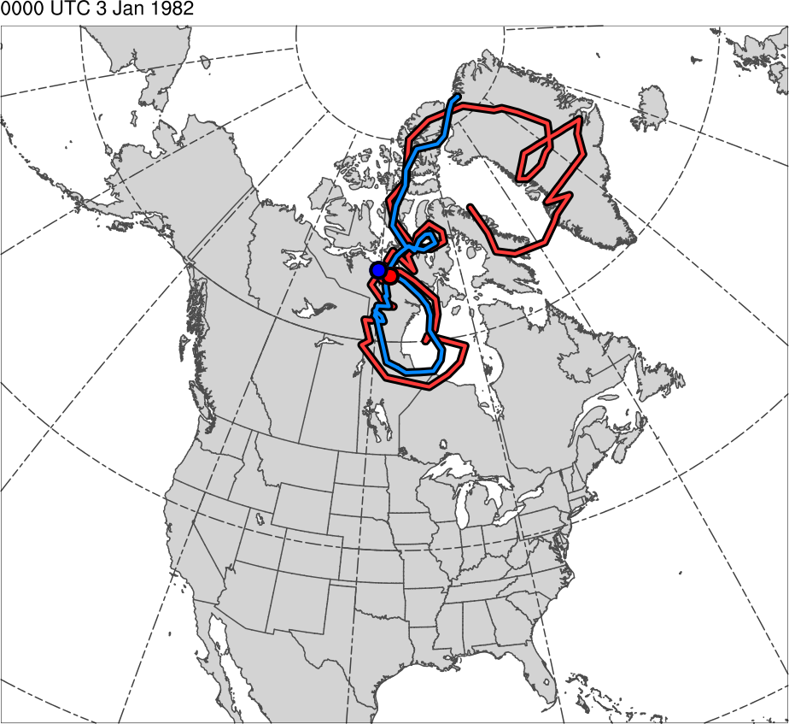
Tracks for Jan 1982 CAO
0000 UTC 3 Jan 1982
TPV Track:
Genesis:
0600 UTC 15 Dec 1981
Lysis:
0000 UTC 13 Jan 1982
Lifetime:
~29 days
Cold Pool Track:
Genesis:
1800 UTC 20 Dec 1981
Lysis:
1800 UTC 13 Jan 1982
Lifetime:
~24 days
TPV
Cold Pool

Slide 43
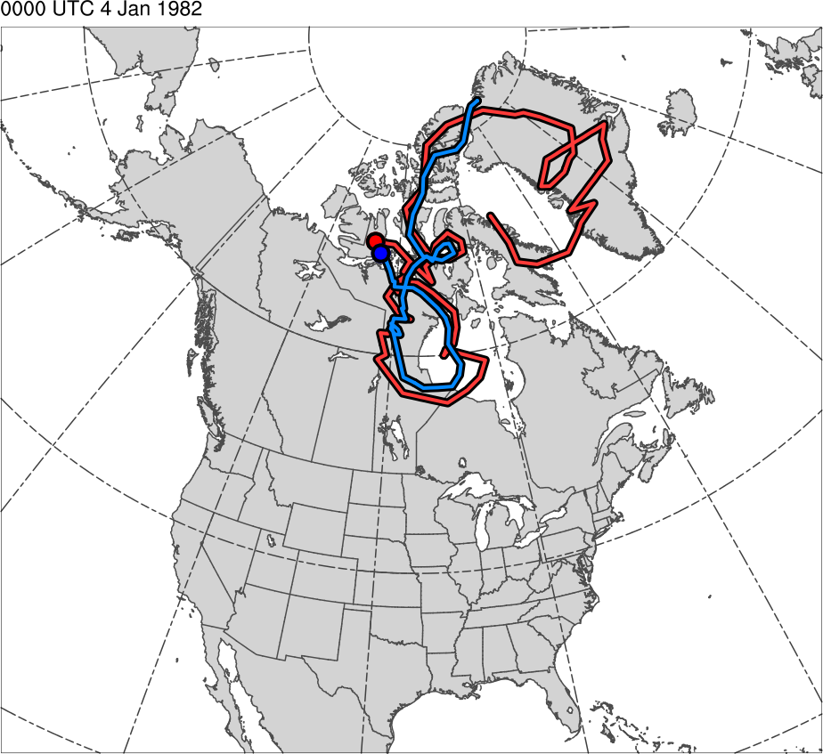
Tracks for Jan 1982 CAO
0000 UTC 4 Jan 1982
TPV Track:
Genesis:
0600 UTC 15 Dec 1981
Lysis:
0000 UTC 13 Jan 1982
Lifetime:
~29 days
Cold Pool Track:
Genesis:
1800 UTC 20 Dec 1981
Lysis:
1800 UTC 13 Jan 1982
Lifetime:
~24 days
TPV
Cold Pool

Slide 44
Tracks for Jan 1982 CAO
0000 UTC 5 Jan 1982
TPV Track:
Genesis:
0600 UTC 15 Dec 1981
Lysis:
0000 UTC 13 Jan 1982
Lifetime:
~29 days
Cold Pool Track:
Genesis:
1800 UTC 20 Dec 1981
Lysis:
1800 UTC 13 Jan 1982
Lifetime:
~24 days
TPV
Cold Pool

Slide 45
Tracks for Jan 1982 CAO
0000 UTC 6 Jan 1982
TPV Track:
Genesis:
0600 UTC 15 Dec 1981
Lysis:
0000 UTC 13 Jan 1982
Lifetime:
~29 days
Cold Pool Track:
Genesis:
1800 UTC 20 Dec 1981
Lysis:
1800 UTC 13 Jan 1982
Lifetime:
~24 days
TPV
Cold Pool

Slide 46
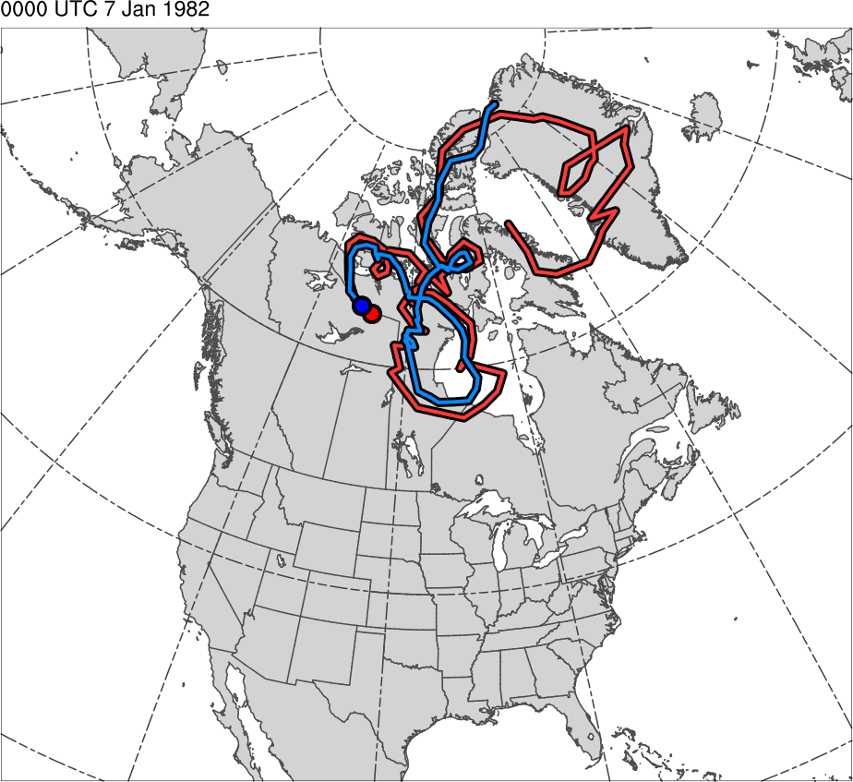
Tracks for Jan 1982 CAO
0000 UTC 7 Jan 1982
TPV Track:
Genesis:
0600 UTC 15 Dec 1981
Lysis:
0000 UTC 13 Jan 1982
Lifetime:
~29 days
Cold Pool Track:
Genesis:
1800 UTC 20 Dec 1981
Lysis:
1800 UTC 13 Jan 1982
Lifetime:
~24 days
TPV
Cold Pool

Slide 47
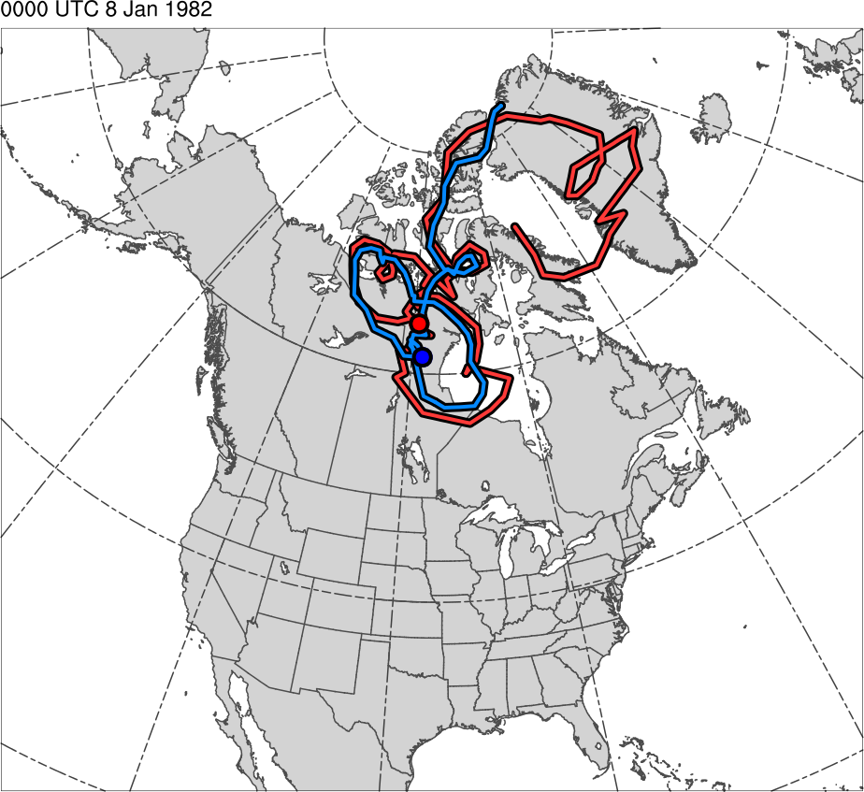
Tracks for Jan 1982 CAO
0000 UTC 8 Jan 1982
TPV Track:
Genesis:
0600 UTC 15 Dec 1981
Lysis:
0000 UTC 13 Jan 1982
Lifetime:
~29 days
Cold Pool Track:
Genesis:
1800 UTC 20 Dec 1981
Lysis:
1800 UTC 13 Jan 1982
Lifetime:
~24 days
TPV
Cold Pool

Slide 48
Tracks for Jan 1982 CAO
0000 UTC 9 Jan 1982
TPV Track:
Genesis:
0600 UTC 15 Dec 1981
Lysis:
0000 UTC 13 Jan 1982
Lifetime:
~29 days
Cold Pool Track:
Genesis:
1800 UTC 20 Dec 1981
Lysis:
1800 UTC 13 Jan 1982
Lifetime:
~24 days
TPV
Cold Pool

Slide 49
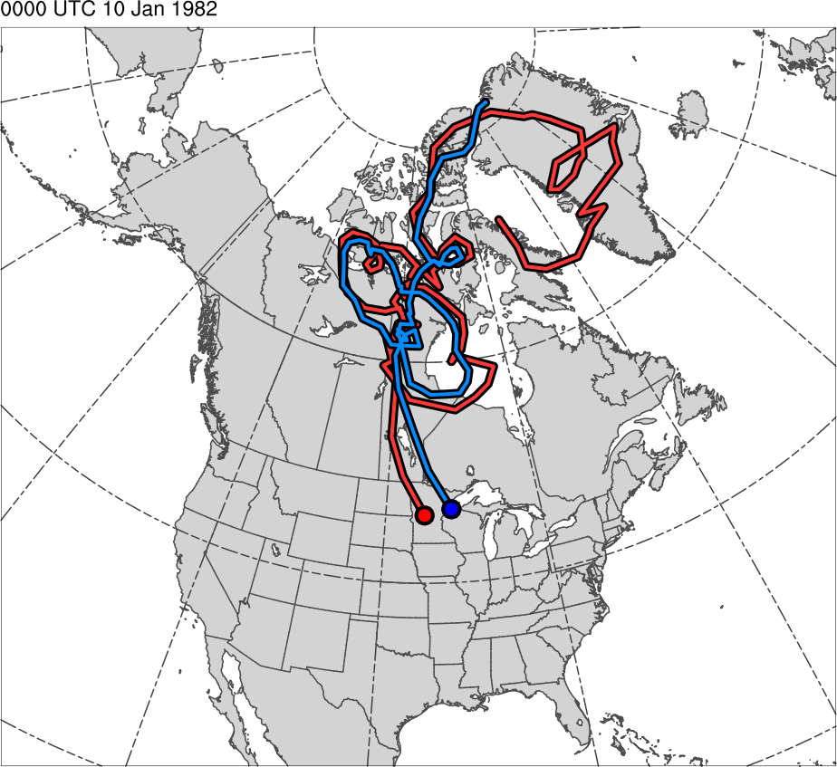
Tracks for Jan 1982 CAO
0000 UTC 10 Jan 1982
TPV Track:
Genesis:
0600 UTC 15 Dec 1981
Lysis:
0000 UTC 13 Jan 1982
Lifetime:
~29 days
Cold Pool Track:
Genesis:
1800 UTC 20 Dec 1981
Lysis:
1800 UTC 13 Jan 1982
Lifetime:
~24 days
TPV
Cold Pool

Slide 50
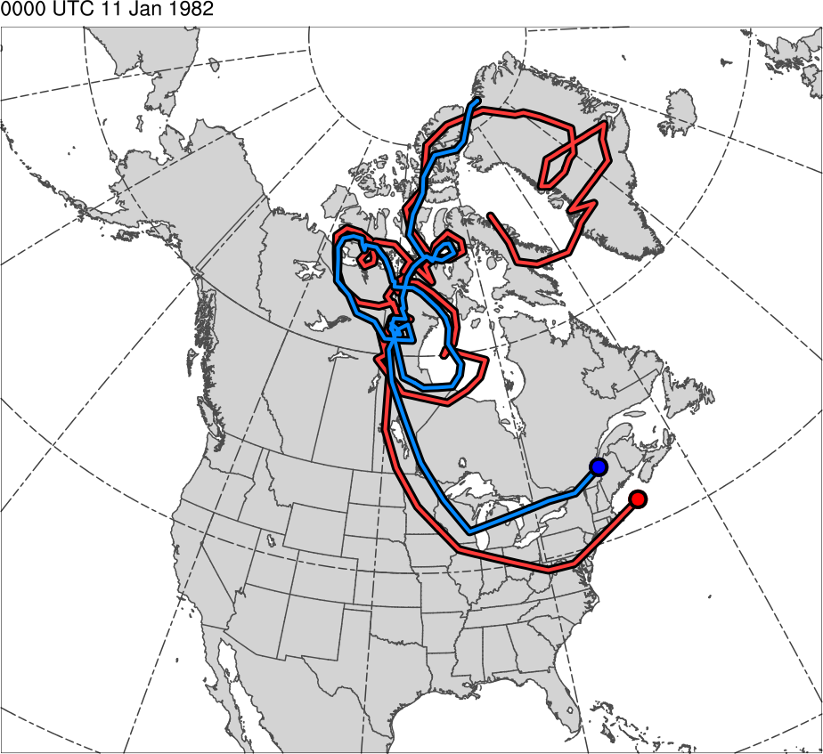
Tracks for Jan 1982 CAO
0000 UTC 11 Jan 1982
TPV Track:
Genesis:
0600 UTC 15 Dec 1981
Lysis:
0000 UTC 13 Jan 1982
Lifetime:
~29 days
Cold Pool Track:
Genesis:
1800 UTC 20 Dec 1981
Lysis:
1800 UTC 13 Jan 1982
Lifetime:
~24 days
TPV
Cold Pool

Slide 51
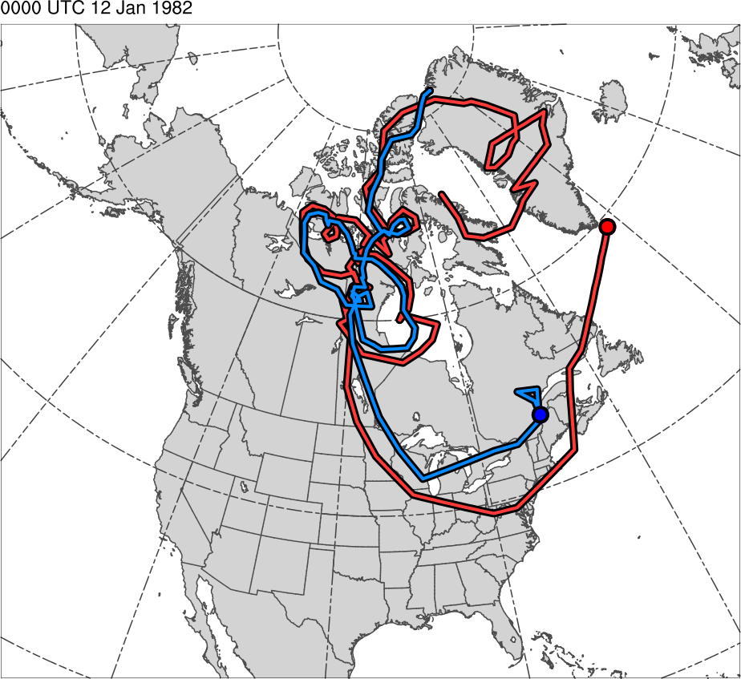
Tracks for Jan 1982 CAO
0000 UTC 12 Jan 1982
TPV Track:
Genesis:
0600 UTC 15 Dec 1981
Lysis:
0000 UTC 13 Jan 1982
Lifetime:
~29 days
Cold Pool Track:
Genesis:
1800 UTC 20 Dec 1981
Lysis:
1800 UTC 13 Jan 1982
Lifetime:
~24 days
TPV
Cold Pool

Slide 52
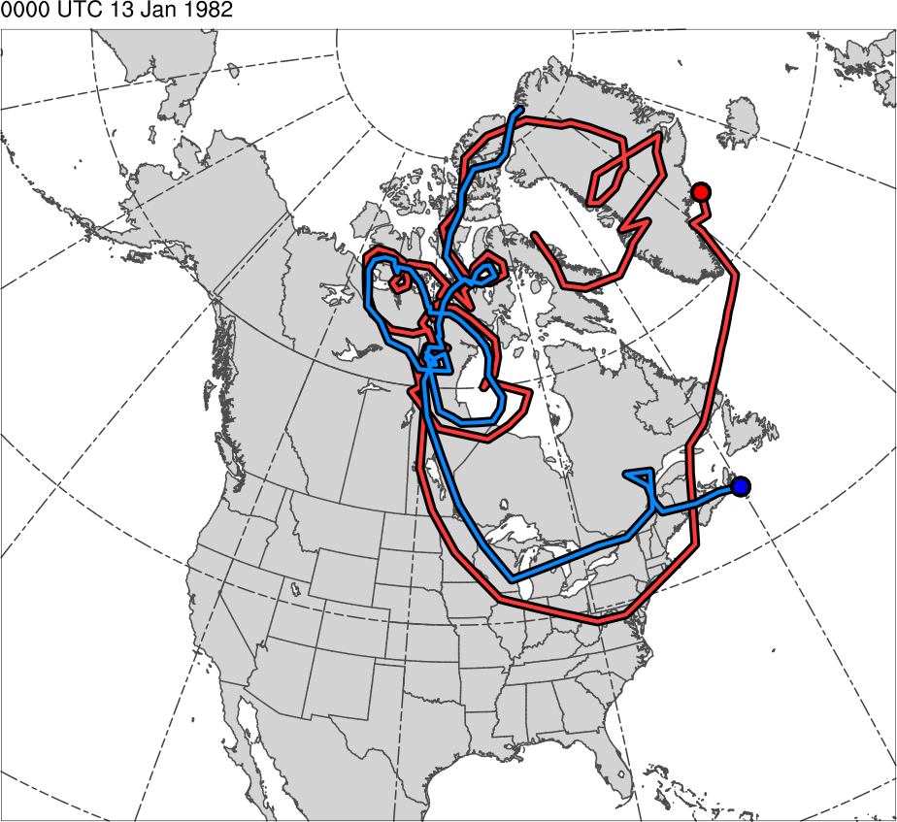
Tracks for Jan 1982 CAO
0000 UTC 13 Jan 1982
TPV Track:
Genesis:
0600 UTC 15 Dec 1981
Lysis:
0000 UTC 13 Jan 1982
Lifetime:
~29 days
Cold Pool Track:
Genesis:
1800 UTC 20 Dec 1981
Lysis:
1800 UTC 13 Jan 1982
Lifetime:
~24 days
TPV
Cold Pool

Slide 53
CAO Identification
Regional CAOs are identified using CAO climatology created by Murphy (2017)
Dataset: Global Historical Climatology Network-Daily minimum temperature data
Period of study: 1979–2015

Slide 54
CAO Identification
Regions studied: Six NCEI climate regions encompassing central and eastern U.S. are examined (regions are color shaded in map below)
Regional CAO Definition:
Two or more stations within a NCEI climate region experience three or more consecutive days where minimum temperatures fall below the 31-day centered moving average of the 5th percentile minimum temperature for those days and share at least one overlapping day
West North Central
East North Central
Northeast
Central
South
Southeast
Station

Slide 55
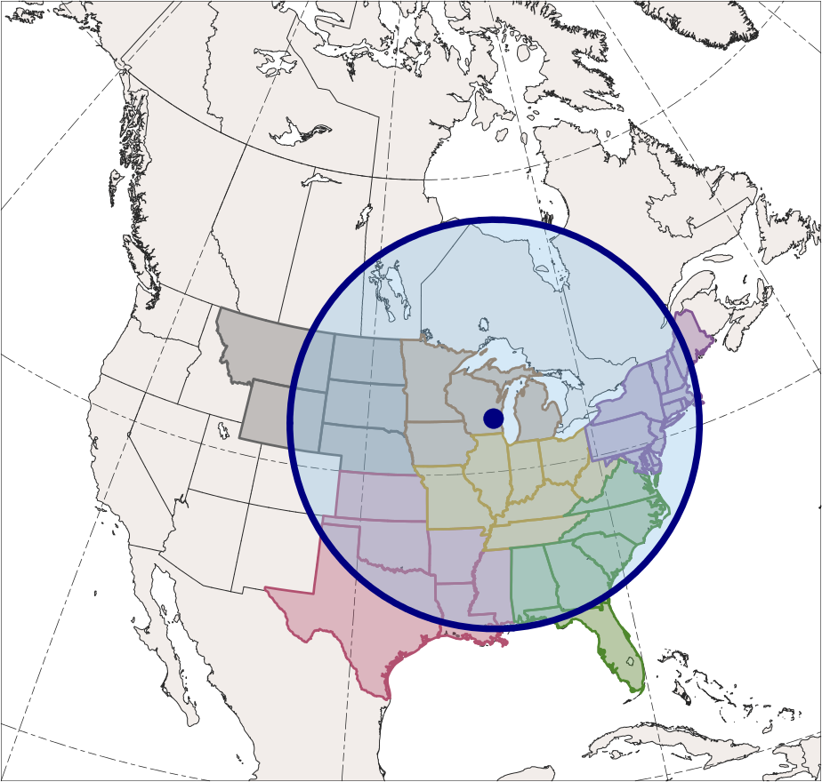
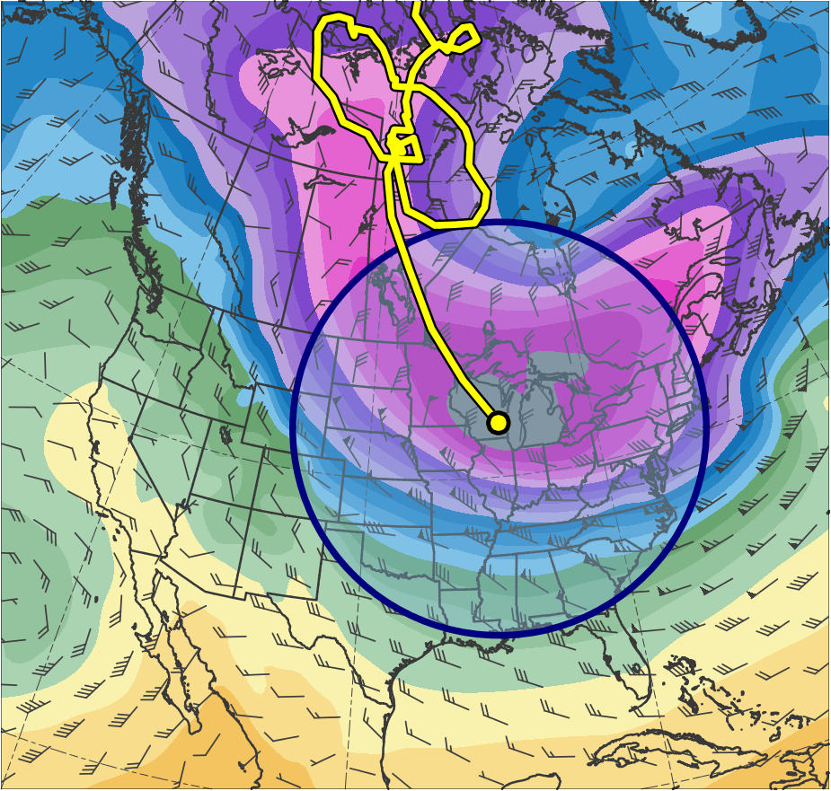
CAOs Linked to Cold Pools
Identification of CAOs linked to cold pools:
Circle of radius 1500 km surrounding 1000–500-hPa thickness minimum of a cold pool must overlap at least one grid point (using a 0.5° grid) of region for at least one time stamp (6 h interval) during CAO
0600 UTC 10 Jan 1982
600
590
580
570
560
550
East North Central
540
West North Central
530
Northeast
520
Central
510
500
Southeast
490
South
480
470
460
(dam)
1500-km
radius circle
Cold Pool

Slide 56
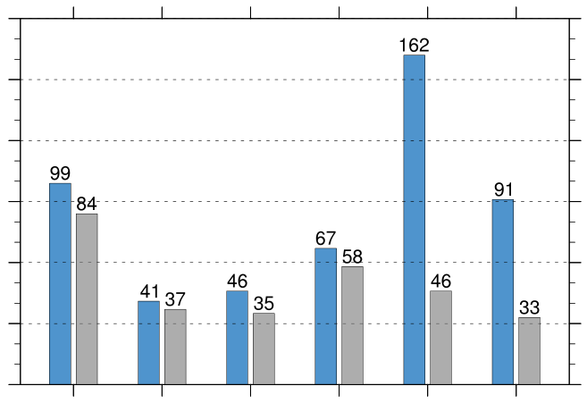
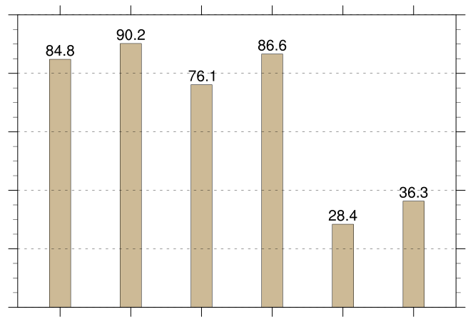
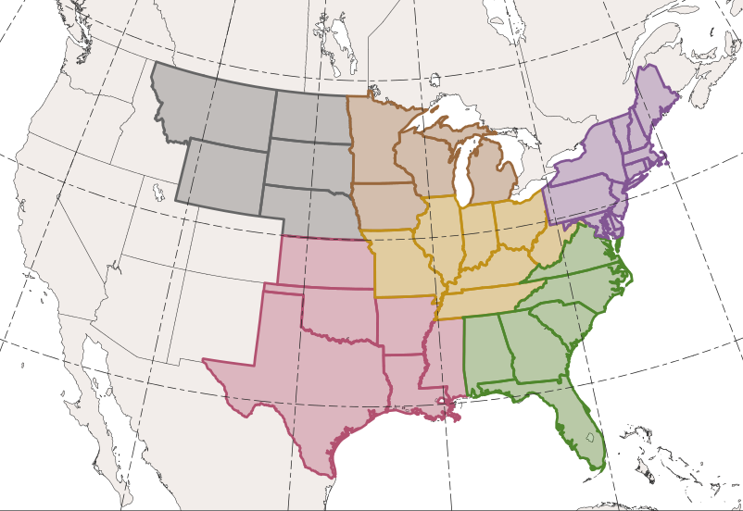
CAOs Linked to Cold Pools
CAOs Linked to Cold Pools
Percentage of CAOs Linked to Cold Pools
180
100
150
80
120
60
90
count
percent
40
60
30
20
0
0
WNC
ENC
Central
Northeast
South
Southeast
WNC
ENC
Central
Northeast
South
Southeast
Total number of CAOs
East North Central (ENC)
West North Central (WNC)
Northeast
Number of unique CAOs linked to at least one cold pool
Central
Percentage of unique CAOs linked to at least one cold pool [(gray/blue) × 100]
Southeast
South

Slide 57
CAOs Linked to Cold Pools
CAOs Linked to Cold Pools
Percentage of CAOs Linked to Cold Pools
180
100
150
80
120
60
90
count
percent
40
60
30
20
0
0
WNC
ENC
Central
Northeast
South
Southeast
WNC
ENC
Central
Northeast
South
Southeast
Total number of CAOs
East North Central (ENC)
West North Central (WNC)
Northeast
Number of unique CAOs linked to at least one cold pool
Central
Percentage of unique CAOs linked to at least one cold pool [(gray/blue) × 100]
Southeast
South

Slide 58
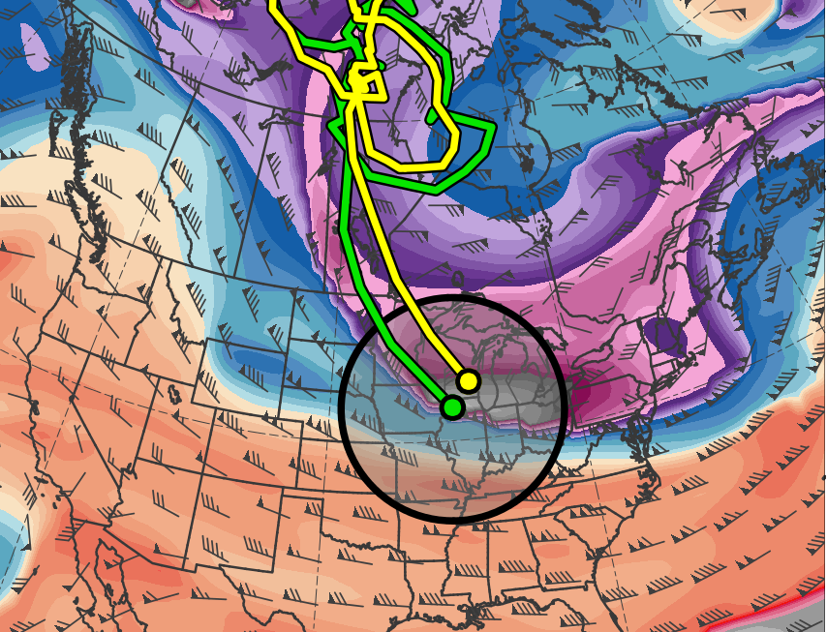
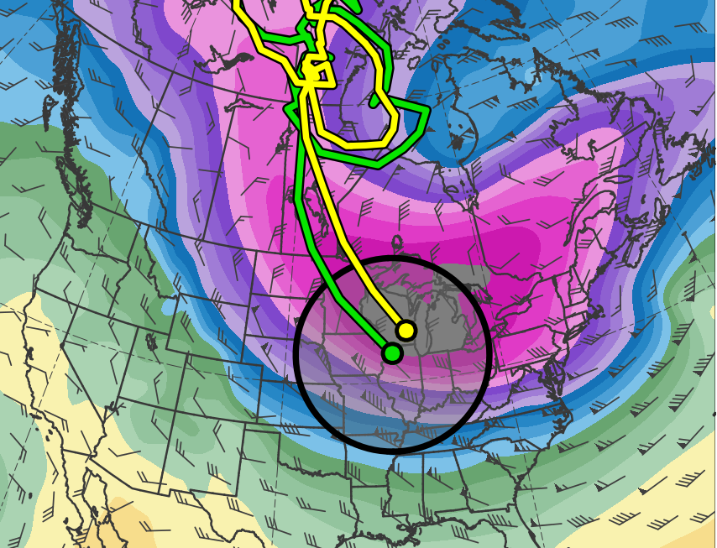
Cold Pools Associated with TPVs
Identification of cold pools associated with TPVs:
Centers of TPVs and cold pools must be located within 750 km of each other for at least two consecutive days to be identified as a match
0600 UTC 10 Jan 1982
(K)
252
258
264
270
276
282
288
294
300
306
312
318
324
330
336
342
348
354
360
366
372
378
(dam)
460
470
480
490
500
510
520
530
540
550
560
570
580
590
600
750-km
radius circle
TPV
Cold Pool

Slide 59
Cold Pools Associated with TPVs
6,288 out of a total of 8,395 cold pools, or 74.9%, match with at least one TPV
6,510 out of a total of 25,085 TPVs, or 26.0%, match with at least one cold pool

Slide 60
Cold Pools Associated with TPVs
6,288 out of a total of 8,395 cold pools, or 74.9%, match with at least one TPV
6,510 out of a total of 25,085 TPVs, or 26.0%, match with at least one cold pool
TPVs may not match with cold pools because:
TPVs may be too small or too weak to be associated with trackable cold pools
TPVs may be associated with thickness troughs that are not trackable
TPVs may match with cold pools not meeting latitude criteria

Slide 61
CAOs Linked to Cold Pools Associated with TPVs
CAOs that are linked to cold pools associated with TPVs can now be identified

Slide 62
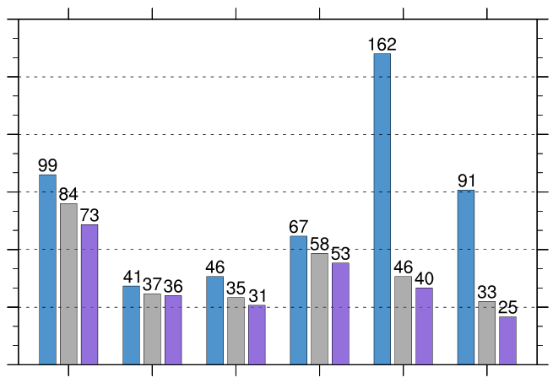
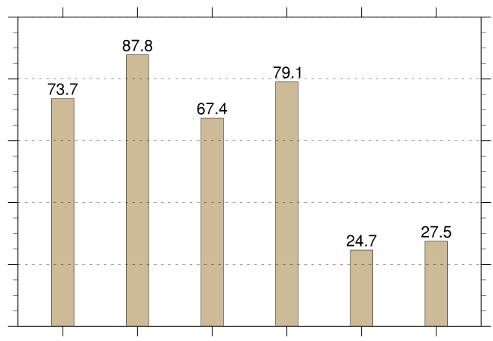
CAOs Linked to Cold Pools Associated with TPVs
CAOs Linked to Cold Pools Associated with TPVs
Percentage of CAOs Linked to Cold Pools Associated with TPVs
180
100
150
80
120
60
90
count
percent
40
60
30
20
0
0
WNC
ENC
Central
Northeast
South
Southeast
WNC
ENC
Central
Northeast
South
Southeast
Total number of CAOs
East North Central (ENC)
West North Central (WNC)
Northeast
Number of unique CAOs linked to at least one cold pool
Number of unique CAOs linked to at least one cold pool associated with TPVs
Central
South
Southeast
Percentage of unique CAOs linked to at least one cold pool associated with TPVs [(purple/blue) × 100]

Slide 63
Examination of January 1982 CAO

Slide 64
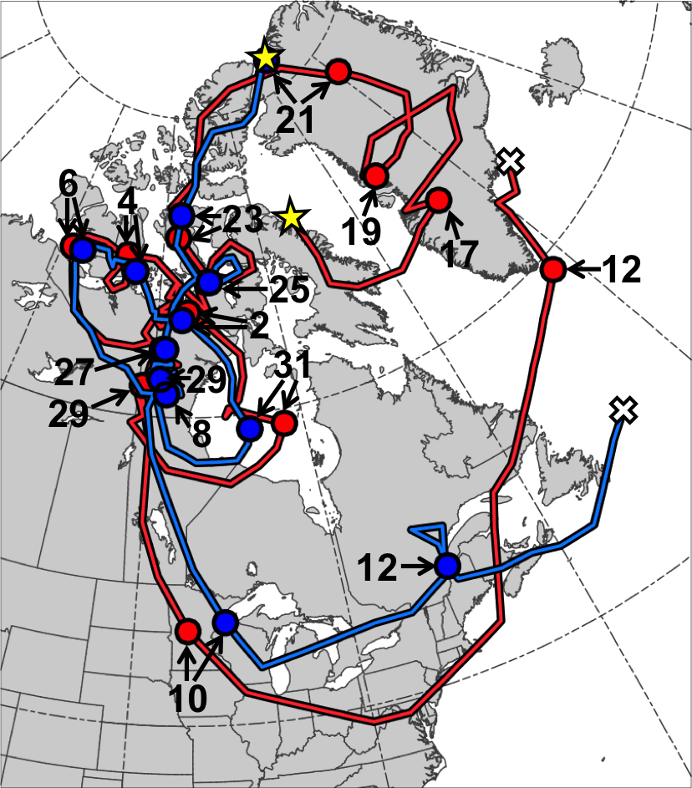
TPV and Cold Pool Track and Intensity
290
510
280
500
270
490
260
480
470
250
460
Dec 1981
Jan 1982
Genesis
TPV
Minimum DT θ of TPV (K)
Lysis
Cold Pool
Minimum 1000–500-hPa thickness of cold pool (dam)

Slide 65
Ridge Amplification
0000 UTC 5 Jan 1982
L
R
TPV
Cold Pool
(K)
252
258
264
270
276
282
288
294
300
306
312
318
324
330
336
342
348
354
360
366
372
378
(m s⁻¹ )
(mm)
50
60
70
80
90
100
110
120
25
30
35
40
45
50
55
Potential temperature (K, shaded), wind speed (black, every 10 m s⁻¹ starting at 50 m s⁻¹), and wind (m s⁻¹, flags and barbs) on 2-PVU surface
250-hPa wind speed (m s⁻¹, shaded),
1000–500-hPa thickness (dam, blue/red),
SLP (hPa, black), PW (mm, shaded)

Slide 66
Ridge Amplification
0000 UTC 6 Jan 1982
L
R
TPV
Cold Pool
(K)
252
258
264
270
276
282
288
294
300
306
312
318
324
330
336
342
348
354
360
366
372
378
(m s⁻¹ )
(mm)
50
60
70
80
90
100
110
120
25
30
35
40
45
50
55
Potential temperature (K, shaded), wind speed (black, every 10 m s⁻¹ starting at 50 m s⁻¹), and wind (m s⁻¹, flags and barbs) on 2-PVU surface
250-hPa wind speed (m s⁻¹, shaded),
1000–500-hPa thickness (dam, blue/red),
SLP (hPa, black), PW (mm, shaded)

Slide 67
Ridge Amplification
0000 UTC 7 Jan 1982
L
R
TPV
Cold Pool
(K)
252
258
264
270
276
282
288
294
300
306
312
318
324
330
336
342
348
354
360
366
372
378
(m s⁻¹ )
(mm)
50
60
70
80
90
100
110
120
25
30
35
40
45
50
55
Potential temperature (K, shaded), wind speed (black, every 10 m s⁻¹ starting at 50 m s⁻¹), and wind (m s⁻¹, flags and barbs) on 2-PVU surface
250-hPa wind speed (m s⁻¹, shaded),
1000–500-hPa thickness (dam, blue/red),
SLP (hPa, black), PW (mm, shaded)

Slide 68
Ridge Amplification
0000 UTC 8 Jan 1982
L
R
TPV
Cold Pool
(K)
252
258
264
270
276
282
288
294
300
306
312
318
324
330
336
342
348
354
360
366
372
378
(m s⁻¹ )
(mm)
50
60
70
80
90
100
110
120
25
30
35
40
45
50
55
Potential temperature (K, shaded), wind speed (black, every 10 m s⁻¹ starting at 50 m s⁻¹), and wind (m s⁻¹, flags and barbs) on 2-PVU surface
250-hPa wind speed (m s⁻¹, shaded),
1000–500-hPa thickness (dam, blue/red),
SLP (hPa, black), PW (mm, shaded)

Slide 69
Ridge Amplification
0000 UTC 6 Jan 1982
0000 UTC 7 Jan 1982
L
R
L
R
(PVU day⁻¹)
(mm)
-2
-6
-10
-14
-18
25
30
35
40
45
50
55
PW (mm, shaded), 600–400-hPa ascent (red, every 2.5 × 10⁻³ hPa s⁻¹), and 300–200-hPa PV (PVU, gray), irrotational wind (m s⁻¹), and negative PV advection by the irrotational wind (PVU day⁻¹, shaded)

Slide 70
CAO Development
0000 UTC 8 Jan 1982
H
R
TPV
Cold Pool
(K)
252
258
264
270
276
282
288
294
300
306
312
318
324
330
336
342
348
354
360
366
372
378
(m s⁻¹ )
(mm)
50
60
70
80
90
100
110
120
25
30
35
40
45
50
55
Potential temperature (K, shaded), wind speed (black, every 10 m s⁻¹ starting at 50 m s⁻¹), and wind (m s⁻¹, flags and barbs) on 2-PVU surface
250-hPa wind speed (m s⁻¹, shaded),
1000–500-hPa thickness (dam, blue/red),
SLP (hPa, black), PW (mm, shaded)

Slide 71
CAO Development
0000 UTC 9 Jan 1982
H
R
TPV
Cold Pool
(K)
252
258
264
270
276
282
288
294
300
306
312
318
324
330
336
342
348
354
360
366
372
378
(m s⁻¹ )
(mm)
50
60
70
80
90
100
110
120
25
30
35
40
45
50
55
Potential temperature (K, shaded), wind speed (black, every 10 m s⁻¹ starting at 50 m s⁻¹), and wind (m s⁻¹, flags and barbs) on 2-PVU surface
250-hPa wind speed (m s⁻¹, shaded),
1000–500-hPa thickness (dam, blue/red),
SLP (hPa, black), PW (mm, shaded)

Slide 72
CAO Development
0000 UTC 10 Jan 1982
H
R
TPV
Cold Pool
(K)
252
258
264
270
276
282
288
294
300
306
312
318
324
330
336
342
348
354
360
366
372
378
(m s⁻¹ )
(mm)
50
60
70
80
90
100
110
120
25
30
35
40
45
50
55
Potential temperature (K, shaded), wind speed (black, every 10 m s⁻¹ starting at 50 m s⁻¹), and wind (m s⁻¹, flags and barbs) on 2-PVU surface
250-hPa wind speed (m s⁻¹, shaded),
1000–500-hPa thickness (dam, blue/red),
SLP (hPa, black), PW (mm, shaded)

Slide 73
CAO Development
0000 UTC 11 Jan 1982
R
H
TPV
Cold Pool
(K)
252
258
264
270
276
282
288
294
300
306
312
318
324
330
336
342
348
354
360
366
372
378
(m s⁻¹ )
(mm)
50
60
70
80
90
100
110
120
25
30
35
40
45
50
55
Potential temperature (K, shaded), wind speed (black, every 10 m s⁻¹ starting at 50 m s⁻¹), and wind (m s⁻¹, flags and barbs) on 2-PVU surface
250-hPa wind speed (m s⁻¹, shaded),
1000–500-hPa thickness (dam, blue/red),
SLP (hPa, black), PW (mm, shaded)

Slide 74
Cross Sections
1200 UTC 16 Dec 1981
PV (PVU, shading), θ (K, black), and wind speed (dashed white, m s⁻¹);
(b) DT (2-PVU surface) θ (K, shaded), wind speed (black, m s⁻¹), and wind (m s⁻¹, flags and barbs);
(c) 1000–500-hPa thickness (dam, shading)

Slide 75
Cross Sections
1200 UTC 2 Jan 1982
PV (PVU, shading), θ (K, black), and wind speed (dashed white, m s⁻¹);
(b) DT (2-PVU surface) θ (K, shaded), wind speed (black, m s⁻¹), and wind (m s⁻¹, flags and barbs);
(c) 1000–500-hPa thickness (dam, shading)

Slide 76
Cross Sections
0000 UTC 10 Jan 1982
PV (PVU, shading), θ (K, black), and wind speed (dashed white, m s⁻¹);
(b) DT (2-PVU surface) θ (K, shaded), wind speed (black, m s⁻¹), and wind (m s⁻¹, flags and barbs);
(c) 1000–500-hPa thickness (dam, shading)

Slide 77
TPV–jet Interaction and Surface Anticyclogenesis
As jet streak strengthens over western North America during TPV–jet interaction, surface anticyclone strengthens and expands in left entrance region of jet streak
Does TPV–jet interaction play a role in surface anticyclogenesis?

Slide 78
Q-vector Diagnosis
Sanders and Hoskins (1990)
Idealized pattern of upper-level geopotential height contours (solid) and isotherms (dashed) for a train of equivalent-barotropic troughs and ridges, with Q-vectors overlaid. Figure 4 and caption adapted from Sanders and Hoskins (1990)
Idealized pattern of confluent frontogenesis corresponding to an entrance region of a jet. Solid lines are contours of low-level geopotential height and dashed contours are contours of lower-tropospheric thickness, with Q-vectors overlaid Figure 5 and caption adapted from Sanders and Hoskins (1990)

Slide 79
Q-vector Diagnosis
Sanders and Hoskins (1990)
H
TPV
TPV
H
Idealized pattern of upper-level geopotential height contours (solid) and isotherms (dashed) for a train of equivalent-barotropic troughs and ridges, with Q-vectors overlaid. Figure 4 and caption adapted from Sanders and Hoskins (1990)
Idealized pattern of confluent frontogenesis corresponding to an entrance region of a jet. Solid lines are contours of low-level geopotential height and dashed contours are contours of lower-tropospheric thickness, with Q-vectors overlaid Figure 5 and caption adapted from Sanders and Hoskins (1990)
How does TPV–jet interaction influence Q-vector forcing for descent and forcing for anticyclogenesis?

Slide 80
Q-vector Diagnosis
Diagnose Q-vector forcing for vertical motion during TPV–jet interaction
Q-vectors in pressure coordinates calculated following Hoskins and Pedder (1980):
Q-vectors separated into across-isentrope (Q_{n}) and along-isentrope (Q_{s}) components following Keyser et al. (1992) as follows:

Slide 81
Q-vector Diagnosis
Q-vector forcing for vertical motion associated with Q_{n} and Q_{s} calculated by adapting Q-vector form of QG omega equation in pressure coordinates from Hoskins and Pedder (1980)
where , or equivalently,
Q-vector components and respective forcings for vertical motion averaged over 600–400-hPa layer

Slide 82
Q-vector Diagnosis
1200 UTC 8 Jan 1982
(a)
(a) 600–400-hPa wind speed (shaded, m s⁻¹)
(b) 600–400-hPa Q_{n} (K m⁻¹ s⁻¹, vectors) and Q_{n} forcing for vertical motion (10⁻¹⁷ Pa⁻¹ s⁻³, shaded)
(c) 600–400-hPa Q_{s} (K m⁻¹ s⁻¹, vectors) and Q_{s} forcing for vertical motion (10⁻¹⁷ Pa⁻¹ s⁻³, shaded
4
120
3.5
3
110
2.5
2
100
1.5
SLP (every 5 hPa, beginning at 1040 hPa)
600–400-hPa θ (every 5°C)
1
600–400-hPa Z (every 10 dam)
90
0.5
TPV
0
(b)
(c)
80
-0.5
-1
70
-1.5
-2
60
-2.5
-3
50
-3.5
-4
(m s⁻¹ )

Slide 83
Q-vector Diagnosis
0000 UTC 9 Jan 1982
(a)
(a) 600–400-hPa wind speed (shaded, m s⁻¹)
(b) 600–400-hPa Q_{n} (K m⁻¹ s⁻¹, vectors) and Q_{n} forcing for vertical motion (10⁻¹⁷ Pa⁻¹ s⁻³, shaded)
(c) 600–400-hPa Q_{s} (K m⁻¹ s⁻¹, vectors) and Q_{s} forcing for vertical motion (10⁻¹⁷ Pa⁻¹ s⁻³, shaded
4
120
3.5
3
110
2.5
2
100
1.5
SLP (every 5 hPa, beginning at 1040 hPa)
600–400-hPa θ (every 5°C)
1
600–400-hPa Z (every 10 dam)
90
0.5
TPV
0
(b)
(c)
80
-0.5
-1
70
-1.5
-2
60
-2.5
-3
50
-3.5
-4
(m s⁻¹ )

Slide 84
Q-vector Diagnosis
1200 UTC 9 Jan 1982
(a)
(a) 600–400-hPa wind speed (shaded, m s⁻¹)
(b) 600–400-hPa Q_{n} (K m⁻¹ s⁻¹, vectors) and Q_{n} forcing for vertical motion (10⁻¹⁷ Pa⁻¹ s⁻³, shaded)
(c) 600–400-hPa Q_{s} (K m⁻¹ s⁻¹, vectors) and Q_{s} forcing for vertical motion (10⁻¹⁷ Pa⁻¹ s⁻³, shaded
4
120
3.5
3
110
2.5
2
100
1.5
SLP (every 5 hPa, beginning at 1040 hPa)
600–400-hPa θ (every 5°C)
1
600–400-hPa Z (every 10 dam)
90
0.5
TPV
0
(b)
(c)
80
-0.5
-1
70
-1.5
-2
60
-2.5
-3
50
-3.5
-4
(m s⁻¹ )

Slide 85
Q-vector Diagnosis
0000 UTC 10 Jan 1982
(a)
(a) 600–400-hPa wind speed (shaded, m s⁻¹)
(b) 600–400-hPa Q_{n} (K m⁻¹ s⁻¹, vectors) and Q_{n} forcing for vertical motion (10⁻¹⁷ Pa⁻¹ s⁻³, shaded)
(c) 600–400-hPa Q_{s} (K m⁻¹ s⁻¹, vectors) and Q_{s} forcing for vertical motion (10⁻¹⁷ Pa⁻¹ s⁻³, shaded
4
120
3.5
3
110
2.5
2
100
1.5
SLP (every 5 hPa, beginning at 1040 hPa)
600–400-hPa θ (every 5°C)
1
600–400-hPa Z (every 10 dam)
90
0.5
TPV
0
(b)
(c)
80
-0.5
-1
70
-1.5
-2
60
-2.5
-3
50
-3.5
-4
(m s⁻¹ )

Slide 86
Conclusions
Central and eastern North America and Siberia and eastern Asia are preferred corridors for the equatorward transport of TPVs and Cold Pools
~85–90% of CAOs over northern region of the U.S. are linked to cold pools
~74–88% of CAOs over northern regions of the U.S. are linked to cold pools associated with TPVs

Slide 87
Conclusions
Large spatial overlap and temporal coincidence of TPV and cold pool in Jan 1982 CAO case suggests a dynamical linkage between the TPV and cold pool
As TPV strengthens and becomes better defined, the cold pool does as well, further illustrating a dynamical linkage between the TPV and cold pool
This dynamical linkage demonstrates that
The influence of TPVs can extend through the depth of the troposphere and over a widespread geographical area
The equatorward transport of TPVs can lead to CAO development

Slide 88
Conclusions
TPV–jet interaction may be associated with enhanced Q-vector forcing for descent in left entrance region of jet streak, which may support strengthening and expansion of strong surface anticyclone in this region
CAO develops as TPV and cold pool move equatorward into the U.S., along with the strong surface anticyclone, and cold air from cold pool associated with TPV spreads far away from core of cold pool
Improved understanding of TPVs and their equatorward transport may lead to improved understanding of CAOs

Slide 89
Thank you!
Lance and Dan
DAES Faculty
Support Staff
Fellow graduate students
ES 234
Zach Murphy and Nicholas Szapiro
My Family

