Slide 1
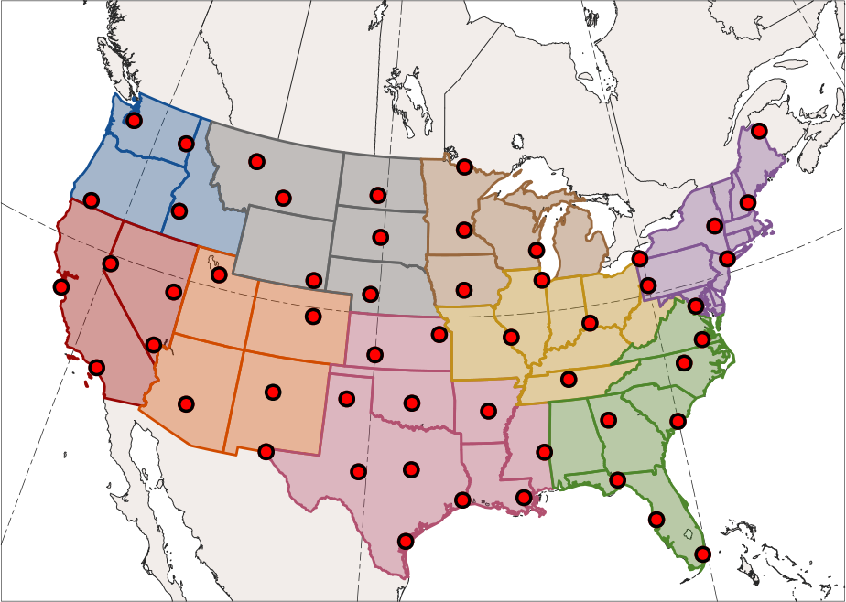
Northwest
West North Central
Northeast
West
East North Central
South
Southwest
Central
Southeast

Slide 2
Northwest
West North Central
Northeast
West
East North Central
South
Southwest
Central
Southeast

Slide 3
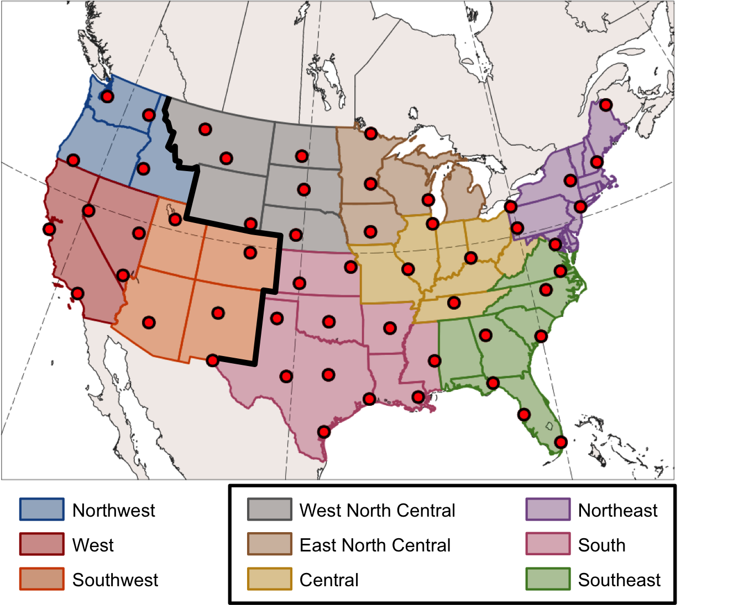

Slide 4
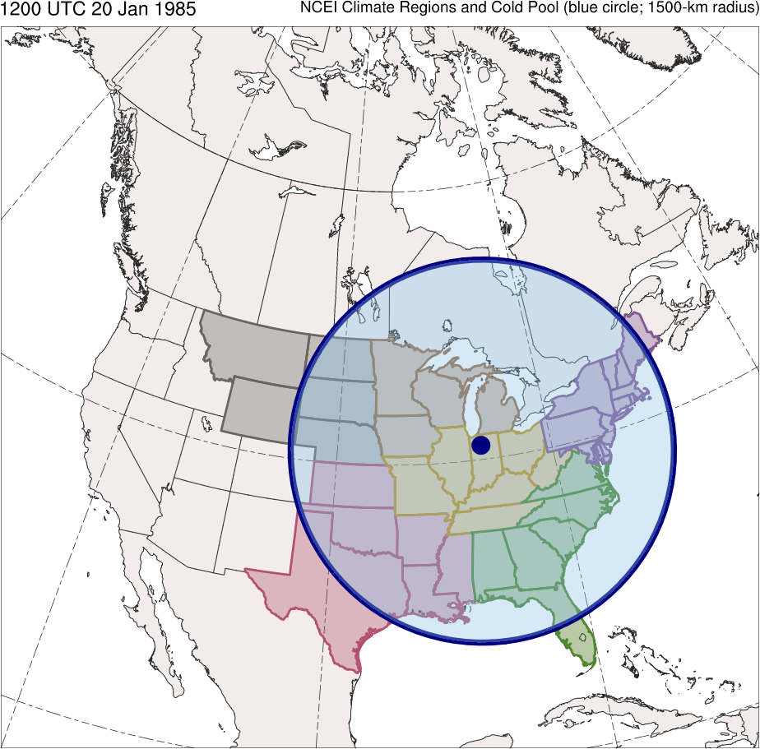
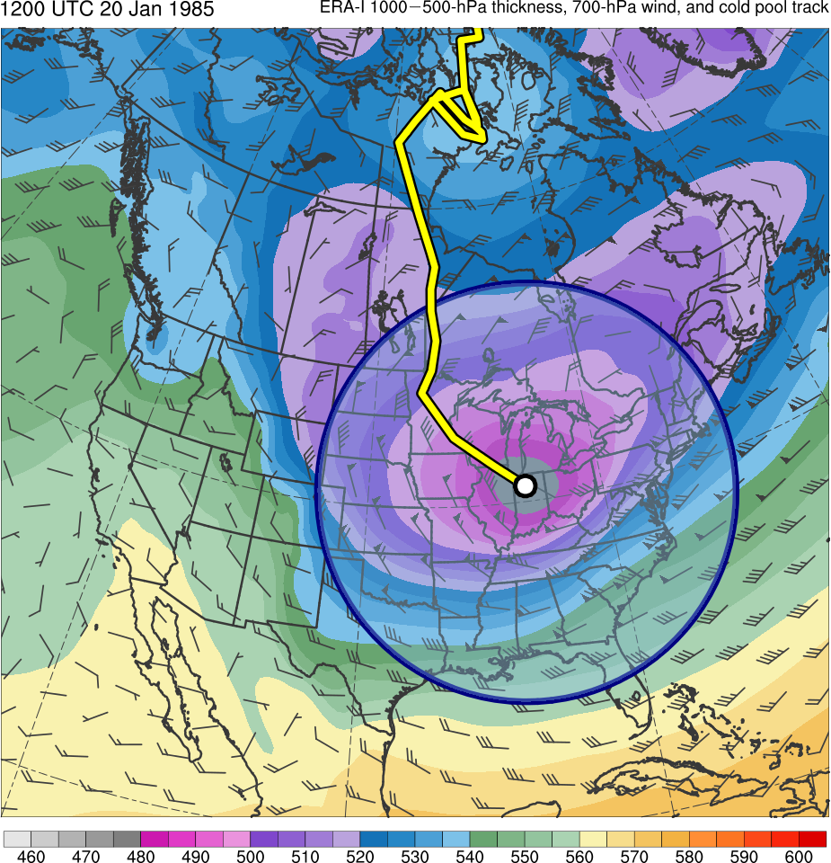
(dam)
460
470
480
490
500
510
520
530
540
550
560
570
580
590
600
West North Central
Central
South
East North Central
Northeast
Southeast
Notes:
1500 km

Slide 5
(dam)
460
470
480
490
500
510
520
530
540
550
560
570
580
590
600
West North Central
East North Central
Central
Northeast
South
Southeast
Notes:
1500 km

Slide 6
1200 UTC 20 Jan 1985
West North Central
East North Central
Central
Northeast
South
Southeast
(dam)
460
470
480
490
500
510
520
530
540
550
560
570
580
590
600
Notes:
1500 km

Slide 7
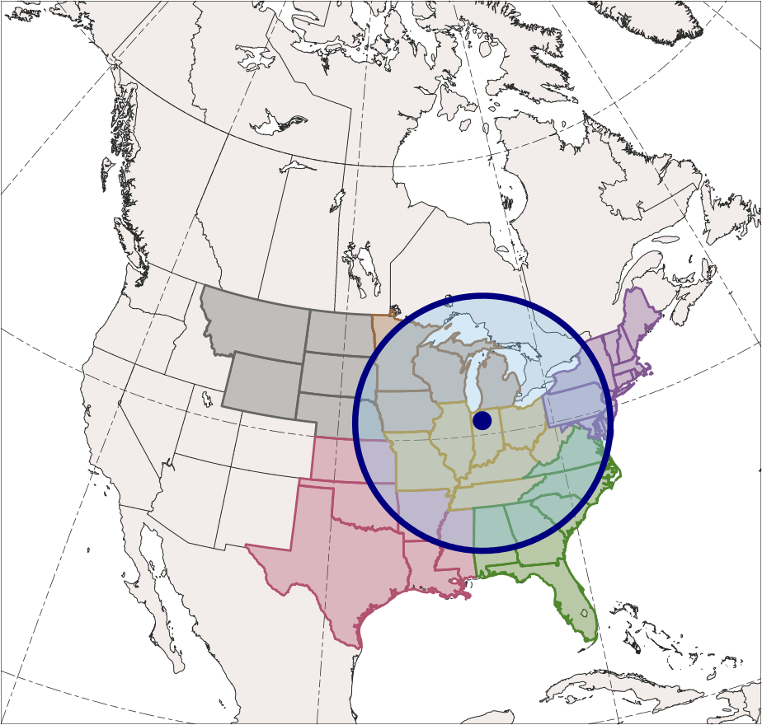
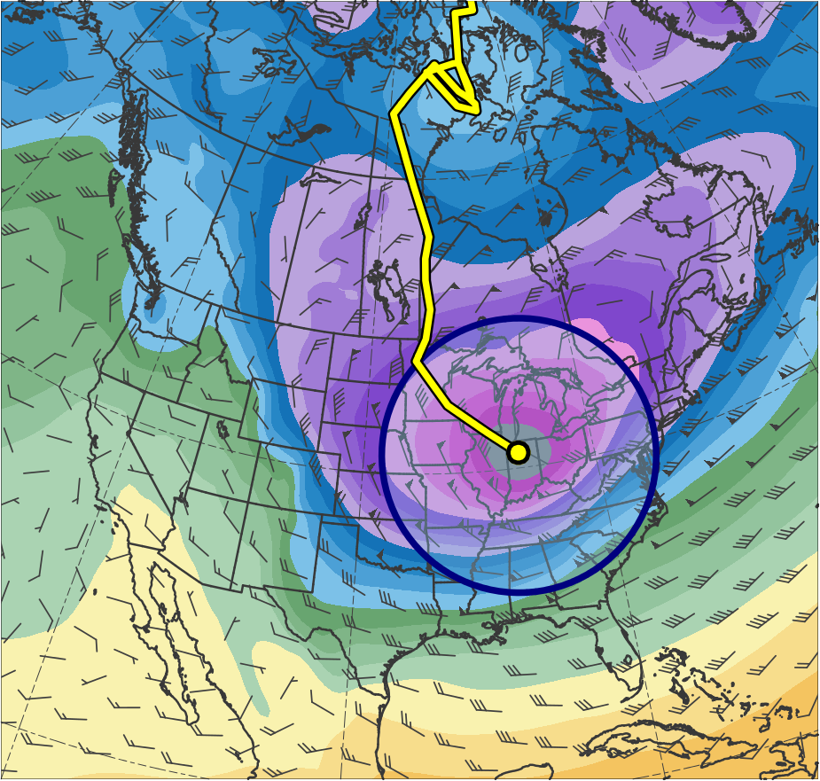
1200 UTC 20 Jan 1985
West North Central
East North Central
Central
Northeast
South
Southeast
(dam)
460
470
480
490
500
510
520
530
540
550
560
570
580
590
600
Notes:
1000 km

Slide 8
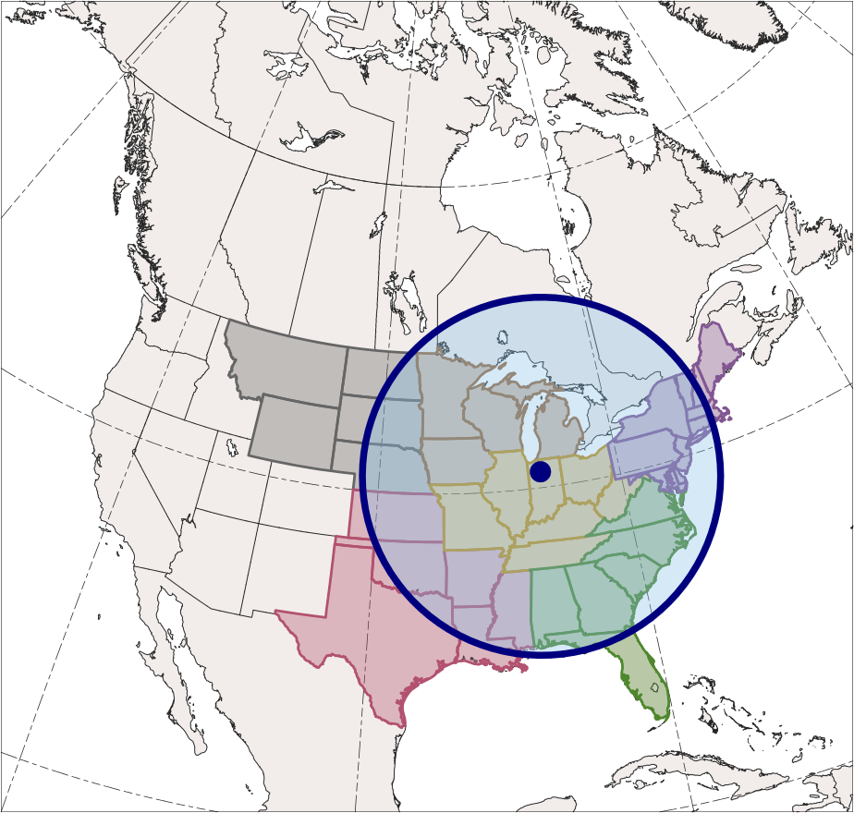
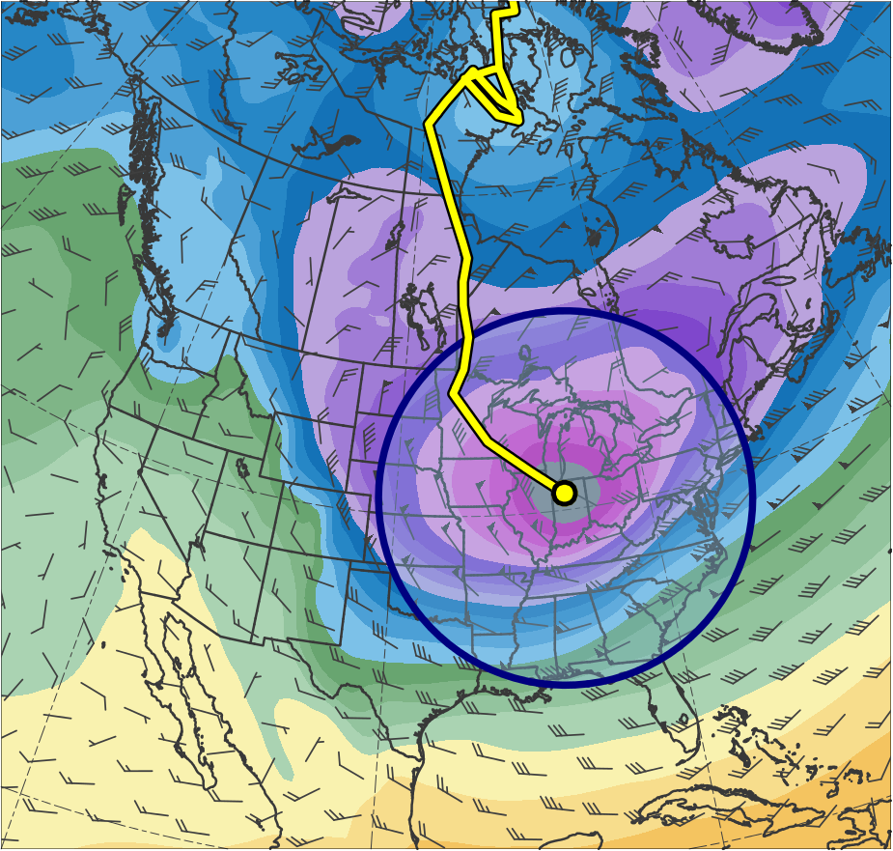
1200 UTC 20 Jan 1985
West North Central
East North Central
Central
Northeast
South
Southeast
(dam)
460
470
480
490
500
510
520
530
540
550
560
570
580
590
600
Notes:
1250 km

Slide 9
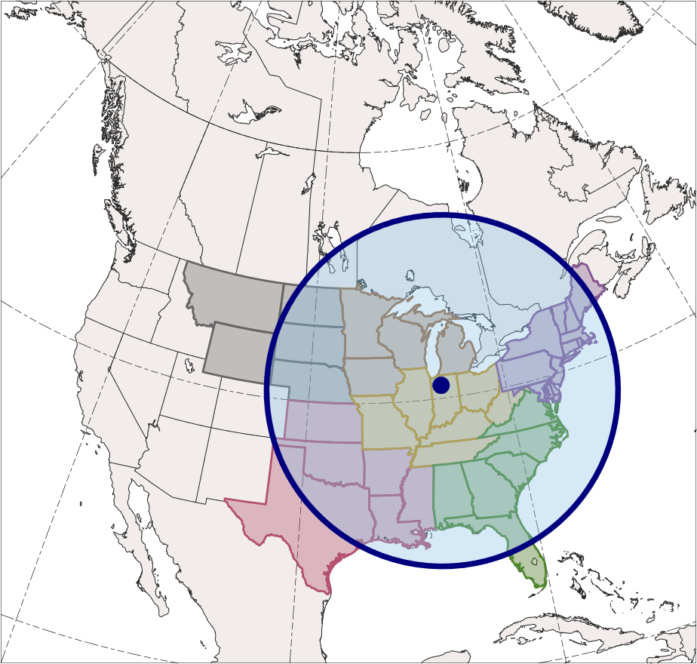
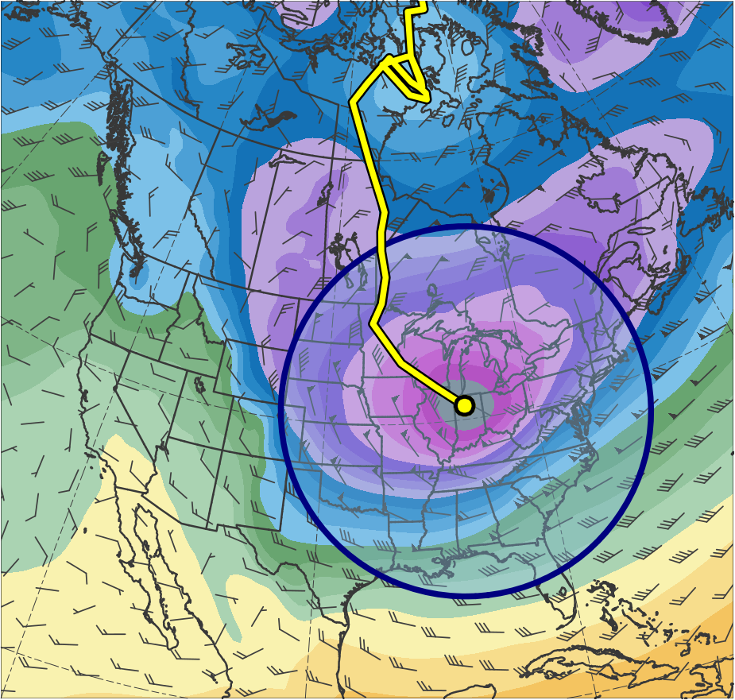
1200 UTC 20 Jan 1985
(a)
(b)
West North Central
East North Central
Central
Northeast
South
Southeast
(dam)
460
470
480
490
500
510
520
530
540
550
560
570
580
590
600
Notes:
1500 km

Slide 10
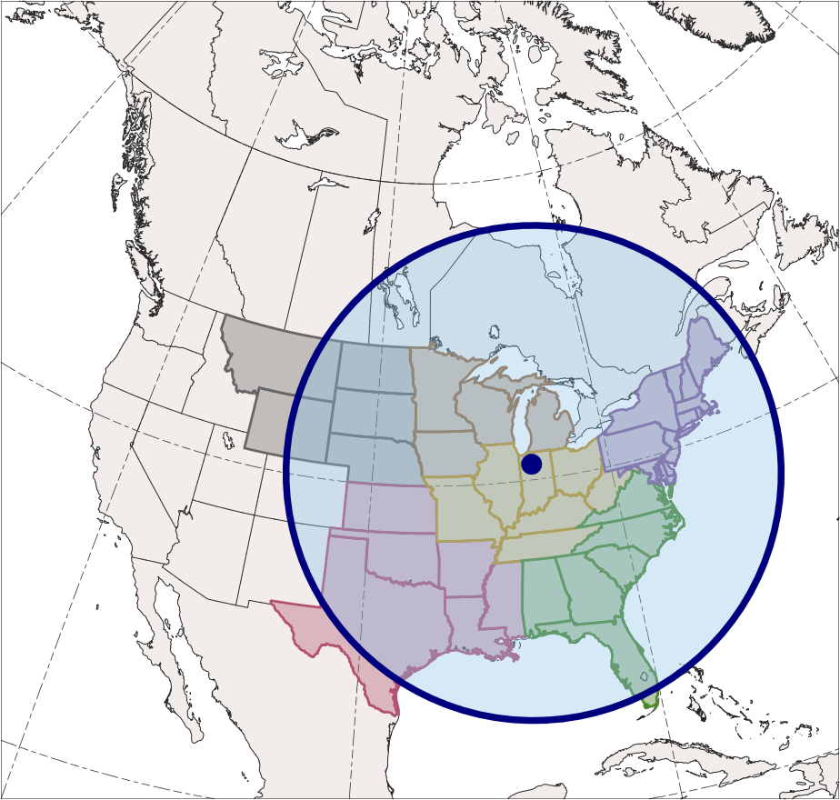
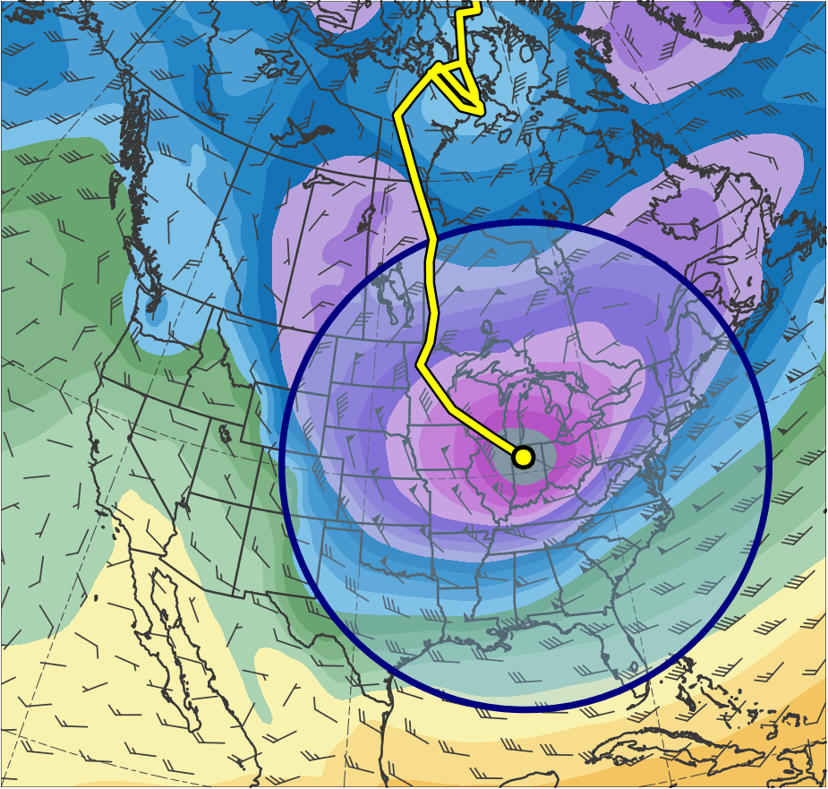
1200 UTC 20 Jan 1985
West North Central
East North Central
Central
Northeast
South
Southeast
(dam)
460
470
480
490
500
510
520
530
540
550
560
570
580
590
600
Notes:
1750 km

Slide 11
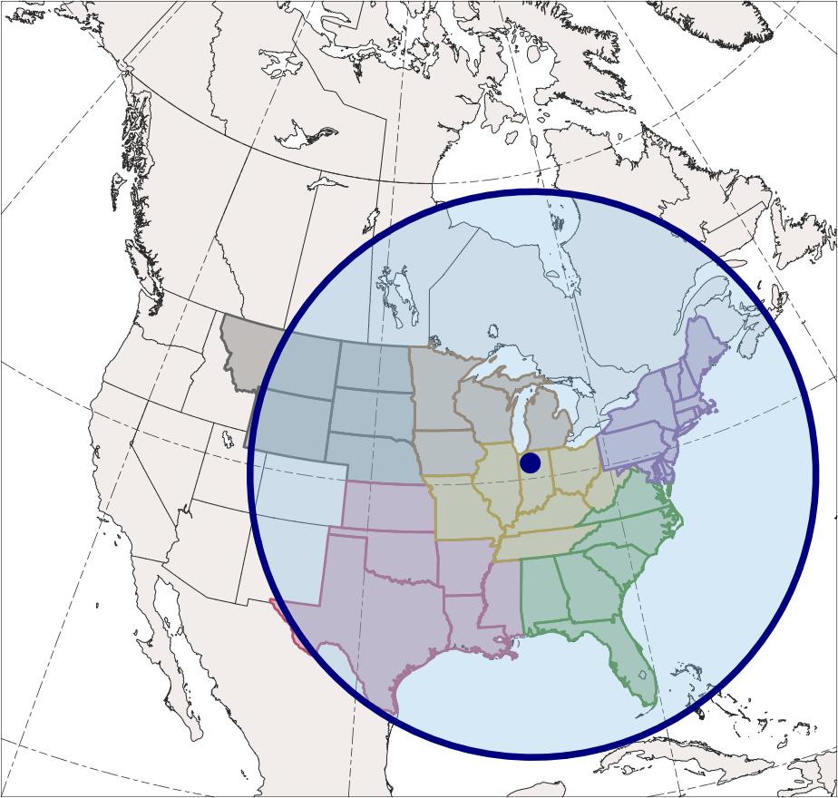
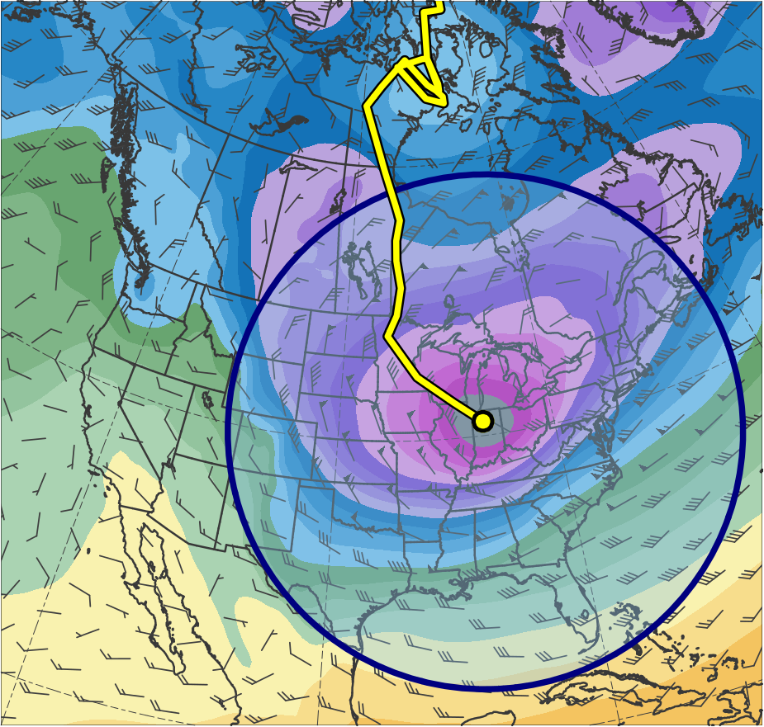
1200 UTC 20 Jan 1985
West North Central
East North Central
Central
Northeast
South
Southeast
(dam)
460
470
480
490
500
510
520
530
540
550
560
570
580
590
600
Notes:
2000 km

Slide 12
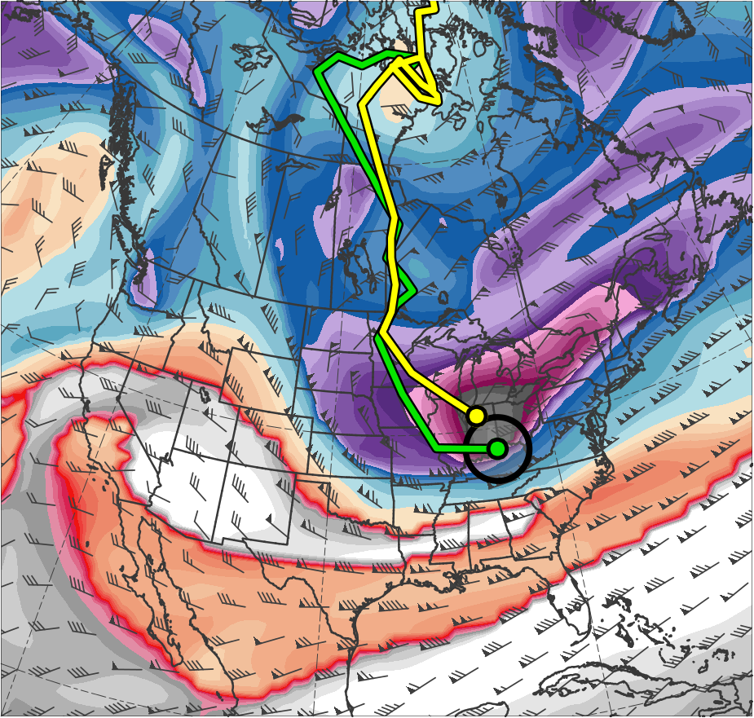
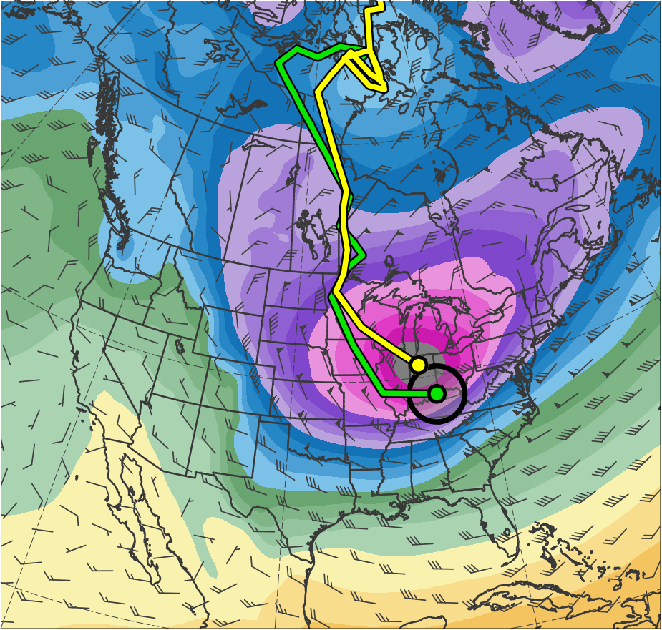
1200 UTC 20 Jan 1985
(K)
252
258
264
270
276
282
288
294
300
306
312
318
324
330
336
342
348
354
360
366
372
378
(dam)
460
470
480
490
500
510
520
530
540
550
560
570
580
590
600
Notes:
250 km

Slide 13
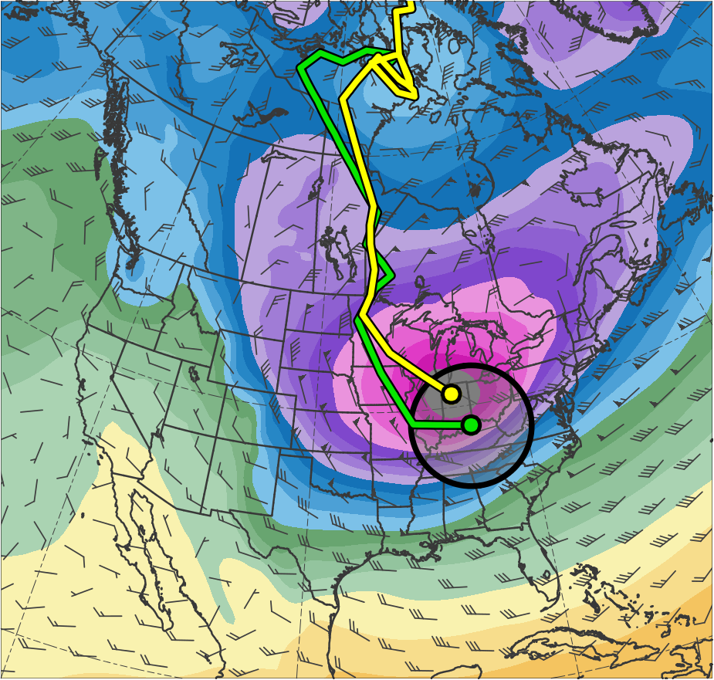
1200 UTC 20 Jan 1985
(K)
252
258
264
270
276
282
288
294
300
306
312
318
324
330
336
342
348
354
360
366
372
378
(dam)
460
470
480
490
500
510
520
530
540
550
560
570
580
590
600
Notes:
500 km

Slide 14
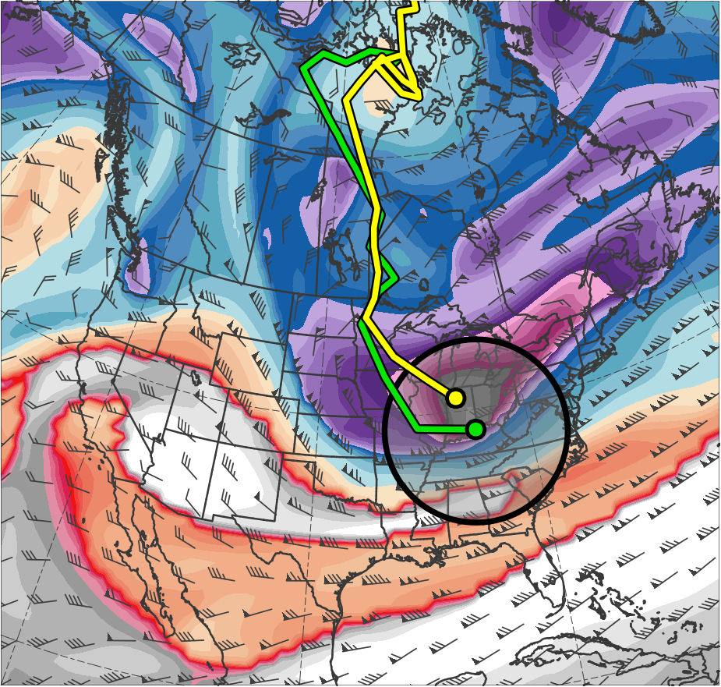
1200 UTC 20 Jan 1985
(a)
(b)
(K)
252
258
264
270
276
282
288
294
300
306
312
318
324
330
336
342
348
354
360
366
372
378
(dam)
460
470
480
490
500
510
520
530
540
550
560
570
580
590
600
Notes:
750 km

Slide 15
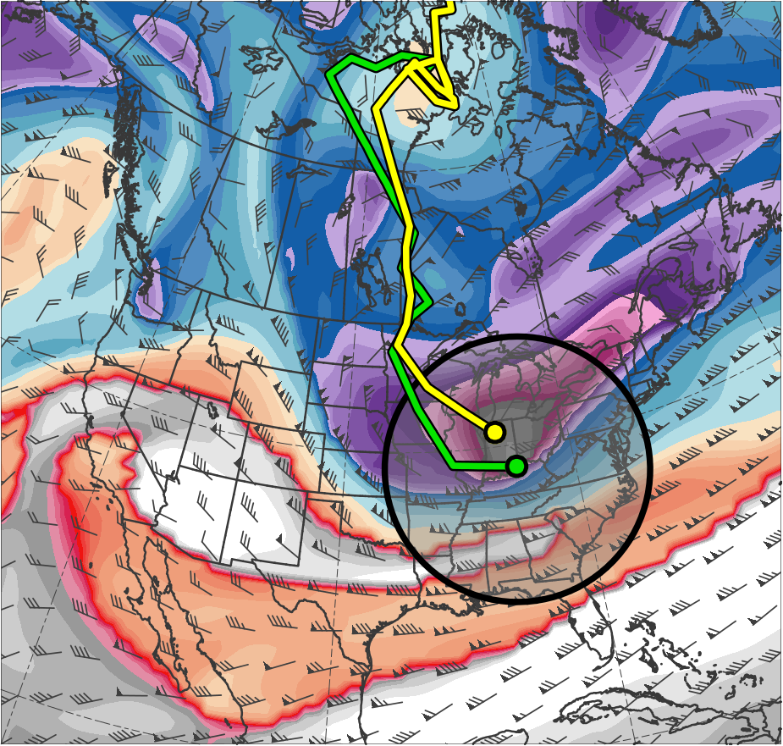
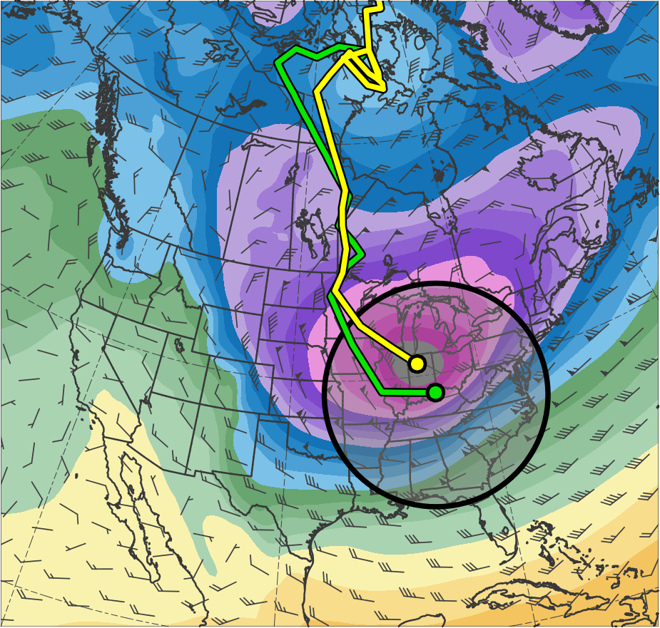
1200 UTC 20 Jan 1985
(K)
252
258
264
270
276
282
288
294
300
306
312
318
324
330
336
342
348
354
360
366
372
378
(dam)
460
470
480
490
500
510
520
530
540
550
560
570
580
590
600
Notes:
1000 km

Slide 16
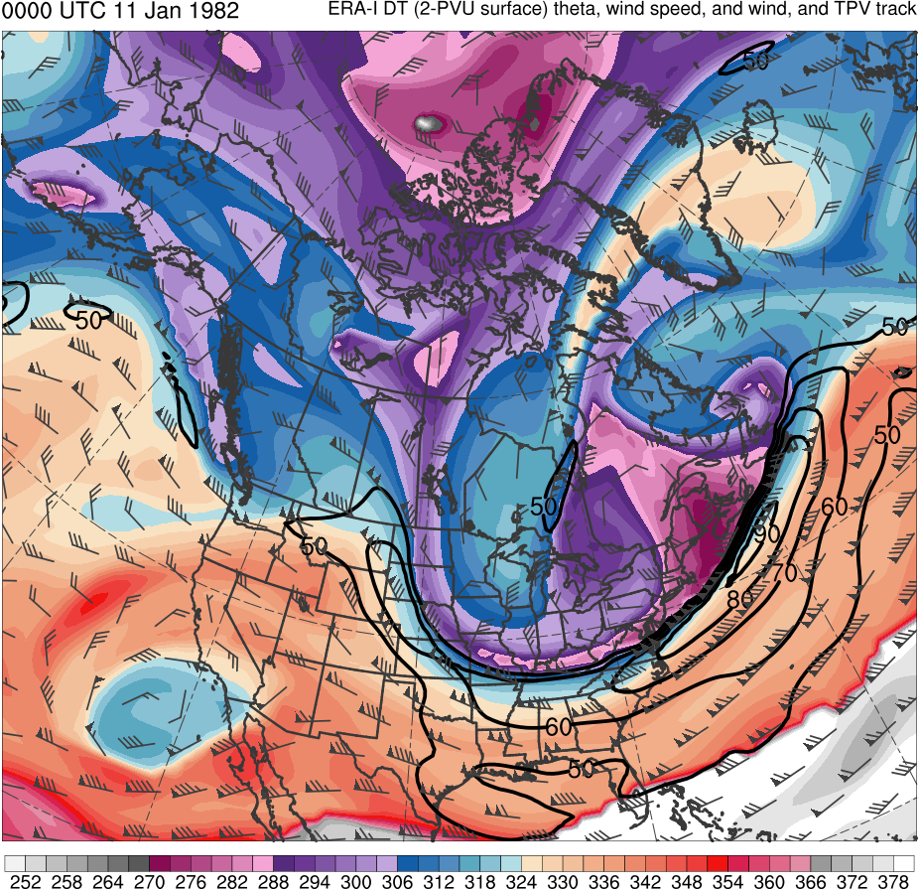
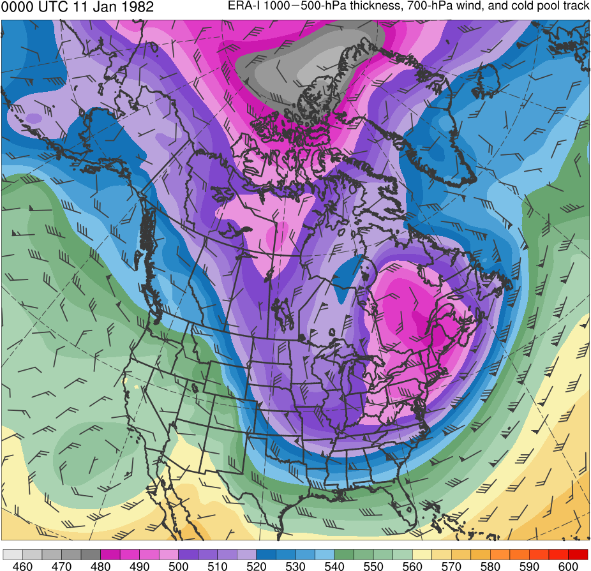
Example: 9–12 Jan 1982 CAO
0000 UTC 11 Jan 1982
Data Source: ERA-Interim
TPV
CP
(K)
252
258
264
270
276
282
288
294
300
306
312
318
324
330
336
342
348
354
360
366
372
378
(dam)
460
470
480
490
500
510
520
530
540
550
560
570
580
590
600
Potential temperature (K, shaded), wind speed (black, every 10 m s⁻¹ starting at 50 m s⁻¹), and wind (m s⁻¹, flags and barbs) on 2-PVU surface
1000–500-hPa thickness (dam, shaded) and 700-hPa wind (m s⁻¹, flags and barbs); CP denotes “cold pool”

Slide 17
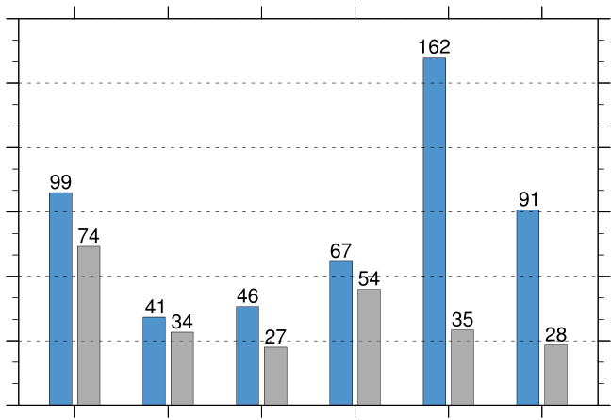
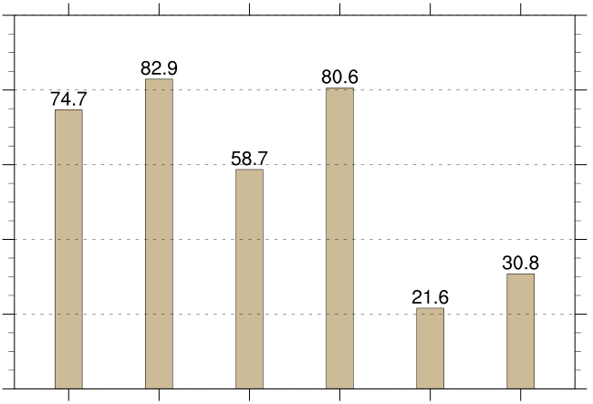
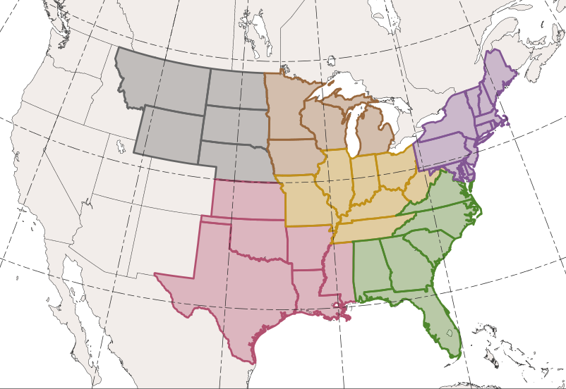
CAOs Linked to Cold Pools
CAOs Linked to Cold Pools
Percentage of CAOs Linked to Cold Pools
180
100
150
80
120
60
90
count
percent
40
60
30
20
0
0
WNC
ENC
Central
Northeast
South
Southeast
WNC
ENC
Central
Northeast
South
Southeast
Total number of CAOs
East North Central (ENC)
West North Central (WNC)
Northeast
Number of unique CAOs linked to at least one cold pool
Central
Percentage of unique CAOs linked to at least one cold pool [(gray/blue) × 100]
Southeast
South

