Slide 1
The Sensitivity of Moisture Flux and Precipitation Formation to WRF Planetary Boundary Layer Parameterizations
Matt Vaughan
Class Project
ATM 621

Slide 2
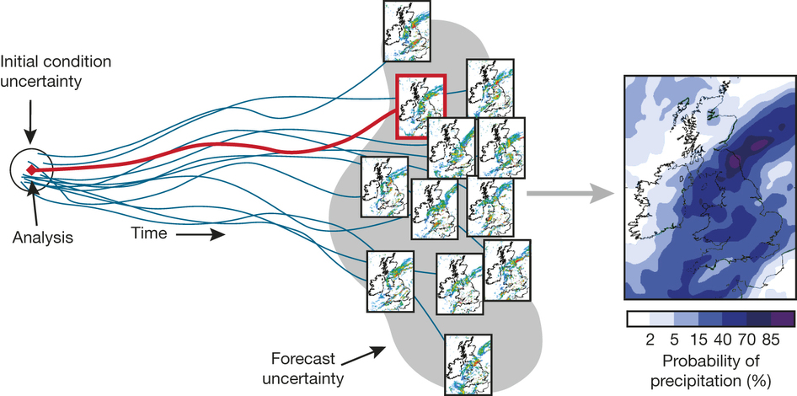
Motivation
Why are there errors in models?
  Initial condition errors
Bauer et al. (2015)

Slide 3
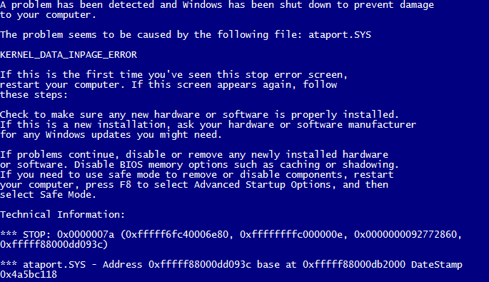
Motivation
Why are there errors in models?
  Initial condition errors
  Model errors

Slide 4
Motivation
Why are there errors in models?
  Initial condition errors
  Model errors
What can cause model errors?
  Numerical integration
  Resolution
  Model physics uncertainty

Slide 5
Motivation
Why are there errors in models?
  Initial condition errors
  Model errors
What can cause model errors?
  Numerical integration
  Resolution
  Model physics uncertainty

Slide 6
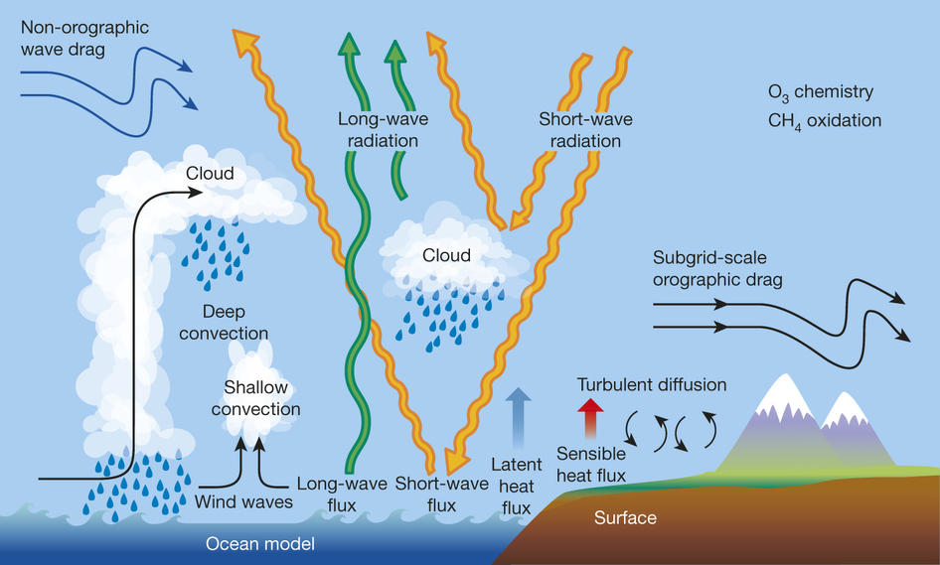
Motivation
Why are there errors in models?
  Initial condition errors
  Model errors
What can cause model errors?
  Numerical integration
  Resolution
  Model physics uncertainty

Slide 7
Motivation
Why are there errors in models?
  Initial condition errors
  Model errors
What can cause model errors?
  Numerical integration
  Resolution
  Model physics uncertainty

Slide 8
PBL Processes in WRF
Turbulent PBL processes are too small to resolve for km-scale models
  Subgrid scale processes must be parameterized
Goal is to describe the mean turbulent vertical transport of heat, momentum and moisture by eddies
  Two common approaches are through local (e.g., MYJ) and nonlocal (e.g., YSU) diffusion schemes

Slide 9

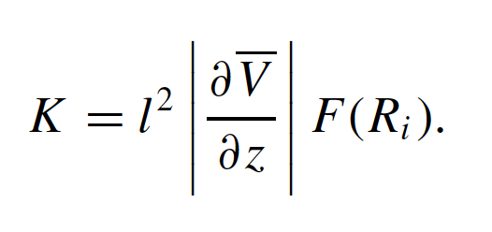
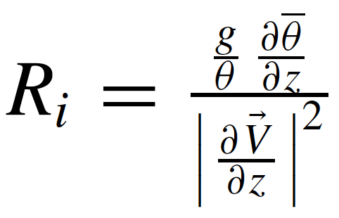


Local vs. Nonlocal
Local scheme uses local gradients to establish K-profile
Nonlocal scheme estimates PBL height and imposes K-profile shape function
Krishnamurti et al. (2007)
Hong and Pan (1996)

Slide 10
Local vs. Nonlocal
Nonlocal scheme estimates PBL height and imposes K-profile shape function
Potential temp at lowest model level
Appropriate surface potential temp
Critical Richardson number. Varies with version (~0.75–0.0). Can be source of sensitivity.
Hong and Pan (1996)

Slide 11
Local vs. Nonlocal
Nonlocal scheme estimates PBL height and imposes K-profile shape function
Critical Richardson number. Varies with version (~0.75–0.0). Can be source of sensitivity.
Hong and Pan (1996)

Slide 12
Local vs. Nonlocal
Nonlocal scheme estimates PBL height and imposes K-profile shape function
Hong and Pan (1996)

Slide 13
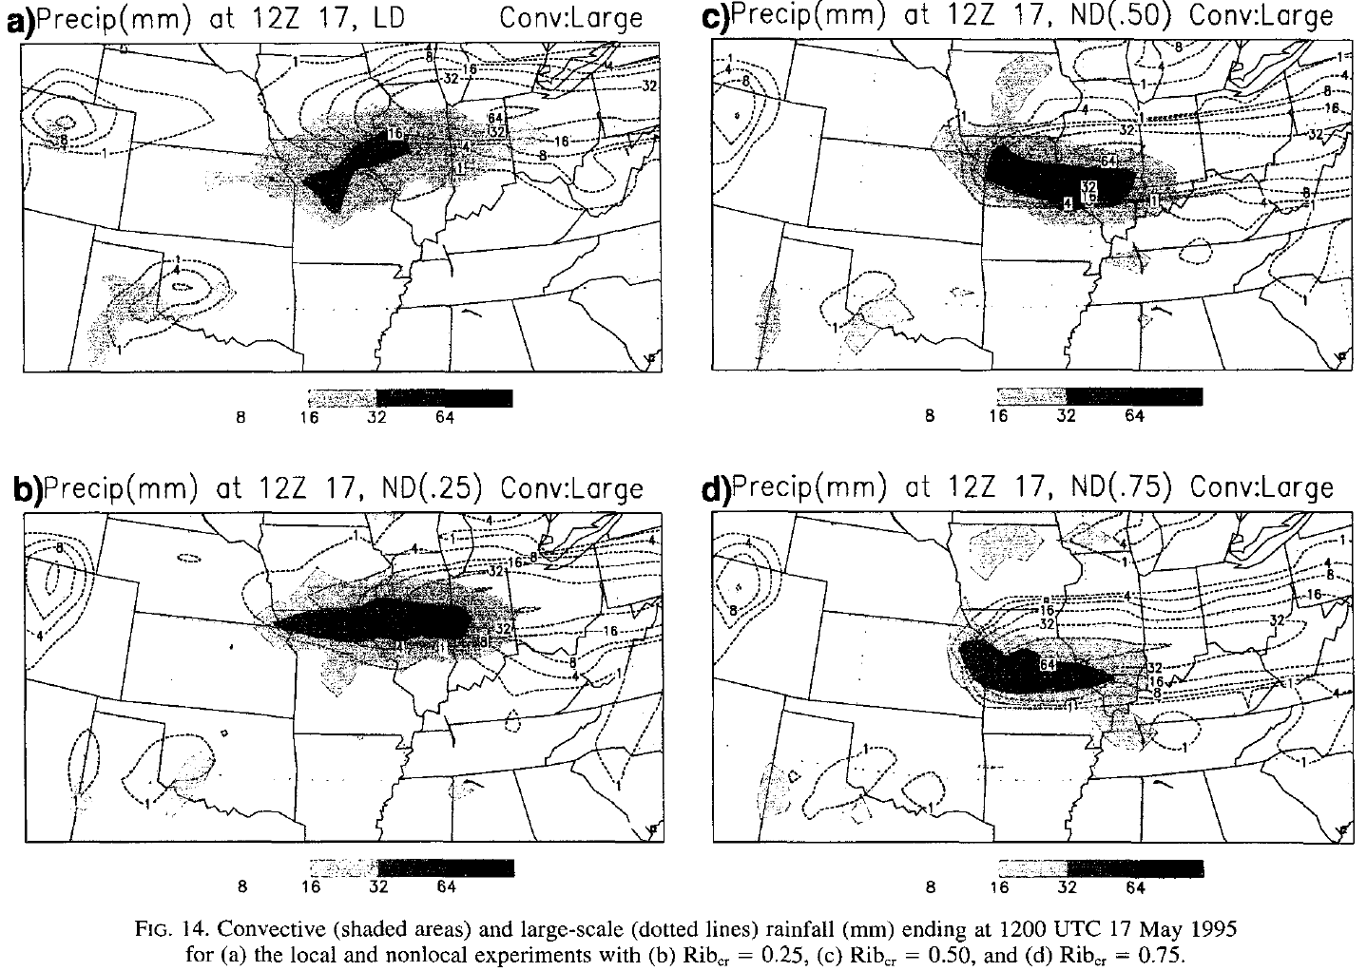
Hong and Pan (1996)

Slide 14
Motivating Question
What significance does critical bulk Richardson number have on precipitation and moisture flux in winter cyclones?

Slide 15
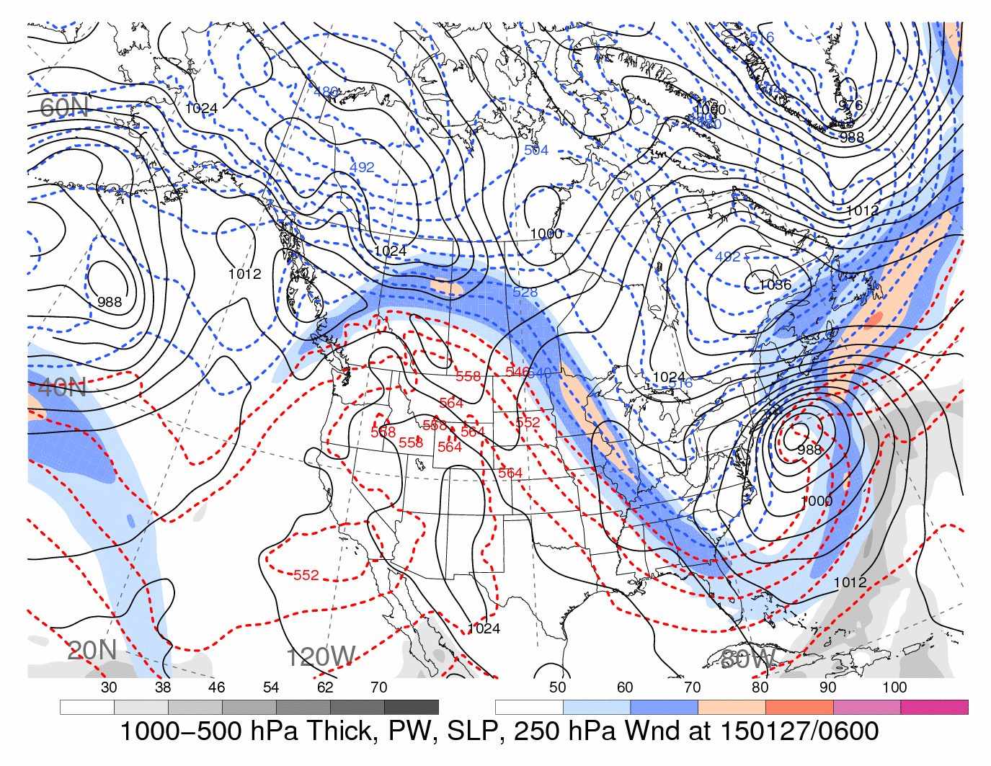
Motivating Question
What significance does critical bulk Richardson number have on precipitation and moisture flux in winter cyclones?
0600 UTC 27 January 2015 “Twitter Apology” snowstorm
H. Archambault

Slide 16
Motivating Question
What significance does critical bulk Richardson number have on precipitation and moisture flux in winter cyclones?
“My deepest apologies to many key decision makers and so many members of the general public,” said Gary Szatkowski, meteorologist-in-charge at the National Weather Service in Mount Holly (NJ.com)
0600 UTC 27 January 2015 “Twitter Apology” snowstorm
H. Archambault

Slide 17
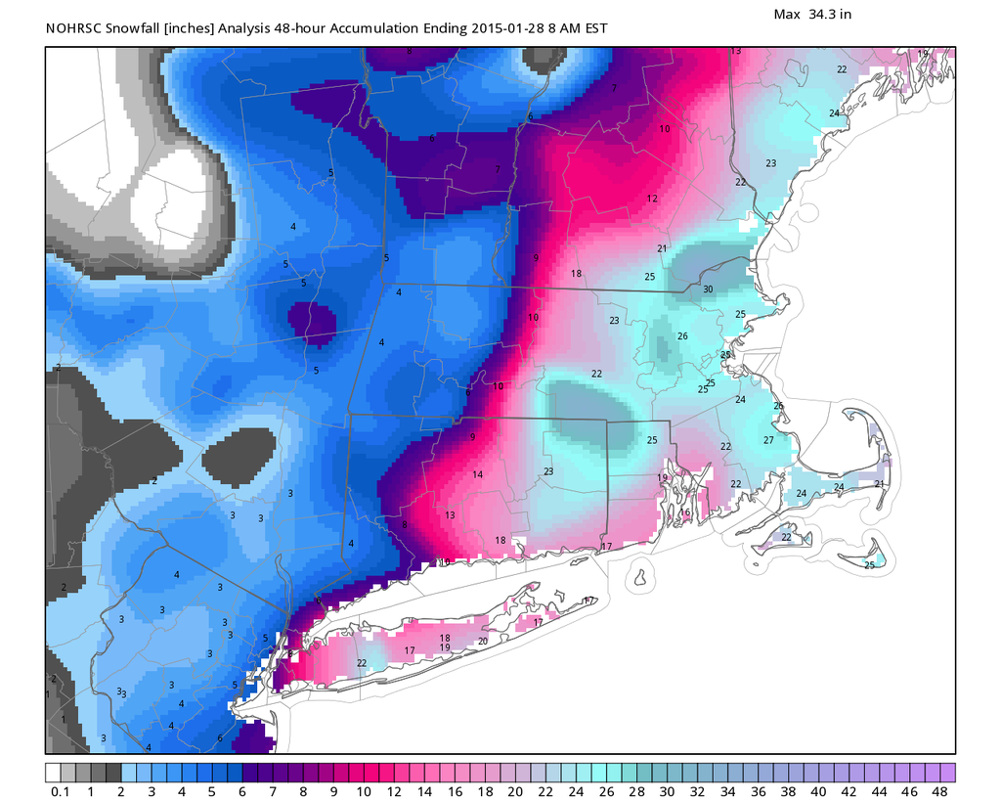
Motivating Question
What significance does critical bulk Richardson number have on precipitation and moisture flux in winter cyclones?
WeatherBell

Slide 18
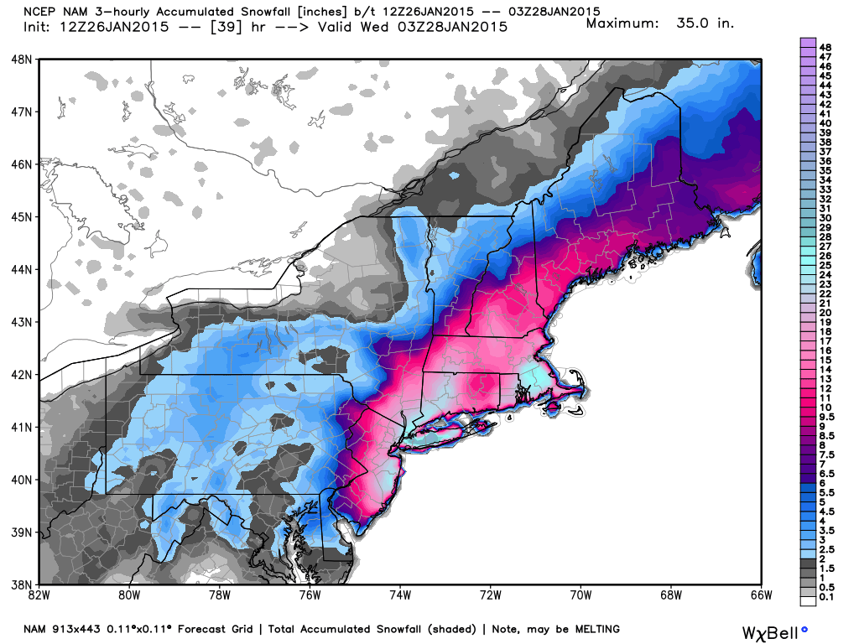
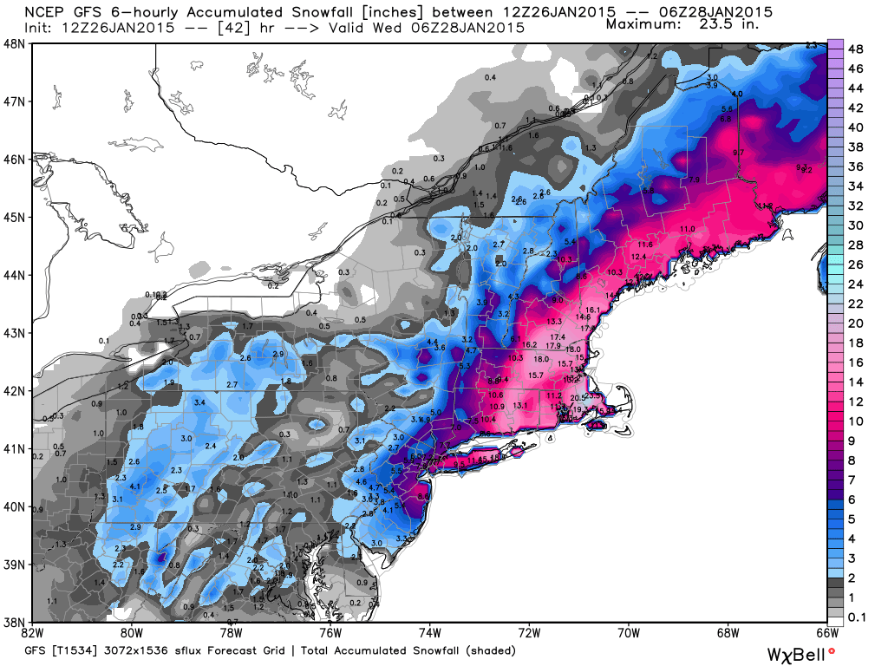
Motivating Question
What significance does critical bulk Richardson number have on precipitation and moisture flux in winter cyclones?
NAM
WeatherBell
GFS

Slide 19
Experimental Design
Vary the critical bulk Richardson number in a WRF simulation of the 27 January 2015 snowstorm
  0000 UTC 26 to 0000 UTC 29 January 2015
YSU uses iterative process to determine PBL height
  Calculates bulk Richardson number between sfc and progessively higher levels until critical Richardson number is reached

Slide 20
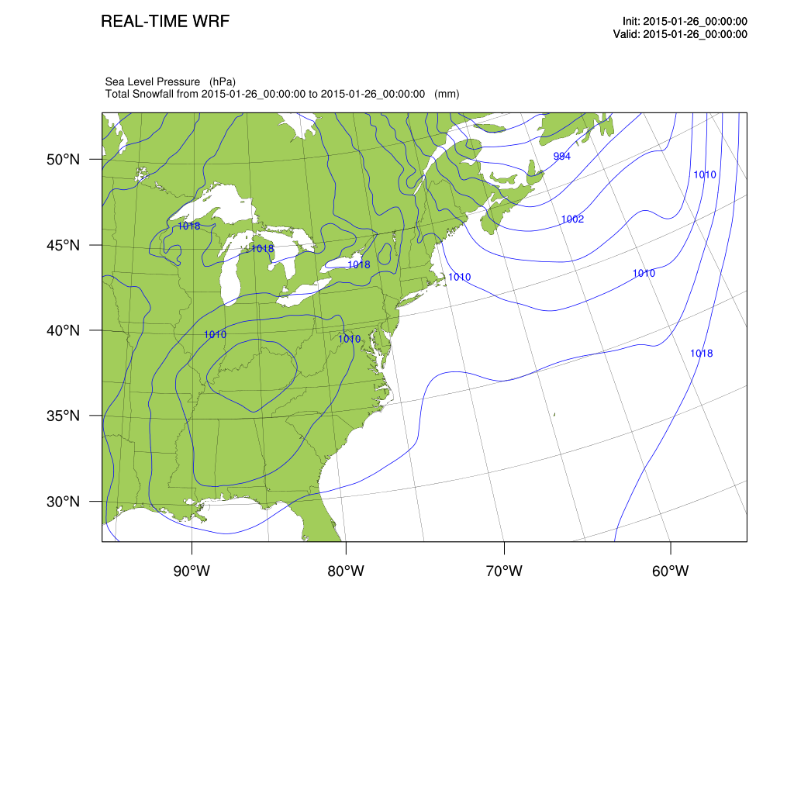
Experimental Design
Initial and boundary conditions: ERA-I
40-km outer domain, 13-km inner domain
Similar physics to RAP
  Benjamin et al. (2016)
Use YSU PBL scheme
Set critical Richardson number to 0.0 or 0.25

Slide 21
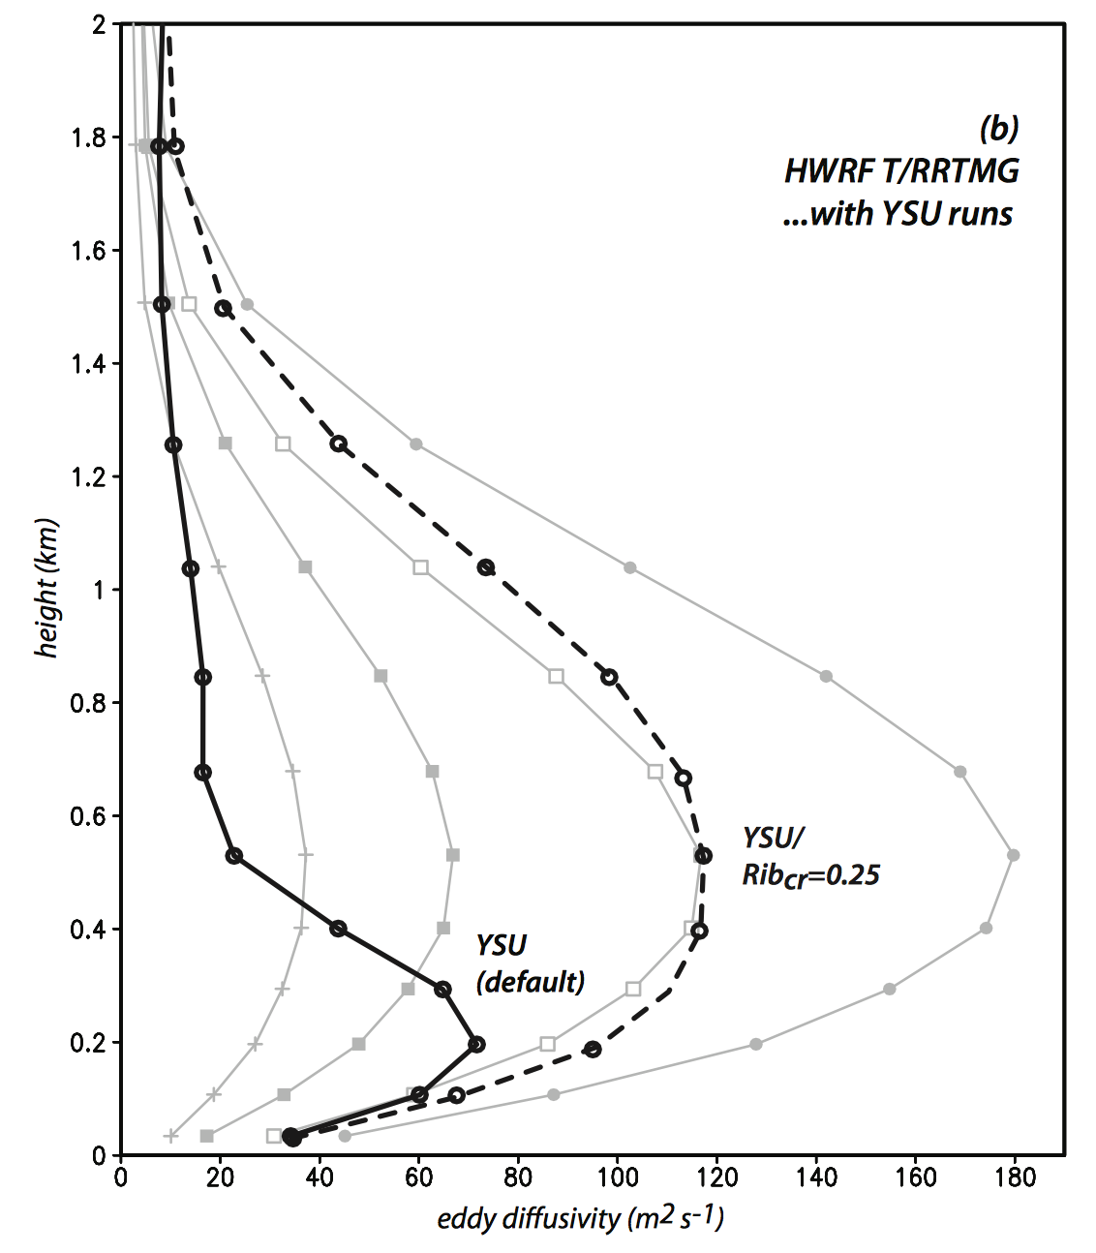
Experimental Design
Initial and boundary conditions: ERA-I
40-km outer domain, 13-km inner domain
Similar physics to RAP
  Benjamin et al. (2016)
Use YSU PBL scheme
Set critical Richardson number to 0.0 or 0.25
Radius vs. height cross-sections showing the temporally-averaged symmetric components of water vapor (shaded) and eddy diffusivity applied to vapor (Kh; 10 m2 s−1 contours) using YSU with (a) Ribcr=0.25, and (b) the default setup. Panel (c) shows difference fields. (Bu et al. 2017)

Slide 22
Track

Slide 23
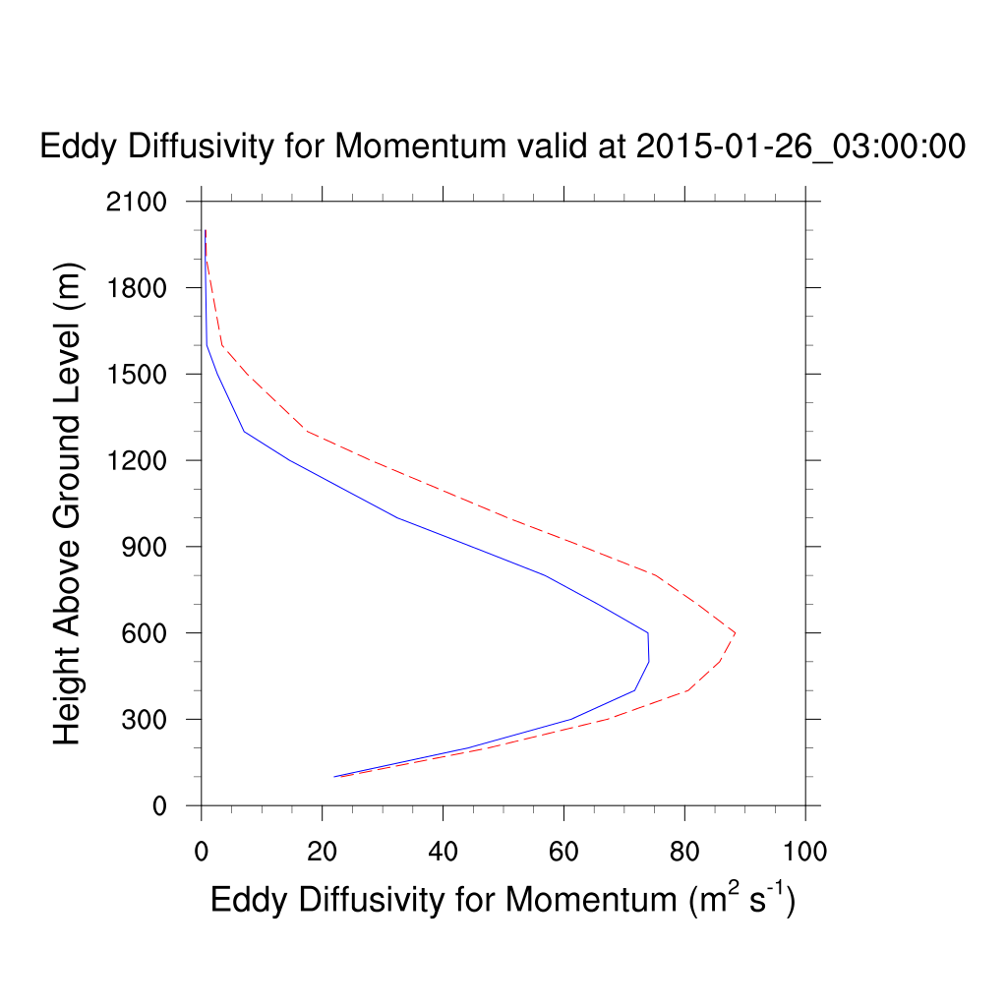
Track
YSU (0.0), YSU (0.25)

Slide 24
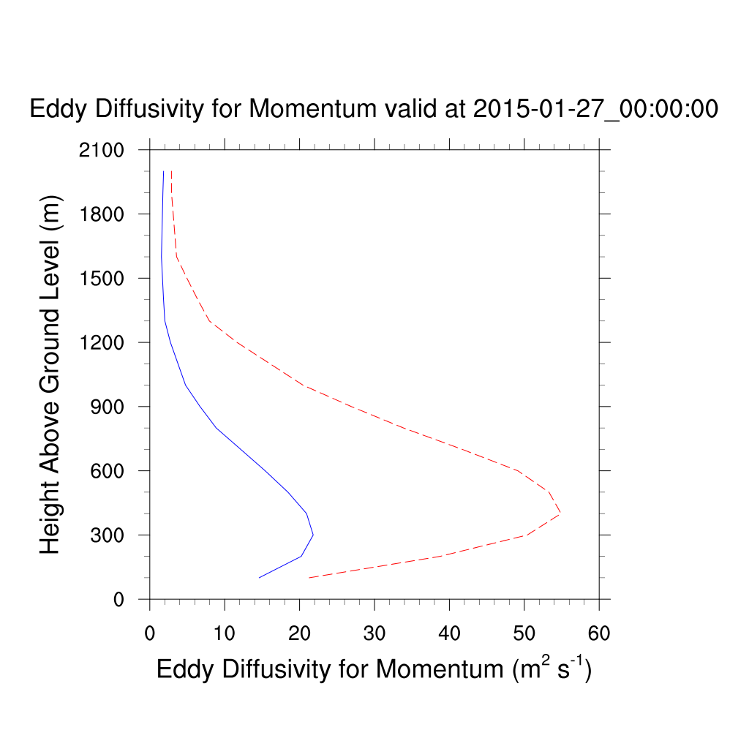
Track
YSU (0.0), YSU (0.25)

Slide 25
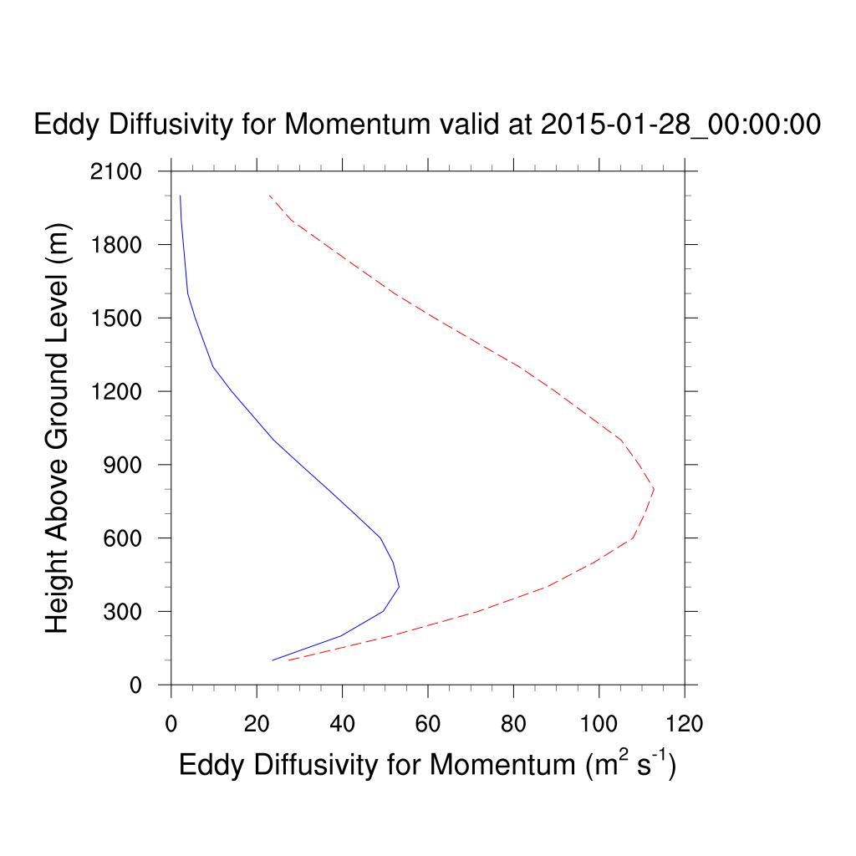
Track
YSU (0.0), YSU (0.25)

Slide 26
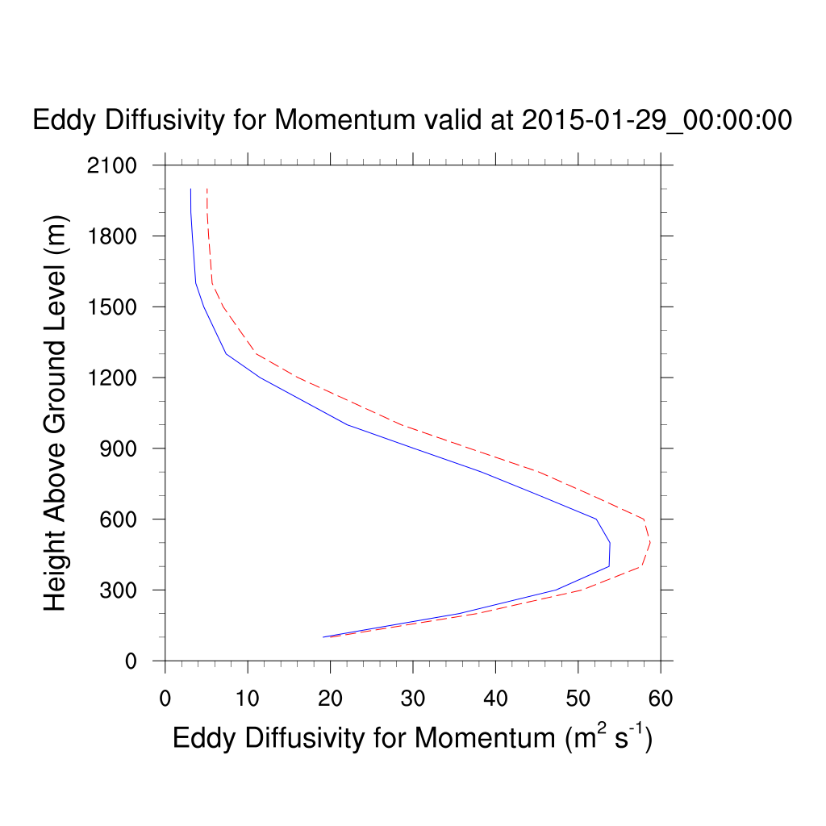
Track
YSU (0.0), YSU (0.25)

Slide 27
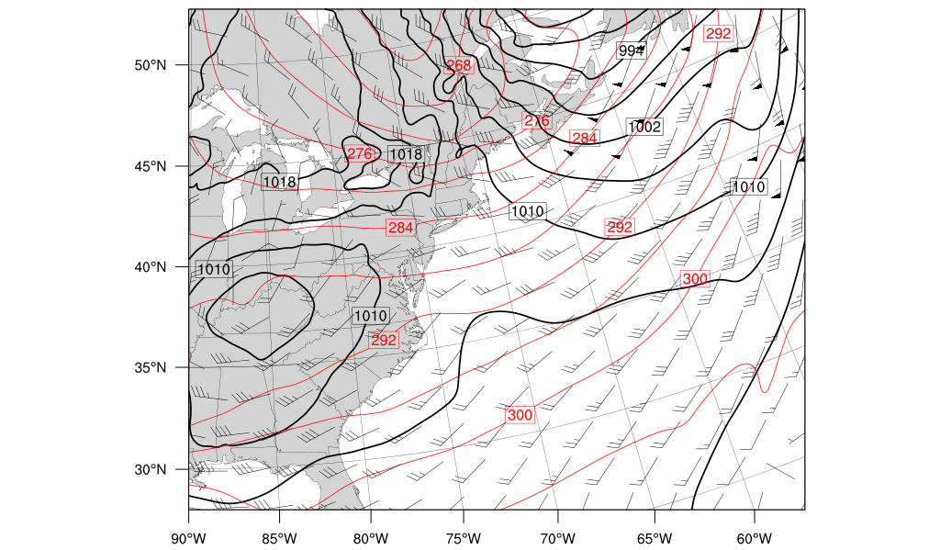
Progression
MSLP (hPa, black contours), 925–700-hPa layer-averaged winds (barbed), and 925–700-hPa layer-averaged potential temperature (K, red contours)
0000 UTC 26 Jan

Slide 28
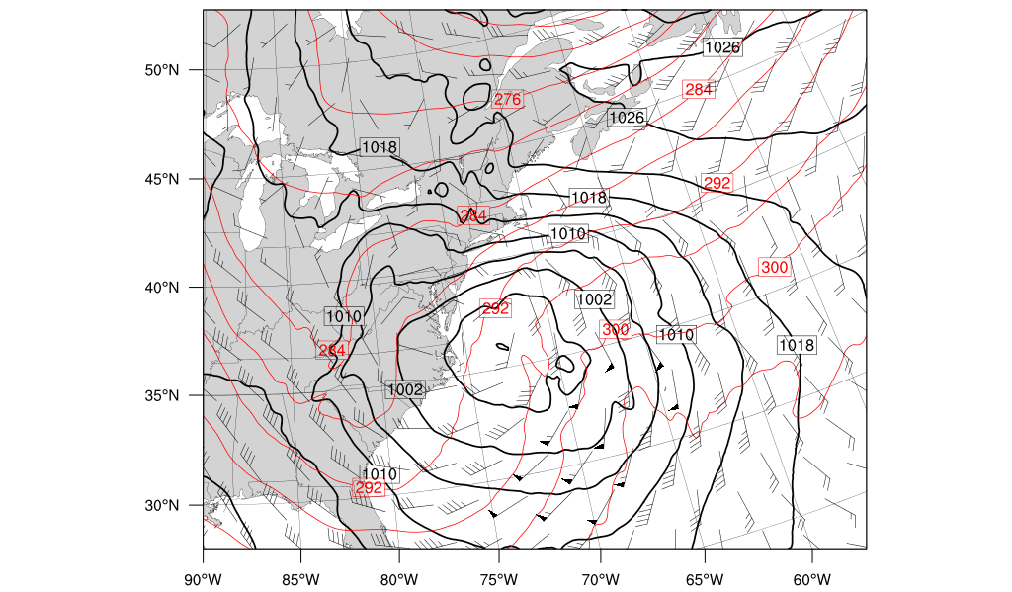
Progression
MSLP (hPa, black contours), 925–700-hPa layer-averaged winds (barbed), and 925–700-hPa layer-averaged potential temperature (K, red contours)
0000 UTC 27 Jan

Slide 29
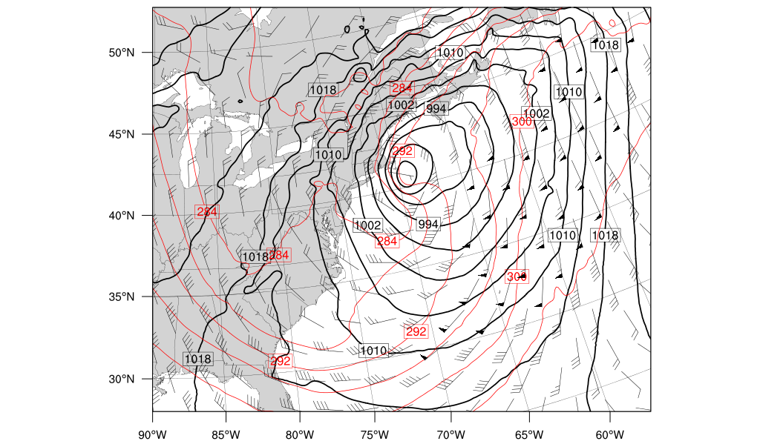
Progression
MSLP (hPa, black contours), 925–700-hPa layer-averaged winds (barbed), and 925–700-hPa layer-averaged potential temperature (K, red contours)
0000 UTC 28 Jan

Slide 30
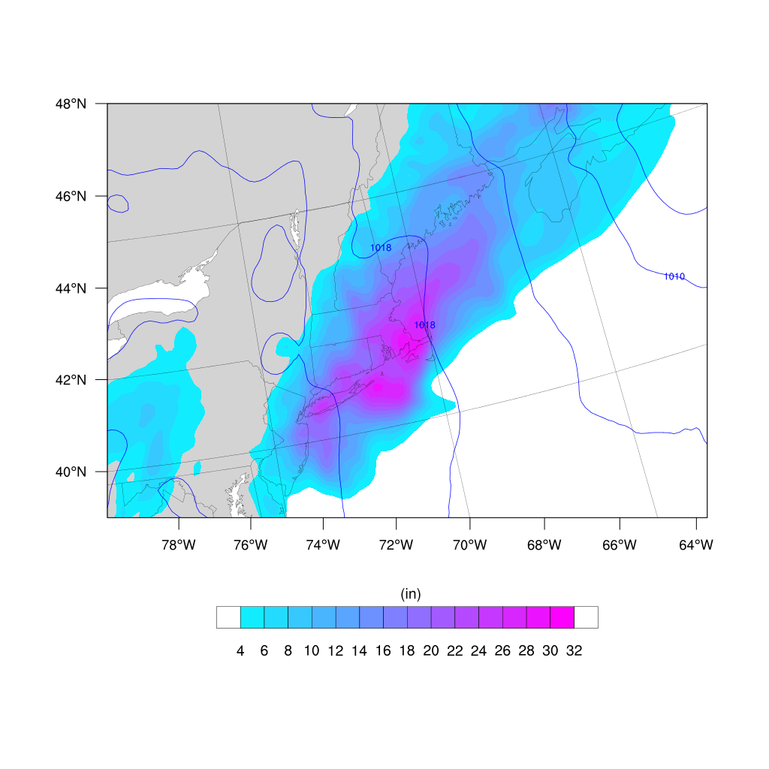
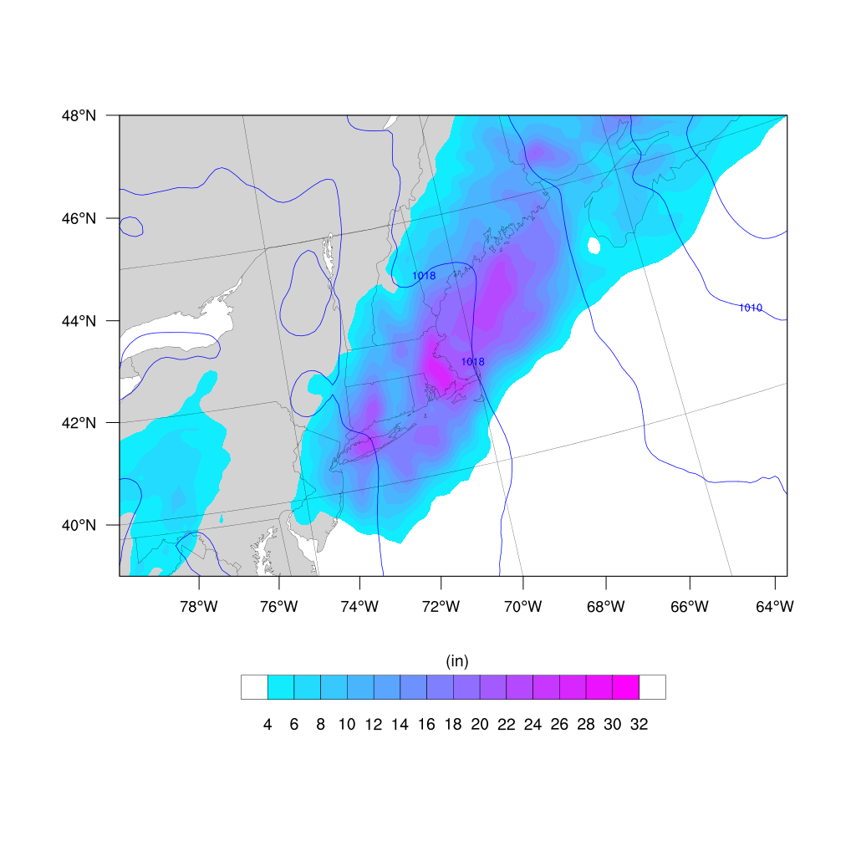
Snowfall
YSU (0.0)
YSU (0.25)
Analysis
Total Snowfall (in)
Total Snowfall (in)
Weatherbell

Slide 31
YSU (0.0)
Storm Total Snowfall (in)
YSU (0.25)
YSU (0.0) generally produced heavier amounts of snow
Both highlight Eastern MA and have a tight gradient around NYC

Slide 32
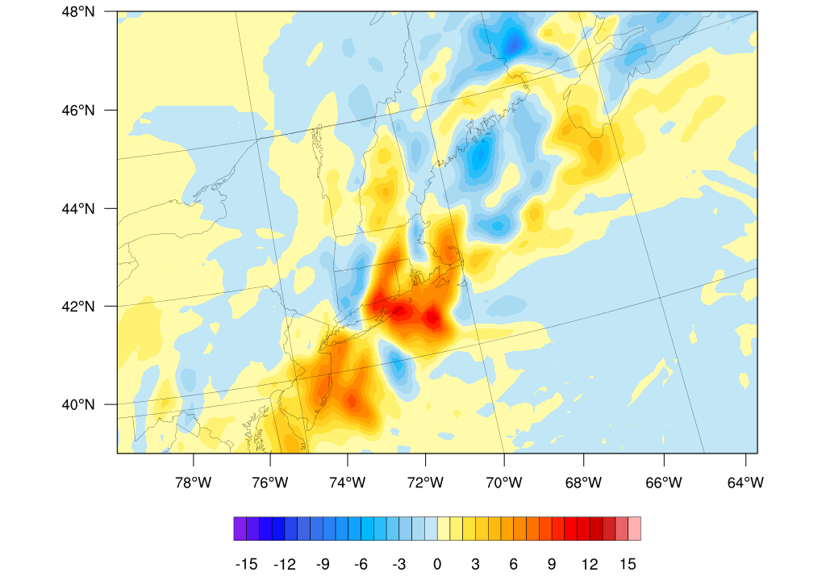
YSU (0.0)
Storm Total Snowfall (in)
YSU (0.25)
YSU(0.0) – YSU(0.25)
YSU (0.0) generally produced heavier amounts of snow
Both highlight Eastern MA and have a tight gradient around NYC

Slide 33
Moisture Flux and Precipitable water

Slide 34
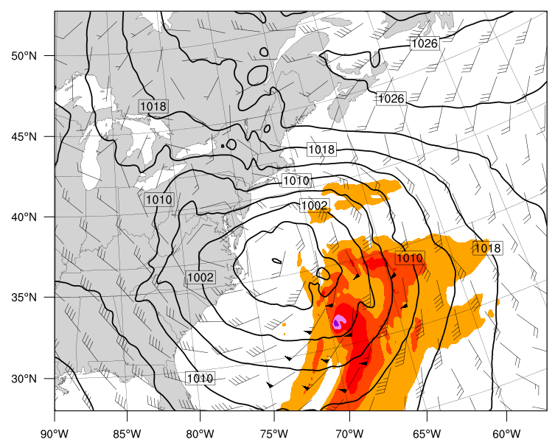
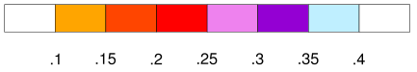
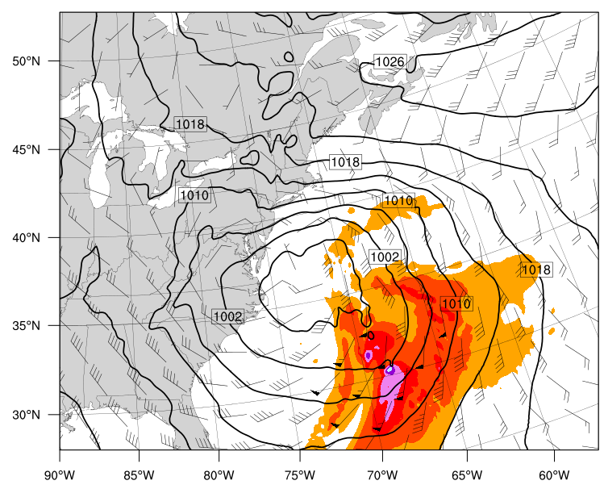
YSU (0.0)
Moisture Flux
YSU (0.25)
MSLP (hPa, black contours), 925–700-hPa layer-averaged winds (barbed), and 925–700-hPa layer-averaged moisture flux(m s^{–1}, red contours)
0000 UTC 27 Jan

Slide 35
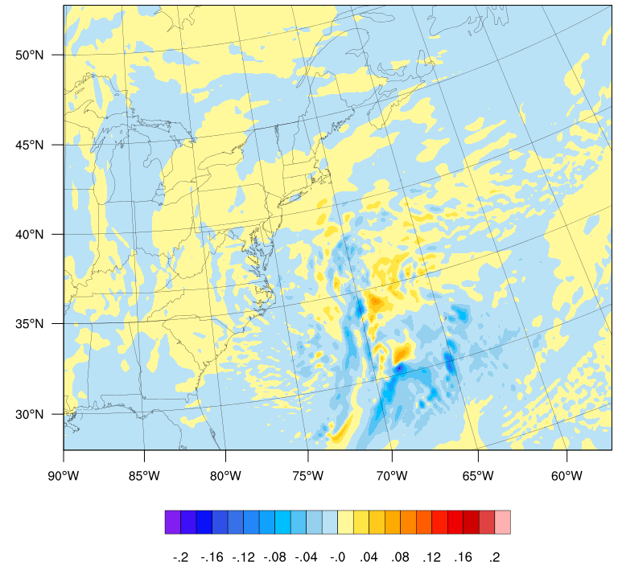
YSU (0.0)
Moisture Flux
YSU (0.25)
MSLP (hPa, black contours), 925–700-hPa layer-averaged winds (barbed), and 925–700-hPa layer-averaged moisture flux(m s^{–1}, red contours)
YSU(0.0) – YSU (0.25)
0000 UTC 27 Jan

Slide 36
YSU (0.0)
Moisture Flux
YSU (0.25)
MSLP (hPa, black contours), 925–700-hPa layer-averaged winds (barbed), and 925–700-hPa layer-averaged moisture flux(m s^{–1}, red contours)
YSU(0.0) – YSU (0.25)
YSU (0.0), YSU (0.25)
0000 UTC 27 Jan

Slide 37
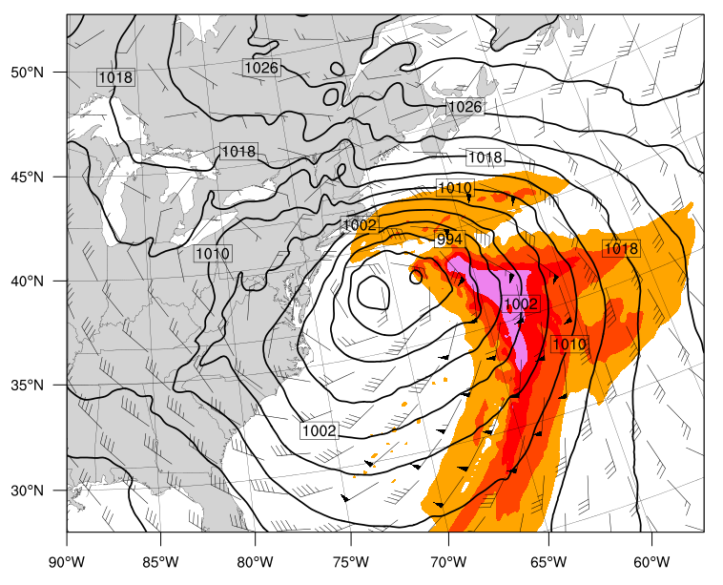
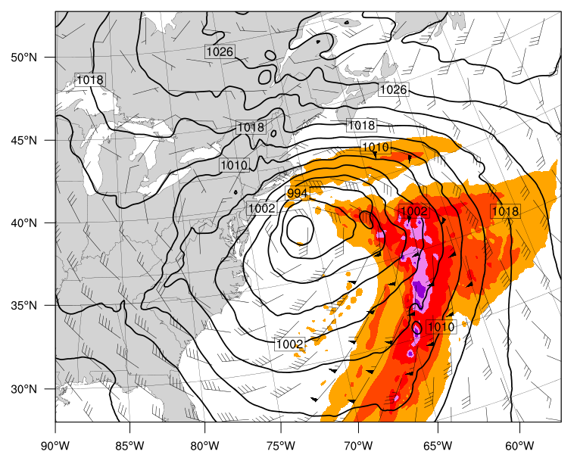
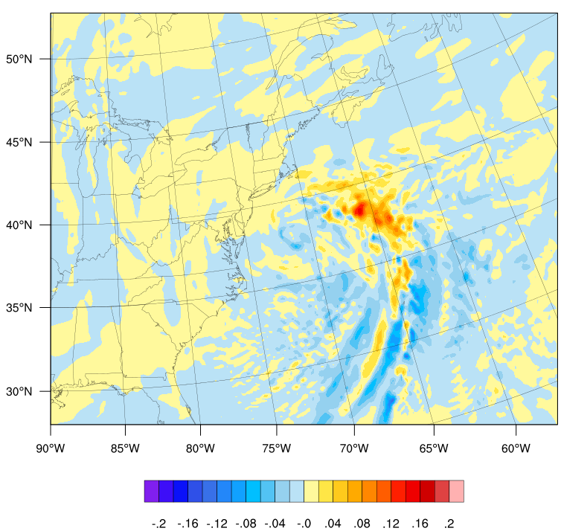
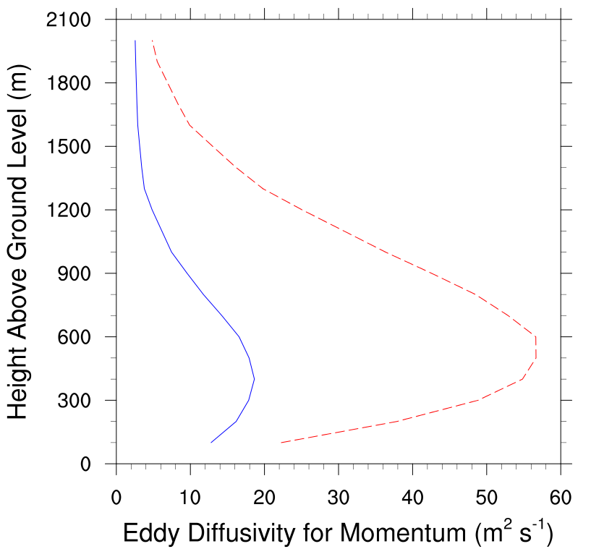
YSU (0.0)
Moisture Flux
YSU (0.25)
MSLP (hPa, black contours), 925–700-hPa layer-averaged winds (barbed), and 925–700-hPa layer-averaged moisture flux(m s^{–1}, red contours)
YSU(0.0) – YSU (0.25)
YSU (0.0), YSU (0.25)
0600 UTC 27 Jan

Slide 38
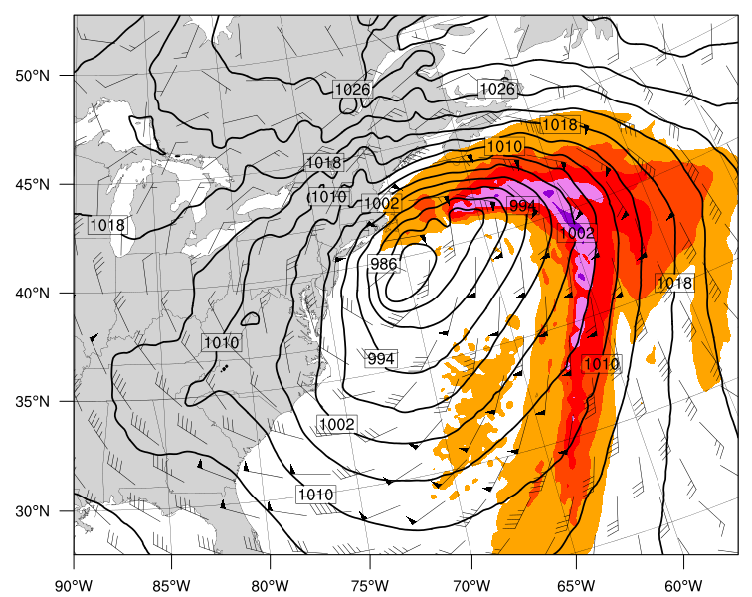
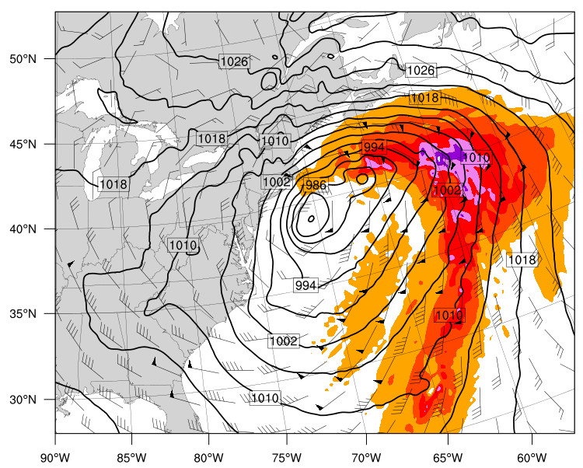
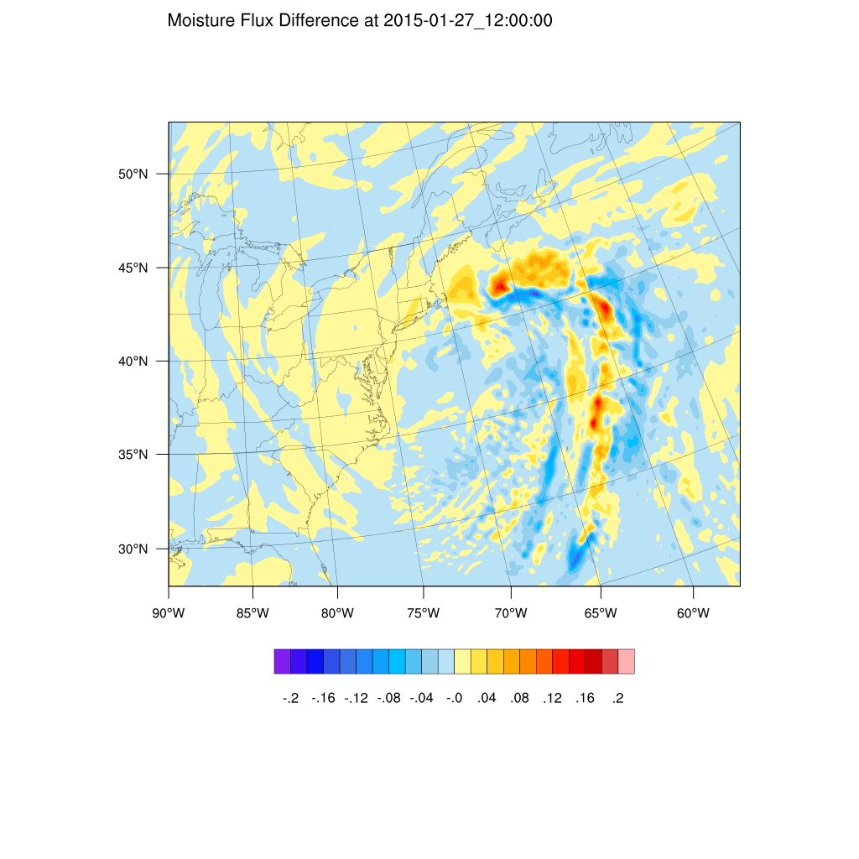
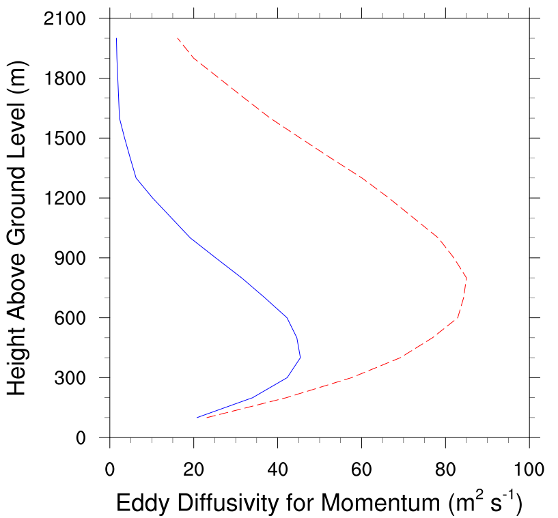
YSU (0.0)
Moisture Flux
YSU (0.25)
YSU(0.0) – YSU (0.25)
MSLP (hPa, black contours), 925–700-hPa layer-averaged winds (barbed), and 925–700-hPa layer-averaged moisture flux(m s^{–1}, red contours)
YSU(0.0) – YSU (0.25)
YSU (0.0), YSU (0.25)
1200 UTC 27 Jan

Slide 39
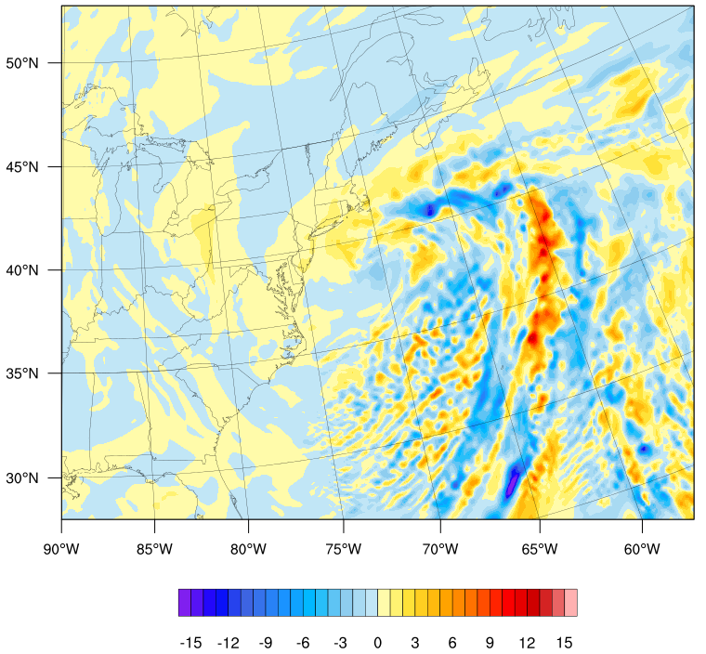
1200 UTC 27 Jan
Moisture Flux Difference (m s^{–1})
Precipitable Water Difference (mm)
Enhanced moisture flux attendant with increasing PWAT over New England
YSU (0.0) – YSU (0.25)

Slide 40
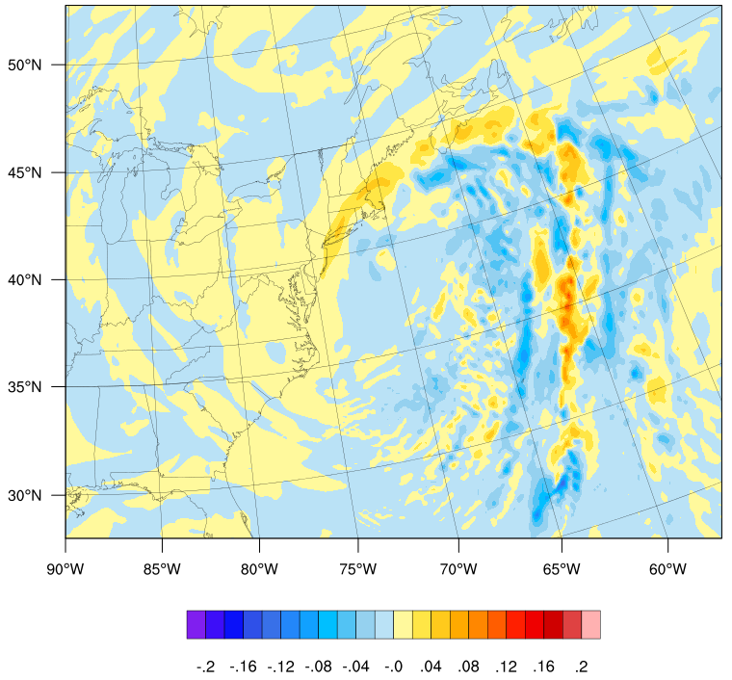
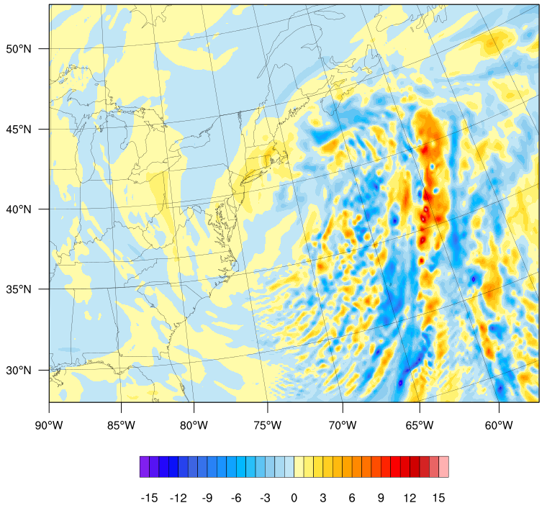
1500 UTC 27 Jan
Moisture Flux Difference (m s^{–1})
Precipitable Water Difference (mm)
Enhanced moisture flux attendant with increasing PWAT over New England
YSU (0.0) – YSU (0.25)

Slide 41
YSU (0.0)
Storm Total Snowfall (in)
YSU (0.25)
YSU (0.0) generally produced heavier amounts of snow
Both highlight Eastern MA and have a tight gradient around NYC

Slide 42
Summary & Future Work
Storm track similar between both simulations
  Physics may need more time to produce diversity
Similar snowfall coverage, different amounts
YSU (0.0) exhibited higher moisture flux values in the warm sector
  May have led to higher PWAT over NE
Ensemble approach is needed to separate out physics influence, especially for smaller-scale phenomena (check back at Cyclone Workshop)

