Slide 1
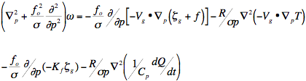
Advanced Weather Course
Quasi-geostrophic Omega Equation (diagnoses ascent and likely cloud location
Severe Weather and Numerical Weather Prediction
Contact: Matthew Vaughan (mvaughan@albany.edu)

Slide 2
Outline
Severe Weather Principles
  Vertical wind shear
  Bow echoes and supercell signatures from radar
  Recognizing severe weather threat in the field
Numerical Weather Prediction
  Principles
  Proper interpretation of ensembles
  Common model biases/trouble spots
Questions and Audience-directed Topics

Slide 3
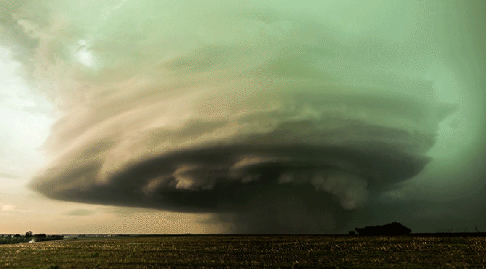
Severe Weather
NWS definition:
  Wind gust greater than 58 MPH
  Hail over 1” (<0.75” prior to 2013)
  Tornado

Slide 4
Severe Weather
Blue = frequency
Red = worse than average forecasts
Green = better than average forecasts
NWS definition:
  Wind gust greater than 58 MPH
  Hail over 1” (<0.75” prior to 2013)
  Tornado
Normalized frequency of occurrence of widespread severe weather days in the Northeast U.S.

Slide 5
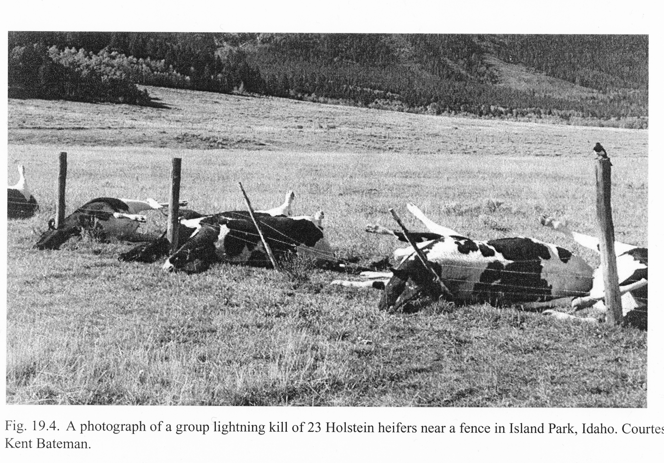
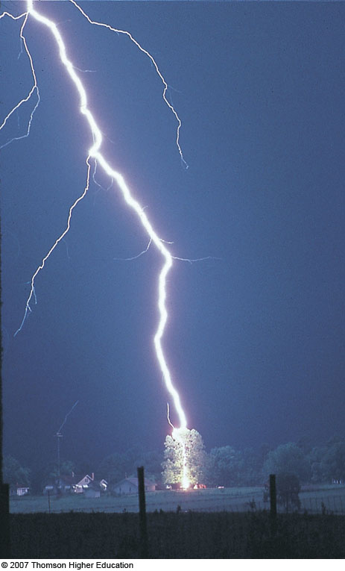
Note on lightning safety
Doesn’t really matter what you’re wearing
  Air <10 times more resistive than rubber
Indirect strikes can kill

Slide 6
Energy of lightning
“Seeing your life flash before your eyes”
Input energy of a flash:
1.21 Gigawatts!!!
  Actually, ~10 Gigawatts
Converted to kwh = 2,777 kwh
Average human = 2.4 kwh/day
  876 kwh/year
  70,000 kwh/80 years
Average bolt = 1–3 years of life

Slide 7
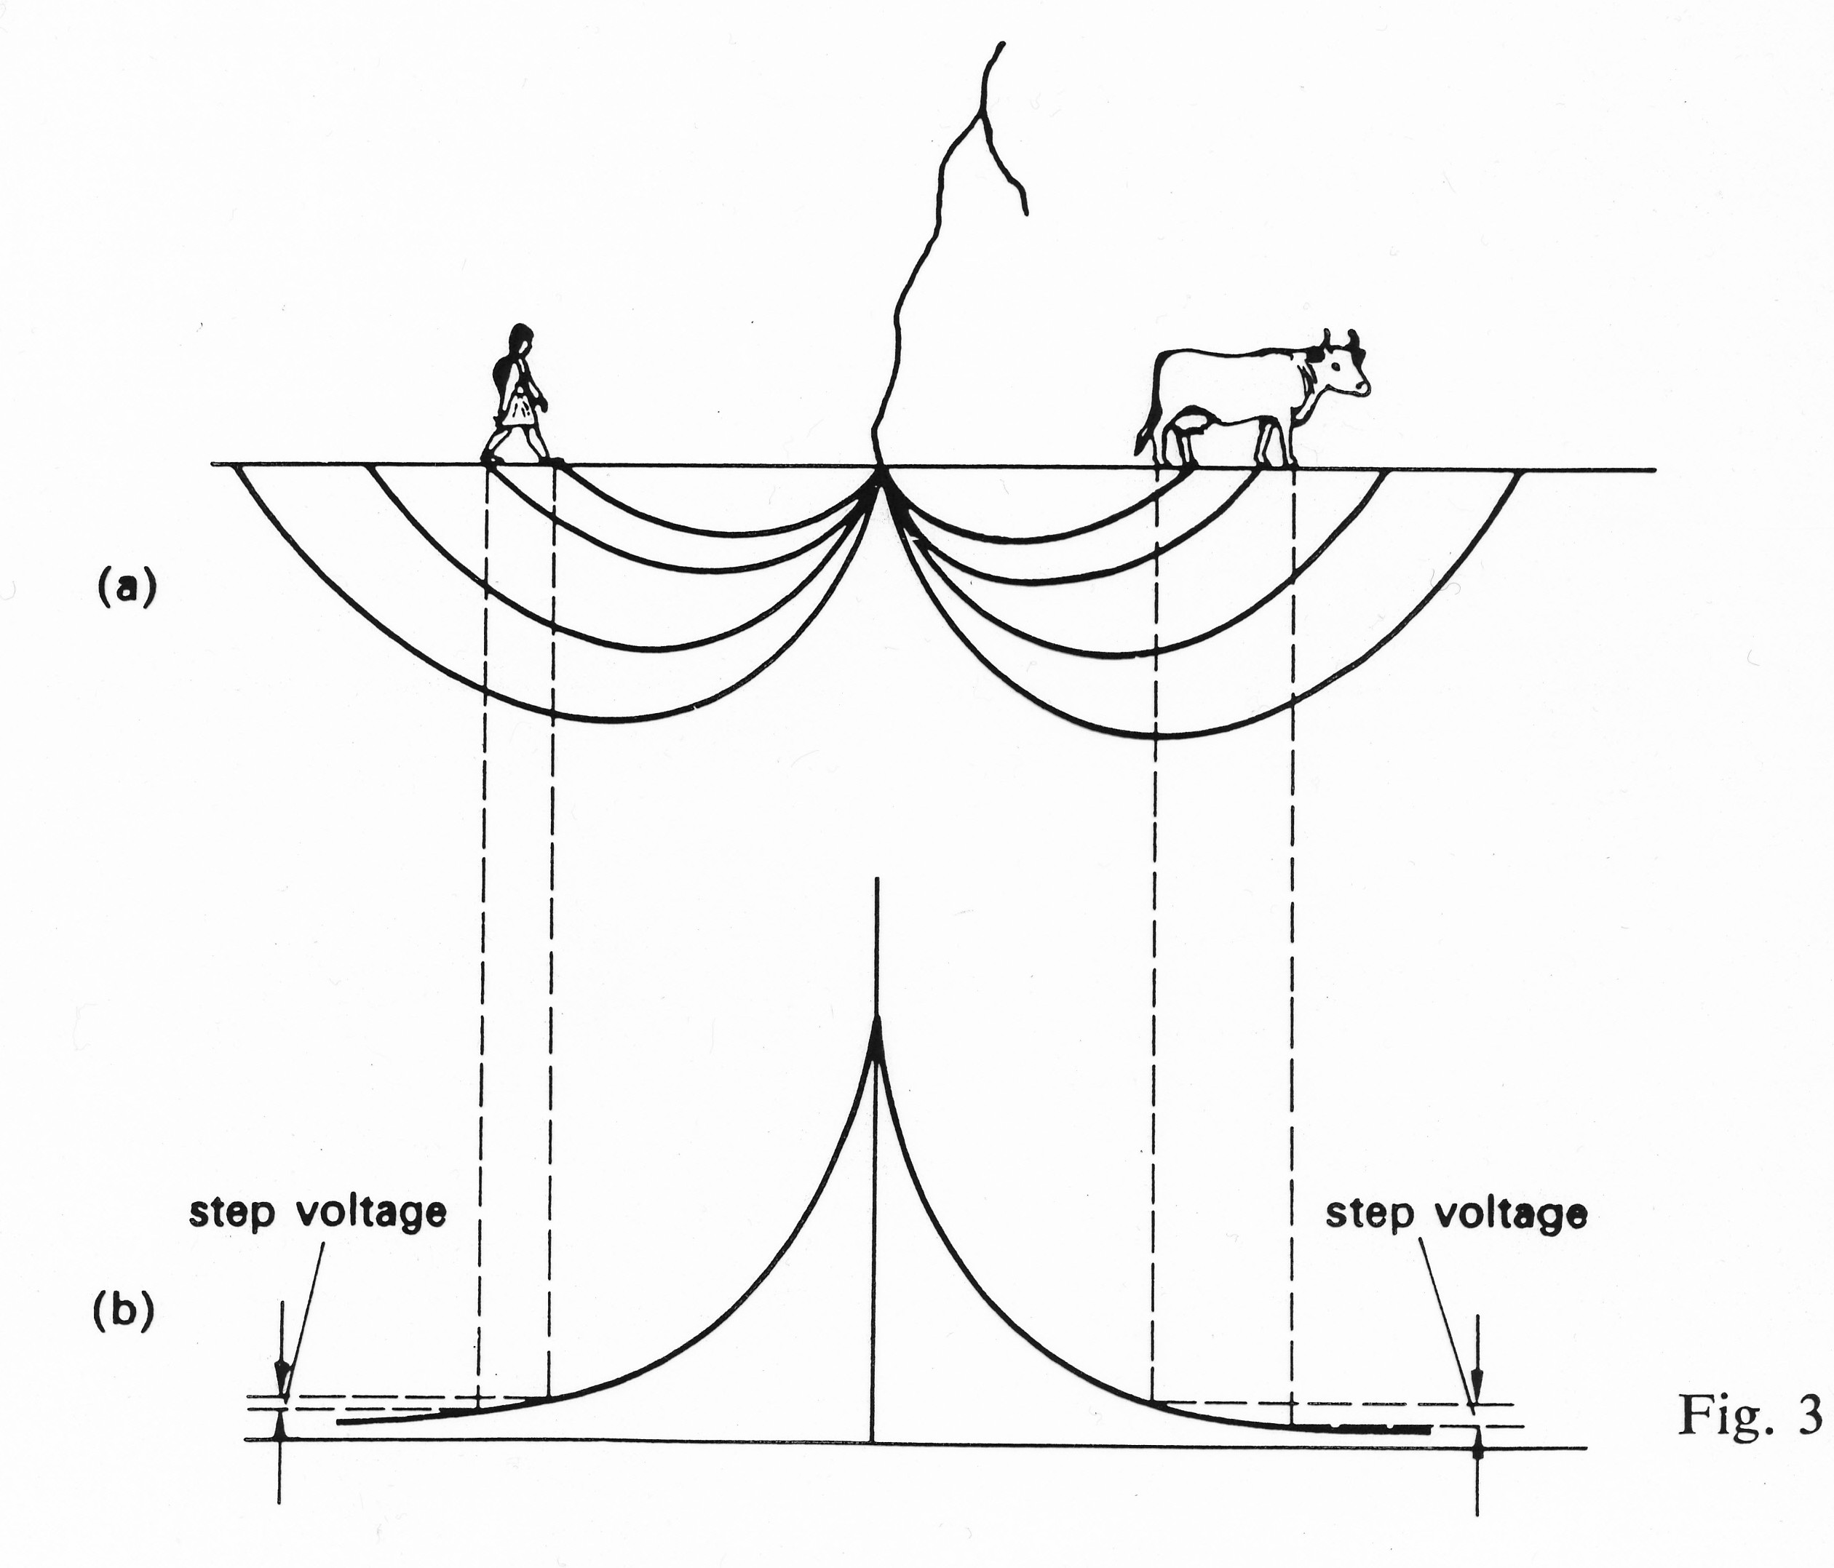
Note on lightning safety
Safest position is to crouch with feet together
DON’T stand near a tree

Slide 8
Severe Weather
Severe weather Ingredients:
  Lifting mechanism
  Instability
  Moisture
  Shear

Slide 9
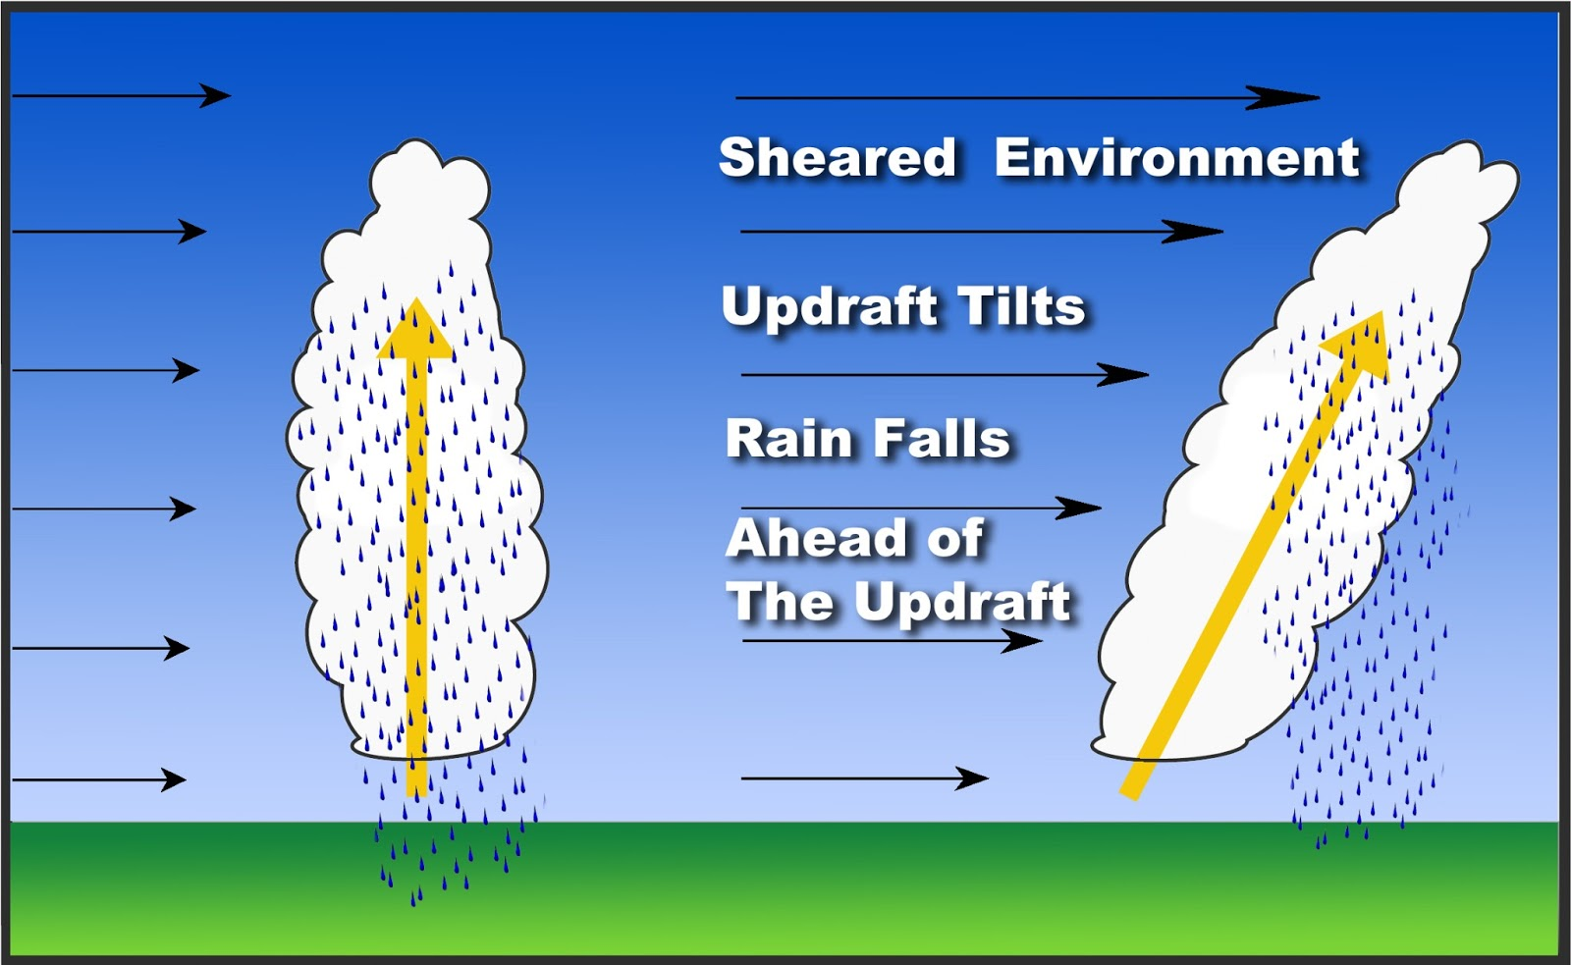
Vertical Wind Shear
Vertical wind shear is a change in wind speed and/or direction with height
  Caused by horizontal gradients in temperature

Slide 10
Vertical Wind Shear
Vertical wind shear is a change in wind speed and/or direction with height
  Caused by horizontal gradients in temperature
From prior research, >30 knots of 0–6-km shear is necessary for severe weather to develop (spc.gov/exper/sounding/)
  spc.noaa.gov/exper/mesoanalysis/ for best computed shear throughout the day

Slide 11
Vertical Wind Shear
Vertical wind shear is a change in wind speed and/or direction with height
  Caused by horizontal gradients in temperature
From prior research, >30 knots of 0–6-km shear is necessary for severe weather to develop (spc.gov/exper/sounding/)
  spc.noaa.gov/exper/mesoanalysis/ for best computed shear throughout the day
Locally, easterly wind tends to enhance shear in NE
  Important for field personnel
    Especially in complex terrain

Slide 12
Vertical Wind Shear
How does vertical wind shear lead to severe weather?

Slide 13
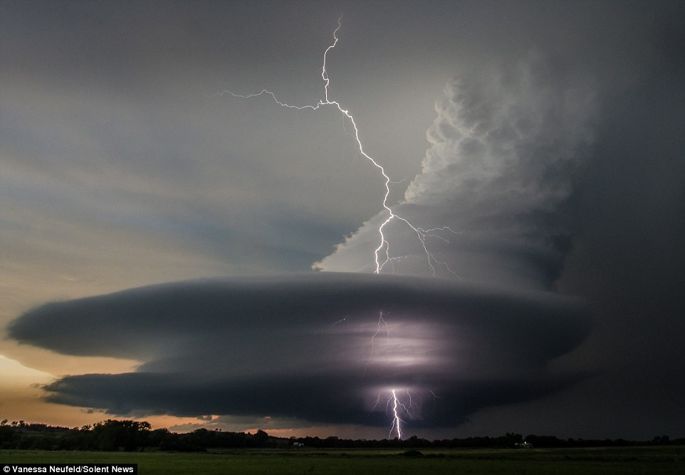
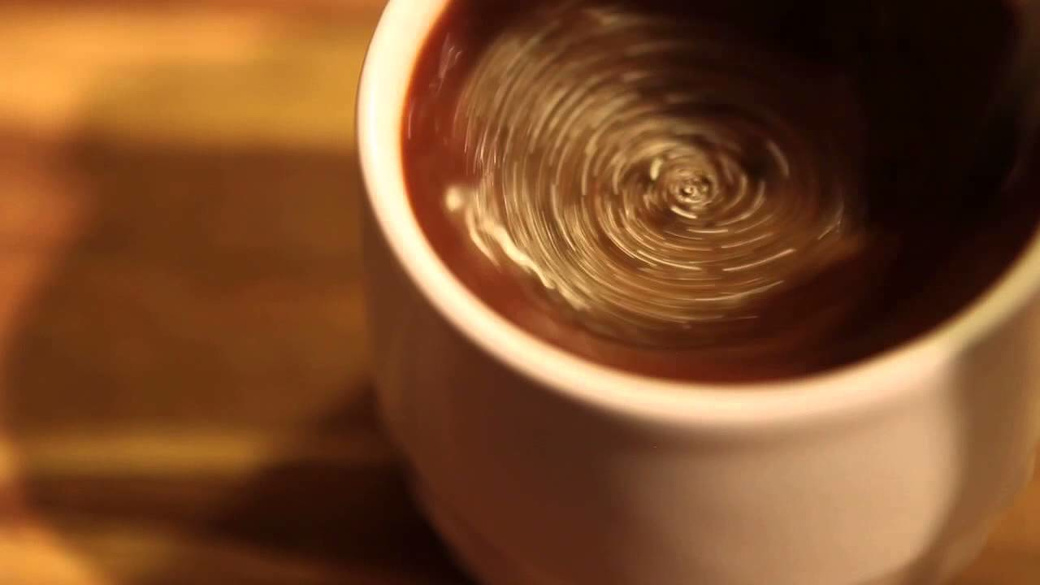
Vortex Tubes and Downdrafts
Tilting of vortex tubes by cumulus clouds can create a rotating updraft
  Like stirring your coffee, this reduces pressure further, strengthening the storm (e.g. Supercell thunderstorm)

Slide 14
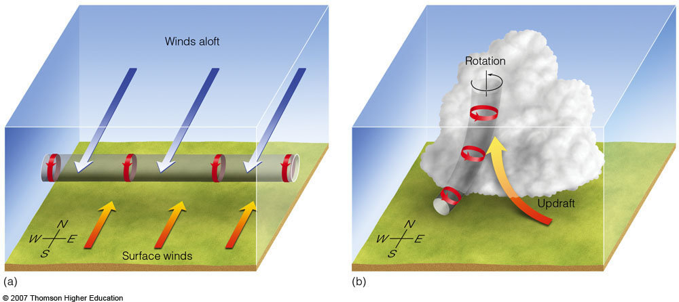
Vortex Tubes and Downdrafts
Tilting of vortex tubes by cumulus clouds can create a rotating updraft
  Like stirring your coffee, this reduces pressure further, strengthening the storm (e.g. Supercell thunderstorm)
Cold pools of air can bring higher momentum air to the surface (e.g. severe squall lines)
Cold pools can tilt vortex tubes downward, creating bookend vortices and high winds at the surface (e.g. Bow echoes)

Slide 15
Vortex Tubes and Downdrafts
Tilting of vortex tubes by cumulus clouds can create a rotating updraft
  Like stirring your coffee, this reduces pressure further, strengthening the storm (e.g. Supercell thunderstorm)
Cold pools of air can bring higher momentum air to the surface (e.g. severe squall lines)

Slide 16
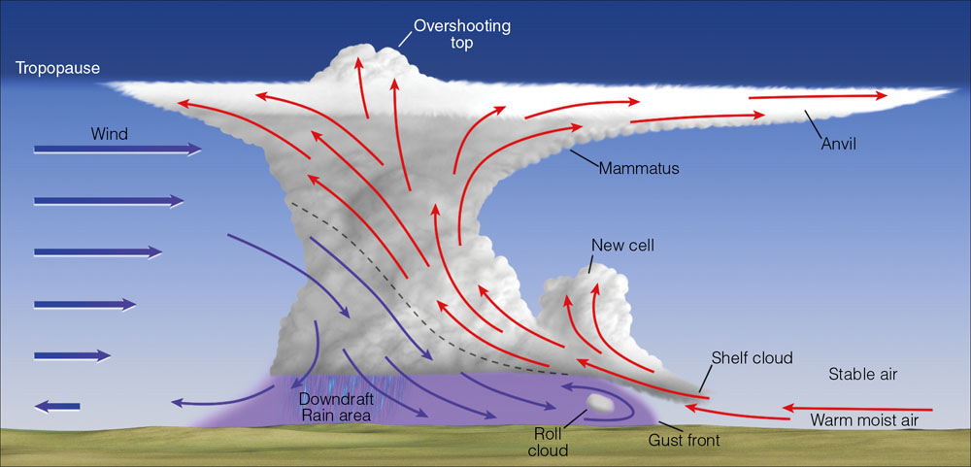
Vortex Tubes and Downdrafts
Tilting of vortex tubes by cumulus clouds can create a rotating updraft
  Like stirring your coffee, this reduces pressure further, strengthening the storm (e.g. Supercell thunderstorm)
Cold pools of air can bring higher momentum air to the surface (e.g. severe squall lines)
Cold pools can tilt vortex tubes downward, creating bookend vortices and high winds at the surface (e.g. Bow echoes)

Slide 17
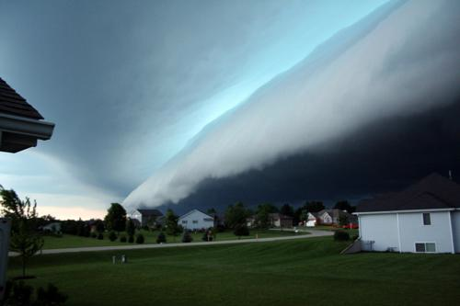
Vortex Tubes and Downdrafts
Tilting of vortex tubes by cumulus clouds can create a rotating updraft
  Like stirring your coffee, this reduces pressure further, strengthening the storm (e.g. Supercell thunderstorm)
Cold pools of air can bring higher momentum air to the surface (e.g. severe squall lines)
Cold pools can tilt vortex tubes downward, creating bookend vortices and high winds at the surface (e.g. Bow echoes)

Slide 18
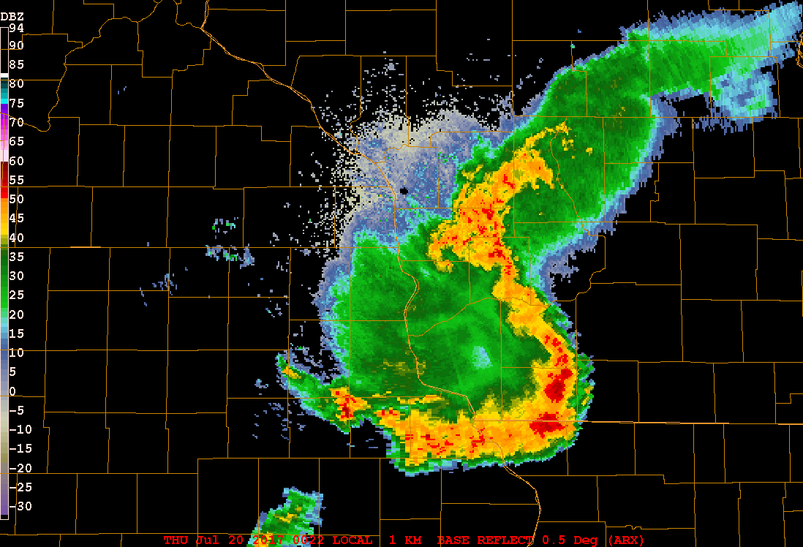
Vortex Tubes and Downdrafts
Tilting of vortex tubes by cumulus clouds can create a rotating updraft
  Like stirring your coffee, this reduces pressure further, strengthening the storm (e.g. Supercell thunderstorm)
Cold pools of air can bring higher momentum air to the surface (e.g. severe squall lines)
Cold pools can tilt vortex tubes downward, creating bookend vortices and high winds at the surface (e.g. Bow echoes)

Slide 19
Vortex Tubes and Downdrafts
Tilting of vortex tubes by cumulus clouds can create a rotating updraft
  Like stirring your coffee, this reduces pressure further, strengthening the storm (e.g. Supercell thunderstorm)
Cold pools of air can bring higher momentum air to the surface (e.g. severe squall lines)
Cold pools can tilt vortex tubes downward, creating bookend vortices and high winds at the surface (e.g. Bow echoes)

Slide 20
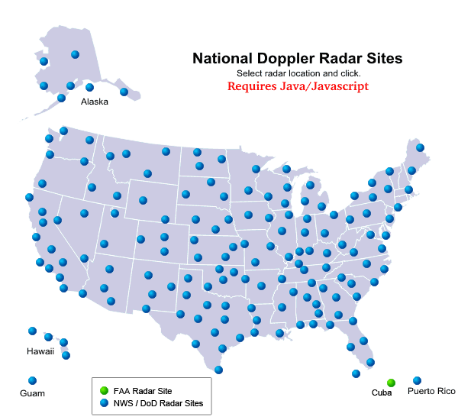
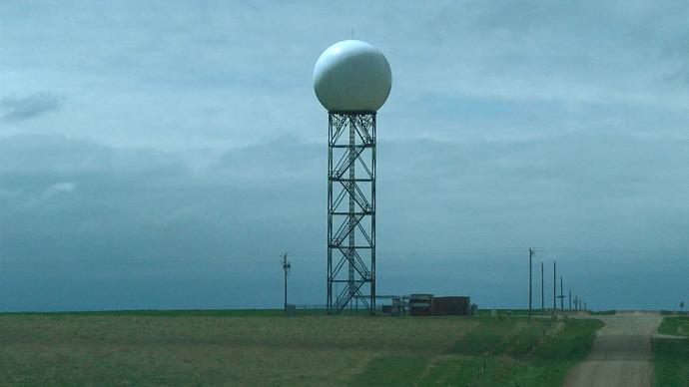
Doppler Radar
Radars collocated at many NWS offices
Radar locations across the country

Slide 21
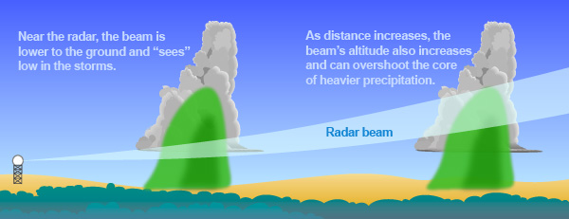
Doppler Radar
Radar beam height gets higher
  Weak bias in far-away storms
Detects anything in the sky

Slide 22
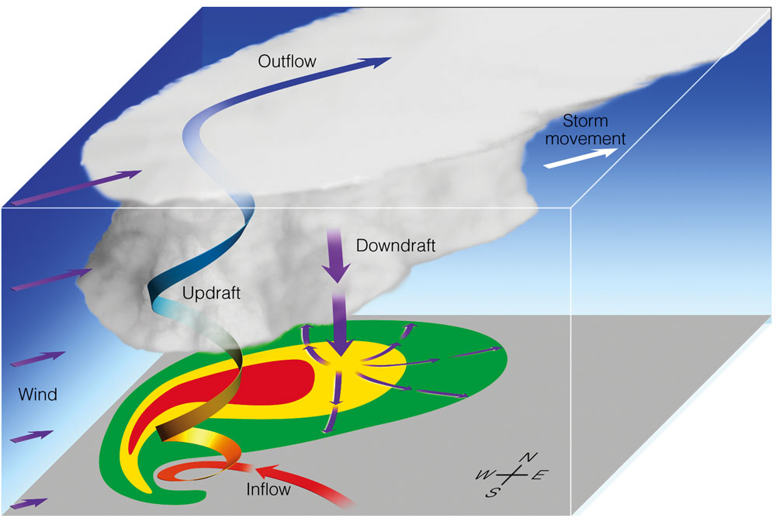
Supercell Reflectivity Signatures

Slide 23
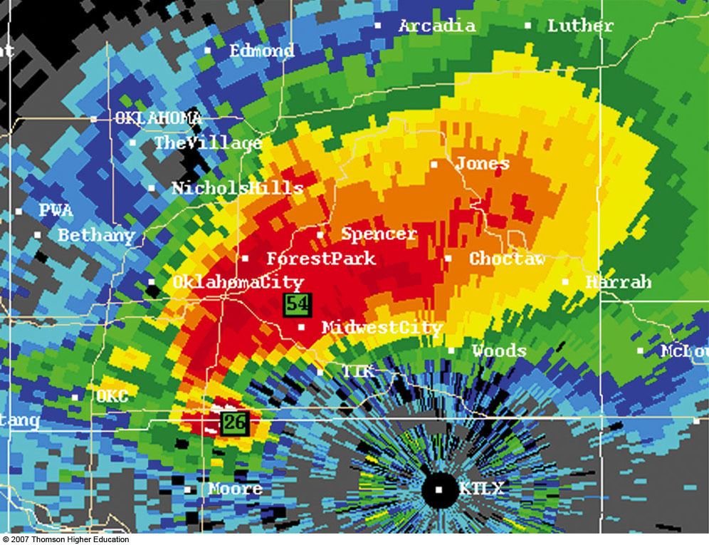
Supercell Reflectivity Signatures

Slide 24
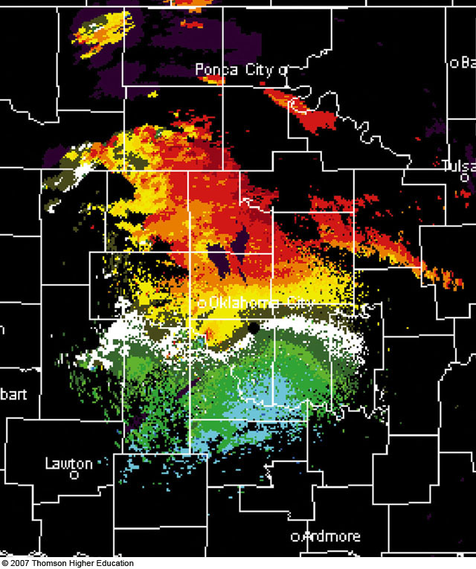
Supercell Radar Velocity Signatures

Slide 25
Supercell Radar Velocity Signatures

Slide 26
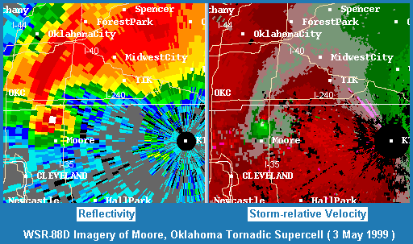
Reflectivity and Velocity of a Supercell

Slide 27
Supercell Radar ID Review
“Hook echo” with top-heavy reflectivity signature
Doppler velocity couplet near the hook echo
Hazards:
  Hail in the front flank (can get very large)
  Damaging winds in front flank and hook
  Tornadoes within the hook echo

Slide 28
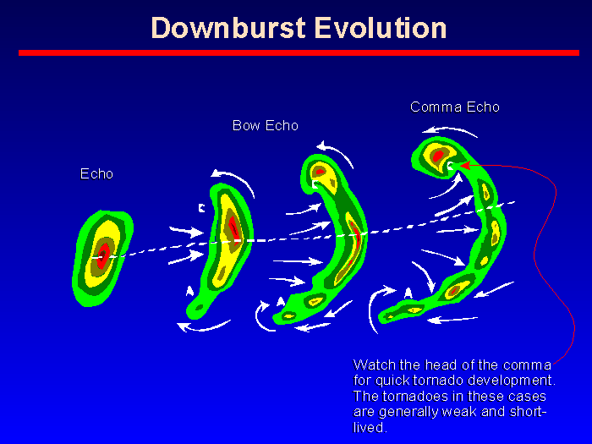
Bow Echo Doppler Radar Signatures

Slide 29
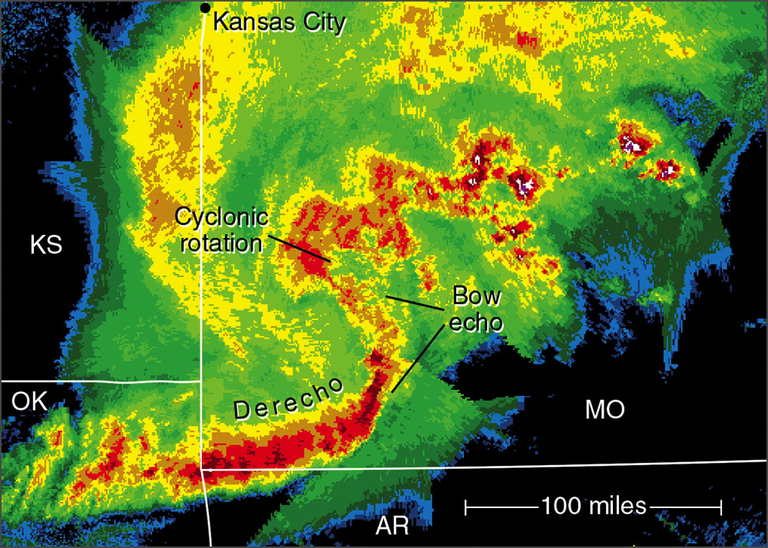
Bow Echo Doppler Radar Signatures

Slide 30
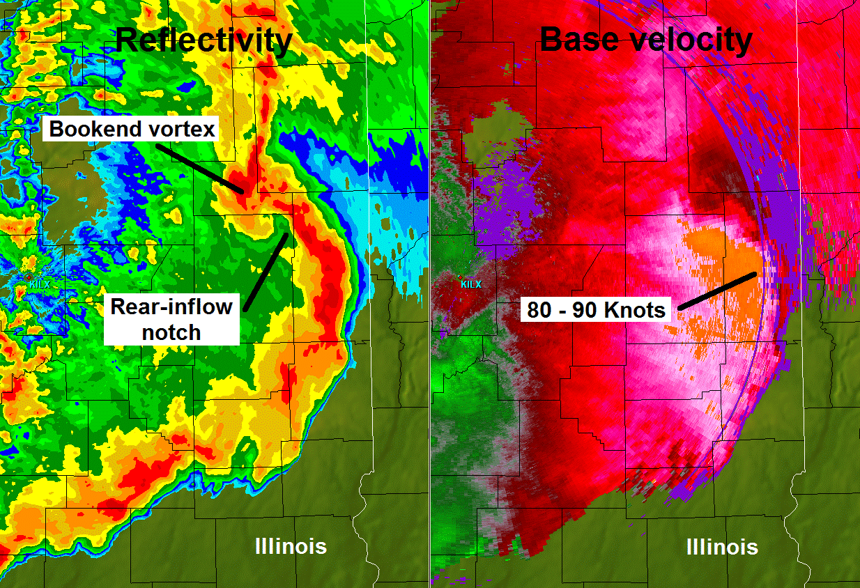
Bow Echo Doppler Radar Signatures

Slide 31
Bow Echo Radar ID review
Watch for “bowing” in the middle of small line segments
  Most common severe weather mode in Northeast
  Bookend vortices are more definitive, though NWS will likely warn that
If radar is close enough, Doppler velocity can confirm wind hazard

Slide 32
Numerical Weather Prediction

Slide 33
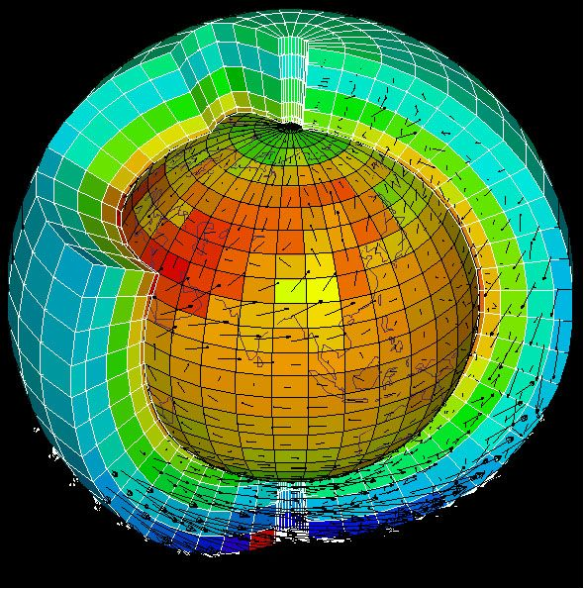
Numerical Weather Prediction
Large computers create grid boxes over the Earth and assign temp, wind, dew point, etc. to each grid box

Slide 34
Numerical Weather Prediction
Large computers create grid boxes over the Earth and assign temp, wind, dew point, terrain height, etc. to each grid box
Spatial resolution varies from ~50 mile to ~1.6 mile “pixel density”
Correlated with observation density

Slide 35
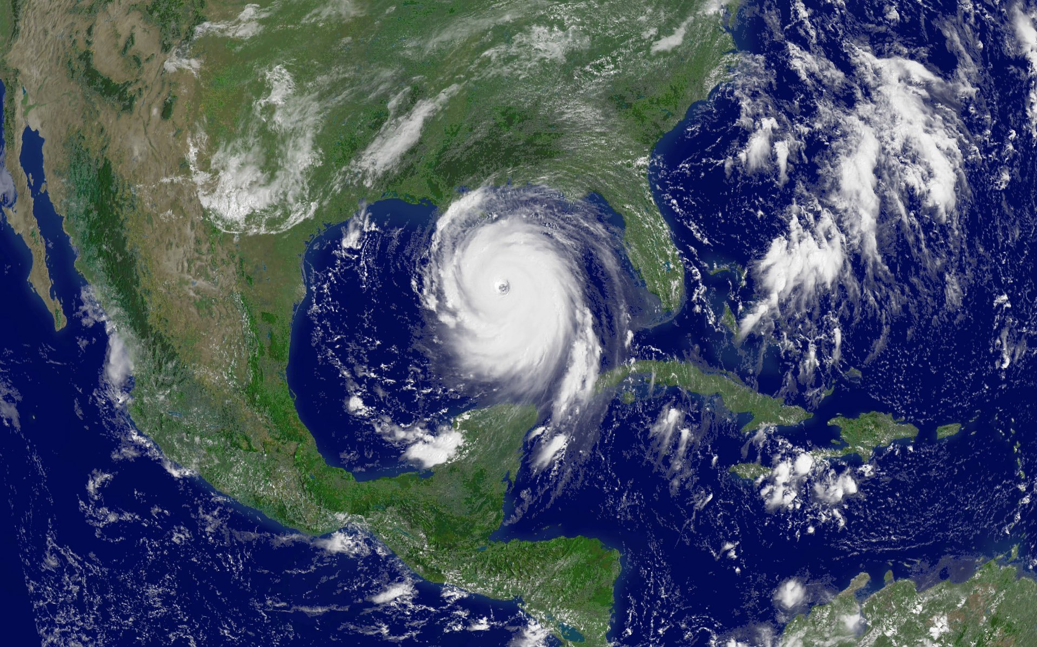
Hurricane Katrina satellite picture composed of 1 km pixels.
High resolution model = possibly accurate, definitely expensive, and extremely time-consuming
Notes:
Calculations take TIME and as resol improves TIME STEP gets smaller

Slide 36
As model resolution increases, we see more, but computers must be much bigger
Notes:
Calculations take TIME and as resol improves TIME STEP gets smaller

Slide 37
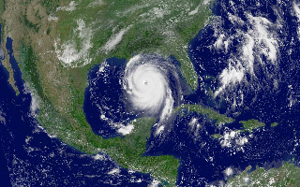
Compromising on the resolution – now it’s 10 km

Slide 38

30 km resolution

Slide 39

60 km…At what point would we not be able to tell that’s a hurricane if we had not known it from the start?

Slide 40
120 km…This is the world as seen by global weather models not so long ago, and still many climate models today.

Slide 41
Numerical Weather Prediction
The equations of motion are integrated forward with time at each location
  (new forecast = old forecast + change function)

Slide 42

Numerical Weather Prediction
The equations of motion are integrated forward with time at each location
  (new forecast = old forecast + change function)
Easy in theory, hard in practice…why?

Slide 43
Why forecasting is tough…
Atmosphere is a “chaotic system”
  Sensitive to initial conditions (ICs)
Our observing systems have errors
  Weather station error
  Weather balloon error
  Satellite error
  Observation location-derived error
Impossible to know ICs with perfect accuracy

Slide 44
Why forecasting is tough…part deux
Model error
  Time integration (now = earlier + (# seconds)) is not perfect
  Sub-grid-scale processes (my dissertation work)
    Small-scale turbulence, precipitation processes, etc. must be parameterized (educated guess)
    We don’t have model resolution down to your back yard

Slide 45
Why forecasting is tough…part deux
Model error
  Time integration (now = earlier + (# seconds)) is not perfect
  Sub-grid-scale processes (my dissertation work)
    Small-scale turbulence, precipitation processes, etc. must be parameterized (educated guess)
    We don’t have model resolution down to your back yard

Slide 46
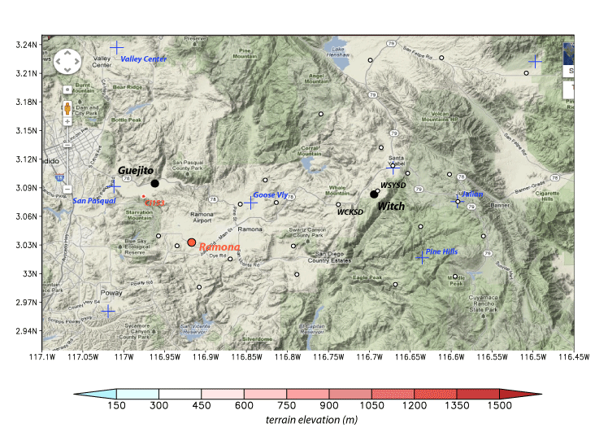
Eastern San Diego county terrain (Google Maps)
SIL
Distortions from map projection differences
Notes:
Witch = where Oct 2007 Witch Creek fire started, one of largest fires in CA history. Guejito fire started later, merged with Witch and other fires.
25+ fires in So Cal in late Oct 2007, during brutally strong Santa Ana wind event

Slide 47
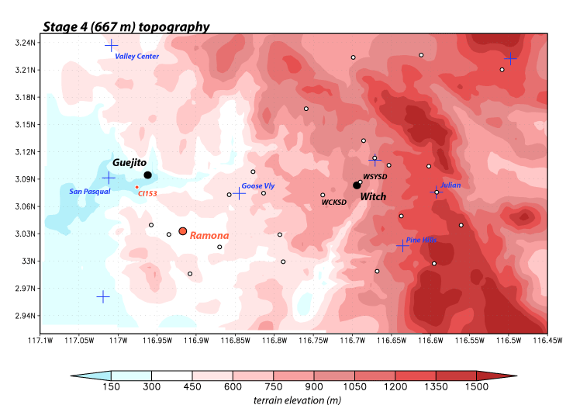
Eastern San Diego county terrain (WRF model)
667 m
SIL

Slide 48
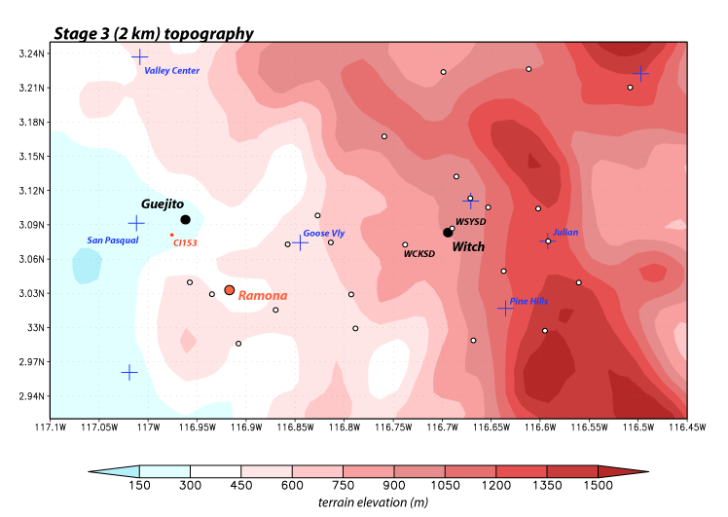
Eastern San Diego county terrain (WRF model)
2 km
SIL

Slide 49
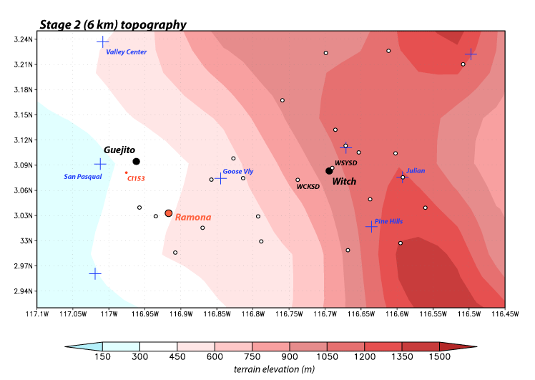
Eastern San Diego county terrain (WRF model)
6 km
SIL

Slide 50
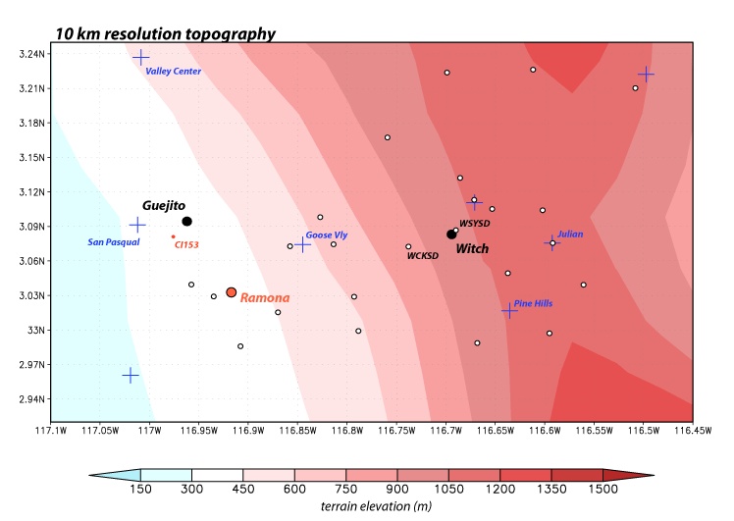
Eastern San Diego county terrain (WRF model)
10 km
SIL
Notes:
When does this become little more than a cartoon version of reality?

Slide 51
Why forecasting is tough…part trois
Model validation and verification is impossible everywhere
  Can’t get better at predicting for your yard if there’s no sensor to verify against
  Some variables, like model turbulent motions or radiative fluxes, are never verified
Data assimilation into a model is an inexact science
  Non-trivial how you start the model

Slide 52
Why forecasting is tough…part cuatro
Equations of motion are elliptic partial differential equations
“x anywhere depends on y everywhere, therefore y anywhere affects x everywhere

Slide 53
So, what do we do?

Slide 54
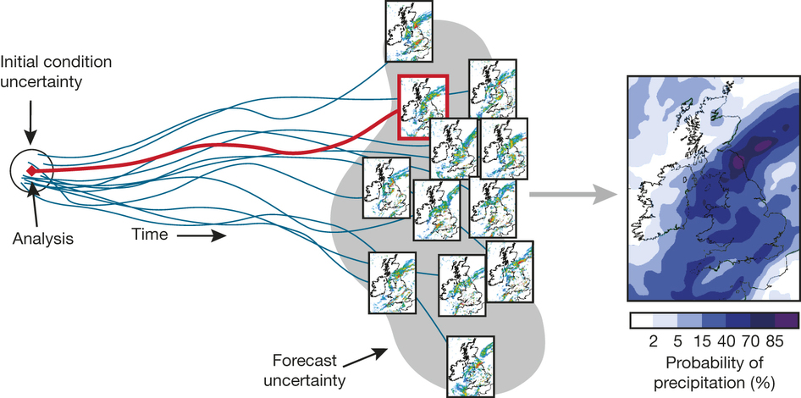
Ensembles

Slide 55
Ensemble Methods
Vary initial state of the atmosphere
  Preferably in “sensitive” locations

Slide 56
Ensemble Methods
Vary initial state of the atmosphere
  Preferably in “sensitive” locations
Run group of models with different states

Slide 57
Ensemble Methods
Vary initial state of the atmosphere
  Preferably in “sensitive” locations
Run group of models with different states
Attain variety of solutions
  Within this distribution (hopefully) lies the answer

Slide 58
Ensemble Methods
This method, while infuriating to those wanting an exact answer, has revolutionized meteorology
For those needing exact answers, the ensemble mean (average) value has the highest skill over time
What do ensemble forecasts look like? (GEFS ensemble page)
  emc.ncep.noaa.gov/gc_wmb/tdorian/gefs/EMCGEFSplumes.html

Slide 59
Known Model Difficulties

Slide 60
Known Model Difficulties
If cloud cover, add (subtract) a few degrees to the forecasted low (high)
If cloud free, do the opposite
  Model Output Statistics causes this phenomenon
Under clear sky nighttime conditions and close temp/dew point spread, expect fog

Slide 61
Known Model Difficulties (cont.)
Cold-season forecasts are better than warm-season forecasts
  Higher confidence
Temperatures in the mountains will likely be more extreme than forecasted
  Due to resolution issues
In complex terrain, cold air takes awhile to remove

Slide 62
Known Model Difficulties (cont.)
Snowfall on the ground drastically effects temperatures at night
  Fresh snowpack + clear sky = rock bottom nighttime low (lower than forecasted)
Soil moisture and soil temperature are poorly observed
  Poorly resolved in models
  Wet/warm ground may effect precipitation type and flooding beyond model solutions

Slide 63
Audience-directed section (if time allows)
Contact: Matthew Vaughan (mvaughan@albany.edu)
Thanks to the Department of Defense’s National Defense Science and Engineering Graduate Fellowship Program (funding) and the University at Albany - SUNY

