Slide 1
Basic Weather Course
Nephology, Fluid Dynamics, and Nowcasting in the Field
Matthew Vaughan

Slide 2
Outline
Essential Principles of Meteorology
Nephology and Weather Systems
Reading a Surface chart
Field Observations and Rules of Thumb (scattered)

Slide 3
Outline
Essential Principles of Meteorology

Slide 4
The Atmosphere
Thin layer of gases above Earth (primarily nitrogen and oxygen)
Water vapor plays large role

Slide 5
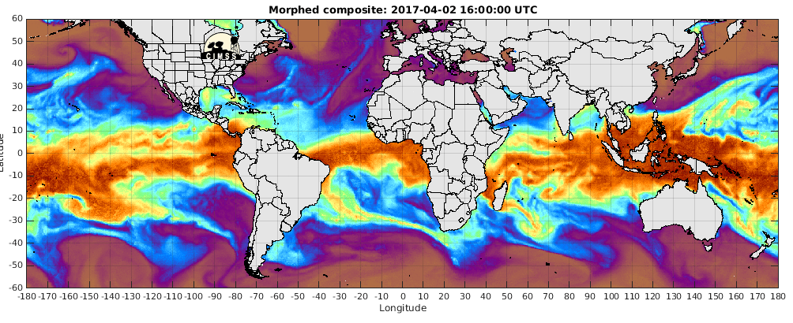
The Atmosphere
Thin layer of gases above Earth (primarily nitrogen and oxygen)
Water vapor plays large role

Slide 6
The Atmosphere
Thin layer of gases above Earth (primarily nitrogen and oxygen)
Water vapor plays large role
Treat the atmosphere as a fluid
Pressure and density variations

Slide 7
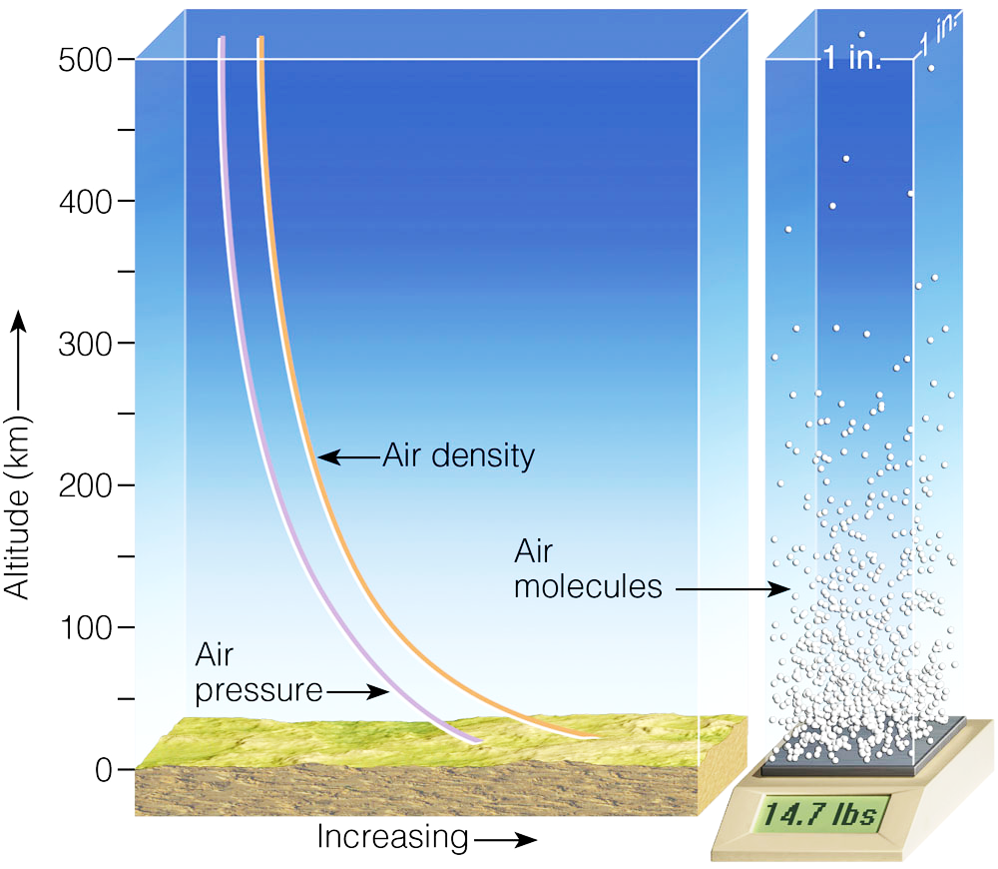
Fig. 1-7, p. 8
Notes:
Figure 1.7: Both air pressure and air density decrease with increasing altitude.

Slide 8
The Atmosphere
Thin layer of gases above Earth (primarily nitrogen and oxygen)
Also care about water vapor content
Treat the atmosphere as a fluid
Pressure and density variations
Waves and currents

Slide 9
Notes:
Figure 1.7: Both air pressure and air density decrease with increasing altitude.

Slide 10
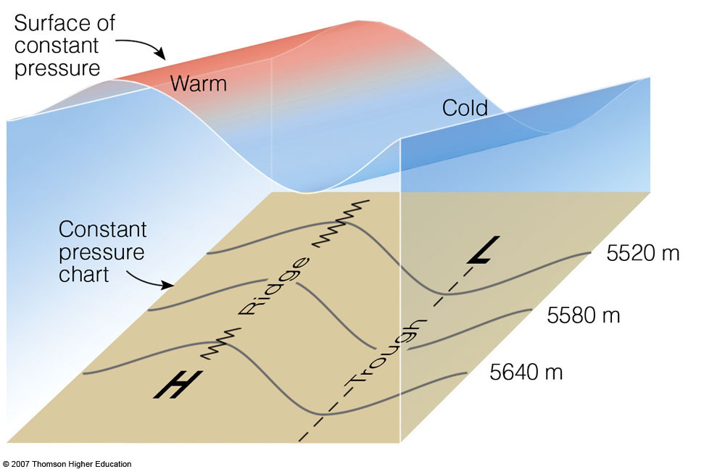
Notes:
Figure 1.7: Both air pressure and air density decrease with increasing altitude.

Slide 11
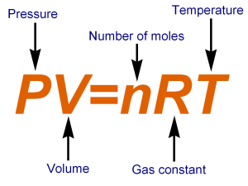
The Atmosphere
Thin layer of gases above Earth (primarily nitrogen and oxygen)
Water vapor plays large role
Treat the atmosphere as a fluid
Pressure and density variations
Waves and currents
Obeys certain laws
Buoyancy
Radiation
Ideal gas law

Slide 12
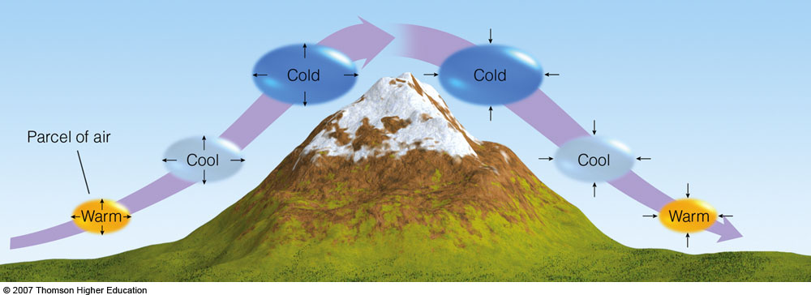
Rising air cools, sinking air warms
Figure 1, p. 31
Notes:
Figure 1: Rising air expands and cools; sinking air is compressed and warms.

Slide 13
What does this mean in the field?
Provides rules of thumb in complex terrain

Slide 14
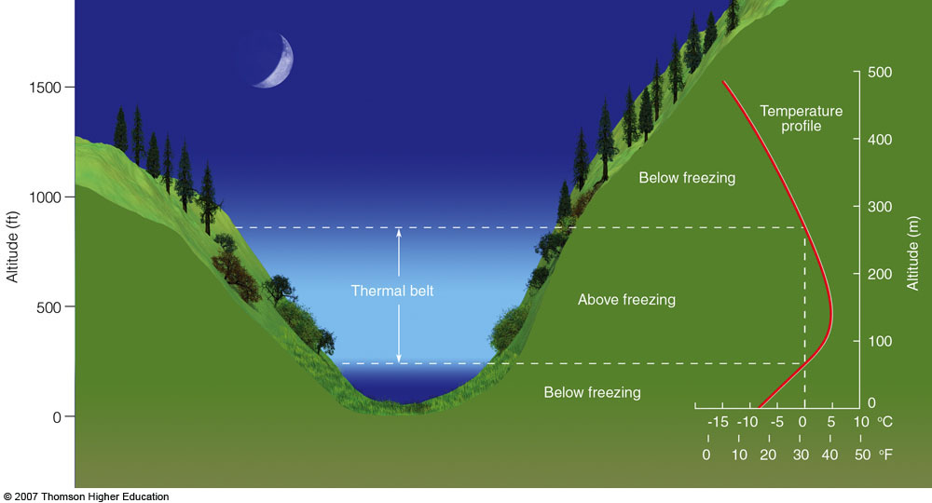
What does this mean in the real world?
Important in complex terrain

Slide 15
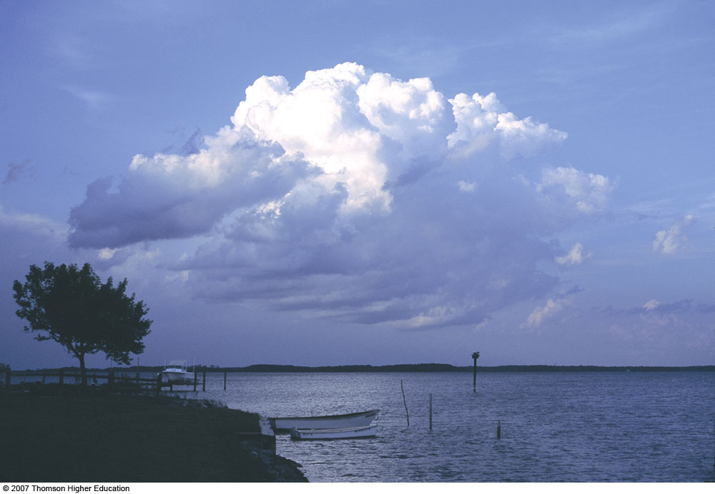
What does this mean in the field?
Provides rules of thumb in complex terrain
In valleys at night, buoyancy-driven, downslope drainage flows result in coldest air in the valley floor
Radiation-driven thermal belts exist above the floor, providing warmer nighttime temperatures
Mountains drive upslope winds during the daytime
Wind direction determines:
Warmer side of mountain
Visibility on the mountain
Preferred precipitation location

Slide 16
Clouds
Can be liquid or ice
100% relative humidity (RH)
Form almost exclusively in areas of ascent

Slide 17
How do clouds form?
When RH = 100%
i.e. when the dew point = the air temperature
Dew point = actual water vapor content of the air
Can either:
Moisten
Cool
Parcel Theory

Slide 18
Note on RH
RH is the moisture value humans are most sensitive to
Determines efficiency of sweat evaporation
Heat index = f(RH)
RH > 80% particularly noticeable

Slide 19
How do clouds form?
When RH = 100%
i.e. when the dew point = the air temperature
Dew point = actual water vapor content of the air
Can either:
Moisten
Cool
Parcel Theory

Slide 20
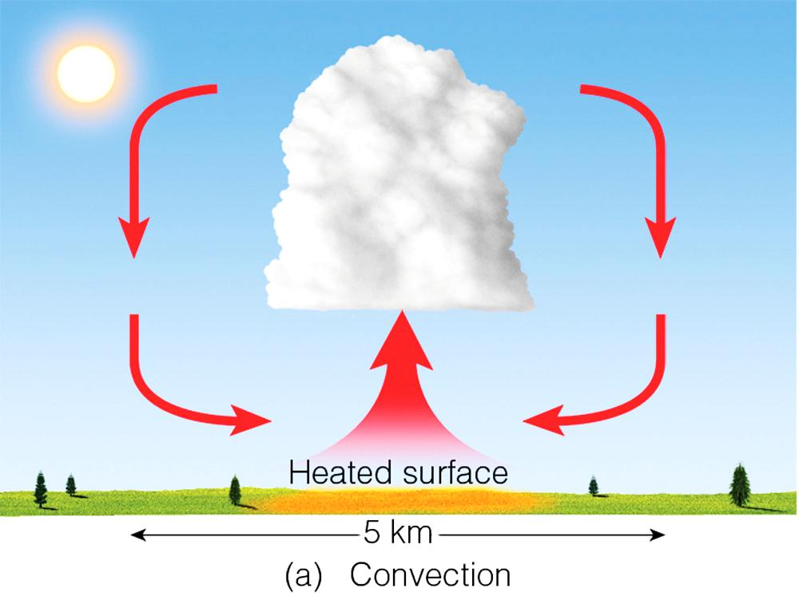
Primary way clouds form: surface heating and convection
Notes:
Figure 5.10: The primary ways clouds form.
(a) surface heating and convection

Slide 21
How do clouds form?
Dry air cools (warms) at a rate of ~10 C per km of ascent (descent)
5.4 F per 1000 ft
Dew point changes at a rate of ~1 F per 1000 ft
Therefore temp/dew spread decreases by 4.4 F per 1000 ft

Slide 22
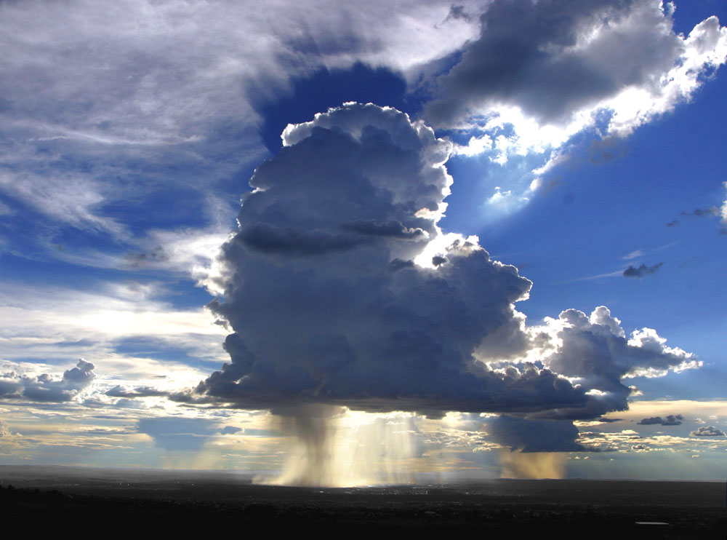
Estimate cloud height
Cloud = 100% RH (dew point = air temp)
Most useful for warm season
Cloud base tends to rise with warmer surface temperatures
Cloud Base Formula:
Lifted Condensation Level (LCL)
[(Air temp – dew point) /4.4]
Multiply by 1000 for cloud base relative to you

Slide 23
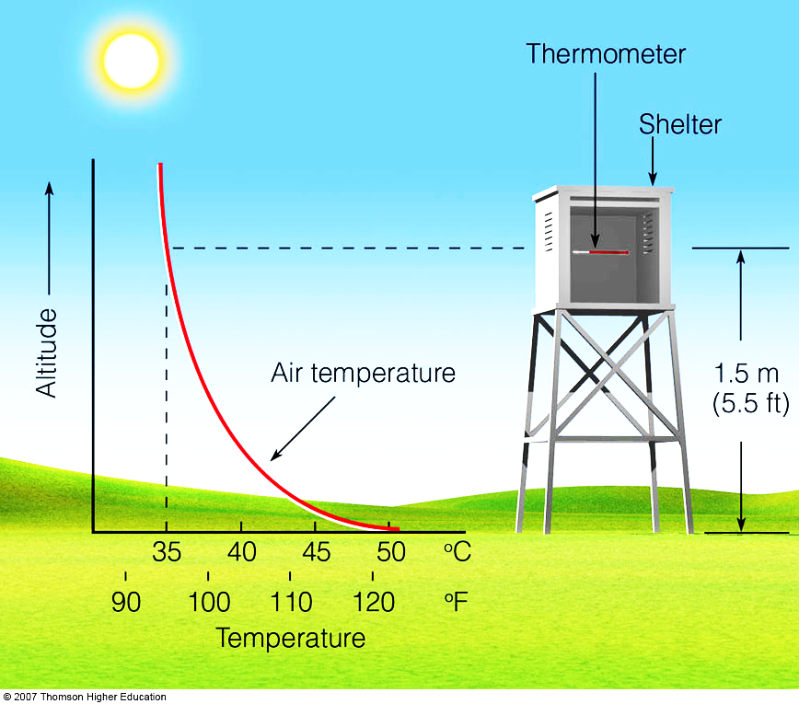
Note on field measurements
Hold device at ~2 m above ground
Walk while taking measurement
Shelter temperature sensor from direct sunlight

Slide 24
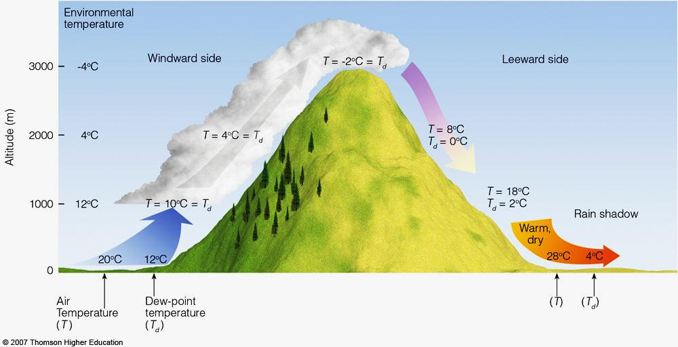
How do clouds form: Terrain

Slide 25
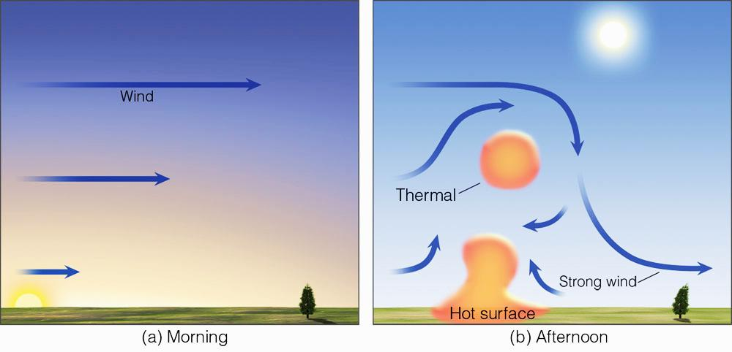
Note on cloudy side of mountain
Look at morning balloon sounding (1200 UTC)
www.spc.gov/exper/soundings/
Use wind direction ~1km above surface

Slide 27
Note on cloudy side of mountain
Look at morning balloon sounding (1200 UTC)
www.spc.gov/exper/sounding
Use wind direction ~1km above surface

Slide 28
Why care about clouds?

Slide 29
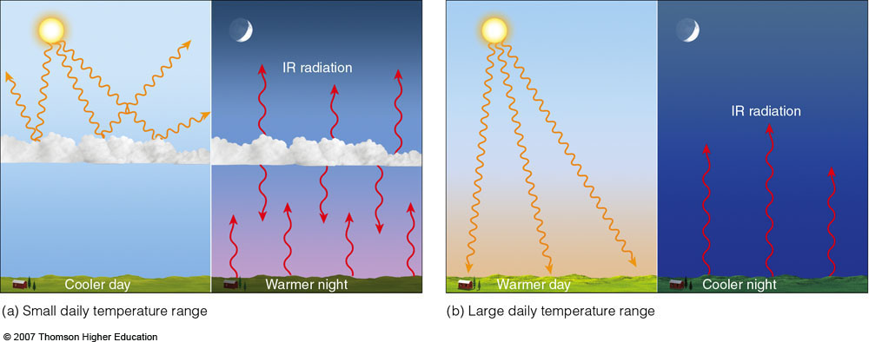
Why care about clouds?
Clouds reduce the diurnal T range.
Deserts have max diurnal range!

Slide 30
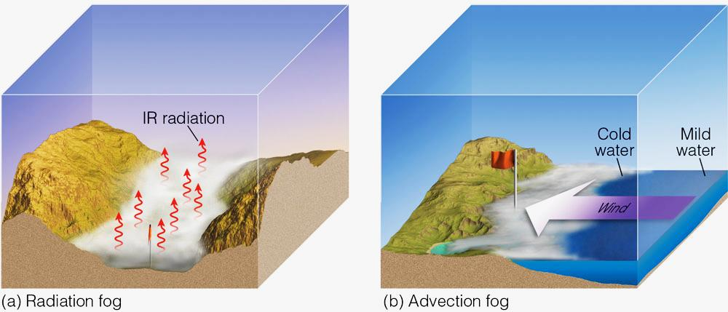
Why care about clouds?
Clouds reduce visibility

Slide 31
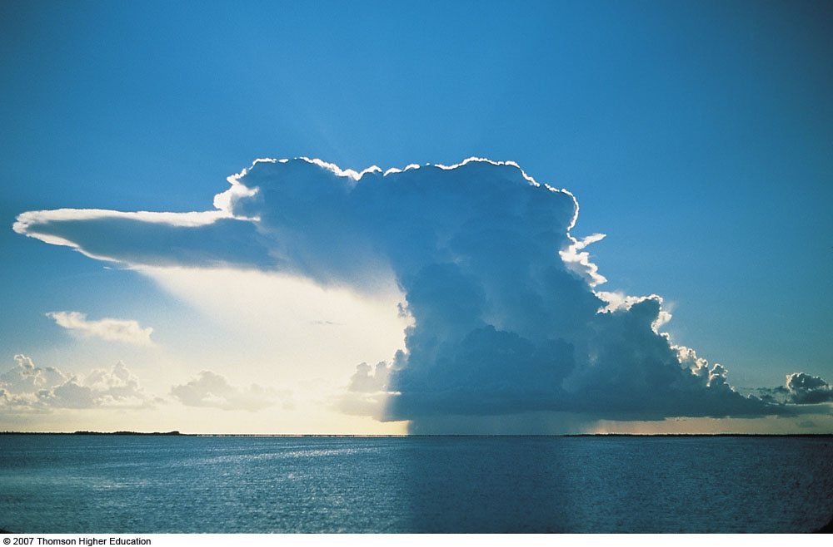
Why care about clouds?
Clouds can precipitate

Slide 32
Why care about clouds?
Clouds may give hints to future weather
Caveats:
We can’t observe clouds with certainty, thus prediction cannot be certain
Different weather patterns can create similar cloud fields
Some weather has no or very little predictive skill using clouds

Slide 33
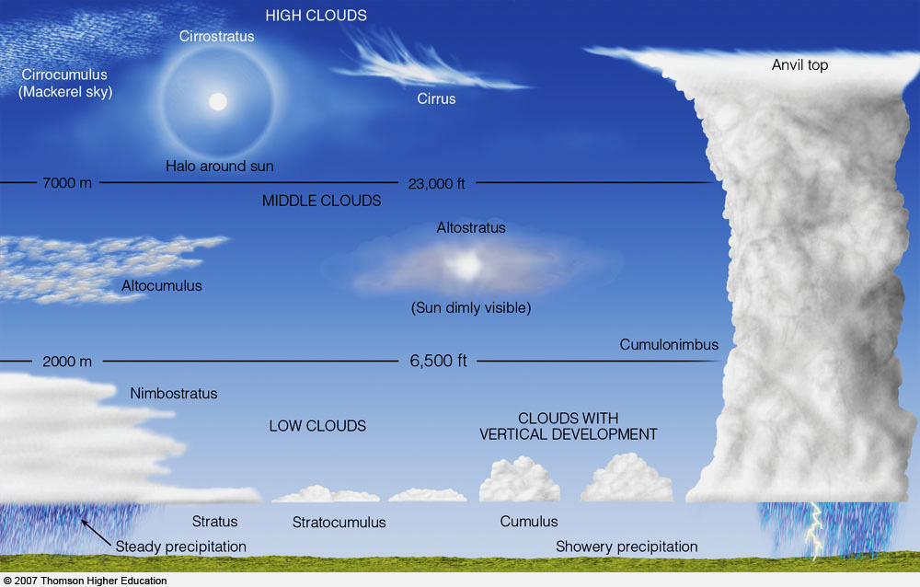
Nephology

Slide 34
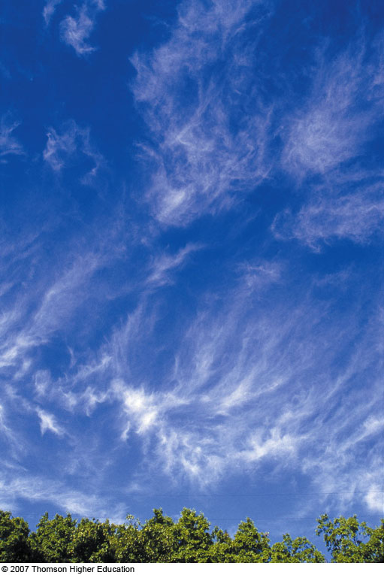
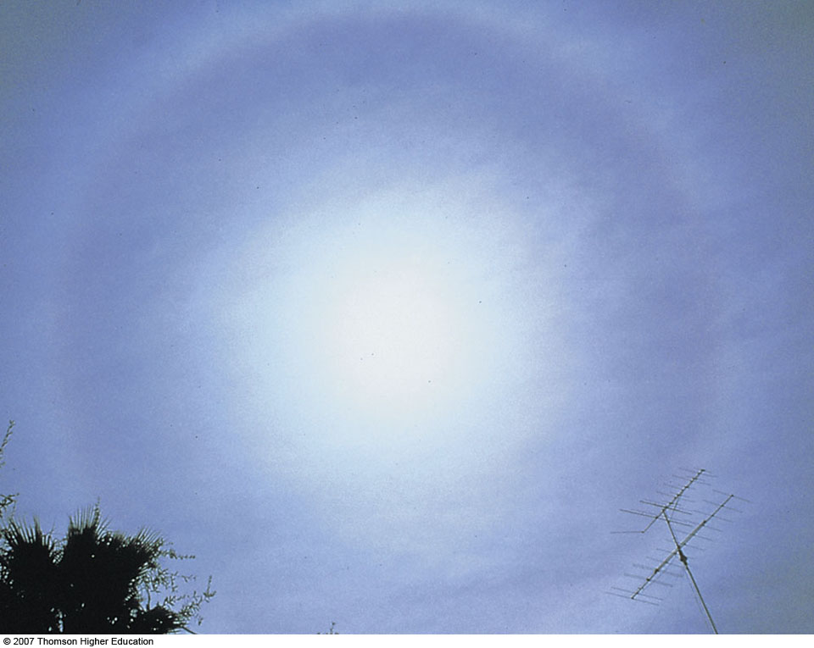
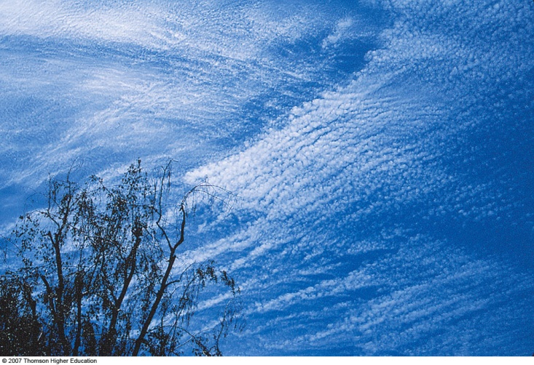
High Clouds
cirrus
cirrocumulus
cirrostratus
Cirrostratus clouds can sometimes be quite thick; mostly ice crystals.

Slide 35
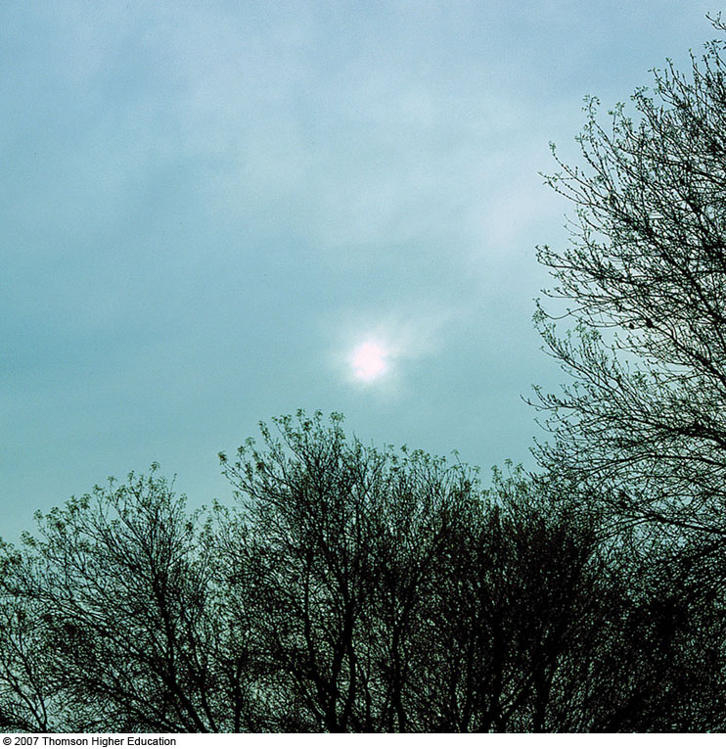
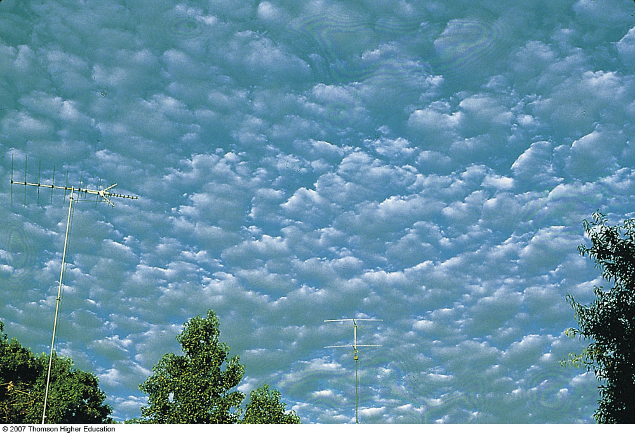
Middle Clouds
altocumulus
altostratus
“Milky, watery sky”

Slide 36
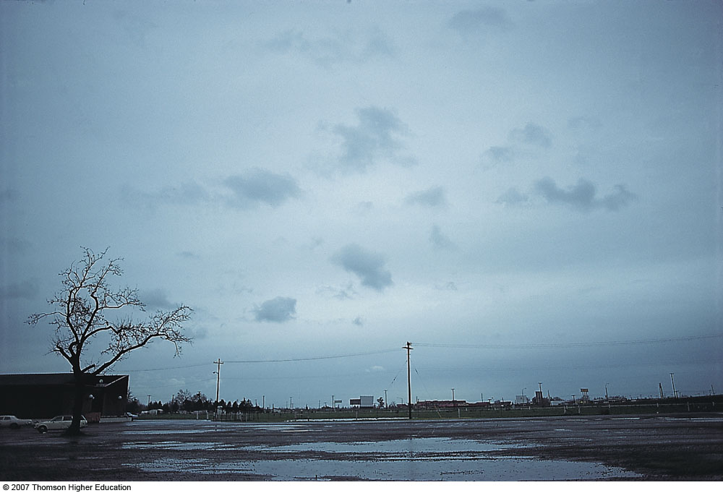
Low Clouds
nimbostratus
stratus

Slide 37
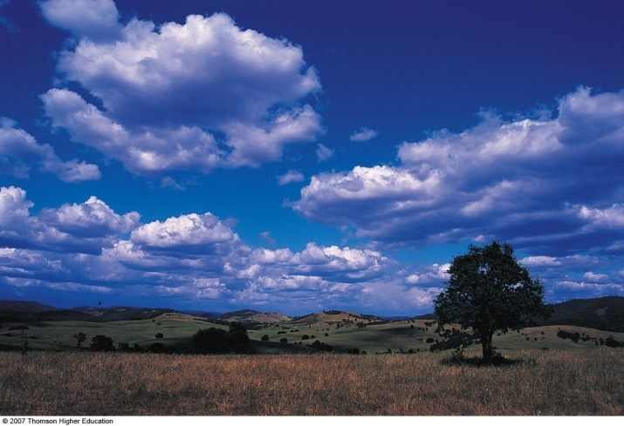
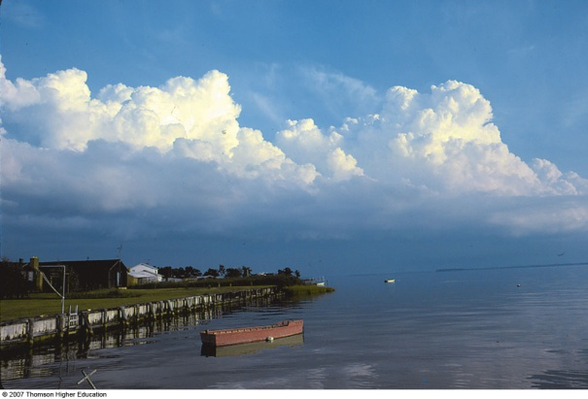
Clouds with Vertical Development
cumulus humilis/mediocris
cumulus congestus
cumulonimbus
Not all cumulus clouds grow to be thunderstorms, but all thunderstorms start out as cumulus clouds.

Slide 38
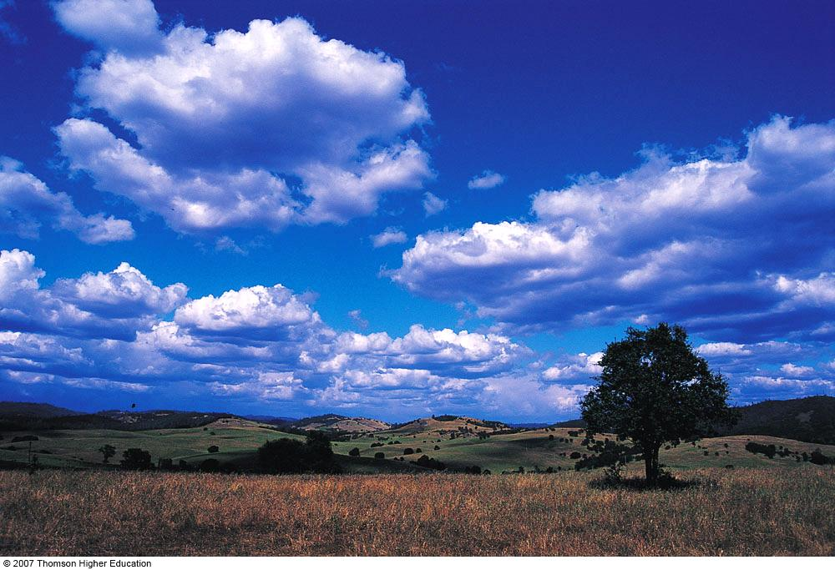
Cumulus Humilis (wider base than height)
Fig. 4-29, p. 102
Notes:
Figure 4.29: Cumulus clouds. Small cumulus clouds such as these are sometimes called fair weather cumulus, or cumulus humilis.

Slide 39
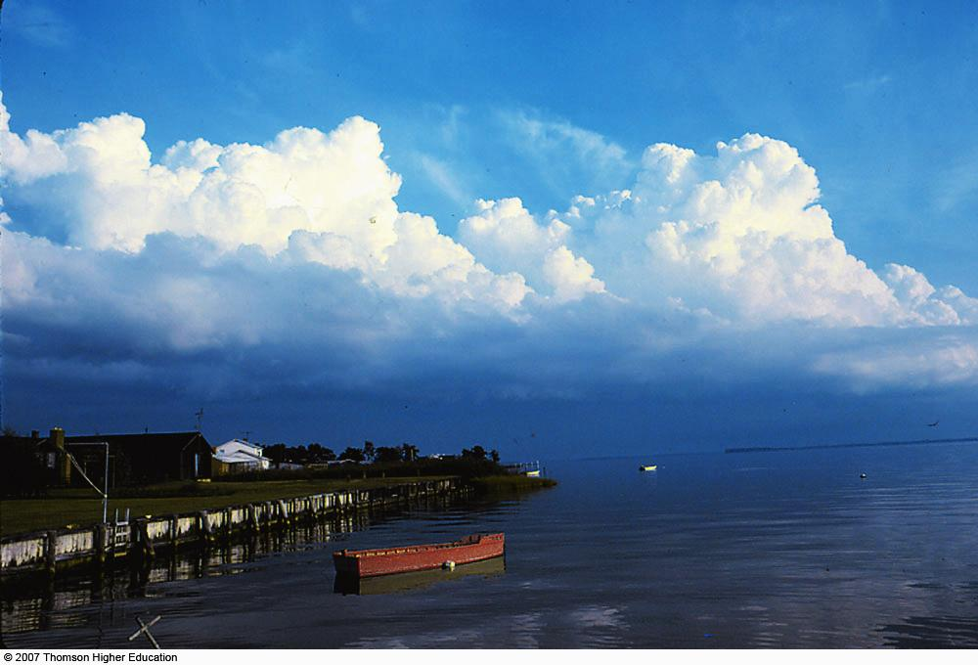
Cumulus congestus (taller height than base width)
Fig. 4-30, p. 103
Notes:
Figure 4.30: Cumulus congestus. This line of cumulus congestus clouds is building along Maryland’s eastern shore.

Slide 40
Cumulonimbus
Fig. 4-31, p. 103
Notes:
Figure 4.31: A cumulonimbus cloud. Strong upper-level winds blowing from right to left produce a well-defined anvil. Sunlight scattered by falling ice crystals produces the white (bright) area beneath the anvil. Notice the heavy rain shower falling from the base of the cloud.

Slide 41
Reading the clouds
Cumulus field
Widespread cumulus humulus = fair weather
Band of growing cumulus = something to watch
Cumulus mediocris/congestus within veering wind profile = storms possible

Slide 42
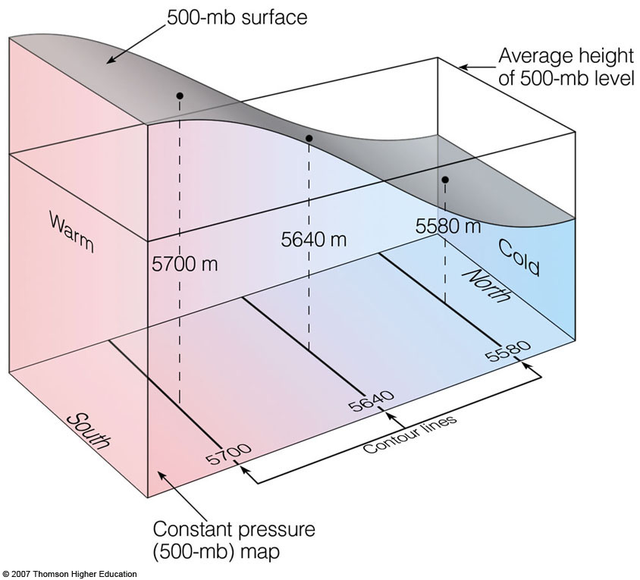
Note on veering wind profile
Complicated, but essentially:
Veering wind = clockwise turning winds with height
Due to governing eqns:
Veering wind = warm air advection (WAA)
Due to Coriolis effect
WAA = large-scale ascent, which leads to clouds and precipitation

Slide 43
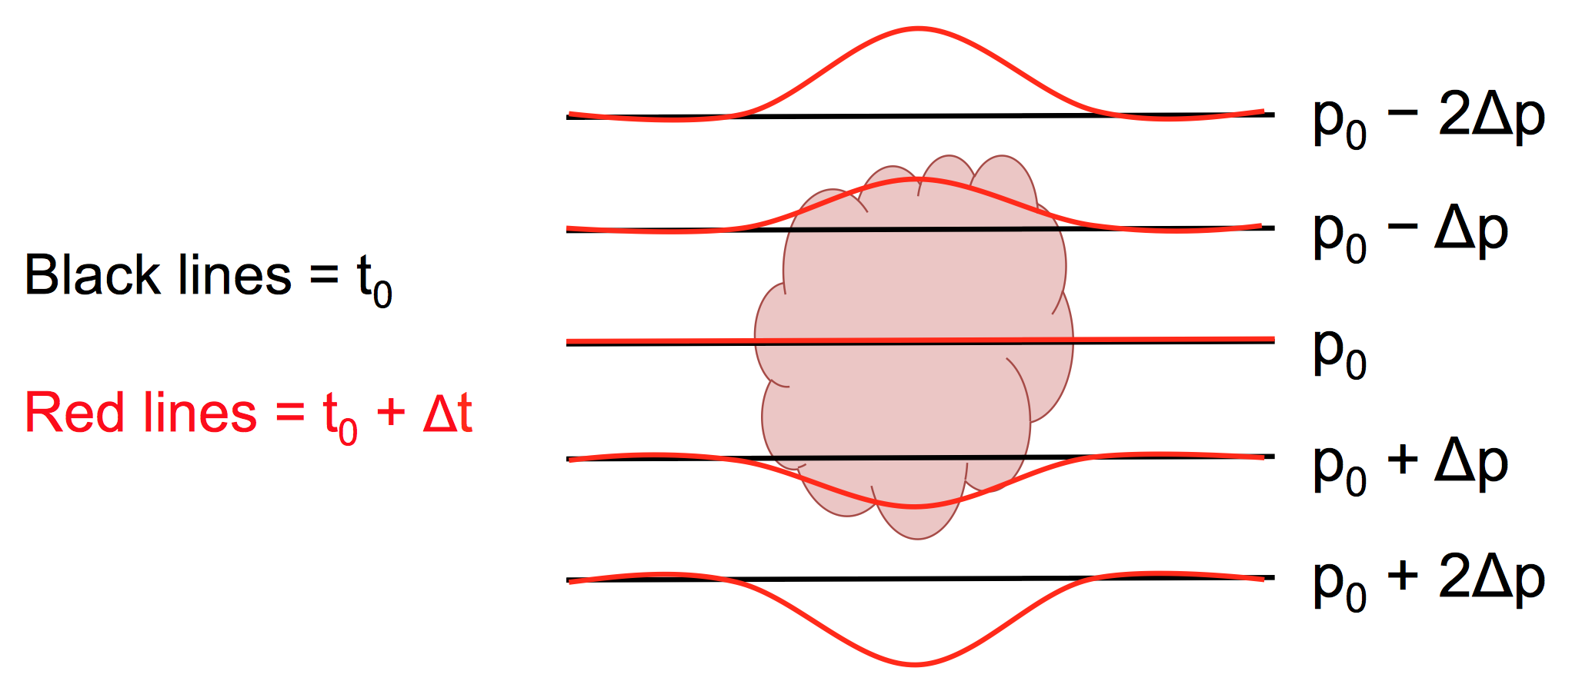
Note on veering wind profile
Area of WAA or latent heating (cloud)
Pressure lines bow down (lowering pressure)

Slide 44
Reading the clouds
Virga below cumulus clouds indicates evaporating rain (downburst potential)

Slide 45
Reading the clouds
Cirrus (ice) and stratus fields
Much tougher to read
Cirrus clouds can come from a variety of sources
Widespread cirrostratus (especially in SW sky) may indicate precipitation in 12–24 h)

Slide 46
Reading the clouds
Cirrus (ice) and stratus fields
Much tougher to read
Cirrus clouds can come from a variety of sources
Widespread, thick cirrostratus (especially in SW sky) may indicate precipitation in 6–24 h)
Altostratus better indicator
No halo around sun

Slide 47
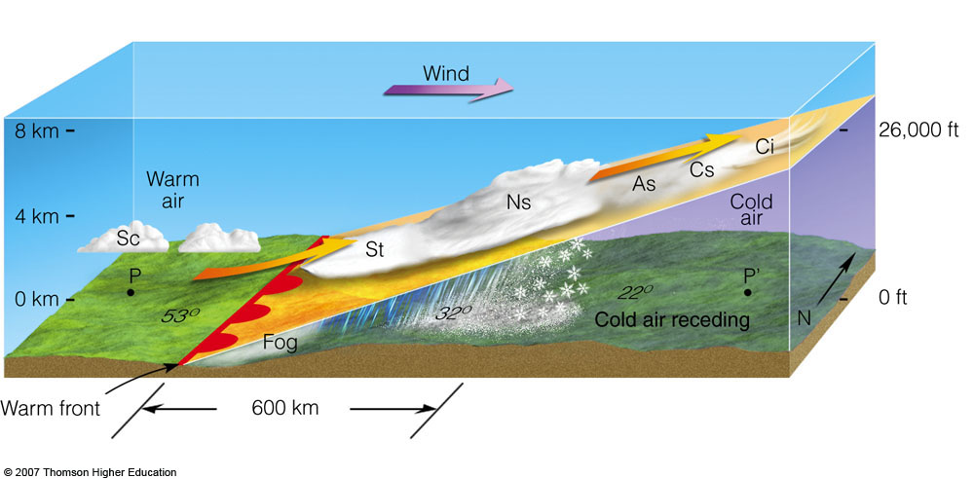
Reading the clouds
Cirrus (ice) and stratus field
Much tougher to read
Cirrus clouds can come from a variety of sources
Widespread cirrostratus (especially in SW sky) may indicate precipitation in 12–36 h)

Slide 48
Brief overview of surface chart
Important concepts
Temperature over dewpoint
Wind barbs = 10 knots; flag = 50 knots
Barbed side is where wind is coming from
Wind is generally parallel to pressure lines
Low pressure to left of wind vector
Areas of friction cause winds to turn
Areas of convergence = likely precipitation locations

Slide 49
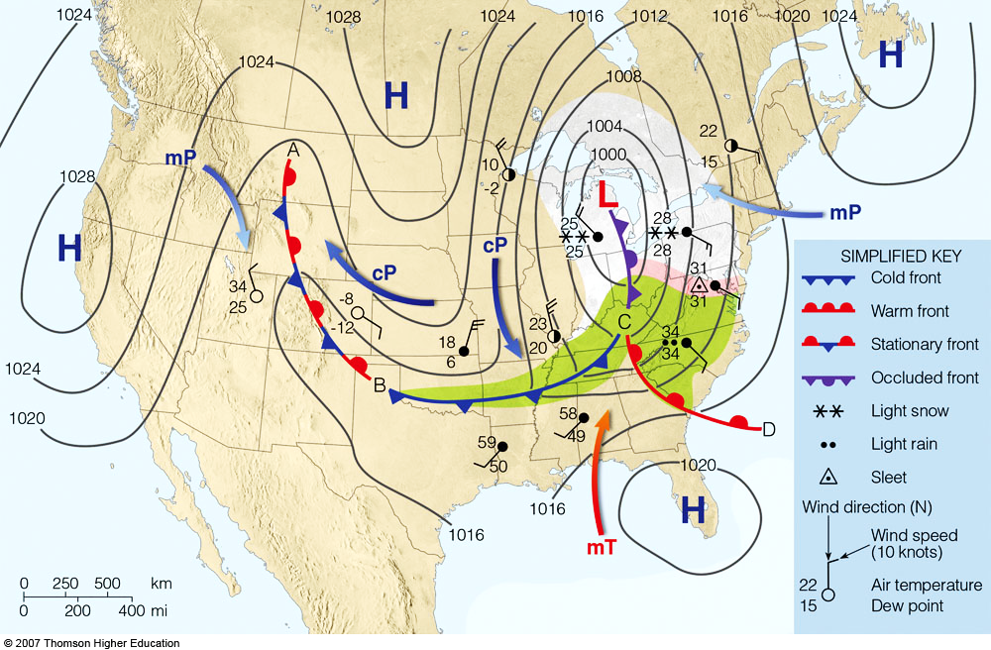
Brief Overview of surface chart
Important concepts
Temperature over dewpoint
Wind barbs = 10 knots; flag = 50 knots
Barbed side is where wind is coming from
Wind is generally parallel to pressure lines
Low pressure to left of wind vector
Areas of friction cause winds to turn
Areas of convergence = likely precipitation locations

Slide 50
Concluding rules of thumb
“Red sky at night…”
Some truth to that
Valley floor colder than slopes; fog forms first in valleys
Veering wind with height and developing cloud field = potential storms
Windward side of mountain preferred for clouds/precipitation

Slide 51
Concluding thoughts and links
Official forecasts = nws.gov
Surface charts = wpc.gov
Soundings = spc.gov/exper/sounding/

Slide 52
Concluding thoughts and links
Official forecasts = nws.gov
Surface charts = wpc.gov
Soundings = spc.gov/exper/sounding/

