Slide 1
Lightning Talk
by
Ajay Raghavendra
University at Albany (SUNY), Albany, NY
07-August-2019
About me
University at Albany, NY (Aug 2016–present)
PhD Candidate in Atmospheric Science
Embry–Riddle Aeronautical University, FL (Aug 2011–May 2016)
BS in Meteorology | BS in Computational Mathematics

Slide 2
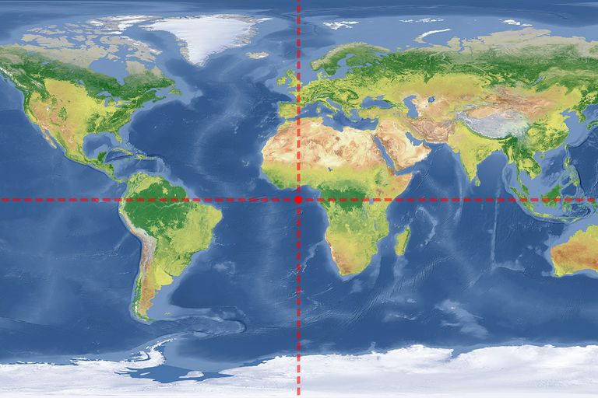
Global Prospective

Slide 3
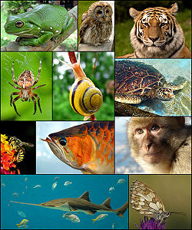
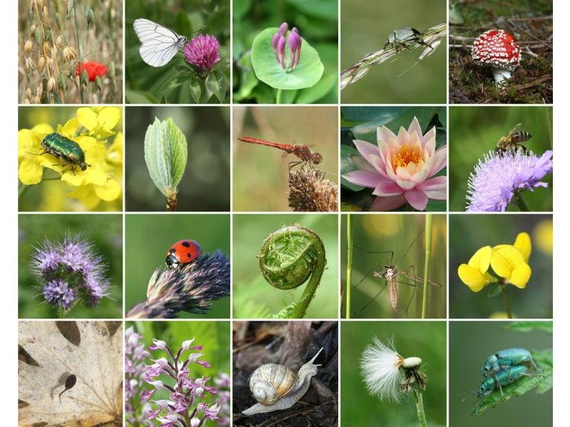
Tropical Rainforests Function as Global Epicenters of Biodiversity
Covering less than 2% of the Earth's total surface area, the world’s rainforests are home to 50% of the Earth's plants and animals.
A typical 4 mile² patch of rainforest contains as many as 1,500 flowering plants, 750 species of trees, 400 species of birds and 150 species of butterflies.

Slide 4
Observations are limited, so I use satellite data for my research

Slide 5
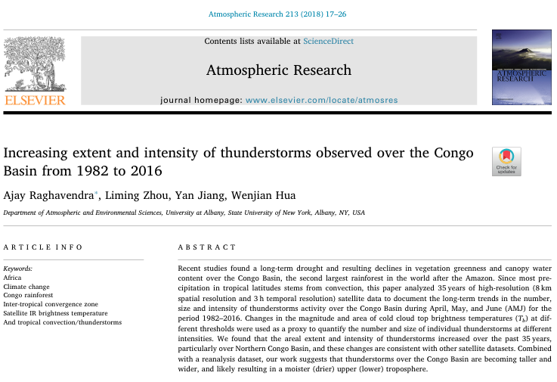
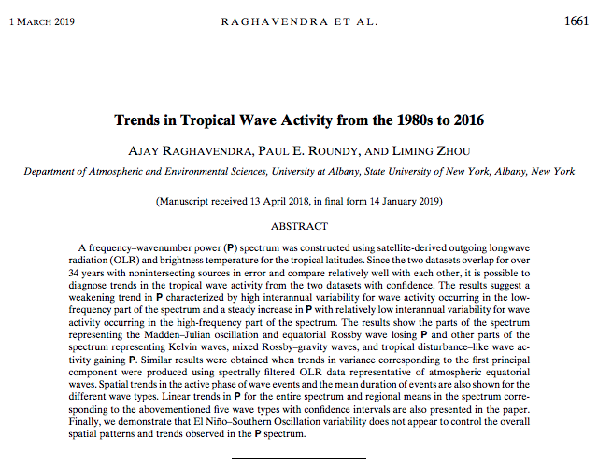
Some discoveries….

Slide 6
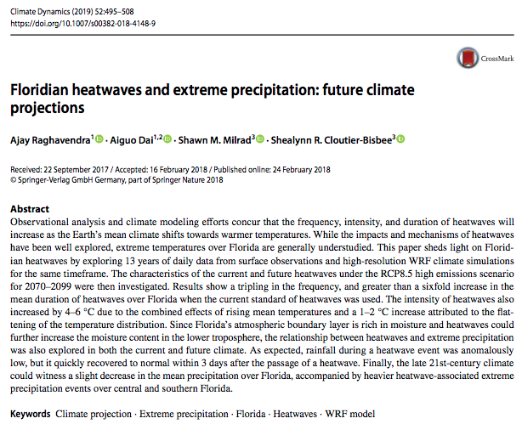
Distractions/Side Projects

Slide 7
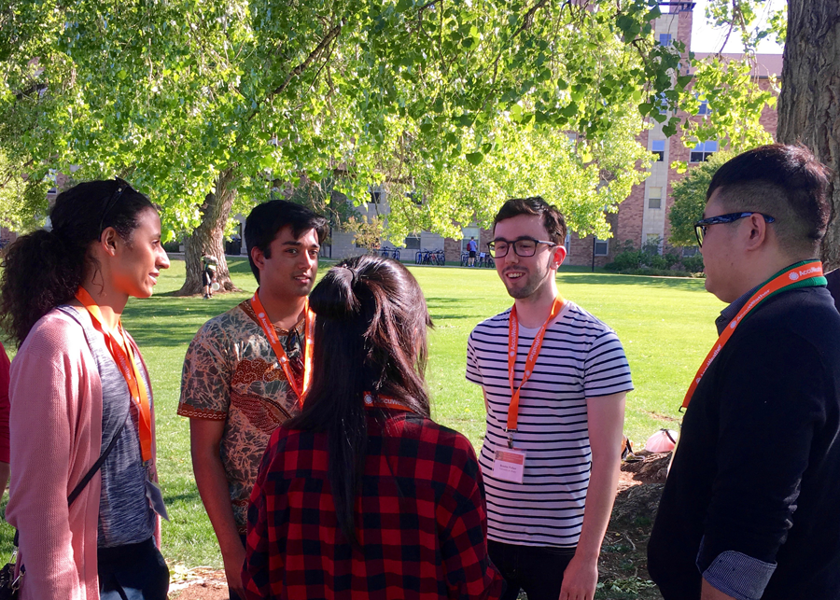
Travel Opportunities

