Slide 1
Stratospheric Polar Vortex and TPVs
Research Goal: Improve Arctic Cyclone Predictability
Stratospheric Polar Vortex
Characterized by strong westerly winds in the stratosphere that materializes in mid-late fall
Can be responsible for extremely anomalous cold air outbreaks in mid-winter
Tropopause Polar Vortices (TPVs)
Cyclonically spinning features that are known to be precursors to arctic cyclones that live on the tropopause

Slide 2
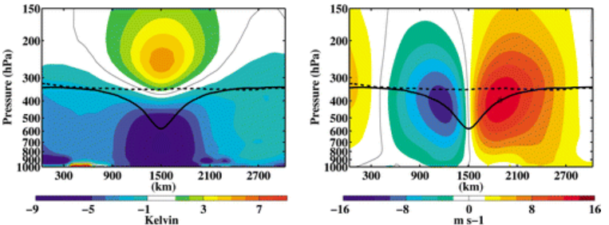
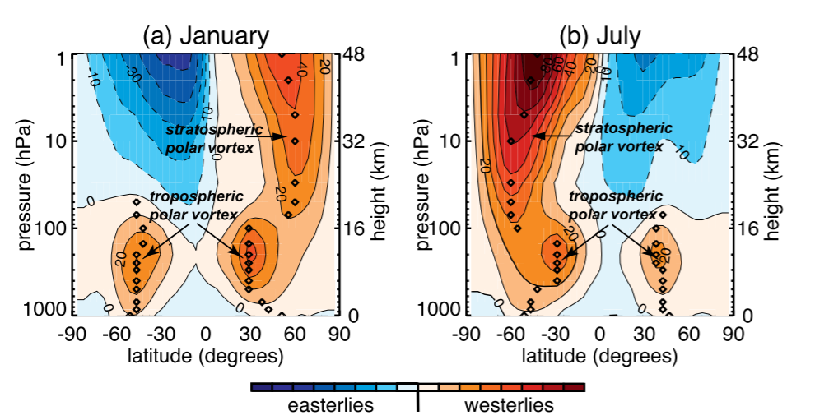
TPV Schematic
Cavallo and Hakim (2013)
Polar Vortex Schematic
Waugh et al. 2017

Slide 3
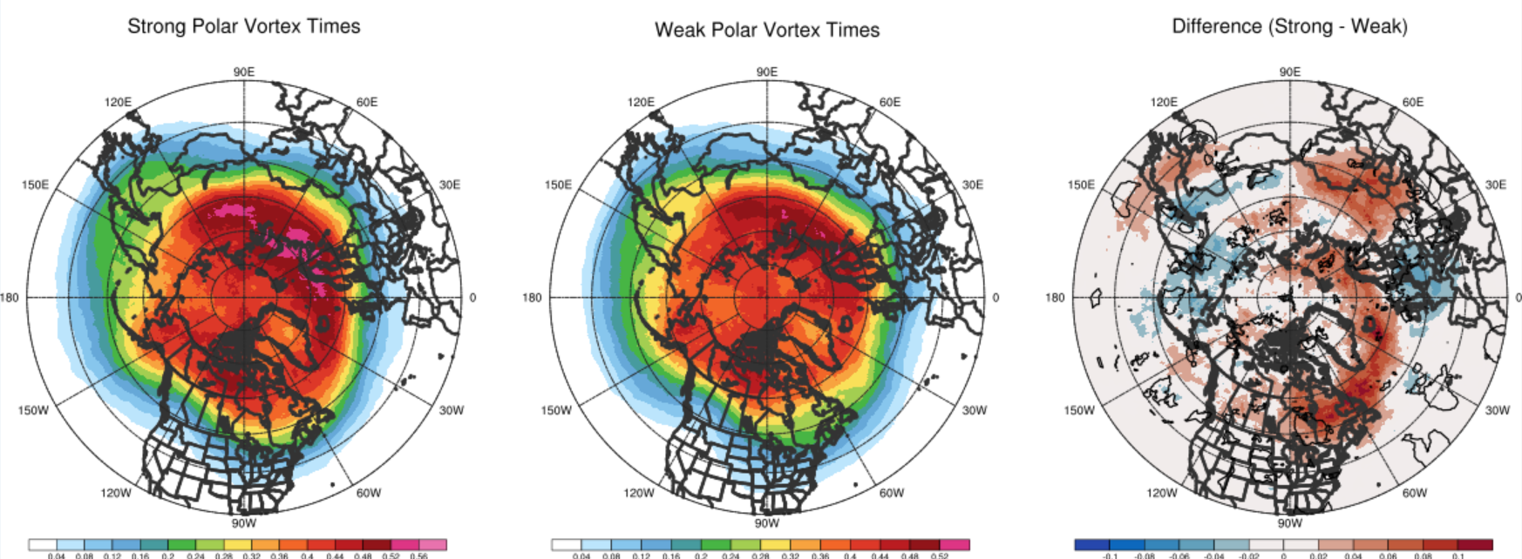

Slide 4
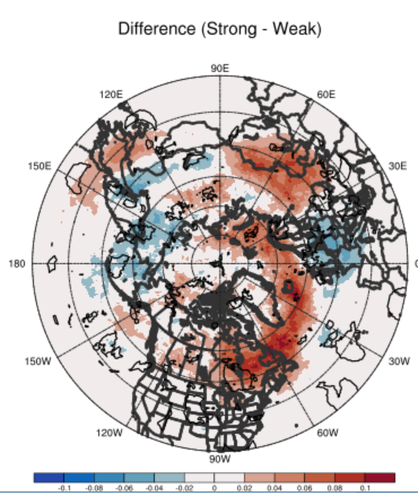
Why?
Hypothesis:
Vertical shear is detrimental to the lifespan of TPVs (similar to that of a tropical cyclone).
Less shear during strong polar vortex cases?

