Slide 1
Using the ESRL Physical Sciences Division Map Room + Other Climate Maps
ATM305
Global Physical Climatology
19 September 2017
Matthew Vaughan & Philippe Papin

Slide 2
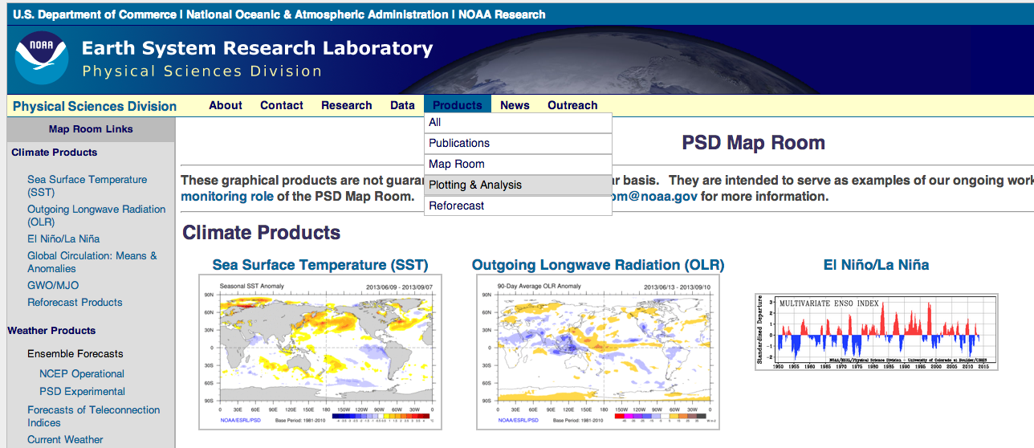
Step One
Go to the following URL
http://www.esrl.noaa.gov/psd/map/
For the purposes of this class lets go to Plotting/Analysis under the Products Section

Slide 3
Step 2
For the first example, lets just plot the anomalous 850 hPa temperatures over the North America during March 2012
Click on the first link (Monthly/Seasonal Mean Composites)
Next, you have to set up the options to create the plot (make adjustments to options in red boxes)

Slide 4
Step 2 Cont.
And Plot!

Slide 5
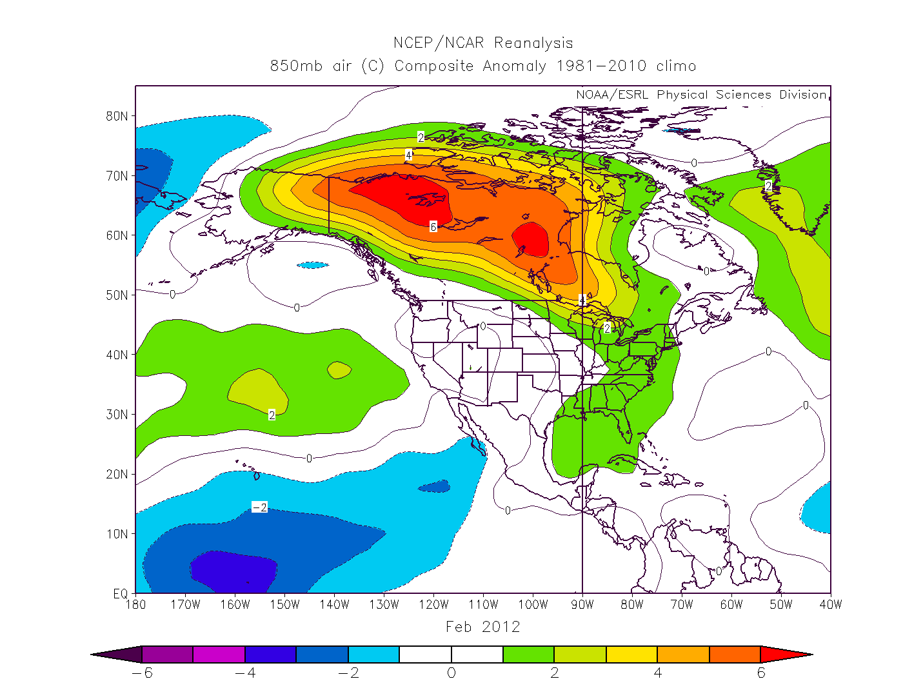
End Map

Slide 6
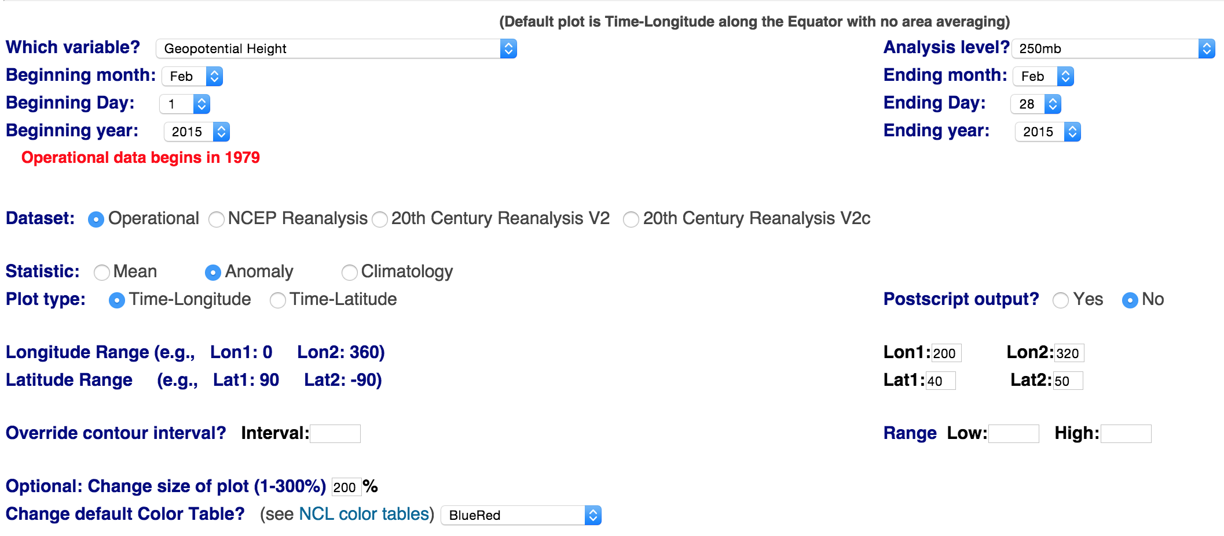
Step 3
Lets Make a Time-Longitude Plot (Hovmöller)
Click on the link (Time-section Plots)
Next, you have to set up the options to create the plot (make adjustments to options in red boxes)

Slide 7
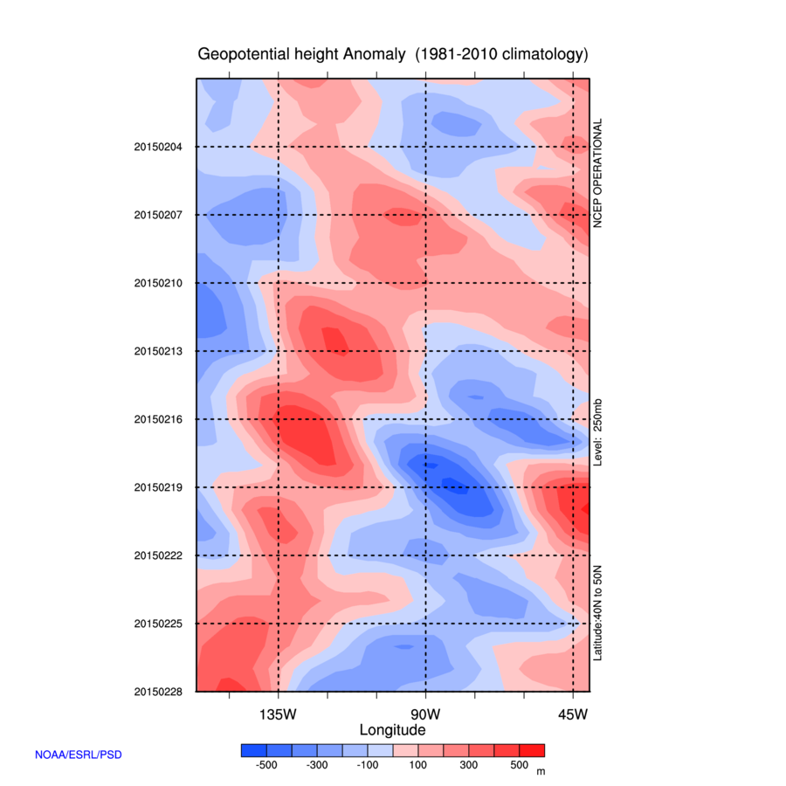
End Map
Try other fields (e.g., temperature, meridional wind) at different pressure levels (e.g., 500-hPa, 850-hPa)

Slide 8
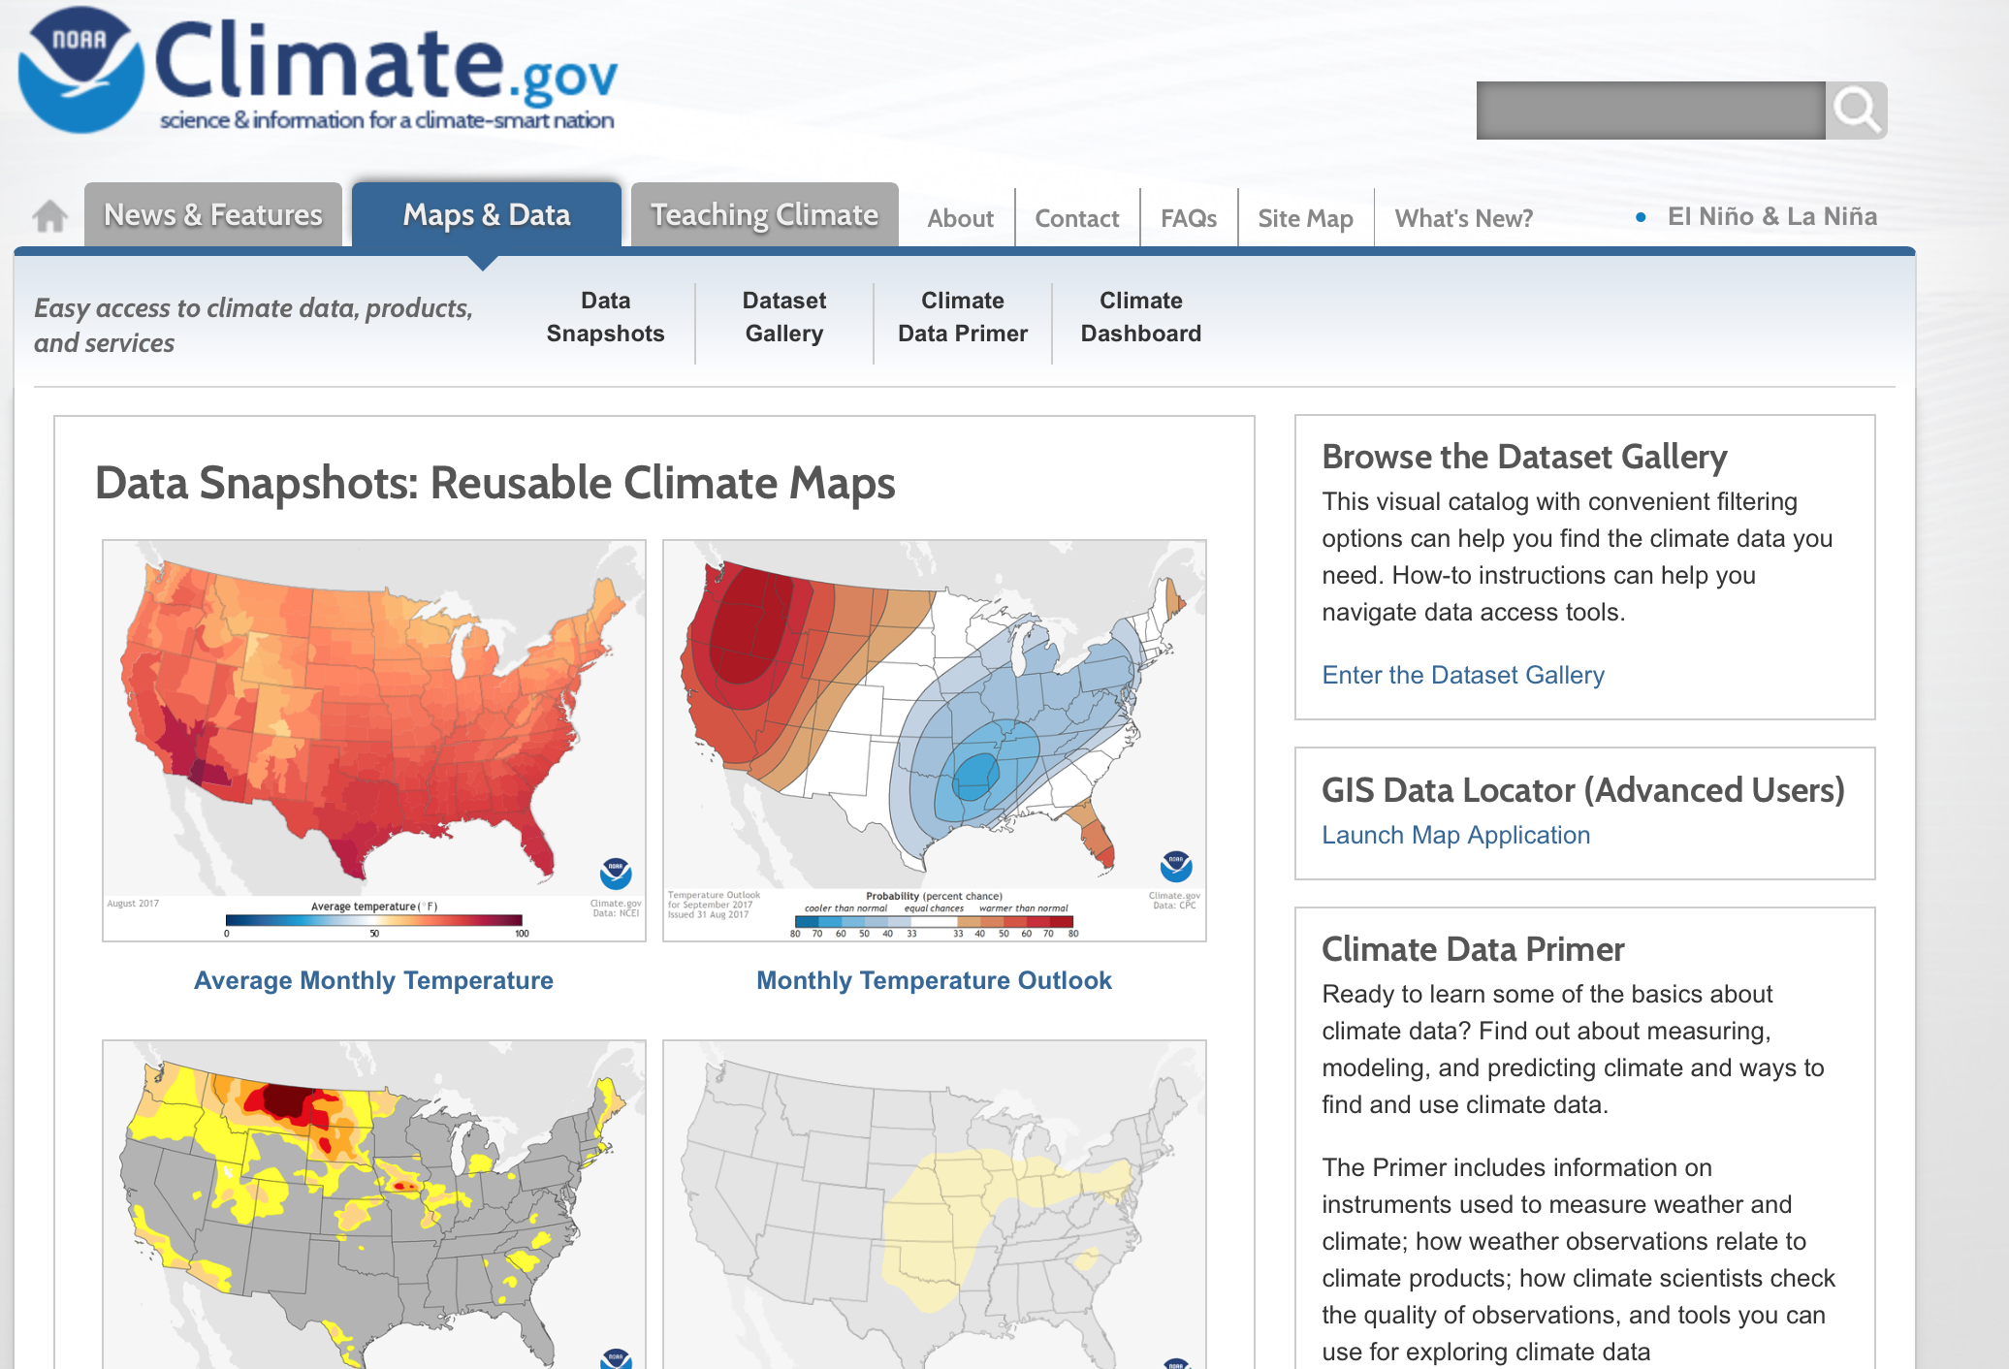
Other Websites
NOAA Climate (https://www.climate.gov/maps-data)

Slide 9
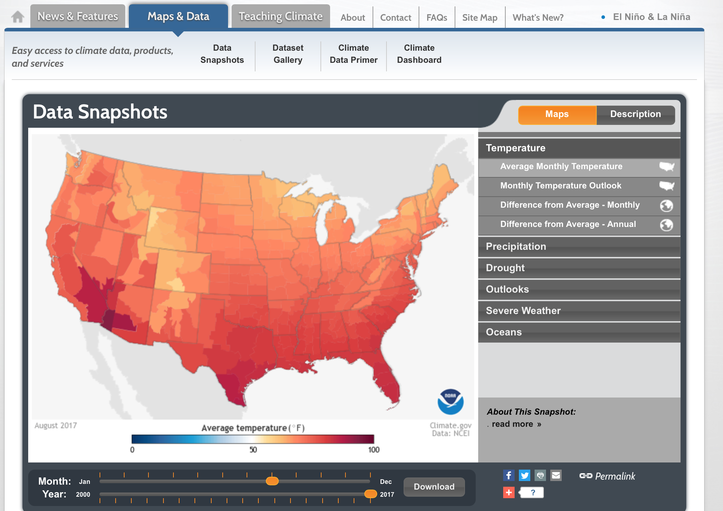
Example
SST Anomaly Map

Slide 10
Example
SST Anomaly Map
For “hard numbers”

Slide 11
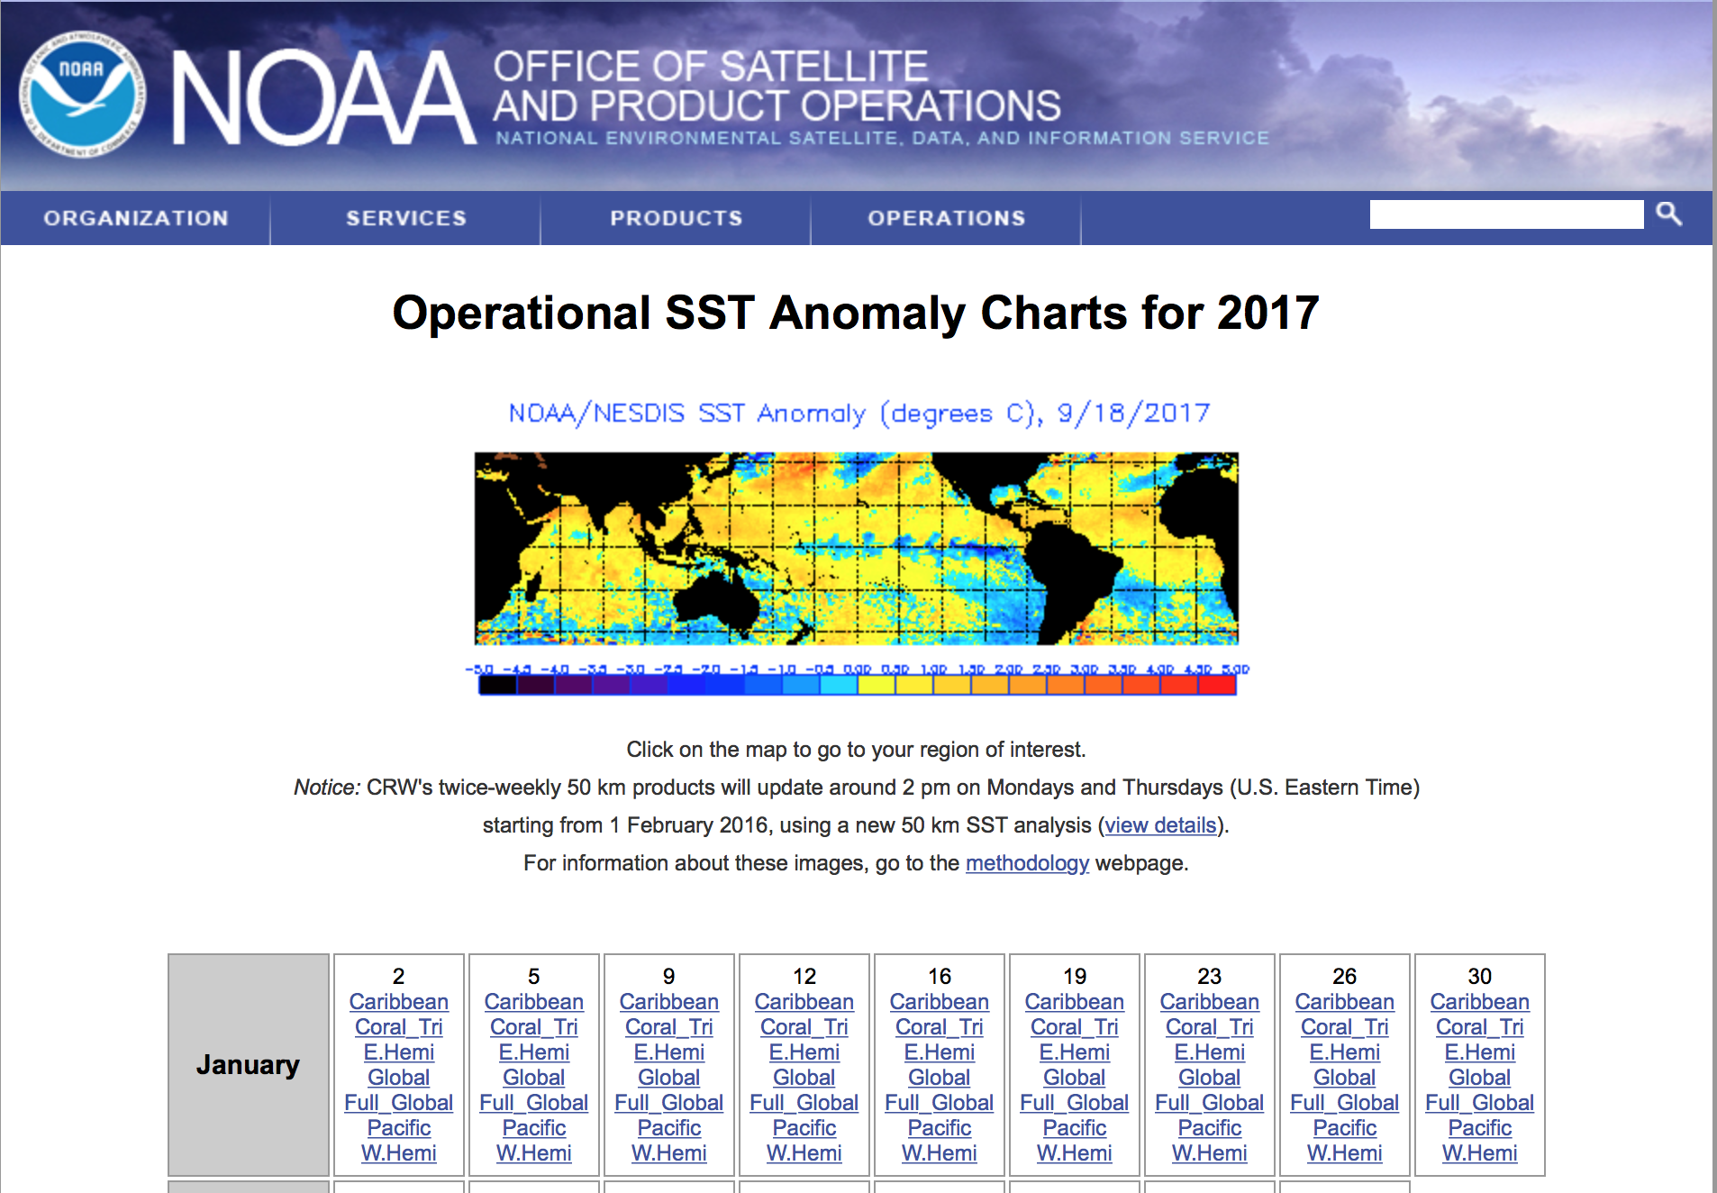
Example
SSTs continued (http://www.ospo.noaa.gov/Products/ocean/sst/anomaly/)

Slide 12
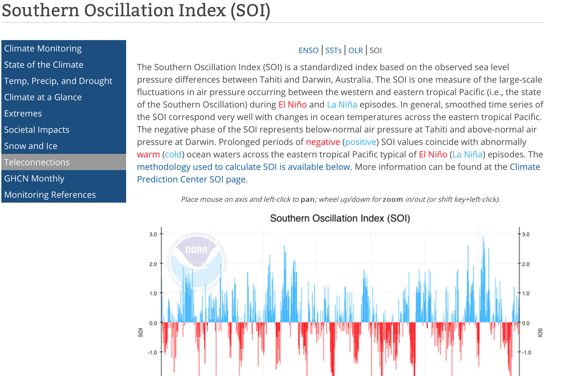
Example
ENSO (SOI) (https://www.ncdc.noaa.gov/teleconnections/enso/indicators/soi/)
Dynamic graph. Hard numbers below

Slide 13
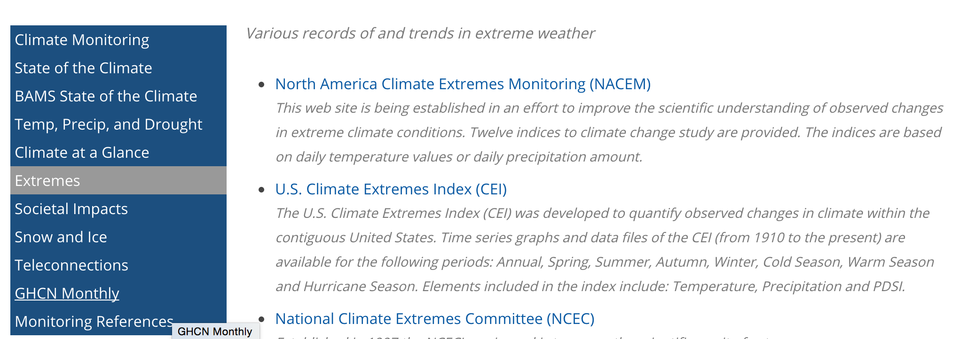
Example
Extremes
http://www.ncdc.noaa.gov/extremes/

Slide 14
Example
Extremes
http://www.ncdc.noaa.gov/extremes/

Slide 15
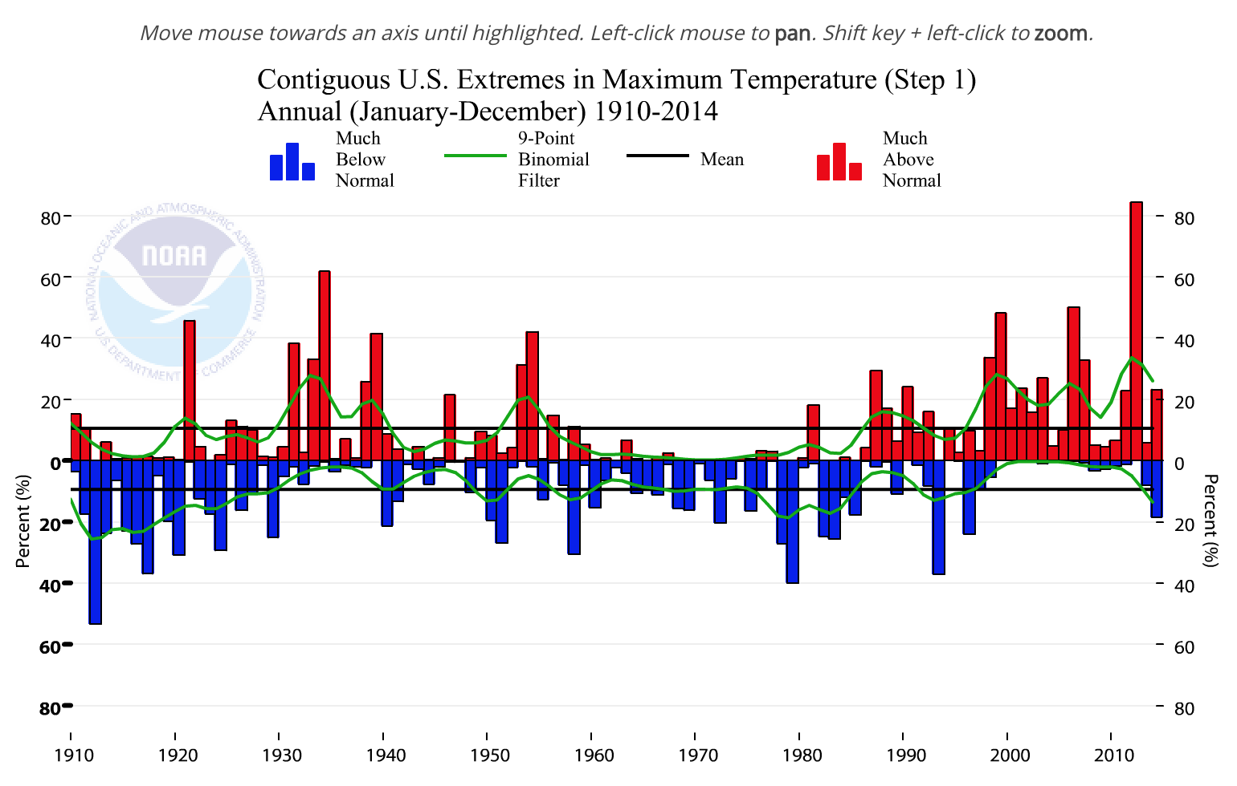
Example

Slide 16
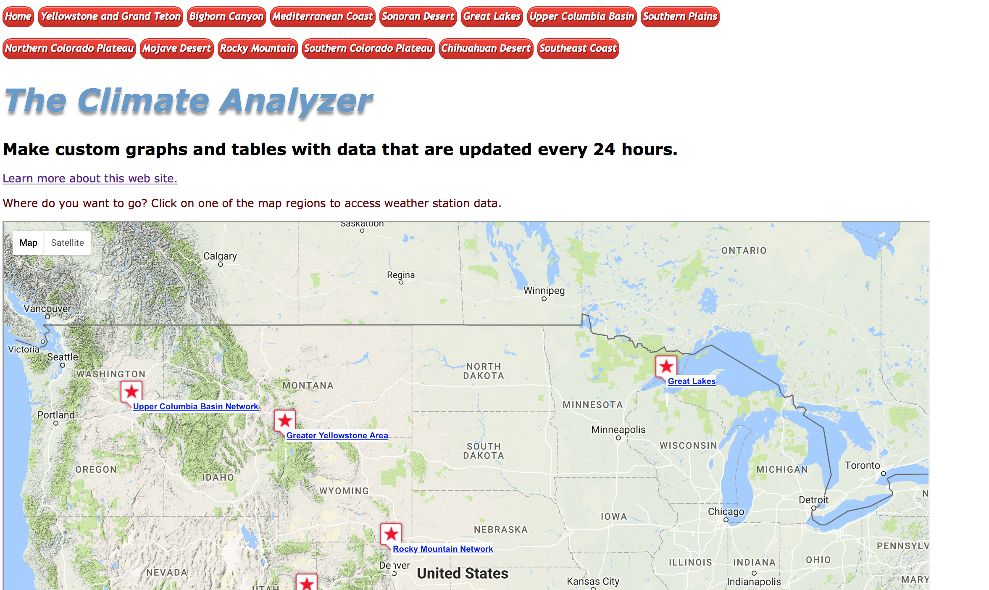
Climateanalyzer.org
Good for:
Station data in Western CONUS put in a climate perspective
Note: COOP stations (red stars) generally have the most usable date. Click stations

Slide 17
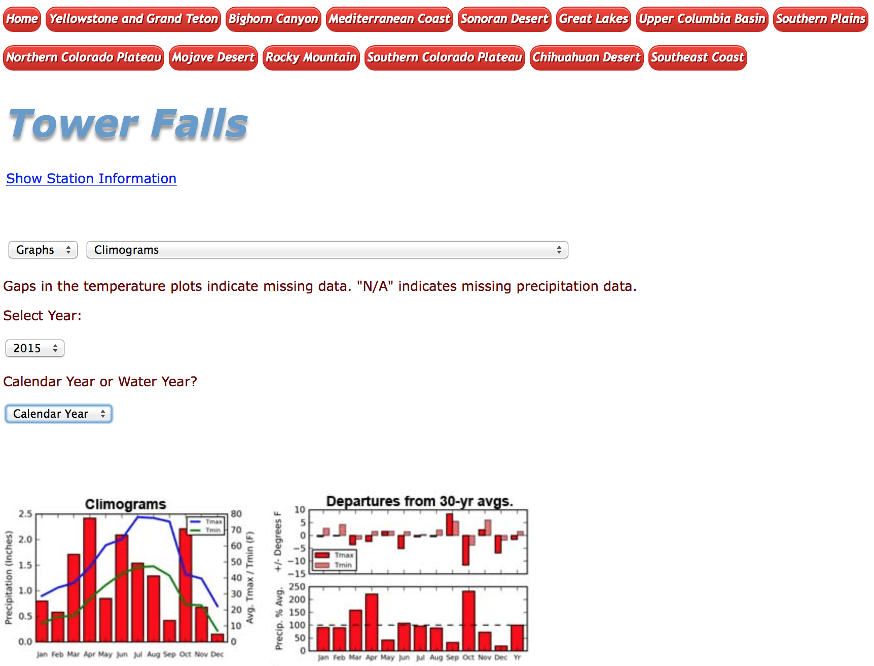
Climateanalyzer.org
Climograms, departures, and trends pretty useful
Dynamic webpage. Don’t be alarmed if option menus don’t appear immediately.

Slide 18
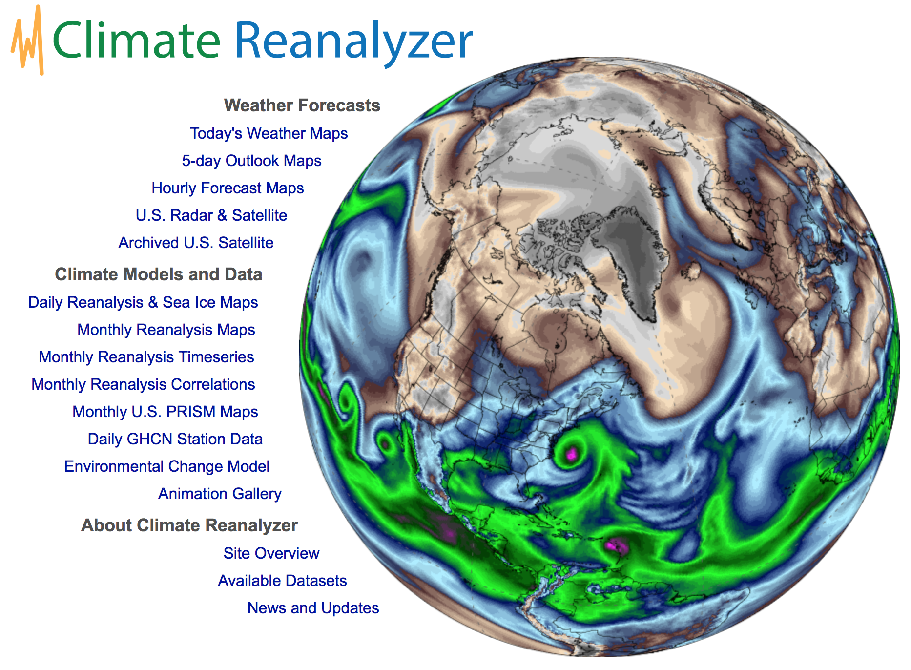
http://cci-reanalyzer.org
Good for:
Model data from a variety of reanalysis datasets
Highly recommended. Beautiful images. Powerful processing.
One stop shop

Slide 19
Other Relevant Links
Archive Weather Data
http://www2.mmm.ucar.edu/imagearchive/ (Radar Archive 1996 – present)
http://www.spc.noaa.gov/exper/ma_archive/index2.html (RUC/RAP archive 2005-present)
http://archive.atmos.colostate.edu/ (Weather Map Archive from CSU)
http://weather.uwyo.edu/upperair/ (Wyoming’s Upper-air sounding archive 1973 – present)
http://www.ncdc.noaa.gov/data-access/weather-balloon/integrated-global-radiosonde-archive (text upper-air sounding archive)
http://mesowest.utah.edu/ (good surface observation archive 2002 – present)
http://vortex.plymouth.edu/upairwx-u.html (plot your own maps)
http://coast.noaa.gov/hurricanes/?redirect=301ocm (query search for tropical cyclone tracks)
http://droughtmonitor.unl.edu/MapsAndData/WeeklyComparison.aspx (drought map comparison 2000 - present)
http://www.climateanalyzer.org/ (Plot climate station data for select locations in the CONUS)
http://cci-reanalyzer.org (Nifty NCL plots using various reanalysis products)

Slide 20
Goal For Rest of Class
Continue to make maps picking your favorite synoptic event
i.e., (1993 Superstorm)
I’ll come around and see what everyone is doing and help those that are having difficulty

