Slide 1
Subtropical Potential Vorticity Streamer Formation and Variability in the North Atlantic Basin
Philippe Papin, Lance F. Bosart, Ryan D. Torn
AMS Annual Meeting
13 January 2015

Slide 2
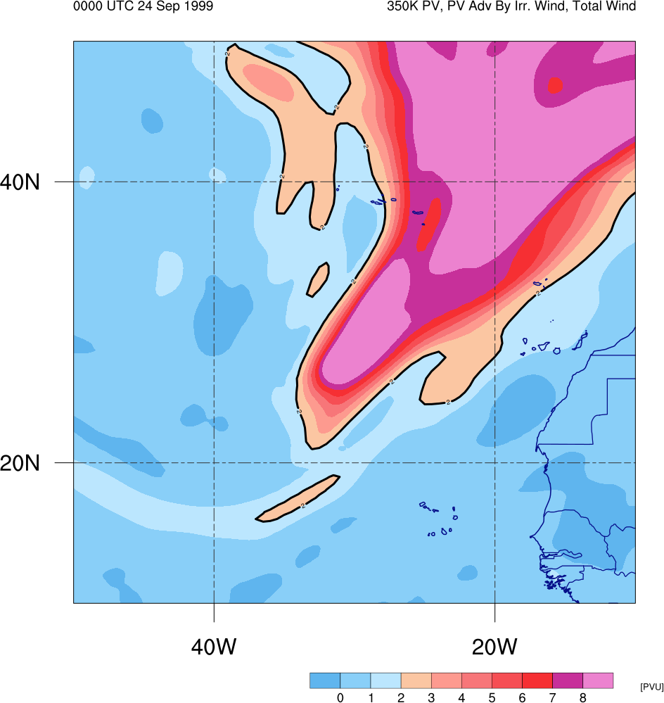
Motivation
Subtropical Potential Vorticity (PV) streamer
    An elongated filament of high PV air
Can occur in conjunction with:
  Tropical cyclones (TCs)
  Other extreme weather events
Formation via Rossby wave breaking (RWB)
Contribute to formation of Mid-Ocean troughs (MOTs ; McTaggart-Cowan et al. 2013)
0000 UTC 24 Sep 1999
350-K PV (color shading, PVU)

Slide 3
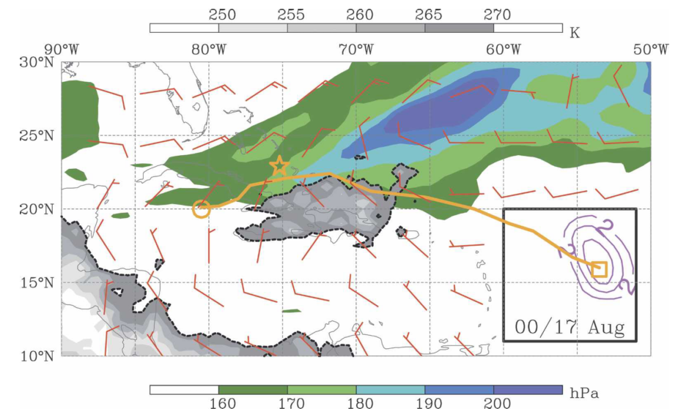

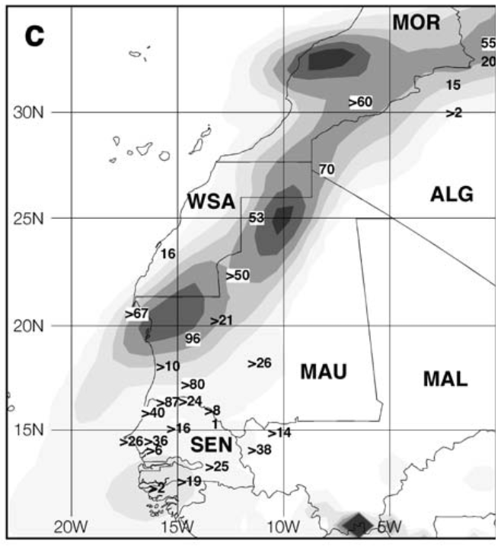
Motivation
Subtropical Potential Vorticity (PV) streamer
    An elongated filament of high PV air
Can occur in conjunction with:
  Tropical cyclones (TCs)
  Other extreme weather events
Formation via Rossby wave breaking (RWB)
Contribute to formation of Mid-Ocean troughs (MOTs ; McTaggart-Cowan et al. 2013)
TC Katrina genesis point
17-23 Aug 2005
Adapted from Fig. 2 of McTaggart-Cowan et al. (2007)
20-24 Oct 2003
> 100 mm
Adapted from Fig. 1 of Knippertz and Martin (2005)

Slide 4
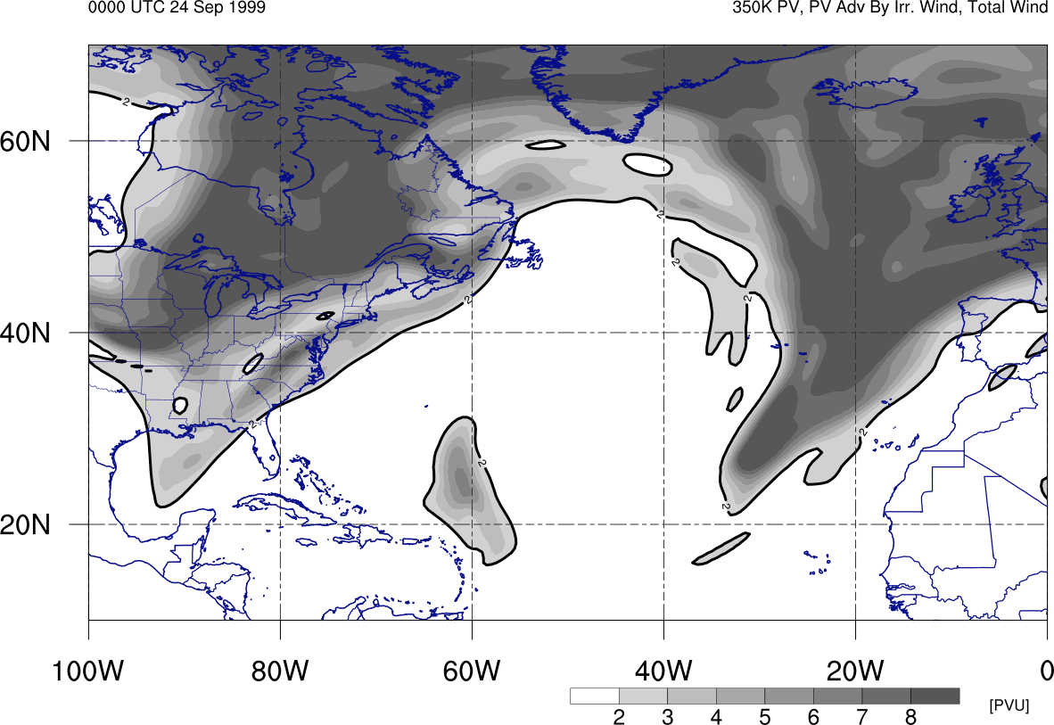
Motivation
Subtropical Potential Vorticity (PV) streamer
    An elongated filament of high PV air
Can occur in conjunction with:
  Tropical cyclones (TCs)
  Other extreme weather events
Formation via Rossby wave breaking (RWB)
Contribute to formation of Mid-Ocean troughs (MOTs ; McTaggart-Cowan et al. 2013)
0000 UTC 24 Sep 1999
RWB
350-K PV (gray shading, PVU)

Slide 5
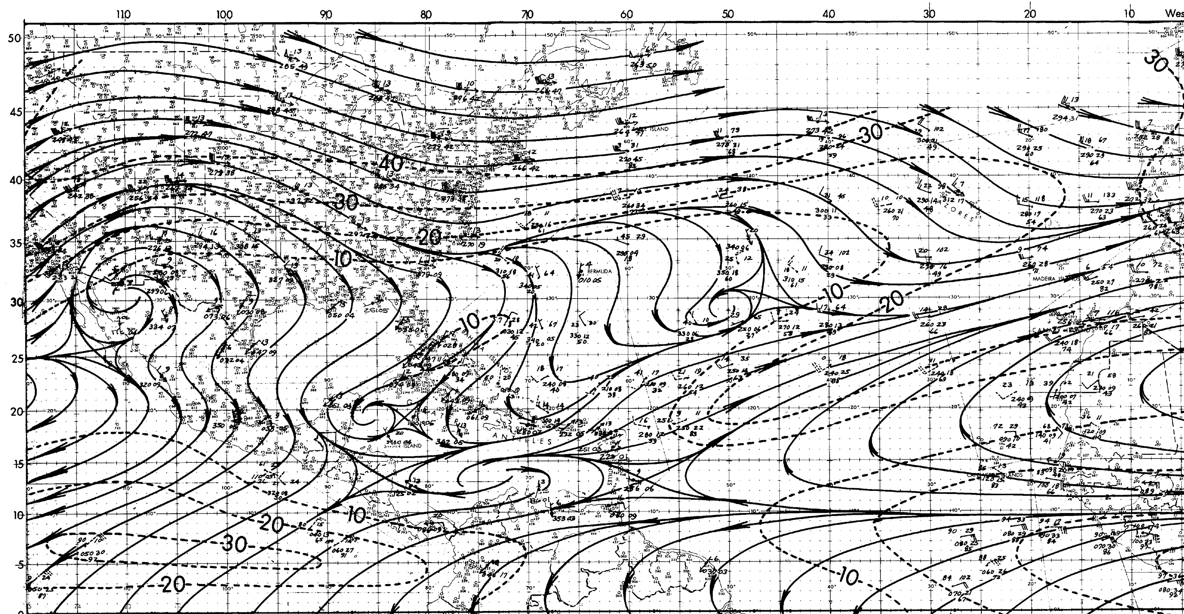
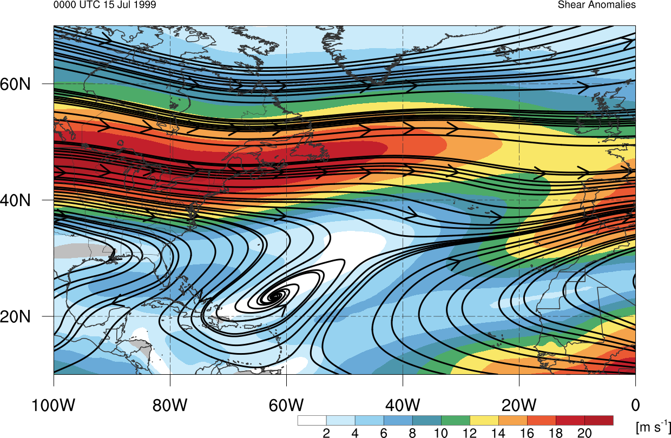
Motivation
200-hPa Streamlines and Winds
August Climatology
Subtropical Potential Vorticity (PV) streamer
    An elongated filament of high PV air
Can occur in conjunction with:
  Tropical cyclones (TCs)
  Other extreme weather events
Formation via Rossby wave breaking (RWB)
Contribute to formation of Mid-Ocean troughs (MOTs ; McTaggart-Cowan et al. 2013)
Adapted from Sadler (1975)
CFSR Climatological 150-hPa Streamlines: 15 Jul

Slide 6
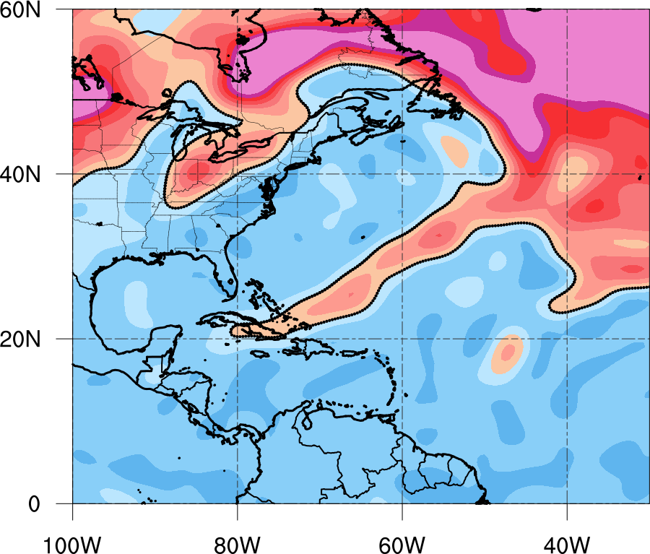
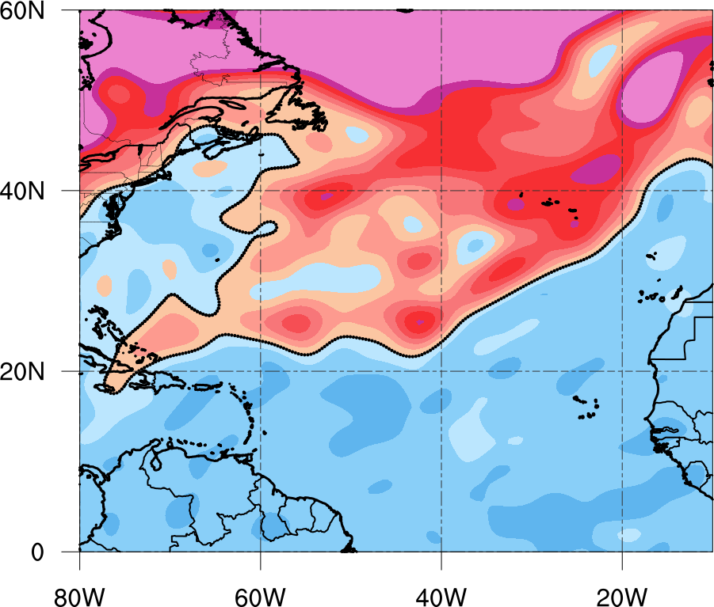
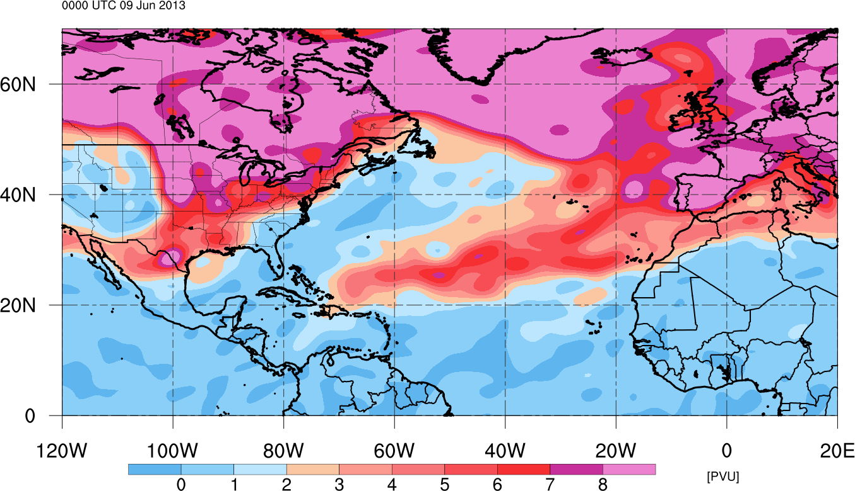
Motivation
PV streamers occur on a variety of sizes and intensities
Changes in these characteristics often affect
  Vertical Wind Shear (VWS) corridors
  Moisture anomalies
  Affect TC activity
0000 UTC 1 Sep 2005
0000 UTC 3 Sep 2013
Small and Weak
Large and Intense

Slide 7
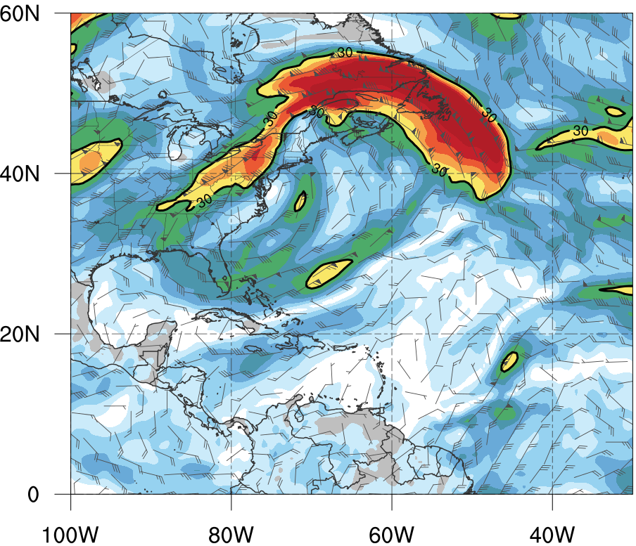
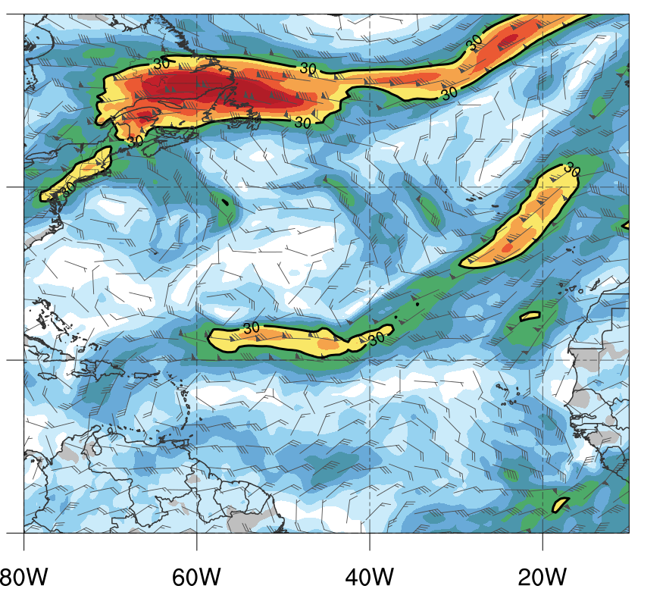
Motivation
PV streamers occur on a variety of sizes and intensities
Changes in these characteristics often affect
  Vertical Wind Shear (VWS) corridors
  Moisture anomalies
  Affect TC activity
0000 UTC 1 Sep 2005
0000 UTC 3 Sep 2013

Slide 8
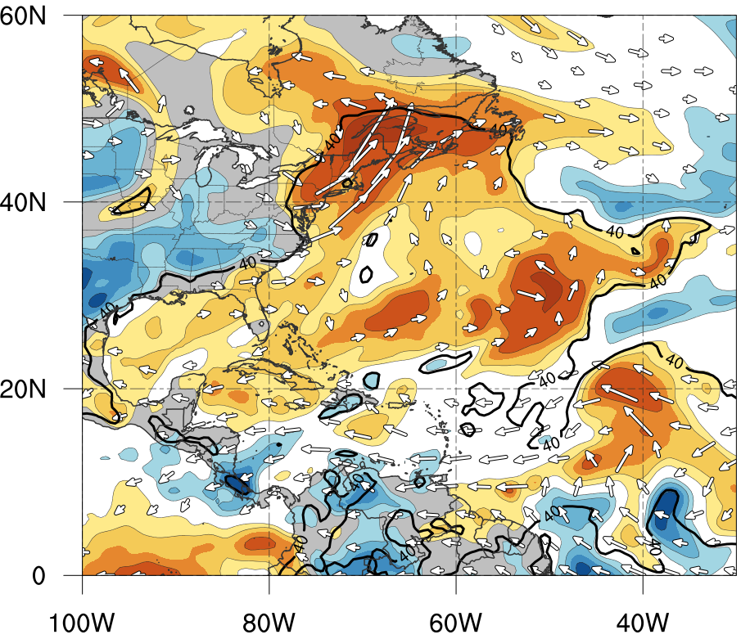
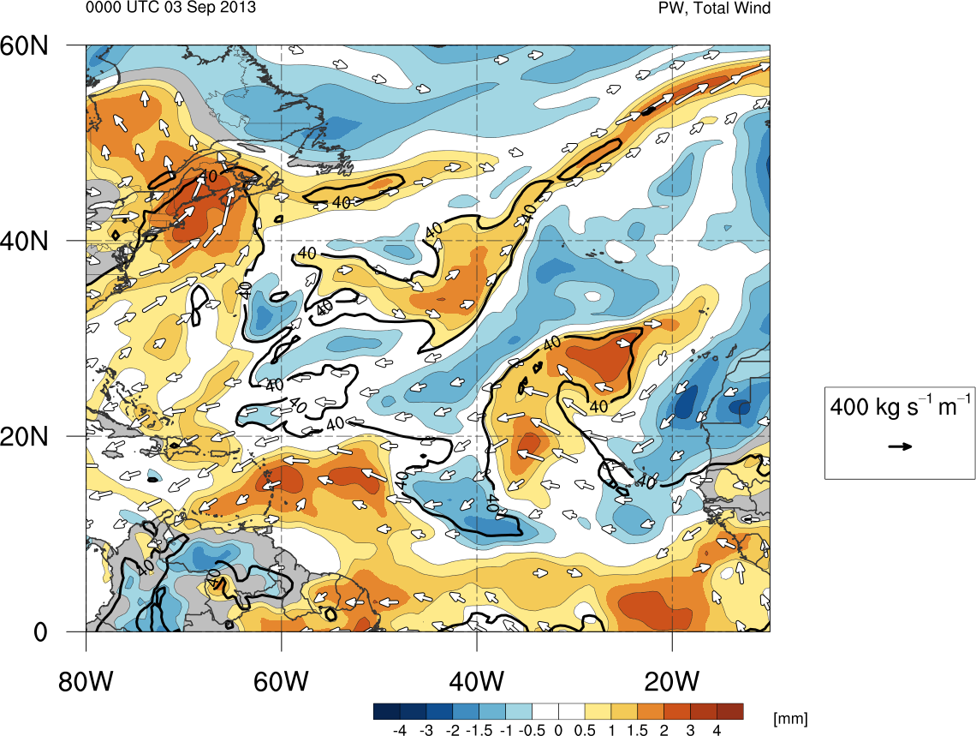
Motivation
PV streamers occur on a variety of sizes and intensities
Changes in these characteristics often affect
How do these environments change with year to year differences in number, size, and intensity of these PV streamers?
  Hasn’t yet been addressed
  Vertical Wind Shear (VWS) corridors
  Moisture anomalies
  Affect TC activity
0000 UTC 1 Sep 2005
0000 UTC 3 Sep 2013

Slide 9
Objectives
Create a new climatology of PV streamers in the North Atlantic basin emphasizing differences in size and intensity
  Dataset: Climate Forecast System Reanalysis (CFSR)
Investigate preliminary results and interannual variability in statistics
  Size, intensity, and spatial distribution
Investigate relationship between PV streamer activity and TC activity if it exists
  How do different modes of TC activity change annually due to changes in PV streamer activity?

Slide 10
PV Streamer Identification
Combine previous methodologies to identify PV streamer areas directly linked to RWB
  Postel and Hitchman (1999)
  Wernli and Sprenger (2007)
Use isentropic surface that represents subtropical tropopause in warm Season
  PV on the 350 K surface
  Calculate intensity of PV streamer as standardized PV anomaly
Identification algorithm run from 1979-2014 at 24 h increments
  CFSR (CFSRv2 after 2010)

Slide 11
PV Streamer Identification Steps
Employ similar methodology to Postel and Hitchman (1999)
  Spectral truncation to 2.5º x 2.5º resolution
  Search for poleward reversal in meridional PV along a 2 PVU contour
  Neglect secluded areas of PV > 2 PVU
    Often originating from subtropical PV streamers
    Will include at a later time

Slide 12
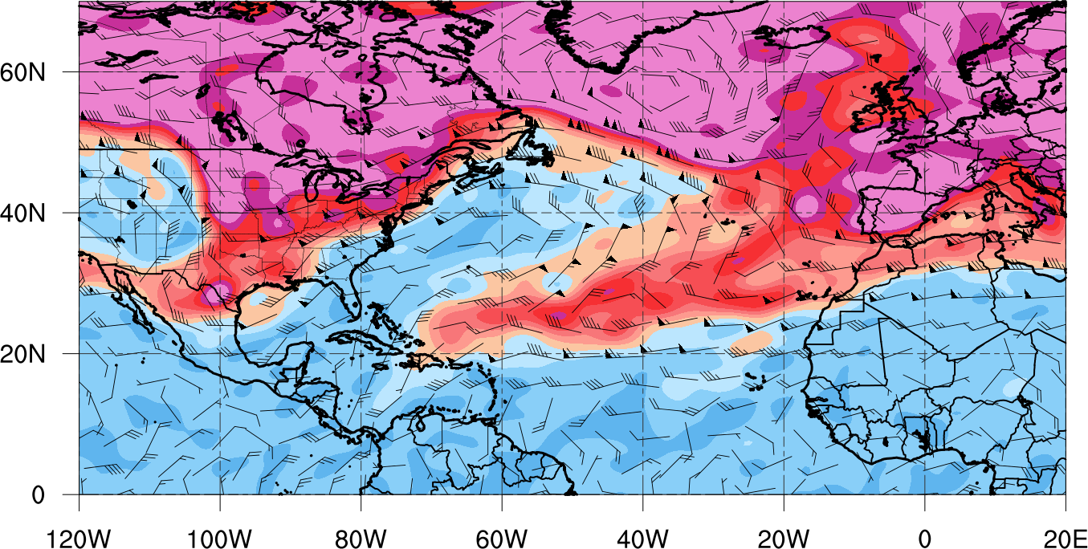
PV Streamer Identification Steps
350-K PV (shaded, PVU), and winds (barbs, kt)
0000 UTC 9 Jun 2013

Slide 13

PV Streamer Identification Steps
350-K PV (shaded, PVU), and winds (barbs, kt)
0000 UTC 9 Jun 2013

Slide 14
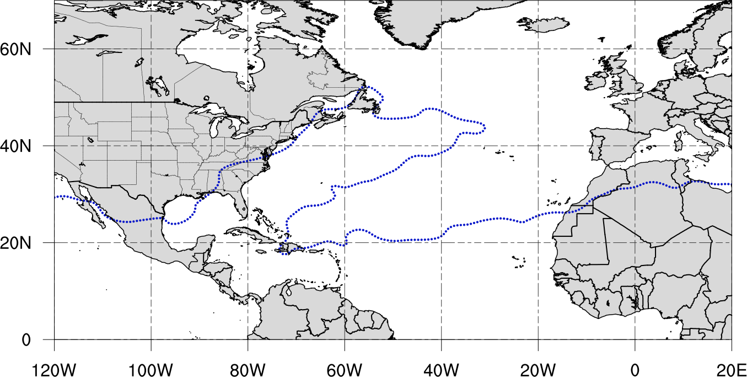
PV Streamer Identification Steps
2 PVU contour on the 350-K Surface (blue dotted contour)
0000 UTC 9 Jun 2013

Slide 15
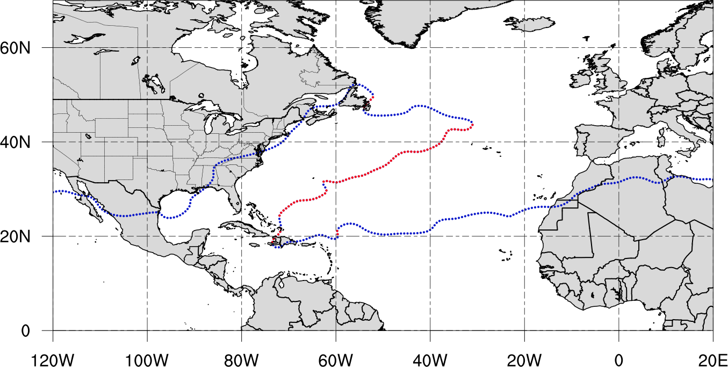
PV Streamer Identification Steps
2 PVU contour on the 350-K Surface (blue dotted contour)
Points along contour where meridional PV gradient reversal is observed (red dotted contour)
0000 UTC 9 Jun 2013
Points along contour where meridional PV gradient reversal is observed

Slide 16
PV Streamer Identification Steps
To define PV streamer area, line is drawn perpendicular to initial reversal points along contour
0000 UTC 9 Jun 2013
90º

Slide 17
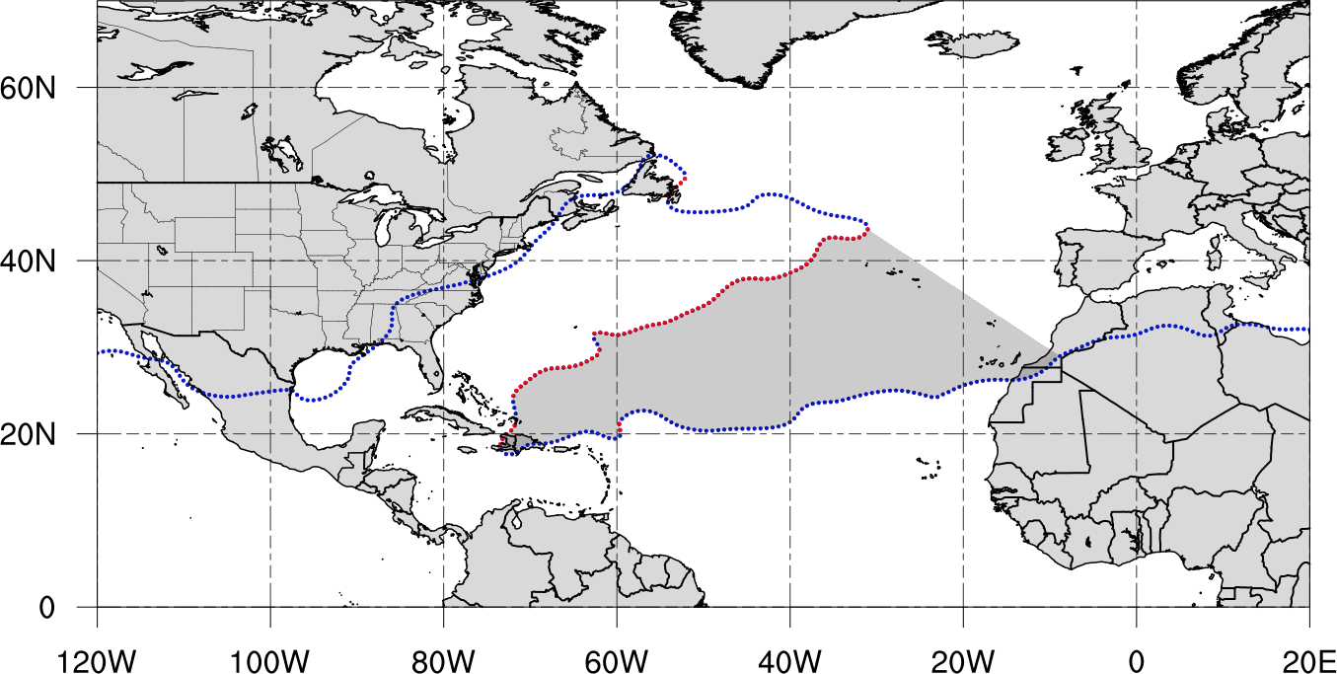
PV Streamer Identification Steps
Candidate PV streamer area (black fill)
0000 UTC 9 Jun 2013
90º

Slide 18
PV Streamer Identification Steps
Adapt methodology of Wernli and Sprenger (2007)
  Calculate width and perimeter of points along PV contour to identify elongated features
    Width → direct spherical distance between two points
    Perimeter → along contour distance between two points
      Old Values: w < 800 km and p > 1500 km
      New Values: w must be less than 1/3 of p and p > 3000 km

Slide 19
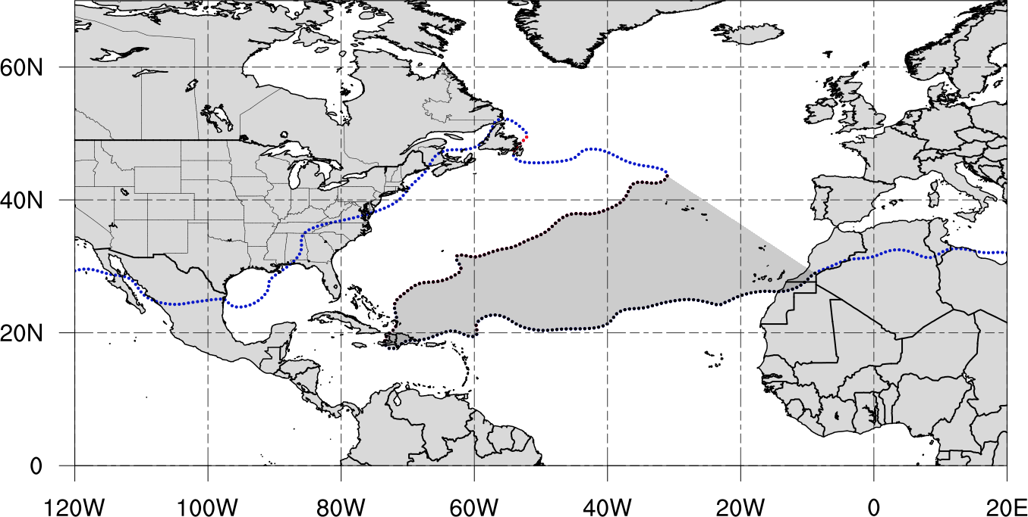
PV Streamer Identification Steps
Candidate PV streamer area (black fill)
0000 UTC 9 Jun 2013
w= 2556 km
Area = 8,569,380 km²
p =12,823 km
Feature is large enough and elongated enough to be considered a PV streamer!

Slide 20
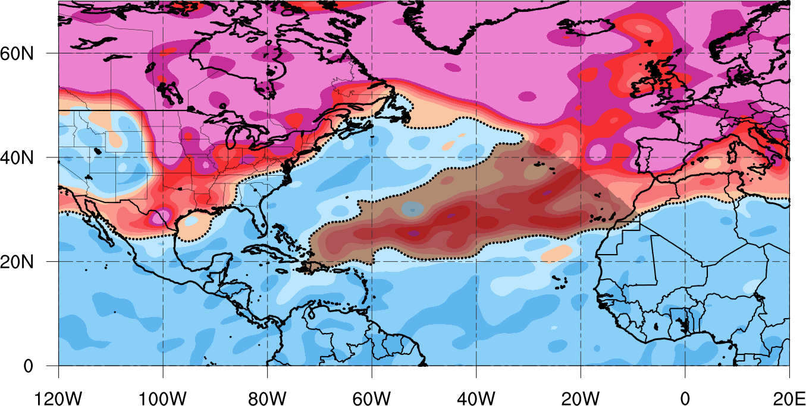
PV Streamer Identification Steps
PV Streamer Intensity
350-K PV (shaded, PVU), and 2-PVU contour (black contour)
0000 UTC 9 Jun 2013
Obtain total PV field for given time

Slide 21
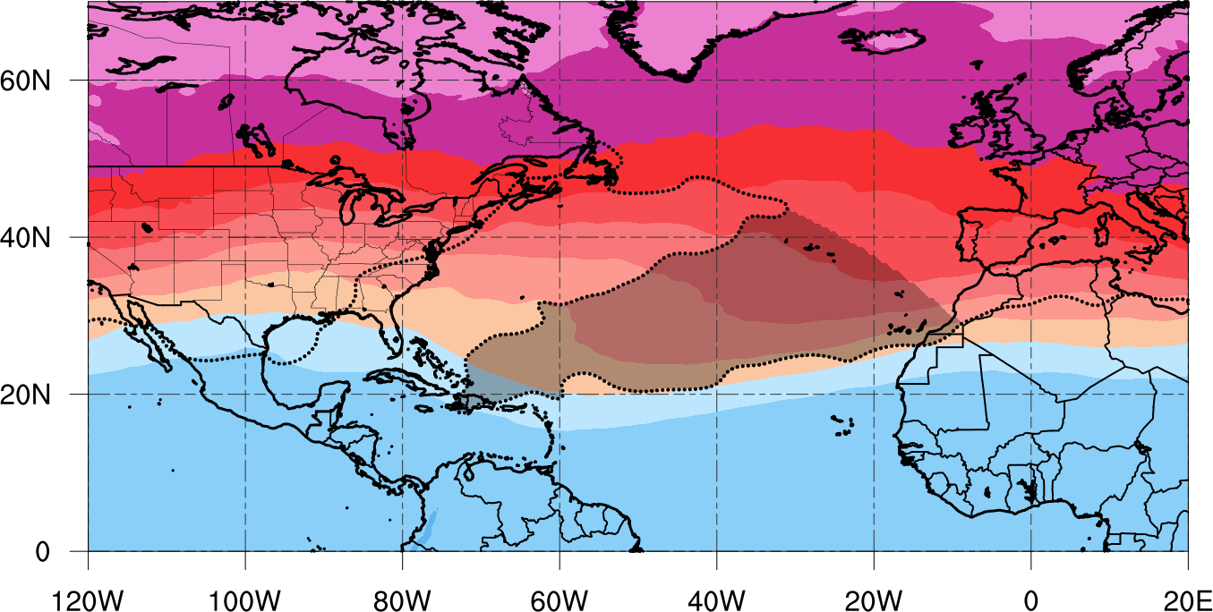
PV Streamer Identification Steps
PV Streamer Intensity
350-K Mean PV (shaded, PVU), and 2-PVU contour (black contour)
0000 UTC 9 Jun 2013
Subtract Mean Climatological PV for given time

Slide 22
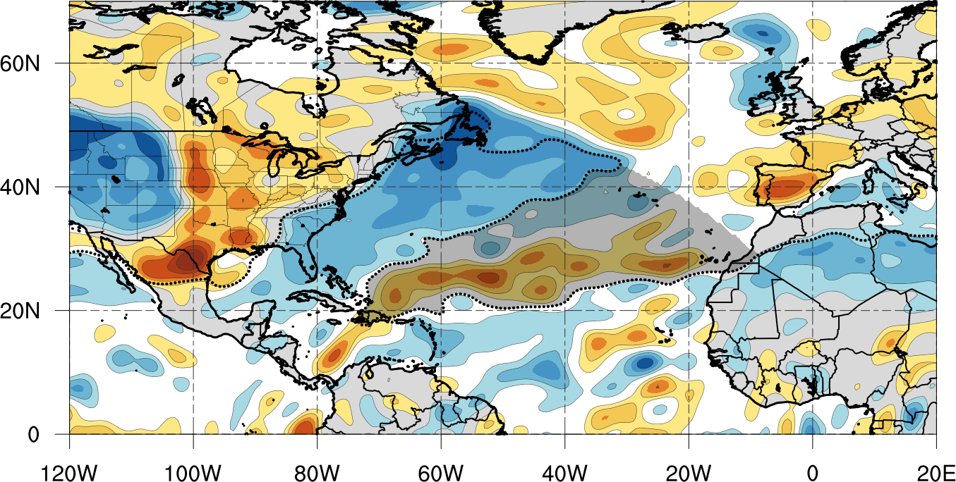
PV Streamer Identification Steps
PV Streamer Intensity
350-K Standardized PV Anomaly (shaded, Sigma), and 2-PVU contour (black contour)
0000 UTC 9 Jun 2013
Average PV Anomaly +0.31 sigma
Divide by Climatological Standard Deviation of PV for given time

Slide 23
Preliminary Results

Slide 24
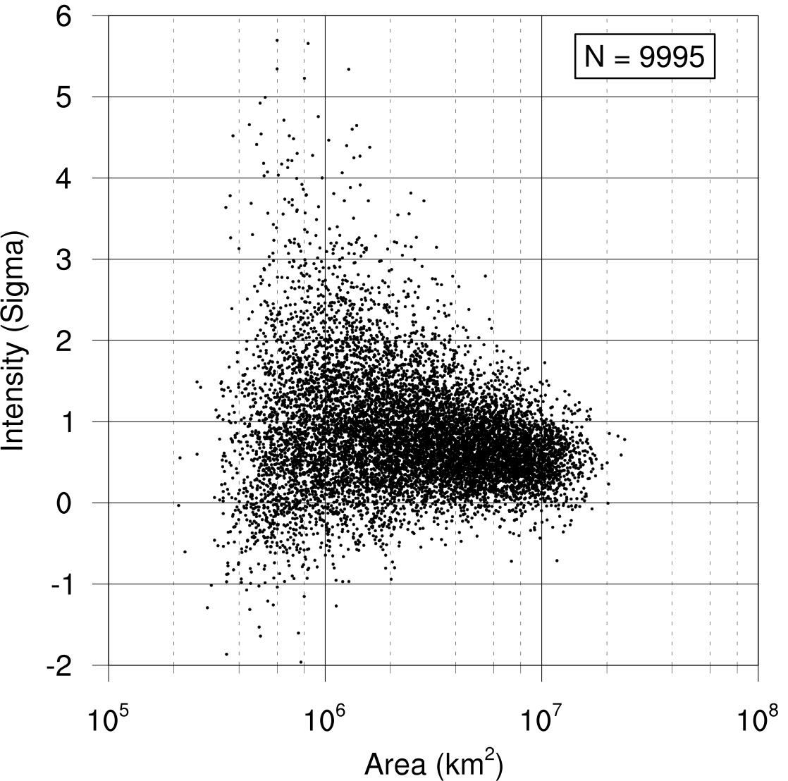
Preliminary Results
1 Jan – 31 Dec
Nearly 10,000 350-K PV streamers identified from 1979-2014
Wide range of sizes and intensities
  In future will composite top and bottom intensity percentiles
Majority of PV streamers occur during TC season (June – Nov)
Significant interannual variability
  1994: larger more intense PV streamers
  1995: smaller less intense PV streamers

Slide 25
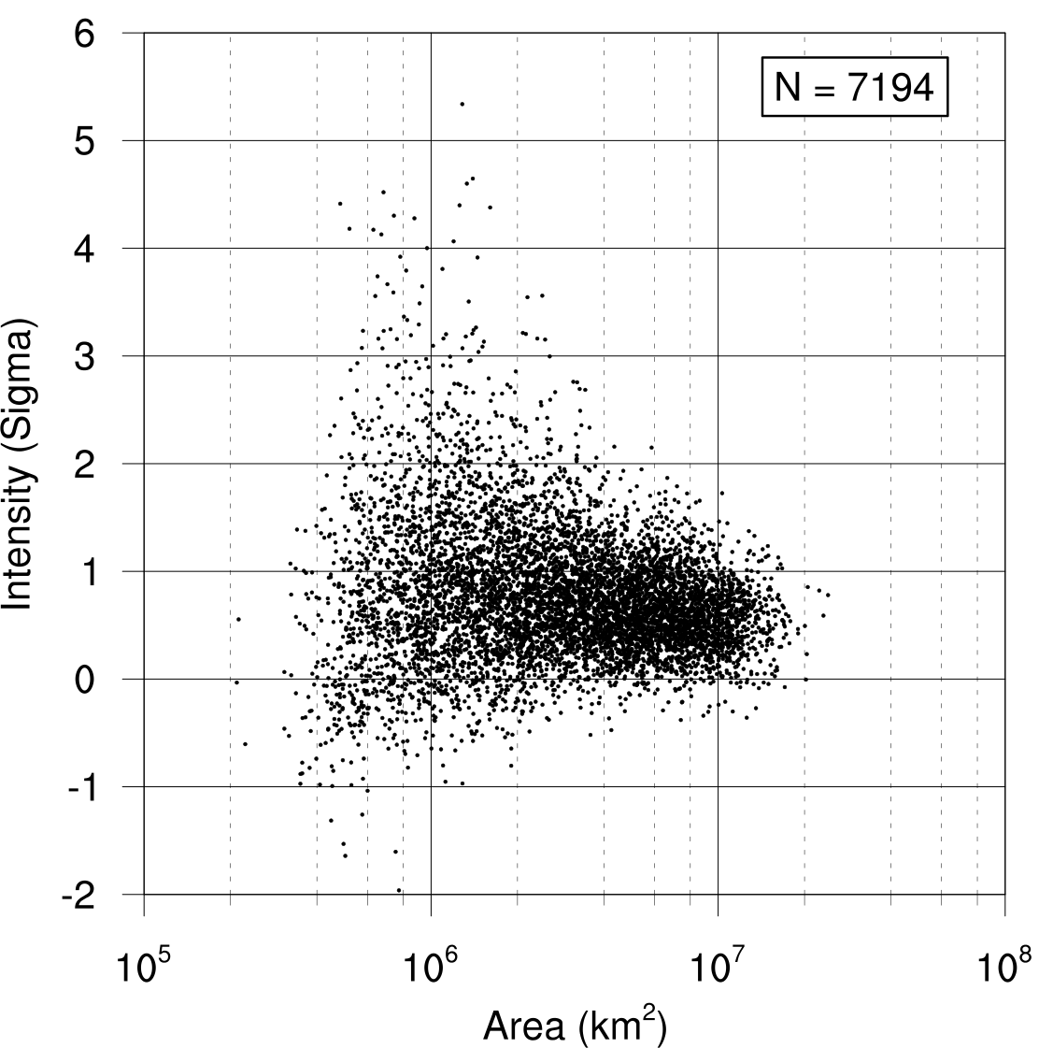
Preliminary Results
1 Jun – 30 Nov
Nearly 10,000 350-K PV streamers identified from 1979-2014
Wide range of sizes and intensities
  In future will composite top and bottom intensity percentiles
Majority of PV streamers occur during TC season (June – Nov)
Significant interannual variability
  1994: larger more intense PV streamers
  1995: smaller less intense PV streamers

Slide 26
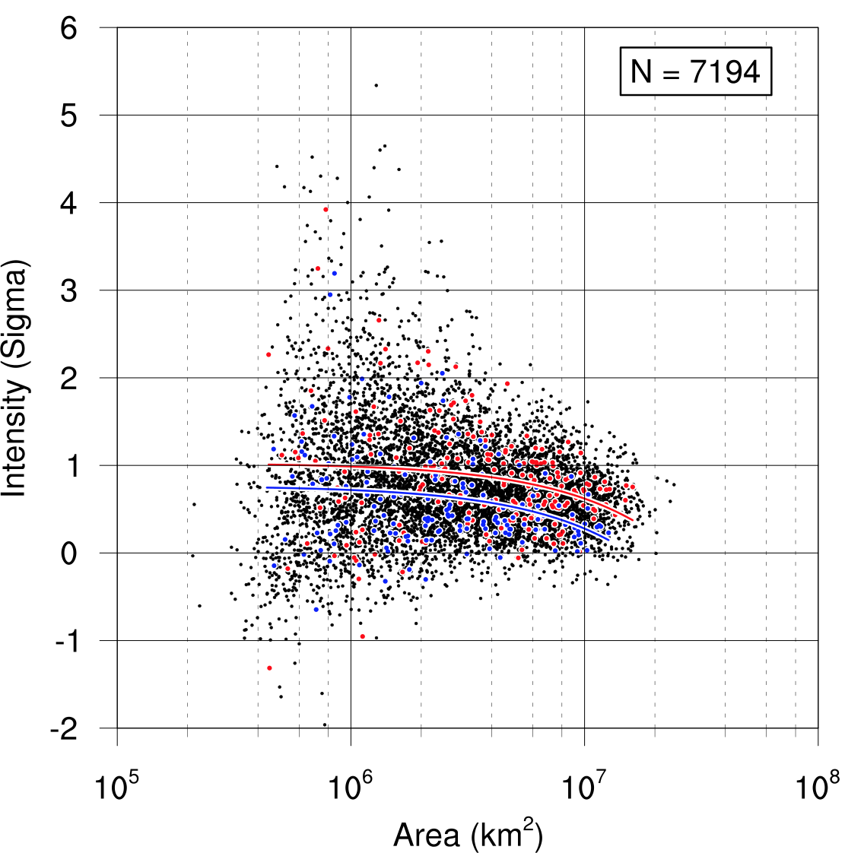
Preliminary Results
1 Jun – 30 Nov
Nearly 10,000 350-K PV streamers identified from 1979-2014
Wide range of sizes and intensities
  In future will composite top and bottom intensity percentiles
Majority of PV streamers occur during TC season (June – Nov)
Significant interannual variability
1994
1995
  1994: larger more intense PV streamers
  1995: smaller less intense PV streamers
Better way to quantify year to year differences in PV streamer activity?
Integrate PV Streamer intensity by area and sum over TC season
“Seasonal PV Streamer Intensity Metric”

Slide 27
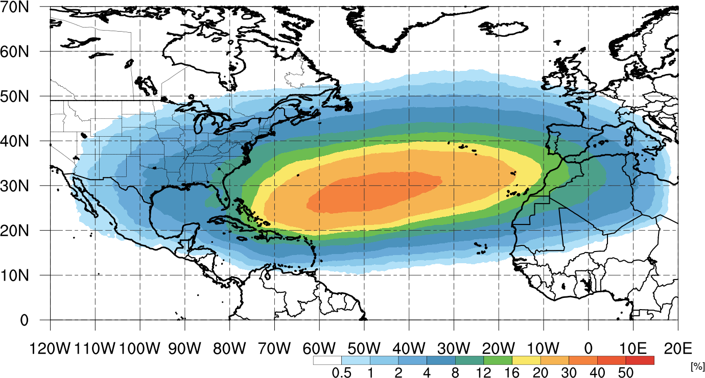
Preliminary Results
PV Streamer Areal Frequency in the North Atlantic
Climatology 1979-2014 (1 Jun – 30 Nov)

Slide 28
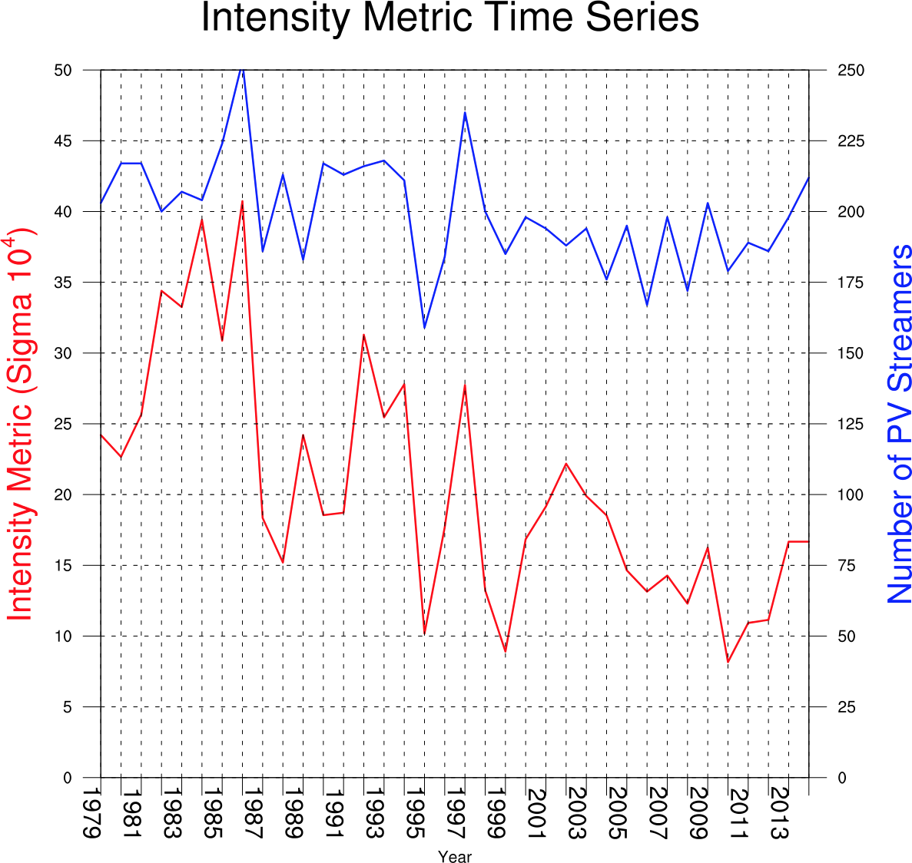
Preliminary Results
1 Jun – 30 Nov
PV streamer activity (1979-2014)
  PV streamer number has changed little in last 35 years
  Seasonal PV streamer intensity has markedly decreased in last 35 years
    Possible connection to climate change?
Relationship to Tropical Cyclones?

Slide 29
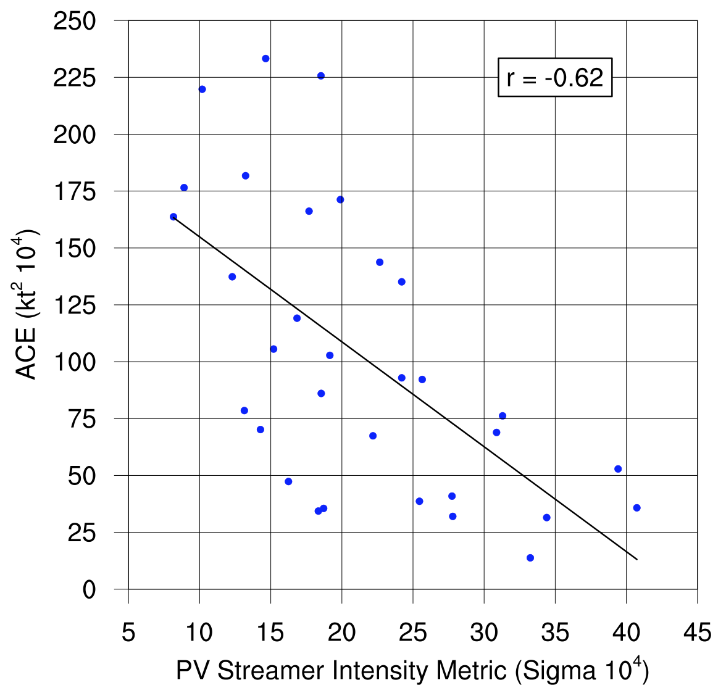
Preliminary Results
PV streamer activity negatively correlated to TC activity
  Larger more intense PV streamers contribute to
    Increase vertical wind shear
    Decrease upstream tropospheric moisture
    Both factors negatively impact TC activity
  Investigate top and bottom 8 TC activity years (in terms of accumulated cyclone energy [ACE])

Slide 30
Preliminary Results
PV streamer activity negatively correlated to TC activity
  Larger more intense PV streamers contribute to
    Increase vertical wind shear
    Decrease upstream tropospheric moisture
    Both factors negatively impact TC activity
  Investigate top and bottom 8 TC activity years (in terms of accumulated cyclone energy [ACE])

Slide 31
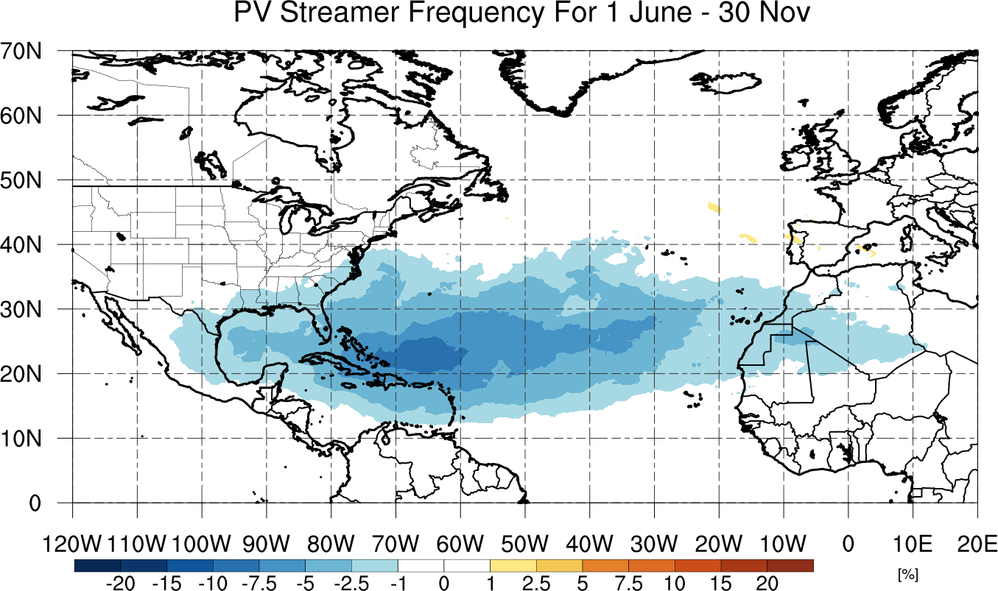
Preliminary Results
Highest 8 years of Accumulated Cyclone Energy
Mean ACE: 157.6 kt² 10⁴

Slide 32
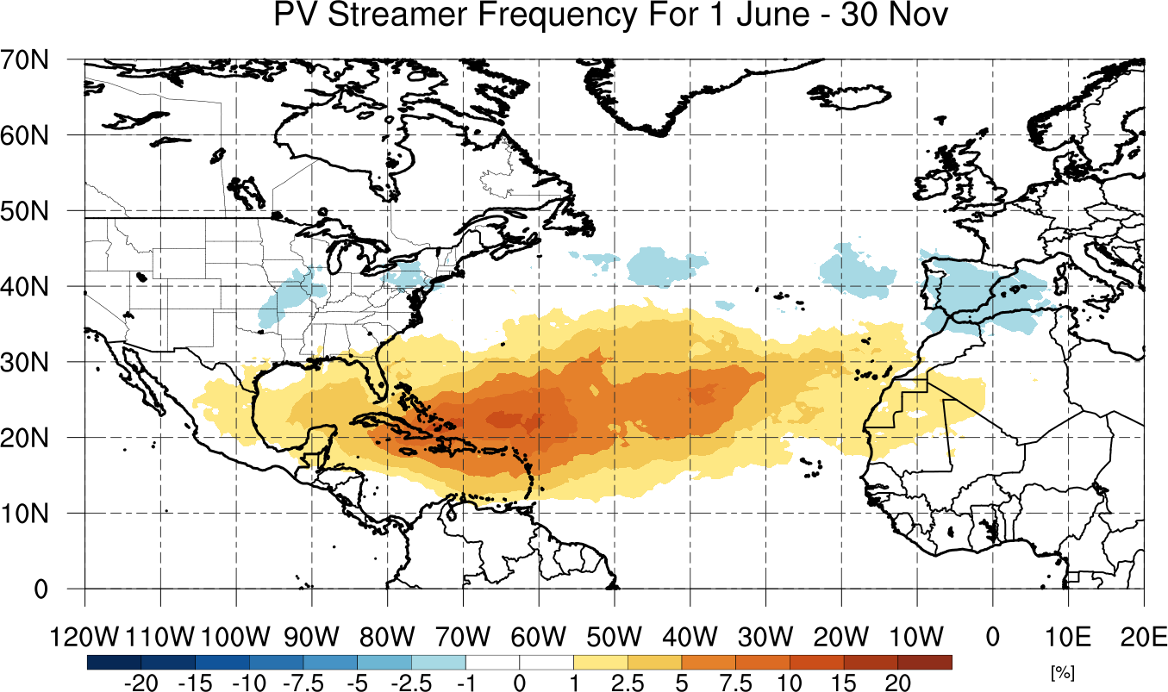
Preliminary Results
Lowest 8 years of Accumulated Cyclone Energy
Mean ACE: 44.0 kt² 10⁴

Slide 33
Conclusions
Created a new PV Streamer climatology
  Links RWB with downstream PV streamers
  Area and Intensity statistics obtained from each PV streamer identified
PV streamers come in a large variety of sizes and intensities
  Decadal trend in decreasing PV streamer activity (in terms of size and intensity) but not number of cases
  Large interannual differences as well
Distinct relationship between PV streamer activity and tropical cyclone activity
  Negative correlation where increased PV streamer activity results in reduced tropical cyclone activity
  Top 8 high and low ACE years reveal expansion and retraction of PV streamer frequency between 10-30ºN in the NATL basin.

Slide 34
Extra Slides

Slide 35
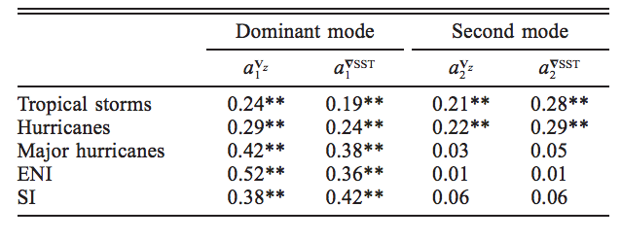
Pick 8 Highest and 8 Lowest PV Streamer Intensity Metric
Plot ENSO?
Plot SSTs?

Slide 36
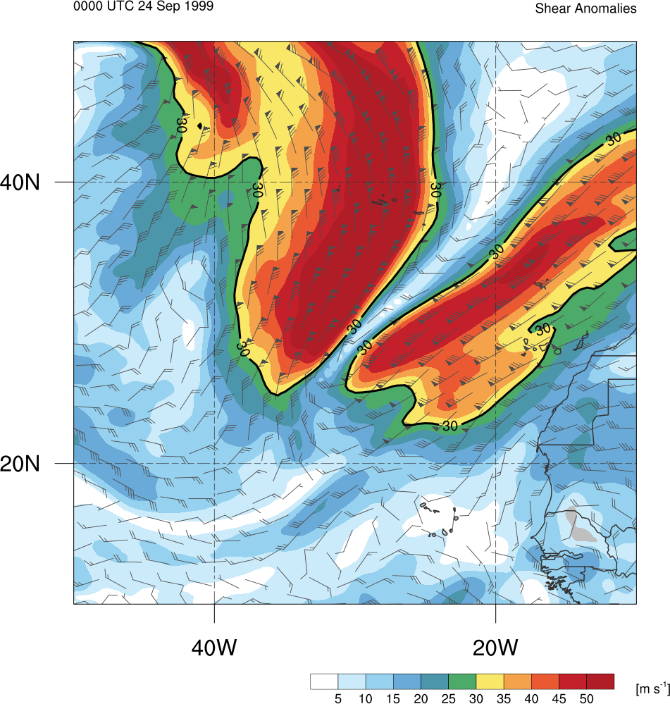
Motivation
Subtropical Potential Vorticity (PV) streamer
    An elongated filament of high PV air
Can occur in conjunction with:
  Vertical Wind Shear (VWS) corridors
  Moisture anomalies
  Tropical cyclones (TCs)
  Other extreme weather events
Formation via Rossby wave breaking (RWB)
Contribute to formation of Mid-Ocean troughs (MOTs ; McTaggart-Cowan et al. 2013)
How do these environments change with different number, size, and intensity of these PV streamers?
  Hasn’t yet been addressed
0000 UTC 24 Sep 1999
850–200-hPa Vertical Wind Shear Magnitude (color shading, m s⁻¹) and Vector (barbs, kt)

Slide 37
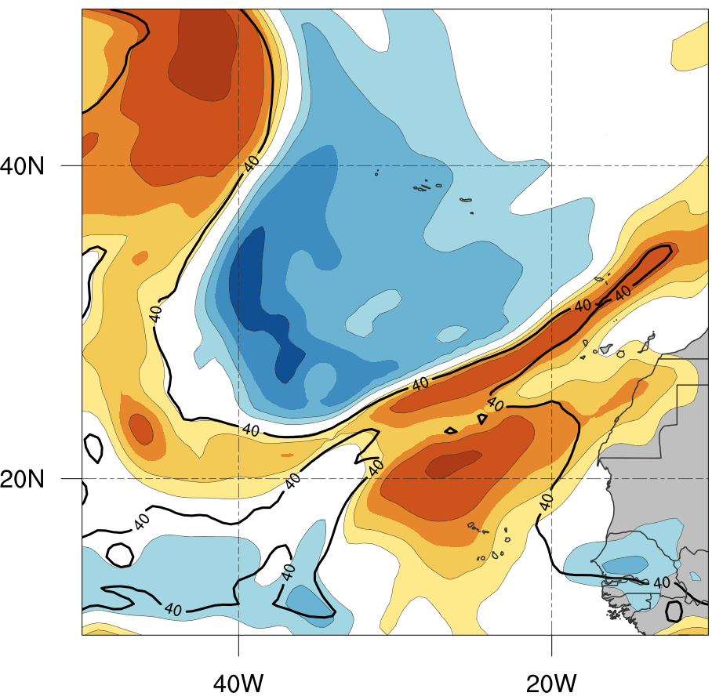
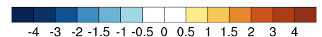
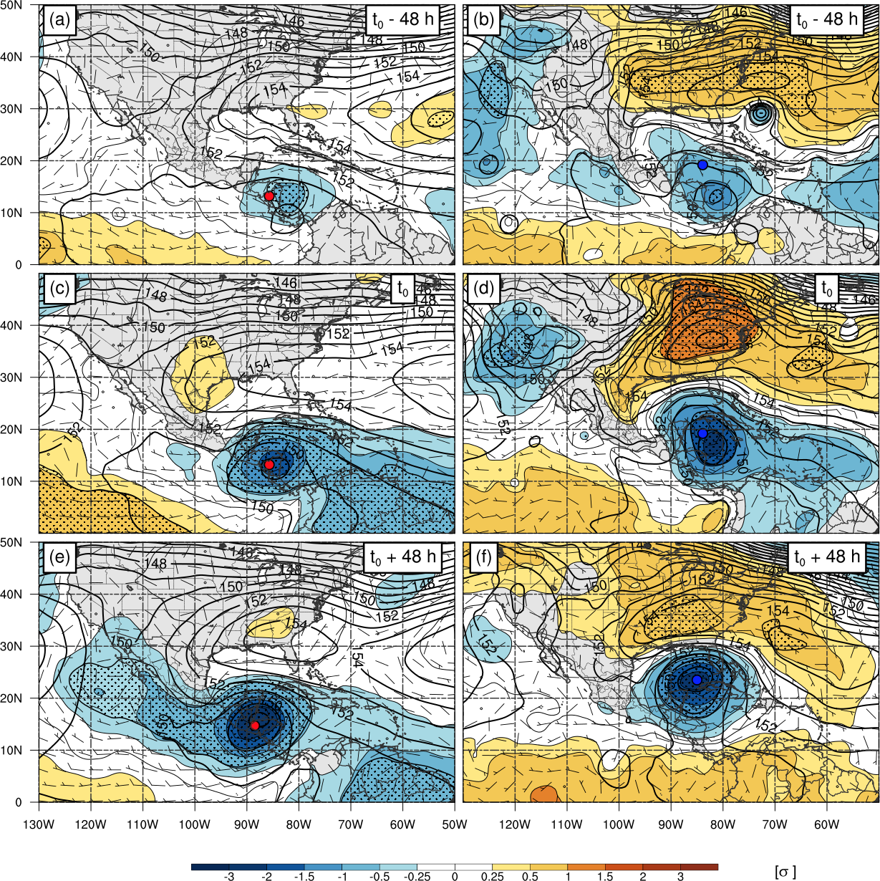
Motivation
Subtropical Potential Vorticity (PV) streamer
    An elongated filament of high PV air
Can occur in conjunction with:
  Vertical Wind Shear (VWS) corridors
  Moisture anomalies
  Tropical cyclones (TCs)
  Other extreme weather events
Formation via Rossby wave breaking (RWB)
Contribute to formation of Mid-Ocean troughs (MOTs ; McTaggart-Cowan et al. 2013)
How do these environments change with different number, size, and intensity of these PV streamers?
  Hasn’t yet been addressed
0000 UTC 24 Sep 1999
Standardized PW Anomaly (color shading, shading), 40 mm PW contour (black contour, mm)

