Slide 1
A Climatology of Central American Gyres
IR Satellite Image of a Gyre (Nicole) 29 Sep, 2010
Philippe Papin, University at Albany, SUNY
Acknowledgements: Lance Bosart and Ryan Torn
31st Conference on Hurricanes and Tropical Meteorology
31 March, 2014
Research support was provided by NSF grant ATM-0849491

Slide 2
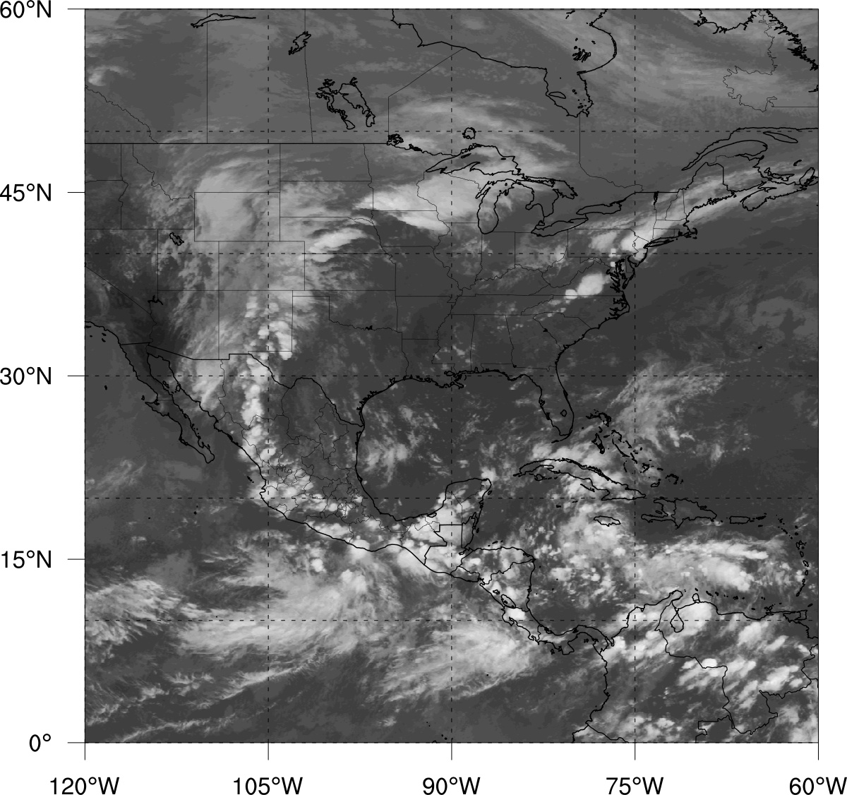
Motivation
PREDICT disturbance (gyre) in late Sep 2010:
Included multiple TCs
Triggered major flooding over Central America (CA)
Prompted a study of gyre frequency and formation mechanisms
IR Satellite Animation – 23 Sep – 01 Oct

Slide 3
Motivation
PREDICT disturbance (gyre) in late Sep 2010:
Included multiple TCs
Triggered major flooding over Central America (CA)
Prompted a study of gyre frequency and formation mechanisms
IR Satellite Animation – 23 Sep – 01 Oct

Slide 4
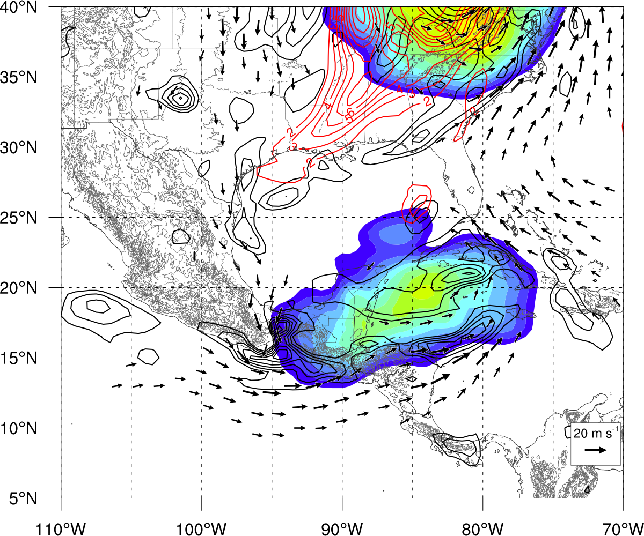
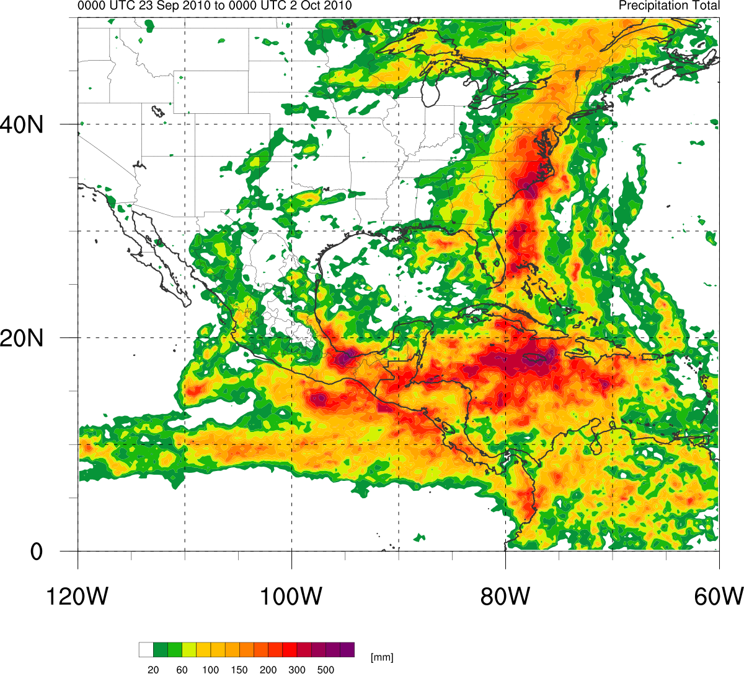
Motivation
PREDICT disturbance (gyre) in late Sep 2010:
Included multiple TCs
Triggered major flooding over Central America (CA)
Prompted a study of gyre frequency and formation mechanisms
Circulation 1200 UTC 29 Sep
TRMM rainfall totals
23 Sep – 01 Oct

Slide 5
Outline
Literature review
Large-scale low-level cyclonic circulations in other basins
Constructing a climatology of CA gyres
Algorithm for CA gyre identification
Dataset - Climate Forecast System Reanalysis (Saha et al. 2010)
Composite analysis of CA gyres
Relationship of gyres to the large scale flow

Slide 6
Outline
Literature review
Large-scale low-level cyclonic circulations in other basins
Constructing a climatology of CA gyres
Algorithm for CA gyre identification
Dataset - Climate Forecast System Reanalysis (Saha et al. 2010)
Composite analysis of CA gyres
Relationship of gyres to the large scale flow

Slide 7
Outline
Literature review
Large-scale low-level cyclonic circulations in other basins
Constructing a climatology of CA gyres
Algorithm for CA gyre identification
Dataset - Climate Forecast System Reanalysis (Saha et al. 2010)
Composite analysis of CA gyres
Relationship of gyres to the large scale flow

Slide 8
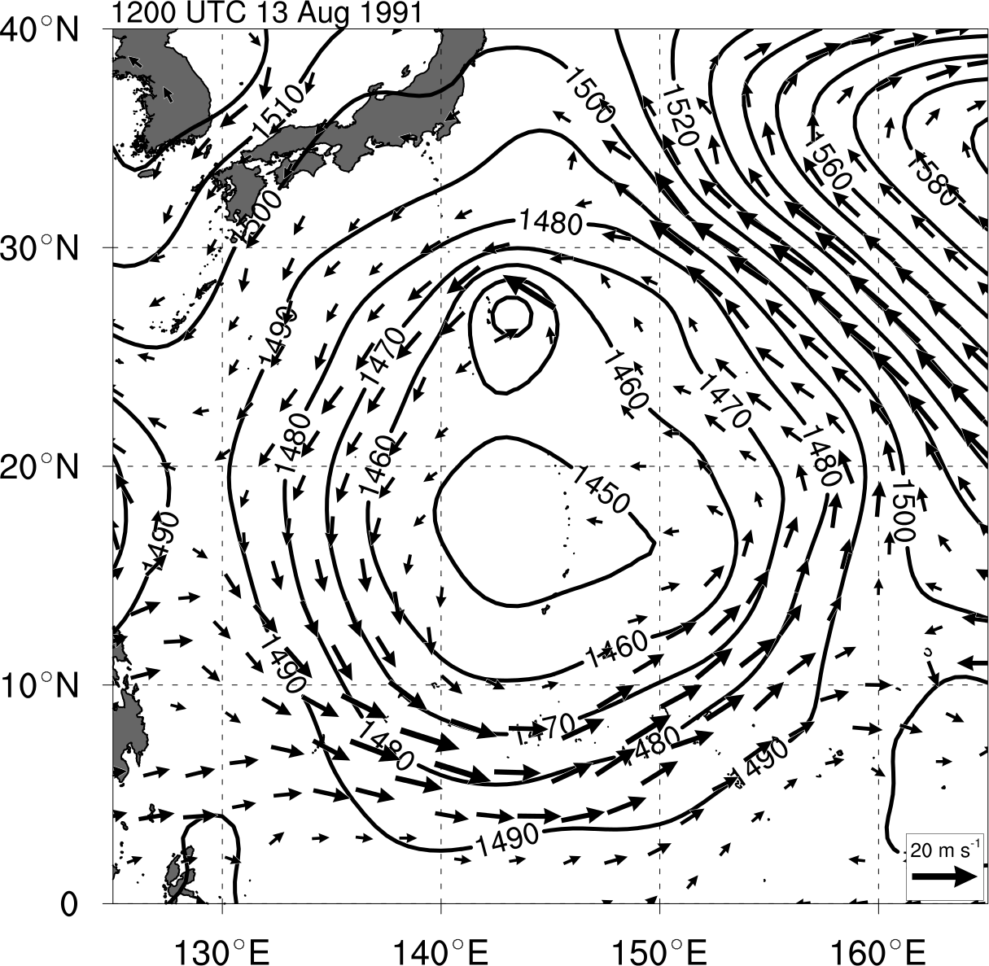
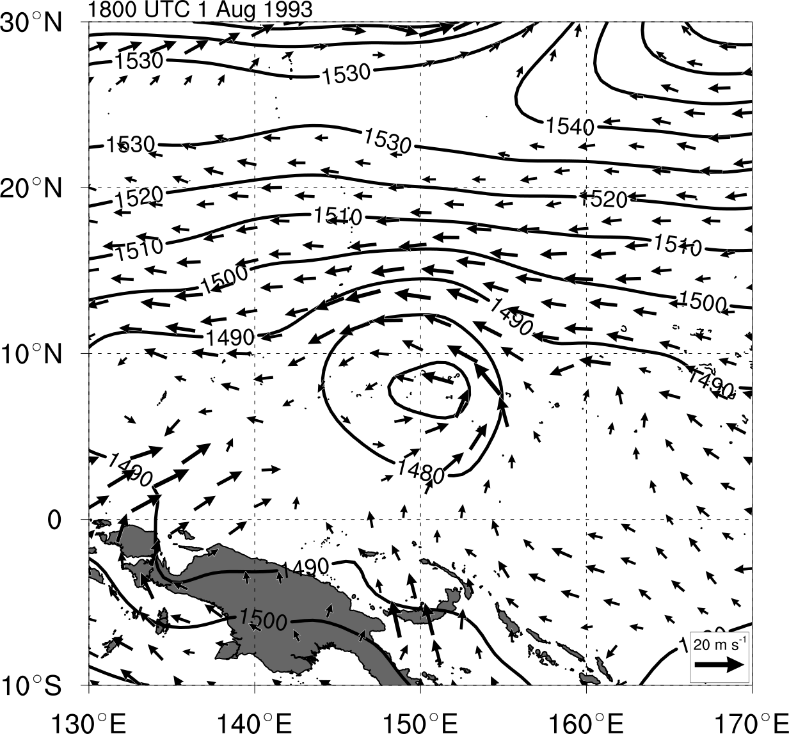
Literature Review
Monsoon Gyre (MG)
Lander (1994), Holland (1995), Molinari and Vollaro (2012)
Monsoon Depression (MD)
Harr et al. (1996), Beattie and Elsberry (2010, 2012)
Lifespan: 3-15 days
Lifespan: 3-5 days
Gyre identified by Lander (1994)
Depression identified by Harr et al. (1996)

Slide 9
Literature Review
Monsoon Gyre (MG)
Lander (1994), Holland (1995), Molinari and Vollaro (2012)
Monsoon Depression (MD)
Harr et al. (1996), Beattie and Elsberry (2010, 2012)
1000 – 1250km Radius
500 – 600km Radius
Gyre identified by Lander (1994)
Depression identified by Harr et al. (1996)

Slide 10
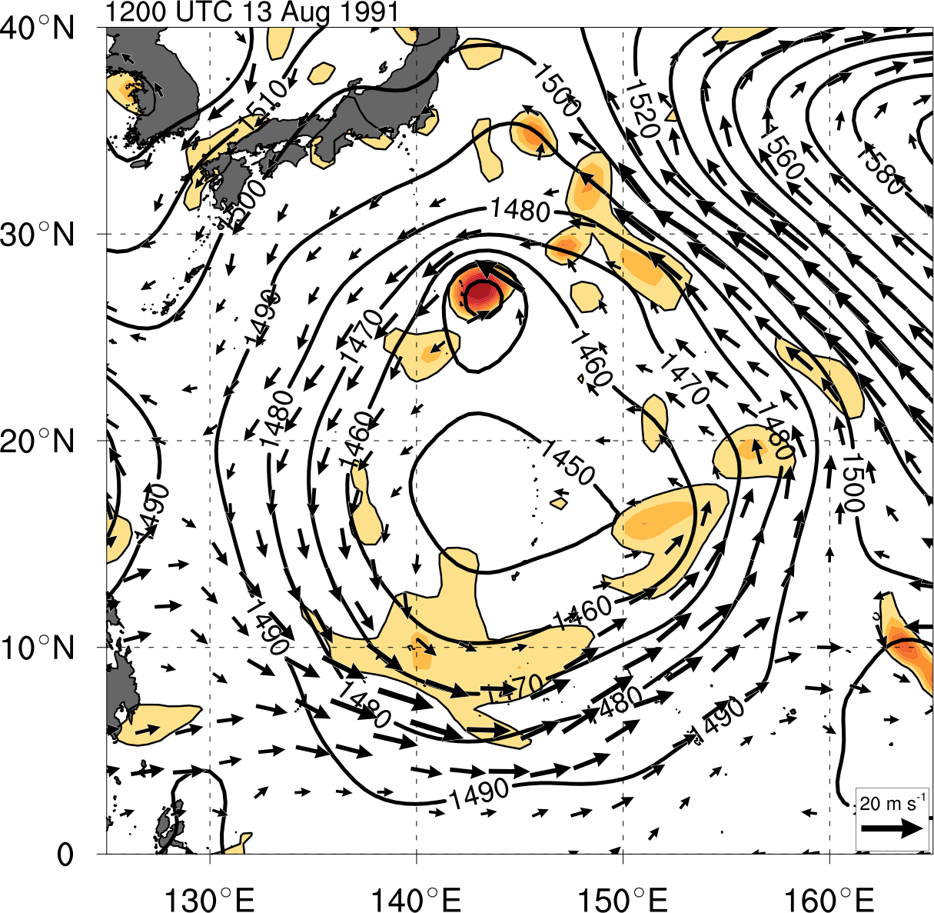
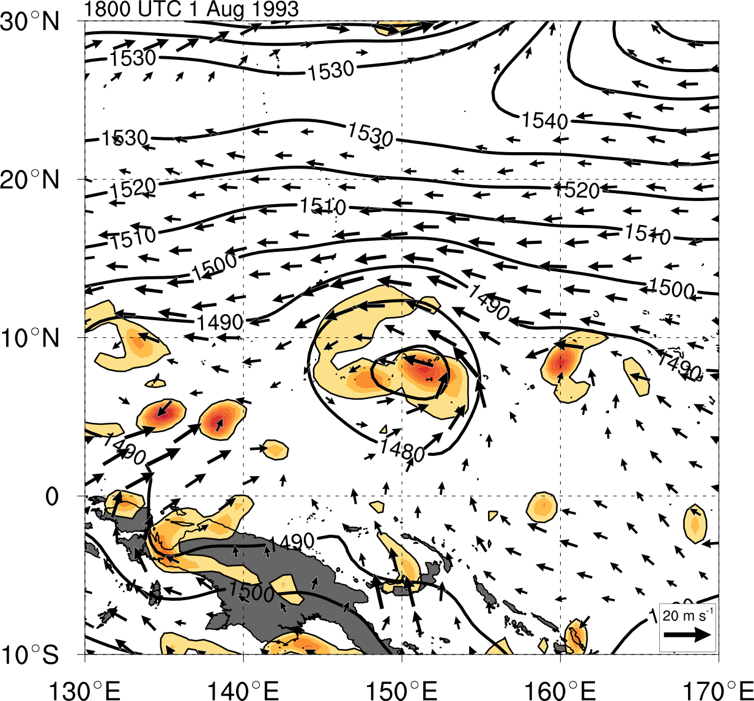
Literature Review
Monsoon Gyre (MG)
Lander (1994), Holland (1995), Molinari and Vollaro (2012)
Monsoon Depression (MD)
Harr et al. (1996), Beattie and Elsberry (2010, 2012)
Asymmetric Vorticity
Symmetric Vorticity
Gyre identified by Lander (1994)
Depression identified by Harr et al. (1996)

Slide 11
Algorithm for CA Gyre Identification
Formulate a series of objective tests using criteria identified from prior literature of MGs and MDs
Screening to omit other large scale features
Large TCs
Monsoon trough
Easterly waves
Low-level jets
Other non-closed disturbances

Slide 12
Algorithm for CA Gyre Identification
Formulate a series of objective tests using criteria identified from prior literature of MGs and MDs
Screening to omit other large scale features
Large TCs
Monsoon troughs
Easterly waves
Low-level jets
Other non-closed disturbances

Slide 13
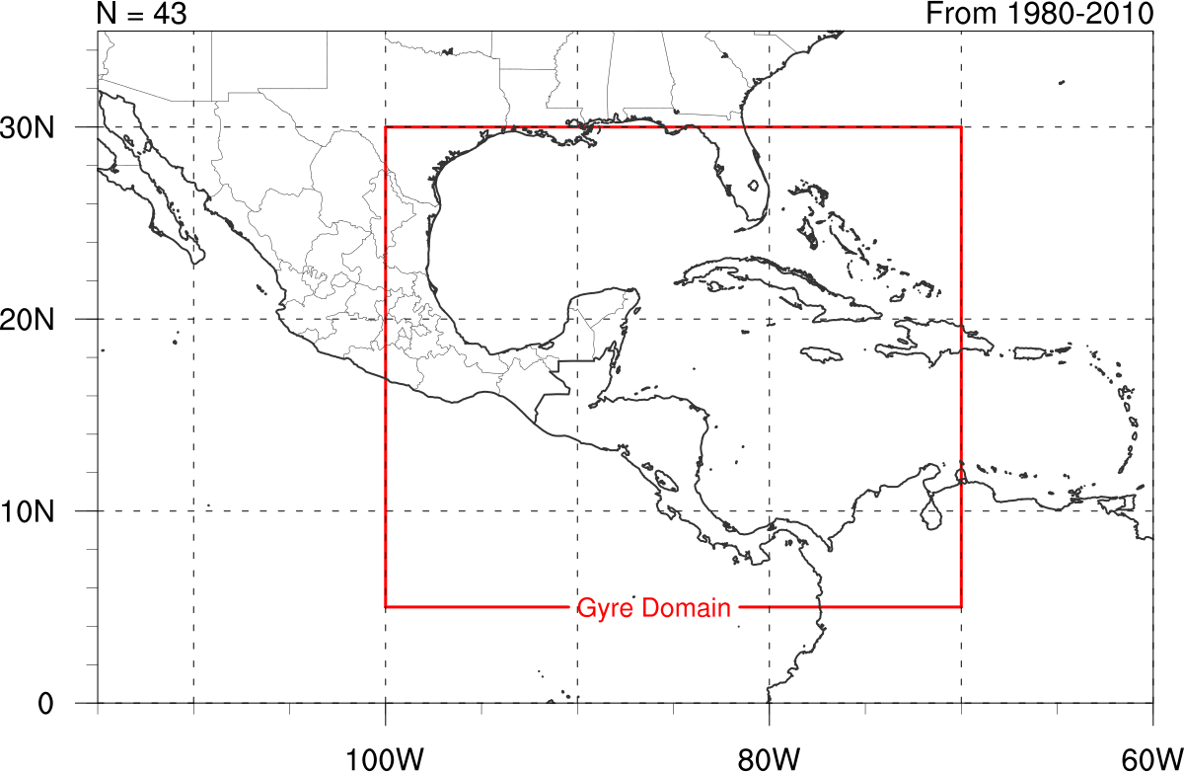
Algorithm for CA Gyre Identification
1. Area Domain
30ºN,100ºW
30ºN,70ºW
Region screened every 6 hours
1May – 30 November
1980 – 2010 (31 years)
5ºN,100ºW
5ºN,70ºW

Slide 14
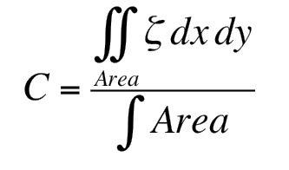
Algorithm for CA Gyre Identification
1. Area Domain
Period: 1 May – 30 November 1980-2010
30ºN,100ºW
30ºN,70ºW
500 – 1000 km
Circulation
Value > 1*10⁻⁵ s⁻¹
500 km
5ºN,100ºW
5ºN,70ºW
1000 km
2. Circulation
Using Stokes’s theorem
Macroscopic measure of rotation
500 – 1000 km circulation > 1*10⁻⁵ s⁻¹
Maximum value identifies gyre center

Slide 15
Algorithm for CA Gyre Identification
1. Area Domain
2. Circulation Magnitude and Center
Period: 1 May – 30 November 1980-2010
30ºN,100ºW
30ºN,70ºW
500 – 1000 km
Circulation
C Max = Gyre Center
Value > 1*10⁻⁵ s⁻¹
500 km
5ºN,100ºW
5ºN,70ºW
1000 km
3. Azimuthally Averaged Tangential Wind
True in case of circular circuit
Max V_{t} Wind > 5 m s⁻¹
At distance > 500 km
Max tangential wind > 5 m s⁻¹
Distance of max tangential wind > 500 km
Most effective at omitting large TCs
500 km

Slide 16
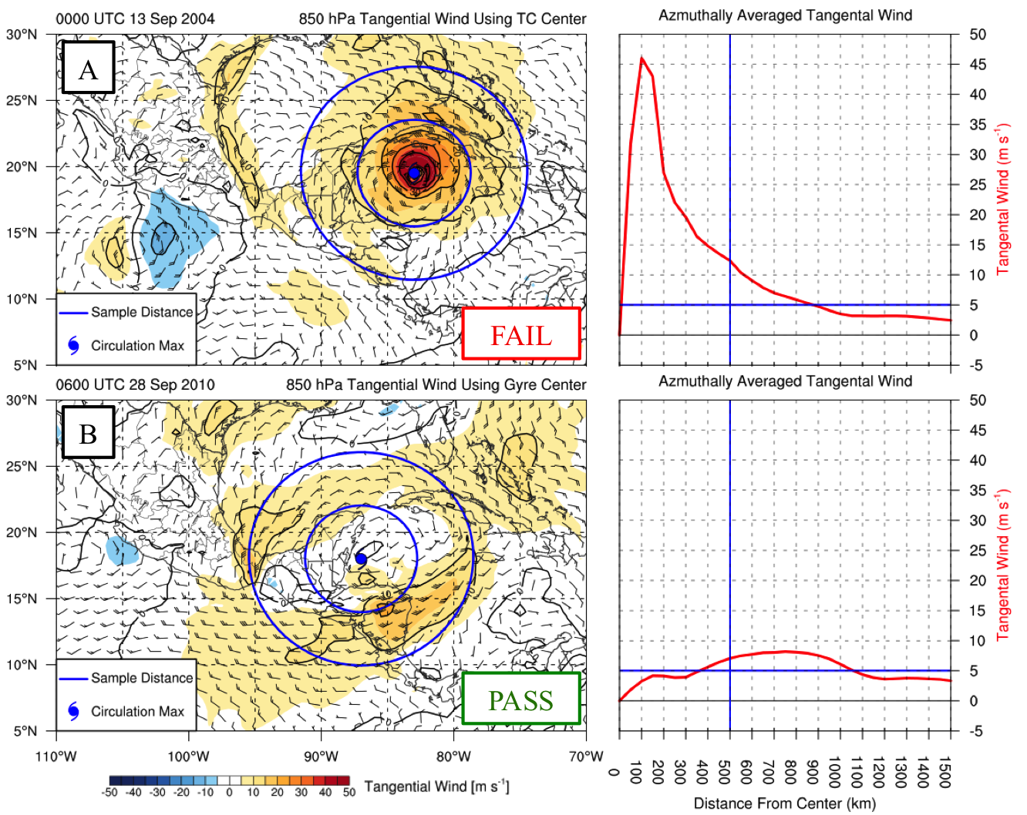
Algorithm for CA Gyre Identification
1. Area Domain
2. Circulation Magnitude and Center
Period: 1 May – 30 November 1980-2012
Max: 46 m s⁻¹
Dist: 100 km
30ºN,100ºW
30ºN,70ºW
TC Ivan
500-1000 km
Circulation
C Max = Gyre Center
Value > 1*10⁻⁵ s⁻¹
500 km
3. Azimuthally Averaged Tangential Wind
5ºN,100ºW
5ºN,70ºW
1000 km
Max tangential wind > 5 m s⁻¹
Distance of max tangential wind > 500 km
Max: 9 m s⁻¹
Dist: 750 km
60º
Min V_{t} Wind
> 1 m s⁻¹
CA Gyre
Max V_{t} Wind > 5 m s⁻¹
Rotated at 10º intervals
At distance > 500 km
500 km
500 km
1000 km

Slide 17
Algorithm for CA Gyre Identification
1. Area Domain
2. Circulation Magnitude and Center
Period: 1 May – 30 November 1980-2010
30ºN,100ºW
30ºN,70ºW
500 – 1000 km
Circulation
C Max = Gyre Center
Value > 1*10⁻⁵ s⁻¹
500 km
5ºN,100ºW
5ºN,70ºW
1000 km
3. Azimuthally Averaged Tangential Wind
True in case of circular circuit
Max V_{t} Wind > 5 m s⁻¹
At distance > 500 km
Max tangential wind > 5 m s⁻¹
Distance of max tangential wind > 500 km
Most effective at omitting large TCs
500 km

Slide 18
Algorithm for CA Gyre Identification
1. Area Domain
2. Circulation Magnitude and Center
Period: 1 May – 30 November 1980-2010
30ºN,100ºW
30ºN,70ºW
500 – 1000 km
Circulation
4. Arc Averaged Tangential Wind
Value > 1*10⁻⁵ s⁻¹
500 km
Min arc averaged tangential wind > 1 m s⁻¹
Test for cyclonic flow around center
Most effective at omitting non-closed circulations
5ºN,100ºW
5ºN,70ºW
1000 km
60º
Min V_{t} Wind
> 1 m s⁻¹
Max V_{t} Wind > 5 m s⁻¹
Rotated at 10º intervals
At distance > 500 km
500 km
500 km
1000 km
3. Azimuthally Averaged Tangential Wind

Slide 19
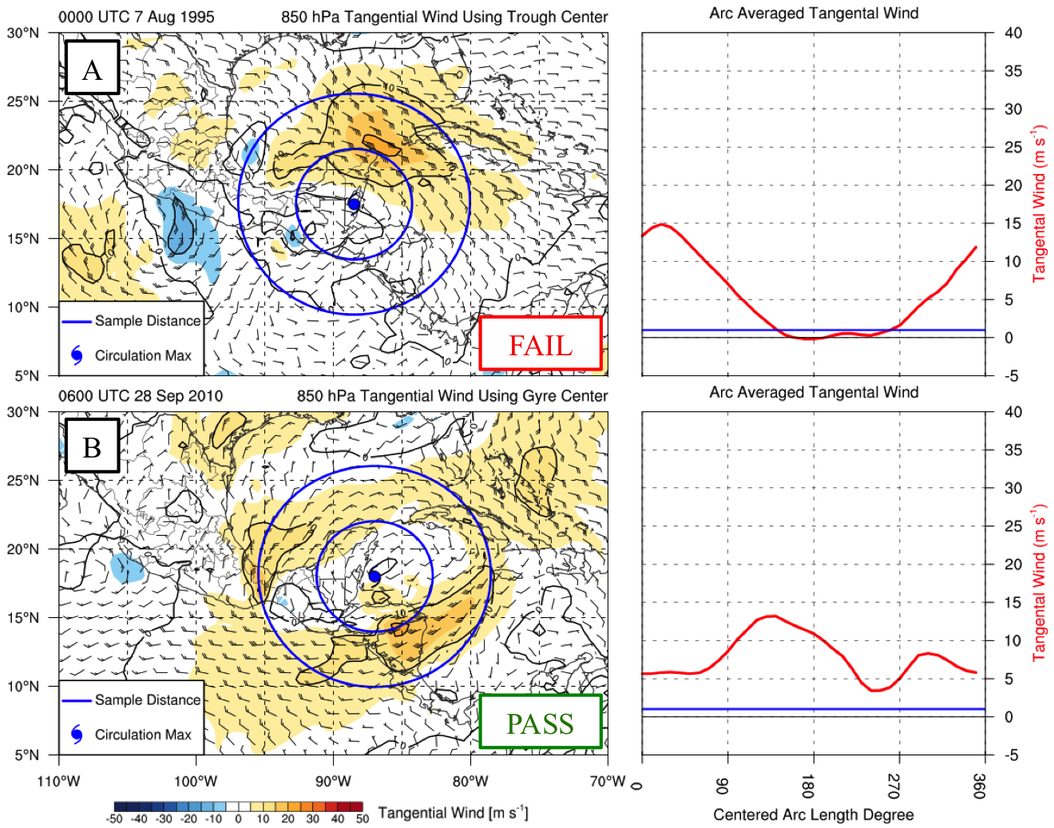
Algorithm for CA Gyre Identification
1. Area Domain
2. Circulation Magnitude and Center
Period: 1 May – 30 November 1980-2012
Min: 0 m s⁻¹
Arc Center: 170º
30ºN,100ºW
30ºN,70ºW
Pass
Trough
500-1000 km
Circulation
C Max = Gyre Center
4. Arc Averaged Tangential Wind
Value > 1*10⁻⁵ s⁻¹
500 km
Min arc averaged tangential wind > 1 m s⁻¹
Test for cyclonic flow around center
Most effective at omitting non-closed circulations
5ºN,100ºW
5ºN,70ºW
1000 km
Min: 3 m s⁻¹
Arc Center: 250º
60º
Min V_{t} Wind
> 1 m s⁻¹
CA Gyre
Max V_{t} Wind > 5 m s⁻¹
Rotated at 10º intervals
At distance > 500 km
500 km
500 km
1000 km
3. Azimuthally Averaged Tangential Wind

Slide 20
Algorithm for CA Gyre Identification
1. Area Domain
2. Circulation Magnitude and Center
Period: 1 May – 30 November 1980-2010
30ºN,100ºW
30ºN,70ºW
500 – 1000 km
Circulation
C Max = Gyre Center
Value > 1*10⁻⁵ s⁻¹
4. Arc Averaged Tangential Wind
500 km
Min arc averaged tangential wind > 1 m s⁻¹
Test for cyclonic flow around center
Most effective at omitting non-closed circulations
5ºN,100ºW
5ºN,70ºW
1000 km
60º
Min V_{t} Wind
> 1 m s⁻¹
Max V_{t} Wind > 5 m s⁻¹
Rotated at 10º intervals
At distance > 500 km
500 km
500 km
1000 km
3. Azimuthally Averaged Tangential Wind

Slide 21
Algorithm for CA Gyre Identification
1. Area Domain
2. Circulation Magnitude and Center
Period: 1 May – 30 November 1980-2010
30ºN,100ºW
30ºN,70ºW
500 – 1000 km
Circulation
C Max = Gyre Center
Value > 1*10⁻⁵ s⁻¹
500 km
5ºN,100ºW
5ºN,70ºW
1000 km
+6h
60º
Min V_{t} Wind
> 1 m s⁻¹
Max V_{t} Wind > 5 m s⁻¹
Rotated at 10º intervals
At distance > 500 km
500 km
500 km
1000 km
4. Arc Averaged Tangential Wind
3. Azimuthally Averaged Tangential Wind

Slide 22
Algorithm for CA Gyre Identification
1. Area Domain
2. Circulation Magnitude and Center
Period: 1 May – 30 November 1980-2010
30ºN,100ºW
30ºN,70ºW
500 – 1000 km
Circulation
C Max = Gyre Center
Value > 1*10⁻⁵ s⁻¹
500 km
5ºN,100ºW
5ºN,70ºW
1000 km
+6h
All Tests Pass ≥ 48 h = Gyre Event
60º
Min V_{t} Wind
> 1 m s⁻¹
Pass
Max V_{t} Wind > 5 m s⁻¹
Rotated at 10º intervals
At distance > 500 km
500 km
500 km
1000 km
4. Arc Averaged Tangential Wind
3. Azimuthally Averaged Tangential Wind

Slide 23
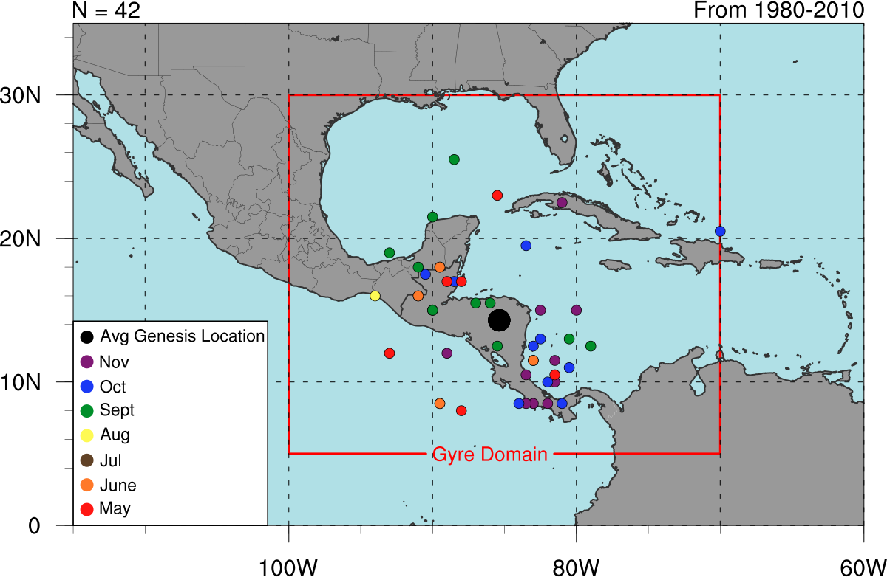
Climatological Statistics
42 cases Identified over 31 Year Period
Seasonal distribution
Bimodal
Minimum in mid-summer
Maxima May – Jun ; Sep – Nov
Horizontal genesis distribution
Most points near or over CA

Slide 24
Composite Analysis of CA Gyres
Earth relative
Grids NOT shifted to a gyre relative center point
Time lagged where t = 0 h at gyre genesis
Standardized precipitable water
850-hPa standardized height anomalies
850-hPa anomalous winds also plotted to illustrate flow

Slide 25
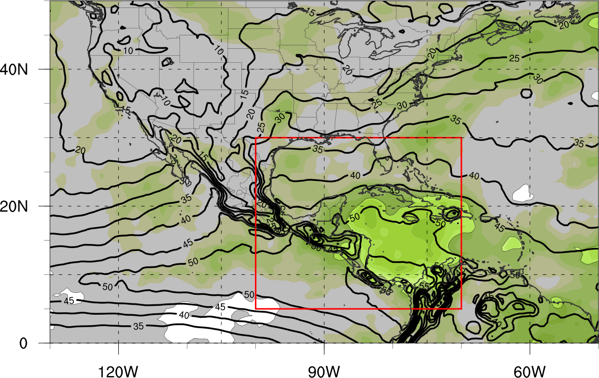
Composite Analysis
Composite Analysis of CA Gyres
Precipitable water (-48 h before genesis)
Enhanced Moisture
Shaded Regions <95% Statistical Significance
N =42

Slide 26
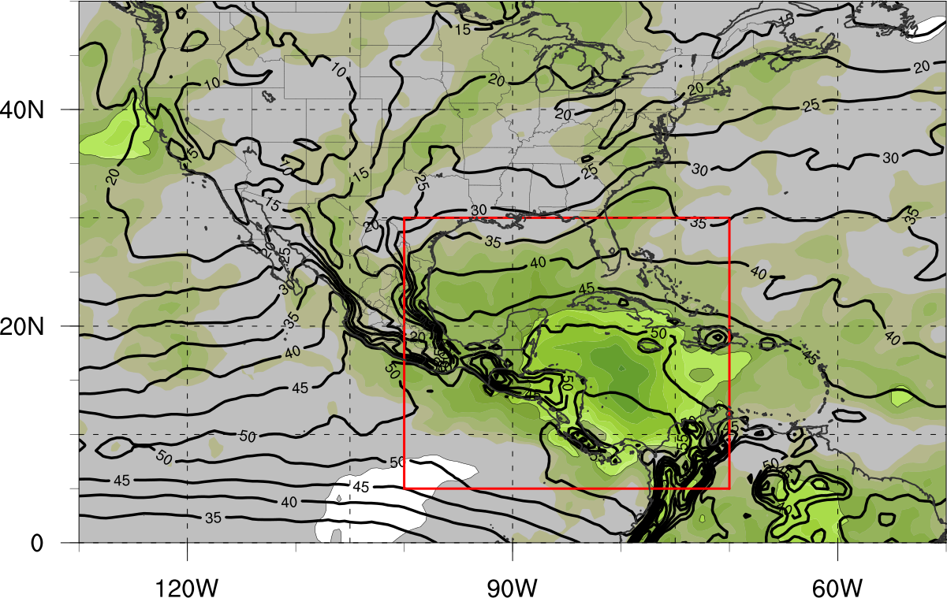
Composite Analysis
Composite Analysis of CA Gyres
Precipitable water (At genesis)
Enhanced Moisture
Shaded Regions <95% Statistical Significance
N =42

Slide 27
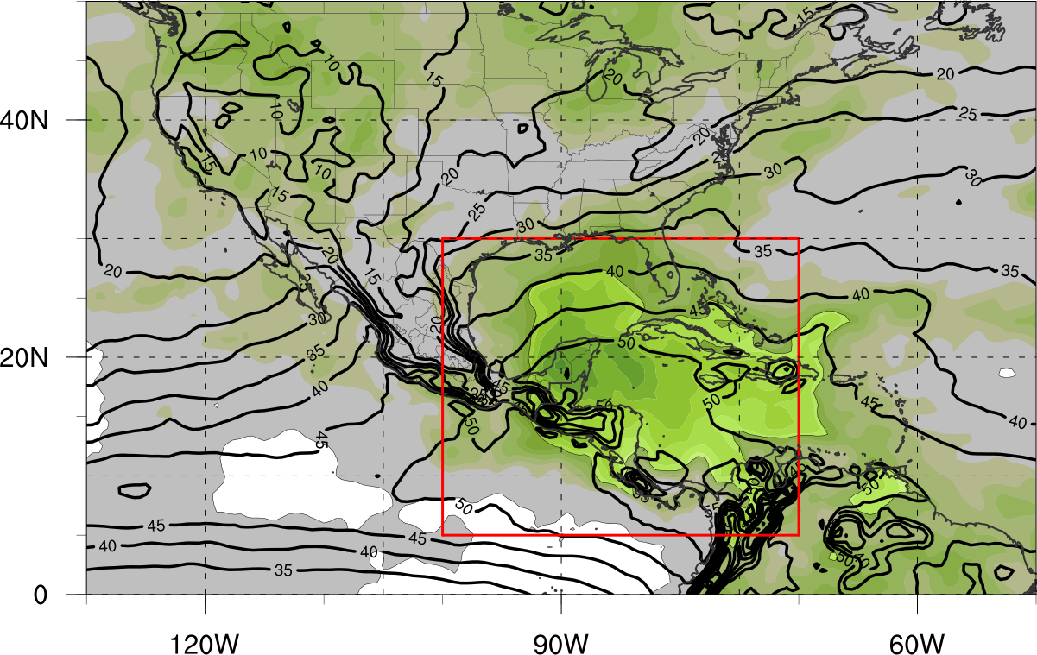
Composite Analysis
Composite Analysis of CA Gyres
Precipitable water (+72 h after genesis)
Enhanced Moisture
Shaded Regions <95% Statistical Significance
N =42

Slide 28
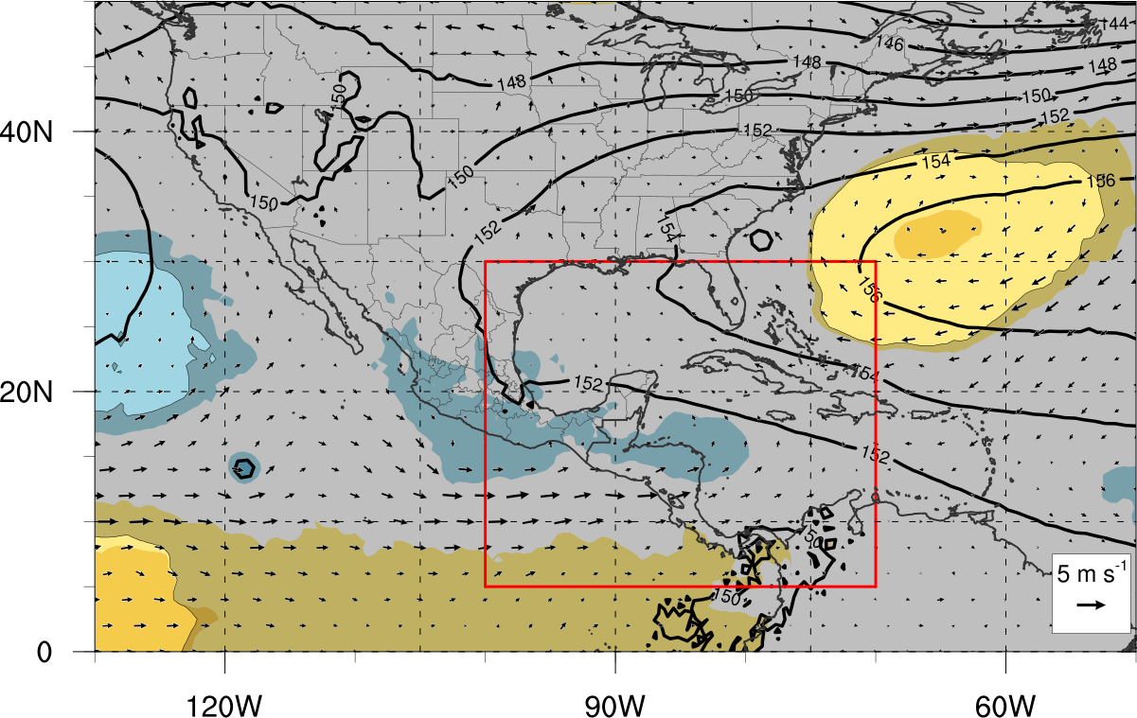
Composite Analysis
Composite Analysis of CA Gyres
850-hPa geo heights and winds (-48 h before genesis)
Enhanced ATL Easterly Flow
H
Enhanced EPAC Westerly Flow
Shaded Regions <95% Statistical Significance
N =42

Slide 29
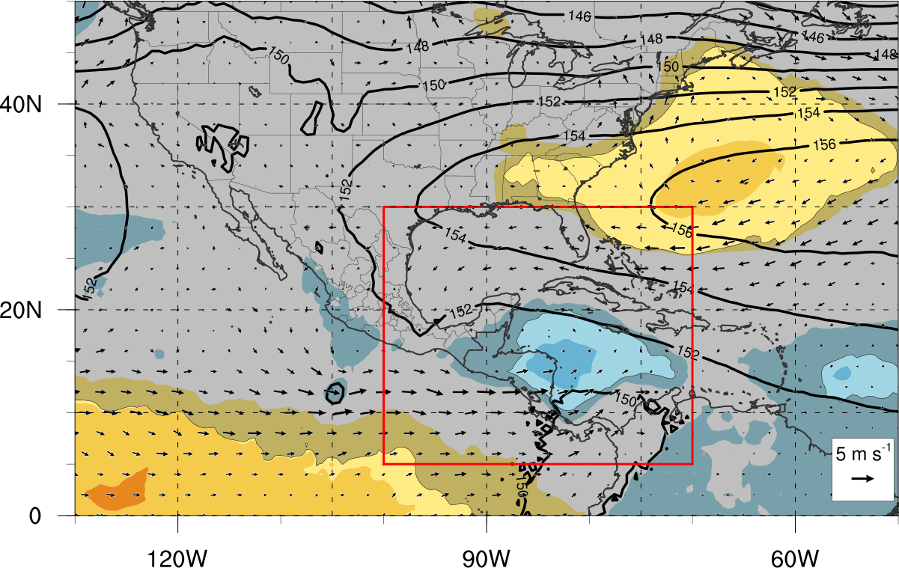
Composite Analysis
Composite Analysis of CA Gyres
850-hPa geo heights and winds (-24 h before genesis)
Enhanced ATL Easterly Flow
H
Enhanced EPAC Westerly Flow
Shaded Regions <95% Statistical Significance
N =42

Slide 30
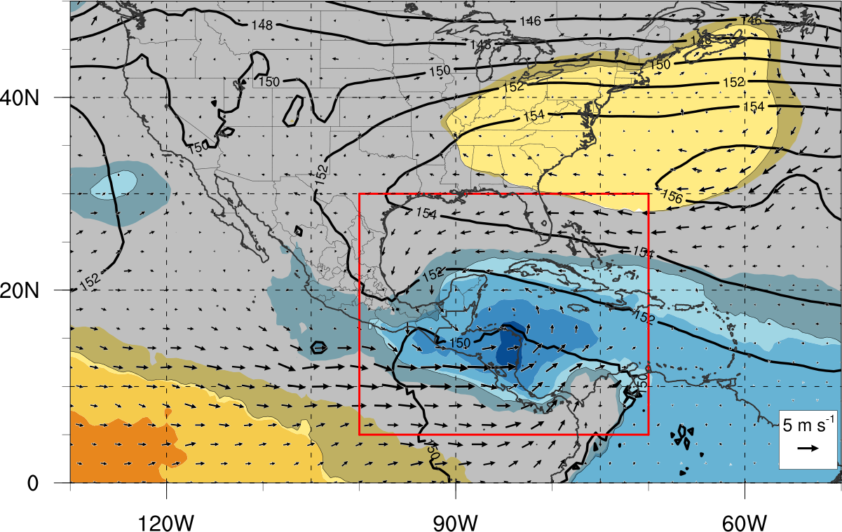
Composite Analysis
Composite Analysis of CA Gyres
850-hPa geo heights and winds (At genesis)
Enhanced ATL Easterly Flow
H
L
Enhanced EPAC Westerly Flow
Shaded Regions <95% Statistical Significance
N =42

Slide 31
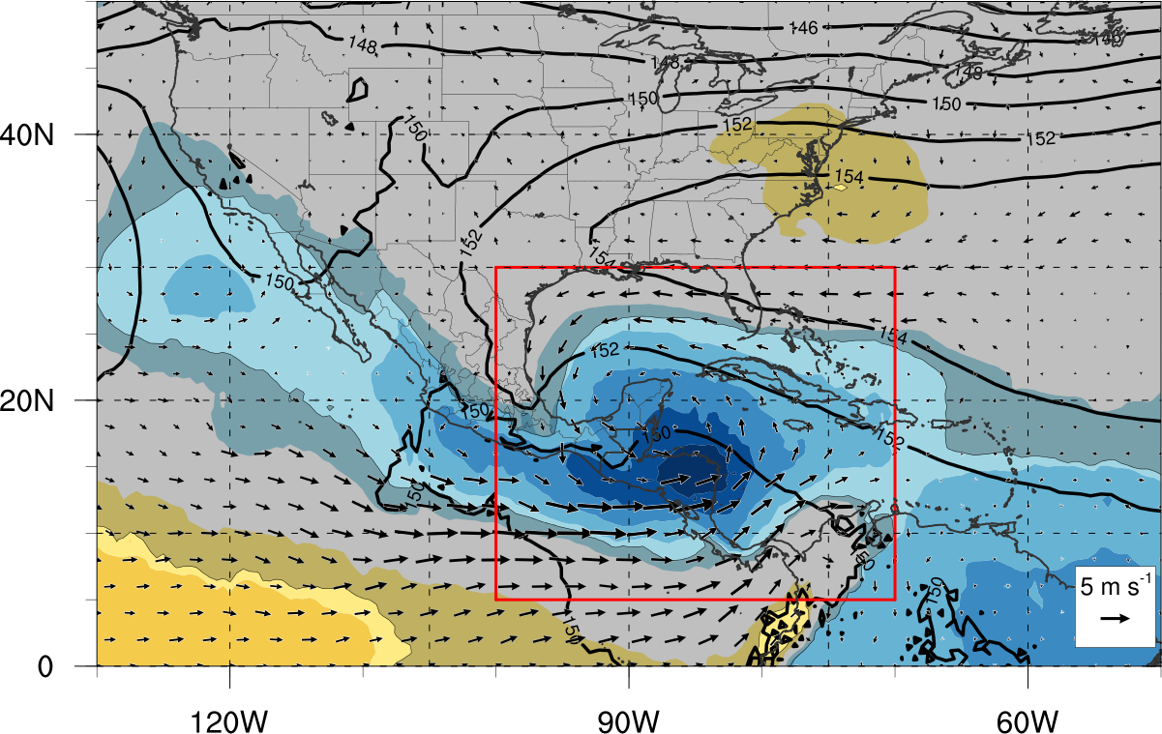
Composite Analysis
Composite Analysis of CA Gyres
850-hPa geo heights and winds (+24 h after genesis)
Enhanced ATL Easterly Flow
H
Conversion of Shear Vorticity into Curvature Vorticity
L
Enhanced EPAC Westerly Flow
Shaded Regions <95% Statistical Significance
N =42

Slide 32
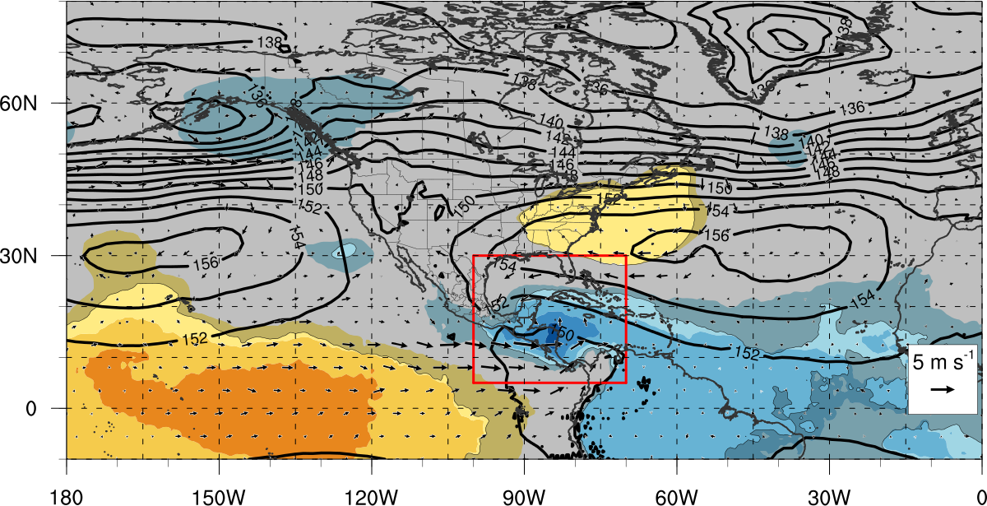
Composite Analysis
Composite Analysis of CA Gyres
850-hPa geo heights and winds (At genesis) Zoomed Out
L
Positive Height Anomaly
Negative Height Anomaly
Shaded Regions <95% Statistical Significance
N =42

Slide 33
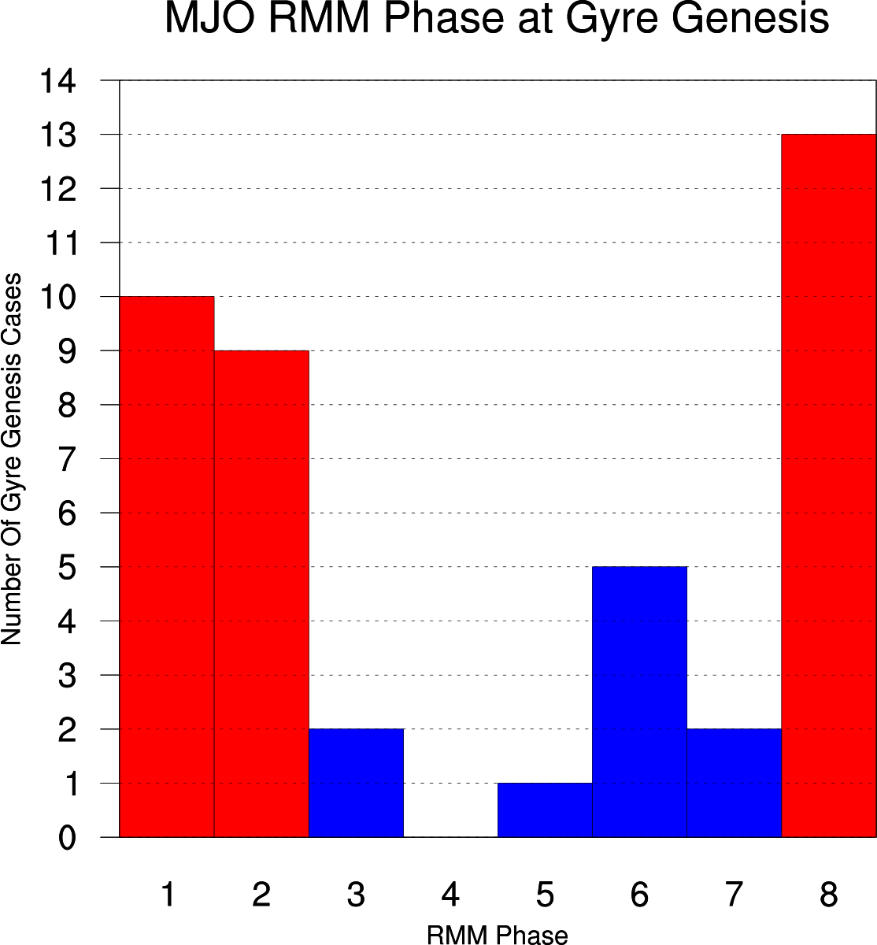
Composite Analysis
Composite Analysis of CA Gyres
MJO signal
76.2% of genesis cases occur in phases 8,1,2
Corresponds to convectively active phase over CA and Atlantic basin.
Implied anomalous westerly low-level flow during these phases
N =42
8
H
L
1
H
L
2
H
L
1
2
8
Sea Level Pressure Composites Based upon Wheeler and Hendon (2004) Climatology

Slide 34
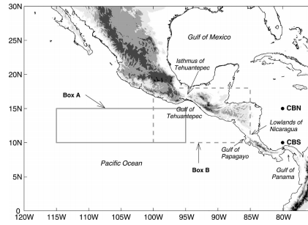
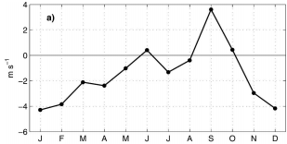
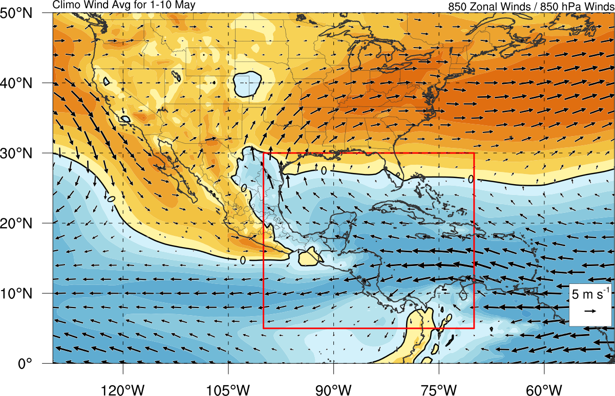
Role of Flow – Climatological Zonal Wind
850-hPa seasonal zonal winds
Zonal westerly winds
June
September
October
Figs. 1 & 3 Romero-Centeno (2007) – From QuikSCAT
Climatological westerly zonal winds (CFSR)
20 May – 30 Jun
01 Sep – 20 Nov
Note propagation of westerly zonal wind

Slide 35
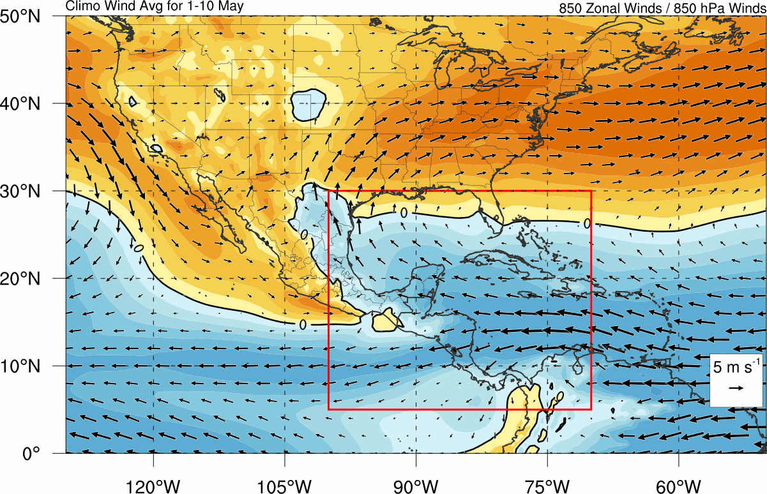
Role of Flow – Climatological Zonal Wind
850-hPa seasonal zonal winds
Zonal westerly winds
June
September
October
Figs. 1 & 3 Romero-Centeno (2007) – From QuikSCAT
Climatological westerly zonal winds (CFSR)
20 May – 30 Jun
01 Sep – 20 Nov
Note propagation of westerly zonal wind

Slide 36
Role of Flow – Climatological Zonal Wind
850-hPa seasonal zonal winds
Zonal westerly winds
June
September
October
Figs. 1 & 3 Romero-Centeno (2007) – From QuikSCAT
W
E
W
Climatology Westerly Zonal Winds
20 May – 30 Jun
01 Sep – 20 Nov
Note Propagation of Westerly Zonal Wind

Slide 37
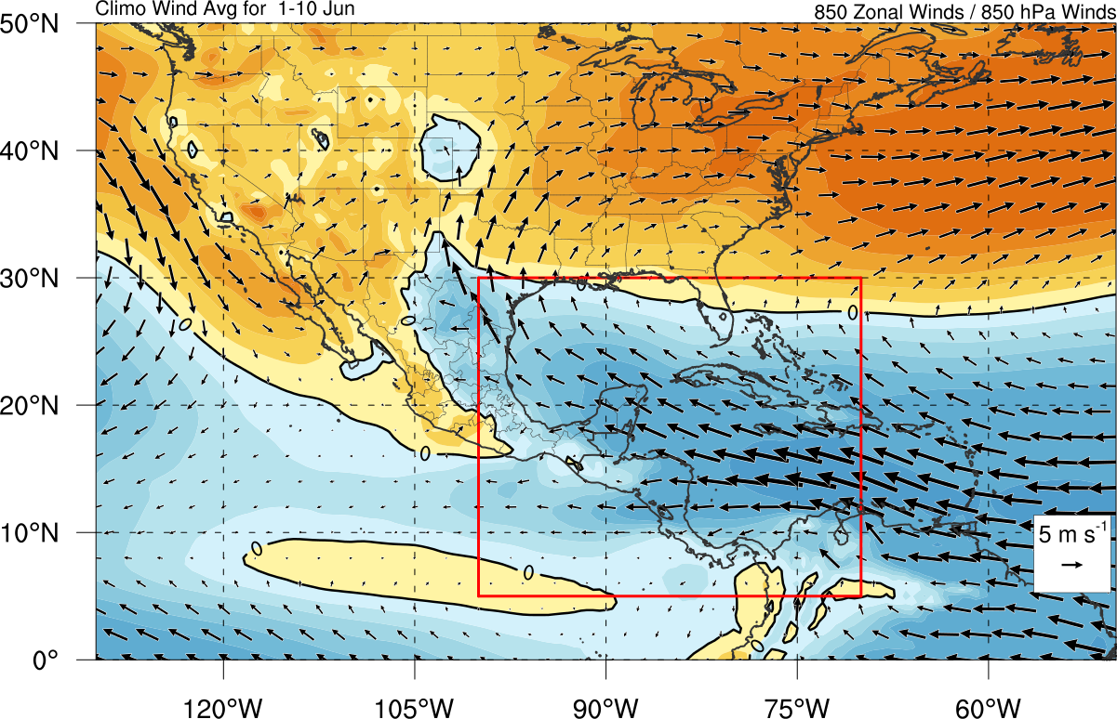
Role of Flow – Climatological Zonal Wind
850-hPa seasonal zonal winds
Zonal westerly winds
June
September
October
Figs. 1 & 3 Romero-Centeno (2007) – From QuikSCAT
1-10 Jun
W
E
W
Climatology Westerly Zonal Winds
20 May – 30 Jun
01 Sep – 20 Nov
Note Propagation of Westerly Zonal Wind
Favorable For Cyclonic Shear Vorticity

Slide 38
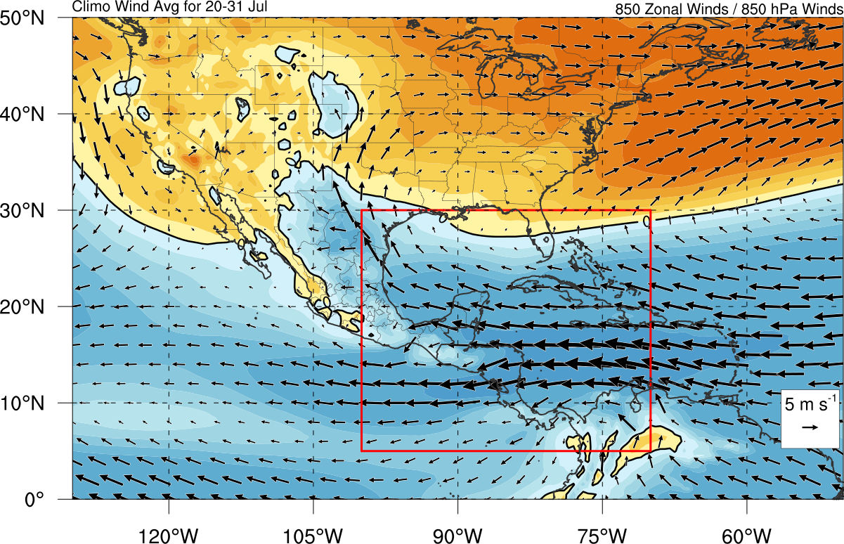
Role of Flow – Climatological Zonal Wind
850-hPa seasonal zonal winds
Zonal westerly winds
June
September
October
Figs. 1 & 3 Romero-Centeno (2007) – From QuikSCAT
20-31 Jul
W
E
W
Climatology Westerly Zonal Winds
20 May – 30 Jun
01 Sep – 20 Nov
Note Propagation of Westerly Zonal Wind
Favorable For Anticyclonic Shear Vorticity

Slide 39
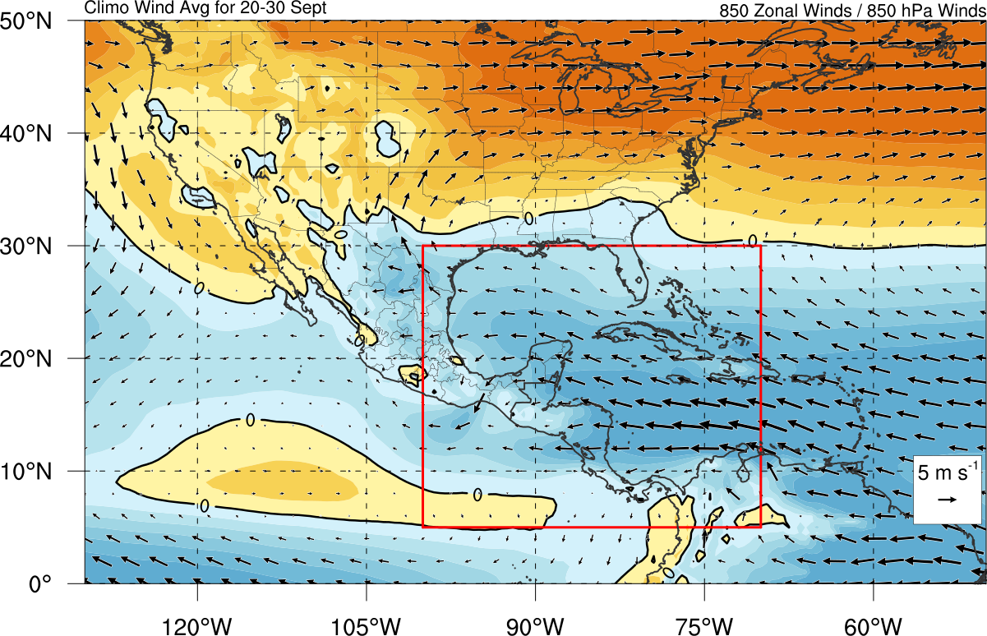
Role of Flow – Climatological Zonal Wind
850-hPa seasonal zonal winds
Zonal westerly winds
June
September
October
Figs. 1 & 3 Romero-Centeno (2007) – From QuikSCAT
20-30 Sep
W
E
W
Climatology Westerly Zonal Winds
20 May – 30 Jun
01 Sep – 20 Nov
Note Propagation of Westerly Zonal Wind
Favorable For Cyclonic Shear Vorticity

Slide 40
Conclusions
Central America gyres
Large low-level circulation
Algorithm identified characteristics similar to Monsoon Gyres and Monsoon Depressions
Climatology identified 42 Gyres
Two peaks
May – June
September – November
Composite analysis
Anomalous low-level flow precedes gyre; Anomalously high PW
MJO RMM phases 8,1,2 may aid in EPAC anomalous westerly low-level flow
Increased climatological probability of westerly winds in the east Pacific
May – June ; September – November
Favors corridor of cyclonic shear vorticity in east Pacific

Slide 41
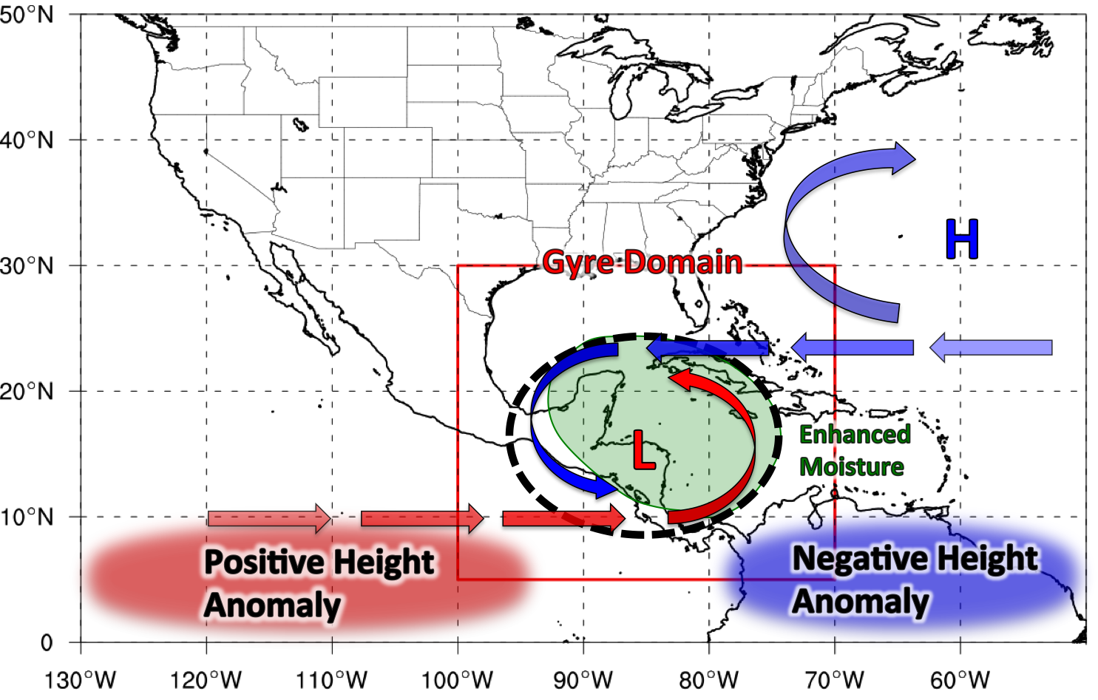
Conclusions ppapin@albany.edu
Summary schematic
MJO Phase
>75% of Gyre Genesis Cases
1
2
8

Slide 42
Conclusions ppapin@albany.edu
Summary schematic

Slide 43
Questions? ppapin@albany.edu

Slide 44
Extra Figures / Schematics

Slide 45
Climatology - Composite Analysis
Partition of vorticity into shear and curvature pieces
Bell and Keyser (1992), Holton (2004)
Stokes theorem allows us to make the same partition for circulation (analogous to area average vorticity within circuit)
=
Shear Vorticity
Curvature Vorticity
V
V

Slide 46
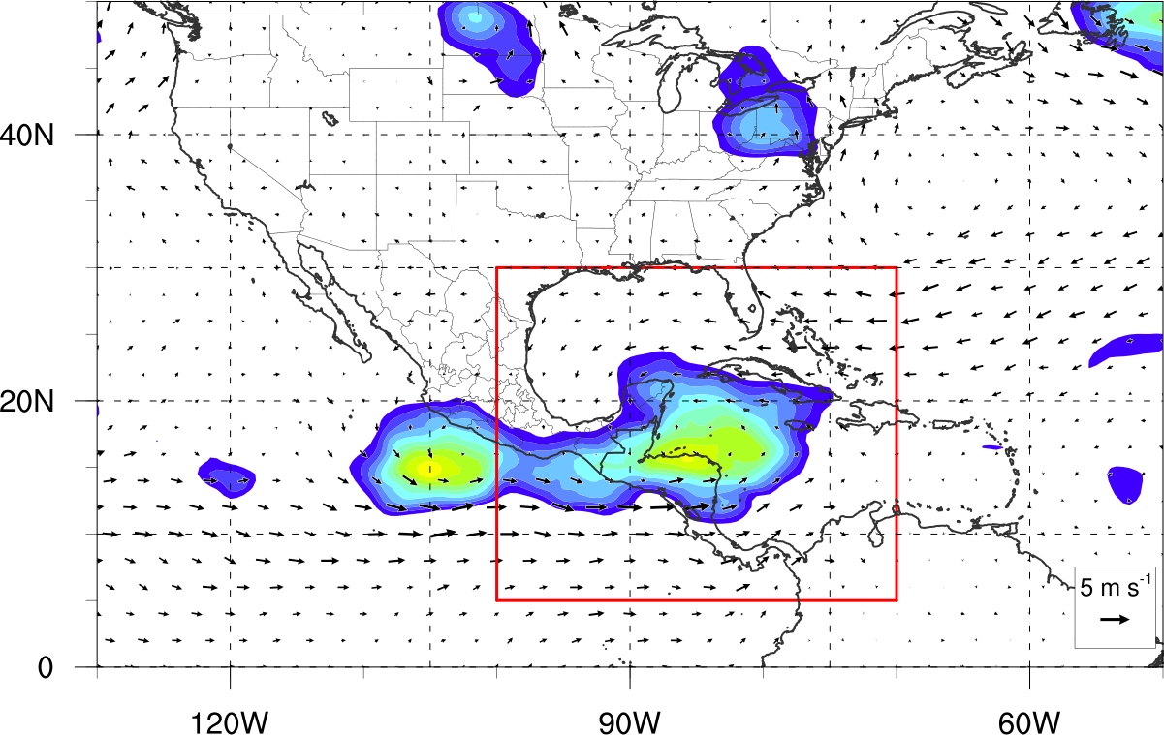
Climatology - Composite Analysis
850-hPa Circulation and Winds (-24 h Before Genesis)
Enhanced Atlantic Easterly Flow
Enhanced EPAC Westerly Flow
Circulation taken at 500 km
N =42

Slide 47
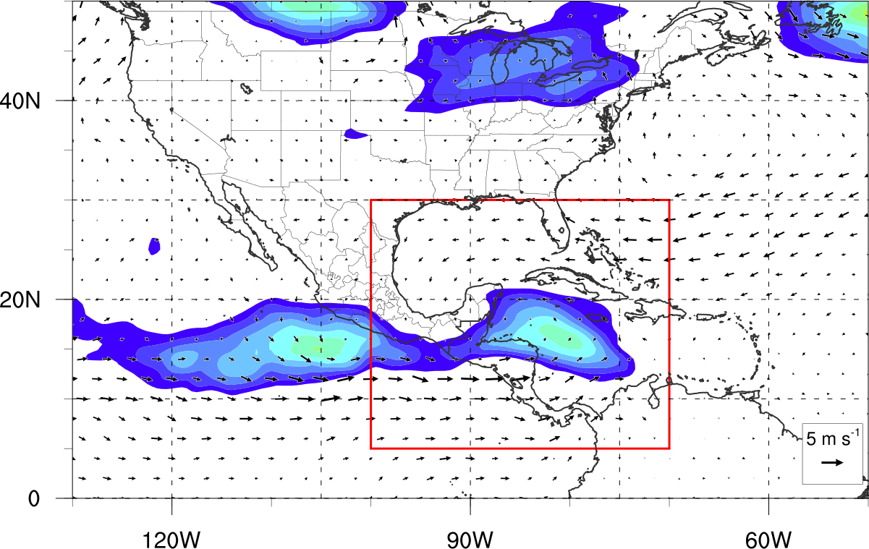
Climatology - Composite Analysis
850-hPa Shear Circulation and Winds (-24 h Before Genesis)
Cyclonic Shear Vorticity Produced
Circulation taken at 500 km
N =42

Slide 48
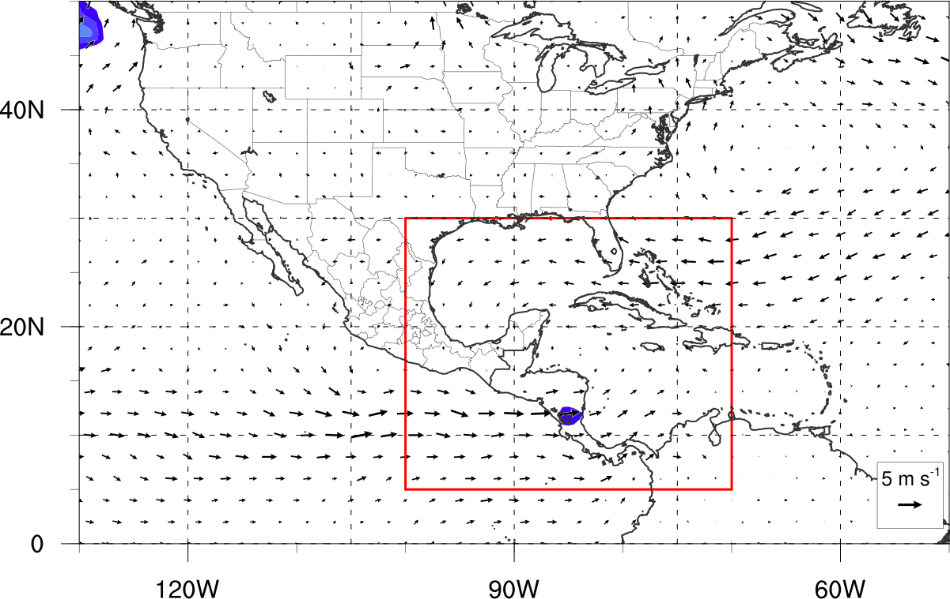
Climatology - Composite Analysis
850-hPa Curvature Circulation and Winds (-24 h Before Genesis)
Little Curvature Vorticity Before Genesis
Circulation taken at 500 km
N =42

Slide 49
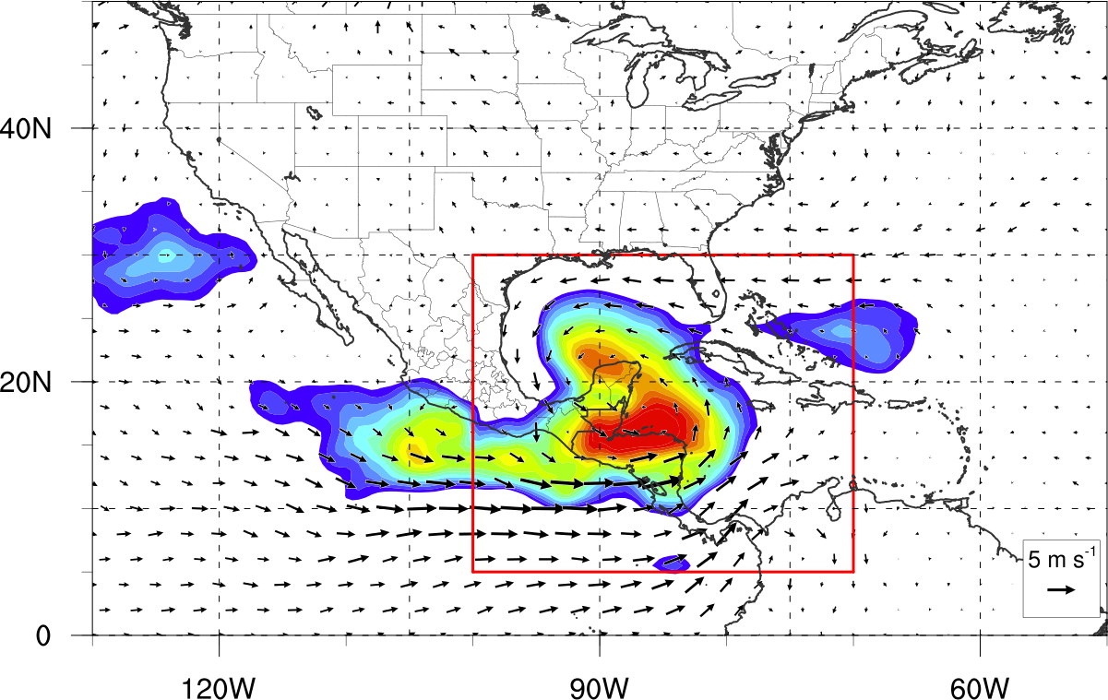
Climatology - Composite Analysis
850-hPa Circulation and Winds (+24 h After Genesis)
Enhanced Atlantic Easterly Flow
Enhanced EPAC Westerly Flow
Circulation taken at 500 km
N =42

Slide 50
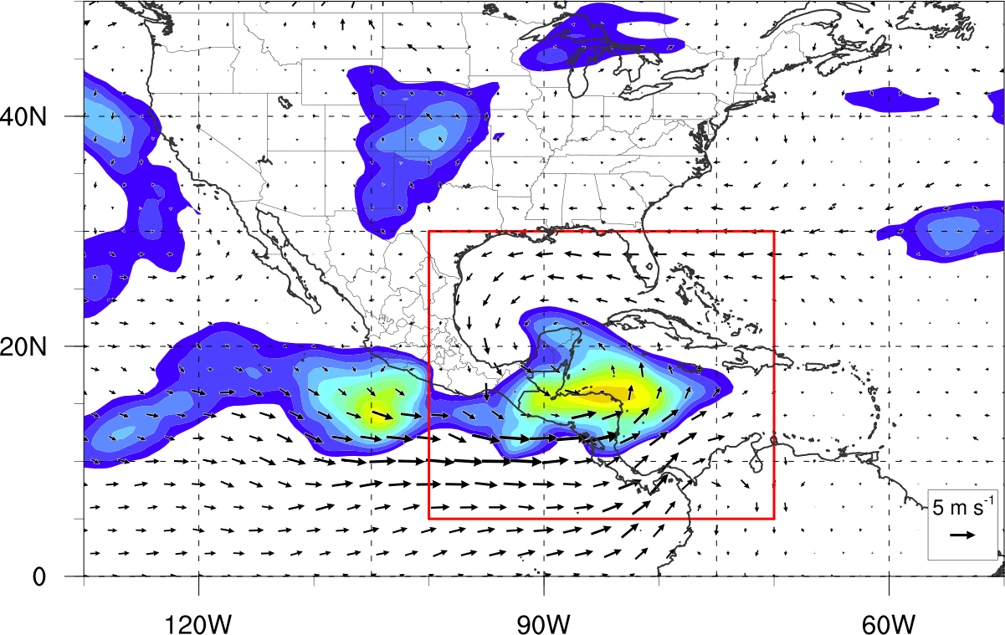
Climatology - Composite Analysis
850-hPa Shear Circulation and Winds (+24 h After Genesis)
Cyclonic Shear Vorticity Produced Over Central America
Circulation taken at 500 km
N =42

Slide 51
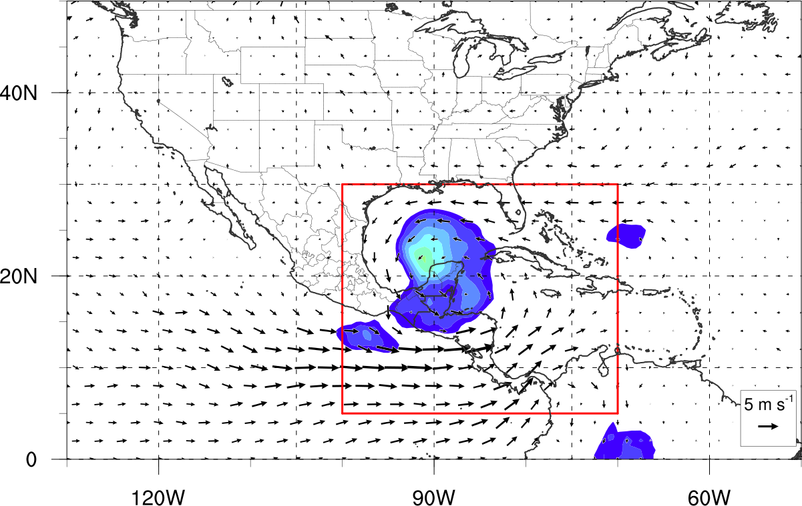
Climatology - Composite Analysis
850-hPa Curvature Circulation and Winds (+24 h After Genesis)
Production of Curvature Vorticity After Gyre Genesis
Circulation taken at 500 km
N =42

Slide 52
Trough Influenced Gyre Classification
Adapted Arc Averaged Test
Looks for average PV > 2 PVU (350 K surface) on at least one 60º arc around gyre.
If True: Trough Influenced Gyre
If False: Primarily Tropical Gyre

Slide 53
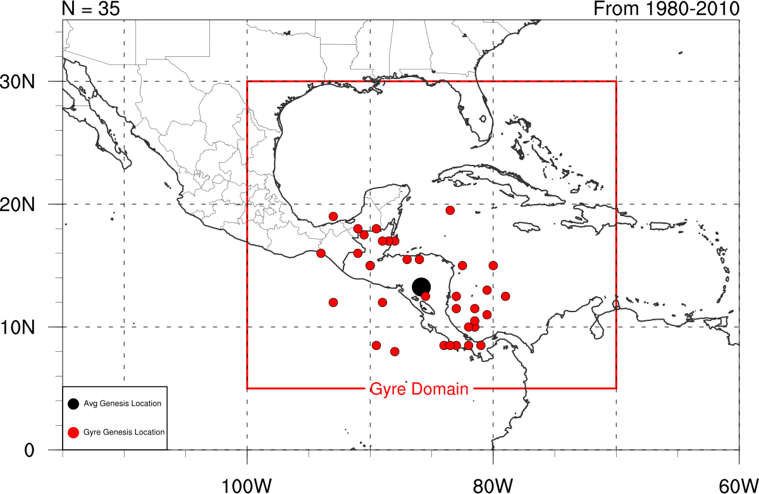
Tropical Gyres vs. Trough Induced Gyres

Slide 54
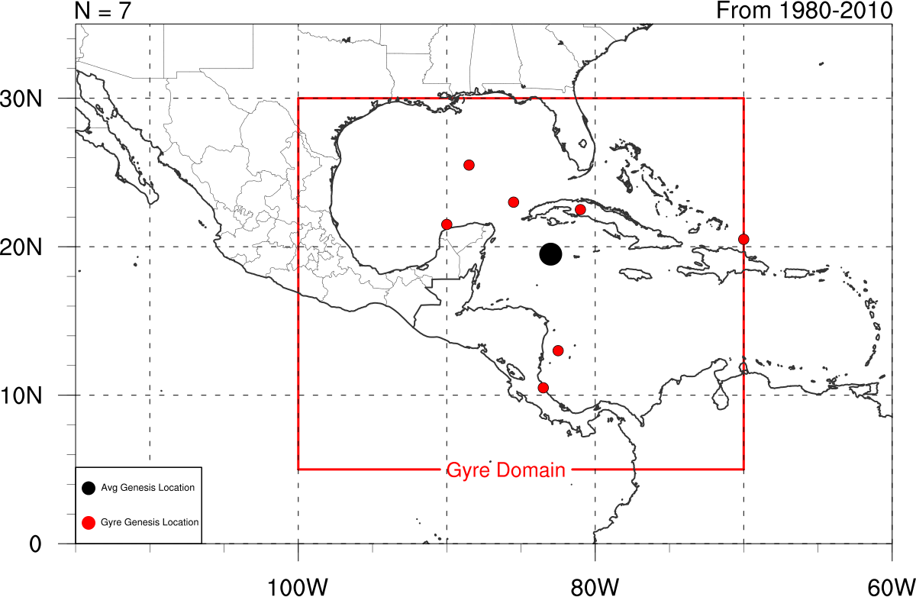
Tropical Gyres vs. Trough Induced Gyres

Slide 55
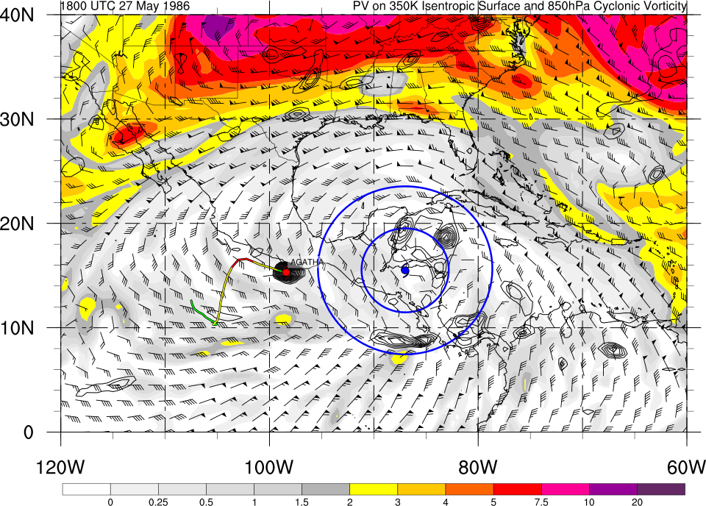
Primarily Tropical Gyre Example

Slide 56
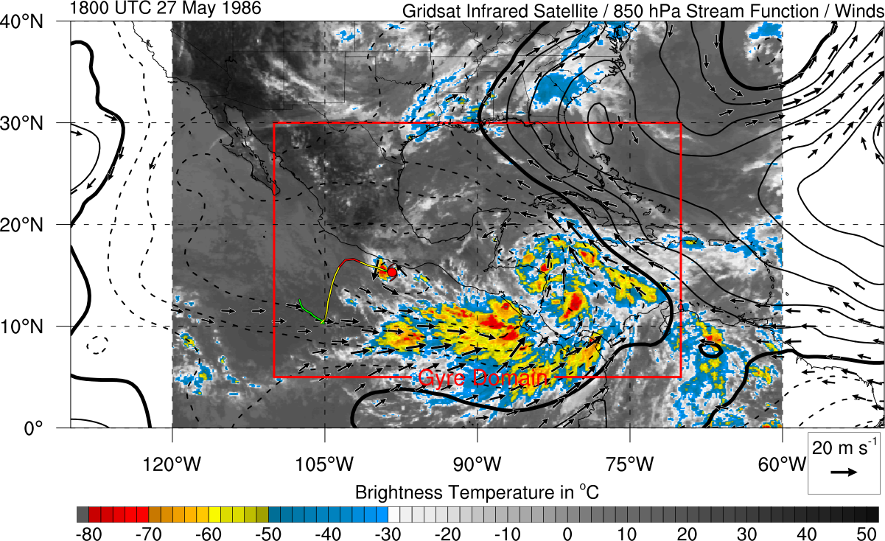
Primarily Tropical Gyre Example
IR Satellite Presentation

Slide 57
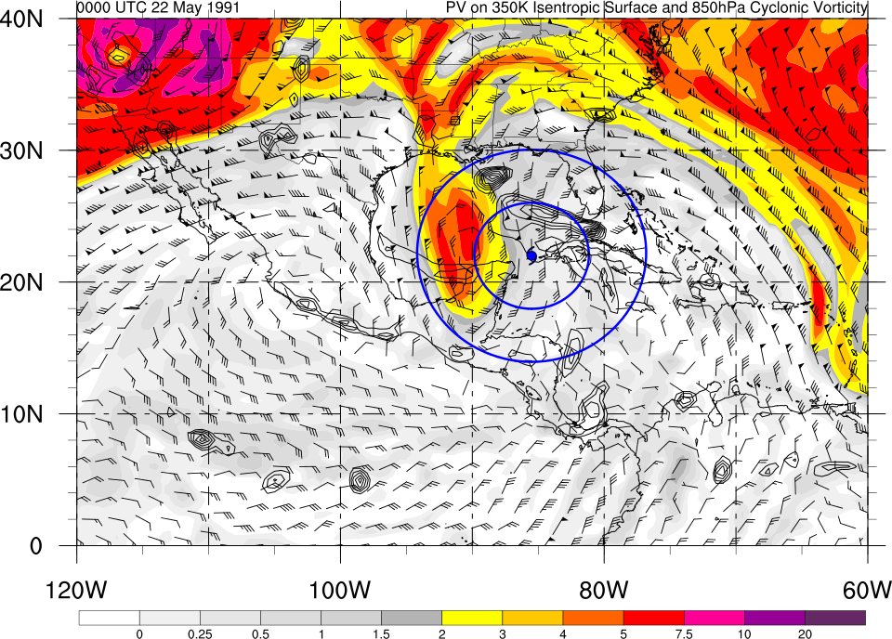
Trough Influenced Gyre Example

Slide 58
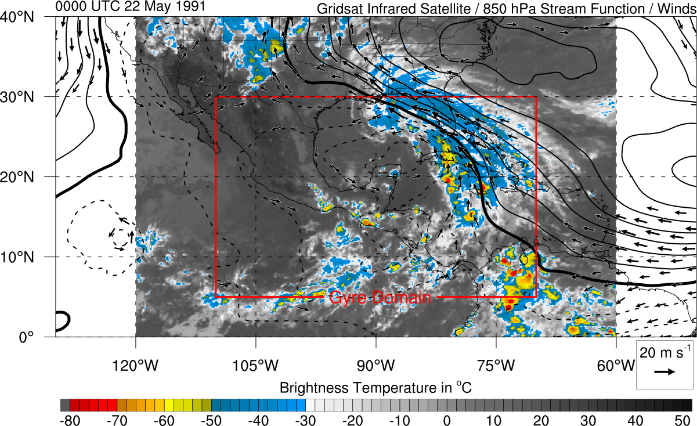
Trough Influenced Gyre Example
IR Satellite Presentation

Slide 59
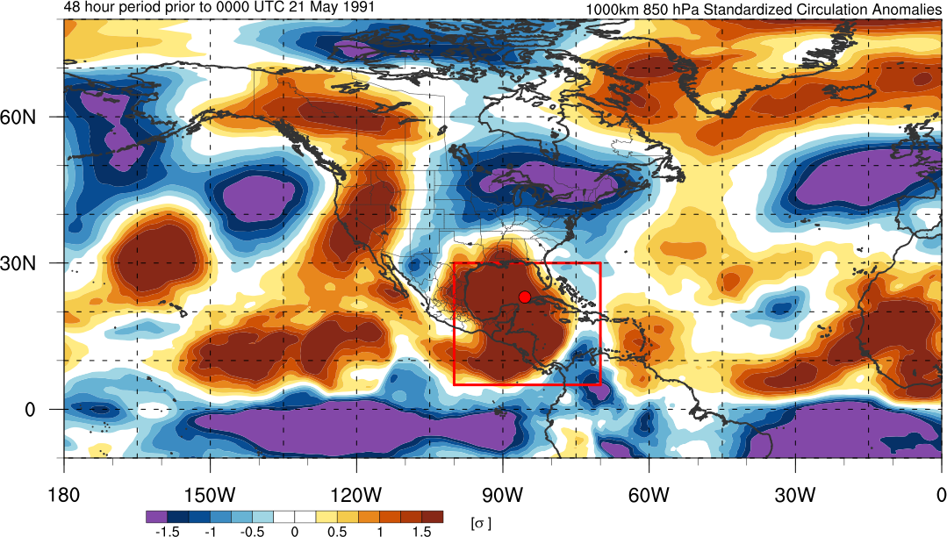
Circulation Anomaly Statistics
Using 1000 km standardized circulation anomaly
(averaged over 48 hour period prior to genesis)
All cases have positive cyclonic circulation anomaly
38/42 cases are > 0.5 sigma anomaly

Slide 60
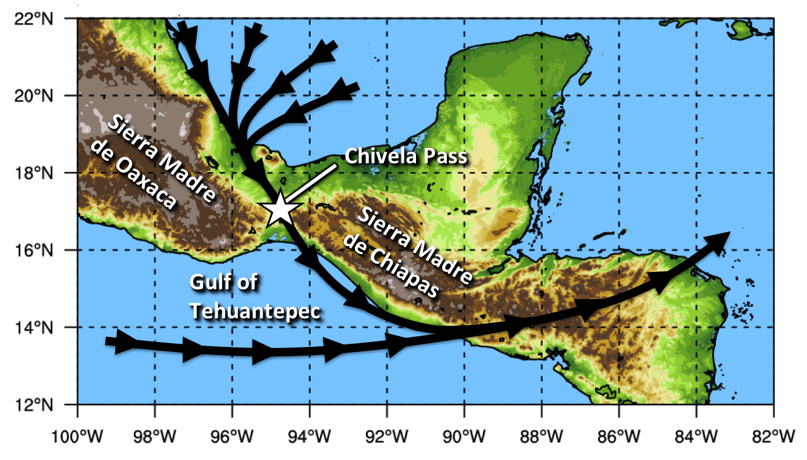
Climatology – Gap Wind Schematic
Cyclonic shear is present poleward of the low – level westerly wind corridor in the East Pacific
Northerly low – level jet surges through Chivela Pass into Gulf of Tehuantepec and can aid in downstream cyclonic vorticity growth

Slide 61
Gyre Identification Graphics

Slide 62
Old Slides That Have Since Been Replaced

Slide 63
Algorithm for CA Gyre Identification
30ºN, 100ºW
30ºN, 70ºW
5ºN, 100ºW
5ºN, 70ºW
1. Area Domain
Region screened every 6 hours
1May – 30 November
1980-2010 (31 years)

Slide 64
Algorithm for CA Gyre Identification
1. Area Domain
Period: 1 May – 30 November 1980-2010
30ºN,100ºW
30ºN,70ºW
500 – 1000 km
Circulation
Value > 1*10⁻⁵ s⁻¹
5ºN,100ºW
5ºN,70ºW
500 km
1000 km
2. Circulation
Using Stokes’s theorem
Macroscopic measure of rotation
500-1000 km circulation > 1*10⁻⁵ s⁻¹
Maximum value identifies gyre center

Slide 65
Algorithm for CA Gyre Identification
2. Circulation Magnitude and Center
500 – 1000 km
Circulation
Max V_{t} Wind > 5 m s⁻¹
Value > 1*10⁻⁵ s⁻¹
At distance > 500 km
500 km
500 km
1000 km
3. Azimuthally Averaged Tangential Wind
True in case of circular circuit
Max tangential wind > 5 m s⁻¹
Distance of max tangential wind > 500 km
Most effective at omitting large TCs

Slide 66
Algorithm for CA Gyre Identification
2. Circulation Magnitude and Center
Max: 46 m s⁻¹
Dist: 100 km
TC Ivan
Max V_{t} Wind > 5 m s⁻¹
500-1000 km
Circulation
Value > 1*10⁻⁵ s⁻¹
At distance > 500 km
500 km
500 km
1000 km
Max: 9 m s⁻¹
Dist: 750 km
3. Azimuthally Averaged Tangential Wind
CA Gyre
True in case of circular circuit
Max tangential wind > 5 m s⁻¹
Distance of max tangential wind > 500 km
Most effective at omitting large TCs

Slide 67
Algorithm for CA Gyre Identification
2. Circulation Magnitude and Center
500-1000 km
Circulation
Max V_{t} Wind > 5 m s⁻¹
Value > 1*10⁻⁵ s⁻¹
At distance > 500 km
500 km
500 km
1000 km
3. Azimuthally Averaged Tangential Wind
True in case of circular circuit
Max tangential wind > 5 m s⁻¹
Distance of max tangential wind > 500 km
Most effective at omitting large TCs

Slide 68
Algorithm for CA Gyre Identification
3. Azimuthally Averaged Tangential Wind
60º
Max V_{t} Wind > 5 m s⁻¹
Min V_{t} Wind
> 1 m s⁻¹
At distance > 500 km
Rotated at 10º intervals
500 km
500 km
1000 km
4. Arc Averaged Tangential Wind
Min arc averaged tangential wind > 1 m s⁻¹
Test for cyclonic flow around center
Most effective at omitting non-closed circulations

Slide 69
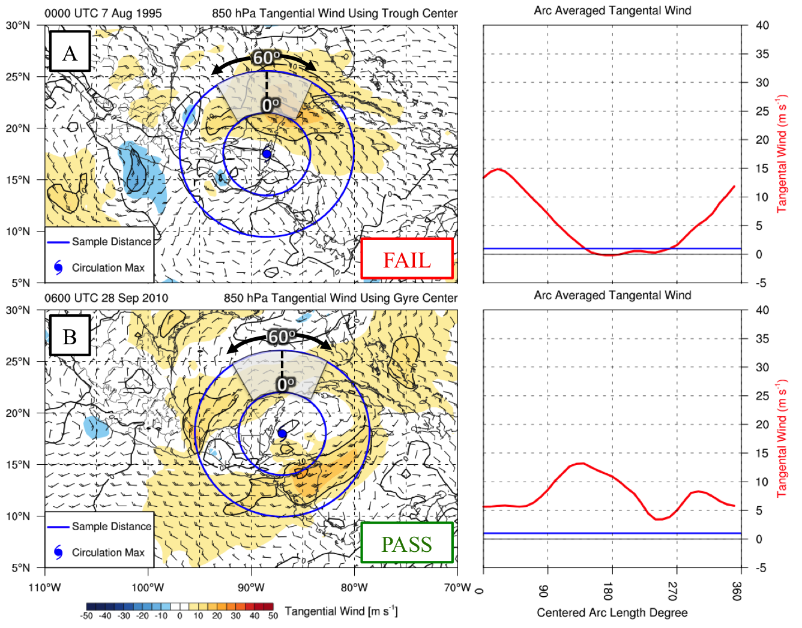
Algorithm for CA Gyre Identification
3. Azimuthally Averaged Tangential Wind
Min: 0 m s⁻¹
Arc Center: 170º
60º
Trough
Min V_{t} Wind
> 1 m s⁻¹
Max V_{t} Wind > 5 m s⁻¹
At distance > 500 km
Rotated at 10º intervals
500 km
500 km
Min: 3 m s⁻¹
Arc Center: 250º
1000 km
CA Gyre
4. Arc Averaged Tangential Wind
Min arc averaged tangential wind > 1 m s⁻¹
Test for cyclonic flow around center
Most effective at omitting non-closed circulations

Slide 70
Algorithm for CA Gyre Identification
3. Azimuthally Averaged Tangential Wind
60º
Max V_{t} Wind > 5 m s⁻¹
Min V_{t} Wind
> 1 m s⁻¹
At distance > 500 km
Rotated at 10º intervals
500 km
500 km
1000 km
4. Arc Averaged Tangential Wind
Min arc averaged tangential wind > 1 m s⁻¹
Test for cyclonic flow around center
Most effective at omitting non-closed circulations

Slide 71
Algorithm for CA Gyre Identification
1. Area Domain
2. Circulation Magnitude and Center
Period: 1 May – 30 November 1980-2010
30ºN,100ºW
30ºN,70ºW
500-1000 km
Circulation
C Max = Gyre Center
Value > 1*10⁻⁵ s⁻¹
500 km
5ºN,100ºW
5ºN,70ºW
1000 km
+6h
60º
Min V_{t} Wind
> 1 m s⁻¹
Max V_{t} Wind > 5 m s⁻¹
Rotated at 10º intervals
At distance > 500 km
500 km
500 km
1000 km
4. Arc Averaged Tangential Wind
3. Azimuthally Averaged Tangential Wind

Slide 72
Algorithm for CA Gyre Identification
1. Area Domain
2. Circulation Magnitude and Center
Period: 1 May – 30 November 1980-2010
30ºN,100ºW
30ºN,70ºW
500-1000 km
Circulation
C Max = Gyre Center
Value > 1*10⁻⁵ s⁻¹
500 km
5ºN,100ºW
5ºN,70ºW
1000 km
+6h
All Tests Pass ≥ 48 h = Gyre Event
60º
Min V_{t} Wind
> 1 m s⁻¹
Pass
Max V_{t} Wind > 5 m s⁻¹
Rotated at 10º intervals
At distance > 500 km
500 km
500 km
1000 km
4. Arc Averaged Tangential Wind
3. Azimuthally Averaged Tangential Wind

Slide 74
Background – CA gyres vs. WPAC gyres
Areal size similar to MDs
Low-level circulation 500 – 1000 km in radius
Lifespan closest to MDs
48 hours or longer
Convective and vorticity distribution similar to MGs
Displaced on south and eastern periphery from center
Mesoscale vortices akin to MGs
Variety of genesis mechanisms
Purely tropical and mid-latitude genesis cases
500 – 1000 km Radius

Slide 75
Background – CA gyres vs. WPAC gyres
Areal size similar to MDs
Low-level circulation 500 – 1000 km in radius
Lifespan closest to MDs
48 hours or longer
Convective and vorticity distribution similar to MGs
Displaced on south and eastern periphery from center
Mesoscale vortices akin to MGs
Variety of genesis mechanisms
Purely tropical and mid-latitude genesis cases
500 – 1000 km Radius
Persists 48 h or Longer

Slide 76
Background – CA gyres vs. WPAC gyres
Areal size similar to MDs
Low-level circulation 500 – 1000 km in radius
Lifespan closest to MDs
48 hours or longer
Convective and vorticity distribution similar to MGs
Displaced on south and eastern periphery from center
Mesoscale vortices akin to MGs
Variety of genesis mechanisms
Purely tropical and mid-latitude genesis cases
500 – 1000 km Radius
Persists 48 h or Longer

Slide 77
Background – CA gyres vs. WPAC gyres
Areal size similar to MDs
Low-level circulation 500 – 1000 km in radius
Lifespan closest to MDs
48 hours or longer
Convective and vorticity distribution similar to MGs
Displaced on south and eastern periphery from center
Mesoscale vortices akin to MGs
Variety of genesis mechanisms
Purely tropical and mid-latitude genesis cases
500 – 1000 km Radius
Persists 48 h or Longer

Slide 78
Background – CA gyres vs. WPAC gyres
Areal size similar to MDs
Low-level circulation 500 – 1000 km in radius
Lifespan closest to MDs
48 hours or longer
Convective and vorticity distribution similar to MGs
Displaced on south and eastern periphery from center
Mesoscale vortices akin to MGs
Variety of genesis mechanisms
Purely tropical and mid-latitude genesis cases
Upper Level
+PV Anomaly
500 – 1000 km Radius
Persists 48 h or Longer
ITCZ

Slide 79
Conclusions
Central America gyres
Large low-level circulation
Algorithm identified characteristics similar to MGs and MDs
500-1000 km Radius
Climatology Identified 42 Gyres
Two peaks
May/June
September/October
Mean westerly low-level flow more favored at these times
Favors corridor of cyclonic shear vorticity in EPAC
W
E
W

Slide 80
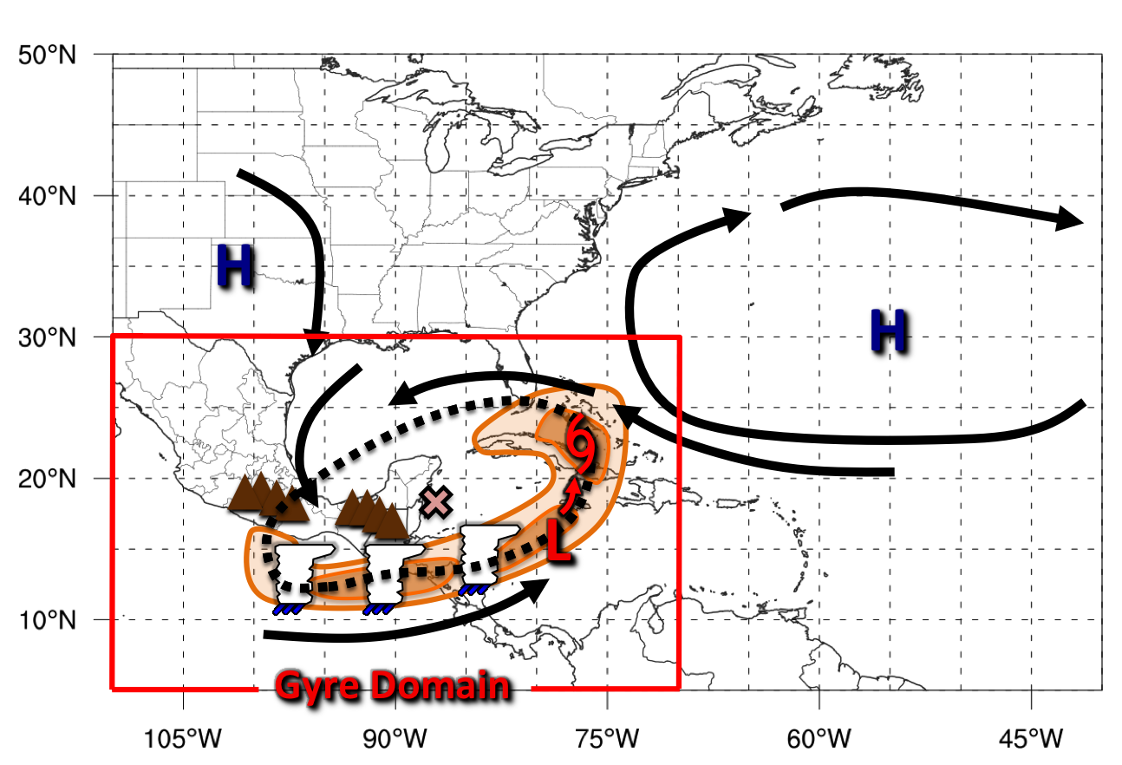
Climatology – Composites – 850 hPa Heights/Winds

Slide 81
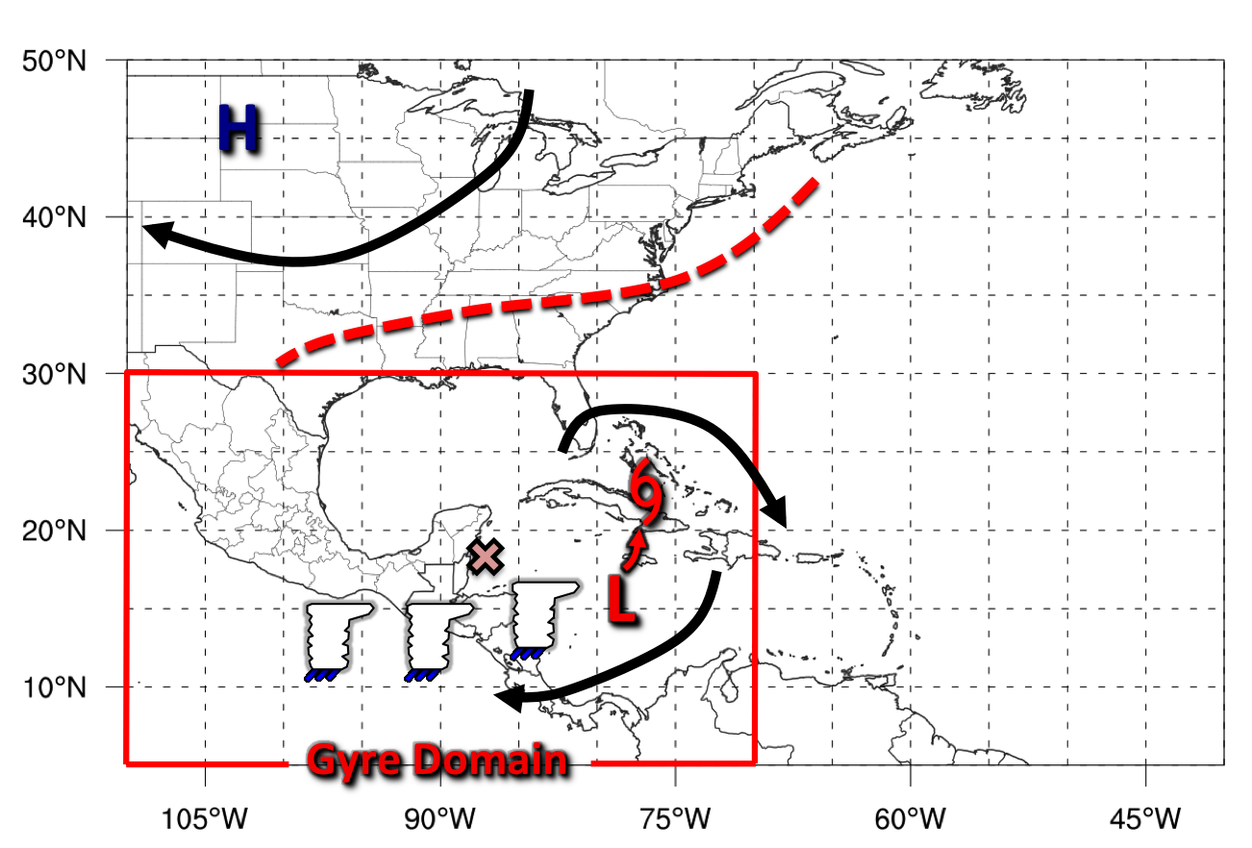
Climatology – Composites – 200 hPa Heights/Winds

Slide 82
Conclusions
Central America gyres
Large low-level circulation
Deep convection and vorticity on south/east periphery
Smaller and shorter than West Pacific MGs and MDs
500-1000 km Radius
Climatology Identified 19 Gyres
Two peaks
May/June
September/October

Slide 83
Conclusions
Composite Analysis
Anomalous low-level flow precedes gyre
Signal for anticyclonic wave breaking in upper levels
Accumulation of high precipitable water within gyre
Low – Level Composite
Upper – Level Composite

Slide 84
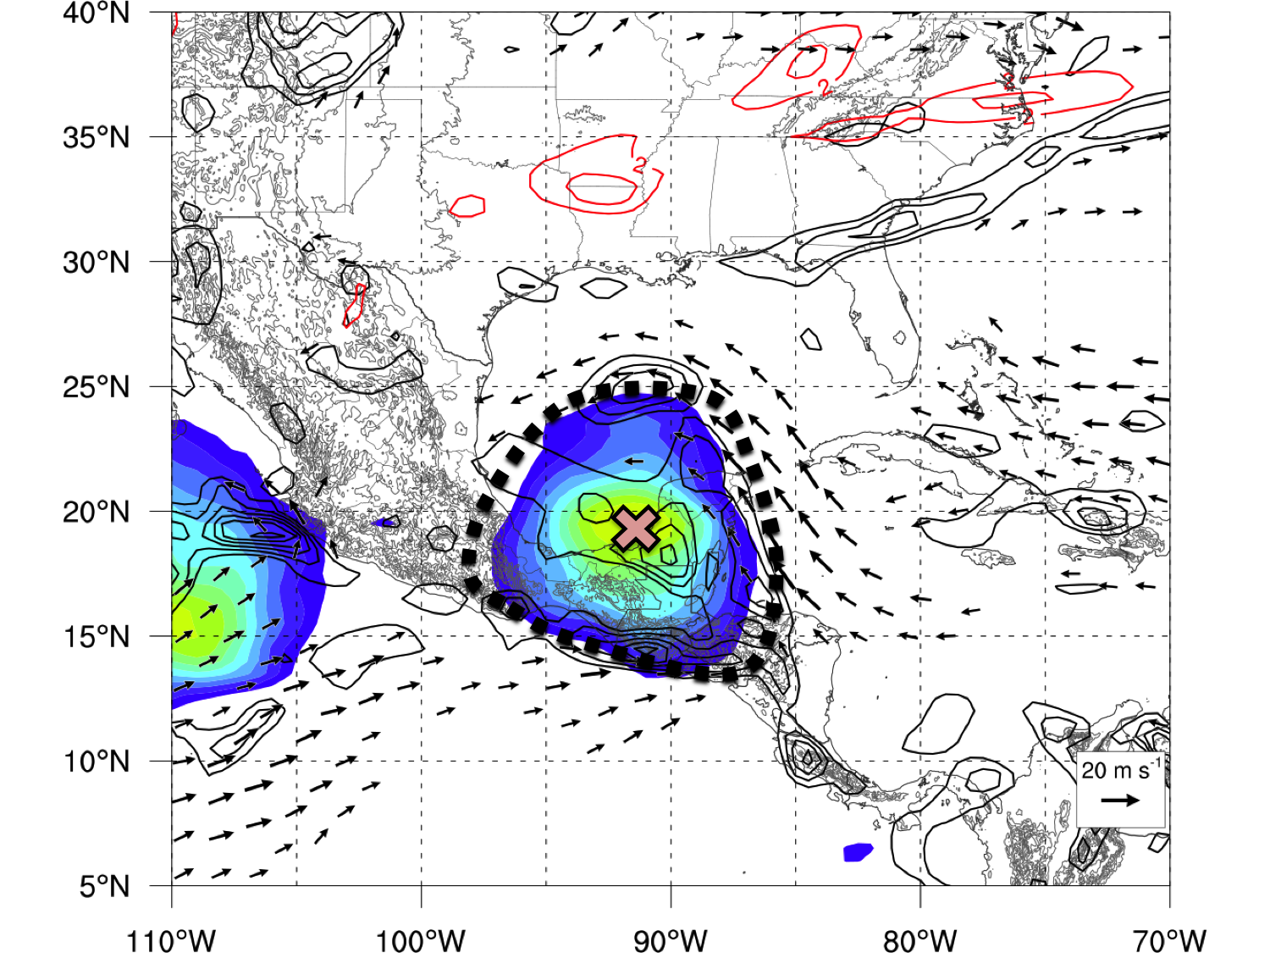
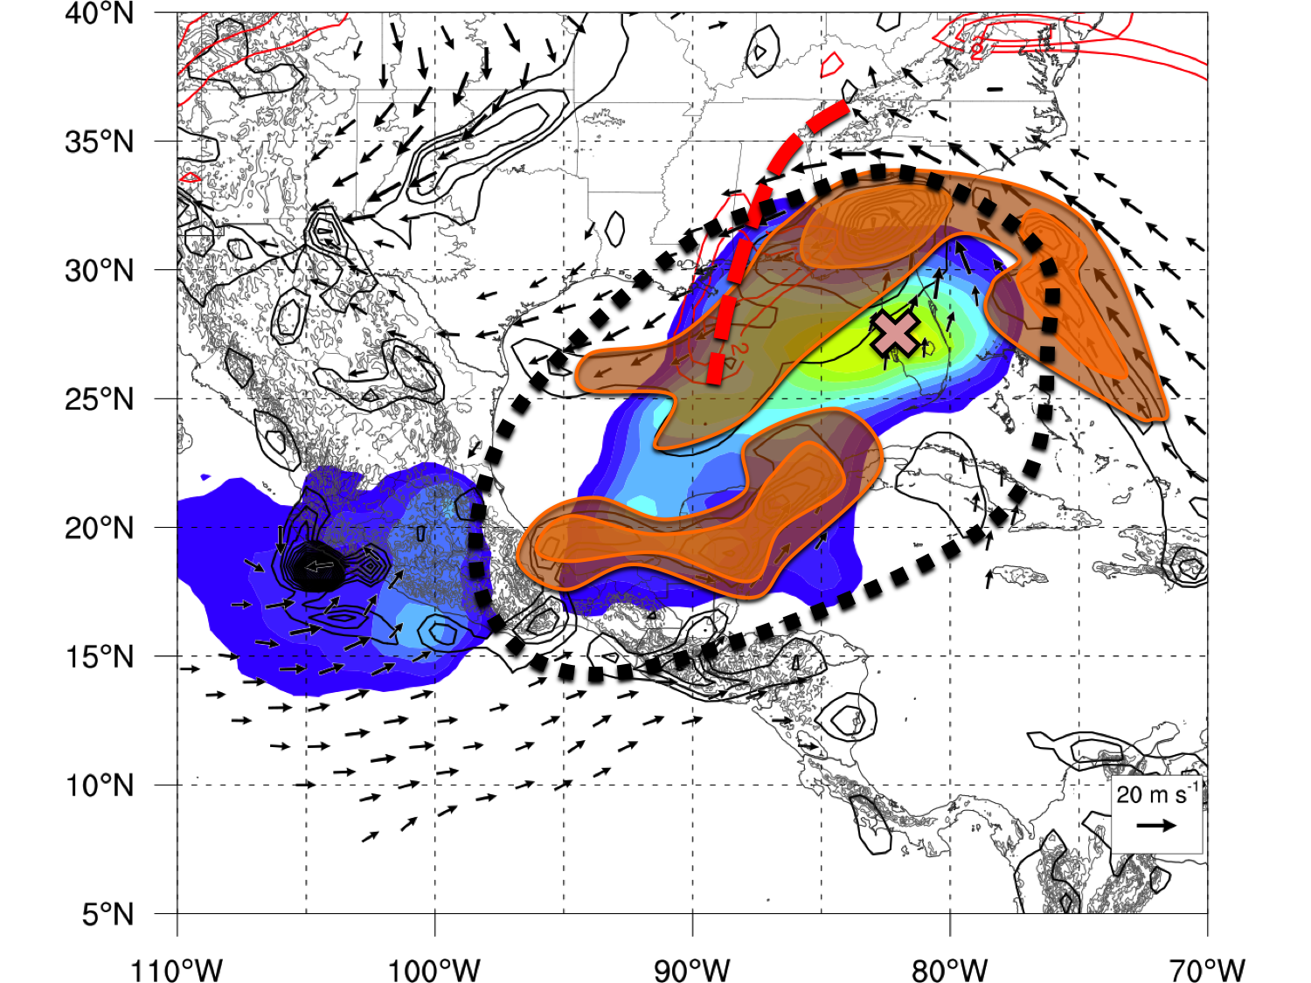
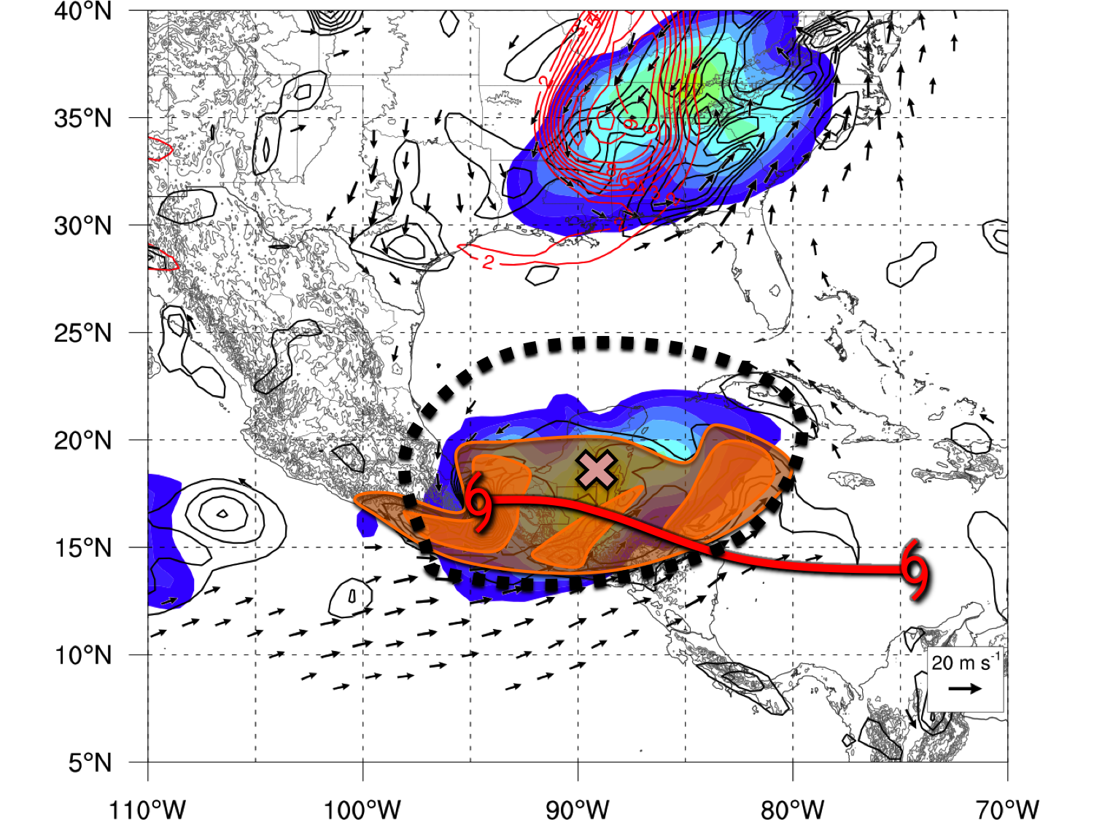
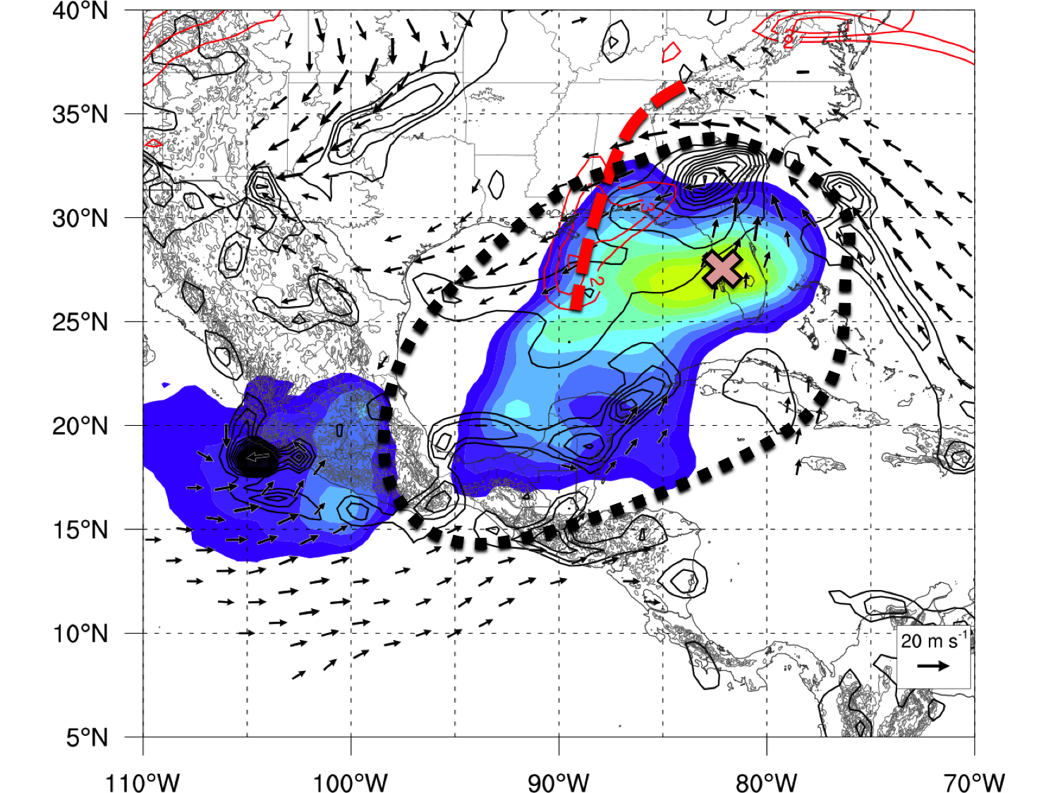
Case Examples
Terrain Induced
Upper-Level Trough Interaction
Predecessor TC
0000 UTC 7 Sep 1998
0600 UTC 6 Oct 2005
1200 UTC 27 Oct 2010
[10⁻⁵ s⁻¹]
[ºC]
Circulation Area
Gyre Center
Convection
Upper Level Trough Axis

Slide 85
Case Examples
Terrain Induced
Upper-Level Trough Interaction
Predecessor TC
0000 UTC 7 Sep 1998
0600 UTC 6 Oct 2005
1200 UTC 27 Oct 2010
[10⁻⁵ s⁻¹]
[ºC]
Circulation Area
Gyre Center
Convection
Upper Level Trough Axis

Slide 86
Case Examples
Terrain Induced
Upper-Level Trough Interaction
Predecessor TC
0000 UTC 7 Sep 1998
0600 UTC 6 Oct 2005
1200 UTC 27 Oct 2010
[10⁻⁵ s⁻¹]
[ºC]
Circulation Area
Gyre Center
Convection
Upper Level Trough Axis

Slide 87
More Objective Classification System
Adapted methods from Brian Crandall’s thesis
Azimuthally-averaged circulation at 850 hPa must remain cyclonic at every radius (at 100 km bins) up to 2000 km
Average tangential wind speed at 850 hPa must reach 8 m s⁻¹ at some radius within the circulation
Some differences
My Circulation netCDF code only go to 1000 km radius
Not averaging different circulation radii together (yet)

Slide 88
More Objective Classification System
Horizontal Tangential Wind Centered over Gyre
Azimuthally Averaged Tangential Wind

Slide 89
More Objective Classification System
Horizontal Tangential Wind Centered over Gyre
Tangential Wind By quadrant of gyre

Slide 90
Circulation Horizontal Plot Example

Slide 91
Test Values
Circulation on 700 km Radius
850 hPa Relative Vorticity /10-20 m s⁻¹ winds
200-300 Layer Mean PV
IBTrACS / Terrain
TC AGATHA
1200 UTC 28 May 1986

Slide 92
Background – Previous Research
Monsoon Gyre (MG)
Lander (1994), Holland (1995), Molinari and Vollaro (2012)
Monsoon Depression (MD)
Harr et al. (1996), Beattie and Elsberry (2010, 2012)
1000 – 1250km Radius
500 – 600km Radius
Figure 16 Molinari and Vollaro (2012)
Figure 1 Beattie and Elsberry (2012)

Slide 93
Background – Previous Research
Monsoon Gyre (MG)
Lander (1994), Holland (1995), Molinari and Vollaro (2012)
Monsoon Depression (MD)
Harr et al. (1996), Beattie and Elsberry (2010, 2012)
1000 – 1250km Radius
500 – 600km Radius
Figure 16 Molinari and Vollaro (2012)
Figure 1 Beattie and Elsberry (2012)

Slide 94
Background – Previous Research
Monsoon Gyre (MG)
Lander (1994), Holland (1995), Molinari and Vollaro (2012)
Monsoon Depression (MD)
Elsberry and Chan (1996), Beattie and Elsberry (2010, 2012)
Asymmetric Vorticity
Symmetric Vorticity
Figure 16 Molinari and Vollaro (2012)
Figure 1 Beattie and Elsberry (2012)

Slide 95
Background – Previous Research
Monsoon Gyre (MG)
Lander (1994), Holland (1995), Molinari and Vollaro (2012)
Monsoon Depression (MD)
Elsberry and Chan (1996), Beattie and Elsberry (2010, 2012)
Embedded Mesovorticies
Focused Vorticity
Figure 16 Molinari and Vollaro (2012)
Figure 1 Beattie and Elsberry (2012)

Slide 96
Background – Previous Research
Monsoon Gyre (MG)
Lander (1994), Holland (1995), Molinari and Vollaro (2012)
Monsoon Depression (MD)
Elsberry and Chan (1996), Beattie and Elsberry (2010, 2012)
Asymmetric Convection
Symmetric Convection
Figure 16 Molinari and Vollaro (2012)
Figure 1 Beattie and Elsberry (2012)

Slide 97
Background – Previous Research
Monsoon Gyre (MG)
Lander (1994), Holland (1995), Molinari and Vollaro (2012)
Monsoon Depression (MD)
Elsberry and Chan (1996), Beattie and Elsberry (2010, 2012)
Lifespan: Multiple Weeks
Lifespan: 3 – 5 days
Figure 16 Molinari and Vollaro (2012)
Figure 1 Beattie and Elsberry (2012)

Slide 98
Background – Previous Research
Monsoon Gyre (MG)
Lander (1994), Holland (1995), Molinari and Vollaro (2012)
Monsoon Depression (MD)
Elsberry and Chan (1996), Beattie and Elsberry (2010, 2012)
Mid-Latitude Forcing
Tropical Forcing
ITCZ / Monsoon
Trough
Upper Level
+PV Anomaly
Figure 16 Molinari and Vollaro (2012)
Figure 1 Beattie and Elsberry (2012)

Slide 99
Climatology - Construction
Period: 1 May – 30 November 1980-2010
Objective Tests: Area domain
30ºN,100ºW
30ºN,70ºW
5ºN,100ºW
5ºN,70ºW

Slide 100
Climatology - Construction
Circulation
Area
Objective Tests: Magnitude and Persistence threshold
30ºN,100ºW
30ºN,70ºW
Circulation Max ≥ 48 h
Value > 1*10⁻⁵ s⁻¹
500 km
5ºN,100ºW
5ºN,70ºW

Slide 101
Climatology - Construction
Azimuthally
Averaged Tan Wind
Circulation
Area
Objective Tests: Azimuthally Averaged Tangential Wind
30ºN,100ºW
30ºN,70ºW
Max Tan Wind > 5 ms⁻¹ at distance > 500km
500 km
5ºN,100ºW
5ºN,70ºW

Slide 102
Climatology - Construction
Azimuthally
Averaged Tan Wind
Circulation
Area
Max: 46 m s⁻¹
Dist: 100 km
TC Ivan
Objective Tests: Azimuthally Averaged Tangential Wind
30ºN,100ºW
30ºN,70ºW
Max Tan Wind > 5 ms⁻¹ at distance > 500km
Max: 9 m s⁻¹
Dist: 750 km
CA Gyre
500 km
5ºN,100ºW
5ºN,70ºW

Slide 103
Climatology - Construction
Azimuthally
Averaged Tan Wind
Arc Averaged Tan Wind
Circulation
Area
Objective Tests: Arc Averaged Tangential Wind
30ºN,100ºW
30ºN,70ºW
60º
Tan Wind > 1 ms⁻¹ rotated at 10º intervals
500 km
1000 km
5ºN,100ºW
5ºN,70ºW

Slide 104
Climatology - Construction
Azimuthally
Averaged Tan Wind
Arc Averaged Tan Wind
Circulation
Area
Min: 0 m s⁻¹
Arc Center: 170º
Trough
Objective Tests: Arc Averaged Tangential Wind
30ºN,100ºW
30ºN,70ºW
60º
Tan Wind > 1 ms⁻¹ rotated at 10º intervals
Min: 3 m s⁻¹
Arc Center: 250º
CA Gyre
500 km
1000 km
5ºN,100ºW
5ºN,70ºW

