Slide 1
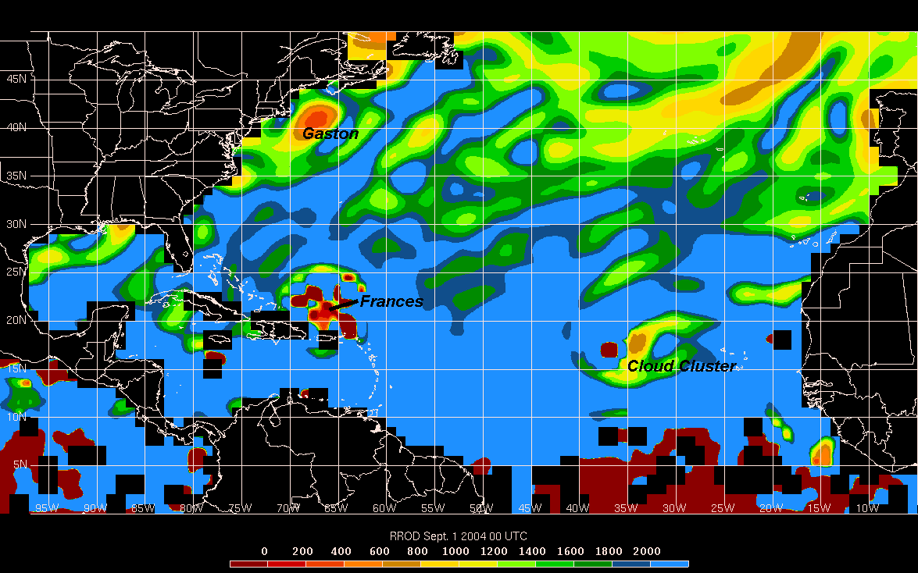
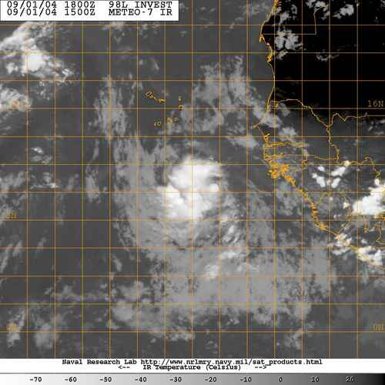
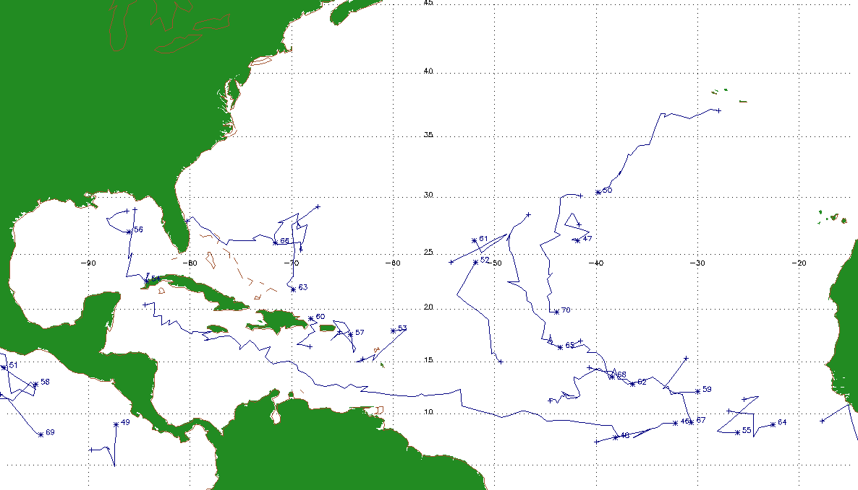

Using the Rossby Radius of Deformation as a Forecasting Tool for Tropical Cyclogenesis
Philippe Papin (Faculty Advisor: Chris Hennon)

Slide 2
Outline
Tropical Cyclogenesis background
  Forecasting TCG
Rossby Radius of Deformation (RROD)
  Equation and Diagrams
Using RROD
  Methodology
  Results
    Identifying Best Prediction Technique
    Contingency Table Forecasting
    Comparing to Other Studies
Complications and Future Work
  Incorporation into other studies

Slide 3
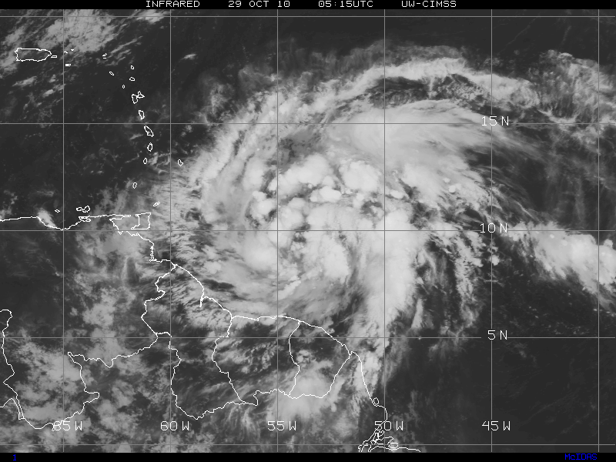
Tropical Cyclogenesis (TCG)
Formation of a tropical cyclone through an initial disturbance over open waters
  Tropical Cloud Clusters (TCC)
    Areas of thunderstorms that have potential to develop into a tropical cyclone

Slide 4
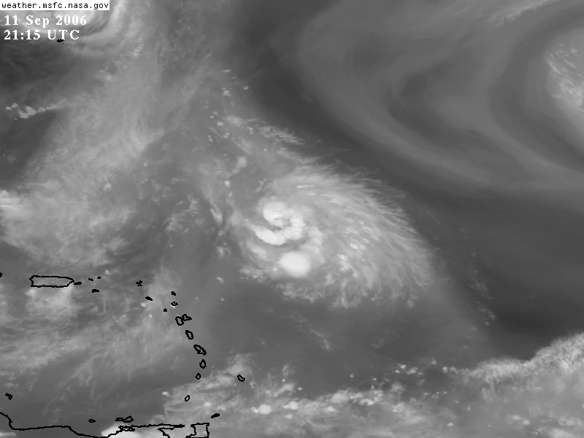
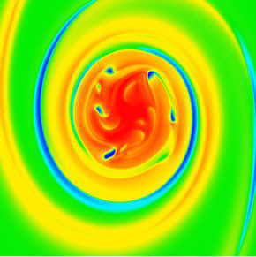
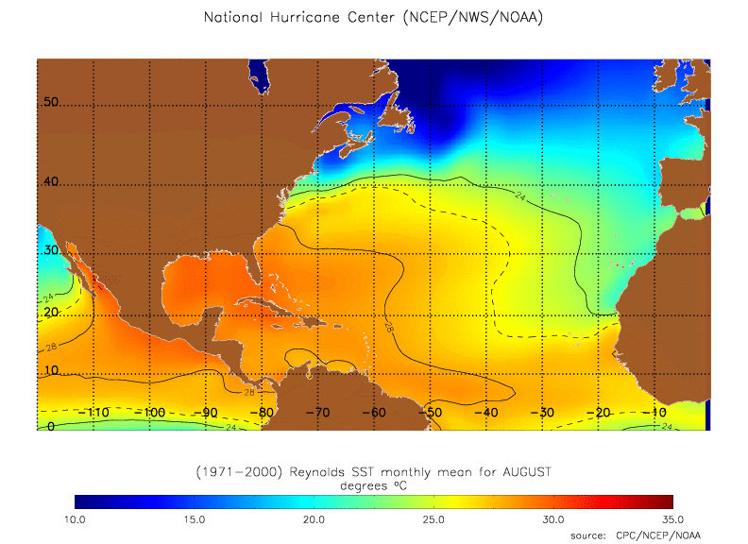
How Tropical Cyclones Develop (Gray 1968)
Sufficient Sea Surface Temperatures (at or greater than 26.5ºC ~80ºF)
  Source of Latent Heat for tropical cyclones
Weak Vertical Wind Shear
  Small change of winds with height
Low Level Relative Vorticity
  Initial spin
Moist Mid Levels
  High relative humidity
Wind Shear Diagram
Dry Air
Upper Levels
Moist Air
Mid Levels
Low Levels
Strong Wind Shear
Weak Wind Shear

Slide 5
Forecasting Tropical Cyclogenesis
Rare Event
  90% of all Atlantic Basin tropical cyclone ‘seedlings’ fail to develop despite favorable conditions. (Hennon et. al 2005)
Challenges
  Insufficient Computer Model resolution
    Small scale processes aid developing in TCCs
  Few In-situ observations in Atlantic
    Computer models and Satellite imagery used for forecasting

Slide 6
Potential For Operational Forecasting Parameter for TCG
Previous Studies have sought to find a parameter useful in TCG
  Low Level Vorticity
  Daily Genesis Potential
  Discriminant Analysis
    Combination of multiple variables
Using Rossby Radius of Deformation?

Slide 7
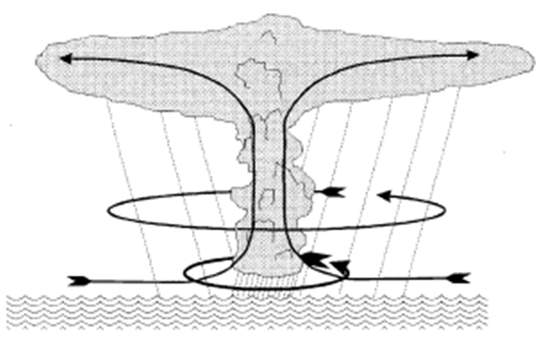
What is the Rossby Radius of Deformation?
Systems Dissapates
Systems Persists
Latent Heat
Latent Heat
Storm Radius
Storm Radius
Distance at which energy disperses by atmospheric waves from the center of a circulation
If this distance exceeds the storm radius, the energy disperses too far away and the system tends to dissipate.
If this distance is contained within the system radius, the storm will persist.

Slide 8
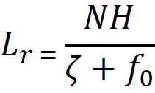
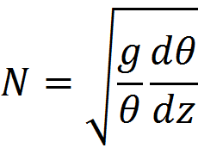
Rossby Radius of Deformation
Defined as
    N = Brunt–Väisälä frequency
    H = Depth of the system
    ζ = Relative Vorticity
    f₀ = Coriolis parameter (planetary vorticity)
  Critical Boundary where rotation becomes as important as buoyancy
  Brunt–Väisälä frequency
    g = Gravity
    θ = Potential Temperature
    Z = Geometric Height

Slide 9
RROD as a Forecasting Parameter
Decreasing Values of RROD typically indicate where conditions are more favorable for development
A RROD value can be assigned to a tropical cloud cluster
  Synoptic Conditions = Model Analysis
  Storm Height = Cloud Top Height

Slide 10
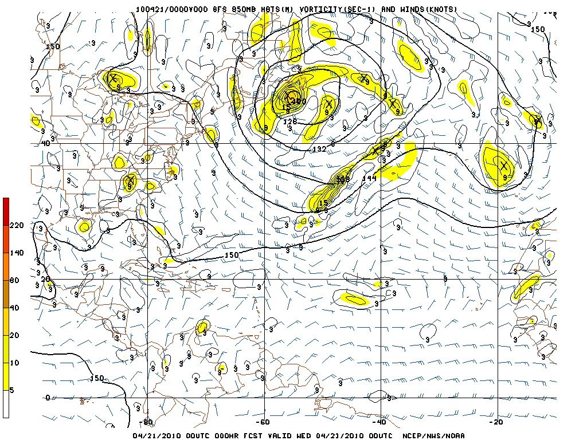
Methodology for RROD
Dataset
  Used Global Forecasting System (GFS) computer model analyses to obtain these variables
    Temperature
    Pressure
    Geopotential Height
    Absolute Vorticity

Slide 11
Methodology for RROD(cont.)
Dataset
  Atlantic Tropical Cloud Cluster Dataset (Hennon et al. 2011) was incorporated to test RROD for particular disturbances
    Cloud shield of cluster was used as storm radius
    Cloud top height used as storm height

Slide 12
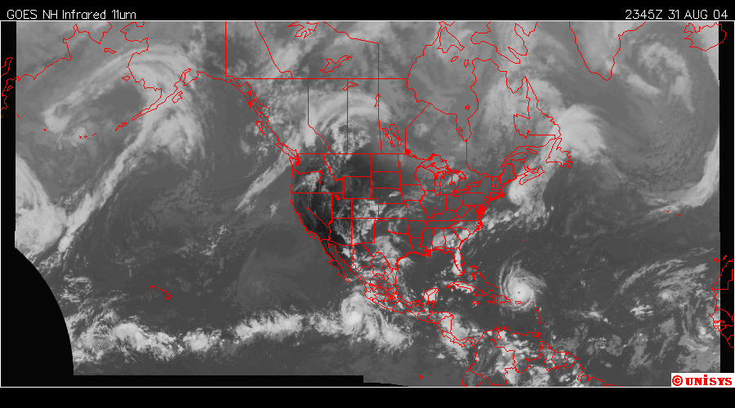
Preliminary RROD Field
Three Obvious RROD Minimums
Preliminary map was created to show if RROD was a feasible value to use for tropical cyclones
Compare the RROD field with the satellite imagery at the same time.
Notice the correlation of low RROD values with clusters/tropical cyclones
Correlation will be pursued to see if it is useful for tropical cyclogenesis

Slide 13
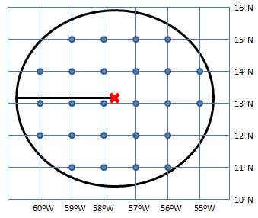
Algorithm for RROD
Fetch Data
TCC Data
Developing / Non-Developing
GFS Data
Identify grid points within TCC radius
RROD File Output
Calculate BVF and RROD
RROD value calculated every 6 hours until TCC dissipates or develops

Slide 14
Atlantic Tropical Cloud Cluster Dataset
1193 clusters were identified from 2004-2008
  65 developing clusters
Cloud Cluster Statistics for the Atlantic Basin
Year | Clusters | Developing Clusters | Development Ratio
2004 | 214 | 13 | 6.07%
2005 | 266 | 22 | 8.27%
2006 | 238 | 8 | 3.36%
2007 | 222 | 10 | 4.50%
2008 | 253 | 12 | 4.74%
Note the low development ratio

Slide 15
Methods For Improving RROD Calculation
Use vorticity at multiple levels
  10 levels used for vorticity (925 hPa to 500 hPa)
  Captures entire scope of circulation, not just a single height
Use mean cluster radius over max radius
  Max radius is the furthest extent of the cloud shield
  Mean radius is the mean extent of the cloud shield
    Better at only capturing only convective elements, with no cloudless air
Convection
Mean Radius
Max Radius

Slide 16
Methods For Improving RROD Algorithm
Rossby Radius Ratio (RRR)
  The environmentally derived RROD divided by the actual storm radius to provide the ratio
    In theory, the lower the number, the more energy is contained within the TCC
    Better value than RROD alone since it takes into account the size of the cluster

Slide 17
RROD Algorithm Results
Substantially lower average RROD in developing cases than non-developing cases
  Note, developing cases occurred at or before 48 hours of cluster initiation
  Mean RRR better discriminator for development
    Note the increased difference in developing and non-developing clusters for RRR mean.
Nice, but means not a great statistic for variables with high variance
Select Values From RROD Algorithm
Type of Tropical Cloud Cluster | RRODmax (km) | RRODmean (km) | RADIUSmax (km) | RADIUSmean (km) | RRRmax | RRRmean
Developing | 3485.68 | 2997.58 | 248.10 | 149.99 | 15.63 | 21.81
Non-Developing | 11629.81 | 11417.74 | 255.93 | 147.66 | 50.79 | 84.44

Slide 18
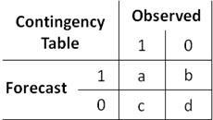
Threshold Value for RRR
Use of a single value that if exceeded indicates an event has or has not taken place
  In this case, if RRR goes beyond a certain value, a TCC won’t develop
  Sort results into a contingency table
    1 Indicates development
    0 Indicates non-development
  Contingency Table for each RRR
    1-50 RRR units
  How can we score this?

Slide 19
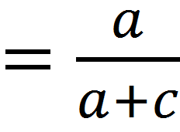
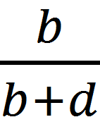
Skill Scores for Contingency Tables
Probability of Detection
  Ability to classify a developing cluster correctly
  1 is a perfect score
False Alarm Rate
  Ratio of false alarms to total number of occurrences
  0 is a perfect score
POD
FAR =

Slide 20
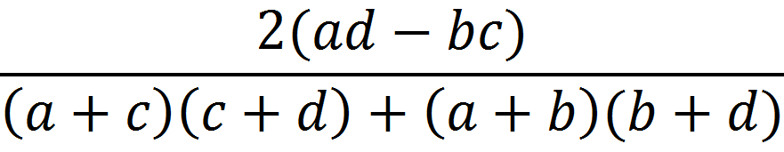
Skill Scores for Contingency Tables
Heidke Skill Score
  Combination of both the POD and FAR
  A more useful skill score for rare events such as tropical cyclogenesis (Marzban 1998)
  Perfect score is 1 with a random score being 0
HSS =

Slide 21
Picking a Threshold Value
Depends on what skill score is most important for the particular study
  Ex. POD is particularly important for Tornadoes
Most efficient combination of POD and FAR is desirable for TCG forecasting
  Heidke Skill Score

Slide 22
Results – Skill Score Tests For RRR
Best HSS value was .17 found at an RRR value of 17
POD of .42 and FAR of .13 for same RRR value
Seems like a low number right?

Slide 23
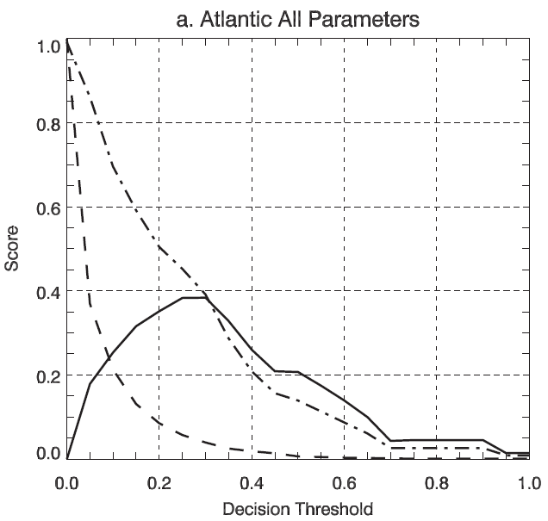
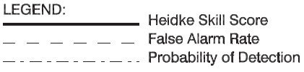
Comparison To Other Studies
Kerns and Zipser (2009)
  HSS found at .37 for a 6-48 hour forecast period (POD .39 and FAR .04)
  Slightly more than double findings of this study
  Used discriminant analysis of a multitude of predictors (10)

Slide 24
Overall Conclusions
RROD determines the distance as which energy travels away from a tropical cloud cluster
RRR is a useful ratio in comparing the RROD to the actual radius of a cluster
Contingency Tables are useful in identifying a threshold value that produces the best prediction capability of RRR
While HSS value is lower than previous studies, this is only based on one predictor as opposed to 10.

Slide 25
Future Work
Employ RRR into other prediction schemes
  Hennon et al. (2005)
Increase Sample Size of Study
  TCC database is reliable all the way to 1982
  Incorporate other ocean basins

Slide 26
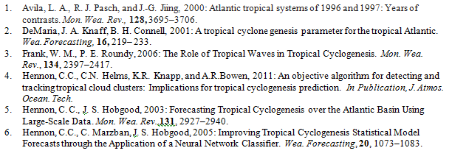
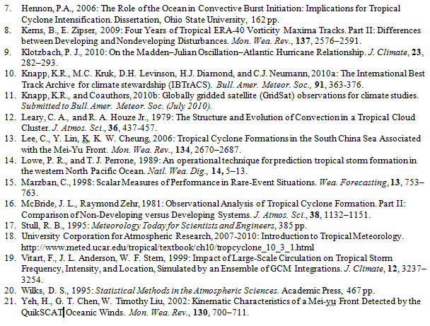
Works Cited

