Slide 1
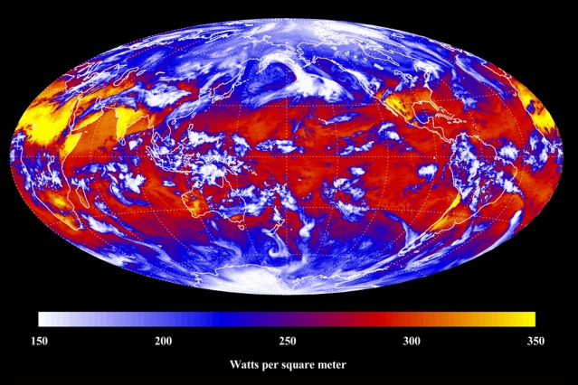
Outgoing Longwave Radiation
Radiation that is emitted by features on earth
  Water
  Clouds
  Land surface
  Infrared spectrum of energy

Slide 2
Connection to Stefan-Boltzmann
E = energy radiating in W m⁻² (Typical units of OLR)
= emissivity (if a blackbody = 1)
= Stefan-Boltzmann Constant = 5.6697 x 10⁻⁸ W m⁻² K⁻⁴
T = Temperature
Example: If a surface has a temperature of -10ºC and is a perfect blackbody, how much energy would it radiate?

Slide 3
Connection to Stefan-Boltzmann
E = energy radiating in W m⁻² (Typical units of OLR)
= emissivity (if a blackbody = 1)
= Stefan-Boltzmann Constant = 5.6697 x 10⁻⁸ W m⁻² K⁻⁴
T = Temperature
Example: If a surface has a temperature of -10ºC and is a perfect blackbody, how much energy would it radiate?
E = (1) * (5.6697 x 10⁻⁸ W m⁻² K⁻⁴) * (-10ºC + 273.15) = 271.9 W m⁻²

Slide 4
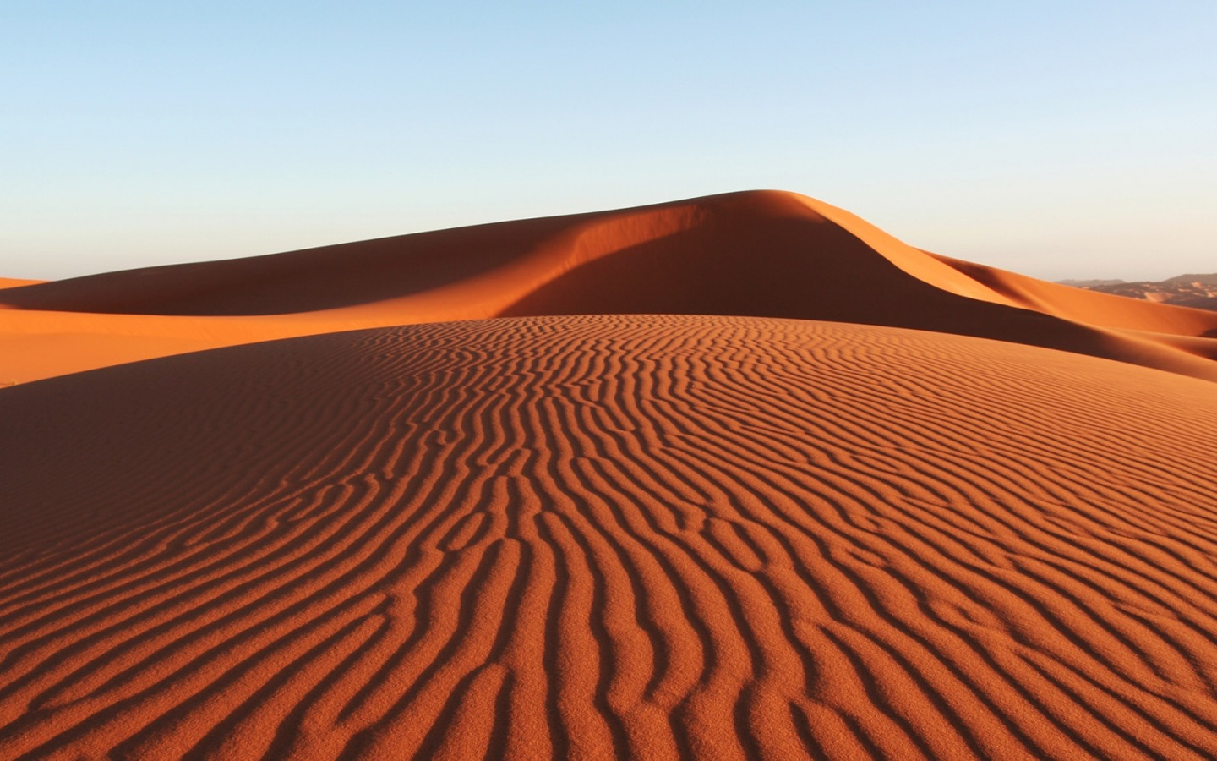
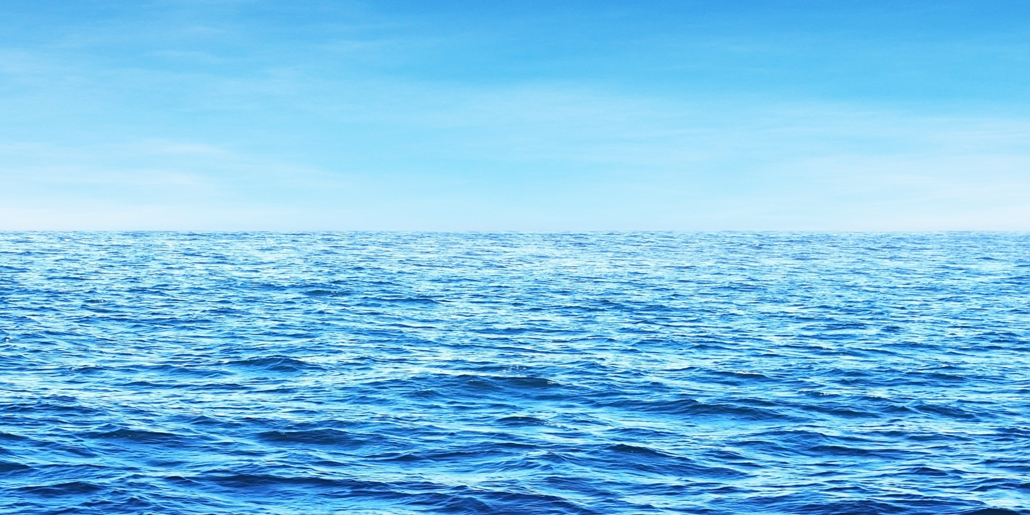
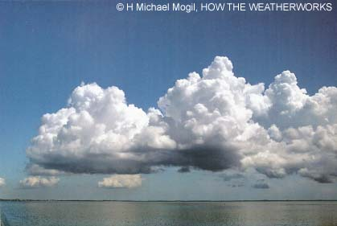
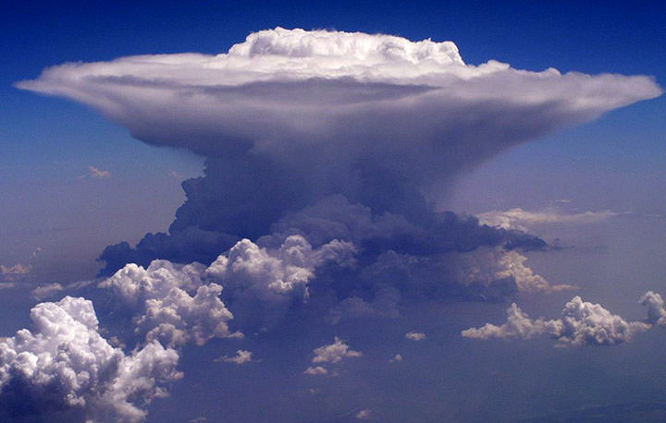
Connection to Stefan-Boltzmann
Which of these features has the highest and lowest outgoing longwave radiation?

Slide 5
Connection to Stefan-Boltzmann
Which of these features has the highest and lowest outgoing longwave radiation?
310 K
300 K
280 K
200 K

Slide 6
Connection to Stefan-Boltzmann
Which of these features has the highest and lowest outgoing longwave radiation?
Highest
High
310 K
300 K
280 K
Lower
200 K
Lowest

Slide 7
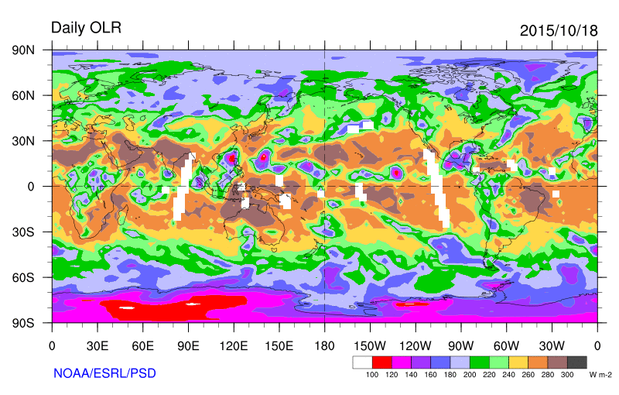
How does OLR change over the earth

Slide 8
How does OLR change over the earth
Tropical Cyclones

Slide 9
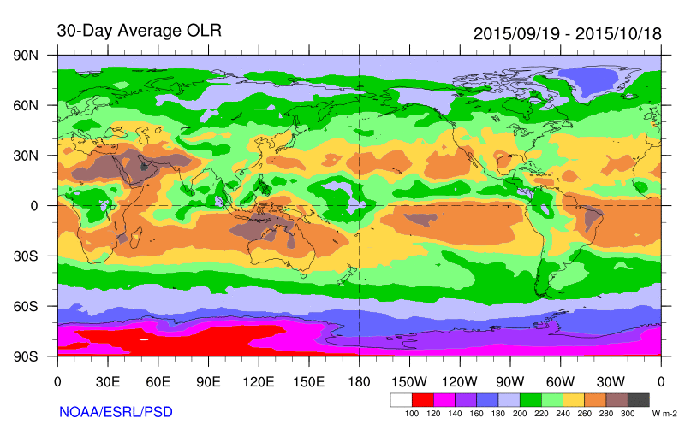
How does OLR change over the earth

Slide 10
How does OLR change over the earth
Desert
ITCZ
Dry Anticyclone
ICE

Slide 11
Climate Maps: Yearly Cycle
Questions to think about:
  Which location undergoes the largest change in OLR over the year?
  Highest OLR?
  Lowest OLR?
  Can you explain the distribution?

Slide 12
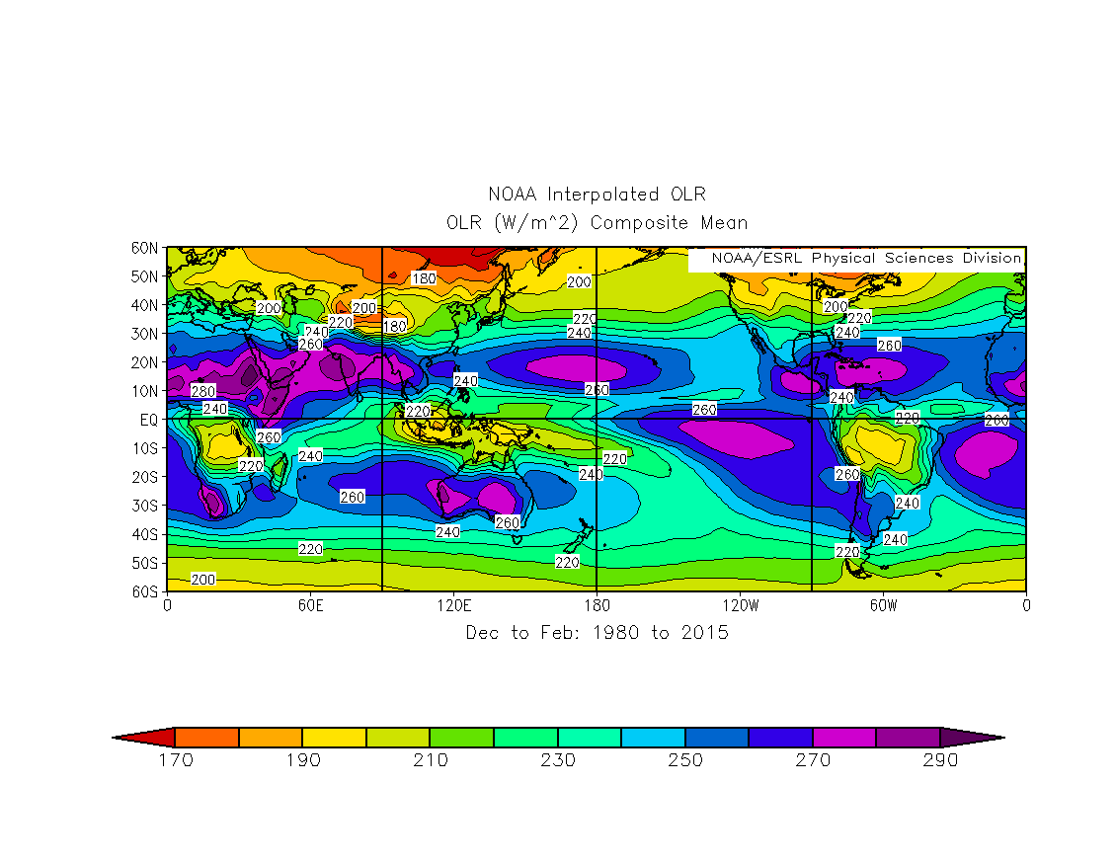
Climate Maps: Yearly Cycle

Slide 13
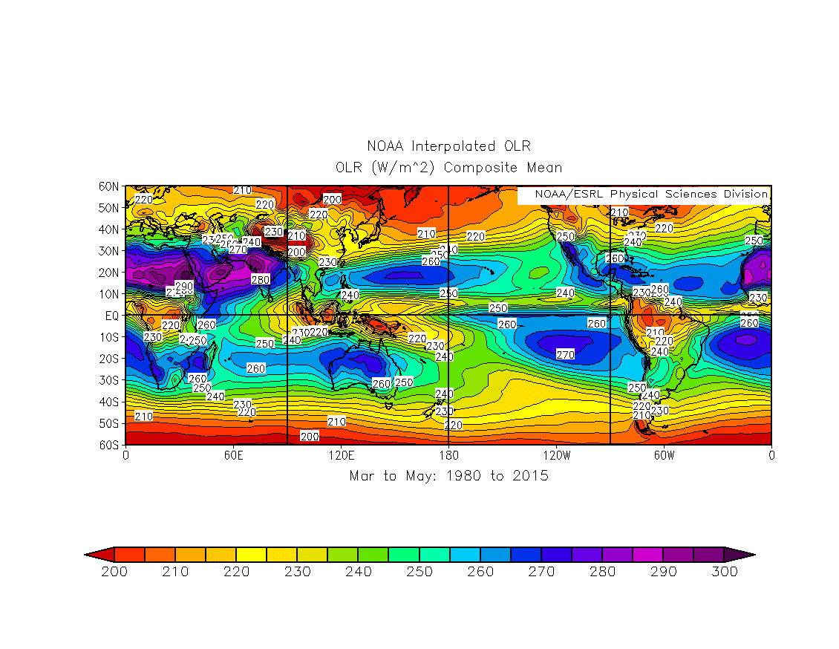
Climate Maps: Yearly Cycle

Slide 14
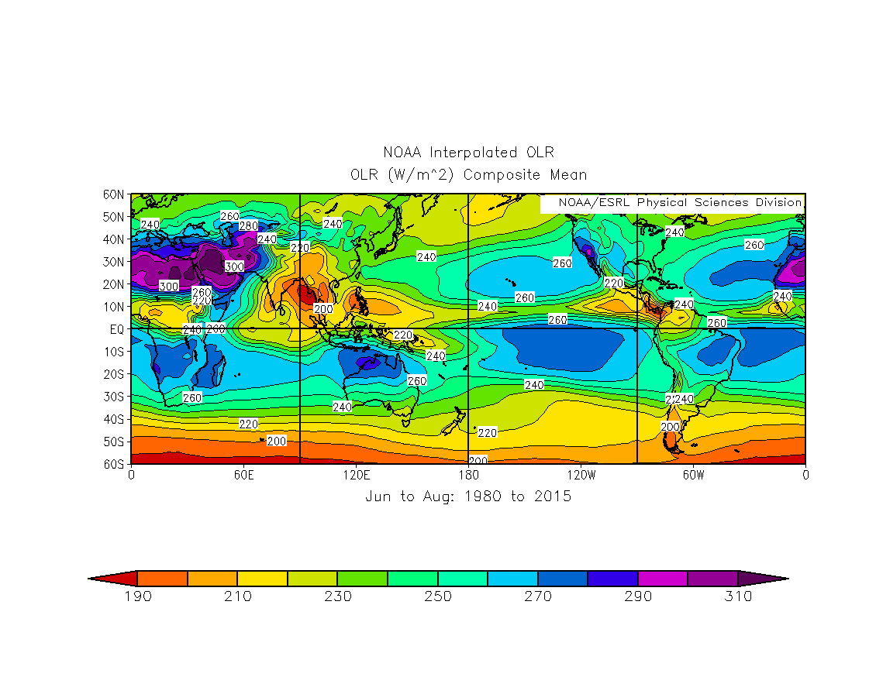
Climate Maps: Yearly Cycle

Slide 15
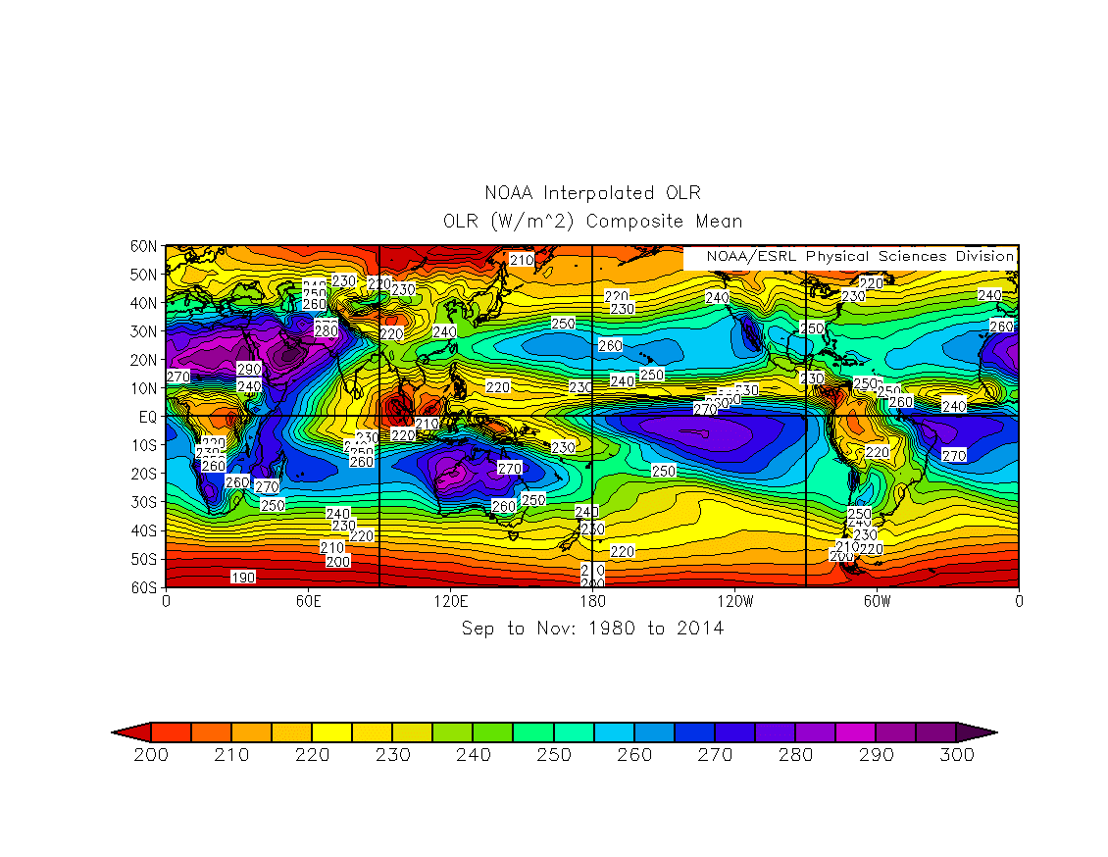
Climate Maps: Yearly Cycle

Slide 16
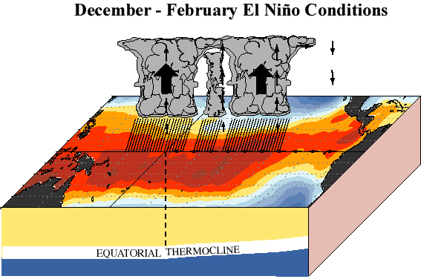
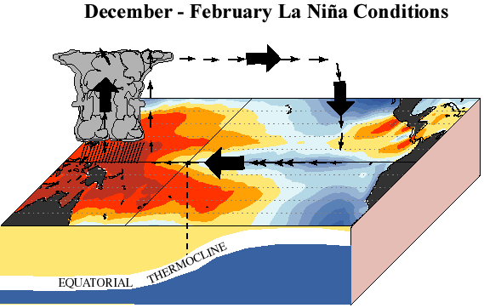
OLR Differences between El Nino and La Nina
http://www.cpc.ncep.noaa.gov/products/analysis_monitoring/ensocycle/enso_cycle.shtml
Related to Changes in the Walker Circulation!

Slide 17
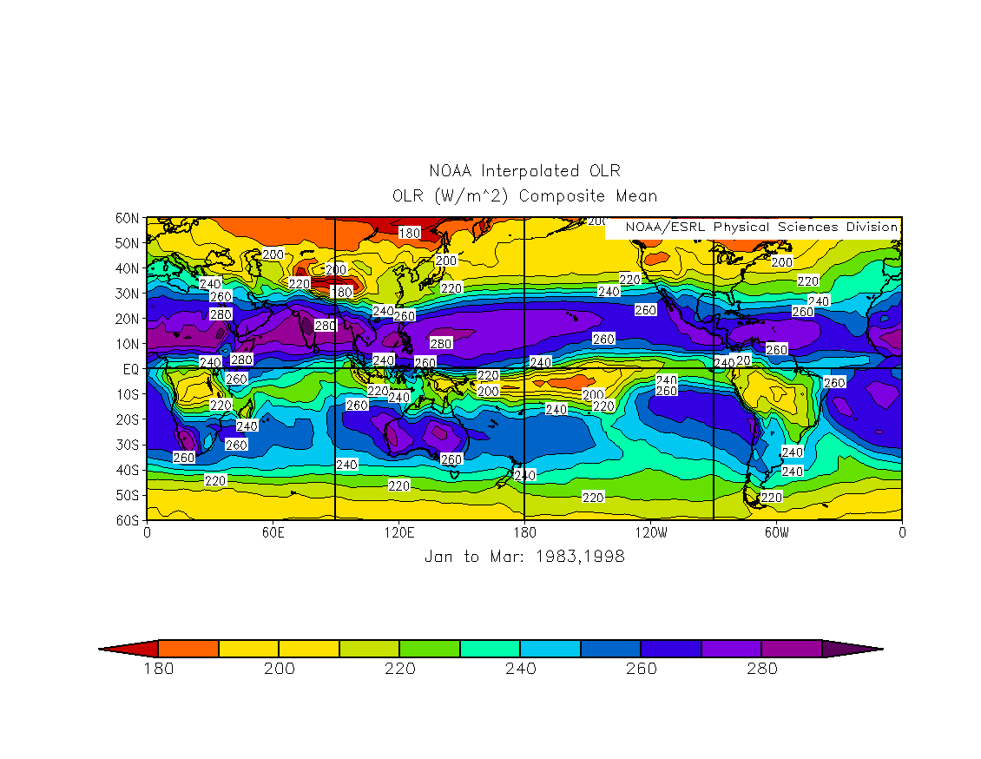
Show Differences between El Nino and La Nina
El Nino

Slide 18
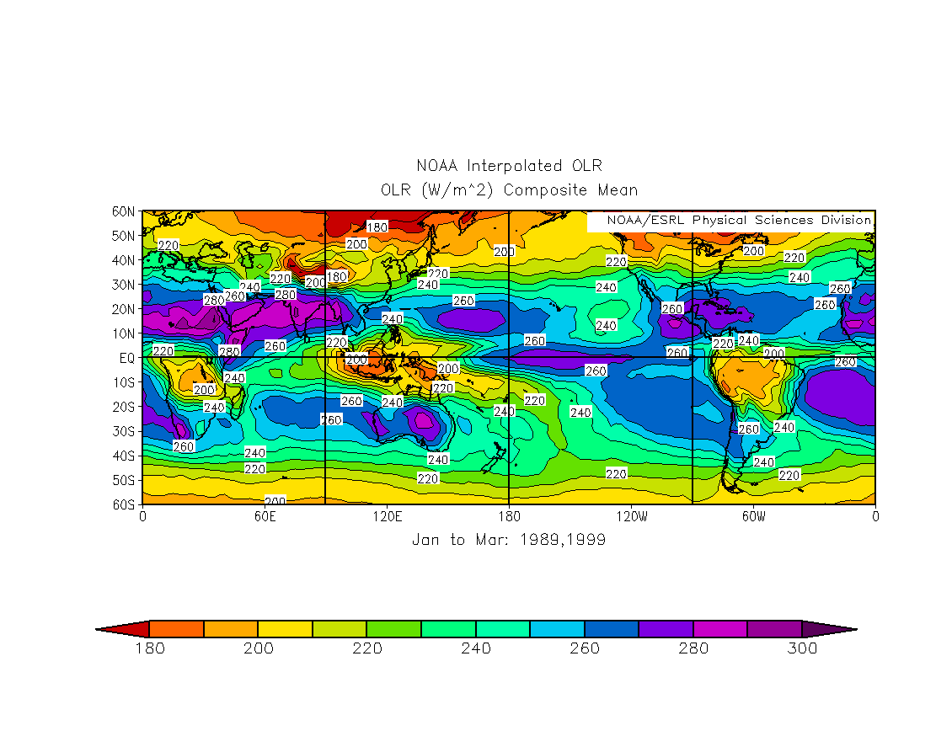
Show Differences between El Nino and La Nina
La Nina

Slide 19
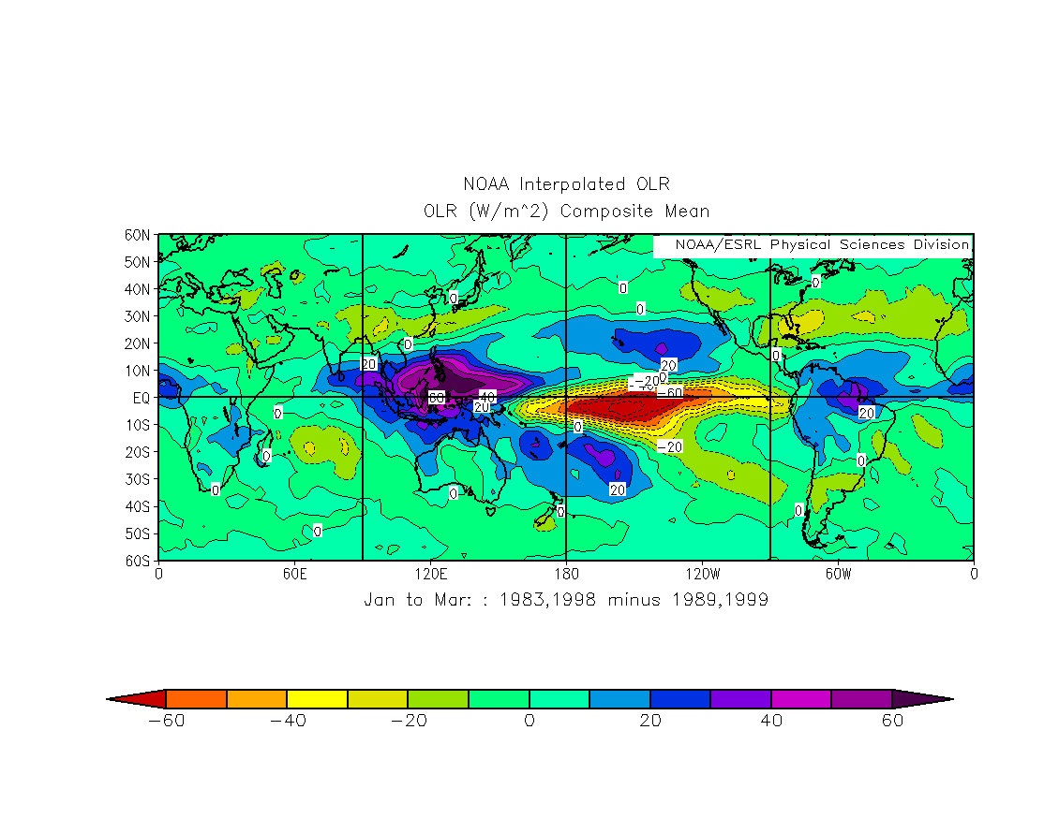
Show Differences between El Nino and La Nina
Difference

Slide 20
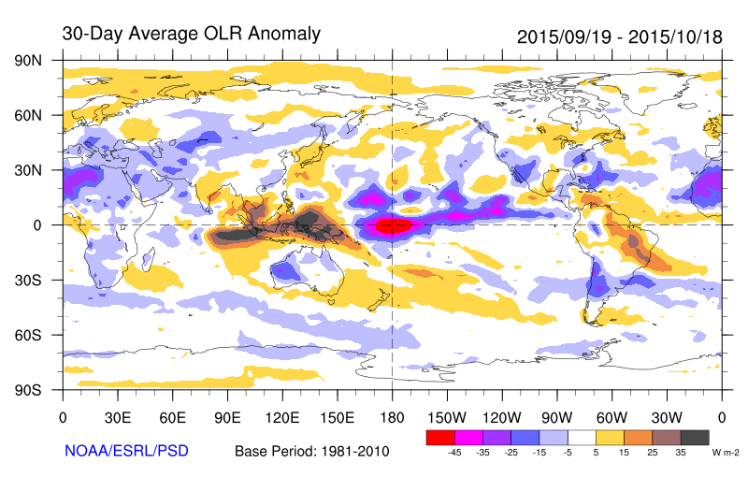
This Year

Slide 21
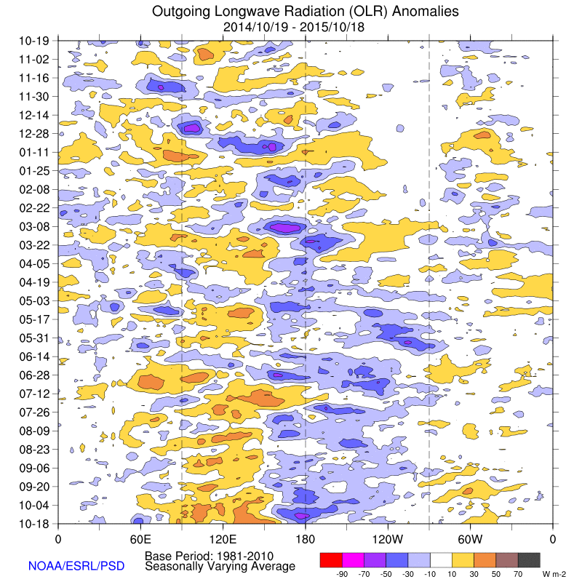
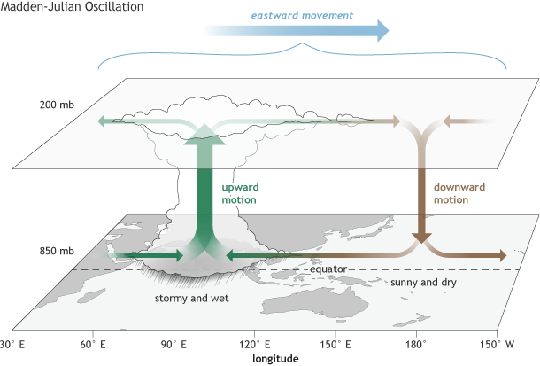
Other Factors that influence OLR
Madden Julian Oscillation

