Slide 1
Using the ESRL Physical Sciences Division Map Room + Other Climate Maps
Philippe Papin

Slide 2
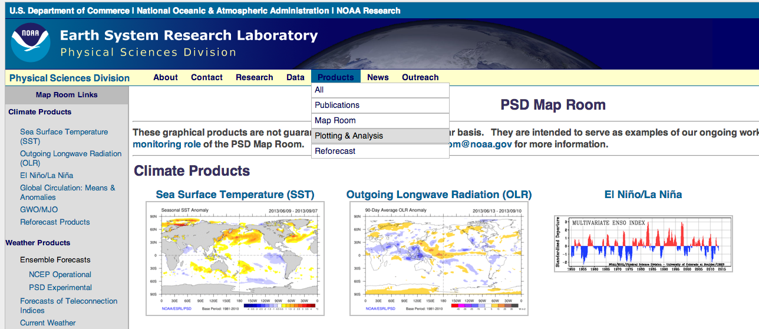
Step One
Go to the following URL
http://www.esrl.noaa.gov/psd/map/
For the purposes of this class lets go to Plotting/Analysis under the Products Section

Slide 3
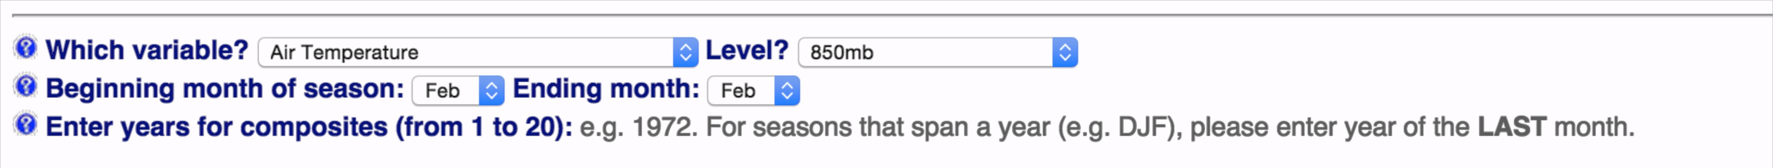
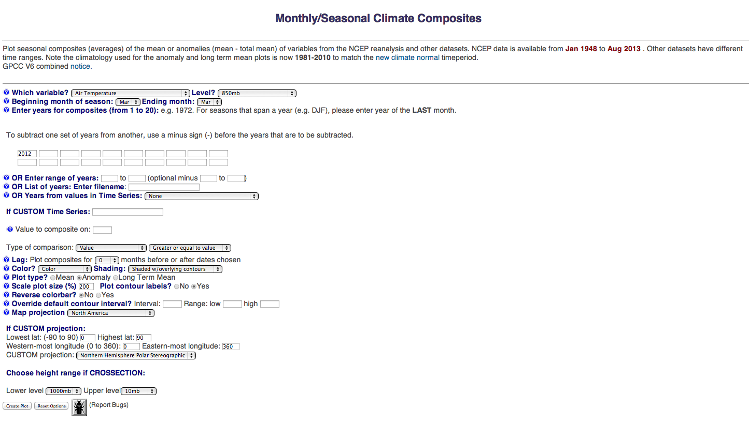
Step 2
For the first example, lets just plot the anomalous 850 hPa temperatures over the North America during March 2012
Click on the first link (Monthly/Seasonal Mean Composites)
Next, you have to set up the options to create the plot (make adjustments to options in red boxes)

Slide 4
Step 2 Cont.
And Plot!

Slide 5
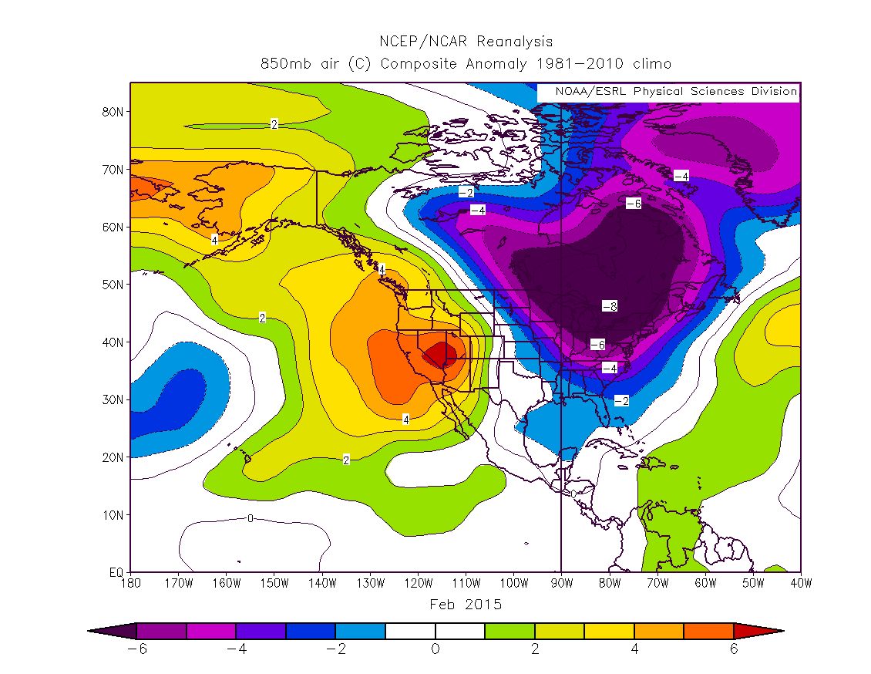
End Map

Slide 6
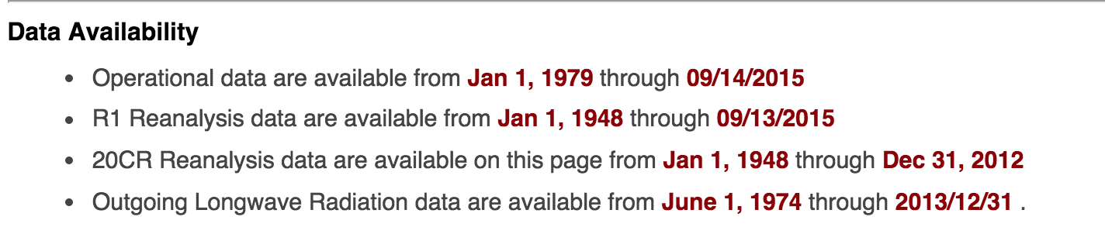
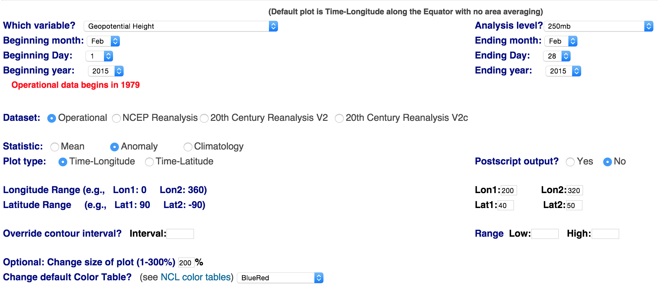
Step 3
Lets Make a Time-Longitude Plot (Hovmöller)
Click on the link (Time-section Plots)
Next, you have to set up the options to create the plot (make adjustments to options in red boxes)

Slide 7
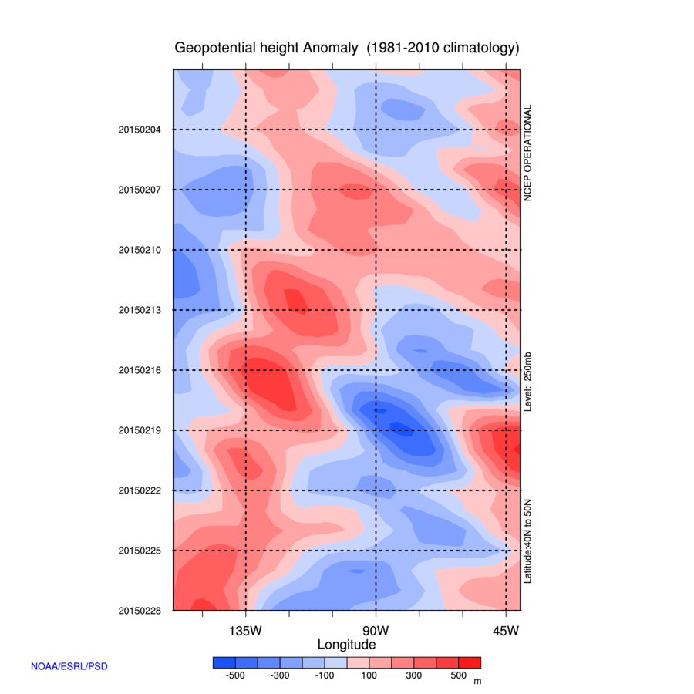
End Map
Try other fields (e.g., temperature, meridional wind) at different pressure levels (e.g., 500-hPa, 850-hPa)

Slide 8
Continue With Examples
Conducting more hands on examples

Slide 9
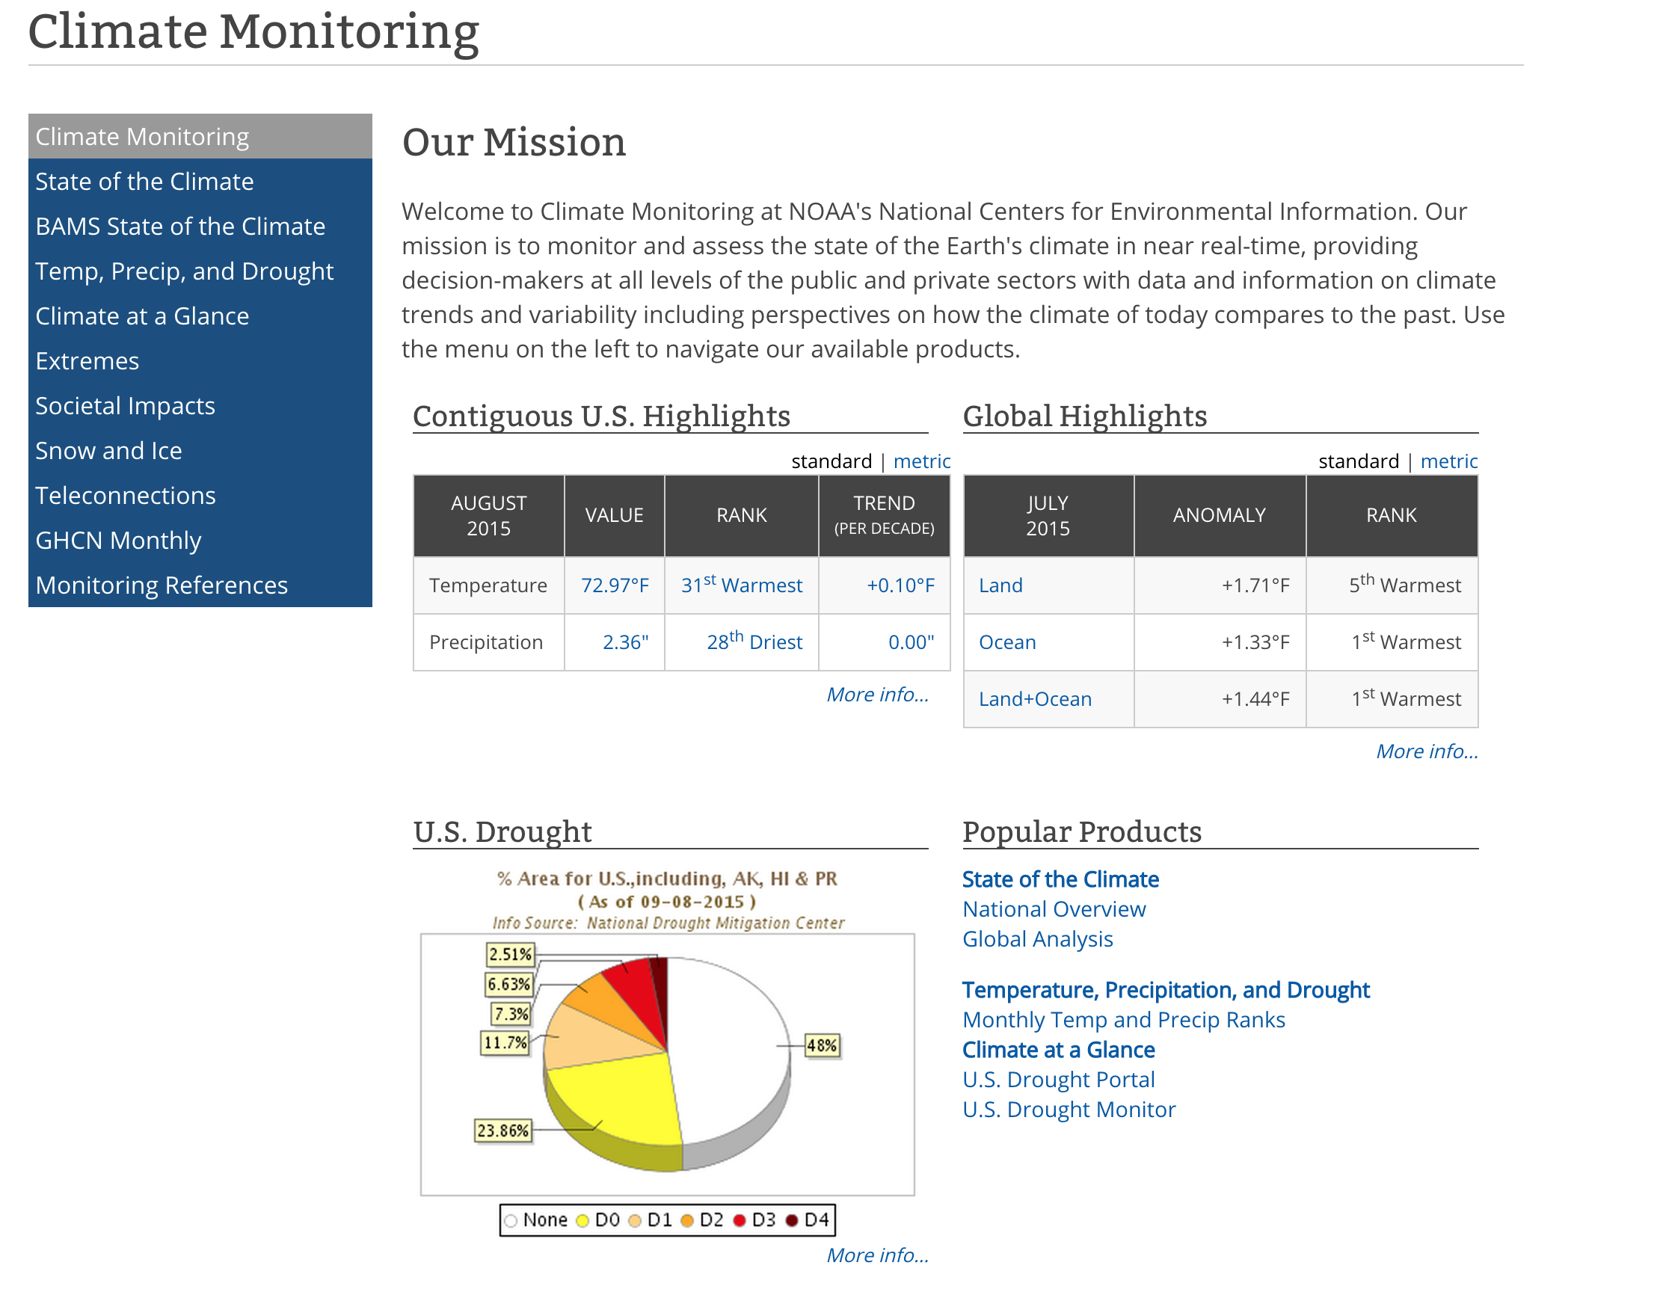
Other Websites
NOAA Climate Monitoring
http://www.ncdc.noaa.gov/climate-monitoring/

Slide 10
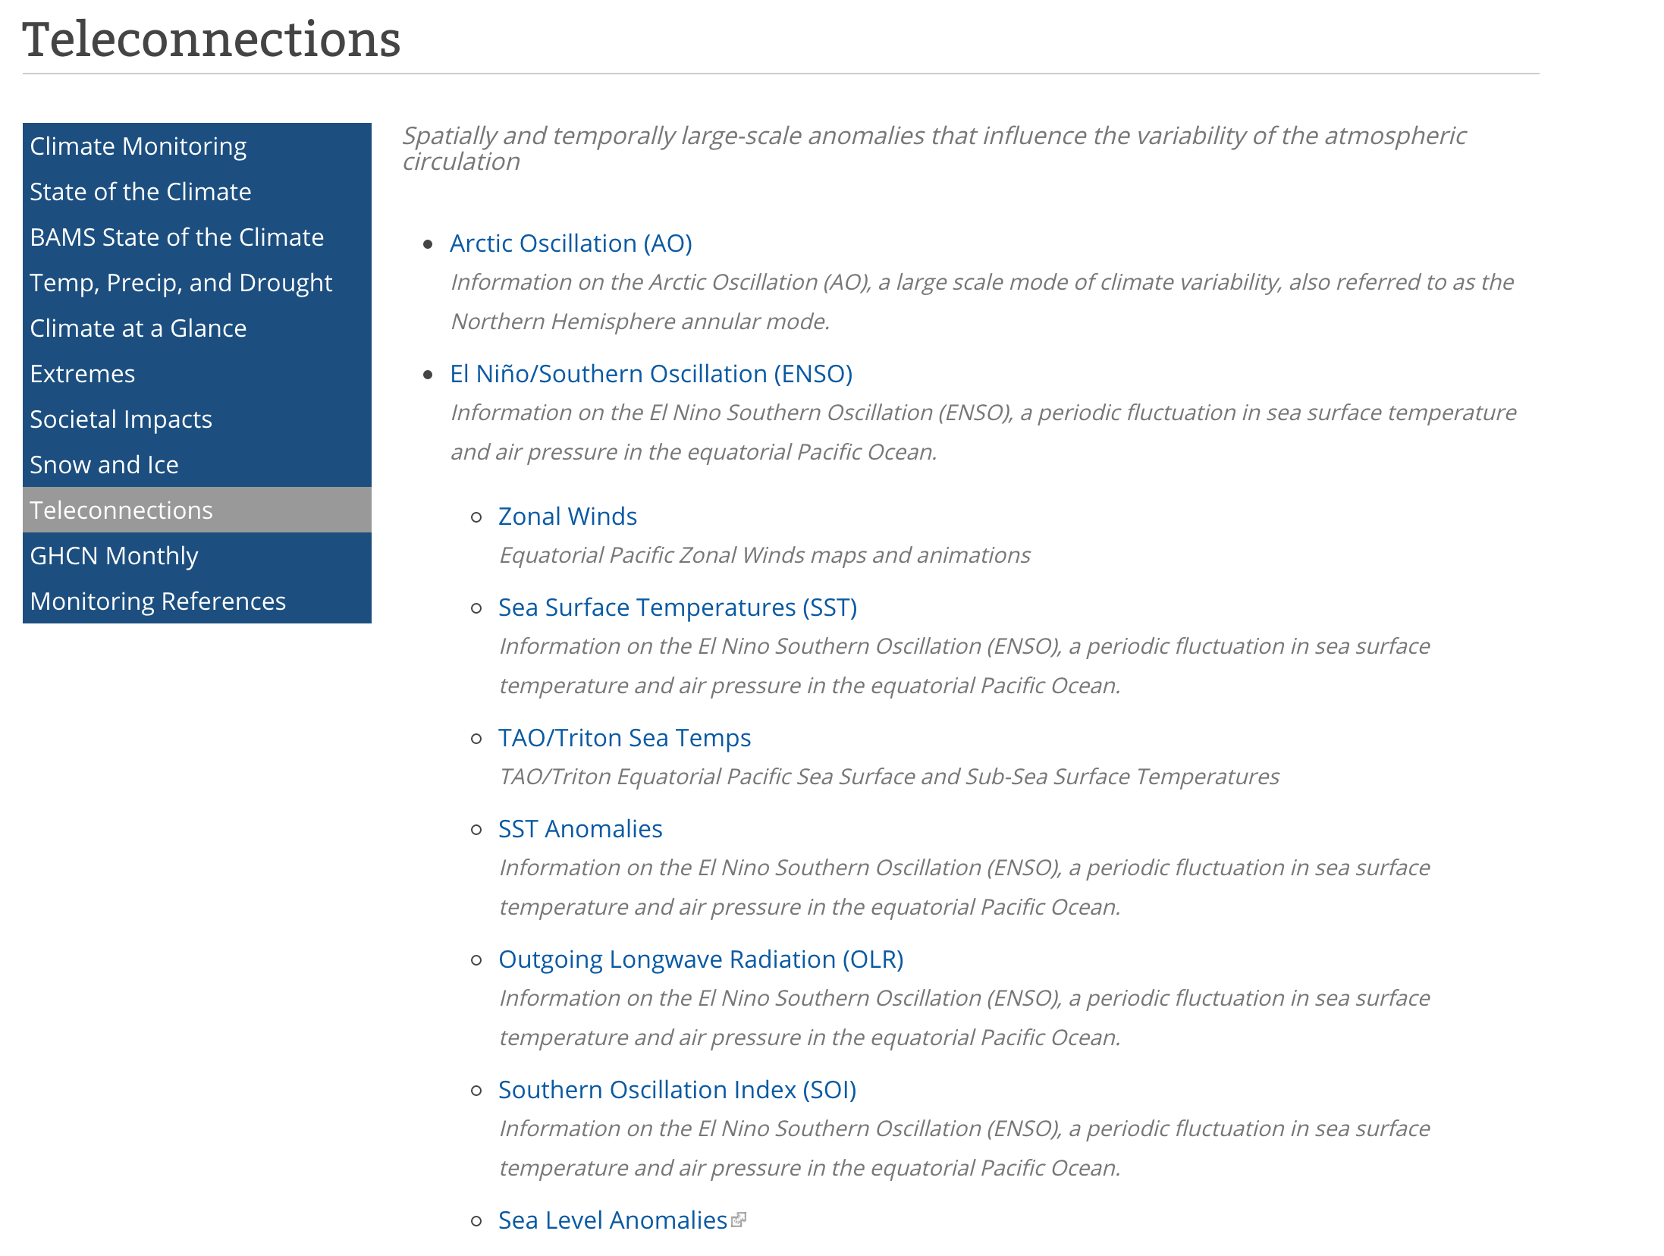
Example
Teleconnections

Slide 11
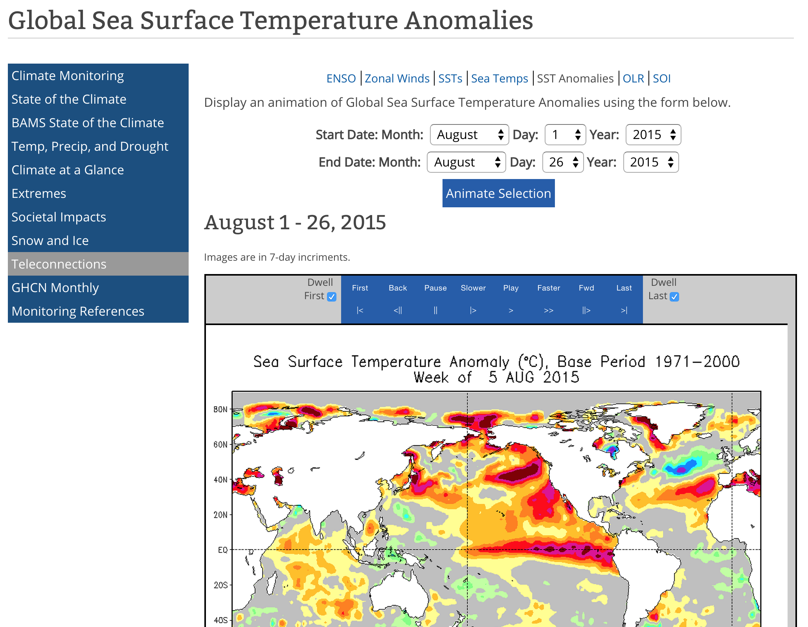
Example
Use to compare with other indices

Slide 12
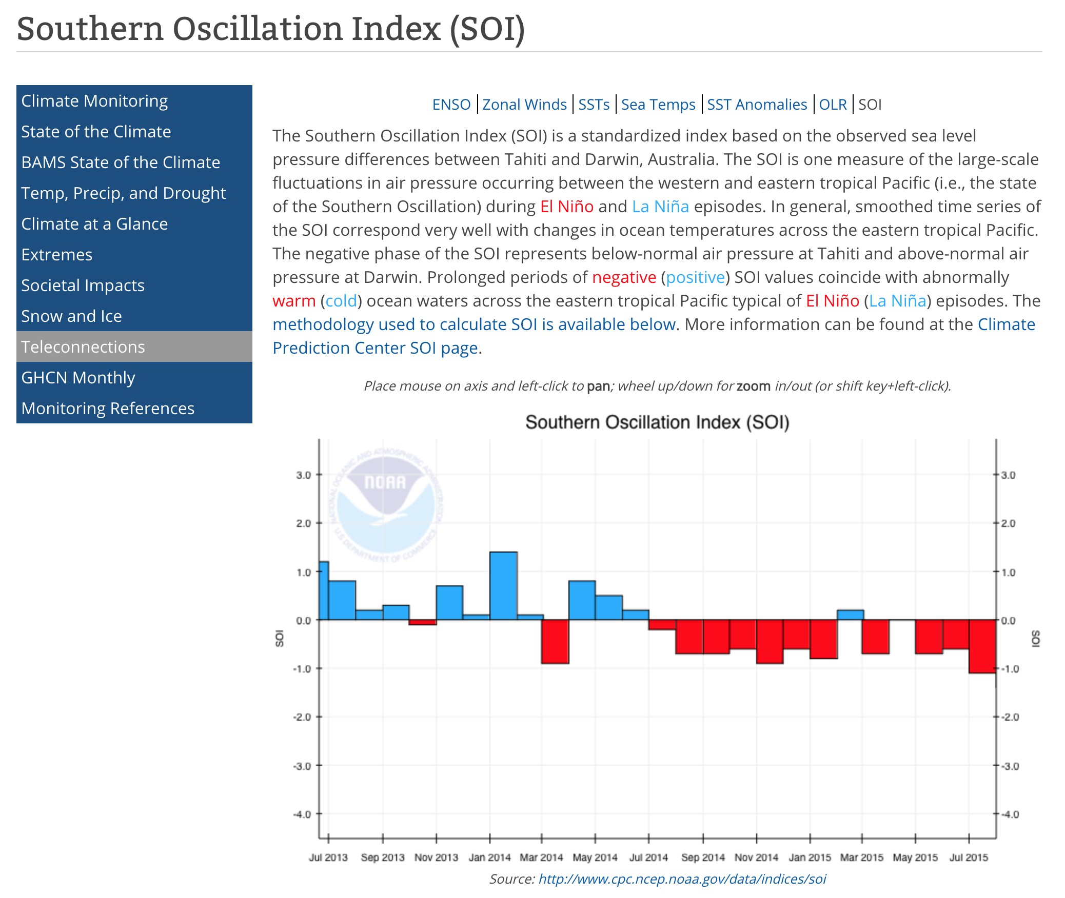
Example
Warm SSTs correlated with -SOI

Slide 13
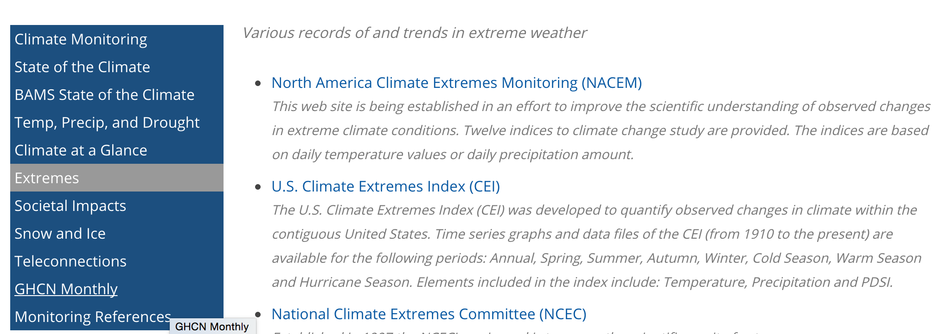
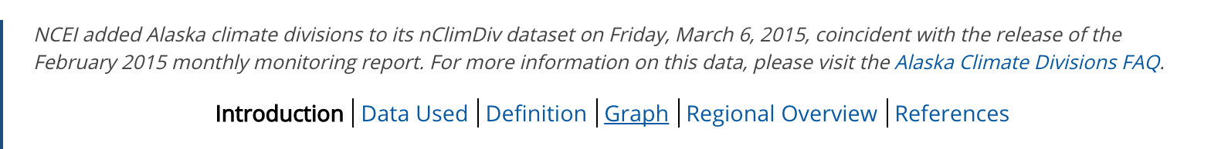
Example 2
Extremes
http://www.ncdc.noaa.gov/extremes/

Slide 14
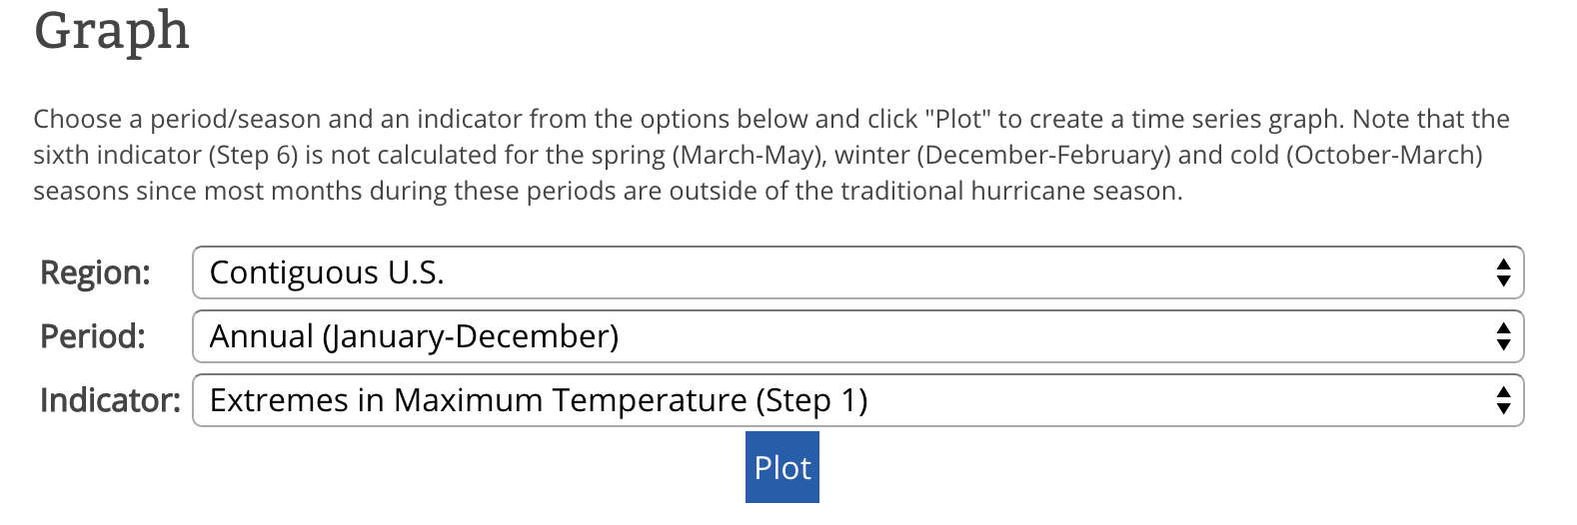
Example 2
Extremes
http://www.ncdc.noaa.gov/extremes/

Slide 15
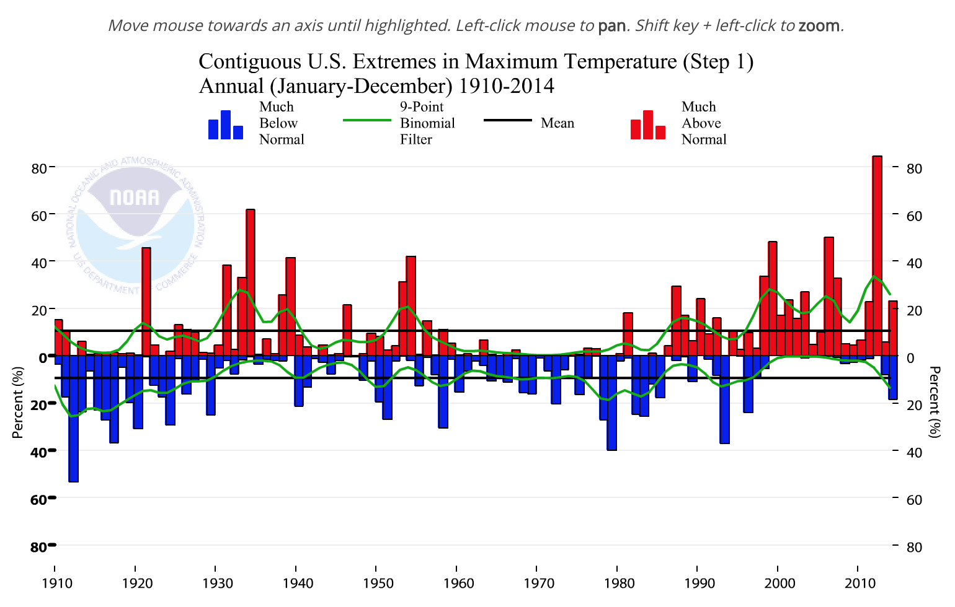
End Plot

Slide 16
Other Relevant Links
Archive Weather Data
http://www2.mmm.ucar.edu/imagearchive/ (Radar Archive 1996 – present)
http://www.spc.noaa.gov/exper/ma_archive/index2.html (RUC/RAP archive 2005-present)
http://archive.atmos.colostate.edu/ (Weather Map Archive from CSU)
http://weather.uwyo.edu/upperair/ (Wyoming’s Upper-air sounding archive 1973 – present)
http://www.ncdc.noaa.gov/data-access/weather-balloon/integrated-global-radiosonde-archive (text upper-air sounding archive)
http://mesowest.utah.edu/ (good surface observation archive 2002 – present)
http://vortex.plymouth.edu/upairwx-u.html (plot your own maps)
http://coast.noaa.gov/hurricanes/?redirect=301ocm (query search for tropical cyclone tracks)
http://droughtmonitor.unl.edu/MapsAndData/WeeklyComparison.aspx (drought map comparison 2000 - present)

Slide 17
Goal For Rest of Class
Continue to make maps picking your favorite synoptic event
i.e., (1993 Superstorm)
I’ll come around and see what everyone is doing and help those that are having difficulty

