Slide 1
A Reality Check on Science Opportunities Going Forward

Slide 2
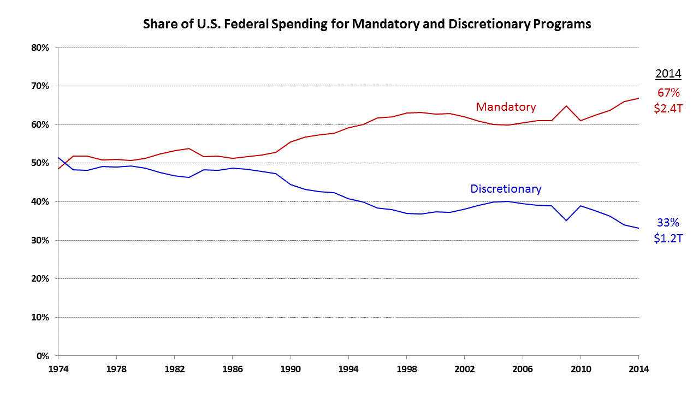
Federal Budget History: 1974–2014

Slide 3
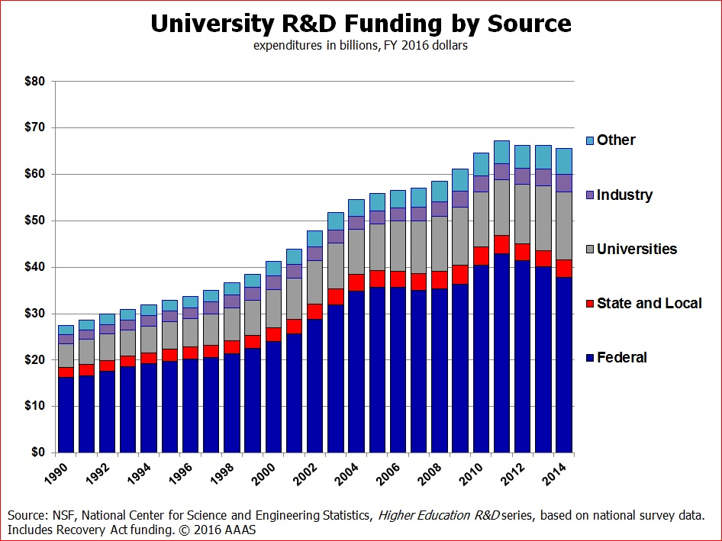

Slide 4
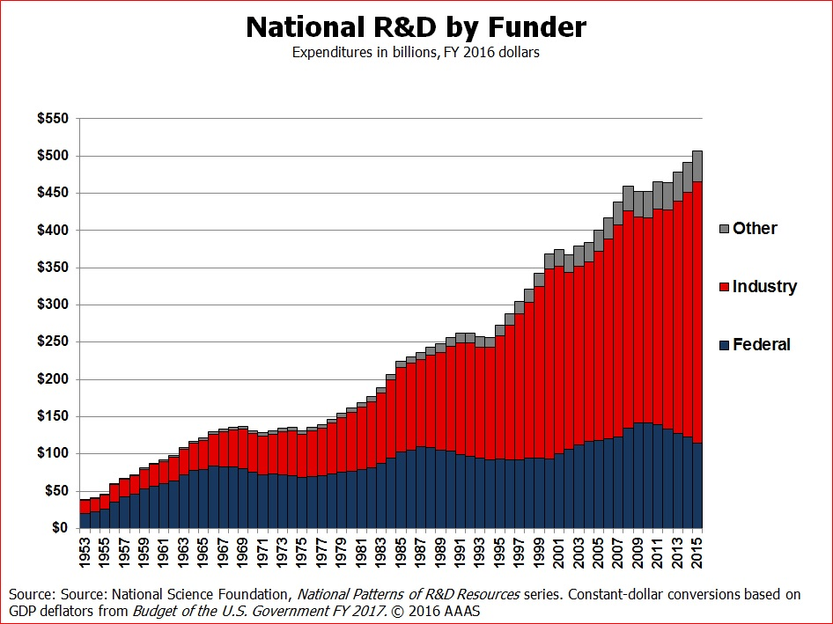

Slide 5
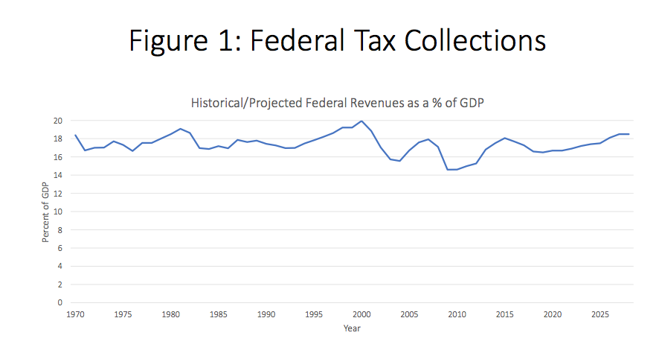
Figure 1 shows that federal tax policy has been largely consistent throughout modern history--collecting between 16 percent and 19 percent of GDP in the vast majority of years.
Source: https://economics21.org/html/rising-entitlements-3050.html

Slide 6
Figure 2 shows federal discretionary spending – including both defense as well as domestic spending – has steadily shrunk as a share of the budget and relative to our economic output.
Source: https://economics21.org/html/rising-entitlements-3050.html

Slide 7
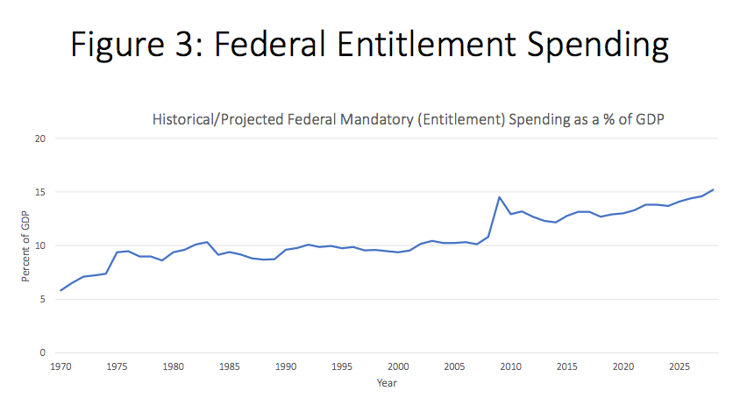
Figure 3 shows that year after year spending on entitlement programs is steadily increasing as a share of the Federal budget and as a share of the total economy
.
Source: https://economics21.org/html/rising-entitlements-3050.html

