Slide 1
Building the Future of the NWS:
NCEP Product Suite Review
Dr. Louis W. Uccellini
Director, National Weather Service College Park, Maryland
NOAA Assistant Administrator for Weather Services December 3, 2013

Slide 2
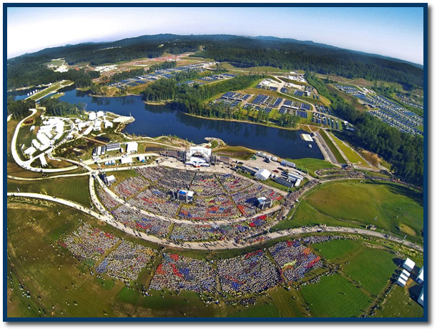

NWS Strategic Outcome:
Weather-Ready Nation Strategic Goals
Strategic Outcome:
Weather-Ready Nation
Ready
Responsive
Resilient
  NWS Strategic Goals
  Improve Weather Decisions Services
  Improve Water Forecasting Services
  Enhance climate services and adapt to climate-related risks
  Improve sector-relevant information in support of economic productivity
  Enable environmental forecast services supporting healthy communities and ecosystems
  Sustain a highly skilled, professional workforce equipped with training, tools, and infrastructure to meet mission
Prediction is what makes us unique!
Notes:
What exactly is Weather-Ready Nation?
Two perspectives:
Internally focused on communications, IDSS, S&T, and delivery of our information.
Externally focused on strengthening our collaborations with established partners as well as new “non-traditional”
partners…insurance industry, home building associations, other advocates of weather preparedness…

Slide 3
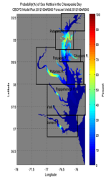
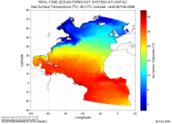
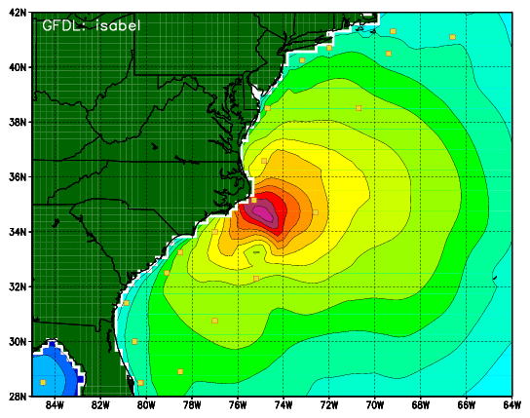
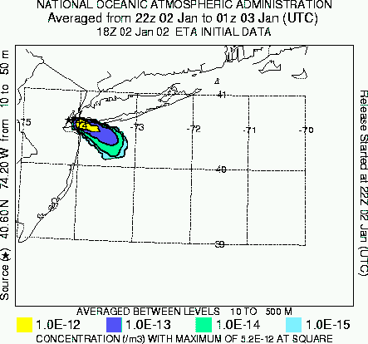
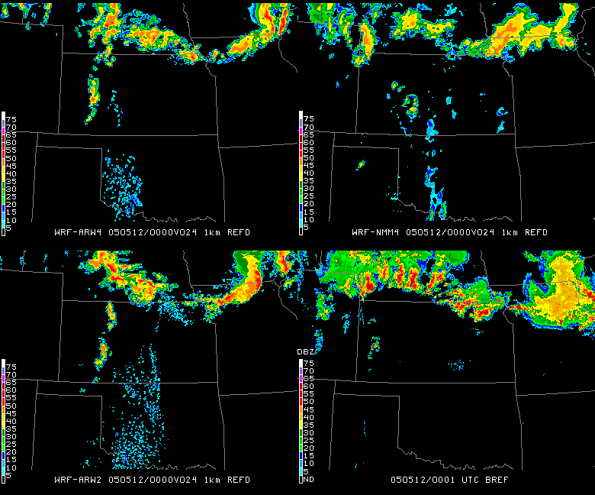
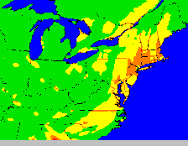
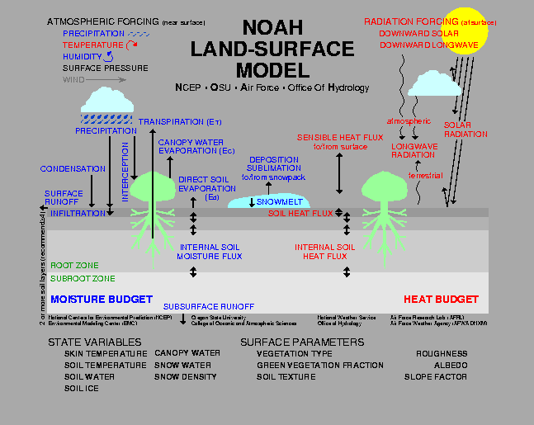
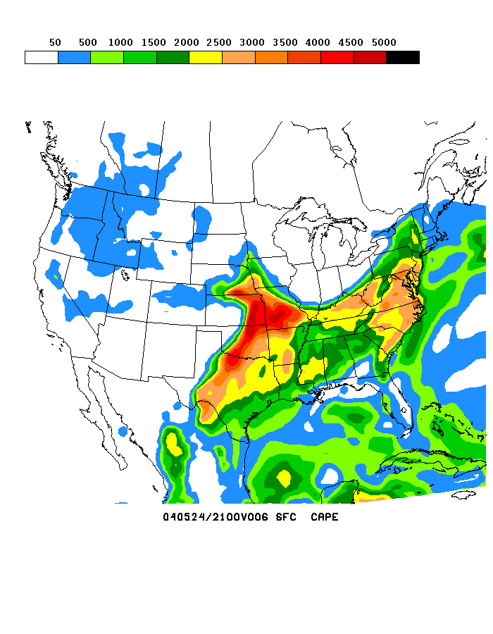
NOAA’s Model Production Suite
Climate Forecast
System
NOS – OFS
Great Lakes
Northern Gulf of Mex
Columbia R.
Bays
Chesapeake
Tampa
Delaware
Oceans
HYCOM
WaveWatch
III
Hurricane GFDL
HWRF
Coupled
GFS MOM4
NOAH Sea Ice
Sea Nettle
Forecast
~2B Obs/Day
Satellites + Radar
99.9%
Regional NAM
WRF NMMB
Dispersion
ARL/HYSPLIT
Global
Forecast
System
Regional
DA
Global Data
Assimilation
Severe Weather
WRF NMM/ARW
Workstation WRF
Short-Range
Ensemble Forecast
Space
Weather
North American Ensemble Forecast System
Regional DA
WRF: ARW, NMM
NMMB
Air Quality
GFS, Canadian Global Model
ENLIL
NAM/CMAQ
Forecast
Rapid Refresh
for Aviation
3
NOAH Land Surface Model
3
Notes:
3

Slide 4
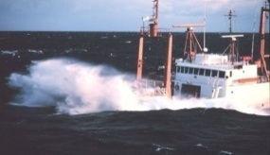

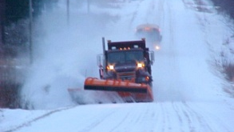
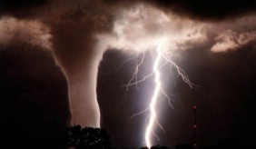
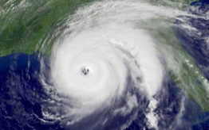

Sandy Supplemental
Congress provides ~$97 million to improve
NWS forecast services
  Computer Upgrades
  Observations
Models
Physical Science Research
Social Science Research
Improved Surge Forecast
Designed to Improve:
Response
Resilience/Recovery
Preparedness

Slide 5
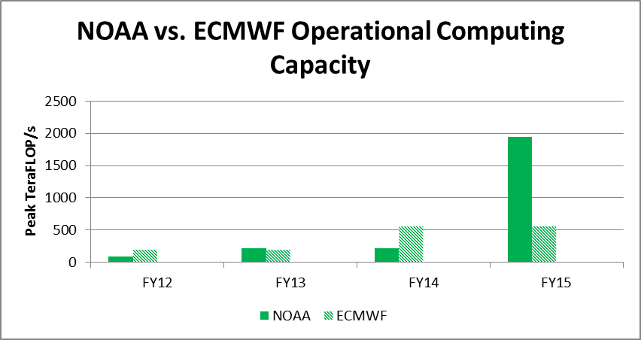
FY 14 Plans:
Sandy Supplemental Augmentation
1900
73
208
208

Slide 6
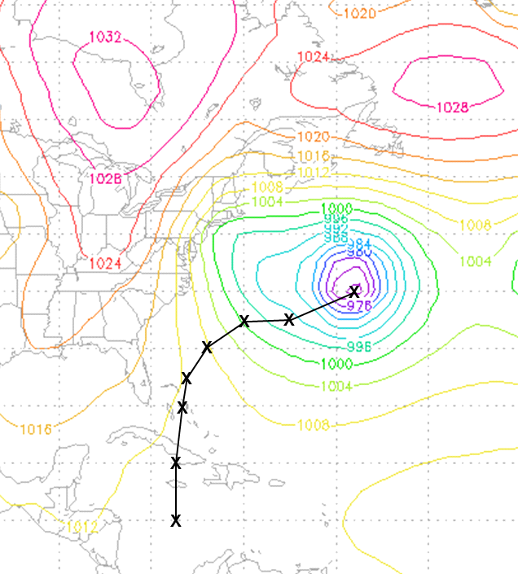
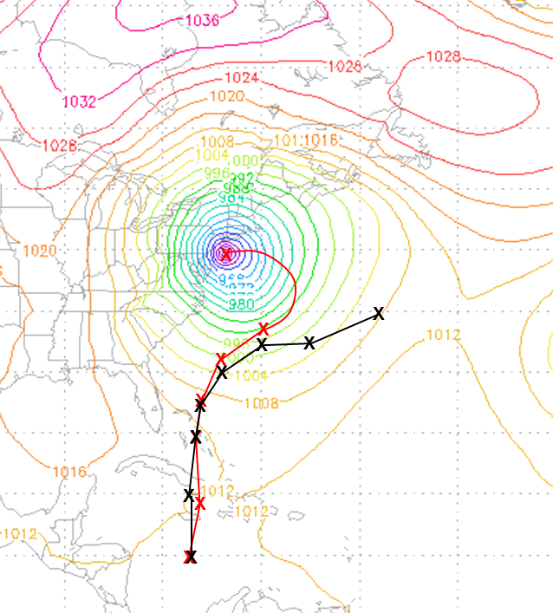
Increasing NCEP Global Model Horizontal Resolution Improves Hurricane Sandy Track Guidance
Model Initialized at 00UTC 24 October 2012
7-Day Sea level Pressure (mb) Forecast valid at 00UTC 31 October 2012
Hurricane Position Shown Every 24h
Operational (T574~ 27km)
Experiment (T1500~ 13km)
Note: Last 24h of the high resolution experiment track based on 6h model output
Hypothesis: Increased horizontal resolution resolves complicated Atlantic blocking pattern, slows simulated hurricane, and allows it to curve toward the East Coast

Slide 7
Summary
  Earth system multi-model ensemble approach is a dominant basis for advancing predictions
    → Basis for NWS Strategic Goal
  Operational computer capacity will be increased to petaflop levels
  4-D Hybrid Data Assimilation is a key development area for improving the model performance and fully utilizing new observing systems
  Challenges remain: End to End capabilities
  Observations – Data Assimilation – Models - Dissemination

