Slide 1
William. M. Lapenta
Acting Director
Environmental Modeling Center
NOAA/NWS/NCEP
The NOAA Operational
Numerical Guidance Suite:
Looking Forward to 2020

Slide 2
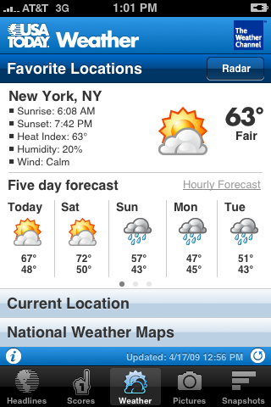
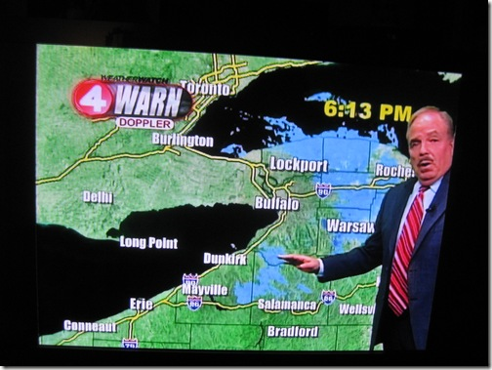
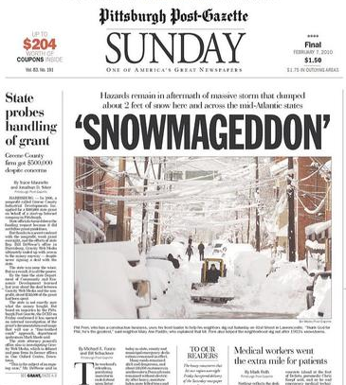


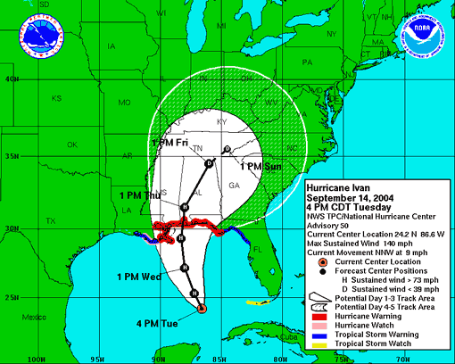
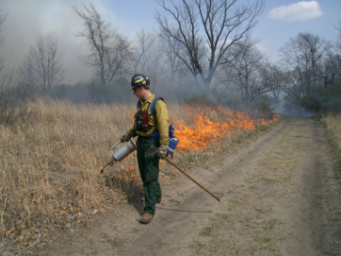
NOAA Operational
Data Assimilation and Modeling
Three Major Components of the Numerical Prediction Enterprise….
Everything you read, see or hear about weather, climate and ocean forecasts is based on numerical prediction
Global Observing System
Computers (WCOSS, AWIPS2)
Data Assimilation, Modeling, Ensembles and Post Processing
NOAA Science Serving Society….
Notes:
2

Slide 3
NOAA Operational Numerical Guidance Supports the Agency Mission
  Numerical Weather Prediction at NOAA
    Required for agency to meet service-based metrics
  National Weather Service GPRA* Metrics
    (* Government Performance & Results Act)
    Hurricane Track and Intensity
    Winter Storm Warning
    Precipitation Threat
    Flood Warning
    Marine Wind Speed and Wave Height
  Operational numerical guidance:
    Foundational tools used by government, public and private industry to improve public safety, quality of life and make business decisions that drive U.S. economic growth
Lead Time and Accuracy!
3

Slide 4
NOAA’s Operational
Numerical Guidance Suite
Climate Forecast
System (CFS)
Regional Hurricane GFDL
WRF-NMM
Waves
WaveWatch III
SURGE
SLOSH
3D-VAR
DA
3D-VAR
DA
GFS, MOM4,
NOAH, Sea Ice
Ecosystem
EwE
Ocean
HYCOM
P-SURGE
SLOSH
ESTOFS
ADCIRC
Regional Bays
Great Lakes (POM)
N Gulf of Mexico (FVCOM)
Columbia R. (SELFE)
Chesapeake (ROMS)
Tampa (ROMS)
Delaware (ROMS)
Global Forecast System (GFS)
3D-En-Var
DA
Regional NAM
NMMB
NOAH
Global Spectral
NOAH
3D-VAR
DA
Global Ensemble Forecast System (GEFS)
Dispersion
HYSPLIT
Short-Range
Ensemble Forecast
21 GFS Members
Air Quality
WRF(ARW, NMM)
NMMB
CMAQ
North American Ensemble Forecast System
Rapid Refresh
High Res Windows
3D-VAR
DA
GEFS, Canadian Global Model
WRF(ARW, NMM) & NMMB
WRF ARW
North American Land Surface Data Assimilation System
NEMS Aerosol Global Component (NGAC)
Space
Weather
High Resolution RR
3D-VAR
DA
WRF ARW
NOAH Land Surface Model
GFS & GOCART
ENLIL
4
Notes:
4

Slide 5
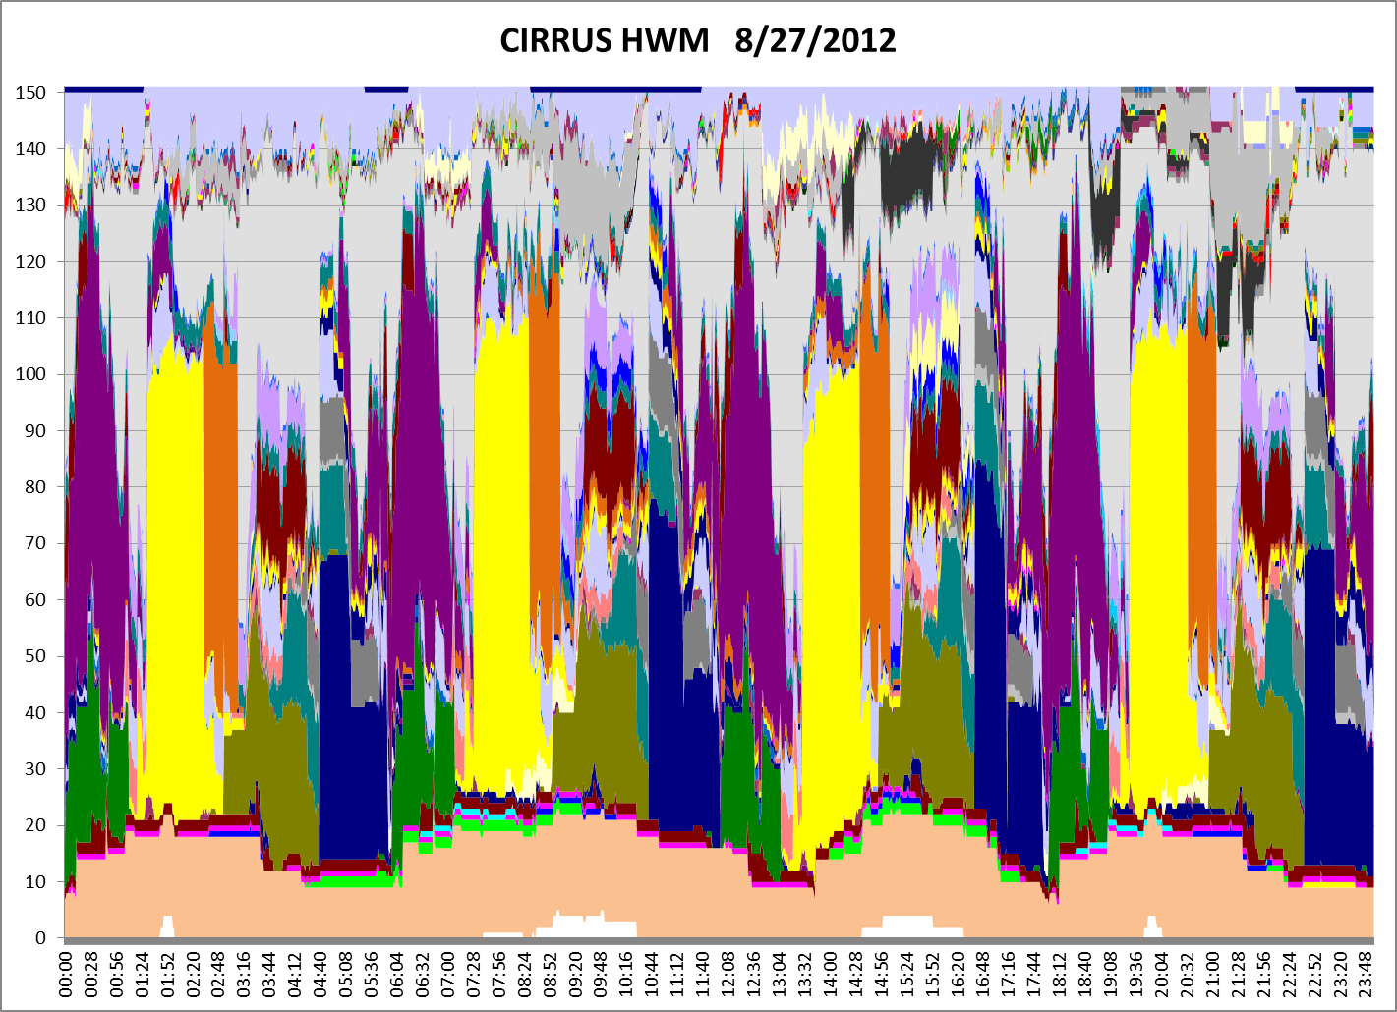
Numerical Guidance Suite Execution
CCS NOAA Supercomputer
24-h Snapshot 20 August 2012
Number of Nodes
High Water Mark 2010
00
CFS
GEFS
06
NAM
12
GFS
18
SREF
00
Time of Day (UTC)
5

Slide 6
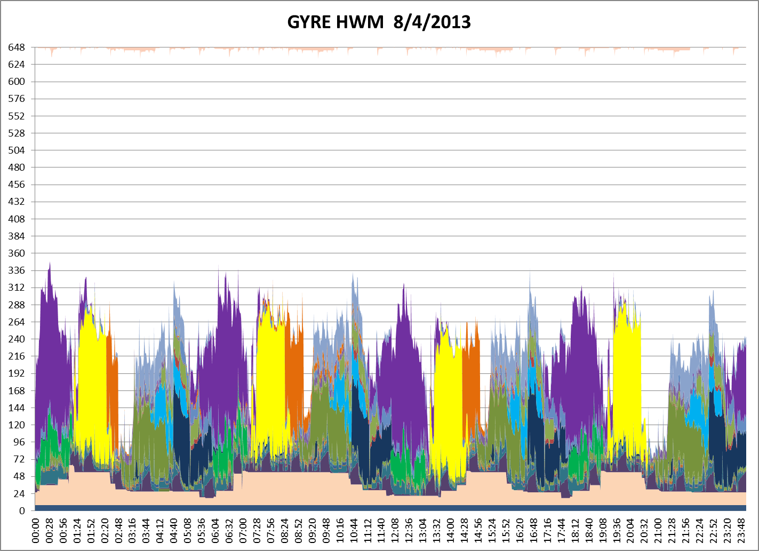
Numerical Guidance Suite Execution
WCOSS NOAA Supercomputer
24-h Snapshot 04 August 2013
Number of Nodes
00
CFS
GEFS
06
NAM
12
GFS
18
SREF
00
Time of Day (UTC)

Slide 7
Major System Upgrades (Planned)
Q1-FY14 to Q1-FY15
List does not include NOS or MDL systems

Slide 8
GFS Skill Improvement Due to Resolution, Data Assimilation and Physics Upgrades
Percentage of GFS 5-Day 500mb Anomaly Correlation Greater Than 0.9
(Northern Hemisphere)
Hybrid-Ensemble 3D-VAR Data Assimilation
38km to 27km
New shallow convection; updated SAS and PBL; positive-definite tracer transport
Percentage of Good Forecasts
Flow-dependent error covariance; Variational QC
55km to 38km
OSU 2-L LSM to 4-L NOHA LSM
70km to 55km
AMSU-A & HIRS-3 data

Slide 9
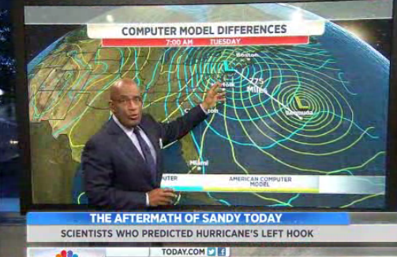
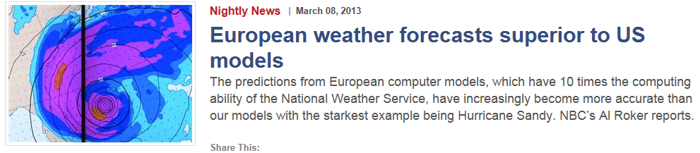
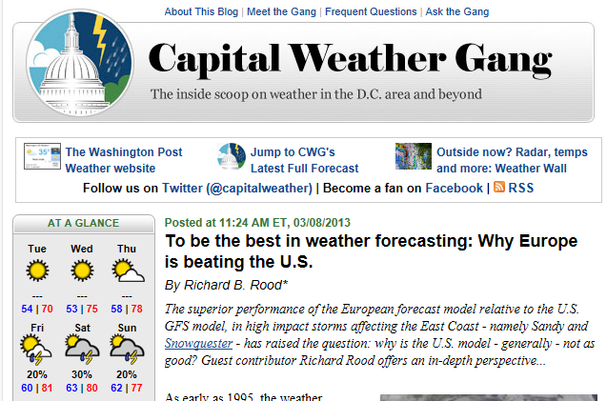

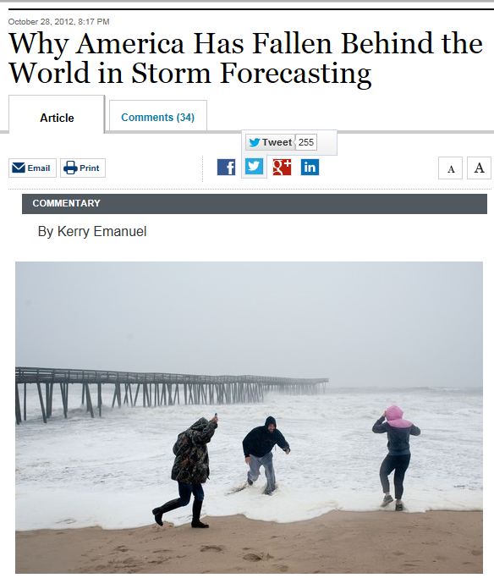
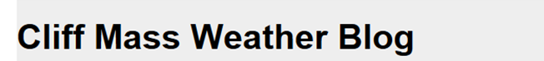
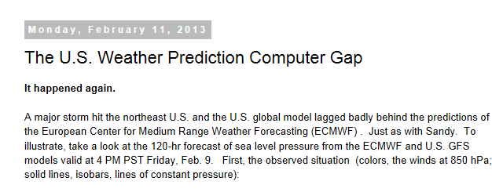
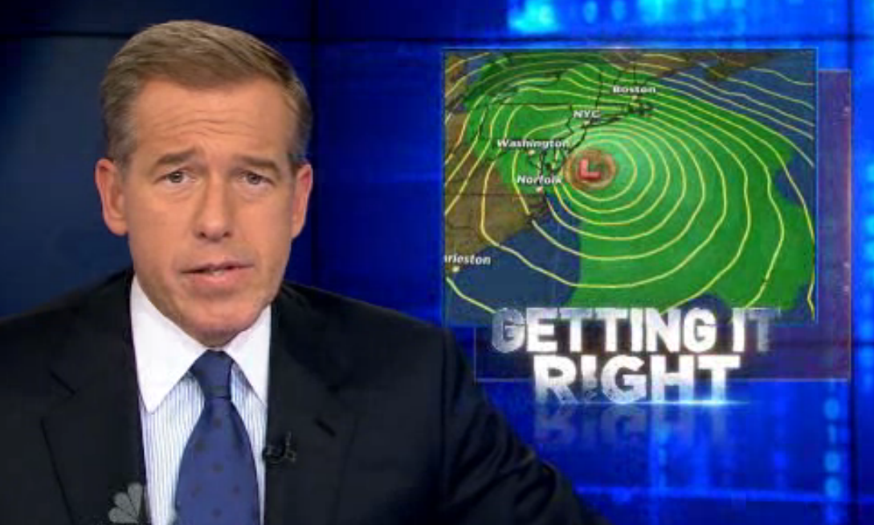
Hurricane Sandy 2012
http://www.washingtonpost.com/blogs/capital-weather-gang/post/to-be-the-best-in-weather-forecasting-why-europe-is-beating-the-us/2013/03/08/429bfcd0-8806-11e2-9d71-f0feafdd1394_blog.html

Slide 10
Sandy Supplemental Projects Involving NCEP/EMC
Majority of projects aligned with ongoing development work
Emphasis on data assimilation, increasing resolution, physics enhancements and optimal ensemble configurations
2 year window of opportunity

Slide 11
Seamless Suite of NOAA Operational Numerical Guidance Systems
Spanning Weather and Climate
Years
Forecast
Uncertainty
Outlook
Seasons
Guidance
Months
Climate Forecast System
2 Week
North American Ensemble Forecast System
Threats Assessments
Global Ensemble Forecast System
1 Week
Global Forecast System
Global Dust
Forecast Lead Time
Forecasts
Short-Range Ensemble Forecast
Wave Ensemble
Days
North American Mesoscale
Waves
Global Ocean
Bays
Watches
Fire Wx
Regional Hurricane
(HWRF & GFDL)
Space Weather
Storm Surge
Hours
Rapid Refresh
Air Quality
Warnings & Alert Coordination
Minutes
Dispersion (smoke)
Benefits
Aviation
Recreation
Health
Tsunami
Whole Atmosphere
HRRR
NMME
NLDAS
Life & Property
Maritime
Fire Weather
Commerce
Hydropower
Agriculture
Ecosystem
Environment
Space Operations
Emergency Mgmt
Energy Planning
Reservoir Control
11

Slide 12
Forcing Factors Shaping NOAA Operational Numerical Guidance
Emerging Requirements
  Weather Ready Nation
  High impact events
  Weather to climate—seamless suite of guidance and products
Science and Technology Advances
  Observing systems
  High performance computing
  Data dissemination
  Numerical Guidance Systems
    Data assimilation (methodology)
    Modeling (physics, coupling & dynamics)
    Ensembles (construction—initialization, membership, etc.)
    Intelligent post processing
  Predictability
    convective systems
    Seasonal to interannual

Slide 13
Some Commonly Asked Questions
  How will the suite evolve as the resolution of the global systems increase?
    GFS capable of satisfying NAM requirements?
    GEFS capable of satisfying SREF requirements?
    Non-hydrostatic global model and medium range reforecasts from GEFS new requirements?
  Will the regional systems shift to convection permitting applications?
    HRRRE & NARRE capable of satisfying WOF requirements
  What will the week 3+ to seasonal guidance system look like?
    Can/should GEFS be extended to 30-days? (coupling required?)
    What level of complexity is required in CFS?
    Can the NMME be developed and sustained?
  How does all the above impact down stream systems?

Slide 14
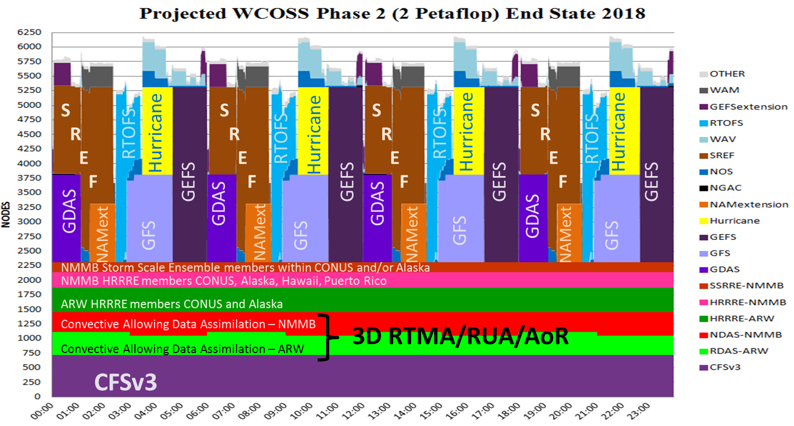
Looking Forward to 2018…

