Slide 1
Global Climate and Weather
Modeling
Presented by
John C. Derber
Work done by GCWMB
NCEP Production Suite Review
December 3, 2013

Slide 2


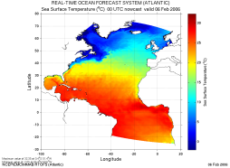



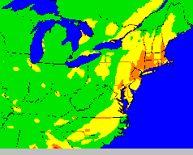
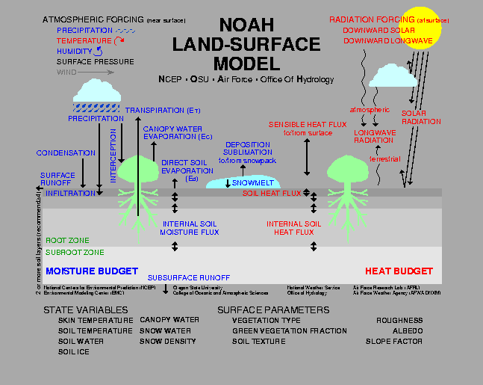

NOAA’s NWS Model Production Suite
Climate
CFS
Oceans
HYCOM
WaveWatch III
Hurricane GFDL
HWRF
Coupled
MOM3
1.7B Obs/Day
Satellites
99.9%
Global
Forecast
System
Regional NAM
WRF NMM
Dispersion
ARL/HYSPLIT
Global Data
Assimilation
Severe Weather
Regional Data
Assimilation
WRF NMM/ARW
Workstation WRF
Short-Range
Ensemble Forecast
North American Ensemble Forecast System
Air Quality
WRF: ARW, NMM
ETA, RSM
GFS, Canadian Global Model
NAM/CMAQ
Forecast
*Rapid Update
for Aviation
NOAH Land Surface Model

Slide 3
Outline
Global Climate and Weather Modeling Branch FY13 Upgrades
  Completed WCOSS transition
  Transitioning to new code management procedures
  Implementations
    Data upgrade for assimilation system
    WAFS grid upgrade
GCWMB and Data Assimilation Plans
  T1534L64 GFS/GDAS upgrade

Slide 4
Global Data Assimilation
System Upgrade
Implemented
Five additional satellite instruments:
  Suomi NPP CrIS
  MetOp-B AMSU-A
  MetOp-B MHS
  MetOp-B GRAS
  Meteosat-10 SEVIRI
Most are in similar orbits to similar current satellite instruments

Slide 5
Configuration
For CrIS we receive a subset of 399 channels (Gambacorta et al., 2013) in BUFR format. We assimilate those channels designated for temperature, cloud, CO₂ and surface that do not suffer from solar contamination. This totals 84 channels from 672.5cm⁻¹ to 1095.0cm⁻¹.
  This is similar to our IASI channel selection.
For all other instruments (AMSU-A, MHS, SEVIRI, GRAS) we use the same configuration as for current operational equivalents.

Slide 6
Pre-Implementation Test Results
Compare three forecast/assimilation experiments
  GFS: Operations (mostly run on CCS)
  prcntrlt: A control run using the operational WCOSS configuration (WCOSS)
  prnurads: prcntrlt + radiance upgrades (WCOSS)
Please note when interpreting these plots that the difference between WCOSS and CCS control runs are often larger than the signal from the new radiances.

Slide 7
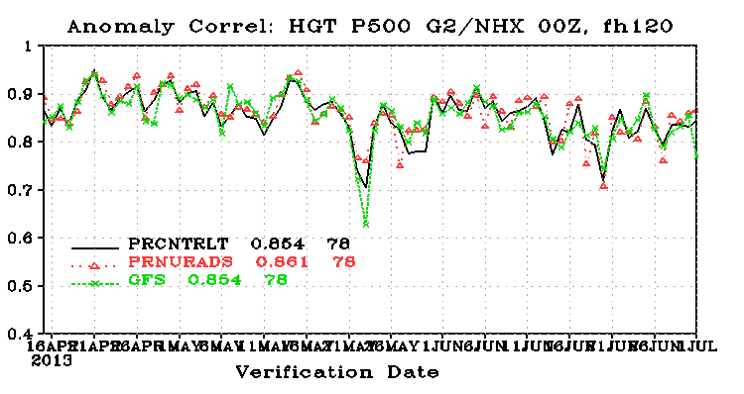
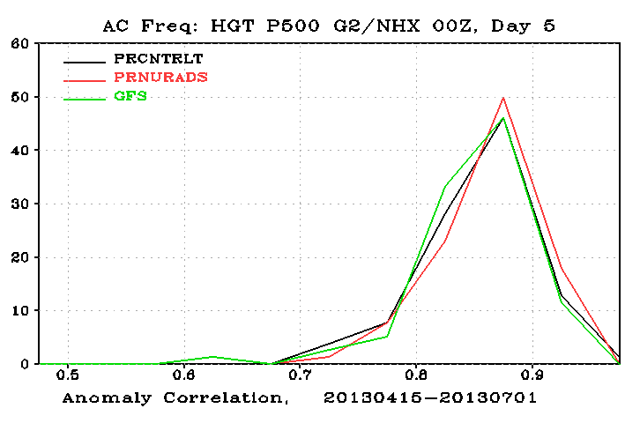
Pre-Implementation Test Results
500 hPa Anomaly Correlation Scores: N. Hemisphere time-series

Slide 8
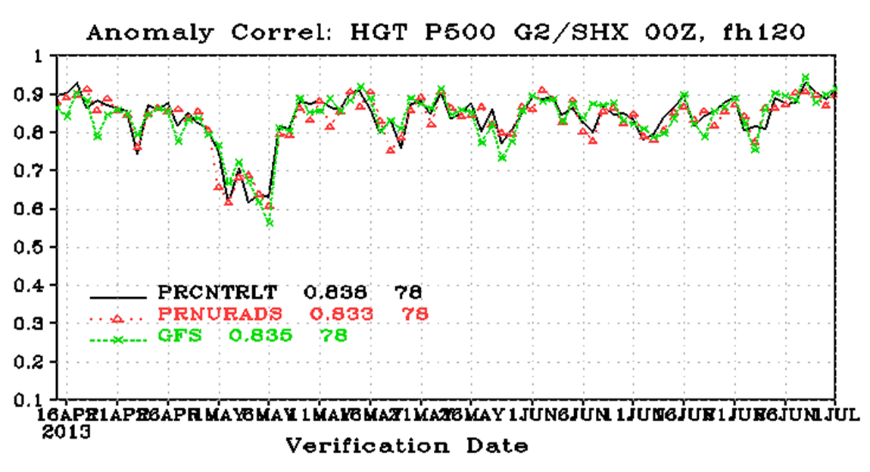
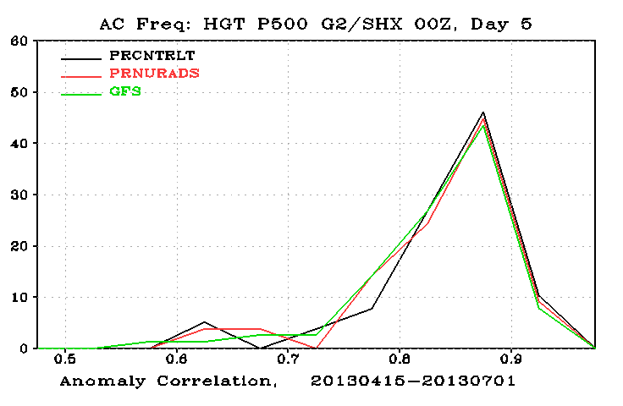
Pre-Implementation Test Results
500 hPa Anomaly Correlation Scores: S. Hemisphere time-series

Slide 9
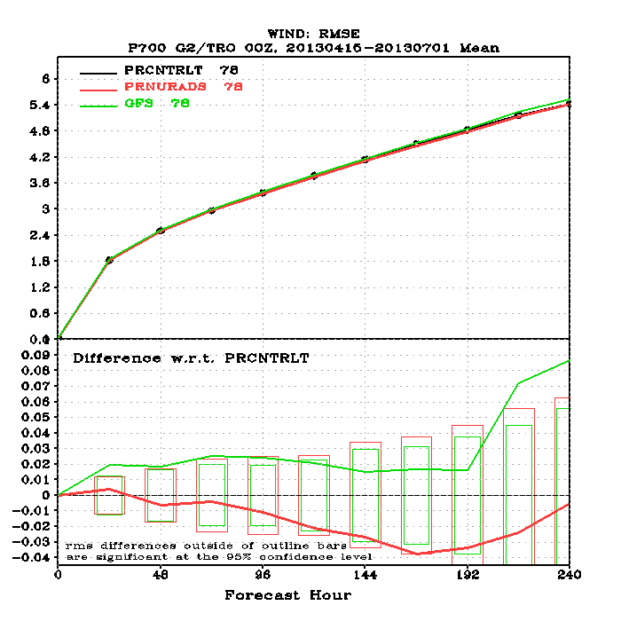
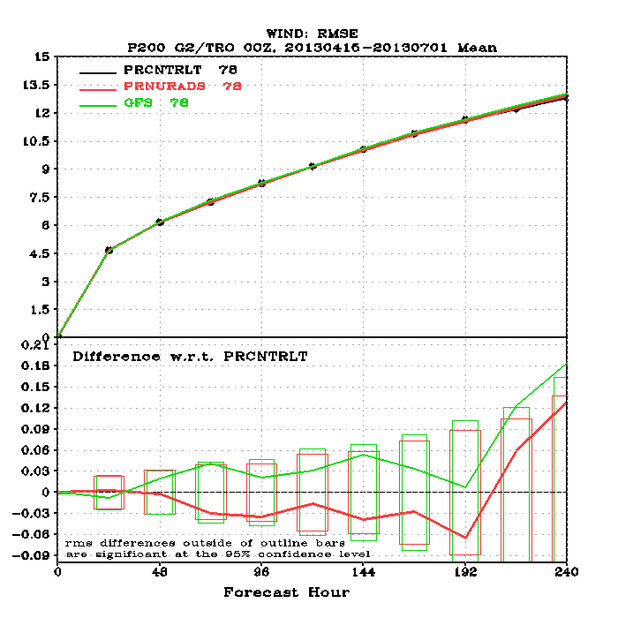
Pre-Implementation Test Results
850hPa and 200hPa Tropical Vector Wind RMS Scores
850hPa
200hPa

Slide 10
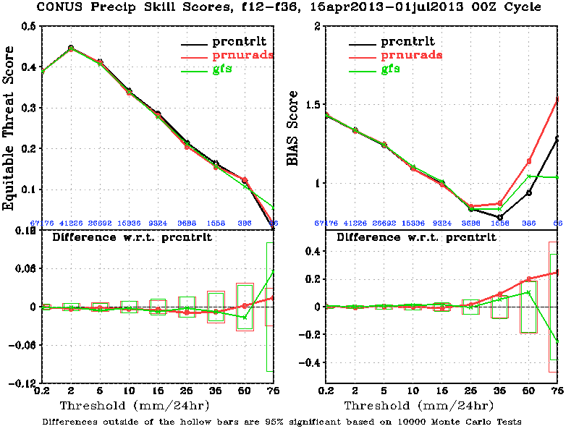
Pre-Implementation Test Results
CONUS Precip Skill Scores: F12-F36

Slide 11
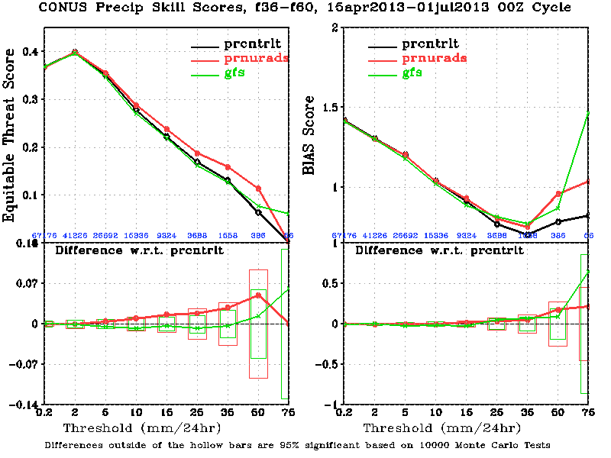
Pre-Implementation Test Results
CONUS Precip Skill Scores: F36-F60

Slide 12
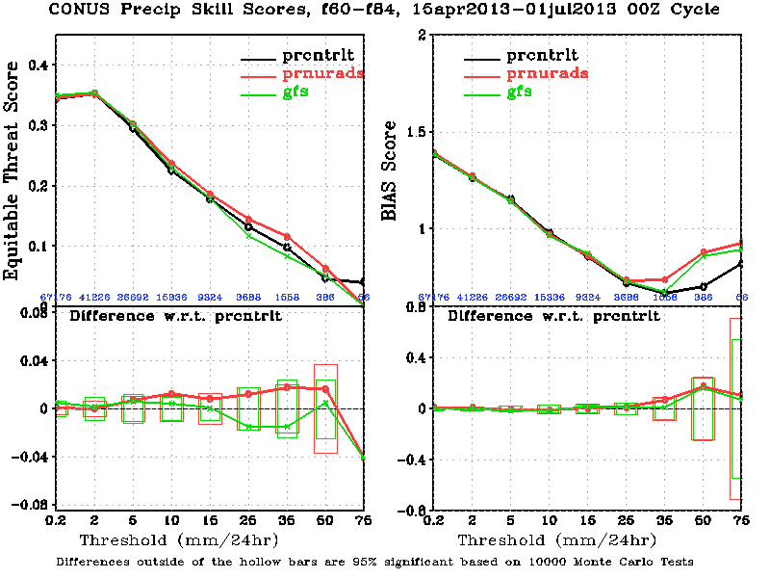
Pre-Implementation Test Results
CONUS Precip Skill Scores: F60-F84

Slide 13
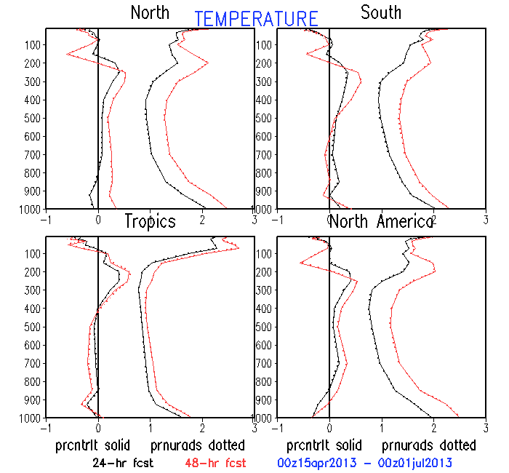
Pre-Implementation Test Results
Fit to Observations: Temperature (24 & 48hr fcsts)
For all variables and forecast lengths – Little impact

Slide 14
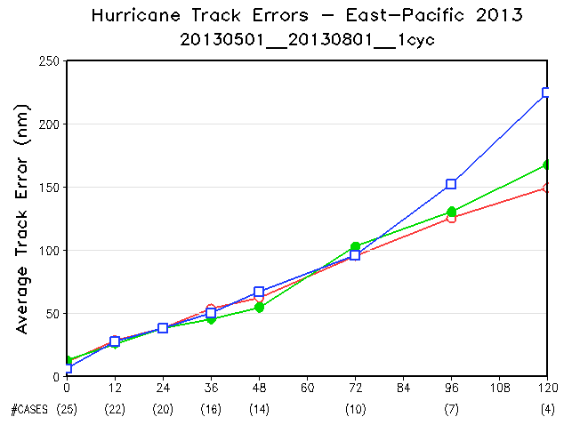
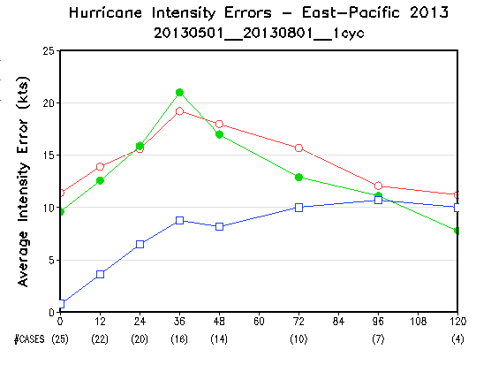
Pre-Implementation Test Results
Hurricane Scores for 2013 E. Pacific Basin
Similar results for other basins. Insufficient sample, but data not available for previous seasons.

Slide 15
Outline
Global Climate and Weather Modeling Branch FY13 Upgrades
  Completed WCOSS transition
  Transitioning to new code management procedures
  Implementations
    Data upgrade for assimilation system
    WAFS grid upgrade
GCWMB and Data Assimilation Plans
  T1534L64 GFS/GDAS upgrade

Slide 16
WAFS grid upgrade
Additional levels added to WAFS file only
  FL80 – t,u,v,q
  FL210 – t,u,v,q
  FL410 – t,u,v – original request
  FL490 – t,u,v

Slide 17
Outline
Global Climate and Weather Modeling Branch FY13 Upgrades
  Completed WCOSS transition
  Transitioning to new code management procedures
  Implementations
    Data upgrade for assimilation system
    WAFS grid upgrade
GCWMB and Data Assimilation Plans
  T1534L64 GFS/GDAS upgrade

Slide 18
Next Implementation – Q4FY14
Schedule Outline
  Configuration Finalized 11/25/2013
  Tuning and initial testing completed 12/31/2013
  EMC retrospective testing begins 01/06/2014
  Real-Time Evaluation begins through NCO feed
  Real-Time Evaluation Ends
  Implementation
Status
  Configuration Finalized
    GEFS upgrade separated from GDAS/GFS upgrade
  2 Major (maybe just 1) issues
    Loss of ozone
    Warm surface temperatures
  Risks
    Testing timetable
    Science uncertainties
  Downstream users have been given early access to output files. NCO has modifications to their processing under development

Slide 19
Model Highlights
T1534 Semi-Lagrangian (~13km)
Use of high resolution daily SST and sea ice analysis
High resolution until 10 days
Physics
  Cloud estimate modifications
  Radiation modifications
  Reduced drag coefficient at high wind speeds
  Stationary convective gravity wave drag
  Consistent GFS diagnosis snow accumulation in post and model
  Compute and output frozen precipitation fraction
  Land Surface
    Soil Moisture climatology from CFSv2
    Changes to roughness length calculations

Slide 20
Post - Processer Highlights
Faster/less memory version
.25 degree post file instead of master grib file (GRIB2)
Accumulation bucket changed from 12 hour to 6 hour between day 8 and day 10
Add user requested fields
  frozen precipitation fraction
  ozone at 150, 200, 250, 300, 350, and 400 mb,
  2m dew point,
  wind chill and heat index,
  instantaneous precipitation type
  membrane SLP in GDAS pgb files
Update BUFR station list to NAM/GFS list

Slide 21
Analysis Highlights
Structure
  T574 analysis for T1534 deterministic
  Single scale background error (for efficiency)
  Code optimization
Observations
  GPSRO enhancements
  Updates to radiance assimilation
    Assimilate SSM/IS UPP LAS data
    CRTM v2.1.3
    New bias correction
    Additional satwind data – hourly GOES, EUMETSAT
EnKF modifications
  Stochastic physics in EnKF forecasts
  T574L64 EnKF ensembles

Slide 22
GCWMB Plans
GEFS
  Unification with global system
GFS
  NEMS
  Higher horizontal and vertical resolution for GFS/GEFS – ~ T2000L128
  Enhanced Physics
    Convection
    Clouds
    Boundary Layer
    Etc.
  Non-hydrostatic
Analysis
  4D – Hybrid
  Improved use of observations
    Inclusion of cloudy radiances
    Bias correction of aircraft data
    Etc.
Whole Atmosphere Model (w SWPC)
Enhanced NGAC

Slide 23
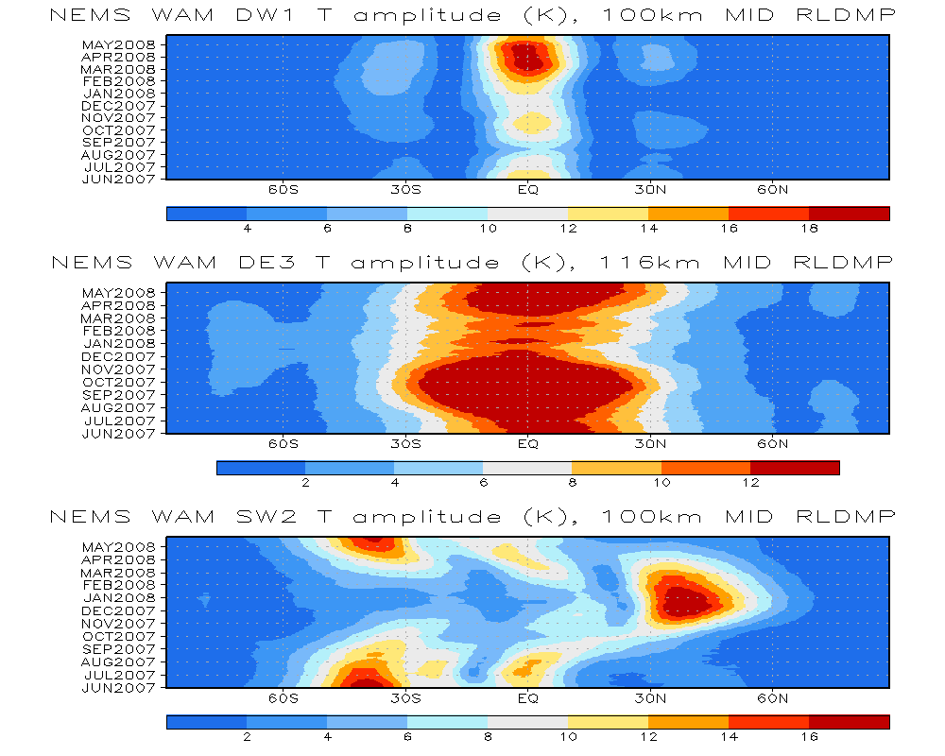
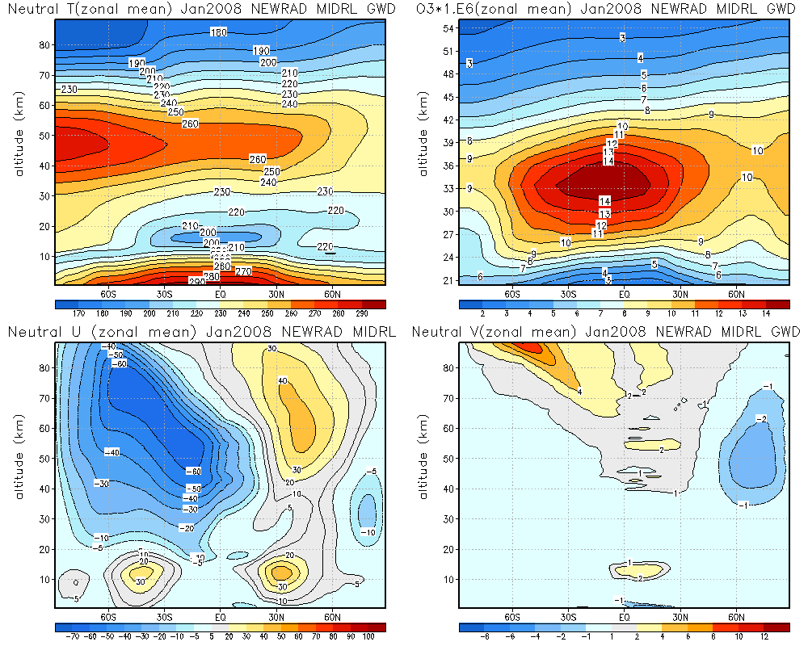
Status update on Whole Atmosphere Model (WAM)
-Joint efforts from EMC and SWPC
- Direct support space weather service as planed in NWS Weather Ready Nation Roadmap (P39, WRN Roadmap Version 2.0-April 2013)
- Personnel: Jun Wang, Miodrag Rancic Henry Juang, Shrinivas Moorthi, Yu-tai Hou, Mark Iredell, Sarah Lu, John Derber, Fanglin Yang (EMC) Rashid Akmaev, Tim Fuller-Rowell, Fei Wu, Houjun Wang (SWPC)
Whole Atmosphere Model
  The neutral atmosphere component of the coupler Integrated Dynamics through Earth’s Atmosphere (IDEA) model is built in GFS general circulation model
  Model is ported in NEMS ESMF frame work
  Vertical level is extended to 150, near a nominal altitude 600km
  It has Eulerian dynamics core, general hybrid coordinate with enthalpy as thermodynamic prognostic variable
  IDEA physics is coupled in GFS physics
Completed Dynamics and physics updates in NEMS WAM model as of Nov 2013
  Thermodynamics equation was revisited, two major updates on the enthalpy vertical flux terms have been done.
  Eighth order horizontal diffusion is added.
  The impact of Rayleigh damping is investigated.
  Non-iteration Dimensional-split Semi-Lagrangian (NDSL) dynamical core for WAM is developed.
  New RRTM-McICA radiation package is added, the new radiation has sub-grid cloud treatment with additional improvement in cloud radiative property scheme, no major impacts are anticipated.
  A scale parameter in gravity wave drag is set to be same as operational setting.
  WAM dry convective adjustment routine has been updated to remove the temperature instability near the model top layers
WDAS – Whole atmosphere model Data Assimilation System
  WDAS is derived by a vertical extension of Grid-point Statistical Interpolation (GSI) data assimilation system used for assimilation of data in GFS
Current Status
  Model has Reasonable upper atmosphere temperature and runs stable
  Model baseline has been set up
  A cycling system with data assimilation and model forecast, post processing, verification and archive is close to finish
Future plan
  Starting parallel cycling run
  Upgrading NEMS WAM model to the latest GFS code
  Reaching out to potential WAM products users
  Preparing project chart for operational implementation
Timeline for FY14
  Q1FY14: NEMS WAM parallel run starts to run
  Target to be implemented in Q1FY15
a
c
b
d
Fig 1. Westward-propagating Diurnal tide with zonal wavenumber 1 (DW1), Eastward-Propagating Diurnal tide with zonal wavenumber 3 (DE3), Westward-Propagating Semi-diurnal tide with zonal wavenumber 2 (SW2)
NEMS WAM reproduces the seasonal variability of tides remarkably well compared to SABER observation
Fig 2.Average January cross section of (a)zonal mean temp(b)zonal mean zonal wind(c)zonal mean ozone(d)zonal mean meridional wind
Results are close to SPARC observation data

Slide 24




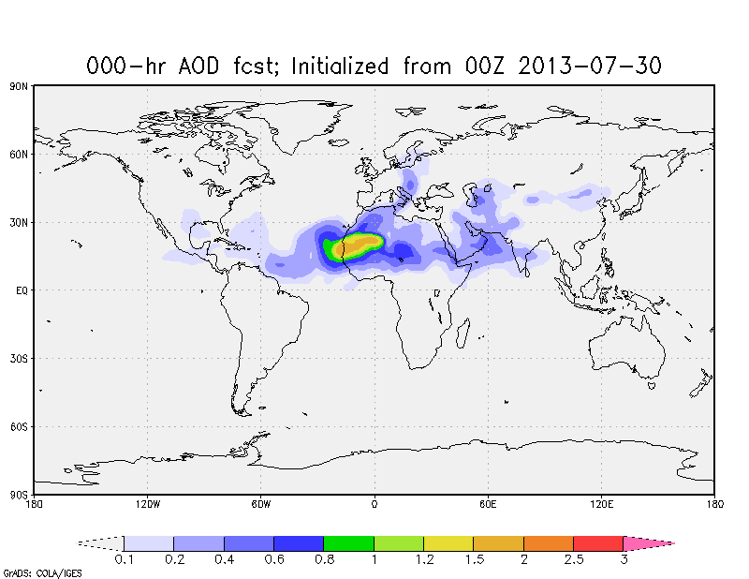
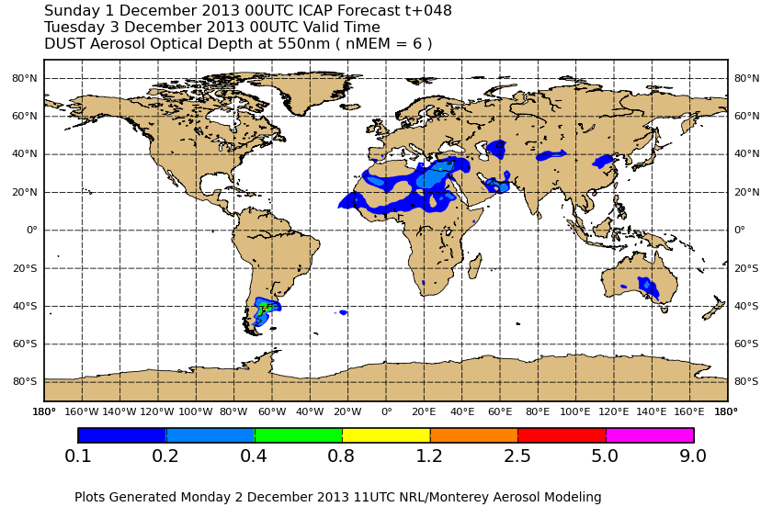
NEMS GFS Aerosol Component (NGAC):
NCEP’s global aerosol forecast system
From NGAC website
Model Configuration:
  Forecast model: Global Forecast System (GFS) based on NOAA Environmental Modeling System (NEMS), NEMS-GFS
  Aerosol model: NASA Goddard Chemistry Aerosol Radiation and Transport Model, GOCART
Near-Real-Time Dust Forecasts
  Global dust-only guidance was established in Q4FY12
  5-day dust forecast once per day (at 00Z), output every 3 hour, at T126 (~ 1 deg) L64 resolution
  Contribute global multi-model ensemble (by International Cooperative for Aerosol Prediction, ICAP) and regional multi-model ensemble (by WMO Sand and Dust Storm Warning Advisory and Assessment System, SDS-WAS)
ICAP MME

