Slide 1
Climate Prediction Center
Review for FY 2013
Jon Gottschalck
Operational Prediction Branch
NWS / NCEP / Climate Prediction Center
NCEP Production Review Meeting
College Park, MD
December 3-5, 2013

Slide 2
Outline
Brief climate conditions overview
Review of CPC official outlooks
Additional model evaluations
Some new activities during FY 2013
Notes:
Weather and Climate extremes (such as floods and droughts, heat and cold waves) have regional and local impacts.
This example for water illustrates some of the kinds of information users need at the regional and local scale (e.g. precipitation forecasts; runoff, river levels, etc) as well as why and how they might use it (evacuation orders; regulating a dam).
NOAA is working to connect global and national climate information to regional and local impacts.

Slide 3
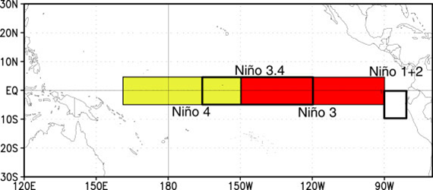
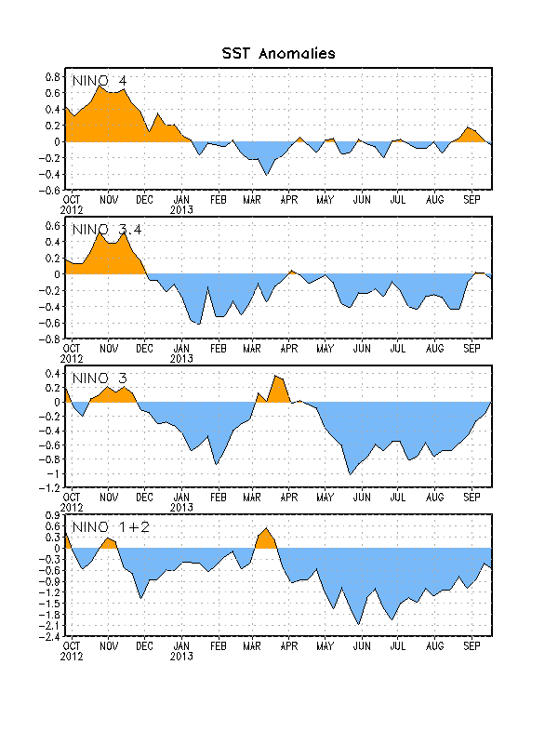
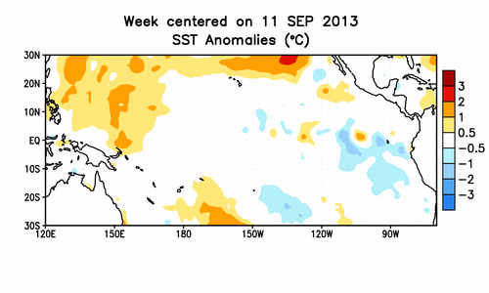
El Nino-Southern Oscillation
Aborted El Nino late 2012
ENSO neutral conditions during FY, although below normal SSTs prevailed for much of 2013
Notes:
Weather and Climate extremes (such as floods and droughts, heat and cold waves) have regional and local impacts.
This example for water illustrates some of the kinds of information users need at the regional and local scale (e.g. precipitation forecasts; runoff, river levels, etc) as well as why and how they might use it (evacuation orders; regulating a dam).
NOAA is working to connect global and national climate information to regional and local impacts.

Slide 4
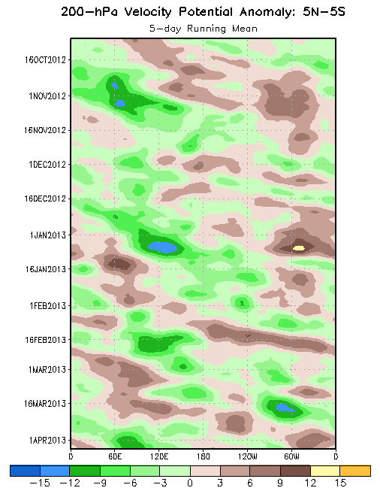
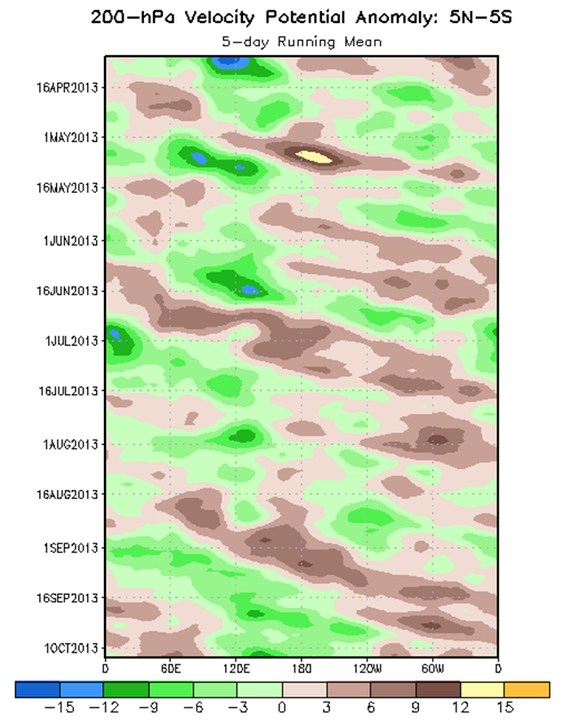
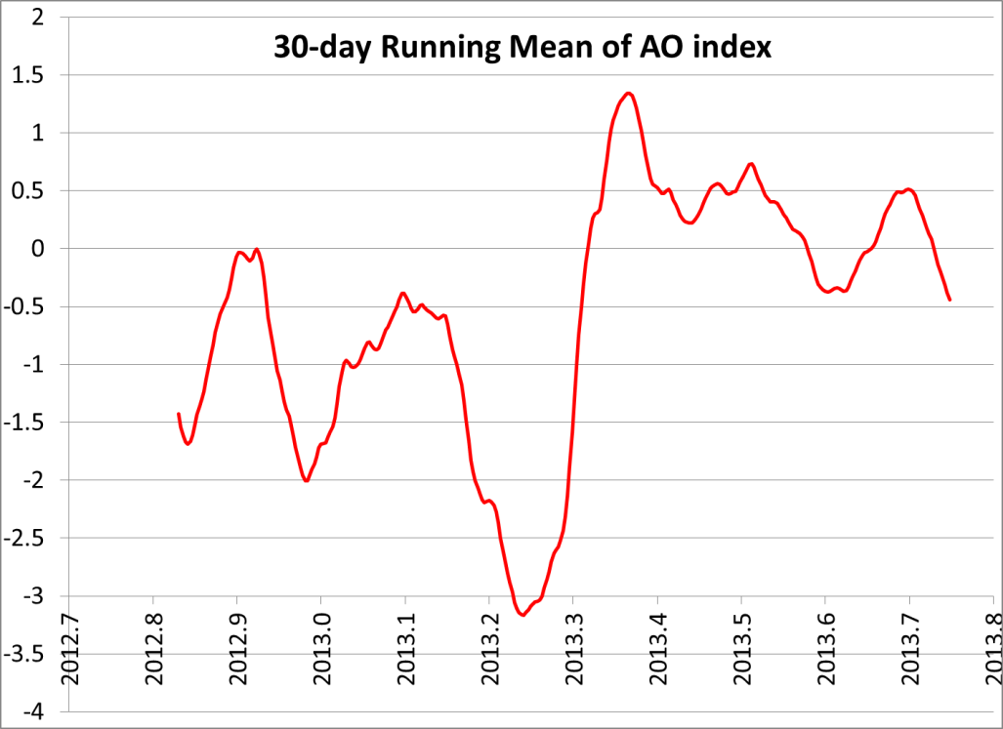
MJO and AO
Madden-Julian Oscillation
Arctic Oscillation

Slide 5
Brief climate conditions overview
Review of CPC official forecasts
Additional model evaluations
Some new activities during FY 2013
Notes:
Weather and Climate extremes (such as floods and droughts, heat and cold waves) have regional and local impacts.
This example for water illustrates some of the kinds of information users need at the regional and local scale (e.g. precipitation forecasts; runoff, river levels, etc) as well as why and how they might use it (evacuation orders; regulating a dam).
NOAA is working to connect global and national climate information to regional and local impacts.

Slide 6
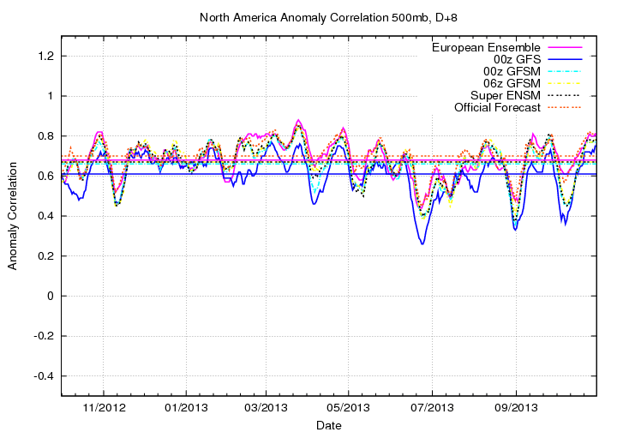
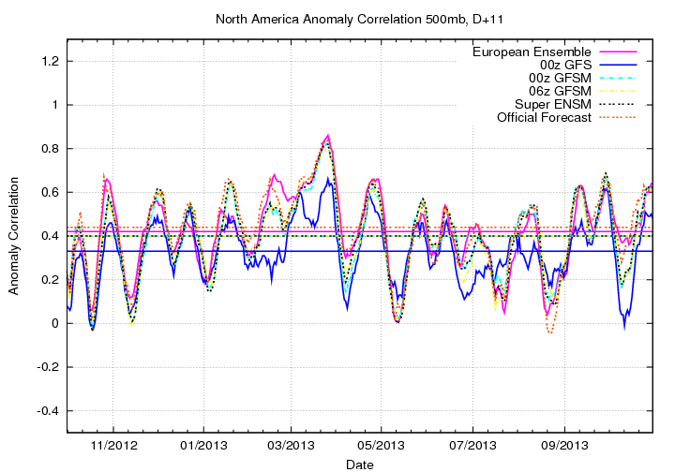
Extended Range Outlooks
Days 6-10
Days 8-14
0z ECMWF Mean: 0.68
0z GFS: 0.60
0z GFSM: 0.66
6z GFSM: 0.67
GFS Super Ensemble: 0.67
Manual: 0.70
0z ECMWF Mean: 0.42
0z GFS: 0.33
0z GFSM: 0.40
6z GFSM: 0.40
Super Ensemble: 0.40
Manual: 0.44
Notes:
Weather and Climate extremes (such as floods and droughts, heat and cold waves) have regional and local impacts.
This example for water illustrates some of the kinds of information users need at the regional and local scale (e.g. precipitation forecasts; runoff, river levels, etc) as well as why and how they might use it (evacuation orders; regulating a dam).
NOAA is working to connect global and national climate information to regional and local impacts.

Slide 7
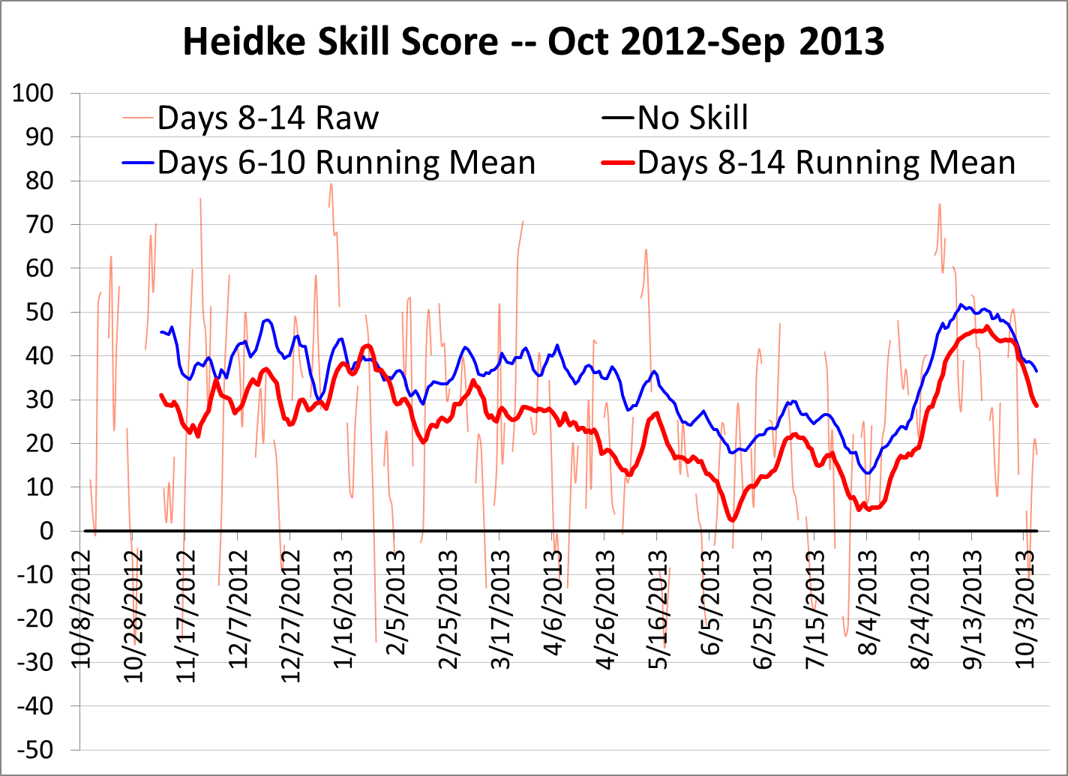
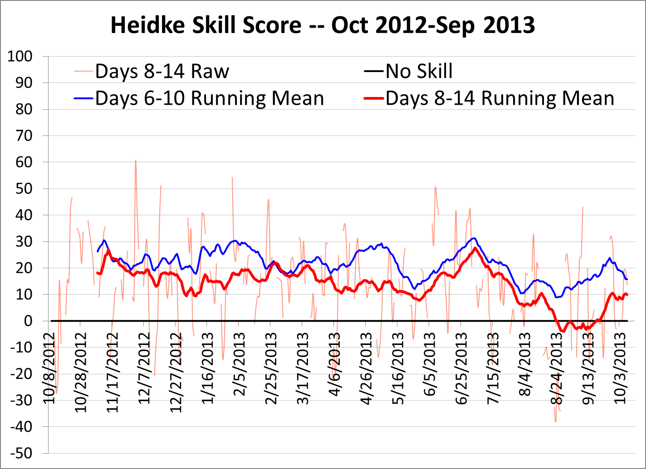
Extended Range Outlooks
Days 8-14 Temperature
Days 8-14 Precipitation
Outlook Type | Averaging Period | HSS
Days 8-14 | Past year | 25.2
Days 6-10 | Past year | 34.7
Days 8-14 | 2008-2013 | 23.4
Outlook Type | Averaging Period | HSS
Days 8-14 | Past year | 13.4
Days 6-10 | Past year | 21.2
Days 8-14 | 2008-2013 | 10.2
Notes:
Weather and Climate extremes (such as floods and droughts, heat and cold waves) have regional and local impacts.
This example for water illustrates some of the kinds of information users need at the regional and local scale (e.g. precipitation forecasts; runoff, river levels, etc) as well as why and how they might use it (evacuation orders; regulating a dam).
NOAA is working to connect global and national climate information to regional and local impacts.

Slide 8
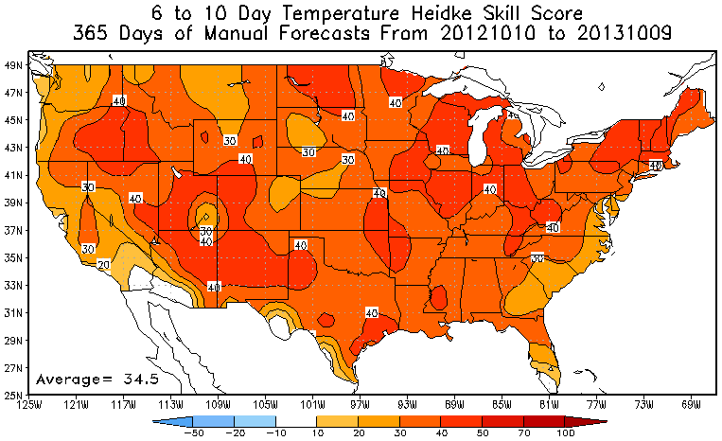
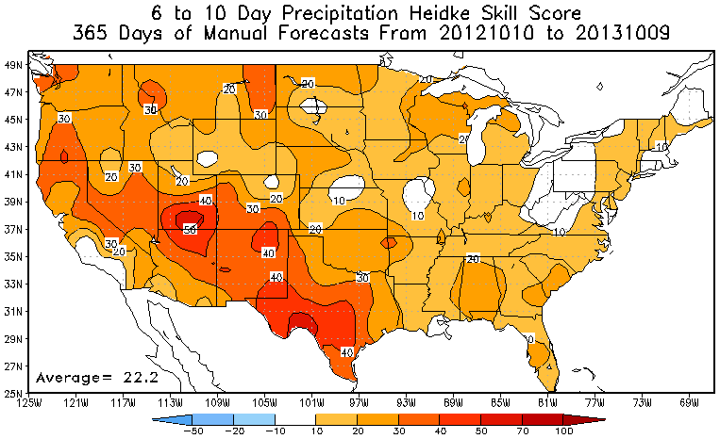
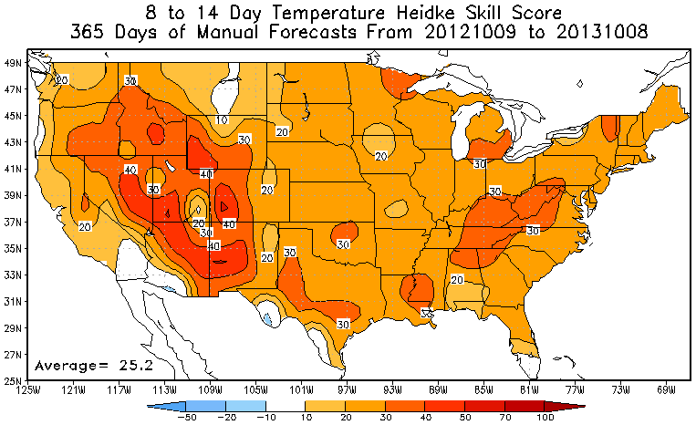
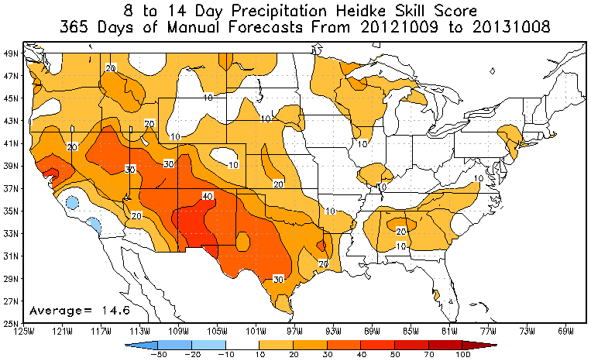
Extended Range Outlooks
Temperature
Precipitation
Notes:
Weather and Climate extremes (such as floods and droughts, heat and cold waves) have regional and local impacts.
This example for water illustrates some of the kinds of information users need at the regional and local scale (e.g. precipitation forecasts; runoff, river levels, etc) as well as why and how they might use it (evacuation orders; regulating a dam).
NOAA is working to connect global and national climate information to regional and local impacts.

Slide 9
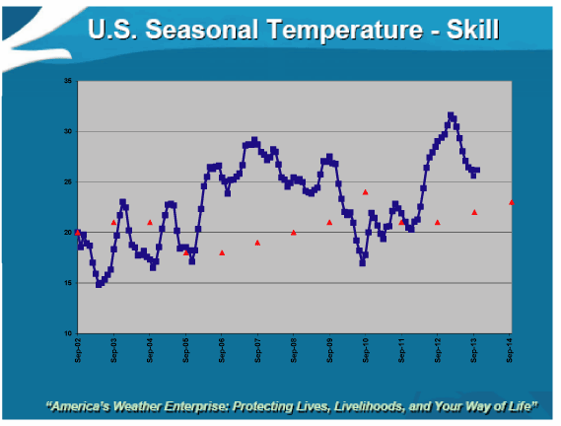
Long Range Outlooks
Goal
48 month running mean of
non-EC seasonal temperature HSS
Notes:
Weather and Climate extremes (such as floods and droughts, heat and cold waves) have regional and local impacts.
This example for water illustrates some of the kinds of information users need at the regional and local scale (e.g. precipitation forecasts; runoff, river levels, etc) as well as why and how they might use it (evacuation orders; regulating a dam).
NOAA is working to connect global and national climate information to regional and local impacts.

Slide 10
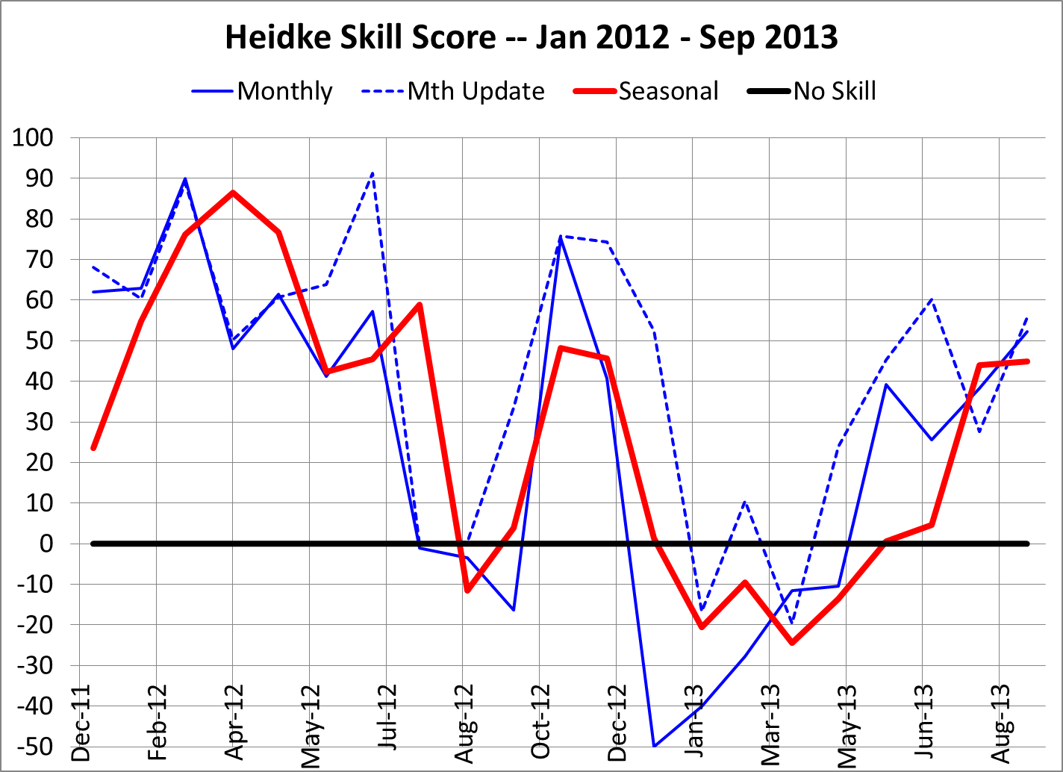
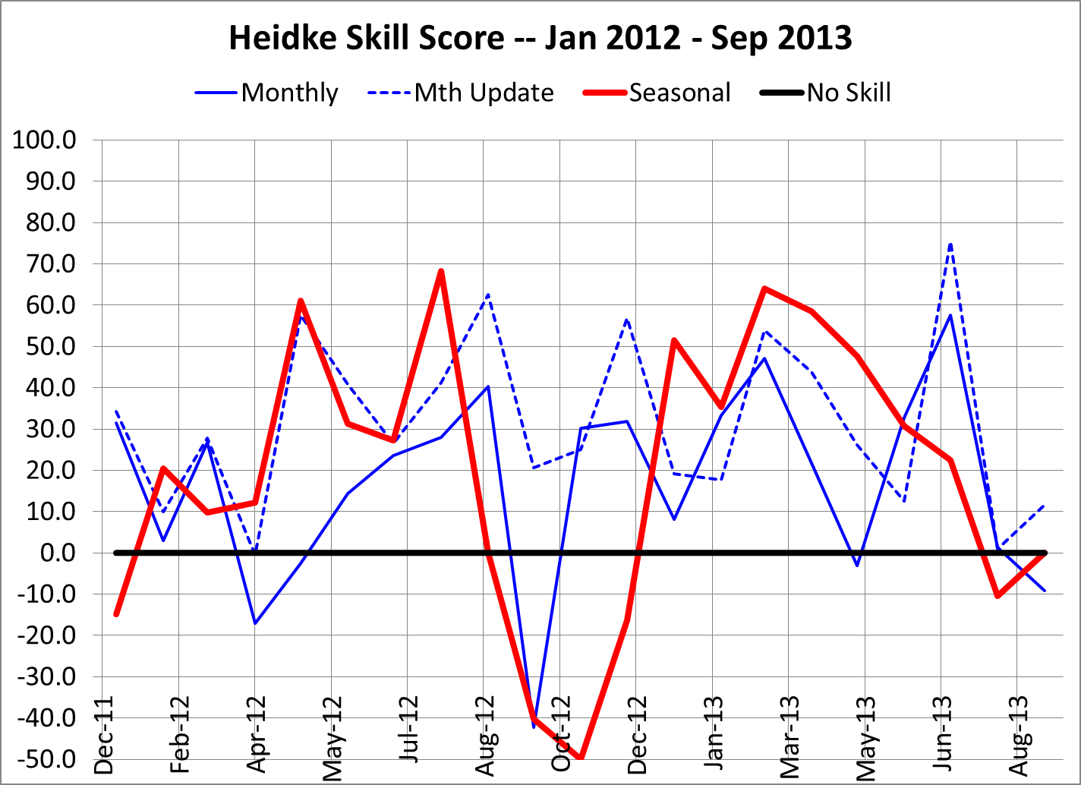
Long Range Outlooks
Temperature
Precipitation
Outlook Type | Averaging Period | HSS
Seasonal | Past year | 27.5
Monthly | Past year | 25.4
Revised Monthly | Past year | 43.2
Seasonal | 1995-2013 | 23.6
Outlook Type | Averaging Period | HSS
Seasonal | Past year | 19.5
Monthly | Past year | 17.0
Revised Monthly | Past year | 31.6
Seasonal | 1995-2013 | 13.3
Notes:
Weather and Climate extremes (such as floods and droughts, heat and cold waves) have regional and local impacts.
This example for water illustrates some of the kinds of information users need at the regional and local scale (e.g. precipitation forecasts; runoff, river levels, etc) as well as why and how they might use it (evacuation orders; regulating a dam).
NOAA is working to connect global and national climate information to regional and local impacts.

Slide 11
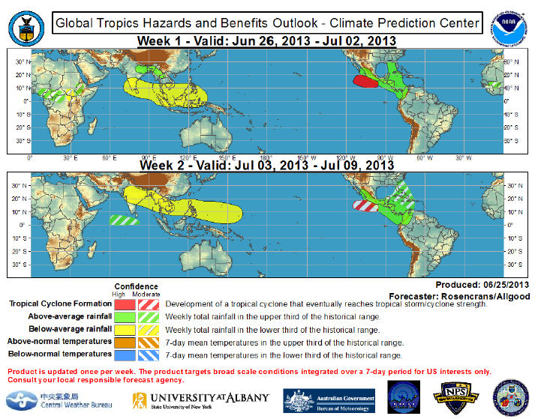
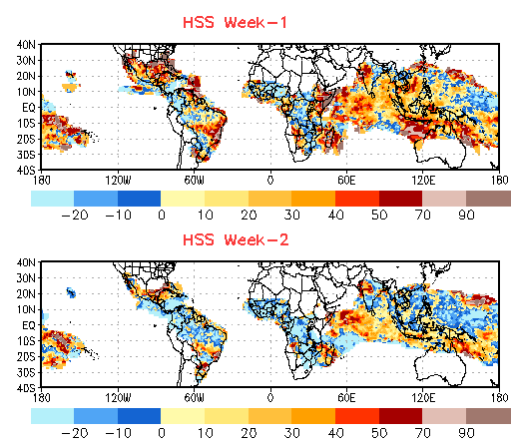
Global Tropics Hazards Outlook
Factors include ENSO, MJO, ER and Kelvin waves, statistical forecast tools (C-LIM, etc.), dynamical model output
Weekly coordination with SUNY, CICS, JTWC, NHC, NPS and NWS regions
Notes:
Weather and Climate extremes (such as floods and droughts, heat and cold waves) have regional and local impacts.
This example for water illustrates some of the kinds of information users need at the regional and local scale (e.g. precipitation forecasts; runoff, river levels, etc) as well as why and how they might use it (evacuation orders; regulating a dam).
NOAA is working to connect global and national climate information to regional and local impacts.

Slide 12
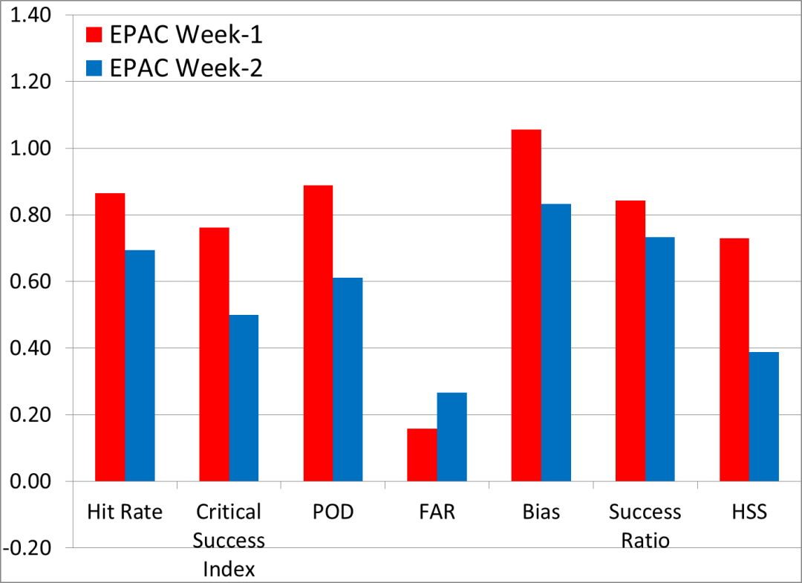
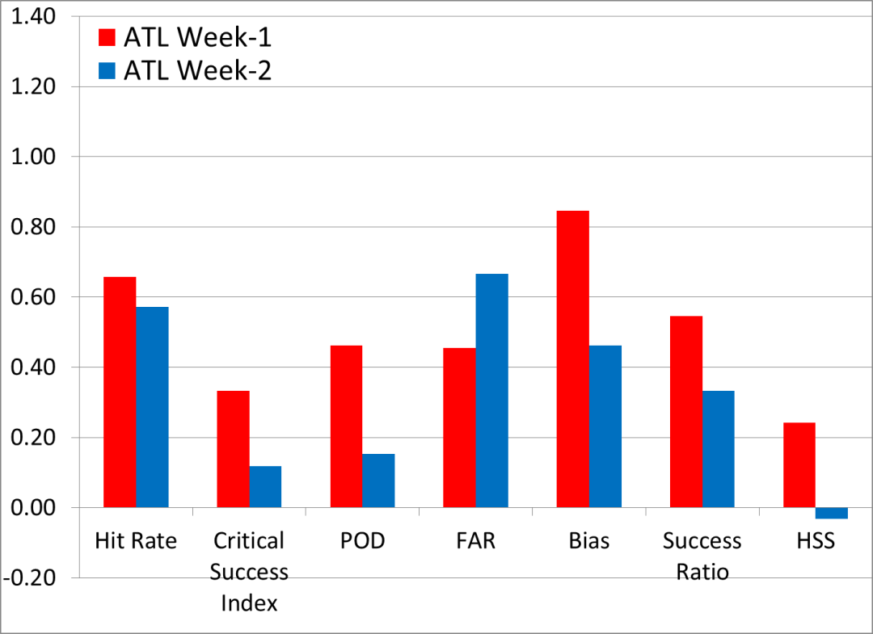
GTH Outlook TC Verification
East Pacific
Atlantic
Notes:
Weather and Climate extremes (such as floods and droughts, heat and cold waves) have regional and local impacts.
This example for water illustrates some of the kinds of information users need at the regional and local scale (e.g. precipitation forecasts; runoff, river levels, etc) as well as why and how they might use it (evacuation orders; regulating a dam).
NOAA is working to connect global and national climate information to regional and local impacts.

Slide 13
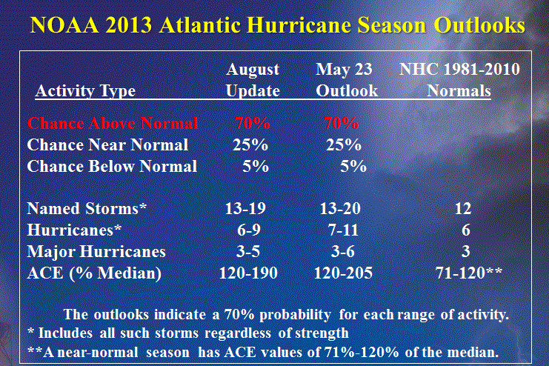
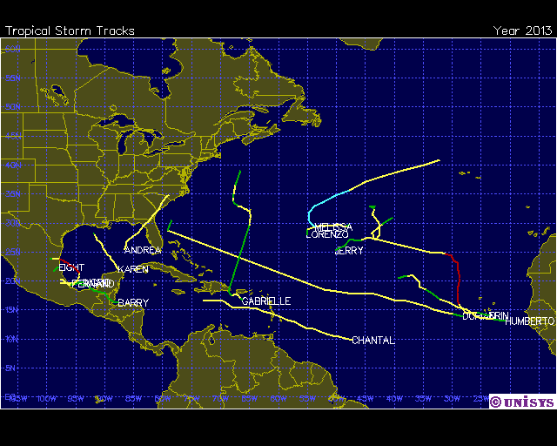
NOAA Seasonal Hurricane Outlook
Observed numbers:
Named storms: 13
Hurricanes: 2
Major Hurricanes : 0
ACE: 36% of median
Notes:
Weather and Climate extremes (such as floods and droughts, heat and cold waves) have regional and local impacts.
This example for water illustrates some of the kinds of information users need at the regional and local scale (e.g. precipitation forecasts; runoff, river levels, etc) as well as why and how they might use it (evacuation orders; regulating a dam).
NOAA is working to connect global and national climate information to regional and local impacts.

Slide 14
Brief climate conditions overview
Review of CPC official forecasts
Additional model evaluations
Some new activities during FY 2013
Notes:
Weather and Climate extremes (such as floods and droughts, heat and cold waves) have regional and local impacts.
This example for water illustrates some of the kinds of information users need at the regional and local scale (e.g. precipitation forecasts; runoff, river levels, etc) as well as why and how they might use it (evacuation orders; regulating a dam).
NOAA is working to connect global and national climate information to regional and local impacts.

Slide 15
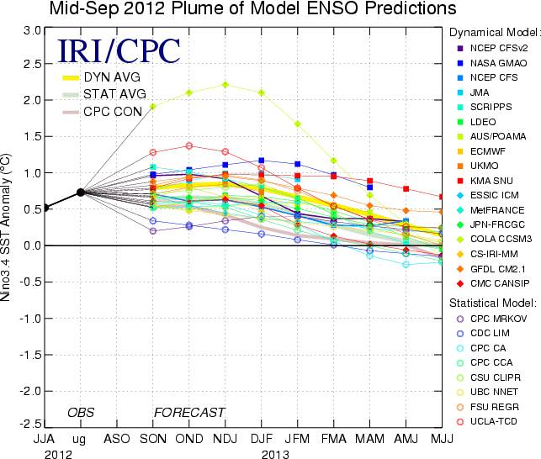
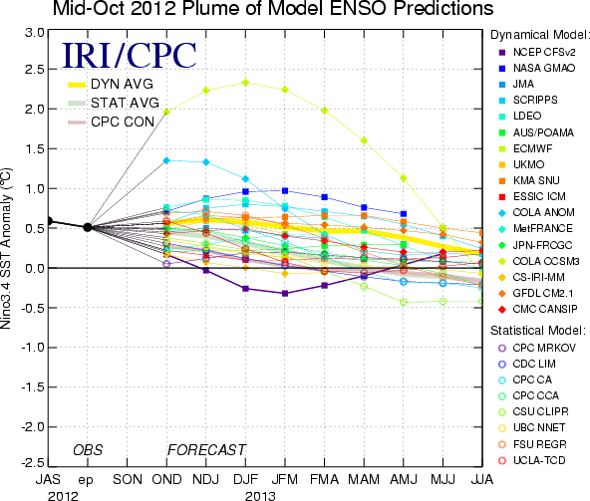
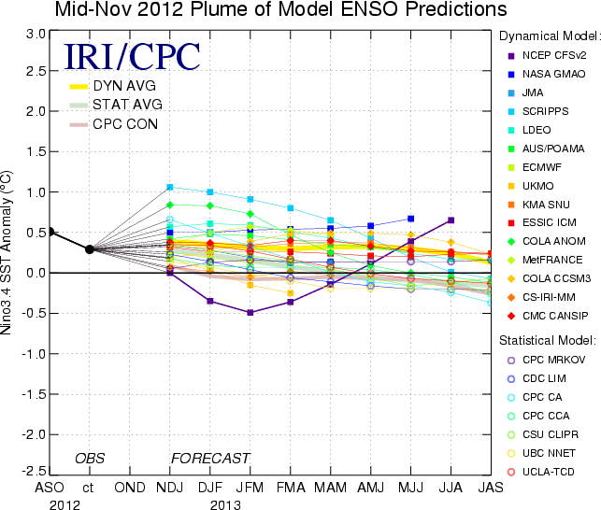
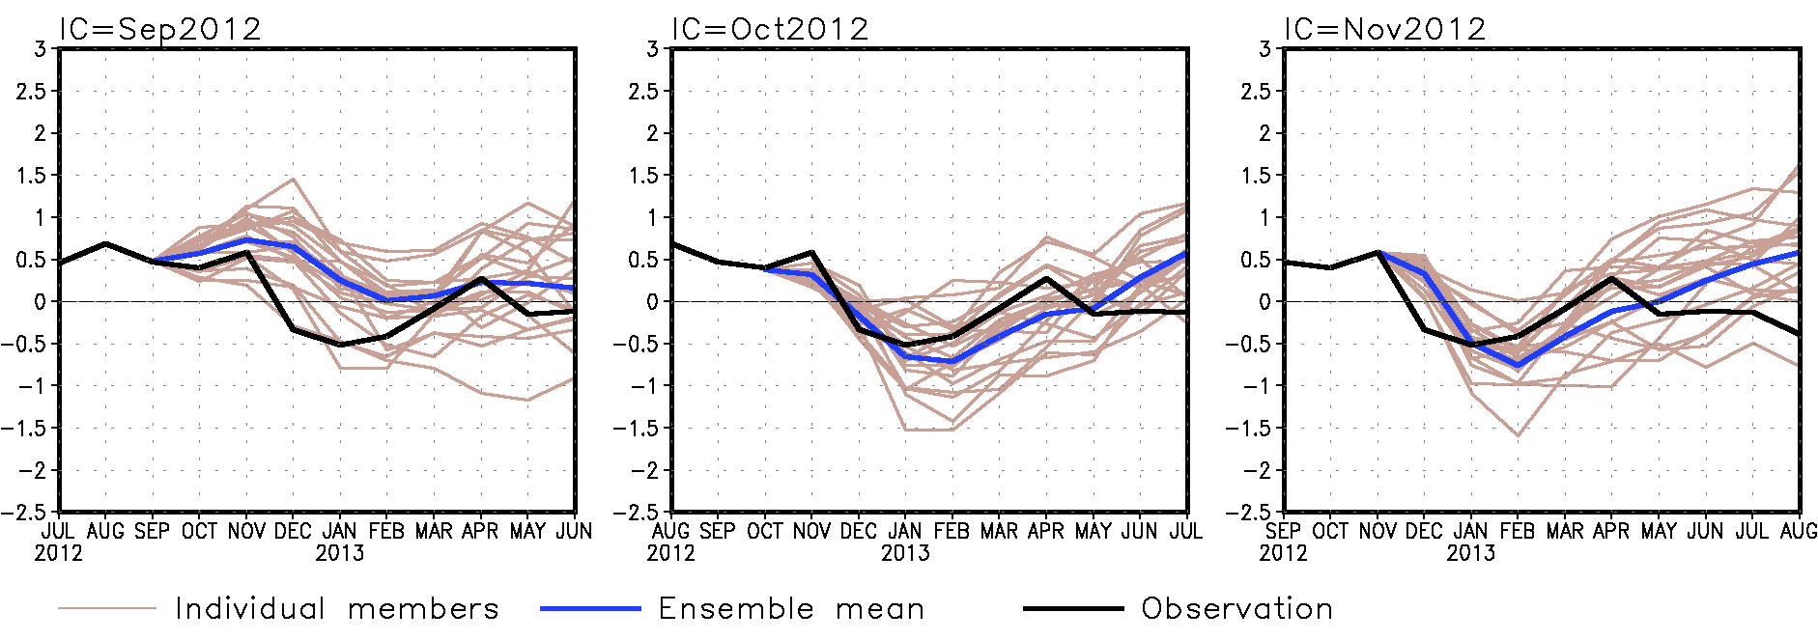
CFS Nino3.4 Forecasts
CFSv2
CFSv2
CFSv2
Courtesy: Wanqiu Wang
Notes:
Weather and Climate extremes (such as floods and droughts, heat and cold waves) have regional and local impacts.
This example for water illustrates some of the kinds of information users need at the regional and local scale (e.g. precipitation forecasts; runoff, river levels, etc) as well as why and how they might use it (evacuation orders; regulating a dam).
NOAA is working to connect global and national climate information to regional and local impacts.

Slide 16
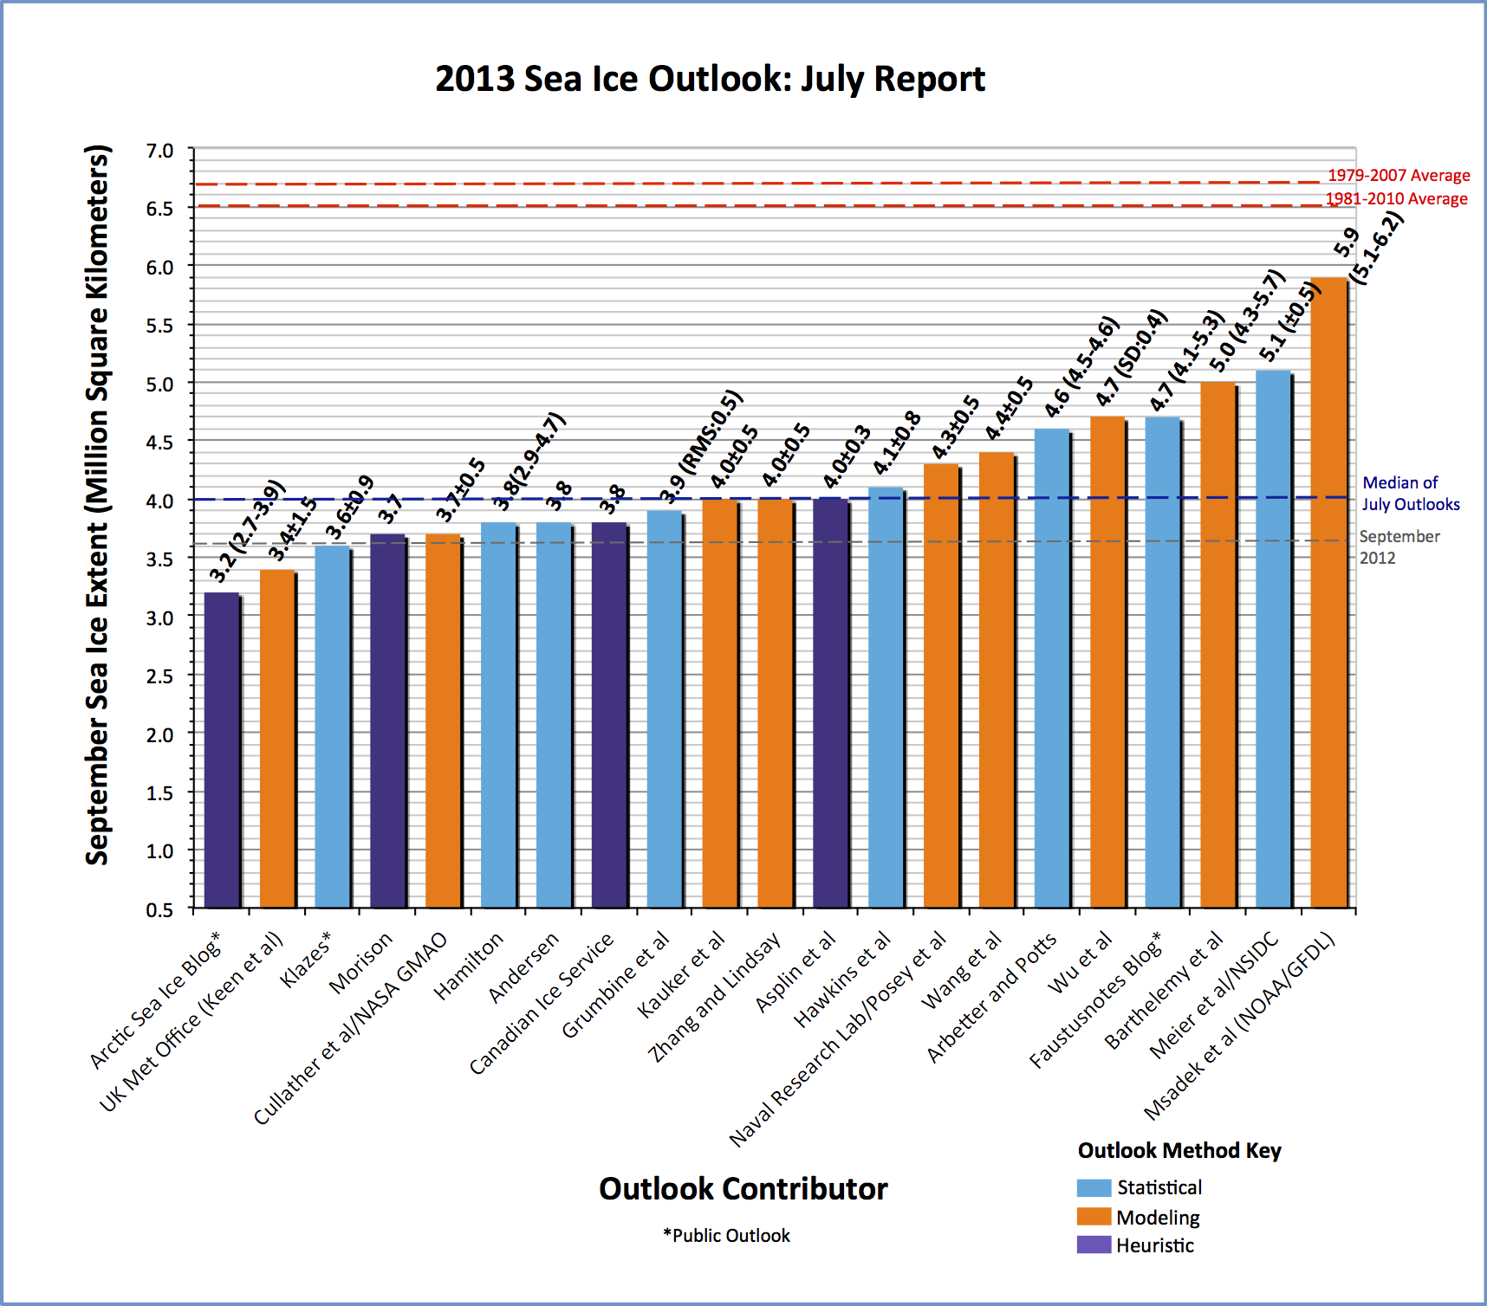
CFS Sea Ice Forecasts
Obs=5.35
CFSv2
Courtesy: Wanqiu Wang
Notes:
Weather and Climate extremes (such as floods and droughts, heat and cold waves) have regional and local impacts.
This example for water illustrates some of the kinds of information users need at the regional and local scale (e.g. precipitation forecasts; runoff, river levels, etc) as well as why and how they might use it (evacuation orders; regulating a dam).
NOAA is working to connect global and national climate information to regional and local impacts.

Slide 17
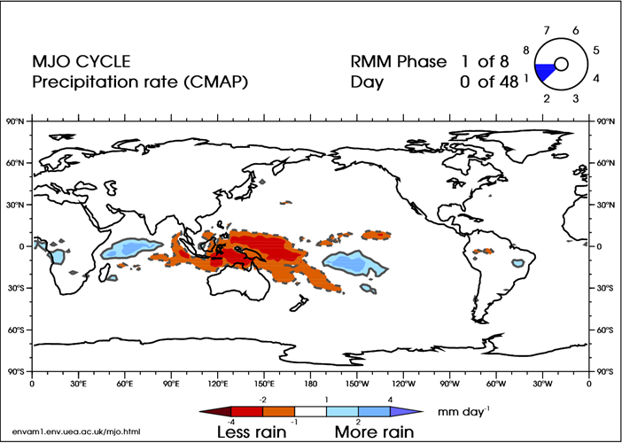
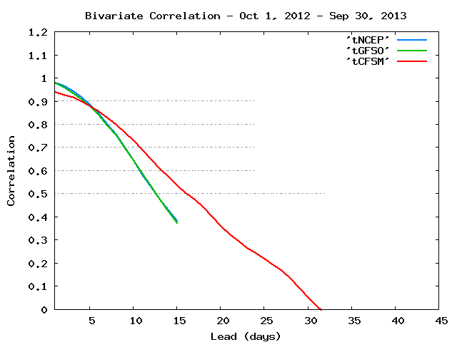
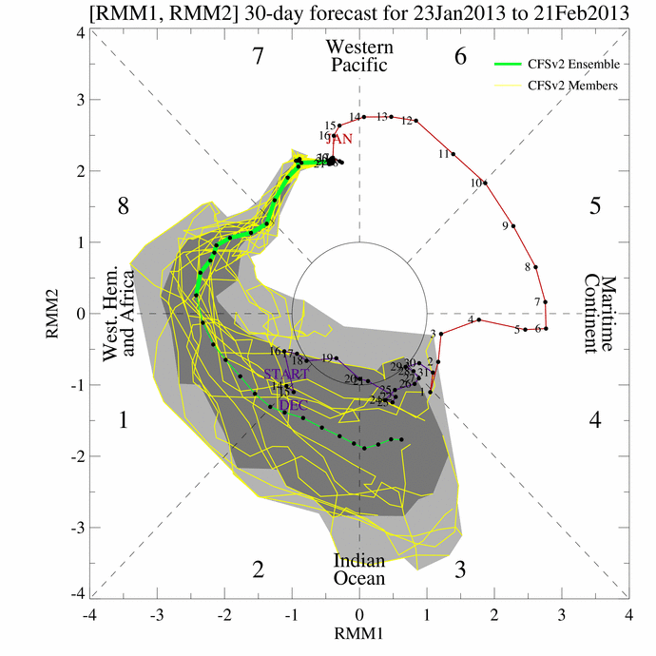
MJO Index Evaluation
Benchmarks for r = 0.5:
GFS: 12 days
GEFS: 14 days
CFS: 21 days
GFS: 12 days
GEFS: 12 days
CFS: 16 days
Notes:
Weather and Climate extremes (such as floods and droughts, heat and cold waves) have regional and local impacts.
This example for water illustrates some of the kinds of information users need at the regional and local scale (e.g. precipitation forecasts; runoff, river levels, etc) as well as why and how they might use it (evacuation orders; regulating a dam).
NOAA is working to connect global and national climate information to regional and local impacts.

Slide 18
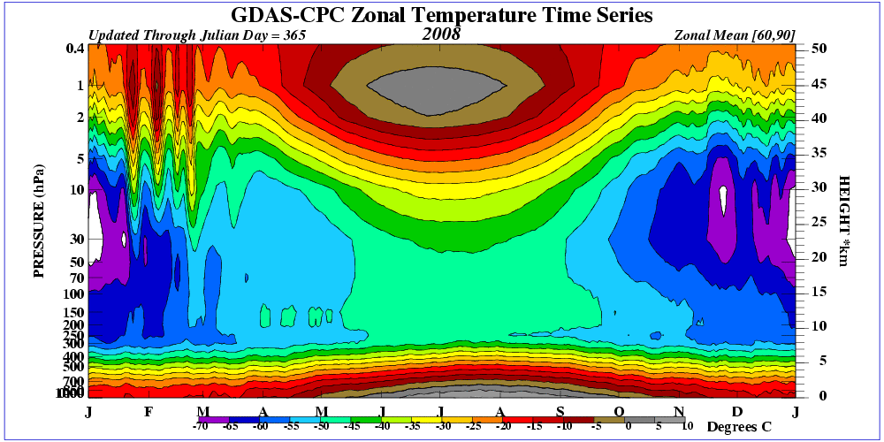
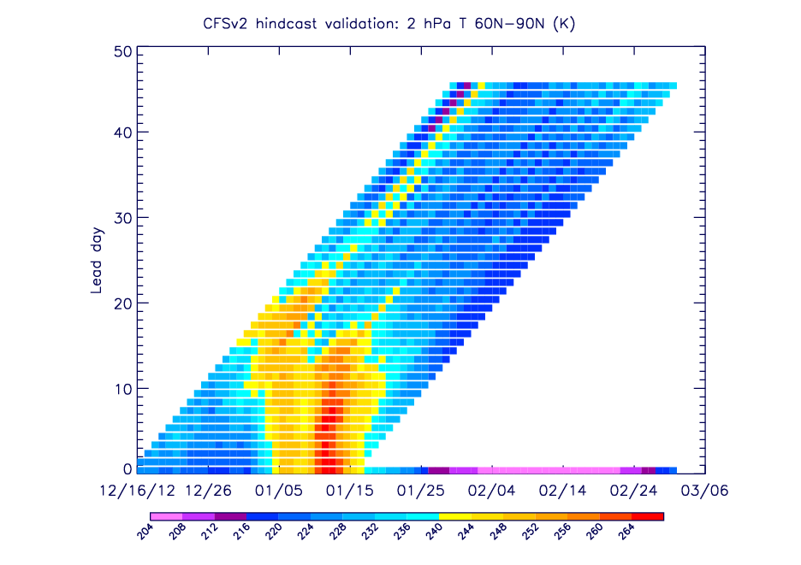
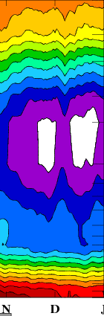
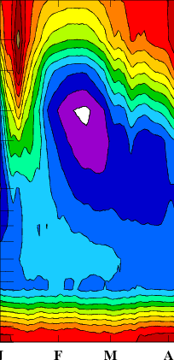
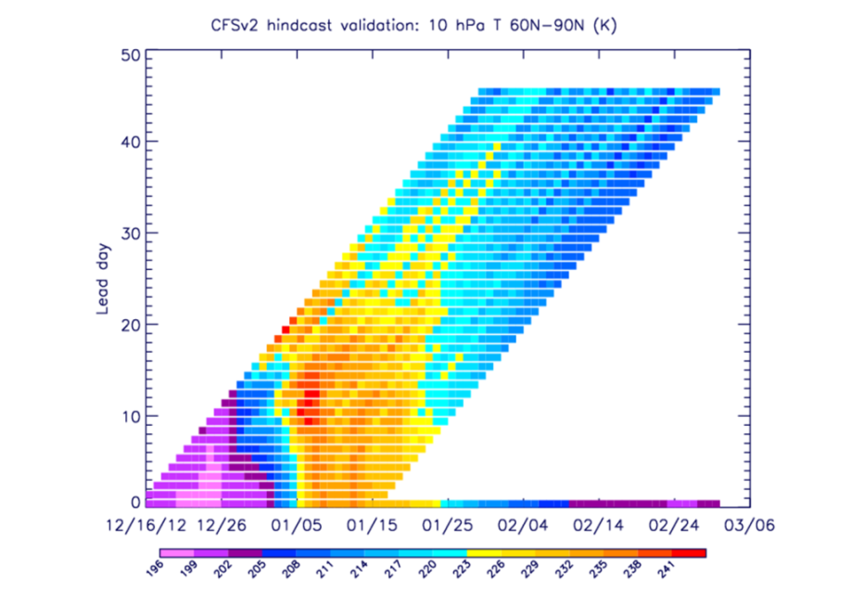
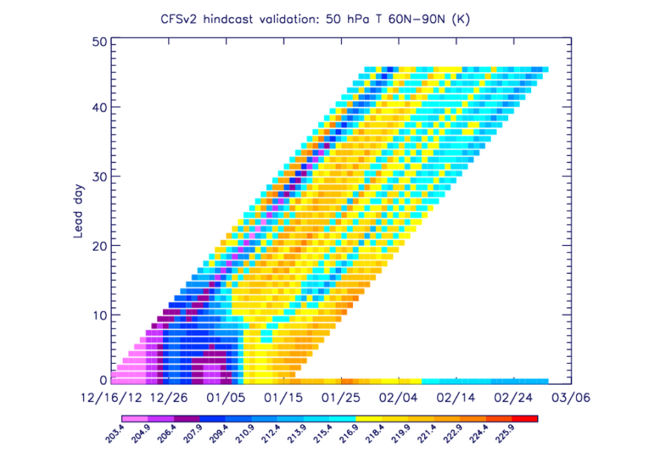
Stratospheric Warming Event
CPC Polar Temp Time Series 2012-2013
Day 45 Fcst
2 mb
Day 1 Fcst
CFS forecasts of early Jan 2013
Obs
10 mb
50 mb
Courtesy: Craig Long
Notes:
Shown in UL is observations of polar (60-90N) temps. Shows how warming was strong in upper strat and weakens (dT) as it moves downward towards 50 hPa. Forecasts of 2 (UR), 10 (LL) and 50 (LR) show SSW was forecasted about 15 days ahead of event at 2 through 10 mb. But at 50 mb, forecast is less decisive.

Slide 19
Brief climate conditions overview
Review of CPC official forecasts
Additional model evaluations
Some new activities during FY 2013
Notes:
Weather and Climate extremes (such as floods and droughts, heat and cold waves) have regional and local impacts.
This example for water illustrates some of the kinds of information users need at the regional and local scale (e.g. precipitation forecasts; runoff, river levels, etc) as well as why and how they might use it (evacuation orders; regulating a dam).
NOAA is working to connect global and national climate information to regional and local impacts.

Slide 20
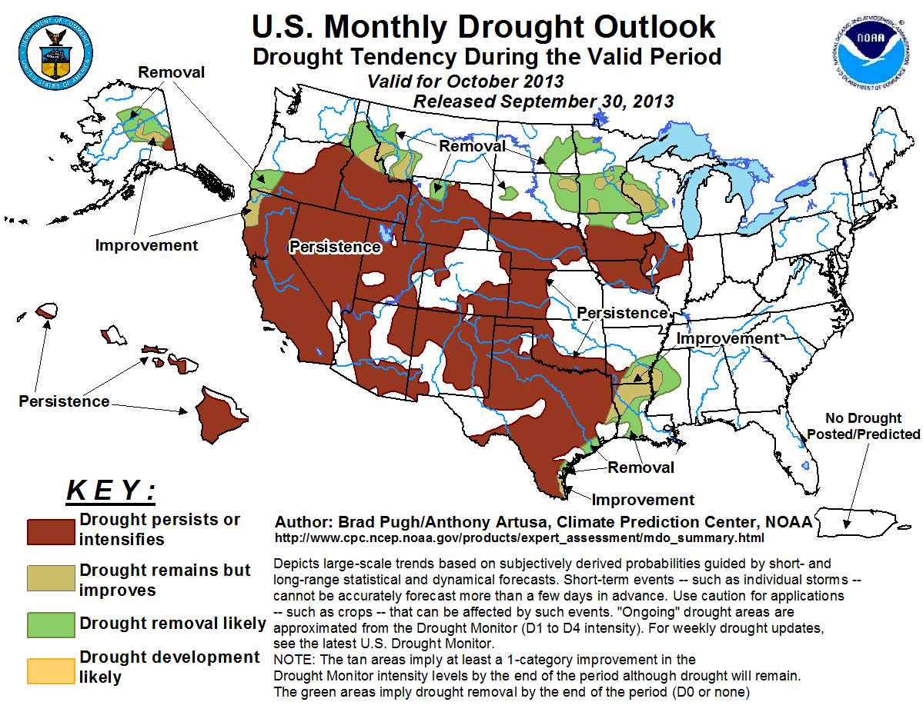
Monthly Drought Outlook
Introduced monthly drought outlook in June 2013
Changes in drought tendency categories this past year

Slide 21
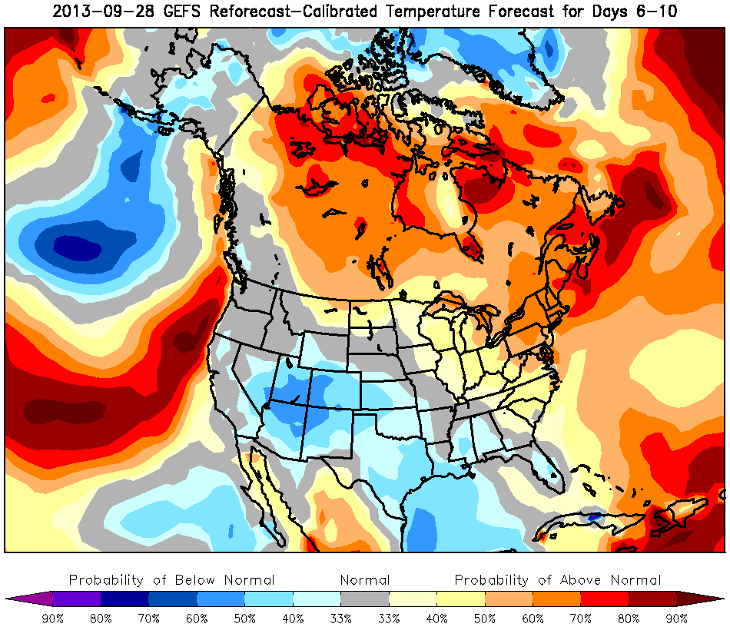
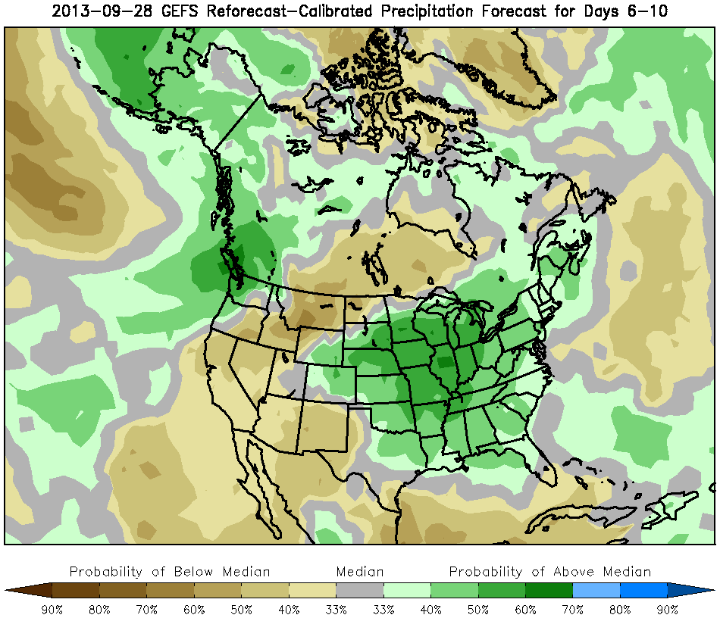
ESRL Reforecast Dataset
CPC developing operational tools based on new ESRL reforecast dataset, some preliminary realtime verification
Reforecast session: Mike Charles will present CPC portion
Notes:
Weather and Climate extremes (such as floods and droughts, heat and cold waves) have regional and local impacts.
This example for water illustrates some of the kinds of information users need at the regional and local scale (e.g. precipitation forecasts; runoff, river levels, etc) as well as why and how they might use it (evacuation orders; regulating a dam).
NOAA is working to connect global and national climate information to regional and local impacts.

Slide 22
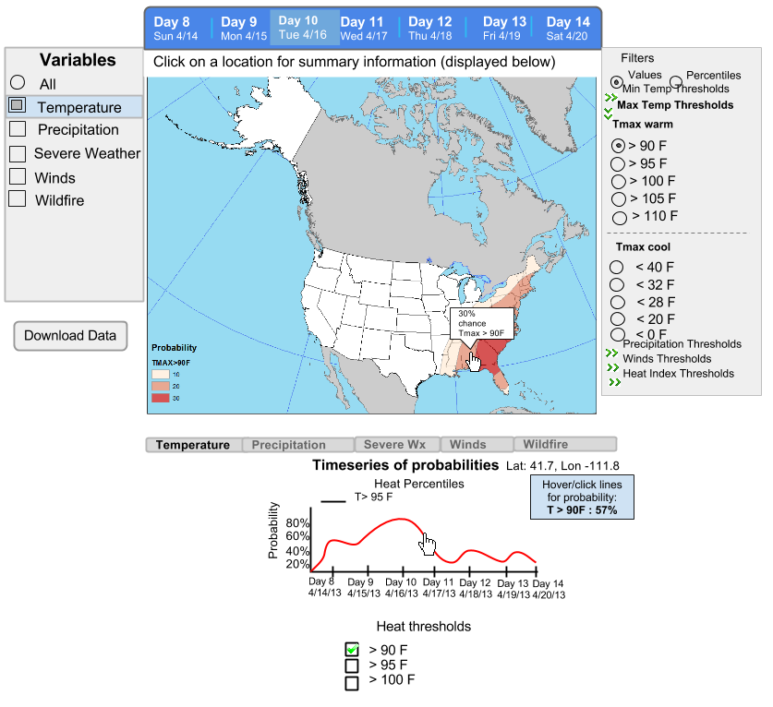
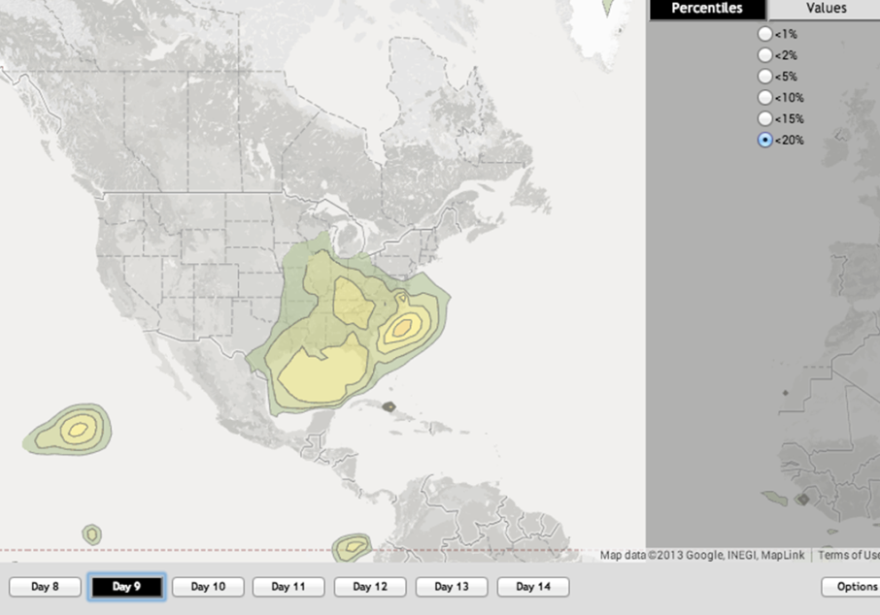

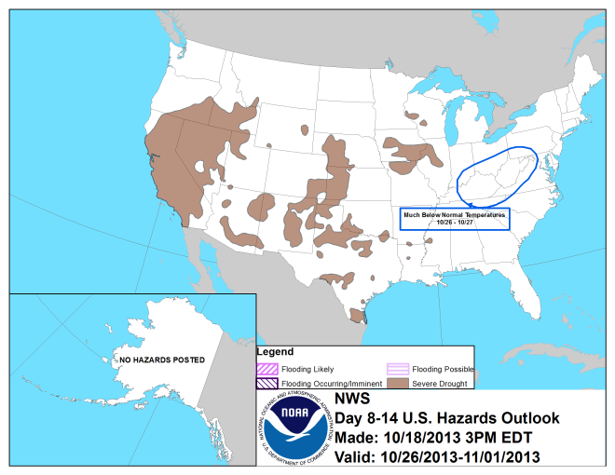
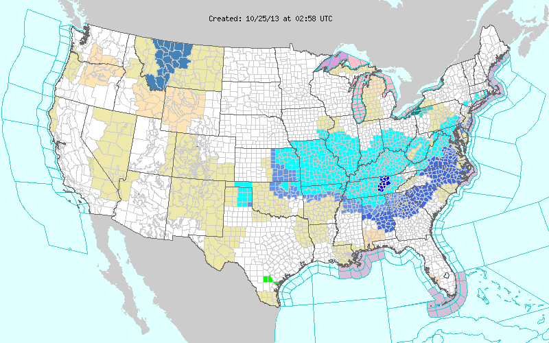
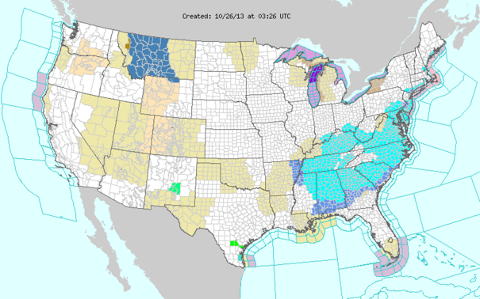
Probabilistic U.S. Hazards Outlook
CPC is developing experimental probabilistic U.S. Hazards outlook
Approach is to do variable by variable, starting with temperature
GEFS ESRL Reforecast pivotal for this product
Notes:
Weather and Climate extremes (such as floods and droughts, heat and cold waves) have regional and local impacts.
This example for water illustrates some of the kinds of information users need at the regional and local scale (e.g. precipitation forecasts; runoff, river levels, etc) as well as why and how they might use it (evacuation orders; regulating a dam).
NOAA is working to connect global and national climate information to regional and local impacts.

Slide 23
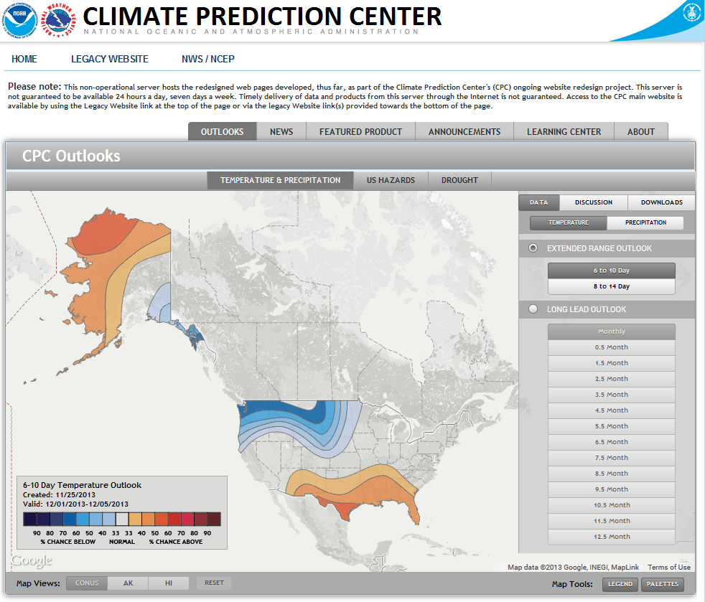
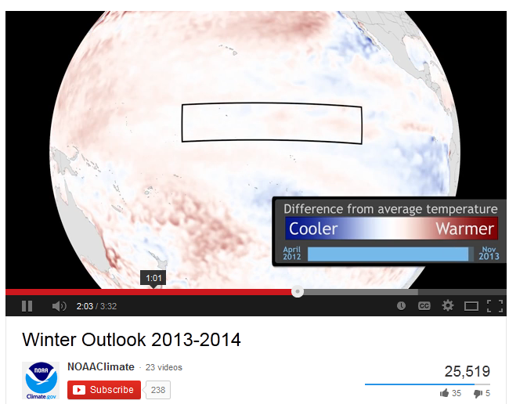
New Web Page and Videos
CPC is rolling out a new web page in phases, first portion was main home page which is under review and public comment
http://www.cpcpara.ncep.noaa.gov
Climate Related Videos
Notes:
Weather and Climate extremes (such as floods and droughts, heat and cold waves) have regional and local impacts.
This example for water illustrates some of the kinds of information users need at the regional and local scale (e.g. precipitation forecasts; runoff, river levels, etc) as well as why and how they might use it (evacuation orders; regulating a dam).
NOAA is working to connect global and national climate information to regional and local impacts.

Slide 24
Other Items
Held 38th Climate Diagnostics and Prediction Workshop at NCWCP in October 2013
CPC contributing to NWS IDP GIS Project, Ken Pelman is co-Project Manager allowing CPC to take a leading role in creating a NOAA-wide enterprise geospatial dissemination system
Operational product timeliness was 99.8% during FY2013
CPC wide team to outline necessary steps to work towards experimental Week 3-4 forecast products (scientific basis, format, content, release frequency, etc.)
Notes:
Weather and Climate extremes (such as floods and droughts, heat and cold waves) have regional and local impacts.
This example for water illustrates some of the kinds of information users need at the regional and local scale (e.g. precipitation forecasts; runoff, river levels, etc) as well as why and how they might use it (evacuation orders; regulating a dam).
NOAA is working to connect global and national climate information to regional and local impacts.

Slide 25
Questions and Comments
Thank you for your attention
Feel free to contact me anytime via e-mail if you have comments or questions.
Jon.Gottschalck@noaa.gov
Notes:
Weather and Climate extremes (such as floods and droughts, heat and cold waves) have regional and local impacts.
This example for water illustrates some of the kinds of information users need at the regional and local scale (e.g. precipitation forecasts; runoff, river levels, etc) as well as why and how they might use it (evacuation orders; regulating a dam).
NOAA is working to connect global and national climate information to regional and local impacts.

Slide 26
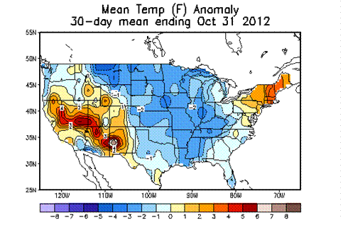
Climate Conditions in FY 2013
Notes:
Weather and Climate extremes (such as floods and droughts, heat and cold waves) have regional and local impacts.
This example for water illustrates some of the kinds of information users need at the regional and local scale (e.g. precipitation forecasts; runoff, river levels, etc) as well as why and how they might use it (evacuation orders; regulating a dam).
NOAA is working to connect global and national climate information to regional and local impacts.

Slide 27
Extended Range Outlooks
Temperature
Precipitation
Notes:
Weather and Climate extremes (such as floods and droughts, heat and cold waves) have regional and local impacts.
This example for water illustrates some of the kinds of information users need at the regional and local scale (e.g. precipitation forecasts; runoff, river levels, etc) as well as why and how they might use it (evacuation orders; regulating a dam).
NOAA is working to connect global and national climate information to regional and local impacts.

Slide 28
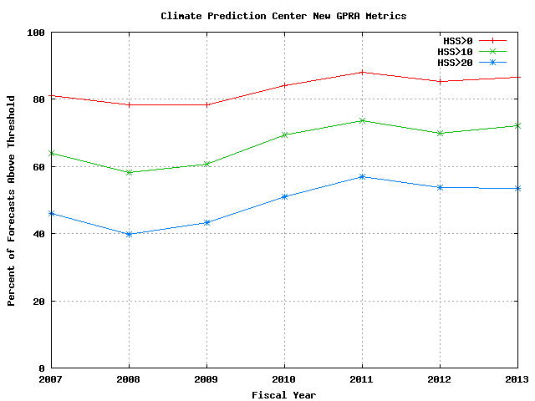
Combined Outlook Metric
Percent of forecasts above a given HSS threshold from extended- and long-range outlooks of temperature and precipitation outlooks
Notes:
Weather and Climate extremes (such as floods and droughts, heat and cold waves) have regional and local impacts.
This example for water illustrates some of the kinds of information users need at the regional and local scale (e.g. precipitation forecasts; runoff, river levels, etc) as well as why and how they might use it (evacuation orders; regulating a dam).
NOAA is working to connect global and national climate information to regional and local impacts.

Slide 29
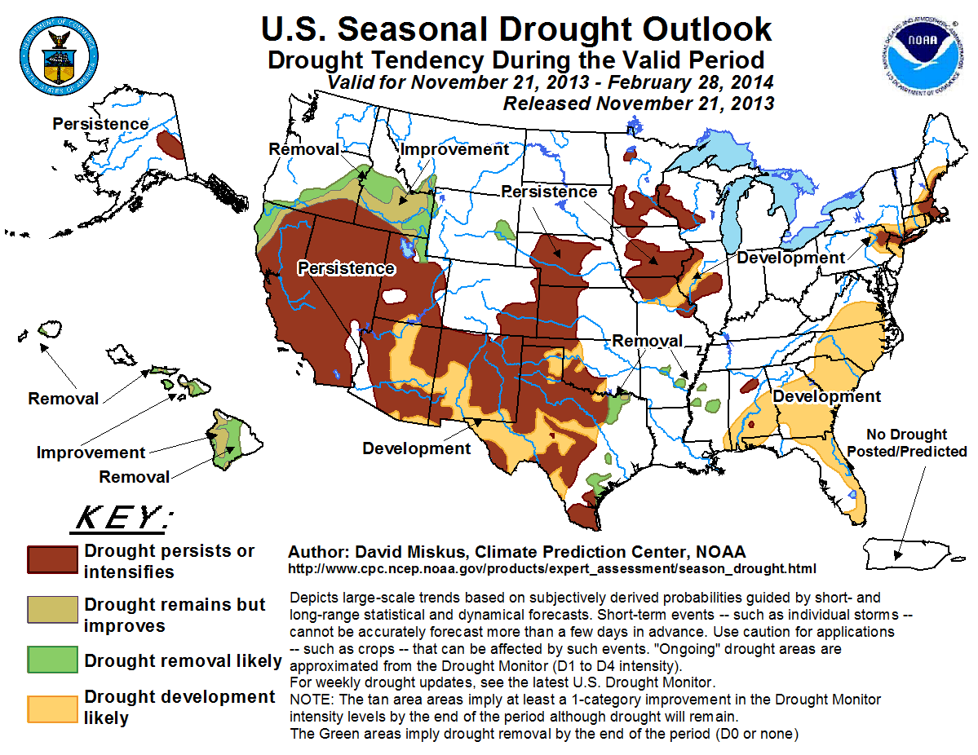

Seasonal Drought Outlook
Metric is difference from persistence over all areas
Verification is U.S. drought monitor
Courtesy: Rich Tinker
Notes:
Weather and Climate extremes (such as floods and droughts, heat and cold waves) have regional and local impacts.
This example for water illustrates some of the kinds of information users need at the regional and local scale (e.g. precipitation forecasts; runoff, river levels, etc) as well as why and how they might use it (evacuation orders; regulating a dam).
NOAA is working to connect global and national climate information to regional and local impacts.

Slide 30



NOAA Seasonal Hurricane Outlook
Anomalous velocity potential
Dry northerly flow into MDR, large scale descent
H
Anomalous shear and upper-air convergence
Anomalously strong TUTT in western Atlantic and anomalously strong upper-level convergence in MDR
Courtesy: Gerry Bell
Notes:
Weather and Climate extremes (such as floods and droughts, heat and cold waves) have regional and local impacts.
This example for water illustrates some of the kinds of information users need at the regional and local scale (e.g. precipitation forecasts; runoff, river levels, etc) as well as why and how they might use it (evacuation orders; regulating a dam).
NOAA is working to connect global and national climate information to regional and local impacts.

Slide 31

CFS Temp/Precip Forecasts
Pattern correlation over Northern Hemisphere and North America
20N-80N
Courtesy: Wanqiu Wang
Notes:
Weather and Climate extremes (such as floods and droughts, heat and cold waves) have regional and local impacts.
This example for water illustrates some of the kinds of information users need at the regional and local scale (e.g. precipitation forecasts; runoff, river levels, etc) as well as why and how they might use it (evacuation orders; regulating a dam).
NOAA is working to connect global and national climate information to regional and local impacts.

Slide 32




CFS Atmospheric Blocking
Courtesy: Mingyue Chen
The blocking strength is defined as the southern gradient of 500hPa height [unit=m/(deg of latitude)].
Observation is from CFSR 6 hourly field.
CFSv2 forecast is from 16 members ensemble mean.
Corl=0.95
Corl=0.88
Corl=0.44
Corl=0.13
Notes:
Weather and Climate extremes (such as floods and droughts, heat and cold waves) have regional and local impacts.
This example for water illustrates some of the kinds of information users need at the regional and local scale (e.g. precipitation forecasts; runoff, river levels, etc) as well as why and how they might use it (evacuation orders; regulating a dam).
NOAA is working to connect global and national climate information to regional and local impacts.

