Slide 1

NCEP Production Suite Review:
“Land Surface Guidance Systems”
EMC Land-Hydrology Team:
Michael Ek, Jesse Meng, Rongqian Yang, Helin Wei, Youlong Xia, Yihua Wu, Weizhong Zheng, Jiarui Dong
Environmental Modeling Center (EMC)
National Centers for Environmental Prediction (NCEP) NOAA/NWS
NCEP Production Suite Review, 3-5 December 2013
NOAA Center for Weather and Climate Prediction, College Park, Maryland

Slide 2
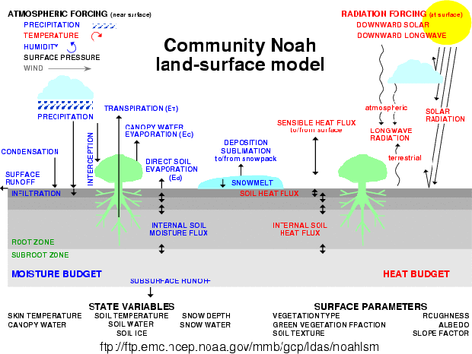
NCEP-NCAR unified Noah land model
Noah land model has relevant land physics & assoc. land data sets, & provides lower boundary conditions (heat, moisture, momentum) for NAM, GFS, CFS.

Slide 3


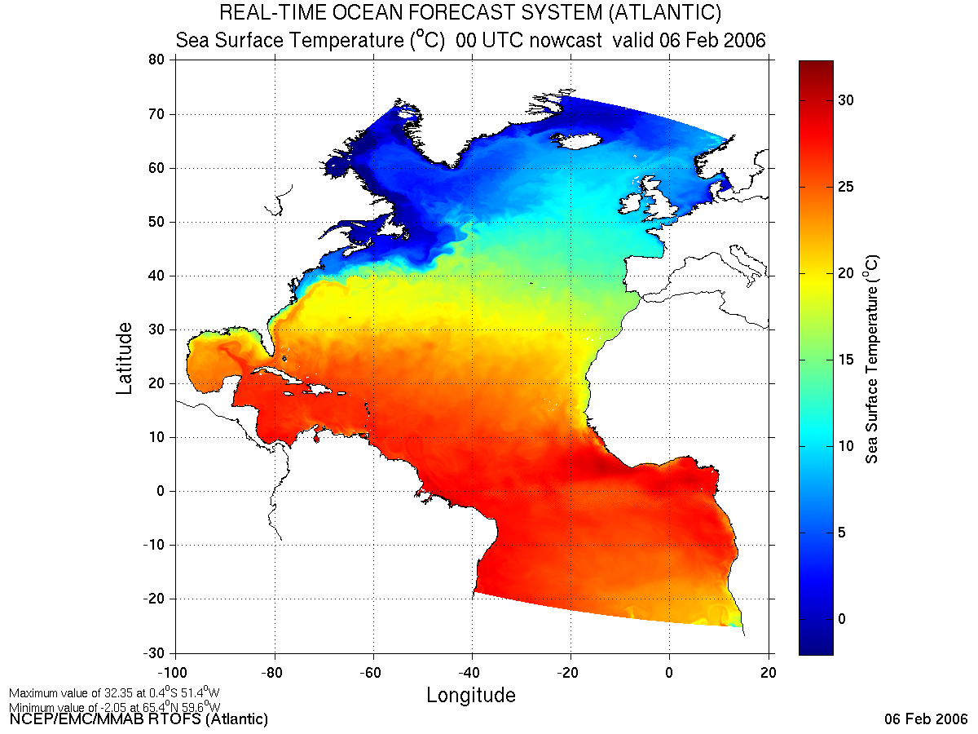
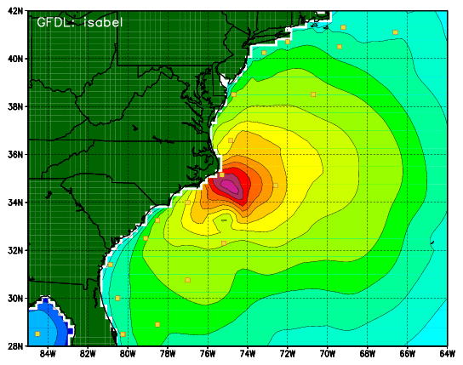
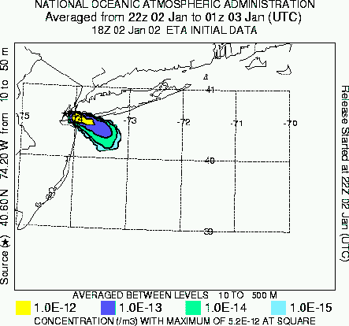
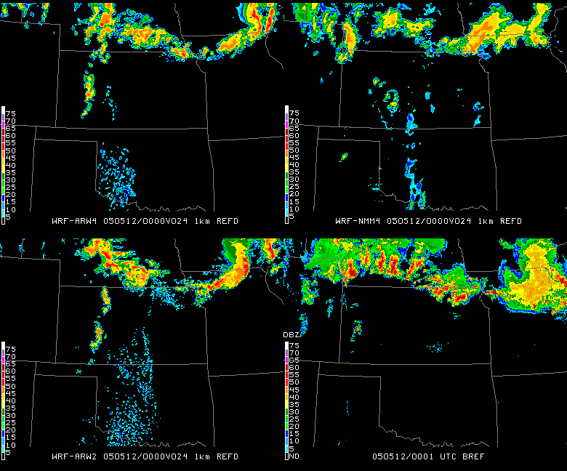
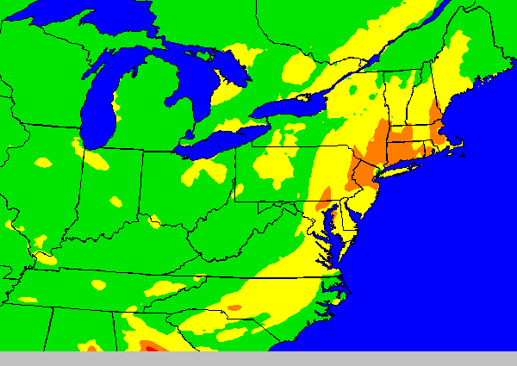
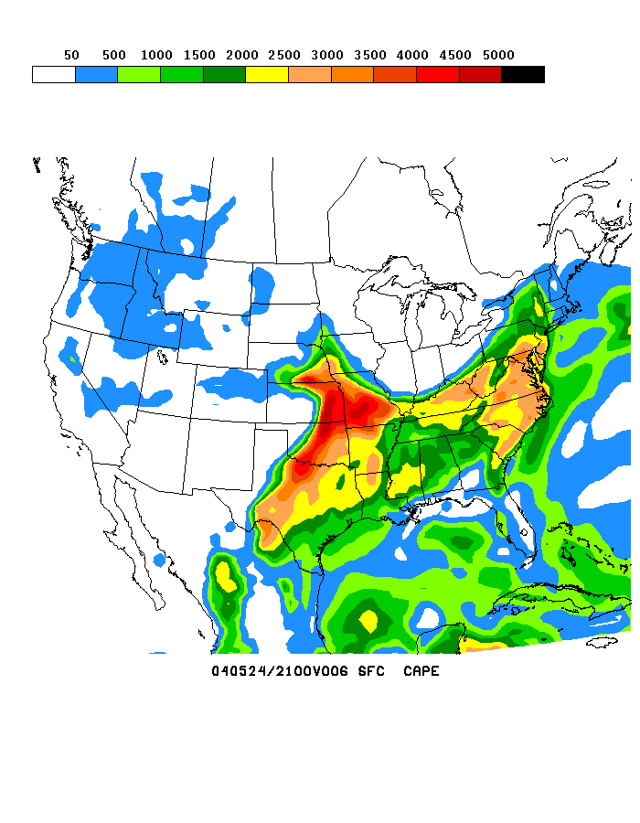
Noah Land Model Connections in NOAA’s NWS Model Production Suite
Climate
CFS
Oceans
HYCOM
WaveWatch III
Hurricane GFDL
HWRF
2-Way Coupled
MOM3
1.7B Obs/Day
Satellites
99.9%
Global
Forecast
System
Regional NAM
WRF NMM
(including NARR)
Dispersion
ARL/HYSPLIT
Global Data
Assimilation
Severe Weather
Regional Data
Assimilation
WRF NMM/ARW
Workstation WRF
Short-Range
Ensemble Forecast
North American Ensemble Forecast System
WRF: ARW, NMM
ETA, RSM
Air Quality
GFS, Canadian Global Model
NAM/CMAQ
Forecast
NCEP-NCAR unified
Uncoupled
“NLDAS”
(drought)
Rapid Update
for Aviation (ARW-based)
Uncoupled
“GLDAS”
NOAH Land Surface Model

Slide 4
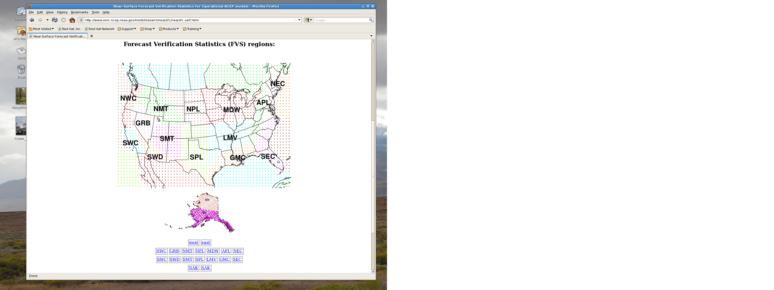
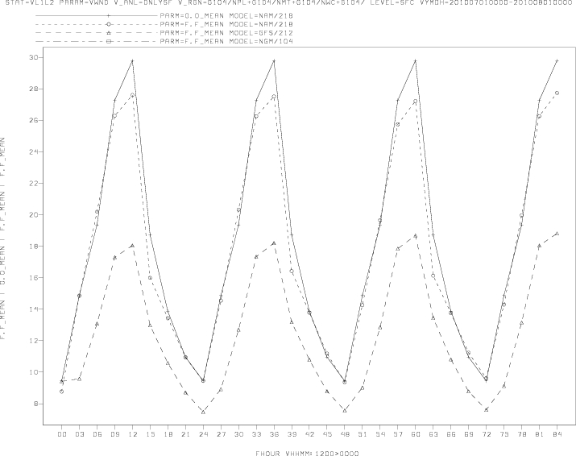
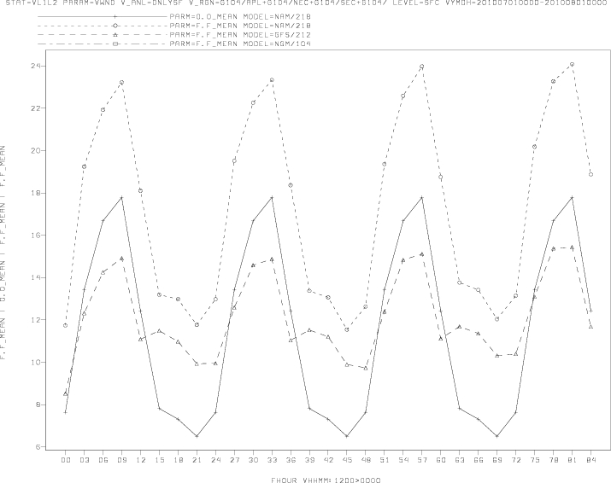
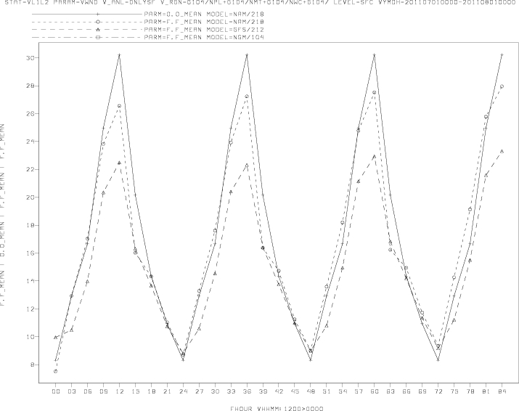
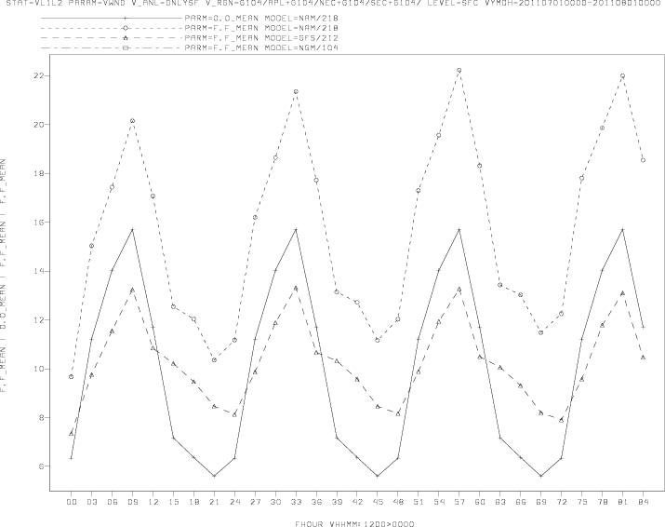
Land model validation
Low-level observations (e.g. 2-m temperature & humidity, 10-m winds); multi-year “fvs” data set.
www.emc.ncep.noaa.gov/mmb/research/nearsfc/nearsfc.verf.html
west
2010
east
5
4
July monthly diurnal 10-m wind (m/s)
3
3
2011
5
4
obs: solid, NAM: short-dash, GFS: long-dash
3
3
0
24
48
72hr
0
24
48
72hr
00Z Forecast Cycle
Additionally: upper air scores, precipitation threat & bias scores, 500mb hgt AC, surface flux sites, etc.
NEW: separate land-use category (global domain).

Slide 5
Near-term upgrades
NAM
Surface-layer changes: addresses low-level T2m and wind biases via adjustment to momentum roughness for some land-use/vegetation categories, thermal roughness effect over snow.
Precipitation: new snow fall algorithm that uses NAM microphysics that accounts for mixed-phase precipitation (liquid and frozen) and riming factor, so increases snow density, reduces snow depth.
GFS
Surface-layer changes: addresses low-level T2m via momentum roughness adjustments (generally lower) and thermal roughness dependent on land-use/vegetation category.
Land-use/veg type and soil type: new higher-resolution.
Soil moisture nudging: new soil moist. climatology.

Slide 6
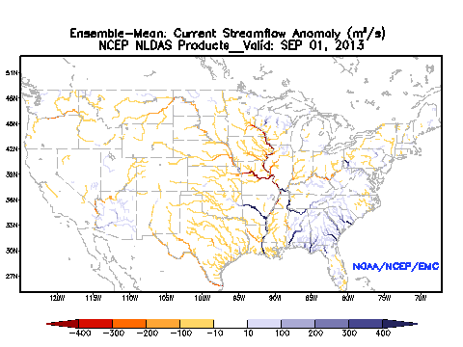
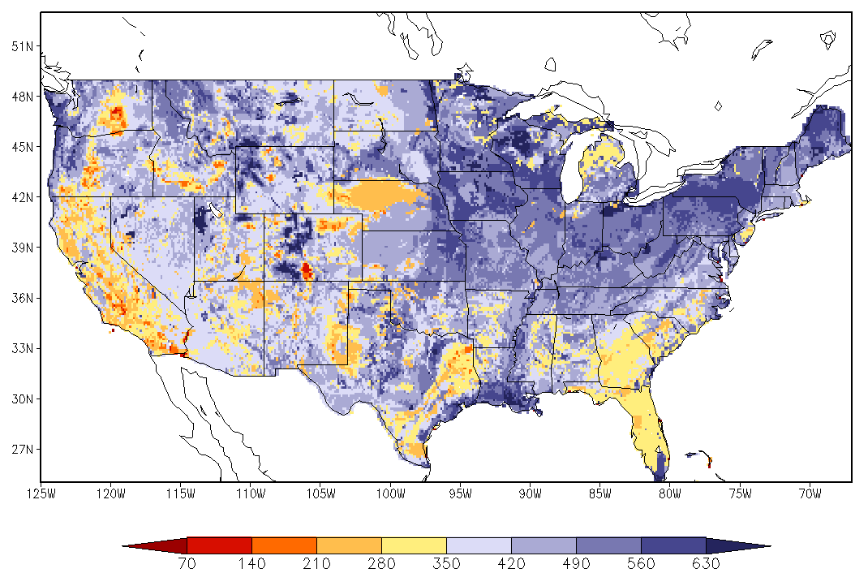
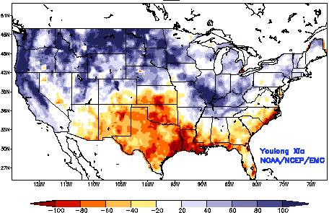
North American Land Data Assimilation System (NLDAS)
FY14Q1 transition to ops: 4 land models run un-coupled, driven by CPC obs precip & atmos forcing from NCEP N. Amer. Reg. Climate Data Assimil Sys.
Output: 1/8-deg. land & soil states, surface fluxes, runoff & streamflow; anomalies compared with climatologies from 30-year land model runs.
Drought: monitoring & seasonal hydrological forecasting for CPC/NIDIS; future global domain.
www.emc.ncep.noaa.gov/mmb/nldas
July 30-year climo.
July 2011
September 2013
Ensemble monthly soil moisture anomaly
Daily streamflow

Slide 7
Future upgrades
NAM, GFS, CFS
Unified Noah land model across NCEP systems.
Global Land Data Assimilation System (GLDAS): higher-resolution that “feeds” (via upscaling) initial conditions to NAM, GFS, CFS --> NEMS.
Improved land data sets: e.g. realtime GVF.
“Formal” Land Data Assimilation: Snow, soil moisture, land skin temp, veg (cover, density).
Freshwater lakes, add’l fire-related upgrades.
Steamflow: River-routing scheme moves water to sea; more complete atmos, land, hydrology, ocean connection, i.e. Earth System Modeling.
Upgraded “Noah-MP” physics: explicit plant canopy, CO2-based photosynthesis, dynamic veg., multi-layer snowpack, groundwater.

Slide 8
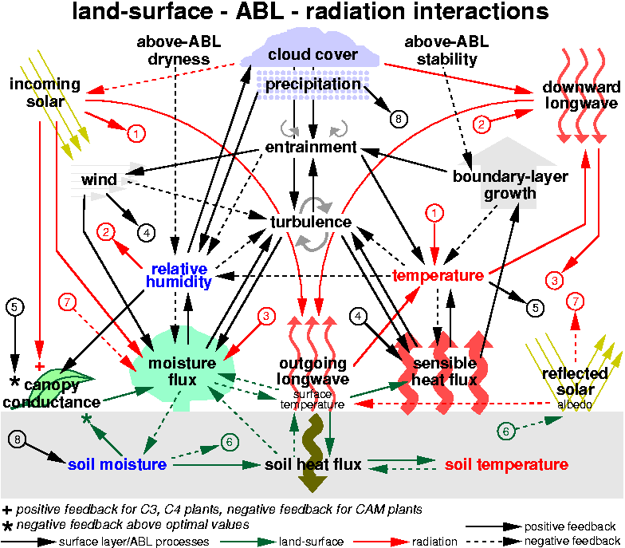
Questions?
Physics “Wheel of Pain”

