Slide 1


The Importance of
Reforecasts at CPC
NCEP Production Suite Review - 3-5 Dec. 2013
Mike Charles, Melissa Ou, Dan Collins, Emily Riddle
Climate Prediction Center

Slide 2
Reforecast-calibrated
6-10 day and 8-14 day Temp and Precip Forecasts

Slide 3
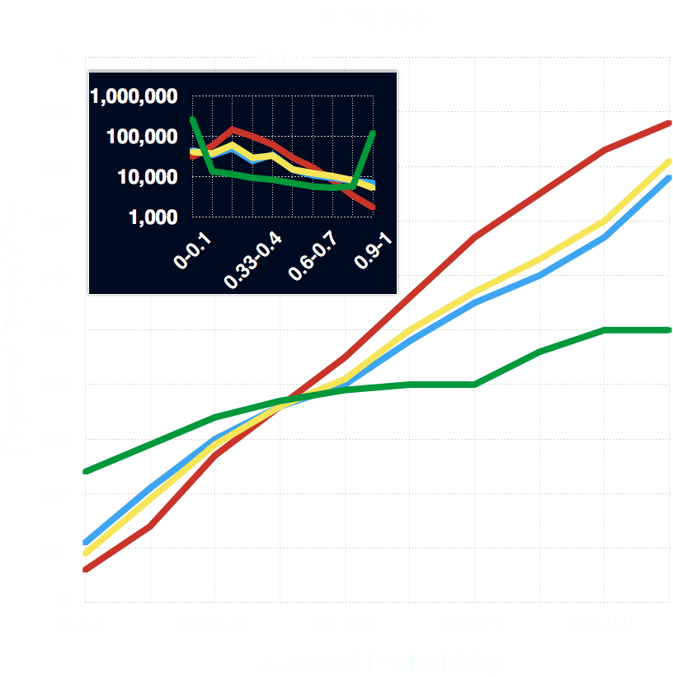
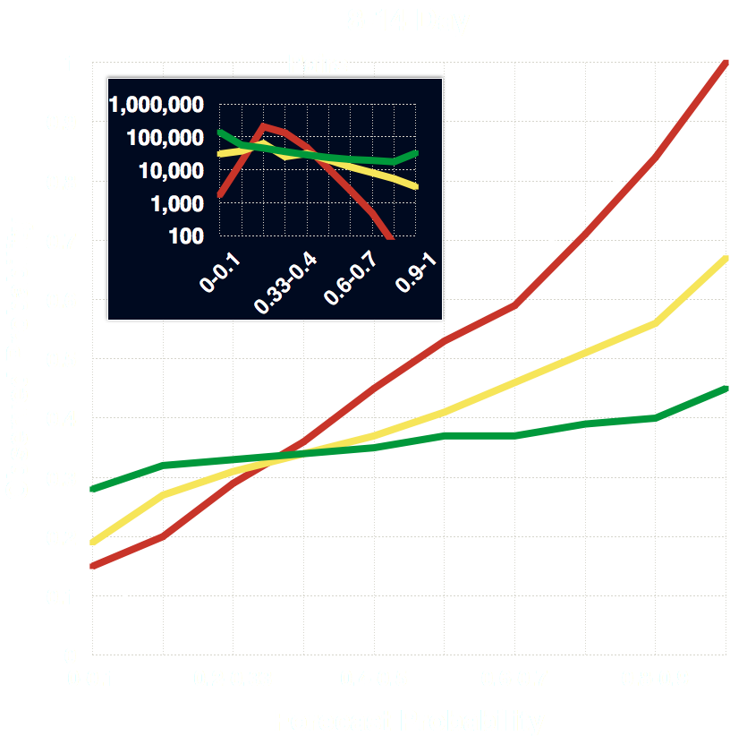
Week-2 Reforecast Tool Reliability
Temperature
Precipitation
Notes:
In the interest time, I’ll just show reliability.
Reliability tells us how accurate the forecast probabilities are
Takeaway for Temp - Manual forecast is conservative; Reforecast 2 has best reliability even at very high probabilities; Reforecast 1 has good reliability for forecast probabilities up to 60%, then overconfident
Takeaway for Precip - Manual and reforecast 2 have best reliability through forecast probabilities up to 70%, but little to no cases above that

Slide 4
Sensitivity of Skill to Reforecast Sampling
Notes:
We did a study where we sampled the reforecast dataset in different ways to test the sensitivity of the skill to things like training years, model run frequency, and the number of ensemble members.

Slide 5
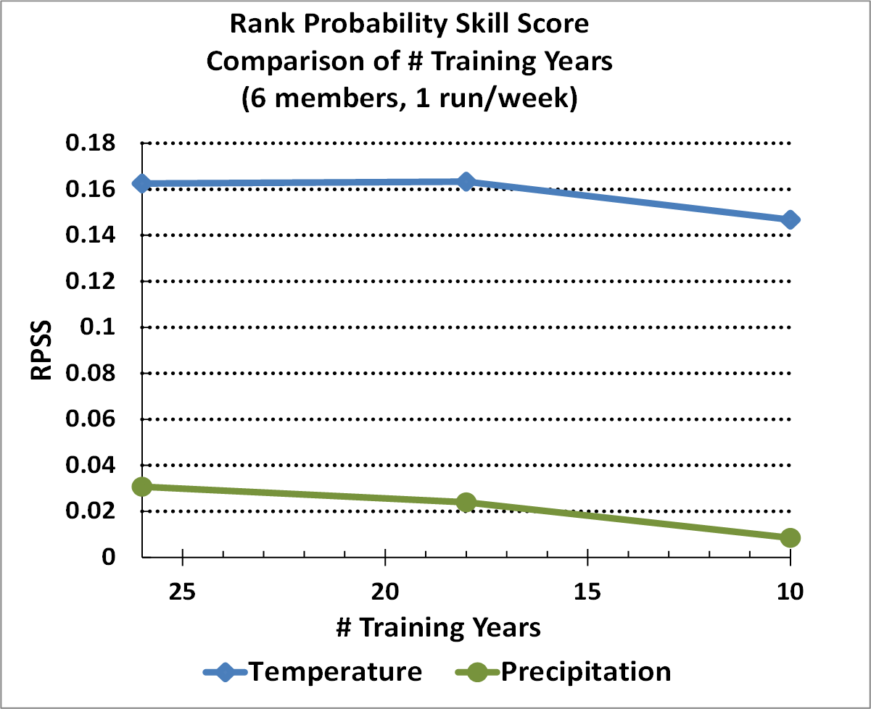
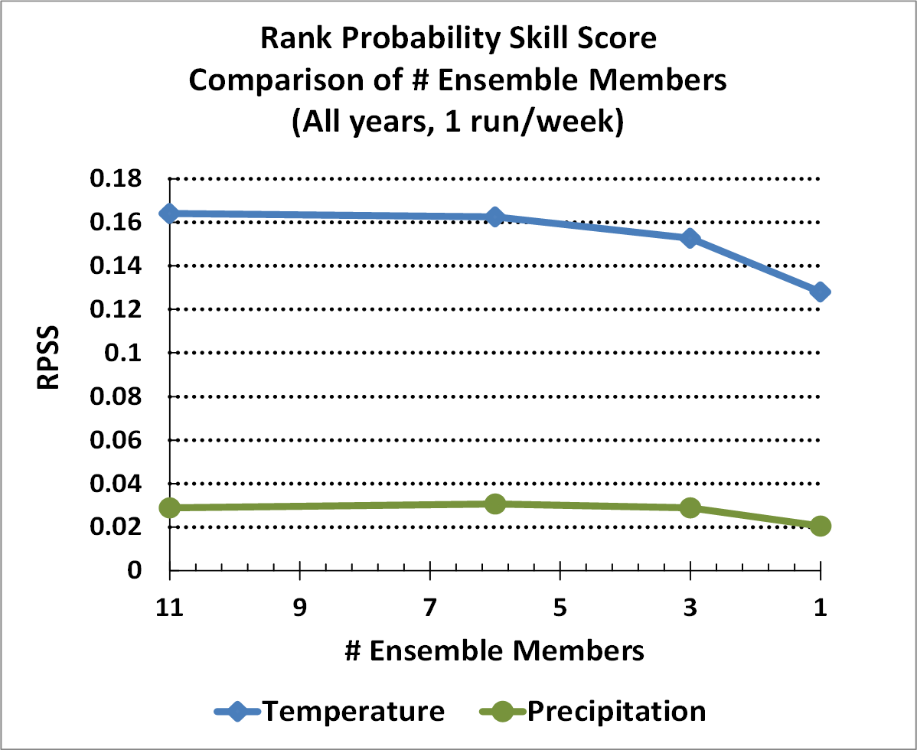
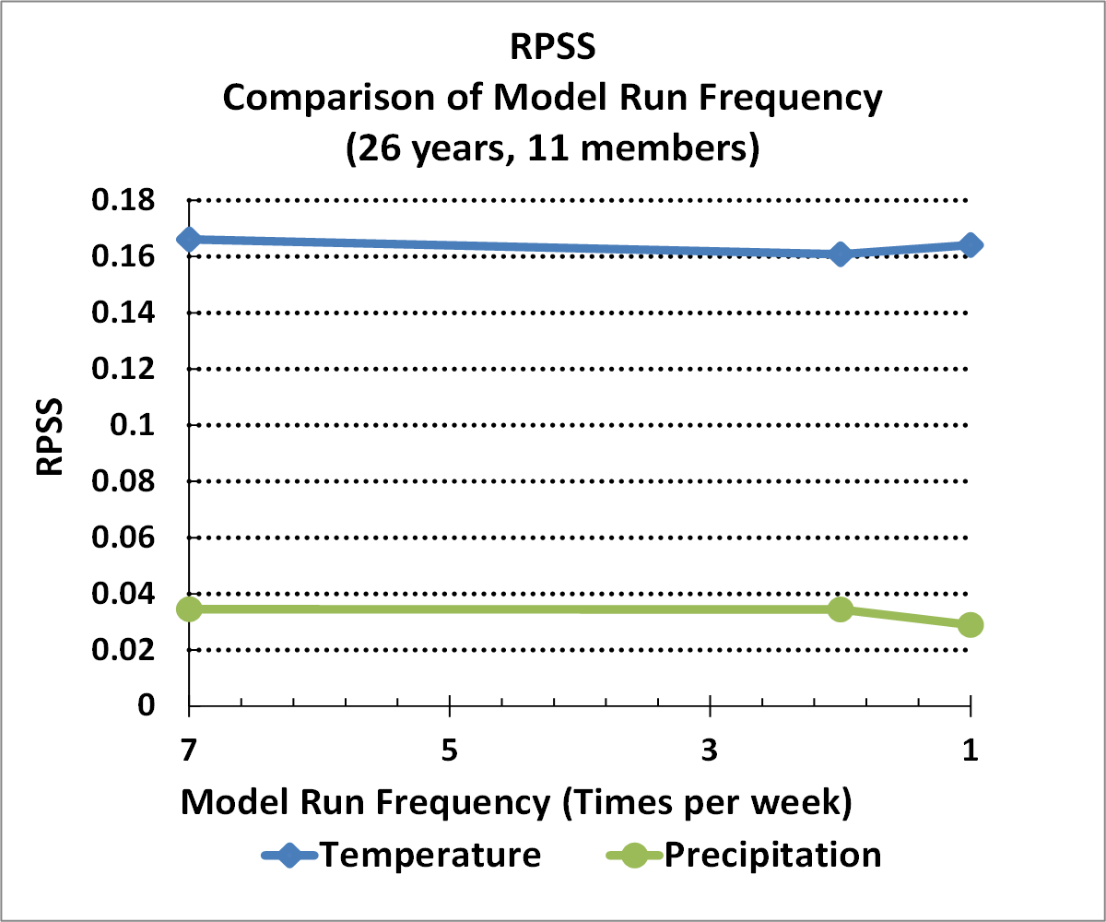
Sensitivity Study - RPSS
Comparison of # training years
(6 members, 1 run/week)
Comparison of # Ensemble Members
(26 years, 1 run/week)
Comparison of model run frequency
(26 years, 11 members)
Temp – no sig. difference between 26 and 18 years
Precip – each drop in the number of training years results in sig. lower skill
Temp – no sig. difference between 11 and 6 members
Precip – no sig. difference between 11 and 6 members
Temp – no sig. difference between any number of days per week
Precip – no sig. difference between 7 and 2 days per week

Slide 6
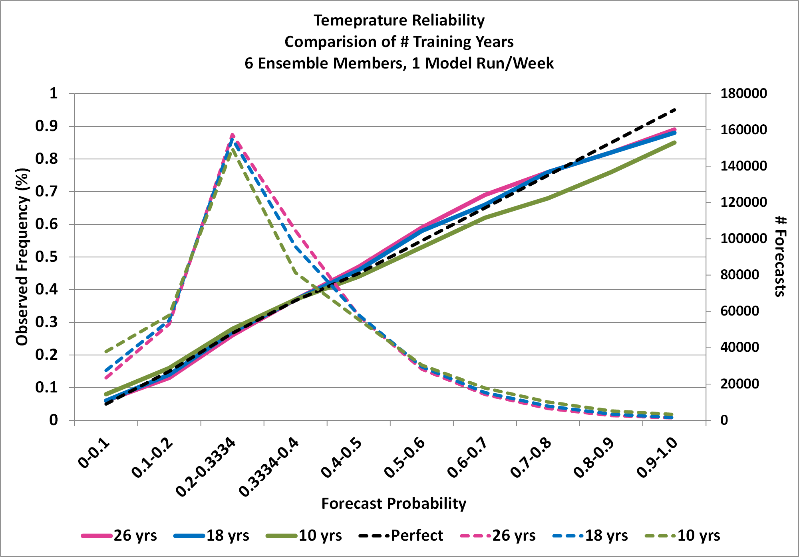
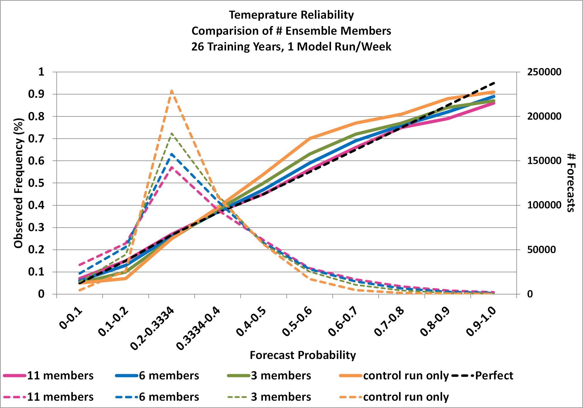
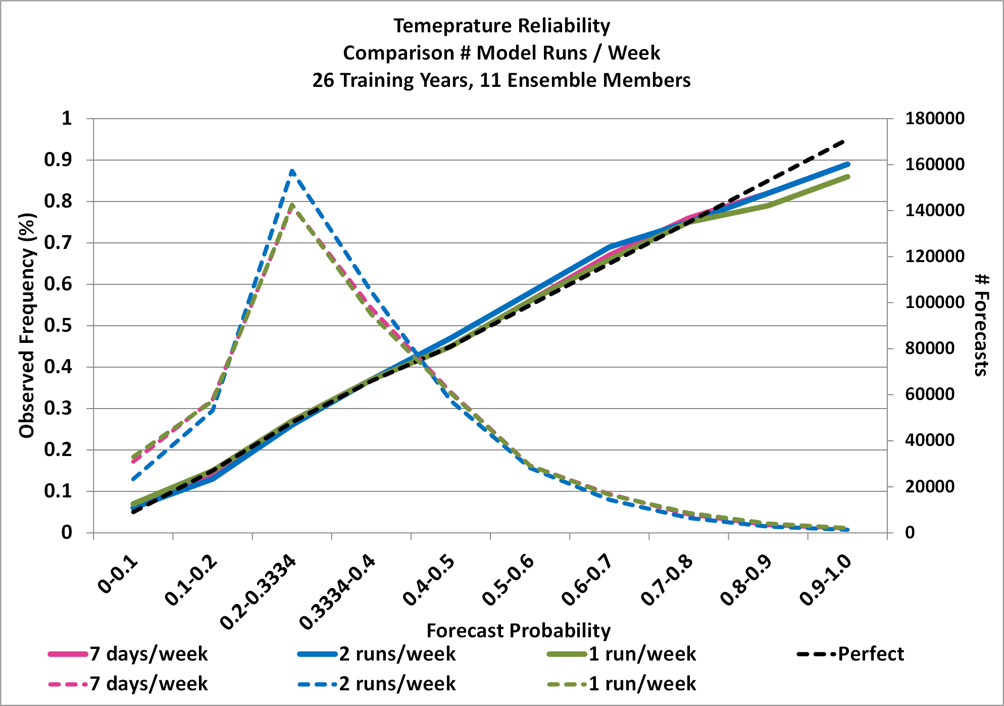
Sensitivity Study – Reliability - Temp
Comparison of # training years
(6 members, 1 run/week)
Comparison of # Ensemble Members
(26 years, 1 run/week)
Comparison of model run frequency
(26 years, 11 members)
Little difference in reliability between 26 and 18 year training period
Noticeable drop in reliability for 10 year training period (model overconfident)
Model becomes more underconfident with decreasing members
Still fairly good reliability with 6 members
Negligible difference in reliability when decreasing runs per week
Slightly more overconfident in extreme probabilities for 1 run per week

Slide 7
Conclusions
For temp and precip, our reforecast-calibrated tool has much better reliability than the raw GEFS and any other post-processing technique at CPC
Week-2 temp and precip skill is most sensitive to the number of training years in the reforecast dataset, and least sensitive to model run frequency.
Our proposed optimal reforecast configuration:
    At least 20 years of reforecasts, preferably 30 years
    5 ensemble members
    2 runs per week
    This proposed 30-year reforecast configuration would cost approximately 52% of the computing of real-time ensemble forecasts, and 16% of the cost of producing the previous reforecast dataset. Using 20 years would be 10% of the cost.
Notes:
An untested (by CPC) once per 5 days might compare in skill to twice a week at 70% the cost (3.5 days / 5 days).

Slide 8
Questions?

Slide 9
Thanks
Melissa Ou and Dan Collins for providing a lot of the content of this presentation

Slide 10
Outline
Reforecast-calibrated 6-10 day and 8-14 day temp and precip tool
Sensitivity of skill to reforecast sampling
Notes:
Describe CPC's use of reforecasts for the week-2 forecast
Give an overview of CPC's reforecast calibration project
Show an evaluation of CPC's new reforecast-calibrated forecast tool

Slide 11
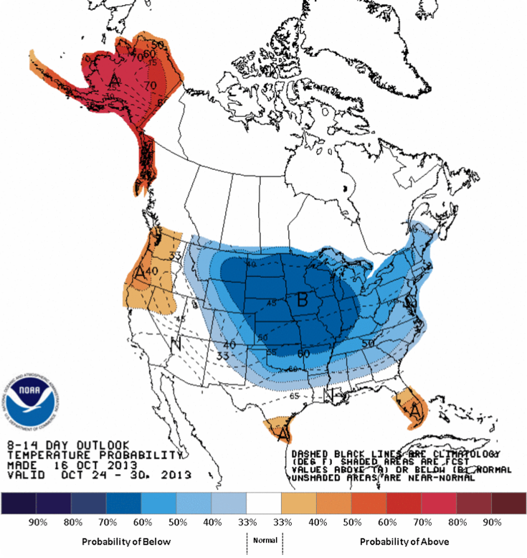
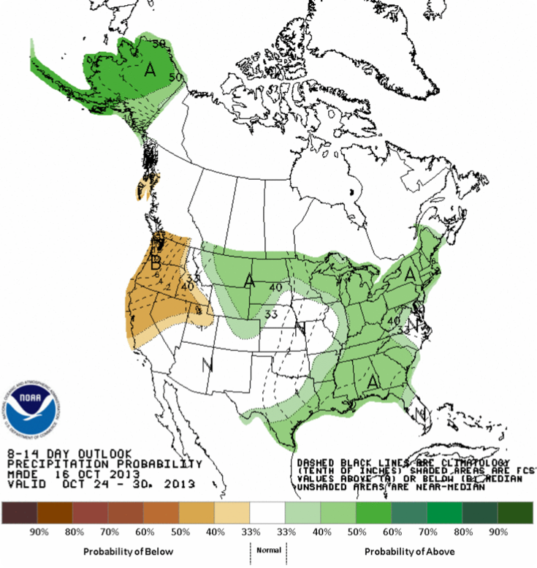
CPC’s Week-2 Forecast
Temperature
Precipitation
Notes:
Heres an example of CPC's week-2 probabilistic temperature and precipitation forecasts

Slide 12
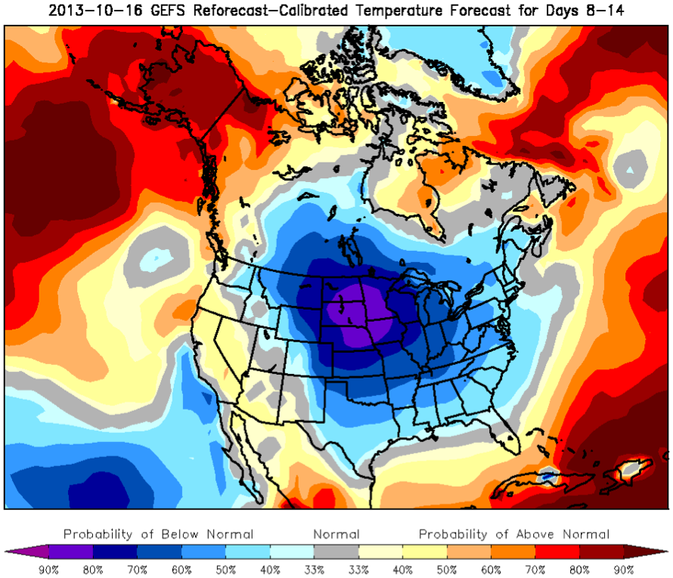
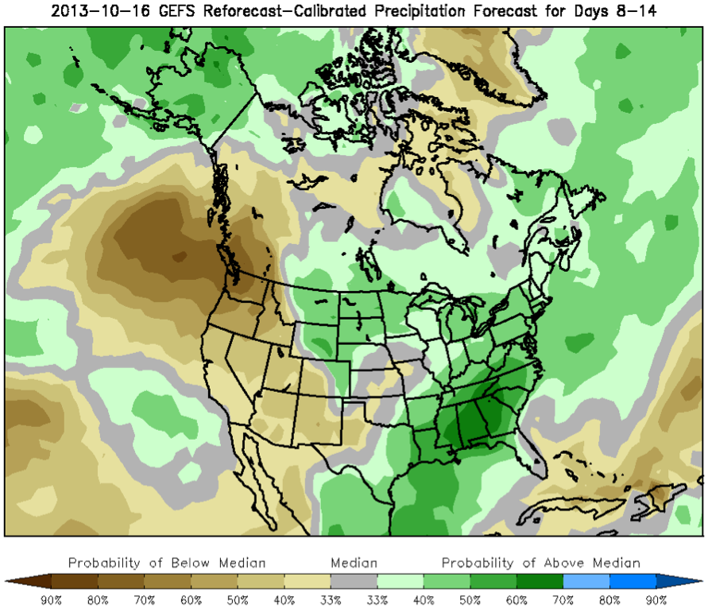
Reforecast-Calibrated Forecast
Temperature
Precipitation
Notes:
How well does the Reforecast-2-calibrated forecast do?

Slide 13
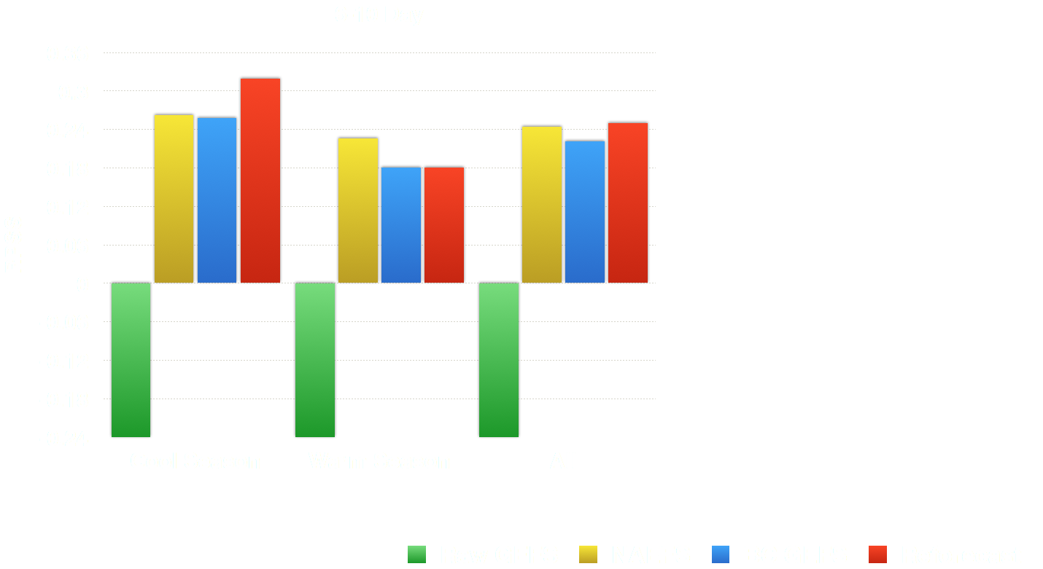
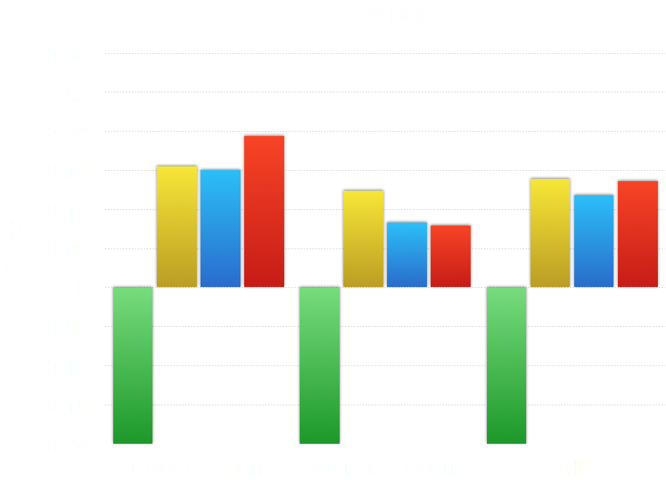
Reforecast Tool Skill - Temp - RPSS
Notes:
Showing 1 cold season for temp because of a cold-bias; probably bug in GEFS soil moisture
Takeaway for Temp - Reforecast 2 huge improvement over Manual and all tools
Takeaway for Precip - Reforecast 2 shows improvements over reforecast 1; competitive with manual

Slide 14
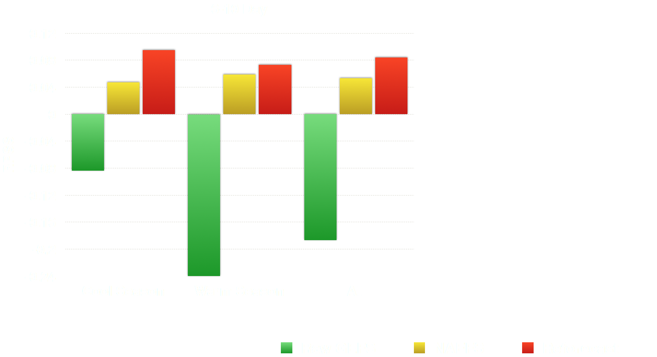
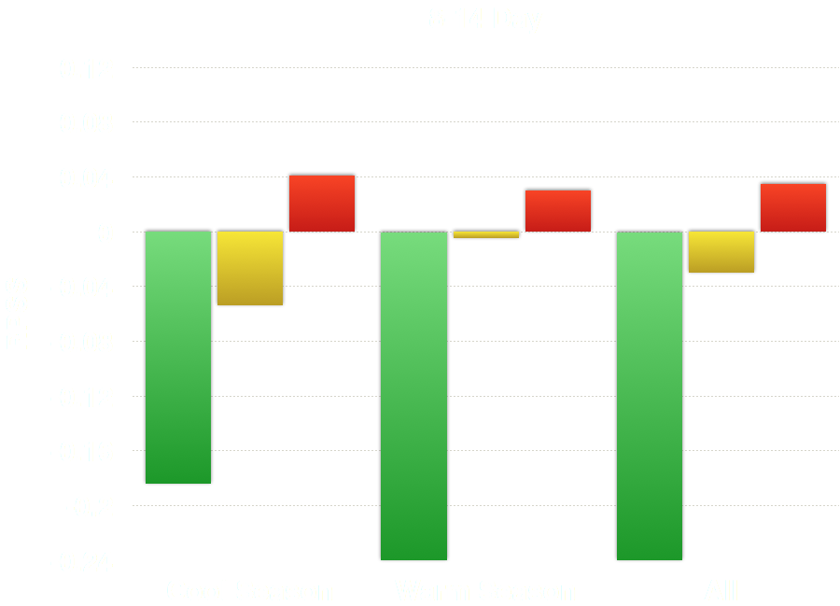
Reforecast Tool Skill - Precip - RPSS
Notes:
Showing 1 cold season for temp because of a cold-bias; probably bug in GEFS soil moisture
Takeaway for Temp - Reforecast 2 huge improvement over Manual and all tools
Takeaway for Precip - Reforecast 2 shows improvements over reforecast 1; competitive with manual

Slide 15
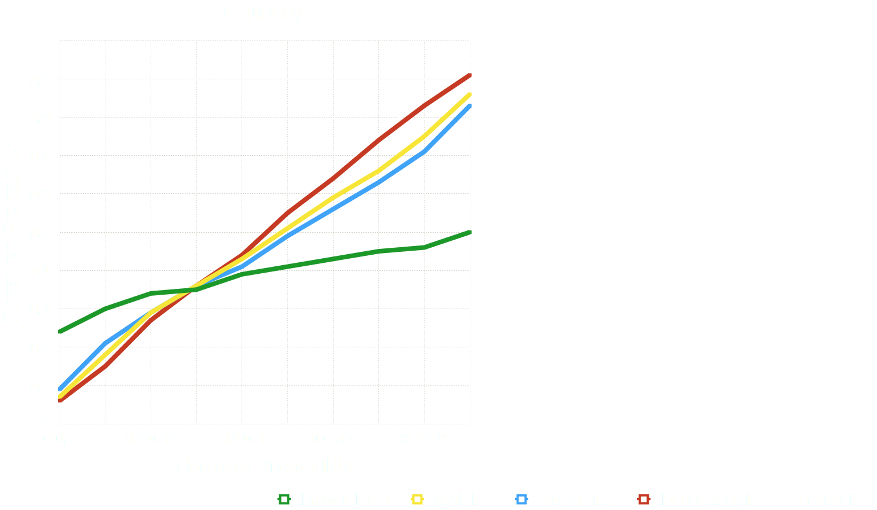
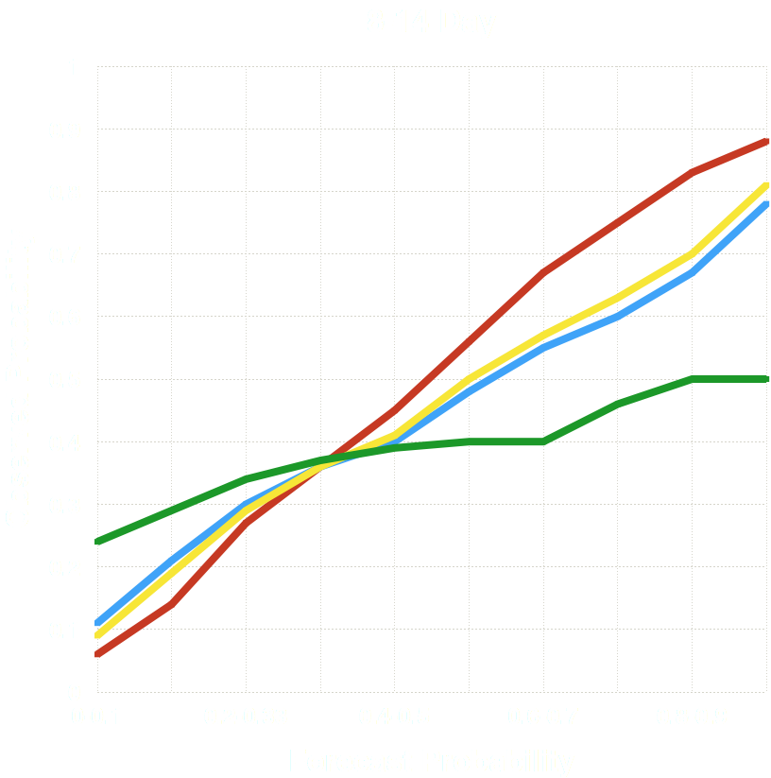
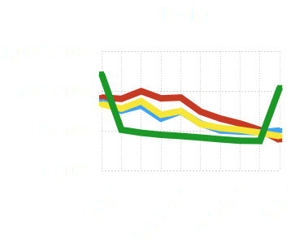
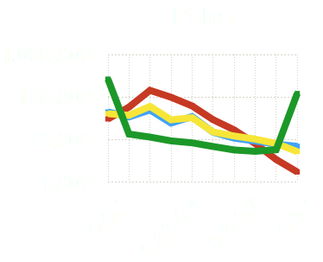
Reforecast Tool Skill - Temp - Reliability
Notes:
Reliability tells us how accurate the forecast probabilities are
Takeaway for Temp - Manual forecast is conservative; Reforecast 2 has best reliability even at very high probabilities; Reforecast 1 has good reliability for forecast probabilities up to 60%, then overconfident
Takeaway for Precip - Manual and reforecast 2 have best reliability through forecast probabilities up to 70%, but little to no cases above that

Slide 16
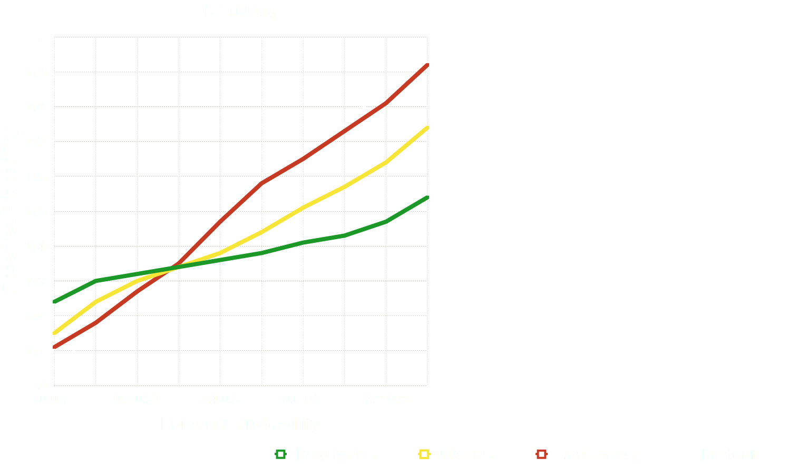
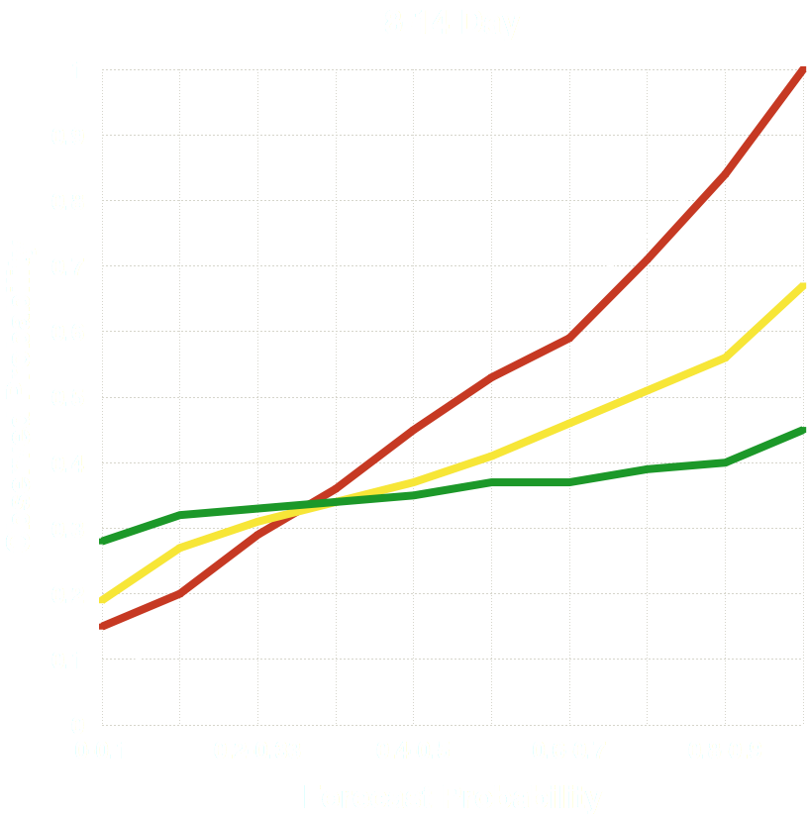
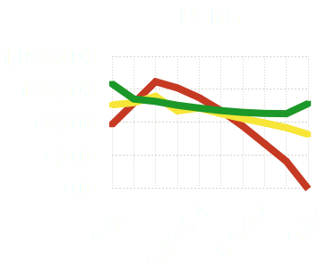
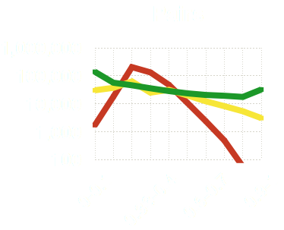
Reforecast Tool Skill - Precip - Reliability
Notes:
Reliability tells us how accurate the forecast probabilities are
Takeaway for Temp - Manual forecast is conservative; Reforecast 2 has best reliability even at very high probabilities; Reforecast 1 has good reliability for forecast probabilities up to 60%, then overconfident
Takeaway for Precip - Manual and reforecast 2 have best reliability through forecast probabilities up to 70%, but little to no cases above that

Slide 17
Sensitivity Study Goals
Determine the impact of changing the sampling of reforecasts on the skill of real-time week-2 (days 8-14) calibrated temperature and precipitation forecasts.
Evaluate the skill of different reforecast sampling cases using various skill scores.
Find optimal reforecast sampling case(s) that maximized forecast scores, while reducing resources needed for producing a reforecast dataset.
Notes:
The goals for this project were to…
1. See how the skill of week-2 temperature and precip reforecast tool forecasts are impacted by changing the sample of reforecats used for calibration
2. Evaluate the skill of different reforecast sampling cases using various skill scores to have a more complete picture of impact to skill.
3. Finally, we wanted to see...

Slide 18
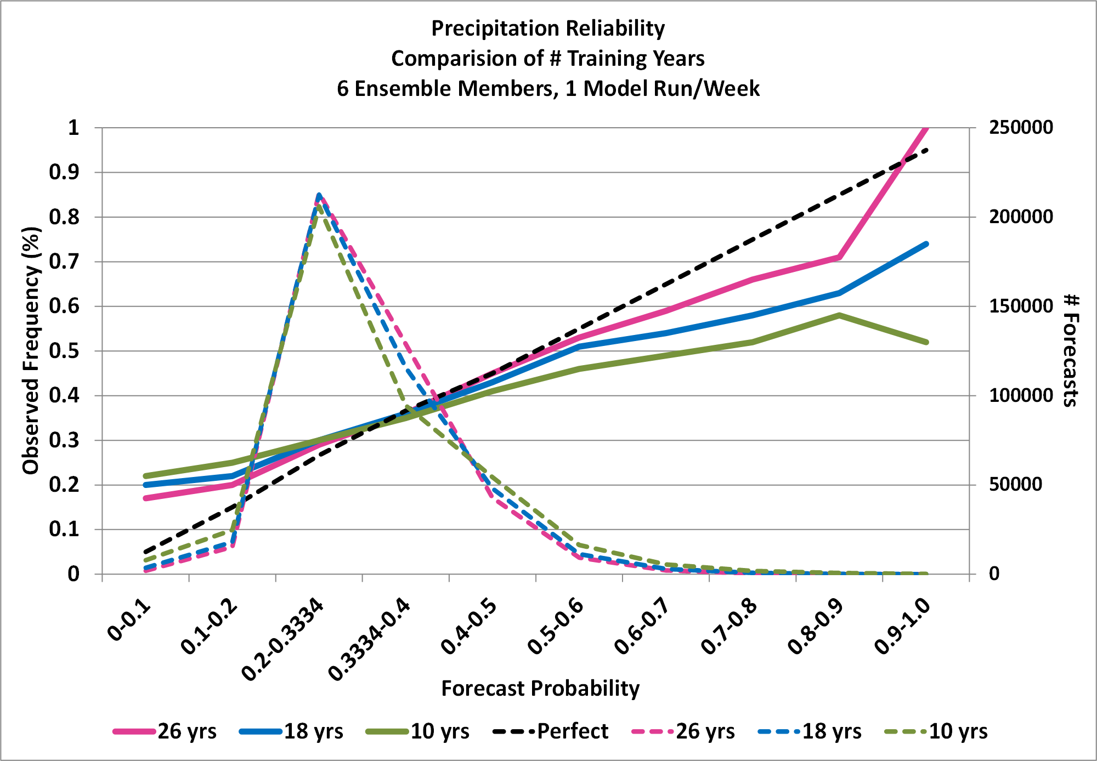
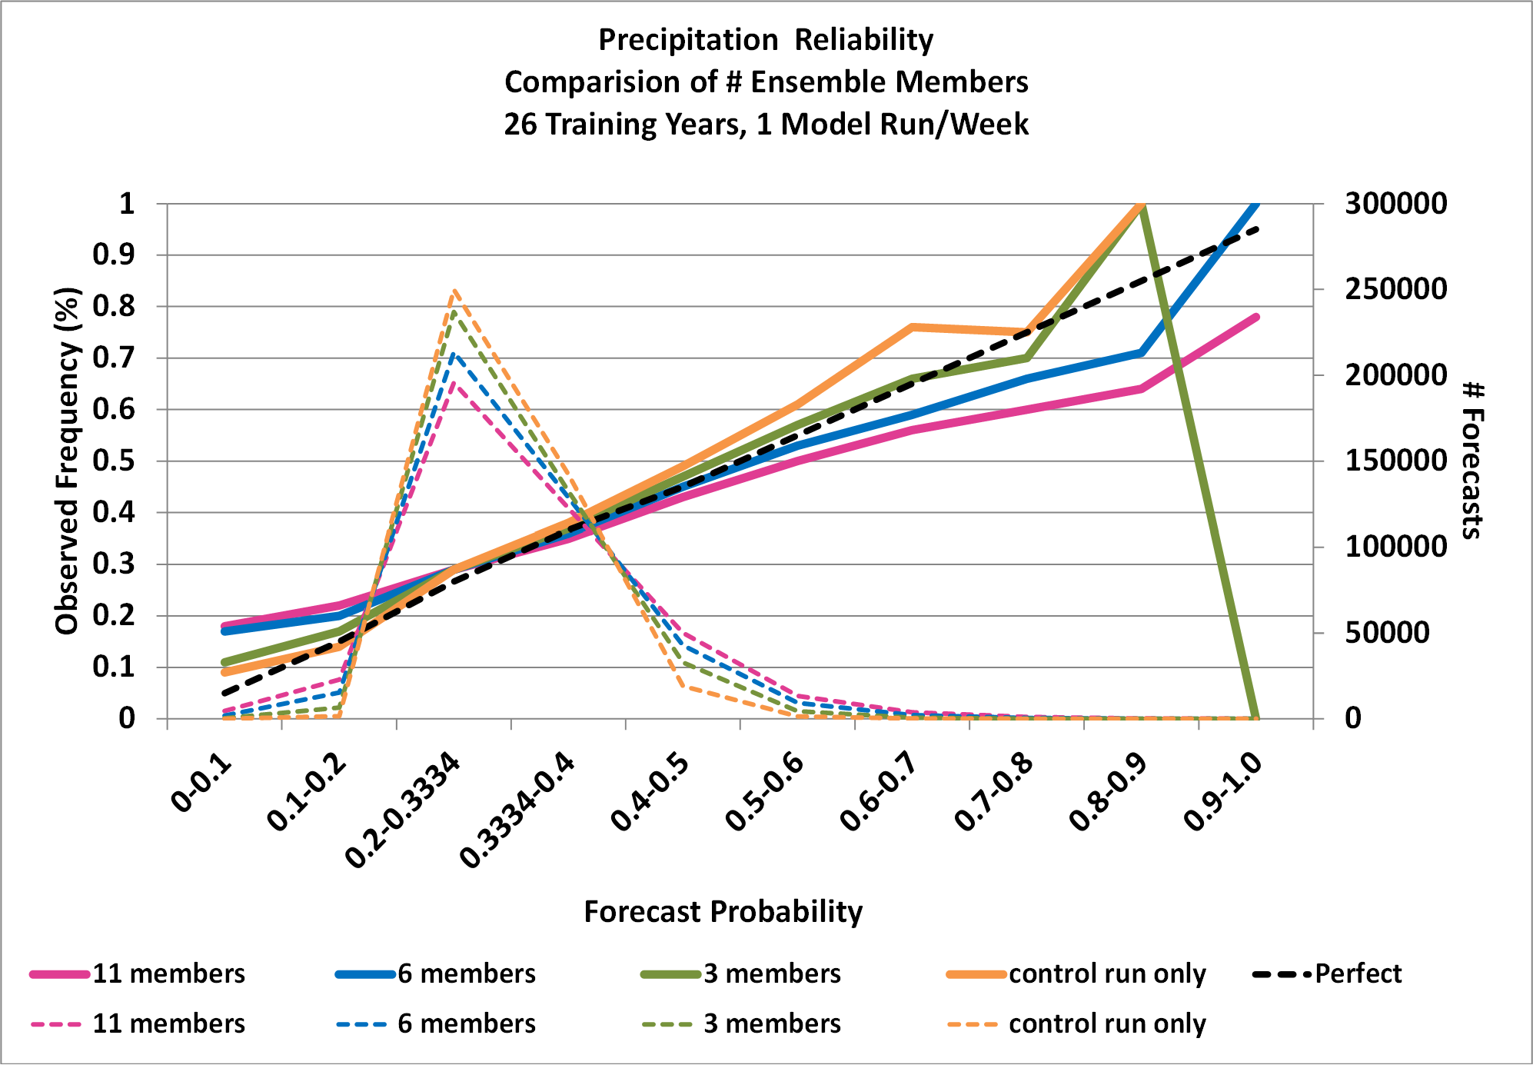
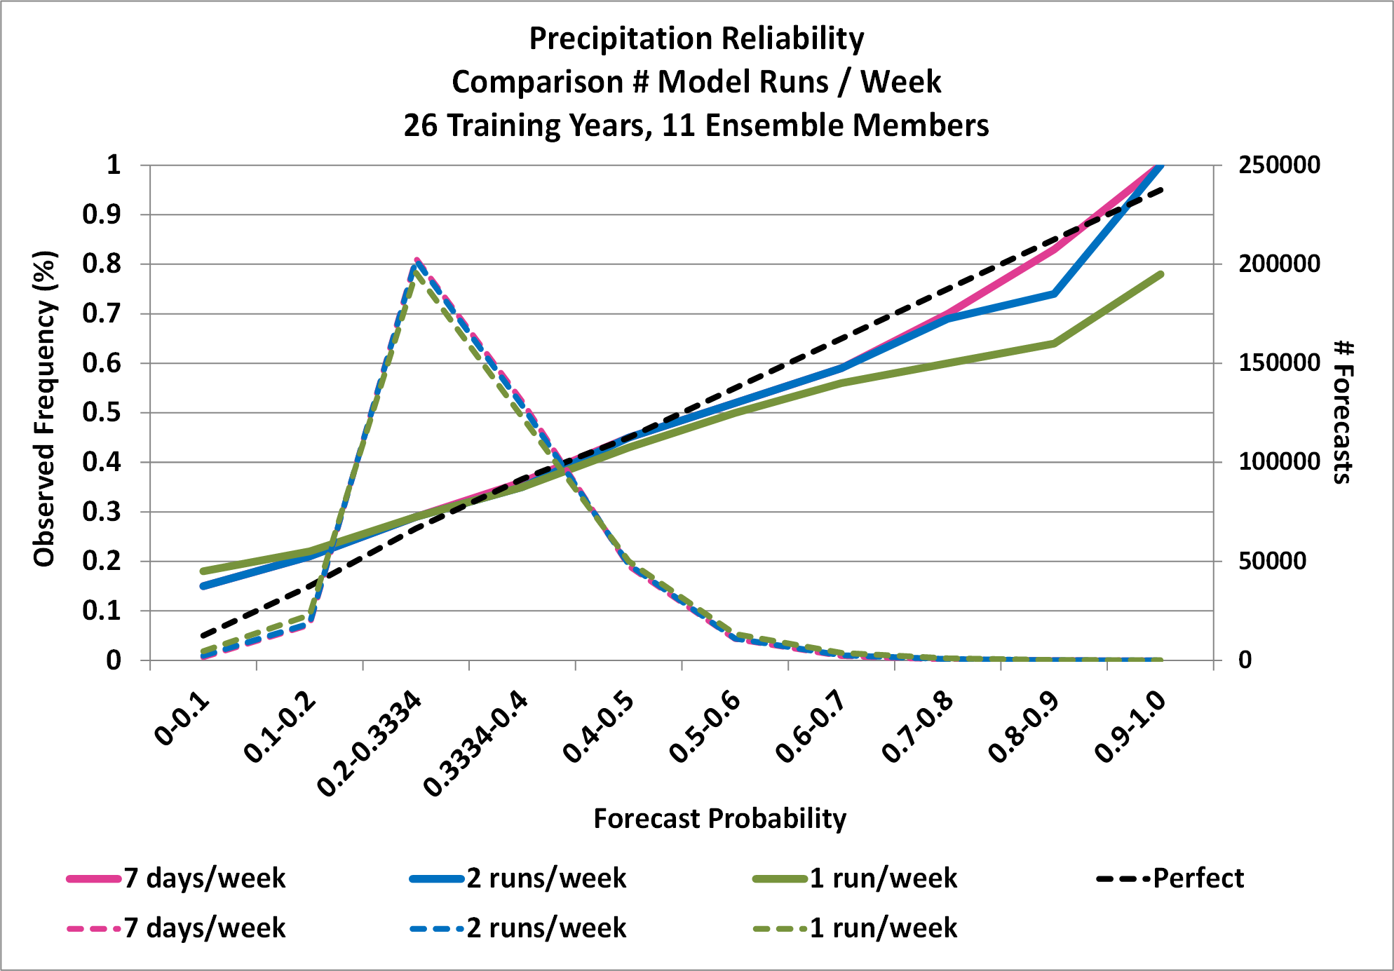
Sensitivity Study – Reliability - Precip
Comparison of # training years
(6 members, 1 run/week)
Comparison of # Ensemble Members
(26 years, 1 run/week)
Comparison of model run frequency
(26 years, 11 members)
Model becomes more overconfident with decreasing training years
3-member ensemble has best reliability through 80% probabilities
Except for a single-member ensemble, model becomes more overconfident with increasing members
Negligible difference in reliability when decreasing to 2 runs per week
More overconfident for 1 run per week

Slide 19
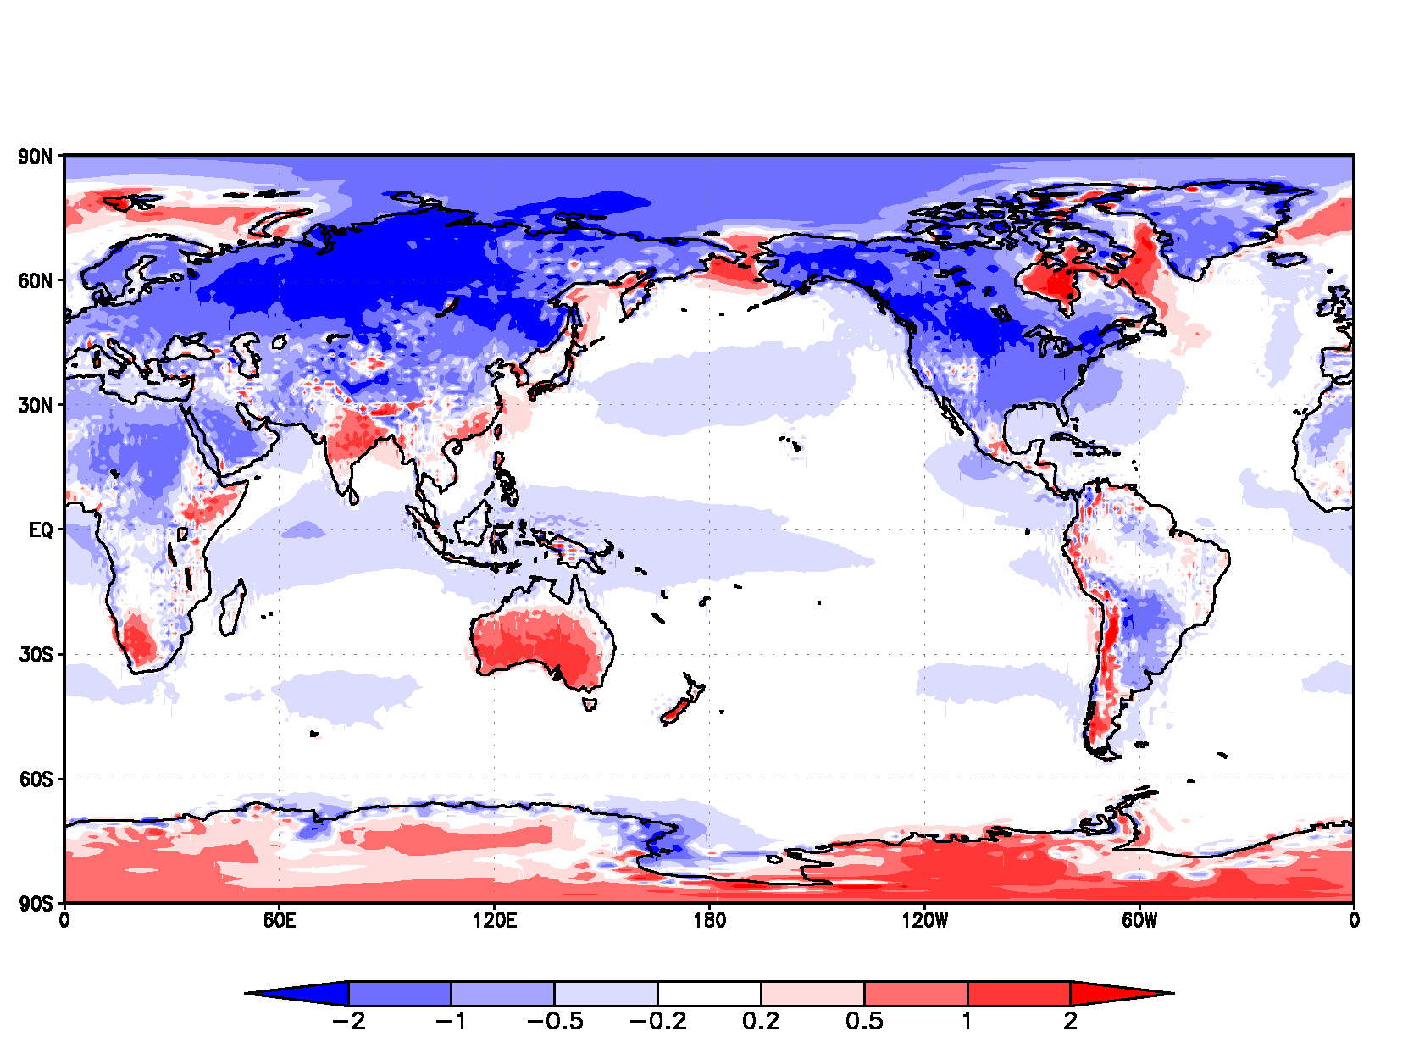
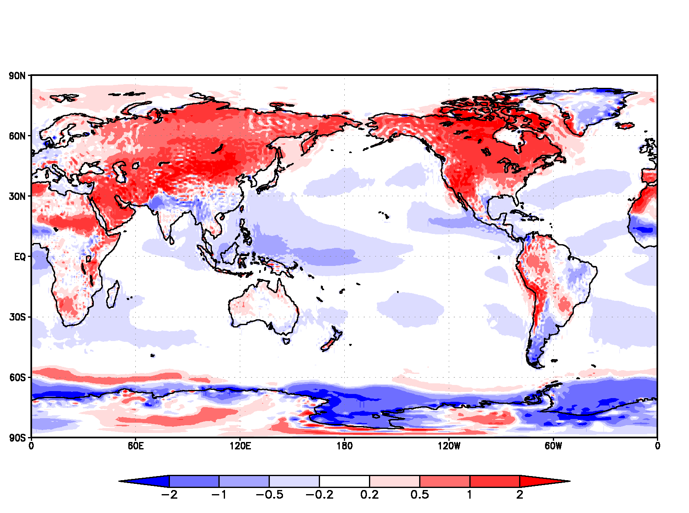
Week-2 GEFS Reforecast Mean Temp Bias
DEC-JAN
Ensemble Mean Bias
JUL-AUG
Ensemble Mean Bias
Bias is a large fraction of the variability
Important to correct raw forecasts
Must capture seasonally varying bias
Notes:
Bias is the week-2 means minus the accumulated day-0 means for the same week.
The weekly means were averaged over the 2-month periods shown.

Slide 20
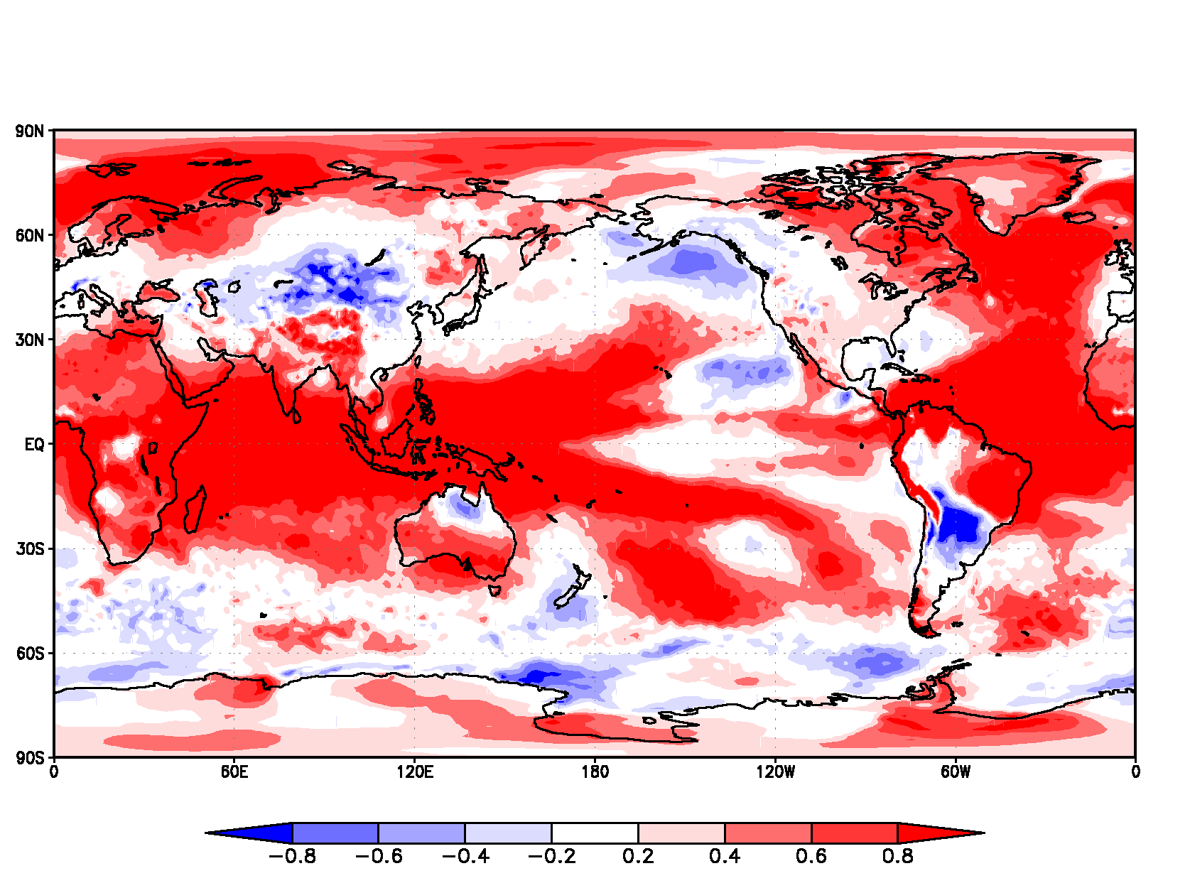
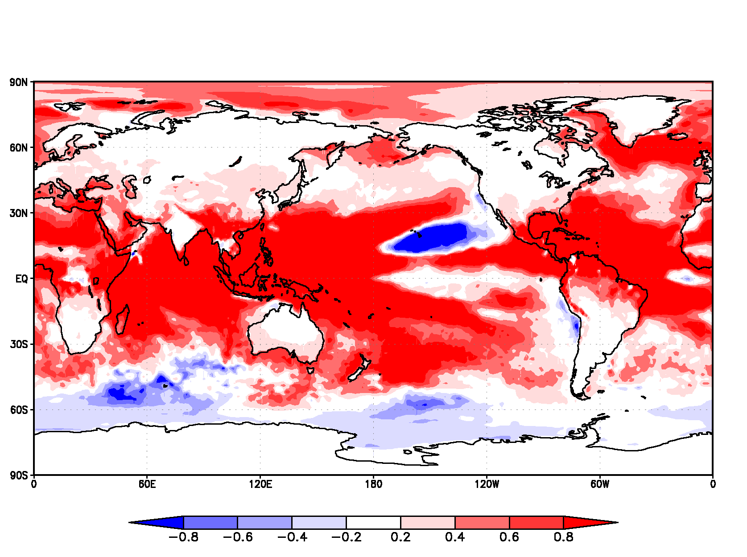
25-year (1985-2010) linear temperature trend standardized by observed weekly variability
DEC-JAN
Standardized Linear Trend
JUL-AUG
Standardized Linear Trend
Trend shifts weekly temperature anomalies by more than 2 tercile categories in some areas.
Notes:
Over the U.S. the trend is more than 0.2 standard deviations, compared to the variance of weekly temperatures.
In many areas of the globe the trend is more than 0.5 standard deviations.
The near-normal tercile is about 0.8 standard deviations wide.

Slide 21
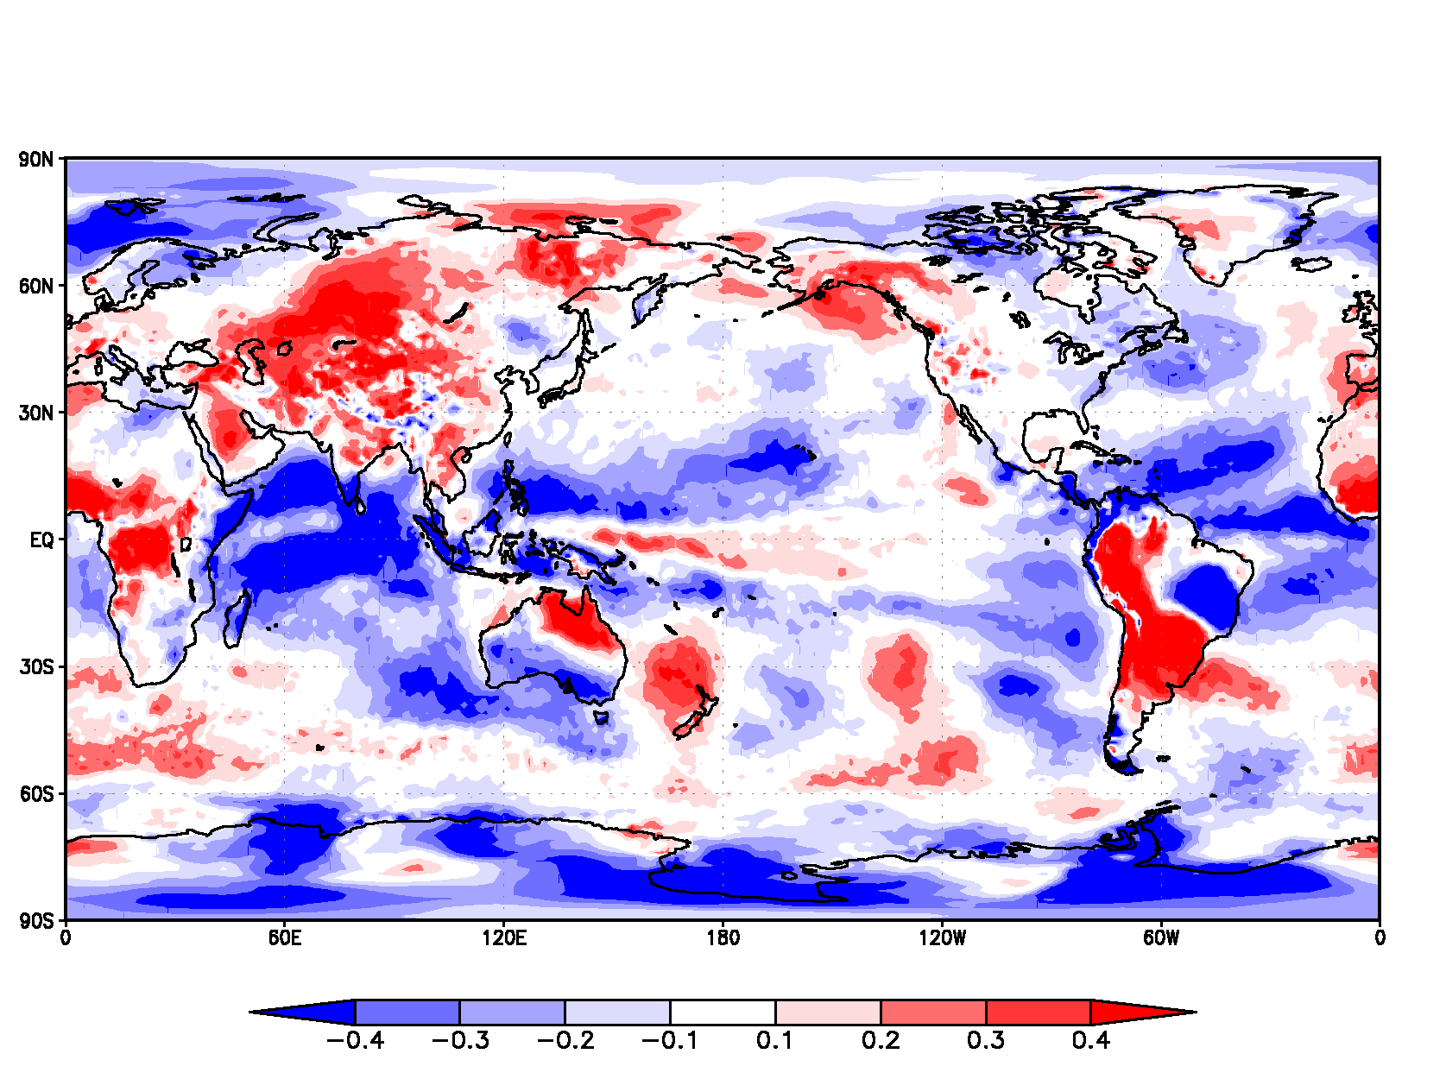
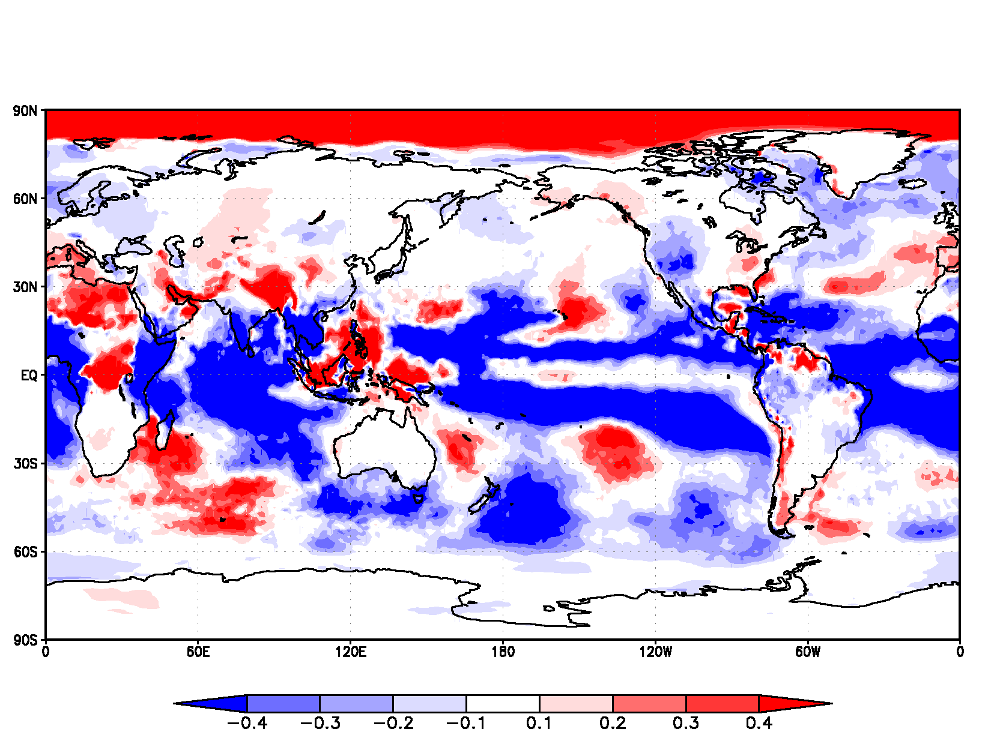
Model bias is changing with changing background climate state
DEC-JAN
Standardized Trend of Mean Bias
JUL-AUG
Standardized Trend of Mean Bias
Trends in the model bias may be systematic and need to be corrected for.
Longer reforecast would be needed to determine trends in the model bias.
Notes:
We have not yet tested using the trend in bias as part of model calibration.

