Slide 1

Instituting Reforecasting at NCEP/EMC
Tom Hamill (ESRL)
Yuejian Zhu (EMC)
Tom Workoff (WPC)
Kathryn Gilbert (MDL)
Mike Charles (CPC)
Hank Herr (OHD)
Trevor Alcott (Western Region)

Slide 2
Weather and climate numerical guidance commonly have systematic errors
Biased 14-day surface temperature forecasts
numerical forecast
Temperature
analyzed
Date
Under-spread ensembles
Temperature
Temperature
Temperature
forecast
lead time
forecast
lead time
forecast
lead time

Slide 3
Weather and climate numerical guidance commonly have systematic errors
Biased 14-day surface temperature forecasts
ensemble-mean
forecast
Temperature
analyzed
We’d like to statistically
adjust the forecast guidance before our customers use it
to make decisions.
Date
Under-spread ensembles
Temperature
Temperature
Temperature
forecast
lead time
forecast
lead time
forecast
lead time

Slide 4
Statistical post-processing for rare events is challenging without a large training sample
Say you want to statistically post-process your model precipitation forecast to improve it.
Heavy precipitation events like the one today are the ones you care about the most. How
do you calibrate today’s forecast given past short sample of forecasts and observations?

Slide 5
Reforecasts and past observations make it straightforward to improve reliability and skill.
T850 reliability before post-processing T850 reliability after post-processing
post-processing here using “non-homogeneous Gaussian regression” and 1985-2011 data over CONUS. Trained and validated against CFSR.

Slide 6
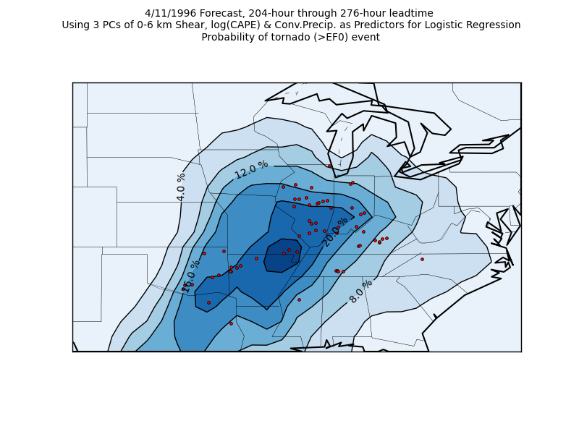
Exciting new products are also possible.
8.5 to 11.5 – day tornado forecast, 4/11/1996
Francisco Alvarez at
St. Louis University,
is working with me
and others on using the
reforecasts to make
extended-range
predictions of
tornado probabilities.
Ph.D. work,
in progress.

Slide 7
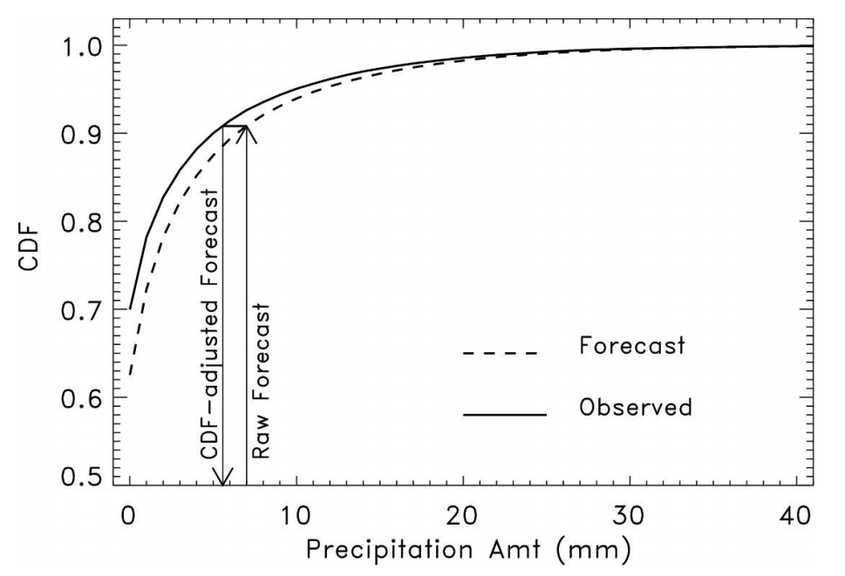
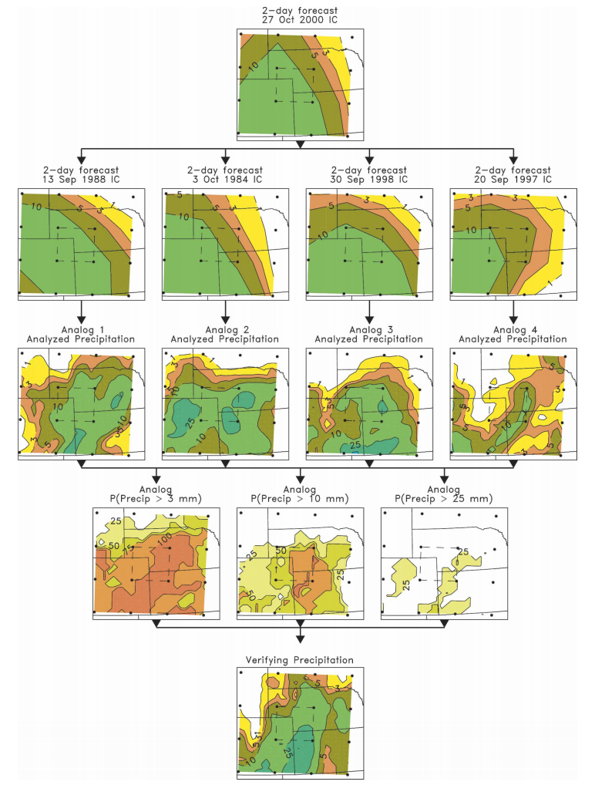
Many methods of post-processing.
CDF-based bias correction
Forecast analog
Ref: Hamill and Whitaker, MWR, 2006

Slide 8
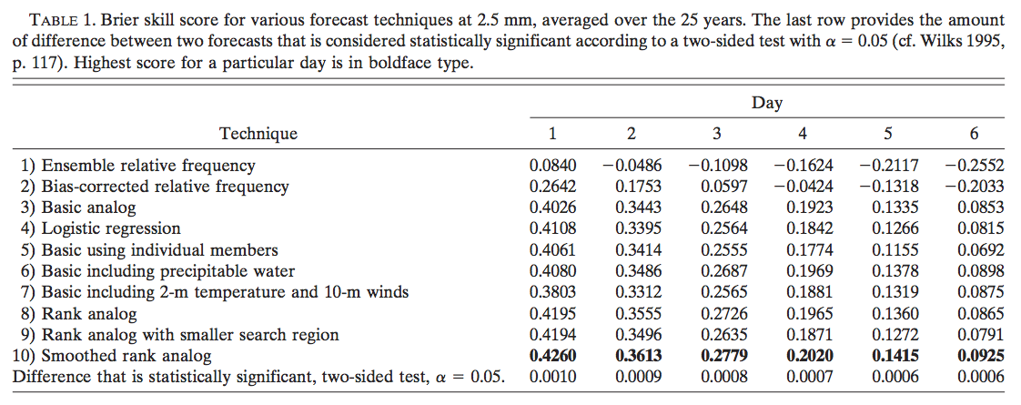
Not all are equally skillful.

Slide 9
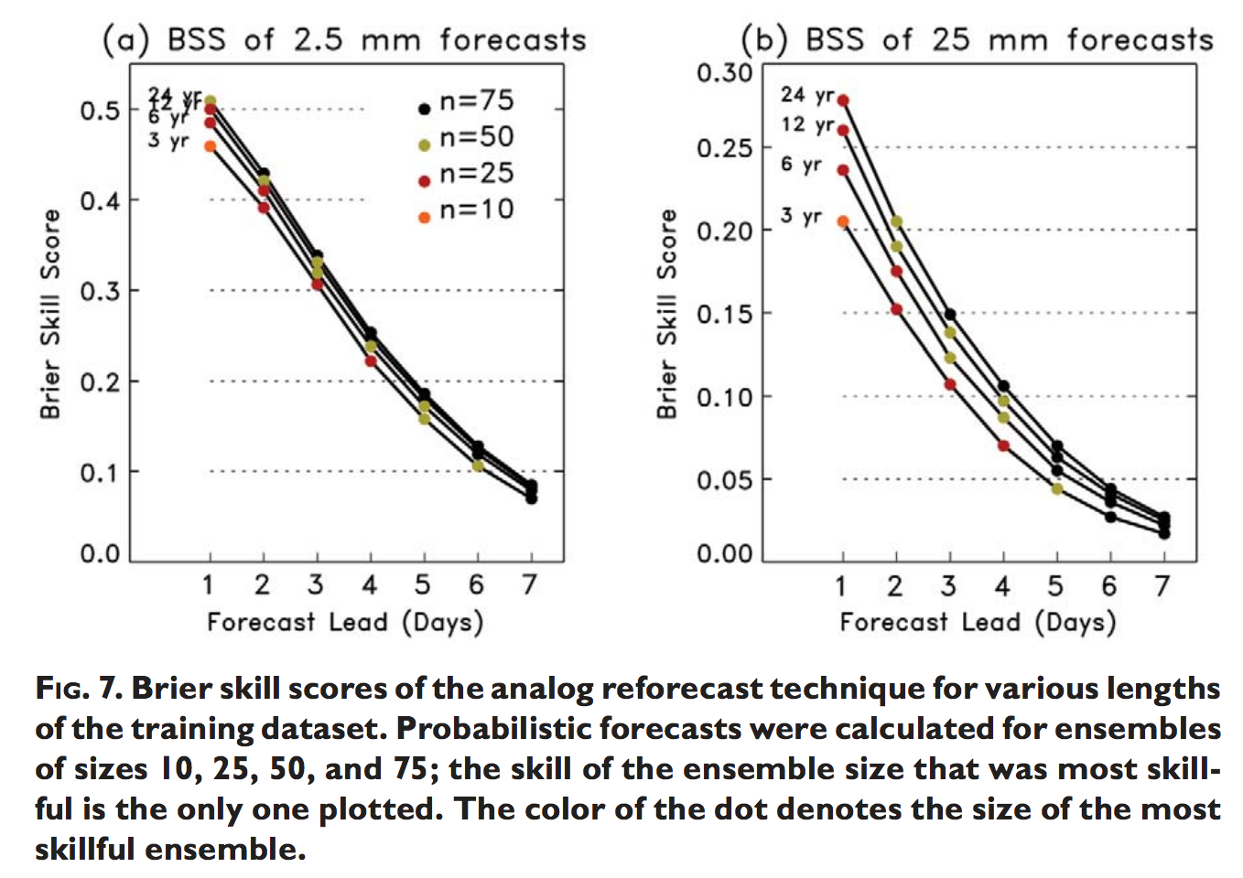
Post-processing skill often depends on training sample size.
There is more skill
dependence on training
sample size for the
heavy precipitation
(uncommon) than for
light precipitation.
For many of the projects
such as the “blender
project” we are asked
to calibrate variables
such as precipitation
that have this strong
sample-size dependence.
Ref: Hamill et al. BAMS, 2006

Slide 10
“Regionalization,” or training with data from supplemental locations can help (and hurt, too).
Here, for a given grid point
(big symbol) supplemental
training data locations
are identified that have
similar forecast, observed
climatologies. Approaches
such as this can enlarge the
training sample size, but
sometimes forecast biases
are very regionally specific,
and this degrades the
post-processing
performance.
Ref: Hamill, yet unpublished work.

Slide 11
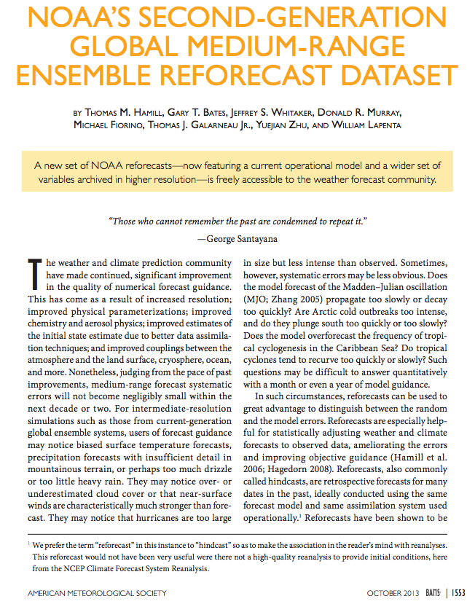
The current operational
NCEP GEFS has a multi-decadal
ensemble reforecast that is
being used by many NWS
organizations:
CPC (for 6-10 day and week +2
forecasts);
OHD (probabilistic streamflow)
WPC (precipitation forecasting)
and others.
What happens after the model
changes again?

Slide 12

Tension?
High
performance
computing
Higher-resolution models,
more models, run more
frequently
Improved assimilation methods
Improved physics
Frequent model updates
More ensemble members
Retrospective forecasts
Reanalyses to initialize
retrospective forecasts
More stable models

Slide 13


A mutual desired outcome?
Rapidly improving models, assimilation methods, ensembles
An institutionalized, light-footprint reforecast capability to make the raw guidance even better

Slide 14
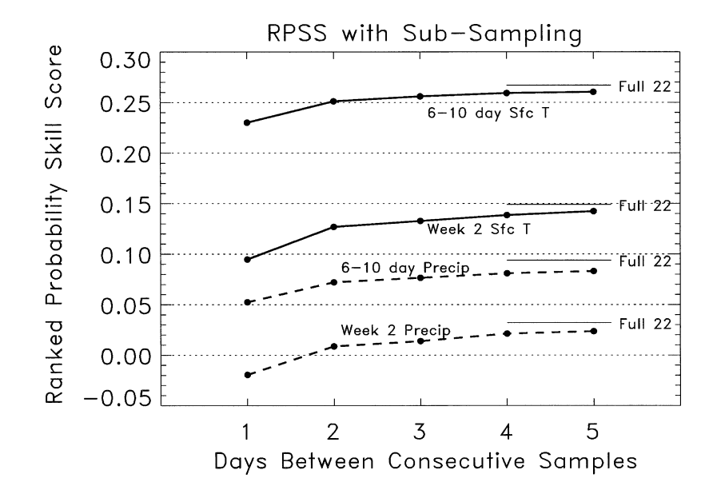
Are there ways to decrease the number of reforecasts needed?
Yes, we think.
Here, four years of reforecast
data are computed, with up
to 5 days between consecutive
samples. Spacing out the
reforecasts provides almost
as much post-processed
skill as training with 22
years of every-day
reforecast data for these
applications.
Ref: Hamill et al., MWR, 2004

Slide 15
Challenges
Reforecasts require past initial conditions with accuracy like that of real-time analyses. Hence, regular reanalyses needed.
  Also, ensembles of initial conditions generated in the same manner as real-time ensemble.
Ensemble systems such as the SREF that use different models, different physics may have larger reforecast requirements than systems with “exchangeable” members. We may need a reforecast for each member, with its unique biases, or need to rethink the SREF configuration.

Slide 16
Participant contributions
CPC, WPC, MDL, Western Region, EMC will all talk about:
  the projects they are involved in that leverage past forecasts
  their experiences with reforecasts
  their requirements for training data

Slide 17
Participant contributions inserted here

Slide 18
Proposal for discussion
Near term (< 2 years):
  Augment EMC staffing and disk storage to support generation of retro runs and reforecasts.
  15-year, 5-member GEFS reforecast, computed every week (75 extra members per week if done for 1 cycle per day) based on CFSR. Options for finding the cycles:
    Fewer real-time members (15 instead of 20?)
    Shorter integrations for 06, 18 UTC (not to +16 days).
    Slightly reduced model resolution
  1 year retro runs for GFS, NAM, SREF prior to any implementations.
  Continue to study optimal small-footprint reforecast configuration using existing GEFS reforecast data set, thinned out.

Slide 19
Proposal, continued
Longer term (2-5 years)
  Augment requirements for future supercomputers to include regular production of reanalyses and reforecasts.
  Periodically generate new reanalyses using modern operational data assimilation system.
  Institutionalize the regular production and storage of year-long retro runs prior to new implementations.
  Conduct GEFS reforecast in configuration as determined in short-term research.

