Slide 1
Reforecast Use In Hydrology
Hank Herr, Mark Fresch (OHD)
James Brown (Hydrologic Solutions Ltd, UK)
December 3, 2013

Slide 2
Hydrologic Ensemble Forecast System
Use of Reforecasts
Implementation and rollout of the Hydrologic Ensemble Forecast System (HEFS) at 13 RFCs
Calibration of the meteorological component of HEFS, the Meteorological Ensemble Forecast Processor (MEFP)
System evaluation through streamflow hindcasting and verification
Collaboration with other agencies who need HEFS hindcasts, supported by meteorological reforecasts, for high priority operational objectives
Example: NYCDEP requires HEFS hindcasts to calibrate and evaluate a decision support tool used to improve water supply to New York City
Requirements of Reforecasts
Long period of record to support reliable calibration with reasonably small sampling uncertainty
As long as possible, but at least 20 years
Including high impact events in the reforecast period is very important
Operational models to be frozen for a period of several years to allow for downstream applications to transition to new models/reforecast data sets
It is time-consuming to re-calibrate and re-evaluate the HEFS with new met models
Notes:
2

Slide 3
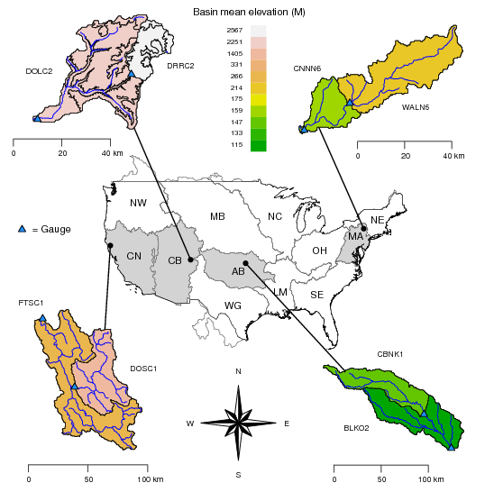
Streamflow hindcasting with HEFS
Selected basins
Four RFCs
Hindcasts: 1985-1999 (limited by obs. data)
Upper/lower pairing
USGS gauge at the outlet of each basin
Relatively small basins (largest 2000 sq. miles)
Lower elevations in AB and MA
Higher elevations in CB and CN
CB and CN have MAT/MAP sub-basins
Notes:
3

Slide 4
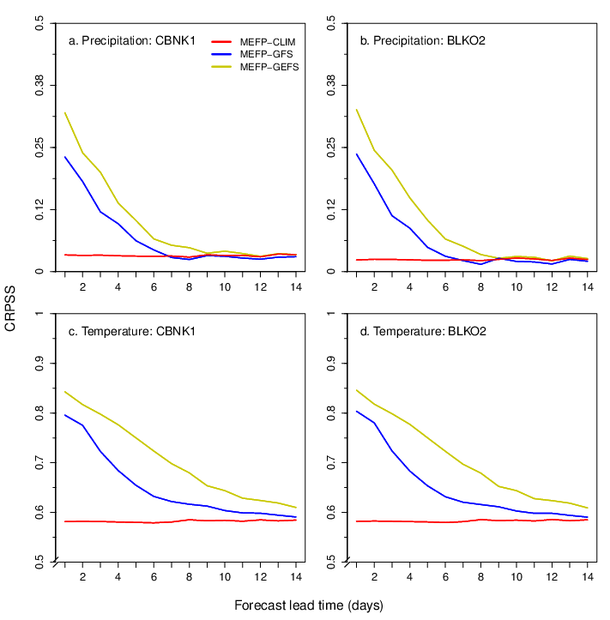
Forcing: MEFP-GEFS vs. MEFP-GFS
MEFP-GEFS adds value
Compared forcing from MEFP-GEFS vs. MEFP-GFS
Skill (CRPSS) from two basins in ABRFC, precipitation (top) and temperature (bottom)
Sample climatology as baseline (unconditional) with MEFP conditional climatology also shown (red)
Raw GEFS improves substantially on GFS and this is reflected in MEFP-GEFS results shown here
Improvements particularly noticeable in first week for P, longer for T
Notes:
4

Slide 5
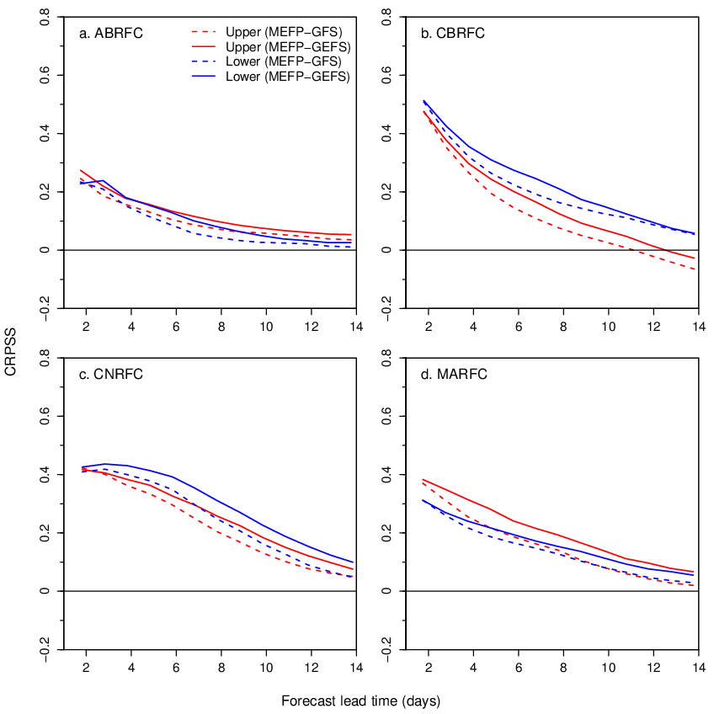
Streamflow: MEFP-GEFS vs. MEFP-GFS
Value also added to flow
Streamflow skill shown for lower and upper basin in each RFC with MEFP-CLIM baseline
Results include hydrologic bias-correction
Skill from hydro. initial conditions dominates early lead times
GEFS consistently beats GFS once forcing washes through, but hydro. uncertainty is also key
On time horizon of ~4-10 days, GEFS adds ~1-2 days in lead time in terms of CRPSS, notwithstanding sampling uncertainty
Notes:
5

