Slide 1
Statistical Post Processing - Using Reforecast to Improve GEFS Forecast
Yuejian Zhu
Hong Guan and Bo Cui
ECM/NCEP/NWS
Dec. 3rd 2013
Acknowledgements:
EMC Ensemble team; Dan Collins (CPC)

Slide 2
GEFS Reforecast Configurations
Model version
GFS v9.01 – last implement – May 2011
GEFS v9.0 – last implement – Feb. 2012
Resolutions
Horizontal – T254 (0-192hrs – 55km); T190 (192-384hrs – 70km)
Vertical – L42 hybrid levels
Initial conditions
CFS reanalysis
ETR for initial perturbations
Memberships
00UTC - 10 perturbations and 1 control
12UTC – 1 control forecast
Output frequency and resolutions
Every 6-hrs, out to 16 days
Most variables with 1*1 degree (and 0.5 degree, too)
Data is available
1985 - current
GEFS operational futures
TS relocation (not in reforecast)
STTP (in reforecast)
Reference:
Hamill and et al. 2013 (BAMS)

Slide 3
Using Reforecast Data for Tests
Bias over 24 years (24X1=24), 25 years (25x1=25)
Bias over 25 years within a window of 31days
Bias over recent 2, 5, 10, and 25 years within a window
of 31days (2x31, 5x31, 10x31, 25x31)
Bias over 25 years with a sample interval of 7days within
a window of 31days and 61days (~25x4 and ~25x8)
31days
1985
1986
day-15
.
.
.
day
day+15
2009
2010

Slide 4
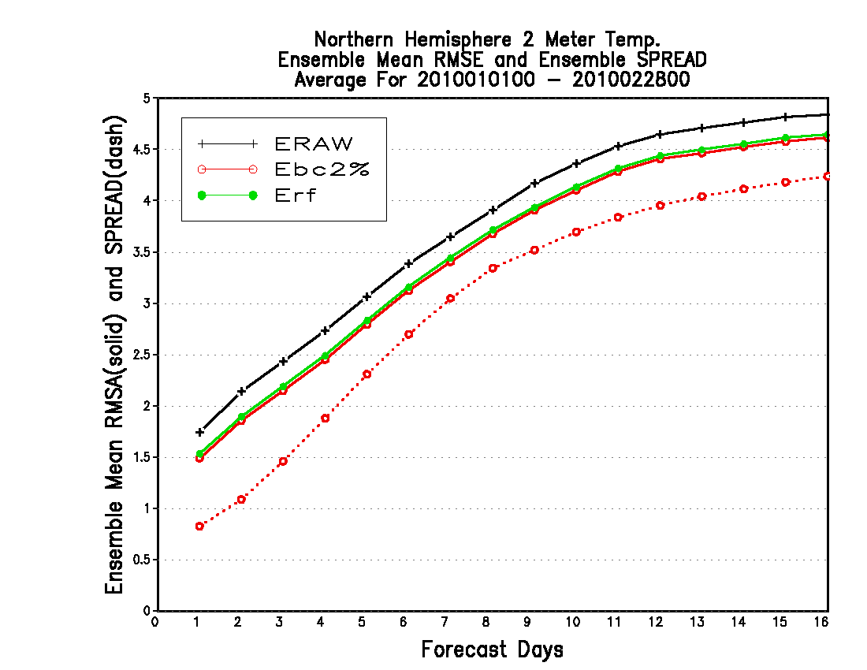
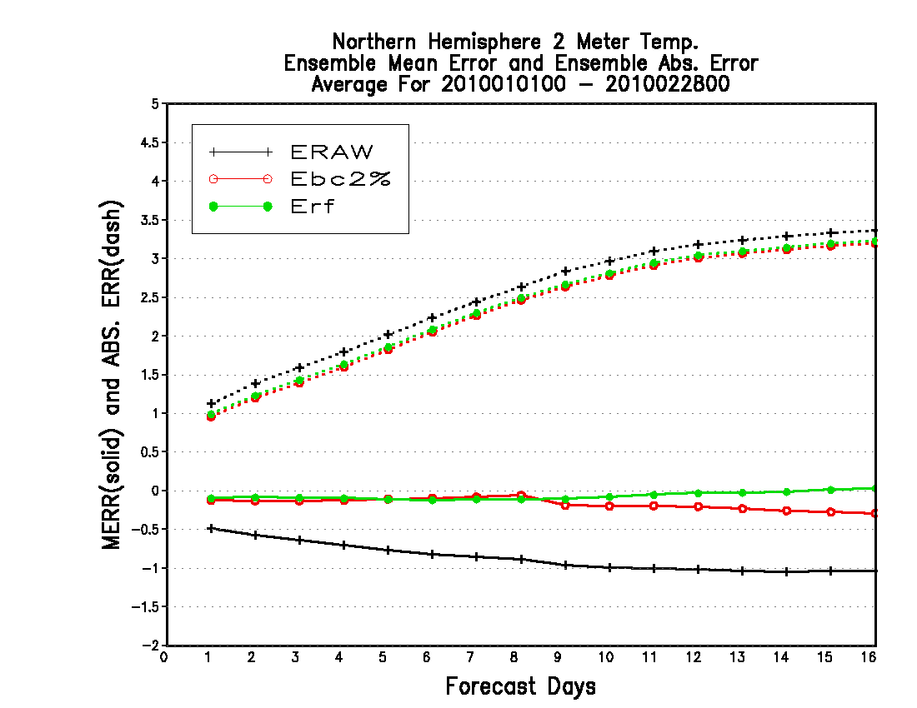
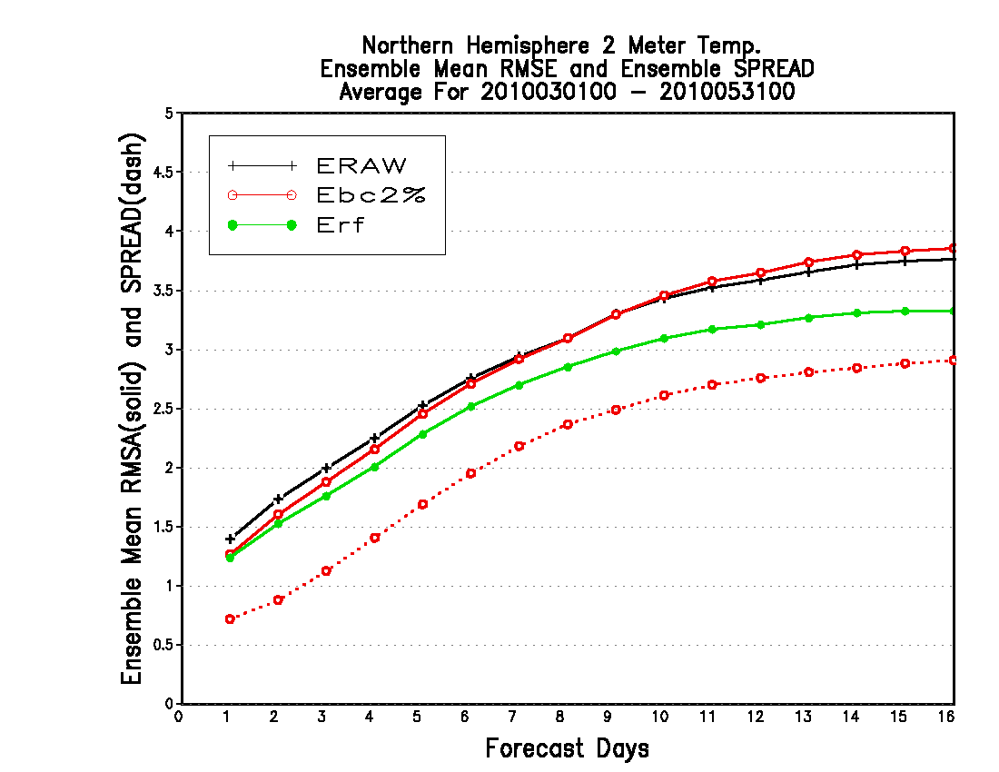
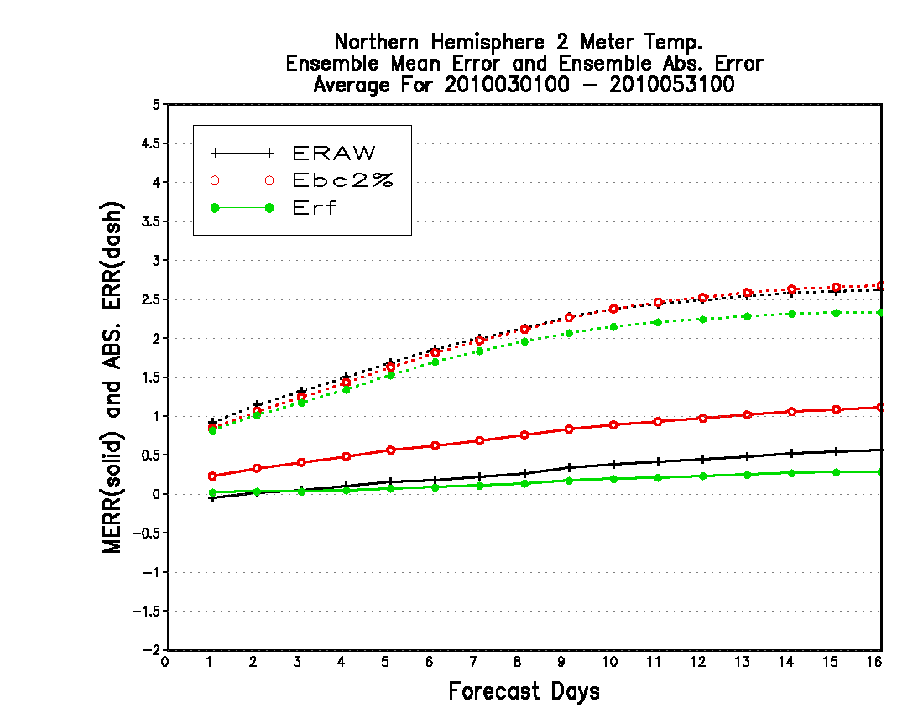
Using 25-year reforecast bias (25 data) to calibrate latest year (2010)
Decaying average is better than reforecast climatology
Winter 2010
Spring 2010
Decaying average is not good for transition season, especially from cold bias (-) to positive bias (+)

Slide 5
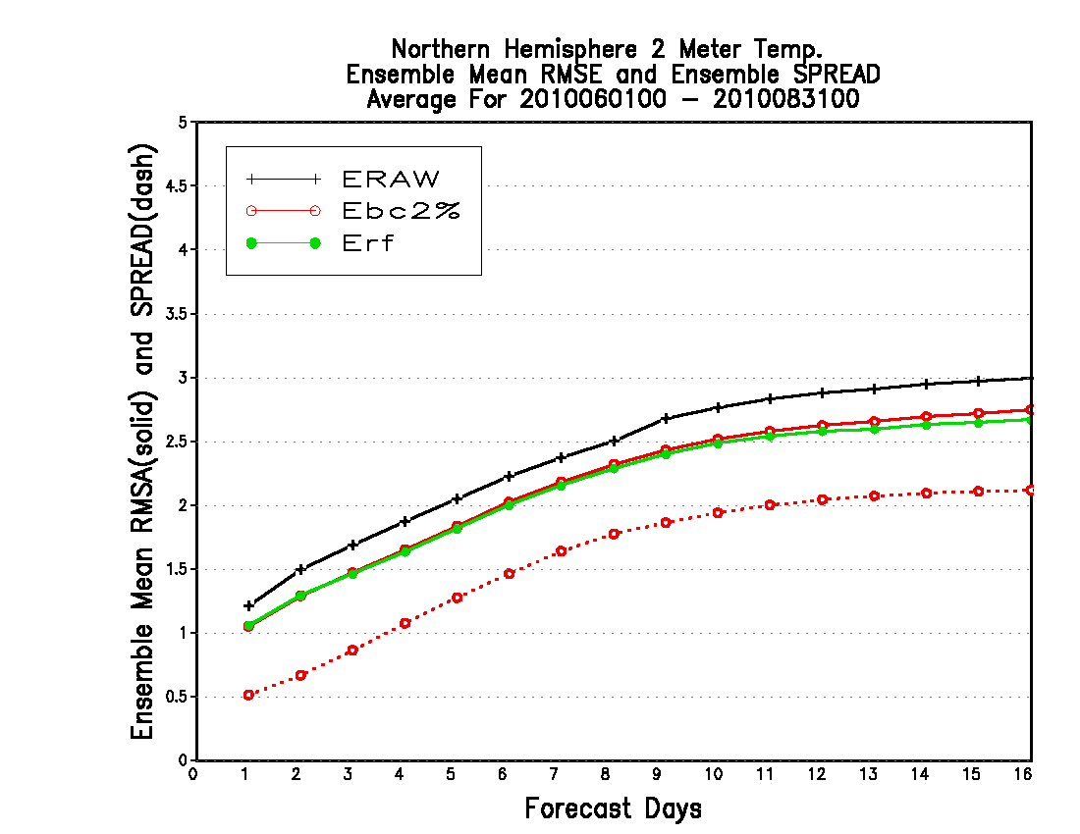
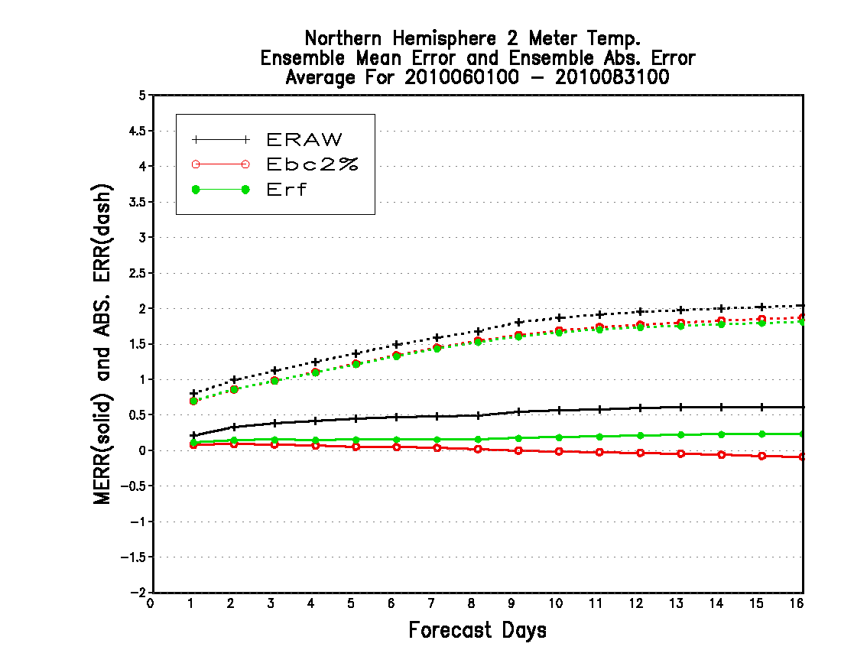
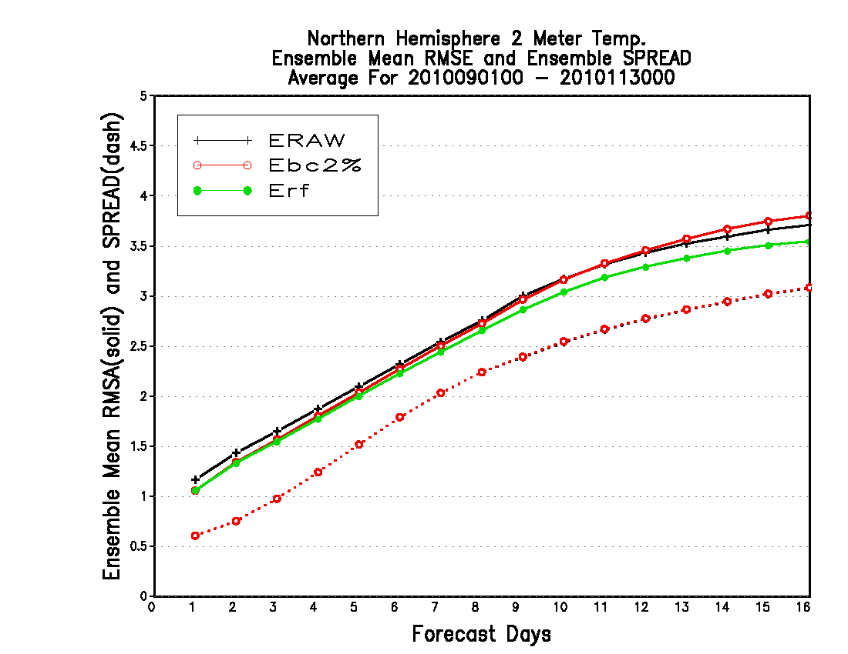
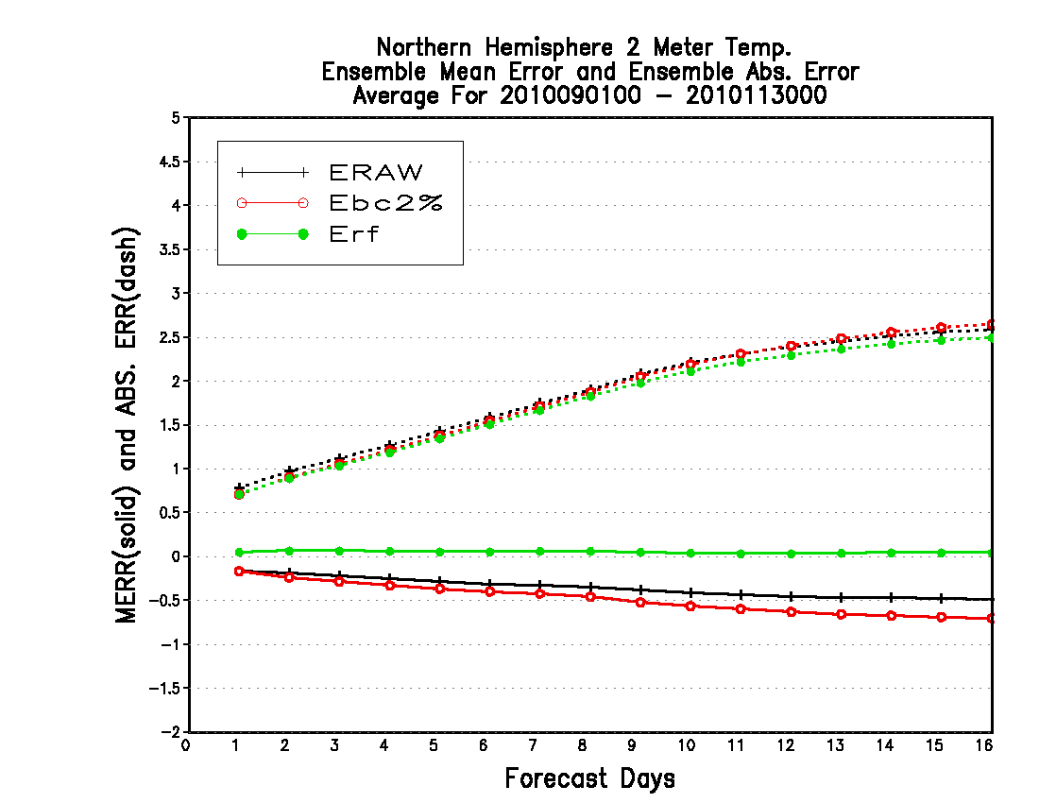
Using 25-year reforecast bias (25 data) to calibrate latest year (2010)
Summer 2010
Decaying average has the same value as reforecast
Fall 2010
Another bad for decaying average for longer lead time since bias from positive (+) to negative (-)

Slide 6
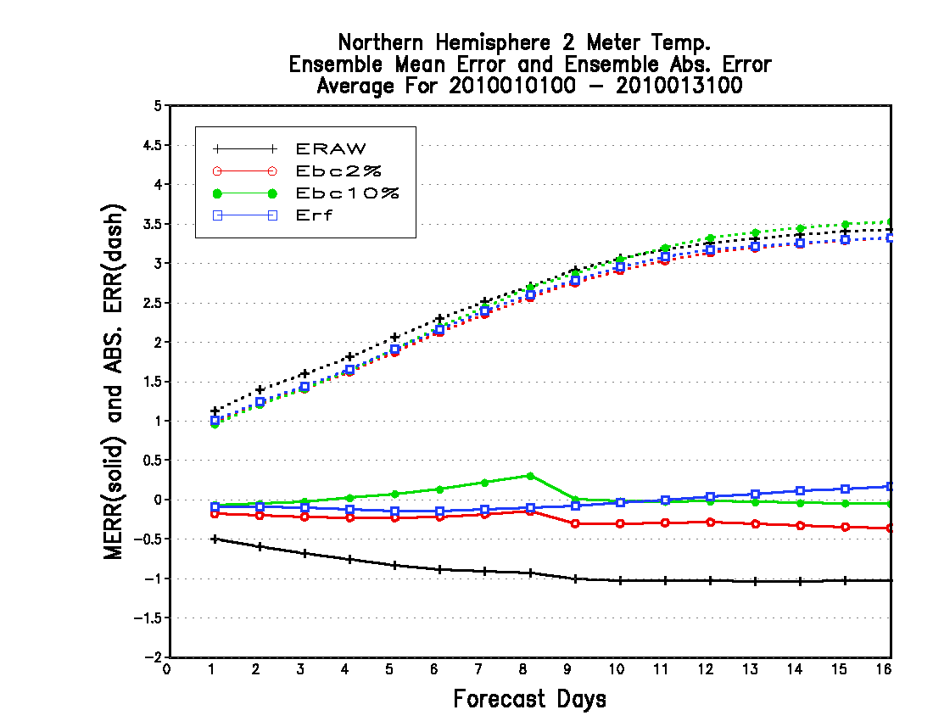
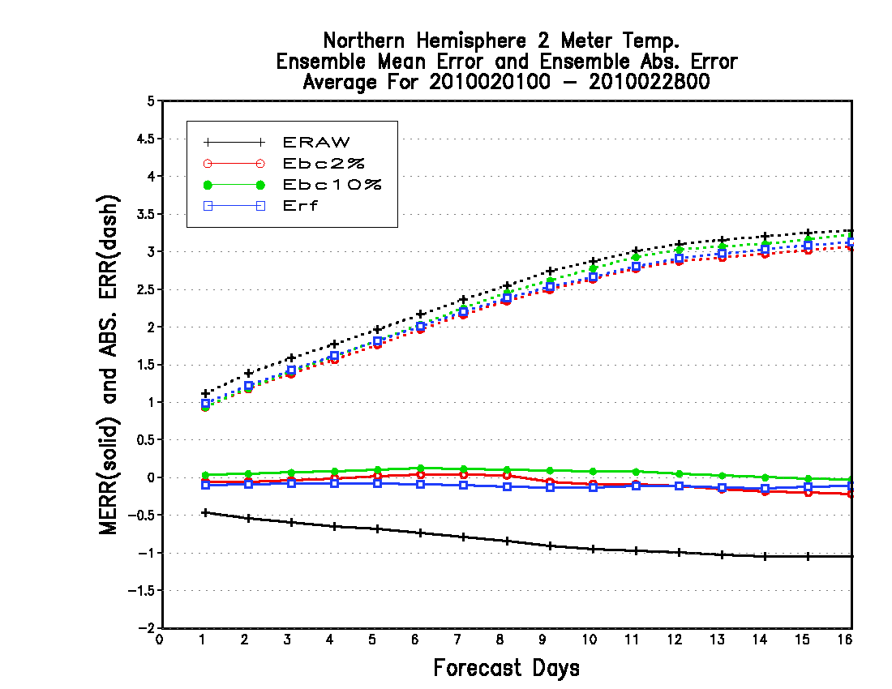
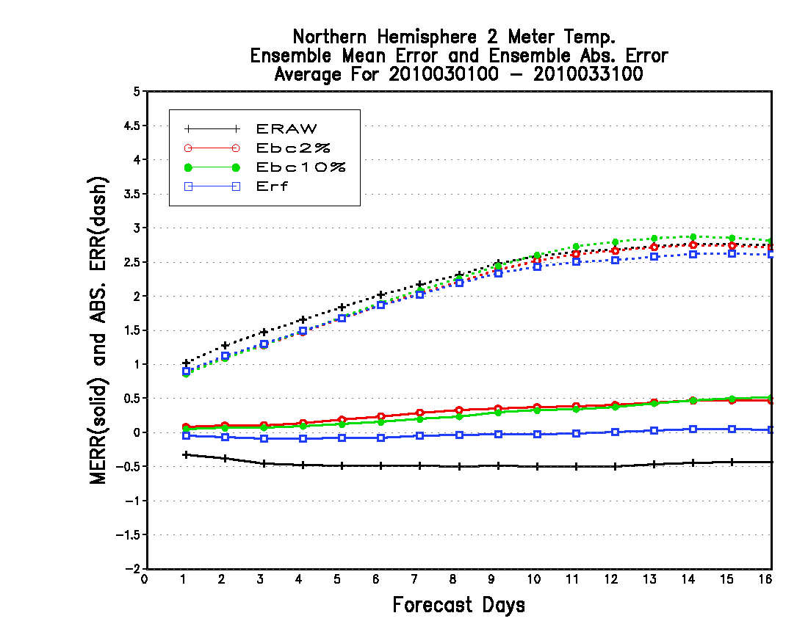
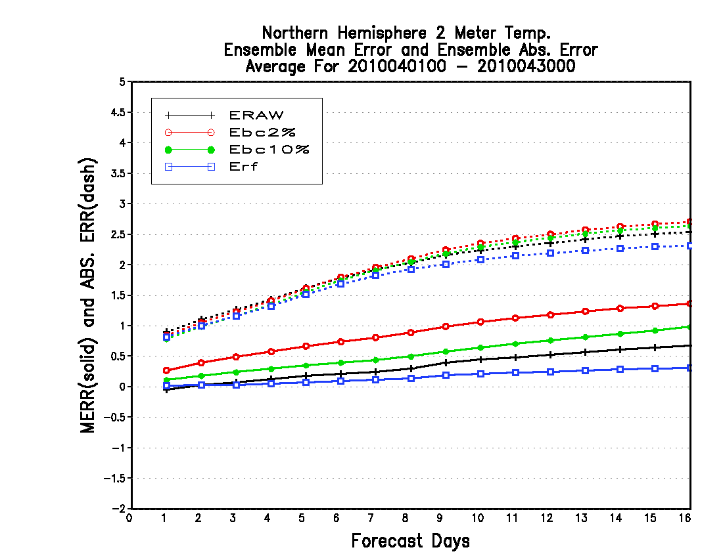
Using 25-year reforecast bias (25 data) to calibrate latest year (2010)
January
Raw – cold bias
February
Raw – cold bias
Look at month by month
For validation
March
Less cold bias
April
Turn to warm bias

Slide 7
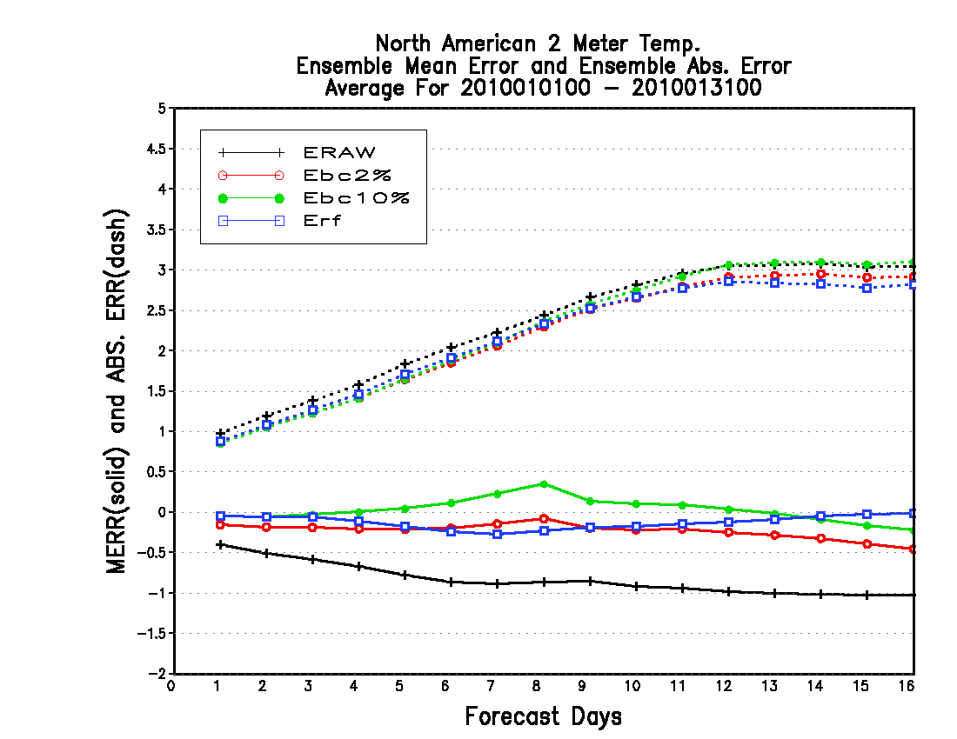
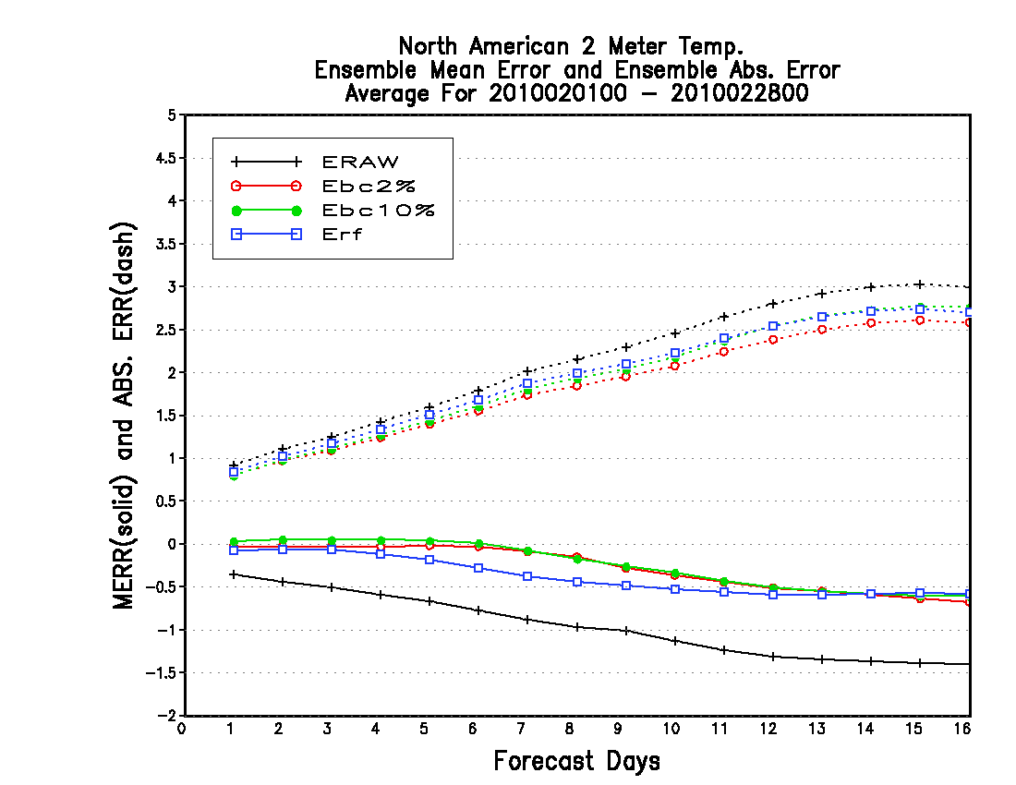
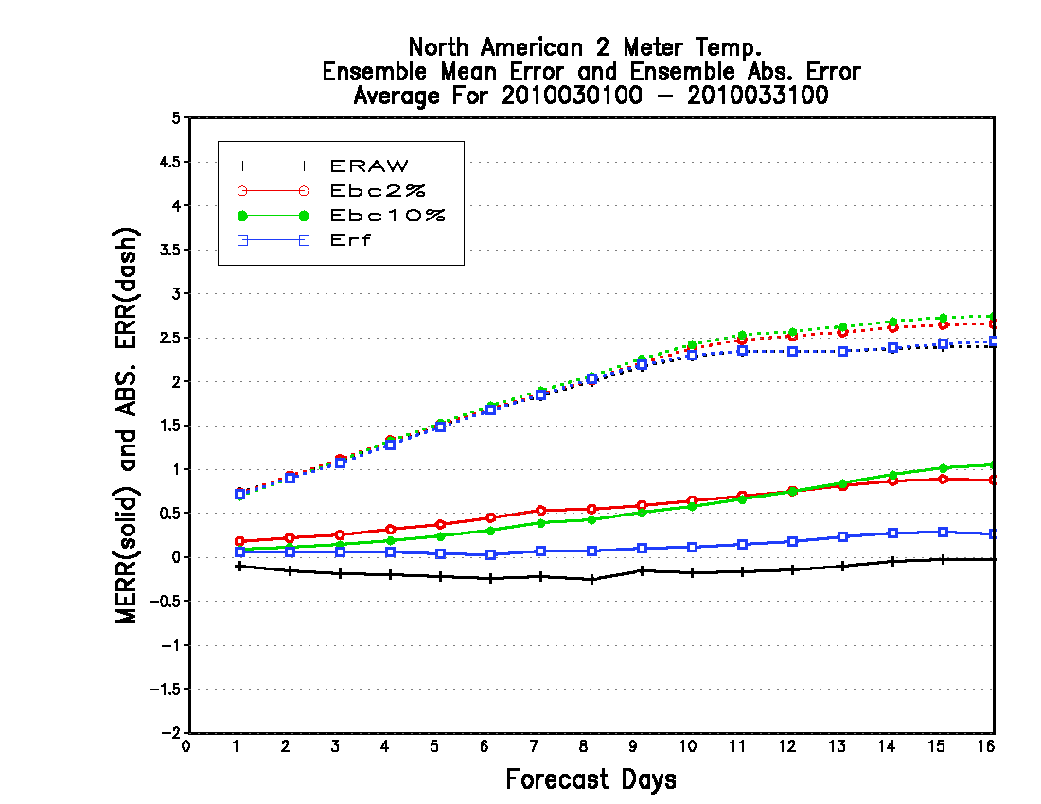
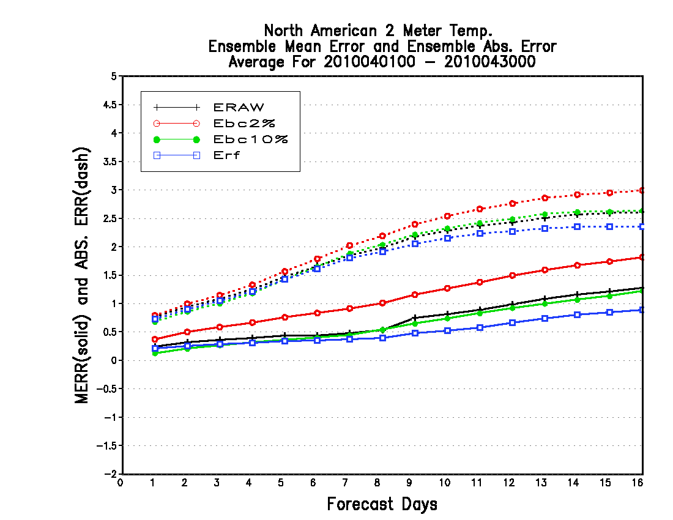
Using 25-year reforecast bias (25 data) to calibrate latest year (2010)
Look at month by month
Northern American has the same characteristics as Northern Hemisphere

Slide 8
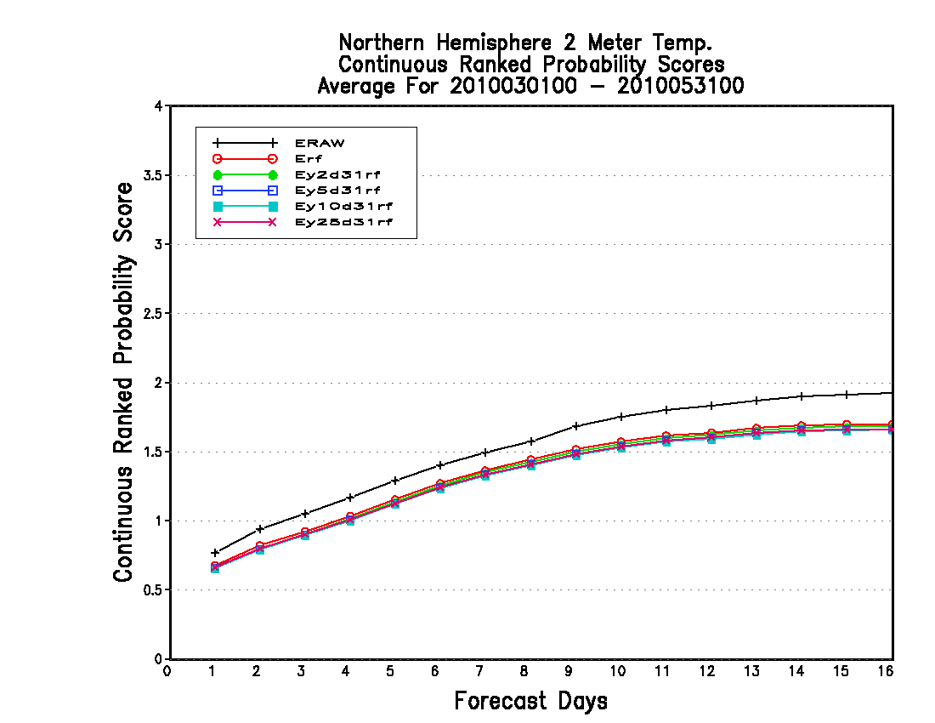
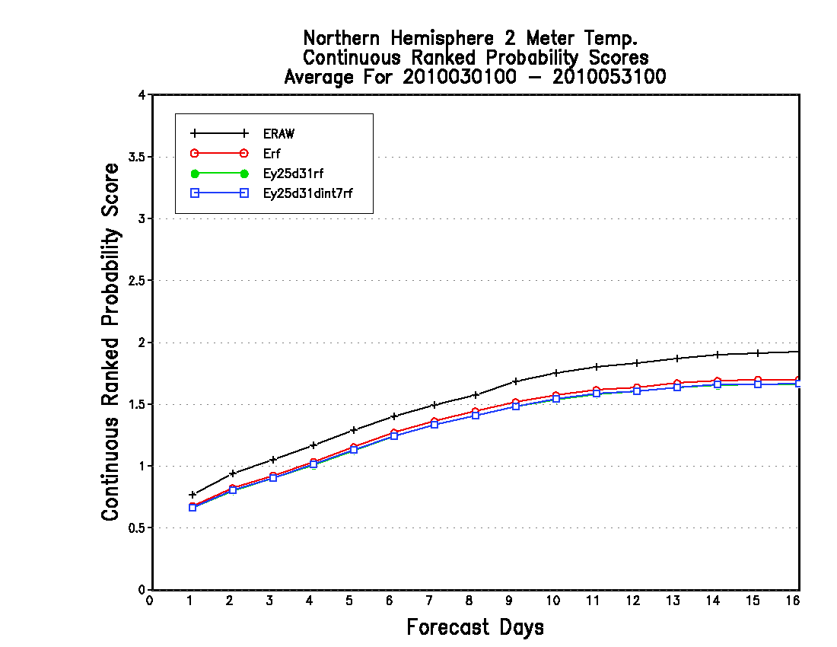
T2m for different reforecast samples
sensitivity on the number of training years (2, 5, 10, and 25 years)
sensitivity on the interval of
training sample (1 day and 7 days)
Long training period (10 or 25 years) is necessary to help avoid a large impact to bias correction from a extreme year case and keep a broader diversity of weather scenario!!
Skill for 25y31d’s running mean is the best. 25y31d’s thinning mean (every 7 days) is very similar to 25y31d’s running mean. 25y31d’s thinning mean can be a candidate to reduce computational expense and keep a broader diversity of weather scenario!!!

Slide 9
Using reforecast to improve current bias corrected product
r could be estimated by linear regression from joint samples, the joint sample mean could be generated from decaying average (Kalman Filter average)
for easy forward.
Bias corrected forecast: The new (or bias corrected) forecast (F) will be generated by applying decaying average bias (B) and reforecast bias (b) to current raw forecast (f) for each lead time, at each grid point, and each parameter.
2
2

Slide 10
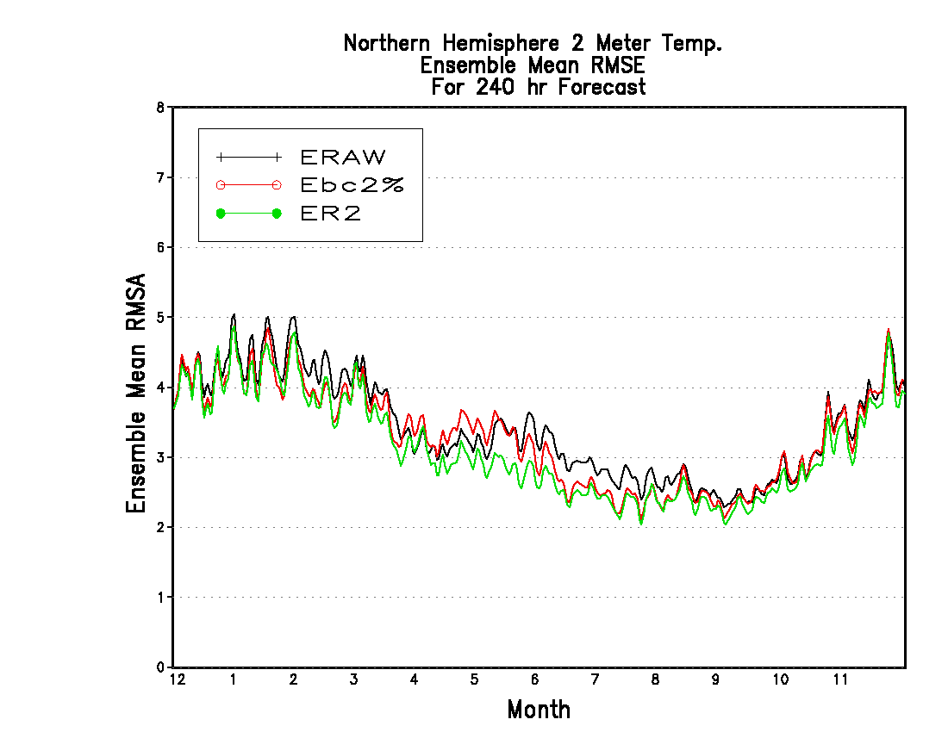
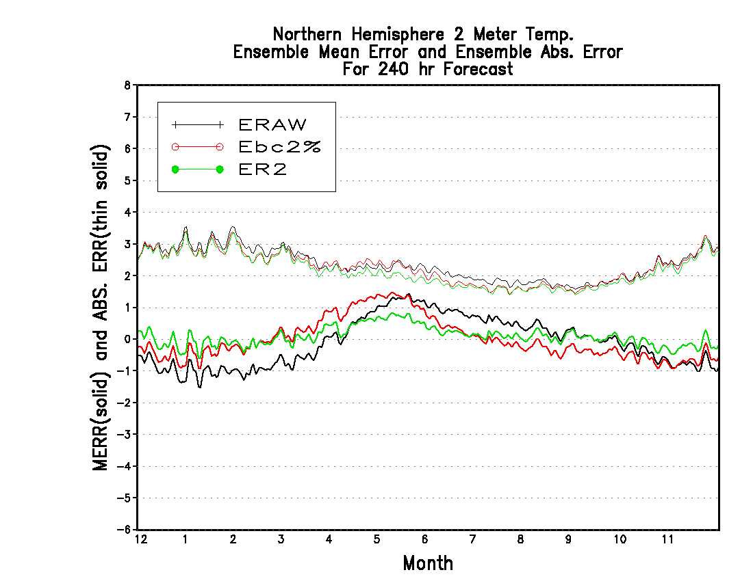
Using reforecast to improve current bias corrected product (240-hr forecast, 2010 )
Spring
Summer
Winter
Full
Perfect bias

Slide 11
Summary
Surface temperature is strongly biased for NH/NA
Cold bias for winter, warm bias for summer
Uncorrected soil moisture table – GFS has been implemented, but GEFS is not.
Decaying averages are good for winter/summer, but not good for extended forecast of transition season.
2% decaying weight has overall better value, but 10% weight is good for short lead time (1-3 days)
Very difficult to improve the skills for 500hPa height possibly due to less bias or insensitivity to bias correction
25y31d’s thinning mean can be a candidate to reduce computational expense and keep a broader diversity of weather scenario
Adding reforecast information will improve current bias-corrected product.
Bias and its seasonal variation are model-dependent. Whether the improvement found here will occur for the new GEFS version need to be confirmed later!!

Slide 12
Background!!!

Slide 13
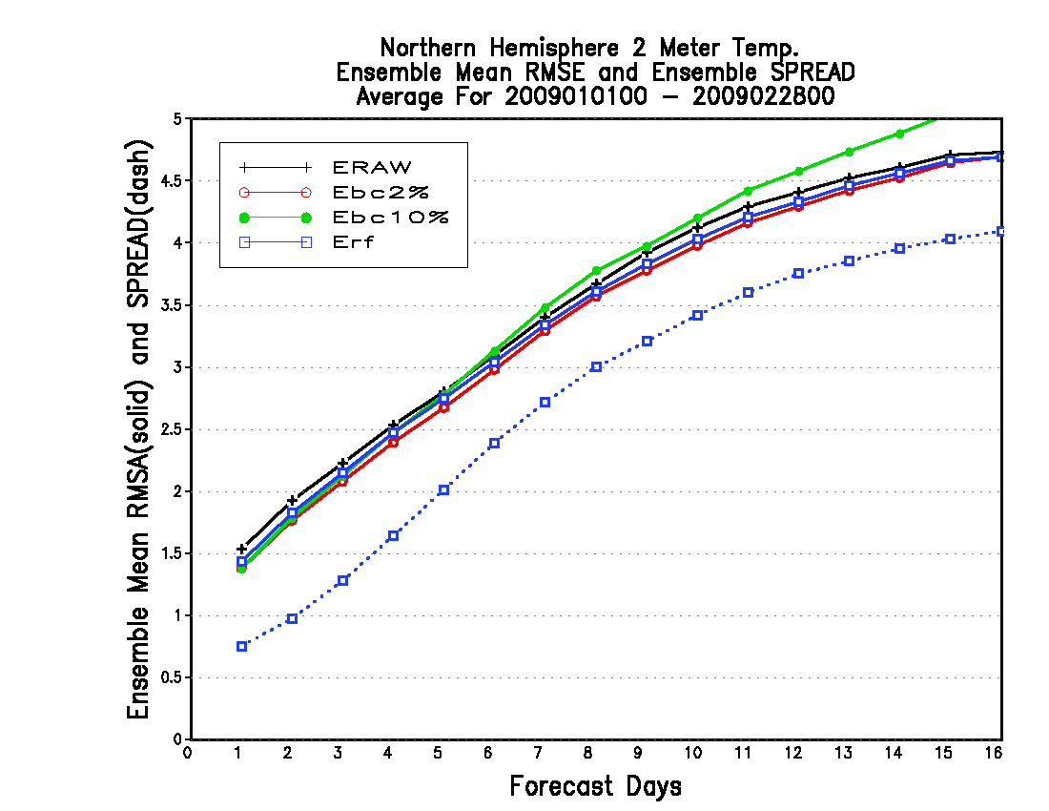
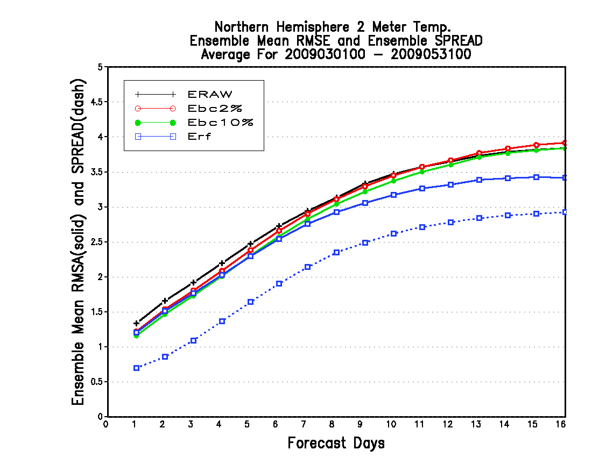
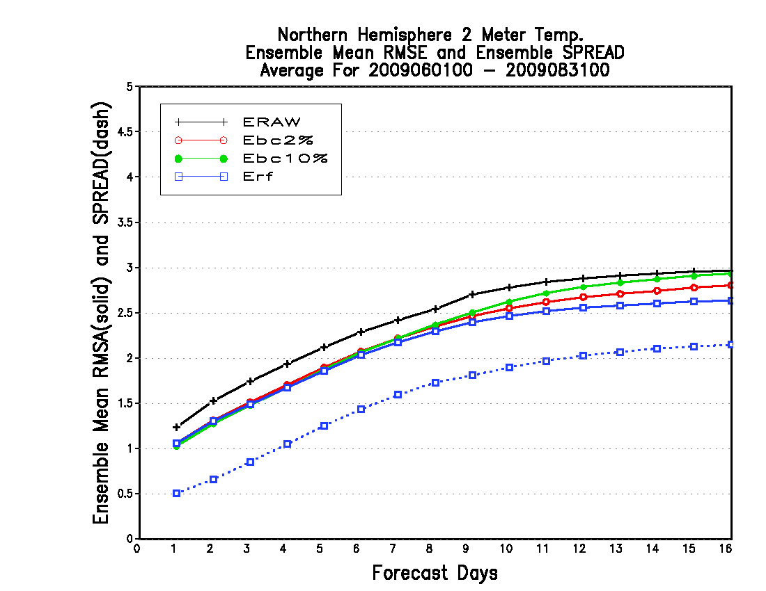
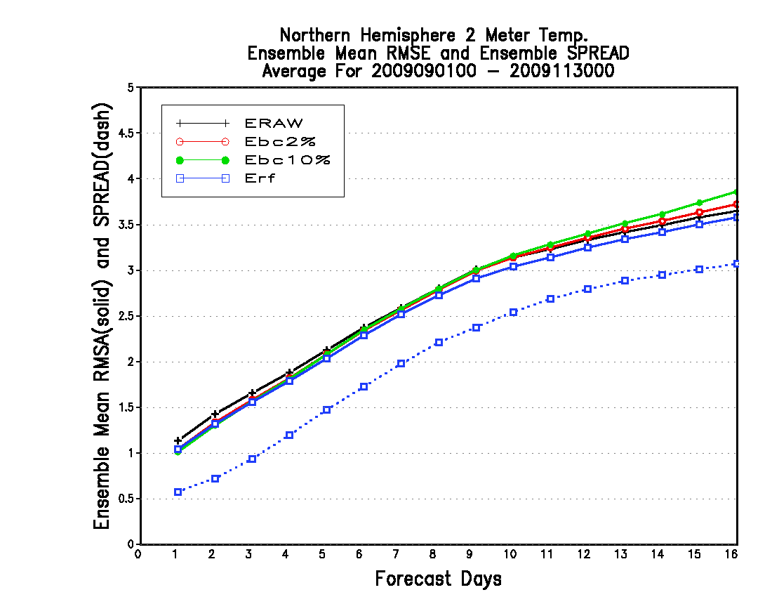
Using 24-year reforecast bias (24 data) to calibrate latest year (2009)
Spring 2009
Winter 2009
2% decaying is best for all lead time
Decaying averages are not good except for day 1-2
Summer 2009
Fall 2009
Decaying average is equal good as reforecast, except for week-2 forecast
Decaying averages are not good except for day 1-3

Slide 14
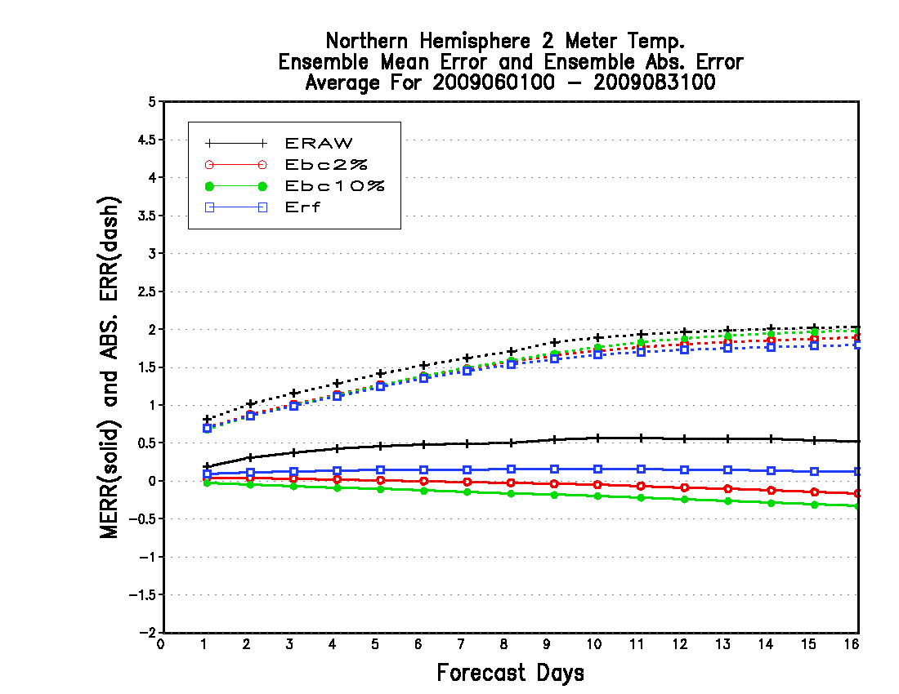
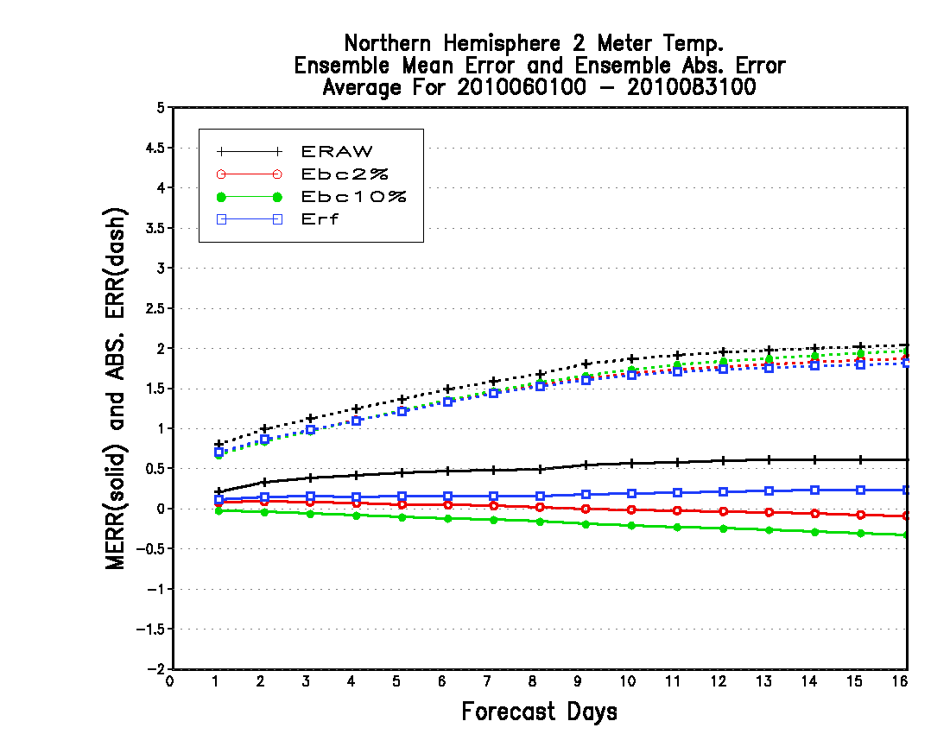
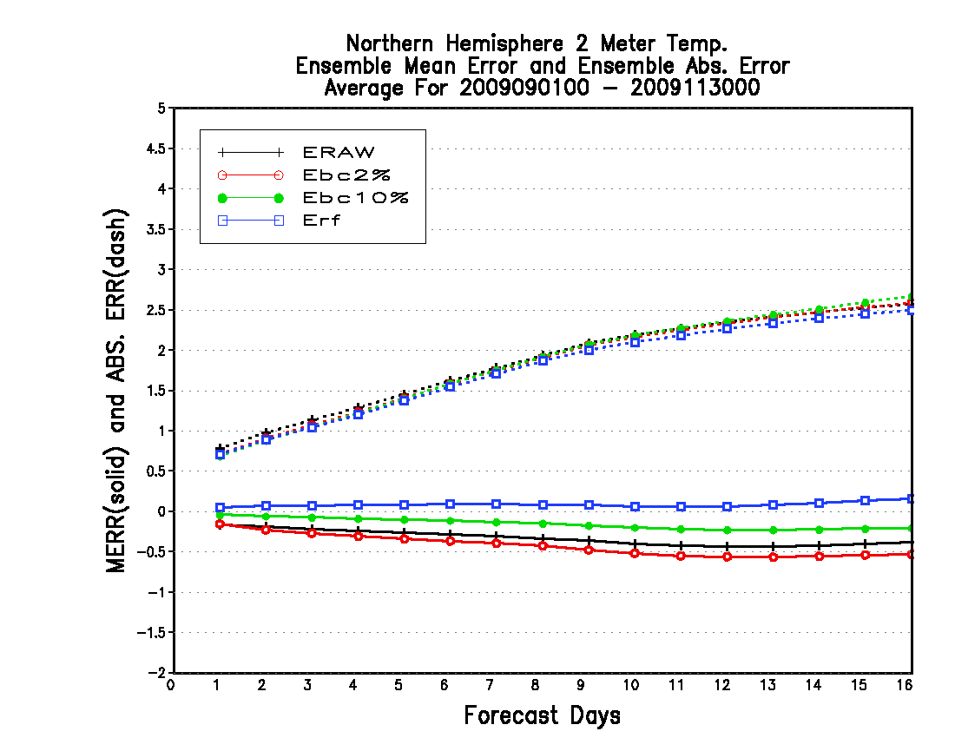
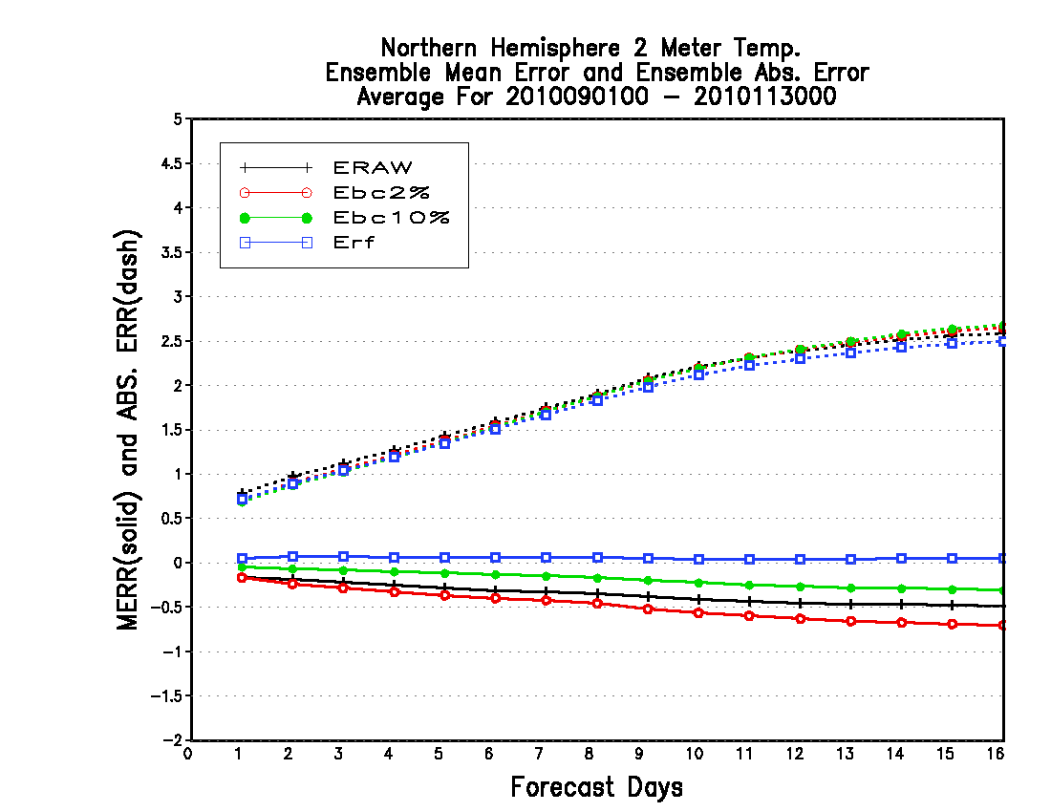
Comparison between 2009 and 2010
Summer 2009
Summer 2010
2009
The bias is very similar
2010
Fall 2009
Fall 2010

Slide 15
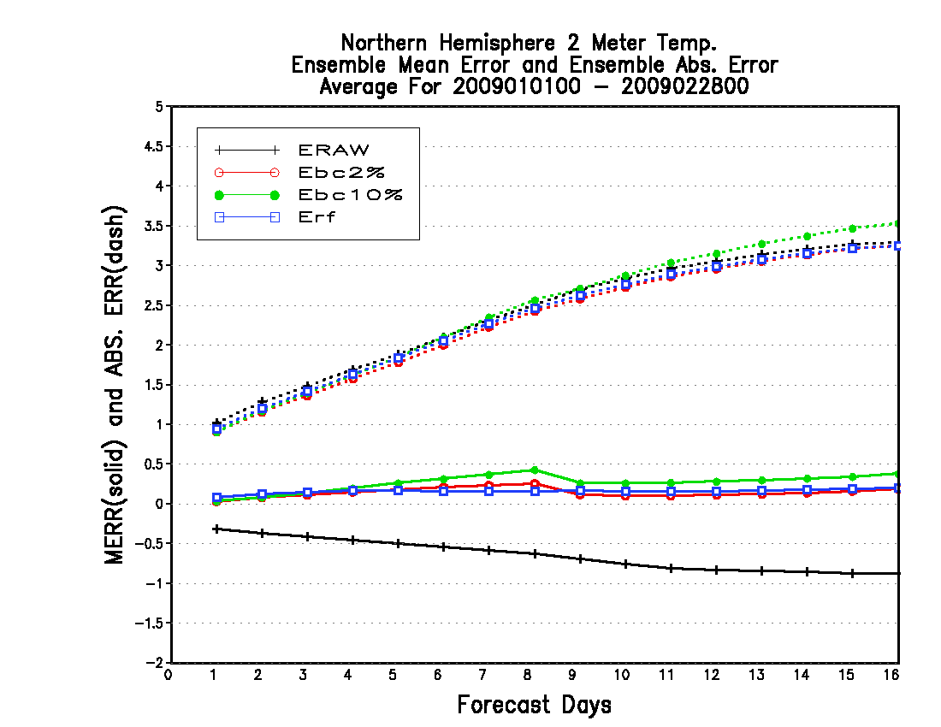
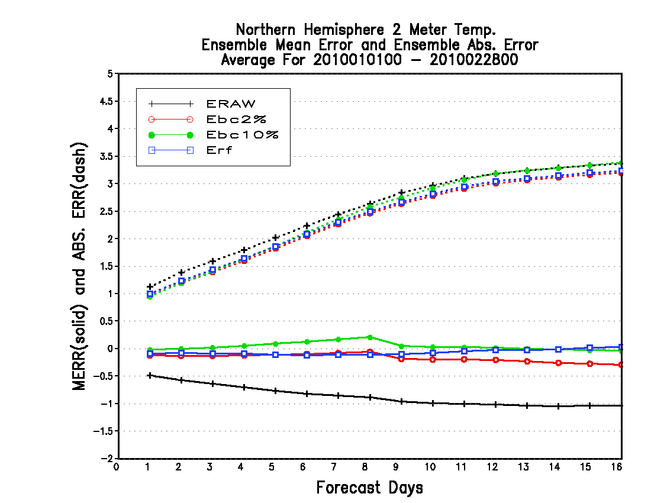
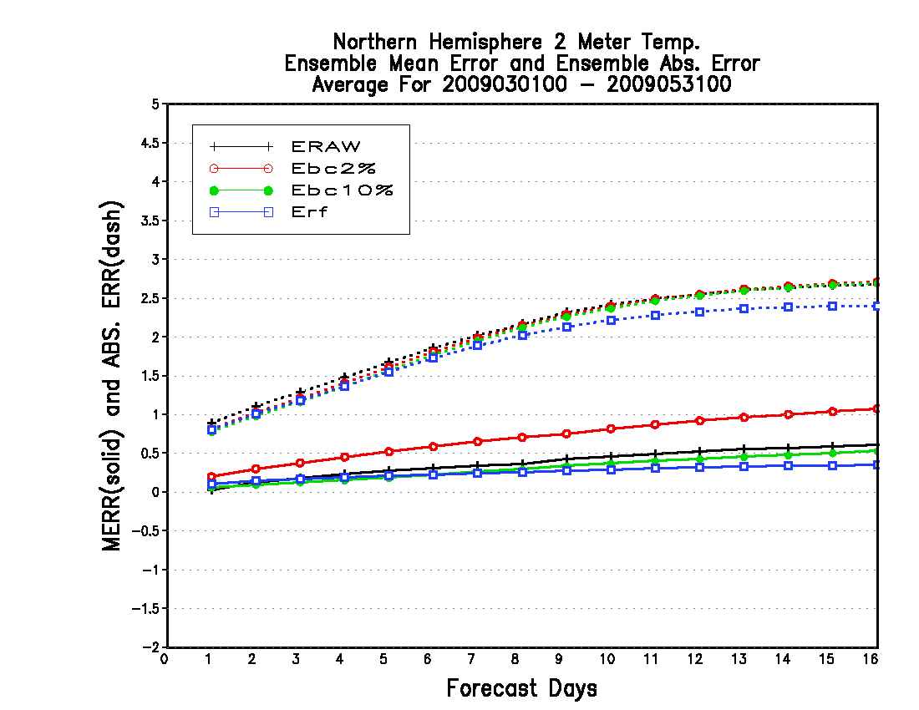
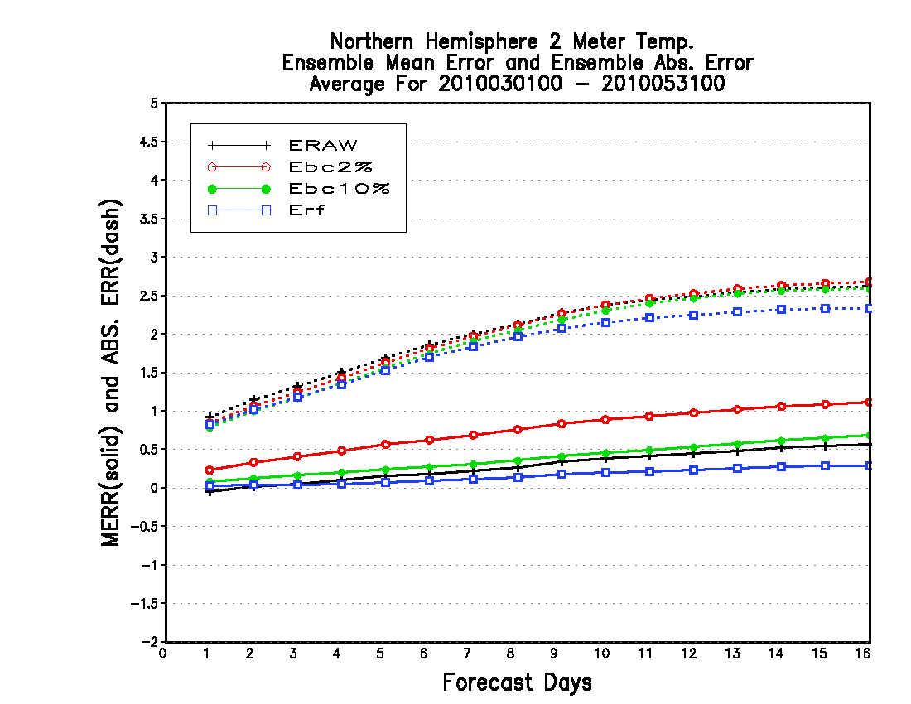
Comparison between 2009 and 2010
Winter 2009
Winter 2010
2009
The bias is very similar
2010
Spring 2009
Spring 2010

Slide 16
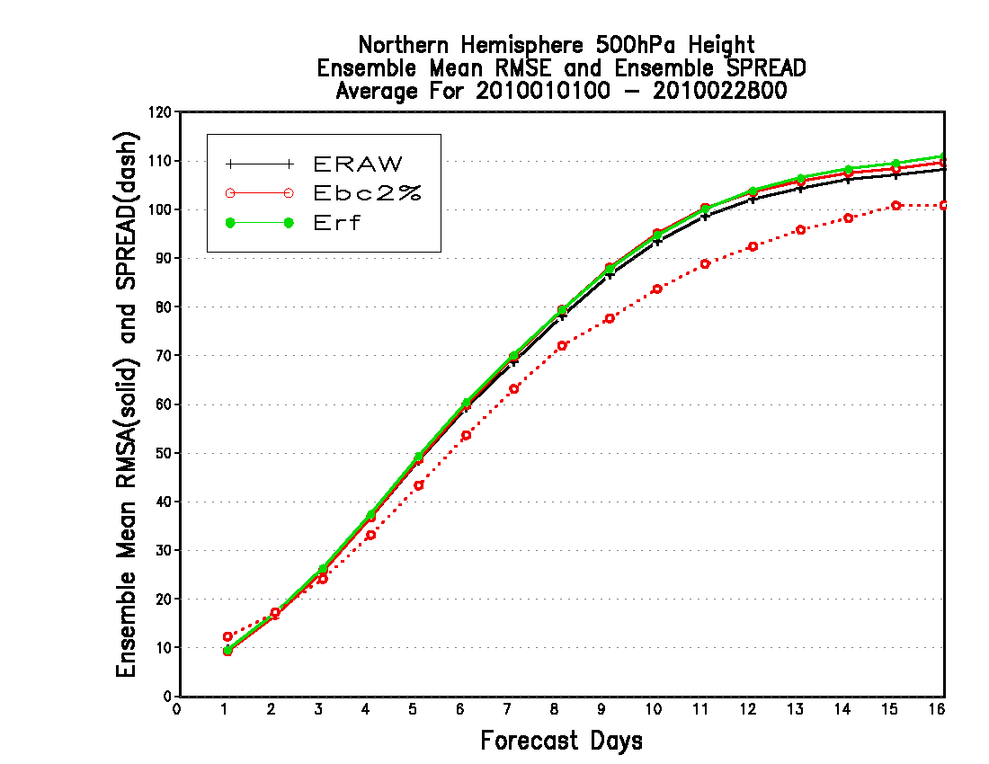
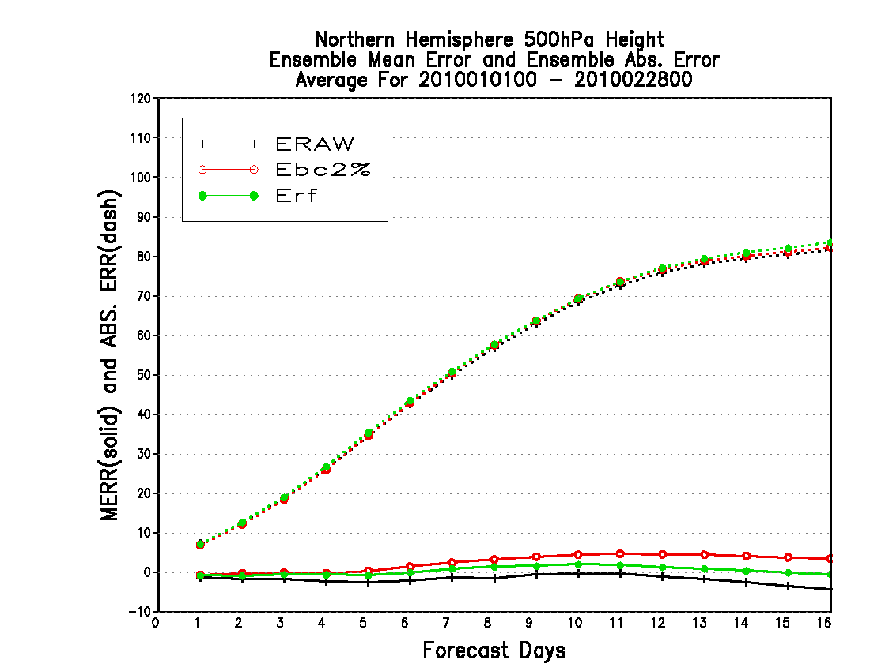
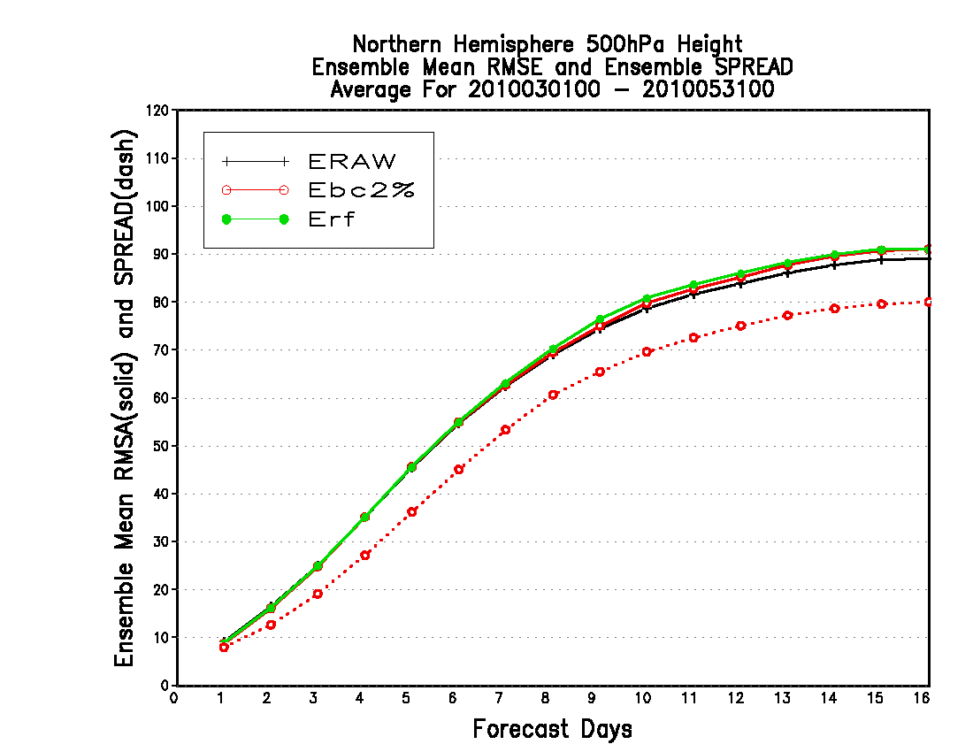
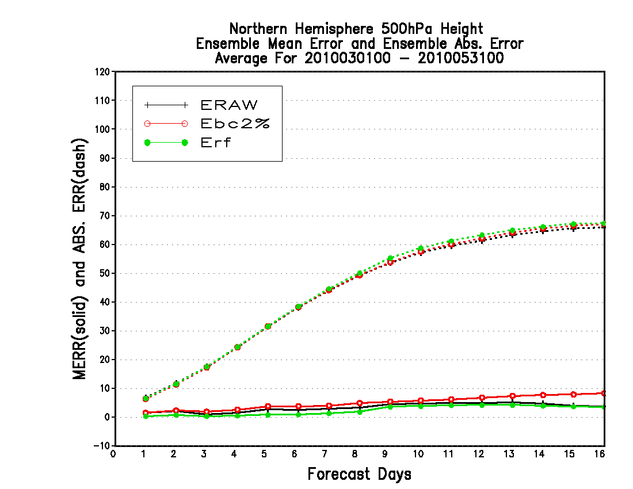
Using 25-year reforecast bias (25 data) to calibrate latest year (2010)
500hPa height
Winter 2010
Very difficult to improve the skills
Spring 2010

