Slide 1
The Application of Reforecasts at WPC
Thomas Workoff¹, Wallace Hogsett, Faye Barthold² and David Novak
Weather Prediction Center
¹Systems Research Group, Inc.
²I.M. Systems Group

Slide 2
Potential use of Reforecast Data at WPC
Extreme precipitation forecasting
Calibrated probabilities
Extreme Forecast Index
Day 3-10 Products and Hazard Outlooks
Flood, winter precip, and temperature hazards
Improved Precipitation Guidance
Shown to improve QPF scores (Hamill et al., 2006)
Prototype day 4 – 7 winter weather outlook
“Trained” QPF guidance and QPF probabilities

Slide 3
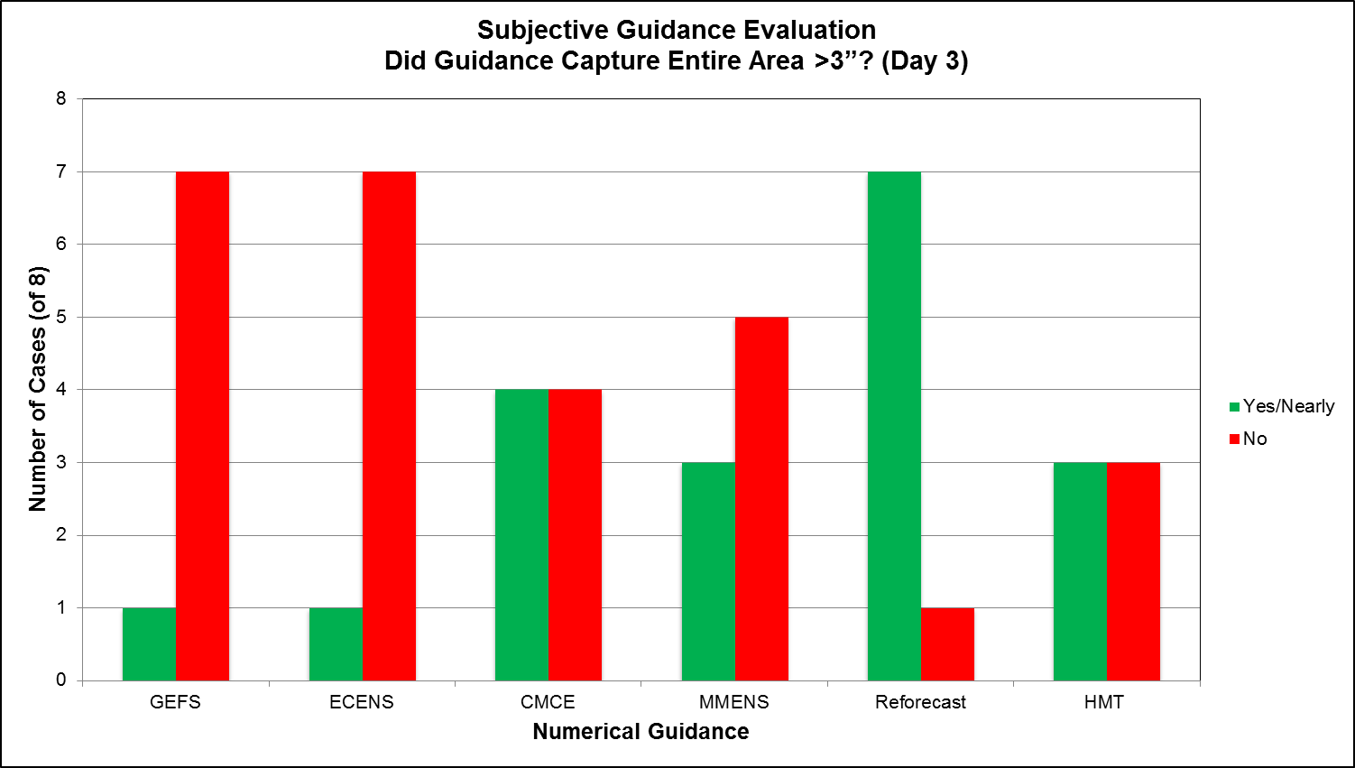
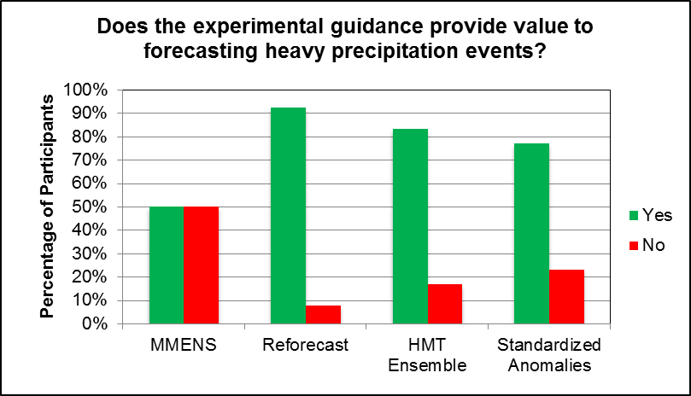
Extreme Precipitation Forecasting
Atmospheric River Retrospective Forecasting Experiment (ARRFEX)
ESRL provided 2nd generation reforecast data
Reforecast data consistently performed better than raw ensembles, likely due in part to well-calibrated probabilities.
Of all the guidance, participants felt it added the most value to AR extreme precipitation forecasts
Reforecast Prob >3” (shaded)

Slide 4
ECMWF EFI: Extreme Precipitation
Obtaining a sufficiently long model climatology allows comparisons between current and previous forecasts to identify rare or extreme model forecasts
EFI of 1 near Boulder shows that
current precip forecast is at the top
of model climatology CDF
Courtesy of ECMWF, via Tim Hewson and Ivan Tsonevsky

Slide 5
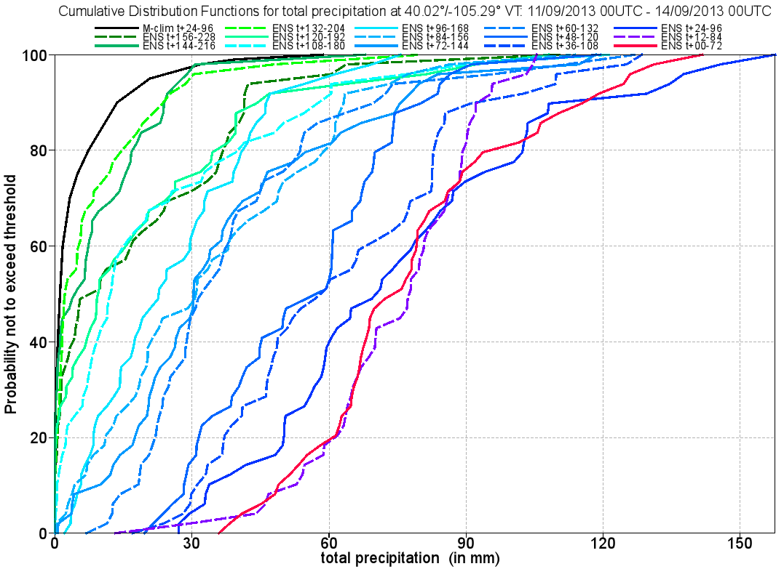
ECMWF EFI: Extreme Precipitation
CDFs of the current ensemble
forecast show the differences
between the current forecast and climatological CDF (black)
Forecasts trended toward a bigger event as the event neared
(CDFs shift toward the right with time)
Courtesy of ECMWF, via Tim Hewson and Ivan Tsonevsky

Slide 6
GEFS EFI: Extreme Precipitation
WPC-ESRL collaboration to develop GEFS-based EFI using reforecast dataset
Temp, precip, and wind hazards on one graphic
GEFS EFI values of >.9 signal
potential for extreme precip
event, relative to the model
climatology
Courtesy of ESRL, via Tom Hamill and Gary Bates

Slide 7
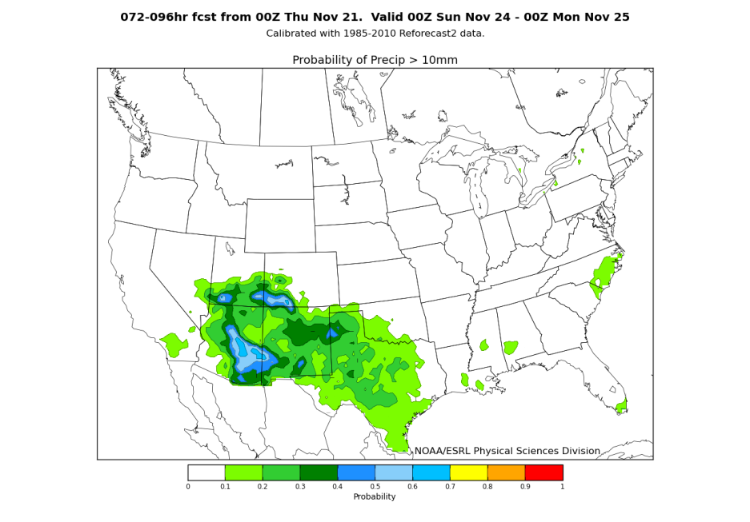
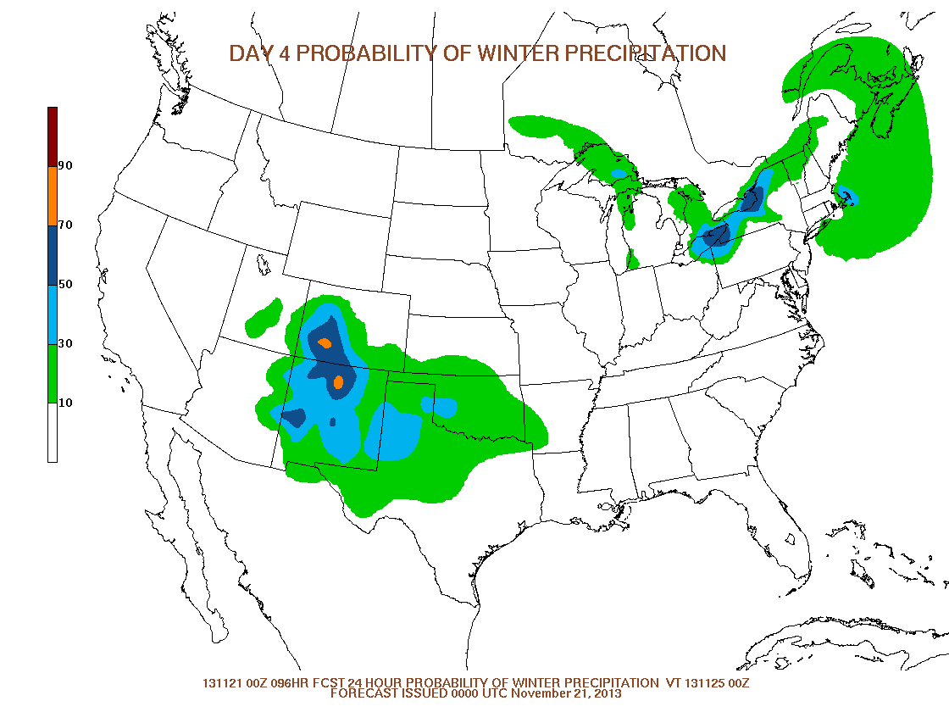
Winter Weather Outlook (Days 4-7)
WPC prototyping Day 4-7 outlooks in 2014
Use reforecast probabilities as inputs to hazard outlooks
Better calibrated probabilities than raw ensemble
Reforecast Probability of 10mm QPF
Winter Weather Outlook

