Slide 1
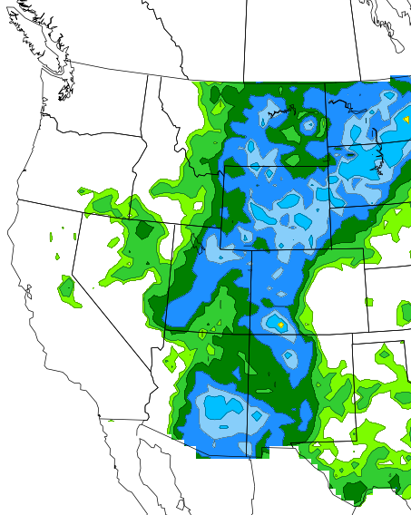
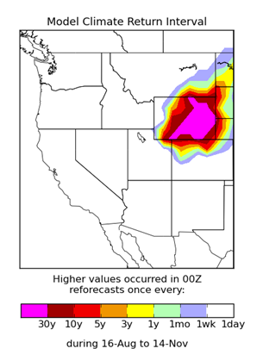
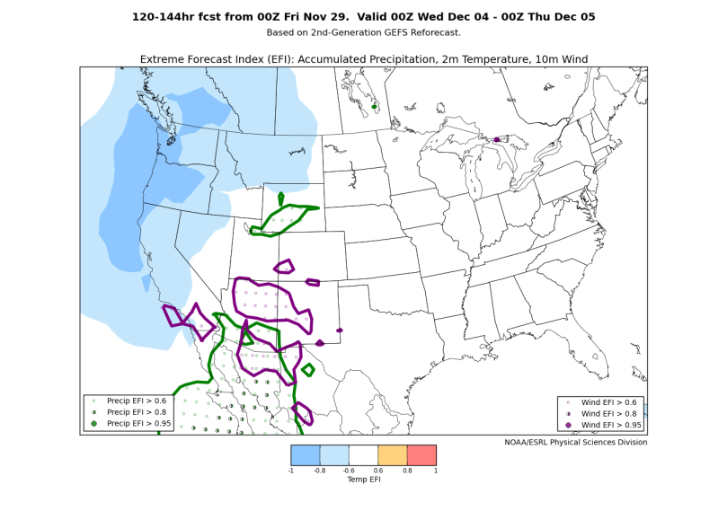
Reforecast Applications at the Regional/WFO Level
Trevor Alcott NWS Western Region

Slide 2
Reforecast Applications
Ugly truth: primary use of global ensemble guidance in operations is to decide which higher-resolution deterministic model(s) to use.
Reforecasting/post-processing offers crucial benefits:
improved model forecast accuracy and reliability, particularly for QPF
Challenge: resolution in complex terrain
Challenge: climatology in desert regions
Challenge: model biases/underdispersion
ability to place model forecast in context at a given lead time (i.e., “M-Climate” diagnostics)
calibrated severe/fire guidance (SREF)

Slide 3
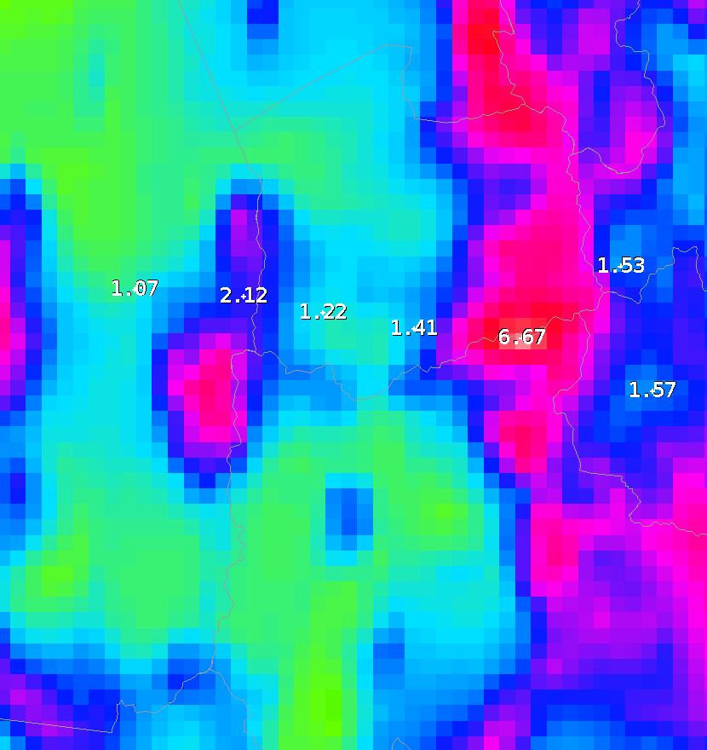
Challenge: Resolution
entire mountain ranges fit between global ensemble grid points
typically addressed with climatological downscaling approaches, but those assume every event looks like PRISM climatology
PQPF downscaling difficult without individual member data
November mean precipitation in inches (approximate size of a 1.0-deg grid cell)
KSLC

Slide 4
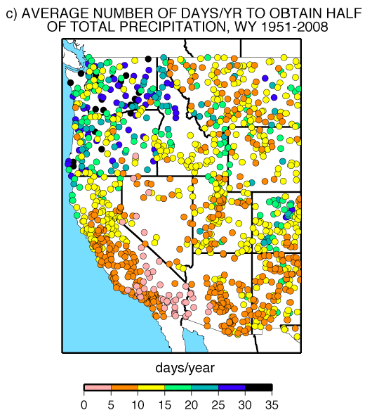
Challenge: Precipitation Variability
Much of the West sees 50% of their annual precipitation on less than 15 days.
Desert SW: 50% on less than 5 days
Short training dataset for model calibration could miss every significant precipitation event over a wide area.
Dettinger et al., 2011

Slide 5
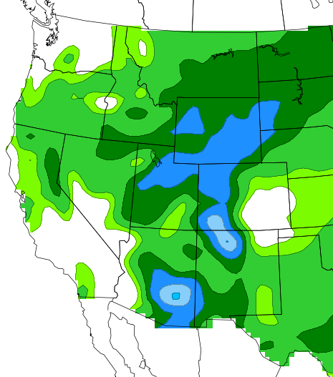
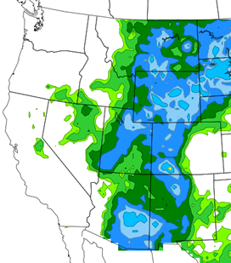
Reforecast Analog QPF Approach
Accomplishes downscaling and bias correction using a long training dataset.
Q: “Should I believe the model?”
A: “Here’s what actually happened when the model forecast looked like this.”
Not in AWIPS yet, but experimental analog QPF/PQPF already being used at western WFOs

Slide 6
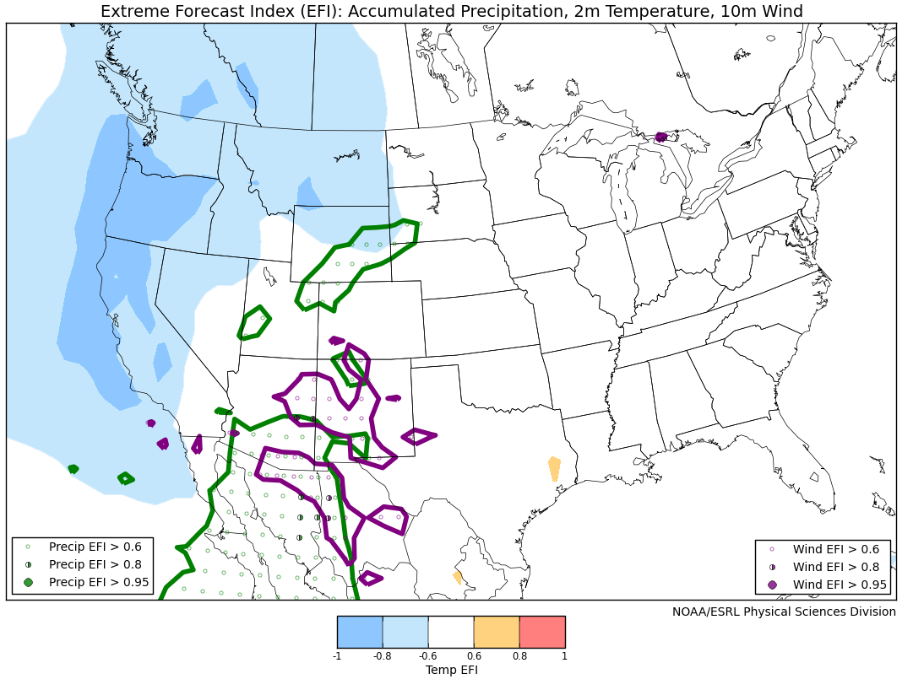
M-Climate Diagnostics
Is the model predicting something unusual?
Mean and PDF approaches (QPF M-Climate for October 2013 SD/WY blizzard and EFI for this week’s cold outbreak):

Slide 7
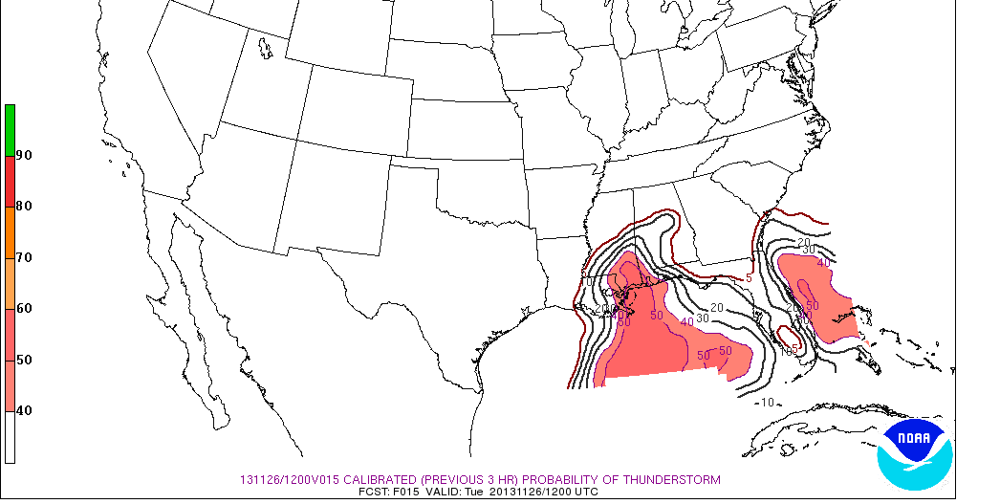
Calibrated Short-Term Guidance
SPC has made great progress with SREF calibrated thunder/severe guidance
Handicapped by short-training dataset, statistics took an entire season to improve
Future efforts could include other multi-element threats (e.g., fire weather)

