Slide 1
NOAA ESRL GSD Assimilation and Modeling Branch
NCEP Production Suite Review 3 -5 December 2013
Hourly updated models:
Rapid Refresh / HRRR review
Rapid Refresh “version 2”
Scheduled implementation 28 Jan 2014
Upgrades: EnKF-3DVAR hybrid DA, MYNN
PBL, 9-layer LSM, better cloud/precip anx
RAPv2 significant improvement over RAPv1
Better winds, mid-level moisture, near-
surface fields, convective environments
High-Resolution Rapid Refresh
Scheduled implementation Q3 2014
3-km, radar assimilation, hourly to 15h
Two real-time experimental versions,
(Jet, Zeus) each with > 90% run reliability
1-h pre-forecast 15-min cycled radar DA
at 3-km, followed by 3-km GSI 3DVAR
Improved storm forecasts from RAPv2
environment fields and 3-km radar DA
Steve Weygandt Curtis Alexander
Stan Benjamin Ming Hu
Tanya Smirnova Haidao Lin
Patrick Hofmann Eric James
John Brown David Dowell
Georg Grell Joe Olson
Bill Moninger Xue Wei
Tracy Smith Brian Jamison
Steven Peckham Kevin Brundage
NOAA NCEP
Geoff Manikin Geoff DiMego
Becky Cosgrove NCO staff

Slide 2
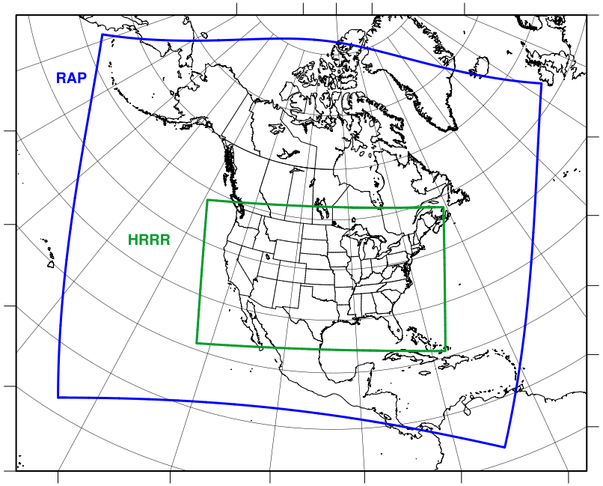
Rapid Refresh and HRRR
NOAA hourly updated models
13km Rapid Refresh (RAP) (mesoscale)
Version 2 – scheduled
NCEP implementation
Q2 (currently 28 Jan)
RAP
3km HRRR (storm-scale)
High-Resolution
Rapid Refresh
Scheduled NCEP
Implementation Q3 2014
HRRR
NCEP Production Suite Review
Rapid Refresh / HRRR
3-4 December 2013

Slide 3
RAPv2 Prediction System Overview
Hourly updated mesoscale analyses / forecasts
WRF-ARW model (Grell-3 cumulus param, Thompson microphysics, RUC-Smirnova land-surface, MYNN PBL scheme)
GSI hybrid analysis using 80-member global ensemble
13-km, 50 levels, 24 cycles/day – each run out to 18 hours
6-hour catch-up “partial” cycle run twice per day from GFS
Output grids: 13, 20, and 40 km CONUS, 32 km full domain, 11 km Alaska, 16 km Puerto Rico
Use and downstream dependencies
Used by SPC, AWC, WPC, NWS FOs, FAA, energy industry, and others for short-range forecasts and hourly analyses
Downscaled RAP serves as first guess for RTMA
RAP serves as initial condition for SREF members
RAP will be used to initialize Hi-Res Rapid Refresh (HRRR), scheduled for implementation Q3 2014 and HRW runs

Slide 4
Rapid Refresh Hourly Update Cycle
Observations Used
Hourly Observations | RAP 2013 N. Amer
Rawinsonde (T,V,RH) | 120
Profiler – NOAA Network (V) | 21
Profiler – 915 MHz (V, Tv) | 25
Radar – VAD (V) | 125
Radar reflectivity - CONUS | 1km
Lightning (proxy reflectivity) | NLDN, GLD360
Aircraft (V,T) | 2-15K
Aircraft - WVSS (RH) | 0-800
Surface/METAR (T,Td,V,ps,cloud, vis, wx) | 2200- 2500
Buoys/ships (V, ps) | 200-400
GOES AMVs (V) | 2000- 4000
AMSU/HIRS/MHS radiances | Used
GOES cloud-top press/temp | 13km
GPS – Precipitable water | 260
WindSat scatterometer | 2-10K
Partial cycle atmospheric fields – introduce GFS information 2x/day
Cycle hydrometeors
Fully cycle all land-sfc fields
(soil temp, moisture, snow)
1-hr
fcst
1-hr
fcst
1-hr
fcst
Back-
ground
Fields
Analysis
Fields
3DVAR
3DVAR
Obs
Obs
Time
(UTC)
11 12 13

Slide 5
RAPv2 Hybrid Data Assimilation
13 km
RAP
Cycle
13z
14z
15z
ESRL/GSD RAP 2013
Uses GFS 80-member ensemble
Available four times per day
valid at 03z, 09z, 15z, 21z
80-member GFS EnKF Ensemble forecast valid at 15Z (9-hr fcst from 6Z)
Obs
Obs
Obs
GSI
Hybrid
GSI
Hybrid
GSI
Hybrid
HM
Obs
1 hr fcst
HM
Obs
1 hr fcst
HM
Obs
GSI HM Anx
GSI HM Anx
GSI HM Anx
Refl
Obs
Refl
Obs
Refl
Obs
Digital
Filter
Digital
Filter
Digital
Filter
18 hr fcst
18 hr fcst
18 hr fcst

Slide 6
RAP version 2 upgrades
Data Assimilation | Model
GFS EnKF-3DVAR hybrid data assimilation PBL-based pseudo-innovations Surface-obs-based soil moisture/temp adjustment Low cloud building / other cloud enhancements Temp-dependent radar hydrometeor building Lightning data assimilation GSI trunk update | Physics changes MYJ → MYNN PBL scheme 9-layer RUC LSM (from 6-layer) MODIS land-use (fractional) Modified roughness length Revised Thompson cloud m-phys. Higher-order numerics introduced Positive definite scalar advection 5th-order vertical advection Update to WRFv3.4.1

Slide 7
RAPv2 enhancements from RAPv1
Data Assimilation | Assimilation Type | PBL Pseudo Innovations | Soil Adjustment | Low-Cloud Building | Snow Cover Building | Lightning Obs (radar refl proxy) | Tower/Nacelle/Sodar Obs
RAPv1 | GSI 3D-VAR | No | No | No | No | No | No
RAPv2 | GSI EnKF-3DVAR Hybrid | Yes | Yes | Yes | Yes + rev trimming | Yes | Yes
Model | Version | Horiz/Vert Advection | Scalar Advection | Upper-Level Damping | SW Radiation Update | Land Use | LSM | PBL | Microphysics | Radiation LW/SW
RAPv1 | WRF-ARW V3.2+ | 5th/3rd | Monotonic | w-Rayleigh 0.02 | 30 min | USGS | RUC 6-lev | MYJ | Thompson V3.1 | RRTM/ Goddard
RAPv2 | WRF-ARW v3.4.1+ | 5th/5th | Positive-Definite | w-Rayleigh 0.2 | 10 min | MODIS Fractional | RUC 9-lev | MYNN | Thompson v3.4.1 | RRTM/ Goddard
Cloud and Precipitating Hydrometeor Analysis Improvements in RAPv2
Surface temperature-dependent radar-hydrometeor building
Consistent rain (droplet) number concentration and mixing ratio retrievals from radar refl obs
Rain and snow mixing ratio retrievals reversible with Thompson reflectivity diagnostic
Conservation of virtual potential temperature during cloud building/clearing
Water vapor reduced to subsaturation when cloud clearing
Elevation correction to match model and observed precipitable water
Limitation of precipitable water innovation to 10% of background

Slide 8
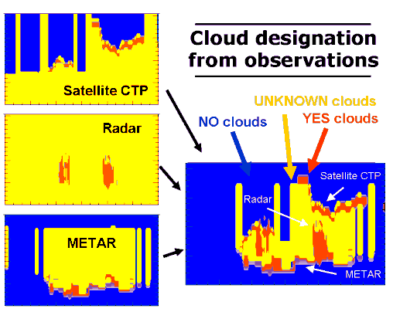
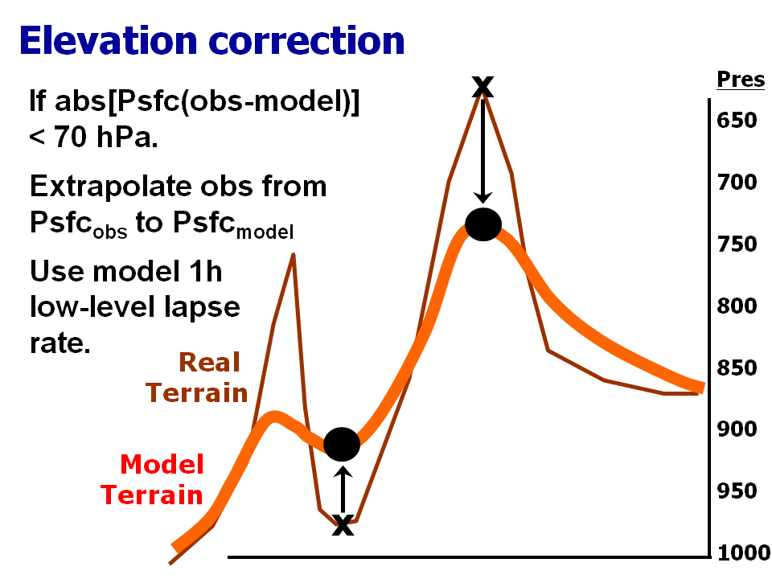
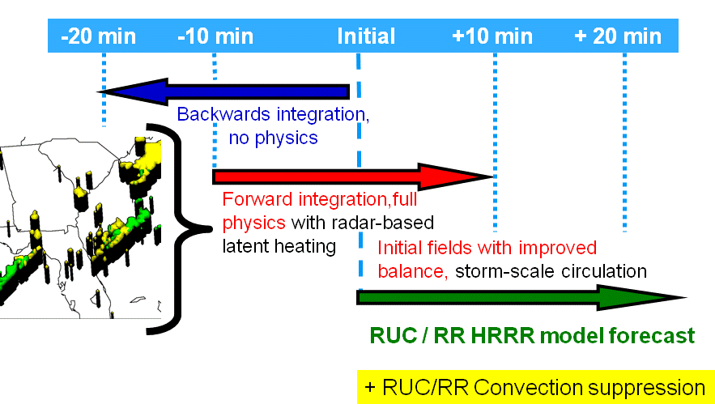
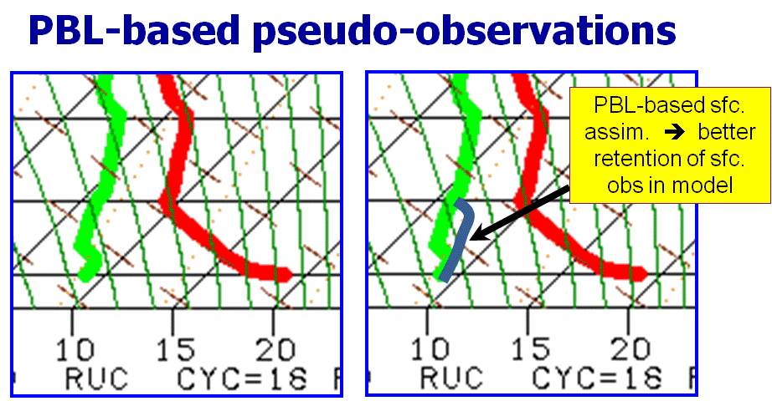
Rapid Refresh Specific Analysis Features
Cloud and hydrometeor analysis
Special treatments for surface observations
Digital filter-based
reflectivity assimilation (DDFI)

Slide 9
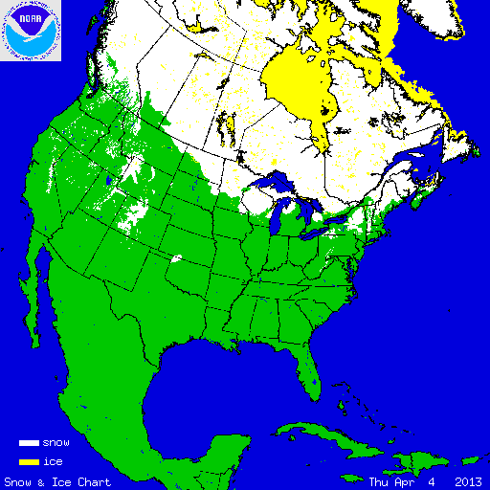
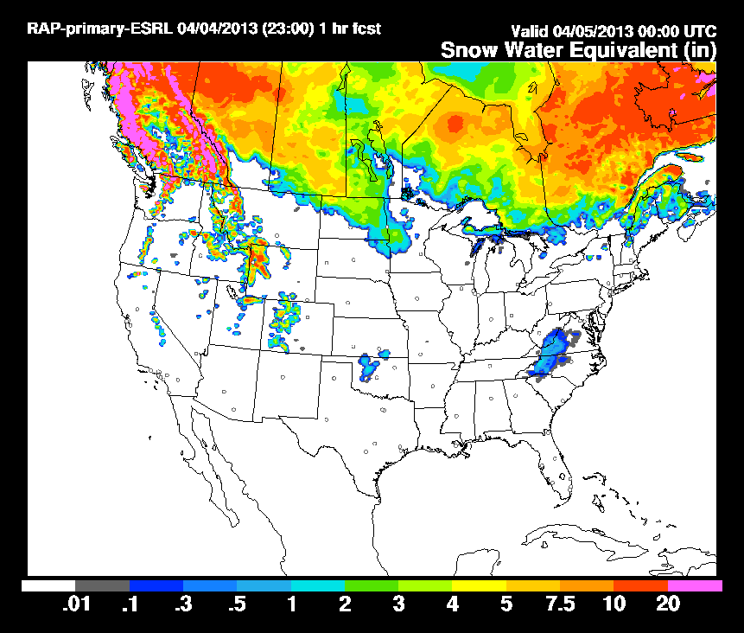
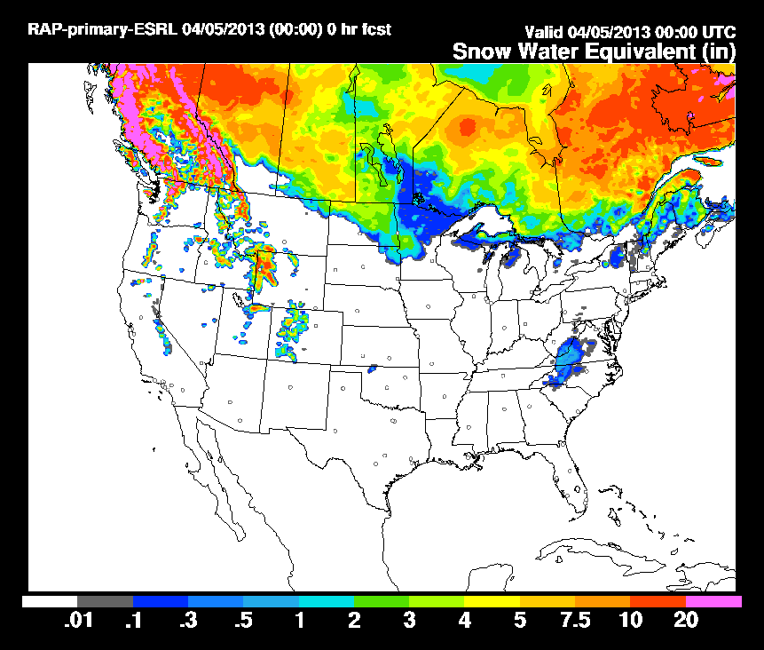
RAPv2 Snow Updating
Surface Snow Water Equivalent
Valid 00z 05 April 2013
Using Interactive Multisensor
Snow/Ice Mapping System (IMS)
GSI Snow
Cover Analysis
(Run 00z Daily)
Build
Trim
Before NOAA IMS
snowcover update
After NOAA IMS
snowcover update
Improved snowcover

Slide 10
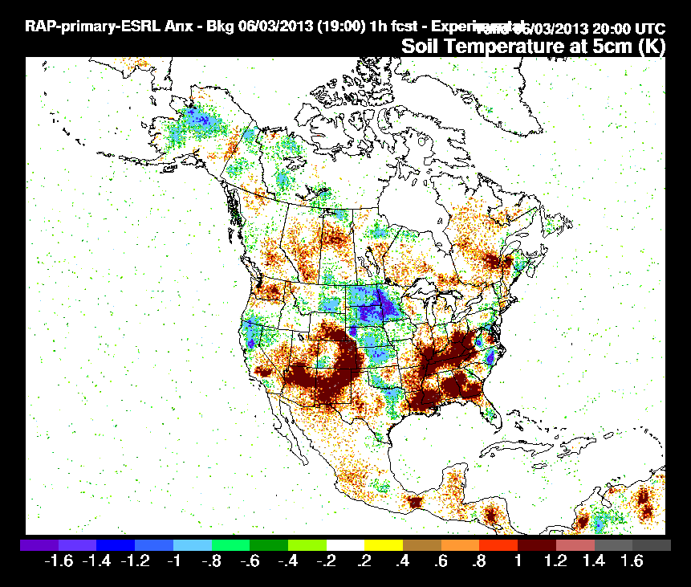
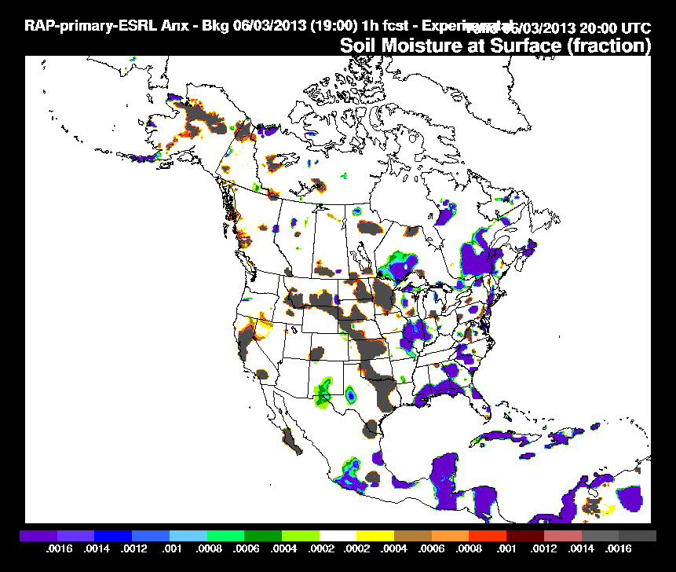
RAPv2 Soil Adjustment
Valid
20 UTC
03 June 2013
Soil Temperature
Soil Moisture
Cooling
Moistening
Drying
Warming
Based upon surface temperature and dewpoint analysis increments – new option within GSI. Critical also for HRRR
Improved soil, near-surface temperature, moisture

Slide 11
RAPv2 development and evaluation
Real-time development and evaluation
Development and testing - 2012 through Winter 2013
Code freeze - April 2013
Real-time parallel evaluation vs. OPER RAPv1
Retrospective evaluation
30 day wintertime period (25 Jan – 25 Feb 2013)
30 day summertime period (15 May – 15 June 2013)
Comparison against real-time OPER RAPv1
Compare: upper-air, surface, precipitation, ceiling/vis
NCEP Production Suite Review
Rapid Refresh / HRRR
3-4 December 2013

Slide 12
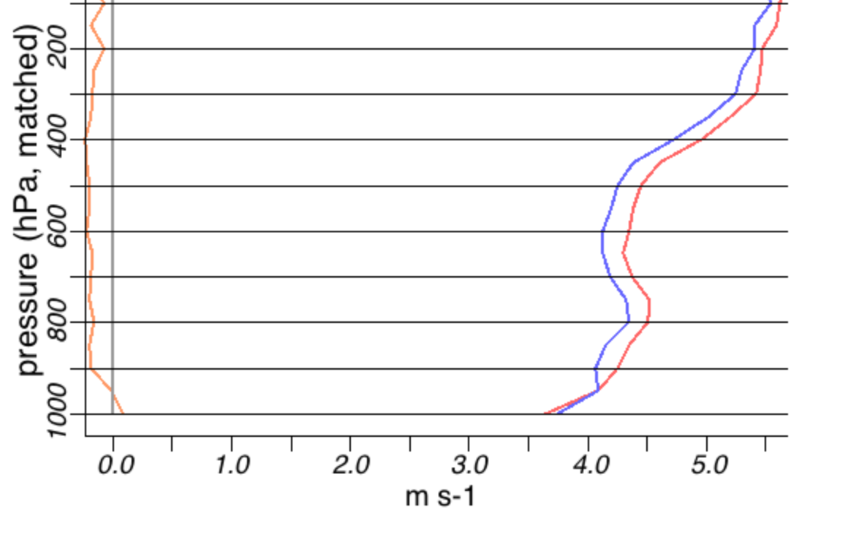
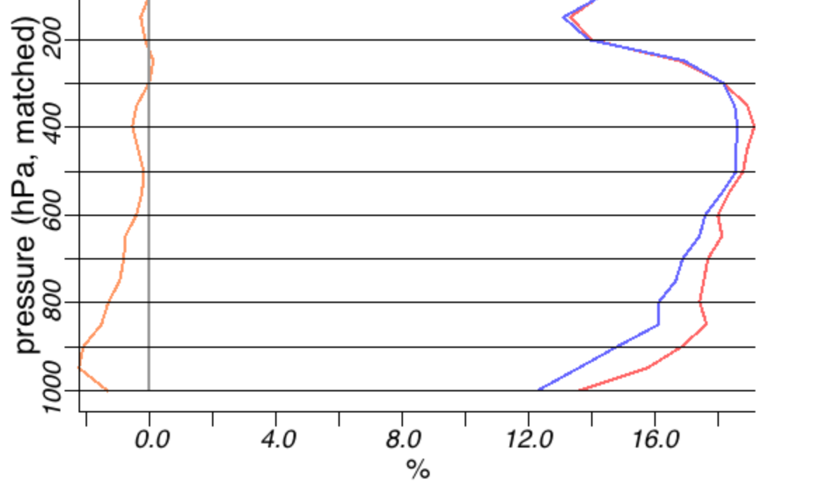
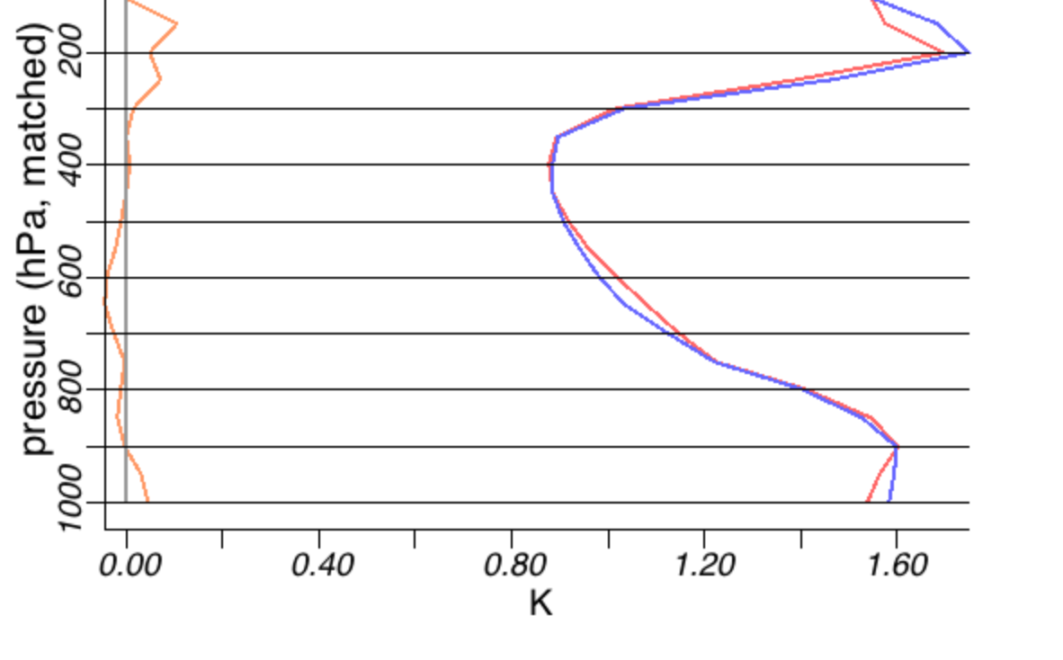
Upper-air: RAPv2 vs. oper RAPv1
Wind
Rel Hum
Bet-ter
Worse
Better
Worse
RAPv2
RAPv1
upper-air verification
+ 6 h forecast
RMS Error
Temp
25 Jan – 25 Feb 2013
(Winter Retro)
Better
Worse

Slide 13
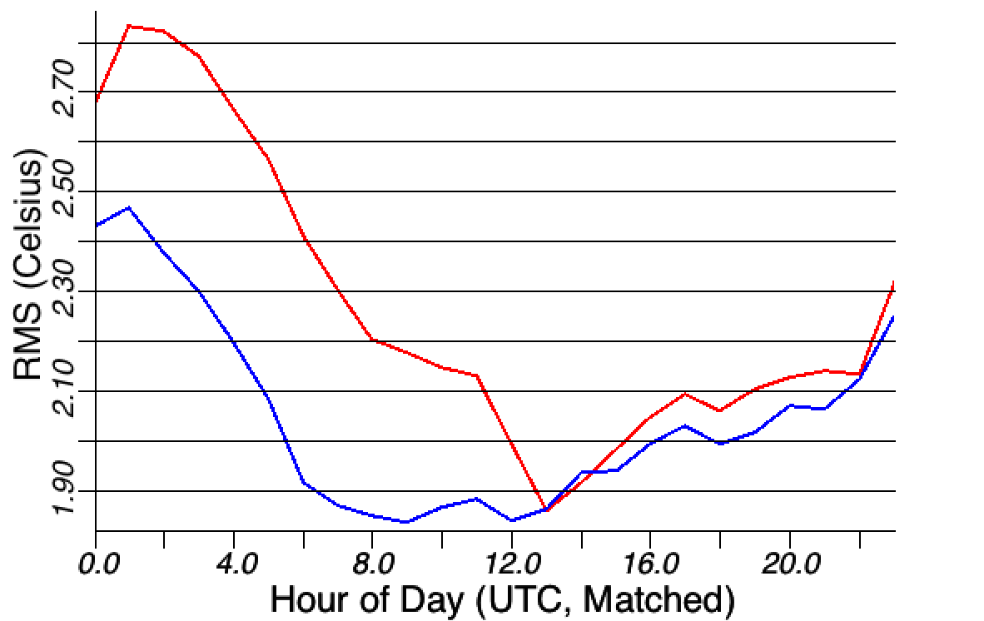
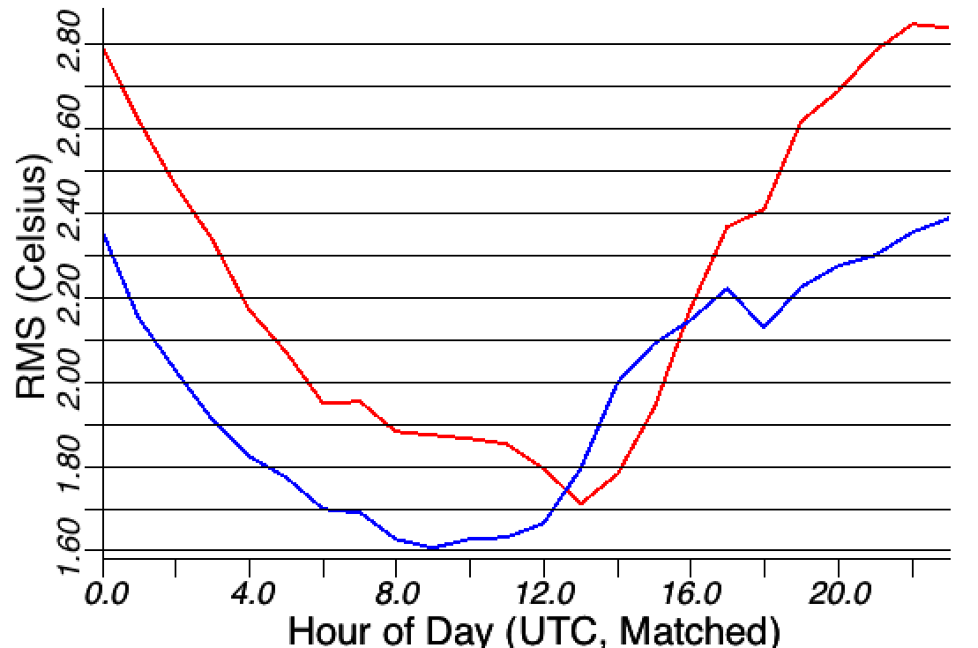
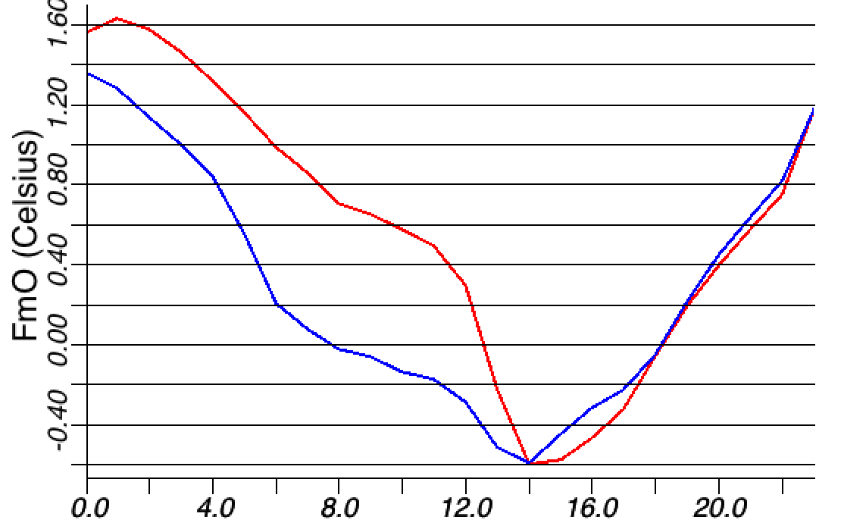
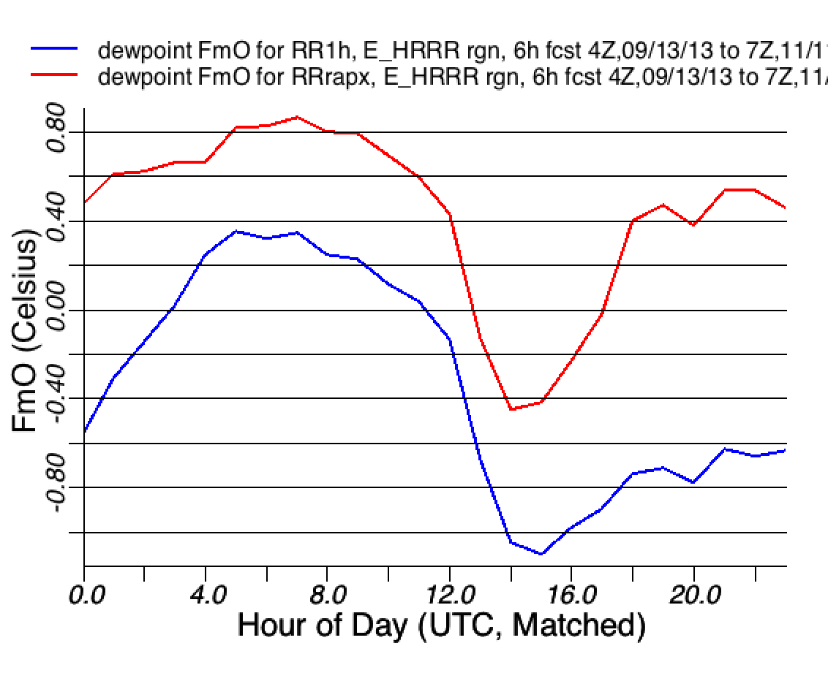
2m T and Td: RAPv2 vs. oper RAPv1
Temp
RMS
Dew point
RAPv2
+ 6 h
forecasts
13 Sept – 11 Nov 2013
(Real-time)
RAPv1
Temp
Bias
Dew point
Moist
Dry
Warm
Cool
Evening
Night
Morning
Afternoon
Evening
Night
Morning
Afternoon

Slide 14
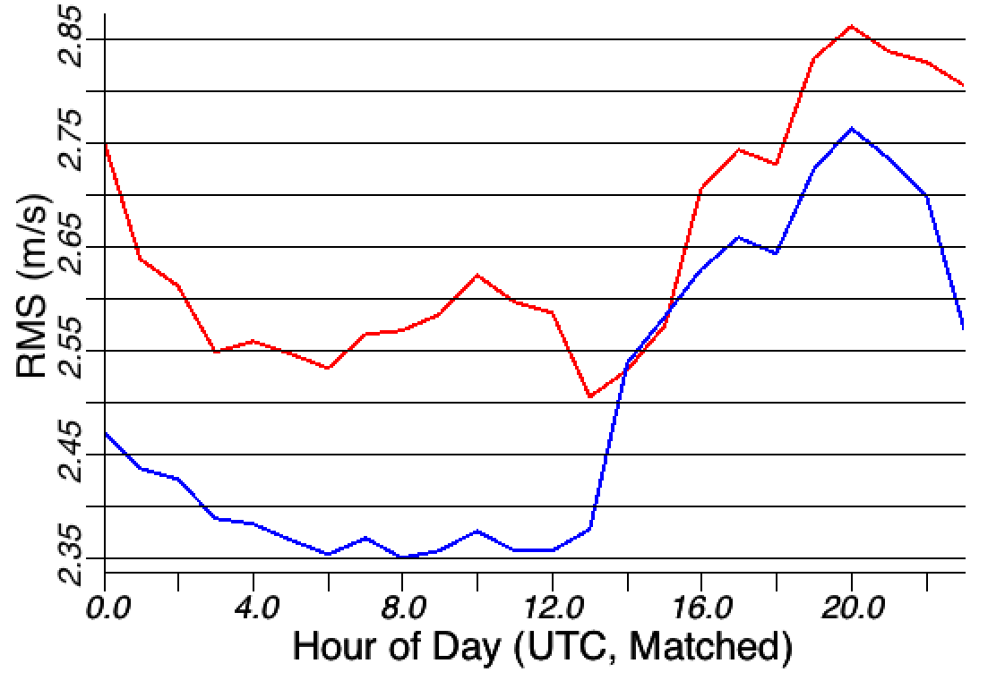
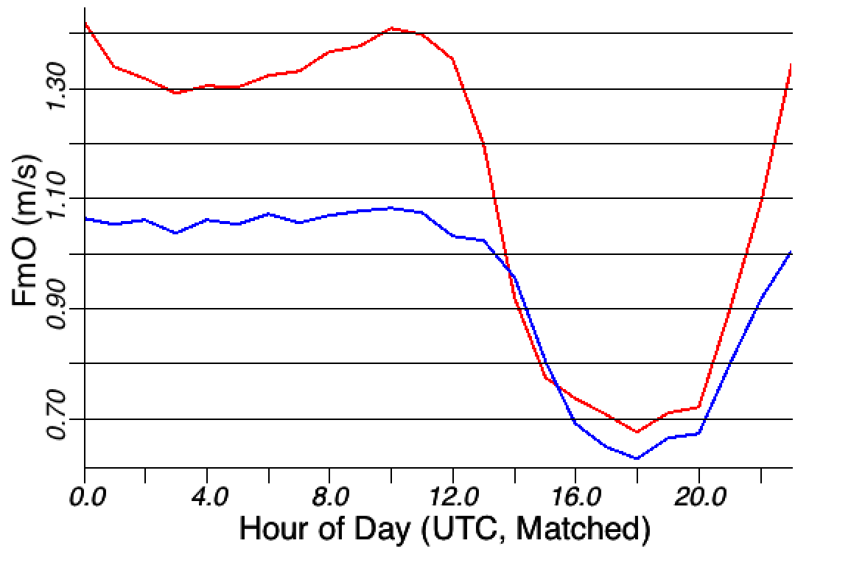
10m winds: RAPv2 vs. oper RAPv1
RMS
RAPv2 has lower RMS vector 10m wind errors than RAPv1 at all times of day.
RAPv2 has lower (better) positive 10m wind speed bias (F-O) than RAPv1 at all times of day
Bias
Evening
Night
Morning
Afternoon
6h 10m wind forecasts
Eastern/Central US
12 Sept – 11 Nov 2013
RAPv1 vs. RAPv2
Too strong
Evening
Night
Morning
Afternoon

Slide 15
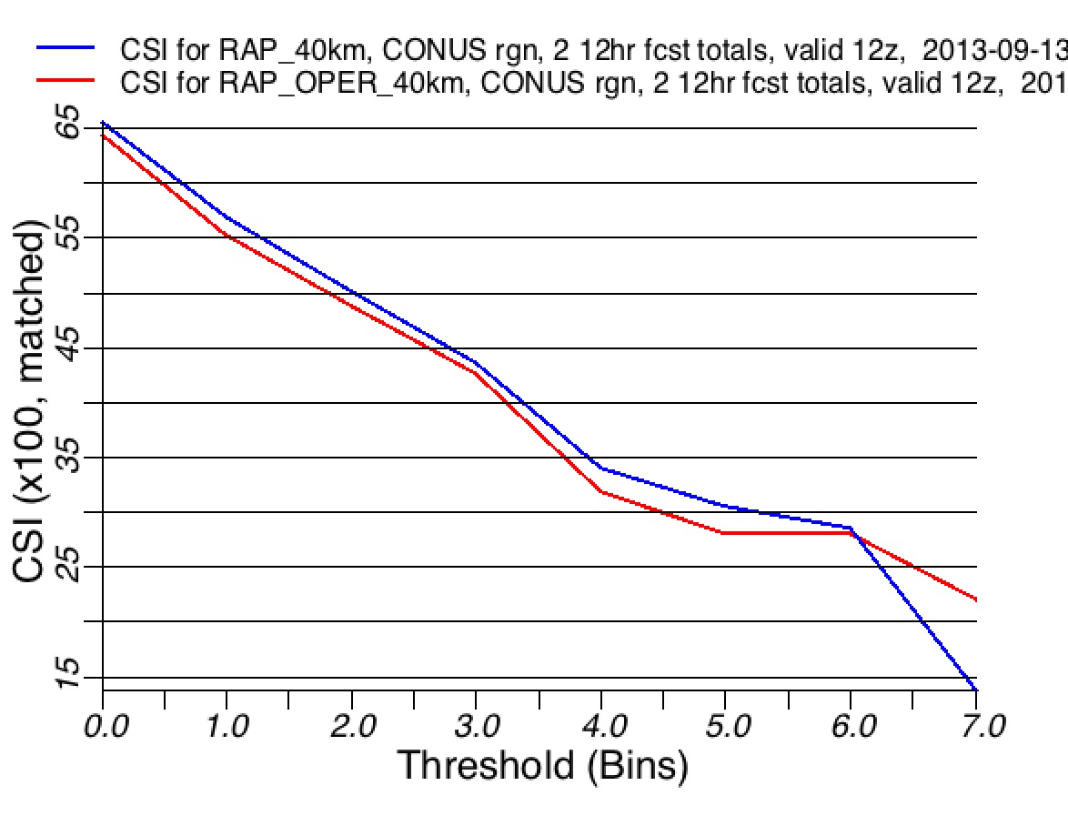
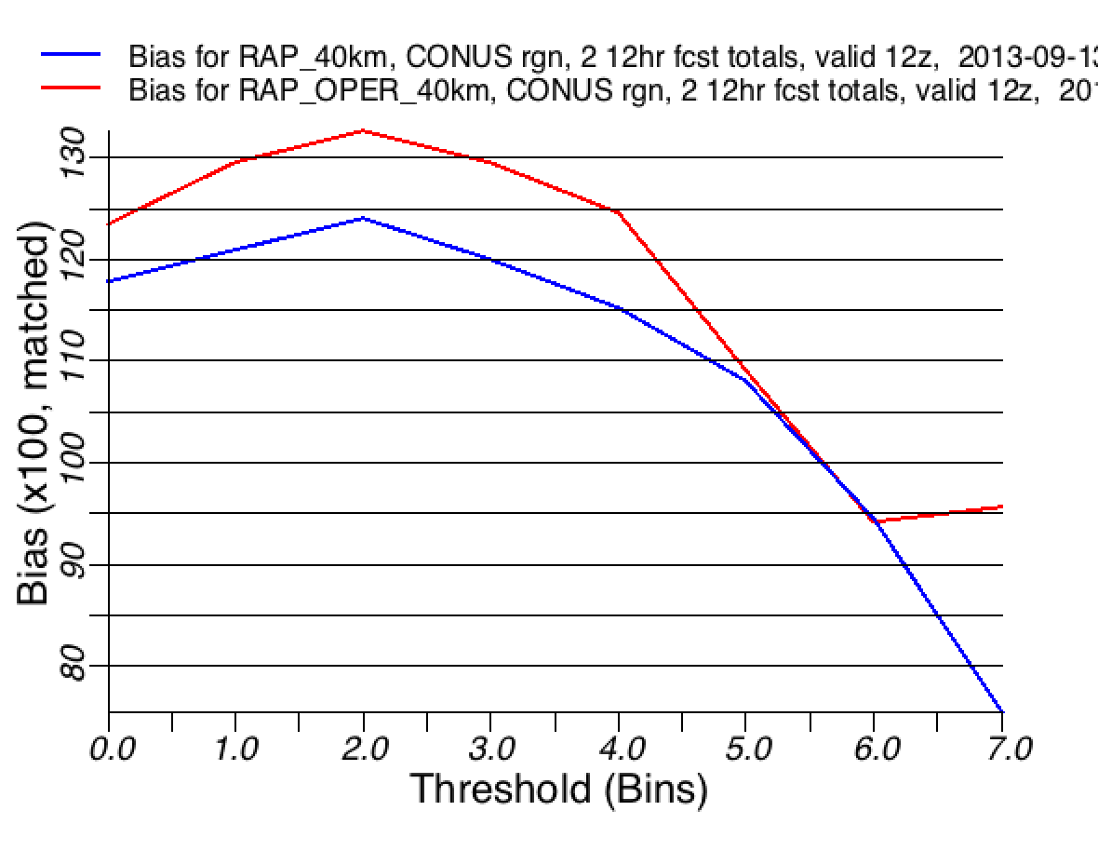
12 h precip: RAPv2 vs. oper RAPv1
Critical
Success
Index
RAPv2
vs.
RAPv1
24-h precip.
verification
| | | | | | |
0.01 0.10 0.25 0.5 1.0 (in) 1.5 2.0
2 x 12h fcst
13 Oct – 11 Nov
2013
Interpolated
to 40-km grid
High
Low
Bias
| | | | | | |
0.01 0.10 0.25 0.5 1.0 (in) 1.5 2.0

Slide 16
Precipitation
Forecasts
Stage 4
24-h
precip
2 x 12h fcst
ending 12z
27 Nov 2013
RAPv2
vs.
RAPv1
observed
RAPv1
RAPv2

Slide 17
Precipitation
Forecasts
Stage 4
24-h
precip
2 x 12h fcst
ending 12z
27 Nov 2013
RAPv2
vs.
RAPv1
Miss FA Hit
observed
RAPv1
RAPv2
Thrs CSI Bias
2.00 .27 1.63
Thrs CSI Bias
2.00 .38 1.13
2” threshold

Slide 18
Aviation Flight Rules
(ceiling and visibility)
RAPv2
vs.
RAPv1
18 UTC
26 Nov
2013
06 UTC
+ 12h fcst
observed
RAPv1
RAPv2

Slide 19
Summary: RAPv2 vs. RAPv1
Winds -- Consistent RAPv2 improvement, for both upper-air and surface, for all seasons
Moisture -- Improved RAPv2 RH forecasts aloft. Reduced RMS 2m dewpoint error, more so at night
Temperature -- Similar RAPv2 skill for upper-air. Improved skill for surface in warm season
Precipitation and clouds – Improvement for precipitation, slight improvement for ceiling
NCEP Production Suite Review
Rapid Refresh / HRRR
4-5 December 2013

Slide 20
Rapid Refresh and HRRR
NOAA hourly updated models
13km Rapid Refresh (RAP) (mesoscale)
Version 2 – scheduled
NCEP implementation
Q2 (currently 28 Jan)
RAP
3km HRRR (storm-scale)
High-Resolution
Rapid Refresh
Scheduled NCEP
Implementation Q3 2014
HRRR
NCEP Production Suite Review
Rapid Refresh / HRRR
3-4 December 2013

Slide 21
HRRR Users and Applications
Aviation
Aviation Weather Center (AWC): 2-D grids
Federal Aviation Administration (FAA) Command Center
National Center for Atmospheric Research (NCAR): 2-D, 3-D, 15-min grids
Operational evaluation in CoSPA
Storm Prediction Center (SPC): 2-D grids
Operational severe weather forecasting and evaluation
National Severe Storms Laboratory (NSSL): 2-D, 3-D and 15-min grids
Mesoscale analysis, Short-term precipitation forecasts
National Centers for Environmental Prediction (NCEP): 15-min grids
Real Time Mesoscale Analysis (RTMA)
Department of Energy/NOAA Wind Forecast Improvement Project (WFIP)
~12 energy private sector companies via WFIP (WindLogics, 3Tier,
AWS Truepower, Iberdrola, Weather Channel, etc.)
Real-time forecasts of turbine-level wind and solar irradiance
Colorado State University (CSU/CIRA): 2-D grids
Verification of solar irradiance forecasts at SURFRAD sites
National Weather Service (NWS): 2-D and 3-D grids
Operational weather forecasting
Weather Prediction Center (WPC): 2-D grids
Quantitative precipitation forecasting
United States Air Force (USAF): 2-D grids
Operational weather forecasting
Air Resources Laboratory (ARL): Tiled 3-D HRRR grids
Dispersion forecasts, Local wind forecasts in complex terrain
Severe Weather
Renewable Energy
Forecasting
NCEP Production Suite Review
Rapid Refresh / HRRR
3-4 December 2013

Slide 22
Verification of RAPv2 vs HRRR
Recent Fall Season (12 Sept 2013 – 18 Nov 2013) HRRR vs RAPv2
Lead Time | Clouds |  | Precip (13 km) |  | Reflectivity (40 km) |  | Upper-Air |  |  | Surface
 | Ceiling < 500 ft | Vis < 0.5 mile | > 0.1 inch | > 1.0 inch | 25 dBZ | 35 dBZ | Temp | RH | Wind | Temp | Dewpt | Wind
3-hr | HRRR | HRRR |  |  | HRRR | HRRR | HRRR | RAP | RAP | Equal | Equal | Equal
6-hr | HRRR | HRRR | HRRR | Equal | HRRR | HRRR | HRRR | HRRR | HRRR | HRRR | Equal | Equal
12-hr | HRRR | HRRR | HRRR | HRRR | HRRR | HRRR | HRRR | HRRR | HRRR | HRRR | HRRR | HRRR
Warm Season (01 May 2013 – 25 June 2013) HRRR vs RAPv2
Lead Time | Clouds |  | Precip (13 km) |  | Reflectivity (40 km) |  | Upper-Air |  |  | Surface
 | Ceiling < 500 ft | Vis < 0.5 mile | > 0.1 inch | > 1.0 inch | 25 dBZ | 35 dBZ | Temp | RH | Wind | Temp | Dewpt | Wind
3-hr | HRRR | HRRR |  |  | HRRR | HRRR | RAP | RAP | RAP | Equal | Equal | RAP
6-hr | HRRR | HRRR | Equal | HRRR | HRRR | HRRR | Equal | Equal | RAP | Equal | Equal | RAP
12-hr | Equal | Equal | HRRR | HRRR | HRRR | HRRR | HRRR | HRRR | RAP | HRRR | HRRR | RAP
NCEP Production Suite Review
Rapid Refresh / HRRR
3-4 December 2013

Slide 23
RAP and HRRR 2012 Configuration
Model | Run at: | Domain | Grid Points | Grid Spacing | Vertical Levels | Pressure Top | Boundary Conditions | Initialized
RAP | GSD, NCO | North America | 758 x 567 | 13 km | 50 | 10 mb | GFS | Hourly (cycled)
HRRR | GSD | CONUS | 1799 x 1059 | 3 km | 50 | 20 mb | RAP | Hourly - RAP (no-cycle)
Model | Version | Assimilation | Radar DA | Radiation LW/SW | Microphysics | Cumulus Param | PBL | LSM
RAP | WRF-ARW v3.3.1+ | GSI 3D-VAR | 13-km DFI | RRTM/ Goddard | Thompson v3.3.1 | G3 + Shallow | MYJ | RUC 6-lev
HRRR | WRF-ARW v3.3.1+ | None: RAP I.C. | None | RRTM/ Dudhia | Thompson v3.3.1 | None | MYJ | RUC 6-lev
Model | Horiz/Vert Advection | Scalar Advection | Upper-Level Damping | 6th Order Diffusion | SW Radiation Update | Land Use | MP Tend Limit | Time-Step
RAP | 5th/5th | Positive-Definite | w-Rayleigh 0.2 | Yes 0.12 | 10 min | MODIS Fractional | 0.01 K/s | 60 s
HRRR | 5th/5th | Positive-Definite | w-Rayleigh 0.2 | No | 5 min | MODIS Fractional | 0.07 K/s | 20-23 s
NCEP Production Suite Review
Rapid Refresh / HRRR
3-4 December 2013

Slide 24
RAP and HRRR 2013 Configuration
Model | Run at: | Domain | Grid Points | Grid Spacing | Vertical Levels | Pressure Top | Boundary Conditions | Initialized
RAP | GSD, NCO | North America | 758 x 567 | 13 km | 50 | 10 mb | GFS | Hourly (cycled)
HRRR | GSD | CONUS | 1799 x 1059 | 3 km | 50 | 20 mb | RAP | Hourly - RAP (no-cycle)
Model | Version | Assimilation | Radar DA | Radiation LW/SW | Microphysics | Cumulus Param | PBL | LSM
RAP | WRF-ARW v3.4.1+ | GSI Hybrid 3D-VAR/Ensemble | 13-km DFI | RRTM/ Goddard | Thompson v3.4.1 | G3 + Shallow | MYNN | RUC 9-lev
HRRR | WRF-ARW v3.4.1+ | GSI 3D-VAR | 3-km 15-min LH | RRTM/ Goddard | Thompson v3.4.1 | None | MYNN | RUC 9-lev
Model | Horiz/Vert Advection | Scalar Advection | Upper-Level Damping | 6th Order Diffusion | SW Radiation Update | Land Use | MP Tend Limit | Time-Step
RAP | 5th/5th | Positive-Definite | w-Rayleigh 0.2 | Yes 0.12 | 10 min | MODIS Fractional | 0.01 K/s | 60 s
HRRR | 5th/5th | Positive-Definite | w-Rayleigh 0.2 | No | 5 min | MODIS Fractional | 0.07 K/s | 20-23 s
NCEP Production Suite Review
Rapid Refresh / HRRR
3-4 December 2013

Slide 25
ESRL RAP/HRRR Changes in Apr 2013
 | Model | Data Assimilation
RAP-ESRL (13 km) | WRFv3.4.1+ incl. physics changes (incl. snow-radiation fix) Physics changes: MYNN PBL scheme –Olson version 9-layer RUC LSM (from 6-layer) Modified roughness length Thompson microphysics update Updated reflectivity diagnostic | Merge with GSI trunk GFS ensemble background error cov Stronger/symmetric soil adjustment, adapted for 9-layer LSM Radar hydrometeor building/clearing Snow cover building (added) /modified trimming (no low-level temp limit)
HRRR (3 km) | WRFv3.4.1+ incl. physics changes (incl. snow-radiation fix) Physics changes: MYNN PBL scheme -Olson version 9-layer RUC LSM (from 6-layer) Modified roughness length Thompson microphysics update Updated reflectivity diagnostic | 3-km/15 min radar reflectivity assim 3-km GSI full-data assim for last pass, including 3-km hydrometeor assim
Changes with high/medium importance for overall
forecast skill

Slide 26
2013 HRRR Initialization from RAPv2
13 km RAP
13z
14z
15z
Obs
GFS
Ens
Obs
GFS
Ens
Obs
GFS
Ens
GSI
Hybrid
GSI
Hybrid
GSI
Hybrid
HM
Obs
HM
Obs
HM
Obs
GSI HM Anx
GSI HM Anx
GSI HM Anx
1 hr fcst
1 hr fcst
Refl
Obs
Refl
Obs
Refl
Obs
Digital
Filter
Digital
Filter
Digital
Filter
18 hr fcst
18 hr fcst
18 hr fcst
Obs
3 km
HRRR
3-km Interp
1 hr pre-fcst
GSI
3D-VAR
45 min
of reduced
latency
HMObs
Refl Obs
GSI HM Anx
15 hr fcst

Slide 27
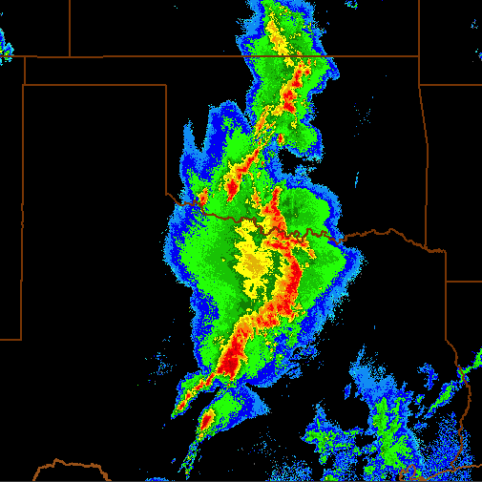
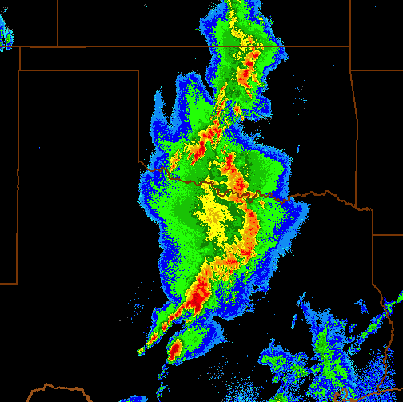
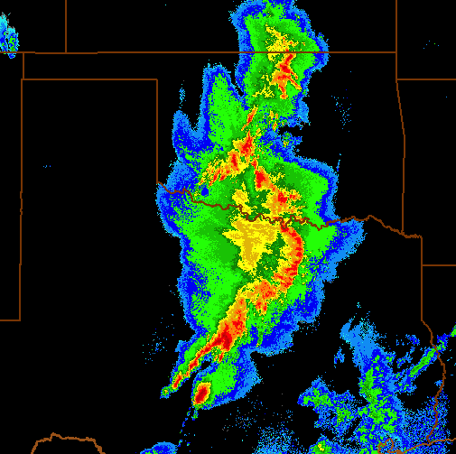
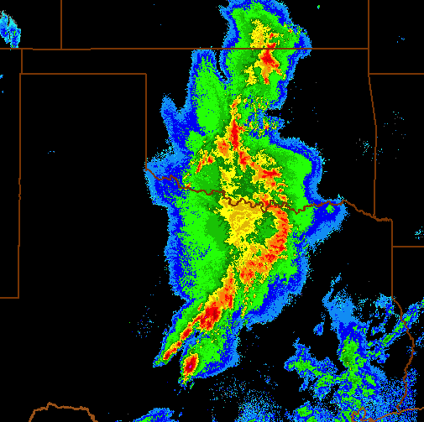
HRRR 2013 Pre-Forecast Hour
Temperature Tendency (i.e. Latent Heating) = f(Observed Reflectivity)
LH specified from reflectivity observations applied in four 15-min periods
NO digital filtering at 3-km
Reflectivity observations used to specify latent heating in previous 15-min period as follows:
Positive heating rate where obs reflectivity ≥ 35 dBZ over depth ≥ 200 mb (avoids bright banding)
Zero heating rate where obs reflectivity ≤ 0 dBZ
Model microphysics heating rate preserved elsewhere
-45
-30
-15
0
LH = Latent Heating Rate (K/s)
p = Pressure
L_{v} = Latent heat of vaporization
L_{f} = Latent heat of fusion
R_{d} = Dry gas constant
c_{p} = Specific heat of dry air at constant p
f[Z_{e}] = Reflectivity factor converted to
rain/snow condensate
t = Time period of condensate formation
(300s i.e. 5 min)
Observed 3-D Radar Reflectivity Time (min)
-60 -45 -30 -15 0
Model Pre-Forecast Time (min)
NCEP Production Suite Review
Rapid Refresh / HRRR
3-4 December 2013

Slide 28
Improved 0-2 hr Convective Fcsts
Radar Obs
05:00z 18 May 2013
05z + 0 min
0-hr fcst 3-km radar DA
0-hr fcst NO 3-km radar DA
NCEP Production Suite Review
Rapid Refresh / HRRR
3-4 December 2013

Slide 29
Improved 0-2 hr Convective Fcsts
Radar Obs
05:15z 18 May 2013
05z + 15 min
15-min fcst 3-km radar DA
15-min fcst NO 3-km radar DA
NCEP Production Suite Review
Rapid Refresh / HRRR
3-4 December 2013

Slide 30
Improved 0-2 hr Convective Fcsts
Radar Obs
05:30z 18 May 2013
05z + 30 min
30-min fcst 3-km radar DA
30-min fcst NO 3-km radar DA
NCEP Production Suite Review
Rapid Refresh / HRRR
3-4 December 2013

Slide 31
Improved 0-2 hr Convective Fcsts
Radar Obs
05:45z 18 May 2013
05z + 45 min
45-min fcst 3-km radar DA
45-min fcst NO 3-km radar DA
NCEP Production Suite Review
Rapid Refresh / HRRR
3-4 December 2013

Slide 32
Improved 0-2 hr Convective Fcsts
Radar Obs
06:00z 18 May 2013
05z + 1 hour
1-hr fcst 3-km radar DA
1-hr fcst NO 3-km radar DA
NCEP Production Suite Review
Rapid Refresh / HRRR
3-4 December 2013

Slide 33
Improved 0-2 hr Convective Fcsts
Radar Obs
06:30z 18 May 2013
05z + 1:30 min
1-hr 30m fcst 3-km radar DA
1-hr 30m fcst NO 3-km radar DA
NCEP Production Suite Review
Rapid Refresh / HRRR
3-4 December 2013

Slide 34
Improved 0-2 hr Convective Fcsts
Radar Obs
07:00z 18 May 2013
05z + 2hr min
2-hr fcst 3-km radar DA
2-hr fcst NO 3-km radar DA
NCEP Production Suite Review
Rapid Refresh / HRRR
3-4 December 2013

Slide 35
HRRR Reflectivity Verification
7-day retrospective period May-June 2012
Forecasts every 2 hours
> 25 dBZ Composite Reflectivity
Eastern half of US upscale to 20 km
Reflectivity CSI
Improved 0-2 hr
Convective Forecasts
Improvement Evident to
~4 hrs
2012 – real-time
With improved 13-km radar DA
Added 3km radar DA
NCEP Production Suite Review
Rapid Refresh / HRRR
3-4 December 2013

Slide 36
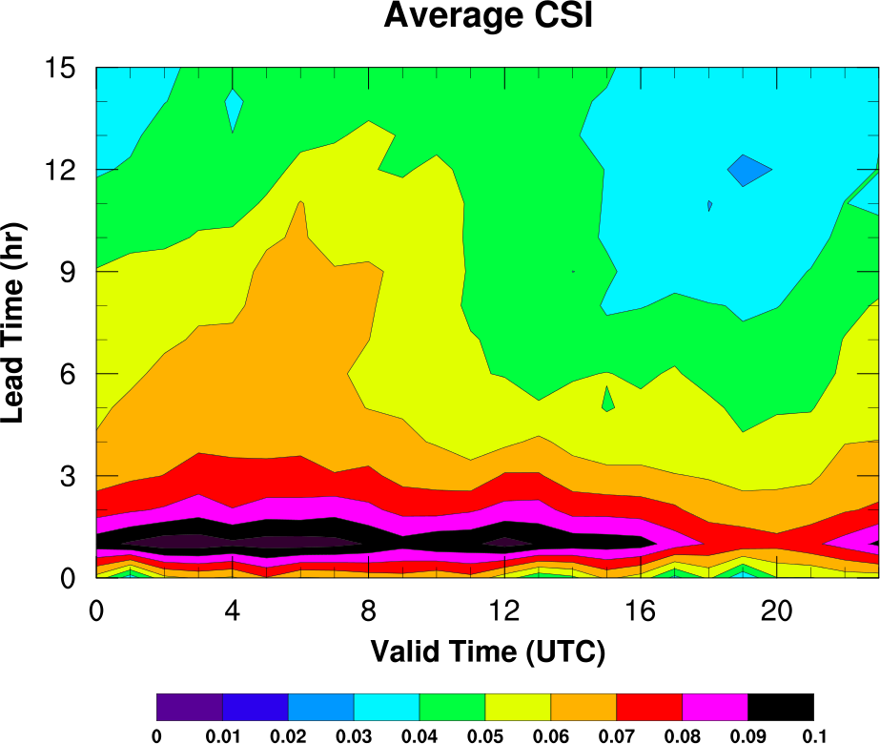
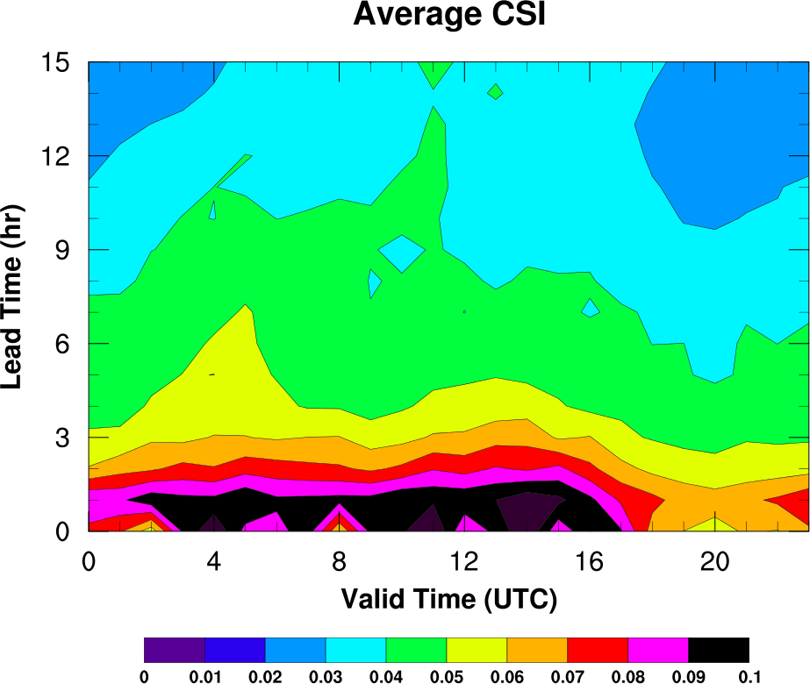
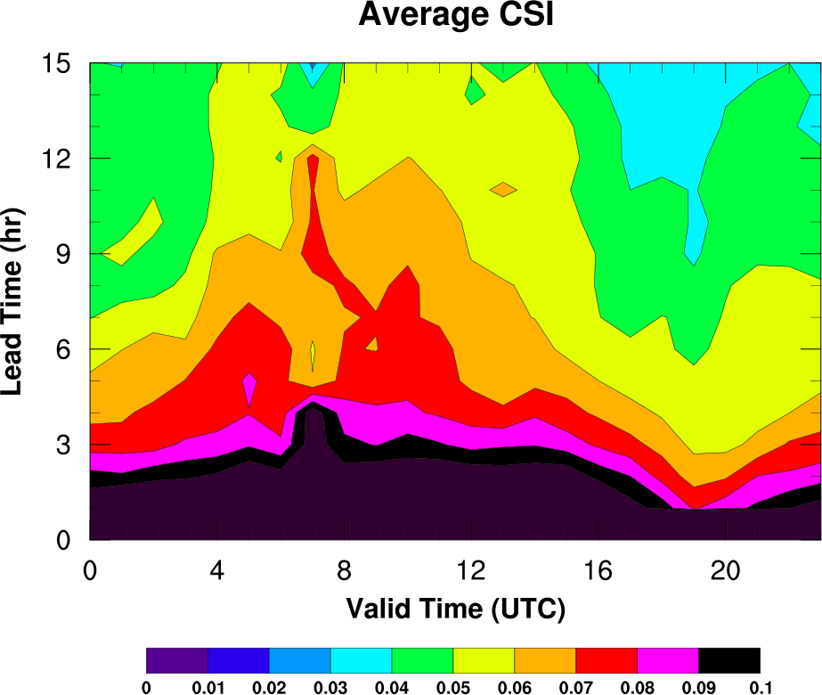
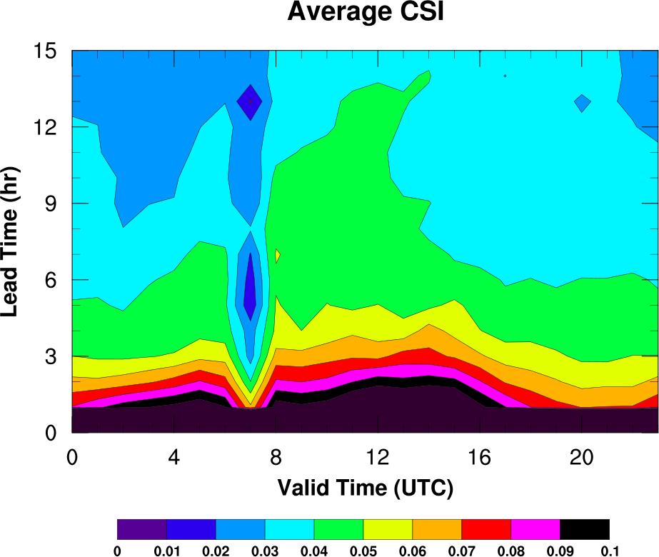
Lead Time vs Valid Time
Spring (Apr-June)
Summer (July-Sept)
Afternoon
Convective
Initiation
2012
Upscale
Growth
Decay
≥ 35 dBZ Composite
3-km Grid East US
Significant
skill increase at short lead times
with 3-km DA
2013

Slide 37
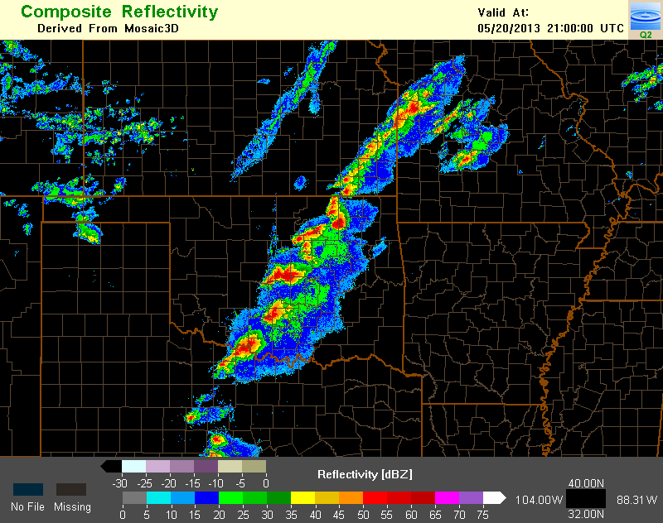
HRRR Case Studies
Observed
Reflectivity
21 UTC
HRRR 1300 UTC run
8 hr forecast
Valid 2100 UTC
Composite
Reflectivity
Moore, OK
20 May 2013
20 – 21 UTC
Tornadic Supercell
1 - 6 km
Updraft
Helicity

Slide 38
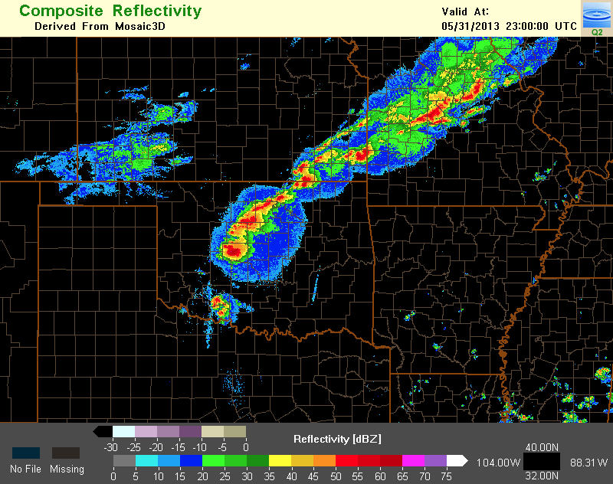
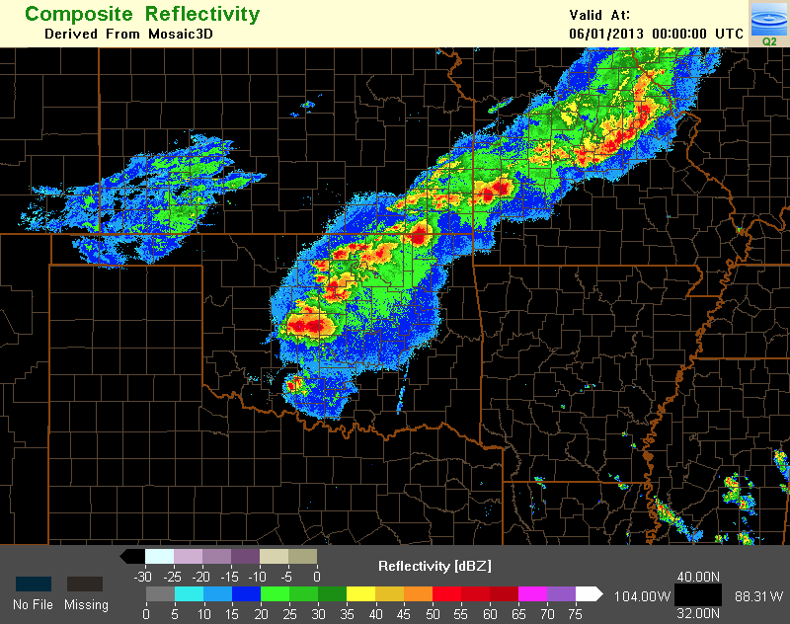
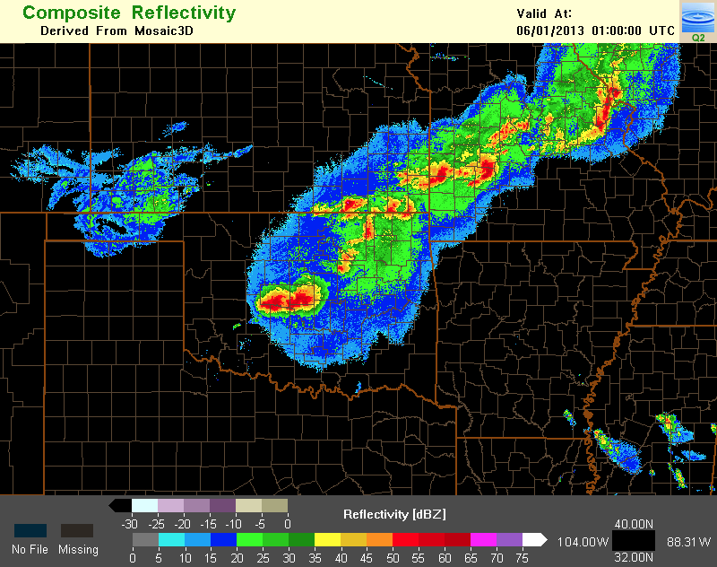
valid 2300 UTC
HRRR 1300 UTC run
valid 0000 UTC
valid 0100 UTC
+10 h fcst
+11 h fcst
+12 h fcst
1-6 km Updraft Helicity
composite reflectivity
observed reflectivity
x
x
x
El Reno – OKC Severe 31 May 2013

Slide 39
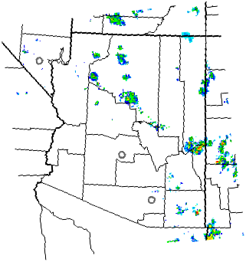
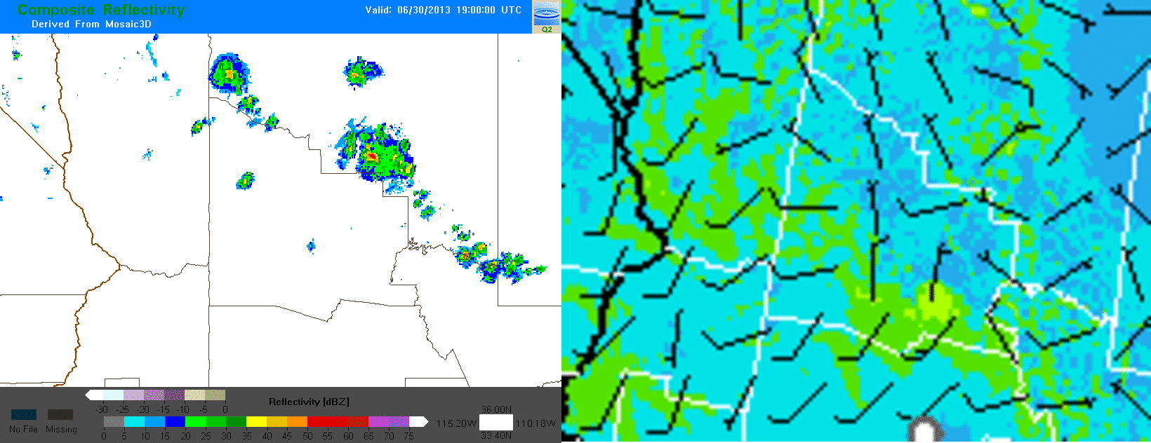
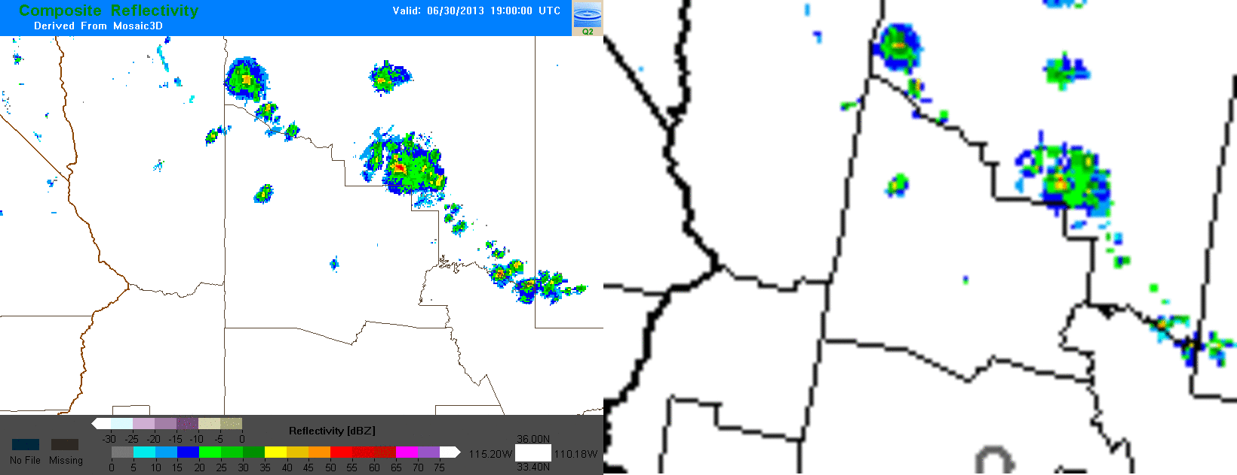
Yarnell, AZ
Wildfire
Driven by
Thunderstorm
Outflow
30 June 2013
19z HRRR run
(12 pm MST)
Available by
2 pm MST
HRRR Fcst 80m Wind (kts)
Yarnell
Observed Radar (dBZ)
HRRR Fcst Radar (dBZ)
Yarnell
Yarnell

Slide 40
Time-lagged Ensemble
Forecasts valid 21-22z 27 April 2011
Forecasts valid 22-23z 27 April 2011
10-11 hr fcst
11-12 hr fcst
HRRR 11z Init
09-10 hr fcst
10-11 hr fcst
HRRR 12z Init
08-09 hr fcst
09-10 hr fcst
HRRR 13z Init
All six forecasts
combined to form
probabilities valid
22z 27 April 2011
Spatial radius 45 km
Time radius 1 hr
UH threshold 25 m²/s²

Slide 41
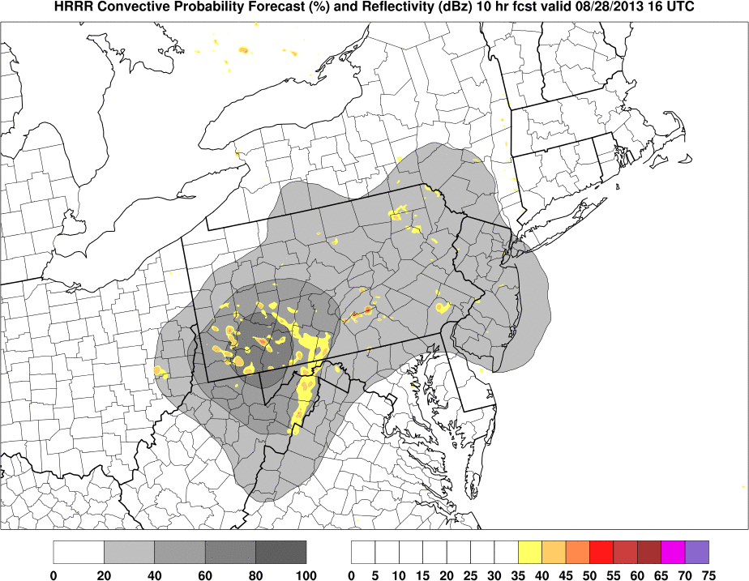
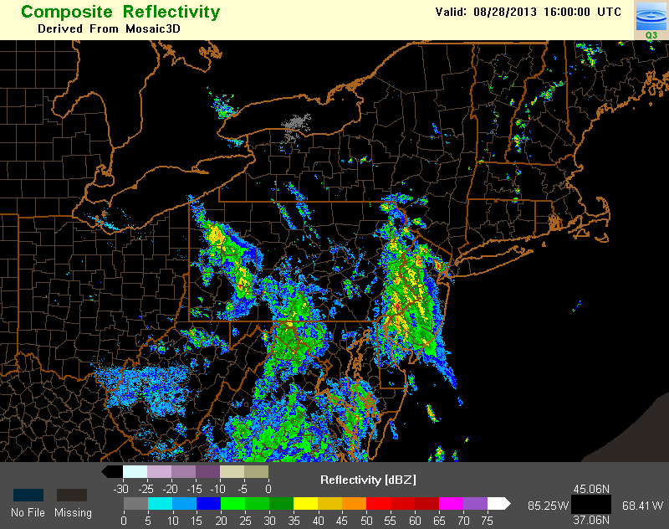
HRRR Conv Prob Fcst (HCPF)
Probabilities slowly evolve providing identifiable run-to-run trends
Convective structure (permeability etc…) still accessible
Distributed in GRIB2 to AWC starting in August 2013
Obs valid 16z 28 Aug 2013
NCEP Production Suite Review
Rapid Refresh / HRRR
3-4 December 2013

Slide 42
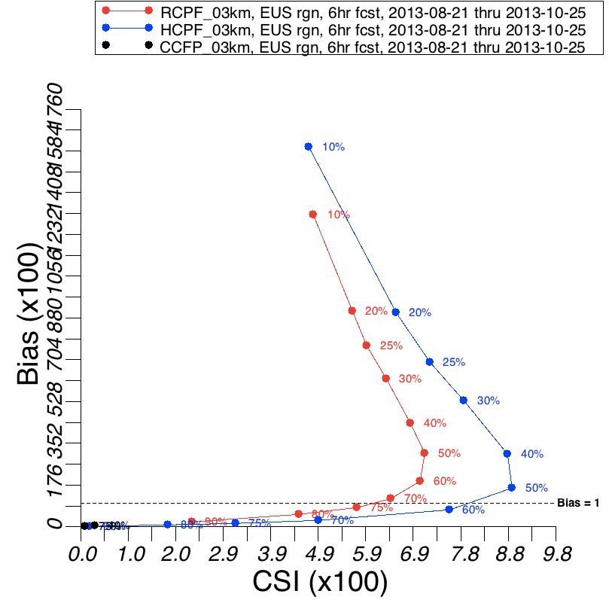
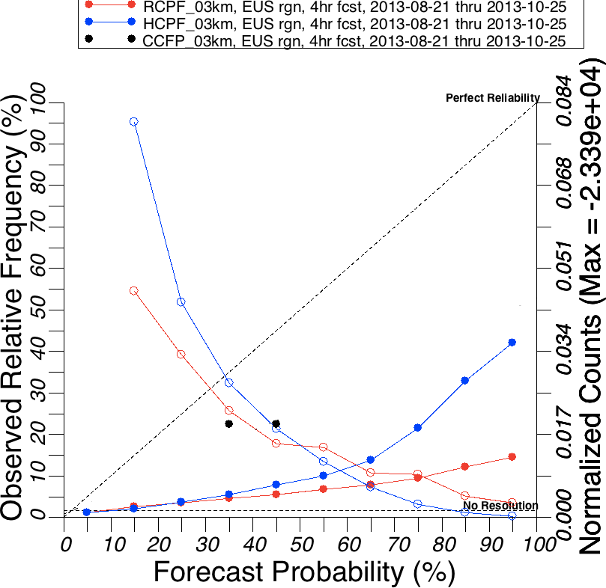
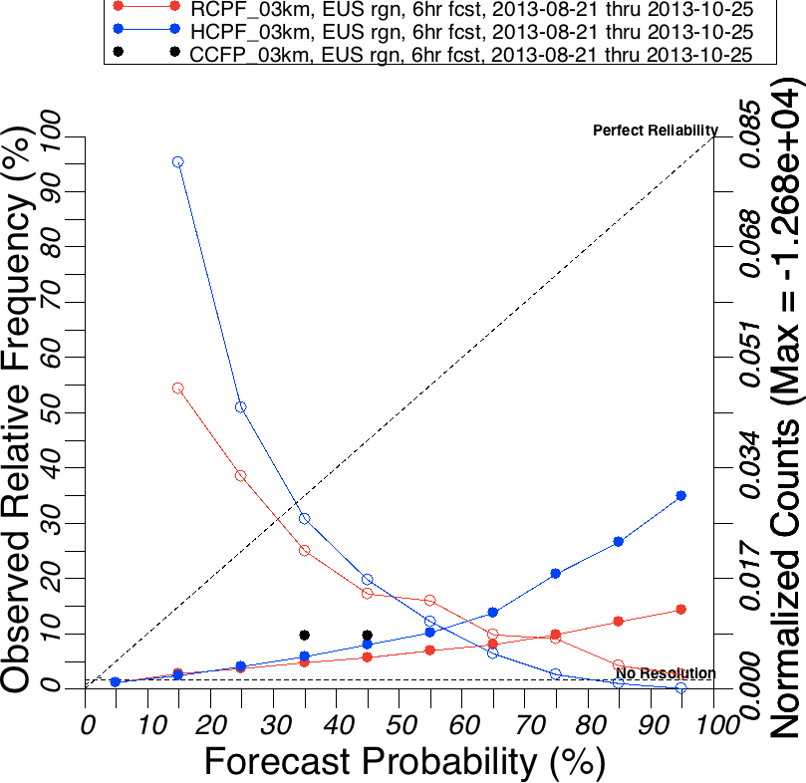
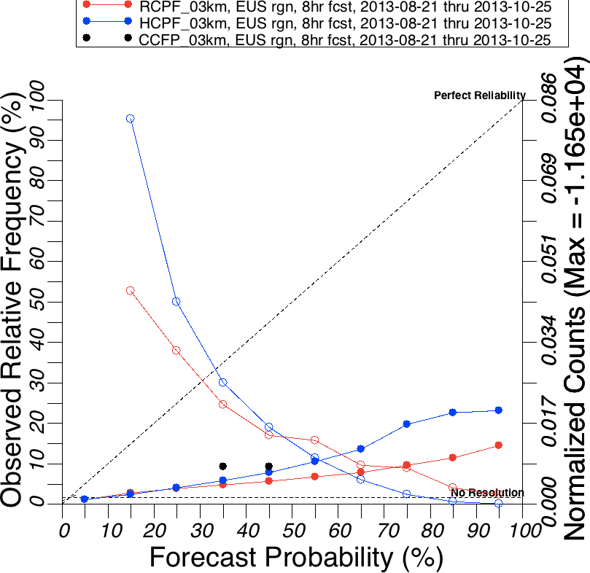
HCPF Verification
HCPF (blue) being developed to replace legacy RUC conv prob fcst (RCPF in red)
HCPF more statistically reliable in eastern US but over forecasts (no calibration yet)
HCPF max CSI @ 50% with BIAS ~1.7
CSI vs BIAS
Reliability Diagrams using 35 dBZ NSSL threshold
on 3-km grid Aug-Oct 2013 Eastern US
4hr Fcsts
6hr Fcsts
8hr Fcsts
NCEP Production Suite Review
Rapid Refresh / HRRR
3-4 December 2013

Slide 43
Candidate RAPv3/HRRRv2 Changes
 | Model | Data Assimilation
RAP-ESRL (13 km) | WRFv3.5.1+ incl. physics changes Physics changes: Grell-Freitas convective scheme MYNN PBL scheme - Olson version Thompson microphysics w/aerosols RRTMG radiation scheme Direct and diffuse GHI components | Merge with GSI trunk Radial velocity assimilation Mesonet assimilation Aircraft temperature bias correction Full-column cloud assimilation Radiance bias correction GOES cloud-top cooling assimilation RARS data assimilation Forward model to cloud fraction from SW radiation variants
HRRR (3 km) | WRFv3.5.1+ incl. physics changes Physics changes: MYNN PBL scheme - Olson version Thompson microphysics w/aerosols RRTMG radiation scheme Direct and diffuse GHI components Shallow cumulus parameterization Numerics changes: 6th order diffusion in flat terrain | 3-km hybrid assimilation Radial velocity assimilation Mesonet assimilation
Changes with high/medium importance for overall
forecast skill

Slide 44
RAP/HRRR Implementation Map
HRRR (and RAP) Future Milestones
HRRR Milestones
ESRL – experimental version
NWS-NCEP - operational
RAPv1 – used in 2011
Initialized 2011 HRRR
effective but too many storms
RAPv2 – used in 2012-2013
Initialized 2012-2013 HRRR
Better use of surface obs / radar, storm bias eliminated, Hybrid DA
HRRR – 2012
Major improvement over 2011 HRRR, storm coverage/accuracy
HRRR – 2013
3km/15min radar assimilation
Initialized from RAPv2-2013
Available 45 min earlier, much more accurate 0-15h storm forecasts, more reliable 2-computer
Implemented 1 May 2012
RAPv2 - Scheduled to be implemented in Jan 2014, running in NCEP/NCO testing now
HRRRv1 – Scheduled to be implemented in Apr 2014, HRRR tested on WCOSS with 45-min runtime on 60 nodes, 3-km DA setup underway
NCEP Production Suite Review
Rapid Refresh / HRRR
3-4 December 2013

Slide 45
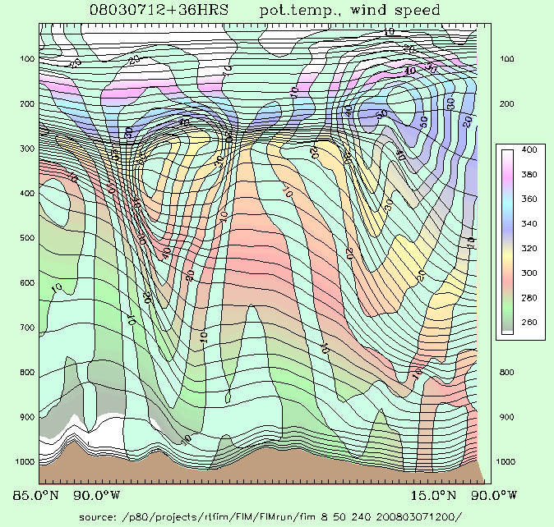
X-section location
Temp at lowest level
Sandy Supplemental funded
High-Impact Wx Pred Proj
(HIWPP) - will include
ESRL/NCEP eval of exper multi-model ensemble -GFS and FIM (10 mem each)
Pre-NMME testing (FIM/iHYCOM)
GSI/hybrid DA dev w/ FIM
Flow-following-
finite-volume
Icosahedral
Model FIM
http://fim.noaa.gov
Notes:
45
Two of the 3 unique aspects of the FIM are ones that you can see, for its vertical and horizontal coordinate systems.
- the isentropic-sigma hybrid vertical coordinate, which DOES adapt and generally follow air parcels up and down (Rainer in 2 talks), and
- the use of the intriguing soccer-ball like icosahedral horizontal grid (which Jin Lee will describe next).

Slide 46
500-hPa Height Anomaly Correlation FIM-30km global vs. GFS operational - FIM with GFS IC, GFS phys, dyn core only diff
NH, dieoff
Aug 12 – Jul 13
SH, dieoff
Aug 12 – Jul 13
SH, dieoff
Jun12 – May13
95% stat
signif diff
Results from 12-month test- August 2012 through July 2013
FIM better skill than GFS for 5+ day duration in N. Hemisphere, 4+ day duration for S. Hemisphere,
statistically significant in both SH and NH
Notes:
This result is a pretty big deal to get such improvement over the GFS for a full 1-year period.

Slide 47
Track Verification
2013 Hurricanes - Atlantic and E. Pacific basins combined
FIM9 (15km) experimental TC guidance provided to NHC through HFIP
- 2011 thru 2013
HWRF
GFS
FIM9
ECMWF

Slide 48
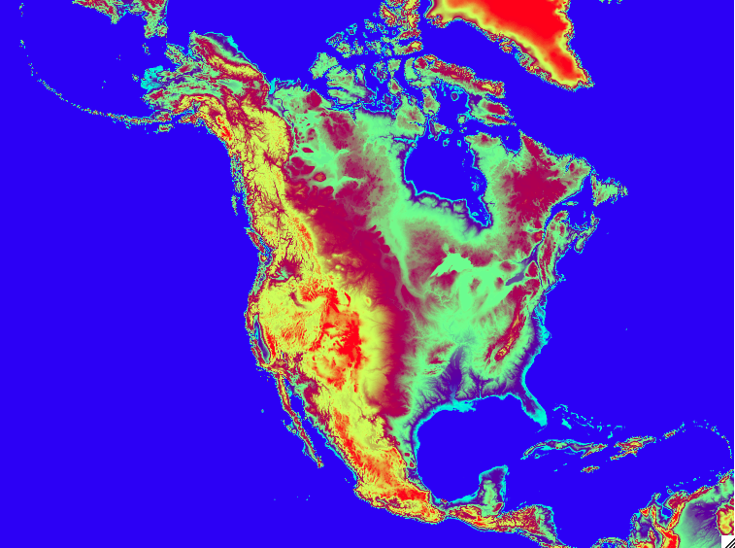
Evolution of hourly updated NOAA modeling
May 2012 – Rapid Refresh oper at NCEP
Jan-Feb 2014 –Rapid Refresh v2 – oper at NCEP
PBL/soil/radar assimilation enhancements
➔ Improved surface forecasts,
convective environment fields
Hybrid ensemble-variational GSI assimilation
Model – improved cloud / PBL / LSM,
numerics improvements, updated WRF
~Apr 2014 – HRRR (3km) - planned oper at NCEP with 3km/15min radar refl. assimilation
HRRR
Rapid
Refresh ➔ NARRE
Future oper @ NCEP
2015 – RAPv3/HRRRv2
2017 – Ensemble Rapid Refresh/NAM – NARRE
(w/ hybrid 4d-ens/var DA)
2019? – Ensemble HRRR
– HRRRE – (ultimately with hourly ~3km ensemble DA)
North American Rapid Refresh Ensemble
NMM, ARW cores
Hourly updating with GSI-hybrid EnKF
Initially 6 members, 3 each core, physics diversity (stochastic only or with RAP/NAM/NCAR suites)
Hourly forecasts to 24-h
NMMB (+ARW?) members to 84-h 4x/day

