Slide 1
Regional ensembles review:
SREF, NARRE-TL and NSSE
Jun Du and Geoff DiMego
Contributors: Binbin Zhou, Dusan Jovic, Bo Yang, Brad Ferrier, George Gayno, Matt Pyle, Geoff Manikin, Eric Rogers, Hui-Ya Chuang, Yuejian Zhu, Jen Yang, Boi Vuong
December 3, 2013

Slide 2
Outline
What’s in plan
(~3-5 years)?
SREF and planned
convection-allowing ensembles
HRRRE
What happened and what is coming (~ 1-2 months)? SREF interim upgrade package
1
3
2
SREF next major
upgrade (~1 year)
Panel Discussion on
regional ensembles
into 2020 to follow

Slide 3
Summary of major accomplishments in FY13
Completed WCOSS transition of both SREF and NARRE-TL in production: for SREF, all three models had a minor version upgrade (3.1 to 3.2), fixed vertical velocity problem, physics fixes allow use of all SREF members to calculate ensemble products for ceiling and visibility;
Delivered a SREF interim upgrade package to NCO for FY14Q2 (January or February 2014) implementation;
Constructed an experimental NCEP Storm-Scale Ensemble (NSSE, Time-Lagged)
Plan to stop producing HREF (SREF+HiresWin) products due to the lack of users and the arrival of NSSE.

Slide 4
24h FCST of vertical velocity at 700mb from 09z, May 23, 2013 (CCS SREF)
nmb
nmm
arw

Slide 5
24h FCST of vertical velocity at 700mb from 09z, May 23, 2013 (WCOSS SREF)

Slide 6
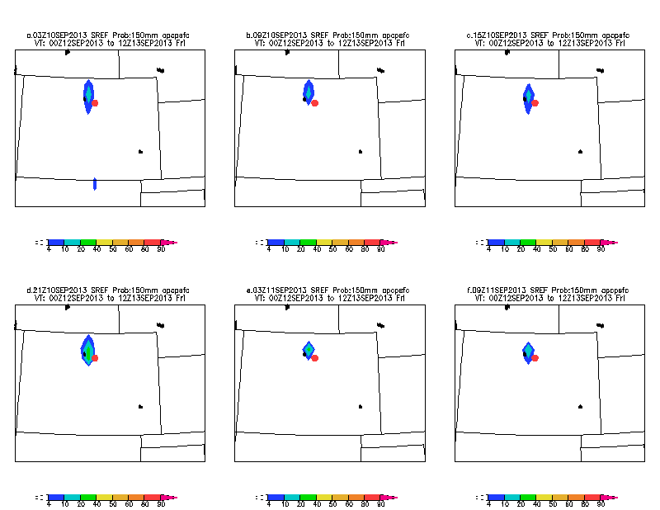
SREF performance in the historical Boulder, CO extreme heavy rain event (from Rich Grumm): it’s almost impossible for any single model forecast to be so consistent over time!
SREF Prob > 100mm (~4”)/36hr
81hr
75hr
69hr
63hr
58hr
52hr
SREF Prob > 150mm (~6”)/36hr
81hr
75hr
69hr
Observed 36hr (00z, Sept. 12 – 12z, Sept. 13,
2013) accumulated precipitation.
63hr
58hr
52hr

Slide 7
SREF interim upgrade package (has been delivered to NCO which is running in real time daily, to be implemented in Jan./Feb. 2014)
Part I: Bug fix
Correct / improve initial conditions:
replace GFS land states (too moist) with NDAS land states in NMM & ARW members;
correct inadvertent use of global initial conditions (too moist) with use of RAP for ARW members to reduce the surface wet and cold biases
Fix bugs in NOAH LSM:
eliminate negative soil moisture fractions for NMM and ARW members;
eliminate “urban swamp” (causing too cold surface temperature over urban regions during heat wave periods) for NMMB members
Correct GFS physics in 2 NMMB members to produce compatible cloud & ceiling guidance with the rest of SREF members
Fix Post-Processor to remove use of snow in diagnosing cloud base height
Correct a mapping bug (eastward shift) in NMM member’s pressure-grib output files.
Part II: New products
Add 4 winter weather variables:
low-level Rime Factor of 21 members;
snow depth of 21 members;
% of frozen precipitation of 21 members;
water equivalent accumulated snow of 7 ARW members
Add 2m temperature and 3-hourly accumulated precipitation of 21 SREF members from the 32km North American domain (grid 221) into AWIPS for RFC to drive their hydrological ensemble system
Modify the clustering algorithm to “make up” time-continuity within a cluster over each of the three preselected forecast periods (00-24hr, 27-51hr, 54-87hr)
Add “Department of Homeland Security” sites in SREF bufr sounding output as well as unify the SREF bufr station list with that used in NAM and RAP.

Slide 8
EMC parallel: RMSE of 2m T for NMM_ctl (Prod vs. Test, 2013, 09z cycle)
Warm season (July 15- Aug. 31) Cold season (Oct. 1 – Nov. 4)
RMSE of 2m T
NMM ctl

Slide 9
EMC parallel: RMSE of 2m T for ARW_ctl (Prod vs. Test, 2013, 09z cycle)
Warm season (July 15 – Aug. 31) Cold season (Oct. 1 – Nov. 4)
RMSE of 2m T
RMSE of 2m T
ARW ctl

Slide 10
EMC parallel: Ranked Probabilistic Skill Score (RPSS) of 2m T (Prod vs. Test, 2013, 09z cycle)
Warm season (July 15-Aug. 31) Cold season (Oct. 1-Nov. 4)
RPSS of 2m T
RPSS of 2m T
SREF based probabilistic forecasts

Slide 11
Summary of the impacts on 2m T and Td Statistically speaking, (1) More impact on NMM and less impact on ARW; (2) More impact on warm season and little impact on cold season; (3) More impact on 2m T and less impact on 2m Td; (4) Little impact on domain-averaged biases (more locally on case by case).

Slide 12
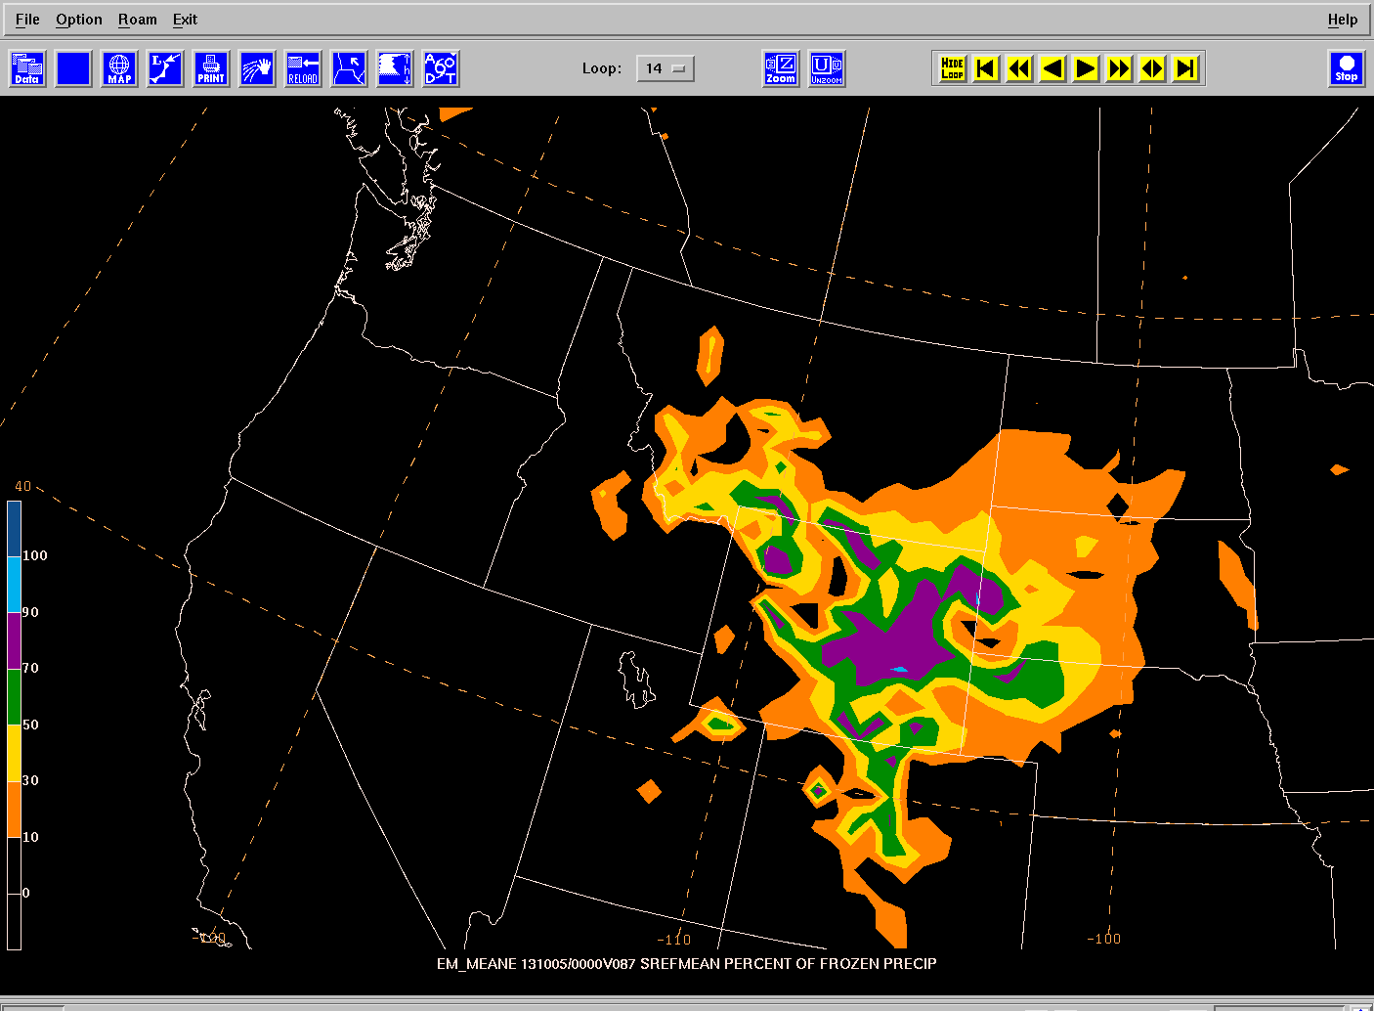
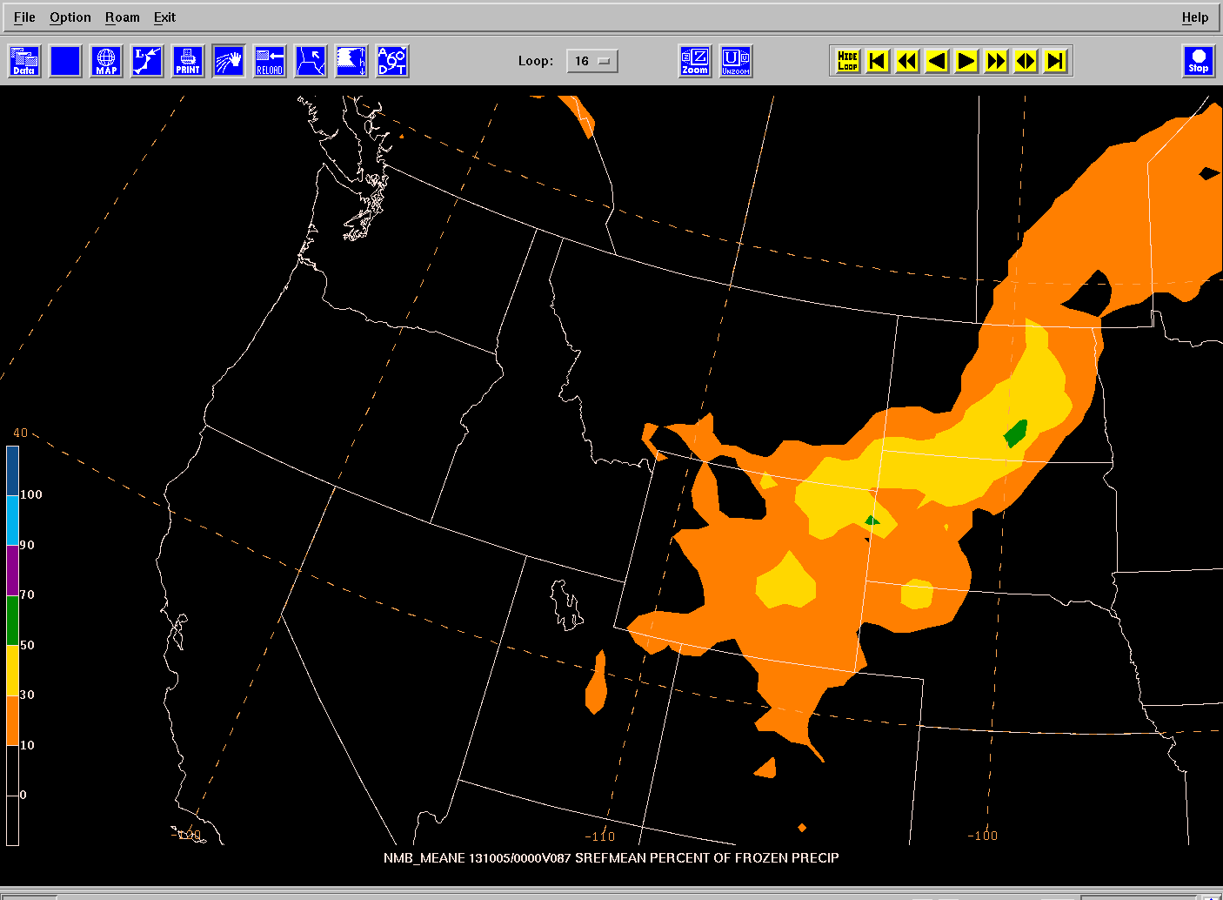
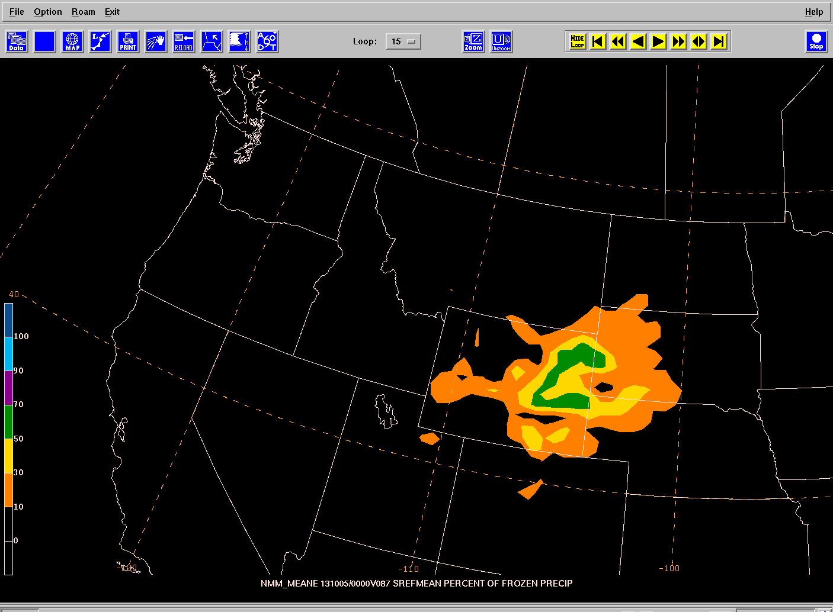
Percent of Frozen Precipitation at Time Stamp F87
SREFp Mean POFP
2013100109F087
ARW Mean POFP
2013100109F087
EM Core ensemble forecast the heaviest snowfall, and also suggsts the coldest POFP values over Wyoming.
NMB Mean POFP
2013100109F087
NMM Mean POFP
2013100109F087

Slide 13
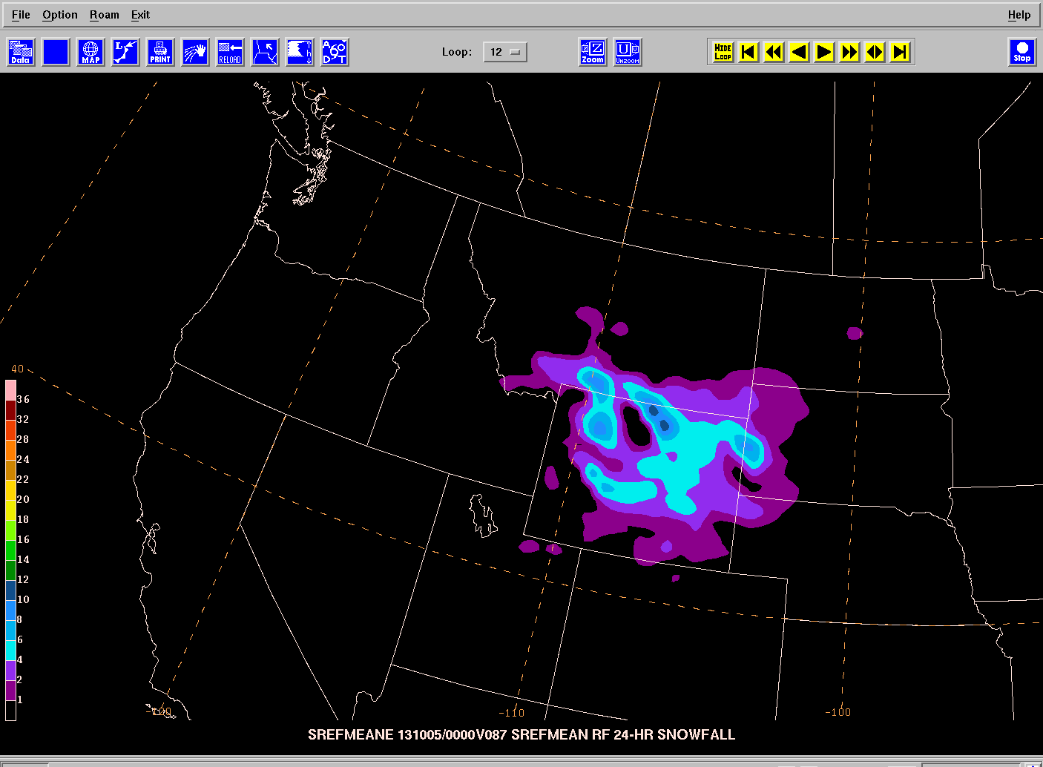
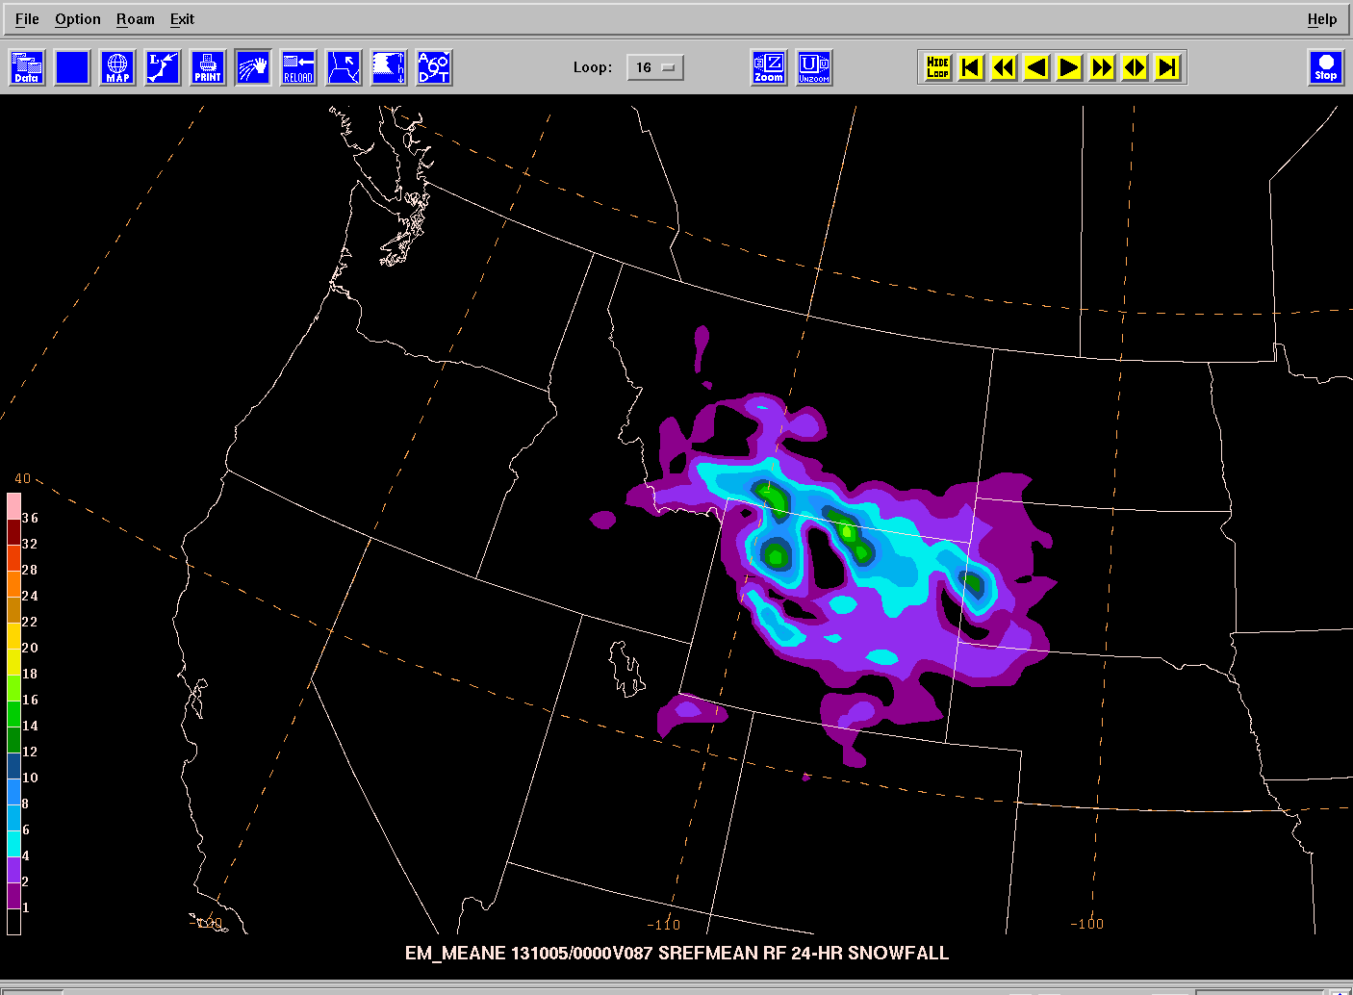
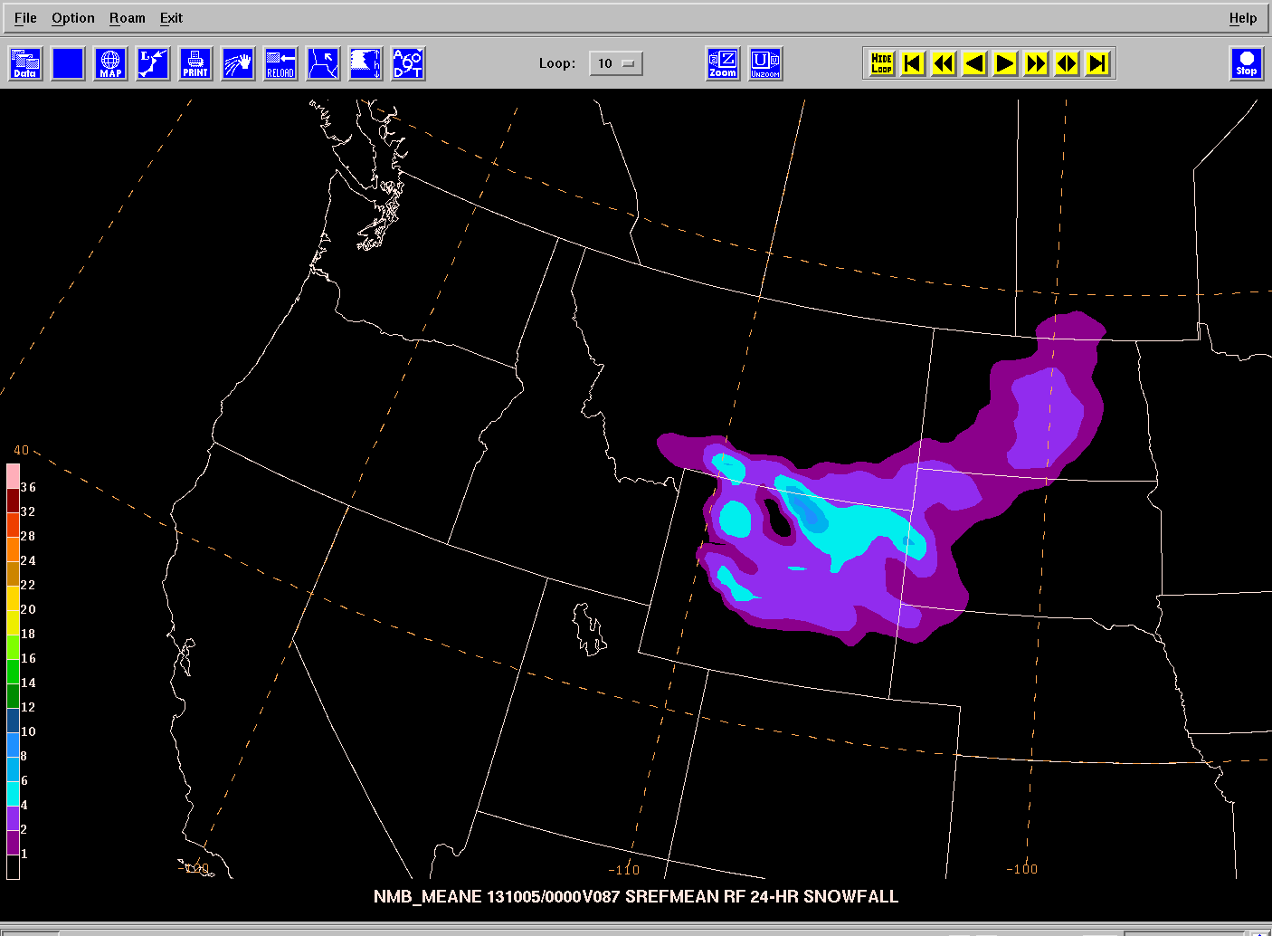
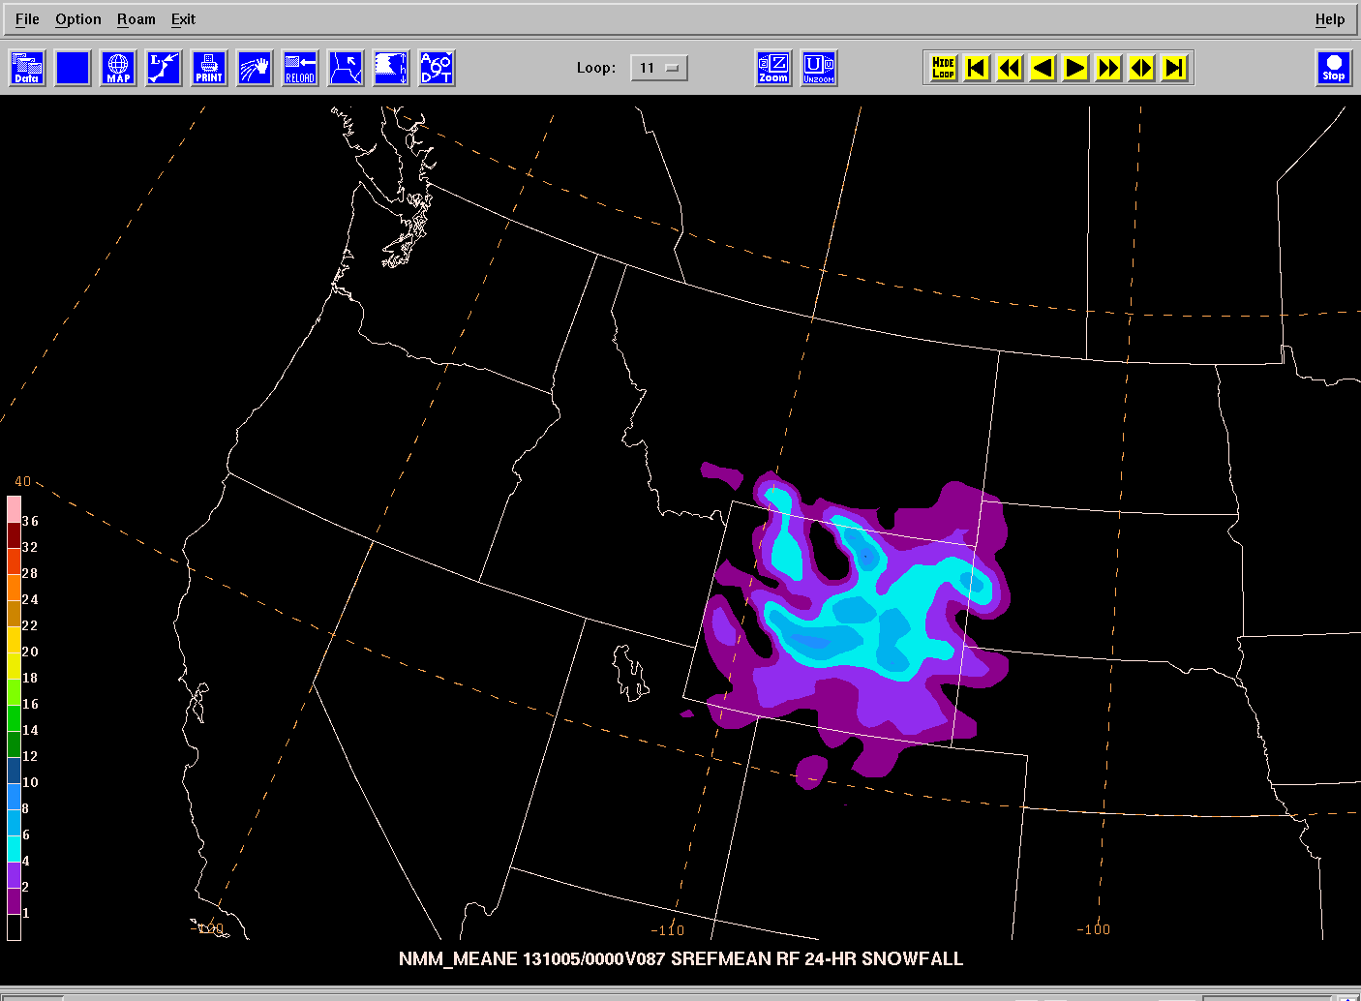
24-hr Snowfall Forecasts
SREFp Mean
2013100109F087
ARW Mean
2013100109F087
SREFp Core member ensemble means of snowfall derived from model implicit rime factor and percent of frozen precipitation.
NMB Mean
2013100109F087
NMM Mean
2013100109F087

Slide 14
http://www.emc.ncep.noaa.gov/mmb/byang/mmbpll/nampll_tide/20130914/09z/nmm/ctl
A demonstration case
(old vs. new in clustering)

Slide 15
NARRE-TL
Many field forecasters are routinely using NARRE-TL (12km RAP + NAM):
~Combining NARRE-TL probability with single model forecasts
~Relying on EMC web for NARRE-TL products
~ NARRE-TL web site has been upgraded based on forecaster feedbacks, e.g.
Added 6 sub-regions plots within CONUS;
Extended NE domain further east to cover New Brunswick, CA
Kept two days of products online

Slide 16
NSSE (NCEP Storm Scale Ensemble)
Time lagged ensemble (20 members):
NCEP 4km NAM nest (NMMB),
NCEP 4km Hi-ResWindow (ARW and NMM),
EMC 5km SPC WRF-NMM run
GSD 4km HRRR (ARW) runs
Current configuration:
3 hourly update, out to 12 hour forecast
CNOUS domain, including 6 sub-region domains
Products focusing on
Storm, aviation, fire weather and energy (wind).
http://www.emc.ncep.noaa.gov/mmb/SREF_avia/FCST/NSSE/web_site/html/storm.html

Slide 17
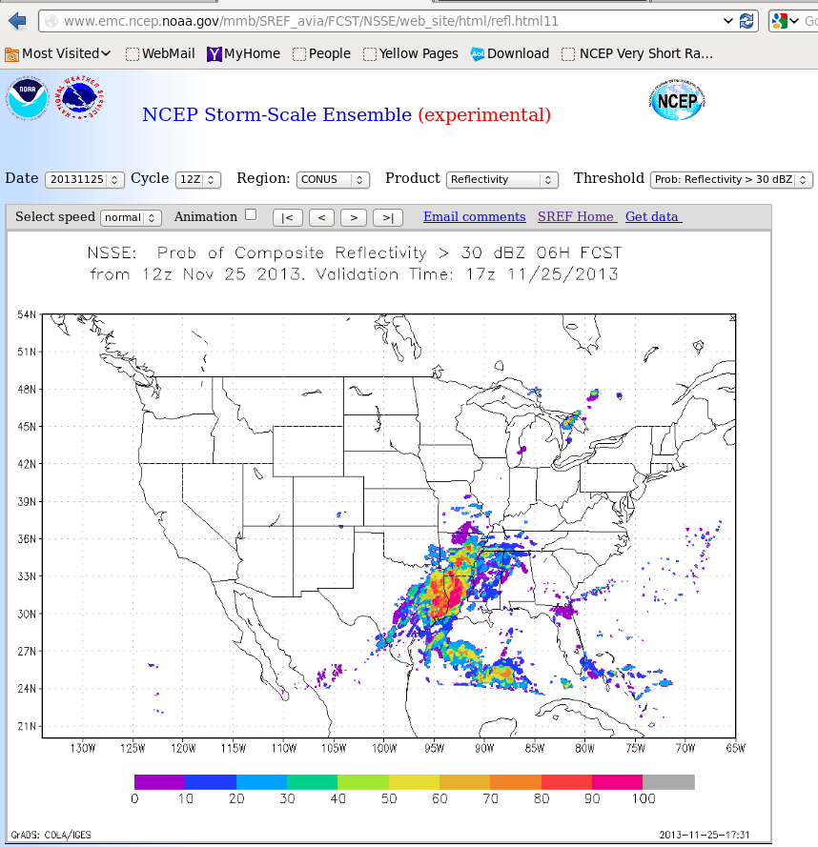

Slide 18
SREF’s next major upgrade(~end of 2014)
Current SREF 2013 | Upgrade SREF 2014 (not yet finalized)
System
nmmb, wrf_arw, wrf_nmm | nmmb, wrf_arw
16km | ~12km
35 levels | 40 levels (same as hi-res window run)
21 members | 22 members
limited diversity | more physics diversity
BV and ETR | EnKF perturbations for a few members
Products
none | anomaly forecasts
simple ensemble mean (precipitation) | probability-matching ensemble mean (precipitation)
none | variables at 80m AGL, TKE, wind chill, heat index, wind gust, …
Downscaling
none | Tmax, Tmin, 2mTd, … (same as NAEFS)
Other
grib1 | grib2 (likely)

Slide 19
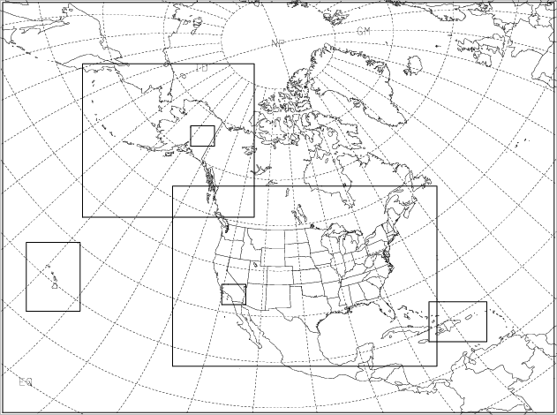
Future 3-tier 2-model (NMMB, ARW) regional ensemble system (~3-5 years)
(1) Combined regional modeling: – SREF/NAM/RAP at 00/06/12/18z,
(2) convection-allowing storm-scale ensemble -- HRRRE
Tier 1: 12 km NA parent ensemble (SREF, NAM, RAP combined), 84hr
Tier 2: nested 3-4 km CONUS, AK, HI, PR ensemble, 48hr?
Tier 3: nested ~1.0 km relocatable high-impact ensemble, 24hr?

Slide 20
Items for the following Panel Discussion
System | Purpose | Domain | Resolution | Update frequency | Membership | Lead time | Products | Model | IC uncertainty | Physics uncertainty | Other | Computer resources
Tier-1: parent SREF | General weather | NA | 12km | 6hr | 22 | 84hr | Mean, prob, clusters | nmmb, arw, parameterized phy | EnKF+multi-anl | Stoch phy &/or diversity | NAM, RAP are parts of it | ?
Tier-2: regions | Aviation and convection | CONUS AK, HI, PR | 3km | 1hr | 11? | 48hr? | Mean, prob, clusters | nmmb, arw, convection-allowing phy | EnKF+multi- anl | Stoch phy &/or diversity | nested | ?
Tier-3: high-impact area | High-impact events | Relocatable | 1km | 1hr | 11? | 24hr? | Mean, prob, clusters | nmmb, arw, convection-allowing phy | EnKF+multi-anl | Stoch phy &/or diversity | nested | ?

