Slide 1
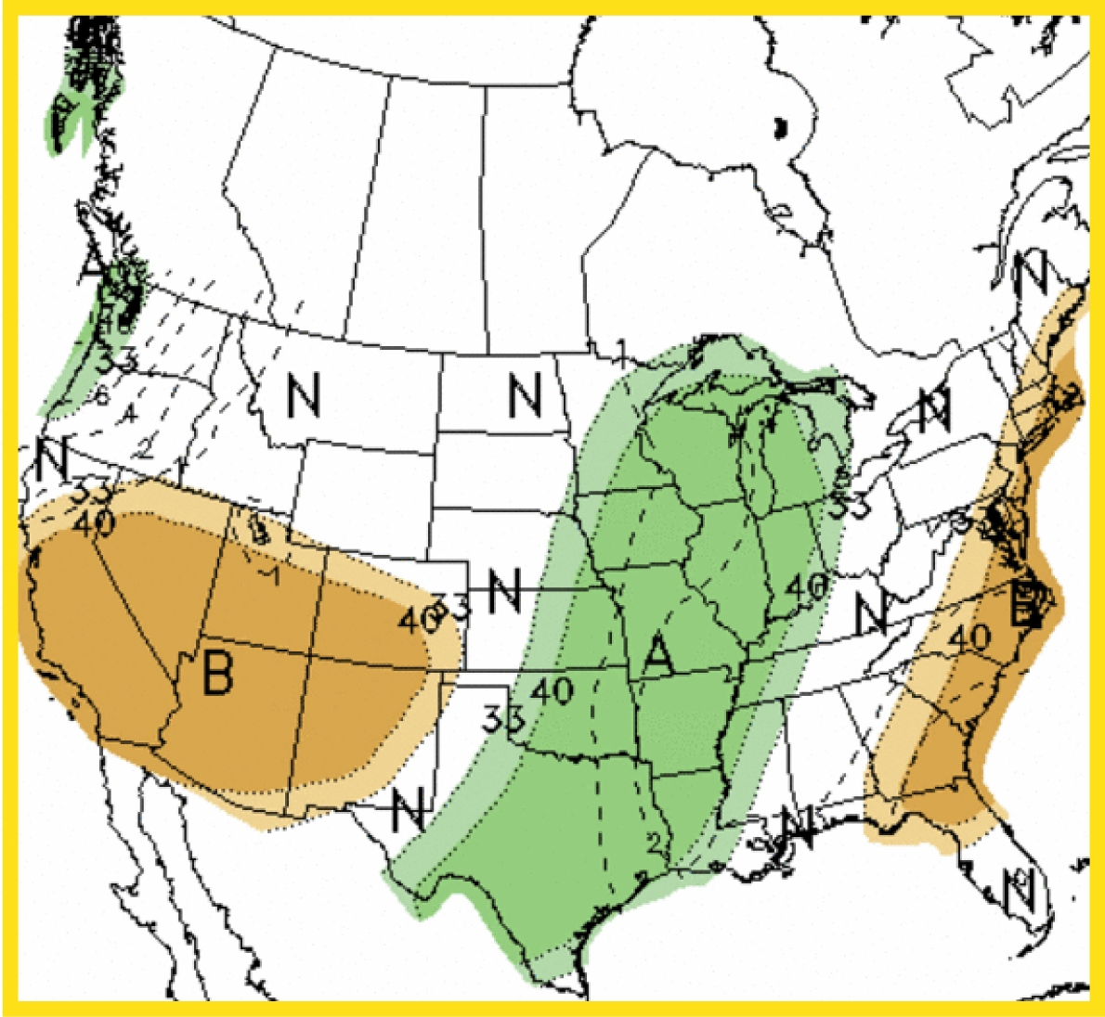
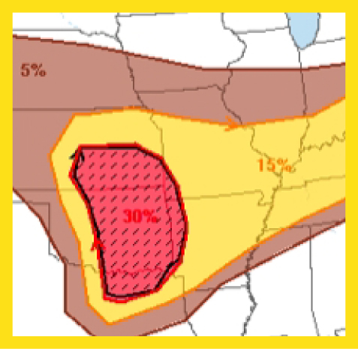
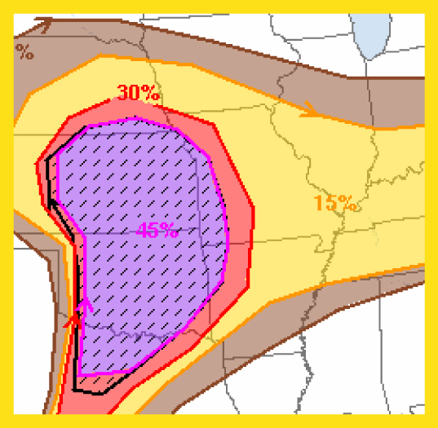
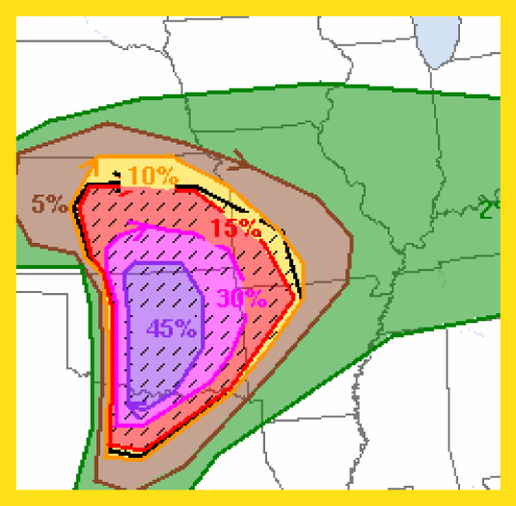
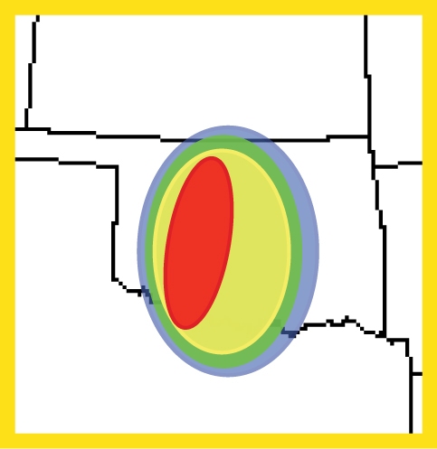
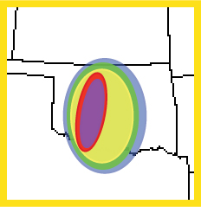
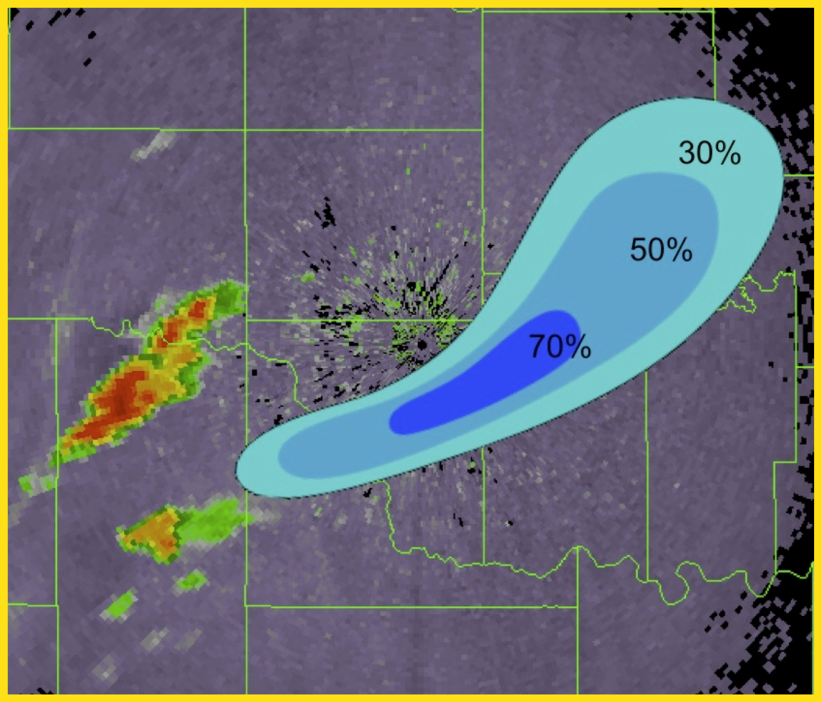
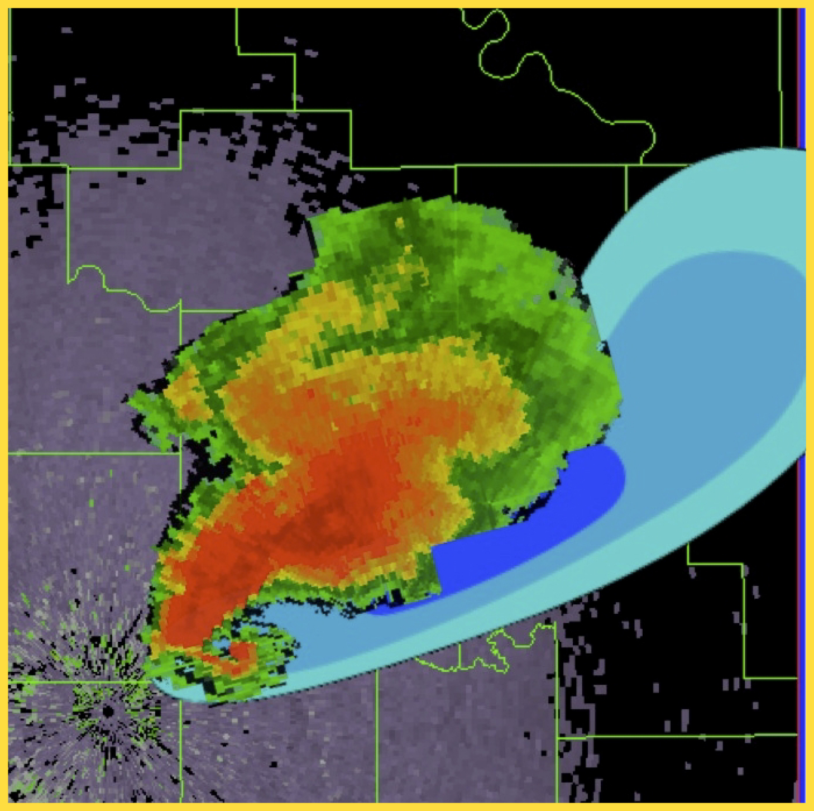
FACETs: Forecasting A Continuum of Environmental Threats
Seasonal
Outlooks
Watches
Warnings
Time
Months
Days
Hours
30-60 Minutes
Event
Space
Regional
State
Local
NSSL Contributions
Continuous, reliable Probabilistic Hazard
Information (PHI) from seasons to minutes
Adapted from Dr. Heather Lazrus (SSWIM) and Lans Rothfusz
Courtesy Dave Stenrud

Slide 2
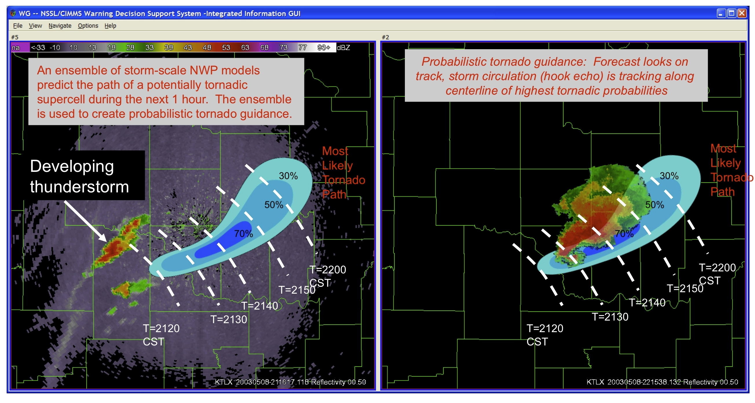
Convective-scale Warn-on-Forecast Vision: Probabilistic convective-scale analysis and forecast system
Updated frequently and providing confidence information with focus on 0 to 1 h time frame

Slide 3
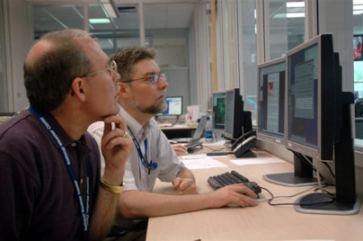
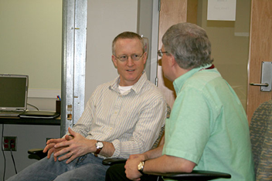
NSSL/SPC Realtime CA-Ensemble Plans (pending HPC allocation)
Develop a small (~8 member) realtime, CONUS scale, convection-allowing ensemble – no data assimilation, focus on 12-36h (SPC Day1) forecast period
Close, daily collaboration with SPC to promote forecaster engagement and iterative progress on ensemble design, data mining, visualization, and post-processing (building on success of NSSL-WRF)
Collaborate with EMC, GSD, and perhaps others to strategize about ensemble design, relevance to HRRRE from a technical-design and forecaster-readiness perspective
Why NSSL and SPC?
- Long history of contributions to ensemble prediction systems
- HWT, strong R2O and O2R track record
- Lessons learned from working with CAPS on CA- EPSs (2007-current)

