Slide 1




NCEP Production Review:
Aviation Weather Center
David R. Bright
Aviation Weather Center
NOAA/NWS/NCEP/AWC
Kansas City, MO
December 3, 2013
NCWCP
College Park, MD
Where Americas Climate and Weather Services Begin

Slide 2
Outline
Aviation Weather Center Operations
FY13 Highlights
FY14 Milestones and Projects
Production Summary

Slide 3
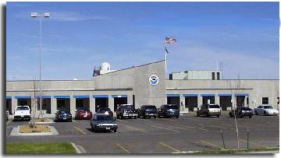

Aviation Weather Center
(AWC)
Per U.S. law, provided by the Department of Commerce to the FAA
Global mission / 4 locations
  Kansas City, MO & Warrenton, VA
  Scott AFB & Offutt AFB (COOP sites)
Operates 24x7
  Forecasts, advisories, & warnings
Primary U.S. source for domestic and international en route aviation weather information

Slide 4
AWC Partners & Stakeholders
FAA
  Command Center
  Flight Service Stations
  Research and Development (AWRP)
  Policy and Requirements
NWS
  CWSUs
  AAWU & HNL
  WFOs
  NCEP Centers
    SPC, SWPC, TPC, HPC, NCO
DOD - USAF
  - Weather Agency
  (AFWA)
  15 OWS, Scott AFB
Industry
  - Airline Met Services
  - Private Sector
  Weather
Government
  United Kingdom’s Meteorological Office
  Meteorological Service of Canada (MSC)

Slide 5
AWC Products & Services
Domestic Branch
International Branch
U.S. Products (except Alaska and Hawaii)
Flight Hazard Forecasts and Warnings
  SIGMET
  Convective SIGMET
  AIRMET
  G-AIRMET
  Area Forecasts (FA)
  Low Level Significant Wx
  Collaborative Convective Forecast Product (CCFP)
  IDSS & Av Wx Statement (AWS)
Global and Oceanic Products
Flight Weather Forecasts Maps for the entire World (Airlines)
  Mid-Level Significant Wx
  High Level Significant Wx
Flight Hazard Warnings for Atlantic, Pacific, Gulf of Mex. and Caribbean
  International SIGMET
  Tropical Aviation Wx
Science, Testbed, & IT Support Branch
Aviation Web & Data Services
Forecaster Training & Guidance
  - Aviation Weather Testbed (AWT)
AWRP Automated Products
  - ADDS: Aviation Digital Data Service
www.AviationWeather.gov
International Flight Folder Documentation Program (IFFDP)
WAFS Internet File Service (WIFS)
AWC IT Infrastructure
Notes:
40 domestic and international forecasters. Weather support branch of 18.

Slide 6
AIRMETs
Airmen’s Meteorological Information: advisories that may be hazardous to single engine or light aircraft and VFR pilots.
Issued for 6-hour periods and generally cover > 3000 mi²
Lgt/Mod Turbulence
Lgt/Mod Icing
Mountain Obscuration
Surface Winds & Wind Shear
Freezing Level
Ceiling & Visibility
Notes:
LIFR = 500 ft or 1 mile
IFR = 1000 ft or 3 miles
MVFR = 3000 ft or <=5 miles
VFR = > 3000 ft AGL or > 5 miles
AIRMET – Airmen’s Meteorological Information, advises of weather that may be hazardous other than convective activity, to single engine or light aircraft and VFR pilots. Issued for 6-hour periods and cover > 3000 mi².
AIRMET Sierra (IFR):
Ceilings less than 1000 feet and/or visibility less than 3 miles affecting over 50% of the area at one time.
Extensive mountain obscuration
AIRMET Tango (Turbulence):
Moderate turbulence
Sustained surface winds of 30 knots or more at the surface
AIRMET Zulu (Icing):
Moderate icing
Freezing levels

Slide 7
SIGMETs
Significant Meteorological Information, concerning the safety of all aircraft. Issued for 6-hour periods and generally cover > 3000 mi²
Severe Turbulence
Severe Icing
Widespread Duststorm & Sandstorms
Volcanic Ash Cloud
Tropical Cyclones
Convection
Notes:
SIGMET – Significant Meteorological Information, concerning the safety of all aircraft. Issued for 6-hour periods and cover > 3000 mi². May be convective or non-convective.
Severe or great turbulence or icing
Instrument meteorological conditions due to dust, sand, or volcanic ash
Convective: thunderstorms, a line of storms > 60 nm long, severe thunderstorms lasting > 30 minutes

Slide 8

World Area Forecast System (WAFS)
World Area Forecast Center (WAFC)
WAFC - Washington (Kansas City)
WAFC - London (Exeter, UK)
Formulated by the International Civil Aviation Organization (ICAO) and WMO
AWC is one of only two WAFCs
Global Significant Weather Charts
  Flight planning & dispatch
WAFC Global Grids for icing & turbulence
Wind and Temperature Charts (NCEP/NCO)
WAFS Internet File System (WIFS)

Slide 9
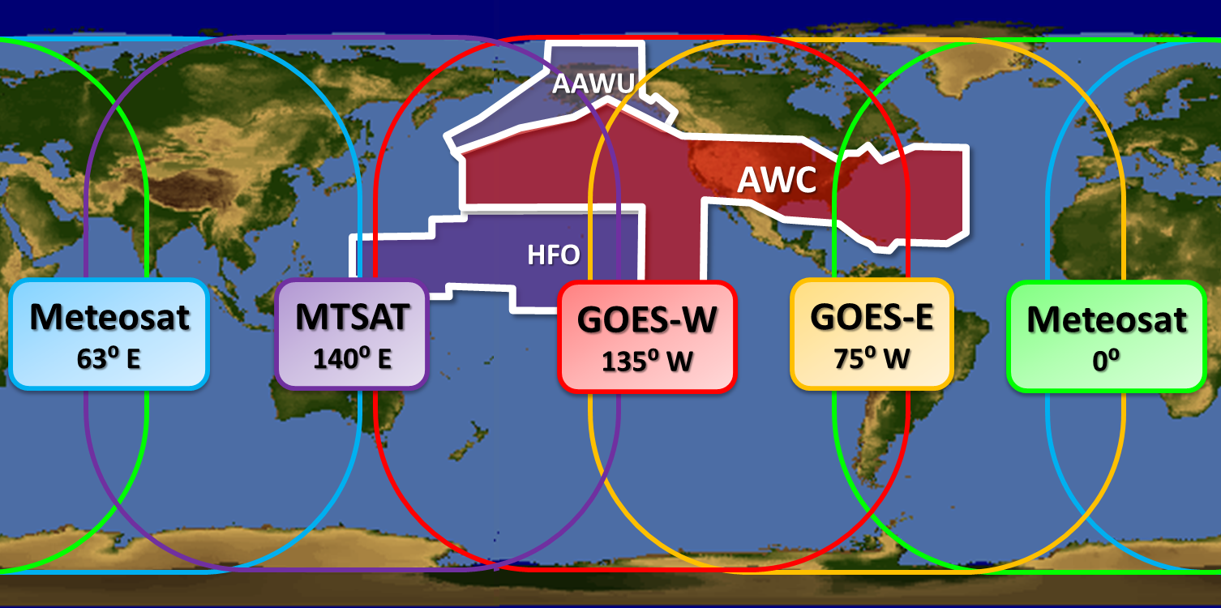
Area of Responsibility for Aviation Warnings (SIGMETs)
AWC’s primary and backup warning responsibility covers nearly 20% of the globe.
AWC’s WAFC Significant Weather Charts cover the entire globe.
Notes:
Meteosat are European satellites operated by EUMETSAT (European Organization for the Exploitation of Meteorological Satellites).
Multifunctional Transport Satellites (MTSAT) are a series of weather and aviation control satellites. They are geostationary satellites owned and operated by the Japanese Ministry of Land, Infrastructure and Transport and the Japan Meteorological Agency (JMA), and provide coverage for the hemisphere centred on 140° East; this includes Japan and Australia who are the principal users of the satellite imagery that MTSAT provides.

Slide 10
AWC Web and Data Services
Hits Volume
Lots of data: Over 20 million hits and 325 GB data served daily

Slide 11
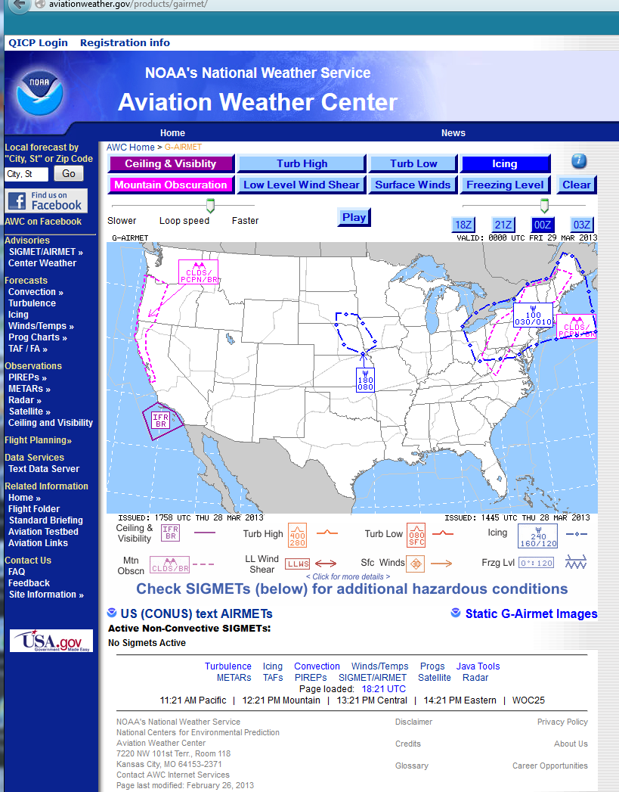
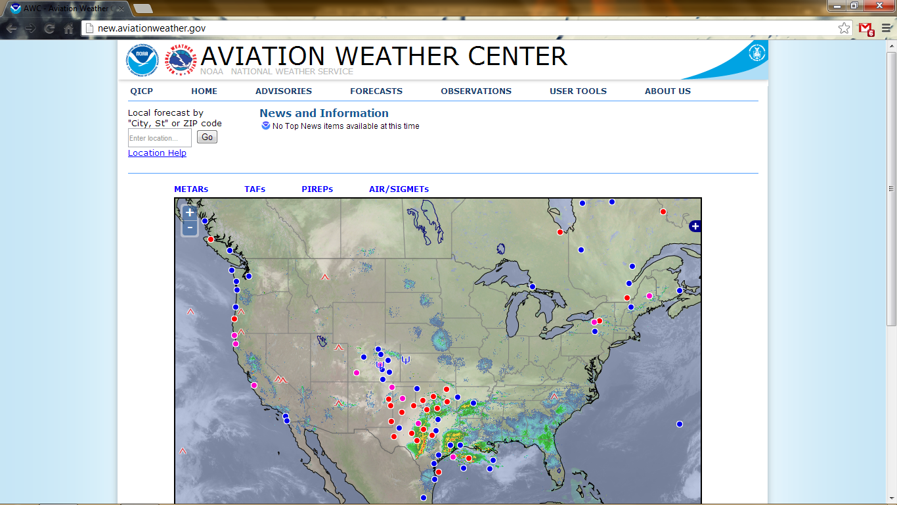
www.aviationweather.gov
new.aviationweather.gov
Coming Q3!
(Preview available now)

Slide 12
Outline
Aviation Weather Center Operations
FY13 Highlights
FY14 Milestones and Projects
Production Summary

Slide 13
FY13 Milestones Completed
Operations
  WAFS Global Grids operationally implemented
    WAFS Science Meeting at NCWCP (Feb, 2013; Matt Strahan – IOB Chief)
  CCFP shifted to 4, 6, 8 hour lead times
  International Training (CAAC; Korea; Taiwan; Japan)
  Aviation Weather Statement & Operational Bridging
Aviation Weather Testbed (AWT)
  Winter & Summer Experiments (Feb. and Aug. 2013)
  SREF-based Dashboards (Winter & Summer)
QMS ISO-9001:2008 Registration
EMC & NCO
Notes:
WAFS science meeting output was requirements for the WAFS roadmap. Clear user requirements vetted through IATA (Intl Air Transport Assoc).

Slide 14
Outline
Aviation Weather Center Operations
FY13 Highlights
FY14 Milestones and Projects
Production Summary

Slide 15
FY14 AWC Major Milestones
PPA | Milestone | Quarter | Other involved Centers, Offices, Agencies
AFS | Increased services to the Federal Aviation Administration (FAA) Air Traffic Control System Command Center (ATCSCC) through implementation of a reimbursable agreement with the FAA to fund four National Aviation Meteorologists | Q2 | FAA, OCWWS
AFS | Establishment of an agreement with Department of Homeland Security (DHS) Customs and Border Patrol (CBP) to provide impact decision support services for the Tethered Aerostat Radar System (TARS) program | Q3 | DHS/CBP, OCWWS, OST, DOD/USAF/AFWA
Disseminate | Acquisition of replacements for AWC's end-of-life Local Area Network (LAN) switches and firewalls. | Q4 | NCO, IDP
ST&I | Completion of one interactive experiment in the Aviation Weather Testbed (AWT) | Q4 | Numerous

Slide 16
FY14 AWC Major Milestones
PPA | Milestone | Quarter | Other involved Centers, Offices, Agencies
AFS | Improved situational awareness of product timeliness through operational implementation of a real-time production dashboard | Q3 | NWSEO
AFS | Operationally implement the Aviation Winter Weather Dashboard (AWWD) on www.AviationWeather.gov | Q2 | WOC or IDP, NCO
Disseminate | Implementation of a modernized www.AviationWeather.gov utilizing a Open Geospatial Consortium (OGC) Web Mapping Service (WMS) and the new National Weather Service (NWS) web page layout | Q3 | WOC or IDP, NCO
ST&I | The Ensemble Processor (EP) availability within the AWT for real-time diagnostics and the research of ensembles for advance probabilistic forecasting | Q4 | CIRA
ST&I | AWC Low-Level Significant Weather Chart availability through Common Support Services–Weather (CSS-Wx) | Q4 | OST, FAA, IDP

Slide 17
Other Important Projects/Efforts
PPA | Projects/Efforts | Other involved Centers, Offices, Agencies
AFS | C-SIGMET 2-hour short-term MITL/MOTL convective forecast product | NWSEO
AFS | ICAO/WMO Meteorological Division Meeting | FAA, OCWWS
AFS | CAR/SAM Backup | OCWWS, NWSEO
AFS | Radiation and Volcanic Ash SIGMETs Changes | FAA, OCWWS
Disseminate | IDP web services transition | IDP, NCO
ST&I | Increased EDR usage | WSI
ST&I | Auto Low-Level SigWx
ST&I | C&V Model Improvements | EMC, DTC
AFS & ST&I | Common operating picture for convection | SPC, WPC, ?
AFS | TRACON Gate Convective Forecast | CWSU, OCWWS
AFS, ST&I, Processing, Disseminate | Icing and Turbulence Improvement to WAFS Global Grids | EMC, NCO, OCWWS

Slide 18
AWIPS II
Technical Implementation
Non-SBN Data Flows
Local Application Migration
Workstation Configurations
Training
Configuration Managers/Focal Points
Support Staff
Forecasters
Aviation Weather Testbed System
(aka Transition System)
Remote Site AWIPS II Systems
FAA ATCSCC/ Warrenton, VA
15th OWS / Scott AFB, St. Louis
1st WG AFWA / Offutt AFB, Omaha

Slide 19
Aviation Weather Testbed (AWT)
Scaled-back activities
Traffic Flow Management
Ensembles/Probabilistic Forecasting
Ceiling and Visibility Modeling
Impact Decision Support Services
Increase Collaboration with the Environmental Modeling Center
Due to Forecaster Retirements, Hiring Freeze, and Budget Cuts

Slide 20
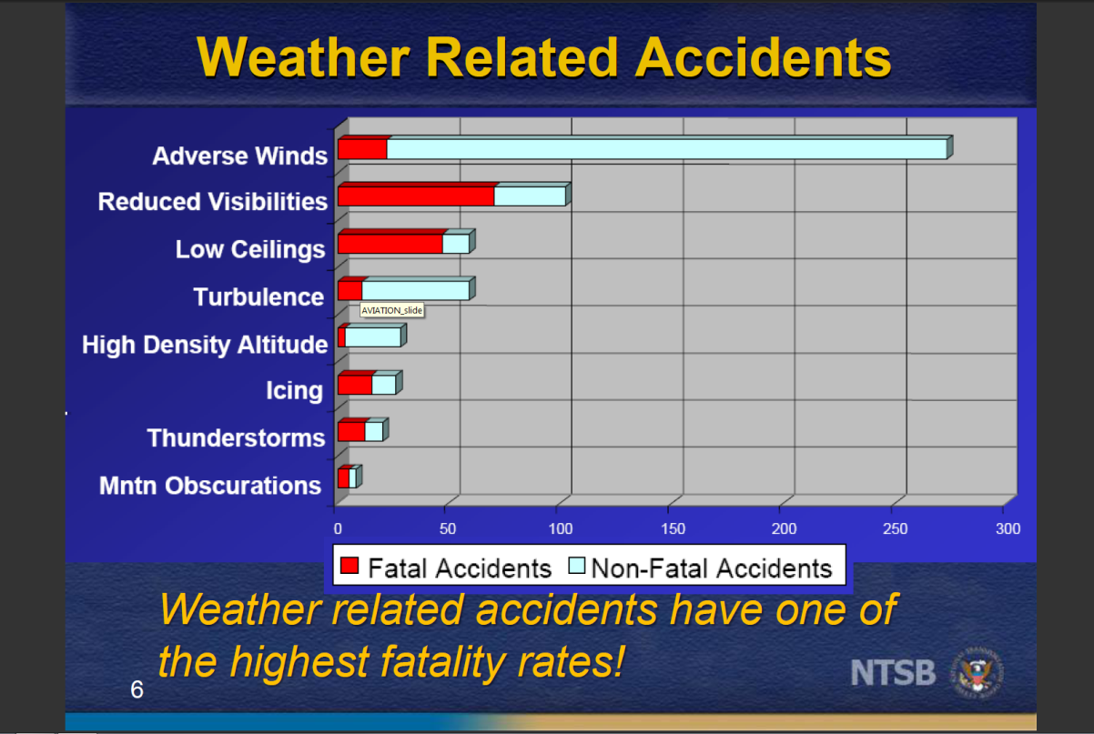
Why C & V?
Over half of all fatalities are
attributable to IFR issues
(2007-2009)
From: Paul Suffern, NTSB
Notes:
Taking a closer look at those ~700 weather-related accidents where weather a cause, adverse winds the primary cause. Then C&V…note that C&V have very high fatality rate (>50%) as these tend to occur at higher speed / surprise and results therefore do not end well.
Density altitude is the altitude in the International Standard Atmosphere at which the air density would be equal to the actual air density at the place of observation, or, in other words, the height when measured in terms of the density of the air rather than the distance from the ground. "Density Altitude" is the pressure altitude adjusted for non-standard temperature.

Slide 21
UCACN Action Plan
(UCACN: UCAR Community Advisory Committee for NCEP)
AWC #2 (January, 2013)
2) Ensure that the AWC’s products and services remain relevant
Develop a long-term strategic effort
Participation on the Aviation Requirements Working Group (ARWG)
Incorporate the knowledge gained from rapid progress in the observational analysis and numerical prediction of convective weather systems into operations
Include applications of ensemble weather forecasting techniques based on high-resolution convection-allowing models into operations
AWC needs to become more proactive in communicating AWC requirements to the EMC for high-resolution (e.g. storm-scale) model output
Focus on the infusion of science and meteorology into operations, along with appropriate training
Develop new IDSS Meteorologist-Over-The-Loop (MOTL) products and services
Invite operational airline personnel (who deal with the impact of weather) when an experiment involves possible output for use by non-meteorologist users

Slide 22
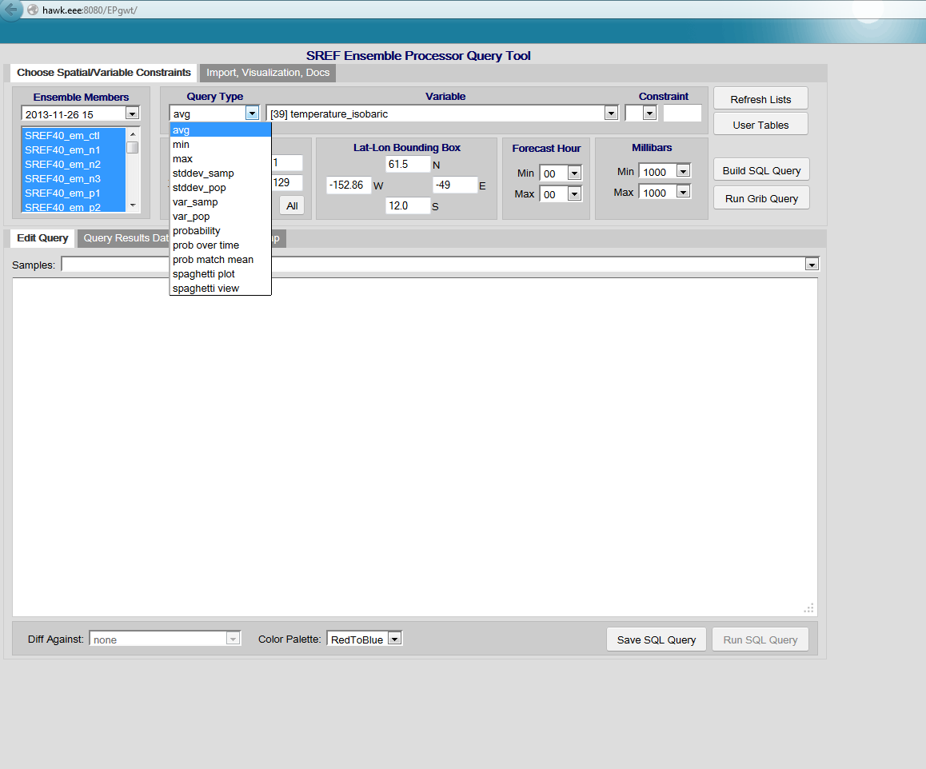
Ensemble Processor
Tool to assist in ensemble post-processing for aviation-specific applications in the AWT

Slide 23
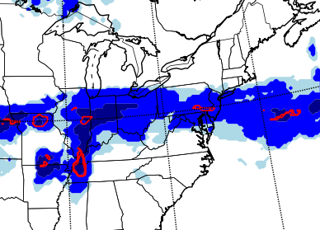
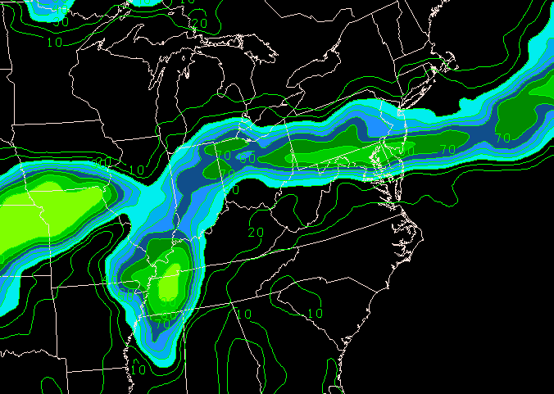
NWP Icing Guidance
RAP Forecast Icing Potential (Shaded: Lgt, Mdt, High)
& Supercooled Large Drops (Red)
12-hour Forecast Valid 15Z 20 Dec 2011
SREF Likelihood of Icing
(> 30% shaded)
12-hour Forecast Valid 15Z 20 Dec 2011
FIP & SREF guidance similar. SLDs identified by RIP farther south.
Can more information be gleaned by diagnostics based on cloud
micro-physics and higher-resolution systems?

Slide 24
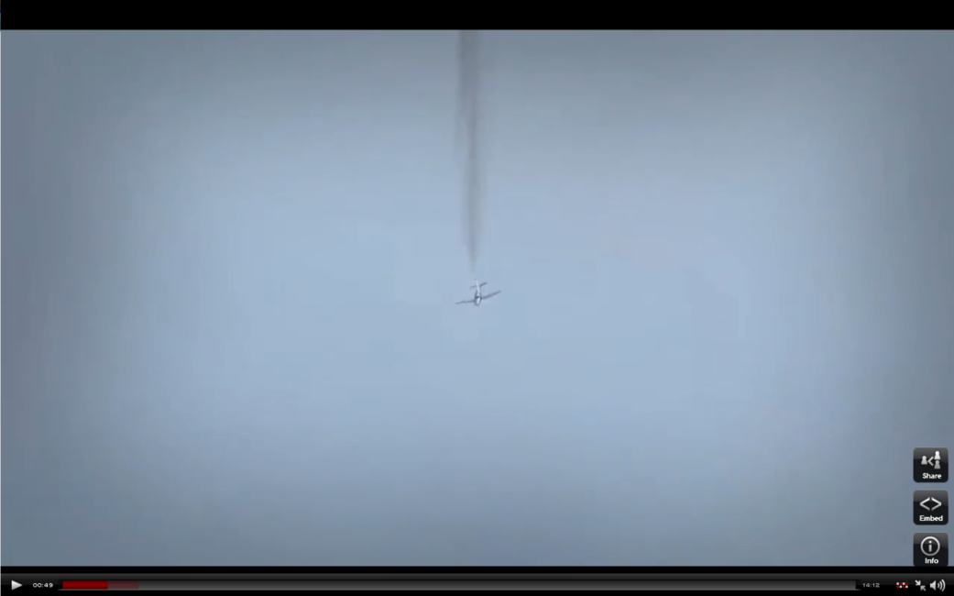
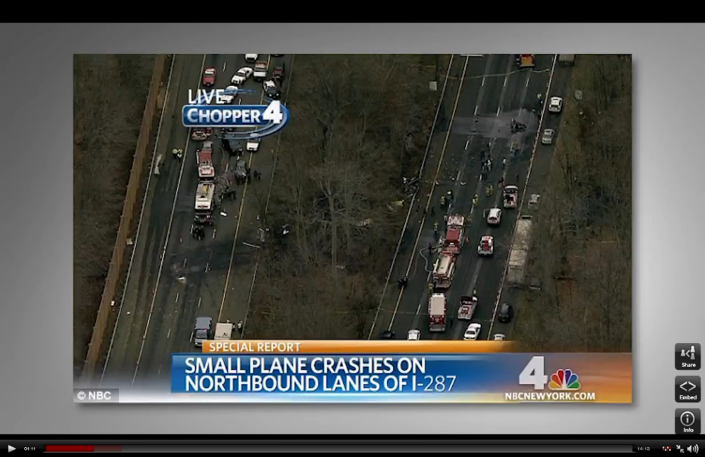
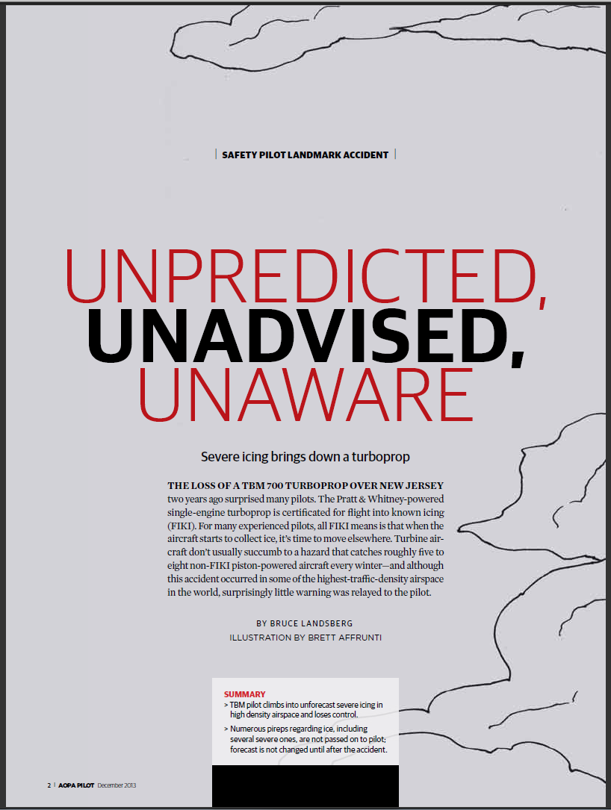
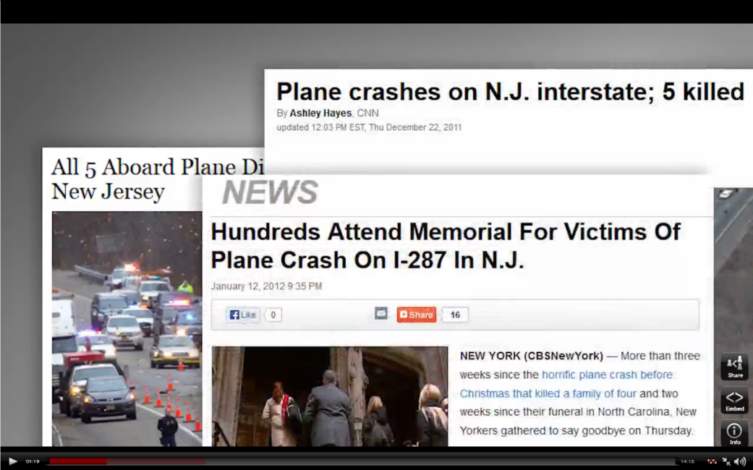
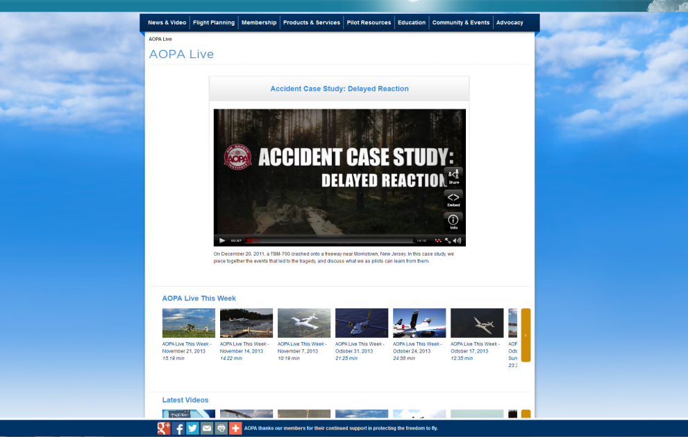
Improving Prediction and IDSS
An excellent AWC forecast, and is there more we can provide?
20 December 2011 ~15Z
http://www.aopa.org/AOPA-Live.aspx?watch={9CC22A1C-9960-43A5-AC03-3757498BE36C}

Slide 25
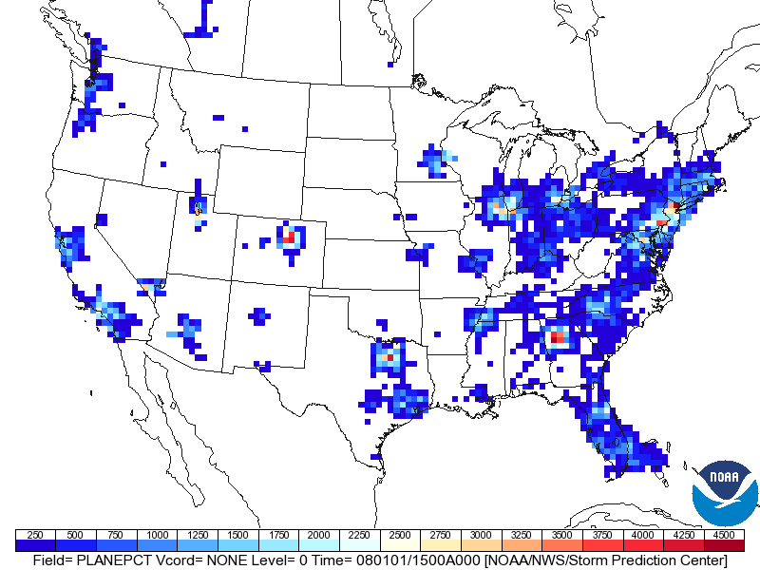
Number of Flights at 1500Z (+/- 30s)
Between 10,000 – 20,000 feet
2004-2008 (Data: J. Huhn, MITRE, Corp.)
Impact Summary:
Some of the busiest airspace in country. In a 40 km
grid box 3000-4000 flights between 10,000 and 20,000 feet MSL over a five year period, averaging > 2 aircraft
in this air space at 15Z.

Slide 26
Note: Error in Cloud Ice Labeling of Units in GRIB/GRIB2/GEMPAK
Example from one member of the SREF:
GRIB2
297:2640402:d=2013112609:CLWMR Cloud Mixing Ratio [kg/kg]:700 mb:87 hr fcst:
298:2642160:d=2013112609:CICE Cloud Ice [kg/m^2]:700 mb:87 hr fcst:
GEMPAK
ncepgrib2.tbl:153 Cloud water kg/kg CWTR 0 -9999.00 0 0
wmogrib128.tbl:058 Cloud ice kg/m^2 CICE 0 -9999.00 0 0

Slide 27
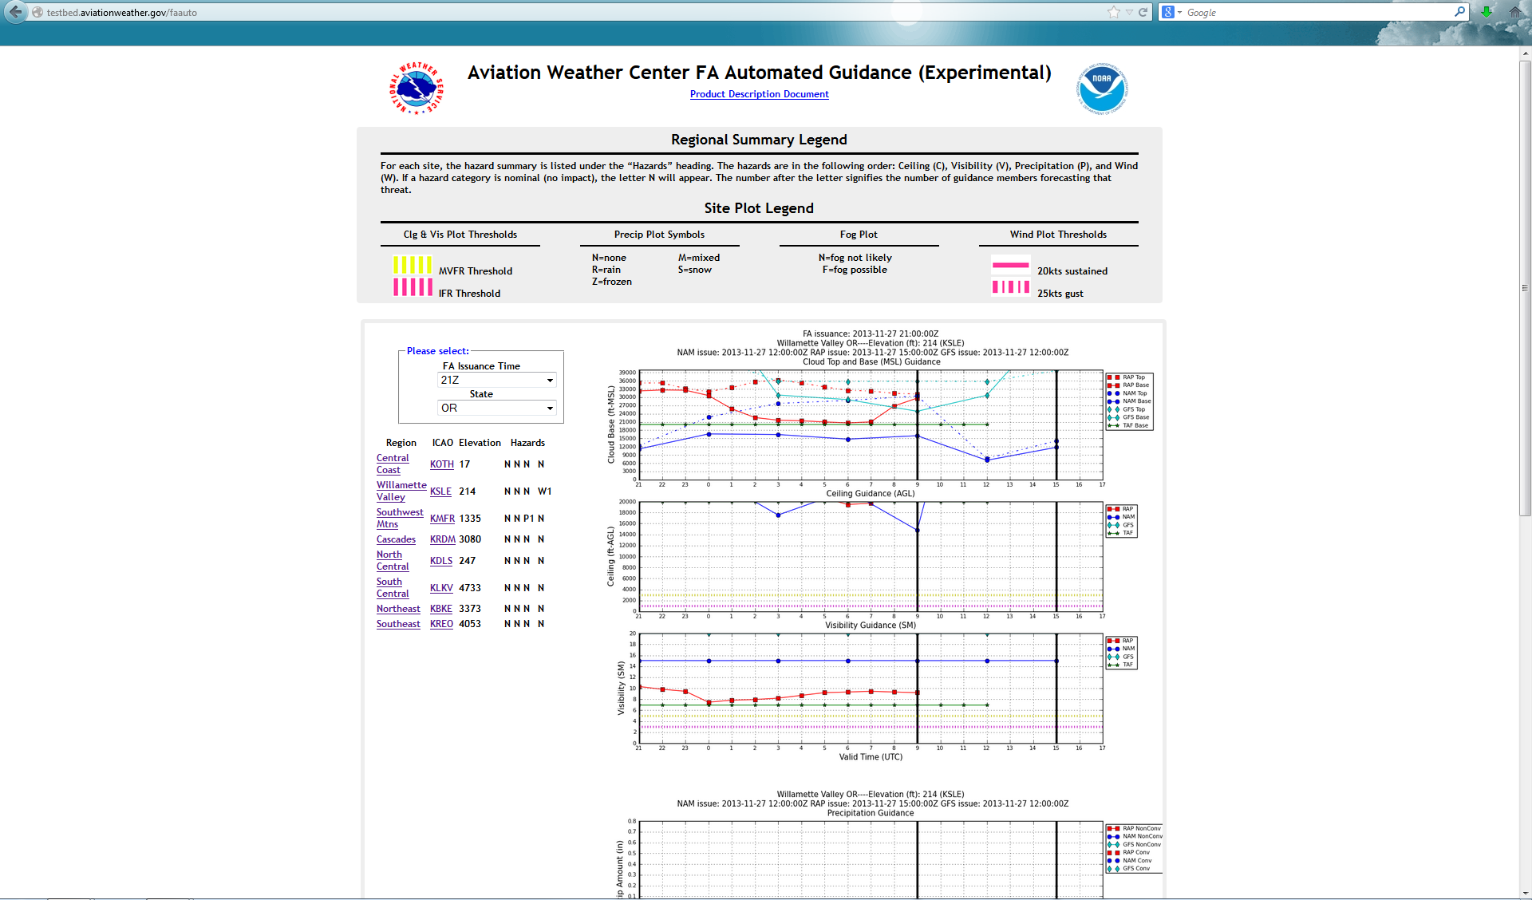
Guidance for the Area Forecast
QC and First-Guess
Selection of area, time, and regions
NWP time series
of clouds, ceilings,
visibilty, precip,
wind, etc.

Slide 28
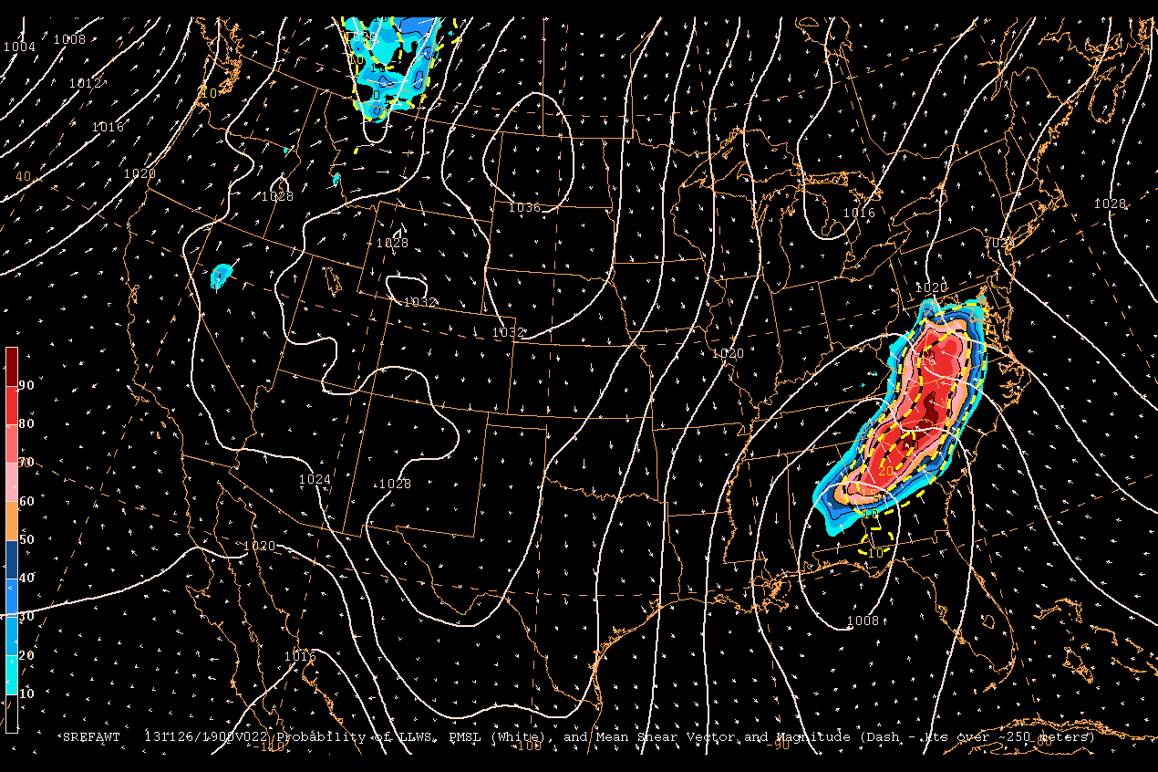
SREF Guidance for AIRMET and SIGMET Production
Numerous reports at
Augusta, GA at this time.
Likelihood of Low-Level Wind Shear, Mean PMSL (white), Mean peak shear (contour) & vector
22-hr Fcst Valid 19Z 26 Nov 2013
Notes:
Numerous reports around Augusta, GA at this time.
20131126_18_pireps.csv:2013-11-26T18:30:38Z,2013-11-26T18:18:00Z,,,,,,,F2TH,33.3699,-81.9645,1000,,,,,,,LLWS,,,,,,,,,,,,,,,,,,,,,,,,Urgent PIREP,AGS UUA /OV AGS/TM 1818/FL010/TP F2TH/RM LLWS +/-10KT SFC-010 DURD,
20131126_19_pireps.csv:2013-11-26T19:43:30Z,2013-11-26T19:33:00Z,,,,,,,UNKN,33.3699,-81.9645,400,,,,,,,LLWS,,,,,,,,,,,,,,,,,,,,,,,,Urgent PIREP,AGS UUA /OV AGS/TM 1933/FL004/TP UNKN/RM LLWS -10 MULTIPLE ACFT,
20131126_19_pireps.csv:2013-11-26T19:29:56Z,2013-11-26T19:10:00Z,,,,TRUE,,,K35A,42.4026,-96.3844,1200,,,,,,,LLWS,,,,,,,,,,,,,,,,,,,,,,,,Urgent PIREP,SUX UUA /OV SUX/TM 1910/FLUNKN/TP K35A/RM LLWS -10 KTS FA RWY31,

Slide 29
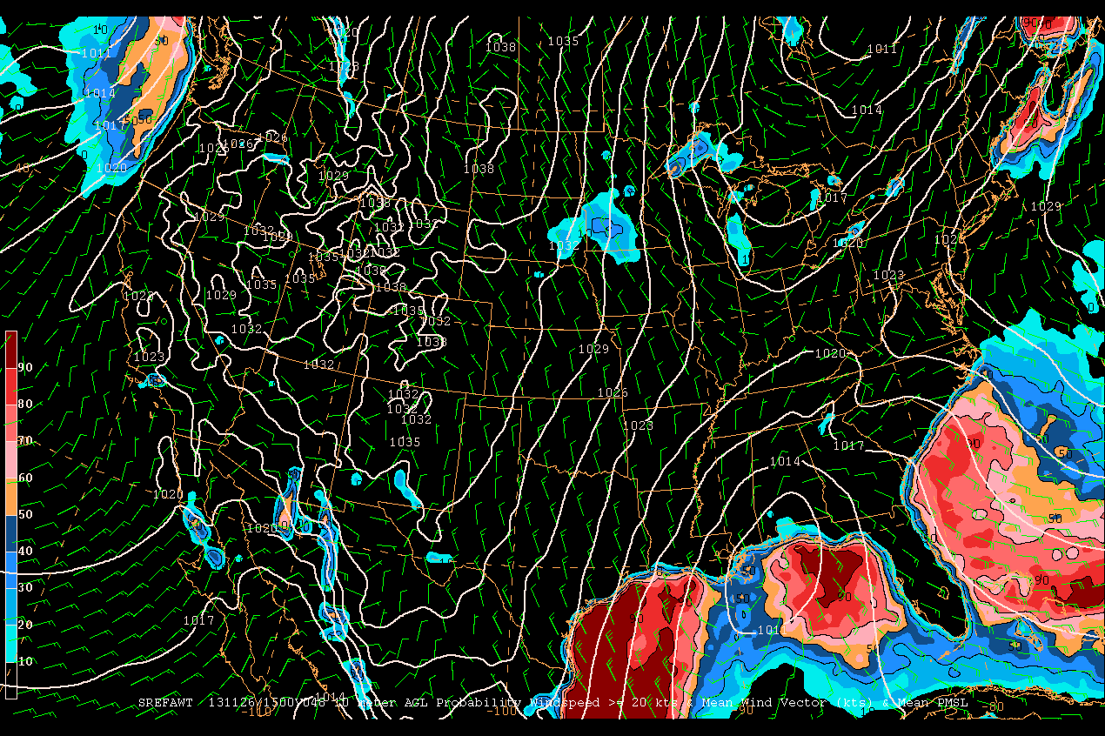
SREF Guidance for AIRMET and SIGMET Production
Likelihood of 10m Wind > 20 kts, Mean PMSL & Mean Wind Barb
48-hr Fcst Valid 15Z 26 Nov 2013

Slide 30
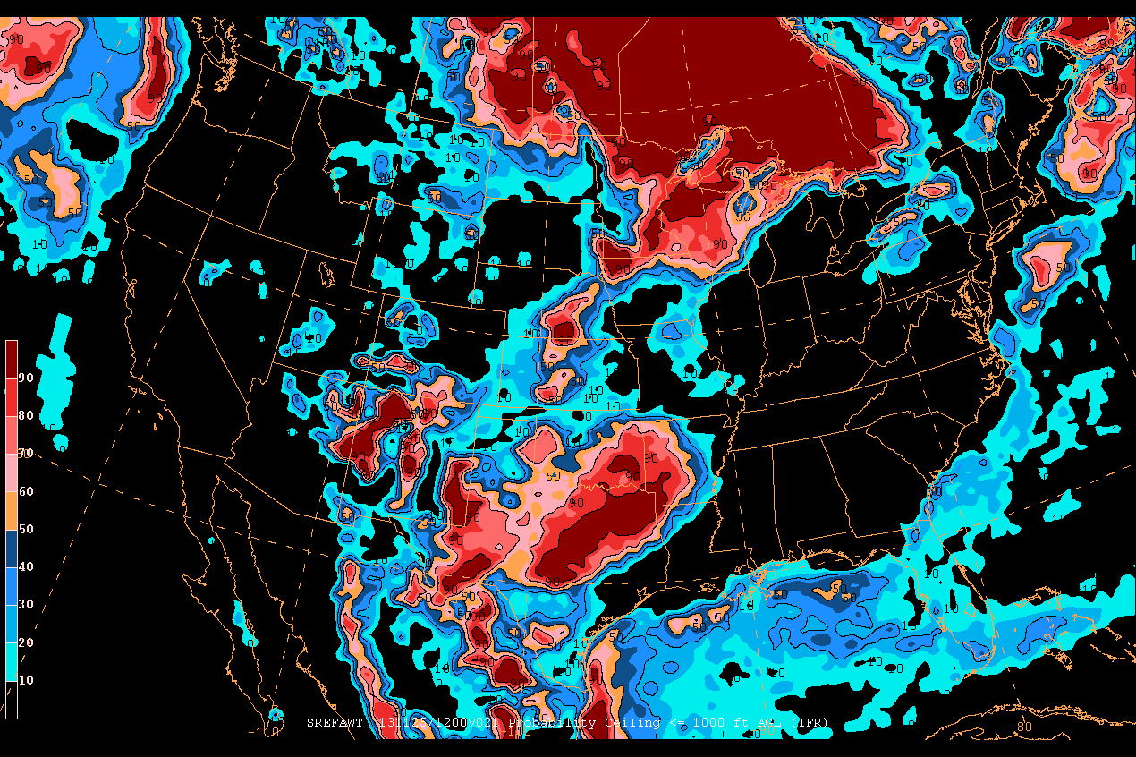
SREF Guidance for AIRMET and SIGMET Production
Likelihood of ceilings < 1000 feet AGL (IFR Ceilings)
21-hr Fcst Valid 12Z 25 Nov 2013

Slide 31
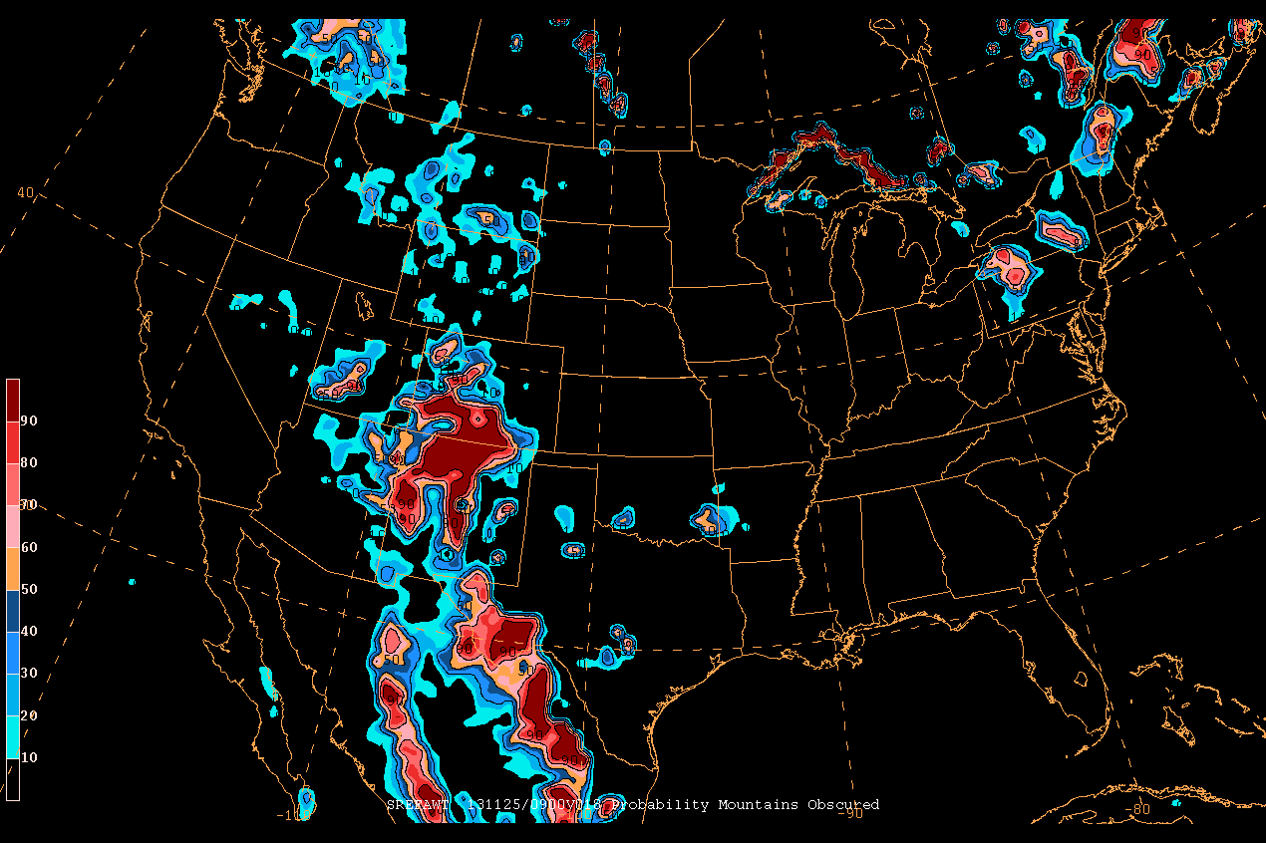
SREF Guidance for AIRMET and SIGMET Production
Likelihood of Mountains Obscured by Clouds
09-hr Fcst Valid 09Z 25 Nov 2013

Slide 32
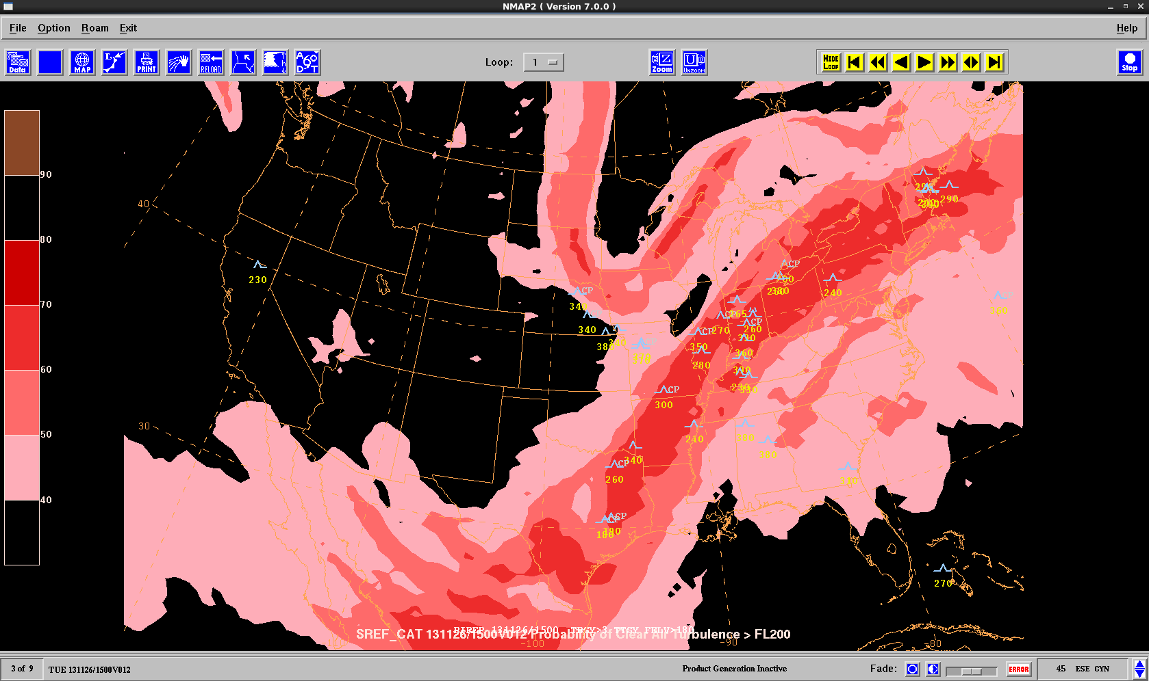
SREF Guidance for AIRMET and SIGMET Production
Likelihood of CAT > 20,000 feet MSL
12-hr Fcst Valid 15Z 26 Nov 2013

Slide 33
Outline
Aviation Weather Center Operations
FY13 Highlights
FY14 Milestones and Projects
Production Summary

Slide 34
Production Summary
Hourly output of SREF 16 km grids on NOMADS
  Only 3-hourly output currently available
Ceiling and visibility guidance
  Correct GRIB/GRIB2 and GEMPAK tables for CICE (minor)
  C & V improvement project with EMC
    Cloud bases, layers, tops, and ceilings all important to General Aviation & AWC efficiencies
    Cloud bases vs. ceilings in the EMC post-processed files
    Sensitivity runs
    Vertical vs. horizontal resolution increases (better C&V, turbulence)
  Add rain and snow mixing ratios to SREF for cloud and icing prediction
  Continue evaluation of aviation hazards from high-resolution models & ensembles
  Consistency in post-processed files (i.e. same fields in all output resolutions)
DS-3 between AWC & WCOSS approaching capacity
Notes:
The Met Office Global and Regional Ensemble Prediction System.
Canadian GEM and Canadian ensemble???? What is available for download.

Slide 35
Production Summary
AWRP Processing on WCOSS
  GTG 3.0 (Summer 2014)
World Area Forecast System (WAFS) Science Meeting
  Initial roadmap developed at NCWCP WAFS Science Meeting (Feb. 2013)
  Since refined and will be presented for approval at joint WMO/ICAO meeting
  Main output is a WAFS global ensemble for aviation hazards
    GTG on the GFS (FIP is done)
    FIP & GTG on GEFS (AWC WAFC ~2015)
      3-Hourly GEFS output on 0.5 degree grid
    Multi-Center WAFS ensemble system (WEPS; IOC ~2018)
      U.S. and U.K. initially (GEFS and MOGREPS, respectively)
    Post-processing: WEPS tuned and calibrated on aviation hazards (turbulence, icing, convection, etc.)
Global total lightning for operations
MRMS Dual-Pol analysis for icing
Notes:
The Met Office Global and Regional Ensemble Prediction System.
Canadian GEM and Canadian ensemble???? What is available for download.

