Slide 1
Space Weather Prediction Center (SWPC)
NCEP PSR 2013
George Millward

Slide 2
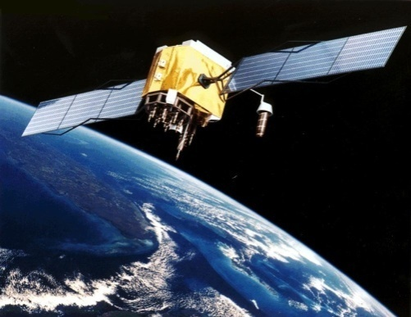
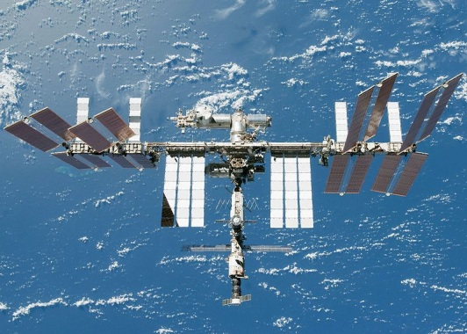
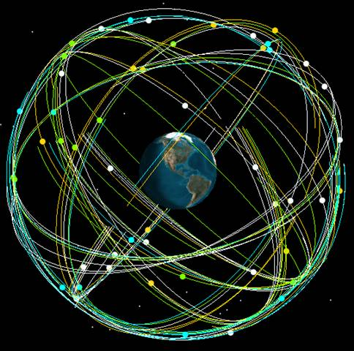
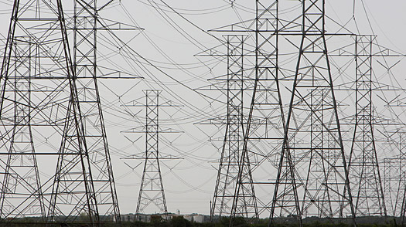

Space Weather Impacts
Impacts from space weather are wide-ranging with potentially significant consequences.
Satellite Operations
Manned Spaceflight
Increased radiation risk
GPS
Precision Agriculture,
Surveying, Drilling, Military
Power Grid Operations
Grid failure, Grid capacity, Component Failure,
GPS Timing
Aircraft Operations,
Airline Communication

Slide 3
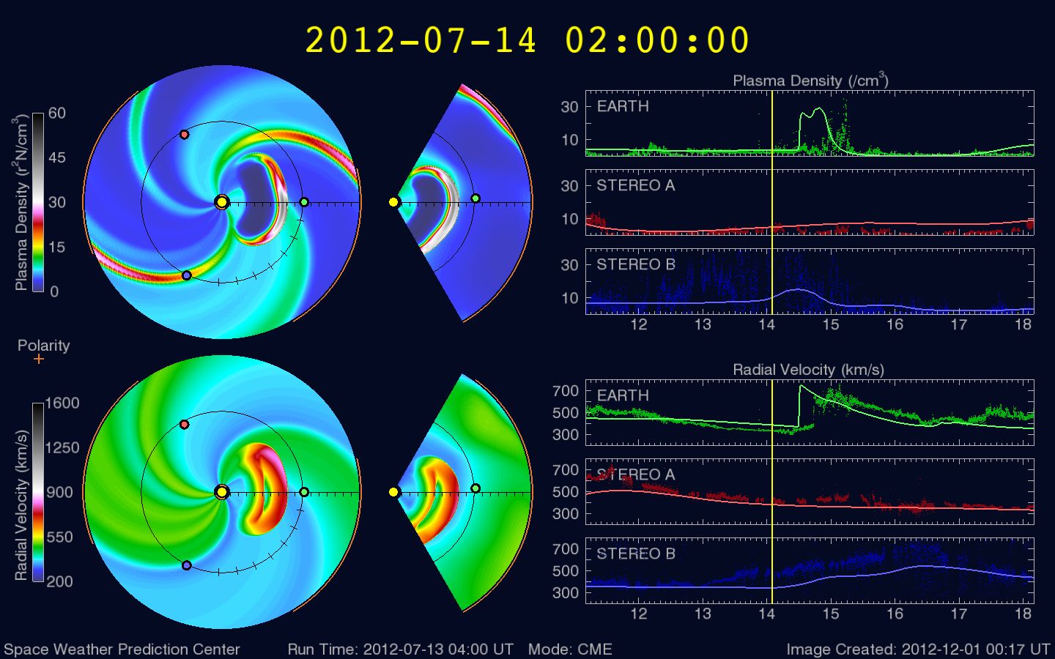
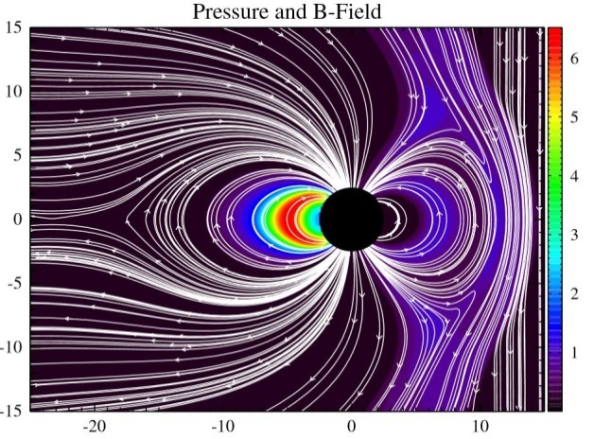
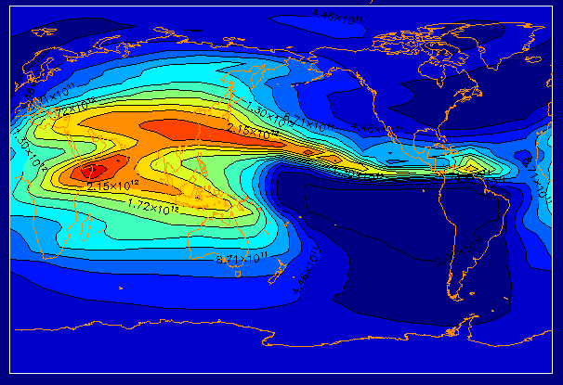
Forecasting CME arrival at Earth
  WSA-Enlil in operations at NWS
Regional Geomagnetic Activity Forecasts
  Geospace Model Evaluation
Ionosphere/Upper Atmosphere:
GPS, Communications, Satellite Drag
  - Whole Atmosphere Modeling

Slide 4
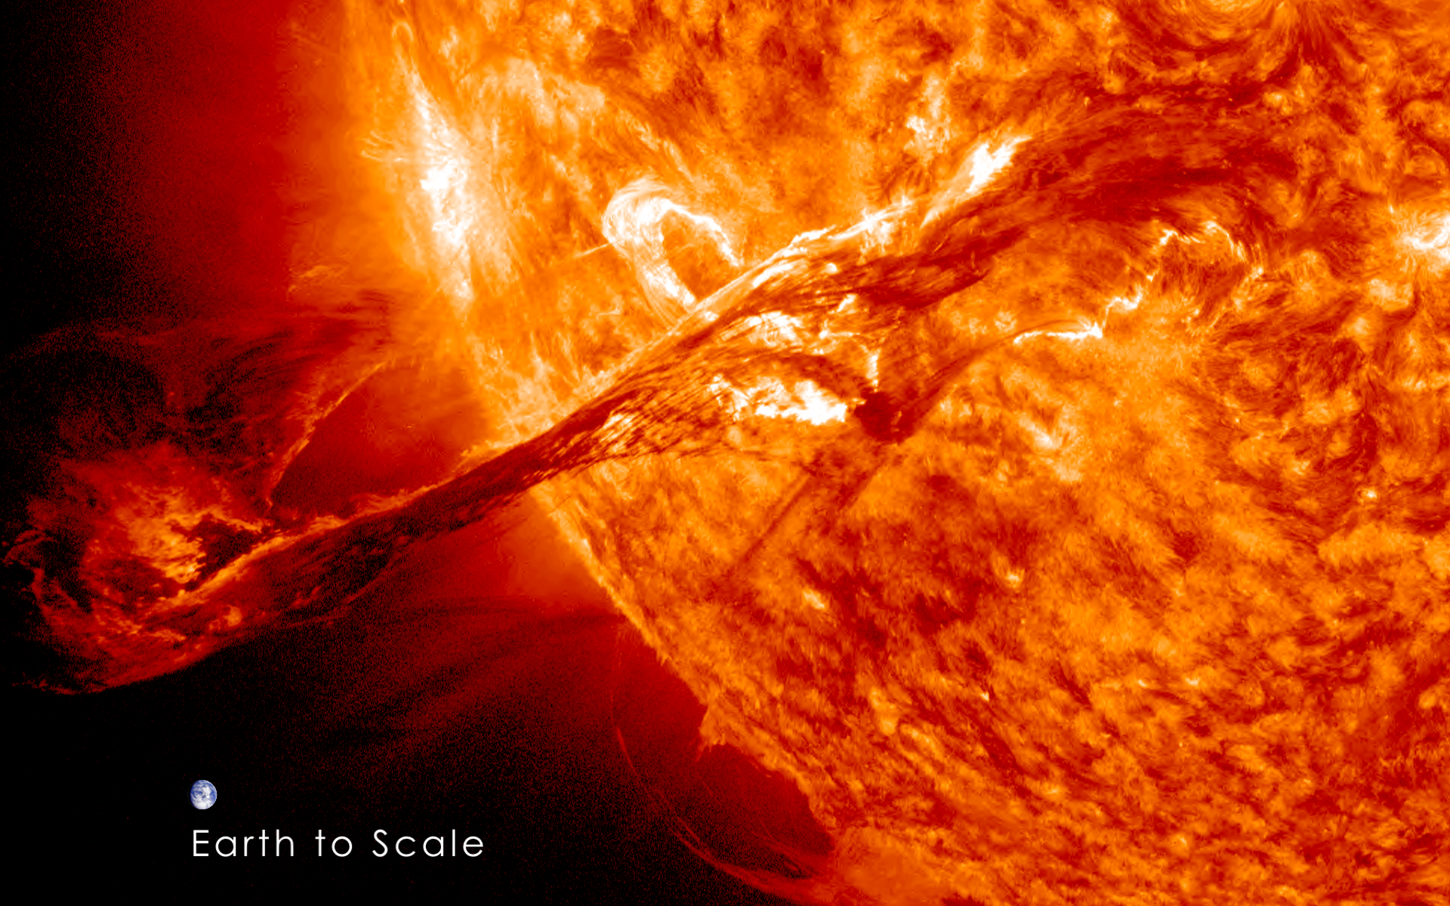
The Problem: Coronal Mass Ejections (CMEs)
Mass: 10¹² to 10¹³ kg, Velocity: 300 to 3500 kms⁻¹
Critical Questions:
Will the CME interact with Earth?
If so, when?
How strong will the effects be?
Filament eruption on August 31 2012
(NASA/SDO)

Slide 5
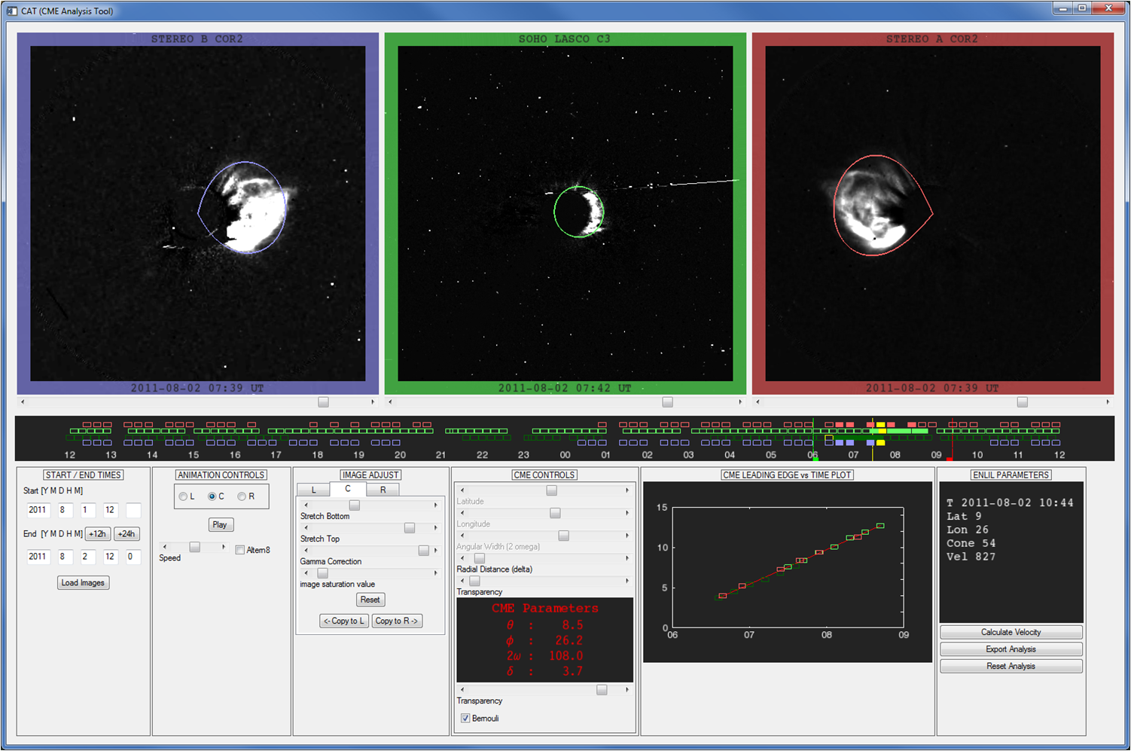
Determining CME Parameters: 3 viewpoints and the
CME Analysis Tool (CAT)
Stereo B Coronagraph
SOHO Coronagraph
Stereo A Coronagraph
CME
CME
CME
CME Direction and Velocity

Slide 6
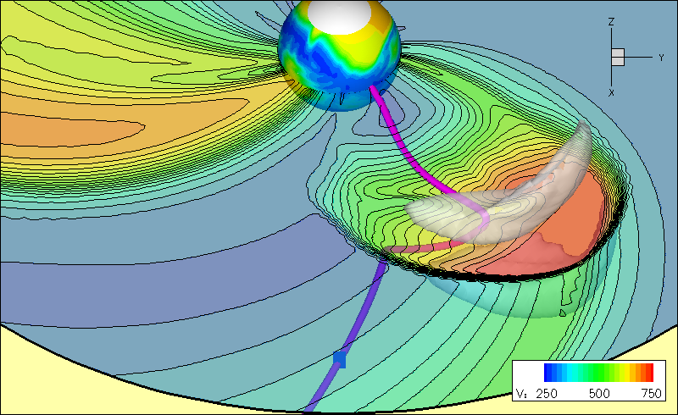
WSA-Enlil model: in operations at NWS since FY12
Enlil: Magneto-Hydrodynamic (MHD) model
Grid: Spherical Coordinate System, 2 deg. lat/long, 512 radial (medium res)
Fortran 90, MPI code, runs on 32 procs on WCOSS (1.5 hours wallclock)
WSA: Empirical model. Provides steady-state background condition.

Slide 7
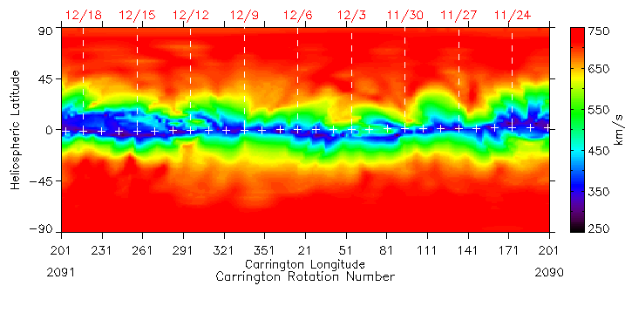

CME Parameterization
SOHO/STEREO + CAT Analysis
Solar Photospheric Magnetic Field (NSO)
WSA
radial velocity
radius
latitude
longitude
Global, co-rotating background flow
10 day model startup
5 days CME injection
T = -15
T = 0
T = 5
1.5 hours Wallclock time on WCOSS
Notes:
Add a transition slide to this section…
WSA semi-empirical…

Slide 8
5.5 hours

Slide 9
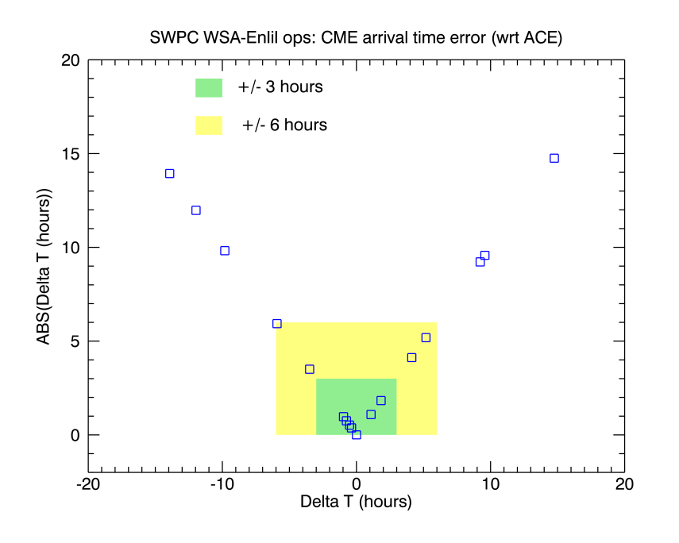
CME arrival time predictions FY2012 and FY2013 (predicted vs observed at ACE satellite)
 | Average (hours) | RMS (hours)
FY2012 | 8:13 | 9:39
FY2013 (up to 7/13) | 5:19 | 7:12
All | 7:04 | 8:59
Compare to:
The ‘community’ accepted error during previous Solar Cycle was ±12 to ±15 hours

Slide 10
Inputs Drive the Performance
Enlil propagates CMEs from the corona out to Earth
  Driven by the empirical WSA Model
    WSA errors in wind speed of 50-100 kms⁻¹ are common
    WSA errors in background wind speed of order 100kms⁻¹ can change arrival time by up to 6 hours
  Driven by the parameterization of CMEs observed in near-real-time
    An educated guess would be the CME parameter estimates are good to no better than 20%
    20% error in CME parameters can change arrival time by more than 6 hours
Improving these inputs is where SWPC efforts will be devoted in FY14 and beyond

Slide 11
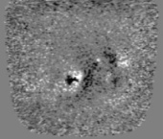
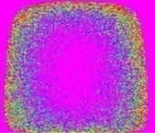
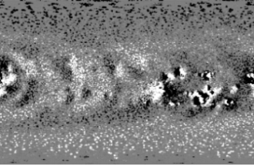
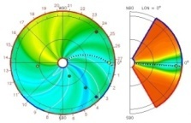
FY2013 Developments: Improved Inputs
Air Force Data Assimilative Photospheric Flux Transport Model (ADAPT)
Dynamically updating boundary…
SWPC collaborating with WSA and Enlil researchers (AFRL and GMU) to operationalize and test this functionality
Data Assimilator
Data Assimilator
Modeling / Forecasting Applications
Intelligent Front
End
Modeling/Forecasting Applications
Input Data
Initial Conditions
Input Data
Intelligent Front End
Solar
Magnetogram
Data
Import & Select Data
for
Data Assimilator
Improved Solar Synoptic Maps
Coronal & Solar Wind Models
Forecast Step:
use the WH model to
calculate forecast
WSA+ENLIL
Analysis Step:
combine observations with forecast
Magnetic
Field
Variance
Global
Magnetic Field
WSA-ENLIL
Solar Wind
Magnetic Field
Variance
Assimilation Results
Global Magnetic Field
WSA-ENLIL
Solar Wind
FY2014 WSA-Enlil -> operational upgrades

Slide 12
Forecasting CME arrival at Earth
  WSA-Enlil in operations at NWS
Regional Geomagnetic Activity Forecasts
  Geospace Model Evaluation
Ionosphere/Upper Atmosphere:
GPS, Communications, Satellite Drag
  - Whole Atmosphere Modeling

Slide 13
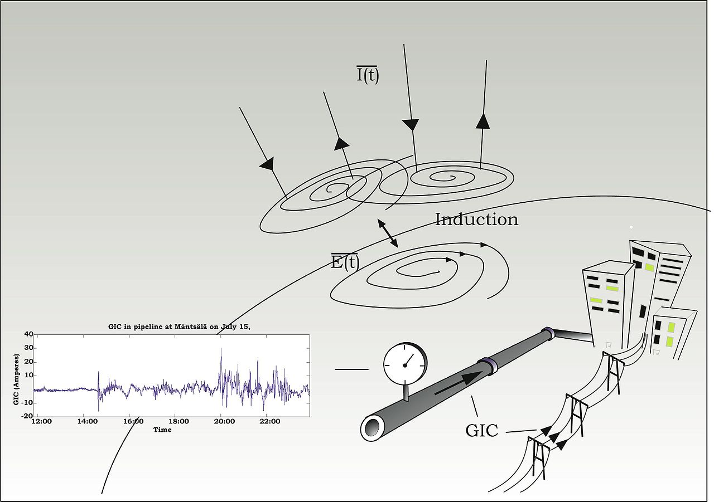
Ground Induced Currents (GICs) resulting from Solar Wind-Magnetosphere interaction

Slide 14
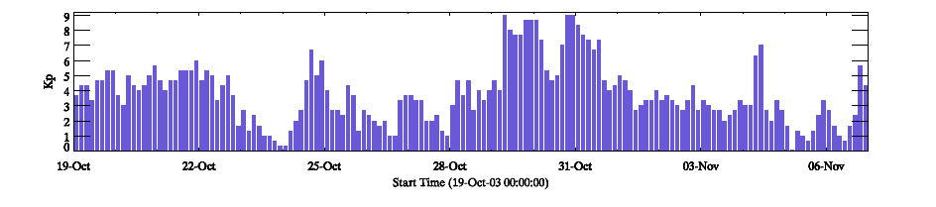
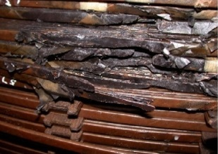
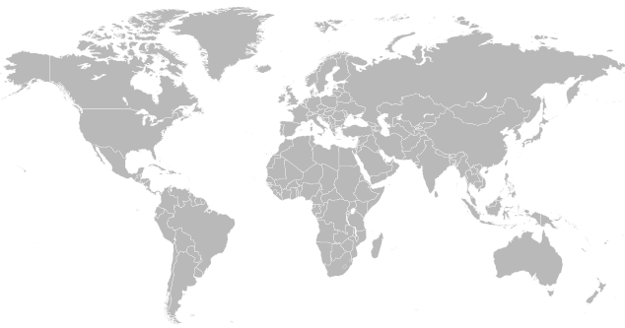

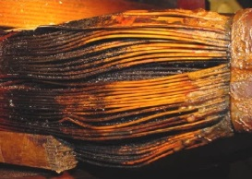
The Need for Regional Geomagnetic Activity Forecasts: Example from 2003
Long intervals of high Kp,
yet…effects regional
Sweden:
- Power outages
- Transformer heating in nuclear power plant
United States:
- Power reduced at nuclear facilities to mitigate impacts
South Africa:
- 15 transformers damaged
- $60 million impact
- Basic commerce and security impaired

Slide 15
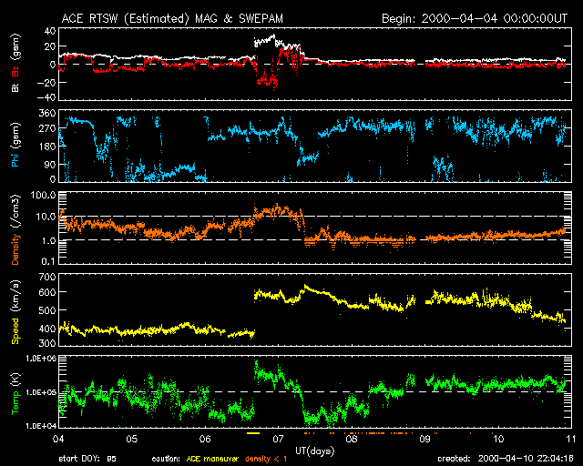
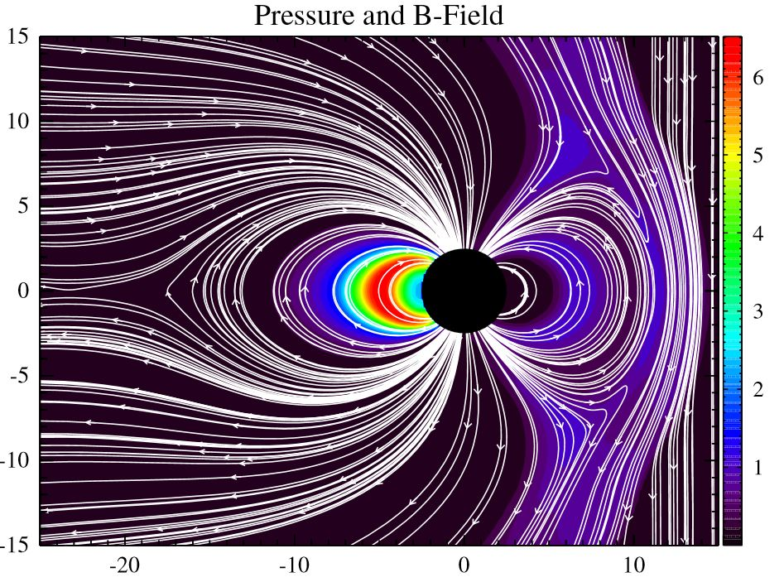
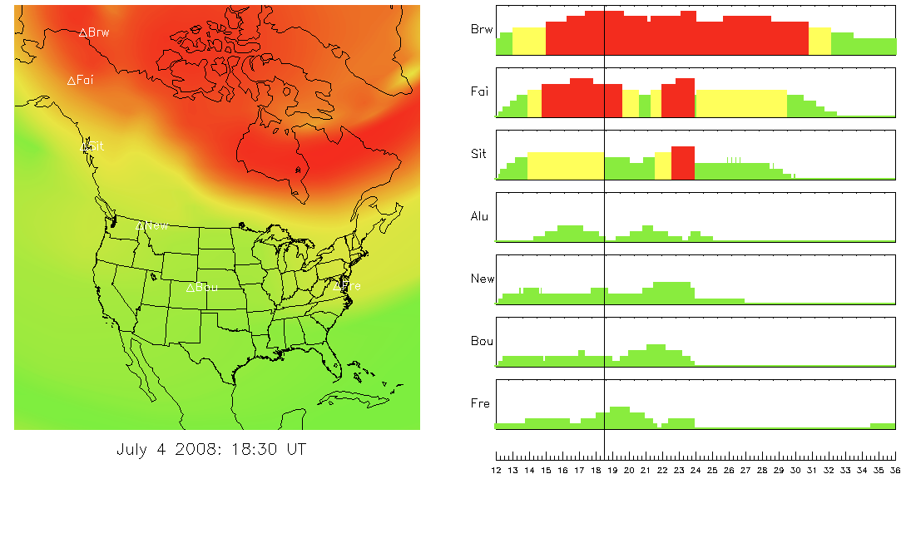
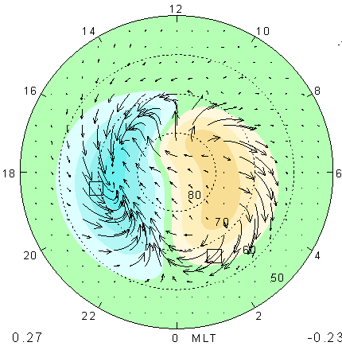
Geomagnetic activity forecasts from Geospace models
real-time solar wind measurements (15 to 60 minutes upstream)
3D geospace MHD model
regional geo-magnetic activity prediction
ionospheric electric currents

Slide 16
Geospace Models: Evaluation and Transition to Operations
Goal: Evaluate Geospace models (MHD and empirical) to determine which model(s) are ready for transition to operations
Focus: Regional K and dB/dt (important to electric utilities)
Partnership: Evaluation at NASA/Goddard CCMC working with SWPC, modelers and science community
Select Models and Events
Establish Metrics
Model-Data Comparisons
CCMC Reports to SWPC
SWPC selects a model for transition
FY11
FY13
Model selection (end FY13) by SWPC based on CCMC reports, internal and external advice, and other considerations such as implementation readiness and cost to operate, maintain and improve.
Operational at NCEP by end of FY15

Slide 17
Models Participating in Geospace Evaluation at NASA CCMC
MHD Models:
The Open Geospace General Circulation Model (Open GGCM) - UNH
Space Weather Modeling Framework (SWMF) - U.Mich
Coupled Magnetosphere-Ionosphere-Thermosphere (CMIT) - BU CISM, Dartmouth, NCAR
Grand Unified Magnetosphere-Ionosphere Coupling Simulation (GUMICS) - Finnish Meteorological Institute (recently parallelized, not ready for full evaluation for selection process)
Empirical Models:
Weimer Empirical Model, Va. Tech
Weigel Empirical Model, GMU

Slide 18
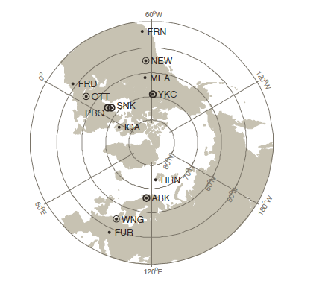
Geospace model evaluation example: For a given location on the Earth, during 145 instances where local magnetic storming registered K=4, what was the spread of K predictions from each of the models?
pretty good
systematic over-estimation
systematic under-estimation

Slide 19
As a result of this extensive evaluation process Dr Howard Singer, Chief Scientist at SWPC recommends that SWPC invest resources in the transition of the University of Michigan’s Space Weather Modeling Framework (SWMF) to operations.
The University of Michigan model capabilities include:
The highest Probability of Detection (POD) and Heidke Skill Scores (HSS) for all dB/dt thresholds and a low Probability of False Detection (POFD)
Greatest skill in predicting Regional K
Computational robustness running through large storm events and for long intervals
Real-time capability running on 64 processors
Codes that can be run with existing NCEP compilers, libraries, software
Skill scores for predicting geomagnetic activity at specific locations that are better than what can be determined from the Wing Kp model (currently in use by the USAF and SWPC)

Slide 20
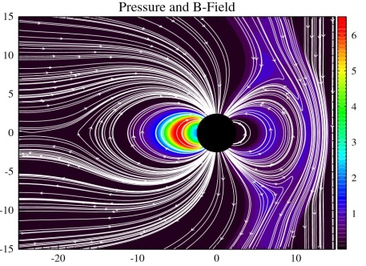
Next Steps (FY14-15)
Official sign-off to begin the transition process from SWPC management
Working on a Concept of Operations (CONOPS)
Inputs
SWMF model
Forecast products
Model/System testing
Operational at NCEP by end of FY15

Slide 21
Forecasting CME arrival at Earth
  WSA-Enlil in operations at NWS
Regional Geomagnetic Activity Forecasts
  Geospace Model Evaluation
Ionosphere/Upper Atmosphere:
GPS, Communications, Satellite Drag
  - Whole Atmosphere Modeling

Slide 22
Whole Atmosphere Modeling
From the Ground to Space
Motivation:
  There is a strong need for improving forecasts of the upper atmosphere and ionosphere
    Structures in the ionosphere affect radio signals and modify radio transmission paths or block transmission altogether
      Changes in Total Electron Content (TEC) impact GPS radio navigation
      Ionospheric irregularities impact satellite communication.
    Neutral density changes affect satellite orbits (drag)
  The lower atmosphere imposes a lot of day-to-day variability on the Ionosphere/Thermosphere system
    Planetary waves, gravity waves, tides, etc… propagate upward to the thermosphere.
    Sudden Stratospheric Warmings change the global structure
    The lower atmosphere modulates the density of the upper atmosphere and deposits energy and heat in region above 100 km.

Slide 23
Motivation: January 2009 stratospheric warming
Polar strat-warm changes global circulation leading to vertical drifts in the ionosphere which in turn leads to instabilities which creates plasma structures and GPS scintillation
Climatological TEC @ 10 and 16 LT from ground GPS observations.
Same on January 27, after the peak of the warming.
Comparison of plasma drift climatology with observations on Jan. 27.
Goncharenko et al. (2010):

Slide 24
Many low and mid latitude ionospheric structures are driven from below
Return Signal Strength
Ionospheric Structures Stimulated by Tropospheric Phenomena
JULIA radar observations (Hysell & Burcham, 1998)

Slide 25
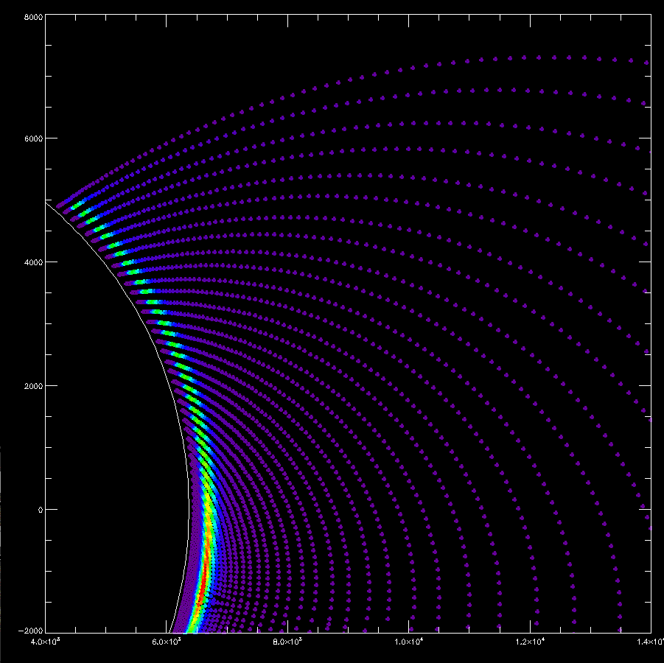
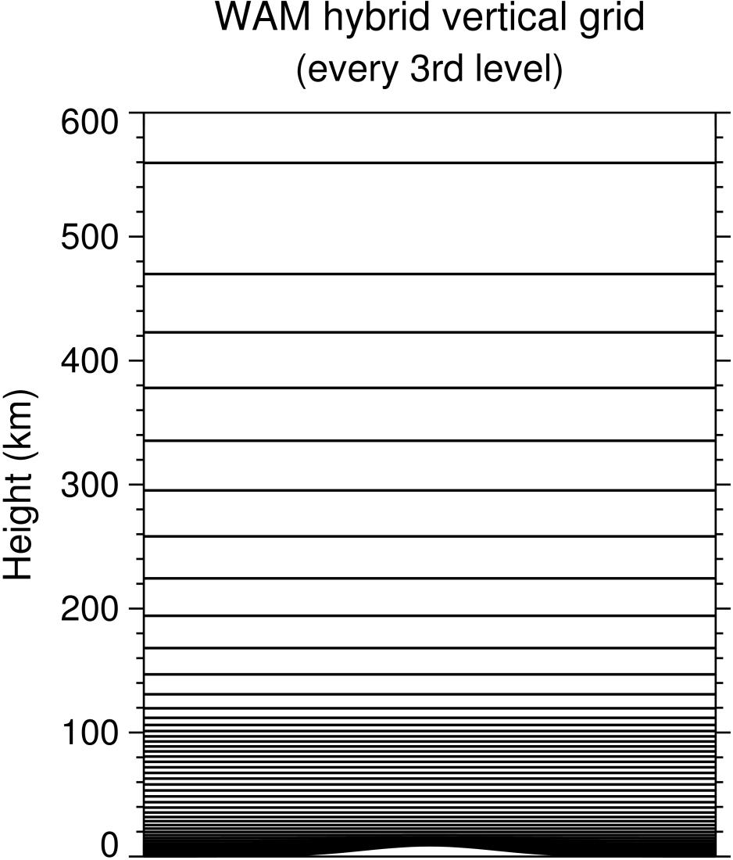
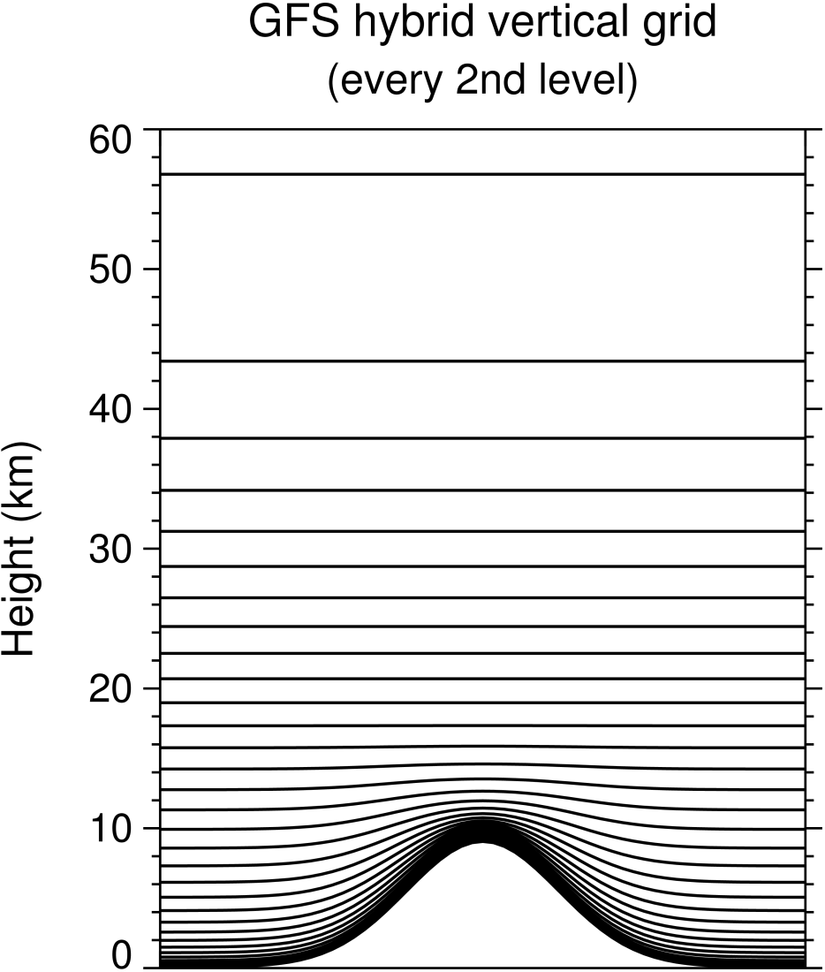
Solution: Couple the Extended GFS or “Whole Atmosphere Model” to the “Ionosphere Plasmasphere Electrodynamics” Model
Multi-day forecasts of ionospheric conditions
IPE Grid Follows Magnetic Field Lines
Ionosphere Plasmasphere Electrodynamics
IPE Model
Whole Atmosphere Model
WAM = Extended GFS
0 – 600 km
Coupling lat.-lon.-pressure level grids to field aligned grids
Parallelizing IPE Model and coupling into WAM: big undertakings during FY13 and FY14
GFS
(Global Forecast Systems)
Weather forecast model
0 – 60 km
Thermosphere

Slide 26
The Basic Tasks and Timeline:
There are three critical research areas that need to be addressed:
  The development and implementation of the Ionosphere-Plasmasphere-Electrodynamics (IPE) module
  Understanding the impact of increasing spatial resolution of the model
  Implementation and testing of new data assimilation techniques applicable to the middle and upper atmospheres and ionosphere.
Fiscal Year | Tasks
2012 | WAM on Zeus
2013 | Higher Resolution WAM Begin coupling to IPE Begin GSI extension to ~120km Establish new data flows for ionospheric input
2014 | Couple to IPE Complete GSI Extension AMIE forcing complete for 120-600km Complete V&V of tropospheric weather Impacts
2015 | V&V Entire IDEA system Develop upper atmosphere product set
2016 | COSMIC2 – First 6 satellites launched (Low-inclination orbits)
2016 | Assimilate COSMIC2 and begin transition to WCOSS operations
2017 | WAM/IDEA operational on WCOSS
2017 – 2018 | Couple magnetosphere to IDEA
2018 | COSMIC2 – Final 6 satellites launched (High-inclination orbits)

Slide 27

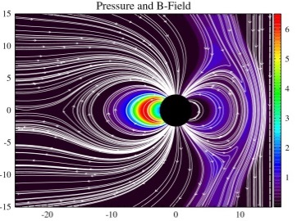
Wrapping Up:
  WSA-Enlil now finished it’s second year in full operations. Continues to predict CME arrival at Earth with mean forecast accuracy of +/- 7 hours. Upgrades being tested by SWPC and collaborators (AFRL, GMU) – improved background wind structure (ADAPT) and time dependent background updating should provide tangible improvements in CME forecast.
  NASA CCMC and NOAA SWPC evaluation of Geospace models complete. SWPC recommends University of Michigan Space Weather Modeling Framework (SWMF) to be transitioned into operations at NWS to provide ability to forecast regional geomagnetic activity (important for power utilities).
  SWPC/ CU CIRES researchers developing WAM/IPE upper atmosphere model as an extension to GFS. Parallelizing and coupling IPE into WAM have been major projects. Operational systems projected in the FY17-18 timeframe.

