Slide 1
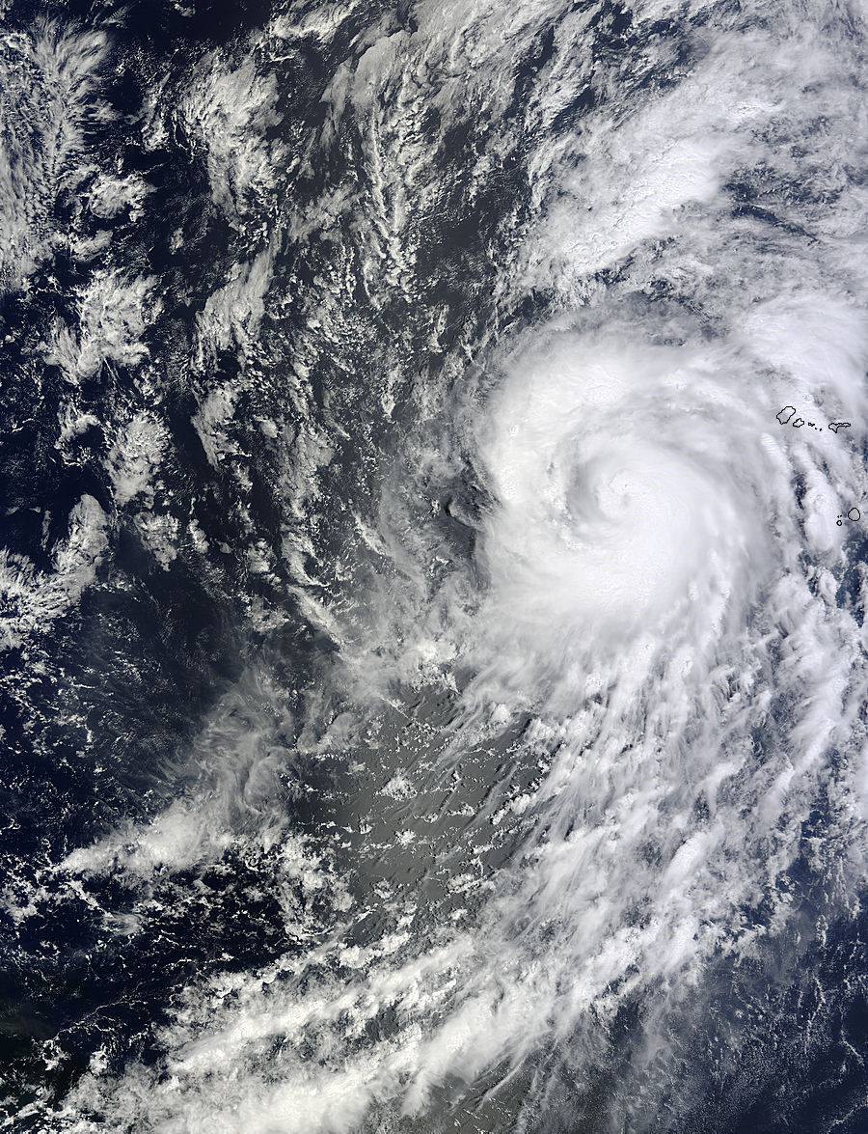

2013 Review of the NCEP Production Suite: Report from NHC
Richard J. Pasch, Eric S. Blake, & Michael J. Brennan
Hurricane Specialists
National Hurricane Center
December 4, 2013

Slide 2
Outline
Summary of 2013 hurricane season
Seasonal forecast verification (ouch!)
Operational highlights
TC track, intensity, and genesis forecast verification
Operational forecasting issues
NHC’s “Wish List” for 2014

Slide 3
2013 Atlantic Season Facts
Above average number of named storms, 13, but well below average numbers of hurricanes and major hurricanes, 2 & 0 respectively
Fewest number of hurricanes since 1982
Accumulated Cyclone Energy about 65% below the 1981-2010 median value
Most systems struggled to intensify; many were weak and short-lived
Season was tied for the latest first hurricane (Humberto on September 11)
No hurricane landfalls in the U.S.
Four TCs in the southwest Gulf of Mexico
Rainfall from Ingrid (and east Pacific Manuel) caused over 100 deaths in Mexico

Slide 4
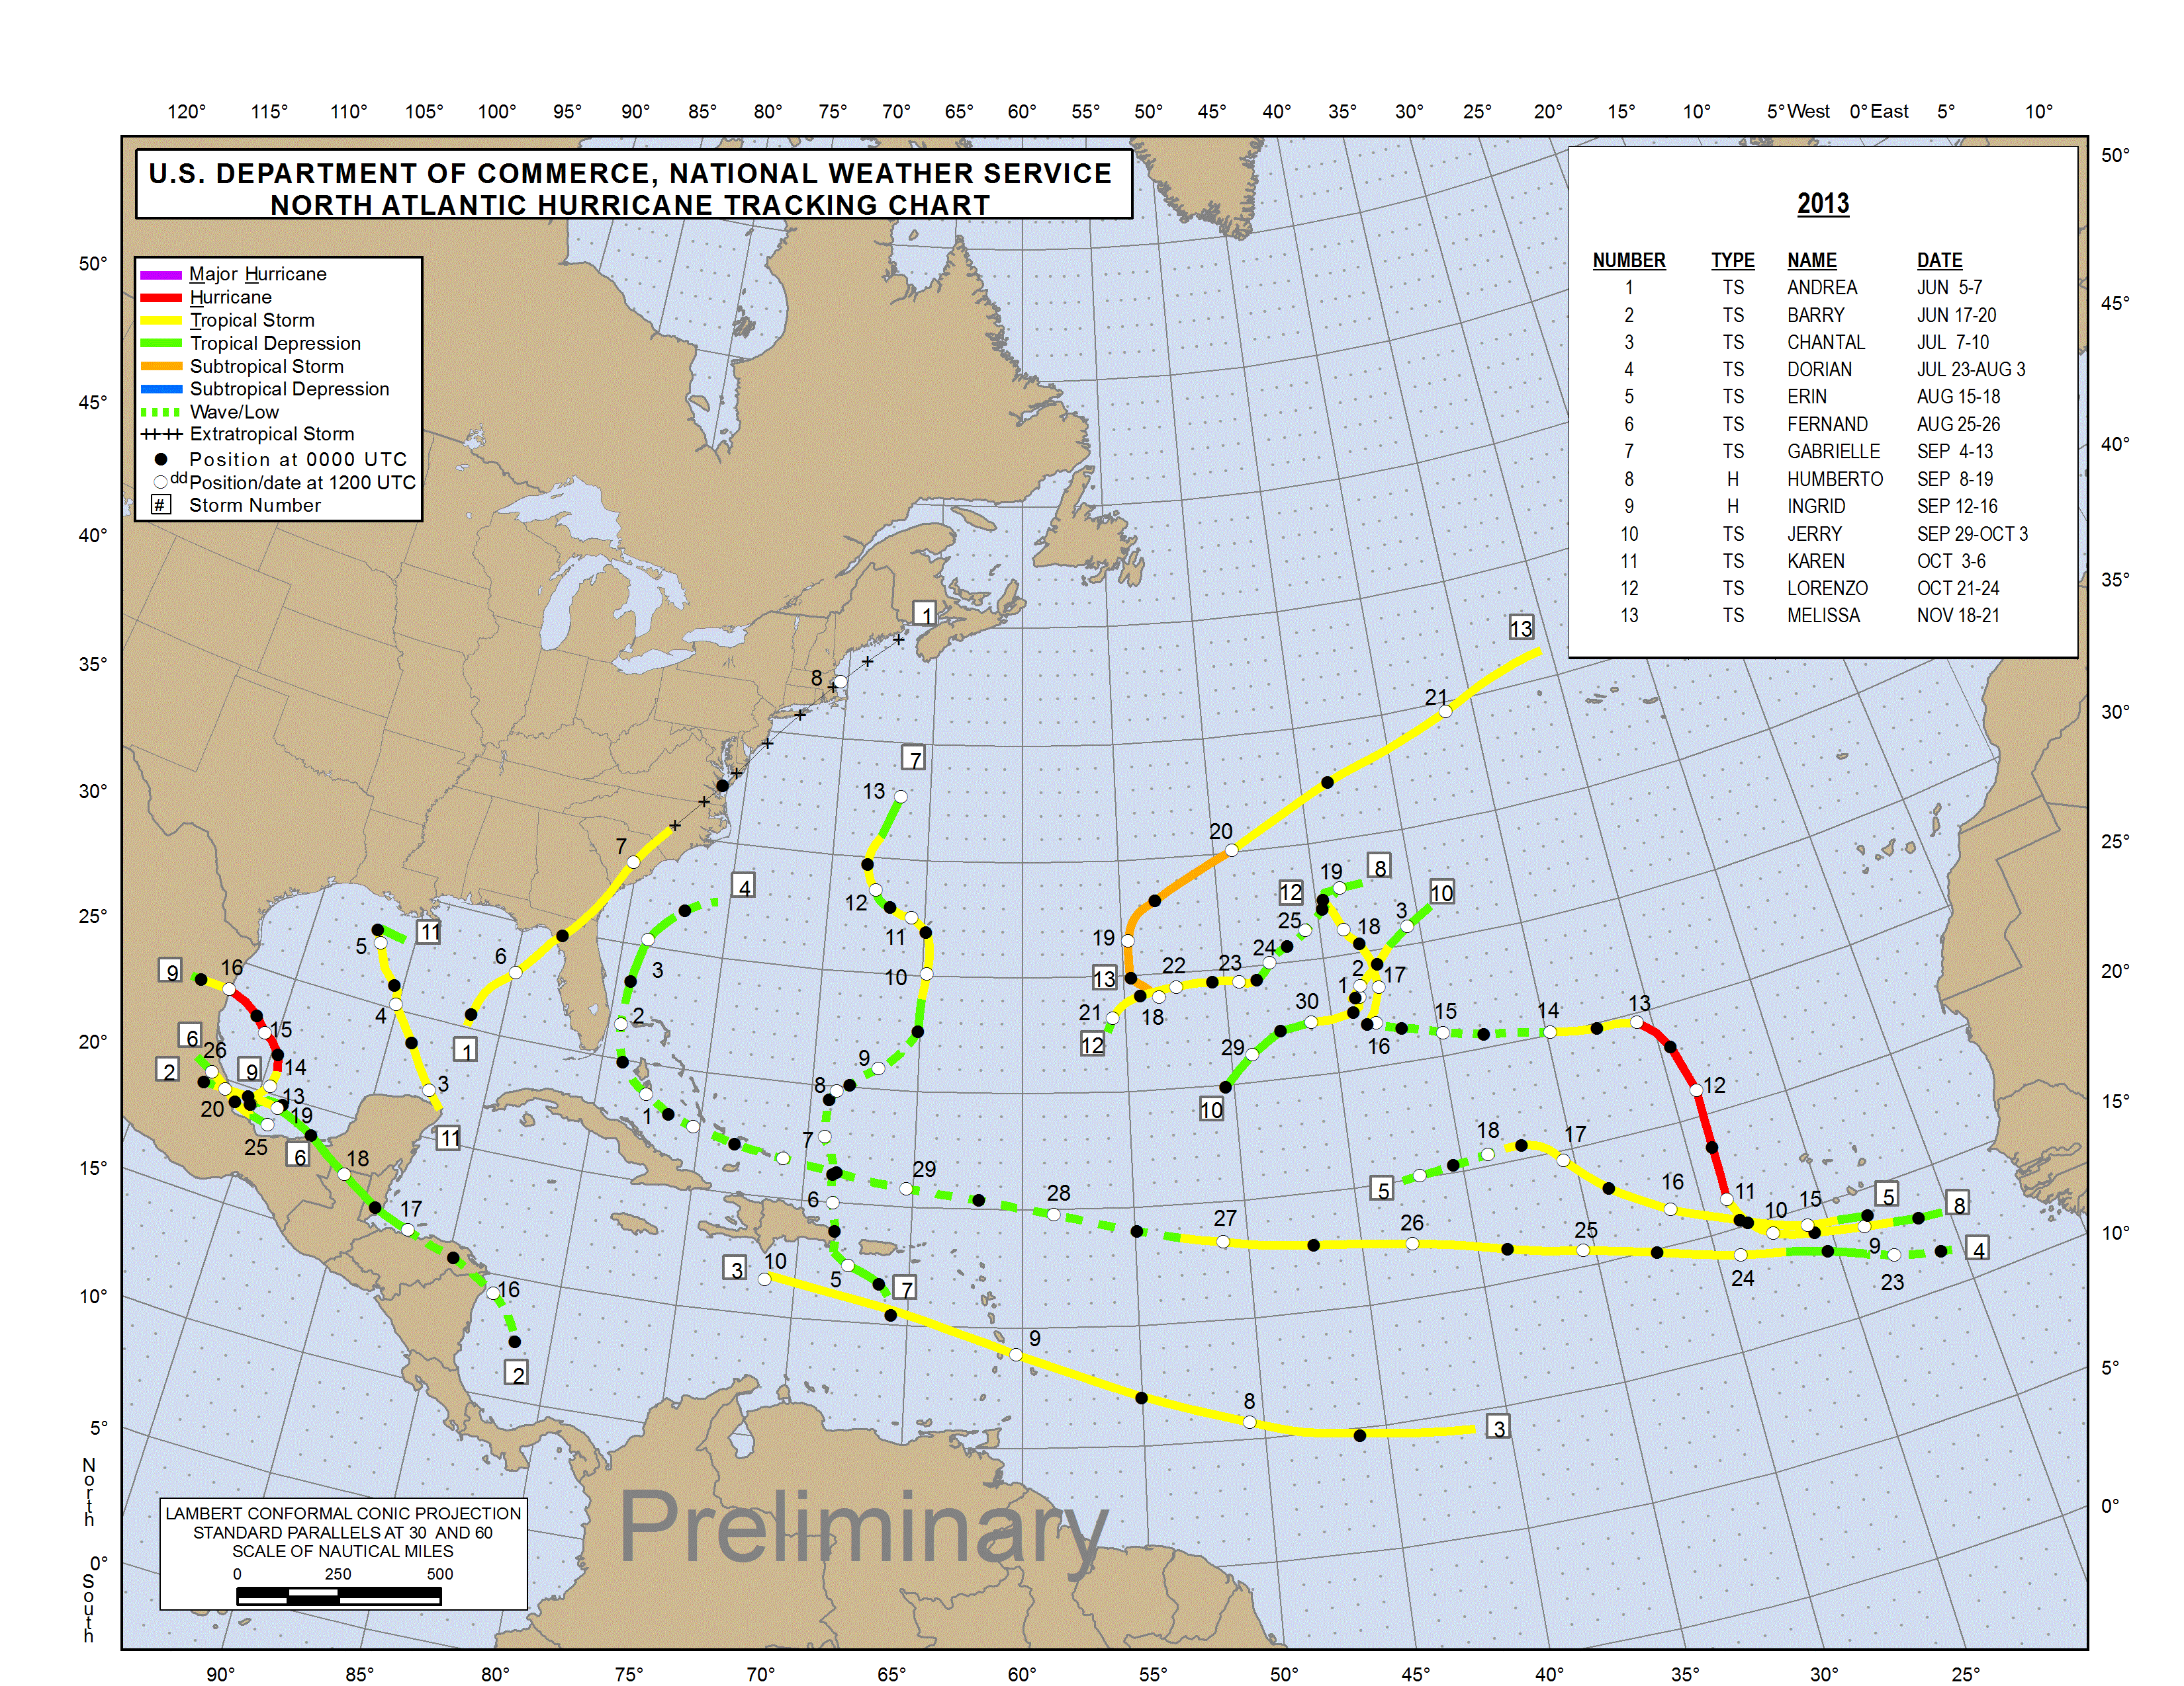

Slide 5
2013 Atlantic Basin Tropical Cyclones - Preliminary
Type/Cat | Name | Dates | Max Wind (mph) | Min Press (mb) | Deaths | Damage
TS | Andrea | 5 - 7 Jun | 65 | 992 | 1 | minor
TS | Barry | 17 – 20 Jun | 45 | 1003 | 5
TS | Chantal | 7 – 10 Jul | 65 | 1003 | 1
TS | Dorian | 23 Jul – 3 Aug | 60 | 1002
TS | Erin | 15 – 18 Aug | 45 | 1006
TS | Fernand | 25 – 26 Aug | 60 | 1001 | 14
TS | Gabrielle | 4 – 13 Sep | 60 | 1003
TD | Eight | 6 -7 Sep | 35 | 1009
H1 | Humberto | 8 – 19 Sep | 85 | 982
H1 | Ingrid | 12 – 16 Sep | 85 | 983 | *
TS | Jerry | 29 Sep – 3 Oct | 50 | 1005
TS | Karen | 3 – 6 Oct | 65 | 999
TS | Lorenzo | 21 – 24 Oct | 50 | 1002
TS | Melissa | 18 – 21 Nov | 65 | 980
*Pending death total for east Pacific Hurricane Manuel

Slide 6
NOAA’s 2013 Atlantic Hurricane Outlook
Season and May 2013 Aug 2013 Observed
Activity Type Outlook Outlook Activity Climatology
Chance Above Average 70% 70% 33%
Chance Near Average 25% 25% 33%
Chance Below Average 5% 5% Below Average 33%
Named Storms 13-20 13-19 13 12
Hurricanes 7-11 6-9 2 6
Major Hurricanes 3-6 3-5 0 3
Acc. Cyclone Energy 120-205% 120-190% 35% 100%
High-resolution CFS pre-season forecast was far too high, but the CFS forecast run in late July was better. Climate indices (e.g. warm Atlantic, lack of El Niño), which were correctly anticipated, seemed consistent with an active season.
Notes:
6
Verification of the 2010 NOAA Atlantic seasonal forecast. All forecast parameters verified within ranges

Slide 7
2013 Operational Highlights
Quiet season for the NHC; 195 TC forecasts issued for Atlantic basin (long-term mean is ~340)
GFS continued to perform as well as the ECMWF in the Atlantic, but not in the east Pacific
GFS ensemble was even a little better than the deterministic run for track in the Atlantic
  GFS and ensemble were also comparable in the east Pacific, but trailed the ECMWF and model consensus in that basin
Improved guidance, both for track and intensity, from the HWRF model; first operational assimilation of aircraft Doppler radar data in the HWRF
Second year of in-house 6- and 7-day TC track and intensity forecasts, but very few of these verified
Experimental 5-day genesis probabilities in the Tropical Weather Outlook; graphical outlook planned for 2014

Slide 8
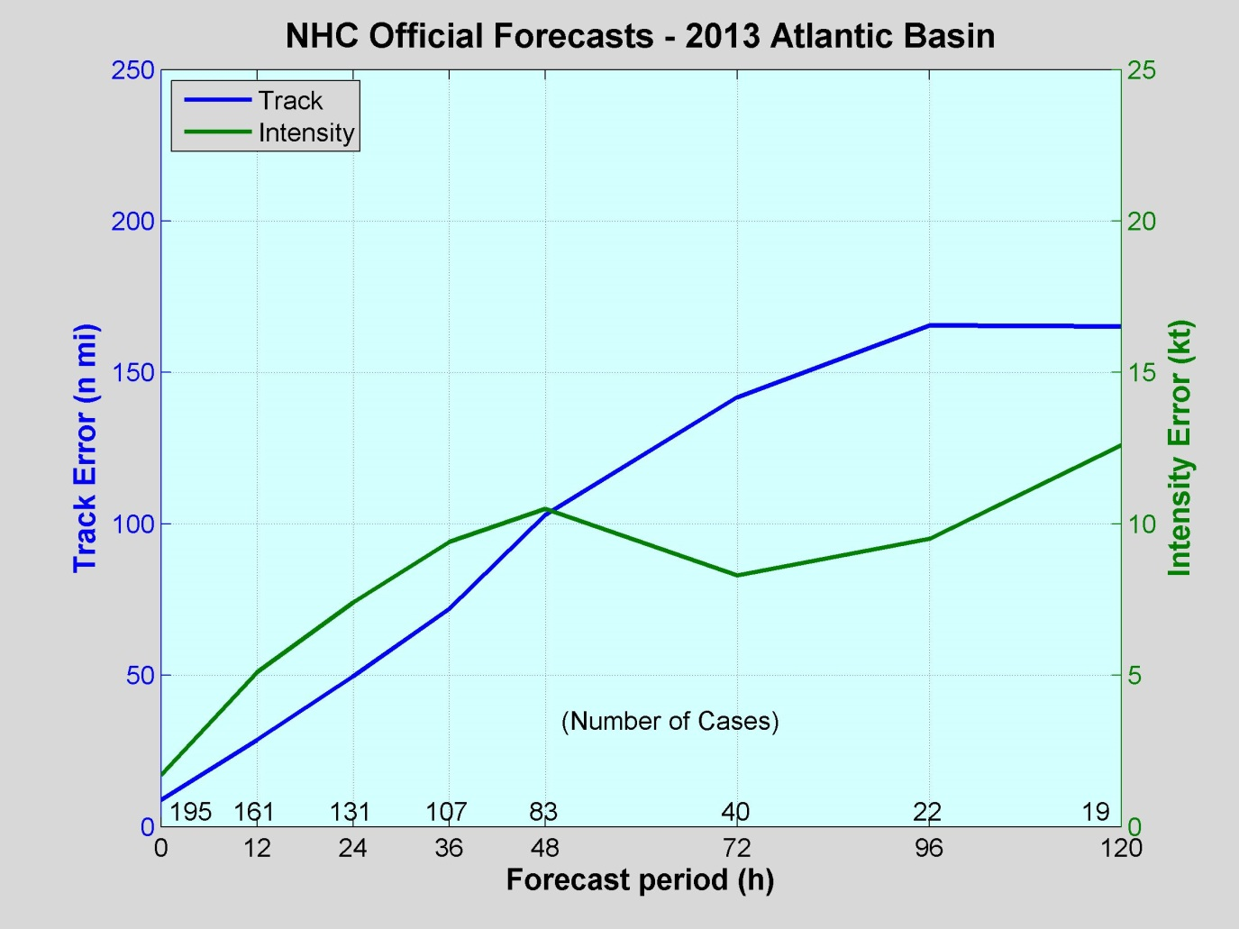
2013 Atlantic Verification
VT NT TRACK INT
(h) (n mi) (kt)
============================
000 195 8.7 1.7
012 161 28.6 5.1
024 131 49.6 7.4
036 107 71.9 9.4
048 83 102.9 10.5
072 40 141.8 8.3
096 22 165.5 9.5
120 19 165.2 12.6
Preliminary
Values in green exceed all-time records.
A lot of intensity error records broken.

Slide 9
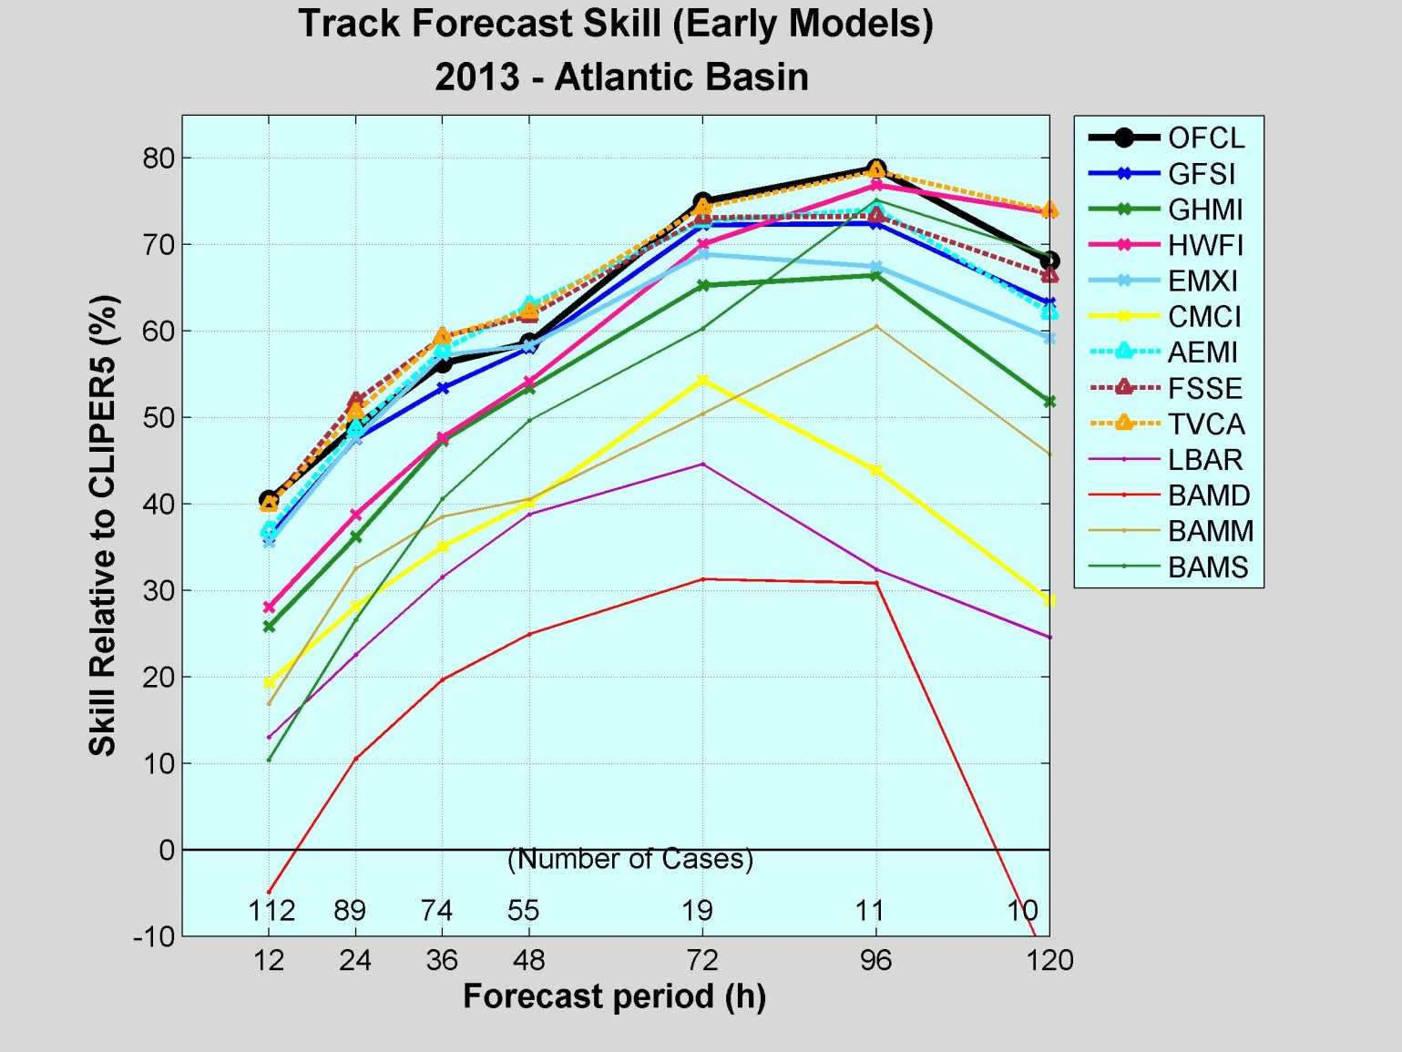
2013 Track Guidance
Official forecasts were very skillful, near the best models.
TVCA best model, beat FSSE from 72-120 h
EMXI and GFSI best individual models in short-term, but HWFI was the best model at the longer range.
GFS ensemble mean excellent performer, better than the GFS.
GHMI middle of the pack, CMCI trailed.
BAMS beat much of the guidance at 96 and120 h.

Slide 10
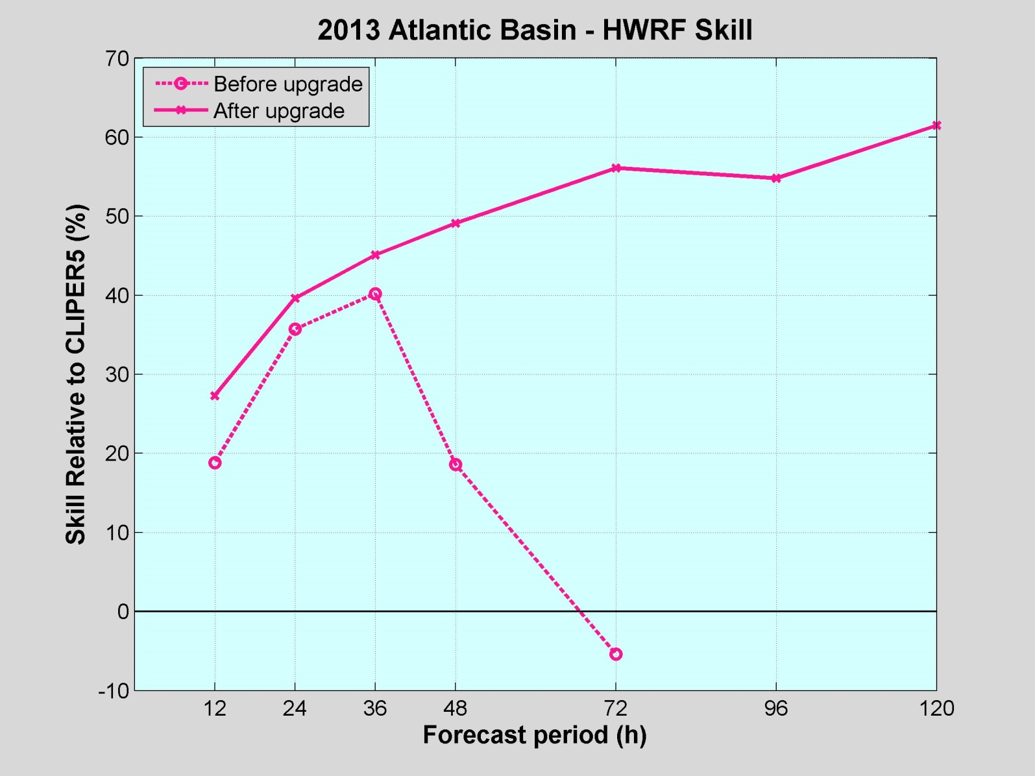
HWRF before and after the upgrade
Substantial track skill
improvements after
the upgrade on July 2.
It should be noted that
sample was small
before the transition.

Slide 11
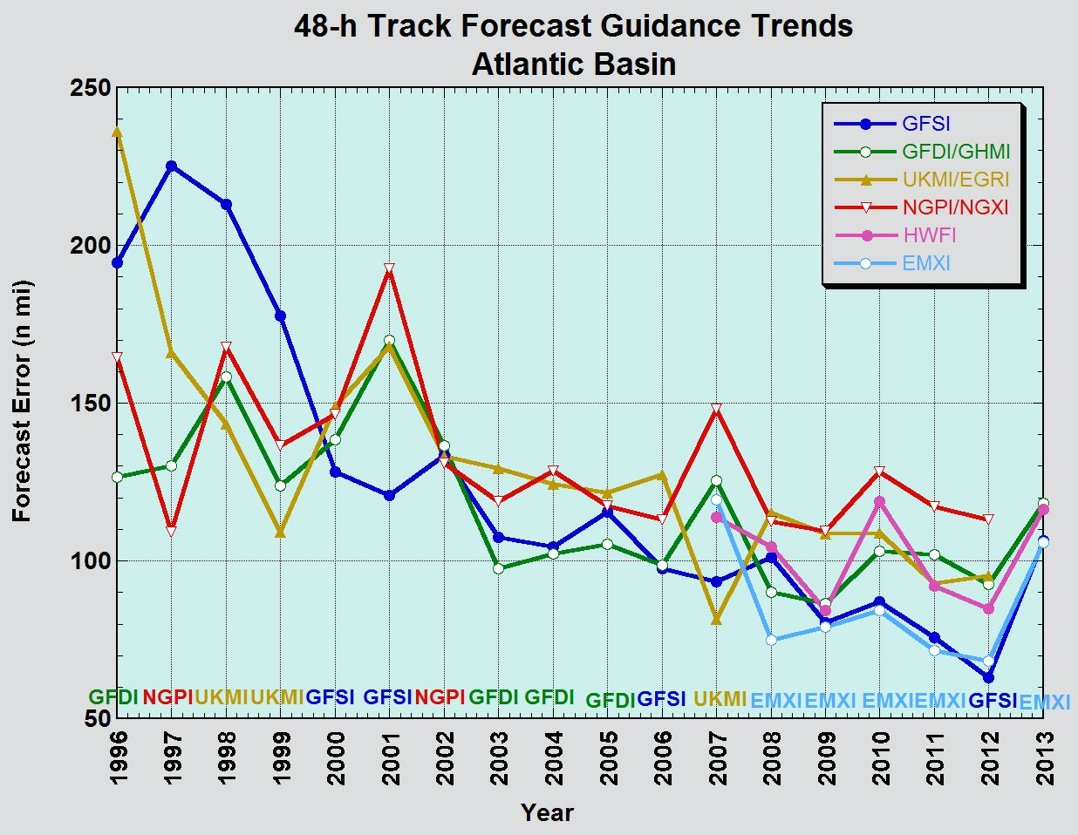
Track Model Trends
Close race continues between GFSI and EMXI.

Slide 12
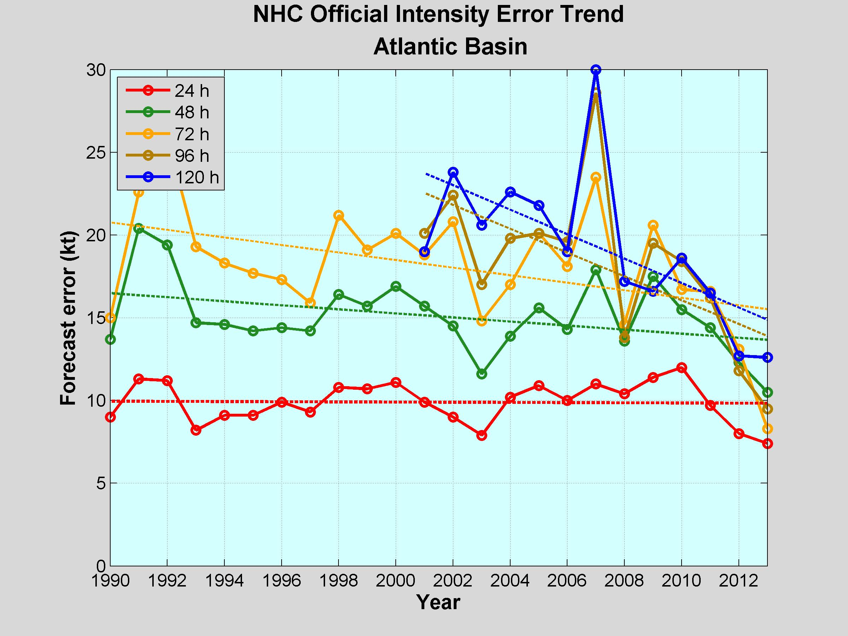
Atlantic Intensity Error Trends
Notable improvements in intensity forecasts over the past few years.
Beginning of a trend?

Slide 13
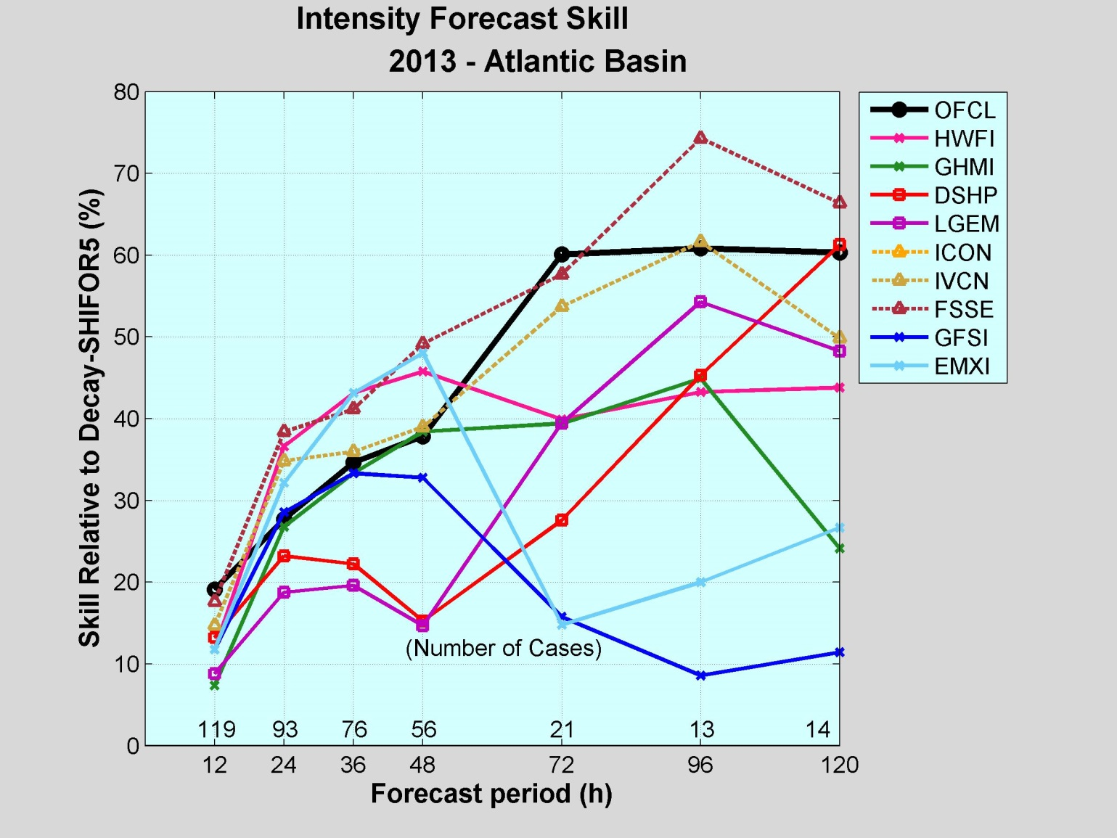
2013 Intensity Guidance
Official forecast skill increased over time, and is near the best models, FSSE and ICON/IVCN.
DSHP and LGEM were least skillful of the models in short-term, competitive with the others at longer time period.
HWRF fairly good performer, better than the statistical guidance.
GFSI and EMXI had notable skill early, decreased late.

Slide 14
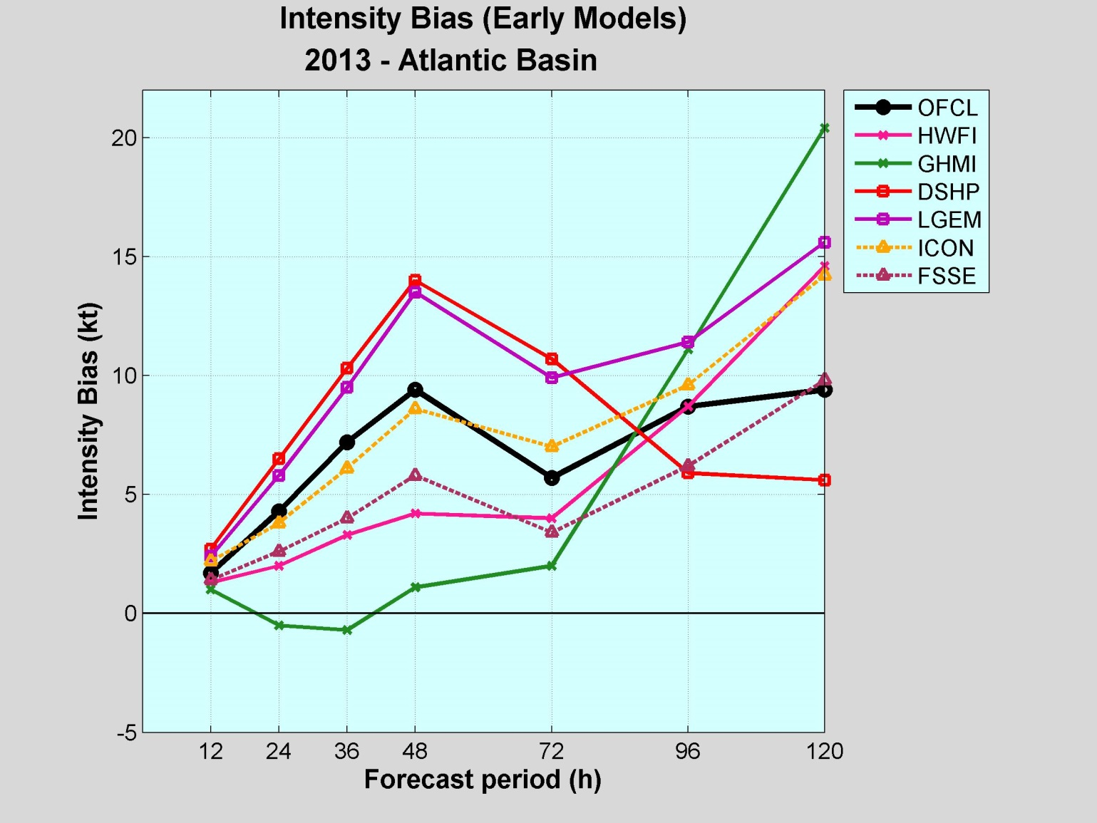
2013 Intensity Bias
The main intensity models had a high bias in 2013.

Slide 15
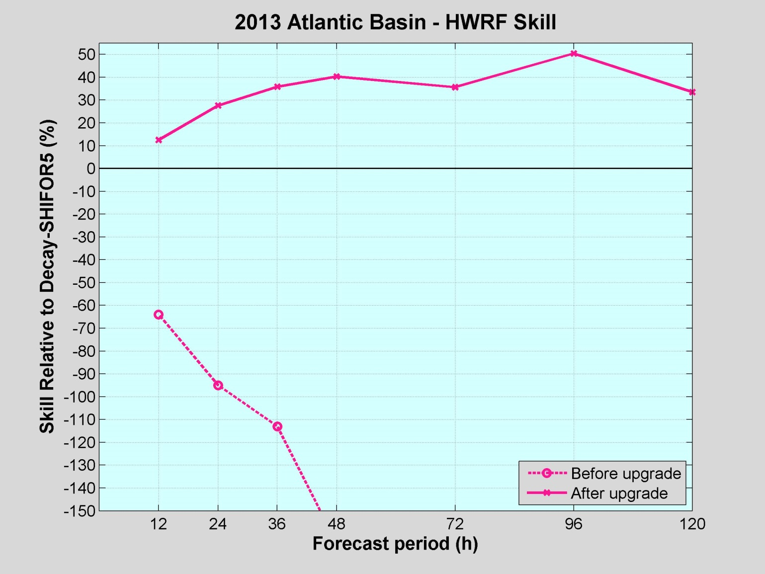
HWRF before and after the upgrade
Wow! Strongly negative
skill before the transition
in early July due to fairly
large HWRF errors
and low Decay-SHIFOR
errors. The opposite is
true for the larger sample
after the transition.

Slide 16
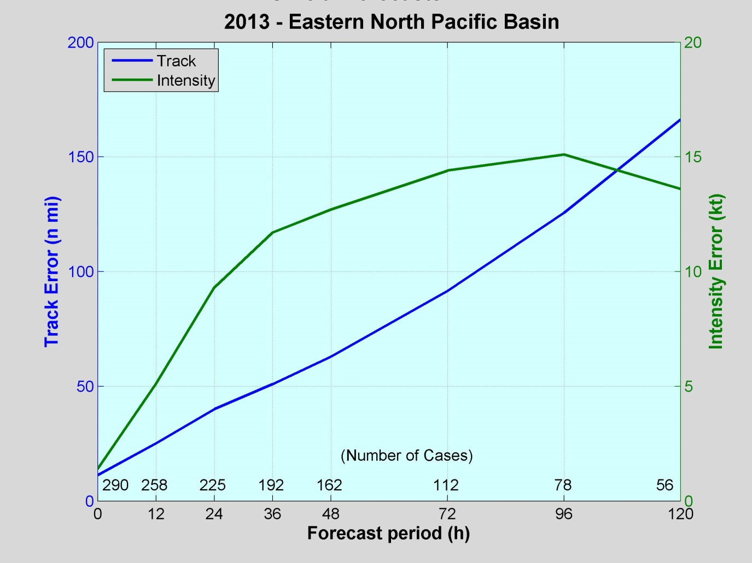
2013 East Pacific Verification
VT NT TRACK IN
(h) (n mi) (kt)
============================
000 290 11.3 1.4
012 258 25.1 5.1
024 225 40.0 9.3
036 192 50.9 11.7
048 162 62.9 12.7
072 112 91.5 14.4
096 78 125.6 15.1
120 56 166.3 13.6
Preliminary
Values in green exceeded all-time lows.

Slide 17
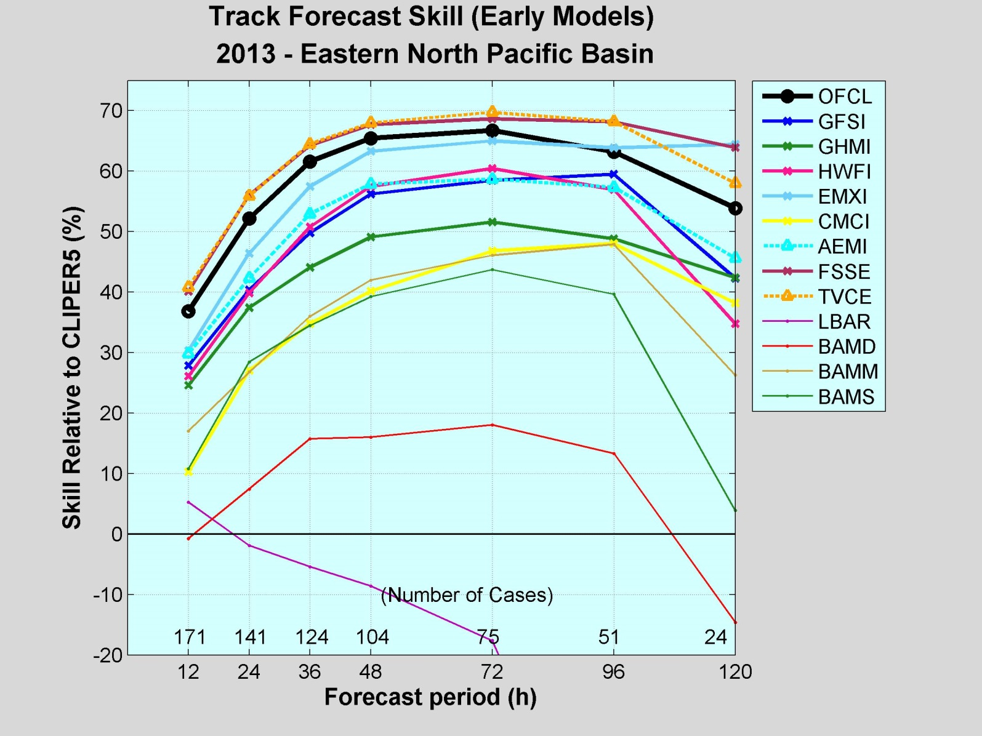
2013 Track Guidance
Official forecasts very skillful, but was bested by the consensus models, TVCE and FSSE.
EMXI best individual model.
GFS, GFS ensemble mean, and HWRF models were fair to good performers.
GHMI and CMCI trailed.

Slide 18
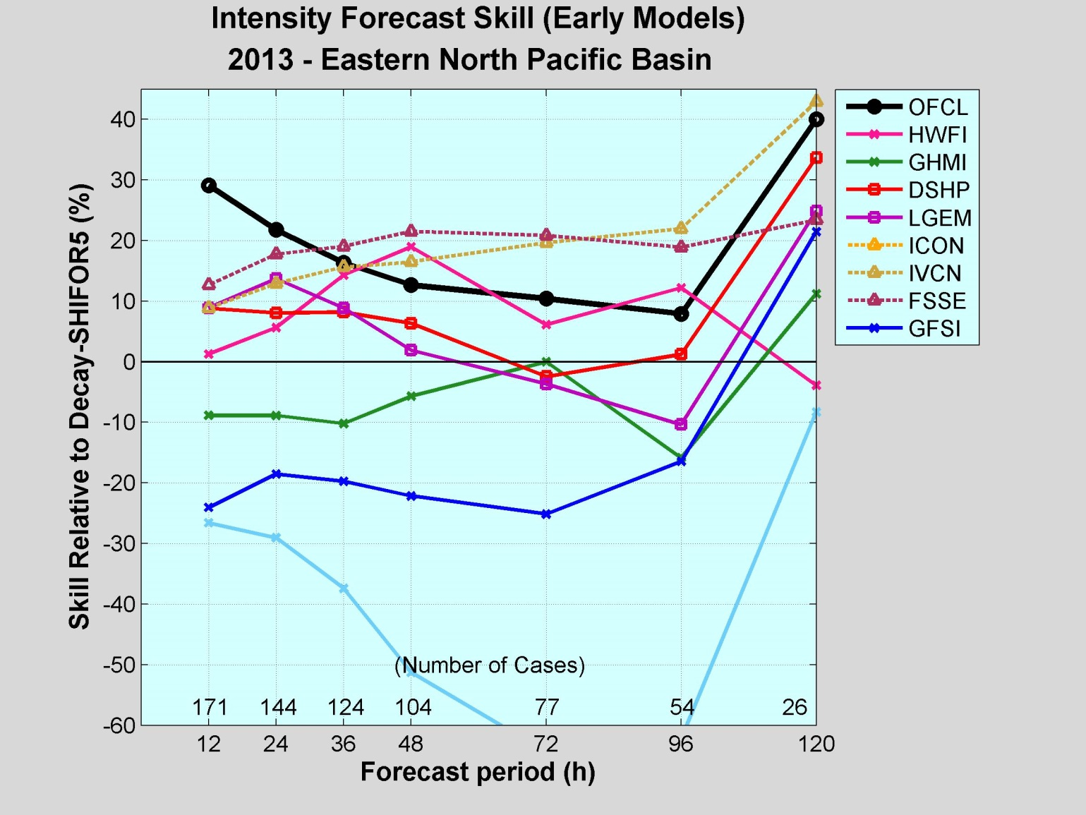
2013 Intensity Guidance
Official forecasts performed better than the guidance from 12-48 h, and near the best guidance beyond that.
FSSE and ICON/IVCN best guidance.
LGEM and GHMI had little skill.
GFSI and especially EMXI not competitive in this basin.

Slide 19
Operational Forecasting Issues
Too many TC genesis false alarms in the GFS
Many weak, short-lived TCs – generally led to overforecasts of intensity (high bias in guidance).
Models had some difficulty predicting genesis and intensification of 4 Bay of Campeche TCs.
Hurricane Humberto - many models continued intensifying the storm but the TC struggled to develop.
Numerical guidance for Karen prompted the issuance of a hurricane watch for the northern Gulf of Mexico coast, but the system did not even make landfall as a TC.
Bogussing of TC data in the GFS for Chantal after it was no longer a TC caused problems.
Wavewatch model predicted significant events well, but often had a low bias for routine weather.

Slide 20
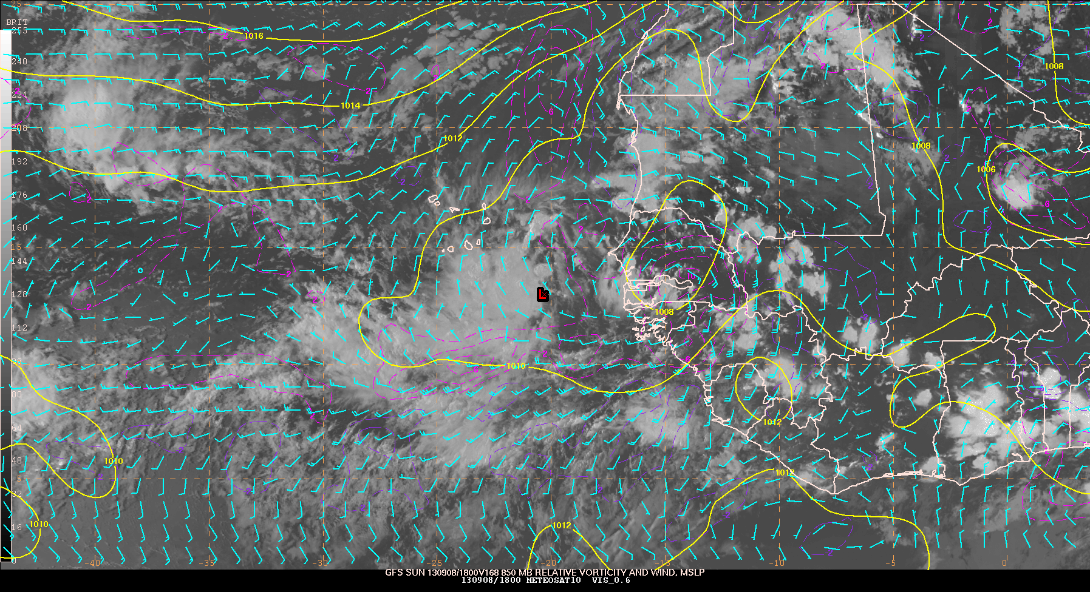
Humberto – GFS Forecasts Valid 18Z 8 September 2013
At genesis, Humberto had winds of 25 kt and a central pressure of 1008 mb

Slide 21
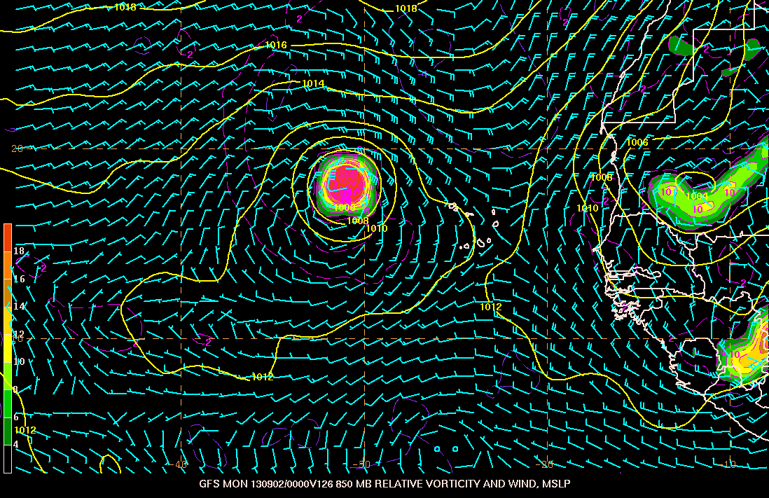
00Z 8/28/13
5-day genesis probability 20%
A TROPICAL WAVE OVER WEST AFRICA IS EXPECTED TO MOVE OVER THE FAR EASTERN ATLANTIC IN ABOUT THREE DAYS. SOME DEVELOPMENT IS POSSIBLE AFTER THAT TIME WHILE THE SYSTEM MOVES WEST-NORTHWESTWARD AT 10 TO 15 MPH. THIS SYSTEM HAS A LOW CHANCE...NEAR 0 PERCENT...OF BECOMING A TROPICAL CYCLONE DURING THE NEXT 48 HOURS...AND A LOW CHANCE...20 PERCENT...OF BECOMING A TROPICAL CYCLONE DURING THE NEXT 5 DAYS.
GFS 126-h forecast valid at 00Z 2 September 2013
850-mb relative vorticity and wind and MSLP

Slide 22
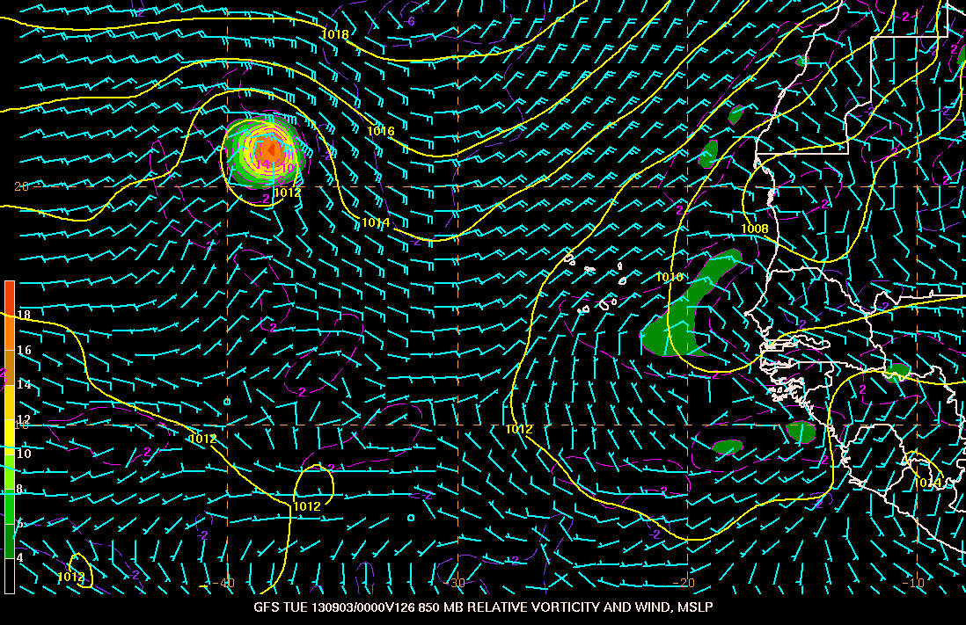
00Z 8/29/13
5-day genesis probability 30%
A TROPICAL WAVE LOCATED OVER WEST AFRICA IS EXPECTED TO MOVE WESTWARD AT 10 TO 15 MPH...AND AN AREA OF LOW PRESSURE COULD FORM AFTER THE WAVE MOVES OFF OF THE COAST ON FRIDAY. SOME DEVELOPMENT OF THIS LOW IS POSSIBLE LATE THIS WEEK OR EARLY THIS WEEKEND BEFORE UPPER-LEVEL WINDS BECOME UNFAVORABLE BY EARLY NEXT WEEK. THIS SYSTEM HAS A LOW CHANCE...10 PERCENT...OF BECOMING A TROPICAL CYCLONE DURING THE NEXT 48 HOURS...AND A MEDIUM CHANCE...30 PERCENT...OF BECOMING A TROPICAL CYCLONE DURING THE NEXT 5 DAYS WHILE IT MOVES NEAR THE CAPE VERDE ISLANDS.
GFS 126-h forecast valid at 00Z 1 September 2013
850-mb relative vorticity and wind and MSLP

Slide 23
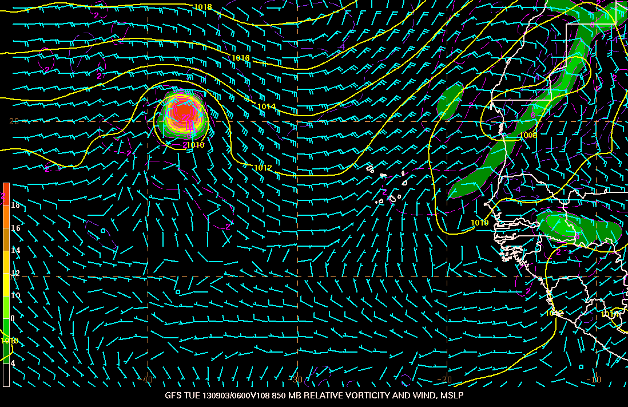
00Z 8/30/13
5-day genesis probability 50%
A BROAD AREA OF LOW PRESSURE ASSOCIATED WITH A TROPICAL WAVE IS PRODUCING SHOWERS AND THUNDERSTORMS OVER WESTERN AFRICA. THIS SYSTEM SHOULD MOVE WESTWARD OVER THE FAR EASTERN ATLANTIC OCEAN ON FRIDAY... AND NEAR THE CAPE VERDE ISLANDS LATE SATURDAY. ENVIRONMENTAL CONDITIONS APPEAR CONDUCIVE FOR DEVELOPMENT...AND A TROPICAL DEPRESSION COULD FORM OVER THE WEEKEND. AFTER THAT TIME...THE ENVIRONMENT IS FORECAST TO BECOME LESS CONDUCIVE WHILE THE SYSTEM MOVES TOWARD THE WEST-NORTHWEST OVER THE EASTERN ATLANTIC. THIS SYSTEM HAS A MEDIUM CHANCE...40 PERCENT...OF BECOMING A TROPICAL CYCLONE DURING THE NEXT 48 HOURS...AND A MEDIUM CHANCE...50 PERCENT...OF BECOMING A TROPICAL CYCLONE DURING THE NEXT 5 DAYS.
GFS 108-h forecast valid at 06Z 3 September 2013
850-mb relative vorticity and wind and MSLP

Slide 24
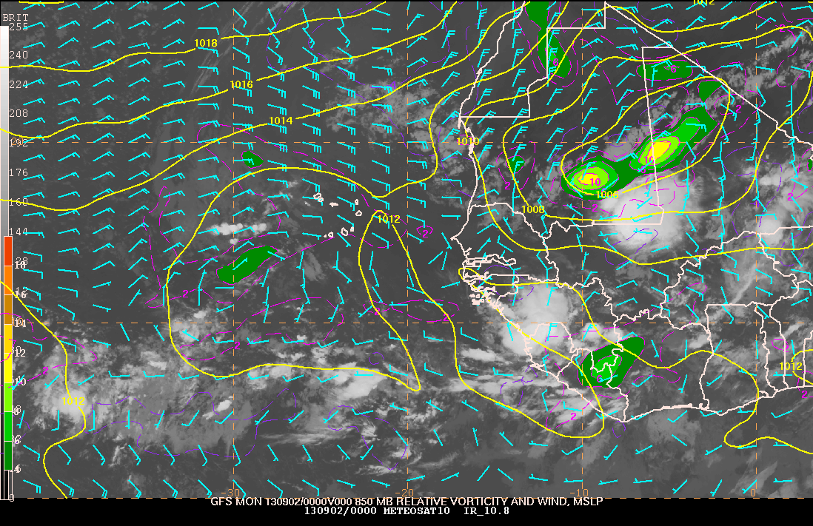
METEOSAT IR Imagery and GFS Analysis valid 00Z 2 September 2013

Slide 25
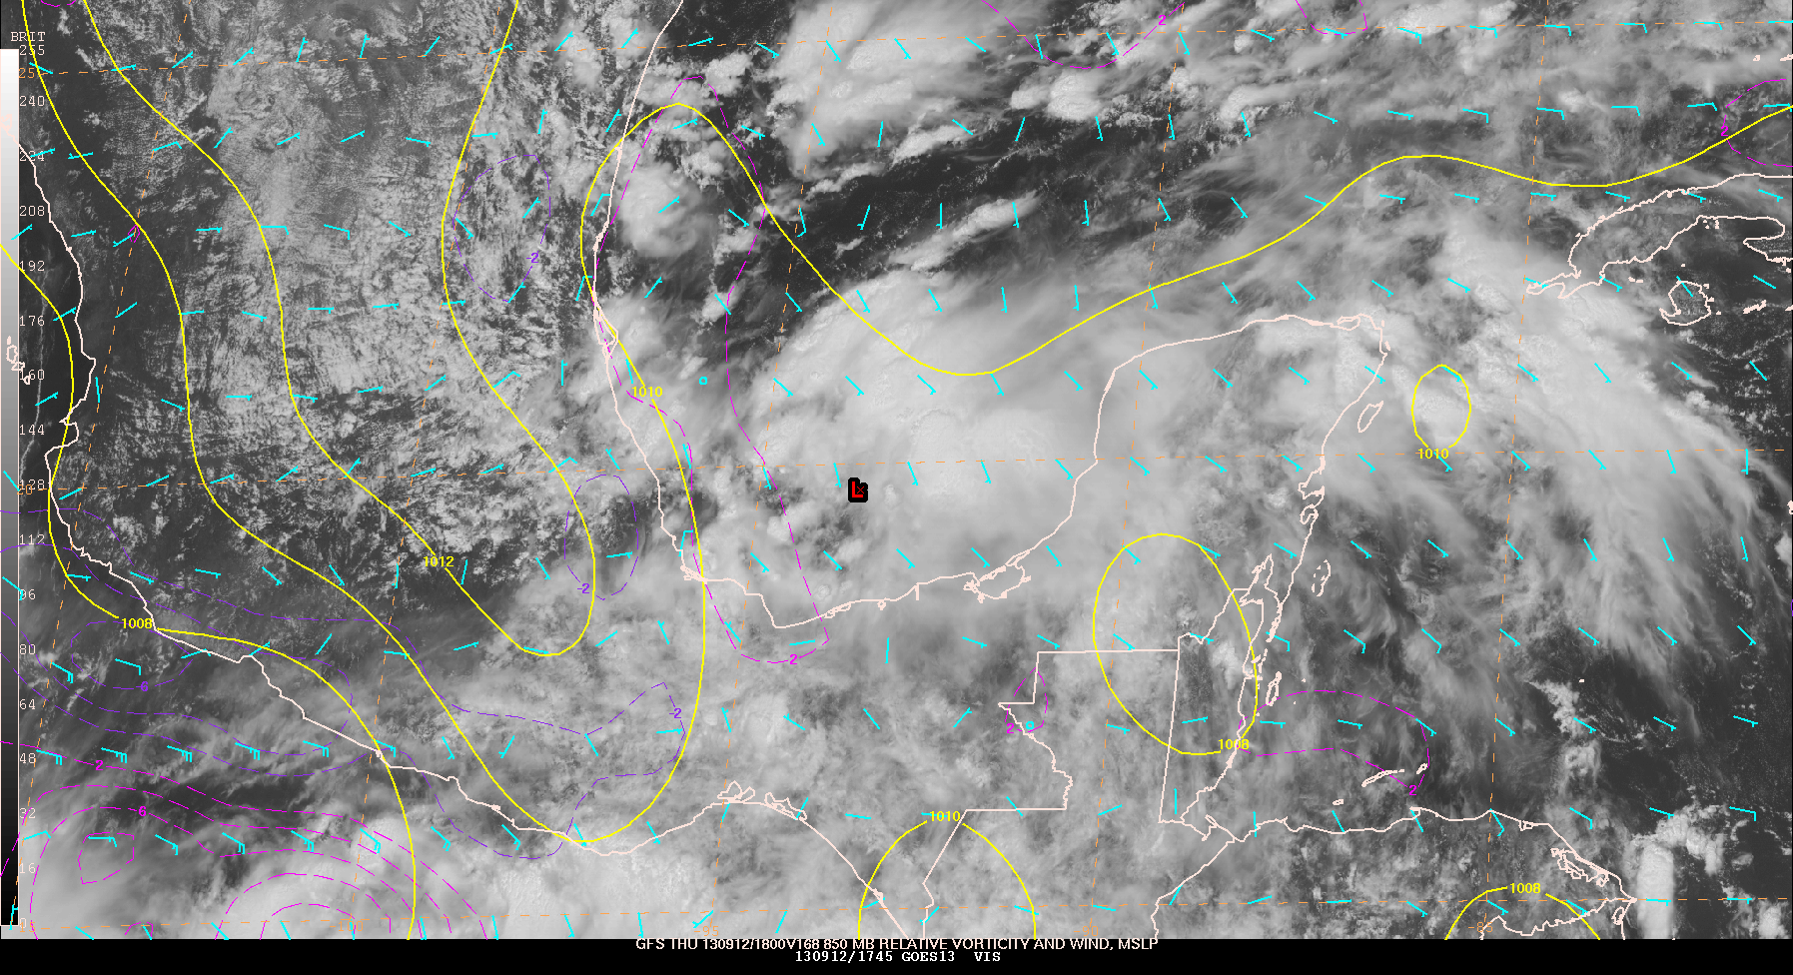
Ingrid – GFS Forecasts Valid 18Z 12 September 2013
At genesis, Ingrid had winds of 30 kt and a central pressure of 1004 mb

Slide 26
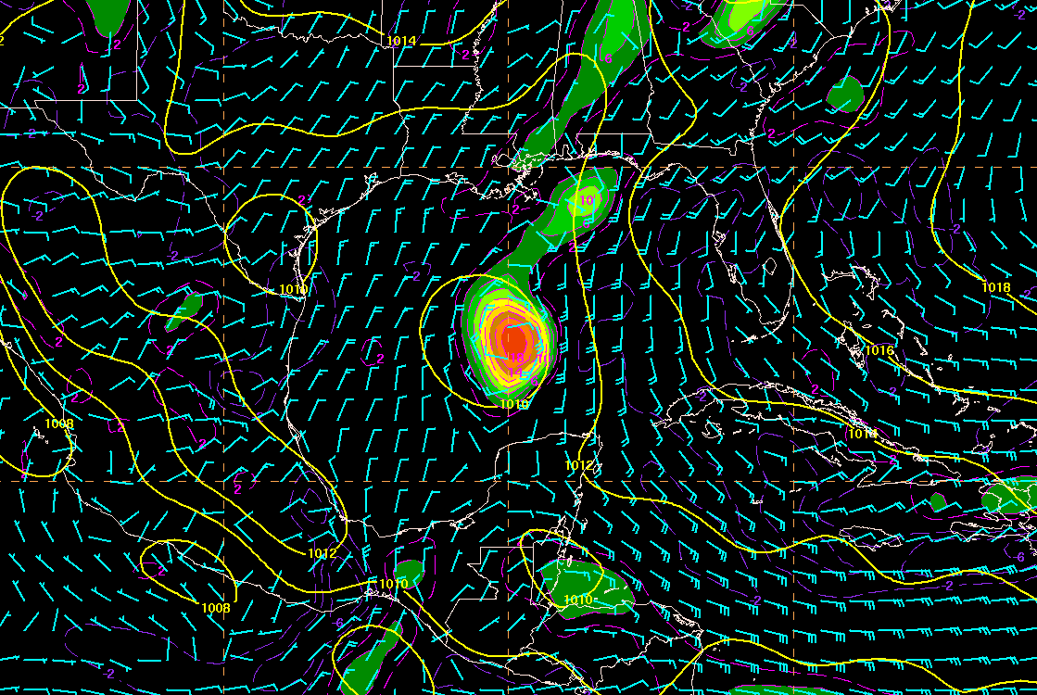
00Z 8/12/2013
5-day genesis probability 20%
AN AREA OF LOW PRESSURE IS EXPECTED TO FORM ACROSS THE NORTHWESTERN CARIBBEAN SEA OR THE SOUTHERN GULF OF MEXICO BY THURSDAY OR FRIDAY...AND ENVIRONMENTAL CONDITIONS ARE FORECAST TO BECOME SOMEWHAT CONDUCIVE FOR DEVELOPMENT DURING THAT TIME. THIS SYSTEM HAS A LOW CHANCE...NEAR 0 PERCENT...OF BECOMING A TROPICAL CYCLONE DURING THE NEXT 48 HOURS...AND A LOW CHANCE...20 PERCENT...OF BECOMING A TROPICAL CYCLONE DURING THE NEXT 5 DAYS.
GFS 126-h forecast valid at 00Z 17 August 2013
850-mb relative vorticity and wind and MSLP

Slide 27
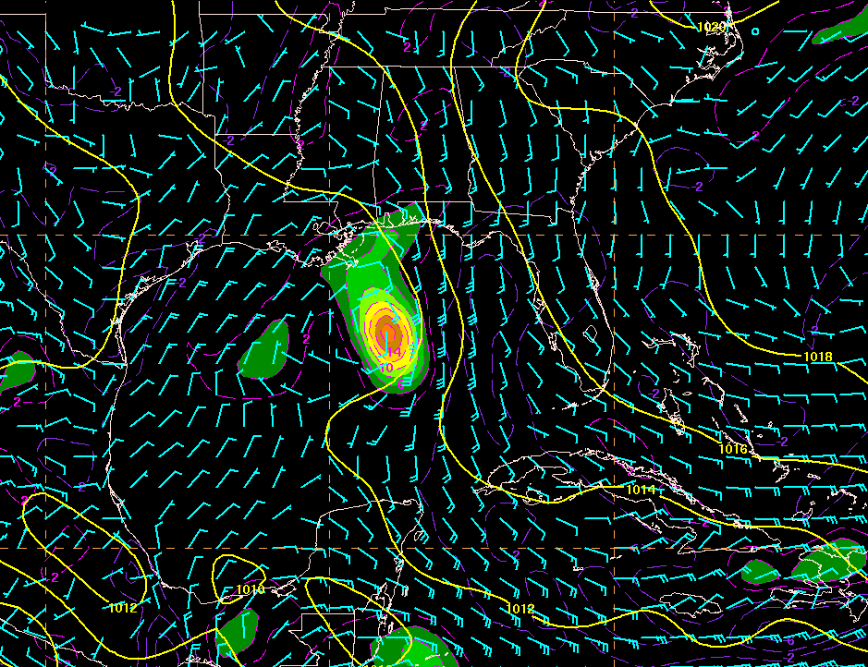
00Z 8/13/2013
5-day genesis probability 30%
CLOUDINESS AND SHOWERS EXTENDING FROM THE SOUTHWESTERN CARIBBEAN SEA NORTHEASTWARD ACROSS MOST OF THE CENTRAL CARIBBEAN TO NEAR HISPANIOLA ARE ASSOCIATED WITH A TROPICAL WAVE AND A BROAD AREA OF LOW PRESSURE INTERACTING WITH AN UPPER-LEVEL TROUGH. ENVIRONMENTAL CONDITIONS ARE FORECAST TO GRADUALLY BECOME MORE CONDUCIVE FOR DEVELOPMENT OVER THE NEXT SEVERAL DAYS AS THE LARGE DISTURBANCE MOVES TOWARD THE YUCATAN PENINSULA AND THE SOUTHERN GULF OF MEXICO. THIS SYSTEM HAS A LOW CHANCE...NEAR 10 PERCENT...OF BECOMING A TROPICAL CYCLONE DURING THE NEXT 48 HOURS...AND A MEDIUM CHANCE...30 PERCENT...OF BECOMING A TROPICAL CYCLONE DURING THE NEXT 5 DAYS.
GFS 102-h forecast valid at 00Z 17 August 2013
850-mb relative vorticity and wind and MSLP

Slide 28
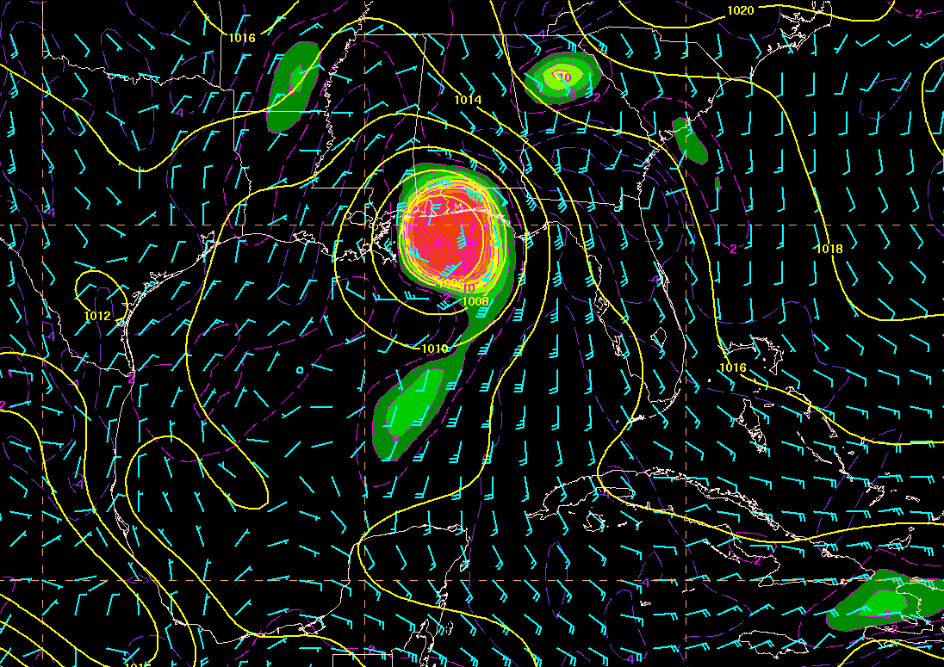
00Z 8/14/2013
5-day genesis probability 40%
A TROPICAL WAVE OVER THE WESTERN CARIBBEAN SEA IS PRODUCING A LARGE AREA OF CLOUDINESS... SHOWERS...AND A FEW THUNDERSTORMS EXTENDING FROM CENTRAL AMERICA NORTHEASTWARD TO JAMAICA AND EASTERN CUBA. UPPER-LEVEL WINDS HAVE BECOME MORE FAVORABLE...AND SOME DEVELOPMENT OF THIS DISTURBANCE IS POSSIBLE OVER THE NEXT COUPLE OF DAYS AS IT MOVES NORTHWESTWARD AT 10 TO 15 MPH TOWARD THE YUCATAN PENINSULA AND SOUTHERN GULF OF MEXICO. ENVIRONMENTAL CONDITIONS COULD BE A LITTLE MORE MARGINAL FOR DEVELOPMENT WHILE THE SYSTEM IS OVER THE GULF OF MEXICO LATER THIS WEEK. THIS SYSTEM HAS A MEDIUM CHANCE... 30 PERCENT...OF BECOMING A TROPICAL CYCLONE DURING THE NEXT 48 HOURS...AND A MEDIUM CHANCE...40 PERCENT...OF BECOMING A TROPICAL CYCLONE DURING THE NEXT 5 DAYS.
GFS 84-h forecast valid at 06Z 17 August 2013
850-mb relative vorticity and wind and MSLP

Slide 29
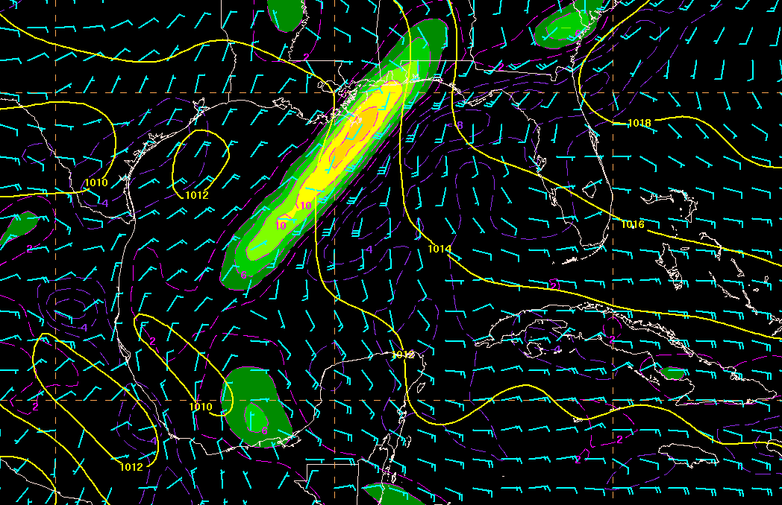
00Z 8/15/2013
5-day genesis probability 80%
THE LOW PRESSURE SYSTEM IN THE NORTHWESTERN CARIBBEAN SEA IS MOVING TOWARD THE WEST-NORTHWEST AT 10 MPH...AND IS PRODUCING WIND GUSTS TO GALE FORCE IN SQUALLS TO THE EAST OF THE CENTER. ASSOCIATED SHOWER AND THUNDERSTORM ACTIVITY CONTINUES TO SHOW SIGNS OF ORGANIZATION...AND A TROPICAL DEPRESSION COULD FORM BEFORE THE DISTURBANCE REACHES THE YUCATAN PENINSULA ON THURSDAY. AFTER THAT...THE LOW IS FORECAST TO MOVE INTO THE SOUTHERN GULF OF MEXICO...WHERE UPPER-LEVEL WINDS COULD BECOME A LITTLE LESS FAVORABLE FOR DEVELOPMENT. THIS SYSTEM HAS A HIGH CHANCE...70 PERCENT...OF BECOMING A TROPICAL CYCLONE DURING THE NEXT 48 HOURS...AND A HIGH CHANCE...80 PERCENT...OF BECOMING A TROPICAL CYCLONE DURING THE NEXT 5 DAYS. REGARDLESS OF WHETHER OR NOT A TROPICAL CYCLONE FORMS...HEAVY RAINS AND GUSTY WINDS ARE FORECAST TO SPREAD OVER THE YUCATAN PENINSULA...WESTERN CUBA...AND BELIZE DURING THE NEXT DAY OR TWO...AND INTERESTS IN THESE AREAS SHOULD MONITOR THE PROGRESS OF THIS DISTURBANCE.
GFS 78-h forecast valid at 00Z 18 August 2013
850-mb relative vorticity and wind and MSLP

Slide 30
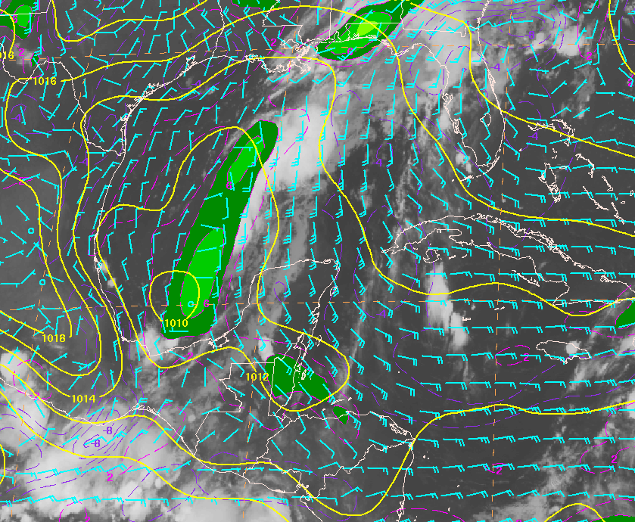
GOES-E IR Imagery and GFS Analysis valid 12Z 17 August 2013

Slide 31
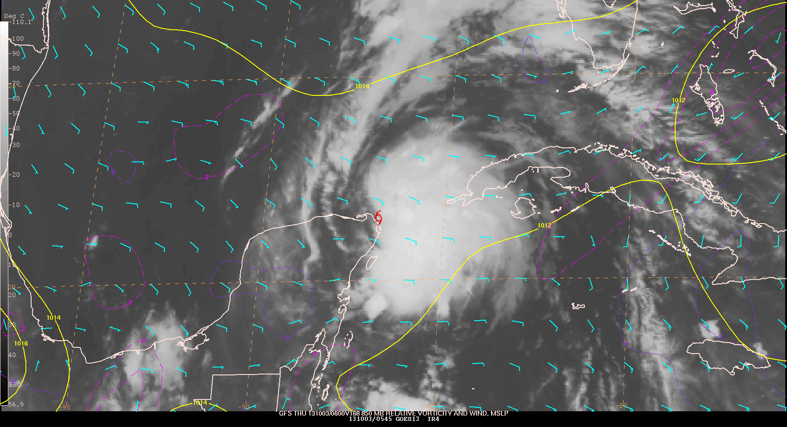
Karen – GFS Forecasts Valid 06Z 3 October 2013
At genesis, Karen had winds of 45 kt and a central pressure of 1006 mb

Slide 32
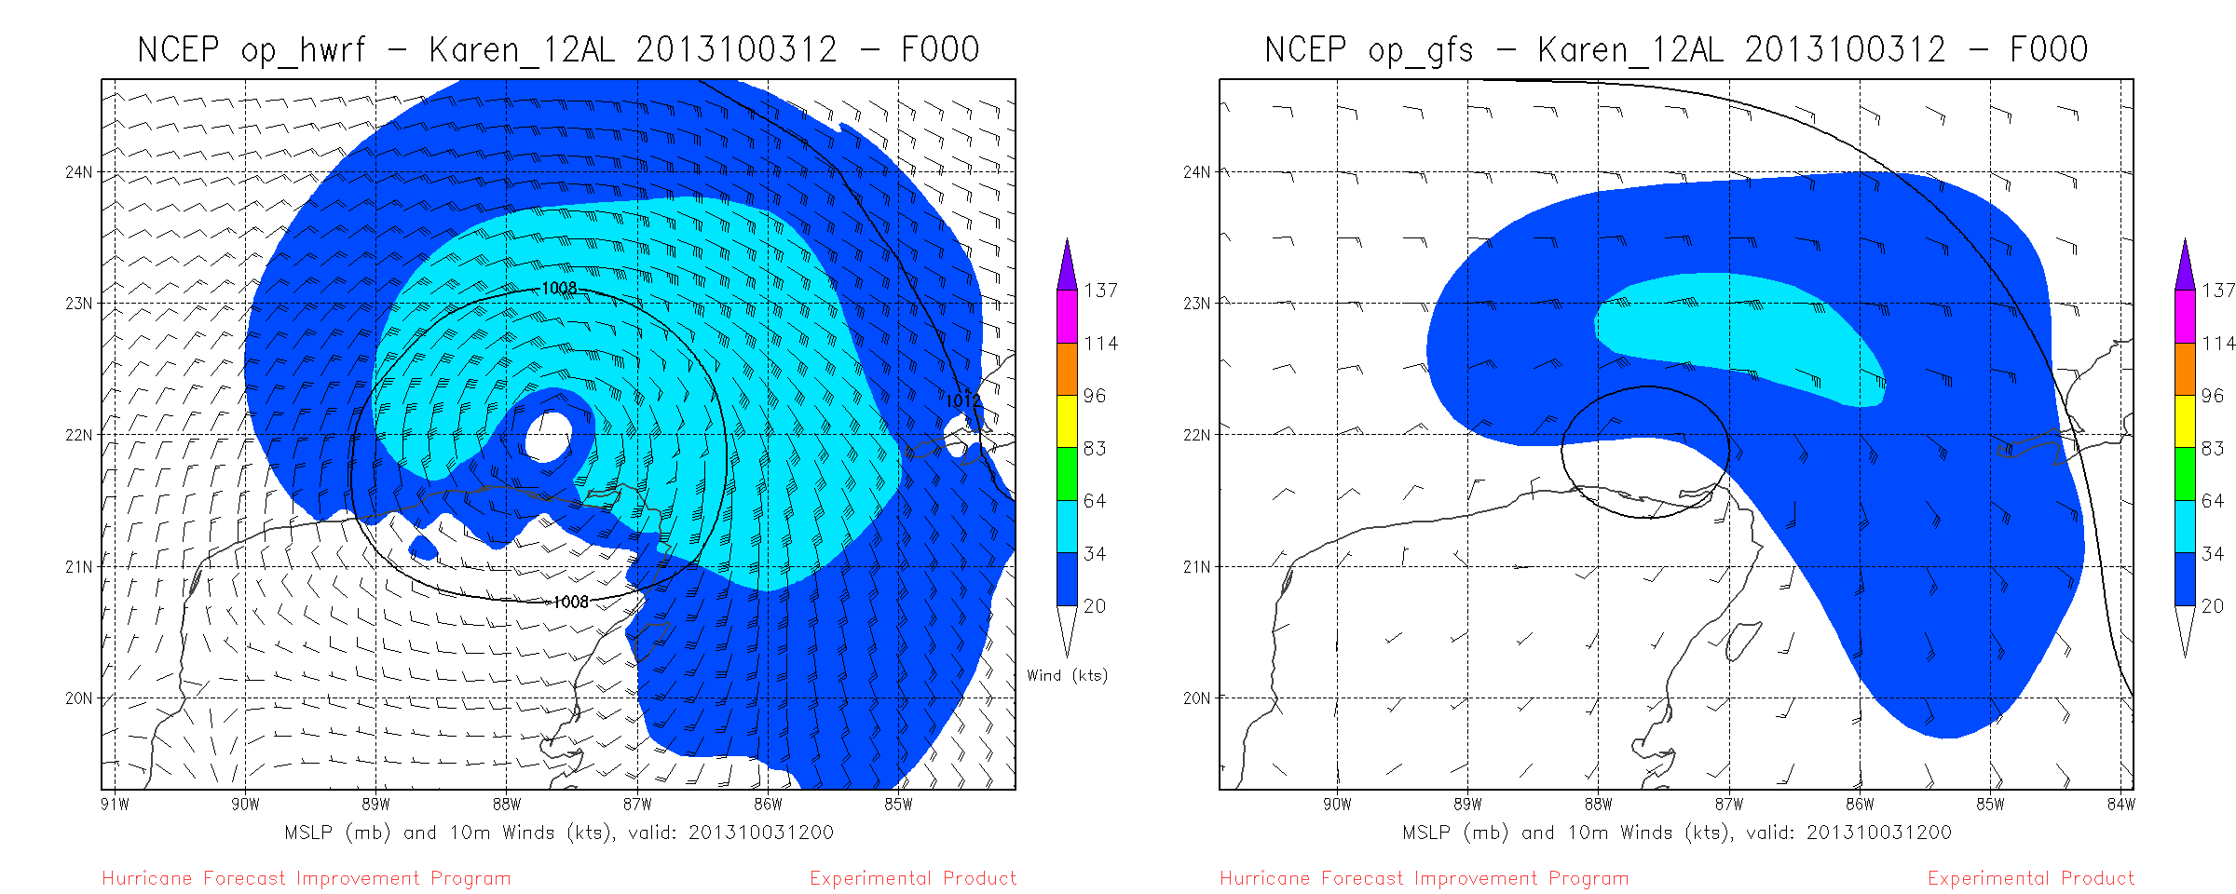
Cold-start HWRF forecast from 12Z 3 October, calling for a hurricane landfall in FL panhandle
Analyses

Slide 33
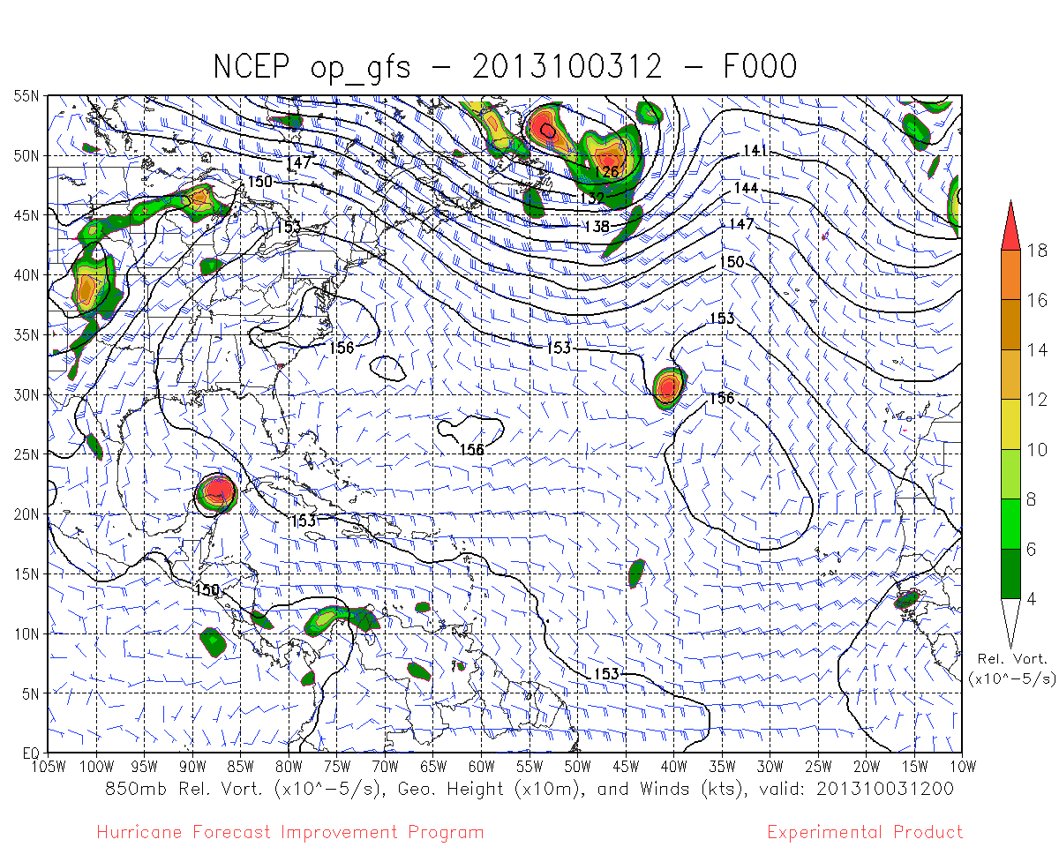
GFS run from 10/3/12Z also called for a “significant” TC to make landfall in FL panhandle

Slide 34
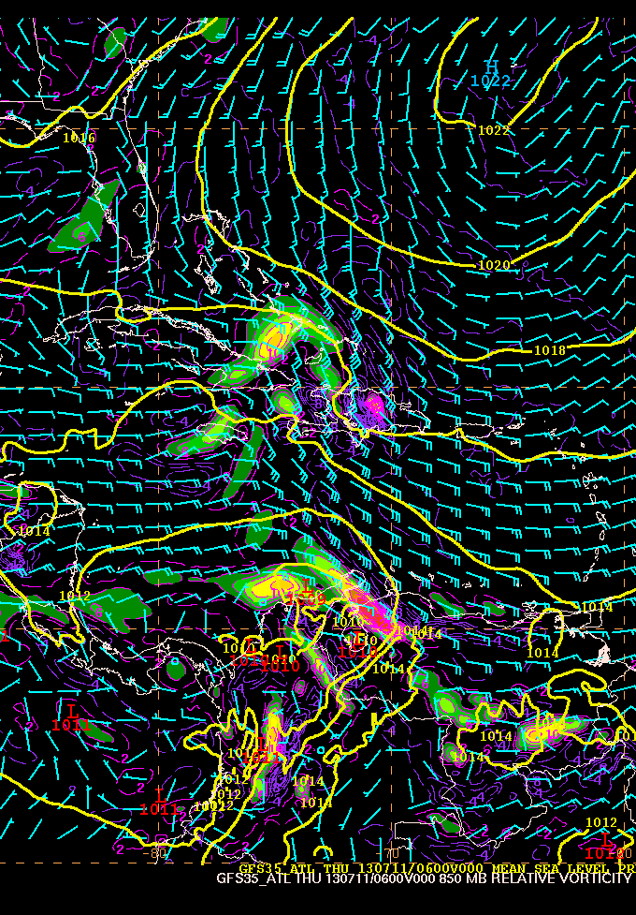
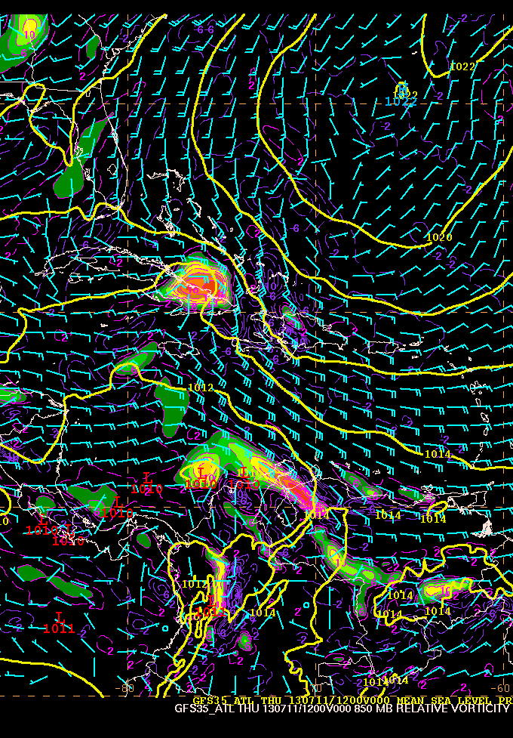
Impact of bogussing on GFS initialization for remnants of Chantal:
No bogus – 06Z 11 July
With bogus – 12Z 11 July
The 12Z GFS run was aggressive on regeneration of Chantal (due to the initialization), which prompted NHC forecasters to erroneously increase the genesis probabilities.

Slide 35
NHC’s Wish List for 2014
Higher-resolution GFS
Assimilation of additional aircraft data (flight-level, dropsonde, and SFMR winds) in the HWRF initialization
Implement improved HWRF initialization, especially for systems transitioning from “invest” to tropical storm status
Smarter bogussing of former TCs in the GFS
Increased bandwidth for high-resolution model output for the remote Centers
Provide subset of variables for large ensembles and high-resolution deterministic model output
Archive of spectral output for WW3 runs

Slide 36
Many Thanks to:
John Cangialosi, Dave Zelinsky, & others at NHC

