Slide 1
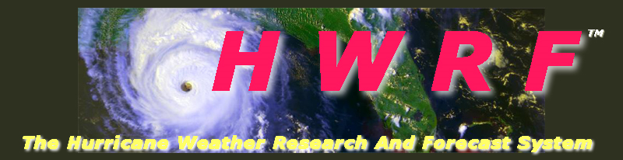

Operational HWRF - Performance for 2013 and Plans for 2014 and beyond.
Vijay Tallapragada & HWRF Team
Environmental Modeling Center,
NCEP/NOAA/NWS, NCWCP, College Park, MD 20740.
NCEP Production Suite Review, December 04, 2013
Notes:
1
1

Slide 2
Outline
Performance of current operational HWRF for 2013 season
Special Projects and Real-Time Parallel HWRF Experiments
Focus areas for further improvements
Plans for FY14 HWRF Upgrades
Plans for FY14 GFDL Upgrades
Ongoing developmental efforts for 2015 and beyond

Slide 3
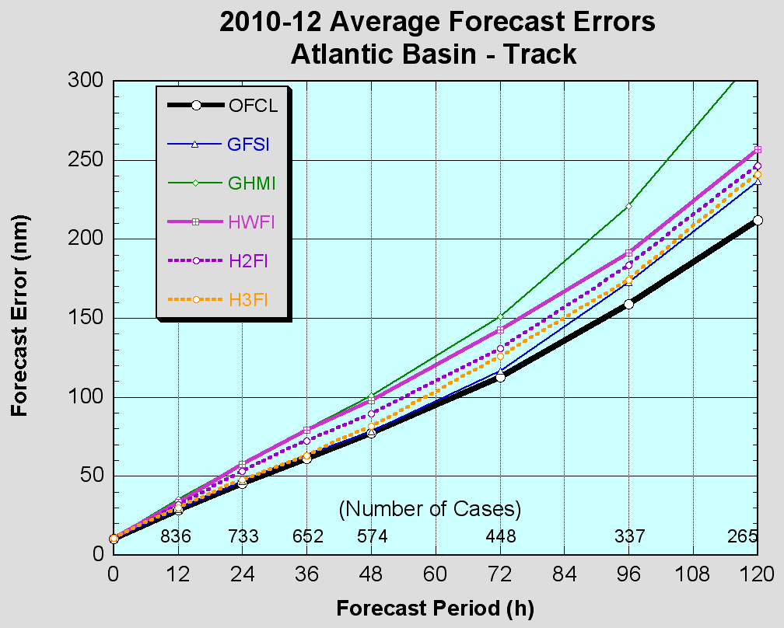
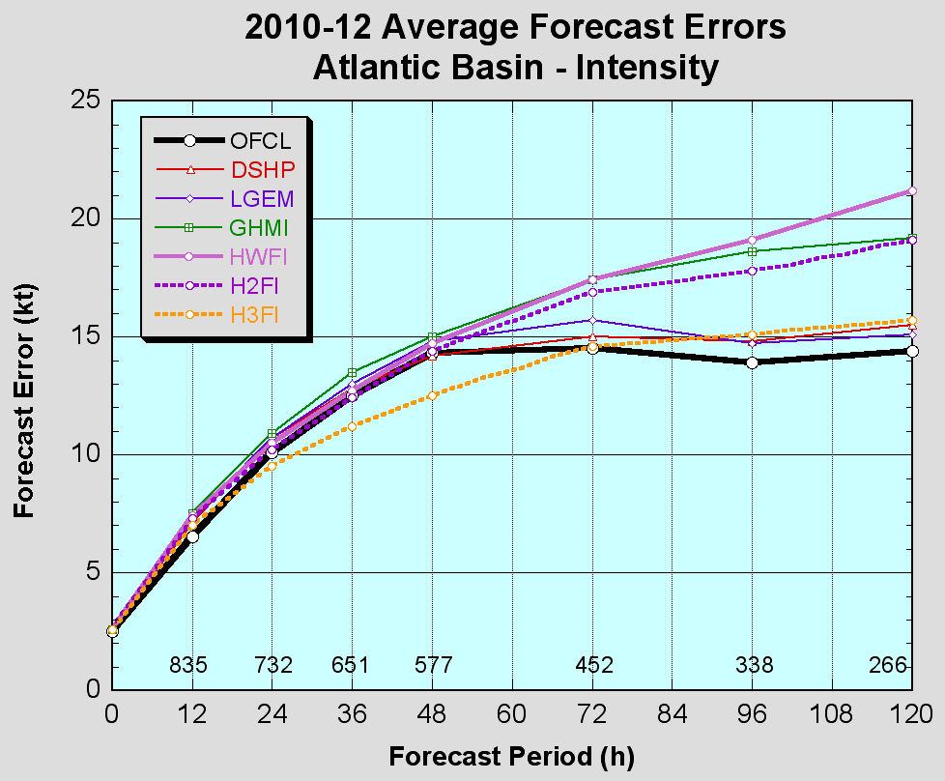
Highlights of FY2013 High-Resolution Triple-Nested HWRF V7.0.0
Infrastructure upgrades:
Upgrade the nest tracking algorithm
Re-design of nest-parent interpolations
Increased frequency of physics calls and increased size of the third domain
Physics upgrades:
Modifications to GFS PBL and bug fix for GFDL radiation
Data Assimilation and Vortex Initialization upgrades:
One-way hybrid EnKF-3DVAR data assimilation and assimilate real-time inner-core TDR datasets
Improved storm size correction, modified filter domain and use of GFS vortex when the storm is weaker than 16 m/s
Extensive evaluation:
Three-season (2010-12) comprehensive evaluation for NATL/EPAC
2012 typhoon season for WPAC
Implemented on July 2, 2013
FY13 HWRF
3
Notes:
3

Slide 4
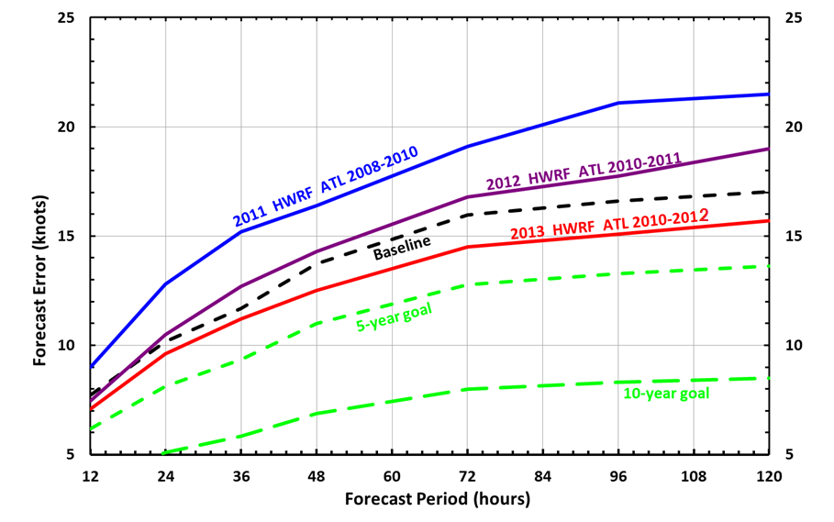
HWRF Intensity ATL Basin: Cumulative Forecast Improvements (Retrospective performance)
4

Slide 5
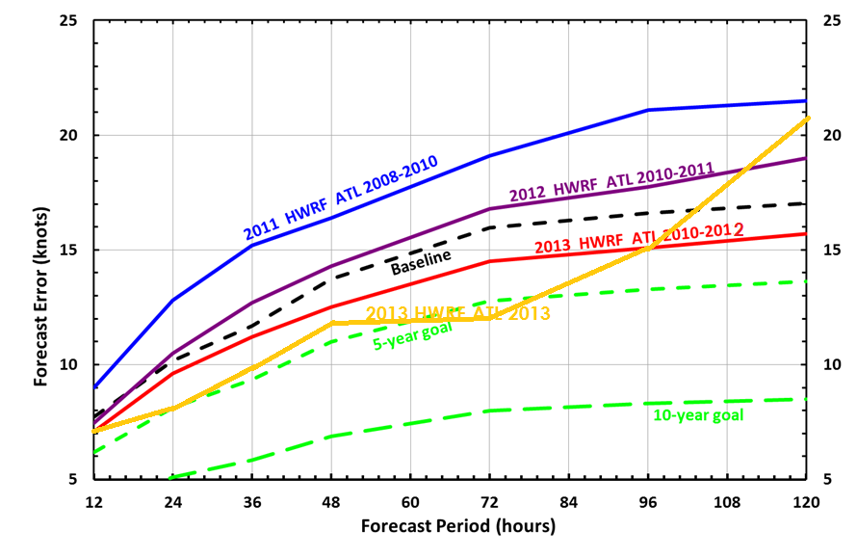
HWRF Intensity ATL Basin: Cumulative Forecast Improvements (Real-Time Performance)
Only 14 cases at 120 hr verified for 2013

Slide 6
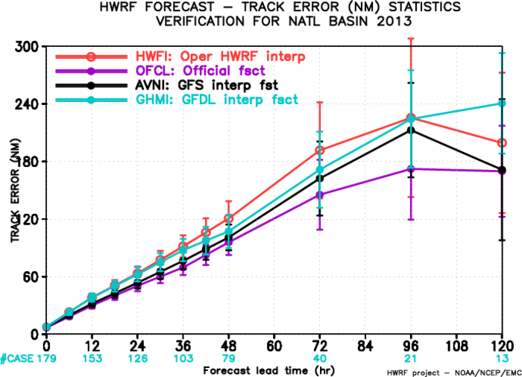
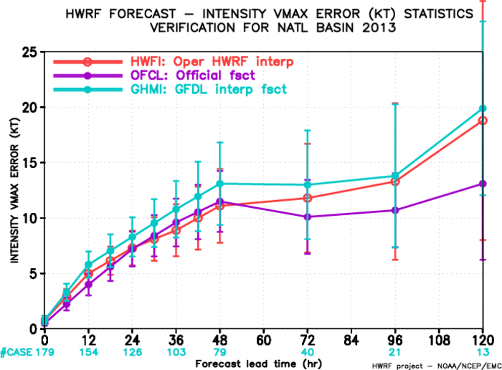
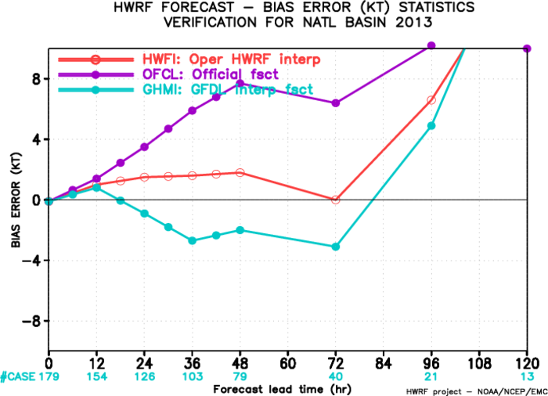
2013 North Atlantic early model verification
Intensity bias and errors from operational HWRF showed similar improvements noted in the retrospective evaluation. Neutral intensity bias through 72-hr lead time.
Season dominated by short lived and weaker storms.

Slide 7
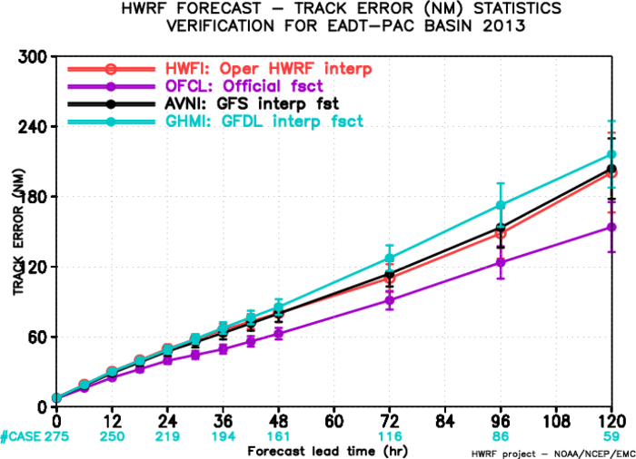
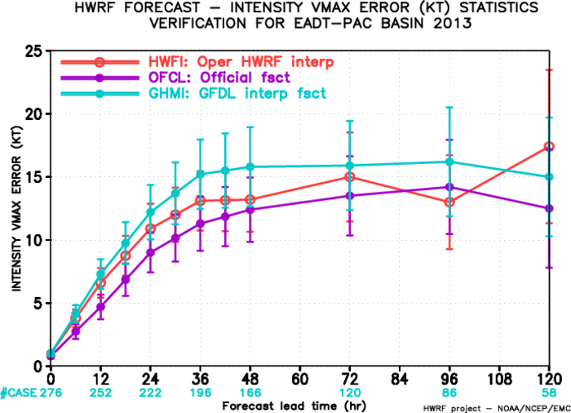
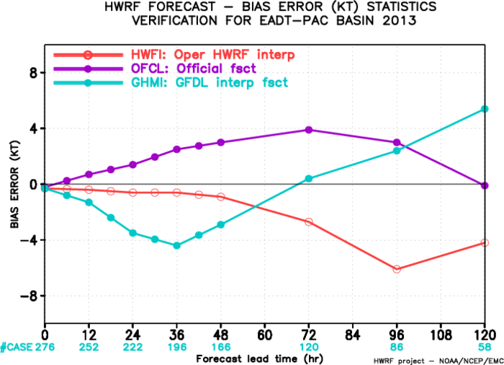
2013 East Pacific early model verification
HWRF track and intensity forecasts for the Eastern Pacific basin have shown better skill compared to other NCEP models
Neutral intensity bias through 48-hr lead time, negative bias at later forecast hours.

Slide 8
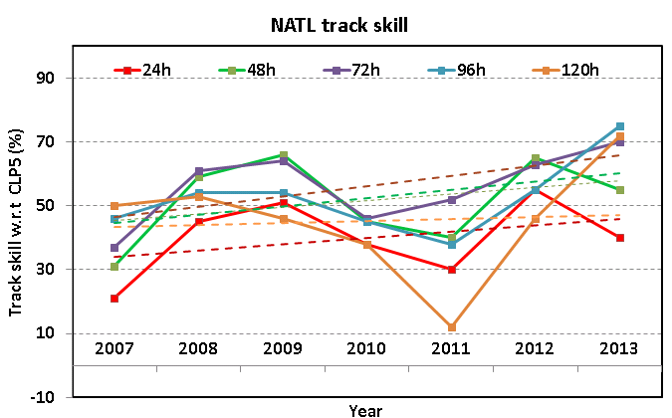
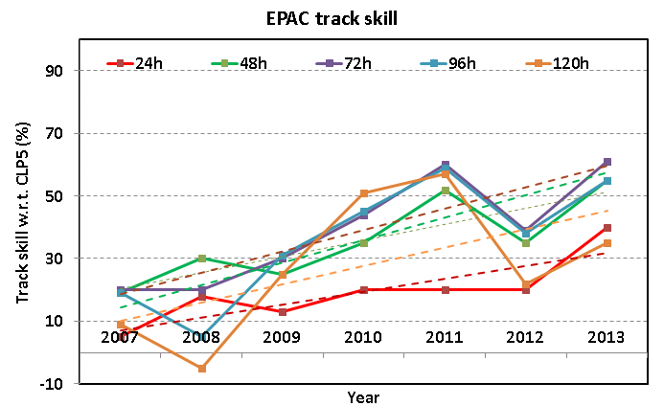
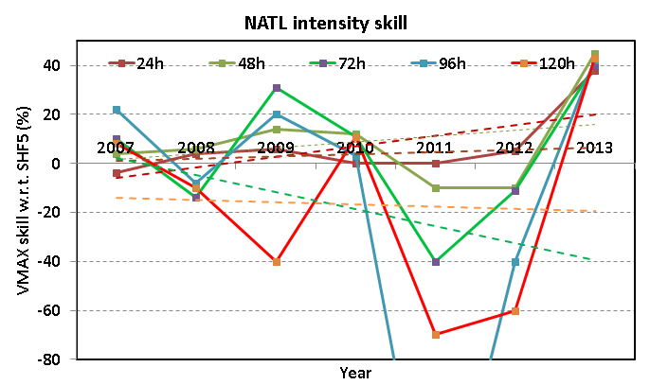
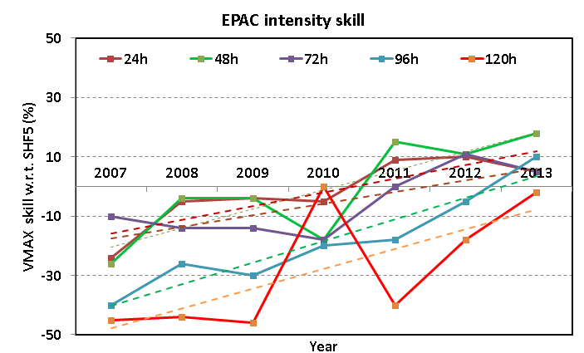
HWRF Forecast Skill Progress & Improvement w.r.t 2012
(FY2013 Operational Goals: 10% improvement in track and intensity skill at all times)
Lead time | 24 | 48 | 72 | 96 | 120
improvement | -15 | -10 | 7 | 20 | 26
Lead time | 24 | 48 | 72 | 96 | 120
improvement | 20 | 20 | 22 | 17 | 13
Lead time | 24 | 48 | 72 | 96 | 120
improvement | 33 | 55 | 51 | 82 | 103
Lead time | 24 | 48 | 72 | 96 | 120
improvement | -5 | 7 | -6 | 15 | 16

Slide 9
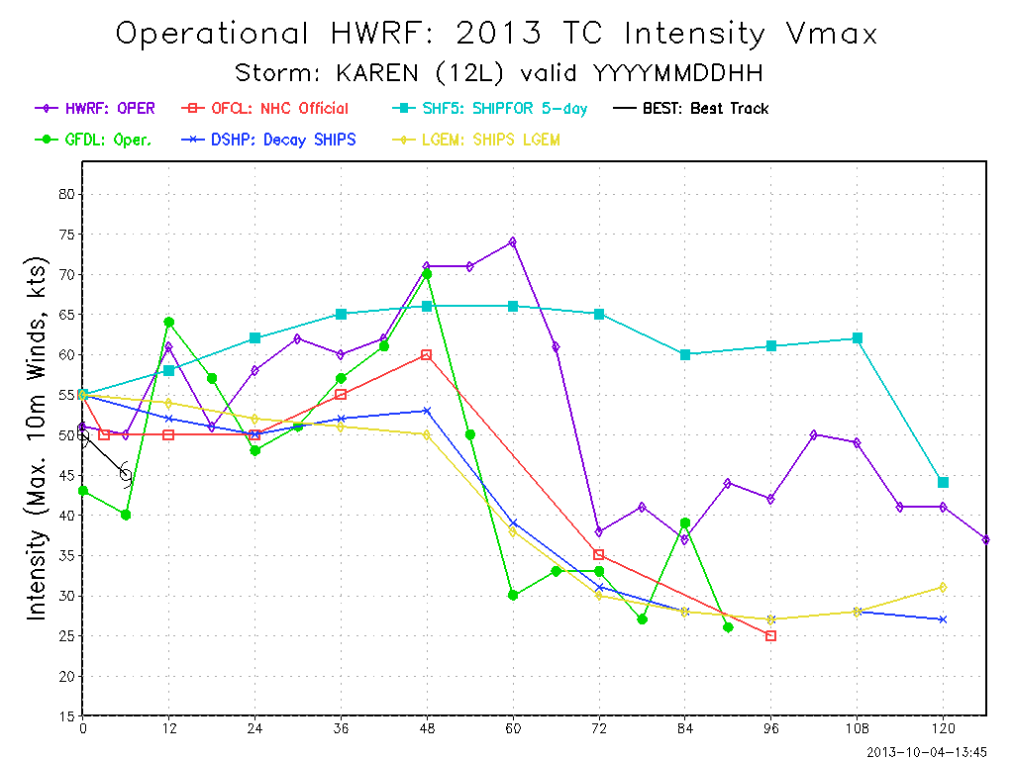
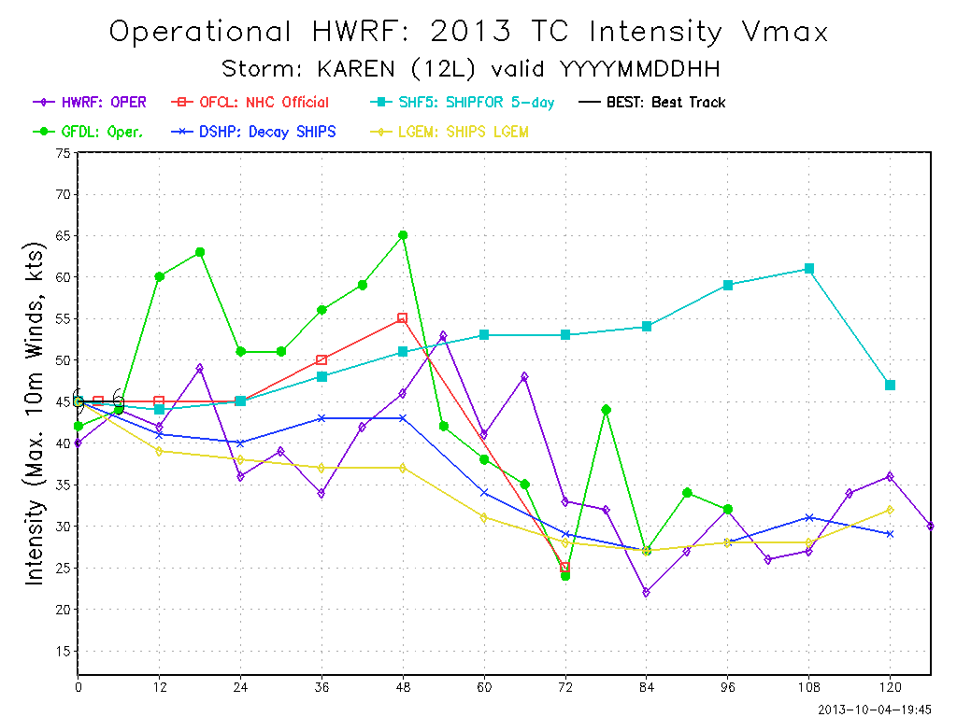
Impact of TDR DA on operational HWRF for TS Karen:
First Cycle w/TDR DA
No TDR
Impact of HWRF forecasts with TDR DA on NHC Operational Forecasts
NHC Forecast Discussion on October 4, 5 PM:
THE 12Z HWRF RUN SHOWED CONSIDERABLY LESS INTENSIFICATION WITH KAREN COMPARED TO PREVIOUS RUNS AFTER ASSIMILATING DATA FROM THE FROM THE NOAA P-3 TAIL DOPPLER RADAR. THIS MARKS THE FIRST TIME DOPPLER RADAR DATA HAVE BEEN ASSIMILATIED INTO AN OPERATIONAL HURRICANE MODEL IN REAL TIME.
-- Forecaster Brennan
Real-time assimilation of NOAA P3 TDR DA for operational HWRF – A First in many years of flying.
Fix issues related to transmission of TDR data to NCO (storm id mismatch etc.)
Conduct experiments to maximize the effective utilization of inner core data

Slide 10
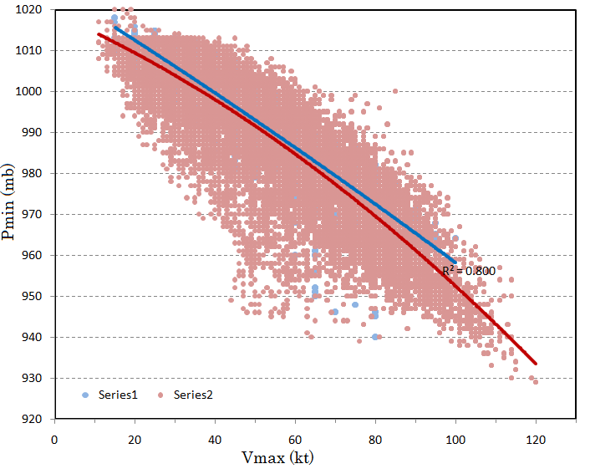
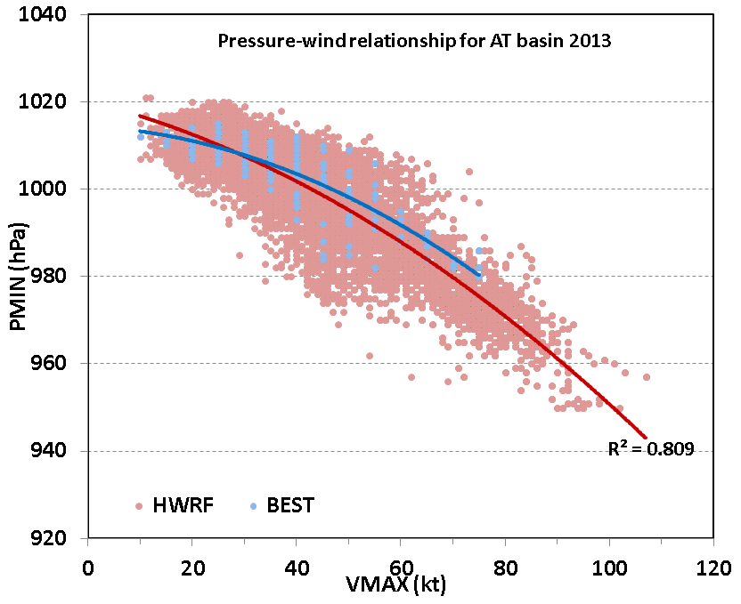
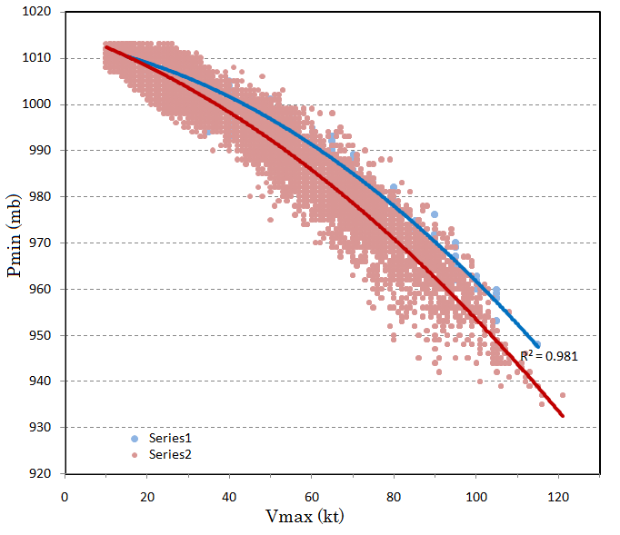
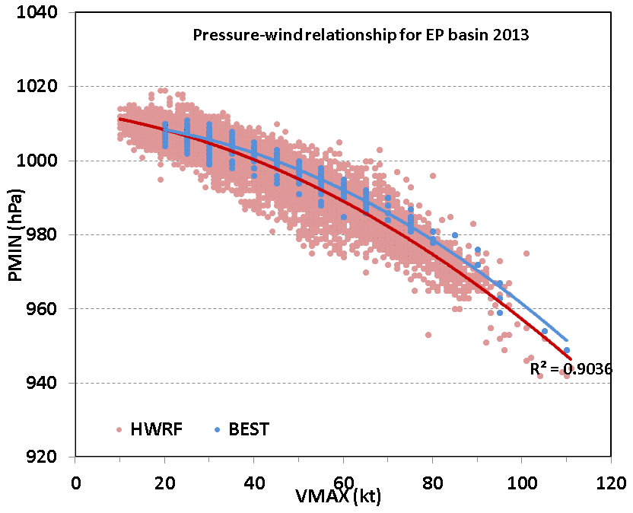
Wind-Pressure relationship: Much improved vortex structure from 2013 HWRF
ATL-basin
2012
ATL-basin
2013
HWRF
Best track
EP-basin
2012
EP-basin
2013

Slide 11
Special Real-Time Projects supported by HFIP
Experimental Real-time HWRF forecasts for Western Pacific and North Indian Ocean (in support of JTWC and IMD)
HFIP Stream 1.5 Demo: 20-member HWRF Ensembles
HFIP Stream 2 Demo: Alternate physics suite
HFIP Stream 2 Demo: Assimilation of Satellite Data
HFIP Stream 2 Demo: Basin-Scale (hemispheric) HWRF (with multiple moveable domains, collaboration with HRD)
HFIP Stream 2 Demo: HWRF-HYCOM
All these projects are supported by HFIP and allowed us to expand the Development Phase of operational HWRF for future upgrades.
HFIP resources on Jet and NCEP resources on Zeus helped us accomplish these real-time parallel systems.
Cross-platform compliancy through strict code management protocols and subversion based repository (supported by DTC) are pivotal for these efforts.

Slide 12
HWRF as an operational forecast guidance tool for JTWC & IMD
Starting in 2012, EMC HWRF team has been experimenting real-time forecasts for the WPAC basin, using NCEP Operational HWRF system, thanks to the support from NOAA’s Hurricane Forecast Improvement Project (HFIP).
~ 85-90% reliability in delivering forecast products to JTWC was accomplished using dedicated resources (three sets of infinite reservations) on HFIP machines in Boulder. Continued delivering real-time forecast guidance for all tropical systems in the Western Pacific and North Indian Ocean basins in 2013
“Performance metrics from 2102 confirmed HWRF added value to both track and intensity guidance available to JTWC forecasters, so we implemented its operational use in 2013. The model continues to perform very well, especially for intensity, where it outperformed other mesoscale models out to 72 hrs and was especially useful during the frequent rapid intensification events that occurred in the Western North Pacific this year”
--Bob Falvey, Director, JTWC
A preliminary analysis of the performance of various models indicate that the performance of NCEP HWRF model was very good. It was a very useful product in terms of track, intensity and landfall forecast guidance as well as rainfall. Its performance was better that that of IMD HWRF.
-- Dr. Mohapatra, Director, Cyclone Warning Division, IMD, India

Slide 13
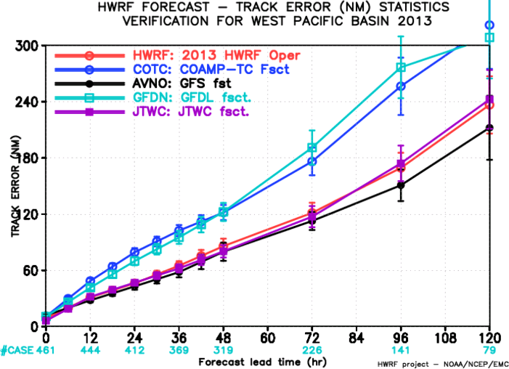
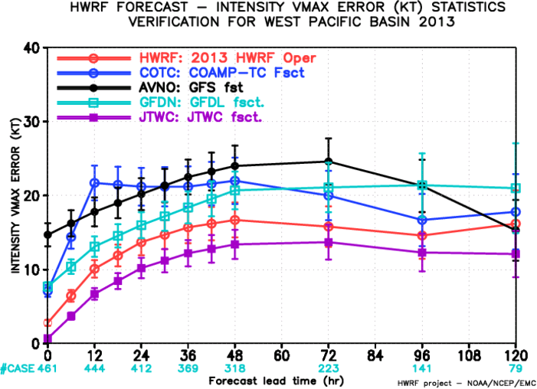
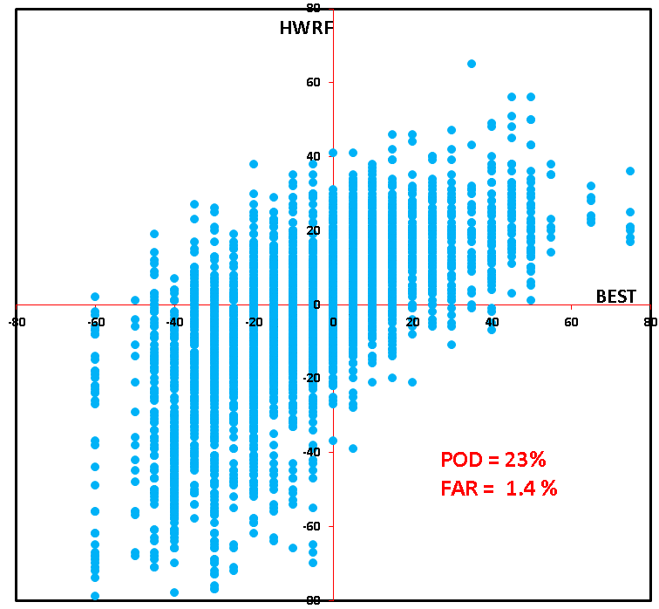
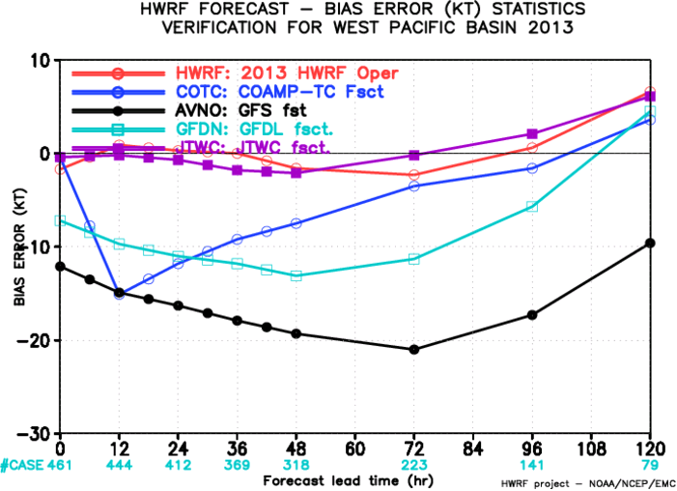
Verification for Western Pacific for 2013
HWRF RI POD skill is ~ 23 % and by far has higher POD index as compared to other models and in other basins (previous analysis of RI for WPAC from 2012 HWRF showed <10% skill).
The POD index is much higher (43%) if one simply considers the intensity change tendency, say 6-h change of VMAX > 5 kt.

Slide 14
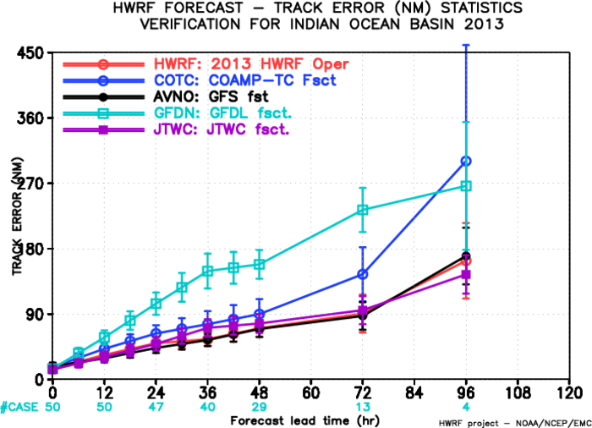
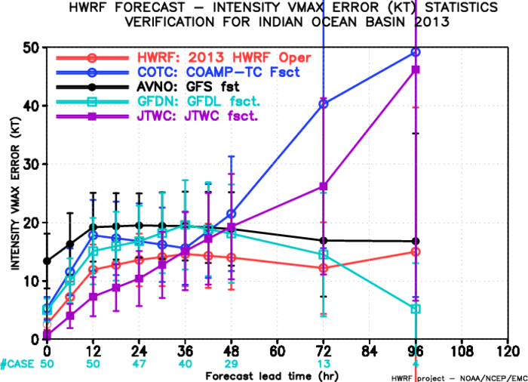
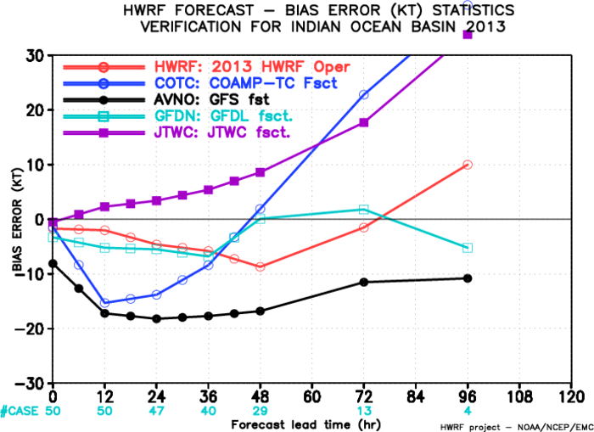
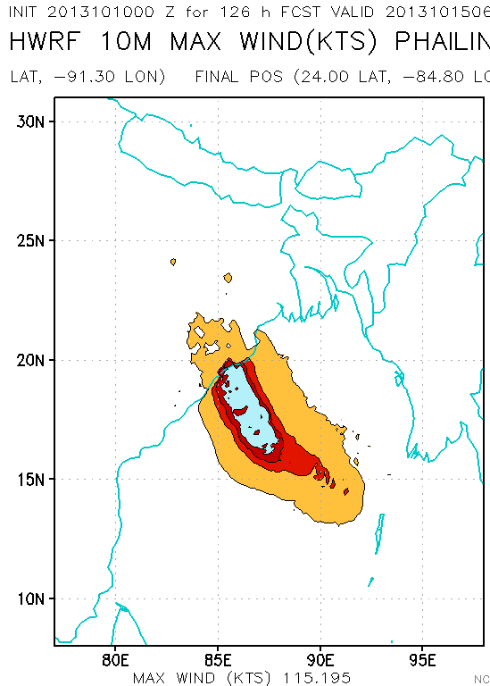
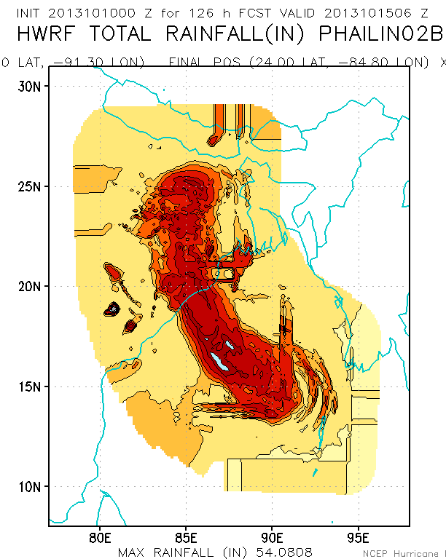
Verification for Indian Ocean for 2013
NCEP HWRF forecasts accurately captured the intensity, structure and rainfall of Phailin

Slide 15
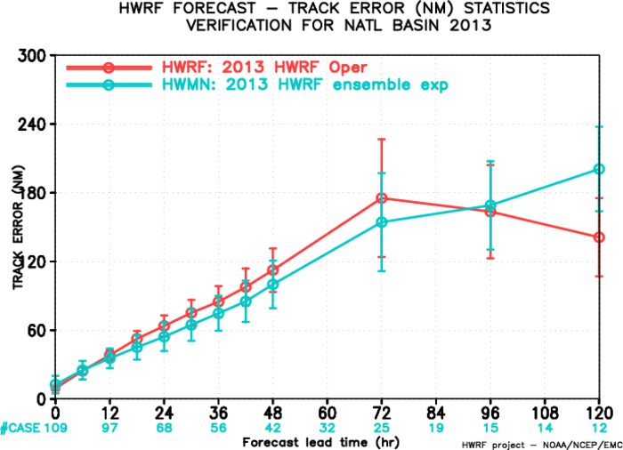
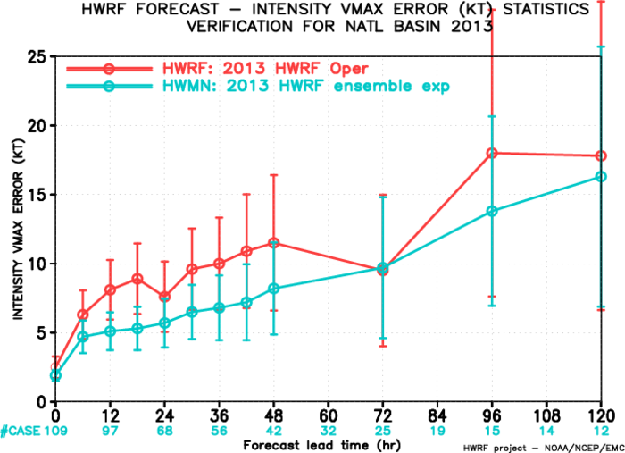
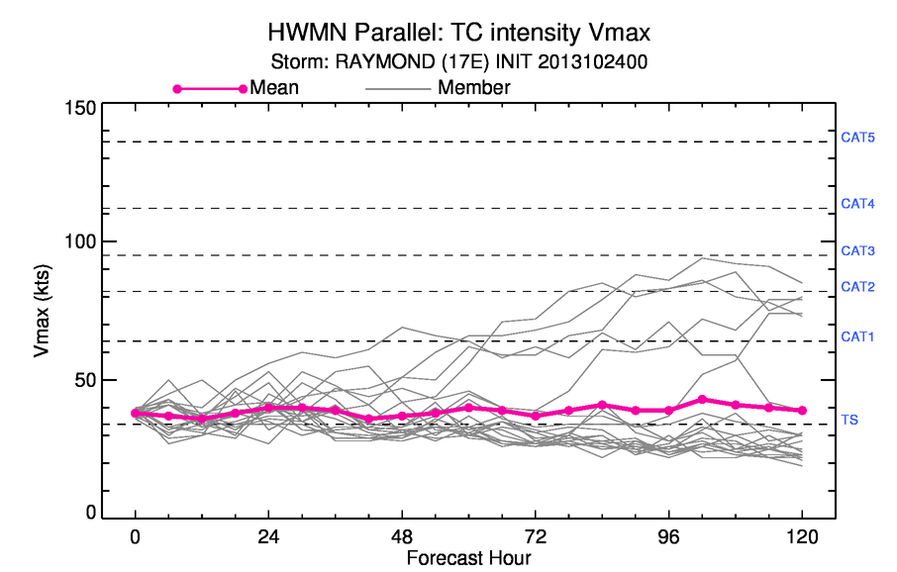
HWRF-ensemble verification: North Atlantic 2013
HWRF ensembles run in HFIP Stream 1.5 showed much improved track and intensity forecast skill compared to the deterministic model
Collaboration with NRL to develop high-resolution multi-model ensembles using HWRF and COAMPS-TC models
A few members of HWRF ensemble did show intensification of Raymond (operational HWRF did not capture the intensification)

Slide 16
Priorities for Operational HWRF for 2014 hurricane season
Address known problems/issues identified during the season:
Weak storms continued posing significant challenge
Moisture initialization in the model less than optimum
Cold start (very first cycle for a numbered storm) cases behave different (worse) than the warm start
Land interactions and cold temperature bias over land
Too small inner most domain to contain large storms
Insufficient vertical resolution for satellite data assimilation
Coarse resolution of ocean model, inadequate conditions for choice of ocean domain in the Atlantic, 1-D coupling in the East Pacific
Focus areas for development, testing and evaluation
Increase the vertical resolution of atmospheric model to 61 levels with higher model top of 2 hPa
Upgrade HWRF physics suite to include RRTM-G, Modified Ferrier microphysics, NOAH LSM.
Upgrade the ocean model (POM) to 1/12º MPI POM with unified trans-Atlantic basin and 3D ocean for Eastern Pacific basin. Upgrade the coupler to run on multiple processors.
Further improvements to HWRF vortex initialization scheme and HWRF Data Assimilation System
Additional operational forecast products from HWRF to include simulated brightness temperatures for new satellite sensors, several new variables for downstream applications and 9-minute ATCF output. Special storm centric helicity & tornadic potential fields for landfalling storms at the request of SPC.
Pre-implementation tests based on proposed Q4FY13 GFS upgrades

Slide 17
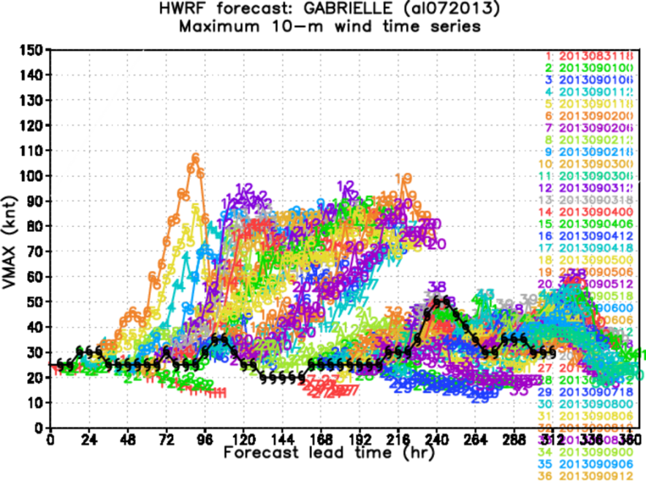
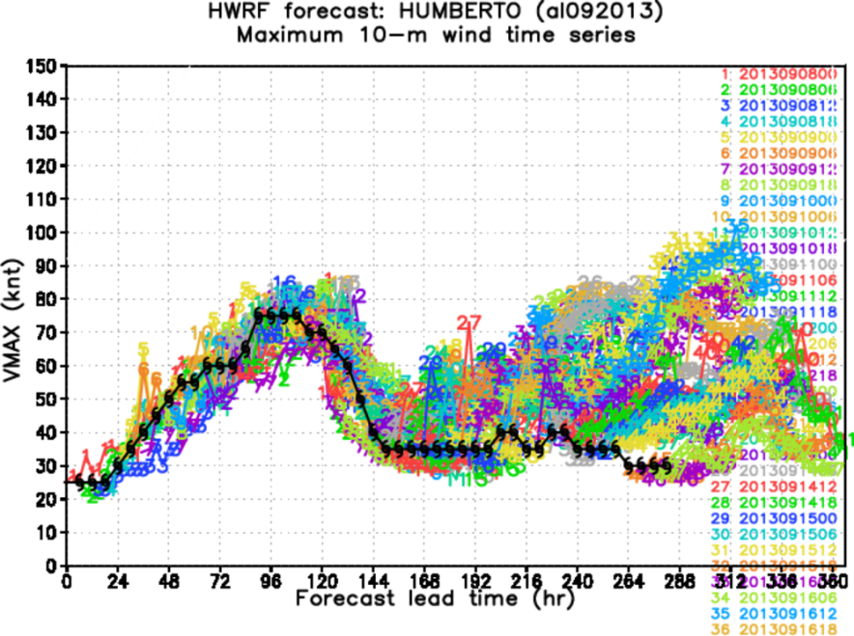
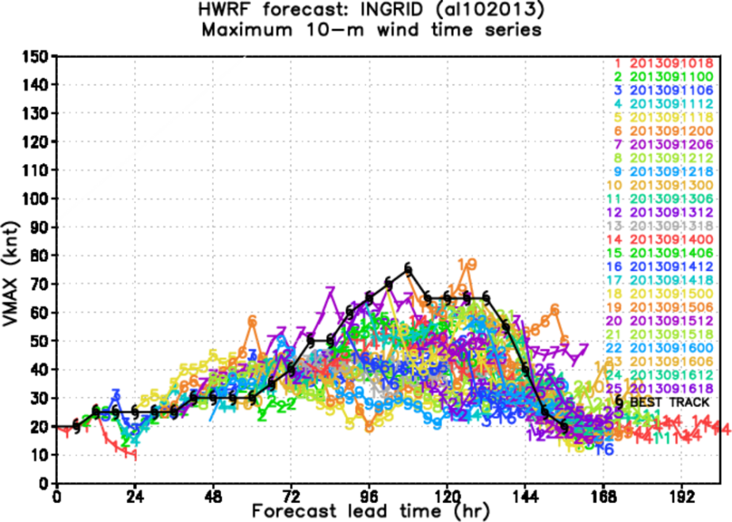
Problematic Storms for Intensity Forecasts
Weak storms still pose a significant challenge for HWRF.
Land interactions also impacted a few intensity forecasts for H. Ingrid
Potential initialization issues for cold start

Slide 18
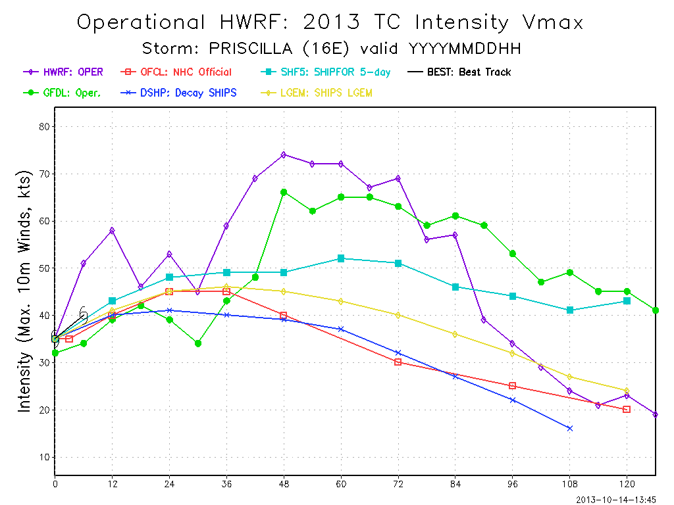
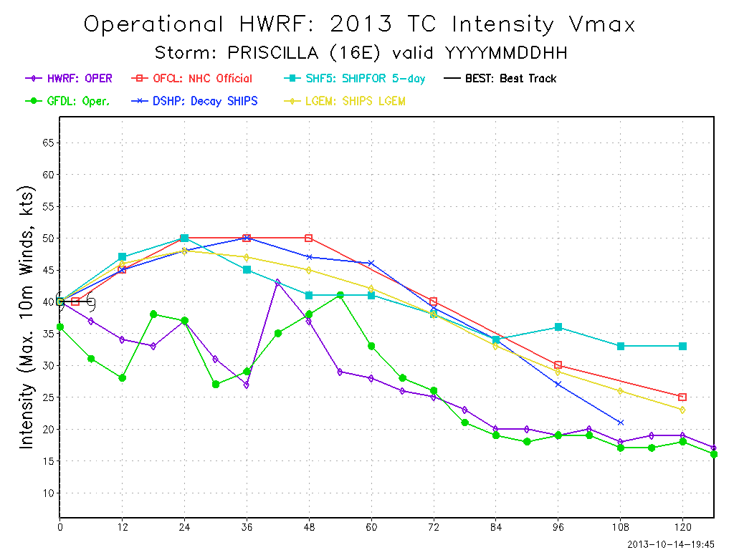
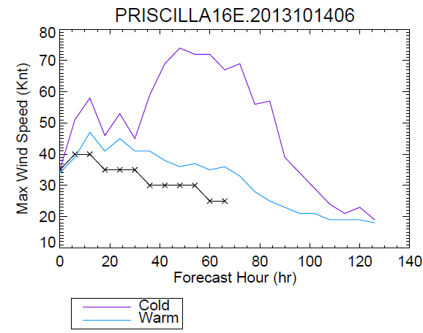
Intensity forecasts for Cold Start
2013101406
2013101412
Cold Start
Warm Start
Invest 95E became Priscilla 16E on 2013101406
Cold start (bogus) intensified the storm significantly
Warm start cycles well behaved
Could we cycle the vortex from Invest 95E for first cycle of Priscilla?
Improved initialization for Cold Start Cycles

Slide 19
Initialization upgrades
1. Match the initial maximum wind speed over the lands
2. Fix the bug of calculating south-west corner of initialization domain
3. Storm center is used in the procedure instead of using parent domain center
4. Remove the vorticity discontinuity along the filter domain
5. Avoid cold starts for the first cycle of named/numbered storm through cycling of vortex from Invest cases
Preliminary results
Strong intensity bias reduced
2013 initialization
Proposed upgraded init.

Slide 20
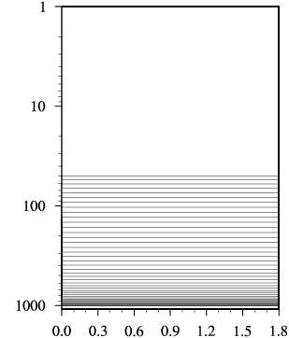
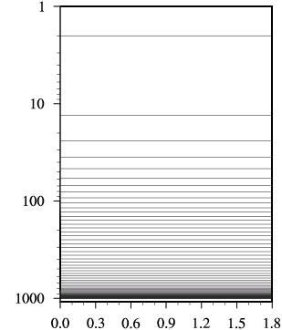
Increased model vertical levels (43 to 61) with higher model top (50mb to 2mb)
Pressure (mb)
Pressure (mb)
Operational HWRF (43level, pt=50mb)
new HWRF (61level, pt=2mb)

Slide 21
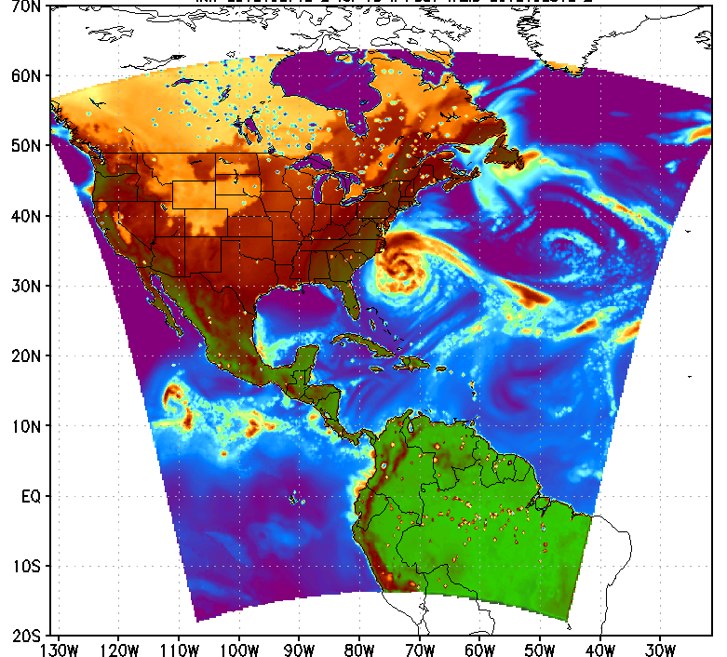
Extended nest domains
Hurricane Sandy (2012102718 +18hr fcst)
d02: 20% extended
10°X10° to 12°X12°
d03: 10% extended
6.5°X6.5° to 7.1°X7.1°

Slide 22
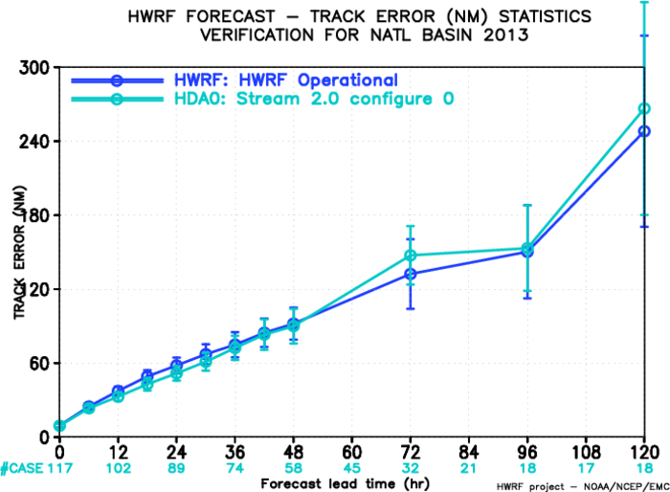
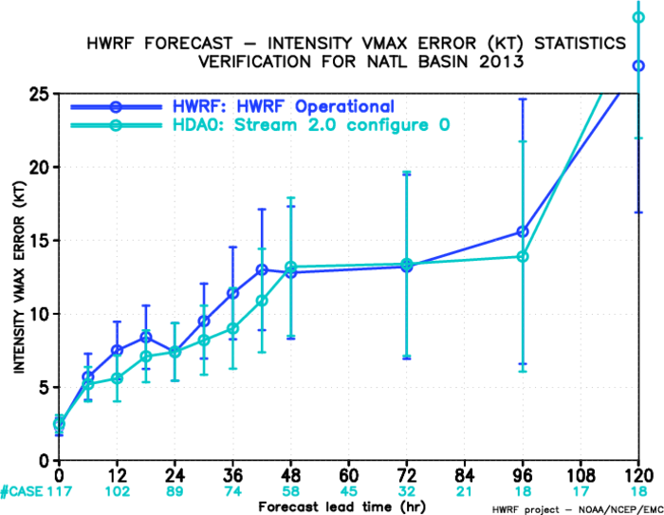
Data assimilation upgrades
  Apply regional hybrid GSI analysis for both D1 and ghost (3km) domains
  Assimilate the conventional data and TDR, GSPRO, satellite derived wind, brightness temperature from IR instruments (HIRS, AIRS, IASI, GOES Sounder) and MW instruments (AMSU-A, MHS, ATMS)
  Set satellite thinning box to 90 KM for IR instruments, and 45 KM for MW instruments
  Change 3-hourly FGAT to hourly FGAT – provide more accurate first guess fields, especially for fast moving and developing storms
  Further refinements in TDR data assimilation including advanced thinning strategies and removal of surface pressure flag (include it in assimilation); add dropsonde data in the inner core when available (especially temperature and moisture data).
Sat DA
OPR
OPR
Sat DA
Track Error
intensity Error

Slide 23
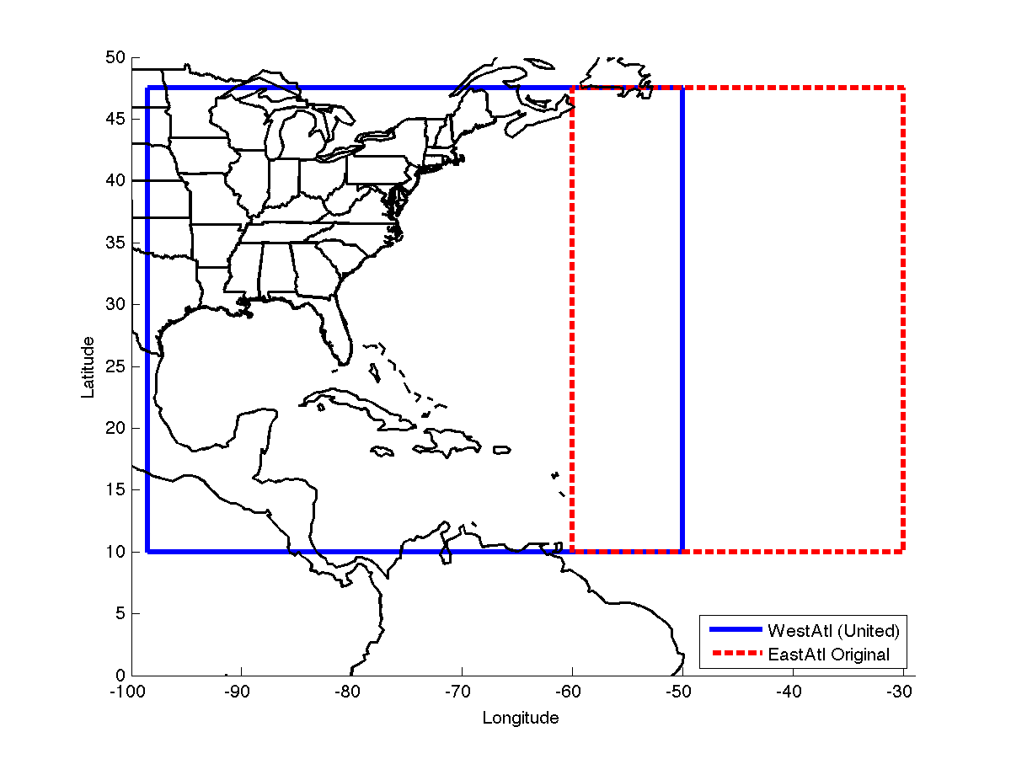
Ocean Upgrades: MPI POM and MPI Coupler
MPIPOM-TC uses MPI software framework for running on multiple processors, allowing for both higher resolution and larger domain sizes;
Unified domains for NATL basin;
MPIPOM-TC accepts flexible initialization options (FB, RTOFS, HYCOM);
MPIPOM-TC includes 18 years of physics updates and bug fixes;
MPIPOM-TC is a modernized code with netCDF I/O.
Upgraded coupler with multi-processor capability and advanced interpolation/ extrapolation techniques
Significant need for coupled model diagnostics
Ocean coupled HWRF forecasts for other basins
Southern Hemispheric TC Forecasts starting in January 2014
POM
1/6 horizontal grid spacing
1/12 horizontal grid spacing
MPIPOM

Slide 24
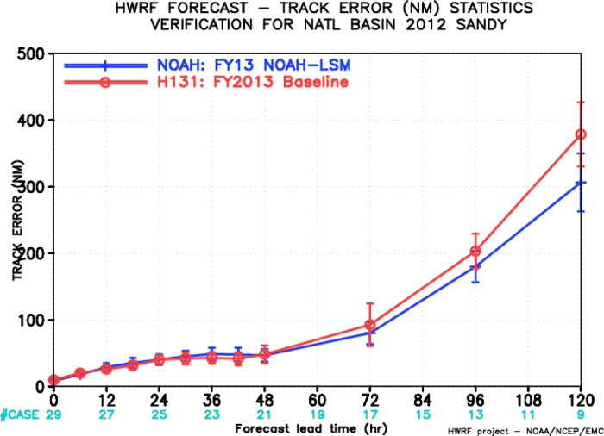
Upgraded Land Surface model
(GFDL slab to NOAH LSM)
GFDL slab has shown large negative temperature bias over SW CONUS
NOAH LSM significantly reduced the negative temperature bias
HWRF will include additional products for down-stream applications (e.g. storm surge, inland flooding)
Track errors of land-falling storms seem to be improved according to preliminary tests
Previous diagnostic studies showed significant cold bias in surface temperatures over land (c.f. Ligia et al.)
How to estimate and evaluate the impacts of land-radiation-PBL-microphysics interactions?
~18% improvement
with NOAH LSM

Slide 25
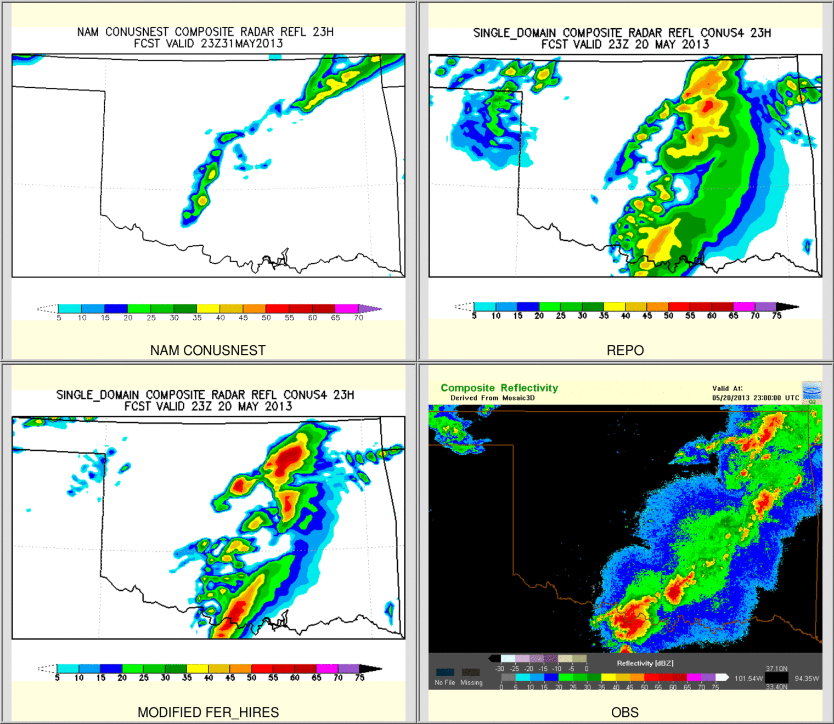
Upgraded Hi-Res Ferrier Microphysics
New ice nucleation scheme to reduce no. concentration of small ice crystals
New, simpler closure for diagnosing small ice crystals and large, precipitating ice particles from ice mixing ratios
Advection of multiple species including mass-weighted rime factor (i.e. “graupel”)
Slightly slower fall speeds of rimed ice
Increase the maximum (minimum) number concentration of small (large) ice in order to simulate better anvil cloud
NAM Parallel
operation
With upgraded Ferrier
obs

Slide 26
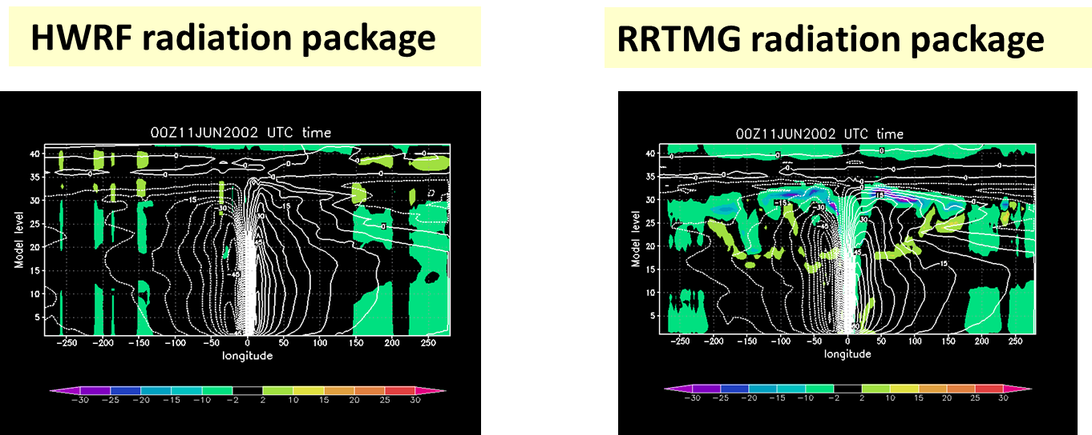
Upgraded SW/LW radiation schemes
(GFDL radiation to RRTMG)
GFDL radiation schemes have problems of proper representations of cloud-radiation interactions, especially net cloud top cooling and net cloud base warming.
Although the use of RRTMG radiations degraded the intensity forecast skills of HWRF model, we are going to test again with tuning of some key parameters.
Cloud top cooling due to radiation

Slide 27
Nest Motion and Diagnostics
  Corrected errors in smoothing parameters – should reduce nest jitter.
  Added GFDL Vortex Tracker “first guess center” algorithm instead of using nest center as first guess. Will prevent nest from lagging fast-moving storms.
  Changing nest motion frequency from 9 minutes to 3 minutes for inner domain. Will help with fast moving storms (ie.: Maria, Harvey)
  Adding diagnostic output every nest motion timestep. Will include tracker-based storm location and intensity and tornadic potential related products in support of SPC.
  Can add additional diagnostic parameters (SST, thermodynamics, etc.) if final configuration has runtime to spare.
Python Rewrite
  Rewrite HWRF scripting system (ush and scripts layers) in Python
  Reduce code complexity, improve reliability and portability
  Reduce footprint of HWRF scripts in operations from 50000 lines to about 10000 lines
  Maintain same scripting system across all collaborators and community, reducing R2O costs.
  Switch to 100% GRIB2 output from HWRF (no GRIB1)

Slide 28
2014 HWRF pre-implementation test plan
 | Baseline |  | Physics upgrades |  |  |  |  | Combined
 | H14A | H14B | Nest motion (H140) | NOAH LSM (H141) | Upgraded Ferrier (H142) | RRTMG (H143) | Ocean (H144) | H214
Description | 1. Sat Da with more 61 levels, 2mb top 2. Extended d02/d03 3. Upgraded vortex init. 4. GSI upgrades | 1. No Sat DA 2. Include Invests in cycling | 1. New nest motion & diagnostics | NOAH LSM | Separate species and F_rime advection with other upgrades | Radiation | MPI-POM with new coupler | Baseline + physics + python based scripts *need to do test runs with new GFS in WCOSS
POC | All | All | Sam | Young | Weiguo | Chanh | Zhan/URI | All
Cases | Whole 2011-2013 & selected 2008-2010 storms | Whole 2011-2013 & selected 2008-2010 storms | Priority cases | Priority cases | Priority cases | Priority cases | Priority cases | Whole 2011-2013 & selected 2008-2010 storms
Due date | Feb. 15 | Feb. 15 | Feb. 15 | Feb. 15 | Feb. 15 | Feb. 15 | Feb. 15 | March 31
Platform | Jet/WCOSS | Jet/WCOSS | Jet | Jet | Jet | Jet | Jet | Jet/WCOSS
Continuing on the same path of extensive testing of individual upgrades and their combination for multiple seasons that resulted in higher confidence in the model

Slide 29
GFDL 2014 Hurricane Model Upgrade
Increased horizontal resolution of inner nest from 1/12th to 1/18th degree with reduced damping of gravity waves in advection scheme.
Improved specification of surface roughness and wetness in surface physics.
Modified PBL with variable Critical Richardson Number.
Advection of individual micro-physics species.
Improved targeting of initial storm maximum wind and storm structure in initialization. (Reduces negative intensity bias in vortex specification).
Upgrade ocean model to 1/12th degree MPI POM with unified trans-Atlantic basin and 3D ocean for Eastern Pacific basin.
Remove global_chgres in analysis step (direct interpolation from hybrid to sigma coordinates).

Slide 30
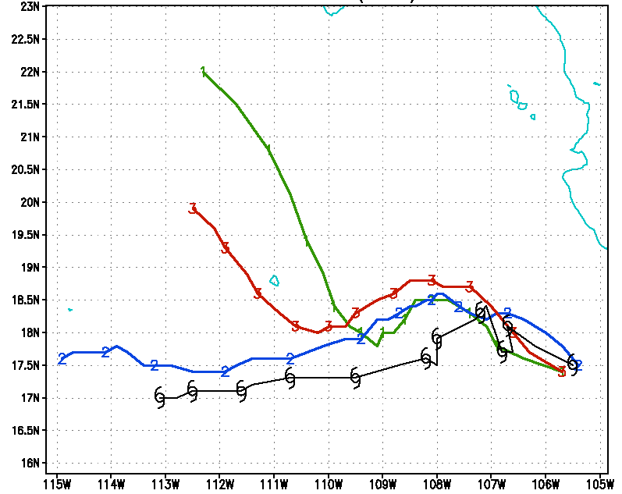
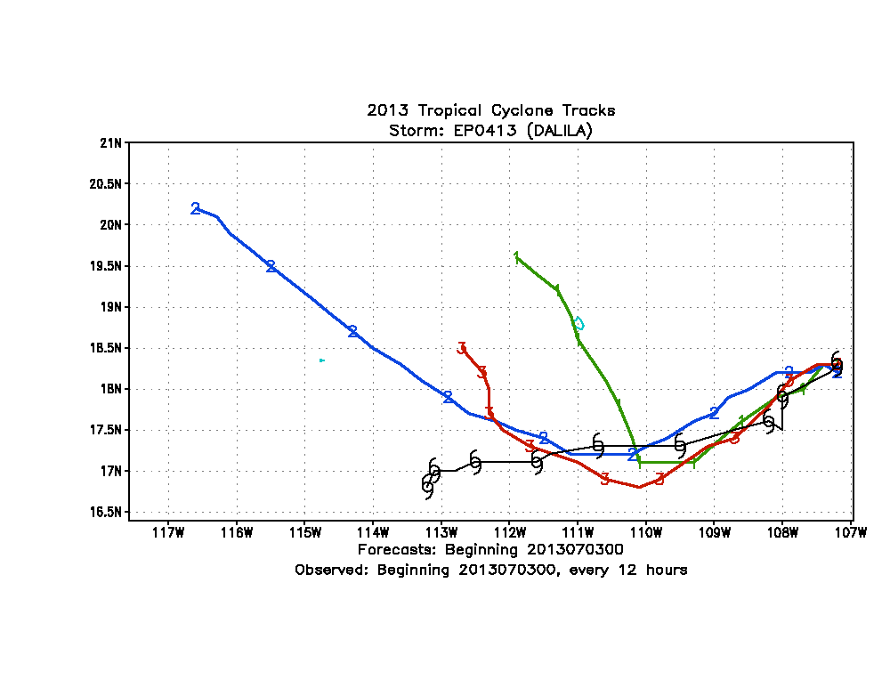


Hurricane Dalila
Hurricane Dalila
Current GFDL
Current GFDL
Current HWRF
New GFDL
New GFDL
Current HWRF
Initial Time: July 1st, 12z, 2013
Initial Time: July 3rd , 0z, 2013
Hurricane Raymond
Hurricane Raymond
Current GFDL
New GFDL
Current HWRF
New GFDL
30
Current GFDL
Initial Time: October 22nd , 0z, 2013
Initial Time: October 24th, 0z, 2013

Slide 31


Advancements to Operational HWRF – Transition to NMM-B/NEMS
Multi-Scale Modeling System with multiple moveable nests
AOML/NCEP Collaborative effort supported by OAR Sandy Supplemental High Impact Weather Prediction Project (HIWPP)
Take advantage of NMMB in NEMS infrastructure for developing next generation global-to-local-scale modeling system for tropical cyclone forecasting needs and for comprehensive forecast solutions for landfalling storms
Planned development, testing and evaluation leading to potential transition to operations in the next 3-5 years

Slide 32
Advancing the HWRF System FY2013 & Beyond
 | 2014* | 2015* | 2016* | 2017*
Resolution/ Infrastructure | Increased vertical resolution with higher model top | community R2O efforts (HFIP), Multiple moving domains | Upgrades to infrastructure - NEMS/ESMF/NMM-B, Other oceanic basins, HWRF Ensembles, Global to local scale modeling for hurricanes
Physics | Microphysics, Radiation, Land Surface | TKE based PBL, Advanced microphysics including impacts of dust and aerosols, Coupling to Waves and Sea Spray, Physics for high-resolution
DA/ Vortex Initialization | Inner core DA (TDR, dropsonde, aircraft recon, clear sky satellite radiances), invest cycling | Hybrid-EnKF DA, advanced vortex relocation procedure, improved GSI/Hybrid techniques, DA for moving nests, HWRF Ensembles in DA, cloudy radiance assimilation Two-Way regional Hybrid DA
Ocean | High-resolution (1/12) POM with unified Atlantic basins, 3D ocean for East Pacific | Improved ocean data assimilation, physics and resolution, unified coupled system for ATL & EPAC
 | HWRF-HYCOM for all oceanic basins (driven by Global RTOFS)
Waves | Atmosphere-Ocean-Wave Coupling | Multi-grid surf zone physics, effects of sea spray
Diagnostics and Product Development | HWRF Ensemble based products, Coupling to Hydrological/ Surge/ Inundation models, advanced model diagnostics based on observations, improved product development
.
2014 upgrades
Planned/ongoing developments
*Resource permitting

Slide 33
Future Outlook 5 to 25 years??????
 | 5-10 years | 2020+
Resolution/ Infrastructure | Basin-Scale HWRF with multiple moveable nests (at cloud resolving resolutions) and high-resolution HWRF ensembles Downstream applications (including landfall related storm surge, waves, flooding and inundation) | Global to Local Scale Modeling to capture multi-scale interactions High-Resolution Ensembles for events of interest
Physics | Observations based physics Incorporate effects of sea-spray, aerosols, waves, boundary layer rolls – explicit representation of inner core processes | Ensemble based physics approach
DA/ Vortex Initialization | Hybrid/EnKF with 4-D VAR Vortex initialization within the DA, focus on assimilation of all-weather radiances and aircraft data | Part of the data assimilation for global system
Ocean/Wave/Land | Fully coupled ocean-wave-land-atmosphere system
Products & Downstream applications | Meeting the next-generation needs of Hurricane Specialists at NHC and JTWC and provide enhanced guidance on rainfall, surge, flooding, inundation, tornadic potential etc. to WPC, SPC and WFOs for landfalling storms.
.

Slide 34
Thanks for your attention
Real-time and pre-implementation T&E
HWRF products:
http://www.emc.ncep.noaa.gov/gc_wmb/vxt/index.html
Questions?
Acknowledgements:
HWRF team at EMC
EMC and HFIP Management
Collaborations with NHC, DTC, HRD, GFDL, URI, CIRA and other HFIP partners
Notes:
34

