Slide 1
Review of the NCEP production Suite: Recent Changes and Plans
Marine Modeling and Analysis Branch
Ocean Numerical Guidance
Hendrik L. Tolman
Chief, Marine Modeling and Analysis Branch
NOAA / NWS / NCEP / EMC
Hendrik.Tolman@NOAA.gov
WHERE AMERICA’S CLIMATE WEATHER AND OCEAN SERVICES BEGIN

Slide 2
Sea Ice and SST

Slide 3
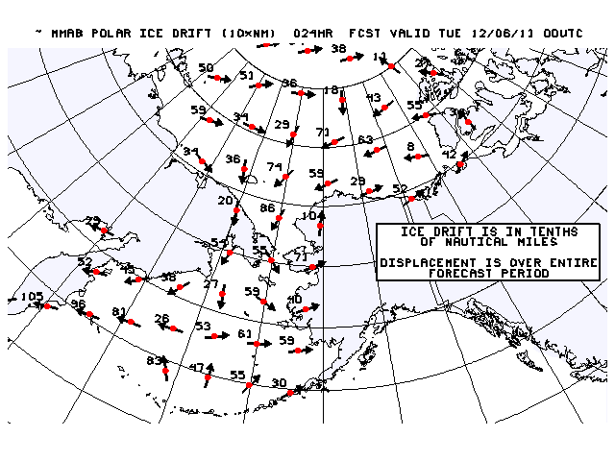
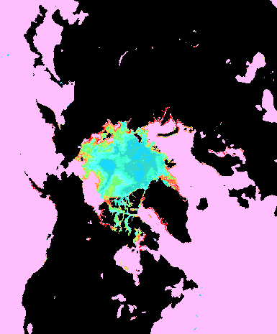
Sea ice and SST products
Present products:
Sea ice concentration.
Service upgrades.
Sea ice drift model.
2013: Resolution x13 upgrade (25km).
Done.
2014: Ensemble approach.
201?: Resolution upgrades ~10km.
RTG-SST and other SSTs
Service upgrades.
Stand alone products needed for many more years.
Used in many weather models.
Validation for ocean models,
Other more appropriate producers ?

Slide 4
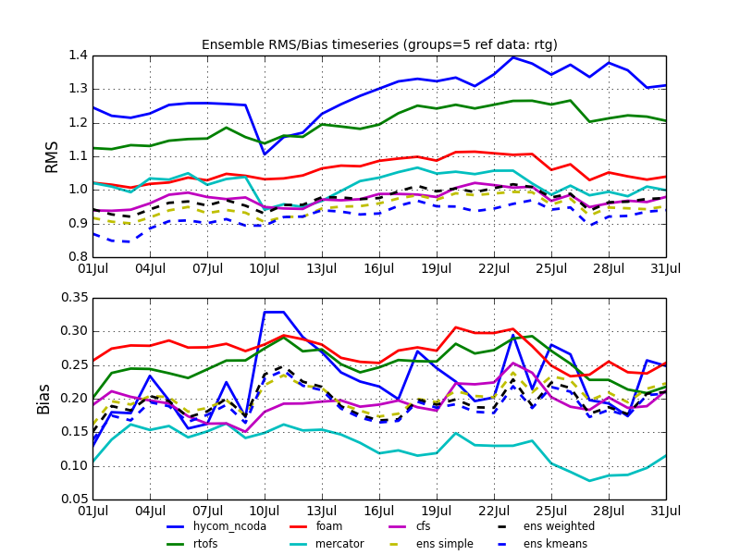
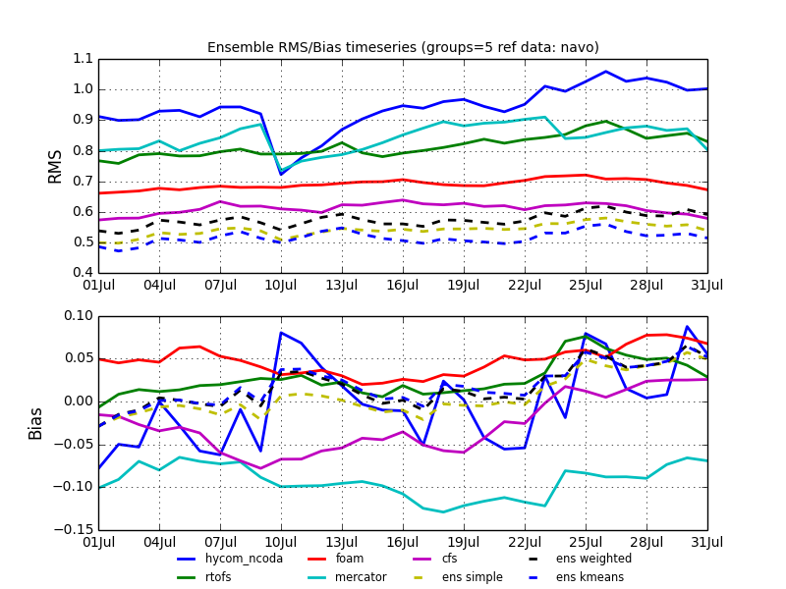
SST modeling
More (future) use of SSTs from models:
RTOFS SST metrics (bias < 0.5°C, rms < 1°C) compatible with SST analyses (but not as good).
Experimental IMME as part of NCEP’s GODAE OceanView contributions.
RMS errors and bias referenced to RTG SST
RMS errors and bias referenced to GMPE

Slide 5
Ice modeling
Present ice “models” at NCEP:
Sea ice drift model.
NAM: ice/no ice field (constant in forecast).
GFS: ice thickness evolves, concentration fixed, no velocity.
CFS-v2: ice th1ckness, concentration and velocity evolve.
WAVEWATCH III: constant ice concentration as model input.
Model allows for evolving ice input.
RTOFS/HYCOM: Global: energy loan sea ice model.
Arctic Cap Nowcast Forecast System (ACNFS, NANO/NRL, data available at NCEP) Los Alamos CICE model two-way coupled to HYCOM.

Slide 6
Ice modeling
In the pipeline:
Collaboration with Navy:
Access to CICE direct in HYCOM.
Collaboration with ESRL:
Porting ice models to ESMF / NUOPC (solo coupler):
Los Alamos CICE.
GFDL ice model.
In house:
CFS-V2 ice model.
Keep Ice’S Simplicity (KISS), introduced last year.
V0: concentration and thickness fixed (e.g., GFS).
V1: velocity from drift model, thickness and concentration evolve with thermodynamics only.
V2: ice advection, thickness classes.

Slide 7
Ice modeling
Justification for developing KISS:
Predictability strongly linked to thermodynamics, secondary to ice drift.
Sea ice drift model ice edge at 72h forecast is as accurate ad ACFNM full ice model at 24h forecast.
Metrics:
Development of proper metrics key element of model development.
Development work ongoing
More to follow on 2014 NPSR.
Ice in coupled models:
Major impact on weather in Canadian models.
Similar impact expected for Arctic and Great Lakes.
Holding back ocean-atmosphere coupling on global scale.

Slide 8
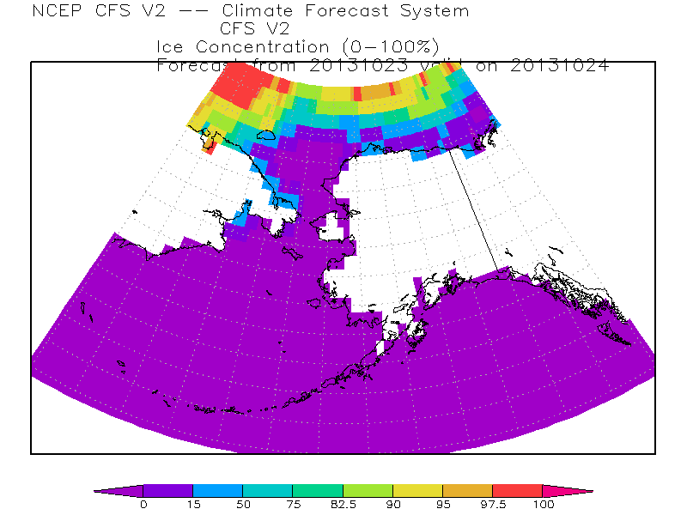
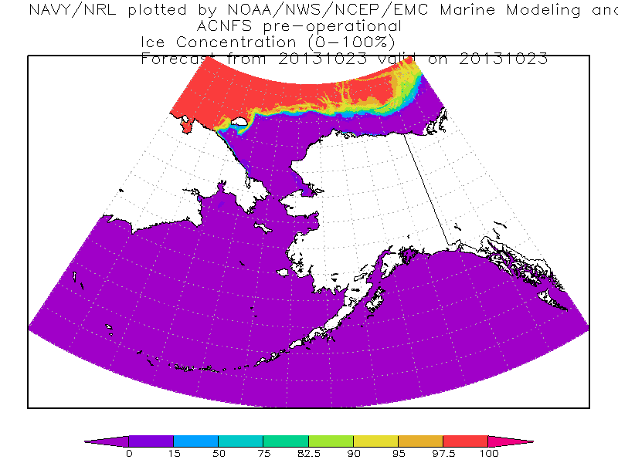
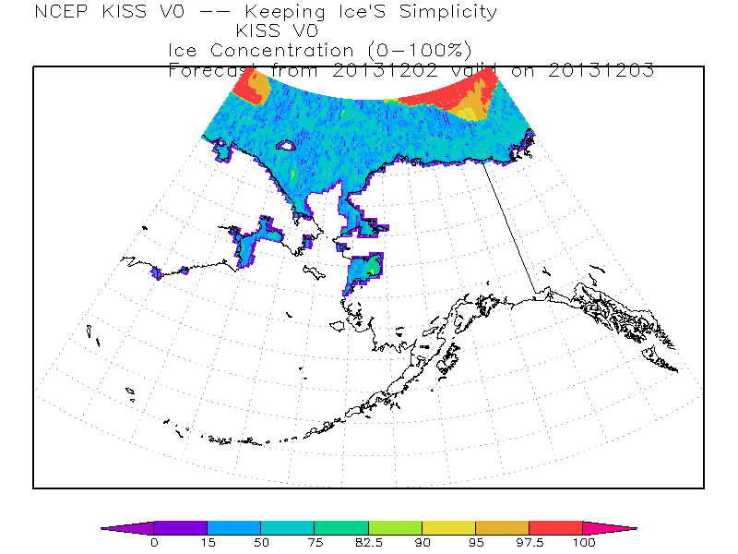
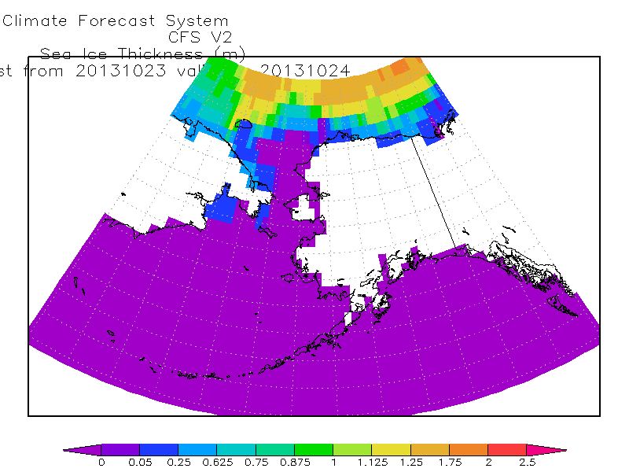
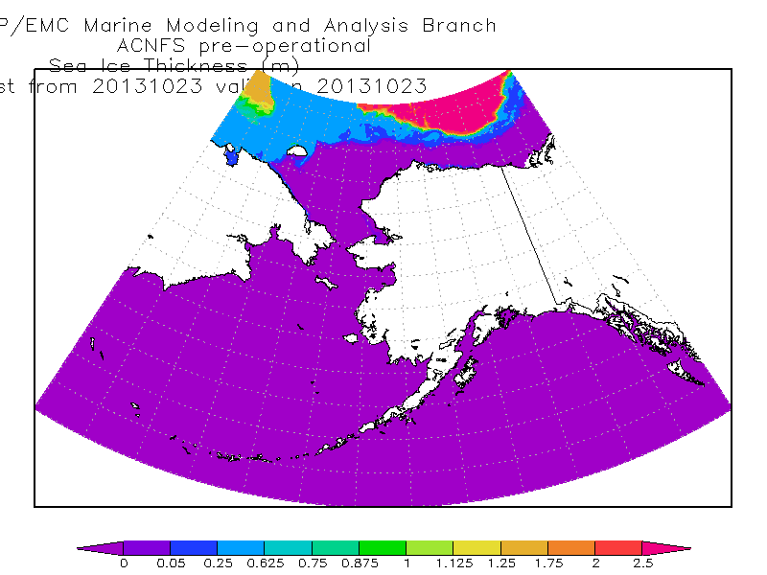
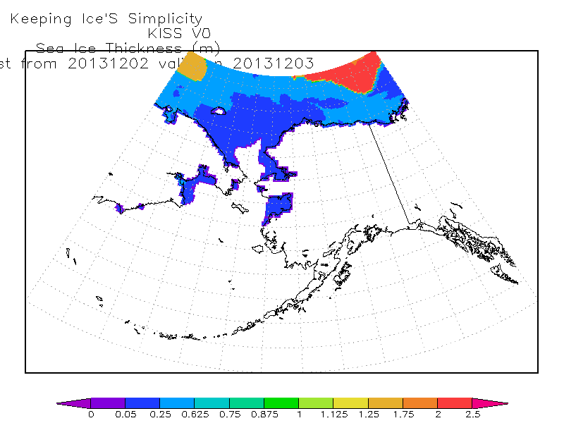
Ice modeling
CFS-v2
ACNFS
KISS-V0
Conc.
thickness

Slide 9
Ocean modeling

Slide 10
RTOFS
Five major efforts:
Eddy resolving ocean modeling.
Eddy resolving ocean initialization.
Coupled modeling for hurricanes.
Coupled modeling for weather – CFS / NEMS.
Episodic tracers
All RTOFS models presently based on HYCOM
RTOFS represent line of products.
HYCOM is underlying ocean model.
Operational 2005
RTOFS-Atlantic
Operational 10/25/2011
RTOFS-Global
Live testing (2015?)
RTOFS-HWRF
Under development
RTOFS-NEMS
Operational 07/24/2012
RTOFS-ET-Pac

Slide 11
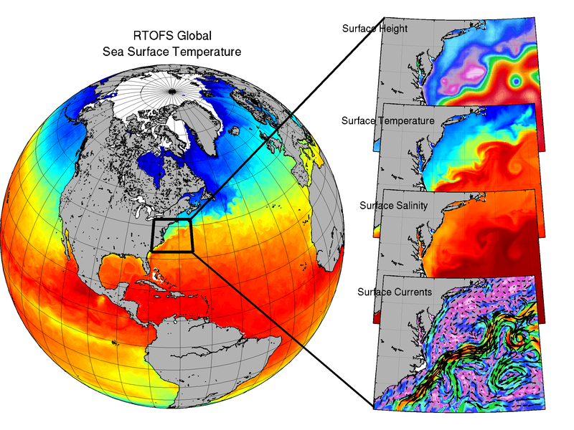
RTOFS-Global

Slide 12
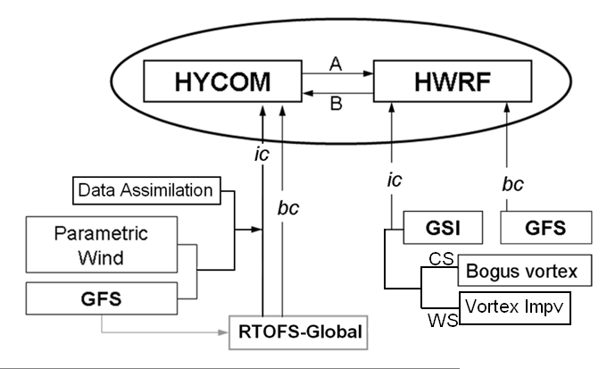
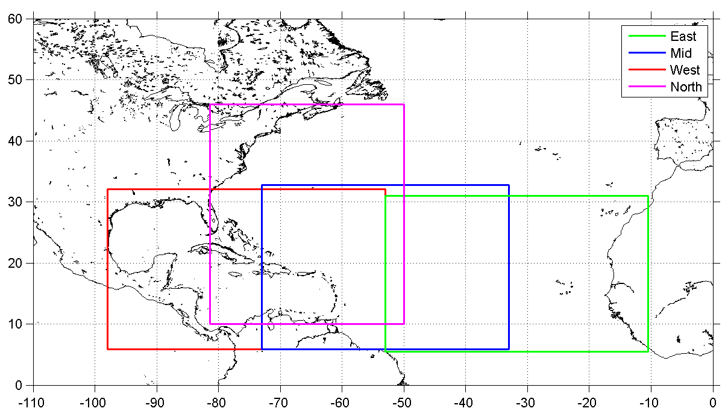
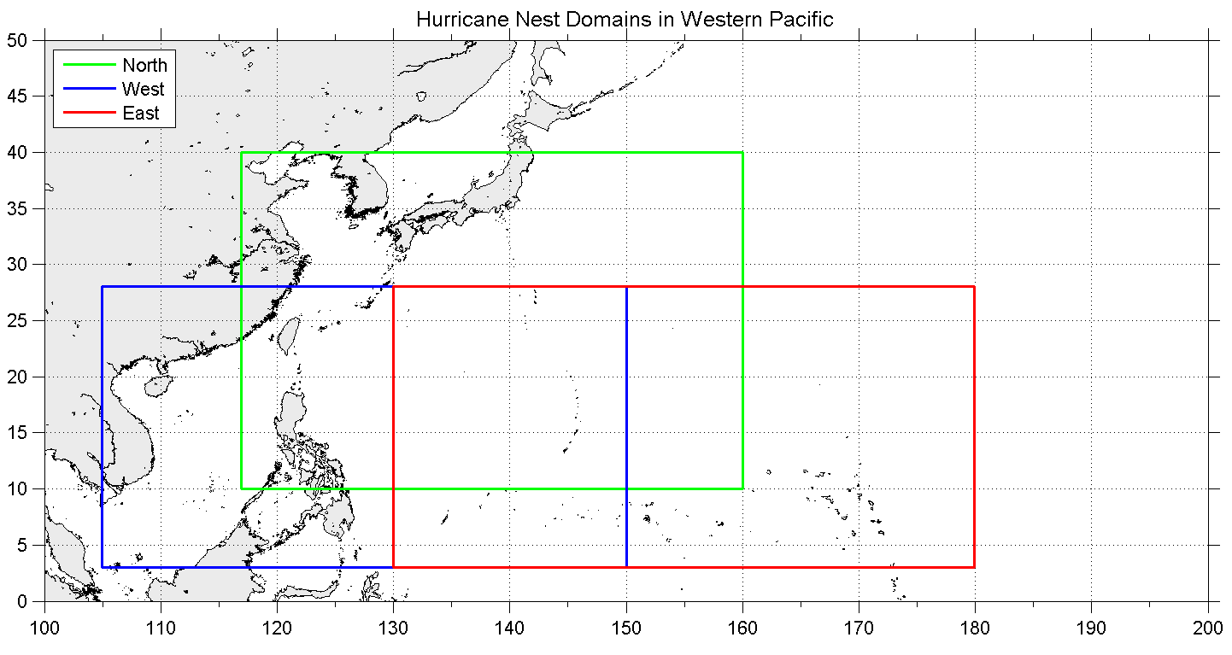
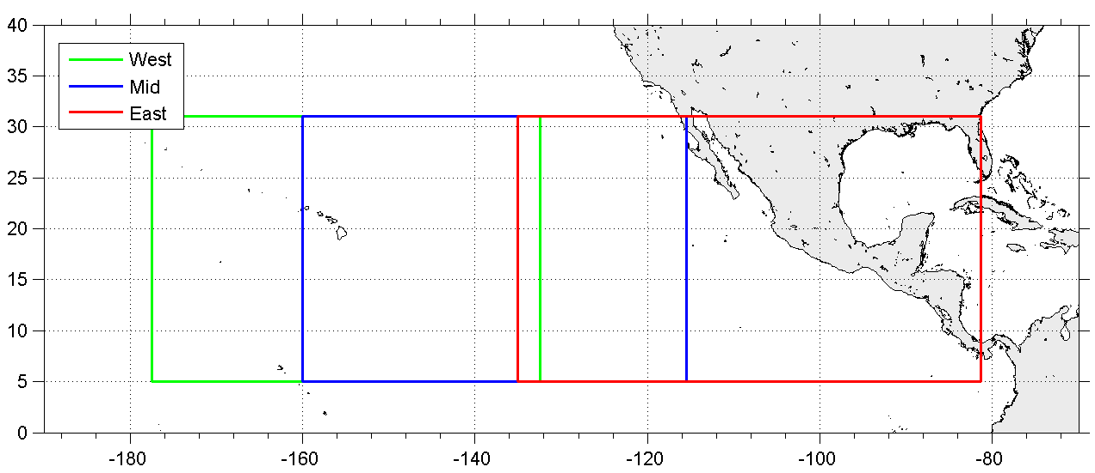
RTOFS-HWRF
Coupled hurricane modeling with regional ocean components
2015 ops?
TPC
TPC
JTWC / ITOP

Slide 13
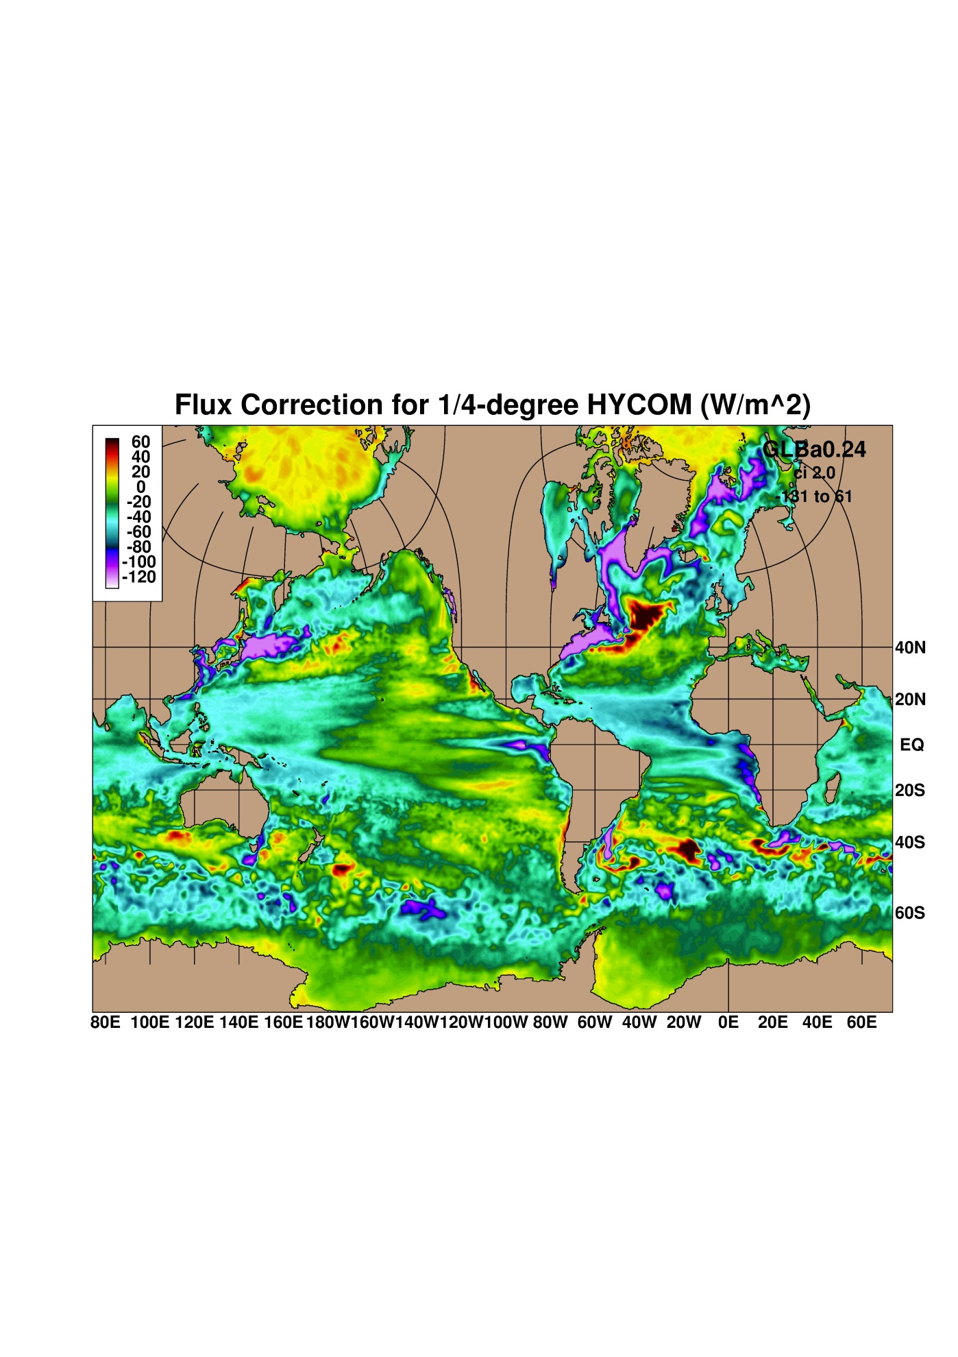
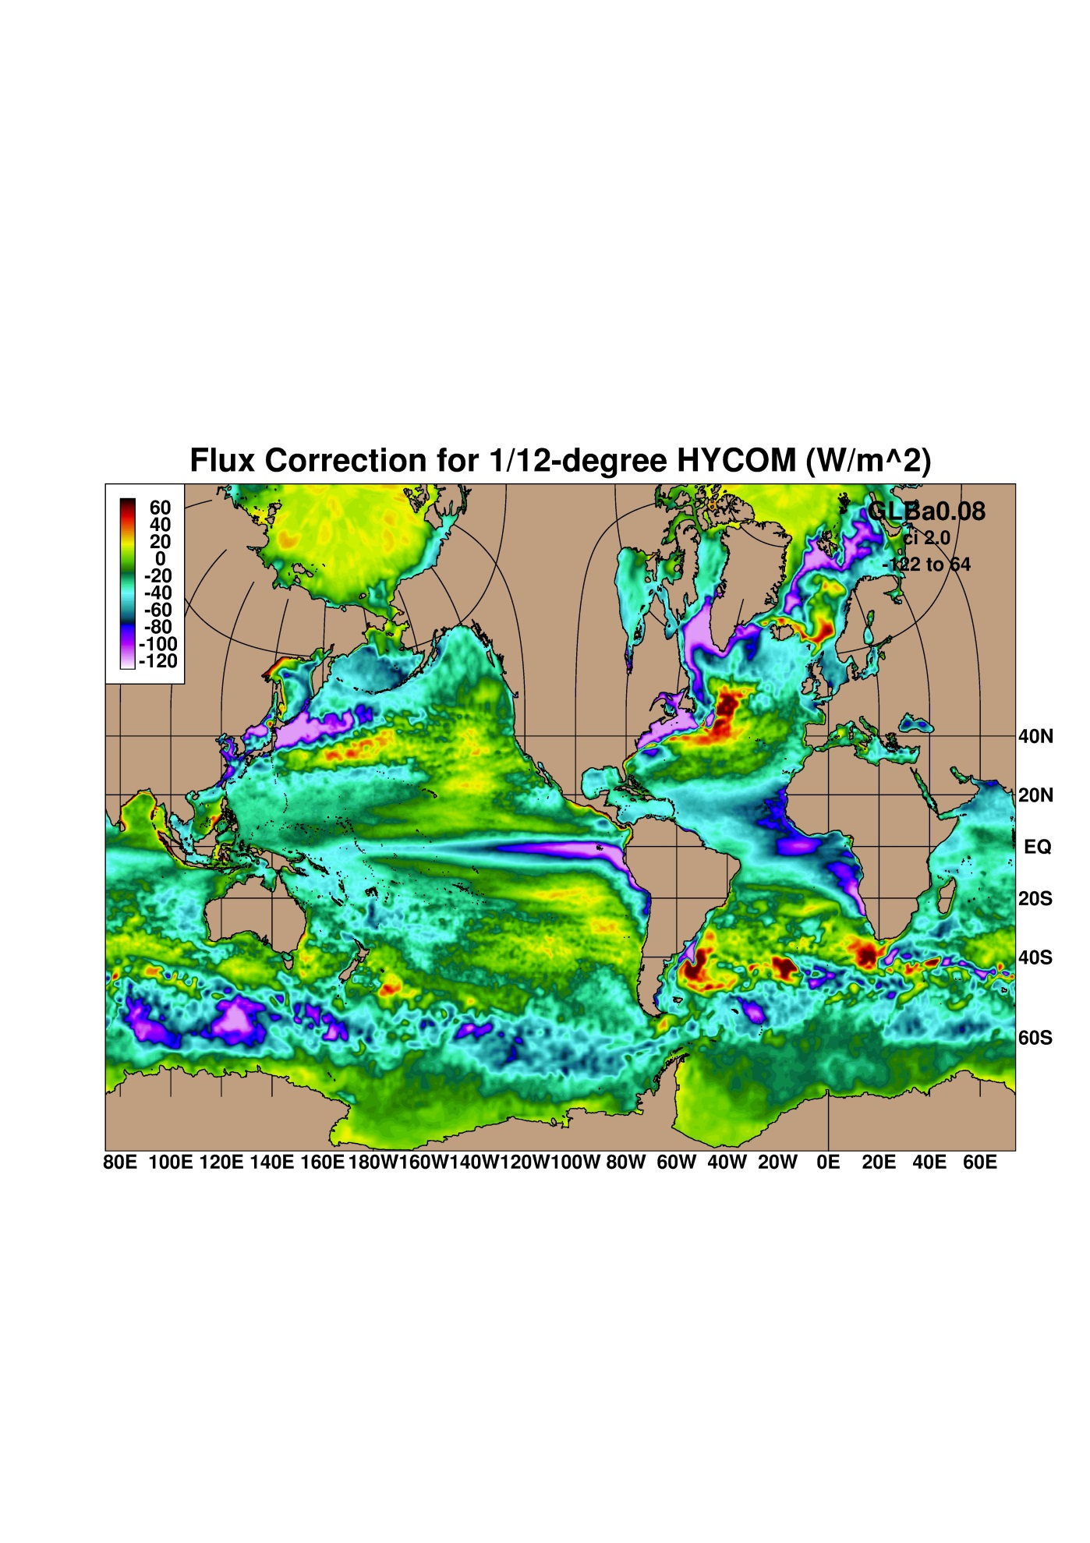
RTOFS-NEMS
First step to coupling: Compute flux corrections based on five year runs
The patterns are qualitatively similar with regional differences
Flux correction using ¼ º model
Flux correction using 1/12º model

Slide 14
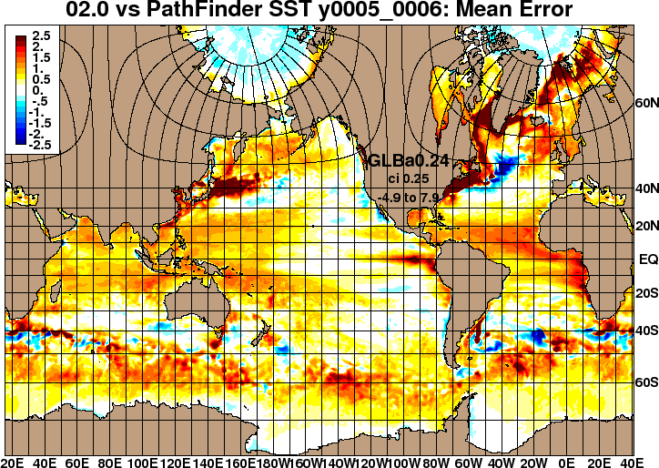
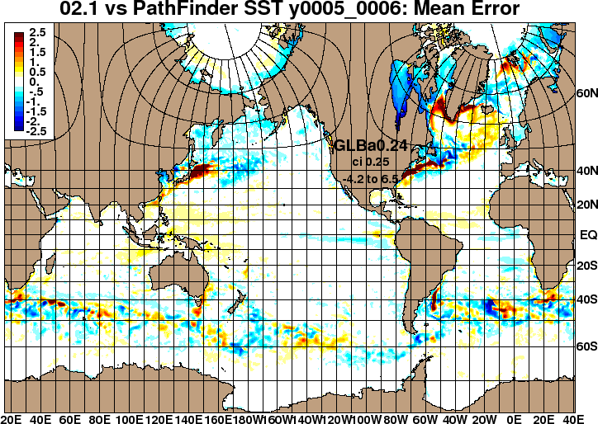
RTOFS-NEMS
Experiments with 1/4º model completed (1/12 º ongoing)
First climatological forcing, then full forcing (CFS ≈ GFS).
vs. Pathfinder (bias), climatological years 5-6
1st climatological simulation
2nd climatological simulation, with flux correction

Slide 15
RTOFS-NEMS
Progress on RTOFS-NEMS
HYCOM coupled to GSM/GFS using ESMF NUOPC layer (with ESRL, GFDL and Navy)
Initial testing of the coupler underway for ¼ º global model
Mediators/couplers will also be built for Sea Ice, Waves and Land
2014: feasibility of RTOFS-NEMS in GFS or CFS context.
Working with climate group in global branch.
Working with CPC on test and development strategy.
Focus on weather time scales will benefit from proper seasonal characteristics too.
Control model drift in coupled model.
Assimilation for constraining rather than correcting model.

Slide 16
RTOFS-ET-Pac
EMC became US government lead on ocean plume modeling for Fukushima Dai’ichi ocean issues.
CONOPS to rapidly generate actionable information for decision makers.
Product 1: Surface particle tracing to identify potentially contaminated areas. (April 6, 180 d)
Product 2: Contamination estimates using particle tracing + HYSPLIT atm. Deposits. (April 20, 180 d)
Product 3: Full dispersion model as passive decaying tracers, using direct release (NOS) and atm. deposit (NCEP) (RTOFS-ET-Pac, 7/24/2012)
To be decommissioned in Q2 FY14.
Prototype for emergency response and ecosystems modeling.
Progress will depend on new resources.

Slide 17
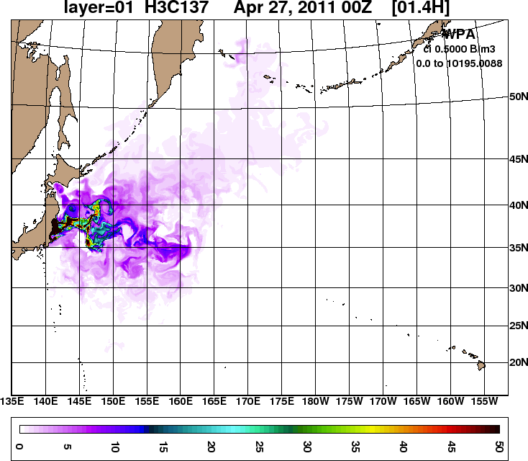
RTOFS-ET-Pac
 | MCL (Bq/l) | 1 mrem dose (Bq/l)
¹³⁷Cs | 7.4 | 33
http://polar.ncep.noaa.gov/global/tracers
Meridional section
Zonal section
¹³⁷Cs surface concentration
(scale max: 0.05 Bq/l or 50 Bq/m³)
Simulated results after atmospheric (HYSPLIT) and coastal (ROMS) sources
were combined (April 27, 2011 ~ December 31, 2011)

Slide 18
Ocean Future
Signed MOU with Navy on bringing NCODA to NCEP for operational use.
Tentative implementation late 2015.
Next step: MOU on joint development work.
Where to go with RTOFS on phase II WCOSS (now – 2018) ?
Global: stay at 1/12°, higher vertical resolution.
Lack of data to constrain model.
Resources for resolution versus resources for ensemble.
High-resolution for NCEP justifiable on US coasts only.
Vertical resolution increase in particular in mixed layer.
Better MLD, OHC, coupling with waves for Langmuir and Stokes mixing in ocean.

Slide 19
Ocean Future
Basin scale models:
RTOFS-Atlantic: New smaller grid.
RTOFS-Pacific: New East Pacific model.
RTOFS-Arctic: New model, similar to ACNFS, may use as staring point
Feature of basin scale models:
1/24° or 1/36° resolution.
Nested in Global.
Coupled:
Waves for upper ocean mixing (and surface fluxes if coupled to atmosphere)
Ice and atmosphere for Arctic.
Ensemble, particular for Arctic.

Slide 20
Ocean Future
How will we do this:
Present staff will work NCODA RTOFS-HWRF, and some RTOFS-NEMS.
Regional models can only be developed if funding gap gets closed:
Possible short term funding from BOEM.
Long term funding gap acknowledged by NOAA, but cannot be addresses before 2016.
With BOEM funding, we will first concentrate on RTOFS-Arctic.
With present finding, we can only address RTOFS-Atlantic as an existing model, but development will be slow.

Slide 21
Questions ?

