Slide 1

Review of the NCEP production Suite:
Recent Changes and Plans
Marine Modeling and Analysis Branch
Wave Numerical Guidance
Arun Chawla
Marine Modeling and Analysis Branch
NOAA / NWS / NCEP / EMC
Arun.Chawla@NOAA.gov
WHERE AMERICA’S CLIMATE WEATHER AND OCEAN SERVICES BEGIN

Slide 2
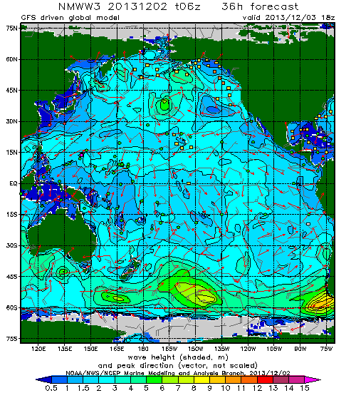
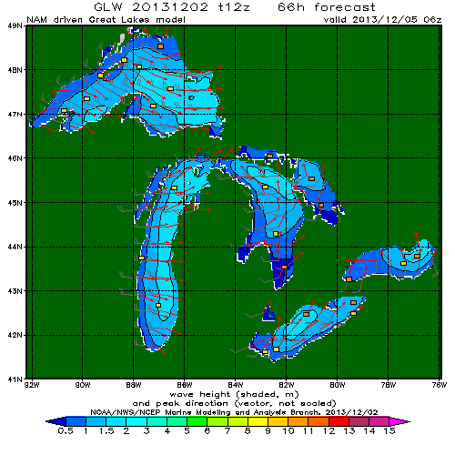
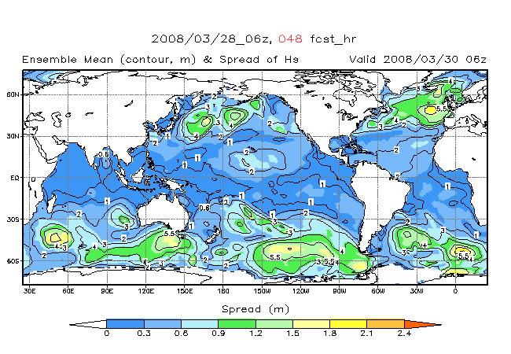
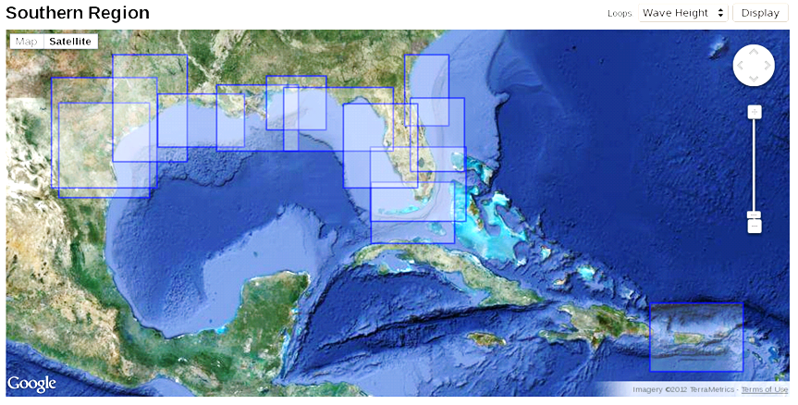
Wind waves
Operational models
  Multi-1 global model.
  Multi-2 global hurricane model.
  Great lakes with 2 staggered cycles (NAM driven and NDFD driven)
  NCEP wave ensemble system
  Combined FNMOC/NCEP wave ensemble system
  Nearshore Wave Prediction System (Alpha testing)

Slide 3
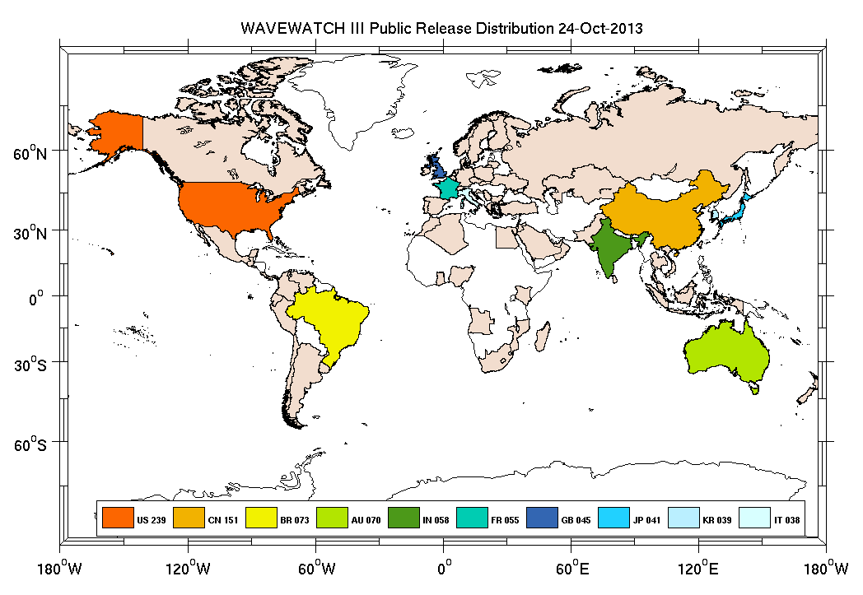
WAVEWATCH III®
WAVEWATCH III® is the model driver for all operational wave model products from NCEP
The model has transitioned from an in house NCEP model to a community model (code management is still controlled at NCEP via SVN)
The model is part of an international 5 year NOPP study to improve operational wave models (currently in its 4th year).
Active developers of the wave model
  NCEP
  NRL
  IFREMER / SHOM
  UKMO
  SWINBURNE UNIVERSITY
  NASA
  UNIVERSITY OF RHODE ISLAND
  UNIVERSITY OF NEW SOUTH WALES
Operational model of choice at UKMO, METEO-FRANCE, BOM, INCOIS, FNMOC, NAVOCEANO, ENVIRONMENT CANADA

Slide 4
WAVEWATCH III®
A new public release of the wave model is planned for late Feb 2014 (first public release since v 3.14 in 2007)
New features that have been introduced into the wave model
  Multiple new physics packages for wave growth and dissipation
  Alternative non-linear wave interaction source terms
  Coastal wave reflections
  Wave blocking from icebergs
  Unstructured, curvilinear and SMC grid types
  Wave – mud and wave – ice interactions
  Infra gravity wave propagation
  Non-linear wave interactions in shallow waters
  Grid splitting to allow for hyper scaling
  An expanded set of output parameters
  NETCDF I/O capability
  Post processing tools for wave system tracking

Slide 5
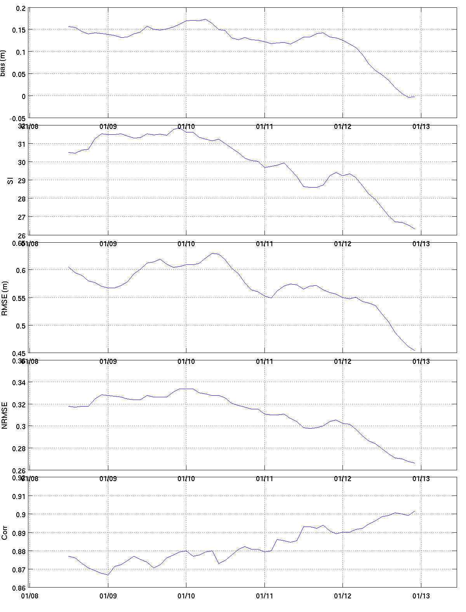
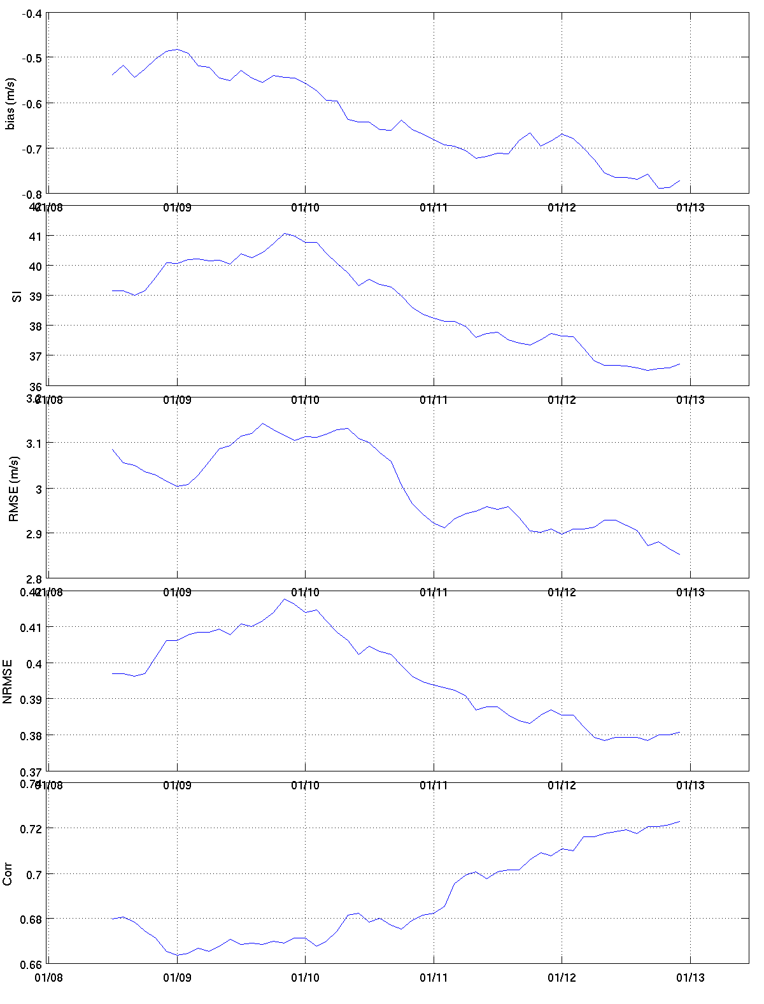
Multi_1 global model
Last year this was the first wave model that was upgraded to one of the new physics wave packages that were added to WAVEWATCH III (first upgrade of wave physics in over 15 years)
Skill scores at 72 hrs. forecast
Wave Ht (m)
Wind Speed (m/s)

Slide 6
Multi_1 global model
Planned upgrades over the next year
To extend the model domain up to the North Pole with a curvilinear grid (current domain stops at 82 N).
Wave grids will be upgraded to use ETOPO-1 bathymetry and regional domains will be expanded to make sure that all the Centers domain requirements are met
In the near future …
Replace regular coastal /regional grids with unstructured grids. Couple with ESTOFS
Global grids to upgrade resolution with GFS model
Couple the global wave model with the global circulation model HYCOM

Slide 7
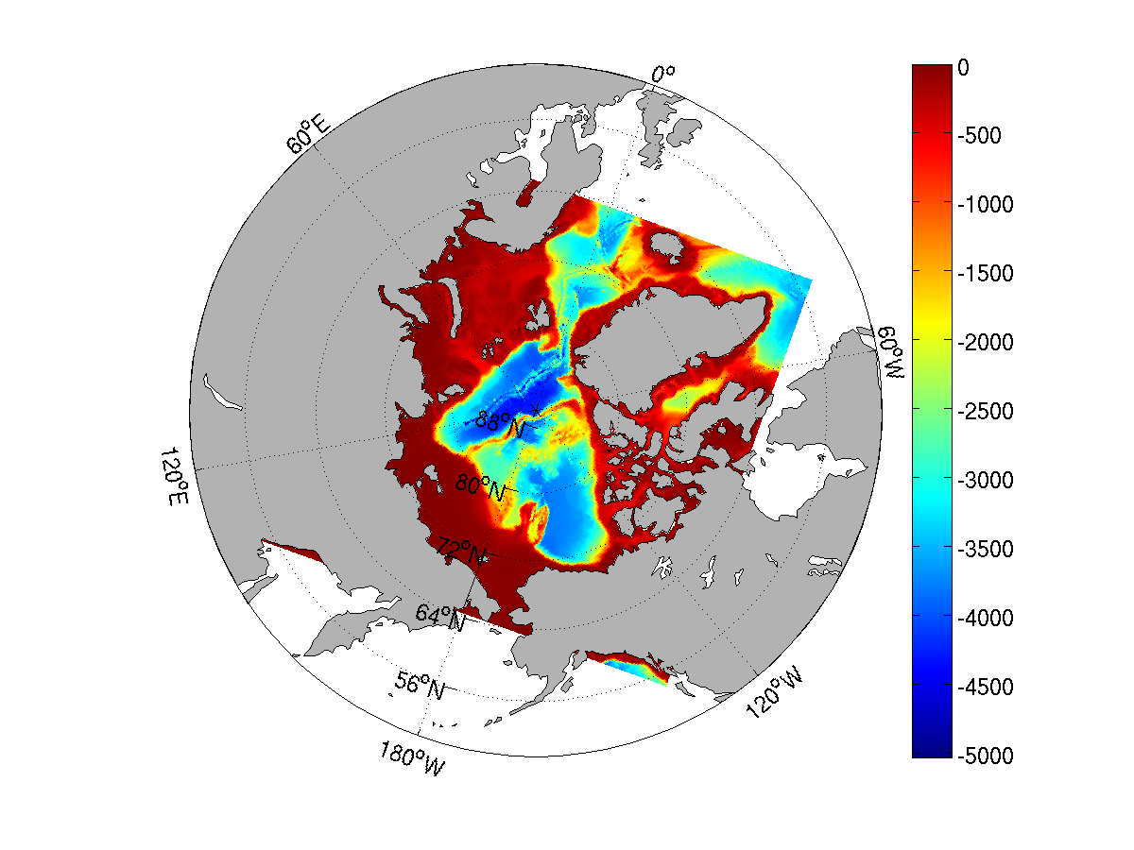
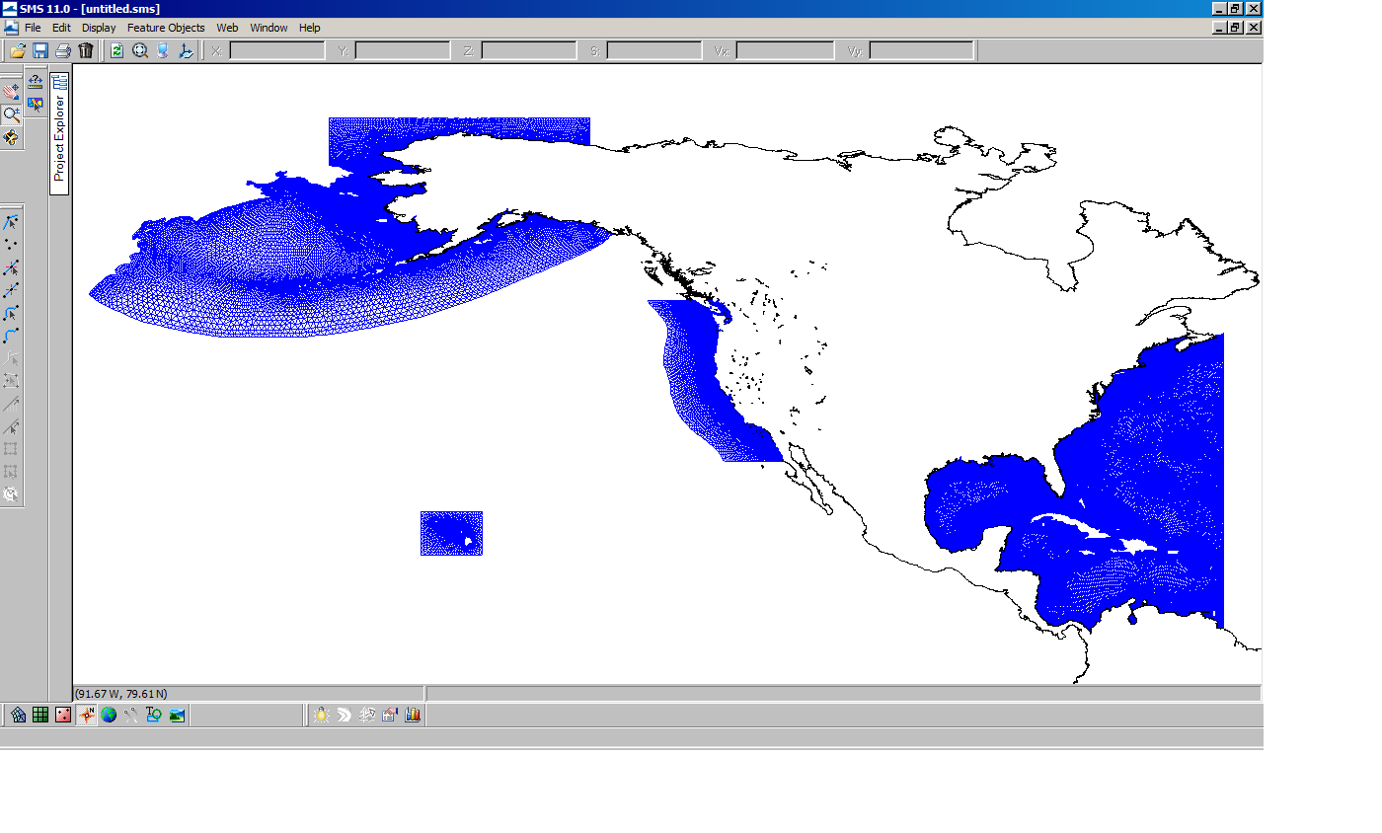
Multi_1 global wave model
Curvilinear Arctic grid to replace regular Arctic grid
Resolution: 4 arc-min (coastal) and 10 arc-min (regional) grids
Resolution: 0.25 deg (offshore) to ~2 km (nearshore)
Replaces 4 and 10 arc-min regular grids

Slide 8

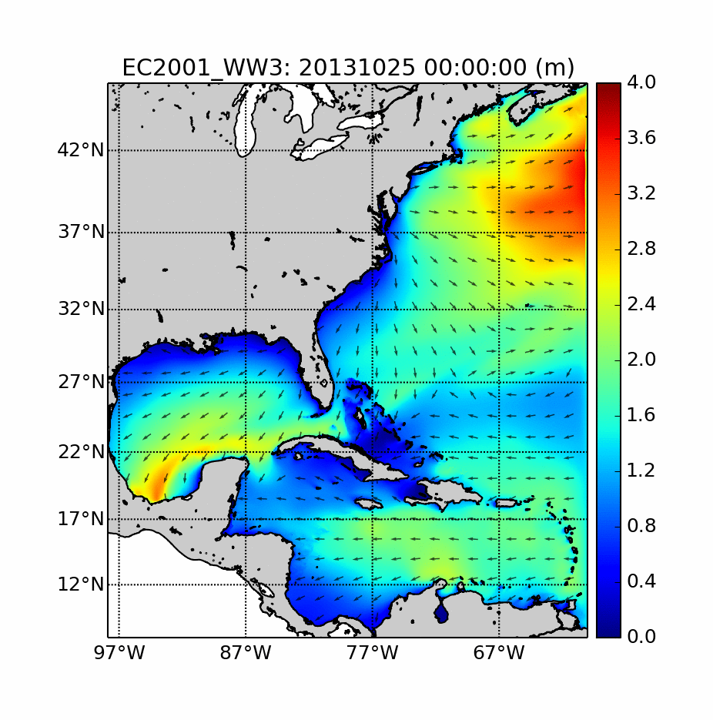
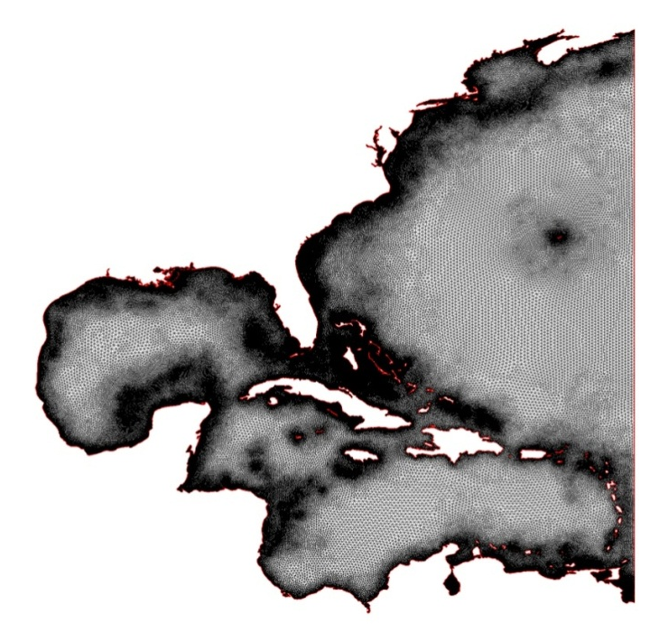
East Coast mesh (0.25 deg – 2 km)
EC2001 mesh
Two-way WW3-ESTOFS coupling under development

Slide 9
Multi_2 global wave model
Multi_2 global wave model is driven by Hurricane model winds
This year the multi_2 system will be upgraded to the new wave physics that have already been implemented for multi_1 and the Great Lakes systems
The wave model will be driven by HWRF winds (currently driven by the GFDL hurricane model)
Moving towards a coupled wave-circulation-atmospheric model in the NEMS framework (depend on developing a moving grid capability in WAVEWATCH III)

Slide 10
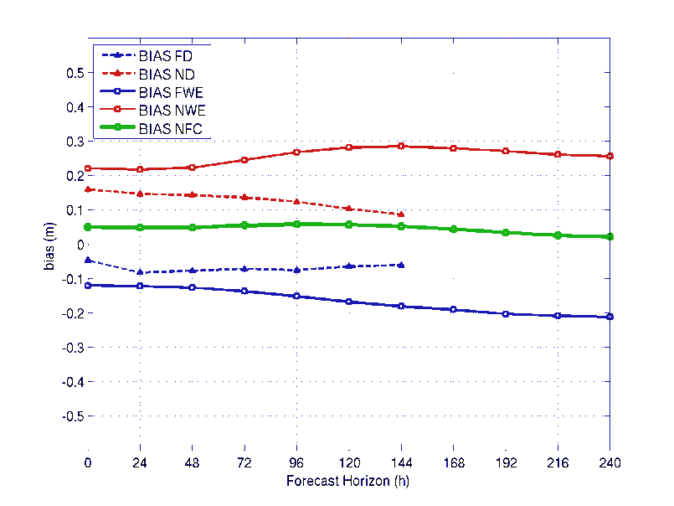
Wave ensemble system
Wave ensemble system consists of a 21 member ensemble on a 1 deg grid driven by GEFS
Planned Upgrades
Increase resolution to 0.5 deg
Upgrade wave model to new physics package
Add a hindcast phase using 80 members (20 at any given cycle) to provide a 24 hr cycle
Upgrade to increased GEFS resolution winds (when they become available)
A combined NCEP / FNMOC wave ensemble product
FNMOC to coordinate ensemble model grids with NCEP
ENVIRONMENT CANADA to join with NCEP and FNMOC to develop a combined wave ensemble product

Slide 11
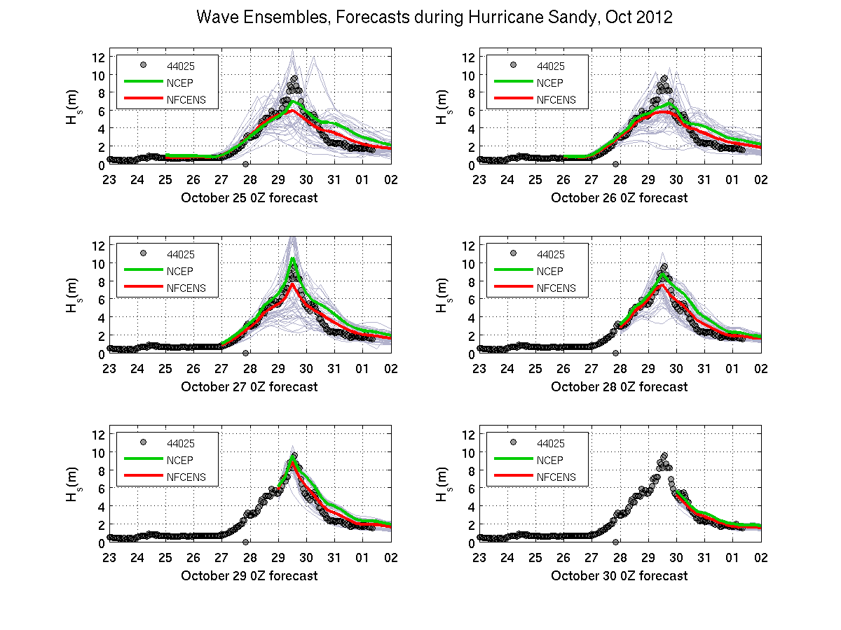
Sandy
120h
96h
72h
48h
24h
0h
Notes:
Time series of Significant Wave height (in m) as a function of time. The time stamp in the x-label of each sub plot shows the nowcast time for the simulation run. Data are shown as gray circles. The NCEP wave ensemble mean is in green, the combine NCEP/FNMOC ensemble mean is in red, individual ensemble members from both NCEP and FNMOC are shown in light gray.

Slide 12
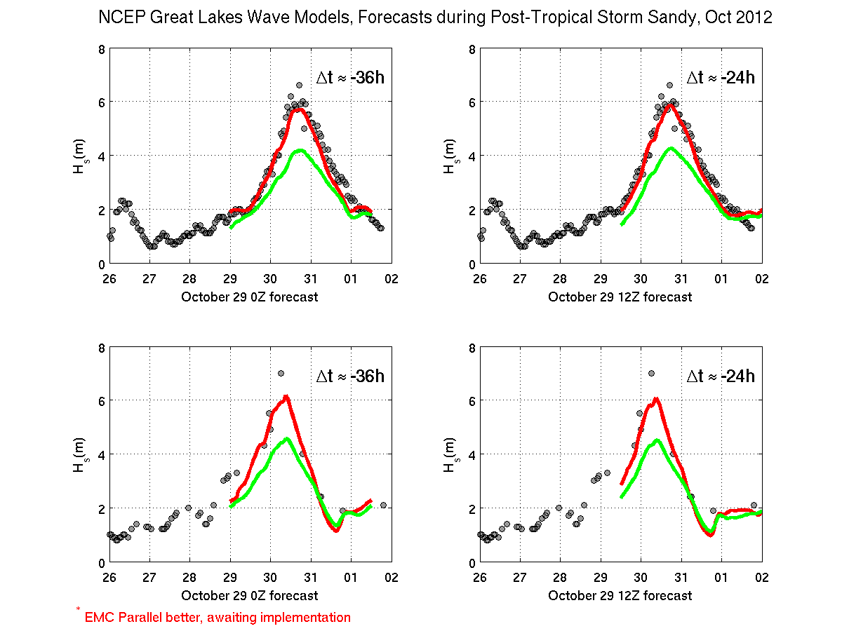
Great Lakes wave model
For the Great Lakes we have a staggered cycle system – an early run that is NAM winds driven and a late run that is NDFD winds driven
Last quarter the Great Lakes wave model was upgraded to use the newer physics packages
Significant improvement has been observed in the operational model

Slide 13
Great Lakes wave model
Planned upgrades
Spatial resolution increase ~2km to use the higher resolution NAM and NDFD winds
Better representation of the coastlines using shapefiles from NOAA coastlines database
Add RTMA surface analysis for NDFD driven hindcasts
Develop an ensemble wave model for the Great Lakes together with ENVIRONMENT CANADA
Develop a coupled wave – atmospheric – circulation model for the Great Lakes in partnership with NOS, GLERL and WFO Detroit

Slide 14
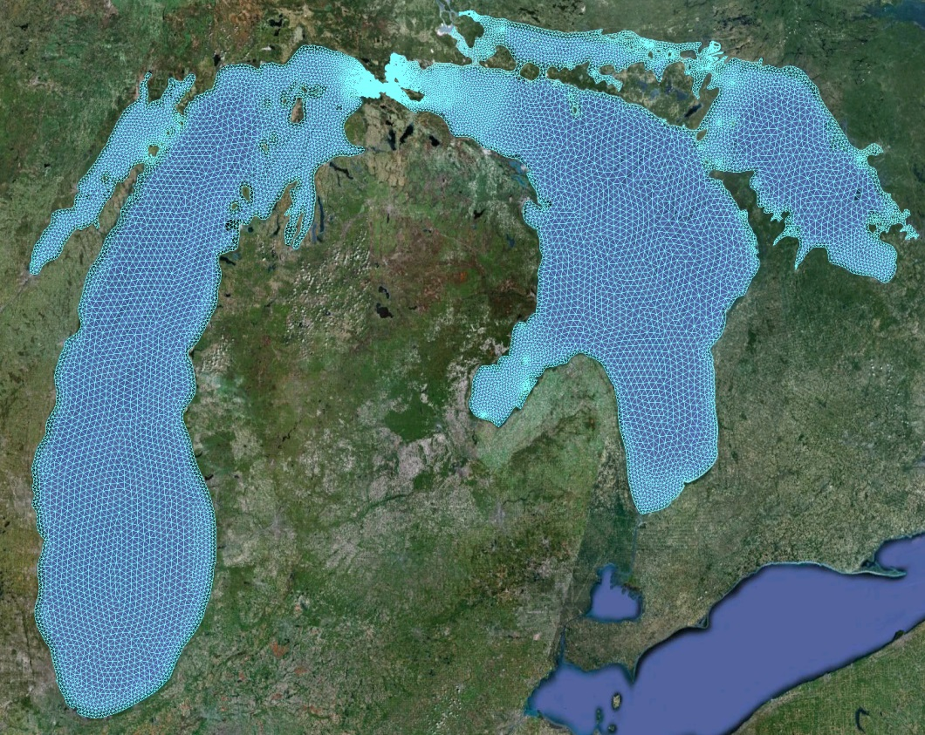
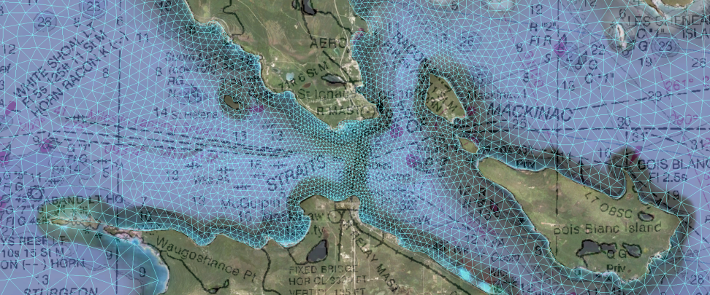
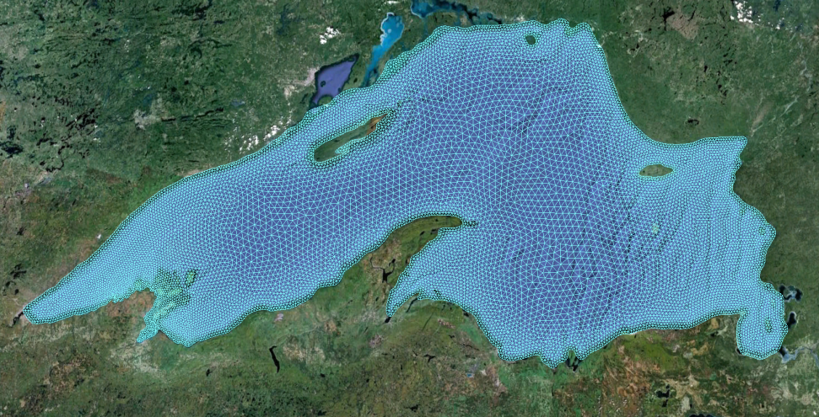
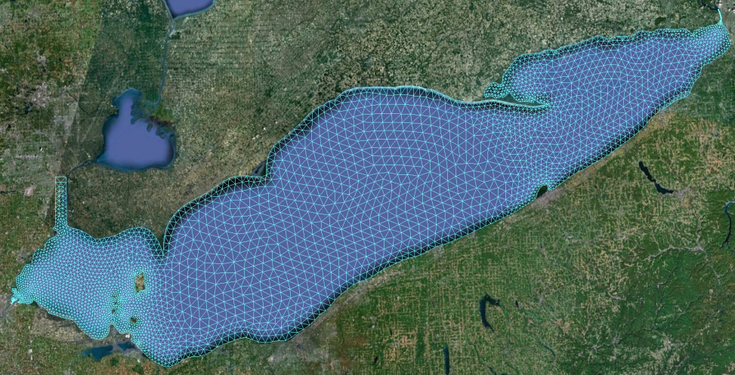
Great Lakes
Courtesy of Eric J. Anderson, Dave Schwab (GLERL) , Greg Lang (GLERL)

Slide 15
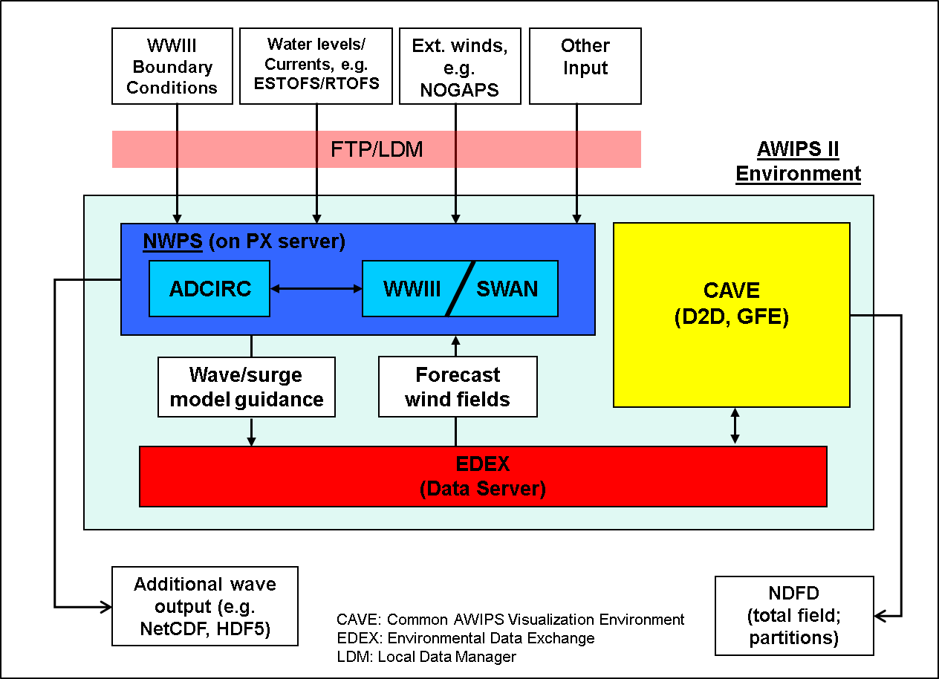
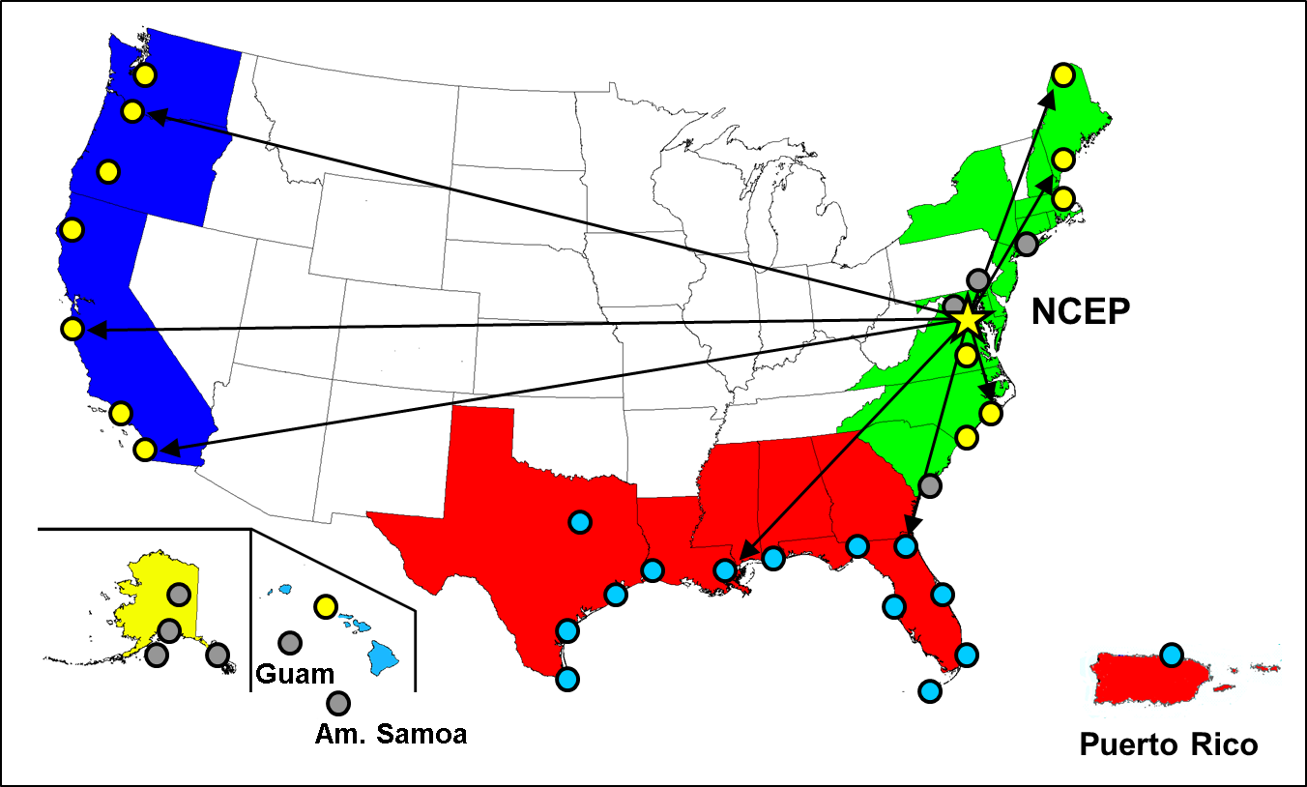
Nearshore Wave Prediction System (NWPS)
WRF/NAM
High-resolution wave guidance in the nearshore.
Applications: wave system tracking, ship routing, rip current and wave runup guidance
Centrally supported by NCEP, but runs locally at WFOs.
Driven by forecaster-developed winds from GFE, WW3 BCs and RTOFS/ESTOFS.
To be included in the AWIPS II baseline.

Slide 16
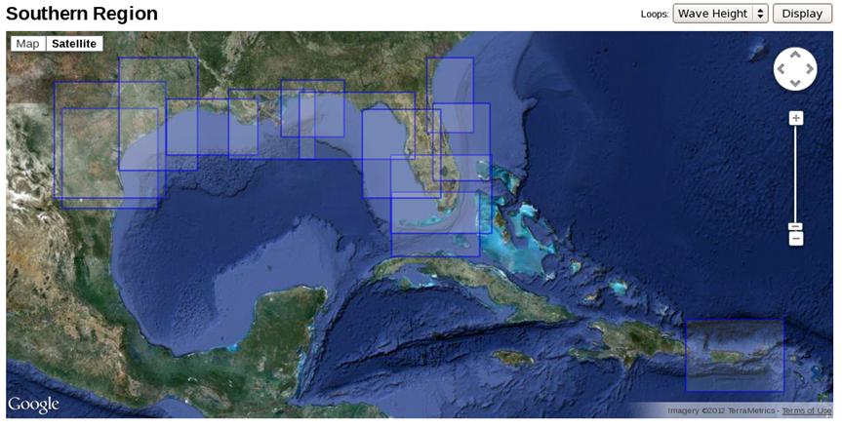
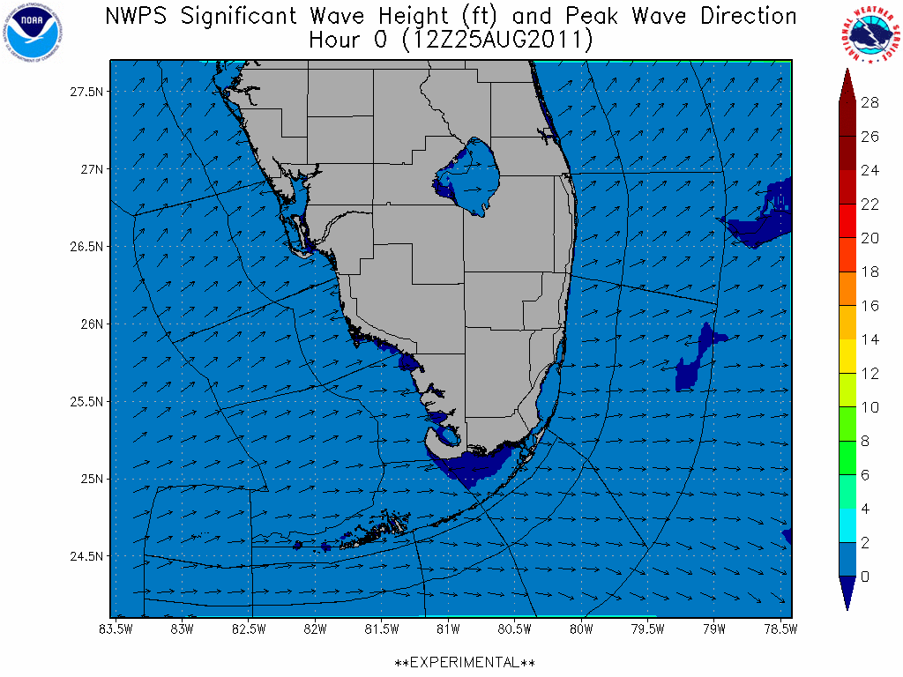
NWPS coverage and sample output
WFO MFL
Alpha testing at all SR WFOs, NHC/TAFB, select WC and EC WFOs
1 arc-min grid, nesting down to 500 m
90 h forecast, 3 hourly

Slide 17
Related developmental/validation projects
NOPP Project
IOOS COMT Test bed: Waves and surge in Puerto Rico & U.S. Virgin Islands
ESMF capability in wave model for coupling
30 year wave hindcast (with new physics/grids)
Sandy Supplemental – incorporating time dependent PSURGE fields into NWPS system
Participation in inter-agency effort to comply with the COASTAL Act of 2012 (White papers, NSEM)
NWPS implementation over OPC Atlantic domain (similar to TAFB)
Development of a wave data assimilation system
Hyper-scaling of the wave model to allow an order of magnitude upgrade in parallelization of the wave model
Development of a moving grid wave model
Coupling with circulation / atmospheric models for climate studies

Slide 18
Questions ?

