Slide 1
NCEP Production Suite Review
NWS Integrated Dissemination Program
December 4, 2013
Program Manager, Integrated Dissemination Program: Luis Cano

Slide 2
Agenda
Integrated Dissemination Program (IDP)
Overview
Capability Improvement Timelines
Questions

Slide 3
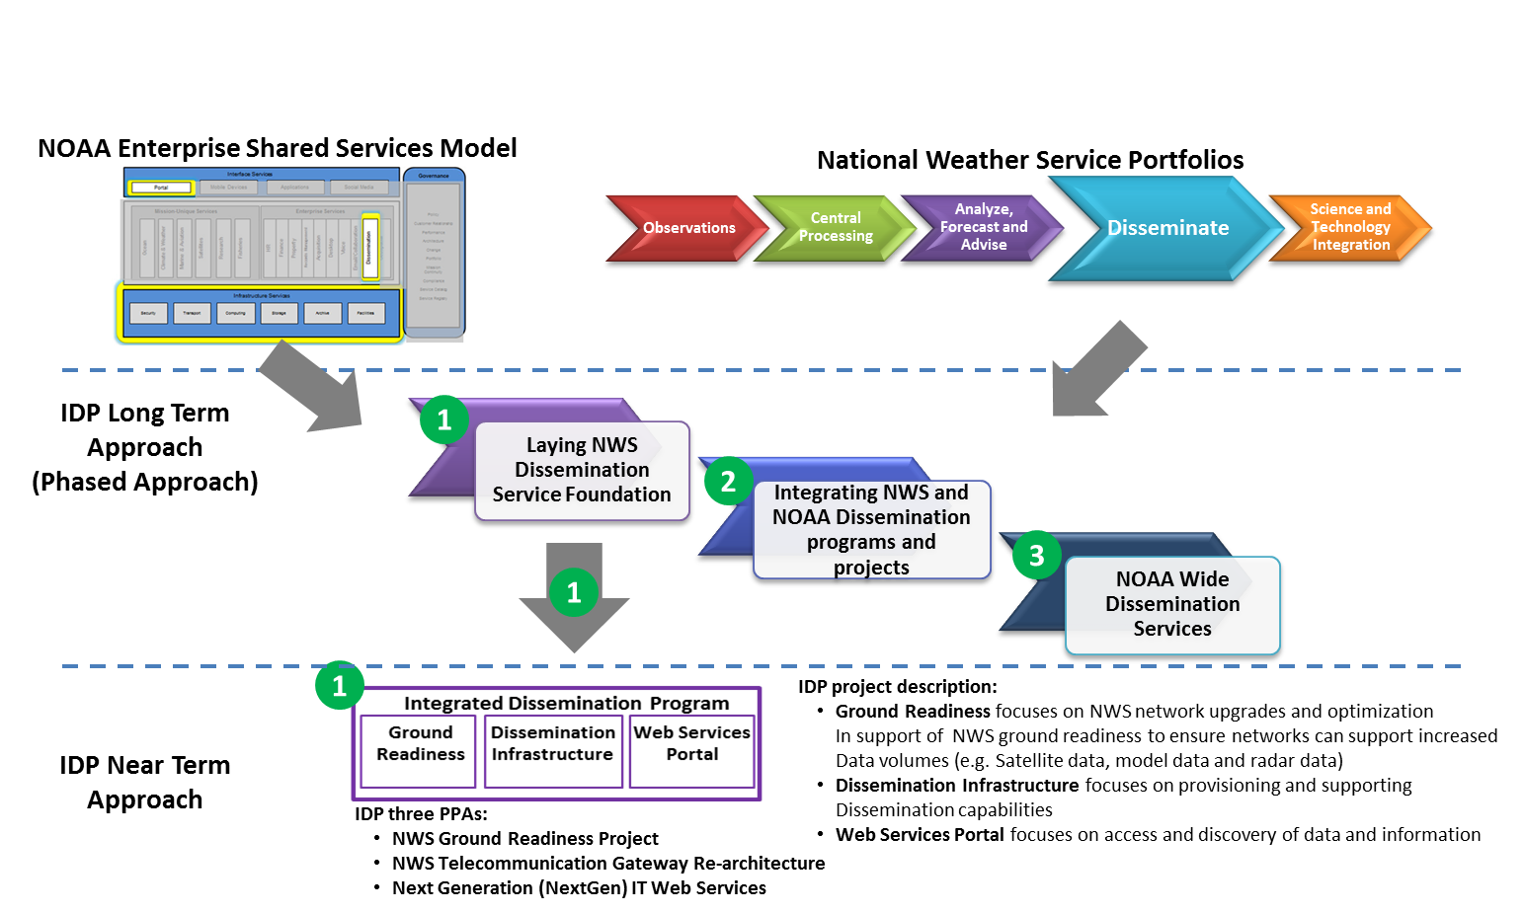
IDP Overview
IDP plans to deliver NOAA Wide Dissemination Services in a phased approach
In Phase 1, IDP’s focus is on executing against its 3 Program, Project and Activities (PPAs) requirements: NWS Ground Readiness Project, NWS Telecommunication Gateway (Re-architecture), and NWS Next Generation IT Web Services.

Slide 4
IDP Phase 1 Challenges/Benefits
Integrated Dissemination Program
Phase 1 Initiatives
Current State (Challenges)
Target State (Benefits)
Aging Infrastructure
Backup Telecommunication Gateway with 74% operational capability
Disbursed dissemination applications
Multiple source of weather data
Inadequate Networks
Next generation of satellite (volume increase) about to launch
Super Computer Upgrade (volume increase)
IDP
Redundant Dissemination Infrastructure at diverse locations with 100% primary and backup operational capability
NWSTG Re-architected functionality
Disseminate a single source of weather data to NWSTG consumers, aviation decision makers, and others
Fully exploit and benefit from new observations and products
Improved and upgraded NWS Networks with increased bandwidth
Dissemination Infrastructure
NWSTG Re-architecture Functionality
NextGen IT
Direct Readout (GRB Antennas)
SBN Upgrade &
Network Upgrade & Optimization

Slide 5
IDP Phase 1 Timeline
High Level View
FY13
FY14
FY15
FY16
FY17
Primary Site (NCWCP)
Req’ts
Design & Build out
Phase 1
Design & Build out
Phase 2
O&M
IDP Infrastructure
Design & Build Out
Backup Site
(DSRC)
Eng’g Study, Req’ts & Acq’n
O&M
Phase 1 - Current NCWCP Compute Farm Augmented
Phase 2–NCWCP Build out complete
Backup Site Build out complete
Refresh
Site A - 100% / Site B - Build and Test
Site A - 100% / Site B - 74%
Retire Legacy NWSTG
NWSTG Re-arch Funct.
Design / Build / Test
Cutover
Re-architecture
Requirement Phase
O&M
Site B-74% Operational Capability
Re-arch Contract Award
NWSTG Functions at IDP Primary Site
NWSTG Functions at IDP Backup
Web Services Prototype
Prototype Dev & Impl
Experimental Operations
Augments & reuses same infrastructure
NextGen IT
NextGen IT Web Services
Acq’n for NextGen IT Web Services
Dev & Impl of NextGen IT Web Services
O&M
Web Services Prototype Delivered
NextGen IT Contract Award
IDP Web Services Implemented
Provide NWS Products for FAA Operations
GVAR
Antennas
O&M
Retiring GVAR Antennas
Direct Readout (GRB)
GRB
Antennas
& SBN Upgrade
GRB Assessment & Site Survey (Req’ts & Acq’n)
Dev & Impl
O&M
GRB Antenna
Contract Award
SBN Upgraded
to Full Transponder
GRB Antennas Installed
GOES-R Launch
Current
Networks
O&M
Retire Legacy
NWS Networks
GRP Network Upgrade & Opt.
GRP Network Upgrade & Optimization
Req’ts & Acq’n
Build & Transition to GRP Network
O&M
Upgrade & Optimization Contract Award
Network Upgraded & Optimized

Slide 6
IDP Phase 1 Timeline IDP Dissemination Infrastructure Sites
Capability Improvements Provided by IDP Dissemination Infrastructure:
Redundant primary and backup capability in two diverse locations (College Park, MD and
Boulder, CO)
Scalable architecture
Hot Backup
Centralized and consolidated infrastructure
Ability to disseminate large amount of data
Secured sites at (near) Trusted Internet Connections Access Providers (TICAP) locations
FY13
FY14
FY15
FY16
FY17
IDP Primary Site
at NCWCP
(College Park, MD)
Build out
IDP Primary Site
Phase 1
Build out
IDP Primary Site
Phase 2
O&M
IDP Primary Site (Phase 1)
Current Compute Farm
Augmented at NCWCP
Build out IDP
Primary Site (Phase 2) at
NCWCP (College Park, MD)
IDP Backup Site
at DSRC
(Boulder, CO)
Facilities Study,
Planning &
Initiate Construction
Build out
IDP Primary Site
Phase 3
O&M
Cutover
O&M
Requirement and Acquisition Phase
Build out IDP
Backup Site (Phase 3) at
DSRC (Boulder, CO)
Design, Build, and Test Phase
Cutover
Operations and Maintenance
Retire/Phase Out

Slide 7
IDP Phase 1 Timeline NWSTG Re-Architecture Functionality
Capability Improvements Provided by NWSTG Re-architecture:
Redundant primary and backup capability in two diverse locations (College Park, MD and Boulder, CO) with 100% hot-hot operational capability on primary (NCWCP College Park, MD) and backup (DSRC Boulder, CO) sites.
Ability to process anticipated increases in environmental data volume from new satellites (e.g. GOES-R and JPSS), increases and enhancements to environmental model prediction (e.g. HRRR), and radar data.
FY13
FY14
FY15
FY16
FY17
NWSTG Refresh
Site A – 100%
Site B -Build and Test
Site A – 100%
Site B – 74%
Site A – 100%
Site B – 80%
Site A – 100%
Site B – 90%
Retire Legacy
NWSTG
Retire Legacy NWSTG
NWSTG Site B -74% Operational Capability
NWSTG
Re-architecture
Design & Build &Test of NWSTG Function
Cutover
IDP A – 100%
IDP B – 100%
O&M
Requirement Phase
Cutover
O&M
Requirement
Phase
NWSTG Functions
on IDP Primary
Dissemination Services
NWSTG Functions
on IDP Backup
Dissemination Service
NWSTG Primary – 100%
Operational Capability
NWSTG Backup -100%
Operational Capability
NWSTG Refresh
Site A = SSMC2 Silver Spring, MD
Site B = NESCC Fairmont, WV
NWSTG Re-architecture
IDP Primary = NCWCP College Park, MD
IDP Backup = DSRC Boulder, CO
Requirement and Acquisition Phase
Design, Build, and Test Phase
Cutover
Operations and Maintenance
Retire/Phase Out

Slide 8
IDP Phase 1 Timeline NextGen IT
Capability Improvements Provided by NextGen IT Web Services:
Common logical entry point for data discovery and access
Consolidation and standardization of data formats
Standardized OGC-compliant Web Services access
Standards-based registry/repository
Near term replaces legacy FAA Bulk Weather Telecommunications Gateway (FBWTG) connection from NWS to FAA
Mid term support for NWS AWIPS consumers
Long term support for other users (NOAA, DoD, DHS, public)
FY13
FY14
FY15
FY16
FY17
NextGen
Prototype
Web Services Prototype Dev & Impl
Experimental Operations
NOAA IDP NextGen Web Services Prototype Delivered Sept 2013
(~400 Products)
Augments & reuses same infrastructure
NextGen IT
Acq’n for NextGen IT Web Services
Dev & Impl of NextGen IT Web Services
O&M
Requirement and Acquisition Phase
NextGen IT Contract Award
NOAA IDP Web Services Implemented
Dec 2015
(~1300 Products)
NOAA IDP
Web Services Provides NWS Products to FAA SEP 2016
Design, Build, and Test Phase
Cutover
Operations and Maintenance
Retire/Phase Out

Slide 9
IDP Phase 1 Timeline Direct Readout (GRB Antennas)
Capability Improvements Provided by Direct Readout:
Ensure NCEP Remote Centers and Alaska and Pacific Regions can fully exploit GOES-R observations by GOES-R launch (currently scheduled for October 2015).
FY13
FY14
FY15
FY16
FY17
GVAR Antennas
Operations and Maintenance
Retiring GVAR
Antennas
GOES-R Launch
Direct Readout
(GRB Antennas)
& SBN Upgrade
GRB Assessment and Site Survey
(Requirement & Acquisition Phase)
Development & Implementation
O&M
Direct Readout (GRB Antenna) Contract Award
SBN Upgraded to
a Full Transponder
GRB Antennas
Installed
Requirement and Acquisition Phase
Design, Build, and Test Phase
Cutover
Operations and Maintenance
Retire/Phase Out

Slide 10
IDP Phase 1 Timeline NWS GRP Network (CONUS and OCONUS) Upgrade & Optimization
Capability Improvements Provided by NWS GRP Network Upgrade & Optimization:
Improve and consolidate NWS networks
Provide increased bandwidth
Upgrade information technology infrastructure and networks at Weather Forecast Offices (WFO), River Forecast Centers (RFC), National Centers for Environmental Prediction (NCEP), and Advanced Weather Interactive Processing System (AWIPS) Network Control Facilities.
FY13
FY14
FY15
FY16
FY17
NWS Current
Networks
O&M
Retire Legacy
NWS Networks
NWS GRP
Network Upgrade
& Optimization
Requirement &
Acquisition Phase
Build & Transition to GRP Network
O&M
NWS GRP Network Upgrade & Optimization Contract Award
NWS GRP Network
Upgraded and Optimized
Requirement and Acquisition Phase
Design, Build, and Test Phase
Cutover
Operations and Maintenance
Retire/Phase Out

