Slide 1
Describe the Process and Prospects for
Adding Data Products to the SBN and
AWIPS Software Baseline
Advanced Weather Interactive
Processing System (AWIPS) Program
December 4, 2013
Edward Mandel
OST/SEC/Development Branch Chief

Slide 2
Challenges
Unable to add new functionality until AWIPS migration is completed
Lack of SBN bandwidth and NWSTG/NCF limitations
Large number of data products desired by field
Lack of a documented end to end process with clear roles and responsibilities
Doesn’t include elimination of obsolete products
Lack of resources to perform key planning functions
Software development, Engineering, and Management
Questionable quality and lack of visibility of existing plans
2

Slide 3
Challenges Addressed
Unable to add new functionality until AWIPS migration is completed
AWIPS Migration Status – moving to second group of sites – page 4
Lack of SBN bandwidth and NWSTG/NCF limitations
SBN Expansion Status – Page 5
NWSTG Limitations – TG/NCF interface problems resolved, IDP plans include the TG re-architecture (FY16/17)
Lack of a documented end to end process with clear roles and responsibilities
Process for Adding Data with Roles and Responsibilities – Page 6
Includes identifying data sets to be retired (obsolete) and removed from the SBN
Identified POCs – Page 7
Lack of resources to perform key engineering and management functions
Assign a full time Data Manager using AWIPS O&M
Redefining R&R to fill gaps in engineering and management
Lack of or questionable quality of existing plans
Established framework for maintaining an Activation Plan
Established early approval of AWIPS release content including commitment of development resources to improve accuracy of release assignments
3

Slide 4
AWIPS Migration Status
Activation Plan
Working through WFO sites in groups of 8
Group 1 sites activated on 11/7/13
OAX, BOU, OUN, HGX, HUN, BYZ, BOX, and RNK
Group 2 sites begin 30-day test on 12/9/13
ARX, MKX, PQR, DMX, RAH, BOI, SLC, and AFG
Group 3 sites begin test period tentatively on 2/3/14
GJT, GID, PUB, OTX, AFC, CTP, MFL, and MRX
Group 4 sites – tentatively scheduled to begin 3/28/14
GLD, DDC, HNX, VEF, ILN, TAE, JAX, EKA, and FSD
Release Schedule (Dates are Release Available, except where noted)
AWIPS I - OB9.14
OB9.15 – 2/18/2014
OB9.16 - 7/21/2014
AWIPS II - OB13.5.2 *
OB13.5.3 – 12/16/2013
OB14.1.1 – 3/31/2014
OB14.2.1 – 5/19/2014 (code check-in - 1/23/2014)
OB14.3.1 – 7/14/2014 (code check-in - 3/20/2014
* - groups not upgraded to most recent release during 30 day test
4

Slide 5
SBN Expansion
Specifics
Increased from 10Mbps to 30Mbps - Phase 1 (late 2011)
Increase Bandwidth from 30Mbps to 60+ (max of 75Mbps) - Phase II (Dec 2014/Jan 2015)
Main drivers for expansion are
GOES-R, Joint Polar Satellite System (JPSS), NCEP/WCOSS and other grid guidance analysis and forecasts
Managed by APO and IDP/GRP, execution by Raytheon, and paid for by Sandy Relief Appropriations
5

Slide 6
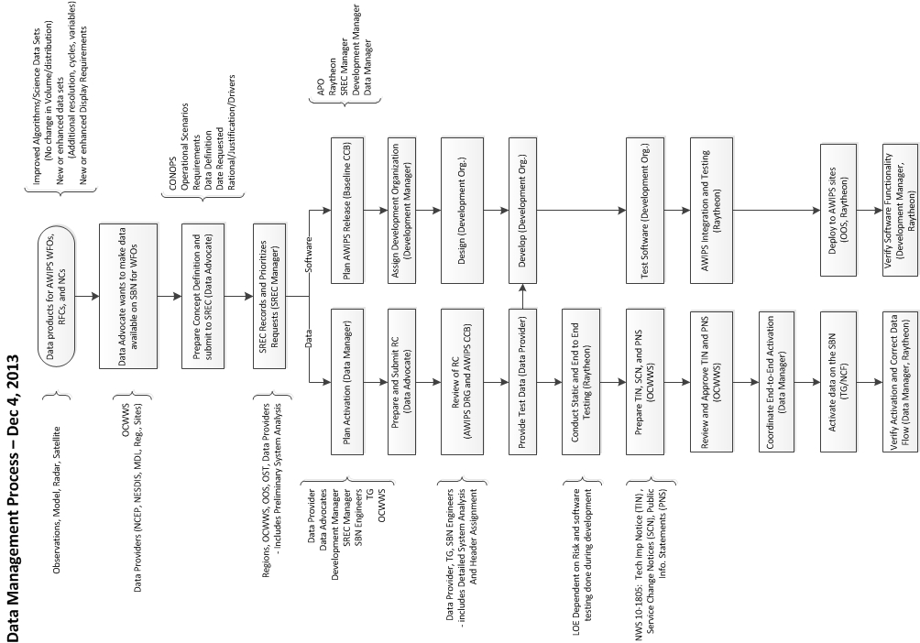
Process to Add Data Products

Slide 7
Data Management Team
Data Manager
POC: Dave Niver (Raytheon)
Data Provider
POCs: NCEP (Rebecca Cosgrove), NESDIS (John Paquette), MDL (Kathryn Gilbert), NSSL (TBD), GSD (Woody Roberts), Radar (Mike Istok), regional and local data product providers.
Data Advocate
POC: Data Provider, OCWWS (Cindy Woods), Region and Site personnel
SREC Manager
POC: Robert Rood (OST/SEC/Development Branch)
Development Manager
POC: Ana Rivera (OST/SEC/Development Branch)
APO/Baseline Configuration Control Board (BCCB)
POC: Steve Schotz (OST/PPD/Program Management Branch
OCWWS/TINs, SCNs, PNSs
POC: Michael Baker (OCWWS)
7

Slide 8
Plans – Data Activation and Release Content
With challenges addressed, started in November 2013 to aggressively:
Began initial planning of data activations - Page 9 and 10
Began initial re-planning of AWIPS Release Content to support data products - Page 11 and 12
Goal is to establish Future Data Activations and AWIPS Software Release content plans for FY14/15
FY14 content - February 2014
FY15 (2Q) – April 2014

Slide 9
Data Activation Plan
Planned Data Activations
Add 2.5 km WPC Medium Range Grids
DRG RC 13783 + AI DR + AWIPS2_DR_16629
AWIPS I: TBD, AWIPS II: Released in OB13.5.1.2
Rationale: High priority NCEP
Proposed Activation: Nov 11
Add GOES Sounder Derived Product Imagery (DPI) for the Pacific Region
DRG RC 13625
AWIPS 1 and AWIPS II: Requirements defined
Rationale: High priority (PR)
Activation: Dec 17, 2013
New Real Time Mesoscale Analysis (RTMA) parameters and Alaska resolution increase
DRG RC 13941
AWIPS II: Requirements Defined
Proposed Activation Jan 28, 2014
Select Grids from Individual Members of the Short Range Ensemble Forecast System (SREF) to support Ensemble River Forecasts
DRG RC 13585
No AWIPS software changes required
Rationale: High Priority ER, supports RFCs
Proposed Activation: Feb 18, 2014
9

Slide 10
Data Activation Plan
Planned Data Activations
Add Gridded Data from the Atlantic and Global Real Time Ocean Forecast System (RTOFS) Model
DRG RC 13853
AWIPS II: Requirements are TBD
Rationale: Supports FY14 Hurricane initiatives
Activation: Feb 2014
High Frequency Radar Surface Current Velocity Data
DRG RC 13833
AWIPS II: Requirements defined
Rationale: Support marine-related impact-based decision support services (IDSS) (e.g. Search and Rescue; Deep-water Horizon)
Activation: Feb 2014
Extra Tropical Storm Surge Needs for AWIPS II (ESTOFS)
DRG RC 13479
AWIPS II: Requirements defined
Rationale: Supports FY14 Hurricane initiatives
Proposed Activation: March 2014
S-NPP NUCAPS Soundings
DRG RC 13580.
Proposed Activation: March 13, 2014
S-NPP Near Constant Contrast (NCC)
Proposed Activation: Sept 2014
10

Slide 11
AWIPS Release Content
Planned Software Release for Data Products
OB14.2.1 – May 19, 2014 (Approved)
GLD360 Lightning Data
OB14.3.1 – July 14, 2014 (Requires Approval)
Total Lightning Data (Product Set #1 - CG point data and Grid of IC and CG)
Tropical Storm Surge Data (PHISH, SLOSH, Tide)
High Frequency Radar Surface Current Data
New Real Time Mesoscale Analysis (RTMA) parameters and Alaska RTMA resolution increase
OB14.4.1 – Sept 2014
TBD
OB14.5.1 – December 2014
TBD
11

Slide 12
Future Data Activations and AWIPS Software Release Plan
SREC High Priority Data Candidates
Extra-tropical Storm Surge Needs for AWIPS II (ESTOFS, ETTS)
Gridded Data from the Atlantic and Global Real Time Ocean Forecast System (RTOFS) Model
Multi-grid WAVEWATCH III Hurricane Wave Model
Hurricane Weather Research and Forecasting Model (HWRF)
High Resolution Window – PR, Guam
Downscaled NWP Grids (DNG) of Sensible Hydromet Elements (GFS 2.5km)
High Resolution Rapid Refresh (HRRR) model
Global Forecast System every 3 hours
North American Model every 1 hour
UKMET grids 72-168 hrs.
UKMET (ECMWF and HIRES) data to display in southern hemisphere
Global Ensemble Forecast System (GEFS)
Gridded MOS
Gridded LAMP
EKDMOS
S-NPP Near Constant Contrast (NCC)
Satellite Precipitation Estimates/Global Hydro-Estimator
Current locally ingested data (e.g., NOGAPS, ECMWF-HIRES, COMAPS)

Slide 13
Remaining Challenges
Still lack of SBN bandwidth and large number of tasks
Still need to document, communicate and train an end to end process with clear roles and responsibilities
Still lack of resources to perform key development functions
Still need to improve visibility of SBN Activation Plans and AWIPS Release Plans
13

Slide 14
Remaining Challenges and Planned Action
Still limited bandwidth and large number of tasks.
Possible Action: Establish a Data Advisory Board to provide a strategic high level vision and prioritization, and provide advice on best methods to meet the need (e.g. use of Data Delivery). This board would work directly with the SREC.
Still need a documented, communicate and train an end to end process with clear roles and responsibilities
Action: SEC will prepare a document that describes the process, and roles and responsibilities
Action: SEC will establish a charter for the Data Management Team
Action: SEC will establish training sessions for Data Providers and Data Advocates
Still limited development resources
Action: Look for additional resources or FTEs, but still need to rely on volunteers from other development communities including regions and sites. Prospect is low.
Still need to improve visibility of plans
Action: Establish a Data Management Team led by the Data Manager and made up of Data Providers, Data Advocates, Development Manager, SREC Manager, SBN engineers, TG, and OCWWS to prepare the Activation Plan
Action: Data Manager will provide monthly reports to the Data Management Team and report out monthly to the SREC and possibly the Data Advisory Board.
14

