Slide 1
AWIPS-II Data Delivery Project Overview
December 2013

Slide 2
Outline
Project Overview and Status
Technical Approach and Key Features
IOC Architecture
Post IOC Architecture and Functionality

Slide 3
AWIPS Program Overview
AWIPS Product Improvement -
AWIPS II Migration: Migrate existing AWIPS capabilities to a modern, robust software architecture (e.g., Service Oriented Architecture (SOA)) to unify stove piped applications into single framework
AWIPS II Extended: Improving services to enable Weather Ready Nation
Extend AWIPS II architecture to the entire NWS weather enterprise: NAWIPS Migration and Thin Client
Extend AWIPS capabilities to meet major future mission challenges: Data Delivery, Collaboration, and Information Generation
Program Manager: Ronla Henry, NWS/OST
AWIPS II Extended Project Manger: Steve Schotz NWS/OST
Primary Contract: Raytheon Technical Services

Slide 4
AWIPS II Extended Data Delivery Project Summary Status
Data Delivery Objectives
Develop operational robust infrastructure to support “intelligent” access to non-local data provider datasets
Key Benefits
Supports high impact forecast and decision assistance processes by allowing users to access just the data they need by space, time, parameter
Mitigates demands on infrastructure associated with high growth in data volume e.g. ensembles, high-resolution models and GOES-R
Status:
IOC released with 13.5.1 version of AWIPS II at Regional HQs
Release to WFOs/RFCs and NCs in coordination with AWIPS II Activation
Additional functionality scheduled for 2Q FY2014
FOC Functionality scheduled for 2Q FY2015
4

Slide 5
Data Delivery Technical Approach Key Features
Allow AWIPS-II users to access data not routinely delivered via SBN
Use “Smart” push/pull technologies for users to discover and request data
On an ad-hoc basis
Through subscription services
Users can temporally, spatially, and/or parametrically subset datasets
Reduces bandwidth
Reduces data processing at receiving AWIPS sites
Integrate request/receive functionality into AWIPS-II
Data Provider Strategy
IOC Data Provider: NOMADS (model data),
Post IOC Data Providers – MADIS (Obs Data), PDA (Satellite Data), Others TBD
Work with data providers and Integrated Dissemination Program (IDP) to support AWIPS II requirements; Services will be standards based to be as compatible with IDP when it comes on line
Smart bandwidth management
Data retrieval latencies and priority are user specified. Software provides predicted latencies based on concurrent subscriptions’ size and available bandwidth - IOC
AWIPS WAN delivery – IOC
SBN Subscription Channel – Utilized for shared subscriptions among sites– Post IOC

Slide 6
High Level Architecture for IOC

Slide 7
Additional Features – Post IOC
Spring 2014 New Features
MADIS – New Data Provider
SBN Subscription Channel will be implemented with an initial bandwidth of 2.0 Mbps
Users will be able to create shared subscriptions, shared among sites
Shared subscriptions will be sent on the SBN Subscription Channel
Software will detect similar subscriptions among sites as candidates for shared subscriptions
Additional Data Providers Currently Identified
NESDIS PDA – Target late 2014
IDP – Target TBD
Additional features added incrementally based on user feedback

Slide 8
Post IOC - High Level Architecture

Slide 9
BACKUP SLIDES

Slide 10
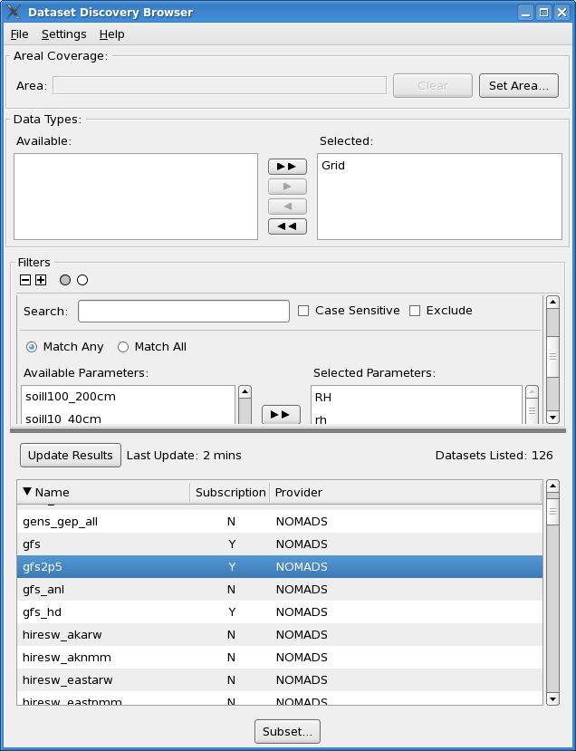
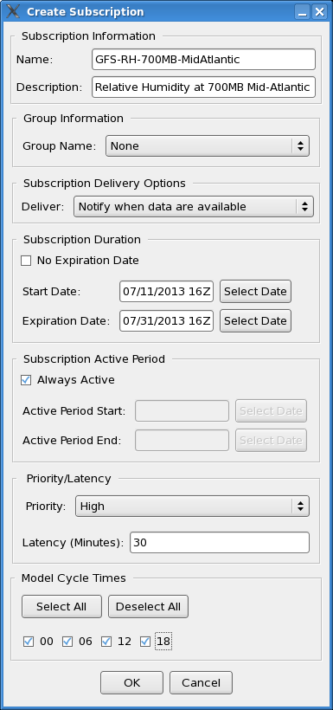
AWIPS-II Data Delivery IOC Screen Shots
Discover and
Subscribe
Source: 13.5.1 OB AWIPS-II
Data Delivery

Slide 11
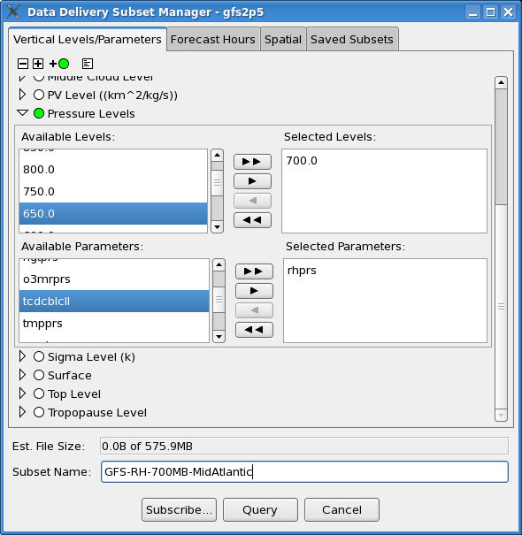
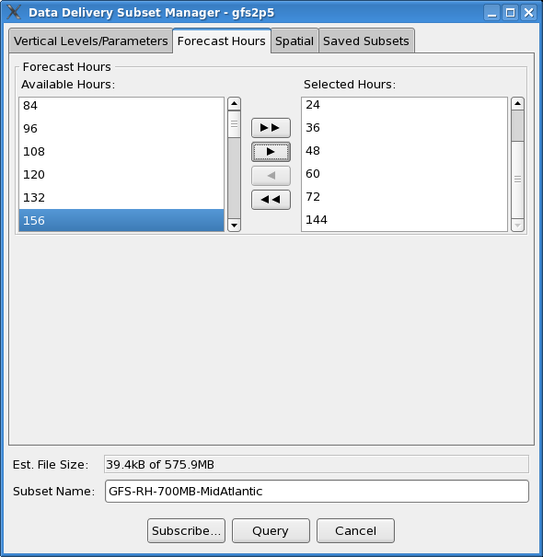
AWIPS-II Data Delivery IOC Screen Shots
Subset by Parameter and Vertical Level
Forecast Hour Subsetting
Source: 13.5.1 OB AWIPS-II
Data Delivery

Slide 12
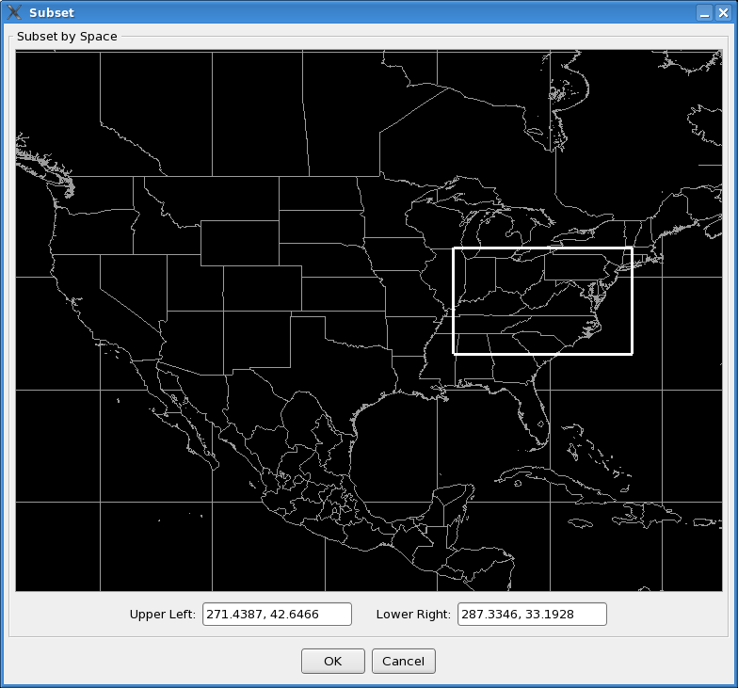
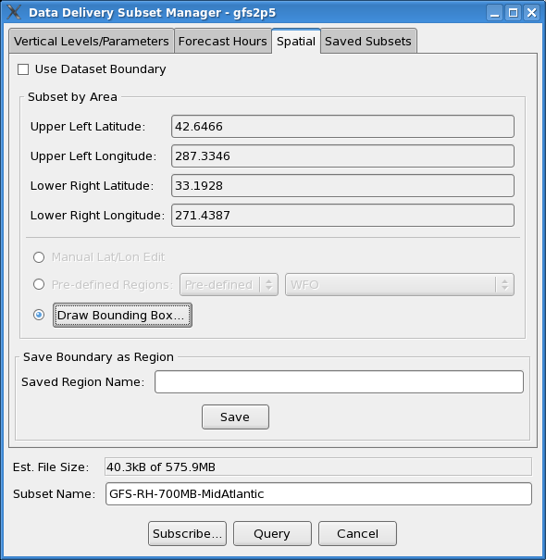
AWIPS-II Data Delivery IOC Screen Shots
Spatial Subsetting
Lat/Long bounds, pre-defined regions or draw a bounding box
Graphical selection
Source: 13.5.1 OB AWIPS-II
Data Delivery

Slide 13
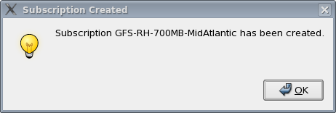
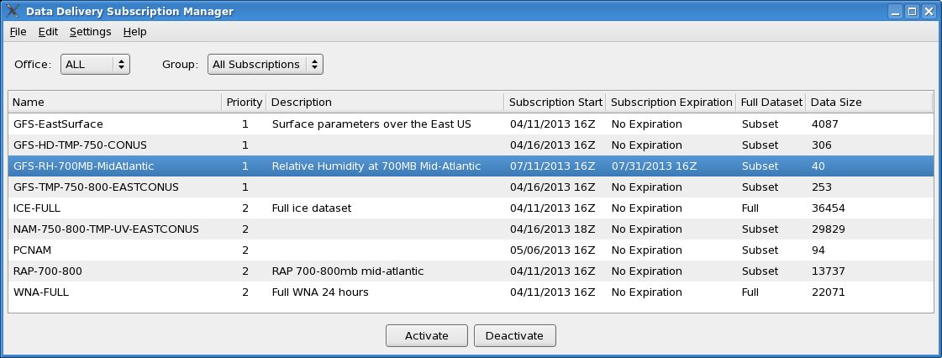
AWIPS-II Data Delivery IOC Screen Shots
Subscription Created and Displayed in Subscription Manager
Source: 13.5.1 OB AWIPS-II
Data Delivery

Slide 14
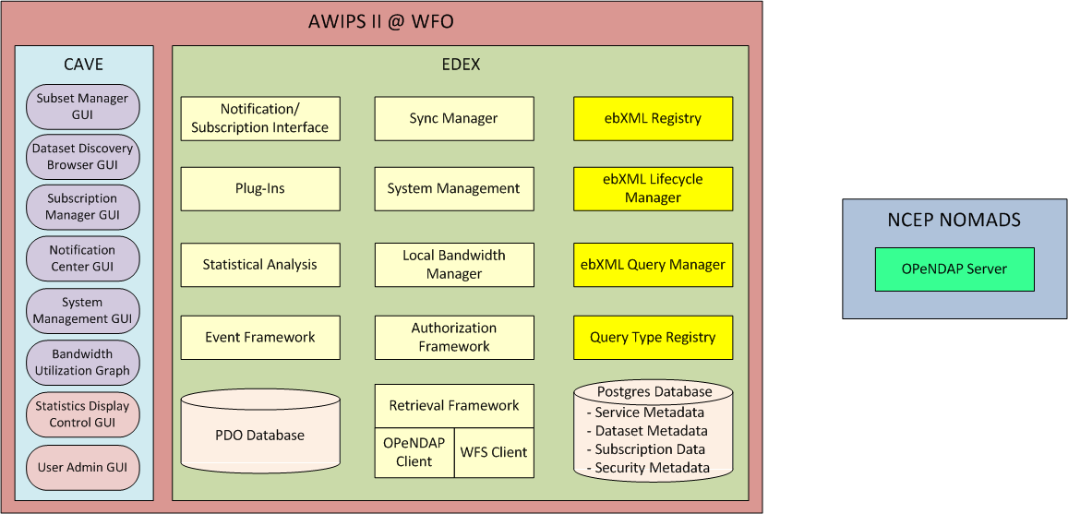
High Level Software Architecture for IOC

Slide 15
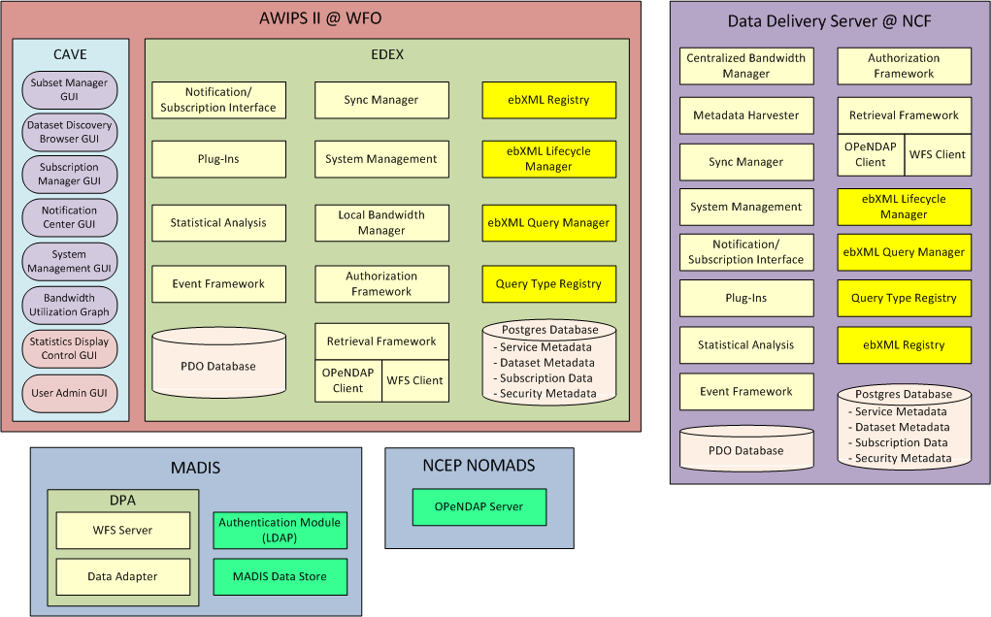
High Level Software Architecture for Post IOC

Slide 16
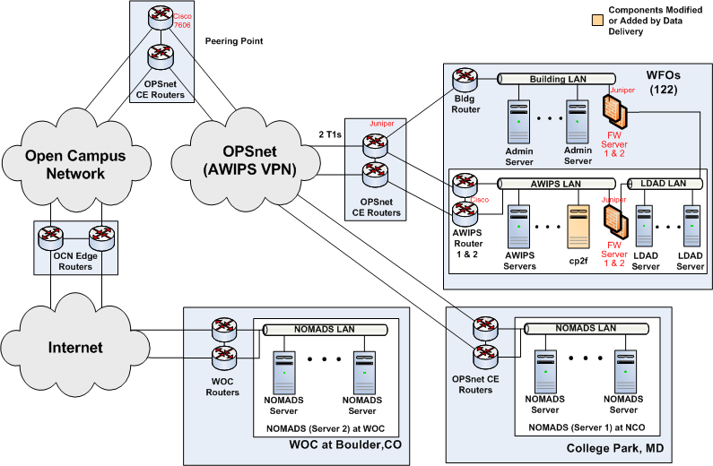
Network Diagram for IOC

Slide 17
Project Schedule/Status
Activity | Date | Status
Technical Requirements completed | 9/30/2011 | √
IT Architecture/Design completed | 7/22/2011 | √
Data Delivery prototypes developed by GSD | 2/29/2012 | √
Data Delivery prototype installed at NWSHQ | 10/12/2011 | √
OSIP Gate 3 | 11/1/2011 | √
RTS Tasking to Develop IOC | 1/1/2012 | √
IOC0 Development complete | 1/14/2013 | √
IOC Deployment Begins (Initially at Regional HQ Sites) | 9/30/2013
14.2.1(MADIS & SBN Subscription Channel) | Spring 2014
PDA Connectivity | Late 2014
FOC Deployment | Spring 2015

