Slide 1
MDL
Accomplishments and Plans:
MOS, LAMP, EKDMOS, Storm Surge, AutoNowCaster, VLab
NCEP Production Suite Review
December 4, 2013

Slide 2
MOS FY14 Implementations
GFS-MOS cool season wind equations update (COMPLETED: 11/5)
Pacific MOS ceiling height and sky cover (COMPLETED: 11/5)
GFS-MOS extended range (MEX) mean sky cover (COMPLETED: 11/5)
Add 216 stations to the Colorado Basin SHEF message
Add predominant weather, probabilistic QPF and precipitation type to GFS-based gridded MOS product suite for CONUS and Alaska
Extend GFS-based gridded MOS forecasts for CONUS and Alaska to day 10
Implement station based ECMWF MOS into the NCEP production suite

Slide 3
FY14 Other MOS Activities
Generate (47/95 km) GFS archive in the GFS-MOS operational job stream
Perform evaluations of parallel NAM and GFS model data to access impact changes will have on the MOS guidance.
Remove all dependencies in operations on GRIB1 model data and convert all output to be GRIB2.

Slide 4
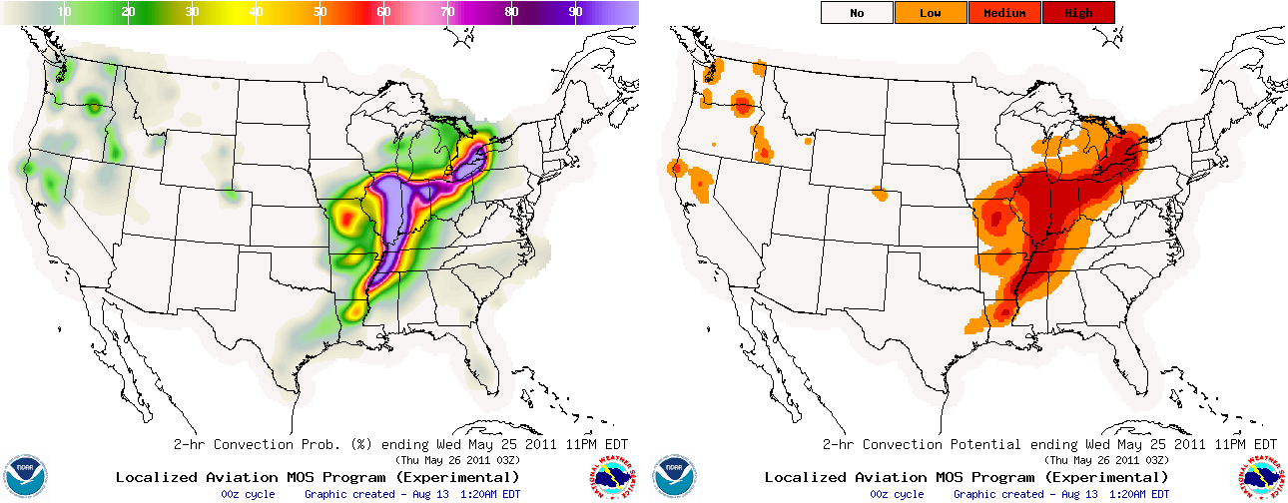
LAMP 2013 Accomplishments
Transitioned LAMP and Gridded LAMP systems to WCOSS
Provided experimental LAMP convection (new) and lightning (upgraded) gridded guidance for 60 day public comment period (Sept-Nov 2013). Comments have been positive, and we are working on handing the code off for implementation.

Slide 5
LAMP Implementations Planned for 2014-2015
Implement LAMP convection and updated 2.5-km lightning guidance into NCEP’s parallel jobstream and experimental NDGD. February 2014.
Implement update to Gridded LAMP forecasts and observations for current elements of temperature, dewpoint, ceiling, and visibility and add sky cover operationally Summer 2014.
Provide experimental prototype guidance for improved LAMP convection, lightning, ceiling height, and visibility guidance Spring 2015.
Provide experimental prototype guidance for gridded LAMP and Gridded observations for winds, probabilities of ceiling height, visibility, and sky cover experimentally by Summer 2015.

Slide 6
Ensemble Kernel Density MOS (EKDMOS)
Probabilistic forecast guidance from NAEFS (GEFS+CMCE)
11 probability levels (0.05, 0.10, 0.20, 0.30, 0.40, 0.50, 0.60, 0.70, 0.80, 0.90, 0.95) and ensemble mean.
NDGD grids
Operational elements
Temperature (T), dew point (Td)
Days 1-10
Daytime maximum temperature (MaxT), nighttime minimum temperature (MinT)
Days 1-16

Slide 7
EKDMOS (Cont.)
Experimental elements
Apparent Temperature (AppT), Wind Speed (WSP)
Days 1-10
Probabilistic Quantitative Precipitation Forecast (PQPF)
6-hr PQPF, Days 1-7
12-hr PQPF, Days 1-10
Current development
Add ECMWF ensembles
Use BMA to weight ensemble forecast systems
Incorporate more Mesonet stations
Include climatology information

Slide 8
SREF Winter Guidance (SWinG)
Supports LWX’s winter weather pilot project
Probabilistic guidance from the SREF ensembles
National Data Assimilation System (NDAS) used as proxy for truth
Use statistical post-processing techniques that can work with short developmental samples
Bayesian Model Averaging (BMA)
Use decaying averages instead of fixed sample size
Select predictands that reliably occur daily
Meteorological parameters vs.sensible weather
Re-use code where possible (SPC, BUFKIT)
Meteograms and text products are currently available at http://www.mdl.nws.noaa.gov/~BMA-SREF/BMAindex.php

Slide 9
Sample SWinG Meteograms
2-M Surface temperature (C)
850 mb Temperature (C)
1000-500 mb Thickness (m)
850-500 mb Thickness (m)
1000-850 mb Thickness (m)
Red line: 50% chance of rain or snow occurrence for that particular location based on climatology captured from a sample of 10 cool seasons.
Blue line: Rule-of-thumb value for differentiating rain and snow

Slide 10
Sample SWinG Meteograms (cont)
1000-700 mb Thickness (m)
Cobb Snow/Liquid Water Ratio
Czys Unconditional Precipitation Type
+/- Energy Conditional Precipitation Type

Slide 11
Extra-Tropical Storm Surge
Sandy Supplemental funding has enabled NWS to accelerate plans to improve extra-tropical storm surge modeling upgrades including:
Upgrading the Extra-Tropical Storm Surge (ETSS) (SLOSH based) model to provide overland inundation (based on surge + tide) for extra-tropical storms for the Gulf of Mexico and East Coast
Re-design the ETSS post processing system
Create Probabilistic Extra-Tropical Storm Surge (PETSS) by forcing the upgraded ETSS model with all 21 GFS ensemble members (scalable to include other ensemble model's members)
Alaska Region is providing OST/MDL with funds to hire a SLOSH basin developer for the Bering Sea/Arctic area.

Slide 12
Tropical Storm Surge
Recent enhancements to probabilistic storm surge (P-Surge) to go into operations for 2014
Latest SLOSH basins
Incorporate tides
Provide above ground level guidance
Provide 6-hr temporal guidance
Sandy Supplemental funding has enabled NWS to accelerate plans to improve tropical storm surge modeling by enhancing P-Surge to:
Incorporate greater than 100-hr tracks
Allow it to handle sub-hurricane strength storms
Allow it handle two simultaneous storms
Develop products for Caribbean Basins

Slide 13
Thunderstorm AutoNowCaster (ANC)
Implemented CONUS version of ANC using MRMS mosaic as radar input
Tested and Evaluated at AWC’s 2013 Aviation Weather Testbed Summer Experiment
1-hour ANC Convective Initiation forecast highly rated by AWC Forecasters
Developing plans to transition ANC to NCEP Operations

Slide 14
Radar Obs(dBZ)
HRRR(dBZ)
ANC Initiation
2106Z
2100Z
2106Z
2154Z
2206Z
2200Z
2324Z
2300Z
2304Z
LAMP
2100Z
2200Z
2300Z

Slide 15
NWS Virtual Laboratory
https://nws.weather.gov/innovate/
The Virtual Laboratory (VLab) is a set of services and IT framework which enables NWS employees and their partners to share ideas, collaborate, engage in software development, and conduct applied research.
The Goal of VLab is to manage innovation, streamline O2R, and accelerate R2O in NOAA.
VLab provides NWS’s R&D partners with a clear and inexpensive path to operations.

Slide 16
VLab Status

Slide 17
Back-up Slides

Slide 18
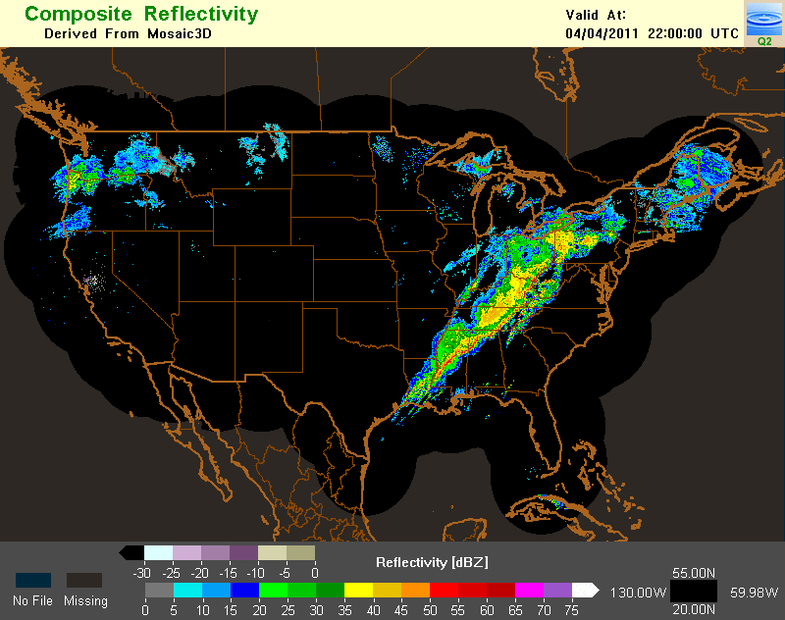
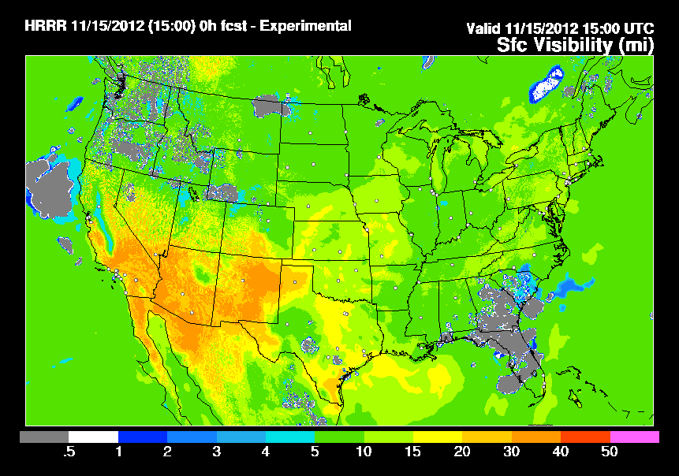
Current and Future LAMP Work
MDL has begun investigating development of improved gridded convection guidance using new input sources of MRMS radar data and RAP/HRRR model data.
MDL will investigate practicality of 1-hr LAMP convection guidance for the very short-term.
MDL has begun investigating the use of new gridded sources of information to augment Gridded LAMP guidance of ceiling height and visibility. Potential sources of additional information are:
RAP/HRRR analysis/forecast grids
Experimental RTMA observation grids

Slide 20
EKDMOS Method
Use forward screening multiple linear regression with the NCEP's GEFS and CMCE’s ensemble means
Estimate error variance directly from the regression
Perform a second regression to obtain a spread-skill relationship
Apply equations to individual ensemble members and combine results with Kernel Density fitting
Gaussian kernel
Standard deviation produced by the regression
Apply a spread-skill relationship to calibrate the spread

Slide 21
SREF Elements
2-M Surface Temperature*
850 mb Temperature*
1000 - 500 mb Thickness*
850 - 700 mb Thickness
1000 - 850 mb Thickness*
1000 - 700 mb Thickness
Snow Liquid Equivalent (Cobb-Waldstreicher algorithm)
Czys Unconditional Precipitation Type
Positive/Negative Energy below freezing level
*Station-specific 50% rain/snow climatology values are also displayed

