Slide 1
NCEP Suite Review December 2013 Alaska Region
Rick Thoman
ESSD Climate Science and Services Manager

Slide 2
NWS Alaska Region
Alaska Aviation Weather Unit
Alaska-Pacific RFC
National Tsunami Warning Center
Sea Ice Desk
TV

Slide 3
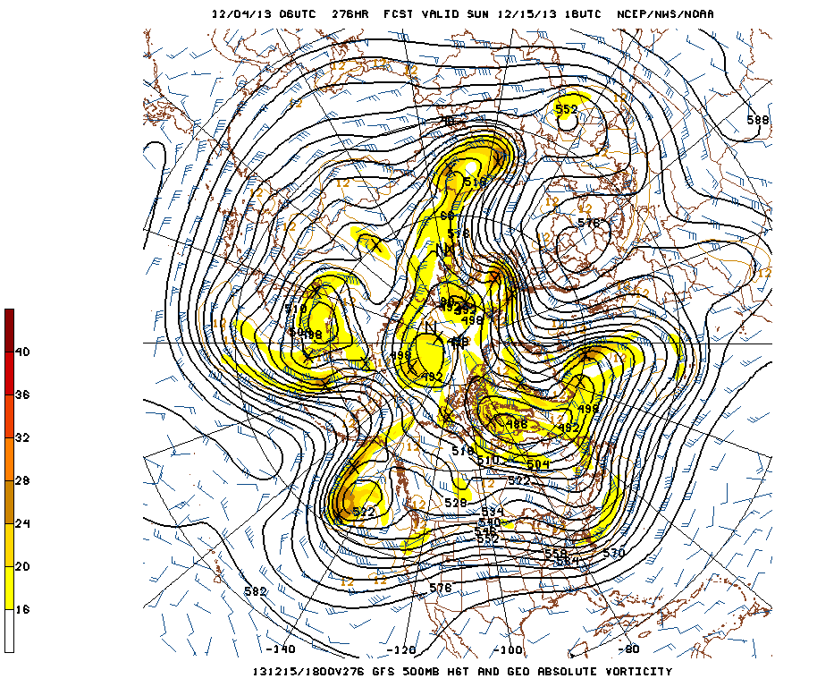
EMC
Usual High Latitude/Complex Terrain Meteorological Modeling Issues
High Latitude Closed Lows
Blocking patterns
Ex-typhoons

Slide 4
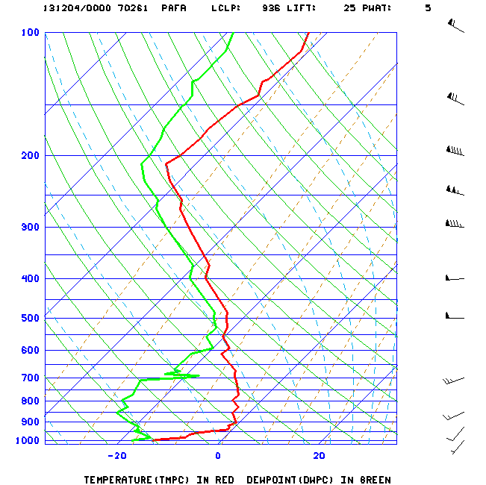
EMC
Usual High Latitude/Complex Terrain Meteorological Modeling Issues
Boundary Layer Processes
Steep Stable Surface inversions (20°C/100m every winter)=Extreme horizontal gradients
Boundary Layer Winds—terrain constrained
Moisture
Marine/Coastal stratus year round
Winter Arctic air mass stratus
Summer Convection

Slide 5
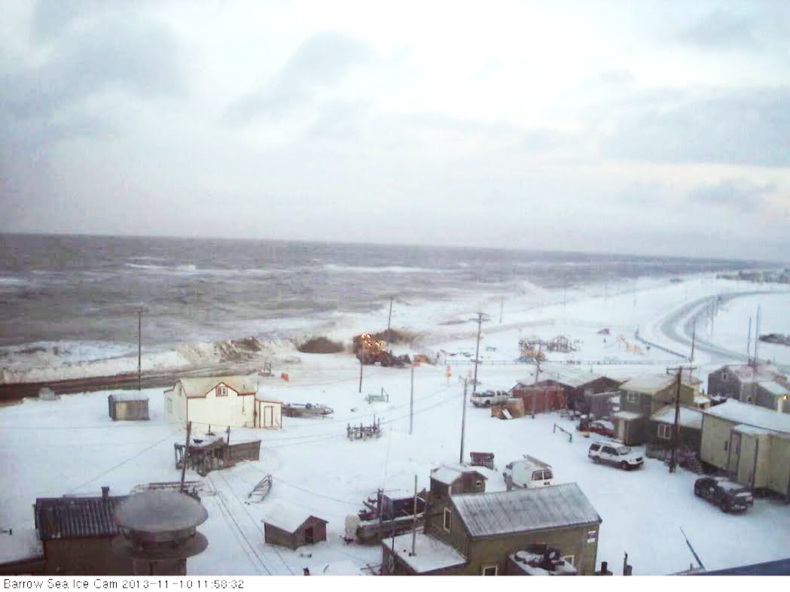
EMC
Sea Ice: an “emerged” requirement
Growth, decay and movement
Binary vs. fractional
At all time scales: day 1 to seasonal

Slide 6
EMC
RTMA
Deep problems remain with temps, especially winter
Winds in terrain
Lack of reliable gridded analysis is a significant contributor to NDFD grids still being “experimental”
WW3
Incorporation/Improvements in sea ice
SREF
Include Alaska on mag.ncep.noaa.gov

Slide 7
SPC
SREF plume diagrams not available via web
Pcpn Type
Fire Wx
Fire Weather Outlooks

Slide 8
WPC & CPC
WPC
4-7 day QPF
P-Type
CPC
Verification
Hazards Criteria
Seasonal scale sea ice forecasts (CFSv2)

Slide 9
Communications: AWIPS
SBN (or VSAT when installed) only high reliability WFO comms…but saturated bandwidth
Alaska FOs require ~10 times large file sizes of a model clip than typical CONUS FO
Unable to include already available EMC guidance
GFS 3 hour resolution
NAM 3km
RAP
No experimental data sets
WAN at 168kb/s to AFG and AJK greatly hinders

Slide 10
Communications: Internet
Terrestrial Internet
3 to 5 times more expensive than CONUS
Multiple single points of failure (ANC & SEA)
TICAP: to keep current bandwidth would be cost prohibitive

Slide 11
MDL
Coop MOS: new site
RAWS MOS
Surge Guidance
Especially Chukchi Sea, forecasts and forecast points

