Slide 1
CONSShort: an hourly short term ensemble for ESTF
Jerry Wiedenfeld, ITO MKX
Jeff Craven, SOO MKX
CRGMAT/VTF
NWS Milwaukee/Sullivan WI

Slide 2
Outline
Background Information:
Observations
Models
Blending of current obs into model consensus
Nowcast feature
PoP calibration differences versus CONSAll
Hourly Weather, QPF, Snow, and Ice grids

Slide 3
Background: Composition of obs
Five background fields, with observations matched via Tim Barker GFE “serp” program
20% LAPS (4 km)
20% RAP (13 km) {still RUC13 in AWIPS}
20% HRRR (3 km)
20% RTMA (5 km)
20% NAM12 (12km)

Slide 4
Model Info
Each CONS Product is run every hour and produces hourly data out to 24 hours for the following elements
  T, Td, RH, Wind, WindGust, Sky, PoP, QPF, SnowAmt, Ice Accumulation, Wx
3, 6, and 12 hourly elements are computed for
  PoP, QPF, and SnowAmt

Slide 5
Composition of CONSShort
Official
Obs (advected by RAP 850-700-500 mb mean wind: PoP, Sky, QPF, Snow)
Persistence/obs (all others) adjusted by 7 day mean diurnal hourly variation
HRRR (3km - weighted four times)
RAP (RUC13 – weighted twice)
GLAMP (2.5 km – weighted twice)
Local wsWRF (4km – weighted twice) *this will vary if you don’t have wsWRF
WRF ARW (4km)
WRF NMM (4km)
NAM12
NAMDNG5 (5km)
ADJLAV (RAP adjusted by LAMP stations) (weighted four times)
ADJMET (NAM12 adjusted by MET stations)
ADJMAV (GFS40 adjusted by MAV stations)
Observations dominate weightings in first 6 hours
Bias Corrected Version as well: BCCONSShort

Slide 6
Composition of CONSShort
(PoP, QPF, Sky, Snow)
Model Weight Fhr 1 2 3 4 5 6
Official 0.5% 1% 2% 3% 4% 4%
Obs/persistence 90% 75% 60% 40% 20% 10%
HRRR 2% 5% 8% 12% 16% 17%
RAP 1% 2% 4% 6% 8% 9%
GLAMP 1% 2% 4% 6% 8% 9%
Local wsWRF 1%* 2%* 4%* 6%* 8%* 9%*
WRF ARW 0.5% 1% 2% 3% 4% 4%
WRF NMM 0.5% 1% 2% 3% 4% 4%
NAM12 0.5% 1% 2% 3% 4% 4%
NAMDNG5 0.5% 1% 2% 3% 4% 4%
ADJLAV 2% 5% 8% 12% 16% 17%
ADJMET 0.5% 1% 2% 3% 4% 4%
ADJMAV 0.5% 1% 2% 3% 4% 4%

Slide 7
Composition of CONSShort
(T, Td, wind, wind gust, RH)
Model Weight Fhr 1 2 3 4 5 6
Official 2% 4% 4% 5% 5% 5%
Obs/persistence 50% 25% 10% 0 0 0
HRRR 10% 14% 17% 20% 20% 20%
RAP 5% 7% 9% 10% 10% 10%
GLAMP 5% 7% 9% 10% 10% 10%
Local wsWRF 5%* 7%* 9%* 10%* 10%* 10%*
WRF ARW 2% 4% 4% 5% 5% 5%
WRF NMM 2% 4% 4% 5% 5% 5%
NAM12 2% 4% 4% 5% 5% 5%
NAMDNG5 2% 4% 4% 5% 5% 5%
ADJLAV 10% 14% 17% 20% 20% 20%
ADJMET 2% 4% 4% 5% 5% 5%
ADJMAV 2% 4% 4% 5% 5% 5%

Slide 8
Composition of CONSShort
Model Approximate Weight in 7-24 hour period
                7-15 16-18 19-24
Official 5% 7% 8%
Obs/Persistence 0% 0% 0%
HRRR 19% NA NA
RAP 10% 13% NA
GLAMP 10% 13% 15%
Local wsWRF 10%* NA NA
WRF ARW 5% 7% 8%
WRF NMM 5% 7% 8%
NAM12 5% 7% 8%
NAMDNG5 5% 7% 8%
ADJLAV 19% 27% 31%
ADJMET 5% 7% 8%
ADJMAV 5% 7% 8%

Slide 9
Resolution and Refresh rate
Model Resolution Length Refresh frequency
Official 1 hr 24+ hr ~3 hr
Obs/Persistence 1 -- 1
HRRR 1 15 1
RAP 1 18 1
GLAMP 1 24 1
Local wsWRF 1 15* 3*
WRF ARW 3 24+ 6
WRF NMM 3 24+ 6
NAM12 3 24+ 6
NAMDNG5 3 24+ 6
ADJLAV 1 24 1
ADJMET 3 24+ 12
ADJMAV 3 24+ 6

Slide 10
Bias Correction
BOIVerify does a 30 day bias correction every 3 hours
BCCONSShort harnesses the 3 hour bias corrected grids, and then does weighted time interpolation to get hourly values
Since BOIVerify starts 12 hours into the future, BOIShort was created to handle 0-12 hour hourly grid verification. It runs every 3 hours out 12 hours
BOIShort is not included in CONSShort Tech Note (due to database size issues)

Slide 11
Temperature and Dew Point
Hourly temperatures are used if available
For those inputs that are 3 hour temporal resolution, a weighted time interpolation is used to compute additional hours
The observation contribution for the next 3 hours is adjusted based on the 7 day running average diurnal change. That way, a 15z observed Temp would be adjusted up, e.g. 3 degrees to be used as a 16z input

Slide 12
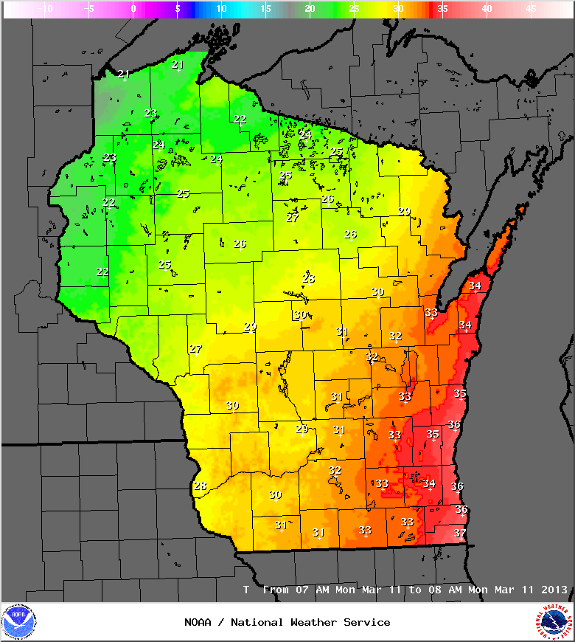
Example hourly temperature

Slide 13
Wind
Wind is treated like T and Td
Bias Correction of the wind is only on the speed, not the direction
The weighted time interpolation for 3 hourly inputs works like T and Td, but does account for both direction and speed
The wind observations are adjusted for 7 day running means, so it should have some diurnal effects as well

Slide 14
Wind Gust
Similar to wind
Smart Inits are used to create Wind Gust for models that don’t specifically generate it
The transport wind magnitude is compared to the Gust Factor looking at the 10 meter wind speed. If the transport wind is within 1.3 to 1.8 range, the transport wind magnitude is used for wind gust. If not, it is capped with lower bound of 1.3 and upper bound of 1.8 times the 10 meter wind
In all other cases, Wind Gust = 1.5 x 10m wind
The Wind Gust QC ensures that Gust > wind

Slide 15
Relative Humidity
The model RH is used for 2 meter level
Possible changes: taking the consensus T and Td, and computing a consensus RH to save computing time in the future

Slide 16
Sky
This field needs work, since we still use sky cover from RH Smart Init. This will improve if we replace these Smart Inits with actual cloud cover generated from model cloud
The MOS components do help out here
For observations, the average of “obs”, LAPS, and RTMA is used. “Obs” include METARs.
This is advected into the future each hour by the mean RAP wind in 850/700/500mb layer

Slide 17
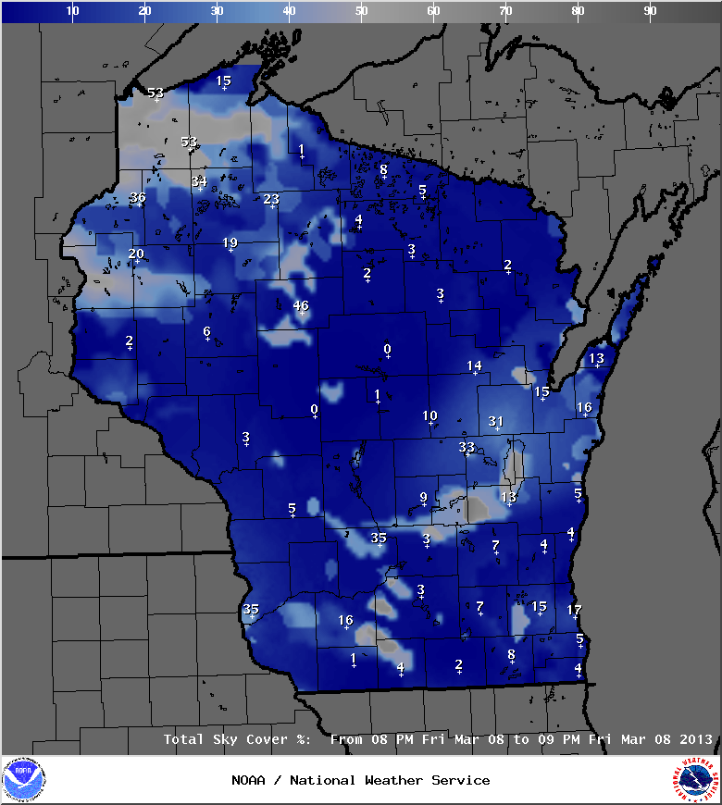
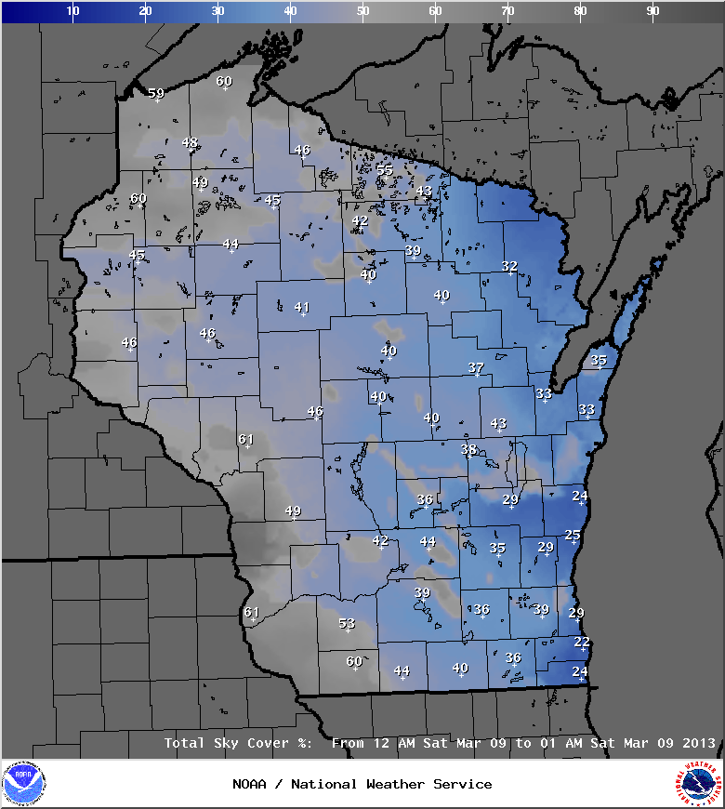
Examples hourly Sky

Slide 18
PoP
Weighted Observed grid is used hours 0-6
  100%, 90%, 75%, 60%, 40%, 20%, 10%
  The Obs grid is advected using an average of the forecasted RAP winds at 850, 700, and 500 mb
Since many models do not have hourly PoP, QPF was used to generate an hourly “PoP”
  Took QPF over its period and fragmented the grid to hourly QPF
  If QPF > .01” PoP=100%, otherwise 0% (not same as CONSALL method which is tied more to QPF amount)
Run a smoother over the final CONSField
Produces 1, 3, 6, and 12 hour PoP, which are consistent

Slide 19
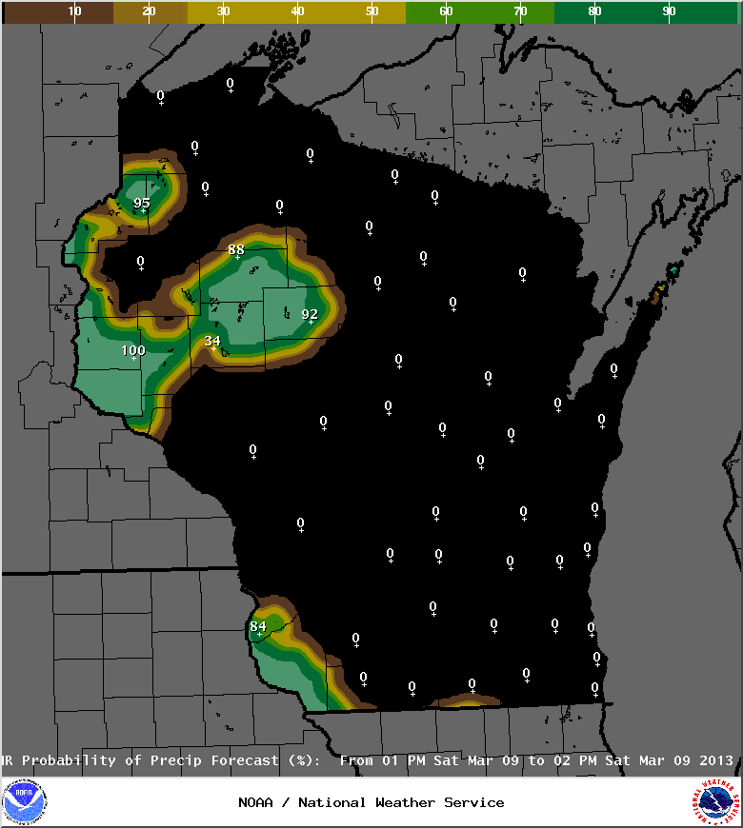
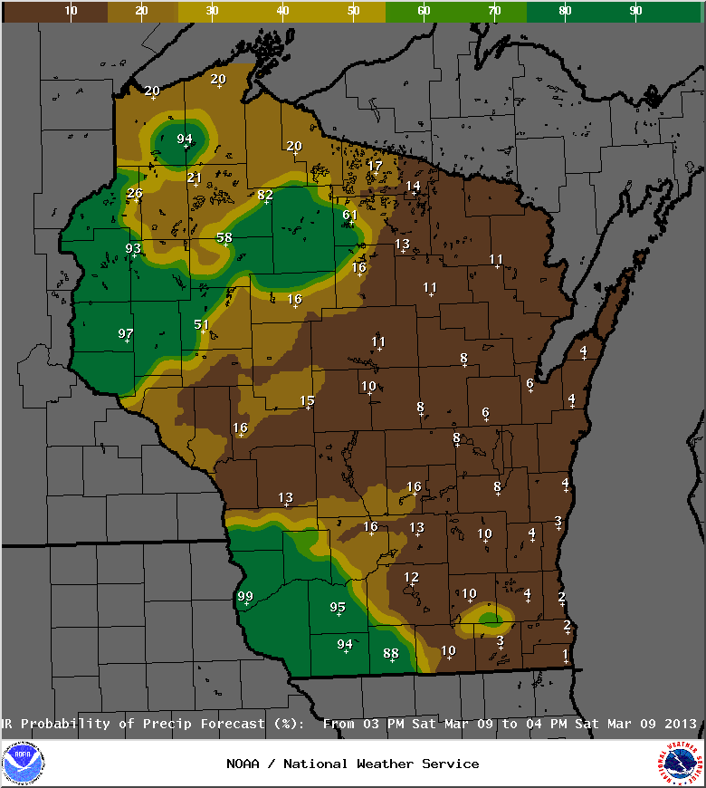
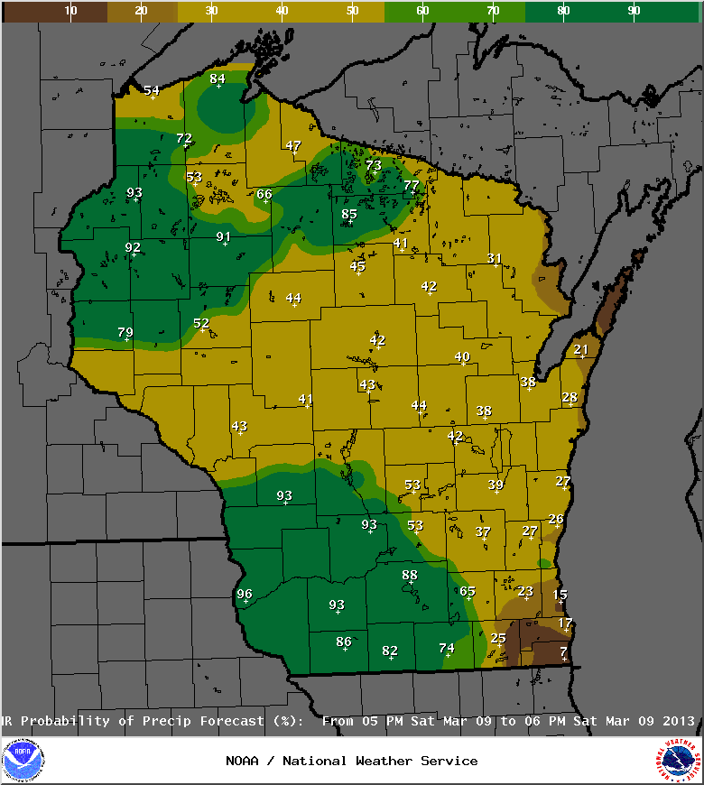
Examples hourly PoP
0 hour 2 hour 4 hour

Slide 20
QPF
Observed grid is created by taking highest value of LAPS, MPE, RTMA. If those are all missing, then the HRRR QPF is used as a starting point. (Great need for better Hourly Precip Analysis)
Weighted Observed grid is used hours 0-6
  100%, 90%, 75%, 60%, 40%, 20%, 10%
  The Ob grid is advected using an average of the forecasted RAP winds at 850, 700, and 500 mb
Since many models do not have hourly QPF, Took QPF over its period and fragmented the grid to hourly QPF
Produces 1, 3, and 6 hour QPF, which are consistent

Slide 21
Details of the nowcast feature
From hours 7-24 of the forecast, the consensus of the available guidance is weighted just about equally with exception of HRRR and ADJLAV
From hours 1-6, there is a heavy weight toward the current observations, which decreases each hour until it is gone at hour 7
For parameters like T, Td, wind, wind gust, the current observations are tweaked in the next 3 hours based on a 7 day running average of the diurnal hour to hour change (for example, you would not want to use a 15z T for 16z, because it would normally go up about 3 degrees)

Slide 22
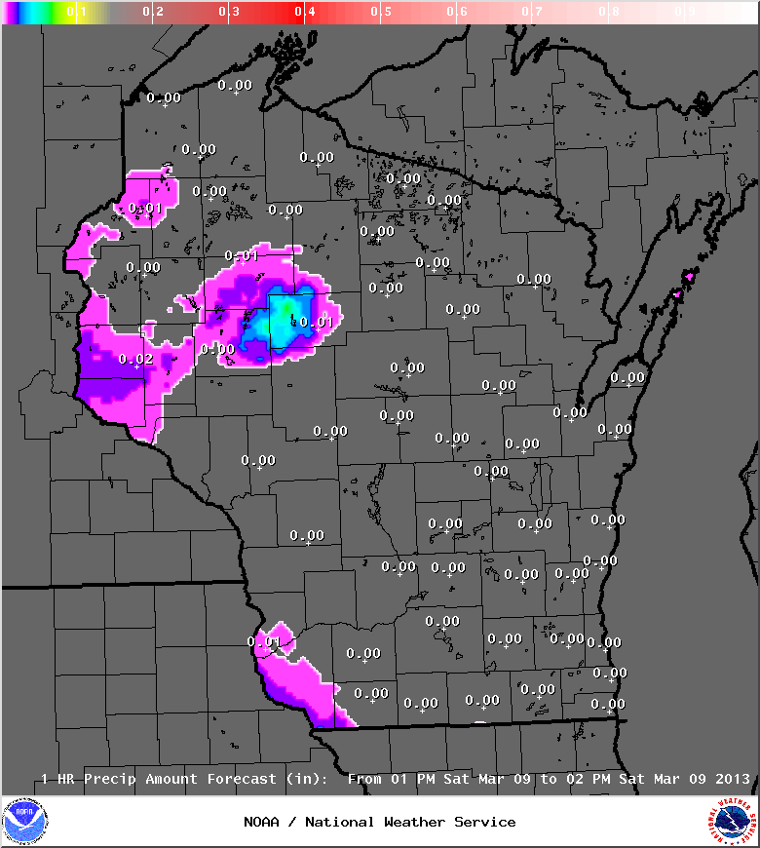
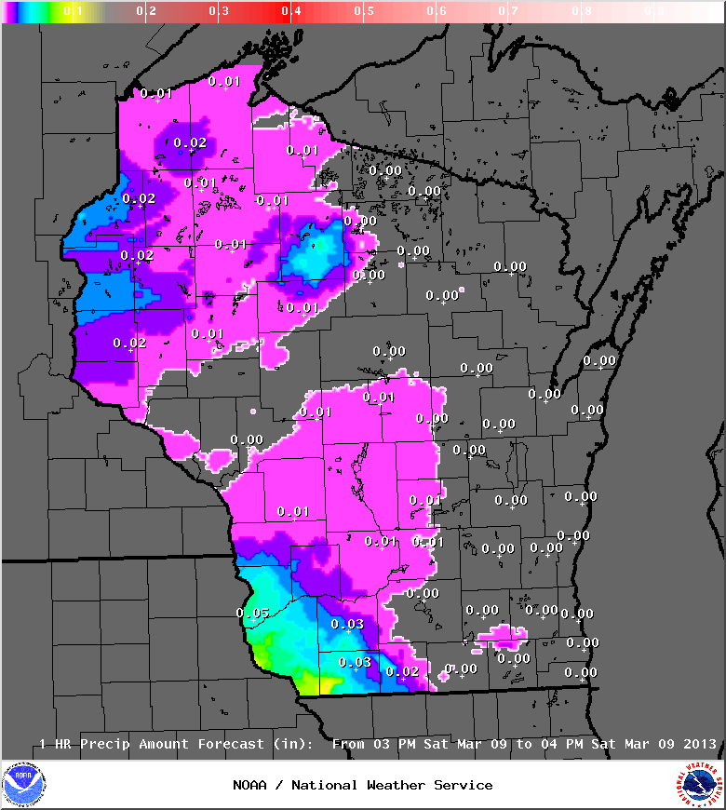
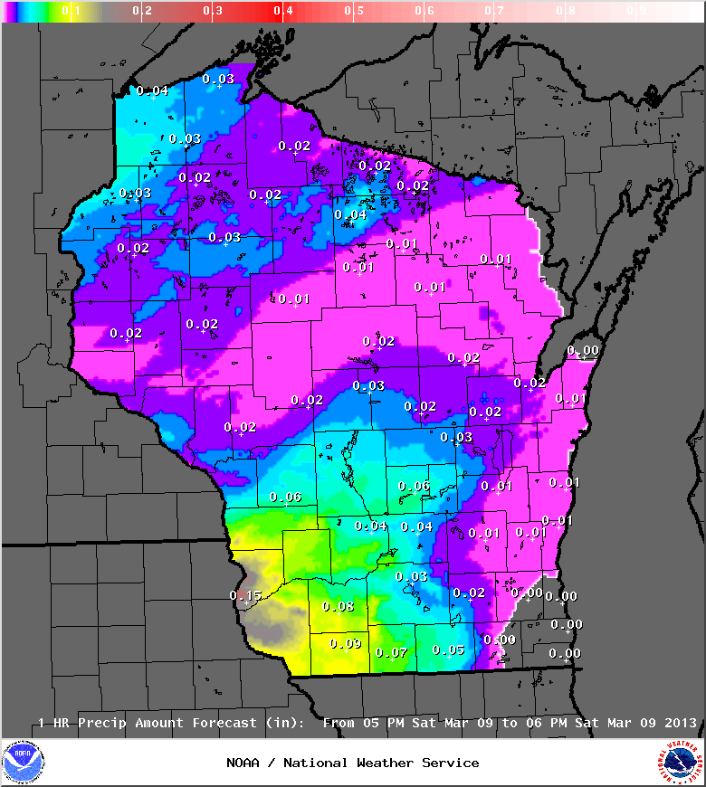
Examples hourly QPF
0 hour 2 hour 4 hour

Slide 23
Details of the nowcast feature
For parameters like Sky, PoP, QPF, and Snow:
The observed Sky, QPF, and Snow are “advected” by the mean hourly RAP wind averaged from 850 mb, 700 mb, and 500 mb
The PoP is derived from the QPF, which is a combination of the advected QPE and the model forecast QPF. This starts heavily weighted towards continuity, but then becomes more model driven as you approach 6 hour mark
Snow is created from QPF, surface temperature, and the Caribou/Cobb derived Snow Ratio using the latest RAP during hours 1-18 then NAM12/GFS40 there after
https://ams.confex.com/ams/pdfpapers/94815.pdf

Slide 24
SnowAmt
Used CONS QPF and Temperature as well as RAP/GFS40/NAM12 consensus SnowRatio (Caribou/Cobb) to compute SnowAmt
  Weighted time interpolation is used for GFS40/NAM12 snow ratios
  First compute raw snow amounts by multiplying QPF by SnowRatio
  Post process based on temperature
  If T > 32, ((36-T)^2/16) x SnowAmt
  If T > 36 set to 0
  Otherwise set to originally computed SnowAmt

Slide 25
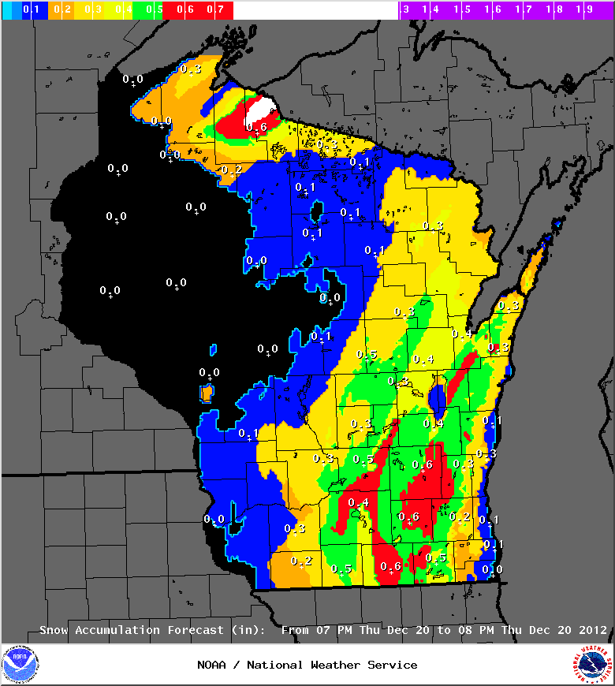
02z
18z
run
KMSN
30F
1 -SN
KMKE
33F
2 ½ -SN
0.02”
0.2” 0.1”
Obs
Fcst
KMSN
0.01”
0.2”
0.4”

Slide 26
The relationship between 1, 3, 6, and 12 hour grids in CONSShort
The 1, 3, 6, and 12 hour grids are consistent
Thus, adding up 6 hourly QPF grids will yield the same value as the QPF6 grid
Adding up the 6 hourly SnowAmt grids will yield the same value as the SnowAmt6 grid

Slide 27
Ice Accumulation
If there is hourly QPF but the hourly Snow Amount is zero, then locations with temperatures of 32F or colder will have that QPF assigned as ice accumulation
This field is later used to determine Wx grids that include Freezing Rain

Slide 28
Weather
Harnessed a variety of information:
Snow Ratio (RAP/NAM12/GFS40)
Snow amounts (CONSShort)
Ice Accumulation (CONSShort)
Surface Temperature (CONSShort)
850 mb Temperature (RAP/NAM12/GFS40)
QPF (CONSShort)
PoP (CONSShort)
SBCAPE (RAP/NAM12/GFS40)

Slide 29
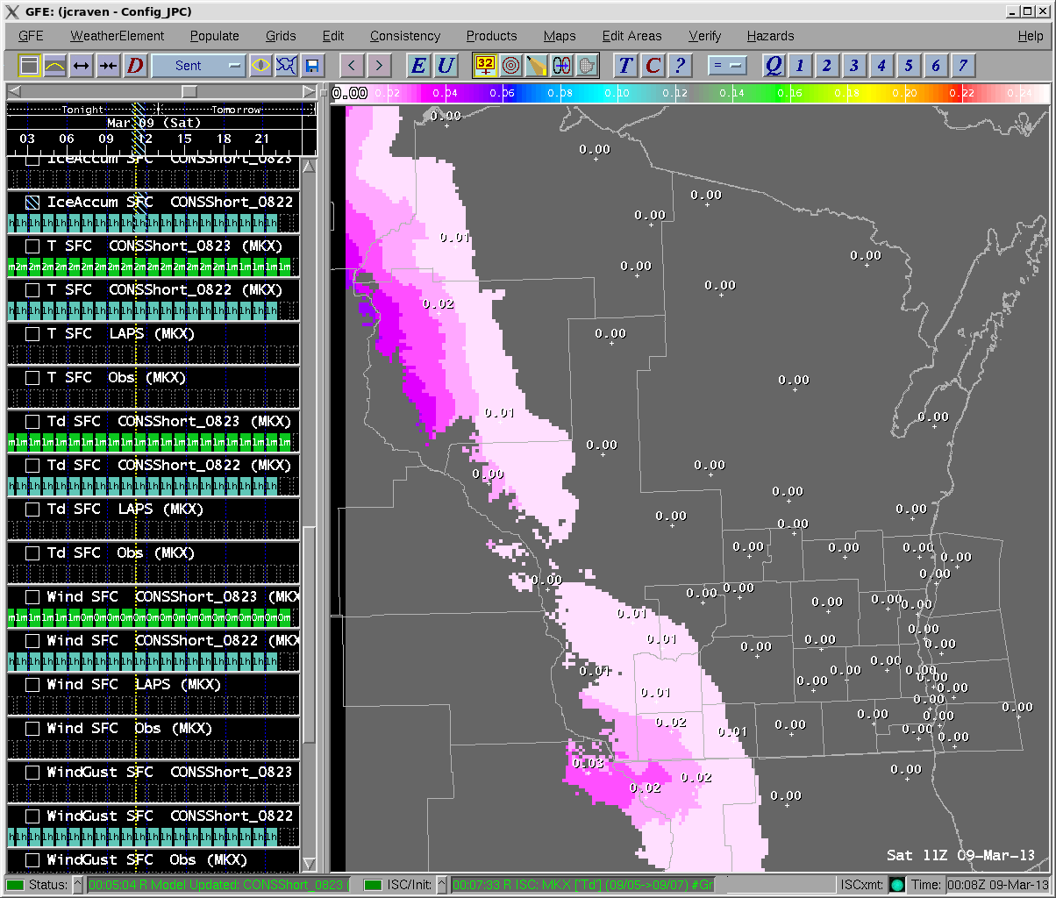
Example hourly Ice Accumulation

Slide 30
Weather
If snow amount calculated, then precip type snow
If no snow and temp 32F or less, then freezing rain with ice accumulation from QPF
Several simple mixed algorithms that look at snow ratio, CONSShort surface temperature, and 850 mb temperature from RAP/NAM12/GFS40 to determine snow, sleet, freezing rain, and rain mixes
If no snow or ice & temp above 33F, then rain when
QPF >.01”
Looks at consensus model SBCAPE to determine stratiform, showers, and thunder
No fog or blowing snow (yet)

Slide 31
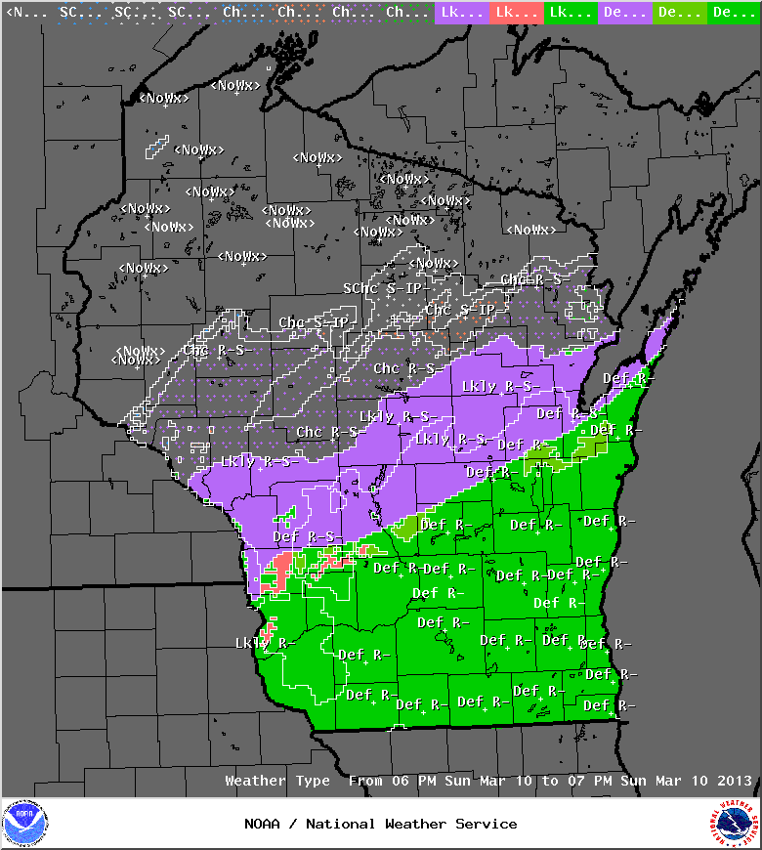
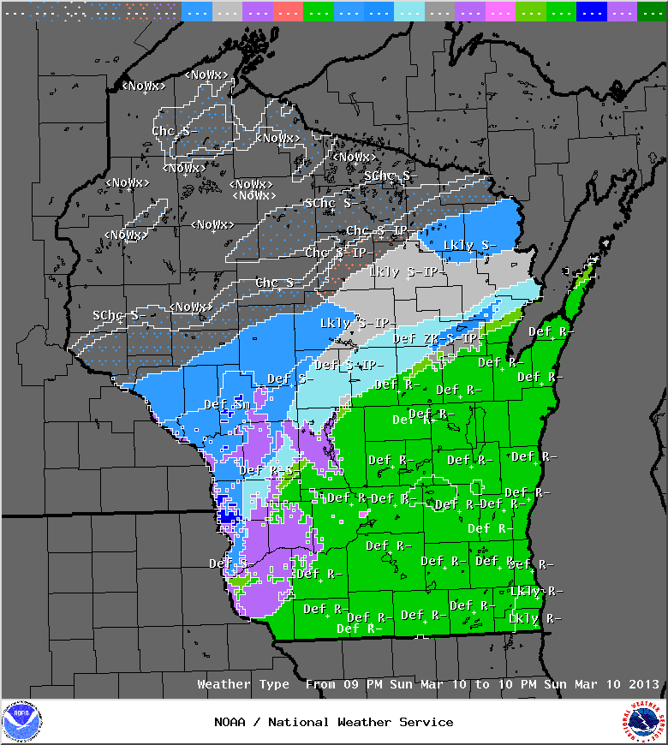
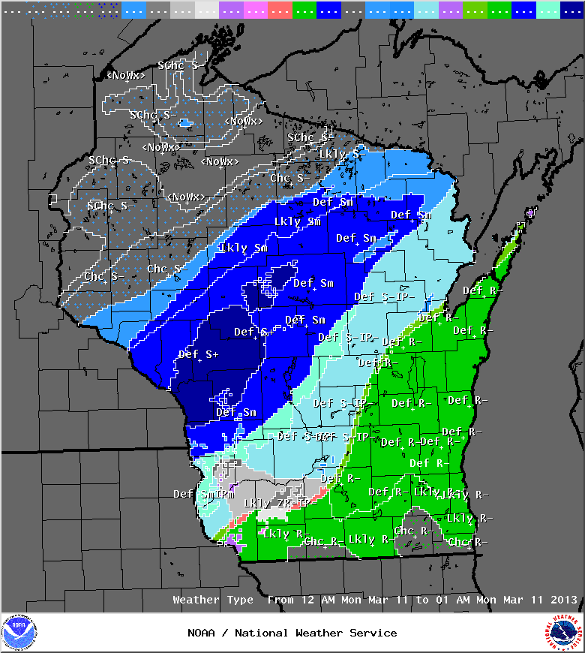
Examples hourly Wx
7 hour 10 hour 13 hour

Slide 32
Weather Matrix
WX | Snow or ice amt? | Snow Ratio | Surface Temp | 850 mb Temp
SN | Snow | > 8:1 | <33F | <0C
RN/SN |  | 0 | 33-36F | <0C
PL/SN |  | <8:1 | <32F | 0-1C
PL |  | 0 | <32F | 0-1C
FZRA/PL |  | 0 | <32F | 1-2C
FZRA/PL/SN | Ice | 0 | <32F | 0-0.5C
FZRA/PL | Ice | 0 | <32F | 0.5-2C
FZRA | Ice | 0 | <32F | >2C
RA/PL |  | <8:1 | 32-35F | <1C
FZRA/RA |  | <8:1 | 32-33F | 1-2C
RA |  | 0 | >33F | >2C

Slide 33
Coming Features (AWIPS2)
Aviation: Ceiling and Visibility Grids
Improved Sky Cover Analysis from CIMSS
Adding Fog, blowing snow, and freezing spray to Weather
Adding Weather to CONSAll
Adding Snow Ratio, Snow, and Ice to CONSAll
BOIShort: Space an issue

Slide 34
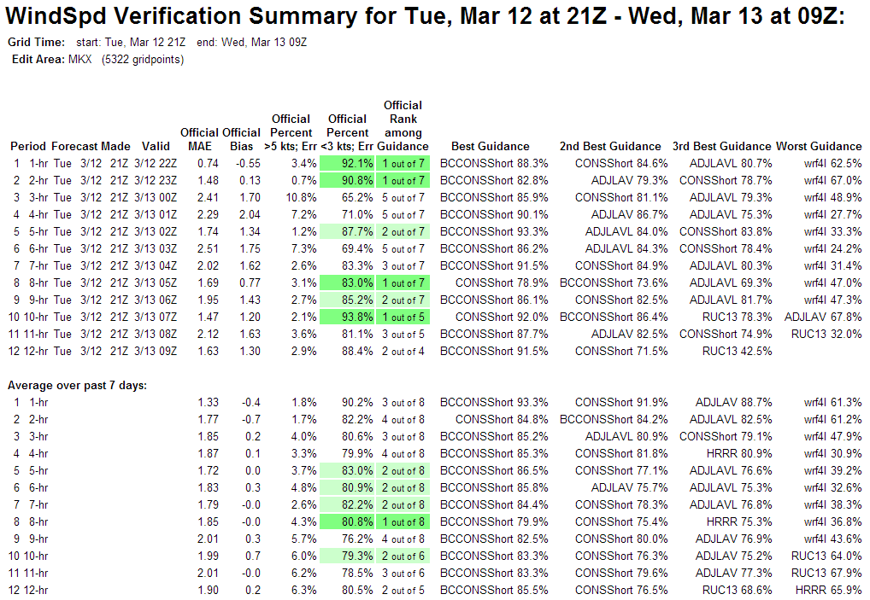
BOIShort

Slide 35
Best Verifying Models at MKX per BOIShort
Temp and Td: ADJLAV, CONSShort and BCCONSShort depending on time of day
Wind and Wind Gust: BCCONShort very dominant. CONSShort often 2nd
Sky: ADJLAV best. CONSShort often worst. Official has 15% high bias (Less confidence in Sky verification due to analysis quality)

Slide 36
Known Issues
Lag/delay between HRRR running and being available in GFE is roughly 4-5 hours and causes spinup issues in precip/QPF
The advection of features using 850/700/500 mb wind can cause poor results (e.g. Lake effect snow showers and orographic features)
Non-diurnal events, especially in first 3 hours (e.g. frontal passage)

Slide 37
Summary
CONSShort creates realistic hourly grids
Detailed features are subject to usual model error and can be off a county or so and a few hours
Observed hourly precip fields like LAPS, RTMA, MPE, RFCQPE could use additional work. These are critical for spinning up the PoP/QPF/Snow
Lots of detail in time and space for QPF, PoP, Snow, Wx. Hard for some forecasters to embrace

