Slide 1
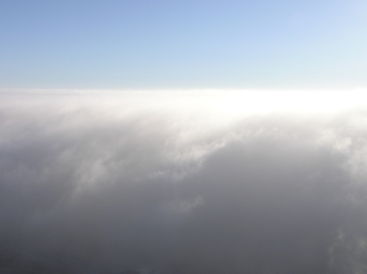
Cloud Microphysics (ATM505 Module 4, 10 Apr 2023)
Overview
Clouds in Earth’s atmosphere (Warm vs. Cold clouds)
Continuum between aerosol and cloud particles
Why do we care about aerosol-cloud interactions?
Real World examples
Cloud droplet formation (nucleation)
Saturation vapor pressure of a droplet
Surface tension term + Solute term = Kohler theory
Dr. S. Lance

Slide 2
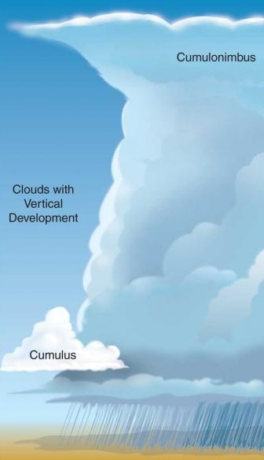
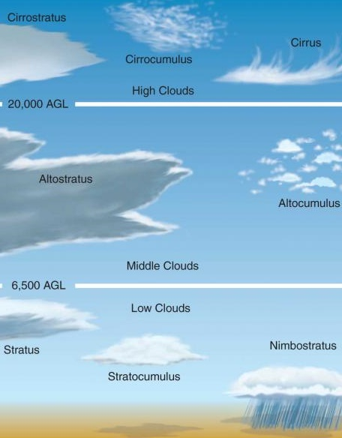
Clouds Exist over a Wide Range of Temperatures
Ice Only
(Glaciated)
(< -35 ºC)
Mixed Ice and Water
(-20 ºC)
Melting Level (0ºC)
Liquid
Water Only
Notes:
In reality both CCN and IN might matter for the cloud evolution, and the sensitivity and response of the cloud to CCN and IN likely varies greatly with cloud type. Here you can see that clouds exist over a wide range of temperatures. Marine stratiform clouds in the lower troposphere and cirrus clouds in the upper troposphere are the most prevalent cloud types, and they exist as liquid-only and ice-only cloud types, respectively, due to the temperatures at which they are found. However, there are mixed-phase cloud types that exist in between the temperature region of 0oC and -35oC, such as deep convective clouds and Arctic stratiform clouds, that have an large impact on the Earth’s radiation balance and hydrological cycle.

Slide 3
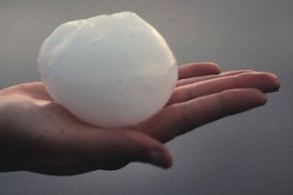
Continuum of Aerosol and Cloud particles
Aerosols: 1 nm – 100 μm (5 Orders of Magnitude in Size)
10⁻⁴ m
1 micron
10⁻⁵ m
10⁻⁶ m
10⁻⁷ m
Pollen
Hail
10⁻⁸ m
Sea Spray/ Dust/Ash
Snow
10⁻¹ m
1 nanometer
Haze
Graupel, Rain
10⁻⁹ m
1 Angstrom
Soot
10⁻² m
10⁻¹⁰ m
Drizzle
New Particle Formation
1 centimeter
Cloud Droplets
10⁻³ m
Atomic bonds
1 millimeter
10⁻⁴ m
100 microns
10⁻⁵ m
10 microns
Clouds: 1μm – 10cm (5 Orders of Magnitude in Size)

Slide 4
Continuum of Aerosol and Cloud particles
Aerosol
Haze Particles
Cloud Droplets
100 nm
(0.1 μm)
300 nm
(0.3 μm)
10 μm
0%
20%
40%
60%
80%
100%
Increasing Relative Humidity

Slide 5
Continuum of Aerosol and Cloud particles
Aerosol
Haze Particles
Cloud Droplets
Aerosol particles that end up becoming cloud droplets are called “Cloud Condensation Nuclei” (CCN)
100 nm
(0.1 μm)
300 nm
(0.3 μm)
10 μm
0%
20%
40%
60%
80%
100%
Increasing Relative Humidity

Slide 6
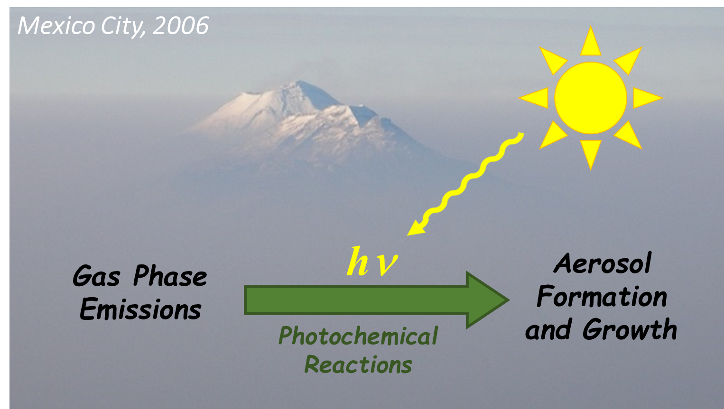
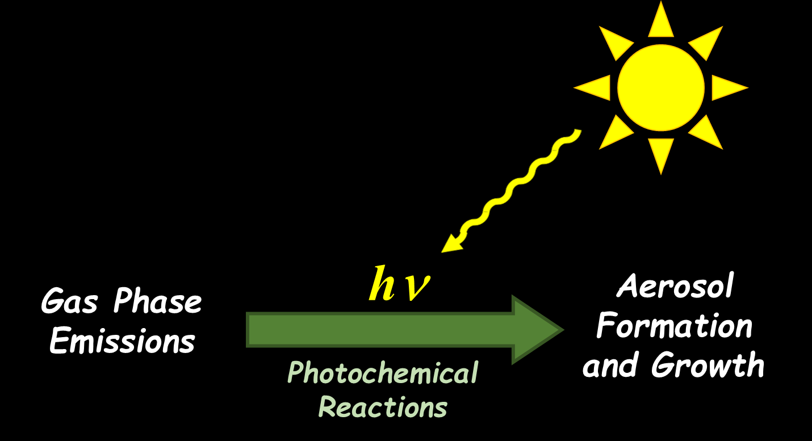
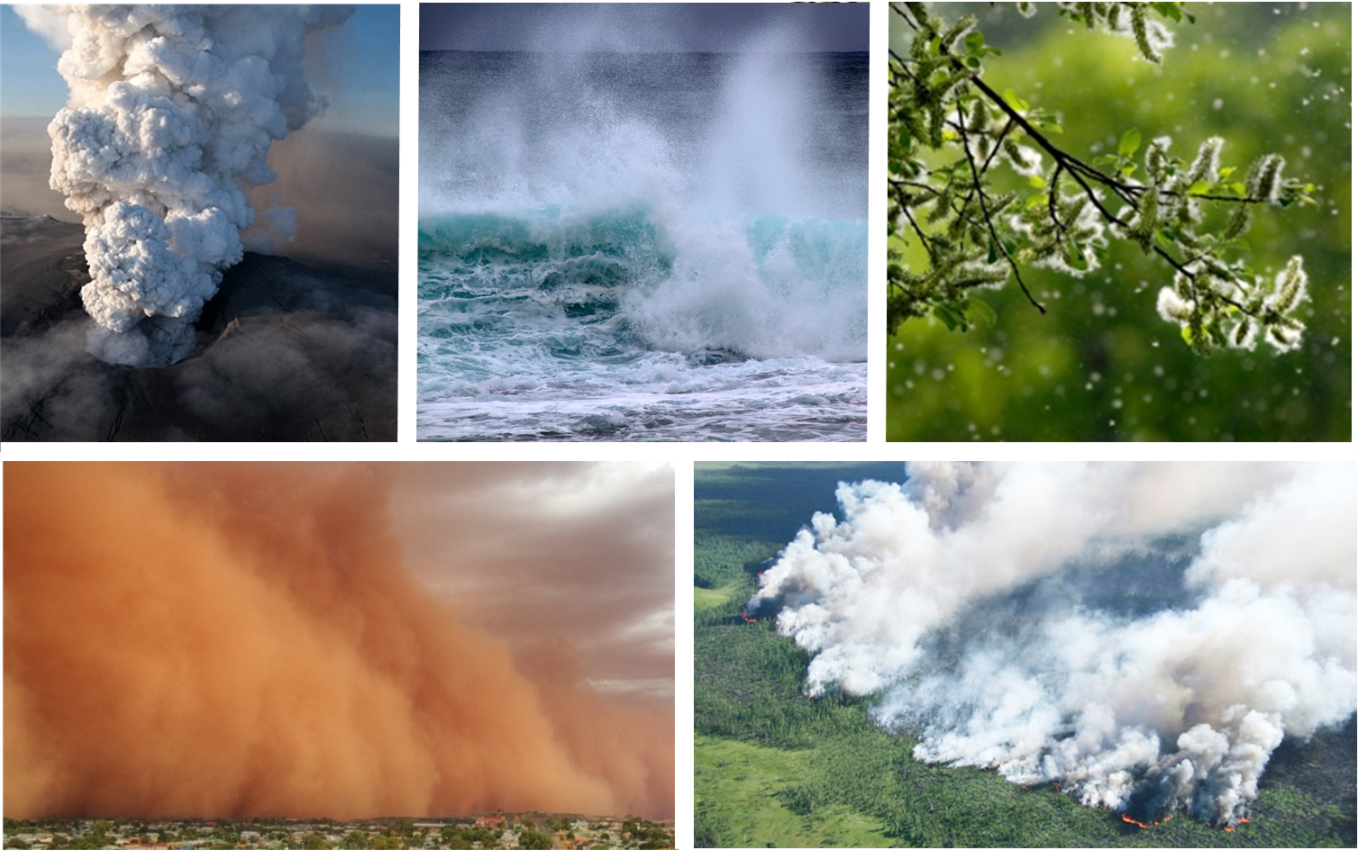
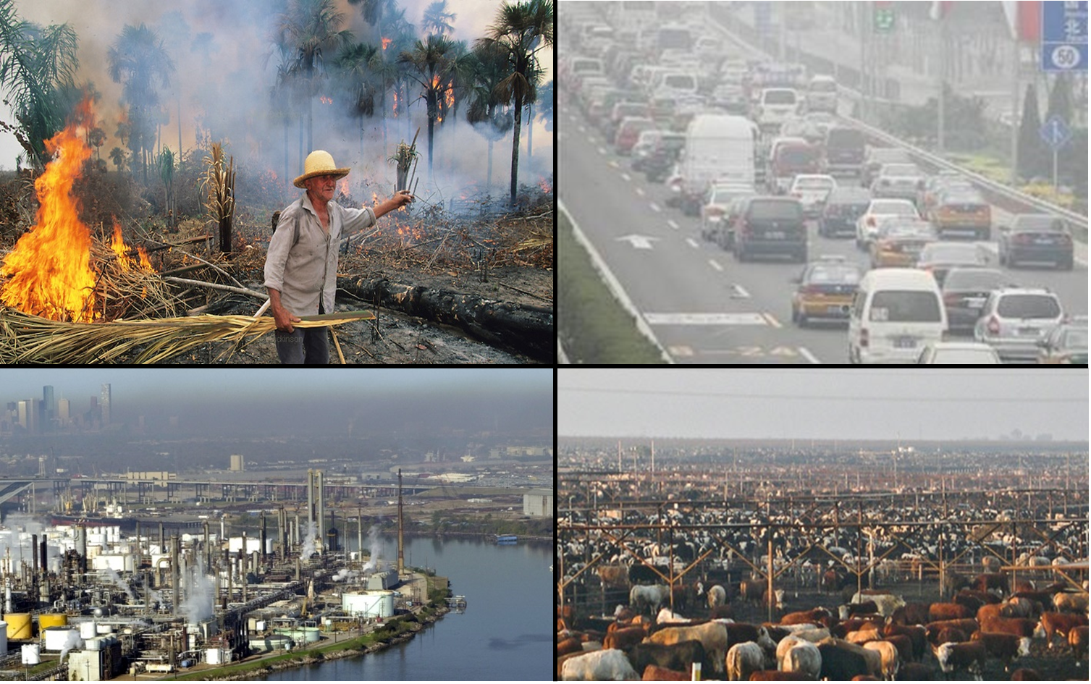
Why do we care? 0)Changing Atm Composition
Natural aerosol sources
Anthropogenic aerosol sources
Great Smoky Mountains

Slide 7
Why do we care? 0)Changing Atm Composition
Natural aerosol sources
Anthropogenic aerosol sources
Great Smoky Mountains
Secondary Aerosol
Mostly Primary Aerosol
Some Primary Aerosol

Slide 8
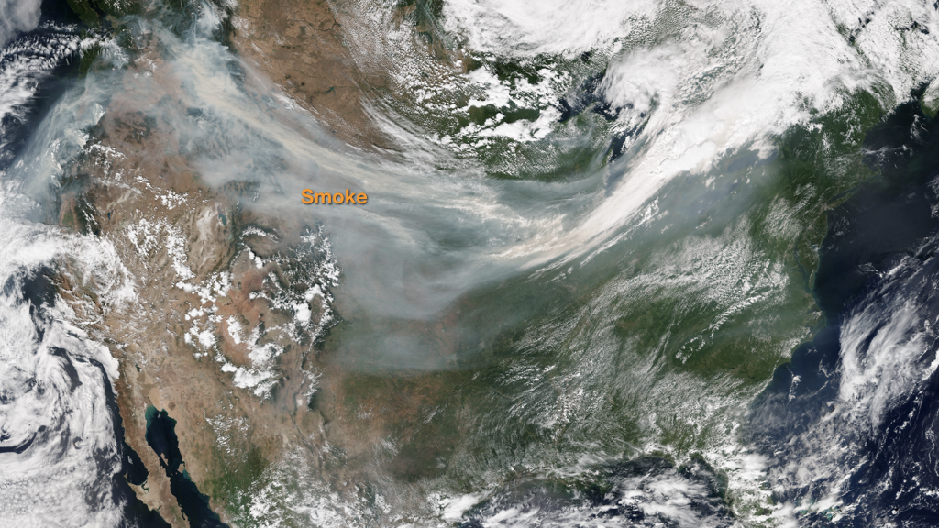
Transport of air pollution can be seen from Space!
In reality: Natural emissions mix with anthropogenic emissions.
Chemical composition and size of aerosol particles changes as they are transported in the atmosphere. Mix with clouds.

Slide 9
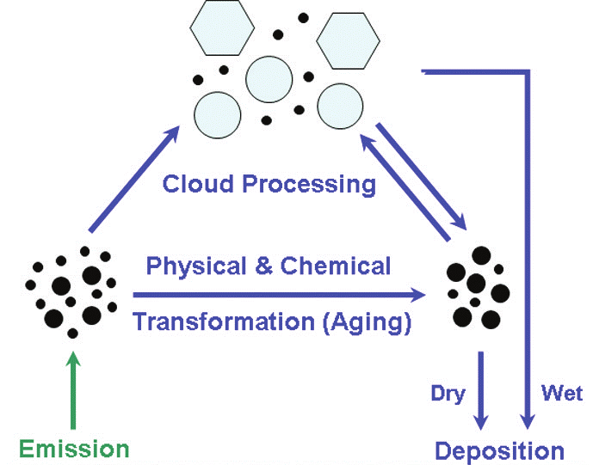
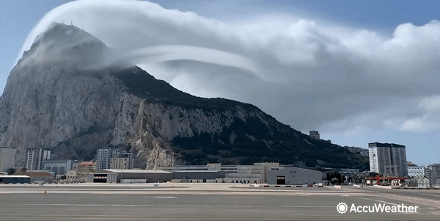
Why do we care? 1) Chemistry
(AQ/climate/ecosystems)
Cloud and Aerosol chemistry are inextricably linked.
Aerosols are continually cycling in and out of clouds.
Some chemical processes only occur in clouds (like sulfate formation)
Interstitial aerosol particles
Ice particle
Cloud droplet
Dry aerosol population after cloud processing and aging
Notes:
Observations obtained within updrafts in stratiform clouds , at the same altitude (corresponding to -8 oC)

Slide 10
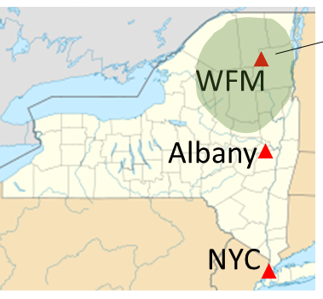
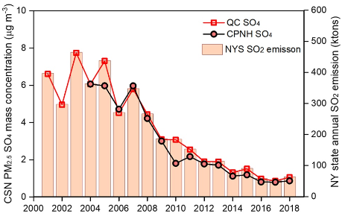
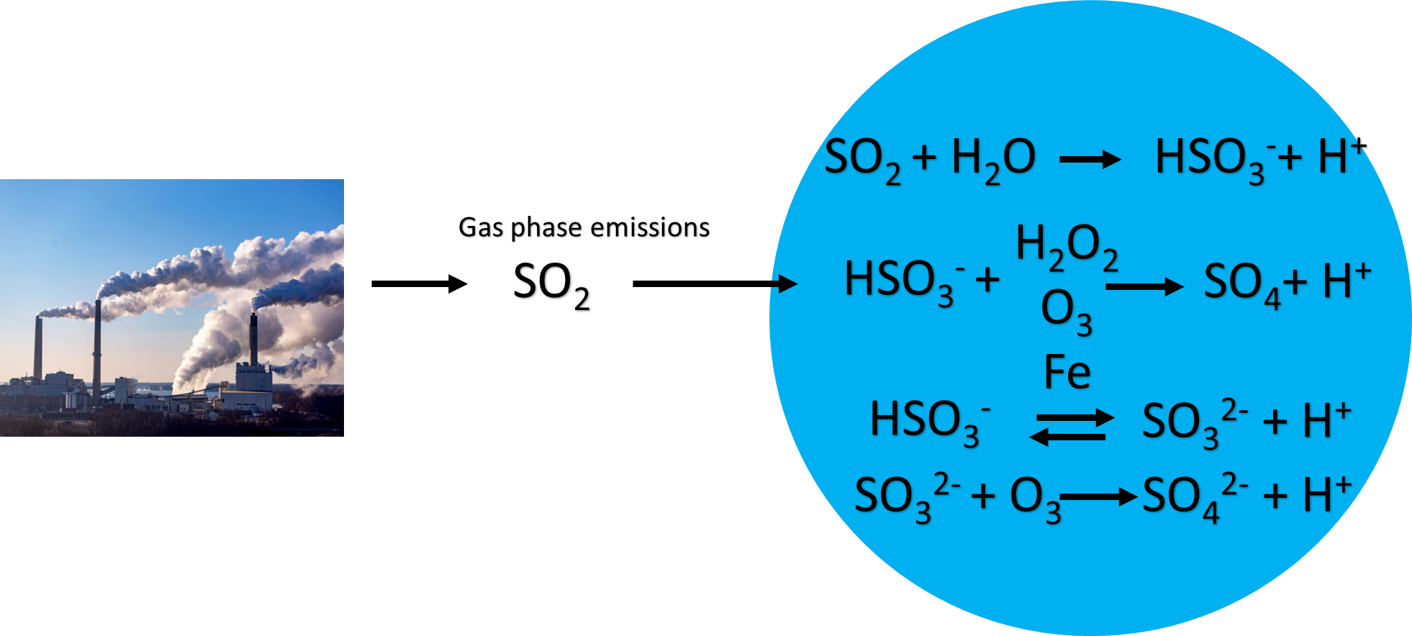
Real World Example.
Policies to reduce “acid rain” also improved AQ
Whiteface Mountain (WFM) as a Natural Laboratory to Study Chemical Processing of Aerosols by Clouds
Sulfate Aerosol concentrations in NY
Zhang et al., JGR, 2022
Long-Term Measurement Program at WFM focused on “acid rain”
Acid Rain resulted from production of sulfuric acid (H₂SO₄) within cloud droplets via aqueous oxidation of dissolved gas phase SO₂.
Discovery of this process led to emissions controls of SO₂.
Acid rain was dramatically reduced, as intended.
Air quality also improved due to reduced secondary production of sulfate (SO₄²⁻ ) aerosol.

Slide 11
Real World Example.
Policies to reduce “acid rain” also improved AQ
Whiteface Mountain (WFM) as a Natural Laboratory to Study Chemical Processing of Aerosols by Clouds
Annual Mean Cloud Water Concentrations
Organics are a dominant & growing component
Total Organic Carbon (TOC)
Sulfuric Acid concentrations substantially decreased

Slide 12
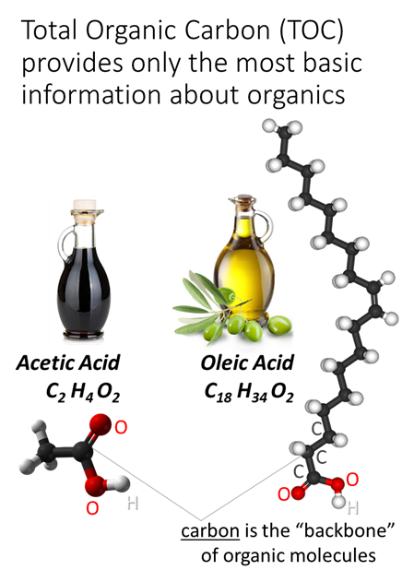
Real World Example.
Policies to reduce “acid rain” also improved AQ
Whiteface Mountain (WFM) as a Natural Laboratory to Study Chemical Processing of Aerosols by Clouds
Annual Mean Cloud Water Concentrations
Organics are a dominant & growing component
Total Organic Carbon (TOC)
Sulfuric Acid concentrations substantially decreased

Slide 13
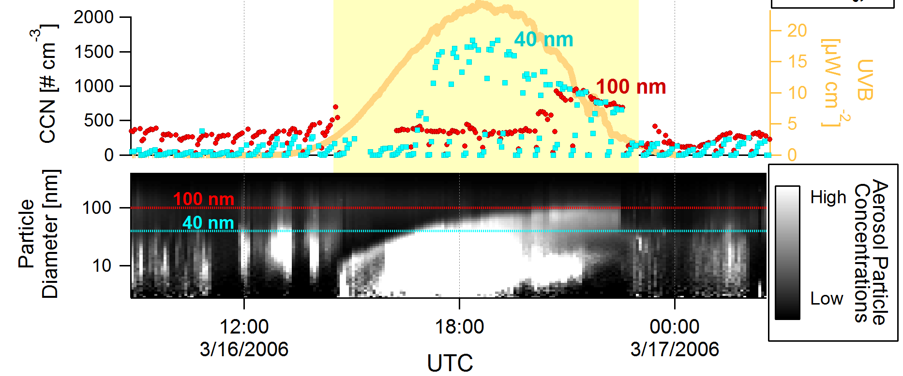
Real World Example.
New Particle Formation Impact on CCN concentrations
New particle formation events can dramatically increase CCN concentrations (resulting in more cloud droplets and reduced droplet size)
Lance et al., 2013. CCN Downwind of Mexico City: Mixing State and Chemical Aging.

Slide 14
Why do we care? 2) Albedo (climate)
All else equal: Clouds with a higher concentration of cloud droplets are brighter
Ship Tracks

Slide 15
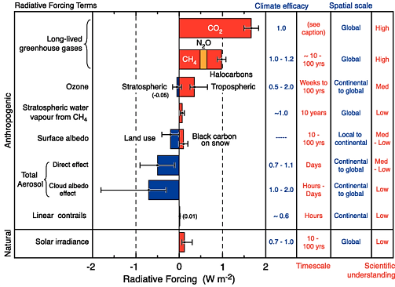
Why do we care? 2) Albedo (climate)
Summary from the IPCC report

Slide 16
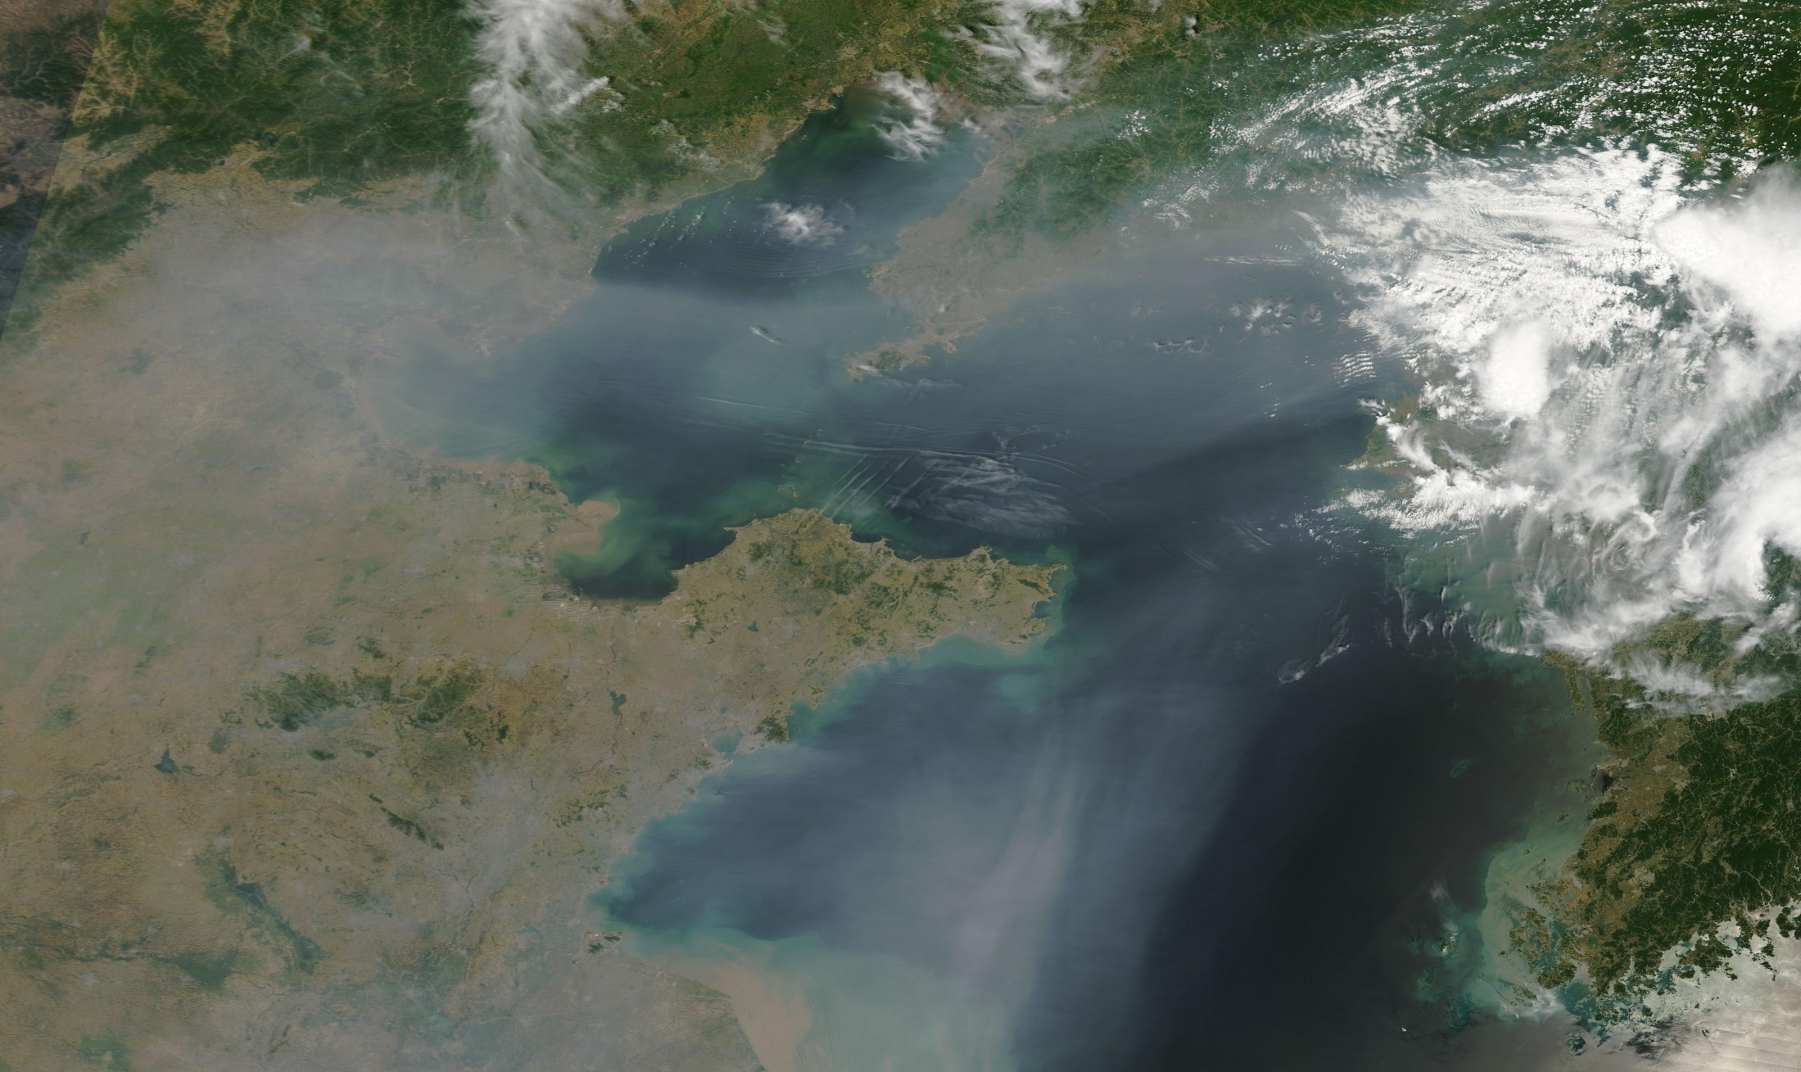
Why do we care? 3) Precipitation (climate)
Beijing
Pollution plumes with higher CCN concentrations can be regional
(not just point sources, like ship track example)

Slide 17
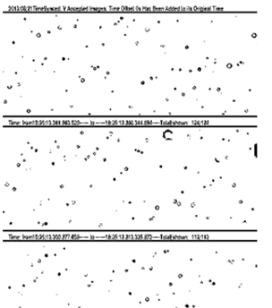
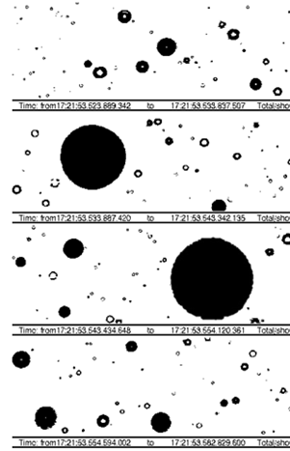
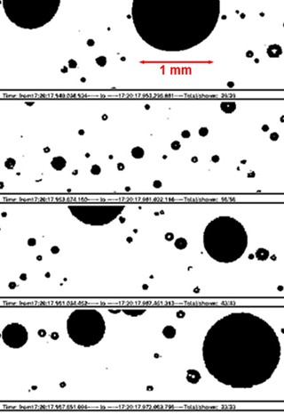
Why do we care? 3) Precipitation (climate)
A higher concentration of cloud droplets inhibits the collision coalescence process (since droplets are smaller, all else equal)
“Warm Cloud” Microphysics
Continental
Coastal
Maritime
Rain-
Drop
Cloud Droplets
1 mm
Notes:
Observations obtained within updrafts in stratiform clouds , at the same altitude (corresponding to -8 oC)

Slide 18
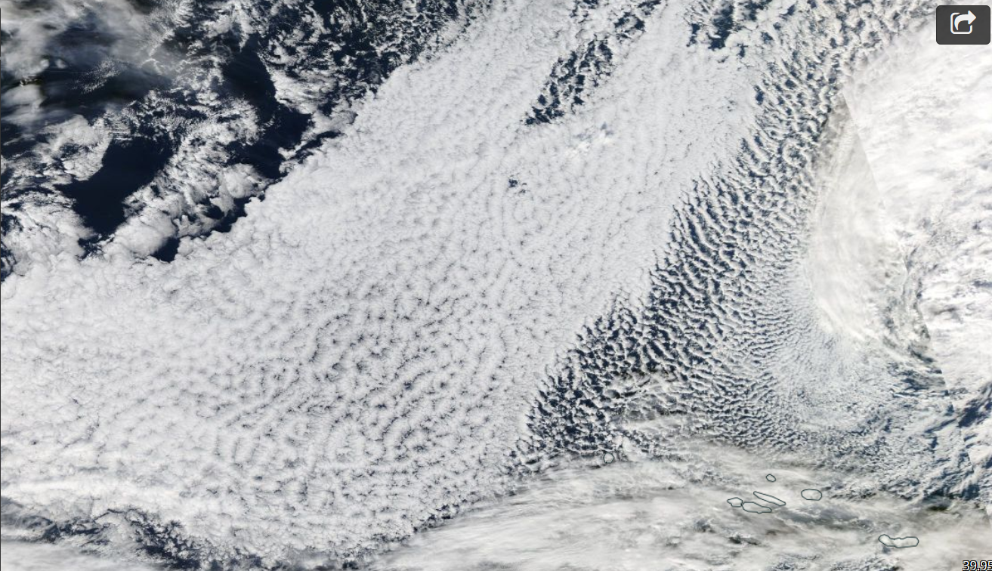
Real World Example.
CCN concentration impacts on cloud macrophysical structure
Macrostructure of marine stratiform cloud field is highly sensitive to precipitation.
NASA worldview

Slide 19
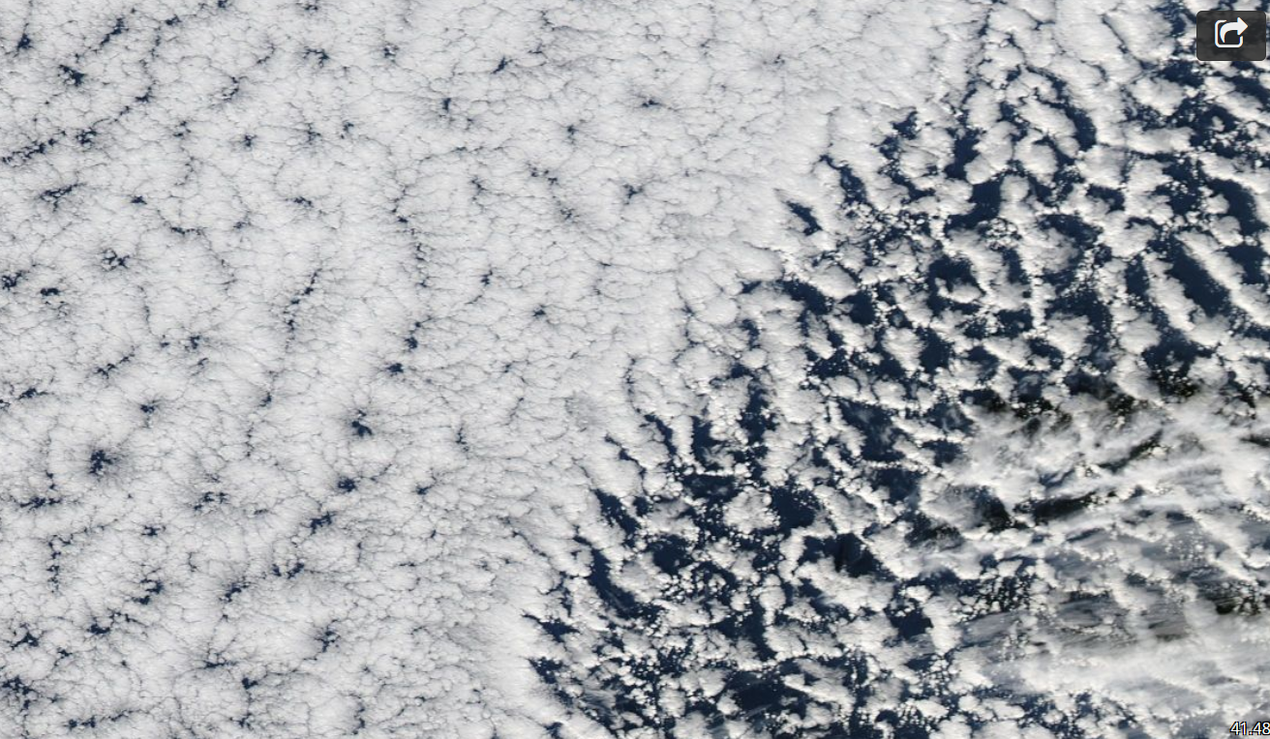
Real World Example.
CCN concentration impacts on cloud macrophysical structure
Macrostructure of marine stratiform cloud field is highly sensitive to precipitation. Precipitation occurs within open cells, not within closed cells.
Closed Cells
Open Cells
NASA worldview

Slide 20
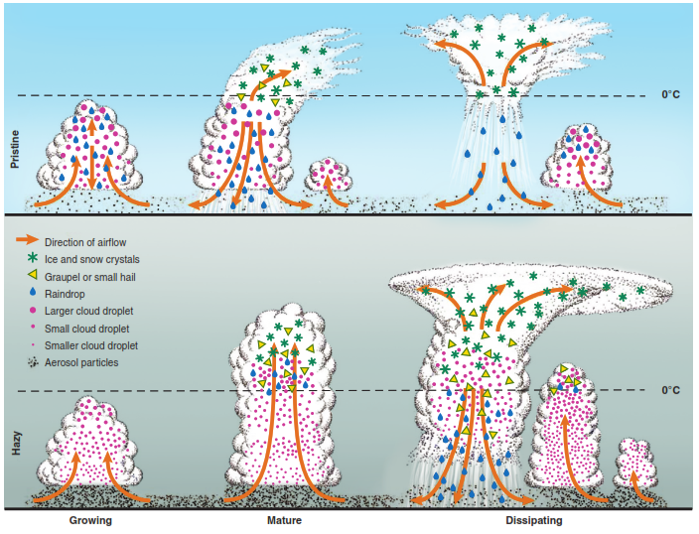
More Complex Real World Example.
CCN and IN impacts on cloud macrophysical structure
Cloud Invigoration
Rosenfeld et al., 2012
Notes:
Under other circumstances, inhibition of the warm rain process can lead to “cloud invigoration”.

Slide 21
Why do we care? 4) Feedbacks
lightning
Cloud macrophysical changes impacts vertical and long range transport of pollutants, lightning production, rainout
(feeding back to chemistry again)
rainout
Dust aerosol

Slide 22
Warm Cloud Microphysical Processes (ATM505 Module 4, 10 Apr 2023)
Overview
Where warm clouds exist in Earth’s atmosphere
Continuum between aerosol and cloud particles
Cloud Condensation Nuclei (CCN)
Why do we care?
Real World examples
Cloud droplet formation (nucleation)
Saturation vapor pressure of a droplet
Surface tension term + Solute term = Kohler theory
Dr. S. Lance

Slide 23
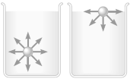
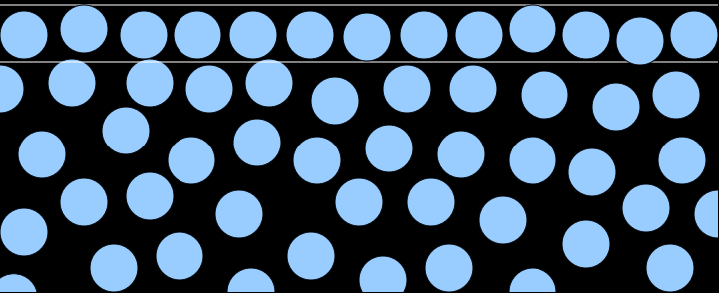
Cloud droplet formation Surface tension:
Molecules at the surface of a liquid are in a state of tension. Why?
vapor
H₂O molecules
liquid
Notes:
At the surface, pull on the molecules is laterally and downward; there is negligible intermolecular attractions above the molecules (from the medium above, such as air). SO, the net force on surface molecules is downward. The result of this downward force is that surface particles are pulled down until counter-balanced by the compression resistance of the liquid: Surface molecules are compressed more tightly together, forming a sort of skin on the surface, with less distance between them compared to the molecules below. Surface molecules also form a much smoother surface than one would expect from randomly moving molecules.

Slide 24
Cloud droplet formation Surface tension:
Molecules at the surface of a liquid are in a state of tension. Why?
vapor
H₂O molecules
Net downward force pulling molecules inward
liquid
Notes:
At the surface, pull on the molecules is laterally and downward; there is negligible intermolecular attractions above the molecules (from the medium above, such as air). SO, the net force on surface molecules is downward. The result of this downward force is that surface particles are pulled down until counter-balanced by the compression resistance of the liquid: Surface molecules are compressed more tightly together, forming a sort of skin on the surface, with less distance between them compared to the molecules below. Surface molecules also form a much smoother surface than one would expect from randomly moving molecules.

Slide 25
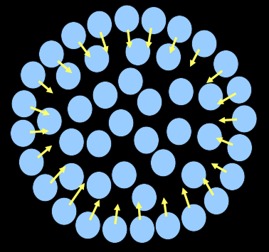
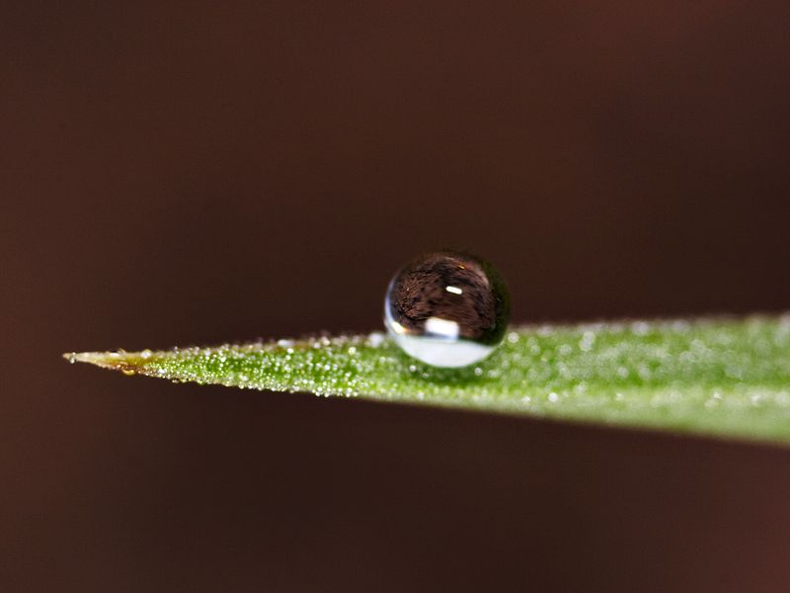
Cloud droplet formation Surface tension:
For a small amount of liquid freely suspended, all molecules are pulled inward, creating a droplet.

Slide 26
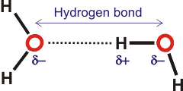
Cloud droplet formation Surface tension:
For a small amount of liquid freely suspended, all molecules are pulled inward, creating a droplet.
Water has a particularly strong “cohesive force” pulling molecules towards one another within the liquid due to Hydrogen bonding.

Slide 27
Cloud droplet formation Surface tension:
For a small amount of liquid freely suspended, all molecules are pulled inward, creating a droplet.
Newton’s Law: the inward force must be balanced, otherwise the surface would accelerate inward.
This balance is attained by an increase in pressure within the liquid.

Slide 28
Cloud droplet formation (Aside on units)
Pressure = Force/Area →N/m²
Force = Mass*Acceleration → kg m/s²
Pressure = kg m/s² → kg
m² m s²
Energy = mc² → kg (m/s)² = kg m²/s² = Nm
Energy = Pressure*Volume

Slide 29
Cloud droplet formation Mechanical equilibrium in droplets:
If the droplet is not to change size (dr/dt = 0), or is in equilibrium, forces on the droplet must balance.
Two ways to do this:
1) Hard way: integrate the tension force along the droplet surface and balance w/ the pressure force integrated over the droplet surface area.
2) Easy way: minimize the change in mechanical energy
(i) Net energy associated w/ pressures pushing on droplet:
E_{p} = (P_{L}-P_{V})V_{L} V_{L}=4/3πr³
P_{L} = Pressure of liquid pushing outward
P_{V} = Pressure of vapor pushing inward
*Recall that Pressure = Energy/Volume

Slide 30
Cloud droplet formation Mechanical equilibrium in droplets:
If the droplet is not to change size (dr/dt = 0), or is in equilibrium, forces on the droplet must balance.
Two ways to do this:
1) Hard way: integrate the tension force along the droplet surface and balance w/ the pressure force integrated over the droplet surface area.
2) Easy way: minimize the change in mechanical energy
(ii) Net energy associated w/ surface tension force:
E_{s} = -σA_{L} σ = Force/Length (N/m, D/cm)
A_{L} = 4πr² σ = Energy/Area (J/m²)
*negative because it takes energy to expand the surface against surface tension

Slide 31
Cloud droplet formation Mechanical equilibrium in droplets:
If the droplet is not to change size (dr/dt = 0), or is in equilibrium, forces on the droplet must balance.
Two ways to do this:
1) Hard way: integrate the tension force along the droplet surface and balance w/ the pressure force integrated over the droplet surface area.
2) Easy way: minimize the change in mechanical energy
(iii) Solve for:
d(E_{p}+E_{s})/dt = 0 = [(P_{L}-P_{V})4πr² – 8πrσ] dr/dt
(P_{L}-P_{V})r² = 2rσ
P_{L} = P_{V} + 2σ ← “Laplace Equation”
r

Slide 32
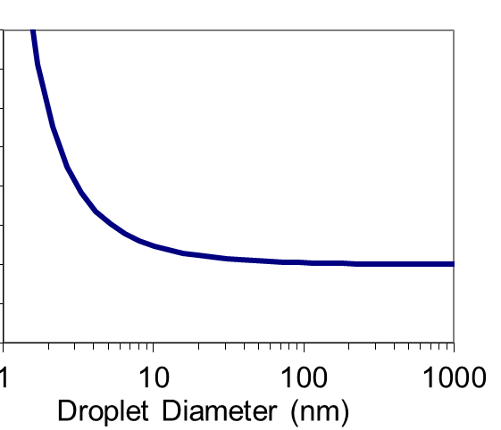
Cloud droplet formation Mechanical equilibrium in droplets:
P_{L} = P_{V} + 2σ ← “Laplace Equation”
r
P_{L}
Pressure rises in droplet as droplet size decreases. Why?
As r decreases, the relative amount of surface area to volume increases:
A = 4πr² = 3
V 4/3πr³ r
Infinitely small drop
Flat surface
P_{V}

Slide 33
Cloud droplet formation Mechanical equilibrium in droplets:
P_{L} = P_{V} + 2σ ← “Laplace Equation”
r
P_{L}
Pressure rises in droplet as droplet size decreases. Why?
Fewer molecules interior to the droplet to balance the surface tension force as droplets shrink.
Internal pressure must rise to balance the surface tension force.
Infinitely small drop
Flat surface
P_{V}

Slide 34
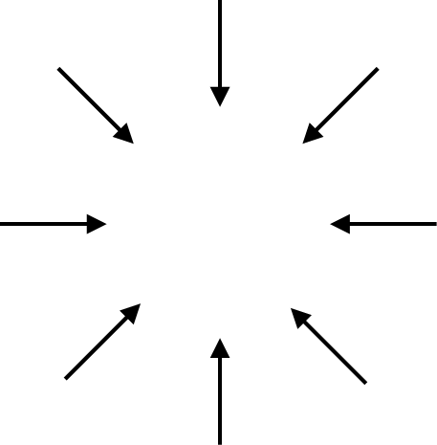
Cloud droplet formation Mechanical equilibrium in droplets:
Large Droplet
Small Droplet
P_{L}
P_{L}
Lots of H₂O internal to surface → large # of molecules to balance inward pull of surface tension → P_{L} low
Few H₂O internal to surface → Few molecules to balance inward pull of surface tension → P_{L} large

Slide 35
Cloud droplet formation Mechanical equilibrium in droplets:
So, we must be able to relate the # of molecules on the droplet surface and those internal:
N_{L} = 4/3πr³n_{L} Total # molecules in droplet
N_{S} = 4πr²L_{b}n_{L} Total # molecules in liquid where surface layer is thickness of one H-bond, L_{b}
N_{s} = 3L_{b} # molecules in surface layer
N_{L} r # molecules in droplet
Liquid molar volume/density
r
$$v_{L}=1/n_{L}$$
V=4/3πr³
$$\frac{mol}{m^{3}}$$
1
droplet
$$\frac{m^{3}}{mol}$$

Slide 36
Cloud droplet formation Mechanical equilibrium in droplets:
So, we must be able to relate the # of molecules on the droplet surface and those internal:
N_{L} = 4/3πr³n_{L} Total # molecules in droplet
N_{S} = 4πr²L_{b}n_{L} Total # molecules in liquid where surface layer is thickness of one H-bond, L_{b}
N_{s} = 3L_{b} # molecules in surface layer
N_{L} r # molecules in droplet
Relative # in surface rises as droplet size falls → surface tension force balanced by fewer molecules → pressure must rise
r
V=4/3πr³
1
droplet

Slide 37
Cloud droplet formation Saturation Vapor Pressure of a droplet:
Higher pressure inside droplets
If molecules are pushed together → they repel!
→ this is pressure!

Slide 38
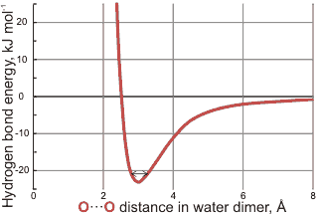
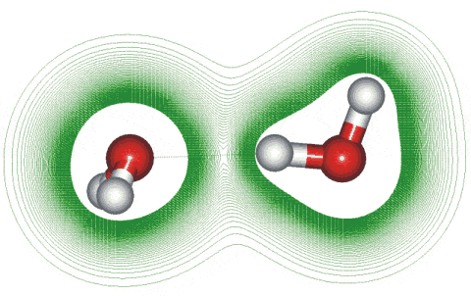
Cloud droplet formation Saturation Vapor Pressure of a droplet:
Higher pressure inside droplets
If molecules are pushed together → they repel!
→ this is pressure!
→ pressure is a force and so requires elevated PE
Bond energy
ε_{b}
Martin Chaplin, London S.Bank Univ.

Slide 39
Cloud droplet formation Saturation Vapor Pressure of a droplet:
Higher pressure inside droplets
If molecules are pushed together → they repel!
Molecules pushed together
Bond energy under pressure
Bond energy
ε_{b}
ε’_{b}
← Push together

Slide 40
Cloud droplet formation Saturation Vapor Pressure of a droplet:
ε’_{b} < ε_{b}
Bond energy is reduced for molecules under pressure.
→ so it becomes easier to remove them!
Molecules pushed together
Bond energy under pressure
Bond energy
ε_{b}
ε’_{b}
← Push together

Slide 41
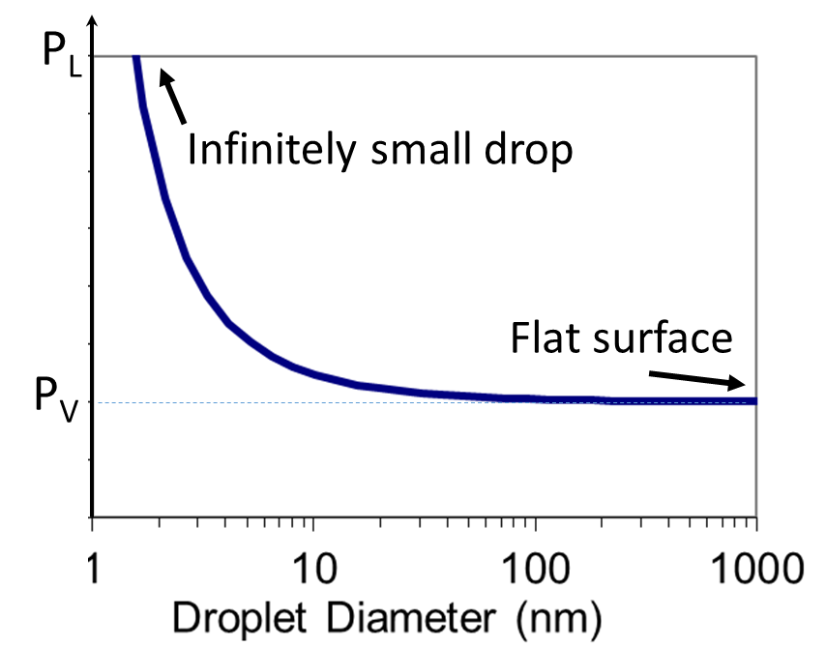
Cloud droplet formation Surface tension impact on bond energies + molecular escape:
Two effects that curvature has on equilibrium vapor pressure:
1) Increase in P_{L}
P_{L} inside drop rises
Bond energy decreases
Easier to evaporate smaller droplets
Bond energy under pressure
ε’_{b}
ε_{b}
← Push together

Slide 42
Cloud droplet formation Surface tension impact on bond energies + molecular escape:
Two effects that curvature has on equilibrium vapor pressure:
2) Loss of nearest neighbor
As droplet gets really small, neighbor molecules gone
Surface energy starts to depend on radius (constant for >10μm)
Lose attractive forces → easier to remove surface molecules from smaller droplets
Big droplet
Gone for small droplets
Small droplet

Slide 43
Cloud droplet formation Saturation vapor pressure of a droplet:
Fundamental definition of latent heating (enthalpy of vaporization):
The energy that must be added to transform a unit mass of liquid to vapor
$$L_{v}=∆u+P_{v}v_{v}−P_{L}v_{L}$$
For a bulk liquid (flat surface):
Molar volume
Energy to break bonds in a liquid
$$P_{v}=P_{L}$$
$$\left(\frac{m^{3}}{mole}\right)$$
$P_{L}\sim P_{v}+$ $2σ/r$
$$L_{v}\sim ∆u+P_{v}(v_{v}−v_{L})$$
← For a flat surface
$L_{v}$ ~ 44 kJ/mol for water @ 20ºC
Note that the molecules in liquid water are held together by relatively strong hydrogen bonds, and water’s enthalpy of vaporization (~41 kJ/mol @ 100ºC) is more than five times the energy required to heat the same quantity of water from 0 °C to 100 °C (C_{p} = 75.3 J mol⁻¹ K⁻¹).

Slide 44
Cloud droplet formation Saturation vapor pressure of a droplet:
Fundamental definition of latent heating (enthalpy of vaporization):
The energy that must be added to transform a unit mass of liquid to vapor
$$L_{v}=∆u+P_{v}v_{v}−P_{L}v_{L}$$
Enthalpy of vaporization for a curved droplet:
$$L_{vc}=∆u+P_{v}v_{v}−{(P}_{v}+2σ/r{)v}_{L}$$
$L_{vc}=∆u+P_{v}{(v}_{v}−v_{L})−(2σ/r$)$v_{L}$
Molar volume
$P_{L}\sim P_{v}+$ $2σ/r$
$$=L_{v}$$
$$v_{L}=1/n_{L}$$
for flat surface
$$\frac{mol}{m^{3}}$$
Big droplet
$$\frac{m^{3}}{mol}$$
$L_{vc}<L_{v}$
Easier to remove molecules!
$L_{vc}$ decreases as r decreases
Gone for small droplets
Small droplet

Slide 45
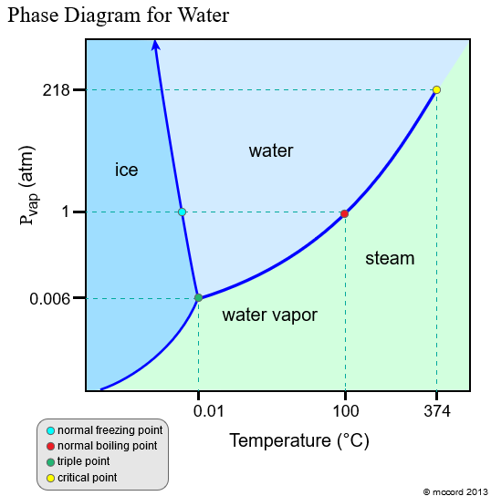
Cloud droplet formation Saturation vapor pressure of a droplet:
Equilibrium vapor pressure (for a flat liquid surface):
$$\frac{dP}{dT}=\frac{L_{v}}{T∆v}$$
Clausius-Clapeyron Equation
Phase Diagram for H₂O:
$$∆v=\left(v_{v}−v_{L}\right)\sim v_{v}$$
$$v_{v}=RT/P$$
← Ideal gas law
$$\int{\frac{dP}{P}}=\frac{L_{v}}{R}\int{\frac{dT}{T^{2}}}$$
Pressure (atm)
Clausius-Clapeyron Equation:
$$\ln\left(P_{2}/P_{1}\right)=−\frac{L_{v}}{R}\left[\frac{1}{T_{2}}−\frac{1}{T_{1}}\right]$$
Gas constant:
R=8.314 J/mol K
Temperature (ºC)

Slide 46
Cloud droplet formation Saturation vapor pressure of a droplet:
Equilibrium vapor pressure (for a flat liquid surface):
$$e_{sat}(T_{2})=e_{sat}(T_{1})exp\left(−\frac{L_{v}}{R}\left[\frac{1}{T_{2}}−\frac{1}{T_{1}}\right] \right)$$
For a curved surface:
At Equilibrium
(or Saturation):
Rate of evaporation = Rate of condensation
$$e_{sat,c}(T)∝exp\left[\frac{−L_{vc}}{RT}\right]=exp\left[\frac{−\left\{L_{v}−\left(\frac{2σ}{rn_{L}}\right)\right\}}{RT}\right]$$
$$e_{sat,c}(T,r)∝exp\left[\frac{−L_{v}}{RT}\right]exp\left[\frac{2σ}{rn_{L}RT}\right]$$
Note that:
exp[𝑎+𝑏]=exp[a]exp[b]
Equilibrium vapor density over a flat surface, $e_{sat}(T)$
Impact on vapor pressure from droplet curvature and $PL$ increase

Slide 47
Cloud droplet formation Saturation vapor pressure of a droplet:
Equilibrium vapor pressure (for a flat liquid surface):
$$e_{sat}(T_{2})=e_{sat}(T_{1})exp\left(−\frac{L_{v}}{R}\left[\frac{1}{T_{2}}−\frac{1}{T_{1}}\right] \right)$$
For a curved surface (no solute):
At Equilibrium
(or Saturation):
Rate of evaporation = Rate of condensation
$$\ln\left(\frac{e_{sat,c}(T,r)}{e_{sat}(T)}\right)\sim \frac{2σ}{rn_{L}RT}=ln⁡(S_{eq})$$
← “Kelvin Equation”
H₂O Saturated vapor pressure over a curved surface
Equilibrium Saturation ratio for a droplet:
$S_{eq}$ > (RH/100%)
Droplets require super-saturation to prevent evaporation
As $r→∞$ (>10μm): $e_{sat,c}\left(T,r\right)$ ${→e}_{sat}(T)$
As $r→0$: $e_{sat,c}\left(T,r\right)→∞$
H₂O Saturated vapor pressure over a flat surface

Slide 48
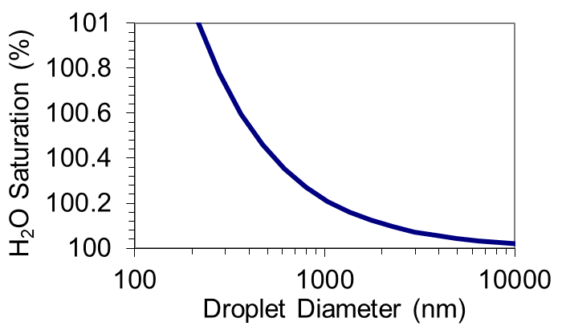
Cloud droplet formation Saturation vapor pressure of a droplet:
Equilibrium vapor pressure (for a flat liquid surface):
$$e_{sat}(T_{2})=e_{sat}(T_{1})exp\left(−\frac{L_{v}}{R}\left[\frac{1}{T_{2}}−\frac{1}{T_{1}}\right] \right)$$
Plot of the “Kelvin Equation”
atmospherically relevant range of relative humidities (i.e. < 101% RH)
For a curved surface (no solute):
$$\ln\left(\frac{e_{sat,c}(T,r)}{e_{sat}(T)}\right)\sim \frac{2σ}{rn_{L}RT}=ln⁡(S_{eq})$$
H₂O Saturated vapor pressure over a curved surface
10μm
Equilibrium Saturation ratio for a droplet:
$S_{eq}$ > (RH/100%)
Droplets require super-saturation to prevent evaporation
As $r→∞$ (>10μm): $e_{sat,c}\left(T,r\right)$ ${→e}_{sat}(T)$
As $r→0$: $e_{sat,c}\left(T,r\right)→∞$
H₂O Saturated vapor pressure over a flat surface

Slide 49
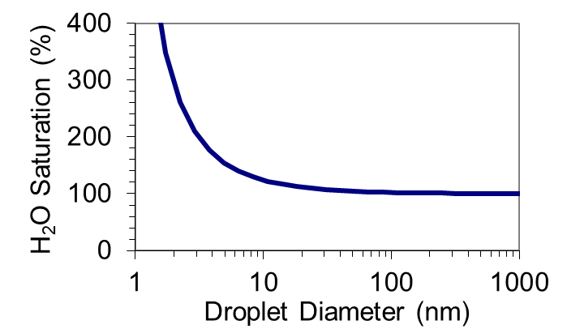
Cloud droplet formation Saturation vapor pressure of a droplet:
Equilibrium vapor pressure (for a flat liquid surface):
$$e_{sat}(T_{2})=e_{sat}(T_{1})exp\left(−\frac{L_{v}}{R}\left[\frac{1}{T_{2}}−\frac{1}{T_{1}}\right] \right)$$
Plot of the “Kelvin Equation”
Homogeneous nucleation (without pre-existing aerosol) requires more than 400% RH
For a curved surface (no solute):
$$\ln\left(\frac{e_{sat,c}(T,r)}{e_{sat}(T)}\right)\sim \frac{2σ}{rn_{L}RT}=ln⁡(S_{eq})$$
H₂O Saturated vapor pressure over a curved surface
1μm
Equilibrium Saturation ratio for a droplet:
$S_{eq}$ > (RH/100%)
Droplets require super-saturation to prevent evaporation
As $r→∞$ (>10μm): $e_{sat,c}\left(T,r\right)$ ${→e}_{sat}(T)$
As $r→0$: $e_{sat,c}\left(T,r\right)→∞$
H₂O Saturated vapor pressure over a flat surface

Slide 50
Cloud droplet formation Saturation vapor pressure of a solution droplet:
${e_{sat,c}\left(T,r\right)>e}_{sat}(T)$
Homogeneous nucleation of pure water droplets requires supersaturation (i.e. ambient vapor pressures, ${e_{amb}≫e}_{sat}(T)$, i.e. RH >> 100%) to bring about condensation and prevent evaporation
But we know that RH rarely exceeds 101% in the atmosphere.
How can droplets form under these conditions?
Plot of the “Kelvin Equation”
Equilibrium vapor pressure of a pure water droplet

Slide 51
Cloud droplet formation Saturation vapor pressure of a solution droplet:
${e_{sat,c}\left(T,r\right)>e}_{sat}(T)$
Homogeneous nucleation of pure water droplets requires supersaturation (i.e. ambient vapor pressures, ${e_{amb}≫e}_{sat}(T)$, i.e. RH >> 100%) to bring about condensation and prevent evaporation
But we know that RH rarely exceeds 101% in the atmosphere.
How can droplets form under these conditions?
Plot of the “Kelvin Equation”
Equilibrium vapor pressure of a pure water droplet
Droplets form on pre-existing aerosols, i.e. Cloud Condensation Nuclei (CCN), which provide:
pre-existing surface
soluble material

Slide 52
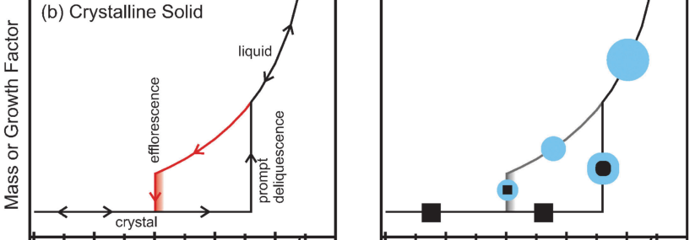
Cloud droplet formation Saturation vapor pressure of a solution droplet:
Deliquescence: the process by which a substance absorbs moisture from the atmosphere and begins to dissolve the substance, forming a solution
Efflorescence: the process by which a supersaturated solution crystalizes, resulting in solvent evaporation
Condensation
of H₂O vapor
Particle Growth Factor
Aqueous solution
from Koop et al., Phys. Chem. Chem. Phys., 2011

