Slide 1
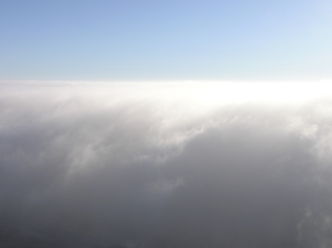
Cloud Microphysics (ATM505 Module 4, 12 Apr 2023)
Cloud droplet formation (nucleation)
Saturation vapor pressure of a droplet
Surface tension term + Solute term = Kohler theory
Droplet growth by condensation
Dr. S. Lance

Slide 2
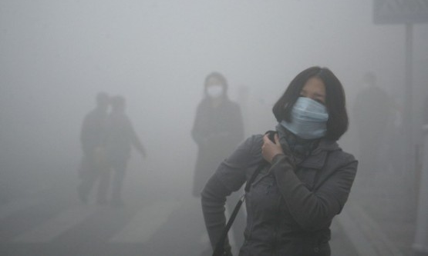
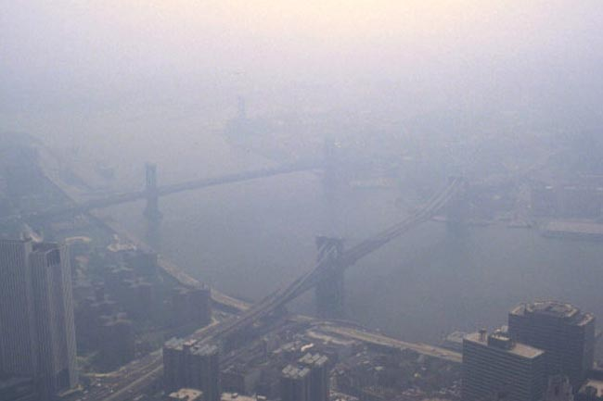
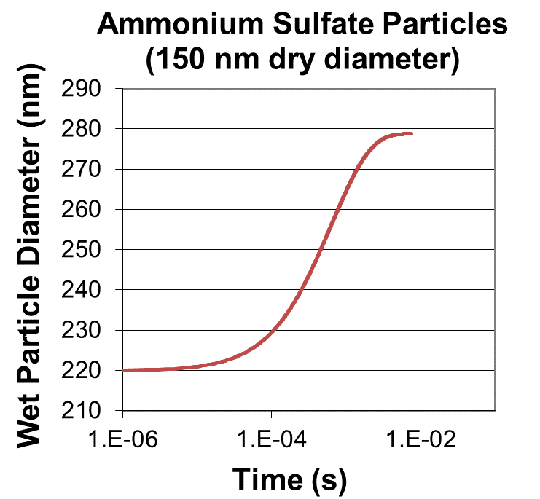
Cloud droplet formation Saturation vapor pressure of a solution droplet:
Deliquescence point of various atmospheric salts
(NH₄)₂SO₄: 80% RH
NaCl: 75% RH
NH₄NO₃: 62% RH
Efflorescence point of various atmospheric salts
(NH₄)₂SO₄: 36% RH
NaCl: 44% RH
NH₄NO₃: 0% RH
at 90% RH
Notes:
No clearly defined boundary – gives a visual clue whether it is a cloud or haze

Slide 3
Cloud droplet formation Saturation vapor pressure of a solution droplet:
Deliquescence point of various atmospheric salts
(NH₄)₂SO₄: 80% RH
NaCl: 75% RH
NH₄NO₃: 62% RH
Deliquesced Ammonium Sulfate aerosols reach equilibrium diameter (almost 2x dry particle diameter, at 90% RH) within ~1ms
Condensed water increases particle mass by substantially more than the initial particle mass, because $mass∝{(diameter)}^{3}$
These haze particles are >75% water by mass (and >95% water by moles) at 90%RH
at 90% RH
Notes:
No clearly defined boundary – gives a visual clue whether it is a cloud or haze

Slide 4
Cloud droplet formation Saturation vapor pressure of a solution droplet:
Deliquescence point of various atmospheric salts
(NH₄)₂SO₄: 80% RH
NaCl: 75% RH
NH₄NO₃: 62% RH
Deliquesced Ammonium Sulfate aerosols reach equilibrium diameter (almost 2x dry particle diameter, at 90% RH) within ~1ms
Condensed water increases particle mass by substantially more than the initial particle mass, because $mass∝{(diameter)}^{3}$
Even at only 60% RH with real atmospheric aerosols, water content can be ~30% of wet aerosol mass (Tsai and Kuo, 2005)
at 90% RH
Notes:
No clearly defined boundary – gives a visual clue whether it is a cloud or haze

Slide 5
Cloud droplet formation Saturation vapor pressure of a solution droplet:
Pop Quiz (just for fun)
What do you expect the dominant chemical component of ambient aerosols to be (on a mole basis, and sometimes even on a mass basis)?
(sort of a trick question)
Notes:
No clearly defined boundary – gives a visual clue whether it is a cloud or haze

Slide 6
Cloud droplet formation Saturation vapor pressure of a solution droplet:
Pop Quiz (just for fun)
What do you expect the dominant chemical component of ambient aerosols to be (on a mole basis, and sometimes even on a mass basis)?
Obviously the answer is: Water! That’s what cloud microphysics is all about. It’s worth noting that water is found abundantly within particles, even when not in-cloud.
Later you should learn what it means, technically, to be “in-cloud”.
Notes:
No clearly defined boundary – gives a visual clue whether it is a cloud or haze

Slide 7
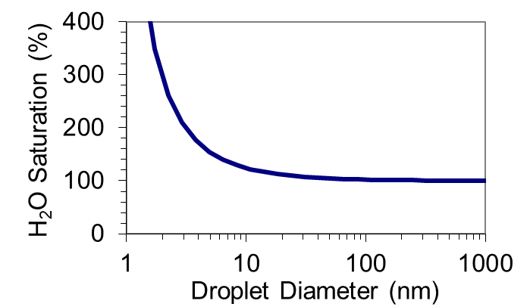
Cloud droplet formation Saturation vapor pressure of a droplet:
Equilibrium vapor pressure (for a flat liquid surface):
$$e_{sat}(T_{2})=e_{sat}(T_{1})exp\left(−\frac{L_{v}}{R}\left[\frac{1}{T_{2}}−\frac{1}{T_{1}}\right] \right)$$
Plot of the “Kelvin Equation”
Homogeneous nucleation (without pre-existing aerosol) requires more than 400% RH
For a curved surface (no solute):
$$\ln\left(\frac{e_{sat,c}(T,r)}{e_{sat}(T)}\right)\sim \frac{2σ}{rn_{L}RT}=ln⁡(S_{eq})$$
H₂O Saturated vapor pressure over a curved surface
1μm
Equilibrium Saturation ratio for a droplet:
$S_{eq}$ > (RH/100%)
Droplets require super-saturation to prevent evaporation
As $r→∞$ (>10μm): $e_{sat,c}\left(T,r\right)$ ${→e}_{sat}(T)$
As $r→0$: $e_{sat,c}\left(T,r\right)→∞$
H₂O Saturated vapor pressure over a flat surface

Slide 8
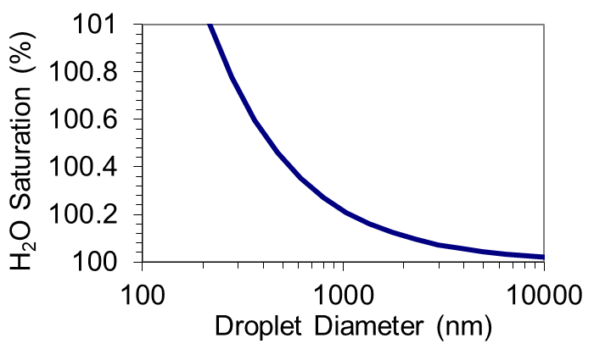
Cloud droplet formation Saturation vapor pressure of a droplet:
${e_{sat,c}\left(T,r\right)>e}_{sat}(T)$
Homogeneous nucleation of pure water droplets requires supersaturation (i.e. ambient vapor pressures, ${e_{amb}≫e}_{sat}(T)$, i.e. RH >> 100%) to bring about condensation and prevent evaporation
But we know that RH rarely exceeds 101% in the atmosphere.
Plot of the “Kelvin Equation”
Equilibrium vapor pressure of a pure water droplet
Let’s say we have a pure water droplet “at equilibrium” ($e_{sat,c}\left(T,r\right)$= $e_{amb}$)
At Equilibrium
(or Saturation):
Rate of evaporation = Rate of condensation
Ambient s (0.2%)

Slide 9
Cloud droplet formation Saturation vapor pressure of a droplet:
${e_{sat,c}\left(T,r\right)>e}_{sat}(T)$
Homogeneous nucleation of pure water droplets requires supersaturation (i.e. ambient vapor pressures, ${e_{amb}≫e}_{sat}(T)$, i.e. RH >> 100%) to bring about condensation and prevent evaporation
But we know that RH rarely exceeds 101% in the atmosphere.
Plot of the “Kelvin Equation”
Equilibrium vapor pressure of a pure water droplet
What happens if droplet grows just a little? (i.e. more H₂O molecules condensing onto the droplet than H₂O molecules evaporating from the droplet for an instant)
At Equilibrium
(or Saturation):
Rate of evaporation = Rate of condensation
Ambient s (0.2%)

Slide 10
Cloud droplet formation Saturation vapor pressure of a droplet:
${e_{sat,c}\left(T,r\right)>e}_{sat}(T)$
Homogeneous nucleation of pure water droplets requires supersaturation (i.e. ambient vapor pressures, ${e_{amb}≫e}_{sat}(T)$, i.e. RH >> 100%) to bring about condensation and prevent evaporation
But we know that RH rarely exceeds 101% in the atmosphere.
Plot of the “Kelvin Equation”
Equilibrium vapor pressure of a pure water droplet
If droplet grows just a little, it will Keep Growing
$e_{amb}$> $e_{sat,c}\left(T,r\right)$
condensation
ΔS= +0.15%
Ambient s (0.2%)
Droplet
equil. S (0.05%)
At Equilibrium
(or Saturation):
Rate of evaporation = Rate of condensation

Slide 11
Cloud droplet formation Saturation vapor pressure of a droplet:
${e_{sat,c}\left(T,r\right)>e}_{sat}(T)$
Homogeneous nucleation of pure water droplets requires supersaturation (i.e. ambient vapor pressures, ${e_{amb}≫e}_{sat}(T)$, i.e. RH >> 100%) to bring about condensation and prevent evaporation
But we know that RH rarely exceeds 101% in the atmosphere.
Plot of the “Kelvin Equation”
Equilibrium vapor pressure of a pure water droplet
Droplet
equil. s (0.6%)
If droplet shrinks just a little, it will Keep Shrinking
$e_{amb}$< $e_{sat,c}\left(T,r\right)$
evaporation
ΔS= -0.4%
Ambient s (0.2%)

Slide 12
Cloud droplet formation Saturation vapor pressure of a droplet:
${e_{sat,c}\left(T,r\right)>e}_{sat}(T)$
Homogeneous nucleation of pure water droplets requires supersaturation (i.e. ambient vapor pressures, ${e_{amb}≫e}_{sat}(T)$, i.e. RH >> 100%) to bring about condensation and prevent evaporation
But we know that RH rarely exceeds 101% in the atmosphere.
Plot of the “Kelvin Equation”
Equilibrium vapor pressure of a pure water droplet
If droplet shrinks just a little, it will Keep Shrinking
Unstable equilibrium
If droplet grows just a little, it will Keep Growing
ΔS= -0.4%
ΔS= +0.15%
Ambient s (0.2%)

Slide 13
Cloud droplet formation Saturation vapor pressure of a solution droplet:
Recall that for pure H₂O:
${e_{sat,c}(T,r)=e}_{sat}\left(T\right)exp\left[\frac{2σ}{rn_{L}RT}\right]$
For liquid w/ solute:
${e_{soln}(T,x_{s})=(1−x_{s})e}_{sat}\left(T\right)$
➔ ${e_{soln}(T,x_{s})\sim \left[exp⁡(−x_{s})\right]e}_{sat}\left(T\right)$
As long as the solute does not affect the surface tension, then can simply combine these terms to get equation for vapor pressure over a solution droplet:
${e_{soln}(T,{r,x}_{s})\sim e}_{sat}\left(T\right)exp\left[\frac{2σ}{rn_{L}RT}\right]exp\left[−x_{s}\right]$
${e_{soln}(T,{r,x}_{s})\sim e}_{sat}\left(T\right)exp\left[\frac{2σ}{rn_{L}RT}−x_{s}\right]$
Taylor Series Expansion:
exp[x]$\sim$1+x
Solute mole fraction
⬅ “Köhler equation”
“Kelvin Term”
“Solute Term”
Again, note that:
exp[𝑎+𝑏]=exp[a]exp[b]

Slide 14
Cloud droplet formation Saturation vapor pressure of a solution droplet:
Rewriting:
$$x_{s}=\frac{moles solute ions}{moles H_{2}O +moles solute ions}=\frac{iN_{s}}{{N_{L}+iN}_{s}}$$
For a dilute solution ($N_{L}≫N_{s}): x_{s}\sim \frac{iN_{s}}{N_{L}}$
$$N_{L}=\left({\frac{π}{6}D}_{p}^{3}\right)\frac{ρ_{H2O}}{M_{H2O}}$$
$$N_{s}=\left({\frac{π}{6}d}_{p}^{3}\right)\frac{ρ_{s}}{M_{s}}$$
$$x_{s}\sim \frac{iN_{s}}{N_{L}}=\frac{iρ_{s}}{M_{s}}\frac{M_{H2O}}{ρ_{H2O}}\frac{d_{p}^{3}}{D_{p}^{3}}$$
Van’t Hoff factor:
$i$ $\sim$ 3 for (NH₄)₂SO₄
$i$ $\sim$ 2 for NaCl
$ρ_{H2O}$= liquid water density (kg/m³)
$M_{H2O}$= molecular weight of H₂O (kg/mol)
$D_{p}$= wet particle diameter (m)
$ρ_{s}$= solute density (kg/m³)
$M_{s}$= solute molecular weight (kg/mol)
$d_{p}$= dry particle diameter (m)
Assuming that the wet particle is mostly H₂O:
$D_{p}^{3}≫d_{p}^{3}$

Slide 15
Cloud droplet formation Saturation vapor pressure of a solution droplet:
From before:
$$x_{s}\sim \frac{iN_{s}}{N_{L}}=\frac{iρ_{s}}{M_{s}}\frac{M_{H2O}}{ρ_{H2O}}\frac{d_{p}^{3}}{D_{p}^{3}}$$
continuing to simplify: and setting A to:
$$x_{s}\sim \frac{iN_{s}}{N_{L}}=\frac{iρ_{s}}{M_{s}}\frac{M_{H2O}}{ρ_{H2O}}\frac{d_{p}^{3}}{D_{p}^{3}}=\frac{B}{D_{p}^{3}}$$
$${e_{soln}(T,{r,x}_{s})\sim e}_{sat}\left(T\right)exp\left[\frac{2σ}{rn_{L}RT}−x_{s}\right]=e_{sat}\left(T\right)exp\left[\frac{A}{D_{p}}−\frac{B}{D_{p}^{3}}\right]$$
$n_{L}=\frac{ρ_{H2O}}{M_{H2O}}$ ⬅ Molar volume
$$A=\left(\frac{4σ}{n_{L}RT}\right)=\left(\frac{4σM_{H2O}}{RTρ_{H2O}}\right)$$
⬅ “Köhler equation”
Note that the droplet radius, $r$ =$D_{p}/2$

Slide 16
Cloud droplet formation Saturation vapor pressure of a solution droplet:
Saturation vapor pressure (for a solution droplet):
$\frac{e_{soln}(T,{D_{p},x}_{s})}{e_{sat}(T)}=exp\left[\frac{A}{D_{p}}−\frac{B}{D_{p}^{3}}\right]$ = $S_{eq}$
Plot of the “Köhler Equation”
Curvature (Kelvin) Term
Solute (Raoult) Term
$$A=\left(\frac{4σM_{H2O}}{RTρ_{H2O}}\right)$$
$$B=\left(\frac{iρ_{s}}{M_{s}}\frac{M_{H2O}}{ρ_{H2O}}d_{p}^{3}\right)$$
Remember that $x_{s}=\left(\frac{B}{D_{p}^{3}}\right)$

Slide 17
Cloud droplet formation Saturation vapor pressure of a solution droplet:
Saturation vapor pressure (for a solution droplet):
$\frac{e_{soln}(T,{D_{p},x}_{s})}{e_{sat}(T)}=exp\left[\frac{A}{D_{p}}−\frac{B}{D_{p}^{3}}\right]$ = $S_{eq}$
Plot of the “Köhler Equation”
Saturation Ratio:
S = RH/100%
Curvature (Kelvin) Term
Solute (Raoult) Term
$$A=\left(\frac{4σM_{H2O}}{RTρ_{H2O}}\right)$$
$$B=\left(\frac{iρ_{s}}{M_{s}}\frac{M_{H2O}}{ρ_{H2O}}d_{p}^{3}\right)$$
Remember that $x_{s}=\left(\frac{B}{D_{p}^{3}}\right)$

Slide 18
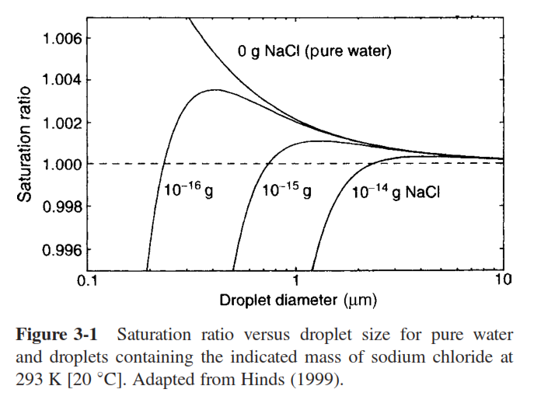
Cloud droplet formation Saturation vapor pressure of a solution droplet:

Slide 19
Cloud droplet formation Saturation vapor pressure of a solution droplet:
$\sim$exp$\left[\frac{A}{D_{p}}\right]$ ⬅ Kelvin
Köhler
Curve
$\sim$exp$\left[−\frac{B}{D_{p}^{3}}\right]$ ⬅ Raoult

Slide 20
Cloud droplet formation Saturation vapor pressure of a solution droplet:
$\sim$exp$\left[\frac{A}{D_{p}}\right]$ ⬅ Kelvin
Small,
concentrated sol’n drop
Large, dilute sol’n drop
Flat,
pure H₂O
Köhler
Curve
$\sim$exp$\left[−\frac{B}{D_{p}^{3}}\right]$ ⬅ Raoult
Droplets become dilute as $D_{p}^{3}→∞ ∴$ Raoult Term strongest for small droplets
Droplets become flat as $D_{p}→∞ ∴$ Kelvin Term stronger for small droplets

Slide 21
Cloud droplet formation Saturation vapor pressure of a solution droplet:
$\sim$exp$\left[\frac{A}{D_{p}}\right]$ ⬅ Kelvin
Köhler
Curve
$\sim$exp$\left[−\frac{B}{D_{p}^{3}}\right]$ ⬅ Raoult
Haze vs. Cloud Droplets: “unactivated” vs. “activated” droplets
This is a “hazy” distinction without physical interpretation of Köhler curves

Slide 22
Cloud droplet formation Saturation vapor pressure of a solution droplet:
Supersaturation:
s = RH - 100%
Saturation Ratio:
S = RH/100%
s_{c} ~ 0.4%
RH/100%
D_{c}
s_{c} = “critical supersaturation” of water vapor corresponding to an aerosol particle of size d_{p} and composition κ
Once the ambient humidity exceeds s_{c} and droplets grow bigger than D_{c}, droplets are considered to have “activated” as cloud droplets

Slide 23
Cloud droplet formation Saturation vapor pressure of a solution droplet:
Supersaturation:
s = RH - 100%
Saturation Ratio:
S = RH/100%
s_{c} ~ 0.4%
s₂=
0.2%
RH/100%
Reversible
H₂O
uptake
s₁=
-0.4%
D_{p1}
D_{p2}
D_{c}
If ambient RH increases from 99.6% to 100.2%, droplets will grow reversibly, i.e. they will grow from D_{p1} to D_{p2} and then shrink back to D_{p1} again if RH decreases back to 99.6%.
Droplets w/ $D_{p}<D_{c}$ (“Haze” droplets) are in equilibrium w/ H₂O vapor

Slide 24
Cloud droplet formation Saturation vapor pressure of a solution droplet:
s₂=
0.6%
Supersaturation:
s = RH - 100%
Saturation Ratio:
S = RH/100%
s_{c} ~ 0.4%
RH/100%
Unstable growth
s₁=
-0.4%
D_{p1}
D_{c}
D_{p2}
However, if RH increases from 99.6% to 100.6% (thereby exceeding the critical supersaturation for this example), droplets will grow unstably until the ambient water vapor has been depleted.
As drop grows, $s_{eq}$ decreases, so the ambient $s$ stays >${ s}_{eq}$

Slide 25
Cloud droplet formation Saturation vapor pressure of a solution droplet:
s_{c} ~ 0.4%
s_{c} ~ 0.1%
s_{c} ~ 0.03%
Increasing solute mass decreases s_{c}, making it easier for particles to activate
Solute mass can increase if the dry particle diameter (d_{p}) is larger or particles are more hygroscopic (or both, as in the case of sea spray aerosol)

Slide 26
Cloud droplet formation Saturation vapor pressure of a solution droplet:
“Activation” of cloud droplets (heterogeneous nucleation)
Important because it divides droplets that are in stable equilibrium from those that are in unstable equilibrium (and will grow continually until water vapor is depleted)
$∴$ If $s_{eq}$ becomes larger than $s_{c}$, a droplet can become larger than D_{c} and grow into a cloud droplet
Need actual values of D_{c} and $s_{c}$
Find max in the Kohler curve!
$${\left.\frac{{∂S}_{eq}}{∂D_{p}}\right|}_{D_{c}}=0$$
$$S_{eq}(D_{p})=exp\left[\frac{A}{D_{p}}−\frac{B}{D_{p}^{3}}\right]$$
$$u=\left[\frac{A}{D_{p}}−\frac{B}{D_{p}^{3}}\right]$$
$$\frac{∂e^{u}}{∂x}=e^{u}\frac{∂u}{∂x}$$
$$\frac{∂u}{∂x}=\left[−\frac{A}{D_{p}^{2}}+\frac{3B}{D_{p}^{4}}\right]$$

Slide 27
Cloud droplet formation Saturation vapor pressure of a solution droplet:
“Activation” of cloud droplets (heterogeneous nucleation)
Important because it divides droplets that are in stable equilibrium from those that are in unstable equilibrium (and will grow continually until water vapor is depleted)
$∴$ If $s_{eq}$ becomes larger than $s_{c}$, a droplet can become larger than D_{c} and grow into a cloud droplet
Need actual values of D_{c} and $s_{c}$
Find max in the Kohler curve!
$${\left.\frac{{∂S}_{eq}}{∂D_{p}}\right|}_{D_{c}}=\left[−\frac{A}{D_{c}^{2}}+\frac{3B}{D_{c}^{4}}\right]exp\left[\frac{A}{D_{c}}−\frac{B}{D_{c}^{3}}\right]=0$$
$$\frac{A}{D_{c}^{2}}=\frac{3B}{D_{c}^{4}}$$
$$D_{c}={\left(3B/A\right)}^{1/2}$$

Slide 28
Cloud droplet formation Saturation vapor pressure of a solution droplet:
“Activation” of cloud droplets (heterogeneous nucleation)
Important because it divides droplets that are in stable equilibrium from those that are in unstable equilibrium (and will grow continually until water vapor is depleted)
$∴$ If $s_{eq}$ becomes larger than $s_{c}$, a droplet can become larger than D_{c} and grow into a cloud droplet
Need actual values of D_{c} and $s_{c}$
Find max in the Kohler curve!
$$D_{c}={\left(3B/A\right)}^{1/2}$$
$$S_{eq}(D_{p})=exp\left[\frac{A}{D_{p}}−\frac{B}{D_{p}^{3}}\right]$$
Solving for $S_{eq}\left(D_{c}\right)=S_{c}$
$$S_{c}=exp\left[\frac{A}{D_{c}}−\frac{B}{D_{c}^{3}}\right]=exp\left[{\left(\frac{4A^{3}}{27B}\right)}^{1/2}\right]$$

Slide 29
Cloud droplet formation Saturation vapor pressure of a solution droplet:
Physical Behavior:
As moles of solute rises ($N_{s}↑$), size of activated droplet rises ($D_{c}↑$)
As moles of solute rises ($N_{s}↑$), vapor required to activate droplet falls ($S_{c}↓$)
$$D_{c}$$
$$S_{c}$$
$$N_{s}$$
$$N_{s}$$
$$S_{c}=exp\left[{\left(\frac{4A^{3}}{27B}\right)}^{1/2}\right]$$
$$D_{c}={\left(3B/A\right)}^{1/2}$$

Slide 30
Cloud droplet formation Saturation vapor pressure of a solution droplet:
Physical Behavior:
As moles of solute rises ($N_{s}↑$), size of activated droplet rises ($D_{c}↑$)
As moles of solute rises ($N_{s}↑$), vapor required to activate droplet falls ($S_{c}↓$)
$$D_{c}$$
$$S_{c}$$
Important for both droplet formation and condensational growth in the atmosphere
$$N_{s}$$
$$N_{s}$$
$$S_{c}=exp\left[{\left(\frac{4A^{3}}{27B}\right)}^{1/2}\right]$$
$$D_{c}={\left(3B/A\right)}^{1/2}$$

Slide 31
Cloud droplet formation Saturation vapor pressure of a solution droplet:
Pop Quiz (just for fun)
What is the difference between a “haze” droplet and a cloud droplet?
Köhler
Curve
RH/100%
D_{p1}
D_{p2}

Slide 32
Cloud droplet formation and Condensational Growth(Recap)
Pop Quiz (just for fun)
What is the difference between a “haze” droplet and a cloud droplet?
Nucleation
(“Activation”)
S_{c}
Unstable
Droplet Growth
RH/100%
Stable
(Reversible)
Droplet
Growth
D_{c}

Slide 33
Cloud droplet formation and Condensational Growth(Recap)
What is the difference between a “haze” droplet and a cloud droplet?
“Haze” droplets are smaller (< D_{c}), and can exist at <100% RH & >100% RH
(but if RH <100%, only haze droplets can exist for significant amounts of time)
Nucleation
(“Activation”)
S_{c}
Cloud Droplet
RH/100%
“Haze” Droplet
D_{c}

Slide 34
Cloud droplet formation and Condensational Growth(Recap)
What is the difference between a “haze” droplet and a cloud droplet?
Cloud droplets are generally more dilute, though it depends on dry particle size (d_{p}), critical supersaturation (S_{c}), and how much time they have had to grow.
Nucleation
(“Activation”)
S_{c}
Cloud Droplet
RH/100%
“Haze” Droplet
D_{c}

Slide 35
Cloud droplet formation and Condensational Growth(Recap)
Another Pop Quiz
What happens to a cloud droplet when humidity drops below S_{c}?
…and below 100% RH?
Nucleation
(“Activation”)
S_{c}
Cloud Droplet
RH/100%
“Haze” Droplet
D_{c}

Slide 36
Cloud droplet formation and Condensational Growth(Recap)
Another Pop Quiz
What happens to a cloud droplet when humidity drops below S_{c}? ⬅ continue growing
…and below 100% RH? ⬅ evaporate (shrink back to their equilibrium size becoming haze droplets again)
If RH >= 100%,
Nucleation
(“Activation”)
S_{c}
Cloud Droplet
RH/100%
“Haze” Droplet
D_{c}

Slide 37
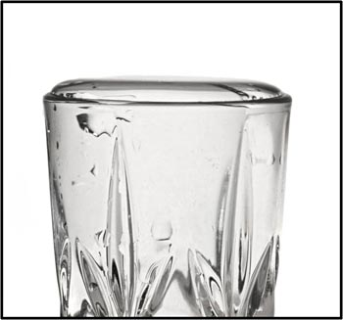
Cloud droplet formation and Condensational Growth(Recap)
Overflowing glass of water, as an analogy:
Water level will rise and fall with the volume of water in the glass (reversibly, like a haze droplet swells and evaporates with RH), but once water level rises high enough to start spilling out (which is actually greater than the height of the glass, because it has to overcome surface tension), water will continue to spill out (unstably, like growth of cloud droplets at RH>100%) until the water level falls below the top edge of the glass again.
Haze
Cloud Droplet

Slide 38
Droplet growth by condensation
Cloud droplet growth depends on:
Cooling rate of an air parcel
Aerosol Size Distribution
In the atmosphere, soluble aerosol (CCN) are distributed in size
Size has the biggest impact on the soluble mass that CCN contribute ($d_{p}^{3}$)
Smallest CCN that activates in this particular cloud
Cloud S_{max}
Aerosol Number (#/cm³)

Slide 39
Droplet growth by condensation
Cloud droplet growth depends on:
Cooling rate of an air parcel
Aerosol Size Distribution
Larger particles (with higher dry particle size, d_{p}) have greater soluble material (N_{s}), and therefore activate at a lower critical supersaturation (S_{c})
Few small aerosol
(low N_{s})
Few large aerosol
(high N_{s})
Smallest CCN that activates in this particular cloud
Cloud S_{max}
Aerosol Number (#/cm³)
N_{s} too low
S_{c} too high

Slide 40
Droplet growth by condensation
Cloud droplet growth depends on:
Cooling rate of an air parcel
Aerosol Size Distribution
Larger CCN (with higher dry particle size, d_{p}) have greater soluble material (N_{s}), and therefore activate at a lower critical supersaturation (S_{c})
Larger CCN activate first and form relatively large droplets
Smallest CCN that activates in this particular cloud
Cloud S_{max}
Aerosol Number (#/cm³)
N_{s} too low
S_{c} too high

Slide 41
Droplet growth by condensation
Cloud droplet growth depends on:
Cooling rate of an air parcel
Aerosol Size Distribution
Smaller particles (with highest S_{c}) activate last, when there is less water vapor available for condensation
Much of it has already condensed on larger particles!
$∴$Smaller particles (in the same air parcel) tend to produce smaller droplets
Smallest CCN that activates in this particular cloud
Cloud S_{max}
Aerosol Number (#/cm³)
N_{s} too low
S_{c} too high

Slide 42
Cloud droplet formation - Recap Saturation vapor pressure of a solution droplet:
Saturation vapor pressure (for a solution droplet):
$\frac{e_{soln}(T,{D_{p},x}_{s})}{e_{sat}(T)}=exp\left[\frac{A}{D_{p}}−\frac{B}{D_{p}^{3}}\right]$ = $S_{eq}$
⬅ Köhler Equation
S_{c}
Curvature (Kelvin) Term
Solute (Raoult) Term
‘Activated’
Droplet
Haze
Particle
$$A=\left(\frac{4σM_{H2O}}{RTρ_{H2O}}\right)$$
$$B=\left(\frac{iρ_{s}}{M_{s}}\frac{M_{H2O}}{ρ_{H2O}}d_{p}^{3}\right)$$
$$S_{c}=exp\left[{\left(\frac{4A^{3}}{27B}\right)}^{1/2}\right]$$

Slide 43
Kappa-Köhler Theory
“A single parameter representation of hygroscopic growth and cloud condensation nucleus activity” – Petters and Kreidenweis, 2007
Previously assumed that the wet particle is mostly H₂O:
$\left(D_{p}^{3}−d_{p}^{3}\right)\sim D_{p}^{3}$
Wet particle diameter
Dry particle diameter
S_{c}
‘Activated’
Droplet
Haze
Particle
Without that assumption:
Approximation for S_{c} when κ > 0.2:
κ-Köhler equation
$$S_{c}=exp\left[{\left(\frac{4A^{3}}{27κd_{p}^{3}}\right)}^{1/2}\right]$$
$S_{eq}=\left(\frac{D_{p}^{3}−d_{p}^{3}}{D_{p}^{3}−{(1−κ)d}_{p}^{3}}\right)exp\left[\frac{A}{D_{p}}\right]$
κ-Köhler applies for both haze and activated droplets

Slide 44
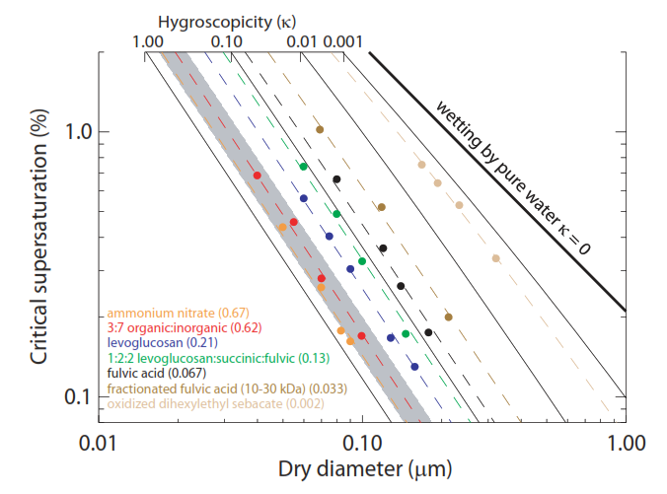
Kappa-Köhler Theory
“A single parameter representation of hygroscopic growth and cloud condensation nucleus activity” – Petters and Kreidenweis, 2007
Approximation for S_{c} when κ > 0.2:
$$S_{c}=exp\left[{\left(\frac{4A^{3}}{27κd_{p}^{3}}\right)}^{1/2}\right]$$
κ-value can also be determined experimentally.
Important for complex mixtures for which the detailed composition is not known.

Slide 45
Continuous-Flow Streamwise Thermal Gradient CCN Counter (CCNc)
Creates a ‘Cloud’, by generating a water vapor supersaturation (0.1% - 2.0 %)
= 100.1-102% RH
based on the design by Roberts and Nenes [2005]
http://www.dropletmeasurement.com
Notes:
The inlet is split into aerosol and sheath flow. The sheath flow is filtered, humidified and heated. The aerosol flow is directed through the centerline of the column, and is surrounded by the annular sheath flow. The inner walls are maintained moist. a temperature gradient is applied to produce a supersaturation of water vapor in the CCN column, where the activated particles grow to become droplets, after which point they are detected with an optical particle counter at the exit of the column.

Slide 46
Principle of Operation for the CCNc
Thermal diffusivity < Molecular diffusivity of water vapor
1.
2.
3.
4.
cold
laminar
flow
Same H₂O mixing ratio
at C and B
A
A
B
B
Same temperature
at C and A
C
hot
Generates a Supersaturation
of water vapor (0.1% - 2.0 %)
CCNc Column
Notes:
The next two facts rely upon the kinetics of mass transfer for heat and moisture from the walls to the centerline of the column.

Slide 47
Principle of Operation for the CCNc
Thermal diffusivity < Molecular diffusivity of water vapor
1.
2.
3.
4.
cold
Same H₂O mixing ratio
at C and B
droplet
activation
Same temperature
at C and A
droplet
growth
hot
Generates a Supersaturation
of water vapor (0.1% - 2.0 %)
Particle counter,
1 um lower size cutoff
Notes:
Generates a supersaturation. Allows particles to activate and grow into cloud droplets. Counts the number of droplets formed.

Slide 48
Calibration of the CCNc instrument supersaturation
Typically use NaCl or Ammonium Sulfate particles of a given size as calibration aerosol
Rose et al, Calibration and measurement uncertainties of a CCN counter, ACP, 2008

Slide 49
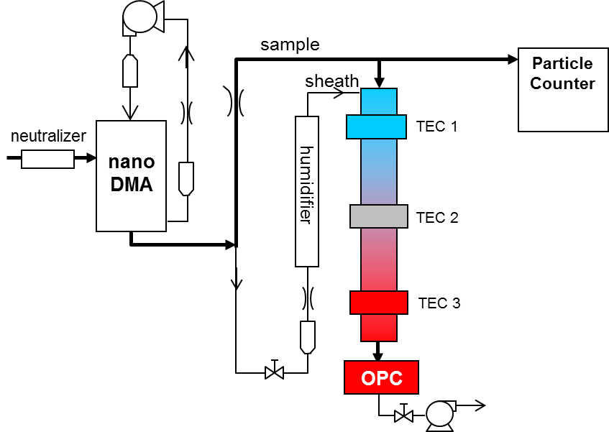
Calibrating the CCNc Supersaturation
N_{CN}(d_{p})
Condensation
Nuclei
d_{p}
Particle Diameter
Activated N_{CCN}(S,d_{p})
Fraction N_{CN}(d_{p})
=
N_{CCN}(S,d_{p})
Cloud
Condensation Nuclei
Notes:
We can vary the particle size and supersaturation in the CCN counter to see how this affects the activated fraction. We performed size resolved CCN measurements in New Hampshire, Mexico, Finland and Greece.
If we scan the diameter, we can get an activation curve in diameter space. selecting one particle size we can also step through supersaturations to get activation curves in supersaturation space. If we have enough time we can step through a set of supersaturations and scan the diameter quickly at each supersaturation to get a very rich multidimensional dataset.

Slide 50
Calibration with Ammonium Nitrate Aerosol
0.2% Supersaturation Setpoint
Activation diameter = 76 nm
Calibration Aerosol and CCN Size Distributions
CN

Slide 51
Ambient Data from the WFM Summit
0.2% Supersaturation Setpoint
Activation diameter = 101 nm
Ambient Aerosol and CCN Size Distributions
CN

Slide 52
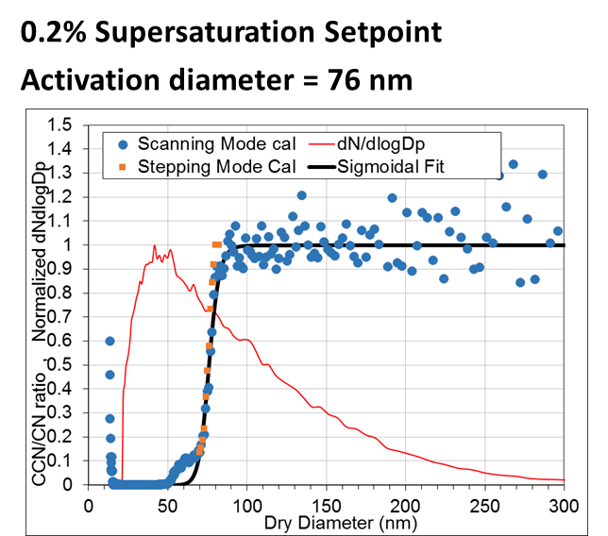
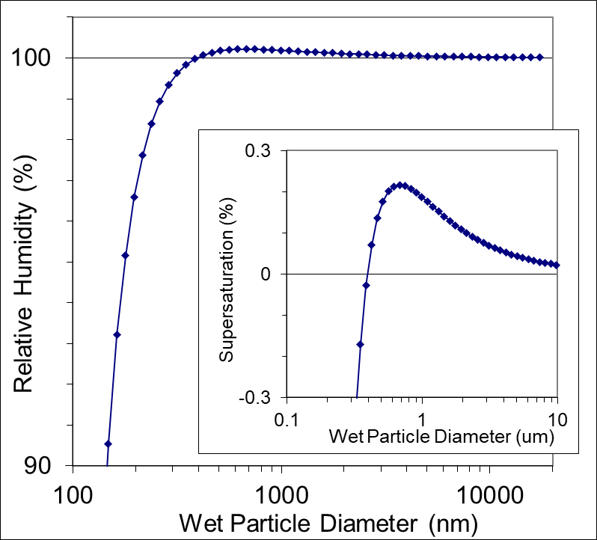
Kappa-Köhler Theory
Ammonium Nitrate Aerosol
➔
κ = 0.77
d_{p} = 76 nm
$S_{eq}=\left(\frac{D_{p}^{3}−d_{p}^{3}}{D_{p}^{3}−{(1−κ)d}_{p}^{3}}\right)exp\left[\frac{A}{D_{p}}\right]$
Petters and Kreidenweis (2007)
To determine kappa for ambient aerosol:
First check the instrument supersaturation (S=S_{c}), by using a known calibration aerosol (in this case ammonium nitrate, which is known to have a kappa of 0.77) and setting d_{p} to the calibrated dry activation diameter
Then calculate kappa at this calibrated supersaturation, by setting the maximum S in the above κ-Köhler equation to the calibrated S and setting d_{p} to the measured dry activation diameter

Slide 53
Kappa-Köhler Theory
Ammonium Nitrate Aerosol
➔
κ = 0.77
d_{p} = 76 nm
$S_{eq}=\left(\frac{D_{p}^{3}−d_{p}^{3}}{D_{p}^{3}−{(1−κ)d}_{p}^{3}}\right)exp\left[\frac{A}{D_{p}}\right]$
Petters and Kreidenweis (2007)
To determine kappa for ambient aerosol:
First check the instrument supersaturation (S=S_{c}), by using a known calibration aerosol (in this case ammonium nitrate, which is known to have a kappa of 0.77) and setting d_{p} to the calibrated dry activation diameter
Then calculate kappa at this calibrated supersaturation, by setting the maximum S in the above κ-Köhler equation to the calibrated S and setting d_{p} to the measured dry activation diameter
Determine:
S_{c} = 0.22%

Slide 54
Kappa-Köhler Theory
Ammonium Nitrate Aerosol
➔
κ = 0.77
d_{p} = 76 nm
$S_{eq}=\left(\frac{D_{p}^{3}−d_{p}^{3}}{D_{p}^{3}−{(1−κ)d}_{p}^{3}}\right)exp\left[\frac{A}{D_{p}}\right]$
Petters and Kreidenweis (2007)
To determine kappa for ambient aerosol:
First check the instrument supersaturation (S=S_{c}), by using a known calibration aerosol (in this case ammonium nitrate, which is known to have a kappa of 0.77) and setting d_{p} to the calibrated dry activation diameter
Then calculate kappa at this calibrated supersaturation, by setting the maximum S in the above κ-Köhler equation to the calibrated S and setting d_{p} to the measured dry activation diameter
Determine:
S_{c} = 0.22%

Slide 55
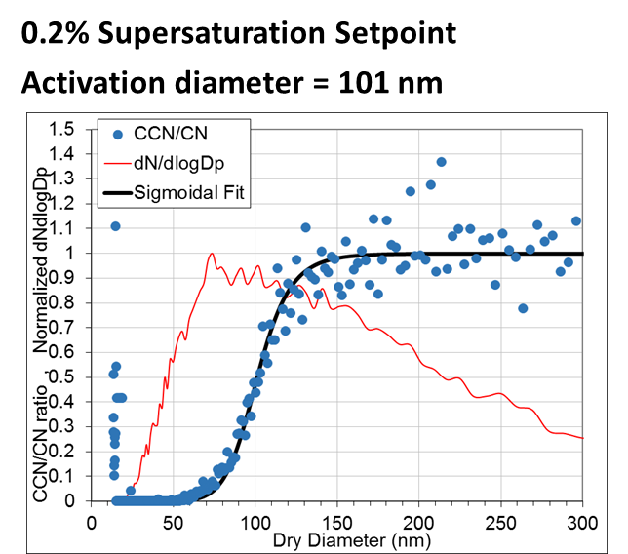
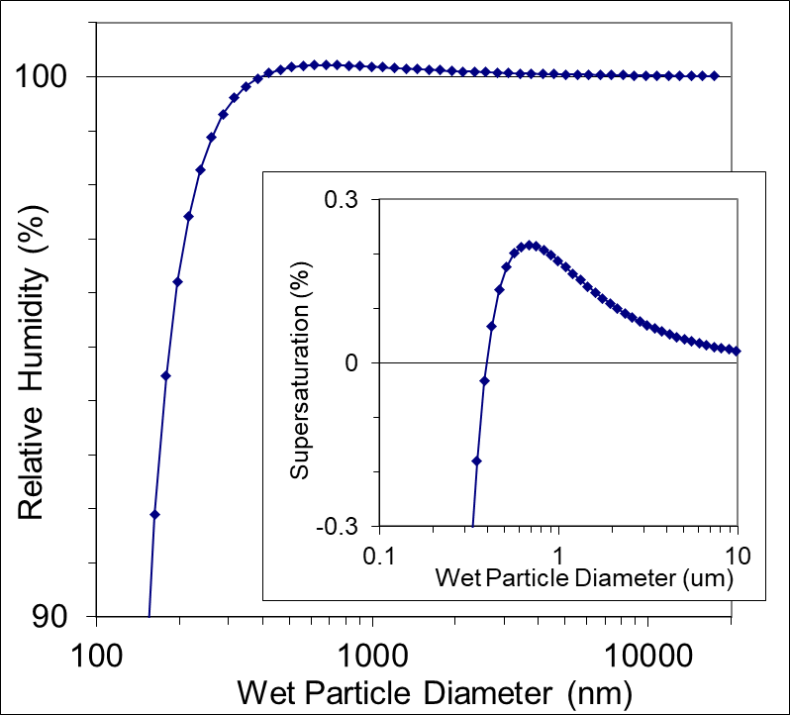
Kappa-Köhler Theory
Ambient Aerosol
➔
d_{p} = 101 nm
$S_{eq}=\left(\frac{D_{p}^{3}−d_{p}^{3}}{D_{p}^{3}−{(1−κ)d}_{p}^{3}}\right)exp\left[\frac{A}{D_{p}}\right]$
Petters and Kreidenweis (2007)
To determine kappa for ambient aerosol:
First check the instrument supersaturation (S=S_{c}), by using a known calibration aerosol (in this case ammonium nitrate, which is known to have a kappa of 0.77) and setting d_{p} to the calibrated dry activation diameter
Then calculate kappa at this calibrated supersaturation, by setting the maximum S in the above κ-Köhler equation to the calibrated S and setting d_{p} to the measured dry activation diameter
S_{c} = 0.22%
Solve for κ:
= 0.33

Slide 56
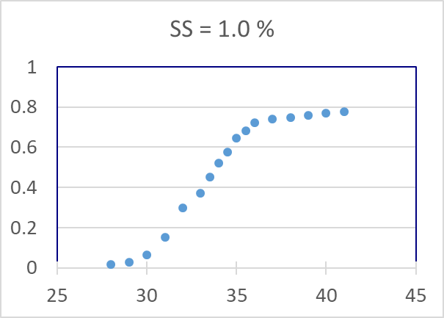
Kappa-Köhler Theory
Pop Quiz (just for fun):
If you have an Ammonium Nitrate calibration of the CCN counter that yields an activated fraction curve that looks like this ➔
(with the supersaturation set to 1%):
A) What is the actual supersaturation in the CCN counter?
B) What would the κ-value be for ambient aerosol if the instrument were operated under these same conditions and the measured inflection point is at 54 nm?
d_{p} = 33nm
Dry particle diameter, nm
Note: Temperature of the calibrations and the ambient measurements is conducted at 278K

Slide 57
Kappa-Köhler Theory
Pop Quiz (just for fun):
If you have an Ammonium Nitrate calibration of the CCN counter that yields an activated fraction curve that looks like this ➔
(with the supersaturation set to 1%):
A) What is the actual supersaturation in the CCN counter?
B) What would the κ-value be for ambient aerosol if the instrument were operated under these same conditions and the measured inflection point is at 54 nm?
d_{p} = 33nm
Dry particle diameter, nm
Note: Temperature of the calibrations and the ambient measurements is conducted at 278K
A) 0.85% (lower than the setpoint, in this case since the ambient pressure is lower than 1 atm)
B) κ = 0.17

