Slide 1
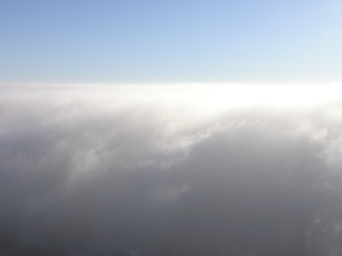
Cloud Microphysics
(ATM505 Module 4, 17 Apr 2023)
Cloud droplet formation (nucleation)
  Saturation vapor pressure of a droplet
    Surface tension term + Solute term = Köhler theory
    kappa-Köhler theory
Droplet growth by condensation
Cloud supersaturation
Droplet growth by collision-coalescence
Ice nucleation and vapor depositional growth
Mixed-phase clouds
Dr. S. Lance

Slide 2
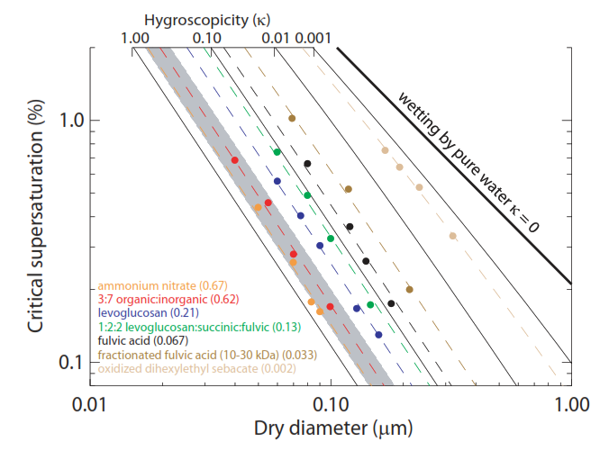
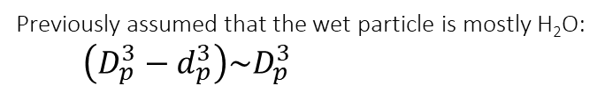
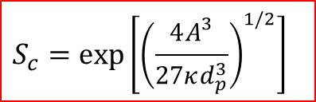
Kappa-Köhler Theory
“A single parameter representation of hygroscopic growth and cloud condensation nucleus activity” – Petters and Kreidenweis (2007)
Previously assumed that the wet particle is mostly H₂O:
$\left(D_{p}^{3}−d_{p}^{3}\right)\sim D_{p}^{3}$
Wet particle diameter
Dry particle diameter
S_{c}
Haze
Particle
‘Activated’
Droplet
Without that assumption:
κ-Köhler equation
$S_{eq}=\left(\frac{D_{p}^{3}−d_{p}^{3}}{D_{p}^{3}−{(1−κ)d}_{p}^{3}}\right)exp\left[\frac{A}{D_{p}}\right]$
Approximation for S_{c} when κ > 0.2:
$$S_{c}=exp\left[{\left(\frac{4A^{3}}{27κd_{p}^{3}}\right)}^{1/2}\right]$$
κ-Köhler applies for both haze and activated droplets

Slide 3
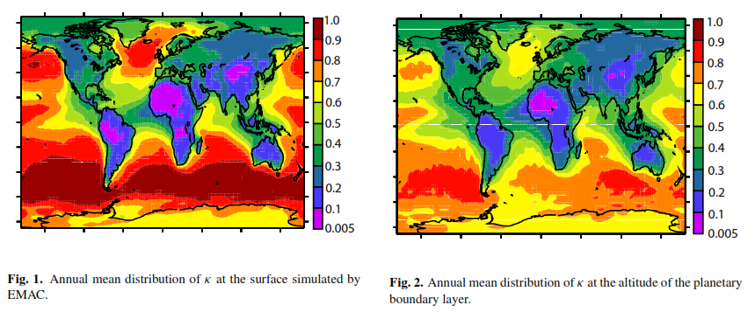
Global estimates for κ-values
Wide range of κ-values spatially and temporally
  Note that κ can be > 1 for aerosols like sea spray (NaCl κ = 1.3)
Neglects the chemical complexity of aerosols
  Size resolved composition (differences in composition of particles of different sizes )
  mixing state (differences in composition of particles of the same size)
Pringle et al., “Global distribution of the effective aerosol hygroscopicity parameter for CCN activation”, 2010

Slide 4
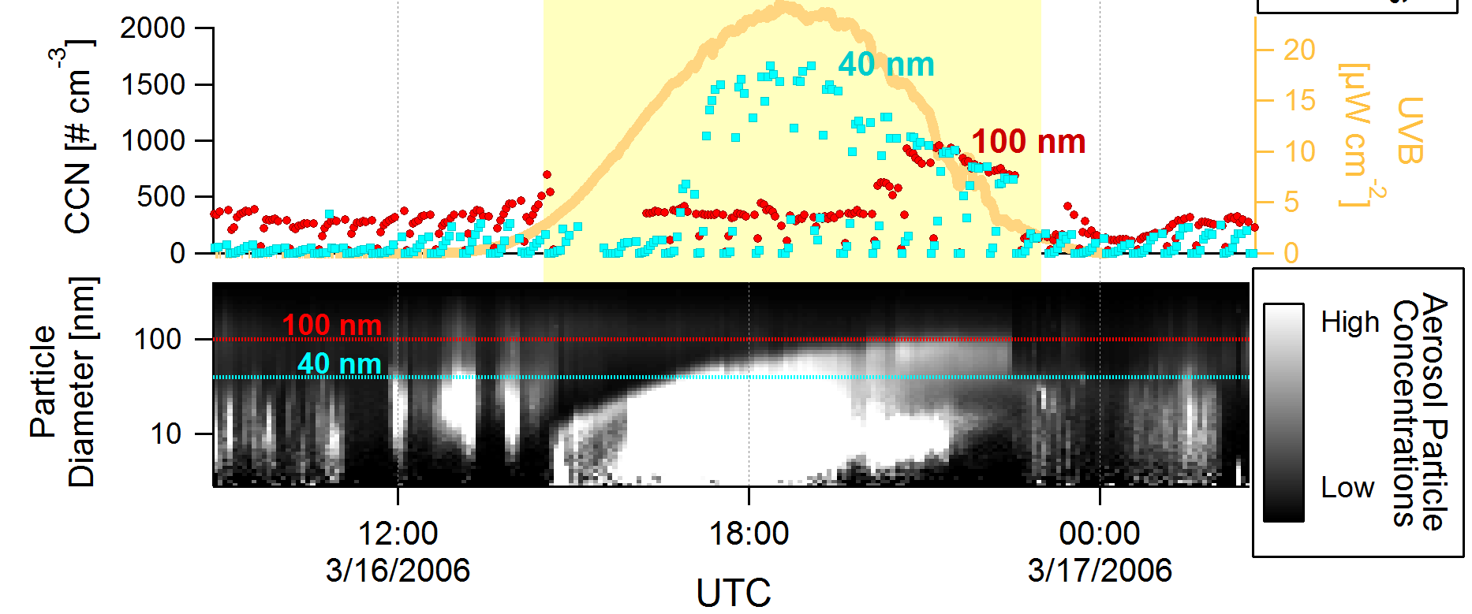
Real World Example.
New Particle Formation Impact on CCN concentrations
New particle formation events can dramatically increase CCN concentrations (resulting in more cloud droplets and reduced droplet size)
Lance et al., 2013. CCN Downwind of Mexico City: Mixing State and Chemical Aging.

Slide 5
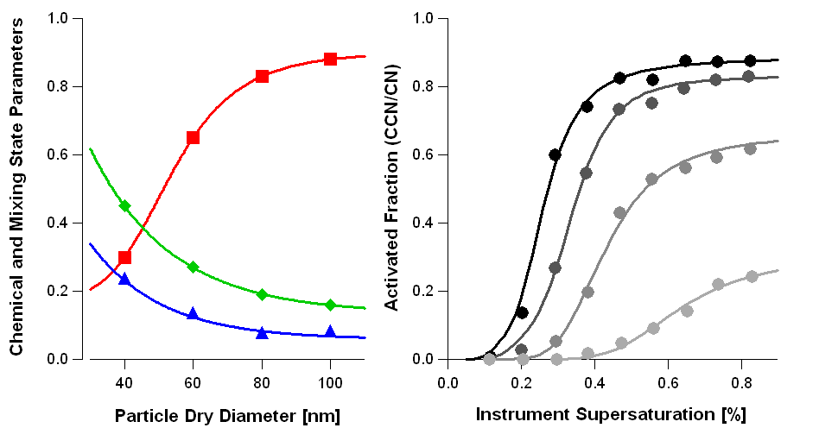
Mixing State of CCN is also important
Larger particles = less hygroscopic but more of them activate
100nm
Activated
fraction
80nm
60nm
κ
40nm
Chemical heterogeneity

Slide 6
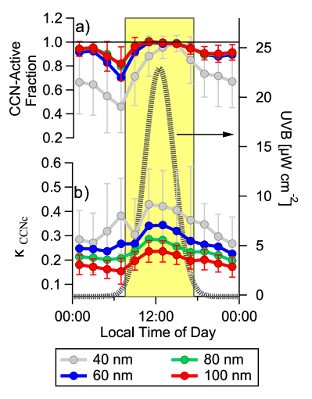
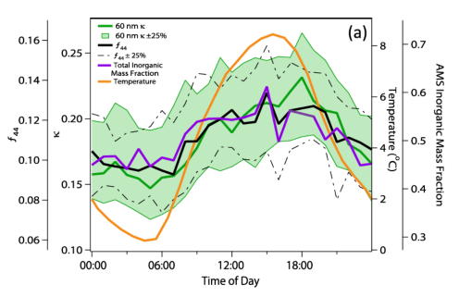
κ-values measured in polluted and remote environments often show diurnal behavior (changes during the day)
Cerully et al., “Aerosol hygroscopicity and CCN activation kinetics in a boreal forest environment”, 2011
Lance et al., “Aerosol mixing state, hygroscopic growth and cloud activation efﬁciency in Mexico City”, 2013

Slide 7
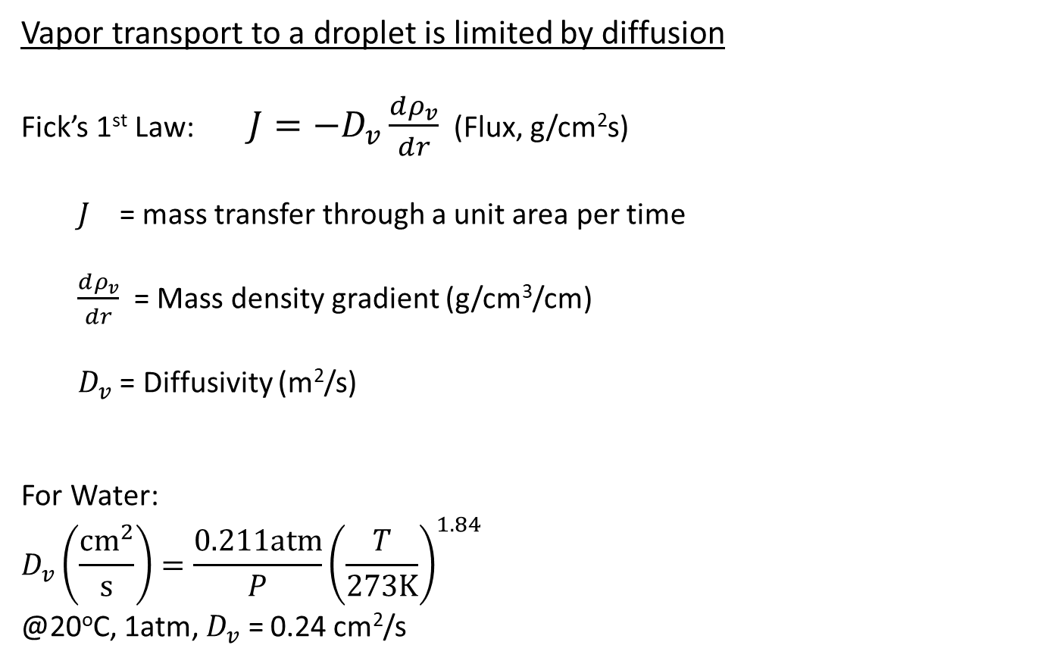
Droplet growth by condensation
Vapor transport to a droplet is limited by diffusion
Fick’s 1st Law: $J=−D_{v}\frac{dρ_{v}}{dr}$ (Flux, g/cm²s)
$J$ = mass transfer through a unit area per time
$\frac{dρ_{v}}{dr}$ = Mass density gradient (g/cm³/cm)
$D_{v}$ = Diffusivity (m²/s)
For Water:
$$D_{v}\left(\frac{{cm}^{2}}{s}\right)=\frac{0.211atm}{P}{\left(\frac{T}{273K}\right)}^{1.84}$$
@20ºC, 1atm, $D_{v}$ = 0.24 cm²/s

Slide 8
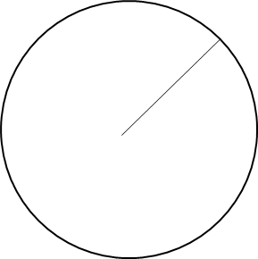
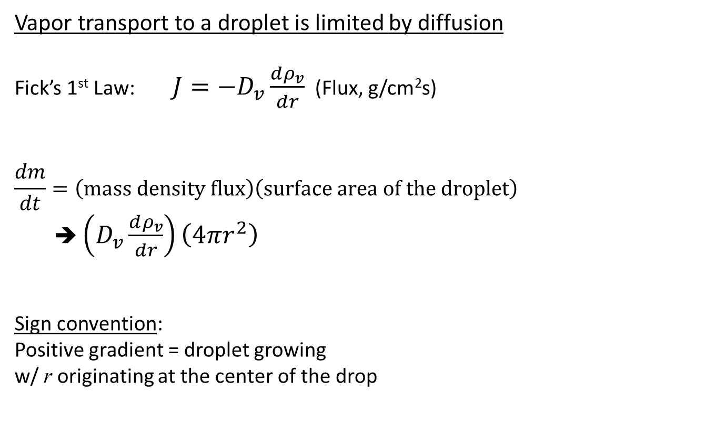
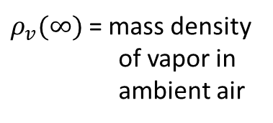
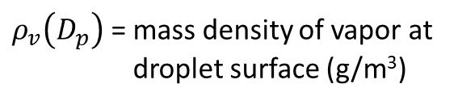
Droplet growth by condensation
Vapor transport to a droplet is limited by diffusion
Fick’s 1st Law: $J=−D_{v}\frac{dρ_{v}}{dr}$ (Flux, g/cm²s)
$$\frac{dm}{dt}=\left(mass density flux\right)\left(surface area of the droplet\right)$$
➔ $\left(D_{v}\frac{dρ_{v}}{dr}\right)\left(4πr^{2}\right)$
Sign convention:
Positive gradient = droplet growing
w/ r originating at the center of the drop
Assumes that all molecules “stick” upon colliding with the droplet, i.e. “mass accommodation coefficient” = 1.
$ρ_{v}(∞)$ = mass density of vapor in ambient air
D_{p}
r
$ρ_{v}\left(D_{p}\right)$ = mass density of vapor at droplet surface (g/m³)

Slide 9
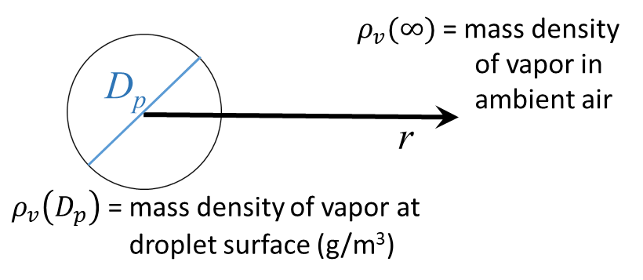
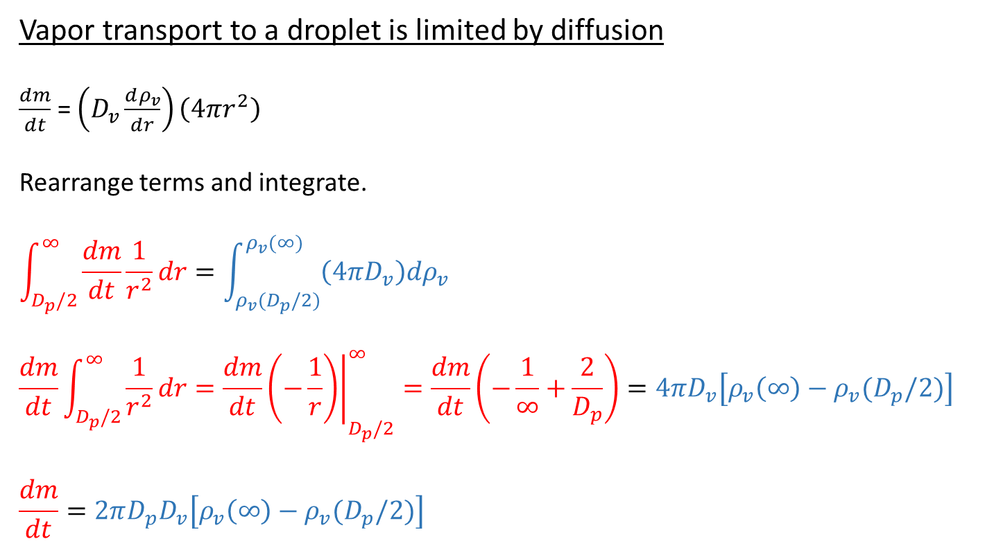
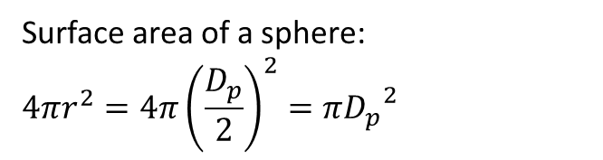
Droplet growth by condensation
Vapor transport to a droplet is limited by diffusion
$\frac{dm}{dt}$ = $\left(D_{v}\frac{dρ_{v}}{dr}\right)\left(4πr^{2}\right)$
Rearrange terms and integrate.
$$\int_{D_{p}/2}^{∞}{\frac{dm}{dt}\frac{1}{r^{2}}dr}=\int_{ρ_{v}(D_{p}/2)}^{ρ_{v}(∞)}{\left(4πD_{v}\right)dρ_{v}}$$
$${\frac{dm}{dt}\int_{D_{p}/2}^{∞}{\frac{1}{r^{2}}}dr=\frac{dm}{dt}\left.\left(−\frac{1}{r}\right)\right|}_{D_{p}/2}^{∞}=\frac{dm}{dt}\left(−\frac{1}{∞}+\frac{2}{D_{p}}\right)=4πD_{v}\left[ρ_{v}\left(∞\right)−ρ_{v}(D_{p}/2)\right]$$
$$\frac{dm}{dt}=2πD_{p}D_{v}\left[ρ_{v}\left(∞\right)−ρ_{v}(D_{p}/2)\right]$$
Surface area of a sphere:
$$4πr^{2}=4π{\left(\frac{D_{p}}{2}\right)}^{2}=π{D_{p}}^{2}$$
0
This difference is the driving force for condensation

Slide 10
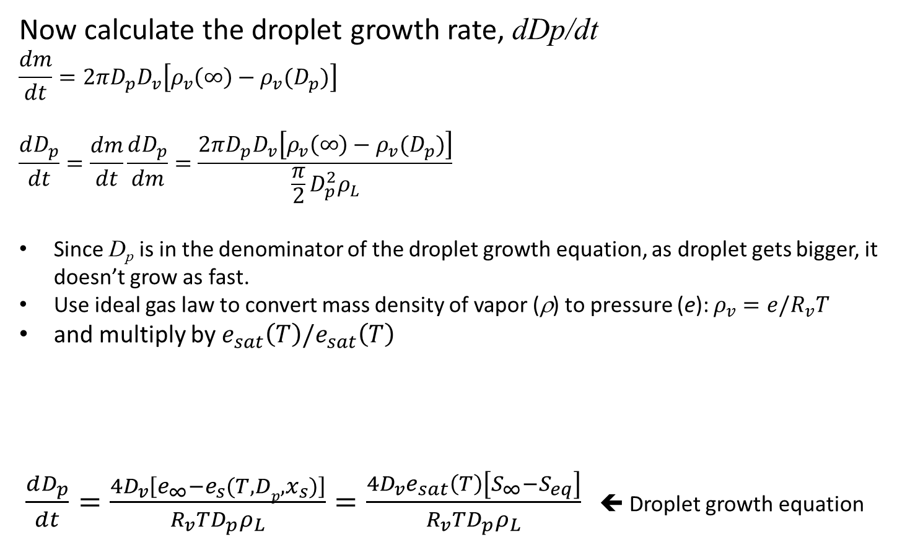
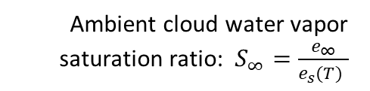

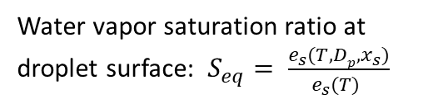
Droplet growth by condensation
Now calculate the droplet growth rate, dDp/dt
$$\frac{dm}{dt}=2πD_{p}D_{v}\left[ρ_{v}\left(∞\right)−ρ_{v}(D_{p})\right]$$
$$\frac{dD_{p}}{dt}=\frac{dm}{dt}\frac{dD_{p}}{dm}=\frac{2πD_{p}D_{v}\left[ρ_{v}\left(∞\right)−ρ_{v}(D_{p})\right]}{\frac{π}{2}D_{p}^{2}ρ_{L}}$$
Since D_{p} is in the denominator of the droplet growth equation, as droplet gets bigger, it doesn’t grow as fast.
Use ideal gas law to convert mass density of vapor (ρ) to pressure (e): $ρ_{v}=e/R_{v}T$
and multiply by $e_{sat}\left(T\right)/e_{sat}\left(T\right)$
$\frac{dD_{p}}{dt}=\frac{{4D}_{v}\left[e_{∞}−e_{s}(T,{Dp,x}_{s})\right]}{R_{v}TD_{p}ρ_{L}}=\frac{4D_{v}e_{sat}\left(T\right)\left[S_{∞}−S_{eq}\right]}{R_{v}TD_{p}ρ_{L}}$ ⬅ Droplet growth equation
Mass of a sphere:
$$m=\frac{π}{6}D_{p}^{3}ρ_{L}$$
$$\frac{dm}{dD_{p}}=\frac{π}{2}D_{p}^{2}ρ_{L}$$
Ambient cloud water vapor saturation ratio: $S_{∞}=\frac{e_{∞}}{e_{s}(T) }$
Water vapor saturation ratio at droplet surface: $S_{eq}= \frac{e_{s}(T,{Dp,x}_{s})}{e_{s}(T) }$

Slide 11
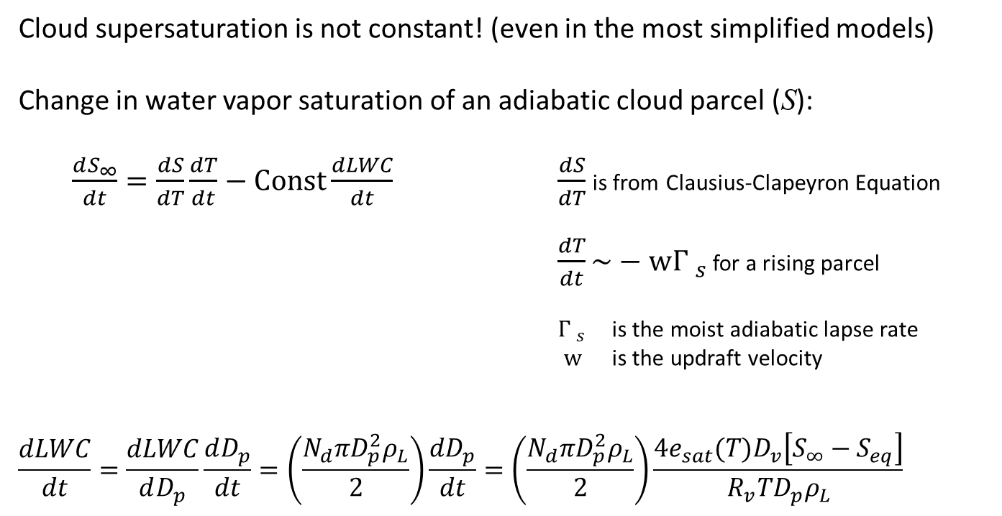

Cloud Supersaturation
Cloud supersaturation is not constant! (even in the most simplified models)
Change in water vapor saturation of an adiabatic cloud parcel (S):
$\frac{dS_{∞}}{dt}=\frac{dS}{dT}\frac{dT}{dt}−Const\frac{dLWC}{dt}$ $\frac{dS}{dT}$ is from Clausius-Clapeyron Equation
$\frac{dT}{dt}\sim −w{Γ }_{s}$ for a rising parcel
${Γ }_{s}$ is the moist adiabatic lapse rate
$w$ is the updraft velocity
$$\frac{dLWC}{dt}=\frac{dLWC}{dD_{p}}\frac{dD_{p}}{dt}=\left(\frac{N_{d}πD_{p}^{2}ρ_{L}}{2}\right)\frac{dD_{p}}{dt}=\left(\frac{N_{d}πD_{p}^{2}ρ_{L}}{2}\right)\frac{{{4e}_{sat}(T)D}_{v}\left[S_{∞}−S_{eq}\right]}{R_{v}TD_{p}ρ_{L}}$$
Rate of H₂O saturation increase from lifting and expansive cooling
Rate of H₂O saturation lost to condensation
Liquid Water Content (g/m³)
$LWC= \frac{N_{d}πD_{p}^{3}ρ_{L}}{6}$
Cloud droplet number concentration (# droplets/cm³)

Slide 12

Cloud Supersaturation
Cloud supersaturation is not constant! (even in the most simplified models)
Change in water vapor saturation of an adiabatic cloud parcel (S):
$\frac{dS_{∞}}{dt}=\frac{dS}{dT}\frac{dT}{dt}−Const\frac{dLWC}{dt}$ $\frac{dS}{dT}$ is from Clausius-Clapeyron Equation
$\frac{dT}{dt}\sim −w{Γ }_{s}$ for a rising parcel
${Γ }_{s}$ is the moist adiabatic lapse rate
$w$ is the updraft velocity
$$\frac{dLWC}{dt}=\frac{dLWC}{dD_{p}}\frac{dD_{p}}{dt}=\left(\frac{N_{d}πD_{p}^{2}ρ_{L}}{2}\right)\frac{dD_{p}}{dt}=\left(\frac{N_{d}πD_{p}^{2}ρ_{L}}{2}\right)\frac{{4e_{sat}(T)D}_{v}\left[S_{∞}−S_{eq}\right]}{R_{v}TD_{p}ρ_{L}}$$
Rate of H₂O saturation increase from lifting and expansive cooling
Rate of H₂O saturation lost to condensation
Liquid Water Content (g/m³)
$LWC= \frac{N_{d}πD_{p}^{3}ρ_{L}}{6}$
$$\frac{dLWC}{dD_{p}}=\left(\frac{N_{d}πD_{p}^{2}ρ_{L}}{2}\right)$$
Cloud droplet mass (g/droplet)
Cloud droplet number concentration (# droplets/cm³)

Slide 13
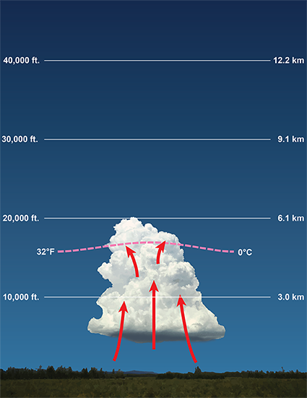
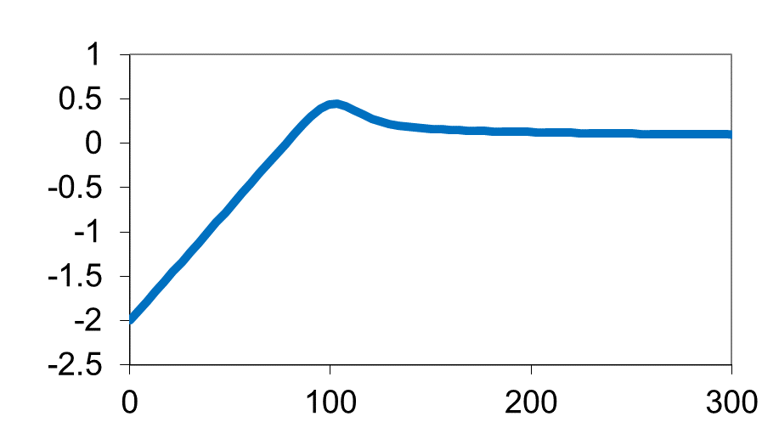
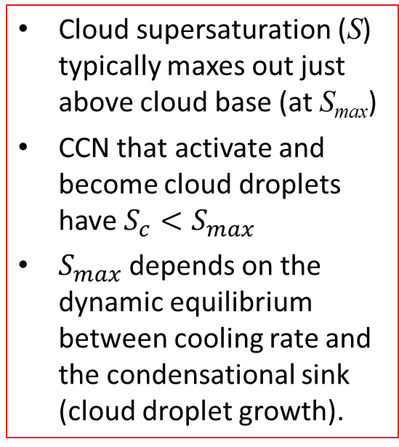


Droplet growth by condensation
Droplet activation in a real cloud
Clouds are dynamic, often with vertical motions (w) that lift parcels of air
Cooling (typically driven by updrafts) drives the cloud supersaturation, S
$$z$$
Cloud supersaturation (S) typically maxes out just above cloud base (at S_{max})
CCN that activate and become cloud droplets have $S_{c}<S_{max}$
$S_{max}$ depends on the dynamic equilibrium between cooling rate and the condensational sink (cloud droplet growth).
S_{max}
Cloud base
0.98
1.0
$$S$$
Isolated cumulus

Slide 14
Droplet growth by condensation
Cloud parcel model of droplet activation:
Simplified by a constant updraft velocity (constant cooling rate)
  No entrainment, no invigoration
  Maximum supersaturation is driven by the condensational sink
S_{max}
Droplet Diameter, D_{p} (m)
Lance et al., 2004. Chemical vs. Dynamical Effects on Cloud Droplet Number.

Slide 15
Droplet growth by condensation
Cloud parcel model of droplet activation:
Droplet growth trajectories for individual haze/cloud droplets tracked
Activated cloud droplets cluster to a tight mode at ~10 μm within < 1 min
Initial (dry) size of CCN was 10⁻⁷ to 3x10⁻⁶ m (i.e. d_{p} = 100nm – 3μm)
S_{max}
Droplet Diameter, D_{p} (m)
Lance et al., 2004. Chemical vs. Dynamical Effects on Cloud Droplet Number.

Slide 16
Droplet growth by condensation
Cloud parcel model of droplet activation:
Particles with d_{p} < 100nm remained unactivated ⬅ these are known as “interstitial aerosol” because they are within a cloudy air parcel but remain unactivated (not called “haze” droplets, though that would make sense).
S_{max}
Droplet Diameter, D_{p} (m)
Lance et al., 2004. Chemical vs. Dynamical Effects on Cloud Droplet Number.

Slide 17
Droplet growth by condensation
Cloud parcel model of droplet activation:
Large separation in D_{p} of activated and unactivated droplets after < 5min
  ➔ Two orders of magnitude difference in size due to unstable drop growth
➔ This is why cloud edges are often so visually distinct (high contrast)
S_{max}
Droplet Diameter, D_{p} (m)
Lance et al., 2004. Chemical vs. Dynamical Effects on Cloud Droplet Number.

Slide 18
Droplet growth by condensation
Cloud parcel model of droplet activation:
However droplet growth appears to asymptote at < 20μm ⬅ droplets are competing for water vapor, depleting the cloud supersaturation
Droplets have to no chance of growing to rain drops by condensation alone
(i.e. >100μm)
S_{max}
Droplet Diameter, D_{p} (m)
Lance et al., 2004. Chemical vs. Dynamical Effects on Cloud Droplet Number.

Slide 19
Droplet growth by condensation
Pop Quiz (just for fun):
If all of the larger CCN (100nm-3um) were suddenly removed (e.g. by precipitation), would a subsequent cloud (forming within the same air parcel) have a higher or lower S_{max}?
S_{max}
Droplet Diameter, D_{p} (m)
Lance et al., 2004. Chemical vs. Dynamical Effects on Cloud Droplet Number.

Slide 20
Droplet growth by condensation
Pop Quiz (Poll #4):
If all of the larger CCN (100nm-3μm) were suddenly removed (e.g. by precipitation), would a subsequent cloud (forming within the same air parcel) have a higher or lower S_{max}? ⬅ Higher, because CCN do not activate until $S_{max}>S_{c}$. And we have established that smaller CCN (<100nm) did not activate in this cloud. (because their S_{c} was too high)
S_{max}
Droplet Diameter, D_{p} (m)
Lance et al., 2004. Chemical vs. Dynamical Effects on Cloud Droplet Number.

Slide 21
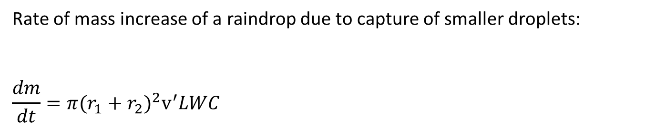

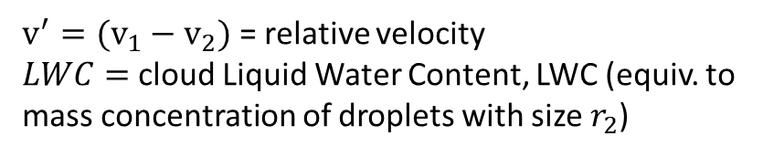
Droplet growth by collision-coalescence
Rate of mass increase of a raindrop due to capture of smaller droplets:
$$\frac{dm}{dt}=π{(r_{1}+r_{2})}^{2}v^{′}LWC$$
Volume swept out per unit time
$v^{′}=(v_{1}−v_{2})$ = relative velocity
$LWC=$ cloud Liquid Water Content, LWC (equiv. to mass concentration of droplets with size $r_{2}$)
Collision cross section
r₂
r₁
Assumes all droplets in the path of a raindrop are collected (i.e. all collisions result in coalescence). Otherwise, multiply dm/dt by collection efficiency, E_{c} (which is size dependent)
r₁+r₂
If we assume that $r_{1}≫r_{2}$, so ${(r}_{1}+r_{2})\sim r_{1}$
$\frac{dm}{dt}=\frac{d\left(\frac{4}{3}πr_{1}^{3}ρ_{L}\right)}{dt}=4πr_{1}^{2}ρ_{L}\frac{dr_{1}}{dt}=E_{c}πr_{1}^{2}v^{′}LWC$ ➔ $\frac{dr_{1}}{dt}=\frac{E_{c}v^{′}LWC}{4ρ_{L}}$

Slide 22
Droplet growth by collision-coalescence
Rate of mass increase of a raindrop due to capture of smaller droplets:
$$\frac{dm}{dt}=π{(r_{1}+r_{2})}^{2}v^{′}LWC$$
Volume swept out per unit time
$v^{′}=(v_{1}−v_{2})$ = relative velocity
$LWC=$ cloud Liquid Water Content, LWC (equiv. to mass concentration of droplets with size $r_{2}$)
Collision cross section
In reality, much more complicated. Relative velocity changes with each successive capture of smaller droplets by rain drops (v’ is not independent of r₁). Also, of course there is a distribution of cloud droplet sizes (r₂) as well as a distribution of rain drop sizes (r₁), and both are changing wrt time.
r₂
r₁
r₁+r₂
If we assume that $r_{1}≫r_{2}$, so ${(r}_{1}+r_{2})\sim r_{1}$
$\frac{dm}{dt}=\frac{d\left(\frac{4}{3}πr_{1}^{3}ρ_{L}\right)}{dt}=4πr_{1}^{2}ρ_{L}\frac{dr_{1}}{dt}=E_{c}πr_{1}^{2}v^{′}LWC$ ➔ $\frac{dr_{1}}{dt}=\frac{E_{c}v^{′}LWC}{4ρ_{L}}$

Slide 23
Droplet growth by collision-coalescence
Rate of mass increase of a raindrop due to capture of smaller droplets:
$$\frac{dm}{dt}=π{(r_{1}+r_{2})}^{2}v^{′}LWC$$
Volume swept out per unit time
$v^{′}=(v_{1}−v_{2})$ = relative velocity
$LWC=$ cloud Liquid Water Content, LWC (equiv. to mass concentration of droplets with size $r_{2}$)
Collision cross section
Collision-coalescence process “snow balls”, in that each collision increases the rain drop size, which leads to an increase in the drop fall velocity, which promotes further collisions, and so on…
r₂
r₁
r₁+r₂
If we assume that $r_{1}≫r_{2}$, so ${(r}_{1}+r_{2})\sim r_{1}$
$\frac{dm}{dt}=\frac{d\left(\frac{4}{3}πr_{1}^{3}ρ_{L}\right)}{dt}=4πr_{1}^{2}ρ_{L}\frac{dr_{1}}{dt}=E_{c}πr_{1}^{2}v^{′}LWC$ ➔ $\frac{dr_{1}}{dt}=\frac{E_{c}v^{′}LWC}{4ρ_{L}}$

Slide 24
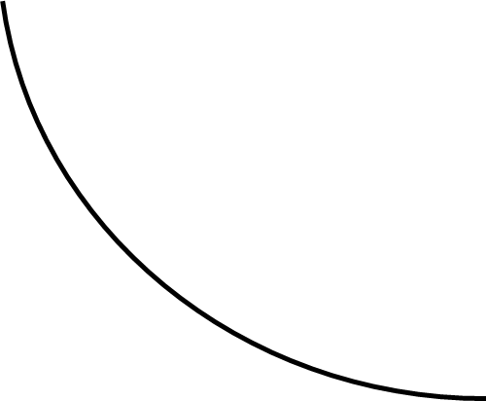

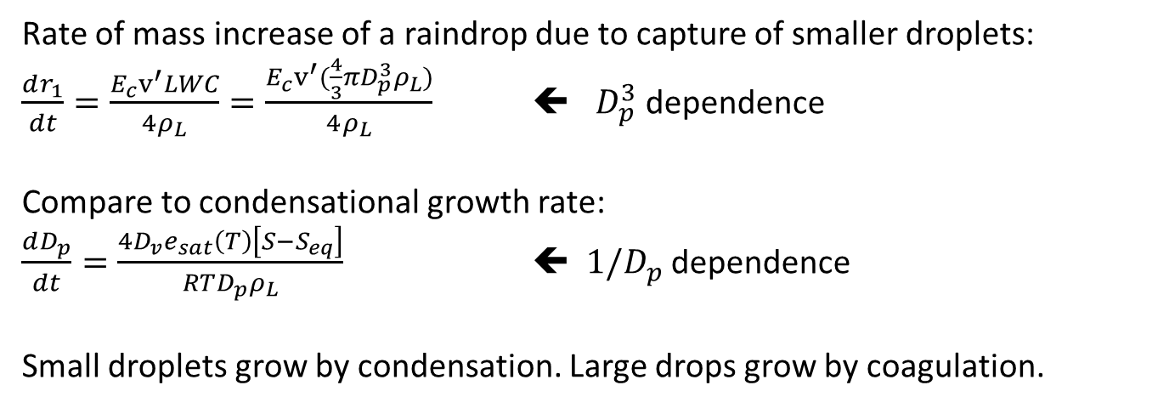


Droplet growth by collision-coalescence
Rate of mass increase of a raindrop due to capture of smaller droplets:
$\frac{dr_{1}}{dt}=\frac{E_{c}v^{′}LWC}{4ρ_{L}}=\frac{E_{c}v^{′}(\frac{4}{3}πD_{p}^{3}ρ_{L})}{4ρ_{L}}$ ⬅ $D_{p}^{3}$ dependence
Compare to condensational growth rate:
$\frac{dD_{p}}{dt}=\frac{4D_{v}e_{sat}\left(T\right)\left[S−S_{eq}\right]}{RTD_{p}ρ_{L}}$ ⬅ $1/D_{p}$ dependence
Small droplets grow by condensation. Large drops grow by coagulation.
$$D_{p}$$
$$r_{1}$$
Condensation
Coagulation
(collision-coalescence)
time
time

Slide 25
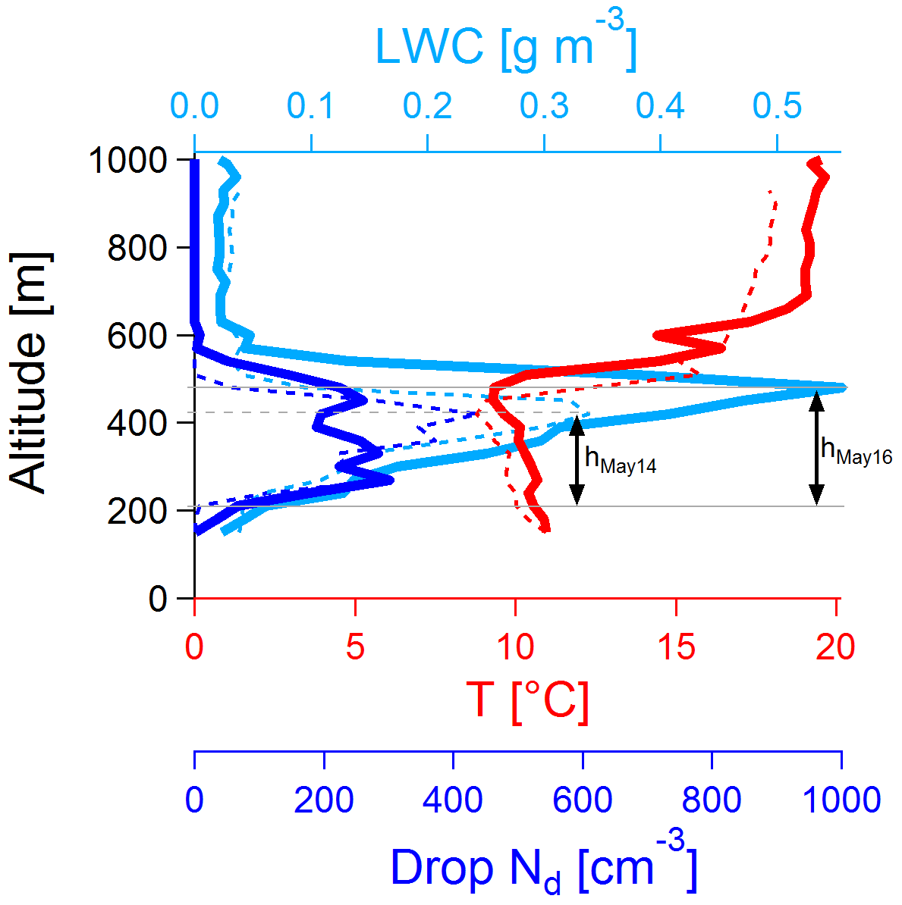
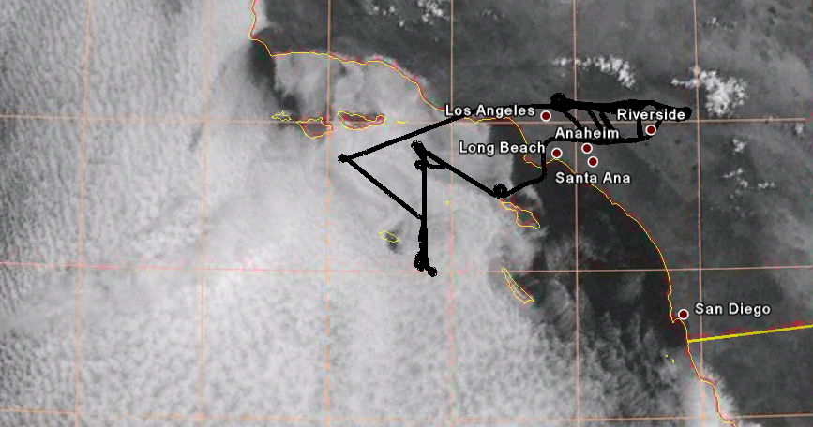
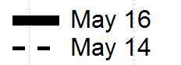
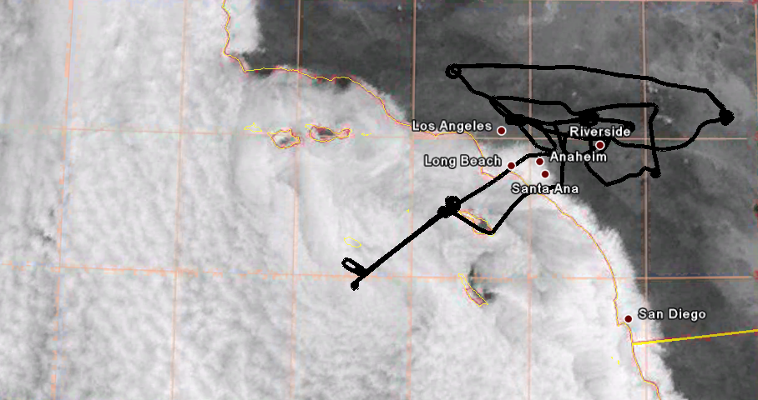
Droplet growth by collision-coalescence
In-situ observations
Flight tracks
Lance et al., 2010

Slide 26
Droplet growth by collision-coalescence
In-situ observations
Droplet concentrations (N_{d}) and below-cloud aerosol concentrations were greater on the May 14 flight.
Flight tracks
Liquid Water Path (LWP) and cloud depth (h) were greater on the May 16 flight.
Higher optical thickness (brighter clouds)
Lance et al., 2010

Slide 27
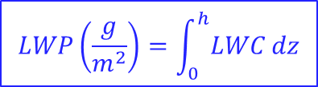
Droplet growth by collision-coalescence
In-situ observations
Droplet concentrations (N_{d}) and below-cloud aerosol concentrations were greater on the May 14 flight.
$$LWP\left(\frac{g}{m^{2}}\right)=\int_{0}^{h}{LWC}dz$$
Liquid Water Path (LWP) and cloud depth (h) were greater on the May 16 flight.
Lance et al., 2010

Slide 28
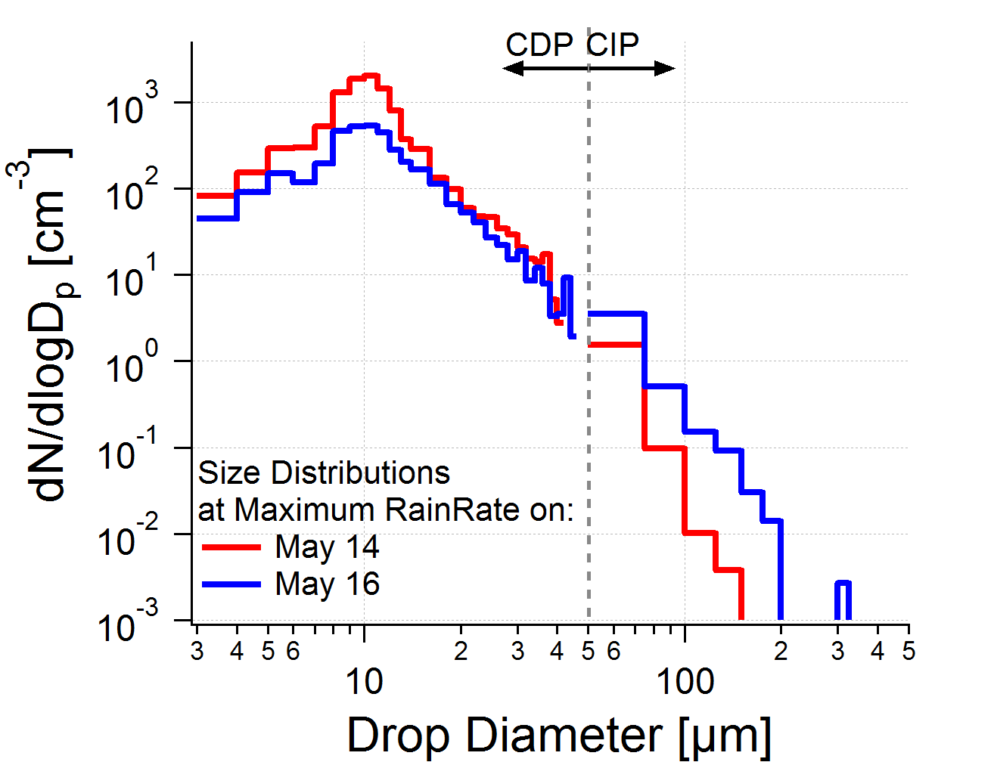
Droplet growth by collision-coalescence
In-situ observations
Droplet concentrations (N_{d}) and below-cloud aerosol concentrations were greater on the May 14 flight.
More cloud droplets
on May 14
More, and larger
drizzle drops
on May 16
Liquid Water Path (LWP) and cloud depth (h) were greater on the May 16 flight.
Lance et al., 2010

Slide 29
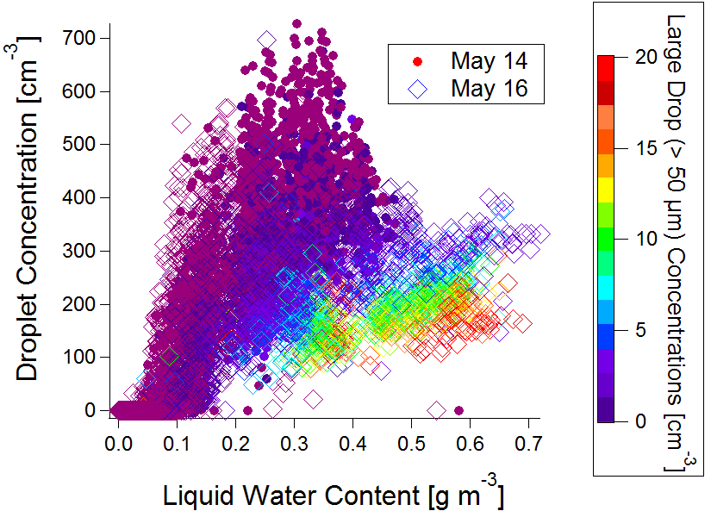
Droplet growth by collision-coalescence
In-situ observations
Droplet concentrations (N_{d}) and below-cloud aerosol concentrations were greater on the May 14 flight.
May 16
May 14
Liquid Water Path (LWP) and cloud depth (h) were greater on the May 16 flight.
Lance et al., 2010

Slide 30
Droplet growth by collision-coalescence
In-situ observations
Droplet concentrations (N_{d}) and below-cloud aerosol concentrations were greater on the May 14 flight.
Large drops produced at the expense of small droplets (collision-coalescence process)
May 16
May 14
Liquid Water Path (LWP) and cloud depth (h) were greater on the May 16 flight.
Lance et al., 2010

Slide 31
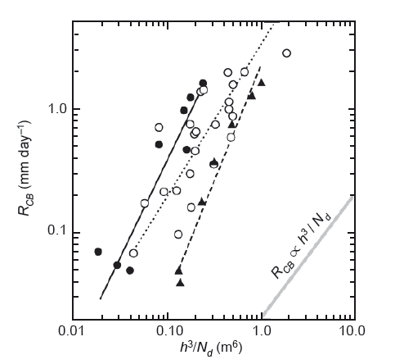
Droplet growth by collision-coalescence
In-situ observations
Parameterization from
Brenguier and Wood (2009)
Droplet concentrations (N_{d}) and below-cloud aerosol concentrations were greater on the May 14 flight.
Rain Rate at Cloud Base (mm/day)
16 May
h = 270 m
Liquid Water Path (LWP) and cloud depth (h) were greater on the May 16 flight.
14 May
h = 210 m
Cloud thickness (h)
Droplet number concentration (N_{d})
Lance et al., 2010

Slide 32
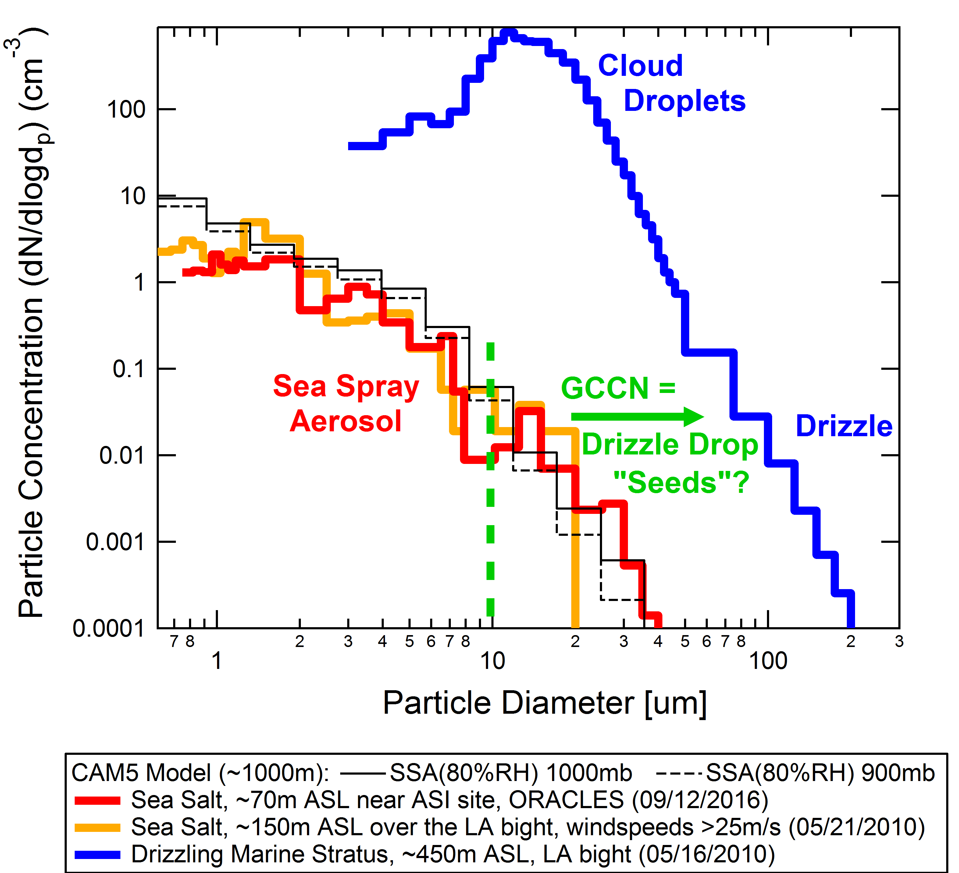
Droplet growth by collision-coalescence
In-situ observations
Droplet concentrations (N_{d}) and below-cloud aerosol concentrations were greater on the May 14 flight.
Liquid Water Path (LWP) and cloud depth (h) were greater on the May 16 flight.
Lance et al., 2010

Slide 33
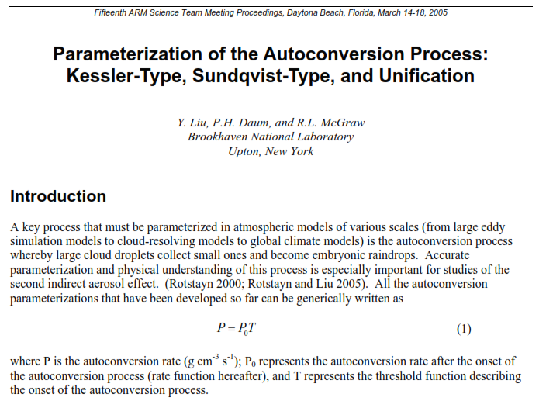
Droplet growth by collision-coalescence

Slide 34
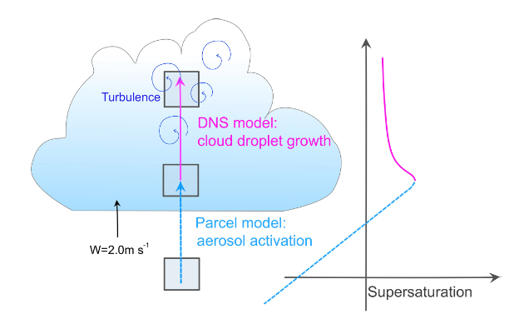
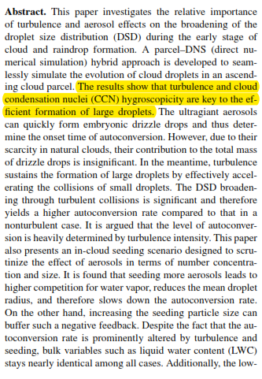
Droplet growth by collision-coalescence
Chen et al., “Impact of aerosols and turbulence on cloud droplet growth: an in-cloud seeding case study using a parcel–DNS (direct numerical simulation) approach” 2020
“Autoconversion” : The initial stage of the collision–coalescence process whereby cloud droplets collide and coalesce to form drizzle drops. (g/cm³s)

Slide 35
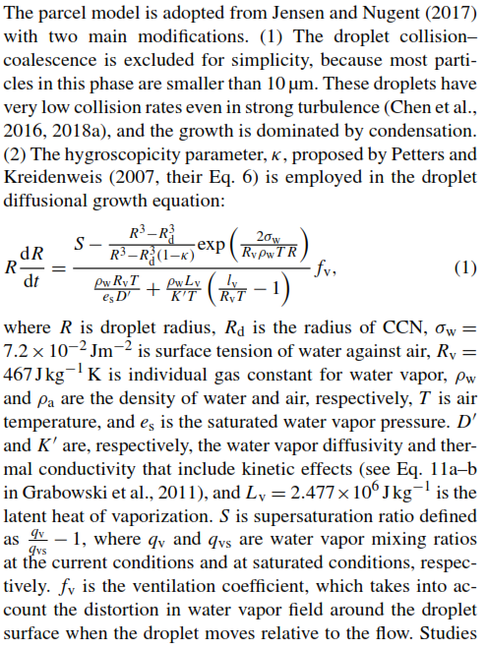
Droplet growth by collision-coalescence
Chen et al., “Impact of aerosols and turbulence on cloud droplet growth: an in-cloud seeding case study using a parcel–DNS (direct numerical simulation) approach” 2020
The droplet growth equation derived in previous lecture is a simplification. Latent heating of the air surrounding the droplet during condensation and drag of the droplets on the upward air motions are important processes that are not always included because of the computational cost.

Slide 36
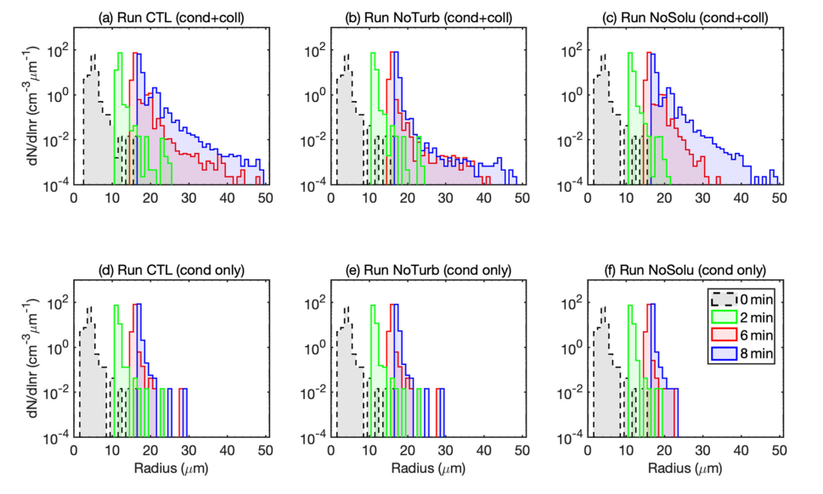
Droplet growth by collision-coalescence
Chen et al., “Impact of aerosols and turbulence on cloud droplet growth: an in-cloud seeding case study using a parcel–DNS (direct numerical simulation) approach” 2020

Slide 37
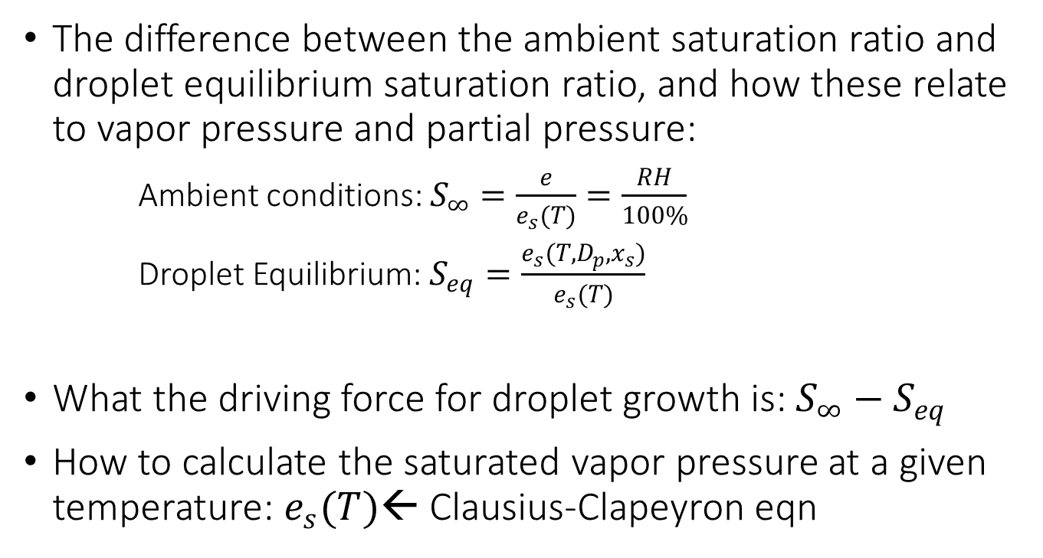
Basic info you need to know:
Cloud droplet formation and growth
The difference between the ambient saturation ratio and droplet equilibrium saturation ratio, and how these relate to vapor pressure and partial pressure:
Ambient conditions: $S_{∞}=\frac{e}{e_{s}(T)}=\frac{RH}{100\%}$
Droplet Equilibrium: $S_{eq}=\frac{e_{s}(T,D_{p},x_{s})}{e_{s}(T)}$
What the driving force for droplet growth is: ${S_{∞}−S}_{eq}$
How to calculate the saturated vapor pressure at a given temperature: $e_{s}(T)$← Clausius-Clapeyron eqn

Slide 38
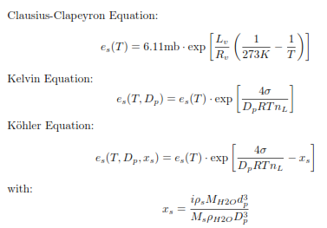
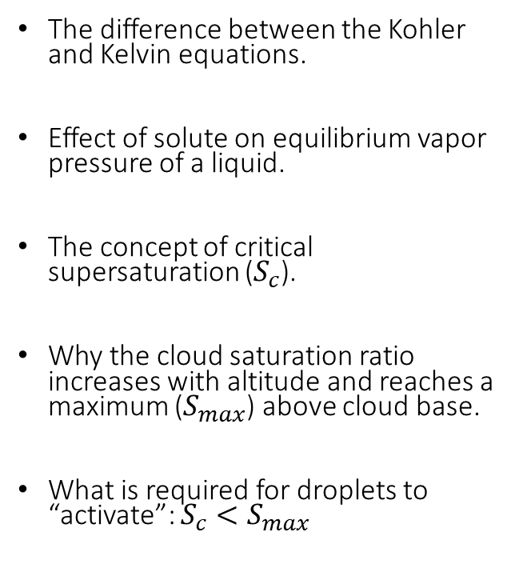

Basic info you need to know:
Cloud droplet formation and growth
The difference between the Kohler and Kelvin equations.
Effect of solute on equilibrium vapor pressure of a liquid.
The concept of critical supersaturation ($S_{c}$).
Why the cloud saturation ratio increases with altitude and reaches a maximum ($S_{max}$) above cloud base.
What is required for droplets to “activate”: ${S_{c}<S}_{max}$
Critical supersaturation in terms of κ:
$$S_{c}=exp\left[{\left(\frac{4A^{3}}{27κd_{p}^{3}}\right)}^{1/2}\right]$$

Slide 39
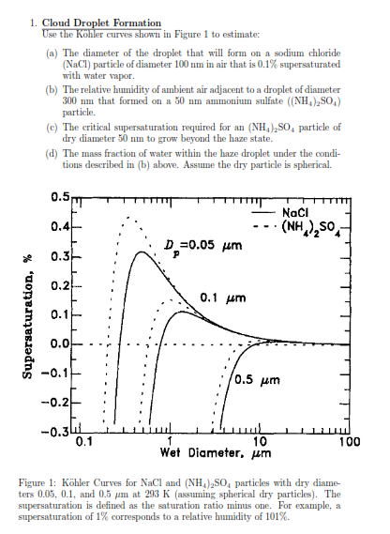
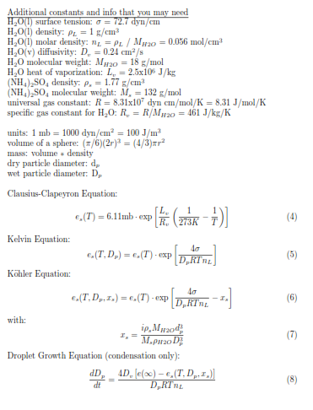

Slide 40
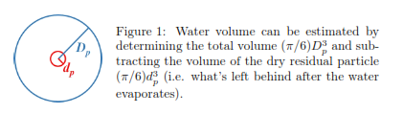
Hint:

Slide 41
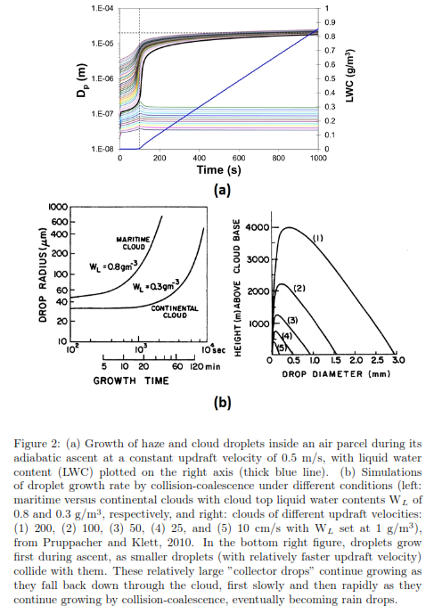

Homework

Slide 42

Homework
…

