Slide 1
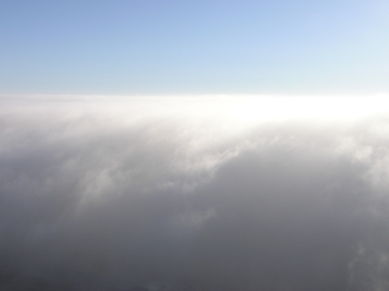
Cloud Microphysics (ATM505 Module 4, 19 Apr 2023)
Cloud droplet formation (nucleation)
Saturation vapor pressure of a droplet
Surface tension term + Solute term = Köhler theory
kappa-Köhler theory
Droplet growth by condensation
Cloud supersaturation
Droplet growth by collision-coalescence
Ice nucleation and vapor depositional growth
Mixed-phase clouds
Dr. S. Lance

Slide 2
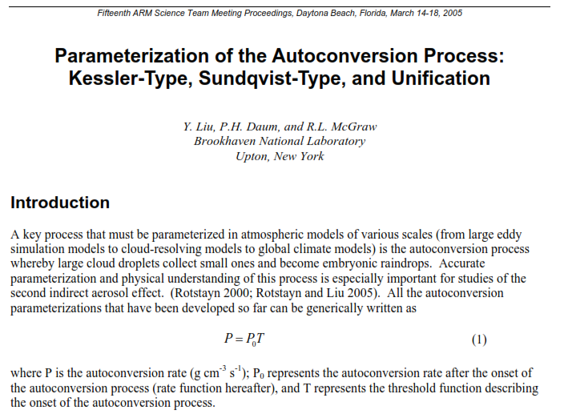
Droplet growth by collision-coalescence

Slide 3
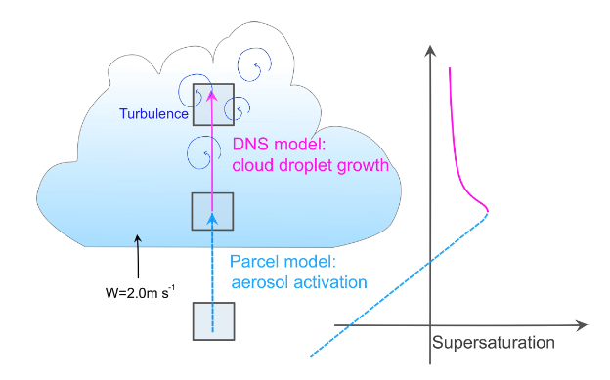
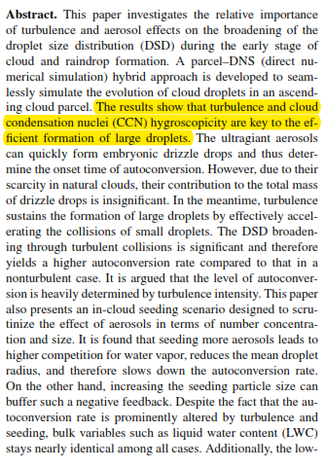
Droplet growth by collision-coalescence
Chen et al., “Impact of aerosols and turbulence on cloud droplet growth: an in-cloud seeding case study using a parcel–DNS (direct numerical simulation) approach” 2020
“Autoconversion” : The initial stage of the collision–coalescence process whereby cloud droplets collide and coalesce to form drizzle drops. (g/cm³s)

Slide 4
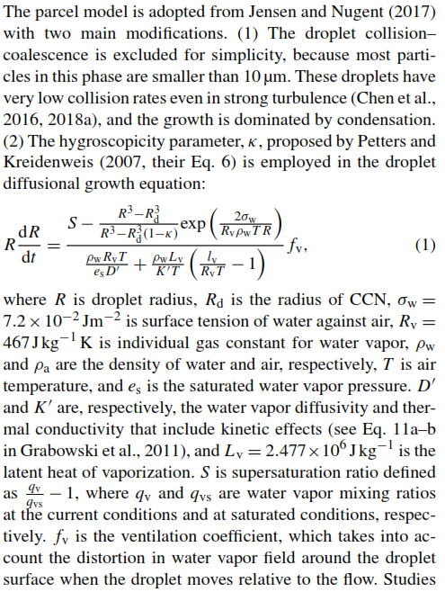
Droplet growth by collision-coalescence
Chen et al., “Impact of aerosols and turbulence on cloud droplet growth: an in-cloud seeding case study using a parcel–DNS (direct numerical simulation) approach” 2020
The droplet growth equation derived in previous lecture is a simplification. Latent heating of the air surrounding the droplet during condensation and drag of the droplets on the upward air motions are important processes that are not always included because of the computational cost.

Slide 5
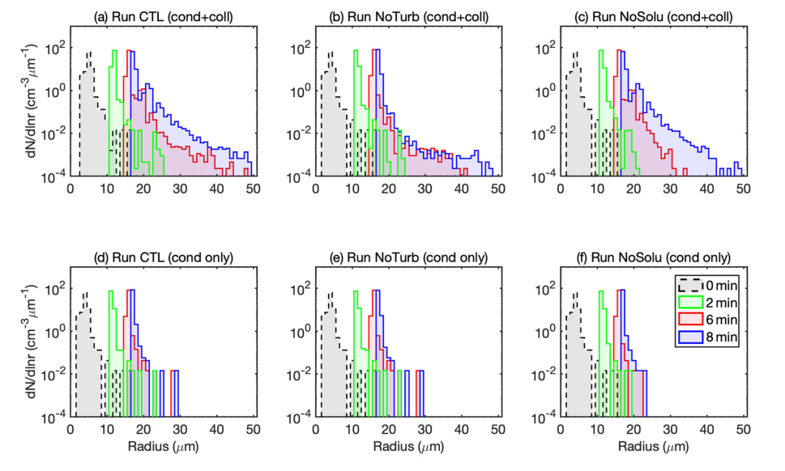
Droplet growth by collision-coalescence
Chen et al., “Impact of aerosols and turbulence on cloud droplet growth: an in-cloud seeding case study using a parcel–DNS (direct numerical simulation) approach” 2020

Slide 6
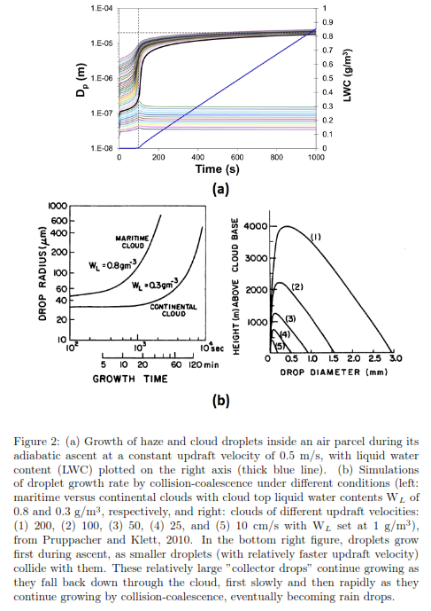
Homework

Slide 7
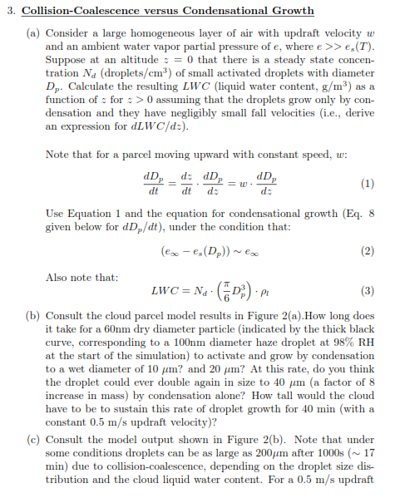
Homework
…

Slide 8
Differences between warm and cold clouds
Warm Clouds
Lots of small drops (which fall slowly)
Few large drops
Cold Clouds
N(D_{p})
Continental Clouds
(lots of aerosol)
Complex size distributions
Large particles → fall quickly
N(D_{p})
Maritime Clouds
(fewer aerosol, more GCCN)
D_{p}
10 μm
100 μm
D_{p}
10 μm
100 μm
1000 μm
Difference in cloud microphysical properties are largely driven by the difference between saturation vapor pressure for water and for ice, $e_{s}$ > $e_{i}$
$e_{∞}=P_{H_{2}O}$ (partial pressure of water vapor)
Excess = condensation/deposition
Saturation Ratio:
$$S_{∞}=\frac{e_{∞}}{e_{eq}}$$
$$e_{eq}=e_{s}$$
liquid
$$e_{eq}$$
$$e_{eq}=e_{i}$$
ice
Supersaturation:
$s$ $=S_{∞}−1=\frac{e_{∞}}{e_{eq}}−1>0$

Slide 9
Cloud Particles → Ice Nucleation
Liquid drops require a soluble catalyst for formation
Ice formation occurs when T < 0ºC and $e$ > $e_{i}$(T) ← can occur with soluble or insoluble catalyst
vapor
Condensation
Deposition
Deposition
liquid
ice
Freezing Modes
Heterogenous Nucleation
Immersion
Contact
Condensation-Freezing
Freezing
Spontaneous Freezing (no catalyst)
Homogenous Nucleation

Slide 10
Phase review!
O
H
O
H
O
disordered hydrogen bonds
H
H
O
Hexagonal Shape!
H
H
LIQUID
H
H
O
H
O
O
O
H
H
H
O
O
H
H
H
O
H
H
H
H
H
H
GAS
O
O
H
no hydrogen bonds
H
H
ICE
H
H
rigid hydrogen bonds
(results in slightly lower density than liquid)

Slide 11
Homogeneous Freezing
Freezing of liquid without a catalyst.
As water cools, ice lattices (structure) form in the water alone
At some critical temperature, molecular energy slows enough for hydrogen bonds to form and not be “rebroken”
liquid droplet
ice
Cooling.
Kinetic Energy drops.
Freezing
water molecule
hydrogen bond
Liquid drops must exist for homogeneous freezing to occur
Liquid is supercooled because T < 0ºC
$e≅e_{s}\left(T\right)$ and $T≤−38℃$

Slide 12
Heterogenous freezing
Catalyst aerosol called Ice Nuclei (IN) cause ice formation.
IN properties:
Must be insoluble (otherwise would depress melting temperature T_{m})
Must have ice-like structure to easily form bonds with H₂O molecules
Must have approximately similar bond length and strength to H₂O
Under most conditions, IN are very special particles (1 in a 1000 or 10,000)

Slide 13
Heterogenous freezing modes
IN
Deposition Nucleation
Condensation-Freezing
Contact Nucleation
Immersion Freezing
$$T<0℃$$
$$e>e_{i}(T)$$
$$T<0℃$$
$$e≅e_{s}(T)$$
$$T<0℃$$
$$e≅e_{s}(T)$$
$$T >0℃$$
$$T<0℃$$
$$e≅e_{s}(T)$$
vapor
vapor
liquid
liquid
liquid
$$T >0℃$$
ice
ice
ice
ice
$$T<0℃$$
Vapor condensed onto IN, then freezes
IN Contacts a supercooled drop, freezing it
IN immersed in drop at T>0ºC advected into <0ºC, freezing drop
Vapor deposits directly onto IN, forming ice

Slide 14
Heterogenous freezing modes, cont.
While theories exist for all modes, they are complex and uncertain.
Experiments confirm the following:
IN activation depends on supersaturation over ice
$S_{i}=\frac{e}{e_{i}}−1$
As $S_{i}$ rises, more aerosol can form ice: $N_{IN}≅a_{s}e^{b_{s}S_{i}}$
IN activation depends on the degree of supercooling (how cold it is!)
$∆T=T_{o}−T$
$T_{o}=273.15K$
$N_{IN}≅a_{T}e^{b_{T}S_{i}}$
Equations like these are typically used to parameterize/estimate ice nucleation

Slide 15
Ice Growth from Vapor
Three Fundamental Differences
Similar in principle to that of liquid, but more complex because of…
$Crystal Shape:$Non-spherical shape with “sharp” edges concentrates the vapor gradients → strong flux = faster growth
crystal shape
”sharp” edges make it impossible to determine $ρ_{v}$ surrounding the crystal (analytically)
F_{v}
$e_{i}\left(T\right)<e_{s}(T)$:
Clouds with liquid & ice experience higher supersaturations → faster growth of ice relative to liquid
But, ice growth through vapor diffusion is important to cloud evolution & precipitation development
* Ice crystals grow large through diffusion, whereas liquid drops do not!
$N_{i}<N_{d}$: Concentrations of ice are typically << drops → spread the available vapor mass over fewer particles means less competition for vapor, resulting in larger particles.
WHY?
Notes:
Ice growth from vapor (click) is similar in principle to that of liquid, but more complex (click) because of crystal shape. Here I have drawn a hexagonal prism, which is representative of an ice crystal.(click) in contrast to a spherical liquid drop, ice crystals have sharp edges that make it impossible to determine the vapor density surrounding the crystal analytically. However, we must be able to capture vapor growth of ice because it is important to cloud evolution and precipitation development. This is because, unlike liquid drops, ice crystals can reach precipitable sizes from vapor diffusion alone. There are three fundamental differences between liquid and ice that make this statement true. The first is crystal shape: the non-spherical shape with sharp edges concentrates the vapor gradients, resulting in a stronger flux and thus faster growth. The second is their differences in vapor pressures. Clouds with liquid and ice experience higher saturations, resulting in faster growth of ice relative to liquid. The third difference are their relative concentrations: concentrations of ice are typically much less than those for drops, meaning that the available vapor is spread over fewer particles, resulting in larger particles.

Slide 16
Shape Influence on Vapor Growth
Hard to quantify.
Simple models are used.
Try to characterize at least with primary habits.
Primary vs. Secondary Habits
Ice crystals are comprised of hexagonal and rectangular faces
Multiple lattices ”stacked” result in a hexagonal prism structure comprised of bonded water molecules.
Stacking can occur in two directions, resulting in two possible hexagonal habits (shapes).
PLATES
COLUMNS
Hexagonal / Basal Face
Rectangular / Prism Face
”Stacking”, or molecular attachment, occurs primarily on the prism (rectangular) face
”Stacking”, or molecular attachment, occurs primarily on the basal (hexagonal) face

Slide 17
Primary vs. Secondary Habits, Cont.
Primary Habit Determined by Temperature
PLATES
COLUMNS
Kinetic Energy of molecules at temperatures preferring plates form rectangular lattice (grow prism face).
Kinetic Energy of molecules at temperatures preferring columns form hexagonal lattice (grow basal face).
a
a
c
c
$$φ=\frac{c}{a}<1$$
$$φ=\frac{c}{a}>1$$
Primary Habit Defined by Aspect Ratio, $φ=\frac{c}{a}$

Slide 18
Primary vs. Secondary Habits, Cont.
Secondary Habit Determined by Saturation
Attachment preferred on corners and edges in higher saturations (easier to “grab onto”)
PLATES
COLUMNS
dendrites
needles
Hollowing
Secondary dependence on $S_{i}=\frac{e}{e_{i}}−1$ concentrates vapor on corners, forming “extreme” aspect ratios
Secondary Habit Defined by Density, $ρ$

Slide 19
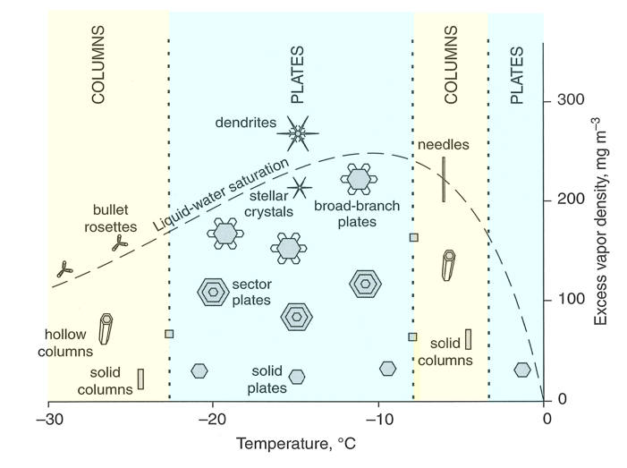

Slide 20
How to capture shape in numerical models?
$$\text{Want} \text{to} \text{capture} \text{primary} \text{habit} \text{at} \text{least}\text{.}$$
$$φ=\frac{c}{a}<1$$
$$φ=\frac{c}{a}>1$$
a
a
c
a
c
$$\text{Analytically} \text{difficult} \text{to}\text{ ”}\text{model}\text{” }\text{hexagons}\text{.}$$
c
$$\text{Use} \text{spheroids} \text{instead}\text{.}$$
a
c
a
a
Oblate spheroid
c
Prolate spheroid

Slide 21
How to capture shape in numerical models?
$$\text{Want} \text{to} \text{capture} \text{primary} \text{habit} \text{at} \text{least}\text{.}$$
$$φ=\frac{c}{a}<1$$
$$φ=\frac{c}{a}>1$$
a
a
c
a
c
$$\text{Analytically} \text{difficult} \text{to}\text{ ”}\text{model}\text{” }\text{hexagons}\text{.}$$
c
$$\text{Use} \text{spheroids} \text{instead}\text{.}$$
a
c
a
a
Oblate spheroid
Volume for both types of spheroid
(4/3 π)$a^{2}c$
c
Prolate spheroid

Slide 22
How to quantify?
To form a plate, the a-axis must grow faster than the c-axis
To form a column, the c-axis must grow faster than the a-axis
Otherwise, a=c=r → sphere!
“Attachment physics” guides vapor to attach (or incorporate into) either the hexagonal (basal) or rectangular (prism) face
What ensures that vapor diffuses toward those edges?
Recall for a sphere:
Equivalent flux of vapor surrounding particle because $∆ρ_{v}$ symmetry follows spherical symmetry
$$ρ_{v∞}$$

Slide 23
Quantify Vapor Flux for Non-Spheres
As size decreases, curvature increases, increasing the flux of vapor.
Less vapor taken up per unit area
Smaller $∆ρ_{v}$
Smaller flux
$F_{v}∝\frac{1}{r}$ = curvature
More vapor taken up per unit area
Larger flux
Larger $∆ρ_{v}$
Fundamental result of diffusion theory, due to mass conservation

Slide 24
Impact of Curvature
$$F_{c}$$
$$F_{a}$$
a
c
Two primary fluxes:
$F_{a}$ → Flux of vapor onto a-axis $∝\frac{∂ρ_{v}}{∂a}$
$$F_{c}$$
$F_{c}$ → Flux of vapor onto c-axis $∝\frac{∂ρ_{v}}{∂c}$
Flux / gradient depends on curvature:
$F_{a}$ $∝\frac{1}{c}$
(smaller $c$, larger $F_{a}$)
(larger $c$, smaller $F_{a}$)
$F_{c}$ $∝\frac{1}{a}$
(smaller $a$, larger $F_{c}$)
(larger $a$, smaller $F_{c}$)
a
$$F_{a}$$
c

Slide 25
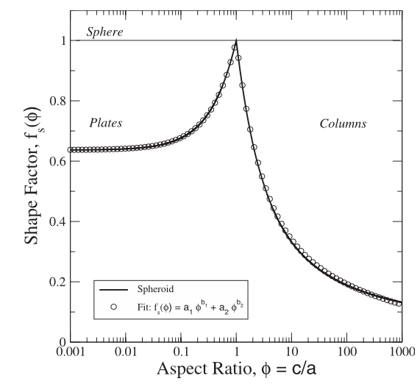
Shape Factor
$f_{ob} \& f_{pr}$ fall as habit becomes more extreme
When $c=a=r, f=1→$ spherical growth
$$F_{v}=\frac{D_{v}∆ρ_{v}}{r}$$
PLATE (OBLATE)
SPHERES
$$F_{a}=\frac{D_{v}∆ρ_{v}}{c}f_{ob}(φ)$$
$$F_{c}=\frac{D_{v}∆ρ_{v}}{a}f_{ob}(φ)$$
COLUMN (PROLATE)
$$F_{a}=\frac{D_{v}∆ρ_{v}}{c}φ f_{pr}(φ)$$
$$F_{c}=\frac{D_{v}∆ρ_{v}}{a}φ f_{pr}(φ)$$
Shape Factor, $f$
$$f_{pr}(φ)=\frac{\sqrt{1−\frac{1}{φ^{2}}}}{\ln\left[\left(1+\sqrt{1−\frac{1}{φ^{2}}}\right)φ\right]}$$
$$f_{ob}(φ)=\frac{\sqrt{1−φ^{2}}}{\sin{(\sqrt{1−φ^{2}})}}$$

Slide 26
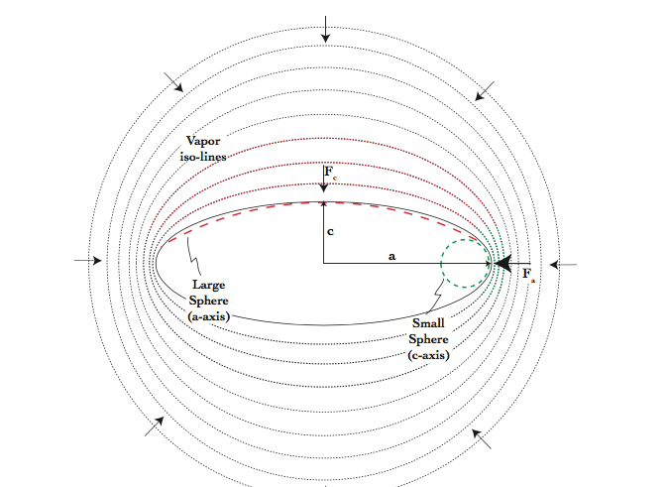
Shape Factor, $f$
$$F_{c}$$
Derives from Capacitance Theory in Electromagnetism
Accounts for
Curvature effect (larger flux where curvature is larger)
Lateral Flux (a secondary flux along the surface flowing from low → high vapor density)
$$F_{a}$$
Knowing the fluxes in the a- and c-directions allows us to find the rate of increase in a and c, and hence, mass.

Slide 27
Mass Growth Equation
Example: Growth of the $a$ axis.
$$∆a$$
$$F_{a}∆t=ρ_{i}∆a$$
$$a$$
$$\frac{F_{a}}{ρ_{i}}=\frac{da}{dt}$$
$$F_{a}$$
$$\text{density}\text{:} ρ_{i}$$
$$\frac{F_{c}}{ρ_{i}}=\frac{dc}{dt}$$
Flux in $a$-direction: $F_{a}∆t \left[=\right]$ kg m⁻²
Mass growth for a spheroid
What is the rate of change in mass?
Total mass added per m² to $a$ in time $∆t$
$$m=\frac{4}{3}πa^{2}cρ_{i}$$
$\frac{dm}{dt}=\frac{4}{3}πρ_{i}(2ac)\frac{da}{dt}$ + $\frac{4}{3}πρ_{i}(a^{2})\frac{dc}{dt}$
Increase in $a$: $ρ_{i}∆a \left[=\right]$ kg m⁻²
Mass added per m² will increase $a$ BUT density will be that of the crystal (not vapor)
$$\frac{dm}{dt}=4π\left[\frac{2}{3}acF_{a}\text{+ }\frac{1}{3}a^{2}F_{c} \right]$$

Slide 28
Mass Growth for a Spheroid
$$\frac{dm}{dt}=4π\left[\frac{2}{3}acF_{a}\text{+ }\frac{1}{3}a^{2}F_{c} \right]$$
Total mass flow to grow the c-axis
$$F_{c}$$
a
a
Total mass flow to grow the a-axis
$$F_{c}$$
a
a
a
a
$$F_{a}$$
c
c
a
c
a
c
$$F_{a}$$

Slide 29
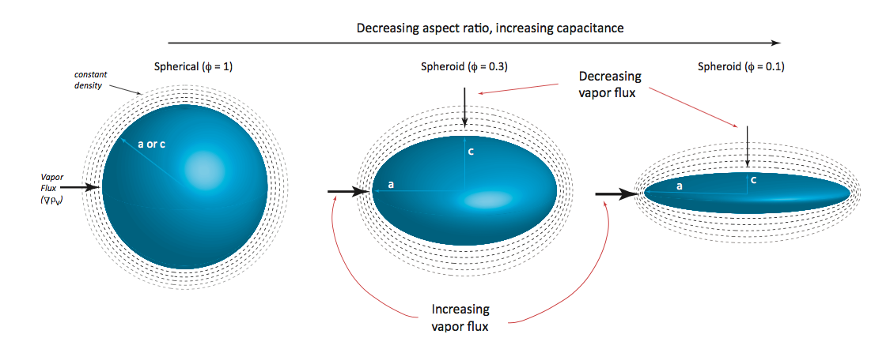
Mass Growth
Plate Example:
Because $ac<a^{2}$ and $ac$ falls quickly as $φ$ decreases, vapor gradients tighten at edges, accelerating diffusive flow and enhancing growth.

Slide 30
Mass Growth of a Spheroid, Cont.
PLATE (OBLATE)
$$F_{a}=\frac{D_{v}∆ρ_{v}}{c}f_{ob}(φ)$$
$$\frac{dm}{dt}=4π\left[\frac{2}{3}ac\frac{D_{v}∆ρ_{v}}{c}f_{ob}(φ) \text{+ }\frac{1}{3}a^{2}\frac{D_{v}∆ρ_{v}}{a}f_{ob}(φ)\right]$$
$$F_{c}=\frac{D_{v}∆ρ_{v}}{a}f_{ob}(φ)$$
$$\frac{dm}{dt}=4π{af}_{ob}\left(φ\right)D_{v}∆ρ_{v}$$
$$\frac{dm}{dt}=4π\left[\frac{2}{3}acF_{a}\text{+ }\frac{1}{3}a^{2}F_{c} \right]$$
$$\frac{dm}{dt}=4πC(c,a)D_{v}∆ρ_{v}$$
$$\frac{dm}{dt}=4π{cf}_{pr}\left(φ\right)D_{v}∆ρ_{v}$$
COLUMN (PROLATE)
$$F_{a}=\frac{D_{v}∆ρ_{v}}{c}φ f_{pr}(φ)$$
$$\frac{dm}{dt}=4π\left[\frac{2}{3}ac\frac{D_{v}∆ρ_{v}}{c}φ f_{pr}(φ) \text{+ }\frac{1}{3}a^{2}\frac{D_{v}∆ρ_{v}}{a}φ f_{pr}(φ)\right]$$
$$F_{c}=\frac{D_{v}∆ρ_{v}}{a}φ f_{pr}(φ)$$

Slide 31
Mass Growth of a Spheroid, Cont.
PLATE (OBLATE)
$$F_{a}=\frac{D_{v}∆ρ_{v}}{c}f_{ob}(φ)$$
$$\frac{dm}{dt}=4π\left[\frac{2}{3}ac\frac{D_{v}∆ρ_{v}}{c}f_{ob}(φ) \text{+ }\frac{1}{3}a^{2}\frac{D_{v}∆ρ_{v}}{a}f_{ob}(φ)\right]$$
Capacitance
$$F_{c}=\frac{D_{v}∆ρ_{v}}{a}f_{ob}(φ)$$
$$\frac{dm}{dt}=4π{af}_{ob}\left(φ\right)D_{v}∆ρ_{v}$$
$$C\left(c,a\right)= \left\{\begin{aligned}{af}_{ob}\left(φ\right) , plate \\ {cf}_{pr}\left(φ\right), column\end{aligned}\right.$$
$$\frac{dm}{dt}=4π\left[\frac{2}{3}acF_{a}\text{+ }\frac{1}{3}a^{2}F_{c} \right]$$
$$\frac{dm}{dt}=4πC(c,a)D_{v}∆ρ_{v}$$
$$\frac{dm}{dt}=4π{cf}_{pr}\left(φ\right)D_{v}∆ρ_{v}$$
COLUMN (PROLATE)
$$F_{a}=\frac{D_{v}∆ρ_{v}}{c}φ f_{pr}(φ)$$
$$\frac{dm}{dt}=4π\left[\frac{2}{3}ac\frac{D_{v}∆ρ_{v}}{c}φ f_{pr}(φ) \text{+ }\frac{1}{3}a^{2}\frac{D_{v}∆ρ_{v}}{a}φ f_{pr}(φ)\right]$$
$$F_{c}=\frac{D_{v}∆ρ_{v}}{a}φ f_{pr}(φ)$$

Slide 32
Mass Growth, Cont.
Thermal Diffusion
(Just as in drop growth)
$$∆ρ_{v}=\left[ρ_{v∞}−ρ_{vi}(T_{i})\right]$$
…follow same procedure as for drop growth…
Equilibrium Vapor Density over Ice: $ρ_{vi}\left(T_{i}\right)=\frac{e_{i}\left(T_{i}\right)}{R_{v}T_{i}}$
Replace $T_{i}$ with $T_{∞}=T$
Expand $ρ_{v}{(T}_{i})$ in Taylor Series
Use $L_{s}\frac{dm}{dt}=4πC\left(c,a\right)K_{T}∆T$
$$\frac{dm}{dt}=4πC\left(c,a\right)G_{i}(T,P)S_{i}$$
Capacitance:
For a particle with the same volume, $C>r$ for plates and columns
$C$ increases as $φ$ deviates further from 1.
Growth of a non-sphere is much larger than for a sphere
$S_{i}=\frac{e}{e_{i}}−1$
$$G_{i}(T,P)=\left[\frac{R_{v}T}{D_{v}e_{i}}+\frac{L_{s}}{K_{T}}\left(\frac{L_{s}}{R_{v}T^{2}}−\frac{1}{T}\right)\right]$$

Slide 33
Bergeron Process
Mixed-Phase Region
Ice typically forms in clouds that contain some liquid if T > -38$℃$
Many smaller drops ($N_{d}\sim 100−1000 cm^{−3}$ / $r_{d} \sim 10−20μm$)
Few crystals ($N_{i}\sim 1−1000 L^{−1}$ / $r_{i} \sim 100−1000μm$)
ICE
*
Ice growth in mixed-phase clouds
*
$$\frac{dm}{dt}=4πC\left(c,a\right)G_{i}(T,P){ S}_{ui}$$
e
*
*
*
$$−38℃$$
$$\frac{dm}{dt}=4πC\left(c,a\right)G_{i}\left(T,P\right){(S}_{i}−1)$$
Mixed-Phase
*
*
*
*
$$\frac{dm}{dt}=4πC\left(c,a\right)G_{i}(T,P)\left(\frac{e−e_{i}}{e_{i}}\right)$$
T
*
e_{s}-e_{i}
*
$$−5℃$$
$$0℃$$
LIQUID
T
Bergeron Process
T ~ -12C
T_{o}
In mixed-phase clouds with many drops → $e \sim e_{s}(T)$
Since $e_{s}>e_{i}$ → ice grows, drops evaporate, keeping $e \sim e_{s}(T)$
Ice growth most rapid where $e_{s}−e_{i}$ maximizes at $\sim −12℃$

Slide 34
Condensational Growth Equations Summary Sheet
Liquid water droplets
Oblate (plate-like) ice particles
Mass flux to a droplet (g/cm²/s): $F=\frac{D_{v}∆ρ_{v}}{{(D}_{p}/2)}=\frac{ρ_{L}}{2}\frac{dD_{p}}{dt}$
$D_{v}$ = H₂O vapor Diffusivity (m²/s)
$∆ρ_{v}$ = Mass density gradient (g/cm³)
$D_{p}$ = Droplet diameter (um)
$$\frac{dm}{dt}=FxA=\left(\frac{D_{v}∆ρ_{v}}{(D_{p}/2)}\right)\left(πD_{p}^{2}\right)$$
$$\frac{dm}{dt}=2πD_{p}D_{v}\left[ρ_{v}\left(∞\right)−ρ_{v}(D_{p})\right]$$
$$\frac{dD_{p}}{dt}=\frac{dm}{dt}\frac{dD_{p}}{dm}=\frac{4D_{v}\left[ρ_{v}\left(∞\right)−ρ_{v}(D_{p},T,x_{s})\right]}{D_{p}ρ_{L}}$$
Mass flux to a-axis (g/cm²/s): $F_{a}=\frac{D_{v}∆ρ_{v}}{c}f\left(φ\right)$ $= ρ_{i}\frac{da}{dt}$
Mass flux to c-axis (g/cm²/s): $F_{c}=\frac{D_{v}∆ρ_{v}}{a}f\left(φ\right)$ $=$ $ρ_{i}\frac{dc}{dt}$
$D_{v}$ = H₂O vapor Diffusivity (m²/s)
$∆ρ_{v}$ = Mass density gradient (g/cm³)
$a$ = radius of basal face (hexagonal) (um)
$c$ = radius of prism face (rectangular) (um)
$f(φ)$= shape factor (accounts for lateral flux & curvature)
$$\frac{dm}{dt}=\frac{dm}{da}\frac{da}{dt}+\frac{dm}{dc}\frac{dc}{dt}=\frac{4}{3}πρ_{i}(2ac)\frac{da}{dt}\text{ + }\frac{4}{3}πρ_{i}(a^{2})\frac{dc}{dt}$$
$$\frac{dm}{dt}=4π\left[\frac{2}{3}acF_{a}\text{+ }\frac{1}{3}a^{2}F_{c} \right]$$
$$\frac{dm}{dt}=4πD_{v}af_{ob}\left(φ\right)\left[ρ_{v∞}−ρ_{vi}(T)\right]$$
Mass of a sphere:
$$m=\frac{π}{6}D_{p}^{3}ρ_{L}$$
$$\frac{dm}{dD_{p}}=\frac{π}{2}D_{p}^{2}ρ_{L}$$
Mass of a spheroid:
$$m=\frac{4π}{3}a^{2}cρ_{i}$$
$$\frac{dm}{da}=\frac{4π}{3}{(2ac)ρ}_{i}$$
$$\frac{dm}{dc}=\frac{4π}{3}{a^{2}ρ}_{i}$$

Slide 35
Condensational Growth Equations Summary Sheet
Liquid water droplets
Prolate (columner) ice particles
Mass flux to a droplet (g/cm²/s): $F=\frac{D_{v}∆ρ_{v}}{{(D}_{p}/2)}=\frac{ρ_{L}}{2}\frac{dD_{p}}{dt}$
$D_{v}$ = H₂O vapor Diffusivity (m²/s)
$∆ρ_{v}$ = Mass density gradient (g/cm³)
$D_{p}$ = Droplet diameter (um)
$$\frac{dm}{dt}=FxA=\left(\frac{D_{v}∆ρ_{v}}{(D_{p}/2)}\right)\left(πD_{p}^{2}\right)$$
$$\frac{dm}{dt}=2πD_{p}D_{v}\left[ρ_{v}\left(∞\right)−ρ_{v}(D_{p})\right]$$
$$\frac{dD_{p}}{dt}=\frac{dm}{dt}\frac{dD_{p}}{dm}=\frac{4D_{v}\left[ρ_{v}\left(∞\right)−ρ_{v}(D_{p},T,x_{s})\right]}{D_{p}ρ_{L}}$$
Mass flux to a-axis (g/cm²/s): $F_{a}=\frac{D_{v}∆ρ_{v}}{c}f\left(φ\right)$ $= ρ_{i}\frac{da}{dt}$
Mass flux to c-axis (g/cm²/s): $F_{c}=\frac{D_{v}∆ρ_{v}}{a}f\left(φ\right)$ $=$ $ρ_{i}\frac{dc}{dt}$
$D_{v}$ = H₂O vapor Diffusivity (m²/s)
$∆ρ_{v}$ = Mass density gradient (g/cm³)
$a$ = radius of basal face (hexagonal) (um)
$c$ = radius of prism face (rectangular) (um)
$f(φ)$= shape factor (accounts for lateral flux & curvature)
$$\frac{dm}{dt}=\frac{dm}{da}\frac{da}{dt}+\frac{dm}{dc}\frac{dc}{dt}=\frac{4}{3}πρ_{i}(2ac)\frac{da}{dt}\text{ + }\frac{4}{3}πρ_{i}(a^{2})\frac{dc}{dt}$$
$$\frac{dm}{dt}=4π\left[\frac{2}{3}acF_{a}\text{+ }\frac{1}{3}a^{2}F_{c} \right]$$
$$\frac{dm}{dt}=4πD_{v}cf_{pr}\left(φ\right)\left[ρ_{v∞}−ρ_{vi}(T)\right]$$
Mass of a sphere:
$$m=\frac{π}{6}D_{p}^{3}ρ_{L}$$
$$\frac{dm}{dD_{p}}=\frac{π}{2}D_{p}^{2}ρ_{L}$$
Mass of a spheroid:
$$m=\frac{4π}{3}a^{2}cρ_{i}$$
$$\frac{dm}{da}=\frac{4π}{3}{(2ac)ρ}_{i}$$
$$\frac{dm}{dc}=\frac{4π}{3}{a^{2}ρ}_{i}$$

Slide 36
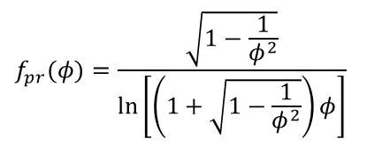
Shape Factor
$f_{ob} \& f_{pr}$ fall as habit becomes more extreme
When $c=a=r, f=1→$ spherical growth
$$F_{v}=\frac{D_{v}∆ρ_{v}}{r}$$
PLATE (OBLATE)
SPHERES
$$F_{a}=\frac{D_{v}∆ρ_{v}}{c}f_{ob}(φ)$$
$$F_{c}=\frac{D_{v}∆ρ_{v}}{a}f_{ob}(φ)$$
COLUMN (PROLATE)
$$F_{a}=\frac{D_{v}∆ρ_{v}}{c}φ f_{pr}(φ)$$
$$F_{c}=\frac{D_{v}∆ρ_{v}}{a}φ f_{pr}(φ)$$
Shape Factor, $f$
$$f_{pr}(φ)=\frac{\sqrt{1−\frac{1}{φ^{2}}}}{\ln\left[\left(1+\sqrt{1−\frac{1}{φ^{2}}}\right)φ\right]}$$
$$f_{ob}(φ)=\frac{\sqrt{1−φ^{2}}}{\sin{(\sqrt{1−φ^{2}})}}$$
$$φ=\frac{c}{a}$$

Slide 37
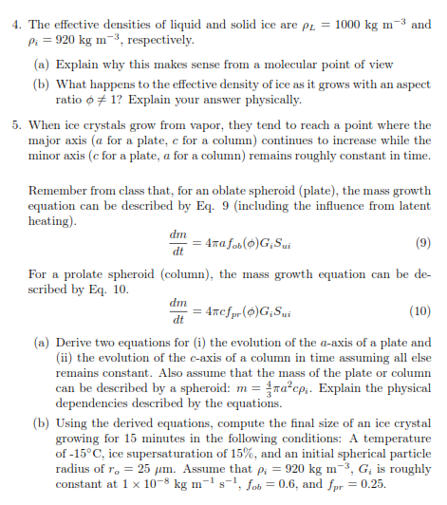
Last two Homework Questions

Slide 38
Last two Homework Questions
Supersaturation with respect to ice, $s_{ui}$
$\text{(}\text{Saturation} \text{ratio}\text{)} S_{ui}=\frac{e_{∞}}{e_{i}(T)}$
$\text{(}\text{S}\text{upersaturation}\text{)} s_{ui}=\frac{e_{∞}}{e_{i}(T)}−1$
$e_{i}$(T) = saturated vapor pressure over ice
$e_{∞}$ = H₂O vapor partial pressure

Slide 39
Last two Homework Questions
What is this G parameter?
$$G={\left[\frac{R_{v}T}{D_{v}e_{sat}(T)}+\left(\frac{L_{v}}{R_{v}T^{2}}−\frac{1}{T}\right)\frac{L_{v}}{K_{T}}\right]}^{−1}$$
Recall from our summary sheet
for a plate:
$$\frac{dm}{dt}=4πaf_{ob}\left(φ\right)D_{v}\left[ρ_{v∞}−ρ_{vi}(T)\right]$$
for a columns
$$\frac{dm}{dt}=4πcf_{pr}\left(φ\right)D_{v}\left[ρ_{v∞}−ρ_{vi}(T)\right]$$
$$\frac{\left[e_{∞}−e_{i}(T)\right]}{R_{v}T}= \frac{e_{i}\left(T\right)\left[S_{∞}−1\right]}{R_{v}T}$$

Slide 40
Last two Homework Questions
What is this G parameter?
$$G={\left[\frac{R_{v}T}{D_{v}e_{sat}(T)}+\left(\frac{L_{v}}{R_{v}T^{2}}−\frac{1}{T}\right)\frac{L_{v}}{K_{T}}\right]}^{−1}$$
Recall from our summary sheet
for a plate:
$$\frac{dm}{dt}=4πaf_{ob}\left(φ\right)D_{v}\left[ρ_{v∞}−ρ_{vi}(T)\right]$$
for a columns
$$\frac{dm}{dt}=4πcf_{pr}\left(φ\right)D_{v}\left[ρ_{v∞}−ρ_{vi}(T)\right]$$
When accounting for both heat and mass transfer,
$G_{i}$ replaces $e_{i}\left(T\right)D_{v}/R_{v}T$ in the mass growth equation
$$\frac{\left[e_{∞}−e_{i}(T)\right]}{R_{v}T}= \frac{e_{i}\left(T\right)\left[S_{∞}−1\right]}{R_{v}T}$$

Slide 41
So what is this G parameter in the hw?
Diffusivity of vapor and heat
For a water drop:
For an ice particle:
Latent enthalpy of vaporization
$$G={\left[\frac{R_{v}T}{D_{v}e_{sat}(T)}+\left(\frac{L_{v}}{R_{v}T^{2}}−\frac{1}{T}\right)\frac{L_{v}}{K_{T}}\right]}^{−1}$$
Saturation vapor pressure wrt water
Latent enthalpy of sublimation
$$G={\left[\frac{R_{v}T}{D_{v}e_{i}(T)}+\left(\frac{L_{s}}{R_{v}T^{2}}−\frac{1}{T}\right)\frac{L_{s}}{K_{T}}\right]}^{−1}$$
Saturation vapor pressure wrt ice

Slide 42
Quantify steady-state diffusional growth
$$\frac{dm}{dt}=4πr^{2}F_{v}$$
$F_{v}$ depends on how quickly diffusion can transport vapor to the surface following the gradient in vapor density, $ρ_{v}$
$$F_{v}=−D_{v}∇ρ_{v}={−D}_{v}\frac{∂ρ_{v}}{∂R}$$
Mass growth rate of particle
[kg s⁻¹]
Particle surface area
[m²]
Mass flux onto particle
[kg m⁻² s⁻¹]
$D_{v}→$ VAPOR DIFFUSIVITY
$→$ measure of how quickly molecules move in a gas ($T$)
$→$ air molecules can collide, changing the transport rate ($P$)
Determining $F_{v}$ requires knowing $ρ_{v}$ at some distance $R$
Assuming steady-state & mass conservation, $F_{v}$ through ${4πR}_{1}^{2}$ must equal $F_{v}$ through ${4πR}_{2}^{2}$:
$$r$$
$$R_{1}$$
$$R_{2}$$
${4πR}_{1}^{2}D_{v}$ ${\left.\frac{∂ρ_{v}}{∂R}\right|}_{R_{1}}={4πR}_{2}^{2}D_{v} {\left.\frac{∂ρ_{v}}{∂R}\right|}_{R_{2}}$
$R^{2}\frac{∂ρ_{v}}{∂R}=C$ (constant)
What is C?

Slide 43
$$F_{v}= ?$$
$$R^{2}\frac{∂ρ_{v}}{∂R}=C$$
$$0$$
$$\lim_{R→∞}{ρ_{v}\left(R\right)}$$
$$ρ_{v}\left(R\right)=ρ_{vs}\left(T_{d}\right)+\frac{C}{r}−\frac{C}{R}$$
$$\int_{ρ_{vs}(T_{d})}^{ρ_{v}(R)}{∂ρ_{v}}$$
$$\int_{R=r}^{R}{\frac{C}{R^{2}}∂R}$$
$$ρ_{v∞}=ρ_{vs}\left(T_{d}\right)+\frac{C}{r}$$
$$∂ρ_{v}= \frac{C}{R^{2}}∂R$$
$${C=r(ρ}_{v∞}−ρ_{vs})$$
$$ρ_{v}\left(R\right)=ρ_{vs}\left(T_{d}\right)+C\left(\frac{1}{r}−\frac{1}{R}\right)$$
$$=\frac{C}{r}−\frac{C}{R}$$
$$ρ_{v}\left(R\right)=ρ_{vs}\left(T_{d}\right)+{r(ρ}_{v∞}−ρ_{vs})\left(\frac{1}{r}−\frac{1}{R}\right)$$
$$ρ_{v}\left(R\right)−ρ_{vs}(T_{d})$$
Assumptions:
$$ρ_{v}\left(R=r\right)=ρ_{vs}(T_{d})$$
$$ρ_{v} \left(R→∞\right)=ρ_{v∞}$$
Derive on your own as we go…
$$ρ_{v}\left(R\right)=ρ_{vs}\left(T_{d}\right)+\frac{C}{r}−\frac{C}{R}$$
$$ρ_{v}\left(R\right)=ρ_{vs}\left(T_{d}\right)+{(ρ}_{v∞}−ρ_{vs})−{(ρ}_{v∞}−ρ_{vs})\frac{r}{R}$$
$$ρ_{v}\left(R\right)=ρ_{v∞}−{(ρ}_{v∞}−ρ_{vs})\frac{r}{R}$$
Steady-State Vapor Profile
$$ρ_{v}\left(R\right)−ρ_{v∞}$$
$$=−{(ρ}_{v∞}−ρ_{vs})\frac{r}{R}$$
$$=R\frac{∂ρ_{v}}{∂R}$$
RECALL: $F_{v}=−D_{v}{\left.\frac{∂ρ_{v}}{∂R}\right|}_{R=r}$
$$−{(ρ}_{v∞}−ρ_{vs}) \frac{r}{R^{2}}$$
$$=−D_{v}{\left[ \right]}_{R=r}$$
$D_{v}→$ How quickly vapor molecules travel through the air (T, P)
$ρ_{v∞}−ρ_{vs}→$ vapor density gradient, controls the directional flow (and rate) at which molecules travel form one point ($∞$) to another ($s$).
$$F_{v}=D_{v}\frac{{(ρ}_{v∞}−ρ_{vs})}{r}$$
$r→$ the length (width or height) onto which traveled vapor molecules can attach.
Vapor Flux Toward the Drop
NOTE: $F_{v}∝\frac{1}{r}→$vapor flux increases as size ($r$) decreases

Slide 44
revisit mass growth equation (Derive on your own…)
$$\frac{dm}{dt}=4πr^{2}F_{v}$$
$$F_{v}=D_{v}\frac{{(ρ}_{v∞}−ρ_{vs}(T_{d}))}{r}$$
Do not know $ρ_{vs}$ because cannot measure $T_{d}$, but can measure $T_{∞}$ (temperature of the environment)
To replace $T_{d}$ with $T_{∞}$ , expand $ρ_{vs}(T_{d})$in a Taylor series where $∆T=T_{d}−T_{∞}$
$$\frac{dm}{dt}=4πrD_{v}{(ρ}_{v∞}−ρ_{vs}(T_{d}))$$
$$ρ_{vs}\left(T_{d}\right)≅ρ_{vs}\left(T_{∞}\right)+{\left.\frac{∂ρ_{vs}}{∂T}\right|}_{T_{∞}}∆T$$
Keep only 1st term since $∆T$ is small
Mass growth rate of particle
[kg s⁻¹]
Particle surface area
[m²]
Mass flux onto particle
[kg m⁻² s⁻¹]
$\frac{∂ρ_{vs}}{∂T}=ρ_{vs}$ $\left(\frac{L_{v}}{R_{v}T^{2}}−\frac{1}{T}\right)$
Ideal Gas Law
Need $\frac{∂ρ_{vs}}{∂T}$, let $T_{∞}≡T$
Ideal Gas Law!
$ρ_{vs}\left(T_{d}\right)≅ρ_{vs}\left(T_{∞}\right){+ ρ}_{vs}$ $\left(\frac{L_{v}}{R_{v}T^{2}}−\frac{1}{T}\right)$ $∆T$
$\frac{∂ρ_{vs}}{∂T}=\frac{1}{R_{v}T}$ $\left(\frac{e_{s}L_{v}}{R_{v}T^{2}}−\frac{e_{s}}{T}\right)$
$$\frac{∂ρ_{vs}}{∂T}=\frac{∂}{∂T}\left(\frac{e_{s}}{R_{v}T}\right)$$
Still don’t know $∆T$!
Chain Rule!
$$ρ_{vs}\left(T_{d}\right)≅ρ_{vs}\left(T_{∞}\right)\left[1\text{+} \left(\frac{L_{v}}{R_{v}T^{2}}−\frac{1}{T}\right) ∆T\right]$$
$$\frac{∂}{∂T}\left(\frac{e_{s}}{R_{v}T}\right)=\frac{∂e_{s}}{∂T}\left(\frac{1}{R_{v}T}\right)−\frac{e_{s}}{R_{v}T^{2}}$$
$$\frac{dm}{dt}=\frac{4πrD_{v}}{R_{v}T}\left\{e−e_{s}\left[1+\left(\frac{L_{v}}{R_{v}T^{2}}−\frac{1}{T}\right) ∆T\right]\right\}$$
$$\frac{∂}{∂T}\left(\frac{e_{s}}{R_{v}T}\right)=\frac{1}{R_{v}T}\left(\frac{∂e_{s}}{∂T}−\frac{e_{s}}{T}\right)$$
Ideal Gas Law
$\frac{dm}{dt}=4πrD_{v}$ $\left\{ρ_{v∞}−ρ_{vs}\left(T_{∞}\right)\left[1\text{+} \left(\frac{L_{v}}{R_{v}T^{2}}−\frac{1}{T}\right) ∆T\right]\right\}$
Clausius-Clapeyron:
$$\frac{∂e_{s}}{∂T}=\frac{e_{s}L_{v}}{R_{v}T^{2}}$$

Slide 45
Mass growth equation, cont. (Derive on your own…)
Need $∆T$, use thermal flux/diffusivity!
$$F_{T}=K_{T}{\left.\frac{∂T}{∂R}\right|}_{R=r}$$
Flow of total Kinetic Energy ($∝T$) away from particle. Look familiar? Analogous to $ρ_{v}$ and $F_{v}$
$$\frac{dm}{dt}=\frac{4πrD_{v}}{R_{v}T}\left\{e−e_{s}\left[1+\left(\frac{L_{v}}{R_{v}T^{2}}−\frac{1}{T}\right)\frac{L_{v}}{4πrK_{T}}\frac{dm}{dt}\right]\right\}$$
Since latent heating generates the energy that flows away from the particle…
$$F_{T}=K_{T}\frac{∆T}{r}$$
$$T\left(R\right)=T_{∞}+∆T\frac{r}{R}$$
$$\frac{dm}{dt}=\frac{4πrD_{v}}{R_{v}T}\left\{e−e_{s}−\left(\frac{L_{v}}{R_{v}T^{2}}−\frac{1}{T}\right)\frac{L_{v}e_{s}}{4πrK_{T}}\frac{dm}{dt}\right\}$$
$$L_{v}\frac{dm}{dt}=4πr^{2}F_{T}$$
$$L_{v}\frac{dm}{dt}=4πr^{2}K_{T}\frac{∆T}{r}$$
$\frac{dm}{dt}=\frac{4πrD_{v}}{R_{v}T}\left(e−e_{s}\right)$ $−\frac{4πrD_{v}}{R_{v}T}\left(\frac{L_{v}}{R_{v}T^{2}}−\frac{1}{T}\right)\frac{L_{v}e_{s}}{4πrK_{T}}\frac{dm}{dt}$
$$G={\left[\frac{R_{v}T}{D_{v}e_{s}}+\left(\frac{L_{v}}{R_{v}T^{2}}−\frac{1}{T}\right)\frac{L_{v}}{K_{T}}\right]}^{−1}$$
Generate energy due to mass growth
Flow away via diffusion
$$∆T=\frac{L_{v}}{4πrK_{T}}\frac{dm}{dt}$$
$$\frac{dm}{dt}+\frac{D_{v}}{R_{v}T}\left(\frac{L_{v}}{R_{v}T^{2}}−\frac{1}{T}\right)\frac{L_{v}e_{s}}{K_{T}}\frac{dm}{dt}=\frac{4πrD_{v}}{R_{v}T}\left(e−e_{s}\right)$$
$$\frac{dm}{dt}\left[\frac{R_{v}T}{D_{v}e_{s}}+\left(\frac{L_{v}}{R_{v}T^{2}}−\frac{1}{T}\right)\frac{L_{v}}{K_{T}}\right]=4πr\left(S−1\right)$$
$$\frac{dm}{dt}\left[1+\frac{D_{v}}{R_{v}T}\left(\frac{L_{v}}{R_{v}T^{2}}−\frac{1}{T}\right)\frac{L_{v}e_{s}}{K_{T}}\right]=\frac{4πrD_{v}}{R_{v}T}e_{s}\left(S−1\right)$$
$$\frac{dm}{dt}=4πrG\left(S−1\right)$$
$$\frac{dm}{dt}=\frac{4πrD_{v}}{R_{v}T}\left\{e−e_{s}\left[1+\left(\frac{L_{v}}{R_{v}T^{2}}−\frac{1}{T}\right) ∆T\right]\right\}$$
$4πr→$ Size of particle
$G→$ diffusivity of vapor & heat
$(S−1)→$ ambient supersaturation

Slide 46
Bergeron Process
Mixed-Phase Region
Ice typically forms in clouds that contain some liquid if T > -38$℃$
Many smaller drops ($N_{d}\sim 100−1000 cm^{−3}$ / $r_{d} \sim 10−20μm$)
Few crystals ($N_{i}\sim 1−1000 L^{−1}$ / $r_{i} \sim 100−1000μm$)
ICE
*
*
*
*
*
$$−38℃$$
e
e_{sat} - e_{i}
Mixed-Phase
*
*
*
*
*
*
T
T
T ~ -12C
T_{o}
T ~ -12C
T_{o}
$$−5℃$$
$$0℃$$
LIQUID
Bergeron Process
In mixed-phase clouds with many drops → $e \sim e_{sat}(T)$
Since $e_{sat}>e_{i}$ → ice grows, drops evaporate, keeping $e \sim e_{sat}(T)$
Ice growth most rapid where $e_{sat}−e_{i}$ maximizes at $\sim −12℃$

