Slide 1
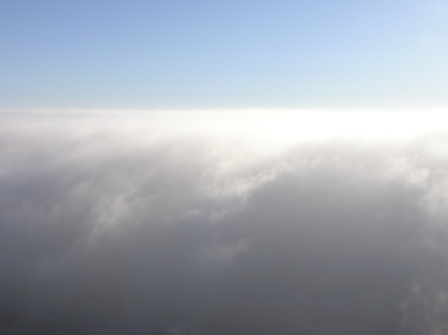
Cloud Microphysics
(ATM505 Module 4, 24 Apr 2023)
Cloud droplet formation (nucleation)
  Saturation vapor pressure of a droplet
    Surface tension term + Solute term = Köhler theory
    kappa-Köhler theory
Droplet growth by condensation
Cloud supersaturation
Droplet growth by collision-coalescence
Ice nucleation and vapor depositional growth
Mixed-phase clouds
Dr. S. Lance

Slide 2

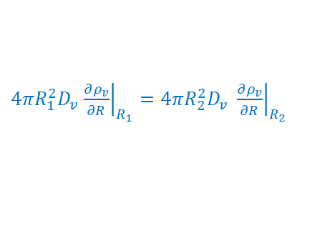





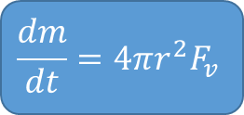


Quantify steady-state diffusional growth
$$\frac{dm}{dt}=4πr^{2}F_{v}$$
$F_{v}$ depends on how quickly diffusion can transport vapor to the surface following the gradient in vapor density, $ρ_{v}$
$$F_{v}=−D_{v}∇ρ_{v}={−D}_{v}\frac{∂ρ_{v}}{∂R}$$
Mass growth rate of particle
[kg s⁻¹]
Particle surface area
[m²]
Mass flux onto particle
[kg m⁻² s⁻¹]
$D_{v}→$ VAPOR DIFFUSIVITY
$→$ measure of how quickly molecules move in a gas ($T$)
$→$ air molecules can collide, changing the transport rate ($P$)
Determining $F_{v}$ requires knowing $ρ_{v}$ at some distance $R$
Assuming steady-state & mass conservation, $F_{v}$ through ${4πR}_{1}^{2}$ must equal $F_{v}$ through ${4πR}_{2}^{2}$:
$$r$$
$$R_{1}$$
$$R_{2}$$
${4πR}_{1}^{2}D_{v}$ ${\left.\frac{∂ρ_{v}}{∂R}\right|}_{R_{1}}={4πR}_{2}^{2}D_{v} {\left.\frac{∂ρ_{v}}{∂R}\right|}_{R_{2}}$
$R^{2}\frac{∂ρ_{v}}{∂R}=C$ (constant)
What is C?

Slide 3




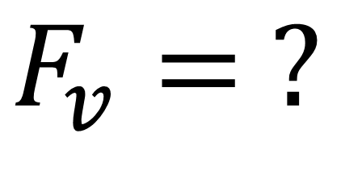











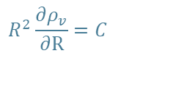

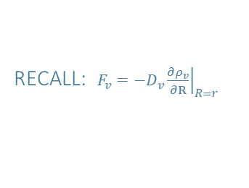




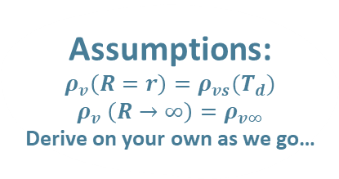



$$F_{v}= ?$$
$$R^{2}\frac{∂ρ_{v}}{∂R}=C$$
$$0$$
$$\lim_{R→∞}{ρ_{v}\left(R\right)}$$
$$ρ_{v}\left(R\right)=ρ_{vs}\left(T_{d}\right)+\frac{C}{r}−\frac{C}{R}$$
$$\int_{ρ_{vs}(T_{d})}^{ρ_{v}(R)}{∂ρ_{v}}$$
$$\int_{R=r}^{R}{\frac{C}{R^{2}}∂R}$$
$$ρ_{v∞}=ρ_{vs}\left(T_{d}\right)+\frac{C}{r}$$
$$∂ρ_{v}= \frac{C}{R^{2}}∂R$$
$${C=r(ρ}_{v∞}−ρ_{vs})$$
$$ρ_{v}\left(R\right)=ρ_{vs}\left(T_{d}\right)+C\left(\frac{1}{r}−\frac{1}{R}\right)$$
$$=\frac{C}{r}−\frac{C}{R}$$
$$ρ_{v}\left(R\right)=ρ_{vs}\left(T_{d}\right)+{r(ρ}_{v∞}−ρ_{vs})\left(\frac{1}{r}−\frac{1}{R}\right)$$
$$ρ_{v}\left(R\right)−ρ_{vs}(T_{d})$$
Assumptions:
$$ρ_{v}\left(R=r\right)=ρ_{vs}(T_{d})$$
$$ρ_{v} \left(R→∞\right)=ρ_{v∞}$$
Derive on your own as we go…
$$ρ_{v}\left(R\right)=ρ_{vs}\left(T_{d}\right)+\frac{C}{r}−\frac{C}{R}$$
$$ρ_{v}\left(R\right)=ρ_{vs}\left(T_{d}\right)+{(ρ}_{v∞}−ρ_{vs})−{(ρ}_{v∞}−ρ_{vs})\frac{r}{R}$$
$$ρ_{v}\left(R\right)=ρ_{v∞}−{(ρ}_{v∞}−ρ_{vs})\frac{r}{R}$$
Steady-State Vapor Profile
$$ρ_{v}\left(R\right)−ρ_{v∞}$$
$$=−{(ρ}_{v∞}−ρ_{vs})\frac{r}{R}$$
$$=R\frac{∂ρ_{v}}{∂R}$$
RECALL: $F_{v}=−D_{v}{\left.\frac{∂ρ_{v}}{∂R}\right|}_{R=r}$
$$−{(ρ}_{v∞}−ρ_{vs}) \frac{r}{R^{2}}$$
$$=−D_{v}{\left[ \right]}_{R=r}$$
$D_{v}→$ How quickly vapor molecules travel through the air (T, P)
$ρ_{v∞}−ρ_{vs}→$ vapor density gradient, controls the directional flow (and rate) at which molecules travel form one point ($∞$) to another ($s$).
$$F_{v}=D_{v}\frac{{(ρ}_{v∞}−ρ_{vs})}{r}$$
$r→$ the length (width or height) onto which traveled vapor molecules can attach.
Vapor Flux Toward the Drop
NOTE: $F_{v}∝\frac{1}{r}→$vapor flux increases as size ($r$) decreases

Slide 4















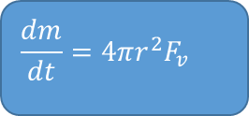
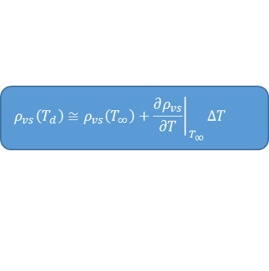


revisit mass growth equation (Derive on your own…)
$$\frac{dm}{dt}=4πr^{2}F_{v}$$
$$F_{v}=D_{v}\frac{{(ρ}_{v∞}−ρ_{vs}(T_{d}))}{r}$$
Do not know $ρ_{vs}$ because cannot measure $T_{d}$, but can measure $T_{∞}$ (temperature of the environment)
To replace $T_{d}$ with $T_{∞}$ , expand $ρ_{vs}(T_{d})$in a Taylor series where $∆T=T_{d}−T_{∞}$
$$\frac{dm}{dt}=4πrD_{v}{(ρ}_{v∞}−ρ_{vs}(T_{d}))$$
$$ρ_{vs}\left(T_{d}\right)≅ρ_{vs}\left(T_{∞}\right)+{\left.\frac{∂ρ_{vs}}{∂T}\right|}_{T_{∞}}∆T$$
Keep only 1st term since $∆T$ is small
Mass growth rate of particle
[kg s⁻¹]
Particle surface area
[m²]
Mass flux onto particle
[kg m⁻² s⁻¹]
$\frac{∂ρ_{vs}}{∂T}=ρ_{vs}$ $\left(\frac{L_{v}}{R_{v}T^{2}}−\frac{1}{T}\right)$
Ideal Gas Law
Need $\frac{∂ρ_{vs}}{∂T}$, let $T_{∞}≡T$
Ideal Gas Law!
$ρ_{vs}\left(T_{d}\right)≅ρ_{vs}\left(T_{∞}\right){+ ρ}_{vs}$ $\left(\frac{L_{v}}{R_{v}T^{2}}−\frac{1}{T}\right)$ $∆T$
$\frac{∂ρ_{vs}}{∂T}=\frac{1}{R_{v}T}$ $\left(\frac{e_{s}L_{v}}{R_{v}T^{2}}−\frac{e_{s}}{T}\right)$
$$\frac{∂ρ_{vs}}{∂T}=\frac{∂}{∂T}\left(\frac{e_{s}}{R_{v}T}\right)$$
Still don’t know $∆T$!
Chain Rule!
$$ρ_{vs}\left(T_{d}\right)≅ρ_{vs}\left(T_{∞}\right)\left[1\text{+} \left(\frac{L_{v}}{R_{v}T^{2}}−\frac{1}{T}\right) ∆T\right]$$
$$\frac{∂}{∂T}\left(\frac{e_{s}}{R_{v}T}\right)=\frac{∂e_{s}}{∂T}\left(\frac{1}{R_{v}T}\right)−\frac{e_{s}}{R_{v}T^{2}}$$
$$\frac{dm}{dt}=\frac{4πrD_{v}}{R_{v}T}\left\{e−e_{s}\left[1+\left(\frac{L_{v}}{R_{v}T^{2}}−\frac{1}{T}\right) ∆T\right]\right\}$$
$$\frac{∂}{∂T}\left(\frac{e_{s}}{R_{v}T}\right)=\frac{1}{R_{v}T}\left(\frac{∂e_{s}}{∂T}−\frac{e_{s}}{T}\right)$$
Ideal Gas Law
$\frac{dm}{dt}=4πrD_{v}$ $\left\{ρ_{v∞}−ρ_{vs}\left(T_{∞}\right)\left[1\text{+} \left(\frac{L_{v}}{R_{v}T^{2}}−\frac{1}{T}\right) ∆T\right]\right\}$
Clausius-Clapeyron:
$$\frac{∂e_{s}}{∂T}=\frac{e_{s}L_{v}}{R_{v}T^{2}}$$

Slide 5












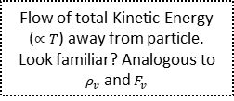



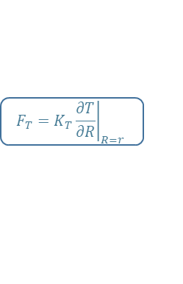



Mass growth equation, cont. (Derive on your own…)
Need $∆T$, use thermal flux/diffusivity!
$$F_{T}=K_{T}{\left.\frac{∂T}{∂R}\right|}_{R=r}$$
Flow of total Kinetic Energy ($∝T$) away from particle. Look familiar? Analogous to $ρ_{v}$ and $F_{v}$
$$\frac{dm}{dt}=\frac{4πrD_{v}}{R_{v}T}\left\{e−e_{s}\left[1+\left(\frac{L_{v}}{R_{v}T^{2}}−\frac{1}{T}\right)\frac{L_{v}}{4πrK_{T}}\frac{dm}{dt}\right]\right\}$$
Since latent heating generates the energy that flows away from the particle…
$$F_{T}=K_{T}\frac{∆T}{r}$$
$$T\left(R\right)=T_{∞}+∆T\frac{r}{R}$$
$$\frac{dm}{dt}=\frac{4πrD_{v}}{R_{v}T}\left\{e−e_{s}−\left(\frac{L_{v}}{R_{v}T^{2}}−\frac{1}{T}\right)\frac{L_{v}e_{s}}{4πrK_{T}}\frac{dm}{dt}\right\}$$
$$L_{v}\frac{dm}{dt}=4πr^{2}F_{T}$$
$$L_{v}\frac{dm}{dt}=4πr^{2}K_{T}\frac{∆T}{r}$$
$\frac{dm}{dt}=\frac{4πrD_{v}}{R_{v}T}\left(e−e_{s}\right)$ $−\frac{4πrD_{v}}{R_{v}T}\left(\frac{L_{v}}{R_{v}T^{2}}−\frac{1}{T}\right)\frac{L_{v}e_{s}}{4πrK_{T}}\frac{dm}{dt}$
$$G={\left[\frac{R_{v}T}{D_{v}e_{s}}+\left(\frac{L_{v}}{R_{v}T^{2}}−\frac{1}{T}\right)\frac{L_{v}}{K_{T}}\right]}^{−1}$$
Generate energy due to mass growth
Flow away via diffusion
$$∆T=\frac{L_{v}}{4πrK_{T}}\frac{dm}{dt}$$
$$\frac{dm}{dt}+\frac{D_{v}}{R_{v}T}\left(\frac{L_{v}}{R_{v}T^{2}}−\frac{1}{T}\right)\frac{L_{v}e_{s}}{K_{T}}\frac{dm}{dt}=\frac{4πrD_{v}}{R_{v}T}\left(e−e_{s}\right)$$
$$\frac{dm}{dt}\left[\frac{R_{v}T}{D_{v}e_{s}}+\left(\frac{L_{v}}{R_{v}T^{2}}−\frac{1}{T}\right)\frac{L_{v}}{K_{T}}\right]=4πr\left(S−1\right)$$
$$\frac{dm}{dt}\left[1+\frac{D_{v}}{R_{v}T}\left(\frac{L_{v}}{R_{v}T^{2}}−\frac{1}{T}\right)\frac{L_{v}e_{s}}{K_{T}}\right]=\frac{4πrD_{v}}{R_{v}T}e_{s}\left(S−1\right)$$
$$\frac{dm}{dt}=4πrG\left(S−1\right)$$
$$\frac{dm}{dt}=\frac{4πrD_{v}}{R_{v}T}\left\{e−e_{s}\left[1+\left(\frac{L_{v}}{R_{v}T^{2}}−\frac{1}{T}\right) ∆T\right]\right\}$$
$4πr→$ Size of particle
$G→$ diffusivity of vapor & heat
$(S−1)→$ ambient supersaturation

Slide 6

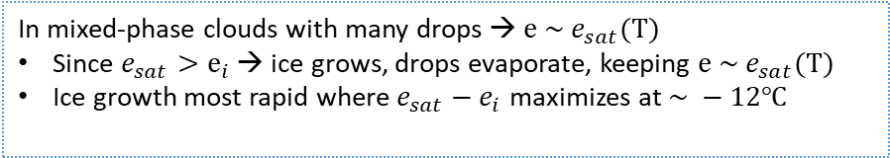
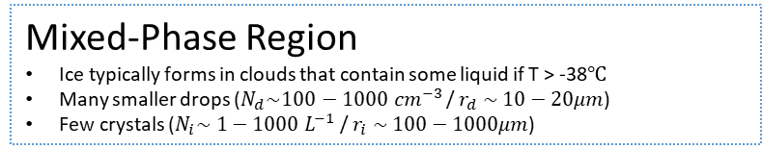


Bergeron Process
Mixed-Phase Region
Ice typically forms in clouds that contain some liquid if T > -38$℃$
Many smaller drops ($N_{d}\sim 100−1000 cm^{−3}$ / $r_{d} \sim 10−20μm$)
Few crystals ($N_{i}\sim 1−1000 L^{−1}$ / $r_{i} \sim 100−1000μm$)
ICE
*
*
*
*
*
$$−38℃$$
e
e_{sat} - e_{i}
Mixed-Phase
*
*
*
*
*
*
T
T
T ~ -12C
T_{o}
T ~ -12C
T_{o}
$$−5℃$$
$$0℃$$
LIQUID
Bergeron Process
In mixed-phase clouds with many drops → $e \sim e_{sat}(T)$
Since $e_{sat}>e_{i}$ → ice grows, drops evaporate, keeping $e \sim e_{sat}(T)$
Ice growth most rapid where $e_{sat}−e_{i}$ maximizes at $\sim −12℃$

Slide 7
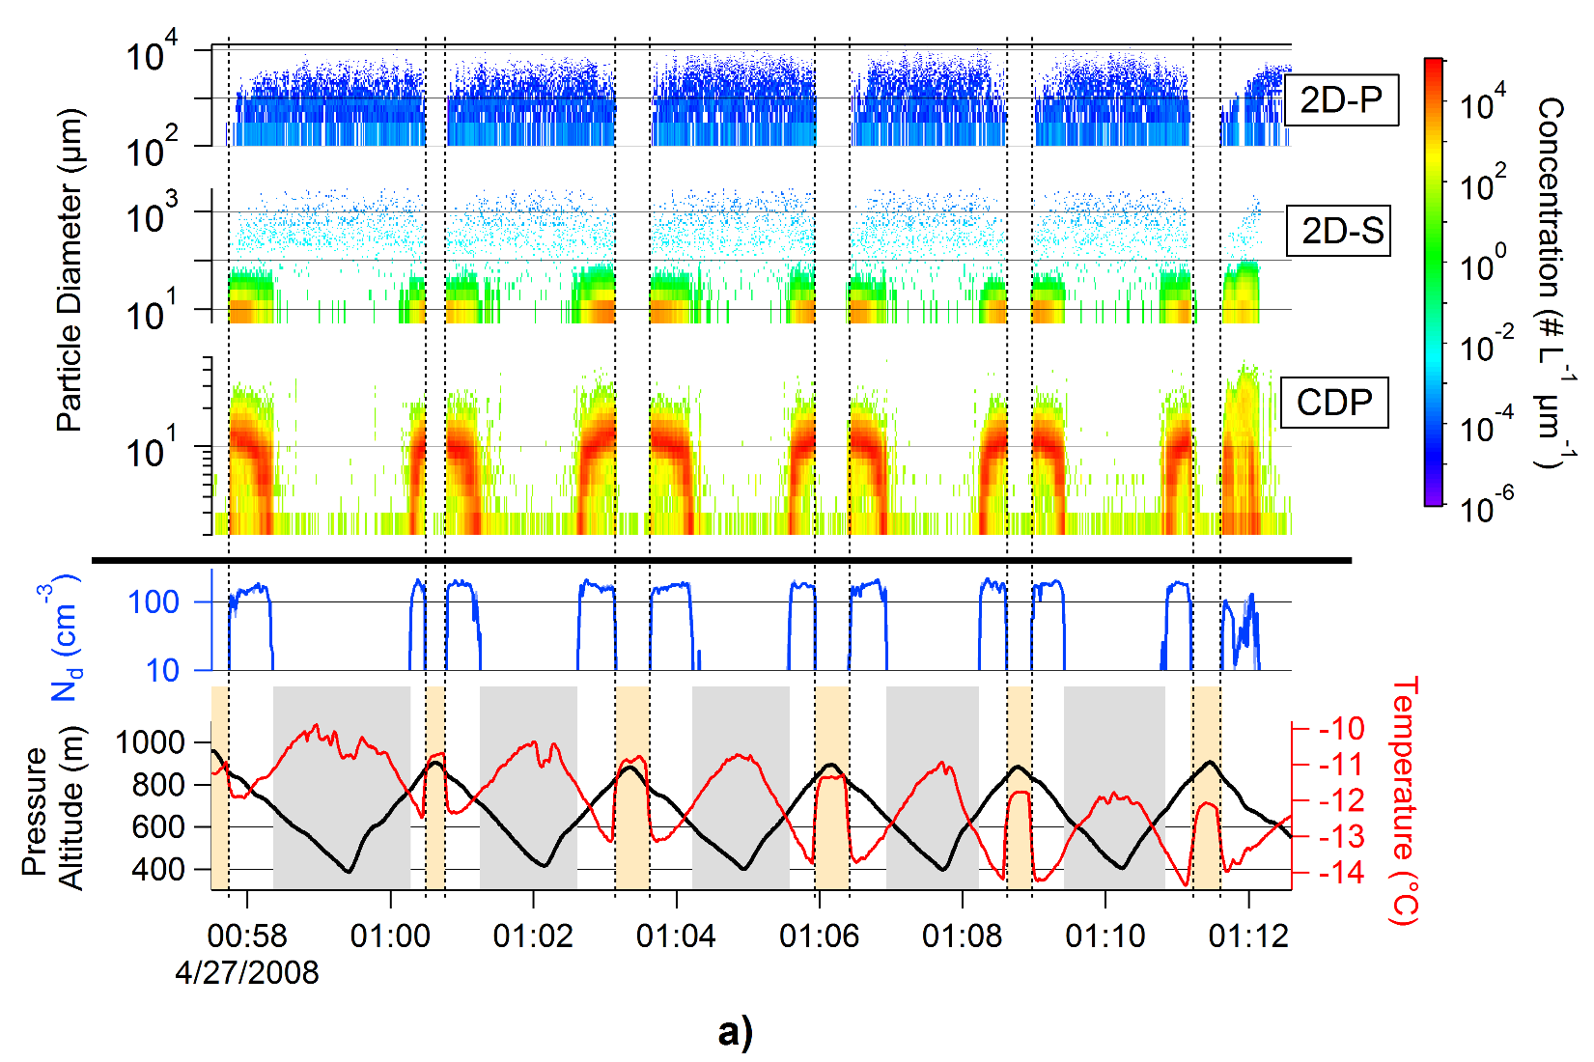
Arctic Mixed-Phase Stratus
In-situ observations
1
2
3
4
5
6
7
8
9
10

Slide 8

Arctic Mixed-Phase Stratus
In-situ observations
ABOVE the CLOUD DECK

Slide 9
Arctic Mixed-Phase Stratus
In-situ observations
BELOW the CLOUD DECK

Slide 10
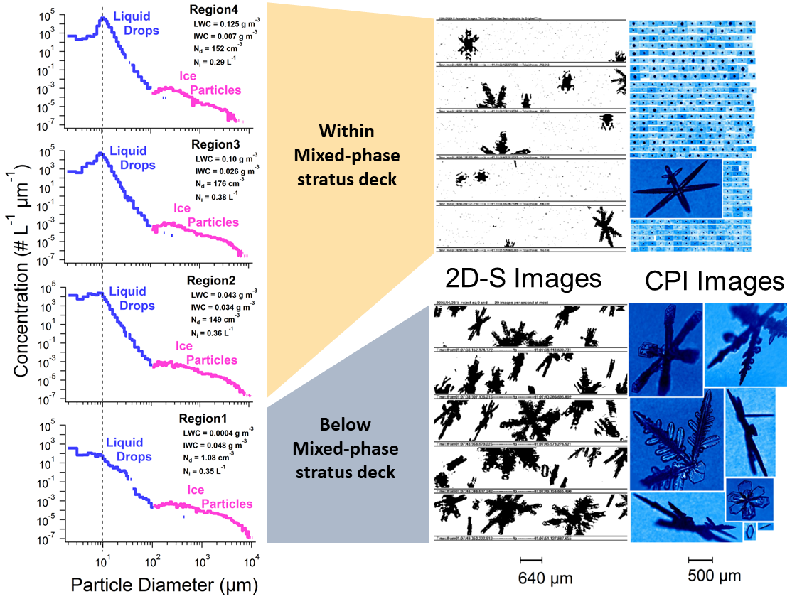

Slide 11
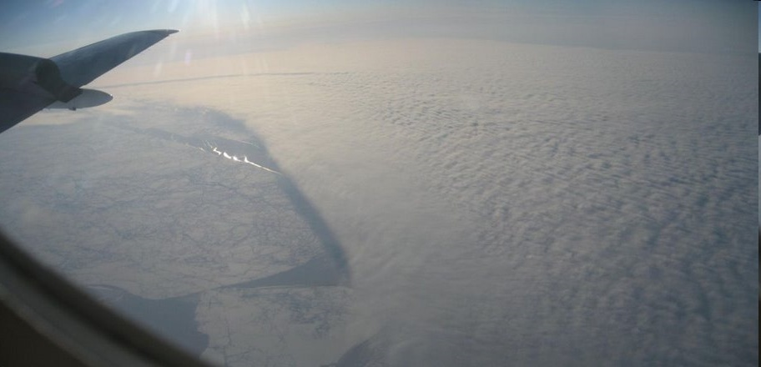





CCN as a Modulator of Ice Processes in Arctic Mixed-Phase Clouds
Aerosol, Radiation and Cloud Processes affecting Arctic Climate: ARCPAC 2008
Sara Lance
Matt Shupe, Charles Brock, Graham Feingold, John Holloway, Julie Cozic, Tom Ryerson, Jeff Peischl, Carsten Warneke, Jerome Brioude, Owen Cooper, Joshua Shwartz, Ryan Spackman, Karl Froyd -- CIRES/NOAA
Richard Moore, Athanasios Nenes -- Georgia Tech
Lance et al., 2011

Slide 12
Aerosol Effect on Arctic Clouds
How does aerosol pollution impact the phase
of Arctic mixed-phase clouds?
(could lead to dramatic change in both radiative properties and cloud lifetime)
complicated by the fact that
Pollution = IN + CCN
Lance et al., 2011
Notes:
In the Arctic springtime, mixed-phase clouds are prevalent. Spring is also the time when the most frequent and intense Arctic haze events occur. These conditions suggest that there can be a strong aerosol affect on the radiative balance of the Arctic, since aerosols are needed to lower the activation barrier for freezing in these types of clouds, and since both the radiative properties and lifetime of these clouds are highly impacted by the distribution of ice and liquid in the cloud.
Part of what makes this problem so difficult is that pollution can include both cloud condensation nuclei and ice nuclei, which may have different effects.

Slide 13
Current Theories regarding the Effect of Pollution on Mixed-Phase Clouds
“Glaciation Indirect Effect” [Lohmann, 2002]:
More IN = More ice precipitation (number)
“Riming Indirect Effect” [Borys et al, 2003]:
More CCN = Smaller droplets =
Less ice precipitation (mass)
Cold 2nd Indirect Effect [Rangno and Hobbs, 2001]:
More CCN = Smaller droplets =
Less ice precipitation (number)
Lance et al., 2011
Notes:
First effect is expected to have maximum impact in the Arctic.
The first two mechanisms are relatively straightforward. The last mechanism is unclear.

Slide 14
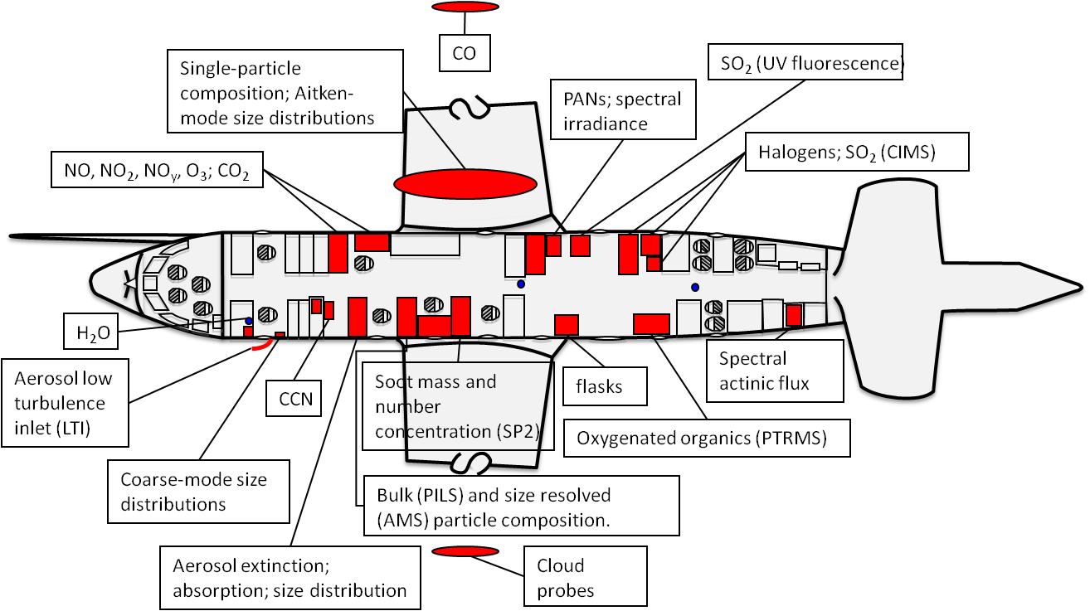
Observations from ARCPAC – Alaska 2008
Unique instrument payload on the NOAA-P3
both cloud/aerosol microphysics and gas phase characterization
Lance et al., 2011

Slide 15
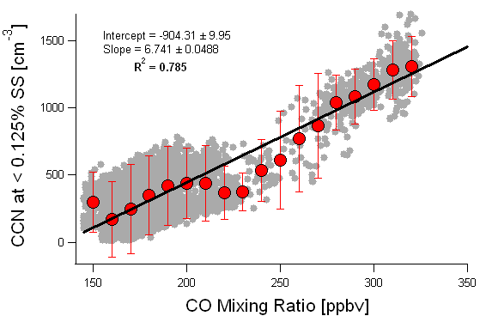
Gas phase pollutants as a proxy for CCN
CO is a passive tracer unaffected by water or ice clouds.
Clear-air only
Lance et al., 2011
Notes:
Our first problem is identifying the number of CCN entering the cloud.
We had CCN measurements, but In-cloud measurements of aerosol and CCN are difficult to interpret.
Out-of-Cloud measurements of CCN above, below and alongside Arctic stratus clouds are all different.
Even on CVI, measurements of the residual aerosol particles are difficult to interpret in mixed-phase clouds. (we did not have a CVI)
To side-step this problem, we use CO measurements in-cloud as a proxy for CCN.

Slide 16
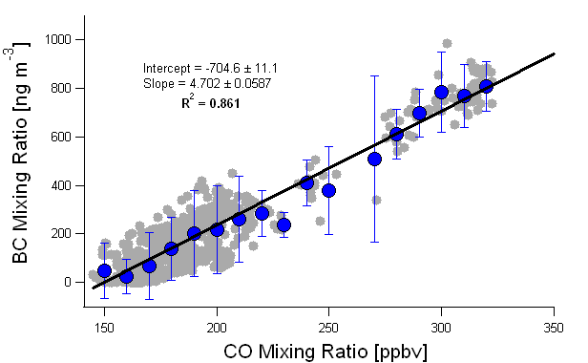
Gas phase pollutants as a proxy for IN -
Black Carbon (BC) and biomass burning particles
Chamber Experiments:
oxidized soot particles are very efficient contact ice nuclei in the temperature range of -5 to -20ºC
Gorbunov et al. [2001]
biomass burning particles
can be efficient ice nuclei
at -30ºC (immersion freezing)
Petters et al [2009]
Ambient Measurements:
enhanced BC in ice crystals when compared to interstitial and cloud droplet residuals in mixed-phase clouds
Cozic et al [2008]
Clear-air only
Lance et al., 2011
Notes:
No IN measurements on board during this study.
IN measurements are difficult to interpret due to the many different ice nucleation mechanisms.
Contact nucleation is not typically measured.
High variability of IN precludes using out-of-cloud measurements to interpret
in-cloud ice concentrations.

Slide 17
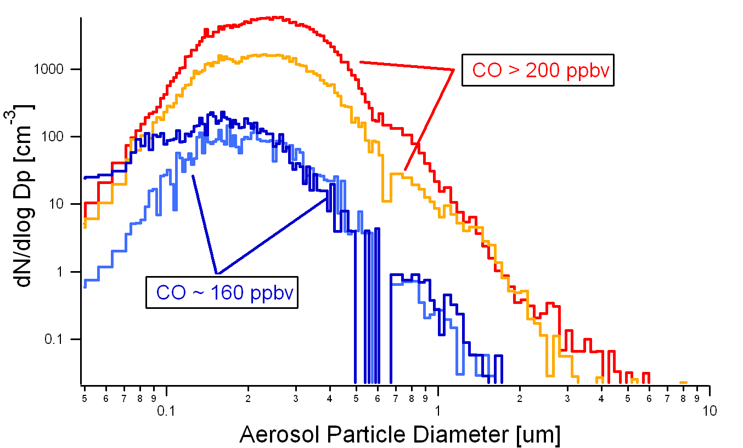
Aerosol Size Distributions
Large aerosol (> 0.5um) concentrations associated strongly with biomass burning
emissions (and CO)
Lance et al., 2011

Slide 18
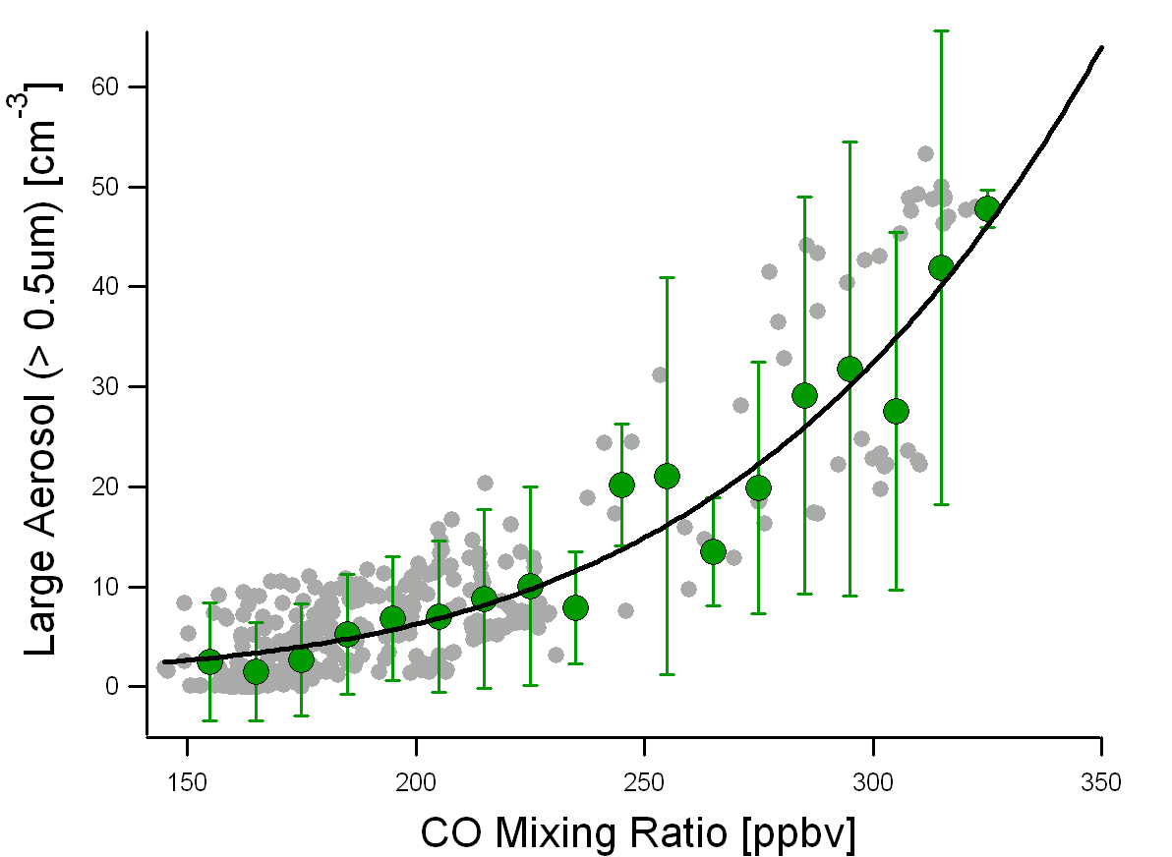
Gas phase pollutants as a proxy for IN -
Large Aerosol (>0.5 um)
Large aerosol particles act preferentially as Ice Nuclei.
Pruppacher and Klett [2001]
DeMott et al, submitted
Clear-air only
Lance et al., 2011

Slide 19
Gas phase pollutants as a proxy for IN -
Large Aerosol (>0.5 um)
BOTTOM LINE: We expect more CCN and more IN in polluted clouds
Large aerosol particles act preferentially as Ice Nuclei.
Pruppacher and Klett [2001]
DeMott et al, submitted
Clear-air only
Lance et al., 2011

Slide 20
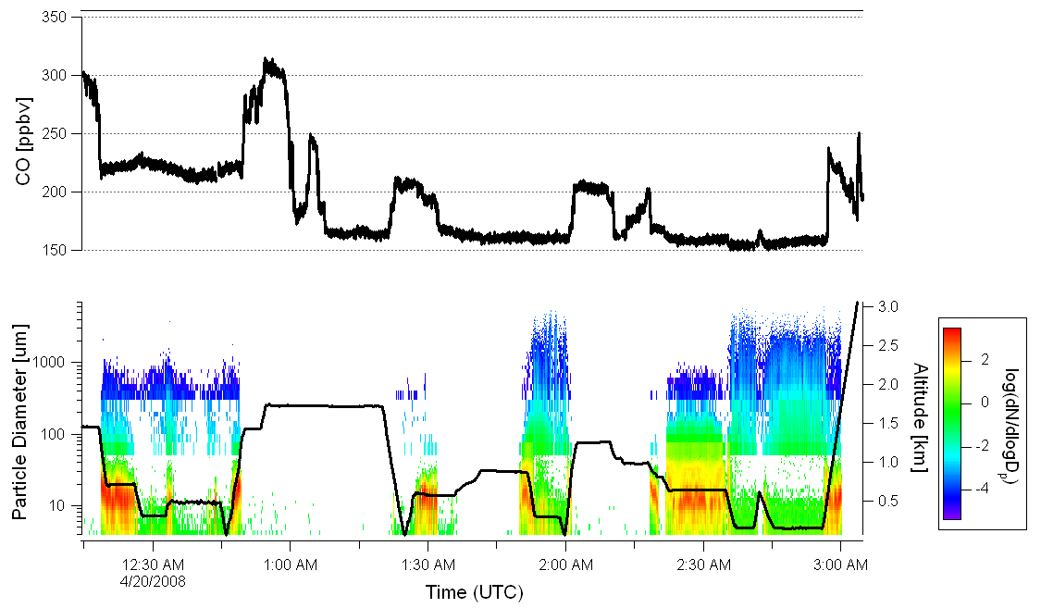
Time Series of 19 April 2008 Flight
Lance et al., 2011
Notes:
Wide range of conditions.

Slide 21
Time Series of 19 April 2008 Flight
Polluted Case
Clean Case
(-6 ºC Avg)
(-12 ºC Avg)
Lance et al., 2011

Slide 22
Time Series of 19 April 2008 Flight
Polluted
and Cold
Polluted Case
Clean Case
(-6 ºC Avg)
(-12 ºC Avg)
(-12 ºC Avg)
Lance et al., 2011

Slide 23
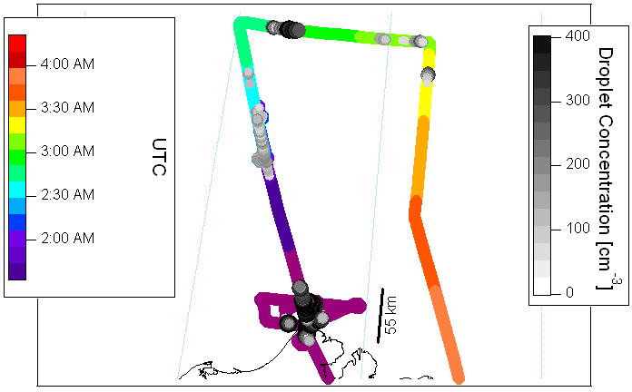
19 April Flight Track
Source of pollution is biomass burning emissions from Asia [Warneke et al, 2008]
Cold Polluted
Clean
Polluted
Lance et al., 2011
Notes:
We have focused on the 4/19 flight, which had the greatest dynamic range in CO concentrations, and the longest duration of in-cloud sampling. This flight also occurred on the same day of the high-pollution event identified in the ISDAC dataset, for which we had coordinated flights over Barrow, Alaska. I will not show this in my talk, but the NOAA scientists have shown quite clearly that the source of pollution advected over Barrow on this day, and also here over the ocean, was biomass burning emissions in southern Russia.

Slide 24
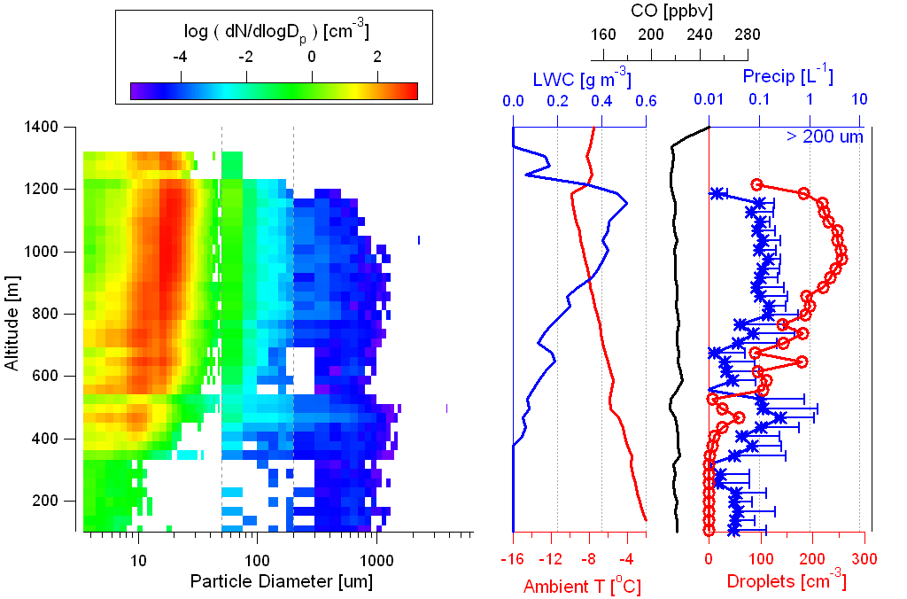
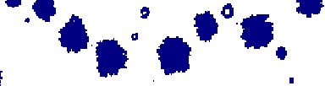
Polluted Case
prevalent riming
narrow droplet distribution
low ice crystal concentrations
2 mm
Notes:
Images show more riming, but the LWC is also higher.

Slide 25
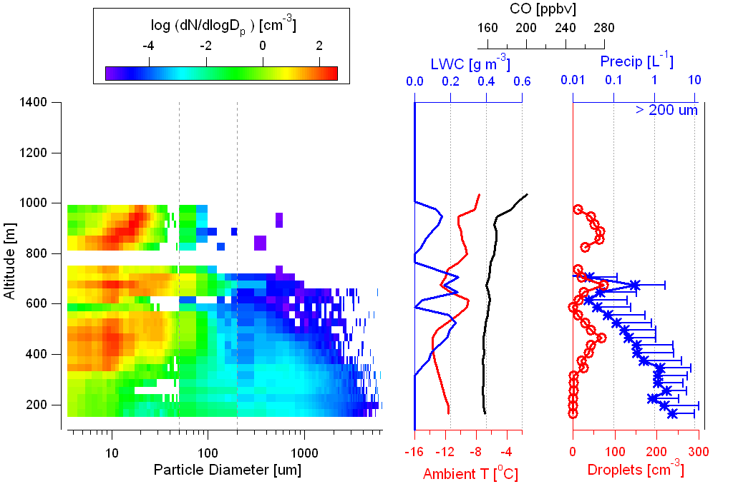
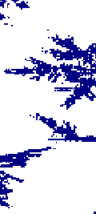
Clean Case
little riming
broad droplet distribution
high ice crystal concentrations
2 mm
Notes:
We see several liquid cloud layers, and the lowest two cloud layers have a broad droplet size distribution with a large mode of droplets centered around 30 um. Droplet concentrations are below 100/cm3 on average. We also see ice precipitation within the lowest two layers and a maximum in ice precipitation below the lowest cloud. Ice crystal concentrations exceed 1/L on average in the lower atmosphere. Note that LWC is at 0.2 g/m3 or below, and Images do not show significant riming. Ice crystals are growing by vapor deposition, which means that droplets are evaporating?

Slide 26
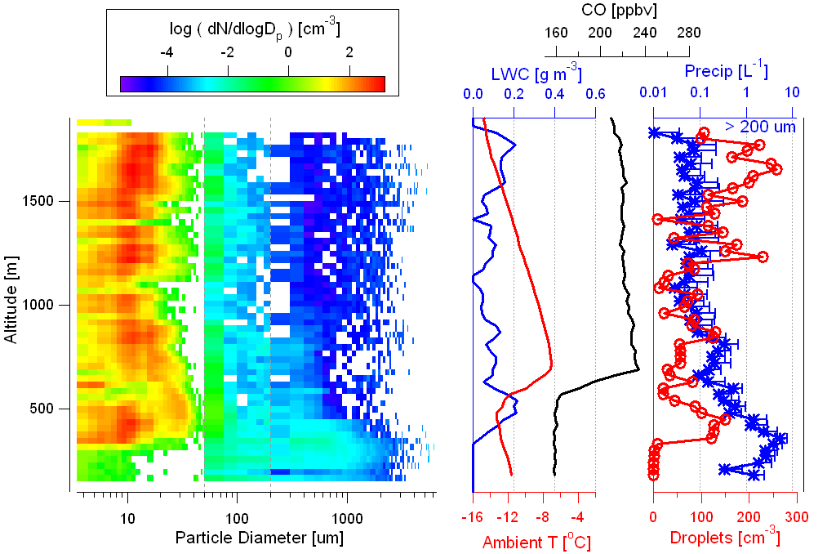
Cold Polluted (over Clean) Case
In Polluted Clouds
10-100 times fewer ice crystals
few large droplets present
polluted
clean
Notes:
A consistent picture emerges.
We see the same behavior as in the other two cases. The polluted clouds (identified from elevated CO concentrations) exhibit very little ice precipitation (with avg concentrations almost always below 0.1/L and never exceeding 1/L). Whereas within and immediately below the clean clouds, the ice crystal concentration shoots up by 1-2 orders of magnitude. This time, however, the LWC and temperature of the polluted cloud are much different from the other polluted case. At the top of the polluted cloud, the temperature is even colder than the coldest temperature in either of the clean clouds. LWC is also comparable now between this cold polluted cloud and the clean cases.
In this case, it isn’t very obvious that the top cloud is “polluted”, because the drop concentrations are highly variable. We suspect that this cloud is relatively aged in its lifecycle and is on its way towards evaporation/glaciation. This is where the in-situ trace gas measurements really help us to indentify the polluted cloud layer.

Slide 27
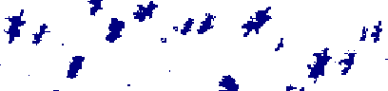
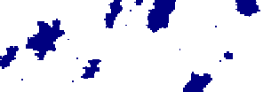
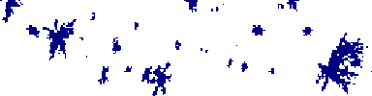
Cold Polluted (over Clean) Case
In Polluted Clouds
more riming
6 mm
6 mm
6 mm
Lance et al., 2011

Slide 28
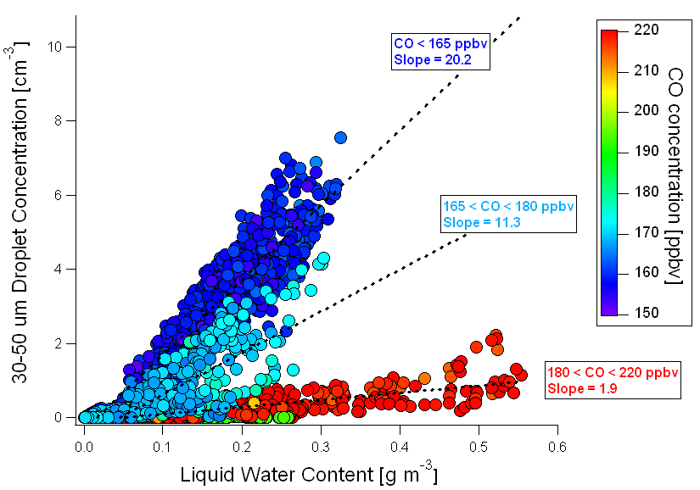
More Large Drops in Cleaner Clouds
Lance et al., 2011

Slide 29
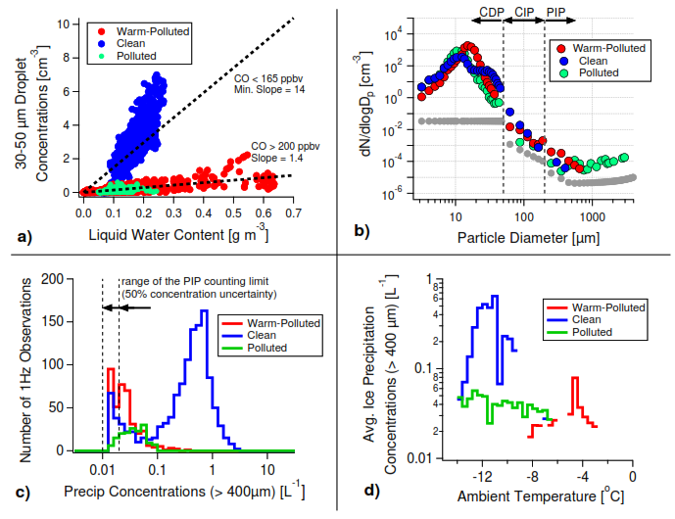
Lance et al., 2011

Slide 30
Conclusions
Our observations show a correlation between the number of large droplets and the number of ice crystal (consistent with Rangno and Hobbs [2001]) that is independent of Liquid Water Content or Temperature.
Polluted clouds show more riming and fewer ice crystals, opposite to the “riming” and “glaciation” indirect effects.
CCN may play an important role in the processes that partition liquid and ice phases in Arctic mixed-phase clouds, through modification of the droplet size distribution.
Lance et al., 2011

Slide 31
Alternative Explanations/ Remaining Questions
Fewer IN in polluted cases
  Is biomass burning aerosol inefficient as IN?
  Is biomass burning aerosol extremely efficient as IN resulting in their immediate loss via precipitation(prior to our sampling)?
More IN in clean cases
  Are there sources of efficient IN originating from the Arctic sea-ice or from open leads? Is blowing snow an IN source?
Difference in cloud dynamics
  Are there recirculation patterns in the lower atmosphere that continually replenish IN in the “clean” clouds?
Lance et al., 2011

Slide 32
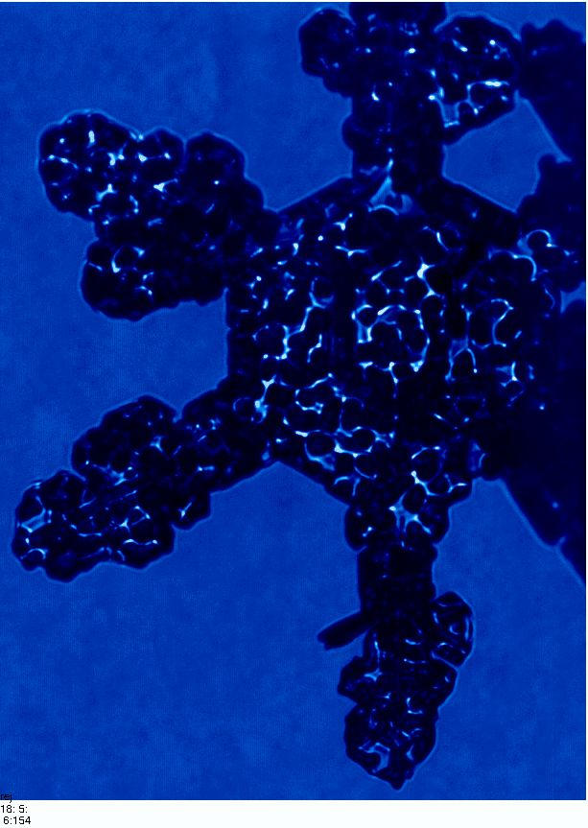
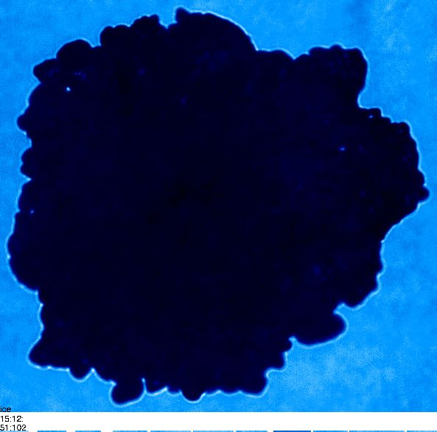
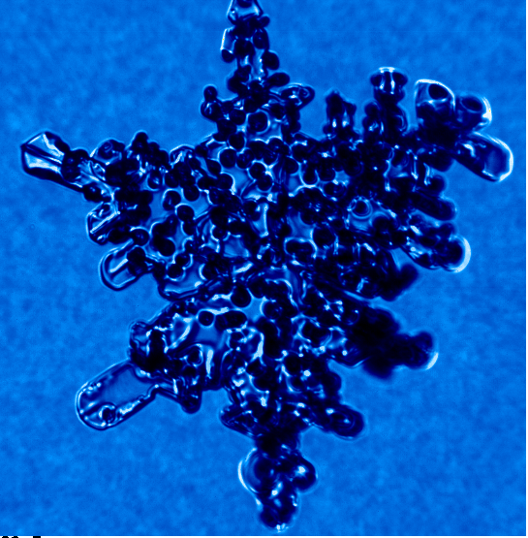
Particle-Particle interactions - Riming

Slide 33
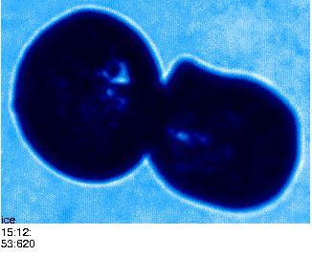
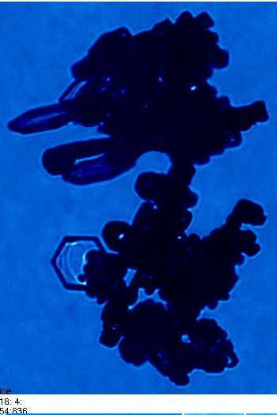
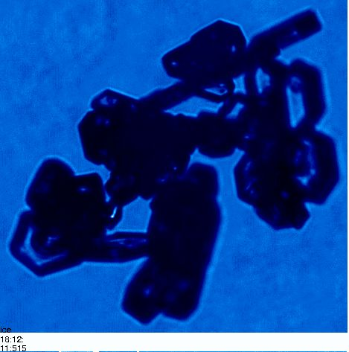
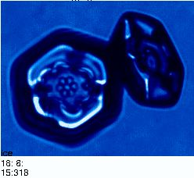
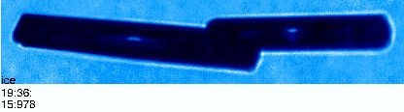
Particle-Particle interactions - Aggregation

Slide 34
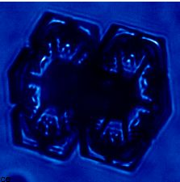
Particle-Particle interactions – Aggregation?

Slide 35
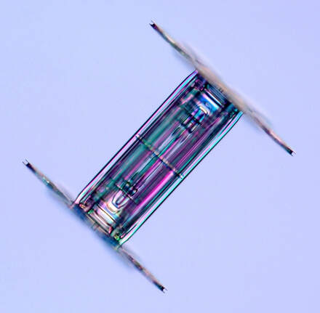
Particle-Particle interactions – Aggregation?
More likely a “capped column”

Slide 36
Cirrus
Space-based measurements reveal cirrus covers about 30% of midlatitudes, while in the tropics coverage can be 60-80% (Baran 2012)
25% of earth covered by subvisible cirrus (Guignard et al. 2012).
Net radiative effect of Ci clouds depends on horizontal & vertical cloud dimensions, size distribution and shape of ice particles
Shapes of cirrus particles have been shown to have significant influence on Earth’s radiation budget (Baran 2012, Feng et al. 2011, Hartmann 2015, Yang et al. 2015, 2018, etc).
Choi & Ho (2006) show that optically thin clouds (OD<10; 60% coverage) have a warming effect while optically thick clouds have a cooling effect, leading to net warming. Corroborated by Fu et al. (2002).

Slide 37
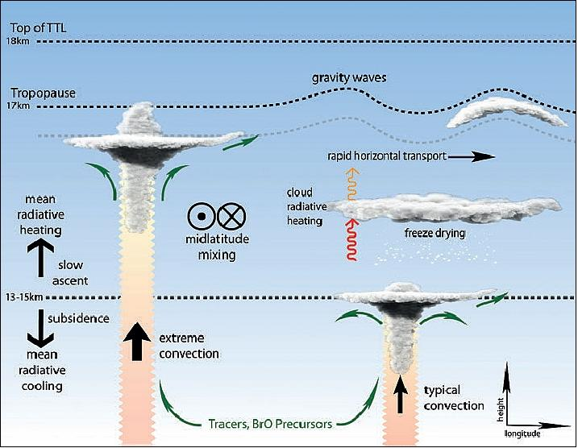
Cirrus
Ci can also strongly influence transport of water vapor into the upper troposphere and stratosphere
Important for O₃ formation

Slide 38
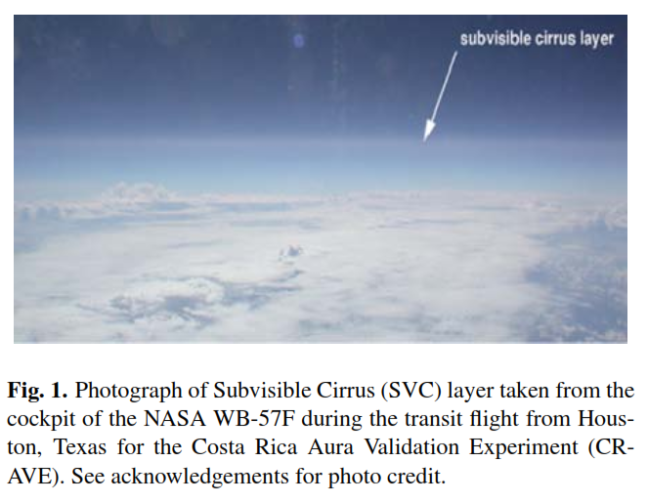
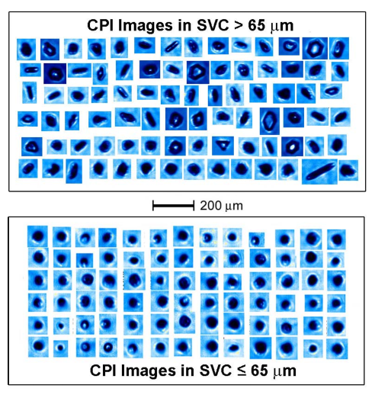
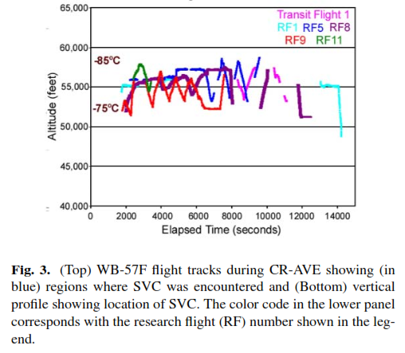
Subvisible (SBV) cirrus, aka “in-situ” cirrus
Lawson et al., Aircraft measurements of microphysical properties of subvisible cirrus in the tropical tropopause layer, 2008

Slide 39

In-situ cirrus
(with embedded layer indicating homogeneous nucleation)

Slide 40

In-situ cirrus
(with embedded layer indicating homogeneous nucleation)

Slide 41
Rosettes and Aggregates of Rosettes
Lance et al., SPARTICUS and MACPEX Cirrus Particle Sizes and Habits as a Function of Temperature and Synoptic Cirrus Type, 2013
Ridge Crest Cirrus
Muhlbauer et al., Impact of large-scale dynamics on the microphysical properties of midlatitude cirrus, 2014

Slide 42
Aggregates, Rosettes, Plates
Lance et al., SPARTICUS and MACPEX Cirrus Particle Sizes and Habits as a Function of Temperature and Synoptic Cirrus Type, 2013
Frontal Cirrus
Muhlbauer et al., Impact of large-scale dynamics on the microphysical properties of midlatitude cirrus, 2014

Slide 43
Columns, Plates and Side-Planes
Lance et al., SPARTICUS and MACPEX Cirrus Particle Sizes and Habits as a Function of Temperature and Synoptic Cirrus Type, 2013
SubTropical Jetstream Cirrus
Muhlbauer et al., Impact of large-scale dynamics on the microphysical properties of midlatitude cirrus, 2014

Slide 44
Large Complex Aggregate with Plates and Chains
Anvil Cirrus
Muhlbauer et al., Impact of large-scale dynamics on the microphysical properties of midlatitude cirrus, 2014

Slide 45


Coordinated Observations of Cloud Microphysical Properties from Multiple Aircraft During the SEAC⁴RS 11 September 2013 Mission
Sara Lance¹, Simone Tanelli², Sarah Woods¹, Paul Lawson¹
¹ SPEC Incorporated, Boulder, CO ² NASA Jet Propulsion Laboratory, Pasadena, CA
In-situ radar retrieval from onboard the DC8
1.4 mm

Slide 46

Learjet and DC-8 Flight Tracks on 11 September 2013
1.4 mm

Slide 47


-53 °C
-50 °C
-46 °C
-40 °C

Slide 48


Radar Retievals are a Function of Both Aspect and Area Ratio
1.4 mm

Slide 49

DC-8 APR-2 (Ku & Ka bands) Up and Down Viewing Radar
APR-2 Microphysical Retrievals
Ice Water Content
1 gm⁻³
0.1 gm⁻³
0.01 gm⁻³
Particle Size
4 mm
3 mm
2 mm
1 mm
1.4 mm

Slide 50

Electrified anvils produce frozen droplet chains
from Stith et al., 2014

