Slide 1
ATM551: Fundamentals of Earth’s Climate
Lecture #1: The Earth Climate System
Instructor: Prof. Aiguo Dai
Email: adai@albany.edu
Department of Atmospheric and Environmental Sci.
University at Albany, NY
Fall, 2025
Classroom: ETEC 482
Class time: MonWed: 1:10-2:30PM
Office hours: TueWed: 10-11AM, ETEC 403
TA: Zuhayr Ishmam (zishmam@albany.edu).
TA’s office hours: MonThu 3-4pm in ETEC 3rd Floor Open Area.
Course web site: http://www.atmos.albany.edu/facstaff/adai/ATM551/
( id = atm551 password=dai551 )

Slide 2
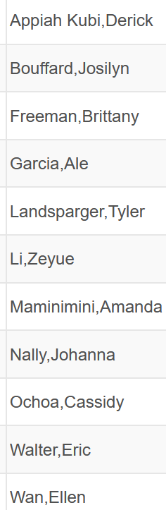
Students Enrolled in the Class:

Slide 3
Design of the Course (1/3)
Goal: To discuss physical processes that control Earth’s climate: its spatial patterns, temporal variations and long-term changes.
Prerequisites: You are assumed to have taken introductory courses in atmospheric science (e.g., Thermodynamics, Radiation, Dynamic Met.).
Part 1 – Overview of Earth’s Climate (3 lectures)
Lecture 1: The Earth Climate System (8/25)
Lecture 2: Characteristics of Earth’s Current Climate (8/27)
Lecture 3: Evolution of Earth’s Climate over its History (9/3)
Part 2 - Basic Controls of Earth’s Climate (12 lectures)
Lecture 4: The Global Energy Balance & Greenhouse Effect (9/8)
Lecture 5: Surface Energy Balance (9/10)
Lecture 6: The Hydrologic Cycle and Climate (9/15)
Lectures 7-8: Atmospheric Circulation and Climate (9/17, 9/22)
Lectures 9-10 Ocean Circulation and Climate (9/24, 2/29)

Slide 4
Design of the Course (2/3)
Part 2 – Basic Controls of Earth’s Climate (cont’d)
Lecture 11: Water Vapor, Clouds, and Aerosols (10/01)
Lecture 12: Atmospheric Convection & Tropical Climate (10/06)
Mid-term review: 10/08
Fall Break: Oct 13-14
Mid-term Exam: Oct. 15
Lecture 13: Air-Sea & Land-Atmosphere Interactions (10/20)
Lecture 14: Sea Ice and Polar Climate (10/22)
Lecture 15: The Global Carbon Cycle and Climate (10/27)
Part 3 – Climate Variability and Modes (3 lectures)
Lecture 16: Climate Internal Variability and Extremes (10/29)
Lecture 17-18: ENSO and its impacts (11/03, 11/05)
Lecture 19-20: Atlantic and Pacific Multidecadal Variability (10/10, 10/12)

Slide 5
Design of the Course (3/3)
Part 4 – Climate Change and Modeling (5 lectures)
Lecture 21: Climate Forcing, Response and Sensitivity (10/17)
Lecture 22: Climate Feedbacks (10/19)
Lecture 23: Introduction to Climate Modeling (10/24)
Thanksgiving break: 11/26-30
Lecture 24: Common Climate Simulations & Projections (12/01)
Lecture 25: Projected future climate changes (12/03)
Final Exam Review Lecture: 12/08
Final Exam: Monday, 12/15, 8:00-10:00AM, ETEC 482

Slide 6
Course Assessment
Homework : 30%
Mid-term Exam (closed-book): 30%
Final Exam (closed-book): 30%
Attendance and Class Discussions: 10%
Assignments:
- May include reading assignments that may be discussed in class.
- Homework questions will be descriptive. For example:
What are the major components of the Earth Climate System?
What are the key roles of water in the Earth Climate System?
To get high score, you need to address all the key aspects relevant to the
question discussed in the class, using concise text not copied from my slides or
the internet.
- One homework for each Part of the course (4 homework assignments).
- Late homework will not be graded, except for special cases!
Mid-term and final exams:
- To test your understanding of the topics discussed in class.
- Two parts: Part I – multiple choice questions, Part II: descriptive questions.

Slide 7
Textbooks and Reading Materials
Main Textbooks:
Hartmann, D. L., 2016: Global Physical Climatology. 2nd ed., Elsevier, 485pp.
Neelin, J. D., 2011: Climate Change and Climate Modeling. Cambridge Univ. Press, 282pp.
Goosse, H., P.Y. Barriat, W. Lefebvre, M.F. Loutre, and V. Zunz, 2012: Introduction to Climate Dynamics and Climate Modeling. Online textbook available at http://www.climate.be/textbook (Or from the course website under OtherReadingMaterials/UCL-ClimDyn/ )
Additional Reading:
Pierrehumbert, R. T., 2010: Principles of Planetary Climate. Cambridge University Press, 652pp.
Washington, W.M. and C.L. Parkinson 2005: An Introduction to Three-Dimensional Climate Modeling. 2nd edition, University Science Books, Sausalito, CA, 353pp.
Moran, J. M., 2010: Climate Studies: Introduction to Climate Science. Amer. Met. Soc., 525pp. (AMS Textbook, pdf files available at the course webpage)

Slide 8
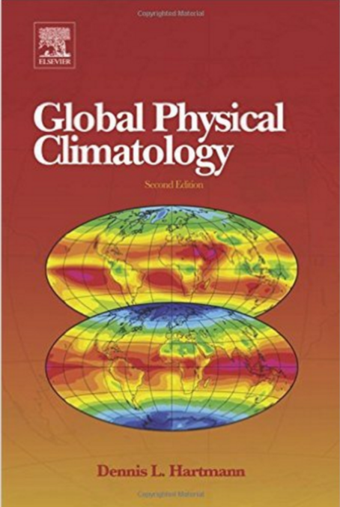
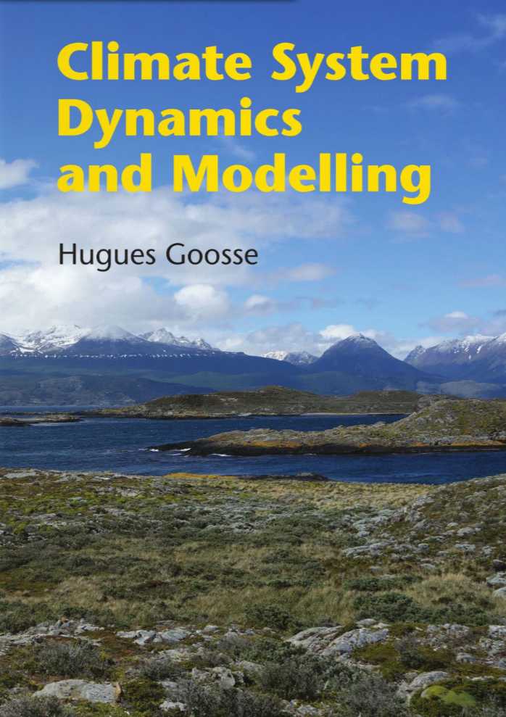
Second Edition (2016, Elsevier)
Hardcopy (8/2015, Cambridge Univ. Press)

Slide 9
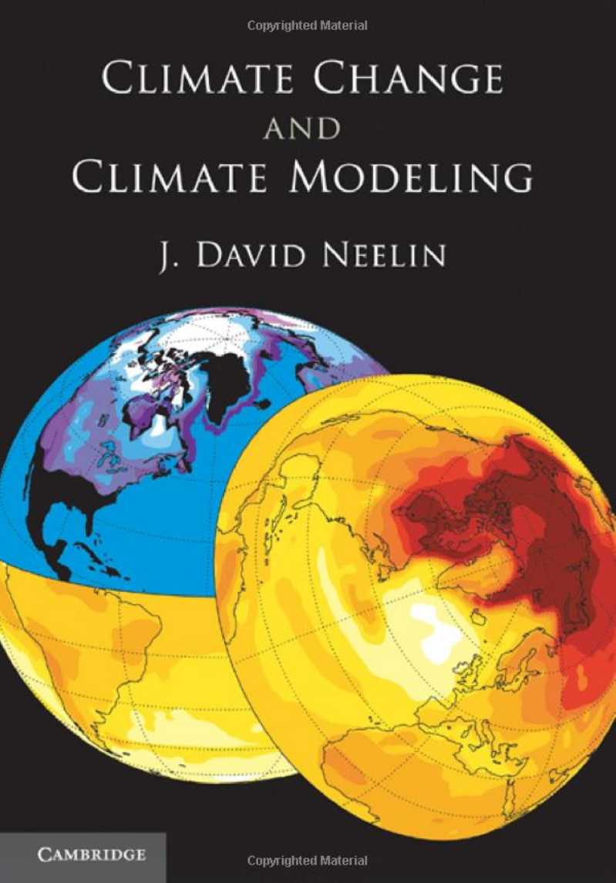
2011

Slide 10
ATM551 Webpage
http://www.atmos.albany.edu/facstaff/adai/ATM551/
( id = atm551 password = dai551 )
My ppt slides will be available at this website about 24 hours before each class.
Other electronic materials will also be posted at this website (under OtherReadingMaterials).
Homework questions will also be posted at the website, often included on one ppt slide of the last lecture of the subject Part.
The course will cover very broad areas to give you a full picture of Earth’s climate; you may need to read the chapters in the textbooks to gain deeper understanding on some of the areas (e.g., radiative transfer, cloud microphysics, PBL, etc.).

Slide 11
Lecture Format
Each lecture will be 80min., with 5-10min. break
(I may show a video clip during the break).
Lectures will be given with PowerPoint slides, which will be available online about 24hrs before the class;
You’re expected study all the ppt slides before and after each class;
I will discuss only some of the key slides and may ask you questions about the content of the other slides;
You’re encouraged to take notes of the key points discussed during the class, but no need to copy the slides;
Discussions and questions will be part of the lecture, and
All students are encouraged to ask and answer questions. This will be part of the evaluation!

Slide 12
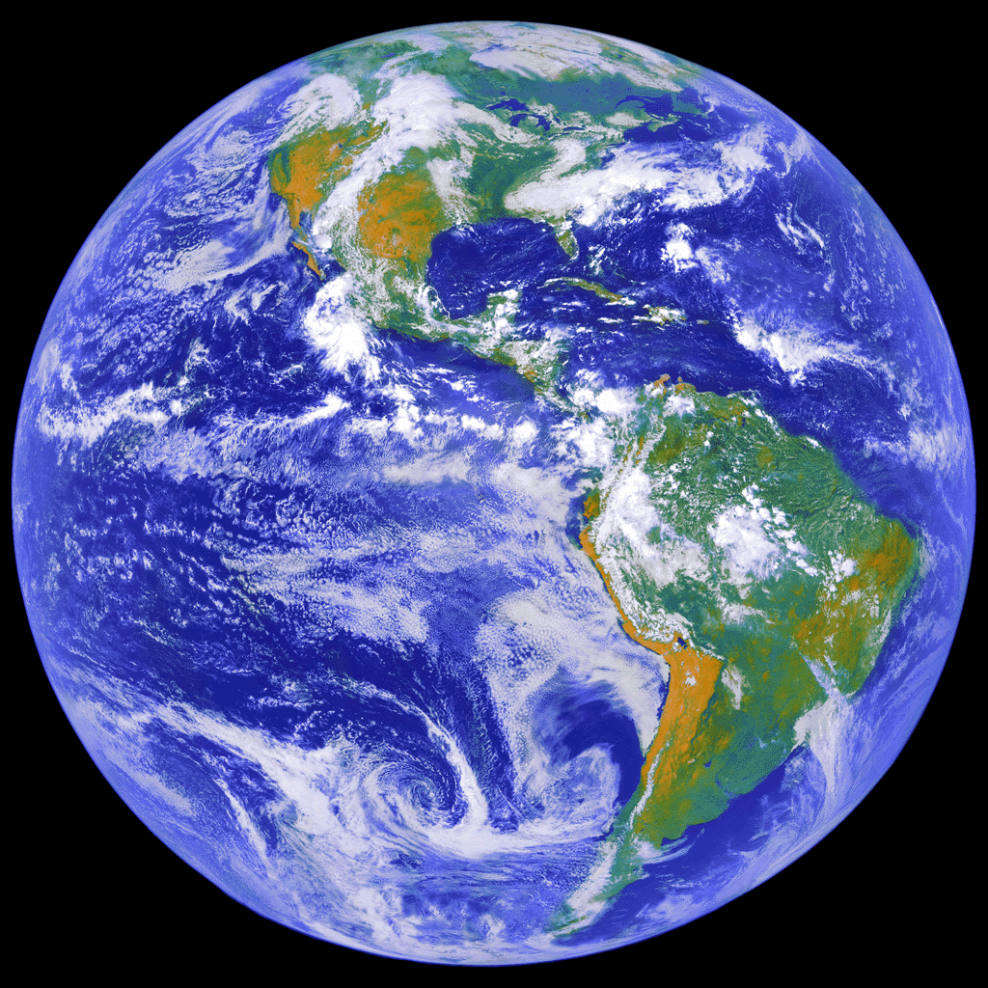
Today’s Topic:
An Overview of the Climate System
Difference between Climate and Weather
What is the Climate System?
The Main Components and their Roles
- The Atmosphere
- The Oceans
- Land and the Biosphere
- The Cryosphere

Slide 13
Weather vs. Climate
1. Weather refers to
- The state of the atmosphere (mainly the troposphere) at a given time.
- Short-term (hour to week) variations in temperature, precipitation,
circulation and other atmospheric fields.
2. Climate refers to
- The mean state near the surface and in the atmosphere averaged
over several decades or longer (typically 30years)
- Often characterized by mean T, P, sunshine & other near-surface fields
- Global climate change can affect local mean climate including extreme
weather, but individual events (such as a cold spell or a heat wave) result
mostly from random weather variations.
3. Climate variation/variability refers to
Year-to-year or decadal fluctuations in monthly, seasonal or annual mean
conditions. It does not mean variations in 30-year averaged fields!

Slide 14
Weather vs. Climate
4. Predictability and Time Scales of Weather and Climate:
- Weather becomes unpredictable after ∼2 weeks due to the chaotic nature of
atmospheric circulation and sensitivity to errors in initial conditions (explain it).
- The atmosphere has a short memory, and what happened ∼2 weeks ago has
little influence on today’s conditions (discuss its implications).
- Monthly-seasonal mean states (e.g., associated with ENSO) may be predicted
several months ahead (why?)
- Variations on >2-week time scales often originates from the oceans or land,
which have longer memories.
- Some decadal climate variations may be predicted many years ahead (why?)
- Greenhouse-gas forced climate changes can be predicted decades into the
future given GHG emissions scenarios (why?).
- Why is there such a difference between weather and climate predictability?

Slide 15
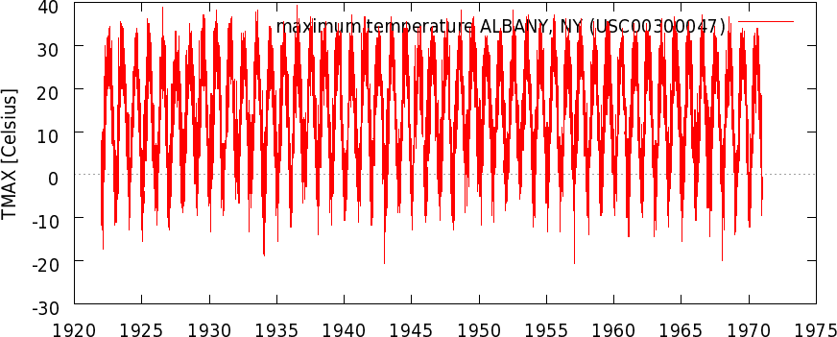
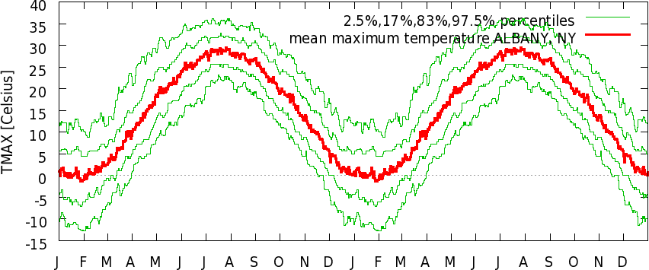
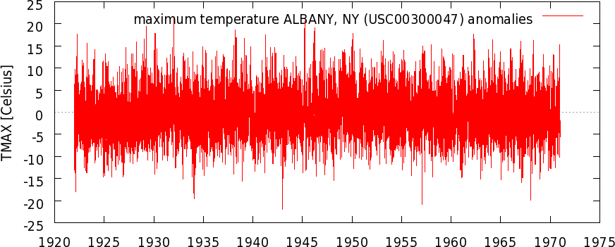
Albany Daily Tmax
Climate: Mean Annual Cycle
Which one is easier to predict for the same lead time?
Weather: Daily Variations

Slide 16
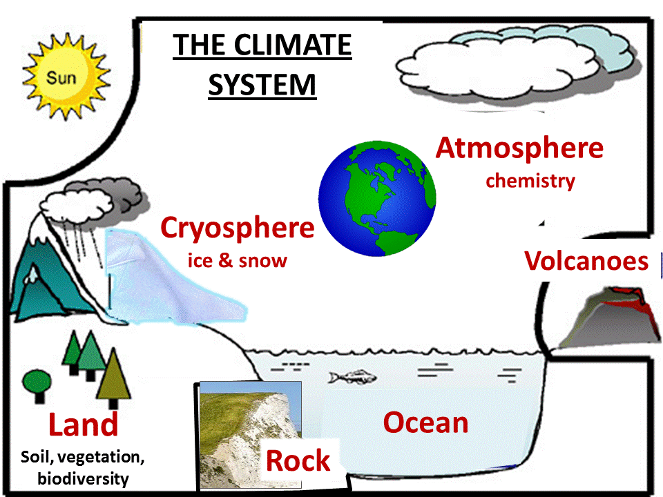
The Earth Climate System
The Sun, volcanoes, and human activities are
considered external to the Climate System
Weather occurs mostly in the troposphere!
Notes:
Weather occurs mostly in the troposphere (the lower 10-18km of the atmosphere).

Slide 17
The Earth Climate System
Major Components:
- The Atmosphere (the troposphere, h<∼12km and the stratosphere, h= ∼12- 50km), time scales: hours to 10 days
- The Oceans: depth up to 4000-5000m. Time scales: seasons to 1000 yrs.
- Land: terrestrial biosphere, soils. Time scales: hours to decades
- The cryosphere: polar ice sheets, mountain glaciers, snowpack, sea-ice. Time scales: seasons to 1000 yrs.
Major Interactions:
- Air – sea interactions (e.g., El Niño, air-sea energy and water fluxes)
- Land – atmosphere interactions (e.g., morning fog, surface fluxes over land)
- Air – sea ice interactions in the Arctic and around Antarctica
Major Cycles:
- The water cycle
- The energy cycle
- The carbon cycle and other biogeochemical cycles (e.g., Sulfur, Nitrogen cycles)
Natural and Anthropogenic Forcing:
- Changes in solar irradiance, volcanic eruptions, CO2 changes on geological times
- CO2 emissions from fossil-fuel burning, human-induced land cover changes, etc.

Slide 18
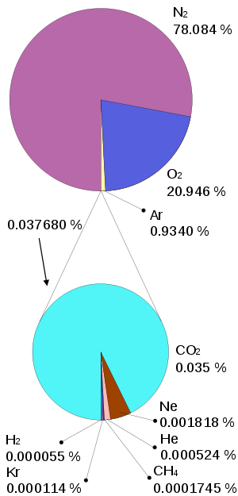
Earth’s Atmosphere
Dry air composition: ~78% N₂, 21% O₂, 1%
trace gases, including 0.035% CO₂ – the
dominant trace gas.
Water vapor: ∼0.4% in the full column (1-4%
near the surface). It plays a key role in weather
and climate. Examples?

Slide 19
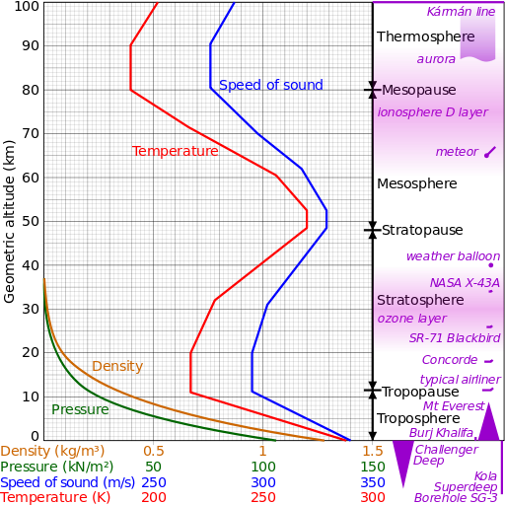
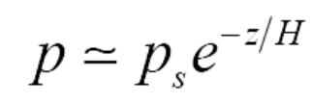
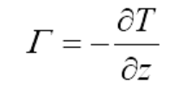
Atmospheric Vertical Profiles
Hydrostatic Equilibrium:
dp ≈ − ρ g dz
where H is a scale height
H=7 to 8 km
Lapse Rate:
Global mean Γ≈6.5 K/km
in the troposphere. Dry
Lapse rate = 9.8 K/km.
Where most weather and climate processes occur

Slide 20
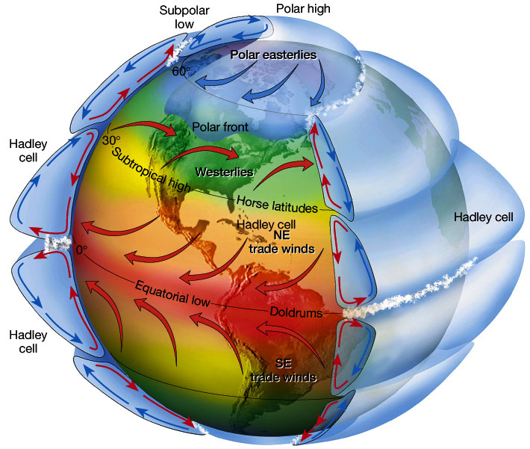
Atmospheric Circulation

Slide 21
Key Roles of the Atmosphere
It affects the amount of sunlight reaches the surface.
It determines the amount of outgoing infrared radiation into the space.
It absorbs harmful UV radiation and protects life on Earth.
It interacts with the oceans and land, and helps redistribute
energy and water on Earth.
It largely controls the weather and climate on Earth!

Slide 22
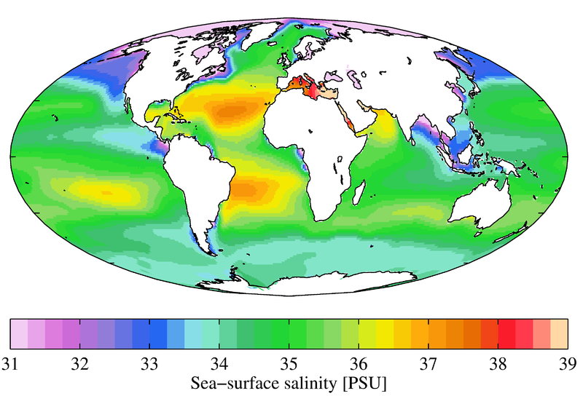
World’s Oceans
Seawater Composition: On average, seawater has a salinity of about 3.5%. This means that every kilogram of seawater has approximately 35 grams of dissolved salts (predominantly sodium (Na⁺) and chloride (Cl⁻) ions). Average density at the surface is 1.025 g/ml. Seawater is denser than both fresh water and pure water.
Sea Surface Salinity Distribution:
Salinity (salt content)
and temperature
determines seawater
density, which differs
among different types
of ocean water
PSU = Practical Salinity Units, A PSU of 35 means 3.5% salt.
Notes:
The Practical Salinity Scale defines salinity in terms of the conductivity ratio of a sample to that of a solution of 32.4356 g of KCl at 15°C in a 1 kg solution. A sample of seawater at 15°C with a conductivity equal to this KCl solution has a salinity of exactly 35 practical salinity units (psu).

Slide 23
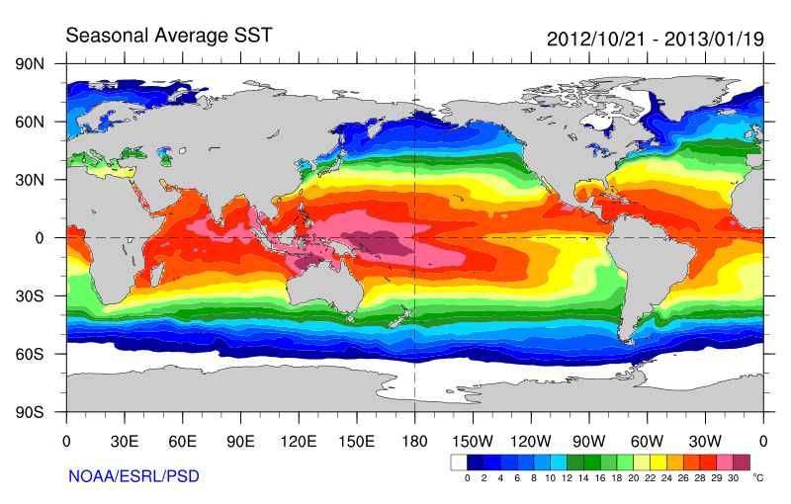
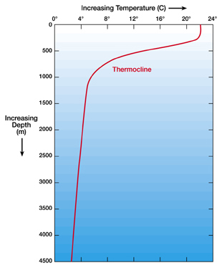
Ocean Temperature
Mixed Layer
What determines the SST patterns?
SST provides the lower boundary condition for the atmosphere!

Slide 24
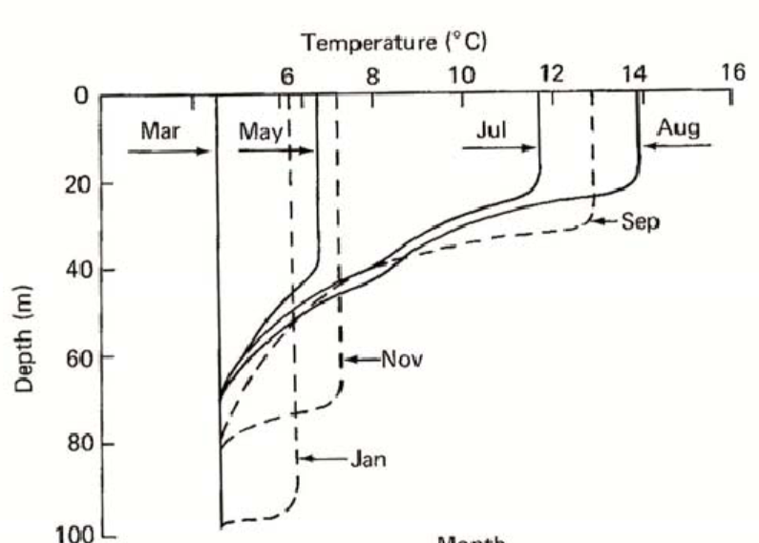
Seasonal Variations in Mixed Layer Depth
(at a northern mid-latitude)
Explain it

Slide 25
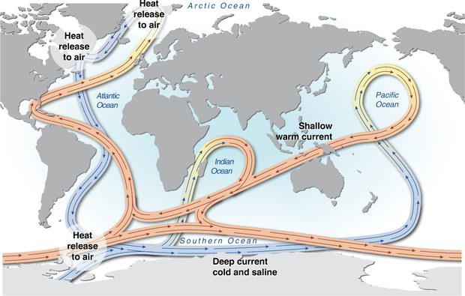
Ocean Overturning Circulation

Slide 26
Key Roles of the Oceans
They absorb and store large amount of solar radiation.
They provide water vapor and heat for the atmosphere.
They help re-distribute energy and water on Earth.
Their long memory induces decadal climate variations.
They affect carbon and other biogeochemical cycles.

Slide 27

Seasonal Cycle in Land Cover as Measured by Satellite NDVI

Slide 28
UK Met Office Video
What is Climate (~3min)

Slide 29
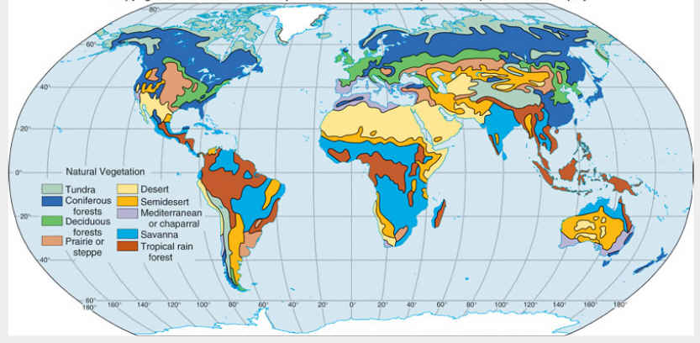
Natural Land Cover Types

Slide 30
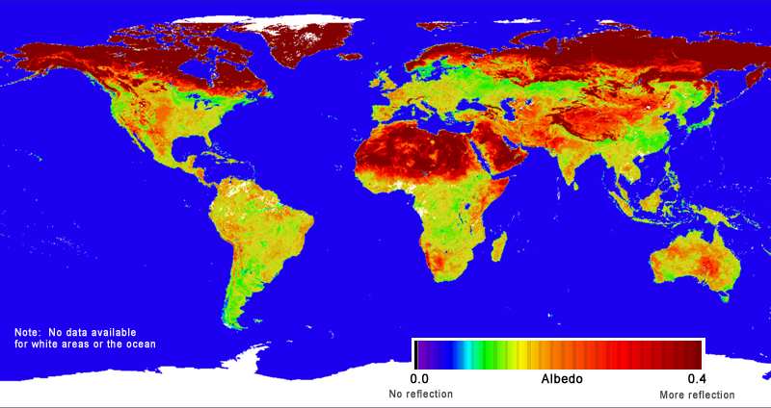
Surface Albedo
(Ratio of reflected to incoming solar radiation)

Slide 31
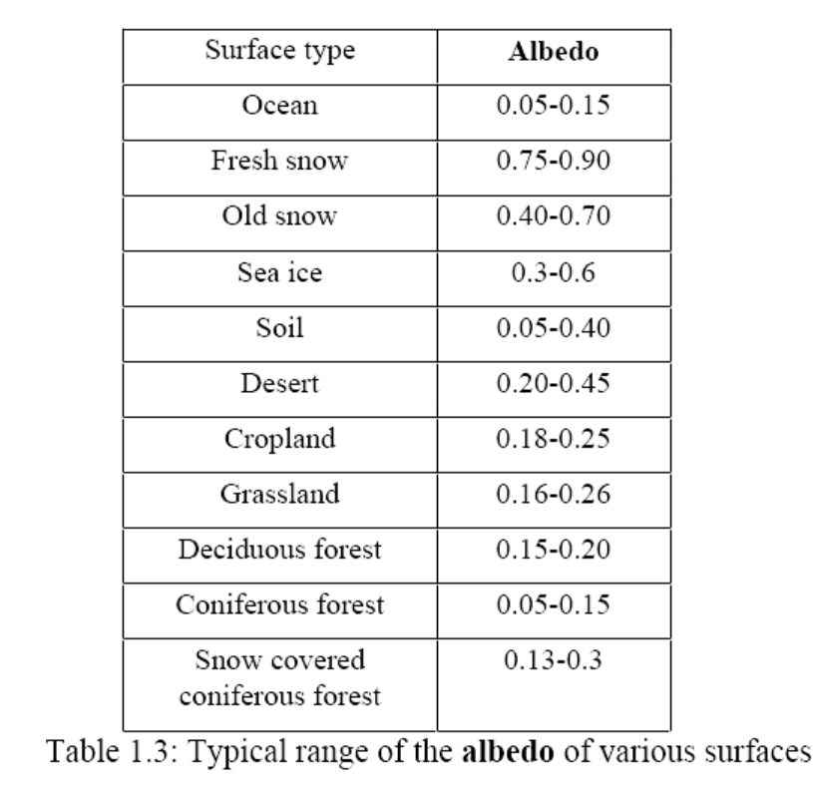
Typical Surface Albedo Values

Slide 32
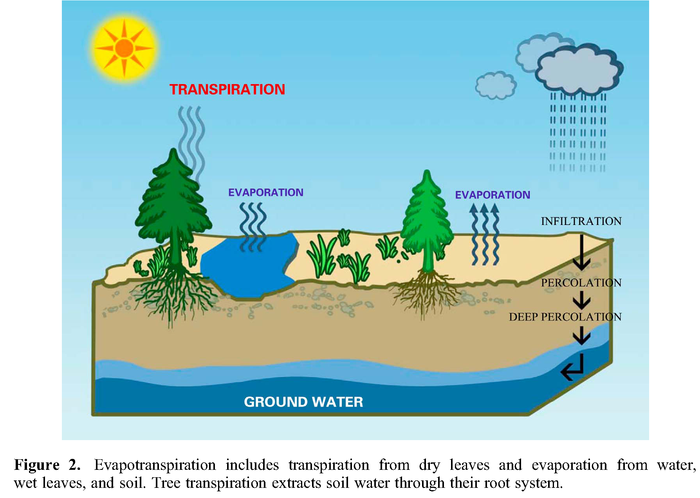
Evapotranspiration over Land
Evaporation
Wang and Dickinson (2012)
Notes:
Transpiration is largest contribution to total E over areas covered with vegetation.

Slide 33
Key Roles of the Continents
Land cover types determine how much sunlight is absorbed and how much is reflected.
Land exchanges water, energy and carbon with the atmosphere, thus affecting atmospheric water and energy balance and CO₂ content.
Terrain over land also affects atmospheric circulation and precipitation.
Soil moisture has a memory of months that can induce seasonal to inter-annual variations in climate.

Slide 34
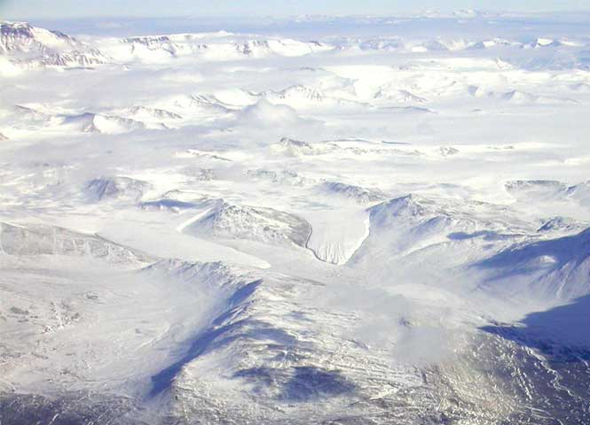
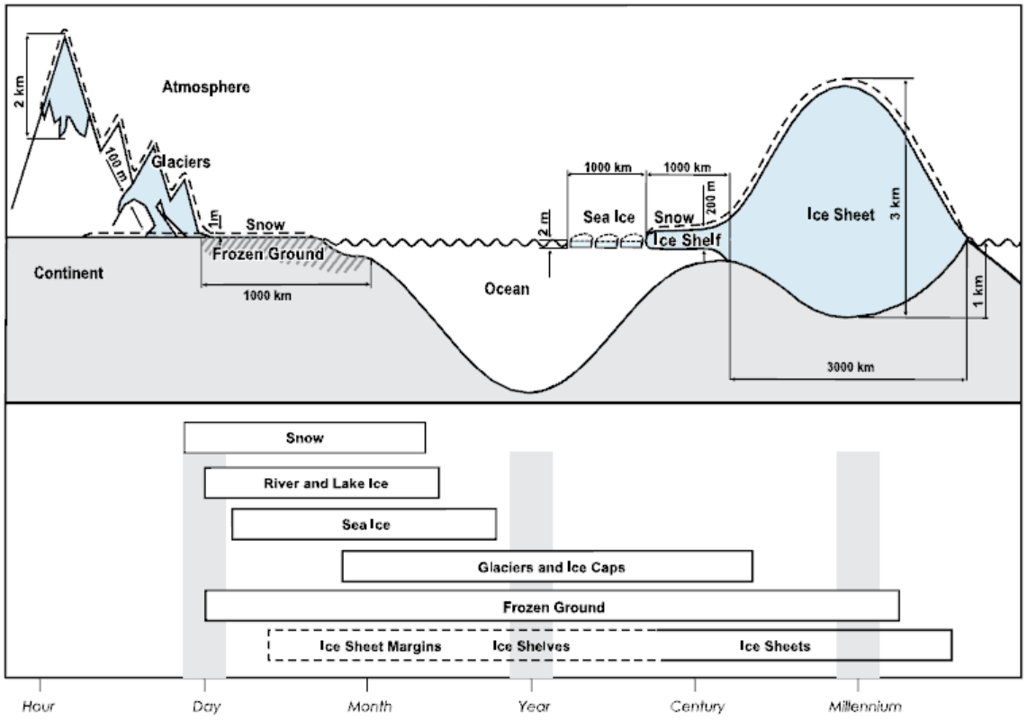
The Cryosphere
The frozen places on Earth, including snow cover, river and lake ice, sea ice, glaciers and ice caps, ice shelves and ice sheets, and frozen ground.
Time Scales

Slide 35
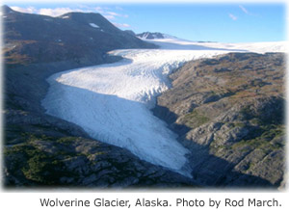
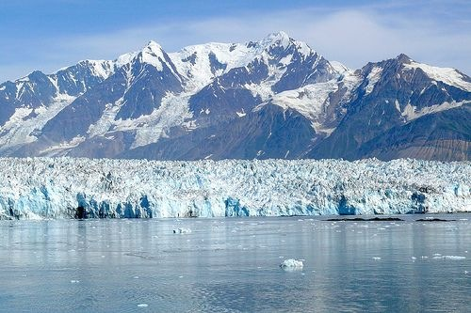
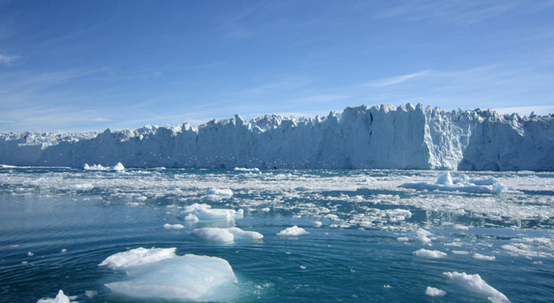
Alaska
Antarctica

Slide 36
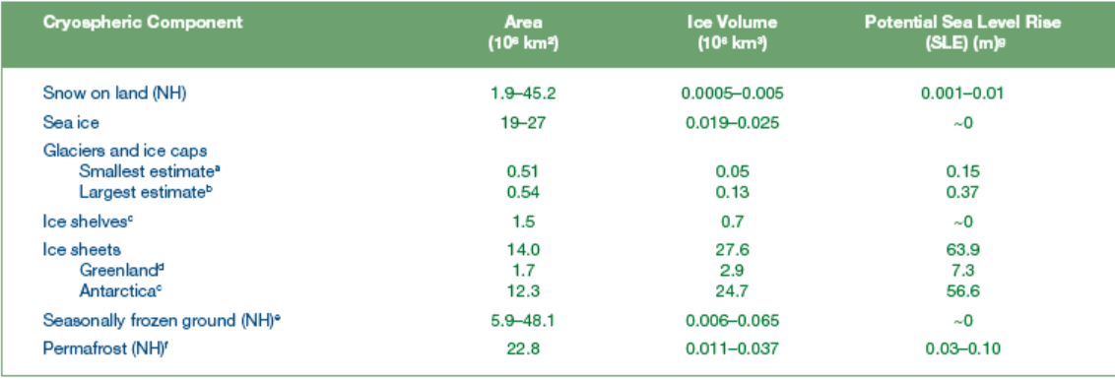
Cryosphere Components
10⁶ km²
10⁶ km³

Slide 37
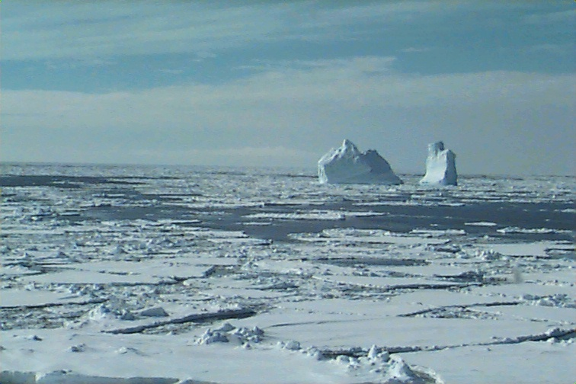
Sea Ice
Sea ice covers both the N. and S. Hemisphere polar regions
Varies seasonally:
S.H.: A minimum of 3-4 million km² in February to a maximum of 17-20 million km² in September, 1-2 m thick
N.H.: A minimum of 7-9 million km² in September to a maximum of 14-16 million km² in March. 2-4 m thick
Satellite passive microwave obs began in the late 1970s.
Main data source: National Snow and Ice Data Center (NSIDC) in Boulder, CO
(http://nsidc.org/cryosphere/sotc/sea_ice.html)

Slide 38
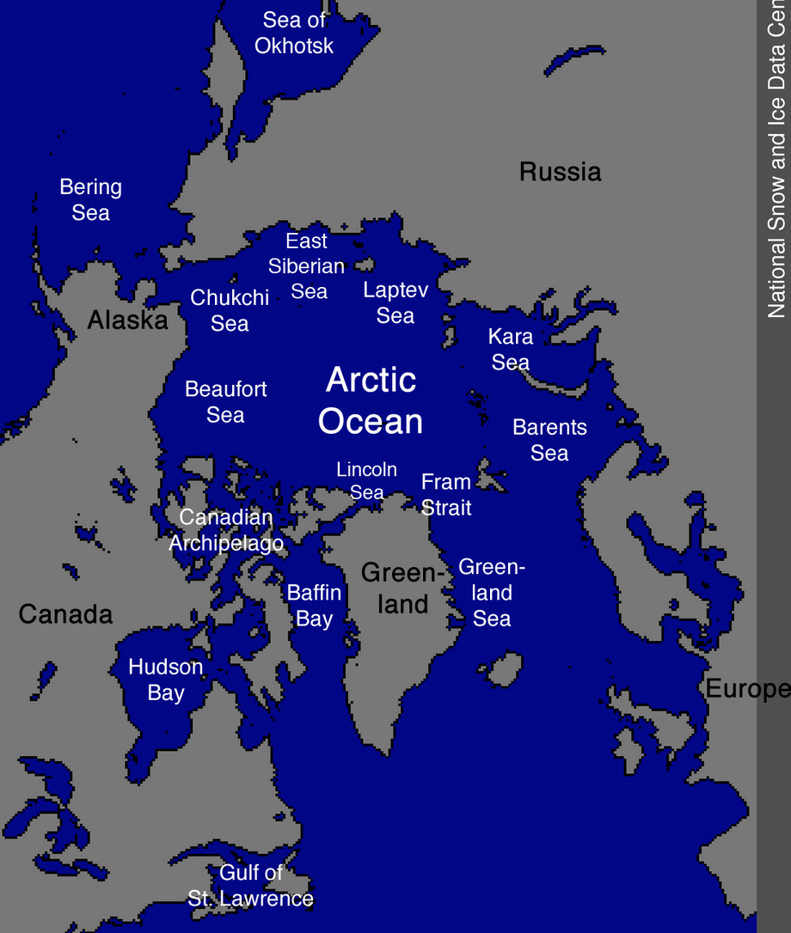
Map of the Arctic Ocean

Slide 39
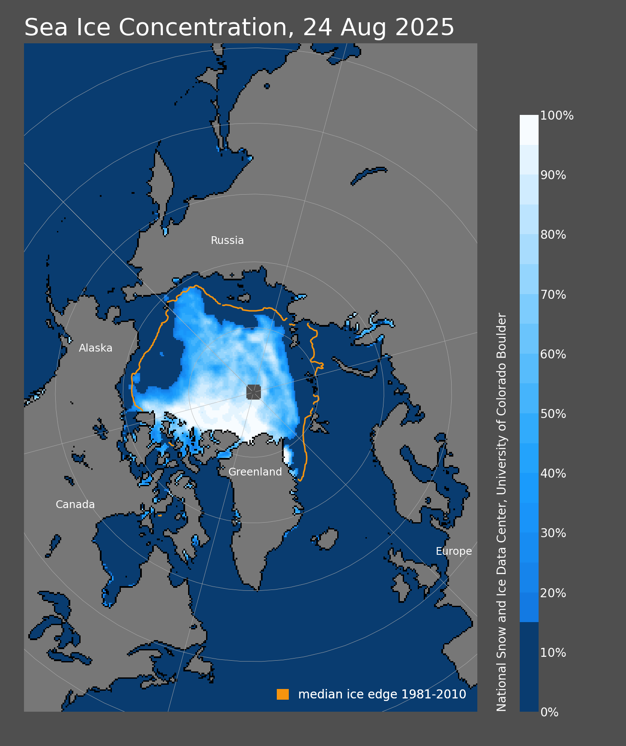
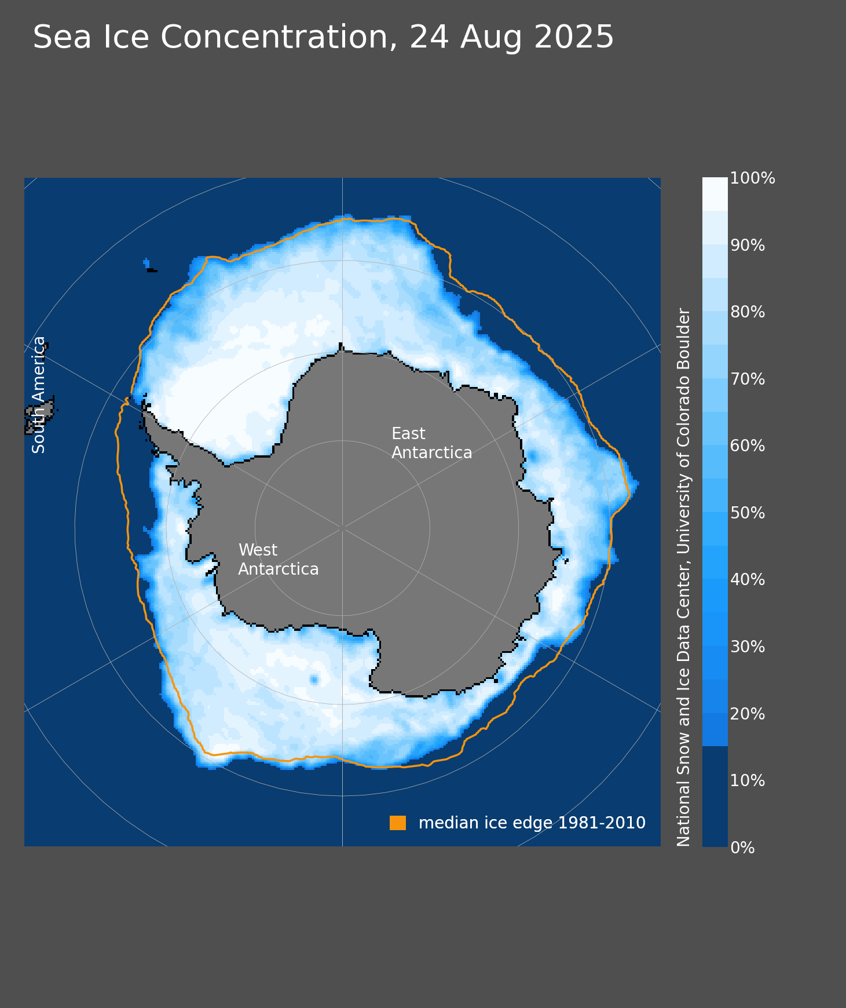
http://nsidc.org/arcticseaicenews/category/daily-image/

Slide 40
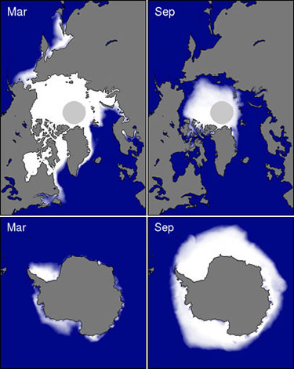
Arctic
Antarctic

Slide 41
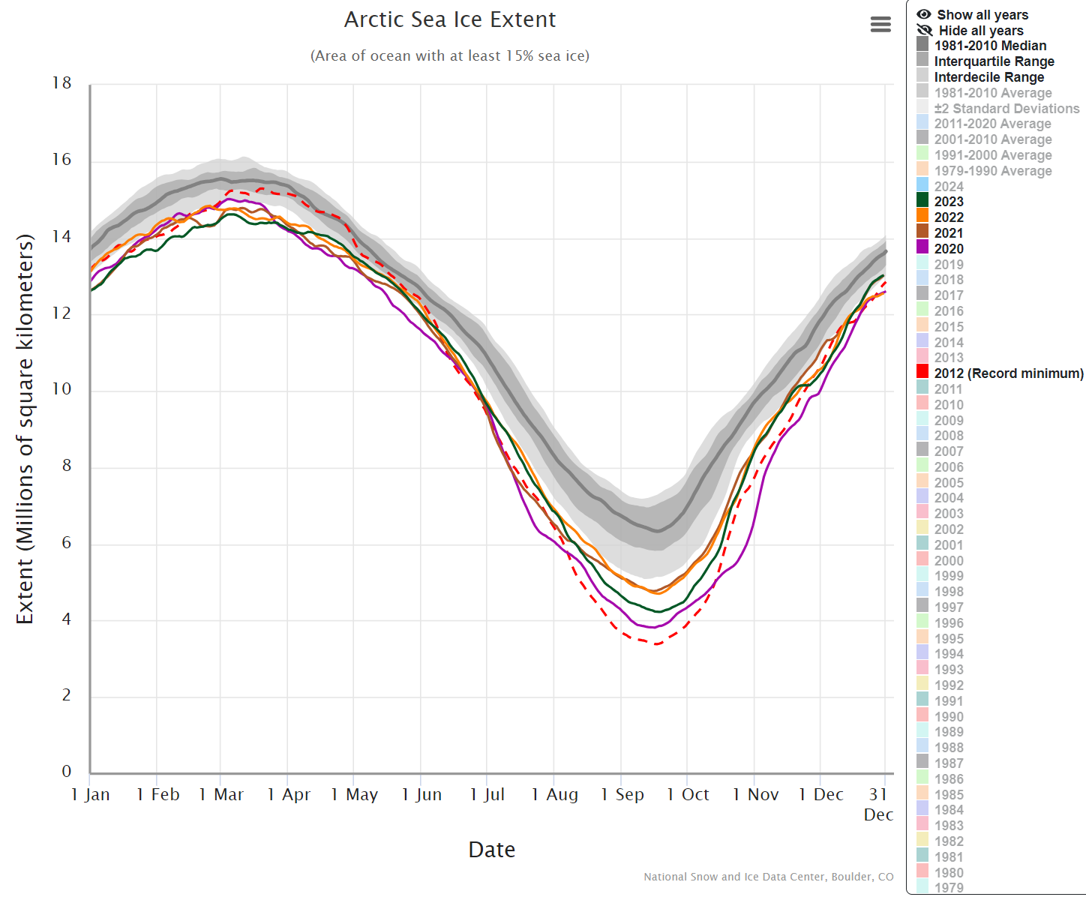
Arctic Sea-ice Annual Cycle
https://nsidc.org/arcticseaicenews/charctic-interactive-sea-ice-graph/

Slide 42
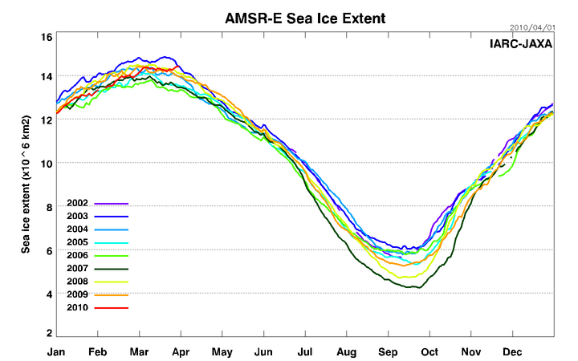
Arctic Sea-ice Annual Cycle

Slide 43
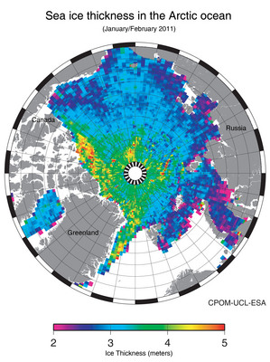
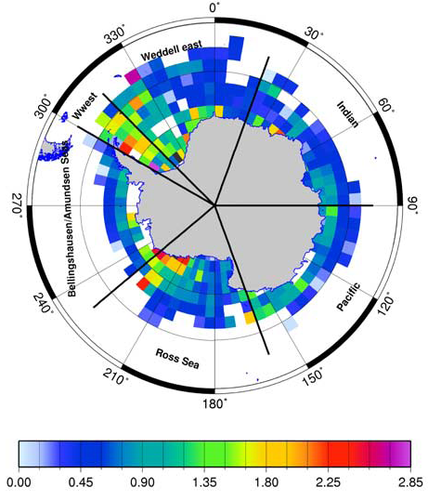
Worby et al. 2008
Antarctic Sea-ice annual-mean thickness (m)
http://www.esa.int/esaCP/SEMAAW0T1PG_index_0.html

Slide 44
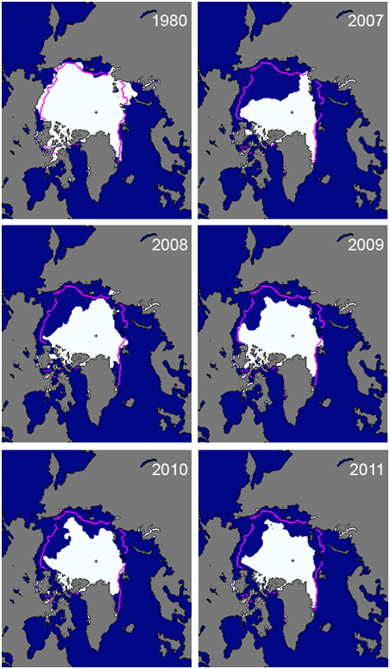
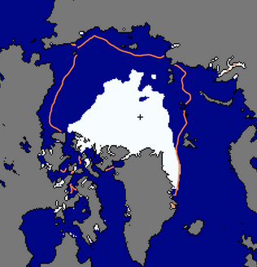
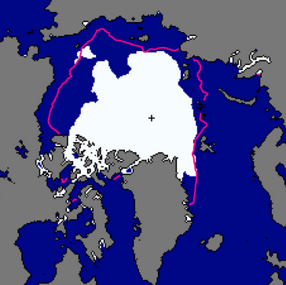
Arctic Sea-ice Loss
Sept Area Coverage
Magenta line = 1979-2000 mean of 8.7 million km²
Source: NSIDC
Lowest on Record
2012
2016
Notes:
Magenta line indicates the 1979-2000 mean coverage

Slide 45
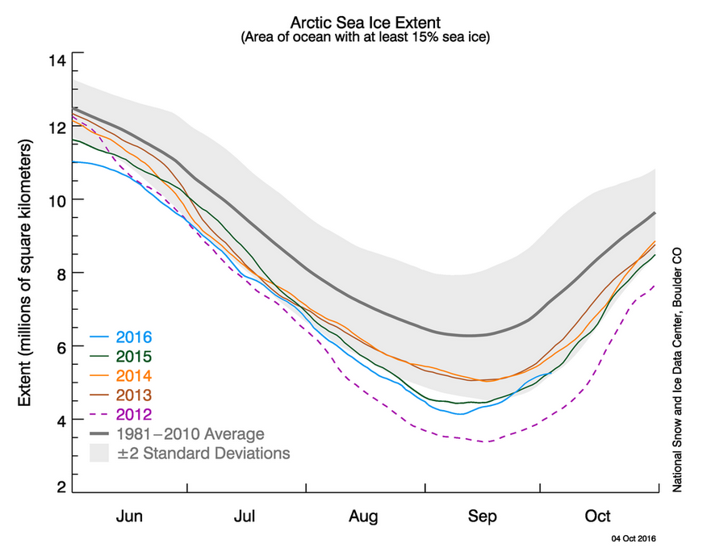

Slide 46
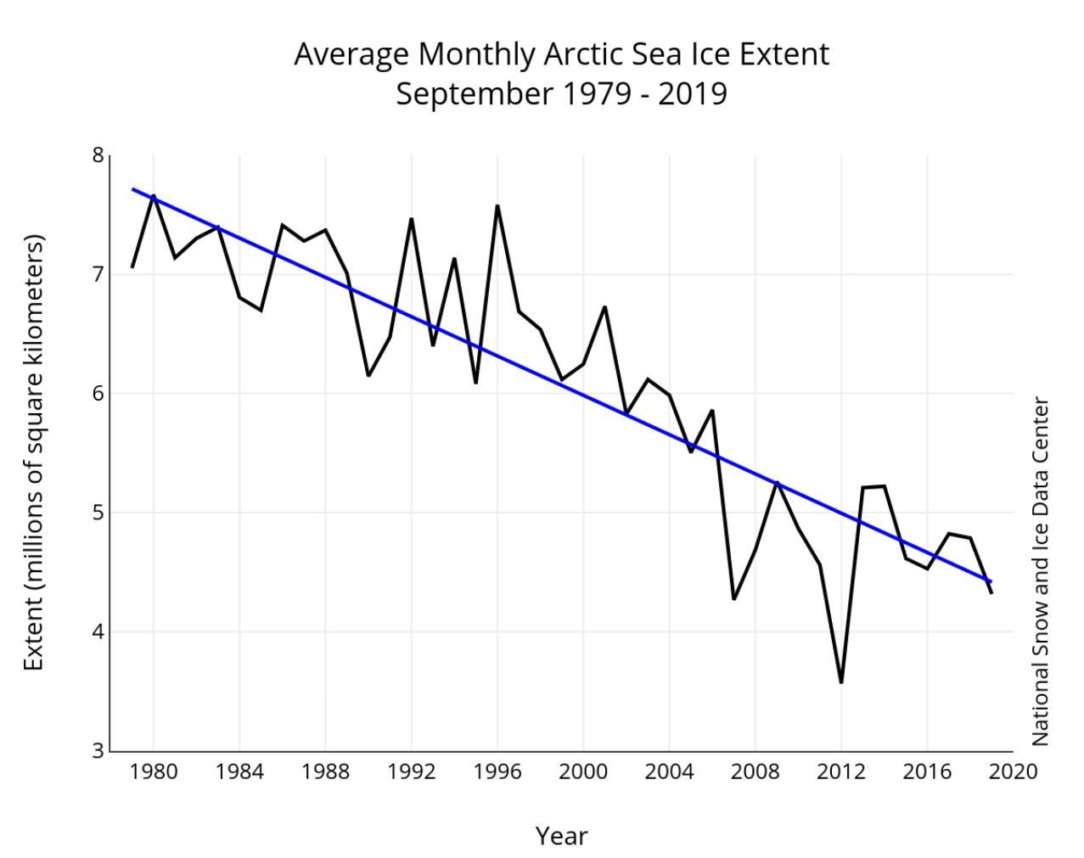
http://nsidc.org/arcticseaicenews/2019/10/falling-up/

Slide 47
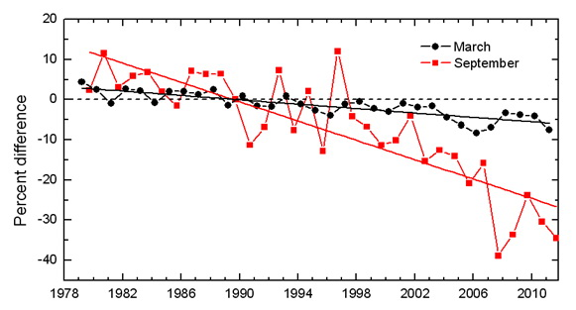
Arctic Sea-ice Loss is Largest in Fall.

Slide 48
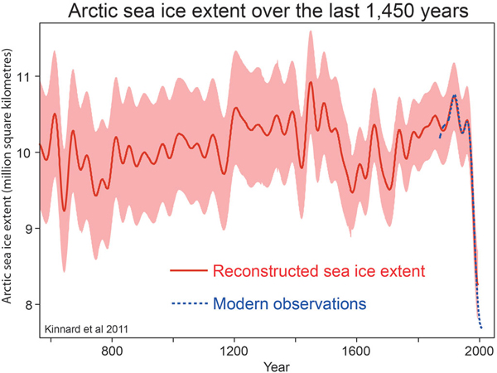
Arctic Sea-ice Extent: Historical Perspective
Kinnard et. al 2011,Nature: based on proxy data from ice-cores, tree-ring, lake sediments, documentary, ocean cores around the Arctic.

Slide 49
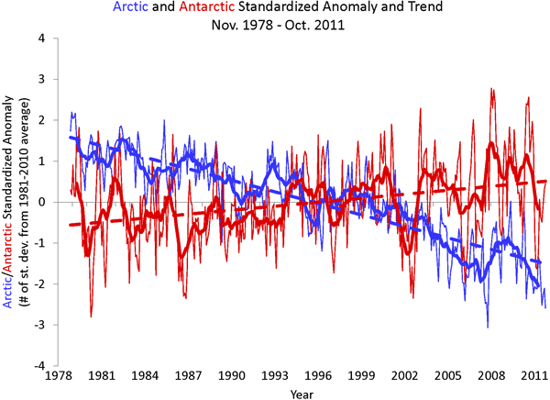
Antarctic vs. Arctic Sea-ice Extent Trends
Source: NSIDC based on satellite microwave obs.
Notes:
Thick line=12month running mean, thin line = monthly anomaly

Slide 50
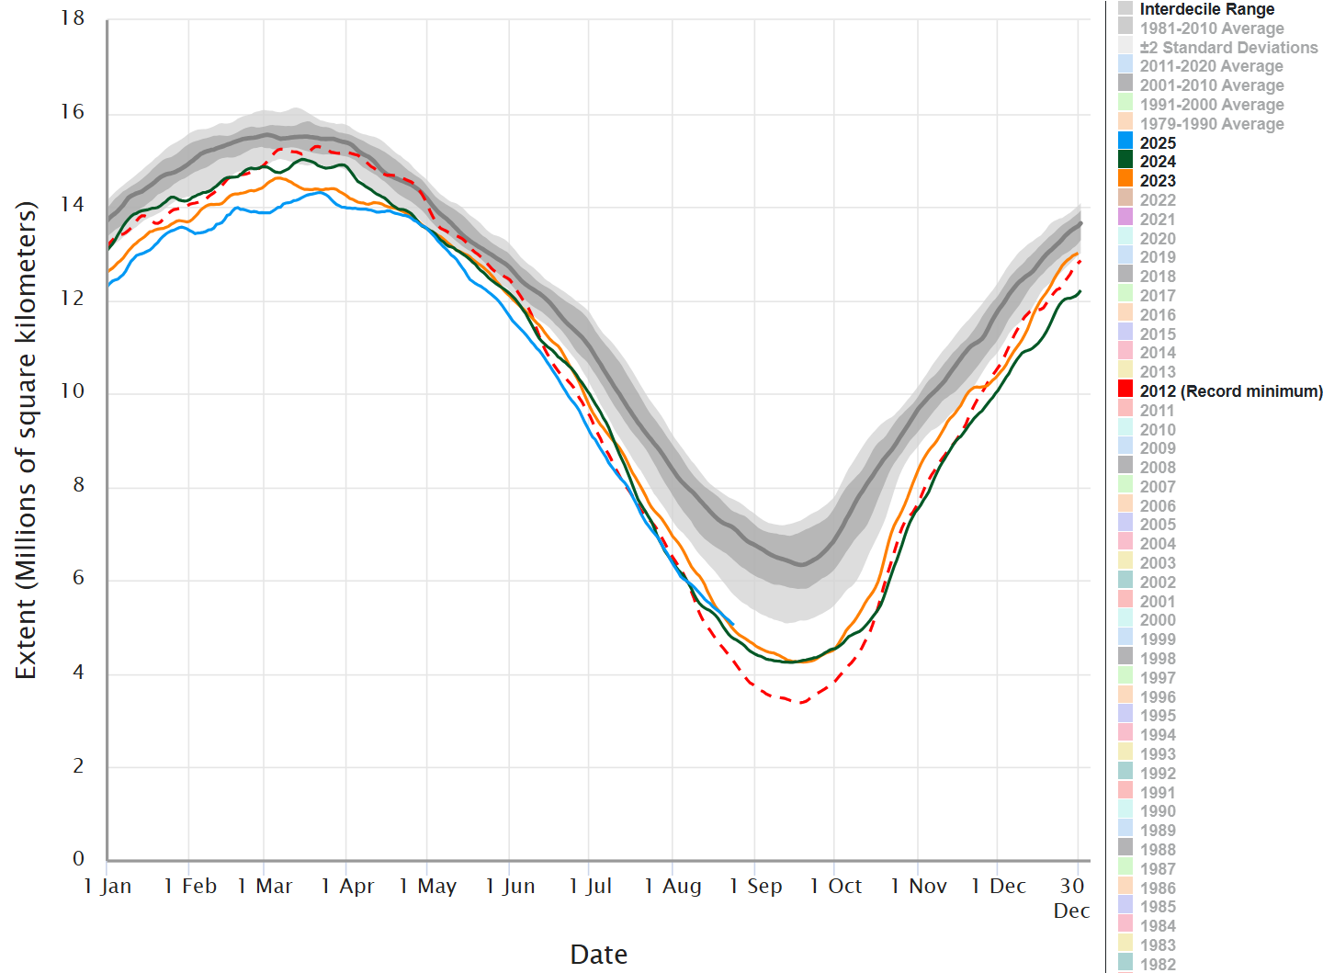

2024
2023
2012
https://nsidc.org/arcticseaicenews/charctic-interactive-sea-ice-graph/

Slide 51
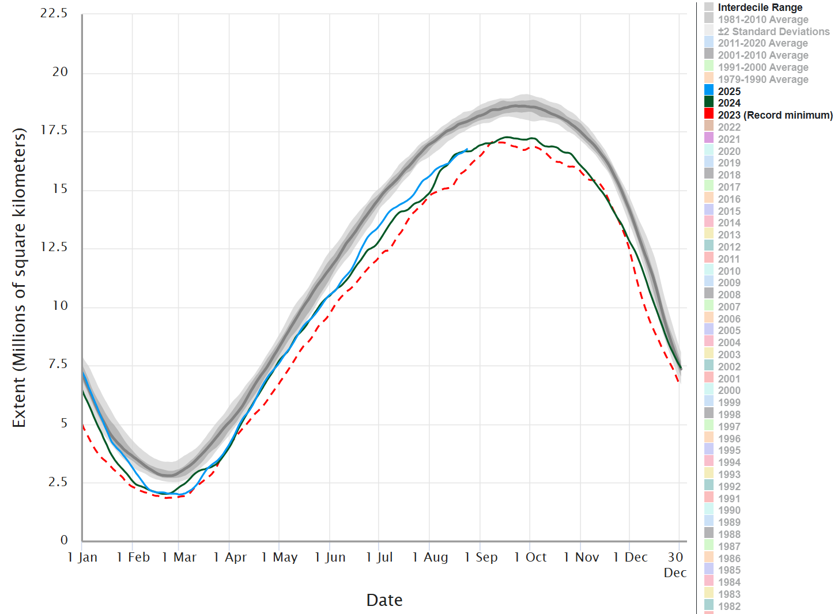

2024
2023
https://nsidc.org/arcticseaicenews/charctic-interactive-sea-ice-graph/

Slide 52
Some Basics about Glaciers
A glacier is a large persistent body of ice that forms where accumulation of snow exceeds its ablation (net melting).
Glacier types:
- alpine glacier or mountain glacier, called an ice cap if over a whole mountain
- ice sheet or continental glacier: Greenland and Antarctica
Glaciers cover ∼10% of global land areas currently, about 1/3 of global land during the LGM about 18ka ago when sea level was 120m lower.
Glaciers store about ∼69% of Earth’s freshwater. They would raise the sea level by 70m if they all melted.
About 1/3 of world’s population depends on glacial water.
Most glaciers move downhill and change on time scales of 10-1000 years
Glacier dynamics is complicated and has not yet been included in most climate models.

Slide 53
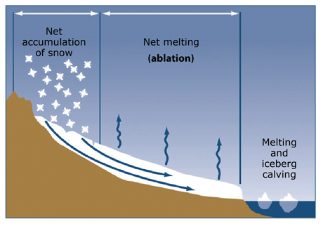
Mass Balance of Glaciers

Slide 54
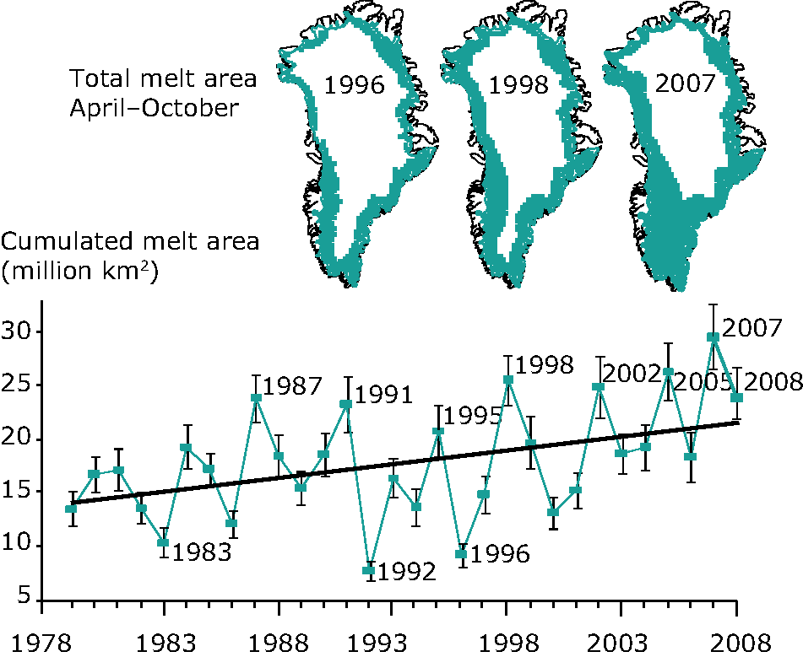
Greenland Ice Sheet Retreat
Source: http://www.eea.europa.eu/data-and-maps/figures/melting-area-197920132008-and-mass
Notes:
Satellite observations based on differences in the emissivity of water and ice at microwave length were used to derive ice melt extent, which occurs primarily in June-Sept season.

Slide 55

Antarctic Ice Shelves
0º
South Atlantic Ocean
Weddell Sea
South Indian Ocean
Antarctic Peninsula
Bellingshausen Sea
West Antarctica
East Antarctica
90ºW
90ºE
Amundsen Sea
Ross Sea
South Pacific Ocean
180º
Notes:
Ice shelves are permanent floating sheets of ice that connect to a landmass, mostly seen in Antarctica.

Slide 56

Antarctic Ice Sheet Mass Change

Slide 57
Key Roles of the Cryosphere
It affects the height of global-mean sea level.
Ice and snow reflect more sunlight to space than other surfaces, thus affecting Earth’s energy balance.
Snowpack and mountain glaciers provide freshwater for 1/3 of world’s population.
It interacts with the atmosphere and oceans, contributing to
the glacier-interglacier cycles in Earth’s history.

Slide 58
Key points of Today’s Lecture
Overview of the course:
- Course outline
- Homework sets
- Mid-term and final exam dates
The Earth Climate System:
- Major components:
The atmosphere, oceans, land, and the cryosphere
- Their basic features
- Their main roles in the climate system

Slide 59
Homework Assignments:
- Read Chapter 1 of UCL online textbook (pdf file
available at https://www.atmos.albany.edu/facstaff/adai/ATM551/OtherReadingMaterials/UCL-ClimDyn/
- Review my ppt slides, and think of the following questions:
What are the main differences between weather and climate?
Why should one trust model simulations of the climate decades into the future when we cannot predict the weather beyond 1-2 weeks?
In your own words, describe the main components of the climate system and their key roles for Earth’s climate.
What are the typical value range and spatial patterns of the sea surface temperature (SST) and sea surface salinity (SSS) in world’s oceans? What determine these spatial variations in SST and SSS?
(You do not need to turn in answers to these questions.)

Slide 60

Next Lecture:
Characteristics of the Current Climate
Thank You!

