Slide 1
A ATM551: Fundamentals of Earth’s Climate, Lecture #5
Global Energy Balance and
Greenhouse Effect
Reading Materials:
Chapter 2 of Hartmann GPC
Or
Chapter 3 of the AMS Textbook +
Section 2.1 of the UCL Online textbook

Slide 2
Key points of Last Lecture
On Geological Time Scales: Controls on CO2 and T
- Global T and CO2 levels have changed greatly. They often are related but not always correlated. (CO2 levels have generally decreased).
- CO2 is released to the air through volcanoes and removed by weathering of rocks and chemical reactions in the oceans, plus biological processes (rapid drawdown ∼350ma ago by plants).
- Changes in solar radiation, CO2 levels, and ice cover are the major factors behind large climate cycles in Earth’s history.
For the last 500,000 years: ice age, glacial-interglacial cycles
- Earth climate has changed greatly, dominated by 100,000yr glacial-
interglacial cycles.
- The eccentricity, obliquity and axial precession of Earth’s movements induce changes in solar radiation (and its seasonality) received by Earth on time scales of 100ka, 41ka, and 26ka (the Milankitch cycles).
- The Earth has been on a global warming trend since the LGM (26-18k.a.BP), with the last 11,500 years (Holocene) being relatively stable and warm.
- The current climate is warmer than any time in the past 2000 years.

Slide 3
Outline
Radiation: some basics
Solar Radiation: solar zenith angle, insolation at TOA
Terrestrial Radiation: Earth’s emission temperature and effective emission altitude, emissivity, atmospheric absorption
Greenhouse Effect: Natural vs. Anthropogenic, magnitudes
Global Energy Fluxes: at TOA, surface and for the Atmosphere
Poleward Energy Transport: by the atmosphere and oceans
Atmospheric Energy Balance: latent heating, radiative transfer

Slide 4
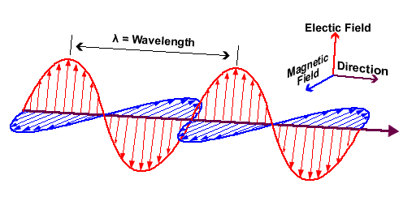
Review of Radiation
Electromagnetic waves can interact with matter in the following ways
  Radiation is emitted by all matter, depending on temperature and “emissivity” of the material
  Radiation can be absorbed by a material, with its energy going into changing the material’s temperature
  Radiation can be transmitted through a medium without loss of amplitude
  Radiation can be reflected or scattered, bouncing off in a different direction

Slide 5
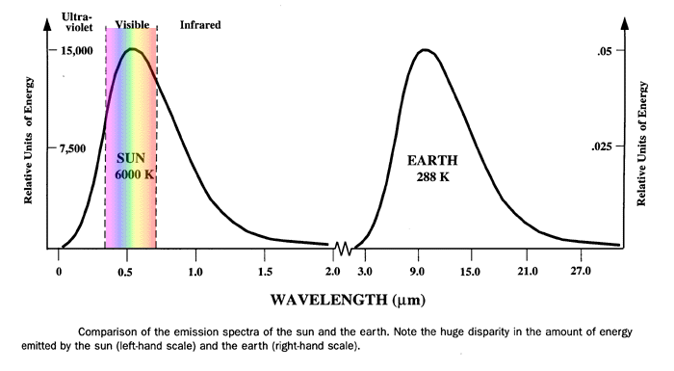
Review of radiation
  All objects warmer than 0 Kelvin emit radiation, depending on their temperature
shortwave
longwave
http://atoc.colorado.edu/wxlab/radiation/background.html

Slide 6
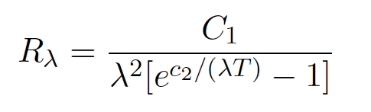
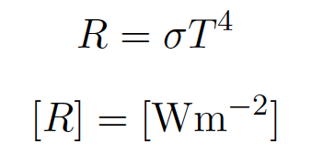
Blackbody radiation
A blackbody is an idealization: a substance that emits radiation in all direction at the maximum rate (for its temperature) and absorbs all incoming radiation
For a blackbody, “spectral flux” :
shortwave
longwave
T in Kelvin
For a blackbody, total flux (all wavelengths):
Stephan-Boltzman Law
σ = 5.67x10⁻⁸ W m⁻² K⁻⁴

Slide 7
“Gray body” radiation
Real substances do not emit and absorb perfectly like a blackbody.
As a result they are sometimes called “gray”
Departure from blackbody behavior is characterized by:
  Emissivity (ε_{λ}): actual emitted radiation / blackbody emitted radiation with the same temperature
  Absorptivity : absorbed radiation / incoming radiation
  Reflectivity (α_{λ}): reflected radiation / incoming radiation
  Transmissivity: transmitted radiation / incoming radiation
  These depend on the properties of the material
Absorptivity = emissivity → surface emissivity ε = (1- α) when transmission=0
For surface radiation balance we will use
  Surface emissivity (ε) : ε_{λ} integrated over all thermal wavelengths
  Surface albedo (α) : α_{λ} integrated over all solar wavelengths

Slide 8
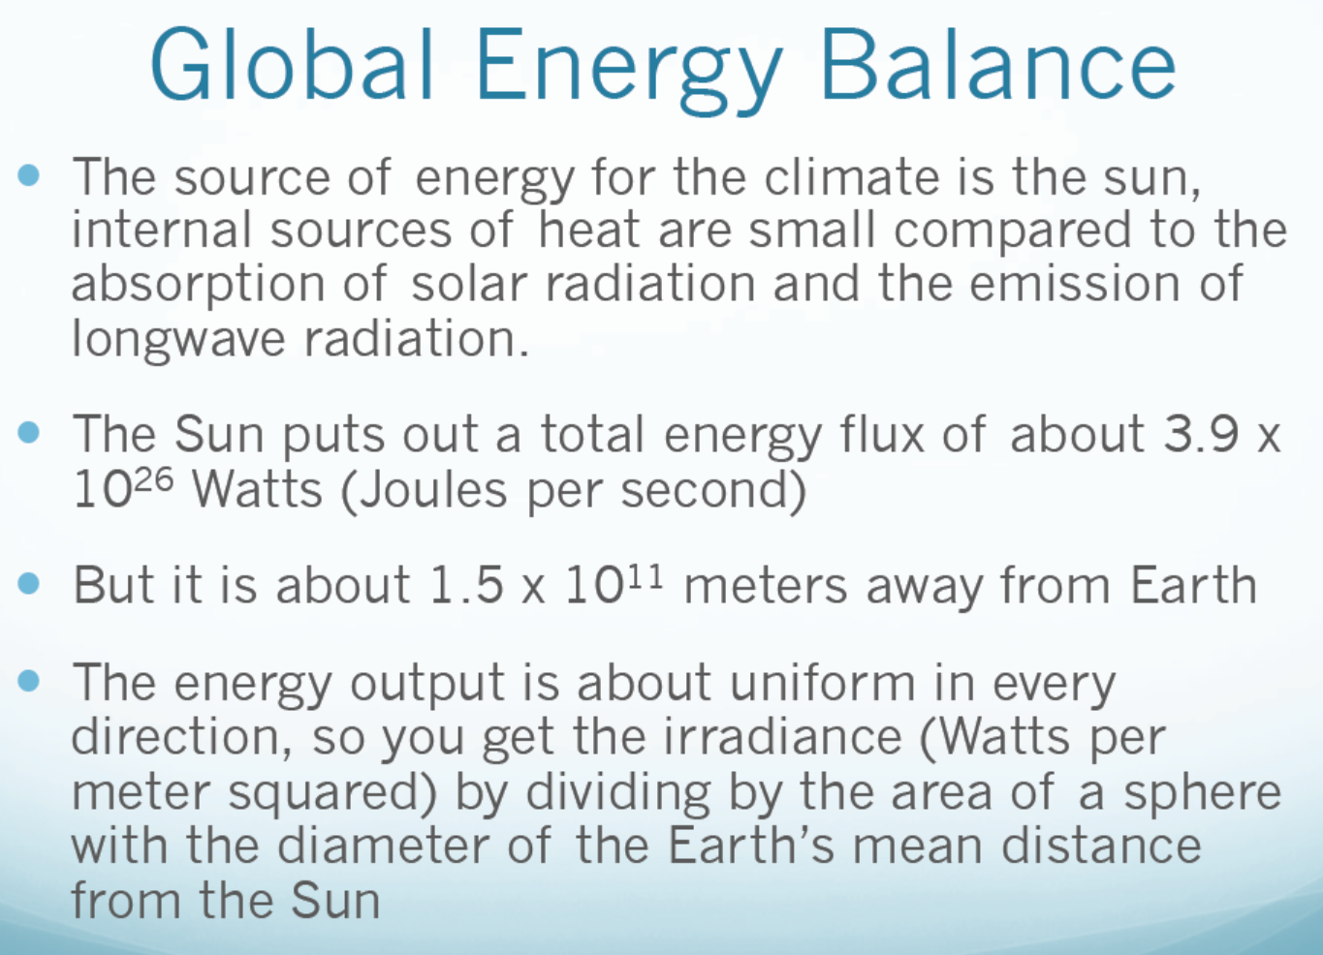

Slide 9
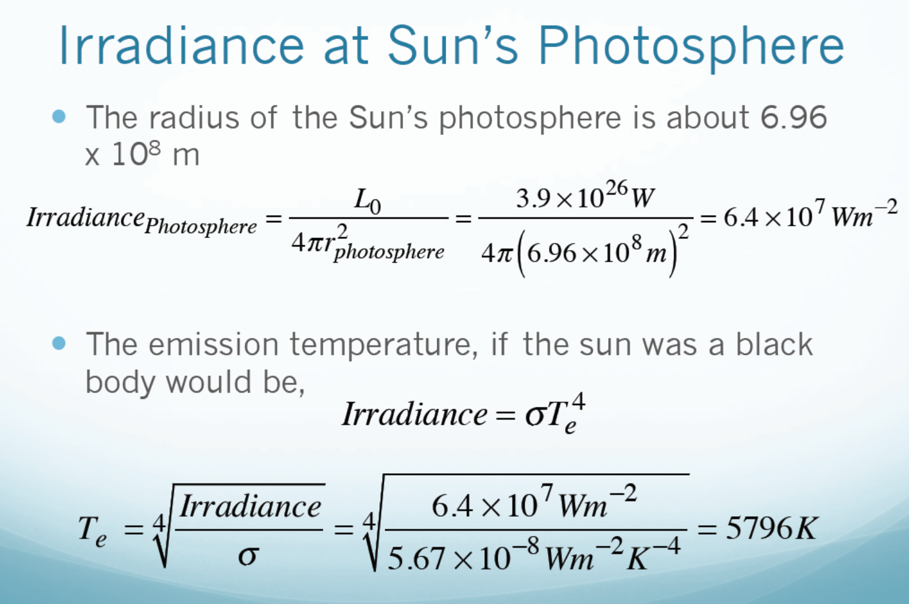

Slide 10
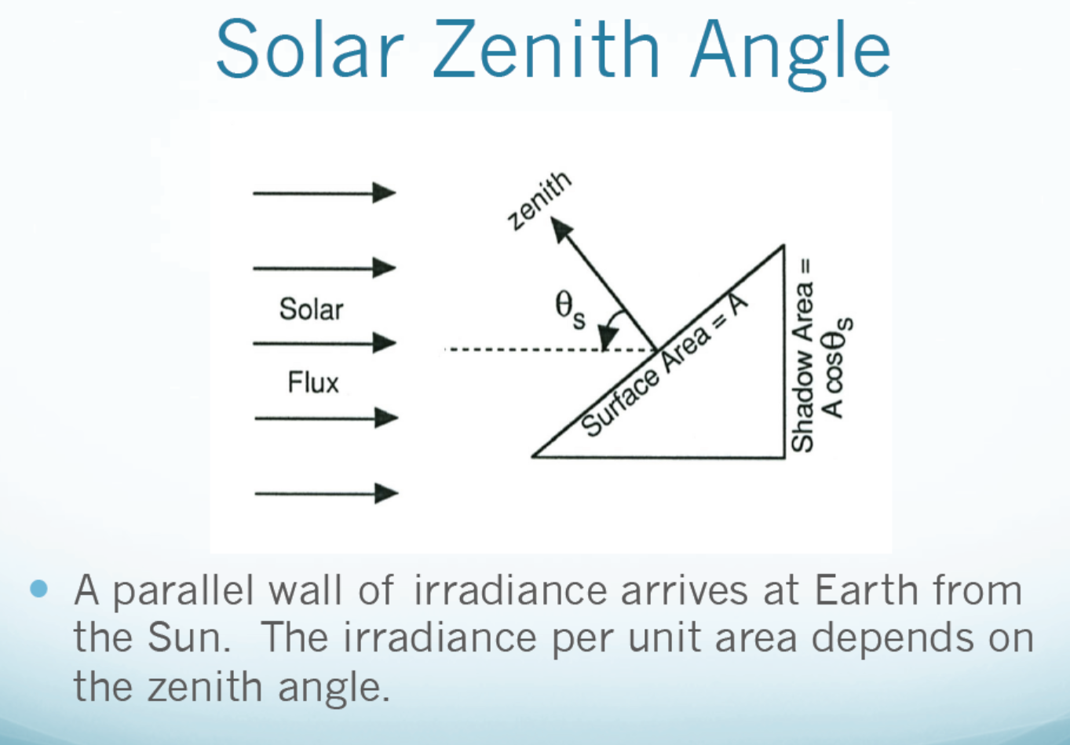

See section 2.7 of Hartmann GPC

Slide 11
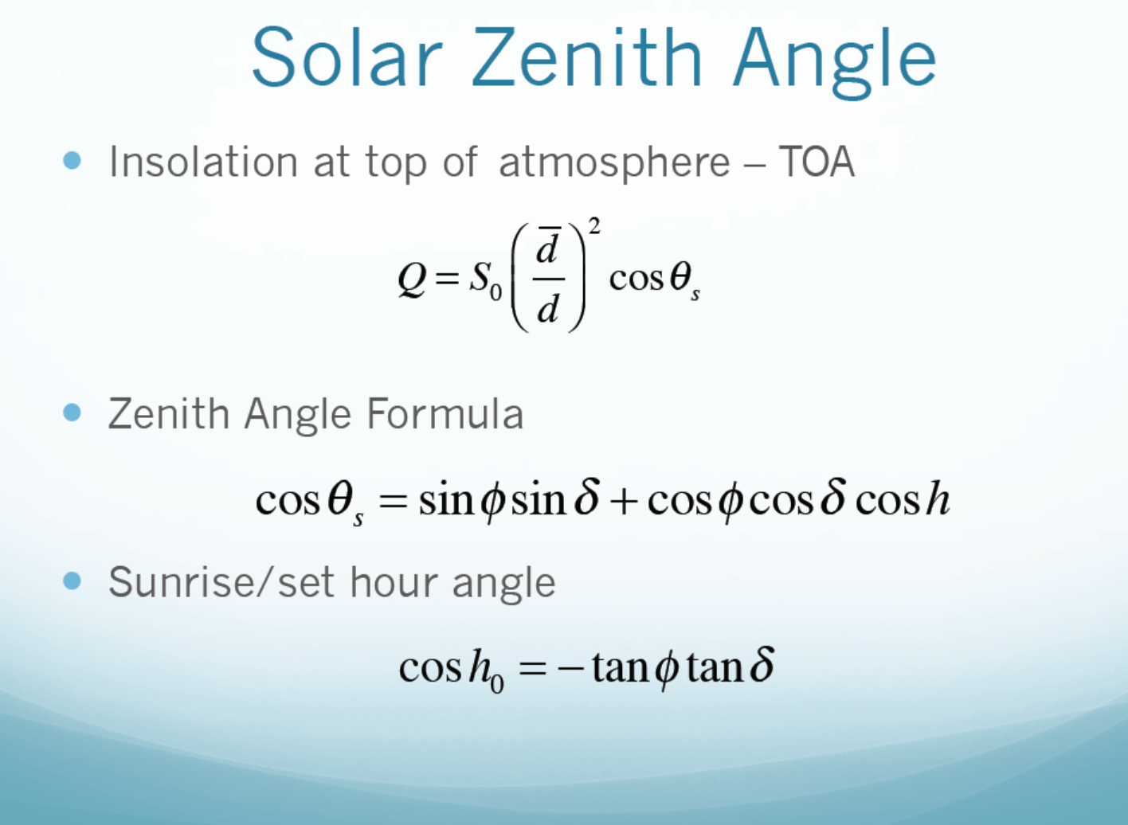
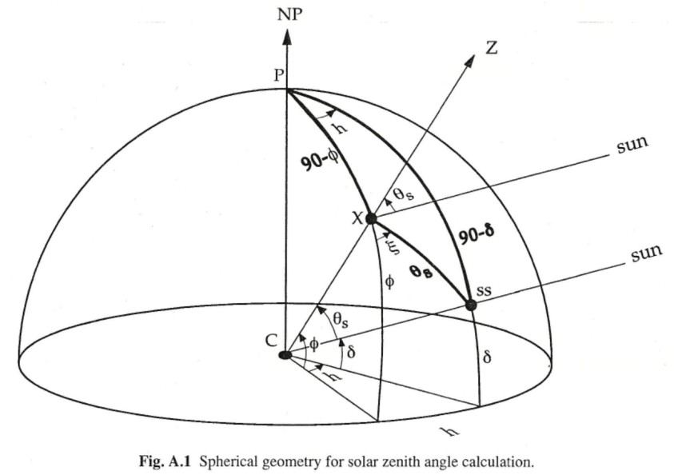
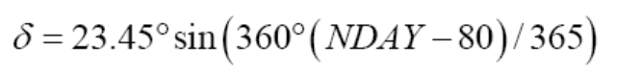
φ = latitude, δ = solar declination, h= hour angle
, where NDAY= day of the year, 1 for Jan. 1
Hour angle: Each hr from noon local solar time is 15º
Notes:
d = actual distance from the Sun, d_overBar = the mean distance for which the flux density So is measured. φ = latitude, δ = solar declination, h= hour angle = (12 - local solar time in hours)/24*360degree, ss=subsolar point (the point the Sun is right above your head). Solar declination =23.5º at summer solstice and -23.5º at winter solstice. See Appendix A of Hartmann book for how to estimate δ for each day of the year.

Slide 12
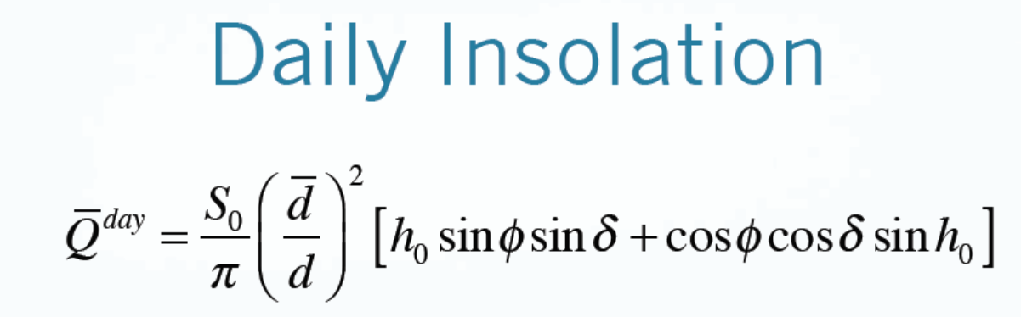
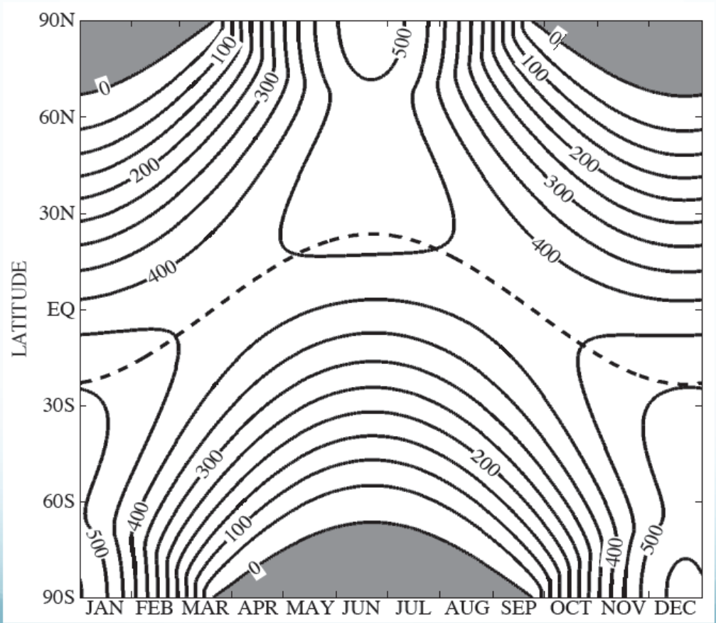
at TOA in W m⁻²
400
h0 is the sunrise and sunset hour angle: cos(h0)=-tanφ tanδ, where φ is latitude, and δ is the declination angle: δ = φ - θs (zenith angle)
d is the distance from the Sun. d_overbar = the mean distance from the Sun for which the flux density S_{o} is measured.
Notes:
Dashed line = subsolar point at noon (i.e. the Sun is directly over head at noon). h0 is the sunrise and sunset hour angle: cos(h0)=-tanφ tanδ, where φ is the latitude, and δ is the declination angle: δ = φ - θs (zenith angle)
d = actual distance from the Sun, d_overBar = the mean distance for which the flux density So is measured. φ = latitude, δ = solar declination, h= hour angle = (12 - local solar time in hours)/24*360degree, ss=subsolar point (the point the Sun is right above your head). Solar declination =23.5º at summer solstice and -23.5º at winter solstice. See Appendix A of Hartmann book for how to estimate δ for each day of the year.

Slide 13
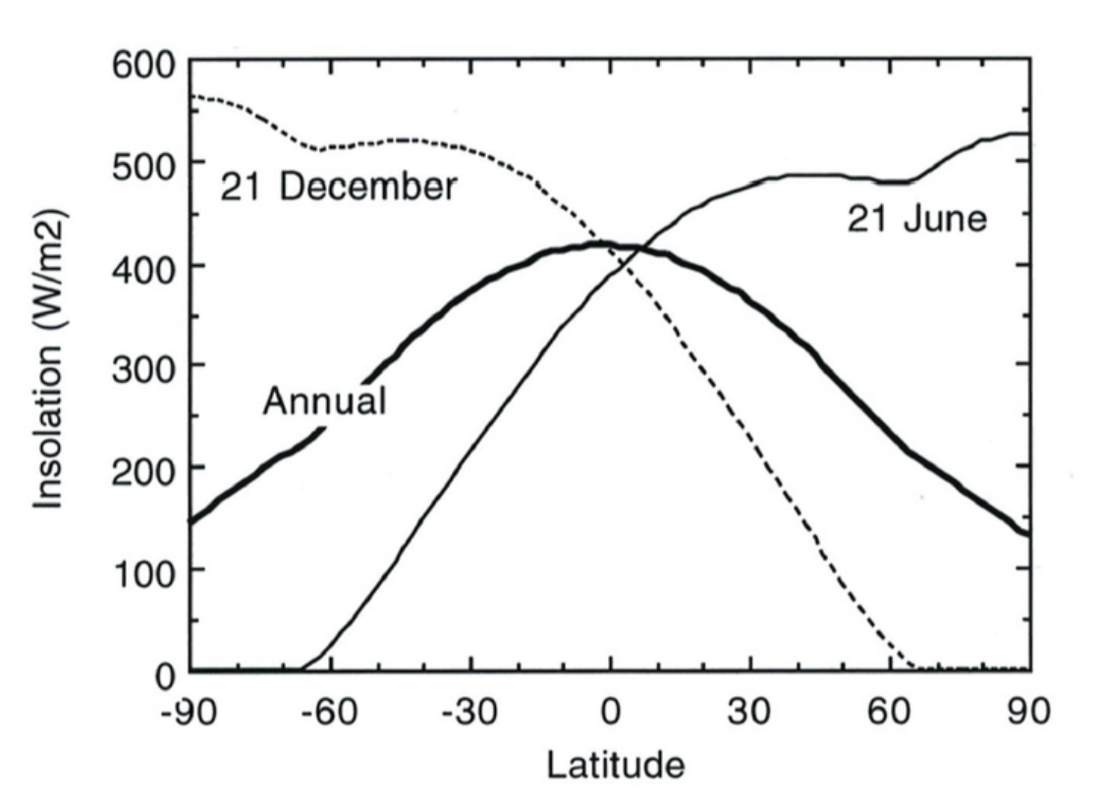
Latitudinal Distribution of Daily Insolation
560
530
400
150
140

Slide 14
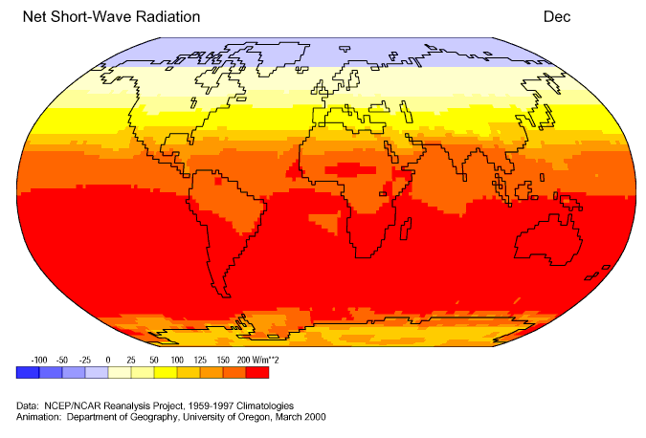
Seasonal Variations in Net Surface Solar Radiation

Slide 15
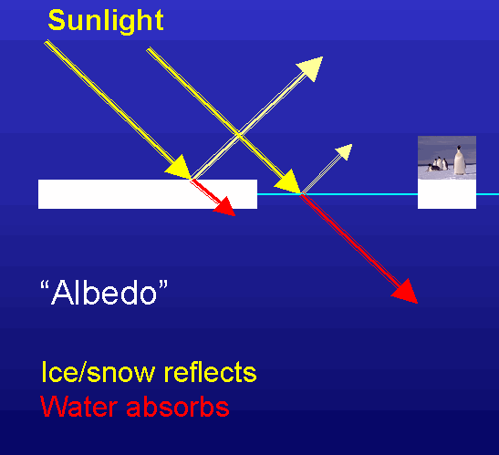
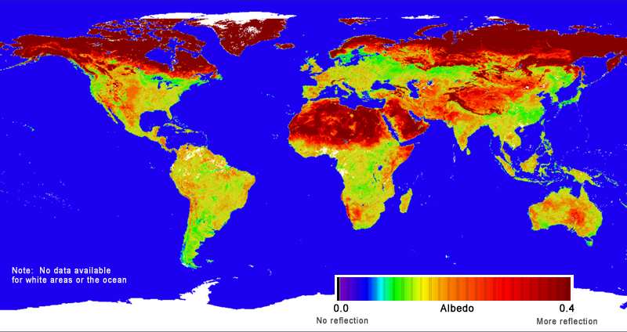
Earth’s Albedo
Solar radiation is reflected by clouds, aerosols and the surface.
Albedo (α) = the ratio of reflected solar radiation to the incoming
solar radiation. High for ice/snow and clouds, low for water
and vegetation. For the Earth as a whole, α ≈ 0.30 − the
planetary albedo, which is primarily due to the reflection
of clouds. Local albedo varies with land cover types and clouds.
The atmosphere can absorb, reflect and transmit sunlight, but it cannot emit short-wave radiation! It can only emits infrared or long-wave radiation at its own temperature.
Surface Albedo

Slide 16
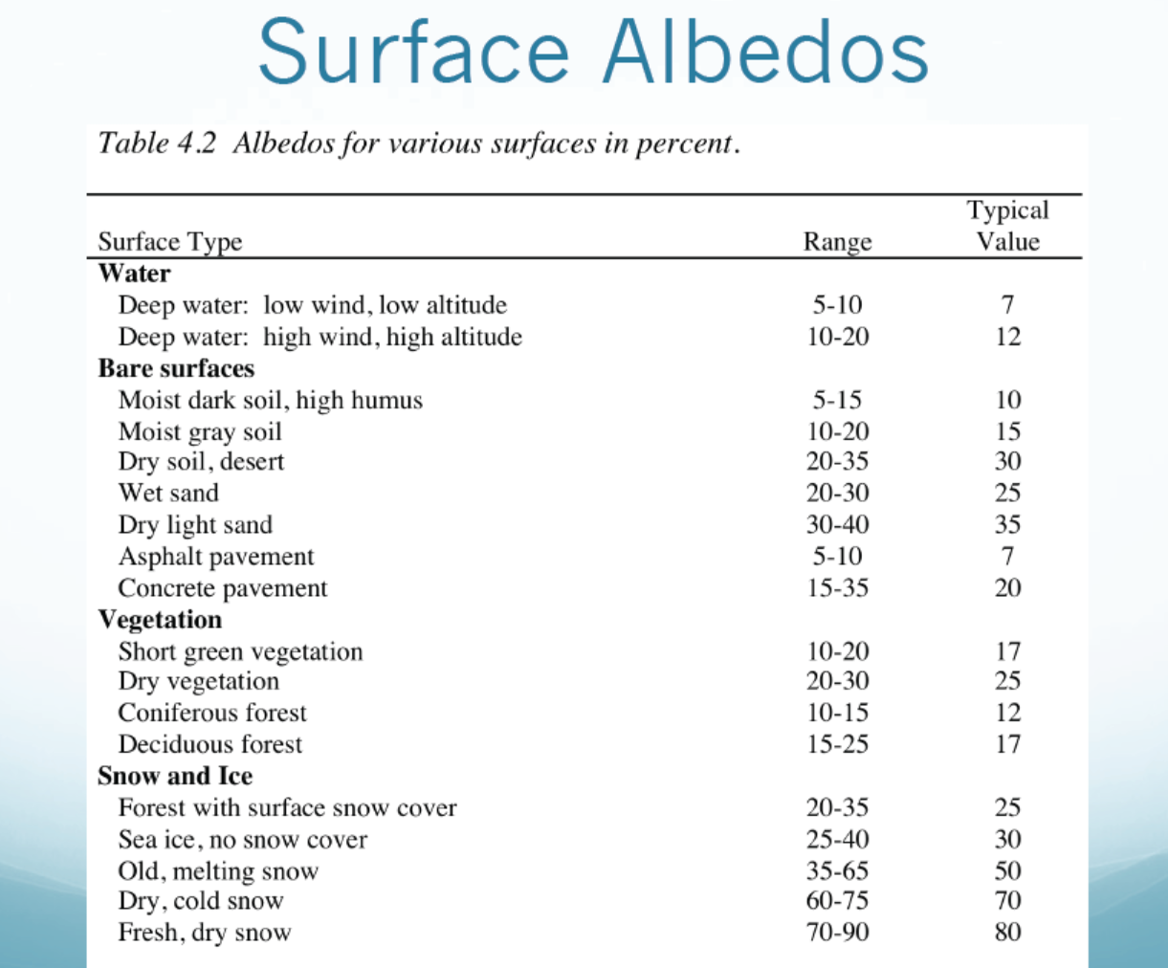
%
Cloud albedo: 10-90%, higher for low thick clouds
Notes:
Cloud albedo varies from less than 10% to more than 90% and depends on drop sizes, liquid water or ice content, thickness of the cloud, and the sun's zenith angle. The smaller the drops and the greater the liquid water content, the greater the cloud albedo, if all other factors are the same.
Low, thick clouds (such as stratocumulus) primarily reflect incoming solar radiation, causing it to have a high albedo, whereas high, thin clouds (such as Cirrus) tend to transmit it to the surface but then trap outgoing infrared radiation, causing it to have low albedo. It contributes to the greenhouse effect.

Slide 17
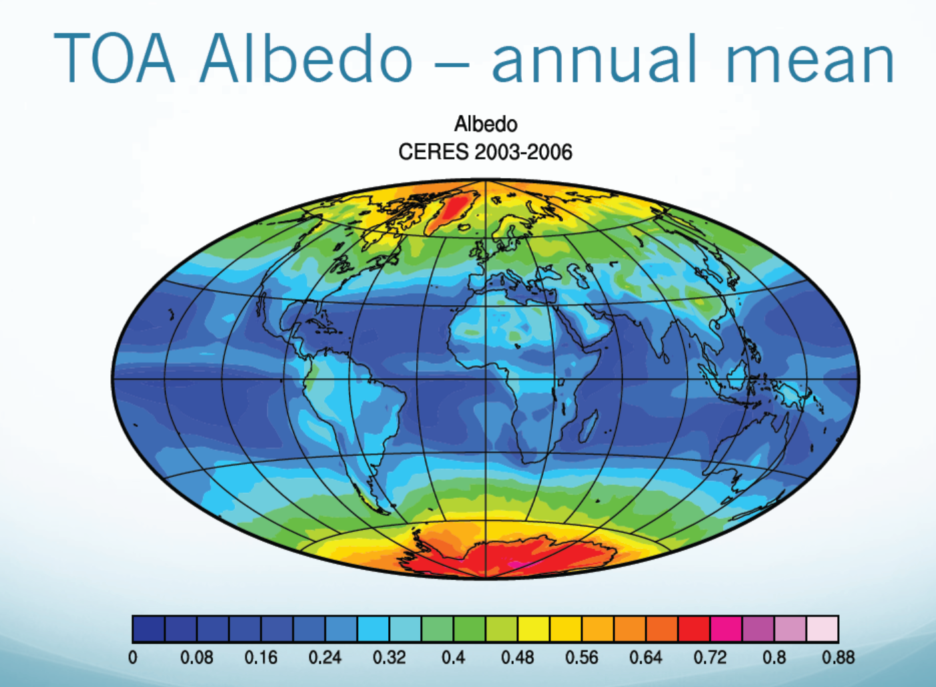
Main determining factors:
Clouds and surface types

Slide 18
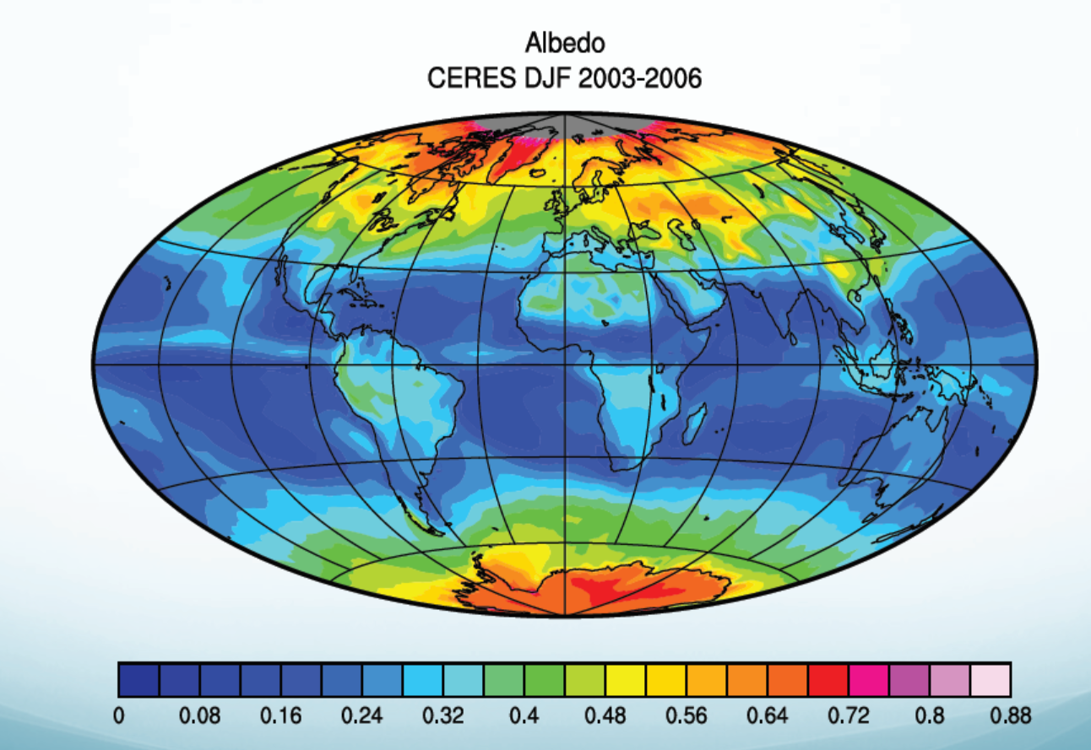
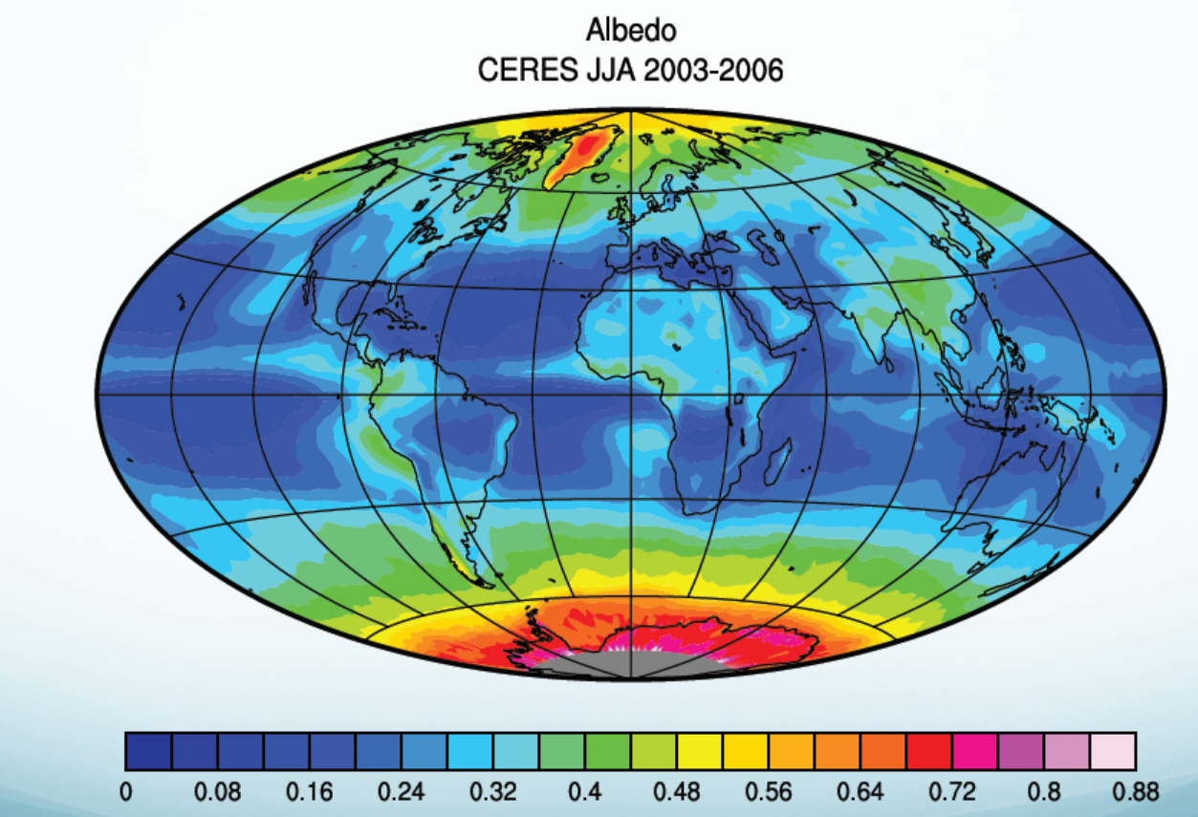
TOA
DJF
JJA

Slide 19
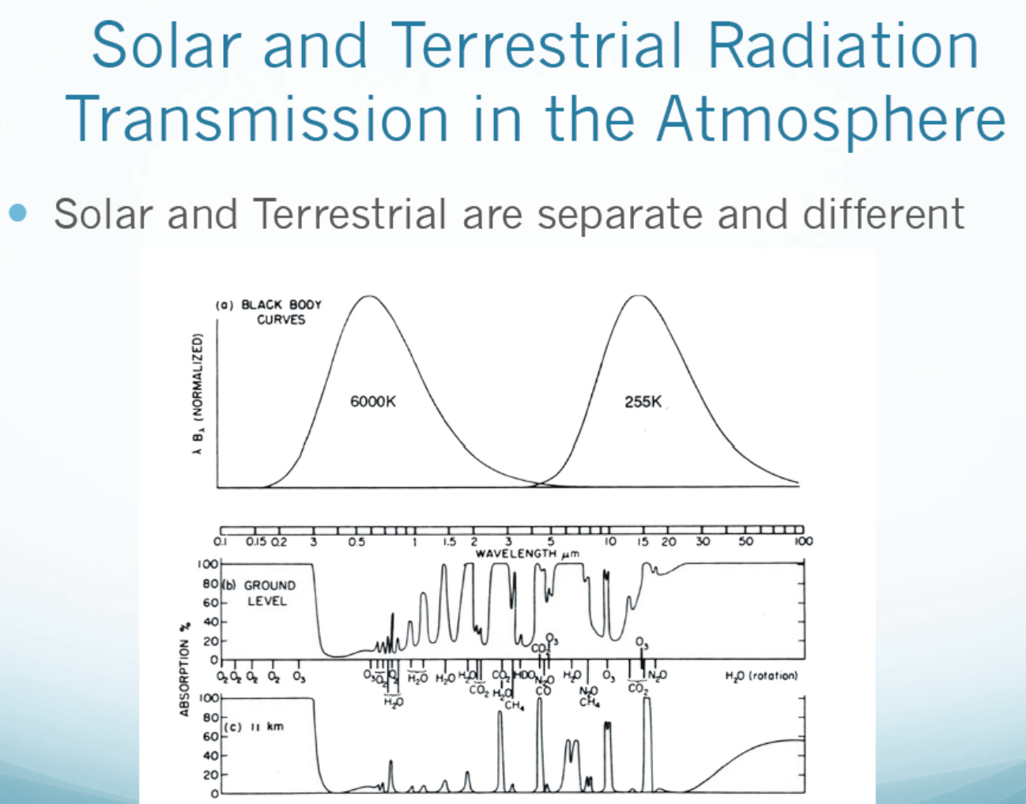
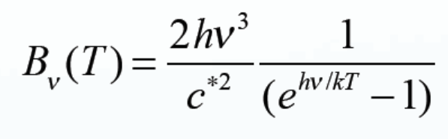
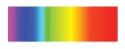
Stefan-Boltzmann Law: Blackbody radiation = σ T⁴, σ=5.67x10⁻⁸ W m⁻² K⁻⁴
SUN
EARTH
1 micrometer (μm)=10⁻⁶m
Low absorption
Atmospheric window
with low absorption

Slide 20
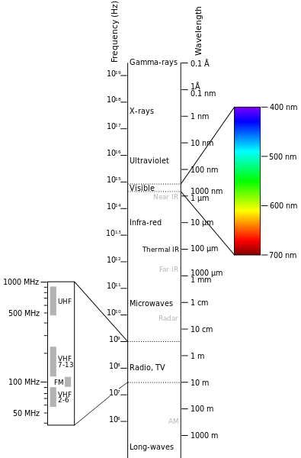
Solar and Terrestrial
Radiation Spectrum
Earth’s radiation
Spectrum
Remote Sensing
Spectrum

Slide 21
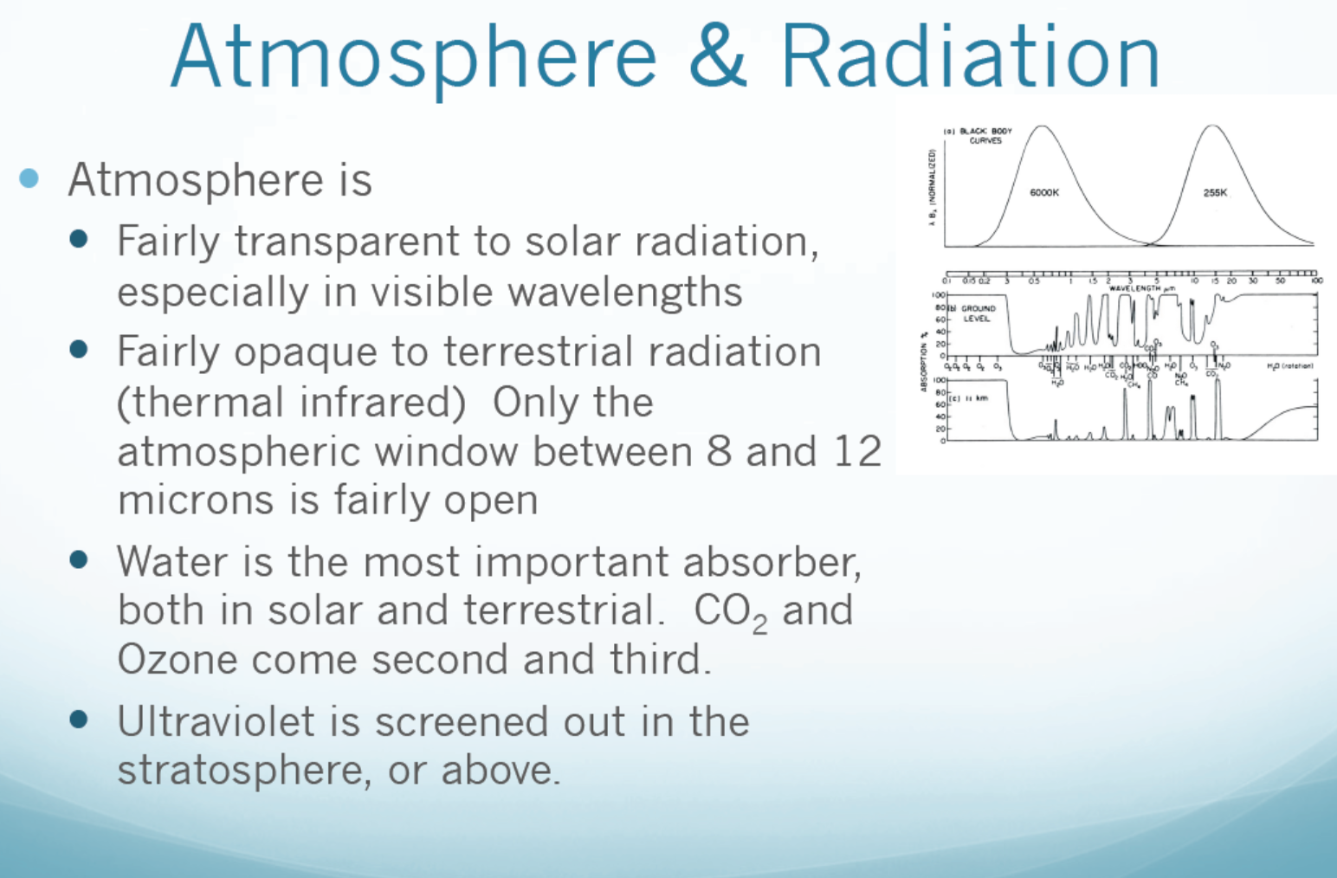
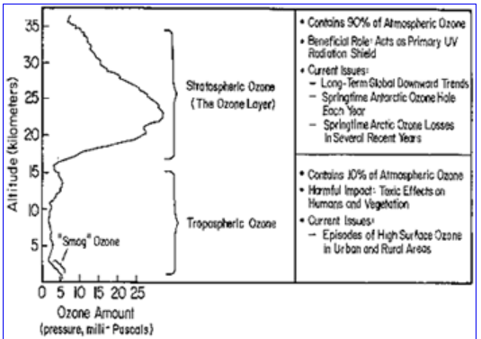
by the ozone layer
(20-30km above ground)

Slide 22
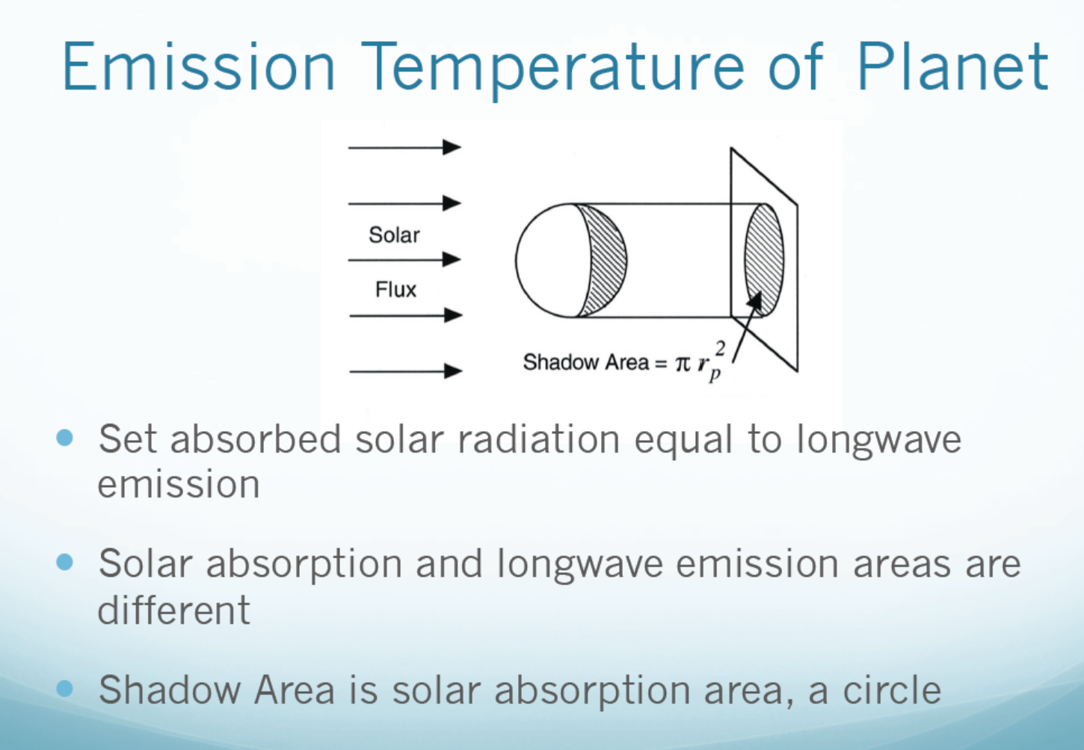

Slide 23
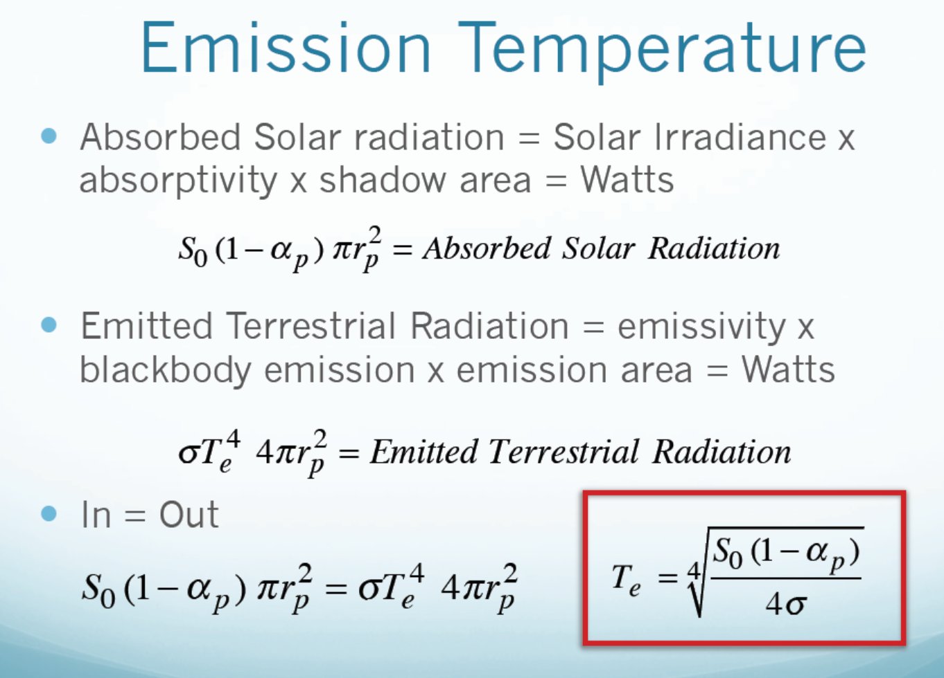
(The T needed to balance incoming solar radiation as a blackbody)

Slide 24
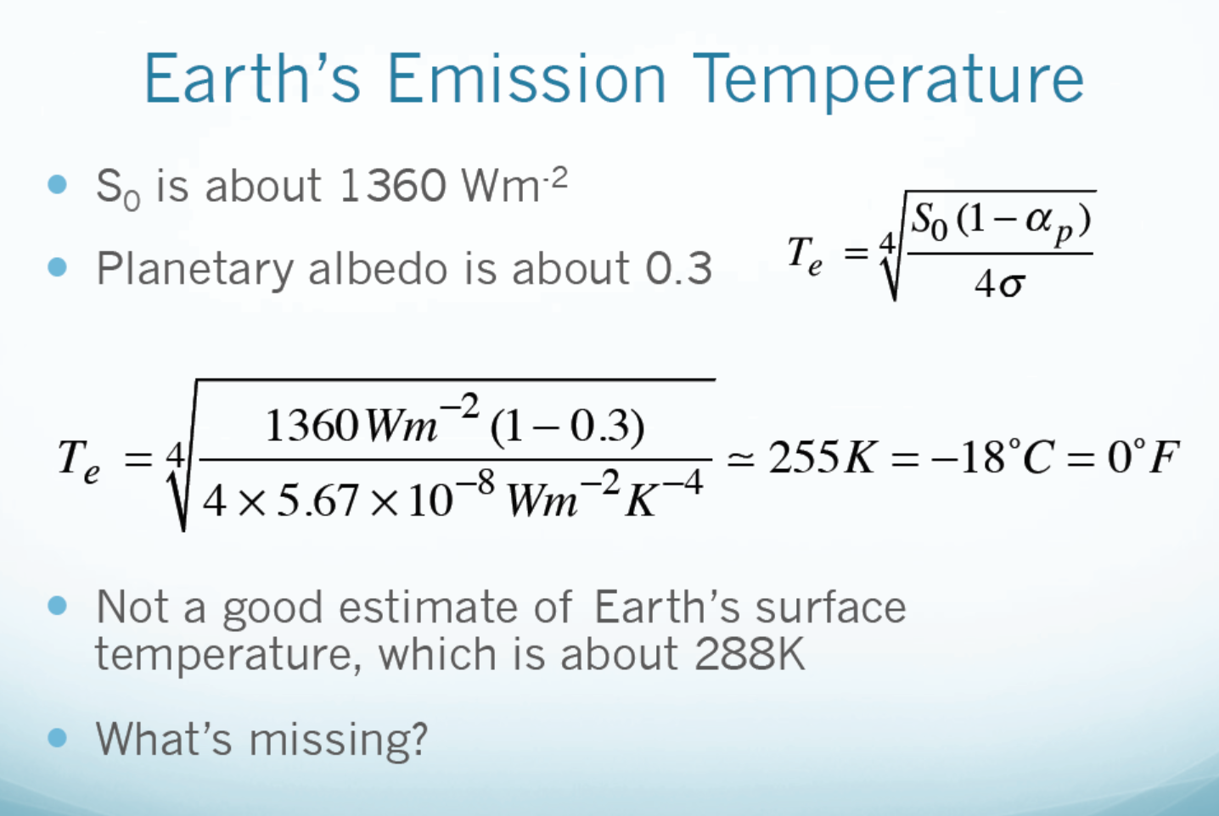
Notes:
No greenhouse effect!

Slide 25
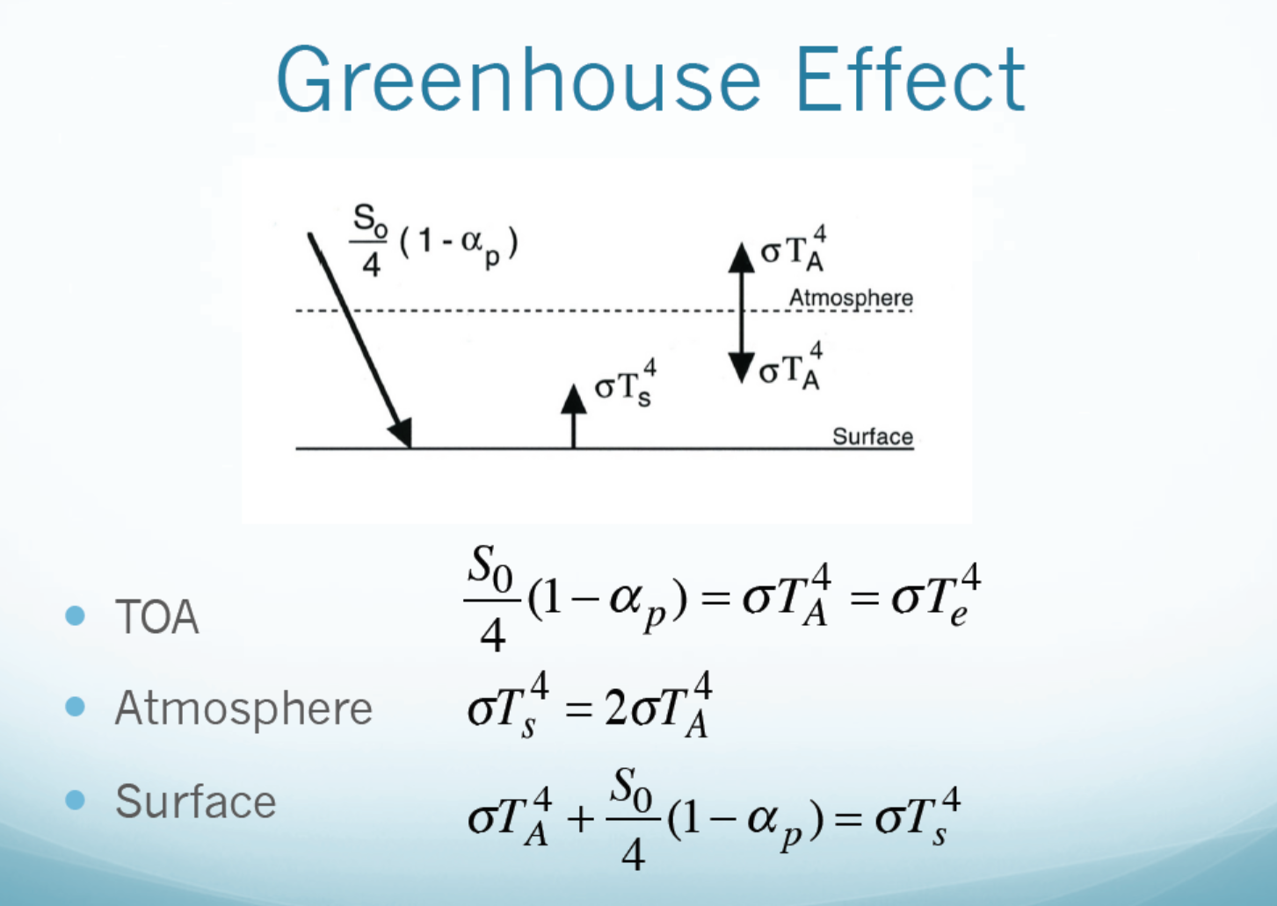
The warming of Ts by H₂O, CO₂, CH₄ and other trace gases in the air
1-layer model
This would yield Ts = 1.19Te = 303K, which is too high. Why?
Notes:
This 1-layer model is too simple and it ignores atmospheric absorption and reflection of sunlight. More layers are needed:
Ts^4 = (n+1)*Te^4, n= no of atmospheric layers. Also, surface sensible and latent heat fluxes are important too, which reduces Ts

Slide 26
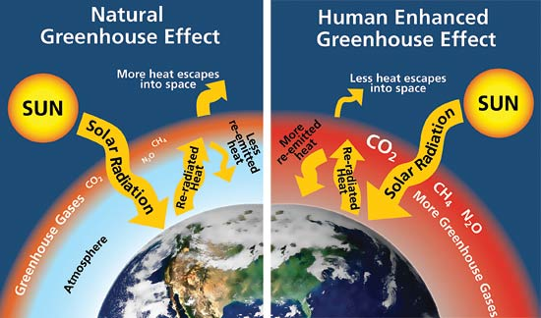
Natural vs. Anthropogenic Greenhouse Effect
Raising Ts from -18ºC to 15ºC
Raising Ts from 15ºC to 18ºC by 2100
H2O
H2O
GHE = 33ºC
GHE = 36ºC

Slide 27
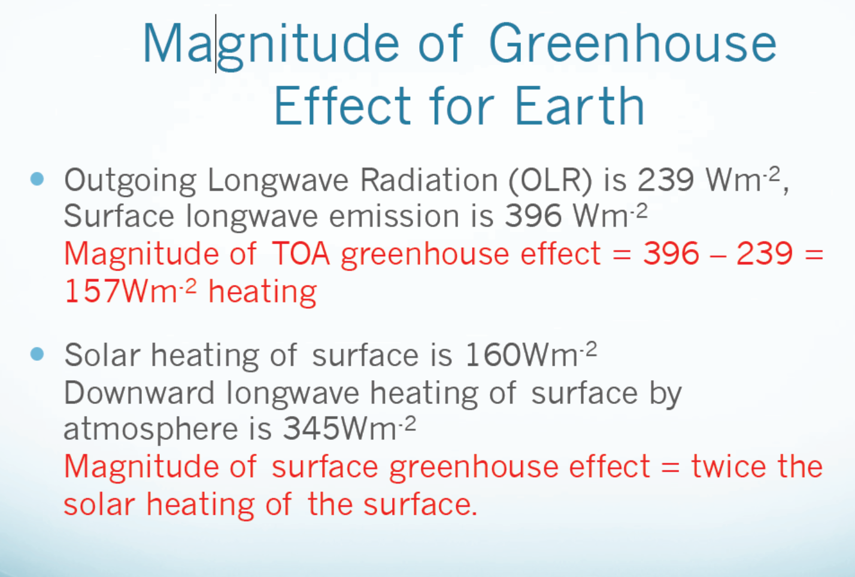
Notes:
Besides using the dTs (=Ts – Te) difference, the upward LW radiation flux difference at the surface and TOA is another way to quantify the GHE.

Slide 28
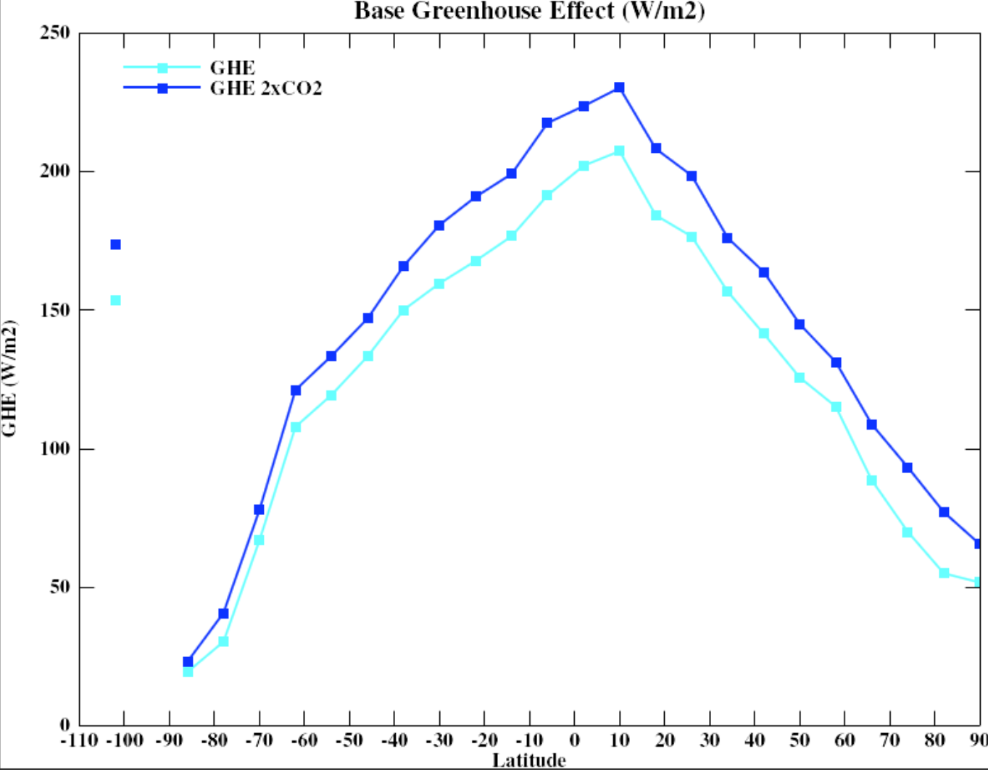
current
Larger at low-latitudes
Smallest at the poles
Why?
From Gavin Schmidt, NASA GISS Model GHE = Surface LW_up minus TOA LW Radiation
Notes:
Mainly due to more water vapor and its stronger greenhouse warming effect in the tropics.

Slide 29
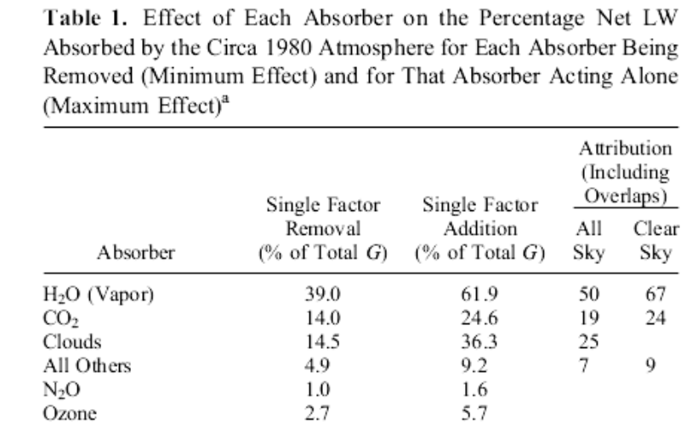
% Contribution to Total Greenhouse Effect by Individual Gases
Valid for both current and 2xCO2 climate
Minimum
Maximum
Schmidt et al. 2010, JGR

Slide 30
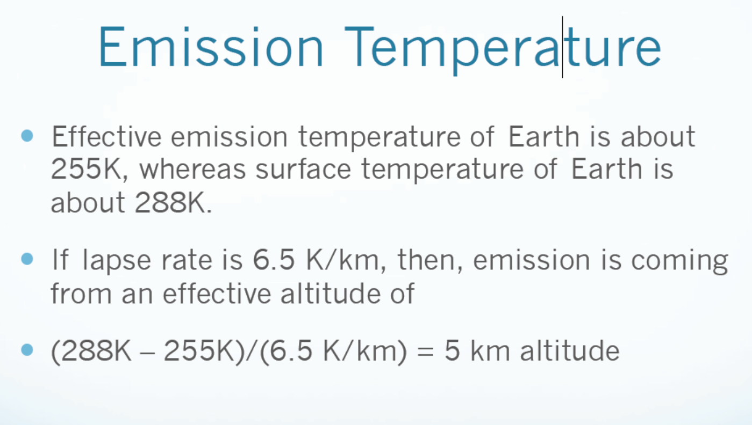
Effective Emission Altitude
GHE = 288 – 225 = 33K warming!

Slide 31
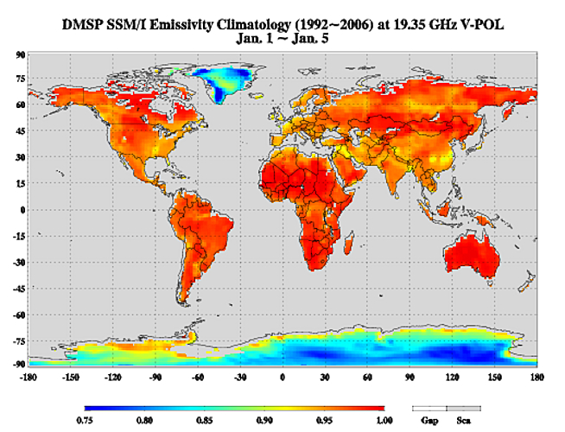
Earth’s Emissivity
Earth is not a true blackbody (i.e., ε <1):
- Emissivity(ε) = radiation by a material divided by radiation from a blackbody with
the same temperature, so that radiation from Earth = ε σT⁴.
- Kirchhof’s law: the emissivity is equal to the absorptivity: strong emitters are also
strong absorbers. Reflectivity =1- ε for materials with no transmittance.
- Atmospheric emissivity varies with clouds and the amount of greenhouse gases,
such as water vapor, carbon dioxide, methane, and ozone – Greenhouse Effect.
- Surface emissivity: 0.984 for ocean surface (Konda et al. 1994, J. Oceanogr.)
- Earth’s effective emissivity is determined by surface & atmospheric emissivity and GHE.
Clouds can affect the climate through
their impacts on both albedo and emissivity.
H₂O, CO₂ and other GHGs affect the
climate mainly through their impact on
atmospheric emissivity and absorption of LW.
Surface Emissivity

Slide 32
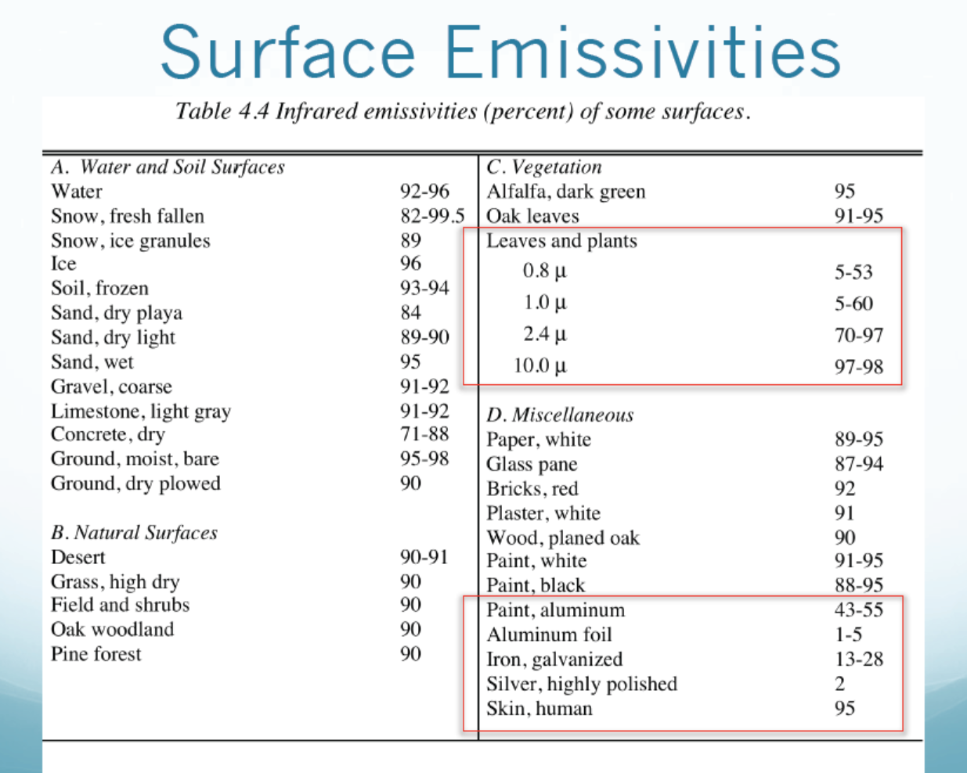
IR reflectivity (1- ε) is low for ice and
snow, but their albedo is high for
solar radiation!
Notes:
Ice’s thermal reflectivity is ~4%, much lower than its solar albedo of

Slide 33
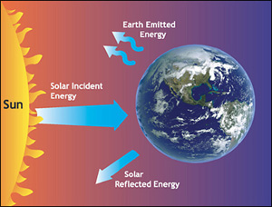
Earth’s Energy Balance
Absorbed solar radiation is balanced by out-going longwave
radiation:
Where
S = the solar constant = 1366 W/m²
α = Earth’s planetary albedo (≈0.3)
r = Earth’s radius (≈6.371 x10⁶m)
ε = Earth’s effective emissivity (≈0.612)
σ = the Stefan-Boltzmann constant—approximately 5.67×10⁻⁸ J·K⁻⁴·m⁻²·s⁻¹
These yield an effective average Earth temperature T = 288K (15ºC or 59ºF)
The global-mean T increases with S, but decreases with α and ε. (HW #5)
Use this Eq. for HW#5

Slide 34
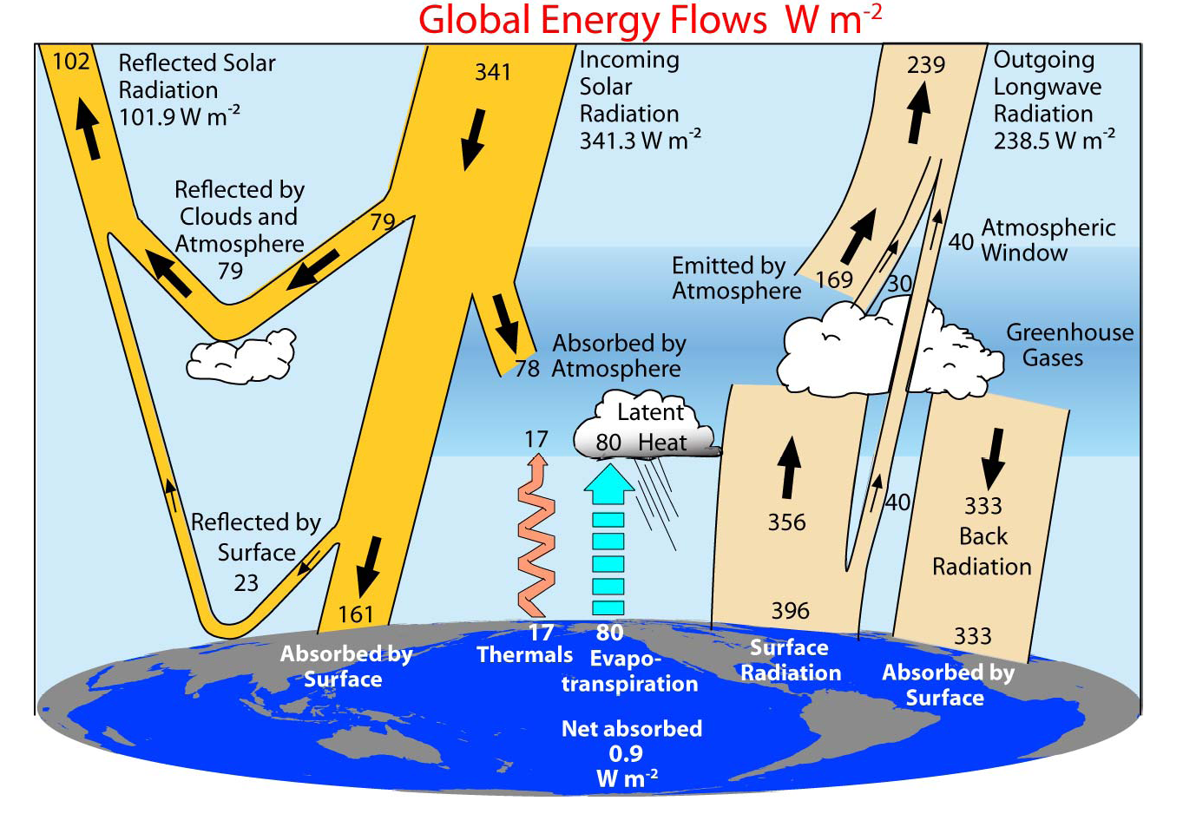
So=?
Trenberth et al. (2009, BAMS)
Notes:
Data used: TOA fluxes: satellite obs. Other fluxes: atmospheric reanalyses. LH: adjusted GPCP

Slide 35
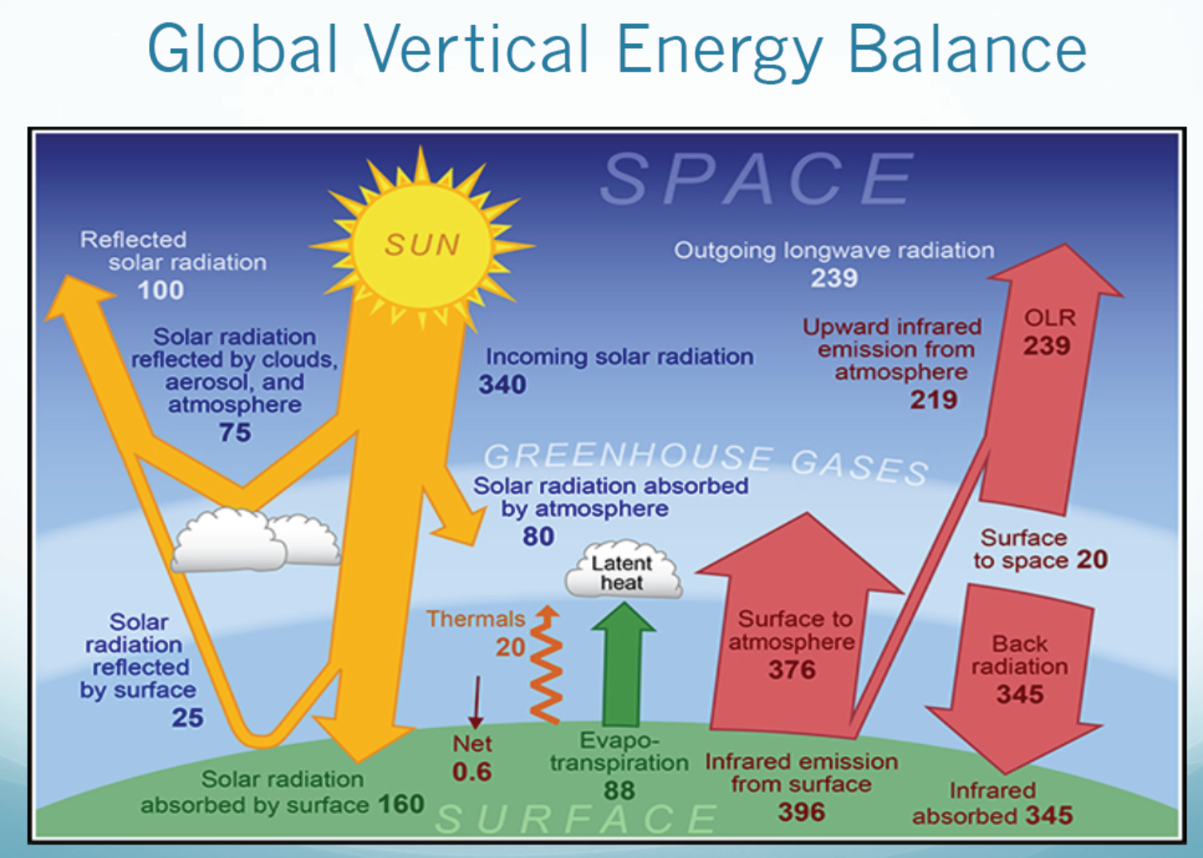
Another Version: Large Uncertainties
(So=1360)
From Dennis Hartmann

Slide 36
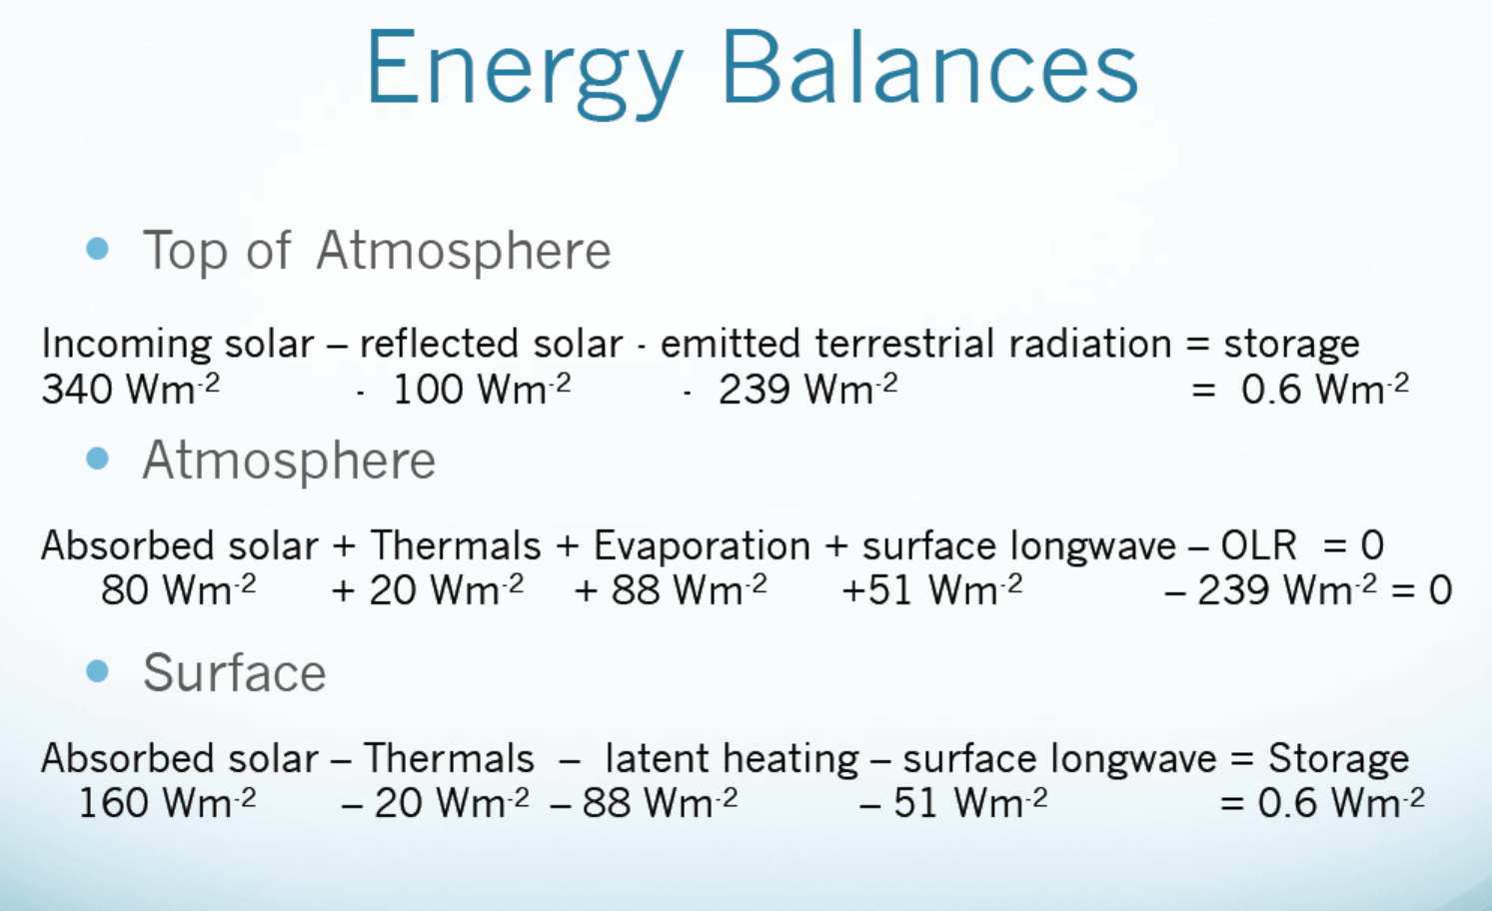
Atmospheric energy storage is small (≈0) →
The TOA imbalance = Surface imbalance!
Atmospheric and surface balances are coupled!

Slide 37
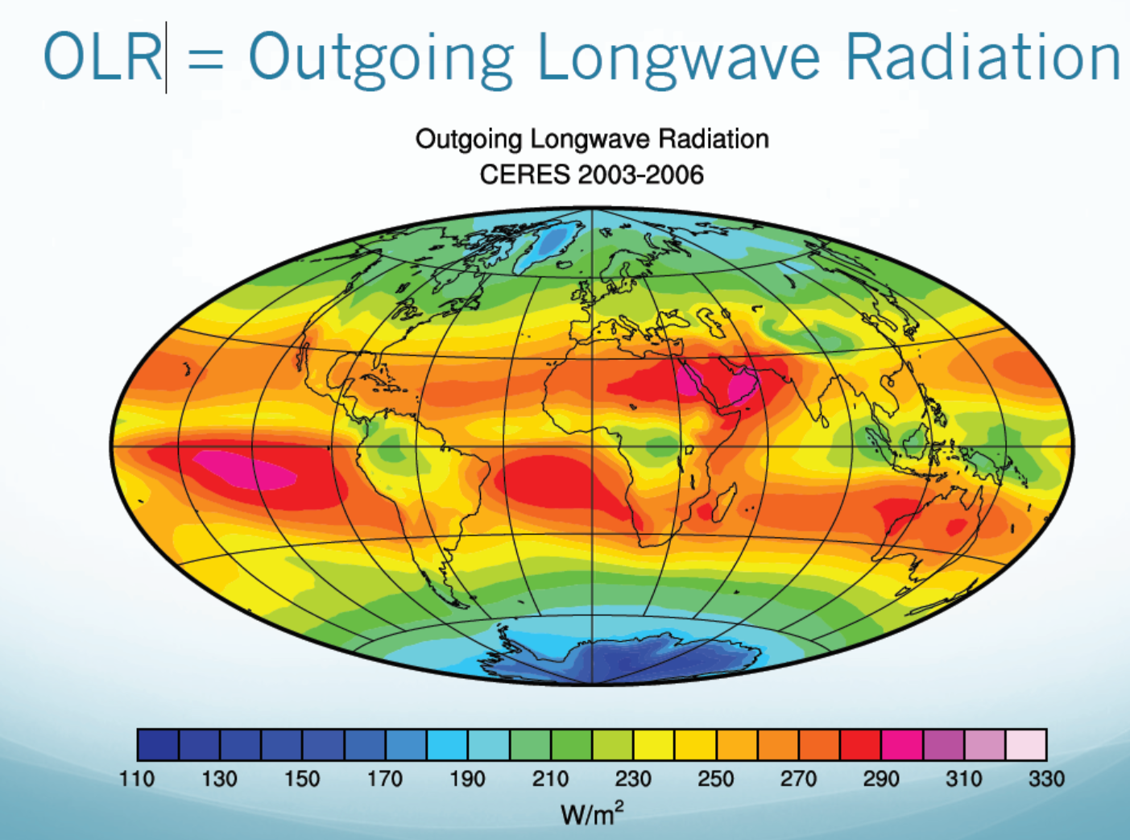
Main determining factors:
Cloud amount and height
and surface temperature
ANN TOA
What cause these
differences?

Slide 38
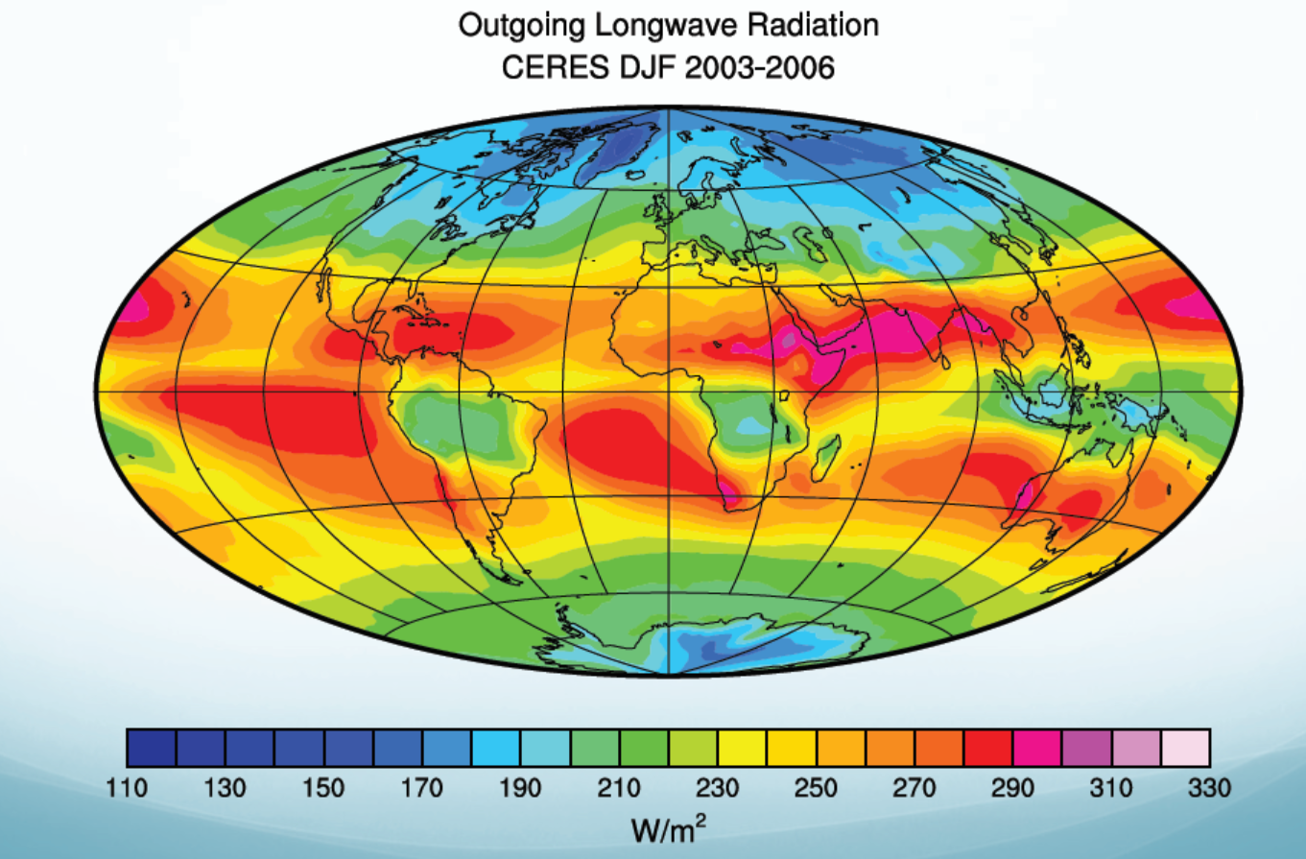
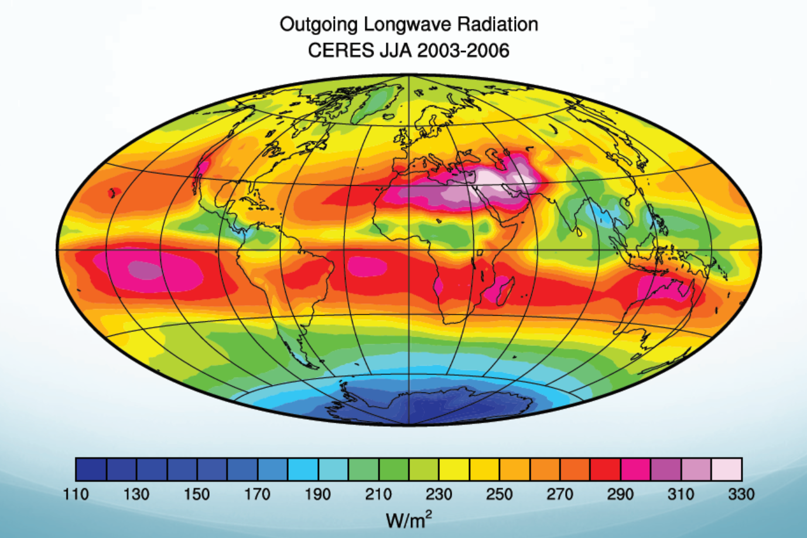
DJF OLR
JJA OLR

Slide 39
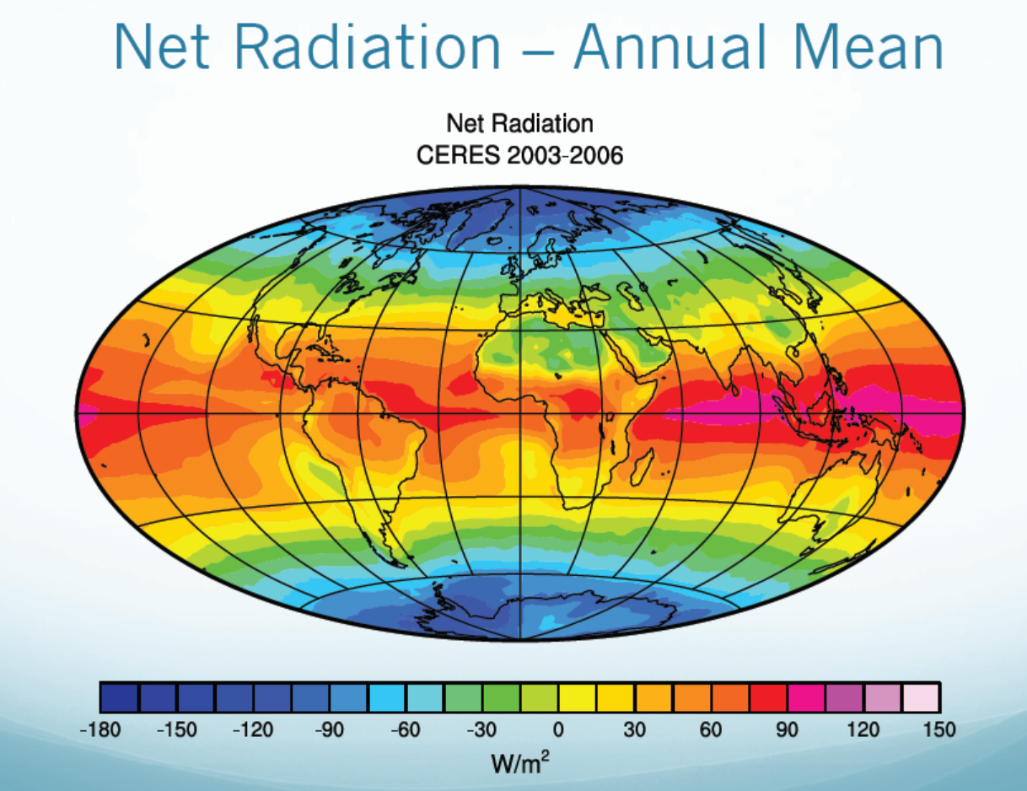
How is the regional imbalance maintained?
ANN TOA
Positive = downward
Cooling
Warming

Slide 40
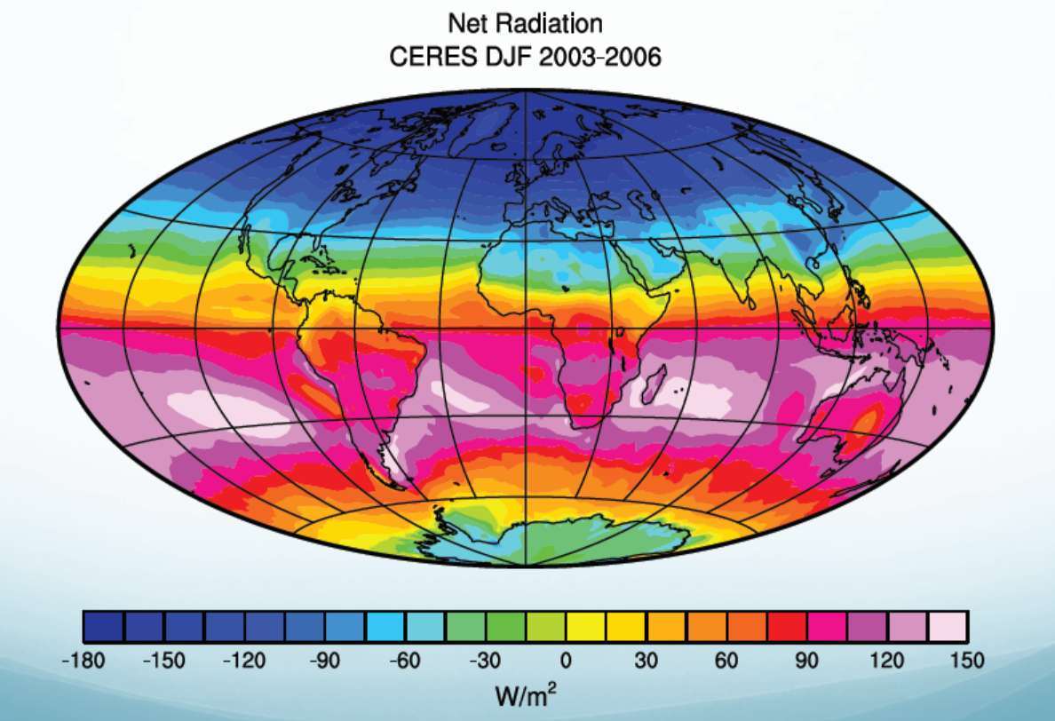
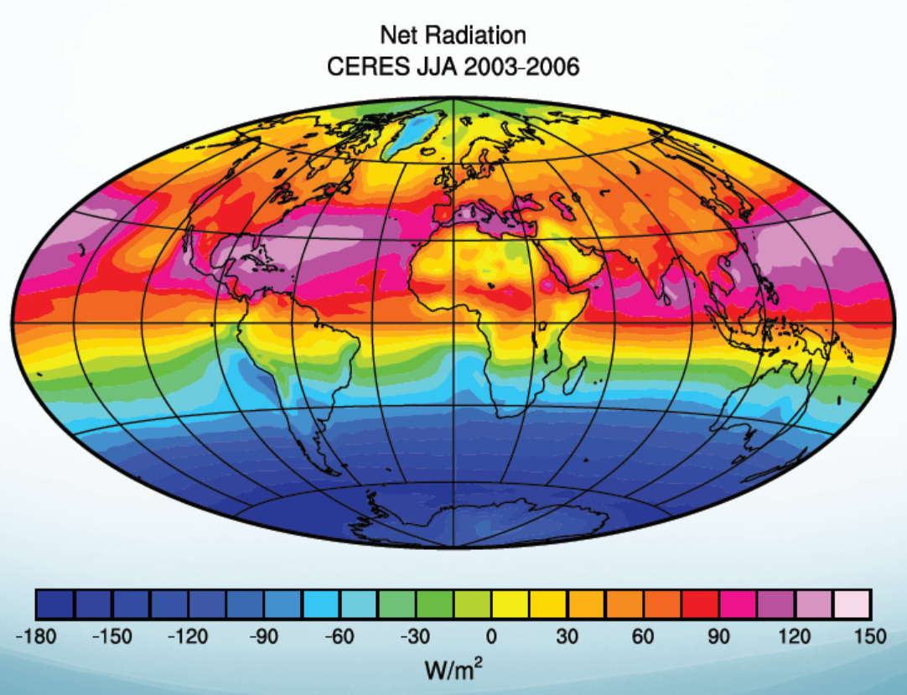
DJF Rnet
JJA Rnet
Positive = downward

Slide 41
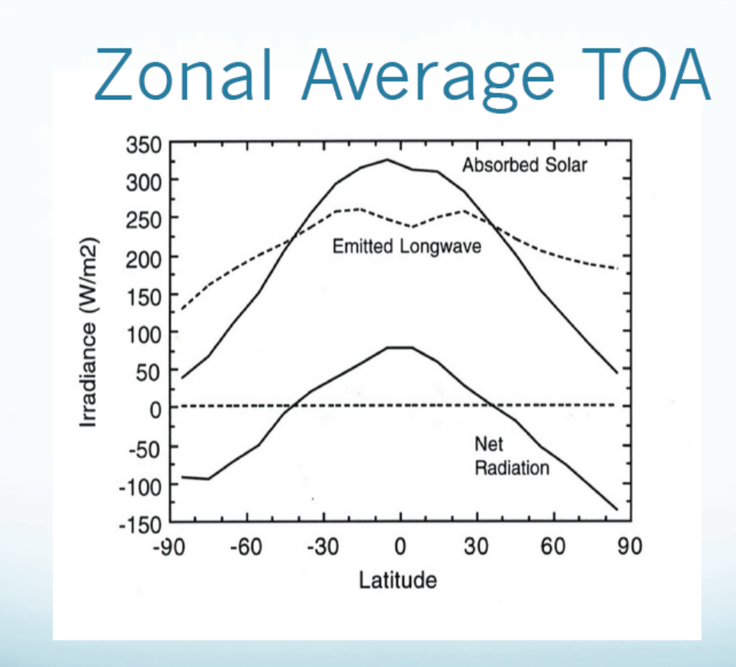

Slide 42
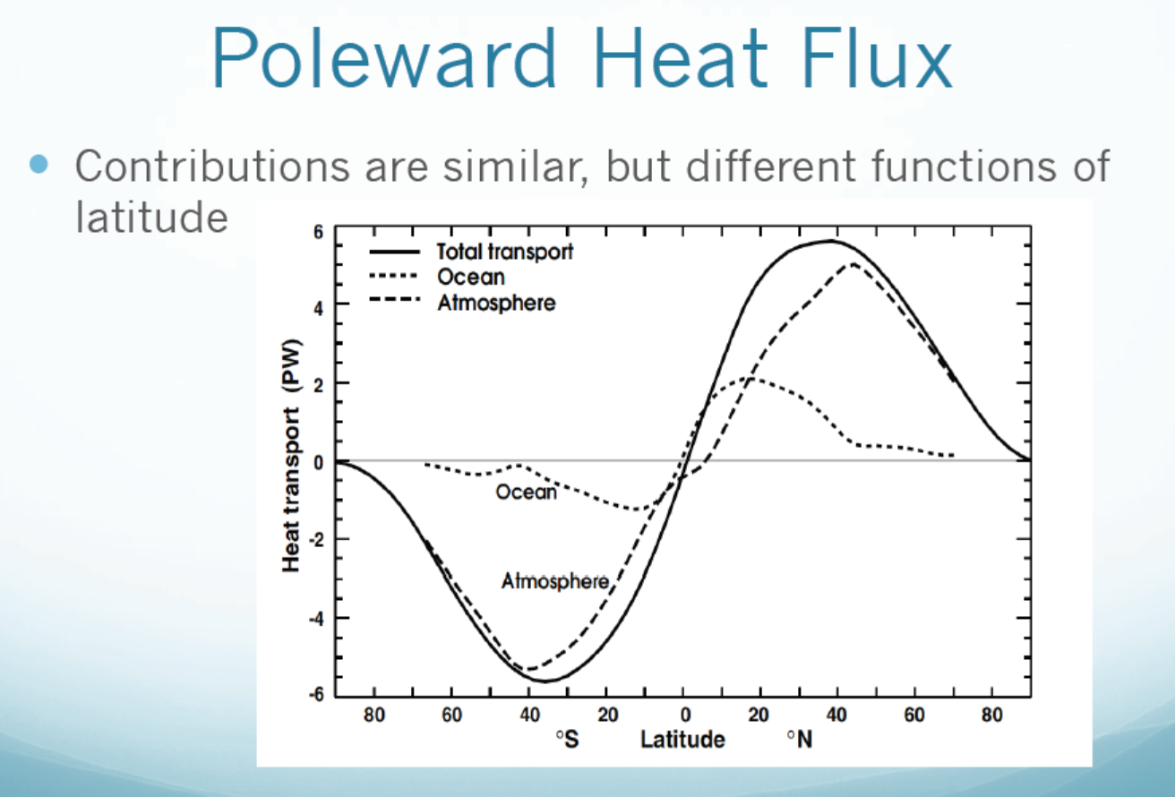
35ºS-35ºN: Heat source
90º-35ºS & 35^{o-}90ºN:
Heat sink
positive=northward
negative=southward
Atmospheric transport dominates
Peaks at 30-40ºN and S
PW (petawatt) = 10¹⁵ W Fasullo and Trenberth (2008)
Notes:
MW (megawatt) = 10⁶ W; GW (Gigawatt)= 10⁹W; PW (petawatt) = 10¹⁵ W

Slide 43
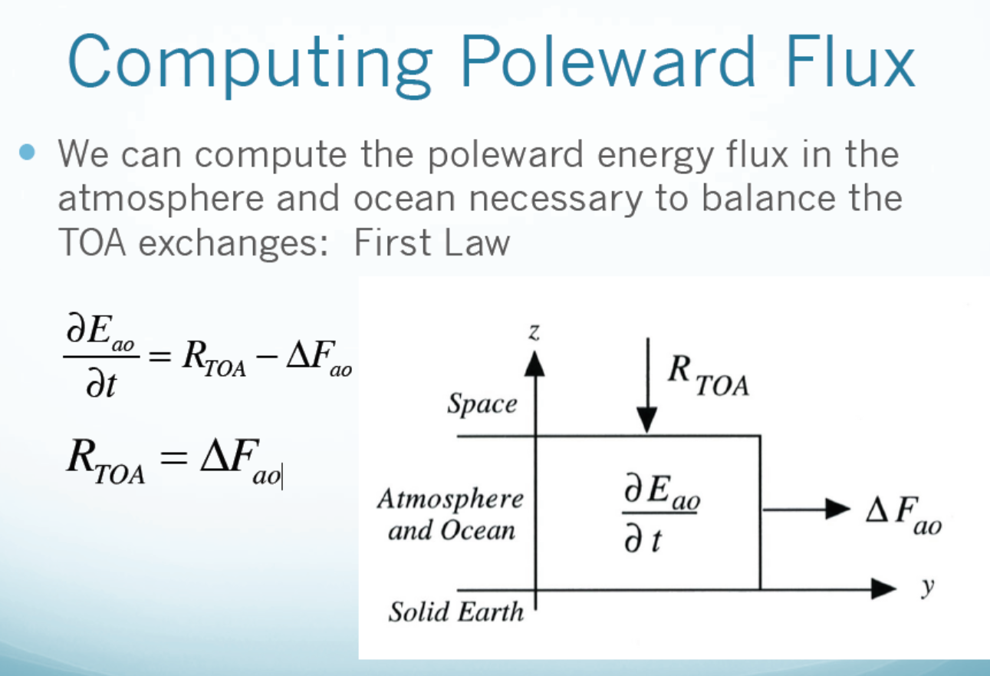

Slide 44


Slide 45



Atmospheric Energy Transport
Why?

Slide 46

or SH
Moist static energy = c_{p}T + gz + Lq = Sensible + potential + Latent energy
Notes:
Cp=1004 J/k/kg, Cv=717 J/k/kg

Slide 47

Southward fluxes
are shaded
Large cancellation
between PE and
SH+LH fluxes for
the mean circulation
Unit: 10¹⁹ Calories/day

Slide 48
Atmospheric Energy Balance
For each layer:
Heating Rate = Absorbed solar radiation (Sin – Sout)
− Longwave cooling rate (L2 - L1 + D1-D2)
+ latent heating from condensation (LH)
+ horizontal heat convergence (F2-F1).
Solar absorption: depends on clouds, aerosols and water vapor; important only during the day
Longwave radiative cooling: depends on T, H2O, clouds
CO2 and other GHGs in, above and below the layer; it is the most important term, which controls air temp. at night.
Latent heating: depends on precipitation and cloud formation; none if clear sky.
Heat convergence: depends on winds and airmass type
The shortwave and longwave radiative fluxes can be
calculated using atmospheric radiative transfer theory given profiles of T, H2O, CO2, clouds and other GHGs.
L2
D2
Sin
F2
F1
LH
Sout
D1
L1
Read Chapter 3 of GPC for
more on Radiative Transfer

Slide 49
Atmospheric Radiative Transfer
At each level:
Solar radiation is reduced by scattering (by aerosols,
cloud droplets) and absorption (by aerosols, clouds, and water vapor molecules). Integration has to be done from TOA to the griven level to derive the solar radiation at that level.
Longwave radiation has two directions: up and downward. For both directions, there is an absorption
and additional emission by water and GHG molecules at the level. Integration has to start from the surface
(for upward) or TOA (for downward) LW fluxes.
L2
D2
Sin
Absorption
Absorption & Emission
Sout
D1
L1
Read Chapter 3 of GPC for
more on Radiative Transfer

Slide 50


Read Chapter 3 of GPC for
more on Radiative Transfer
Optical depth:
kv = absorption coefficient
(optical thickness)

Slide 51


Optical depth:

Slide 52
Global Atmospheric Energy Balance
Consider the global atmosphere as one single layer: heating rate ≈ 0
absorbed solar radiation − net LW cooling + LH + SH ≈ 0
78 − 176 ( 239+333–396) + 80 + 17 = −1

Slide 53
Key Points of Today’s Lecture
Solar Radiation: annual daily insolation at TOA varies from ∼400 W/m² in the tropics to ∼150W/m² at the poles, where it varies with season. Surface S also varies with clouds and water vapor.
Terrestrial Radiation: Earth’s effective emission temperature = 255K or
-18ºC, which is close to atmospheric T at ∼5km altitude.
Greenhouse Effect: natural greenhouse effect raises Earth’s surface temperature to ∼15ºC. It reduces the OLR at TOA to 239 W/m² from 396 W/m² at the surface, a 157W/m² heating. GHE is weaker at the poles.
Global Energy Fluxes (in W/m²):
SW: Incoming S = 341, atmos. absorbed = 78, reflected = 102 (79 by clouds & atmos.) + 23 by surface), absorbed by Earth’s surface=161
LW: OLR = 239 at TOA, sfc downward ∼333 (uncertain), sfc upward = 396
LH=80 (uncertain); SH=17, Net heating ≈0.9
Poleward Energy Transport: total peaks at ∼5.5PW around 30-40º N and S, mostly by the atmosphere, oceans contribute ∼1/3.
Global Atmospheric Energy Balance: LW cooling (∼176) balances heating from solar radiation (78), LH (80) and SH (17).

Slide 54
Reading Assignments:
- Reading Assignments: Chapter 2 of Hartmann GPC
Or
Chapter 3 of the AMS Textbook +
Section 2.1 of the UCL Online textbook

Slide 55
Next Lecture:
Surface Energy Balance

