Slide 1
A ATM551, Lecture #6
Surface Energy Balance
Reading Assignment:
Chapter 4 of Hartmann GPC
Read Zhang et al. 1995, JGR, https://doi.org/10.1029/94JD02747
for controls on surface (and TOA) radiative fluxes

Slide 2
Last Lecture - Global Energy Balance
Solar Radiation: annual daily insolation at TOA varies from ∼400 W/m² in the tropics to ∼150W/m² at the poles, where it varies with season. Surface S also varies with clouds and water vapor.
Terrestrial Radiation: Earth’s effective emission temperature = 255K or
-18ºC, which is close to atmospheric T at ∼5km altitude.
Greenhouse Effect: natural greenhouse effect raises Earth’s surface temperature from -18ºC to 15ºC, a 33ºC warming. It reduces the OLR at TOA to 239 W/m² from 396 W/m² at the surface, a 157W/m² heating.
Global Energy Fluxes (in W/m²): averaged over each m² of Earth’s surface
SW: Incoming S = 341, atmos. absorbed = 78, reflected = 102 (79 by clouds & atmos.) + 23 by surface), absorbed by Earth’s surface=161
LW: OLR = 239 at TOA, sfc downward ∼333 (uncertain), sfc upward = 396
LH = 80 (uncertain); SH =17, Net heating ≈0.9
Poleward Energy Transport: total peaks at ∼5.5PW around 30-40º N and S, mostly by the atmosphere, oceans contribute ∼1/3.
Global Atmospheric Energy Balance: LW cooling (∼176) balances heating from solar radiation (78), surface LH (80) and SH (17).

Slide 3
Outline of Today’s Lecture
Surface Energy Fluxes
Heat Capacity: for the Atmosphere, Oceans, and Land
Heat transport in soils
Surface solar radiation
Surface LW radiation
Surface SH and LH fluxes: Bowen Ratio
Spatial distributions of the surface energy fluxes

Slide 4
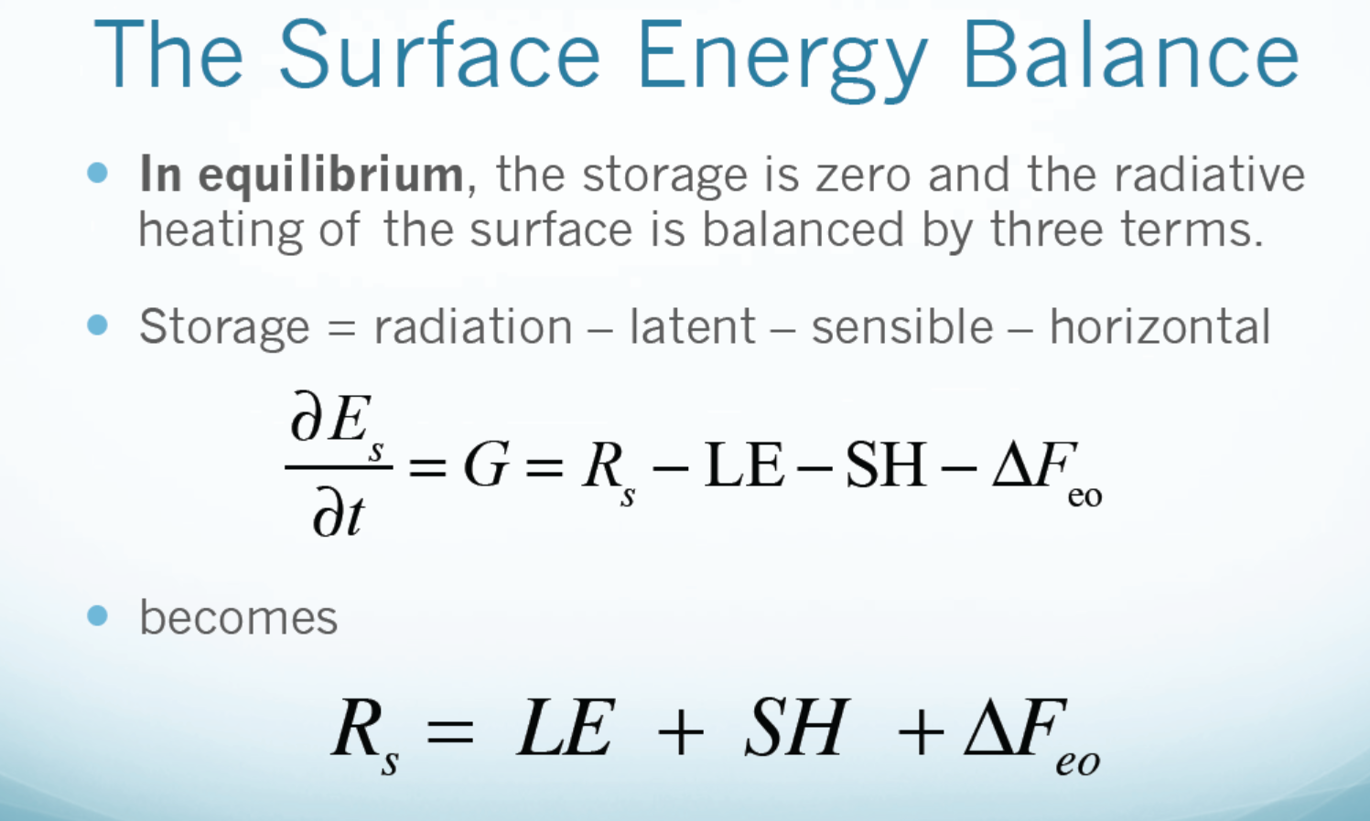
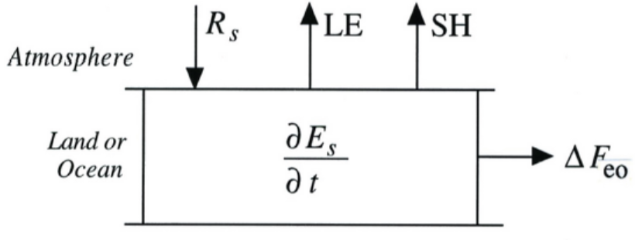
change
net
change
small over land

Slide 5
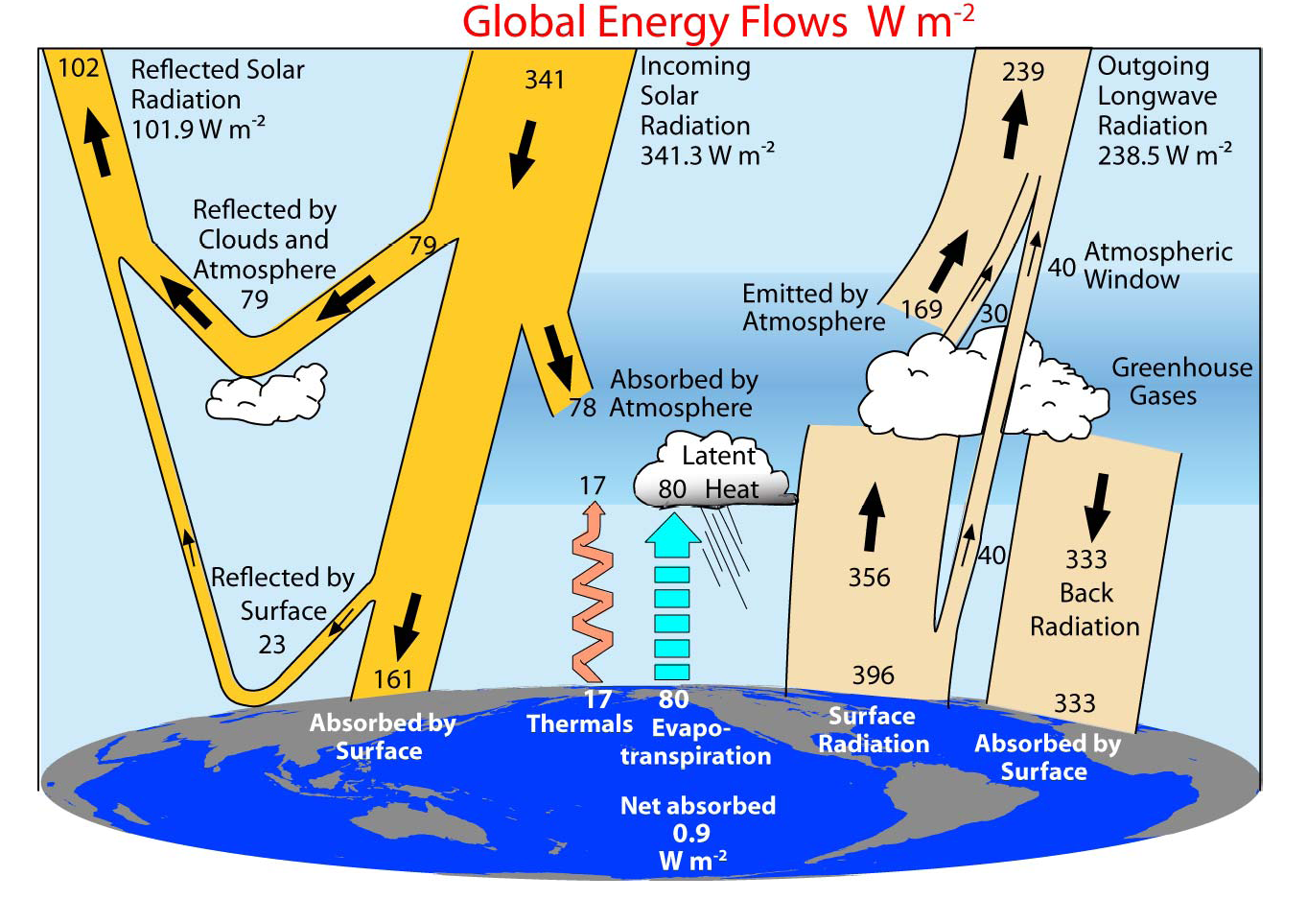
Trenberth et al. (2009, BAMS)
98 (161+333-396) − 80 − 17 = 1
The fluxes vary with location, but annual R-LH-SH ≈0 maintains over most land areas
Notes:
Data used: TOA fluxes: satellite obs. Other fluxes: atmospheric reanalyses. LH: adjusted GPCP

Slide 6
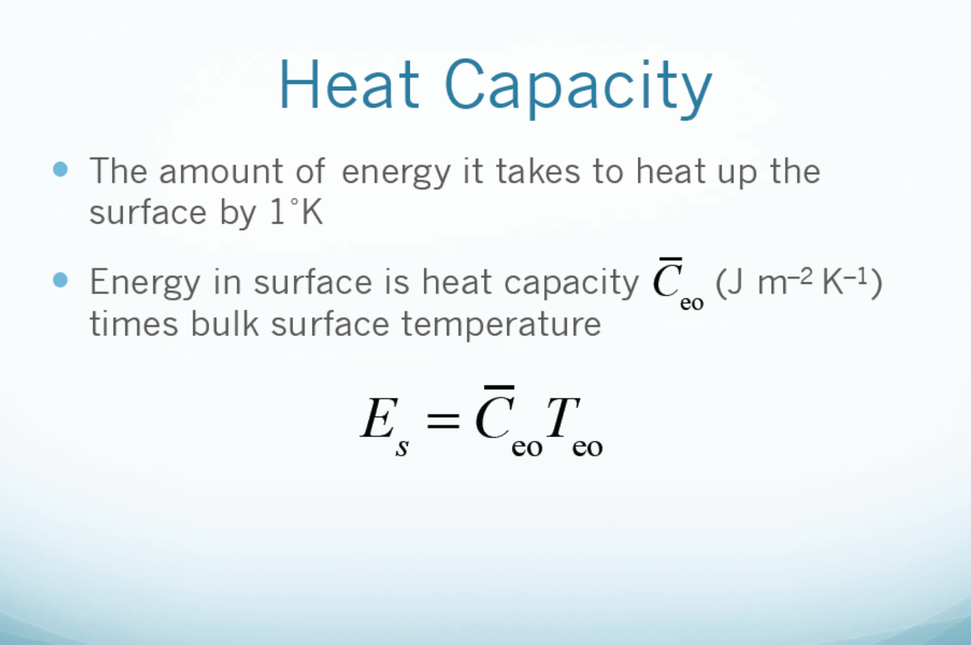
Surface
, depends on surface type and layer depth.

Slide 7
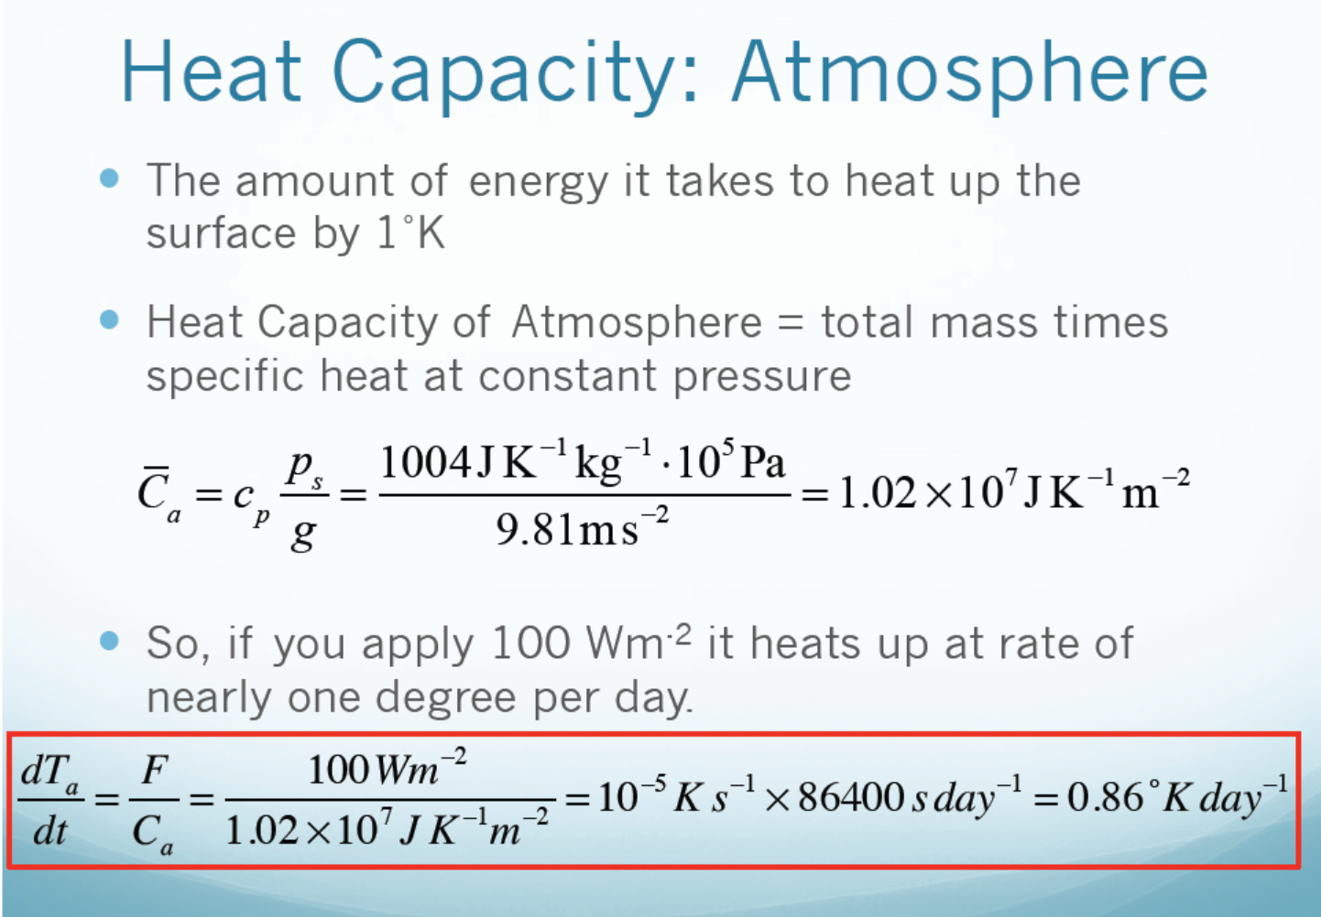
Global LH and solar heating≈80W/m² , each raises atmospheric T by ~0.7K/day

Slide 8
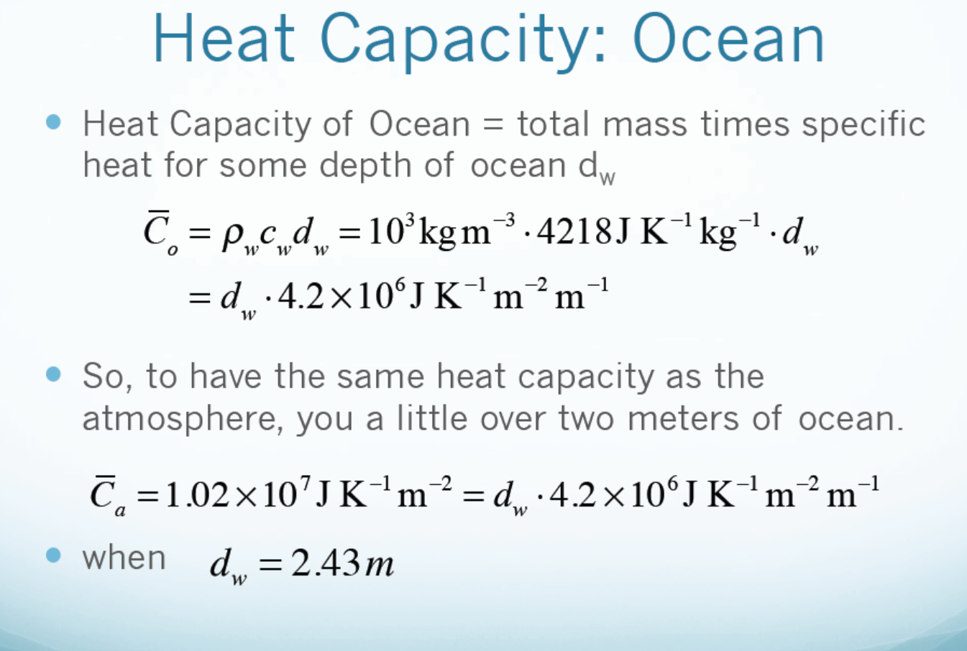
need
Compared to the depth of the troposphere of 12-18km.

Slide 9
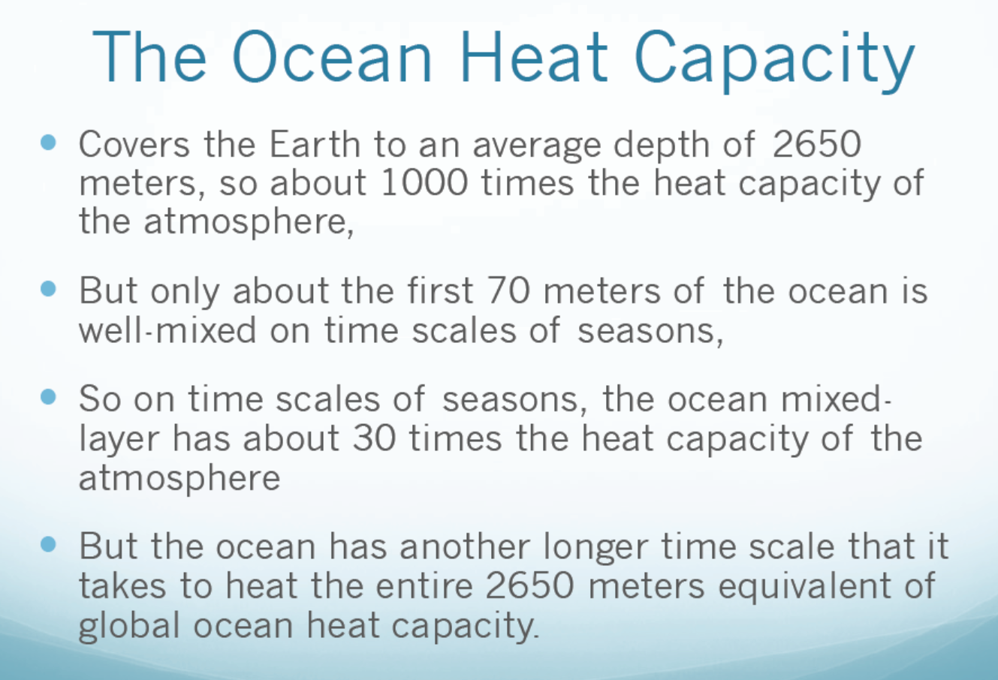

Slide 10
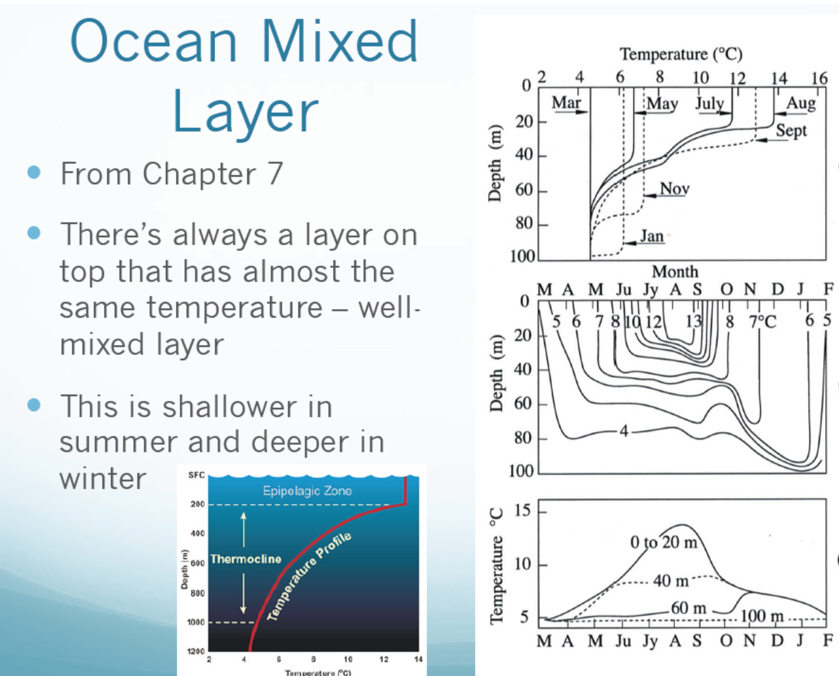

Slide 11
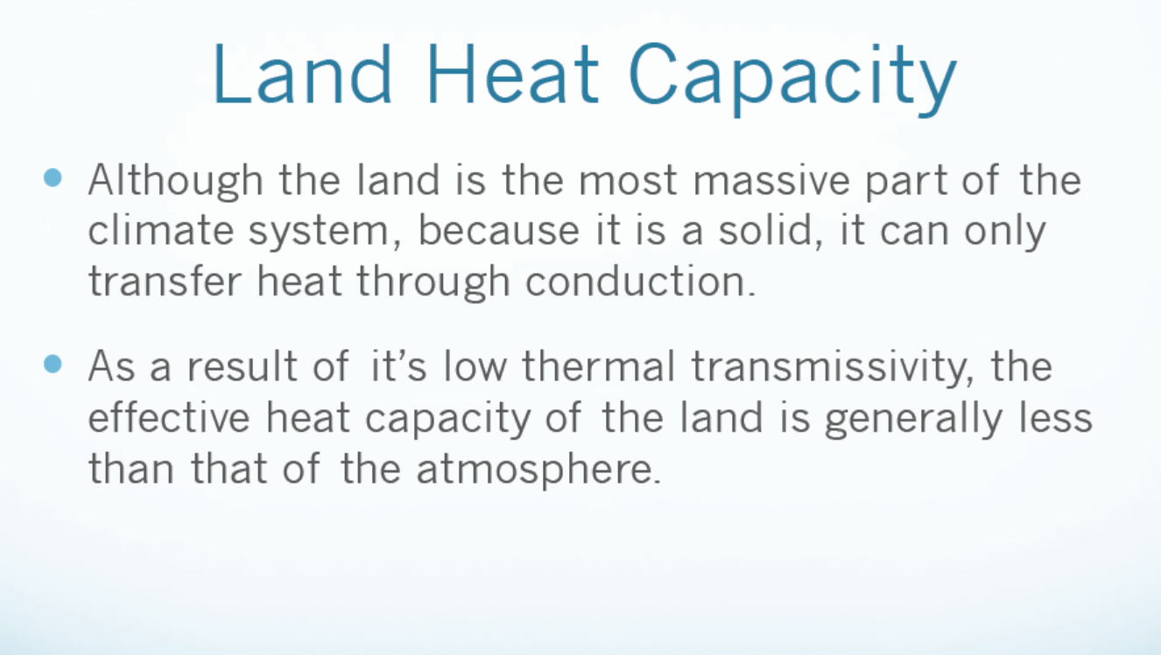

Slide 12
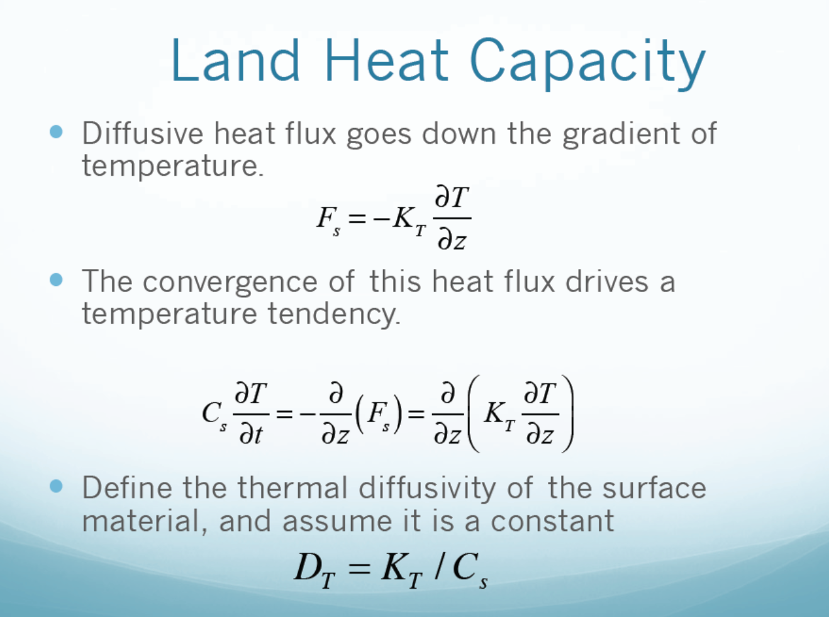

Slide 13
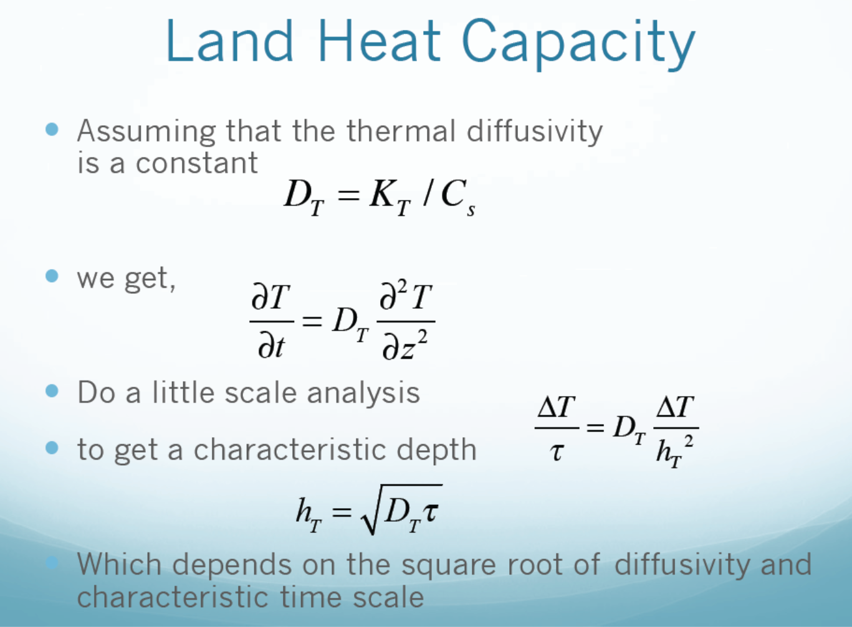

Slide 14
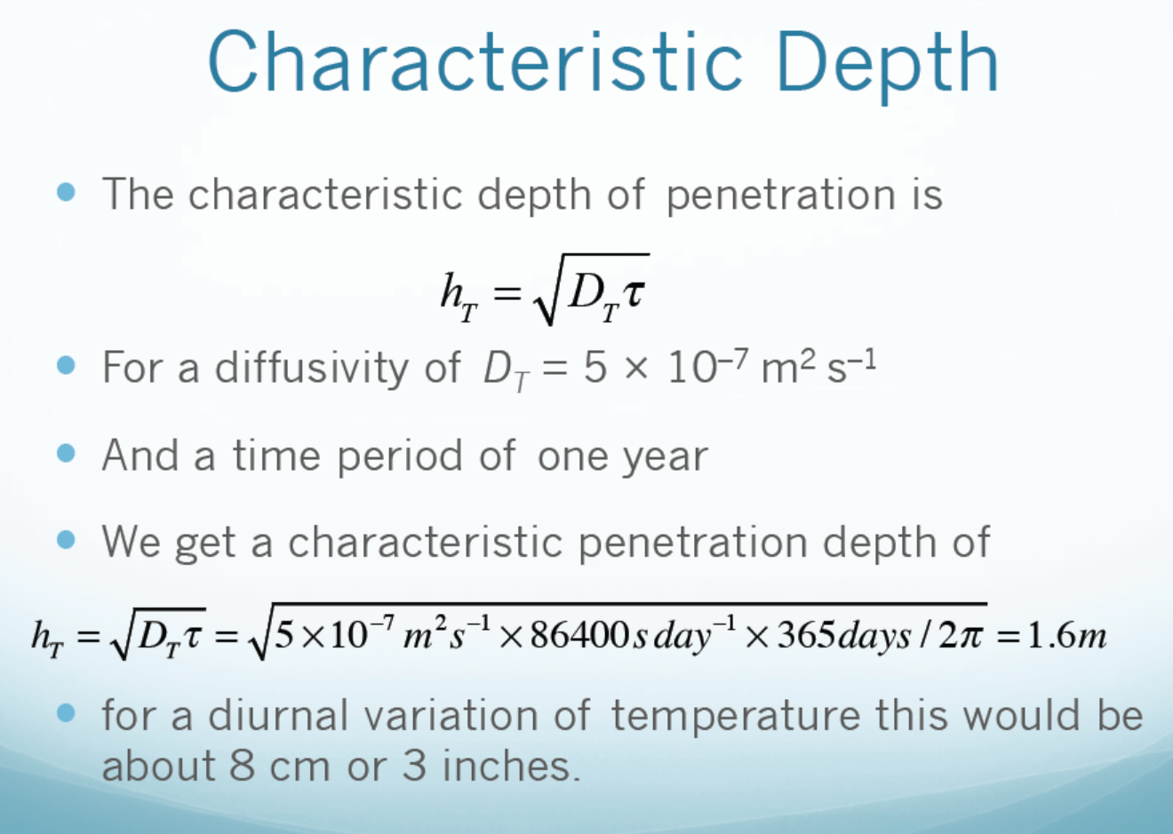

Slide 15
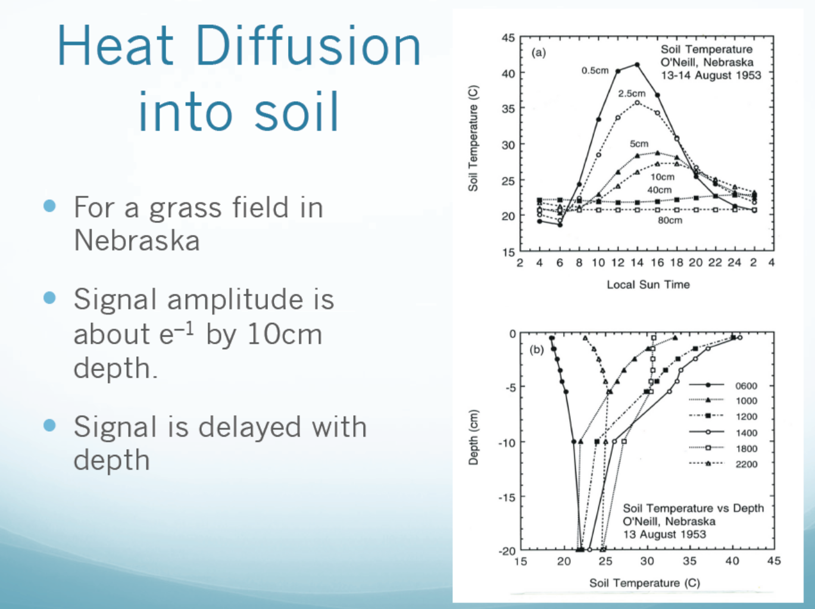
Horizontal heat transport within land
is negligible!

Slide 16
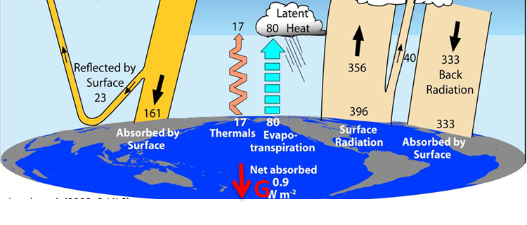
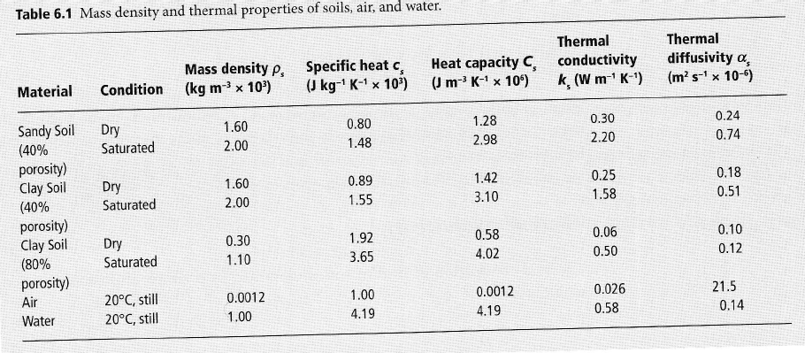
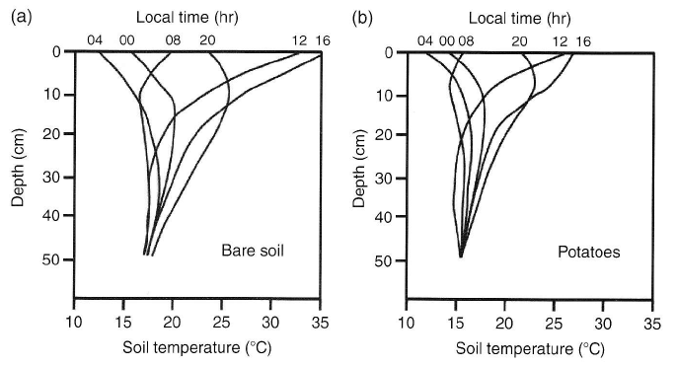
Ground heat flux
within +/- ∼200 W m⁻²
G(z) = -k_{soil} dT_{soil}/dz
k_{s} is thermal conductivity, measure of how easily heat moves through the ground
Upwards (downwards) when temperature increases (decreases) with depth
Shuttleworth (2012)
Shuttleworth (2012)

Slide 17
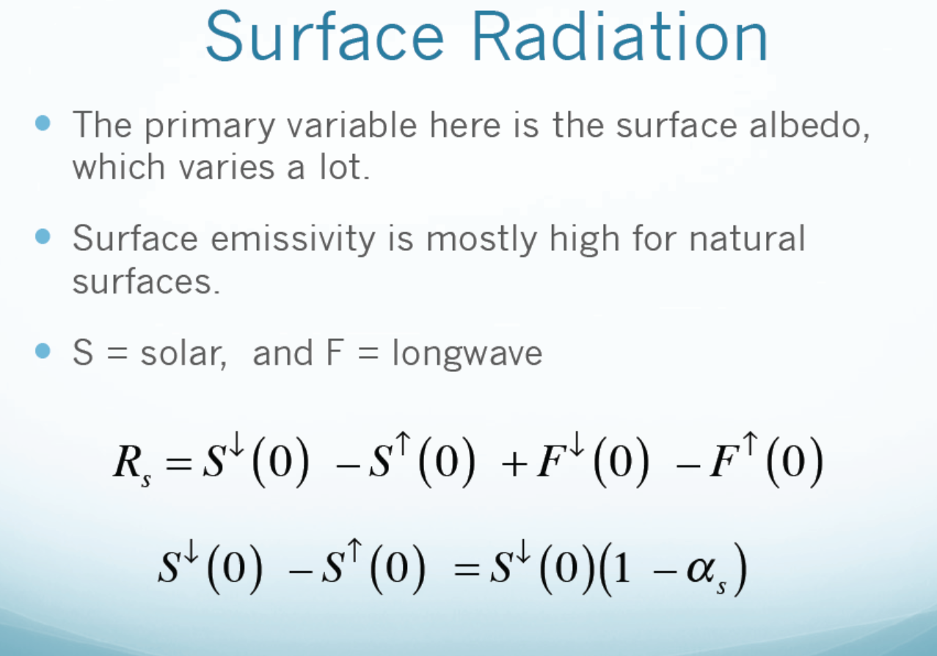

Slide 18
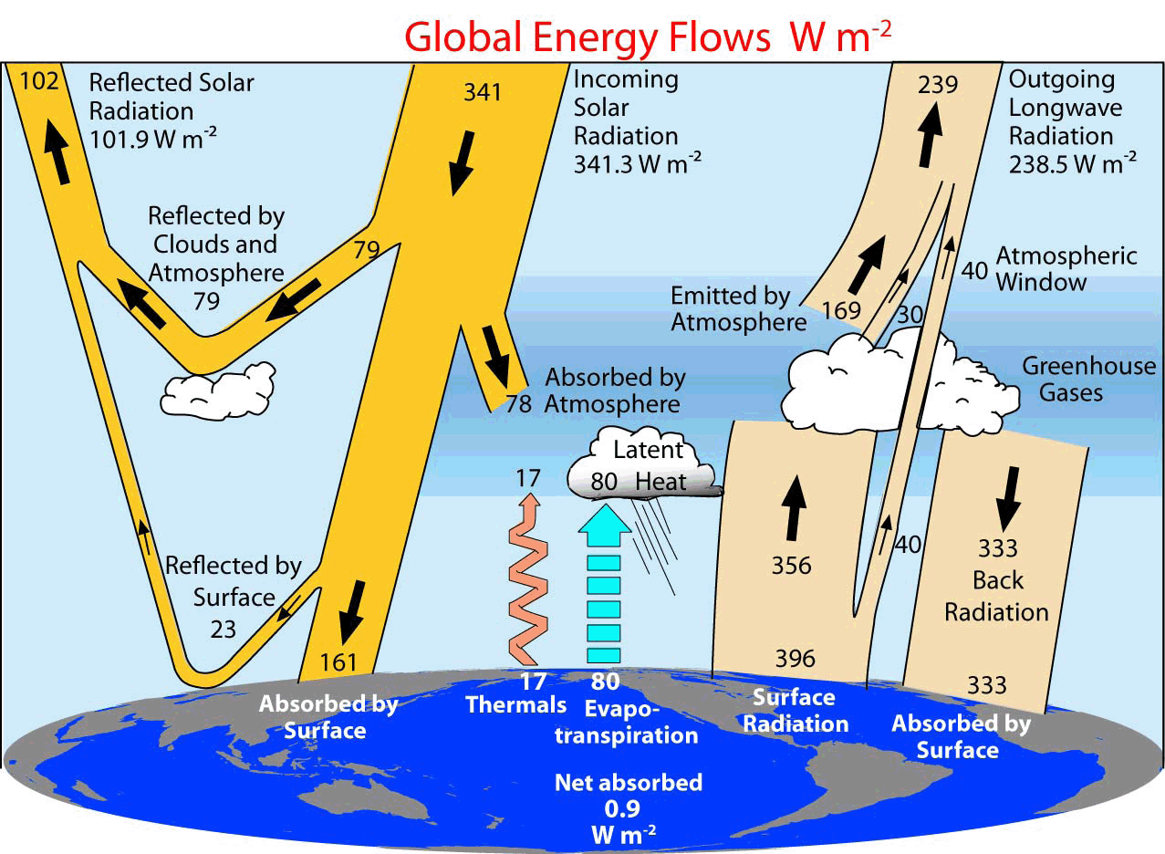

Downward surface solar radiation
0 to ∼1000 W m⁻²
Reduced by absorption of sunlight by gasses, aerosols, and clouds
Reduced by reflection of sunlight by aerosols and clouds
Reduced by topography, vegetation, buildings
Terrain slope
Capturing these effects requires detailed mathematical models of “radiative transfer”
Can be crudely estimated using surface humidity & fractional cloud cover

Slide 19
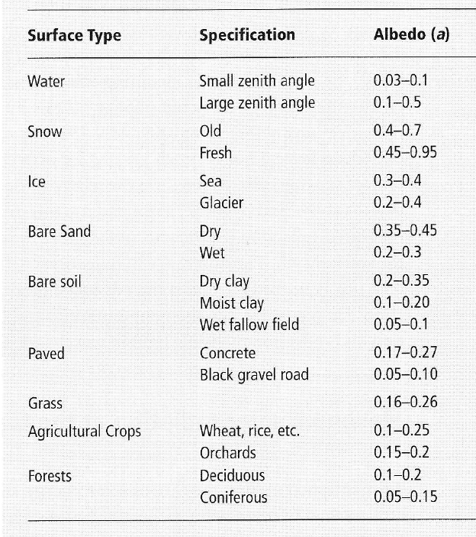
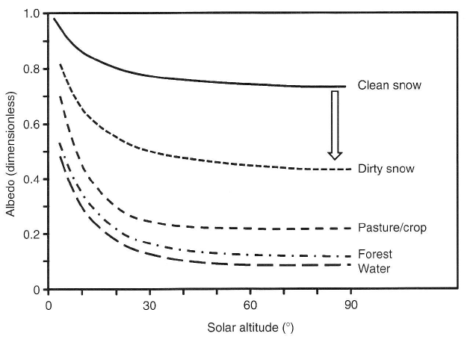
Upward (reflected) surface solar radiation
0 to ∼800 W m⁻²
Determined by:
Downward solar radiation
Surface albedo
S_{u}= α S_{d}
Shuttleworth (2012)
Albedo depends on solar angle & surface properties
Shuttleworth (2012)
(Angle from the horizon = 90º – Zenith Angle)

Slide 20
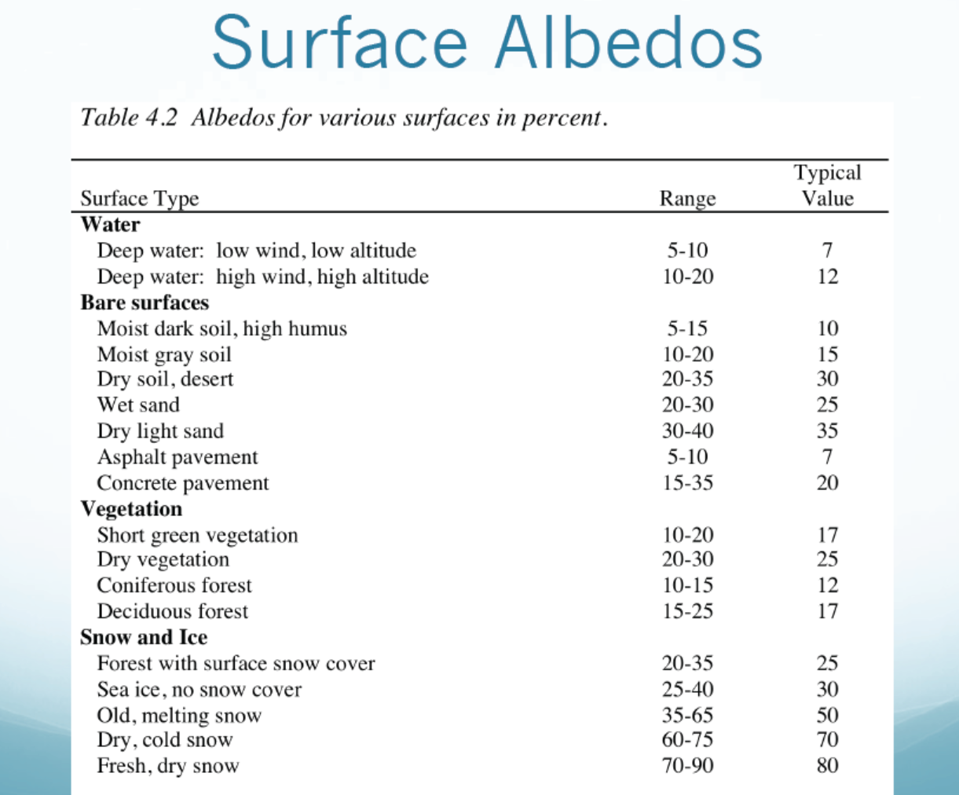

Slide 21
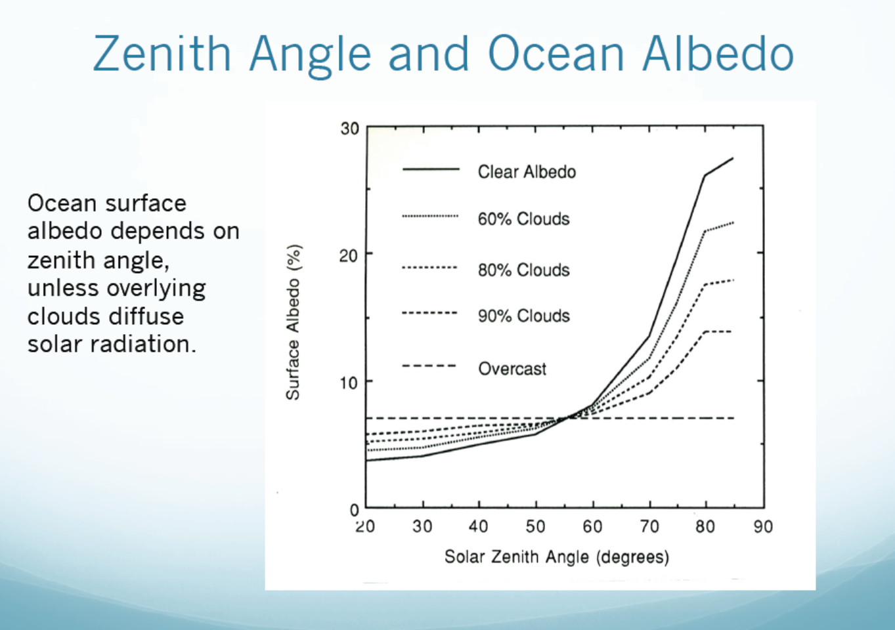
θ
θ

Slide 22
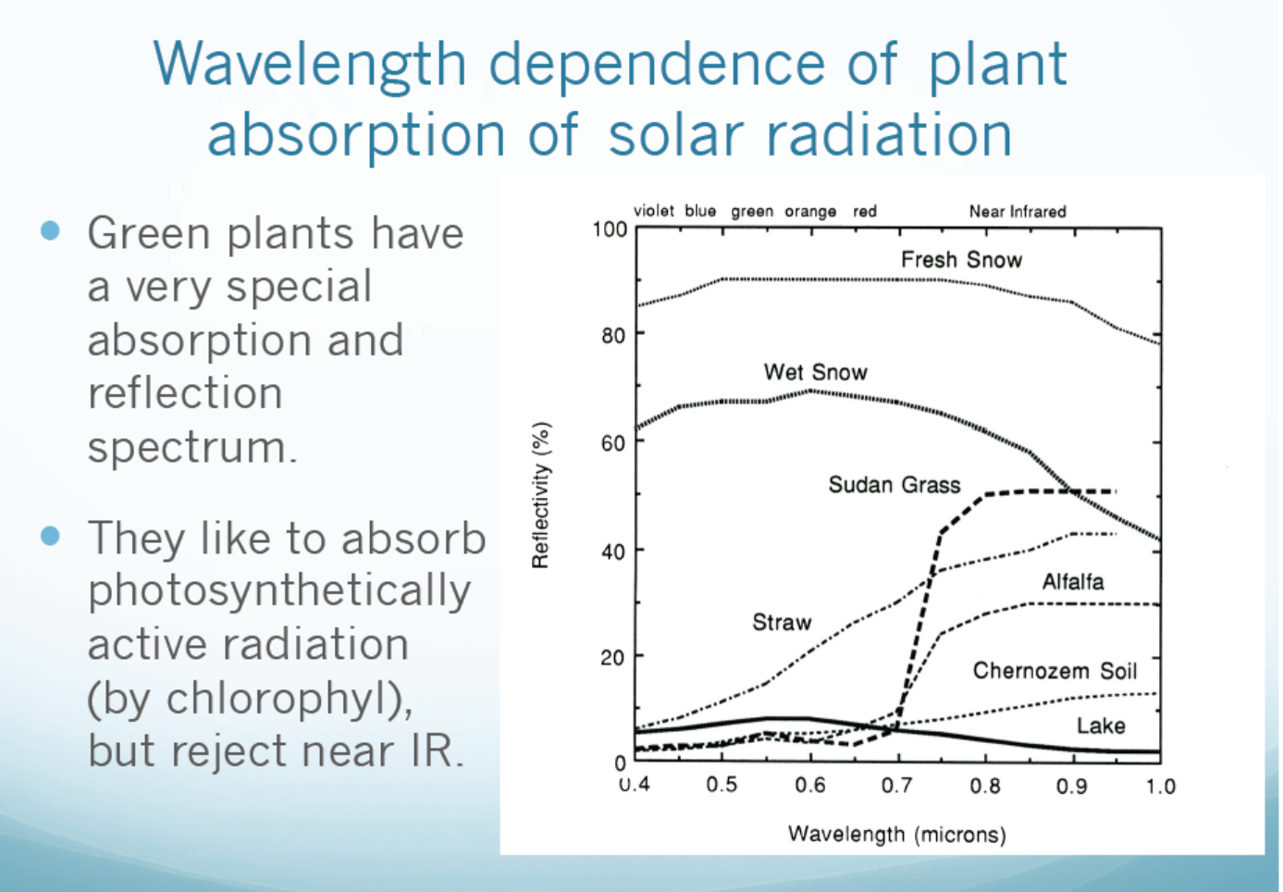

Slide 23
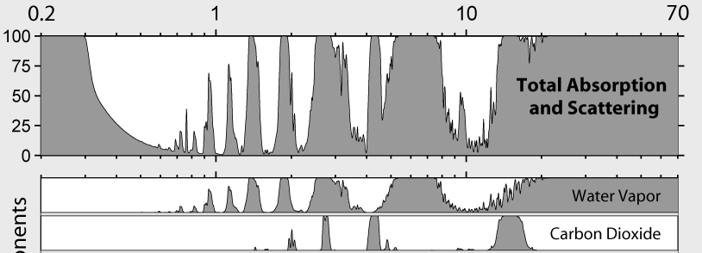
Downward surface longwave radiation
∼180 to ∼550 W m⁻²
Determined by:
Profile of (lower) atmospheric temperatures
Profile of (lower) atmospheric emissivity
  Determined by clouds and greenhouse gases (especially H₂O)
  Both clouds and greenhouse gasses absorb and re-emit longwave radiation, resulting in larger L_{d}
near-surface air T, humidity and cloud fraction
(Zhang et al. 1995, JGR, https://doi.org/10.1029/94JD02747)
Wavelength (μm)
These effects are often crudely estimated from:
fractional cloud cover
near-surface temp.
near-surface humidity
% absorbed
L_{d} ≈ f ε_{atm} σT_{atm}⁴
http://www.globalwarmingart.com/wiki/File:Atmospheric_Absorption_Bands_png
Cloud factor
Near-surface atmospheric values

Slide 24
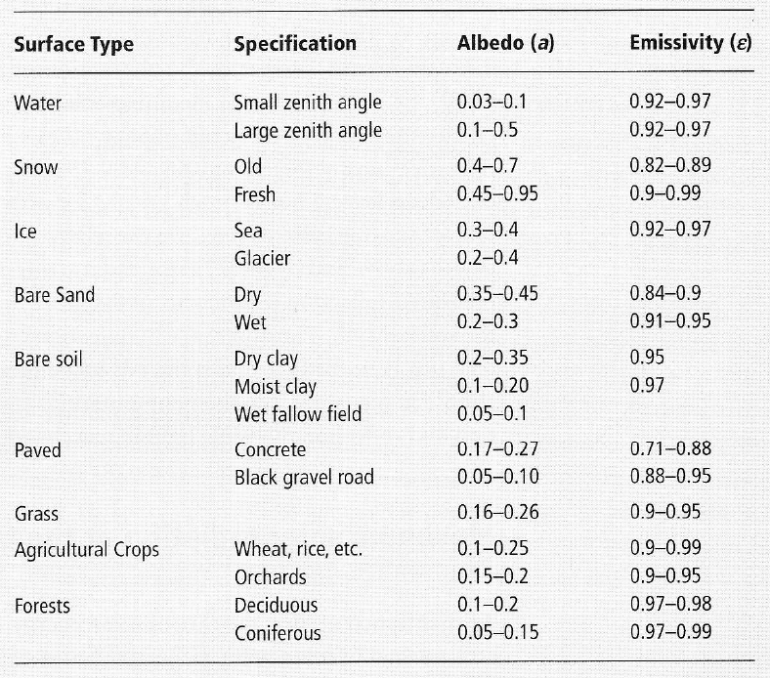
Upward surface longwave radiation
∼180 to ∼550 W m⁻²
Determined by:
Surface temperature
Surface emissivity (ε_{s})
L_{u}= ε_{s} σ T_{s}⁴ + (1- ε_{s}) L_{d}
T in Kelvin
Shuttleworth (2012)

Slide 25
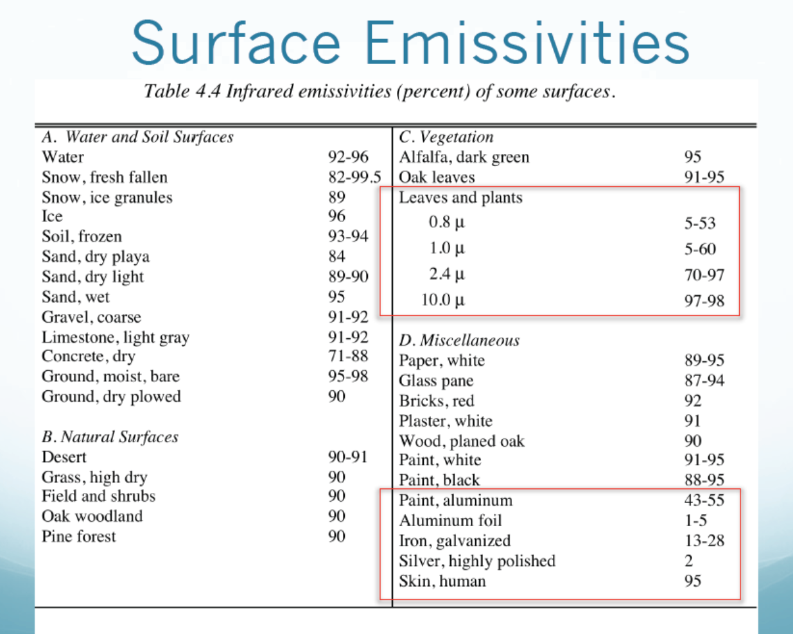

Slide 26
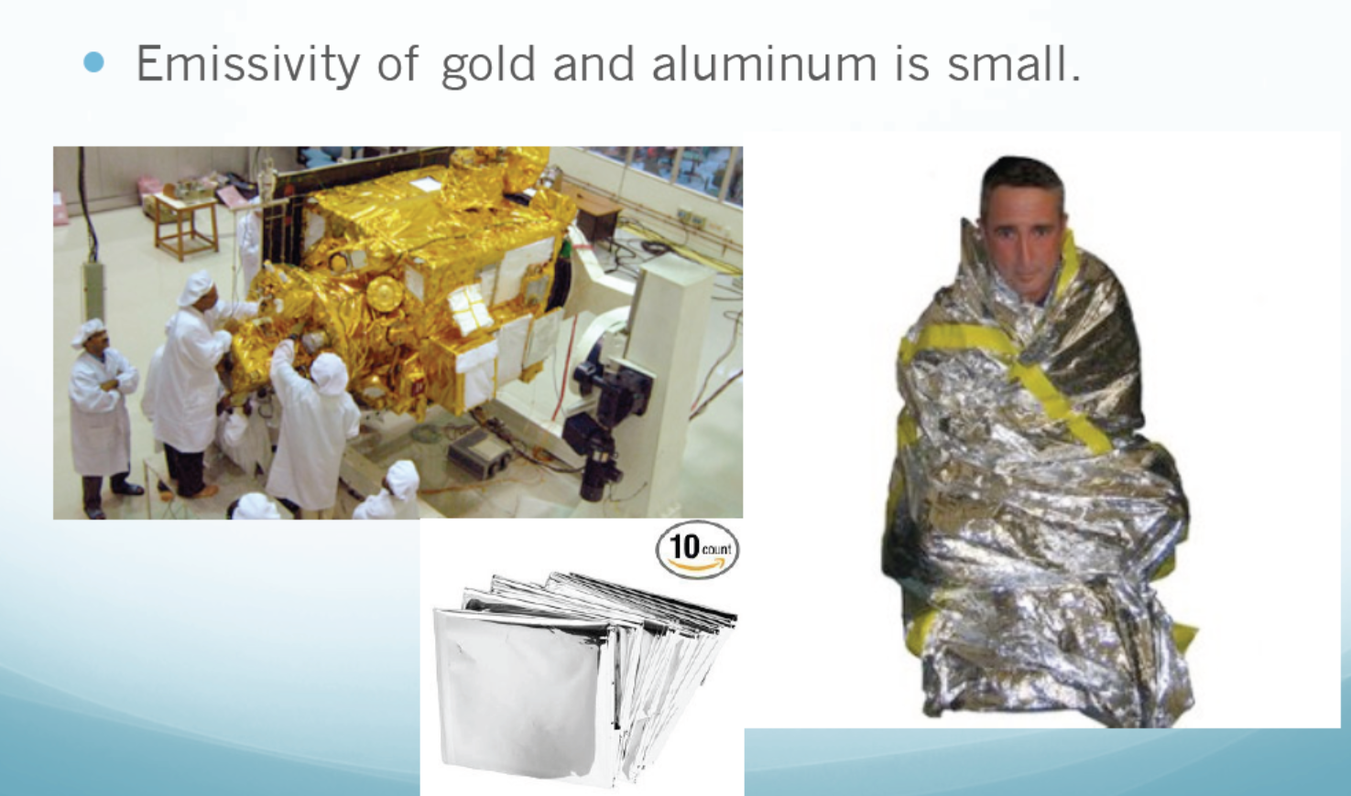

Slide 27
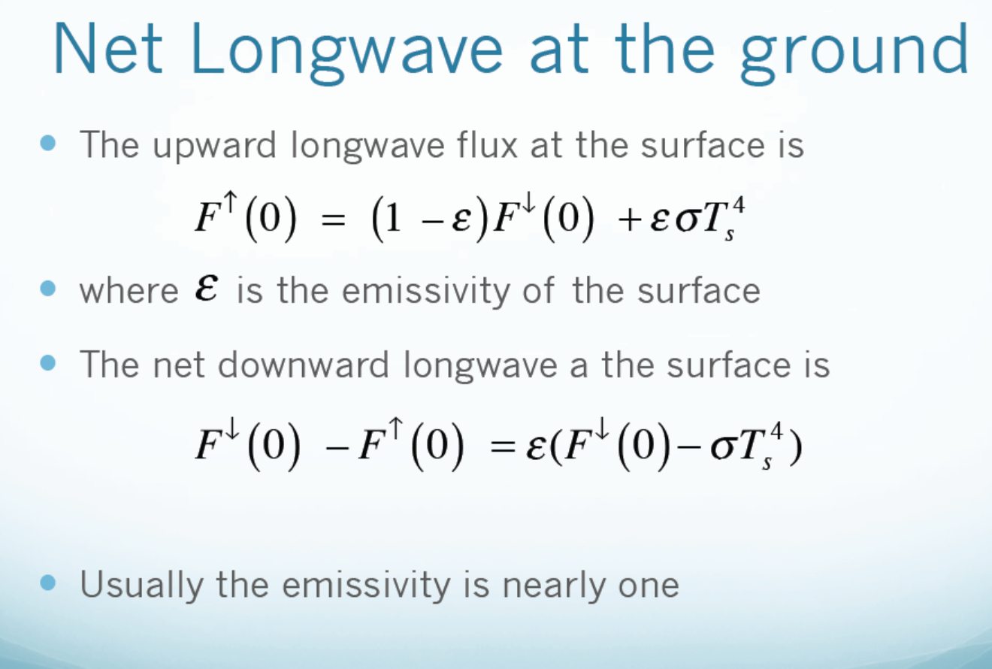
reflected surface emitted
Recall: emissivity=absorptivity, so (1-ε) is the reflectivity
t
So the reflection (1-ε) of LW is often ignored.

Slide 28
Surface radiation budget: Summary
R_{n} = S_{d} – S_{u} + L_{d} - L_{u}
R_{n} = S_{d} (1-α) + ε_{s}L_{d} – ε_{s}σT_{s}⁴
R_{n} ≈ S_{d} (1- α) + ε_{s} σ f ε_{atm} T_{atm}⁴ – ε_{s}σT_{s}⁴
All things we can easily measure or calculate
S_{d}
S_{u}
L_{d}
L_{u}
R_{n}
-
+
-
=
shortwave/solar
(λ<2 μm)
Longwave/terrestrial/Thermal/IR
(λ>3 μm)

Slide 29

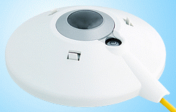

Measuring surface radiation
http://en.wikipedia.org/wiki/Pyranometer
Solar radiation measured with a “pyranometer”:
Records flux of radiation
First filters out all but the solar wavelengths.
Dome isolates sensor from sensible and latent heat fluxes.
http://en.wikipedia.org/wiki/Pyrgeometer
Thermal radiation measured with a “pyrgeometer”:
Records flux of radiation
First filters out the solar wavelengths
Dome isolates sensor
http://en.wikipedia.org/wiki/File:Hukseflux_netto_radiometer_nr01_photo.jpg
Net radiation measured with a net radiometer:
measure all 4 components of R_{n} separately
…or by measure net upward and downward total radiation (no filtering)

Slide 30
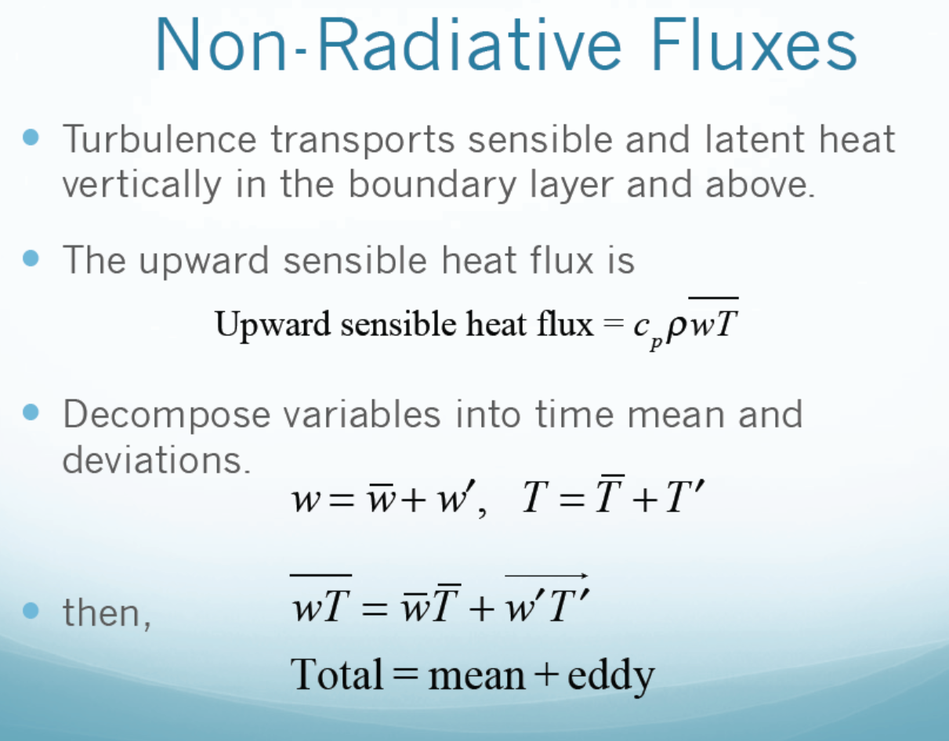
small large

Slide 31
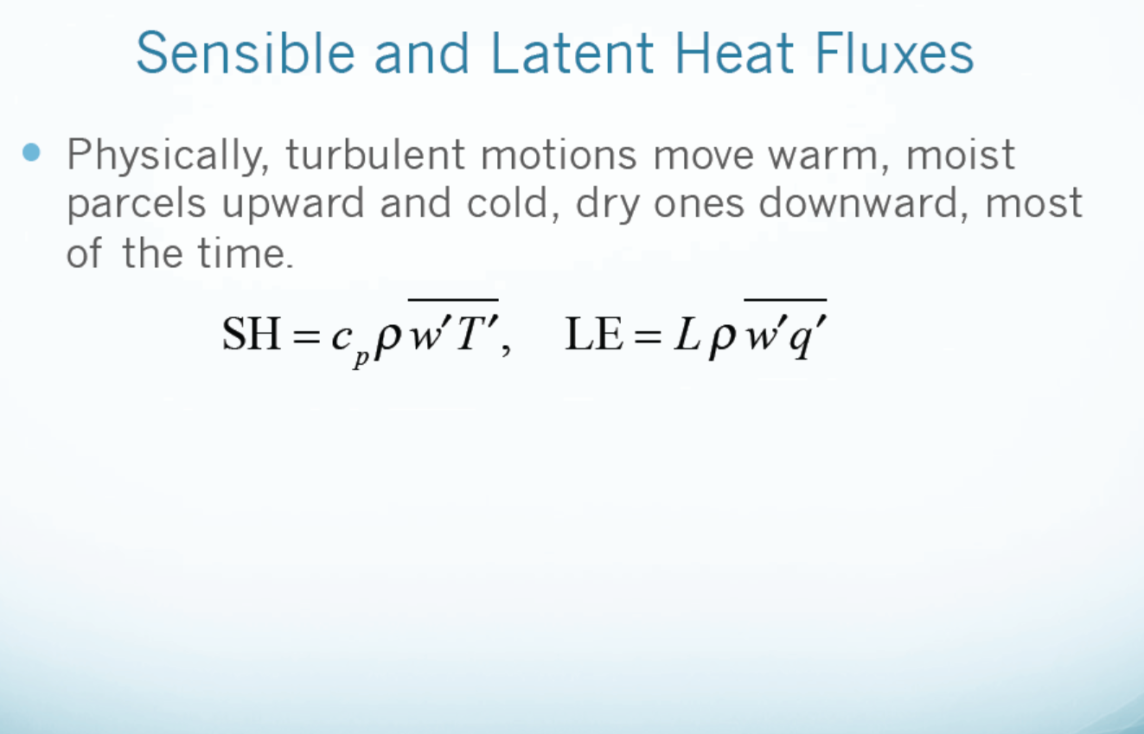
Near surface mean w is small, so the turbulent mixing dominates
LH is also often used for Latent Heat Flux

Slide 32
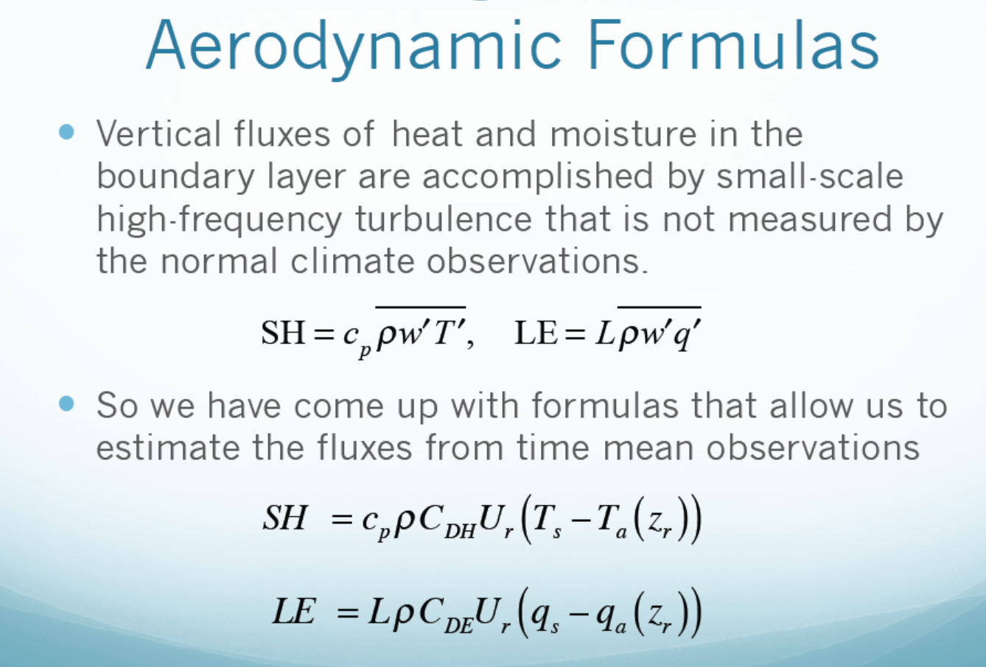
Reference height is often 10m for U (wind speed) and 2m for T_{a} and qa. These bulk formulas are used in climate and weather models. q=specific humidity

Slide 33
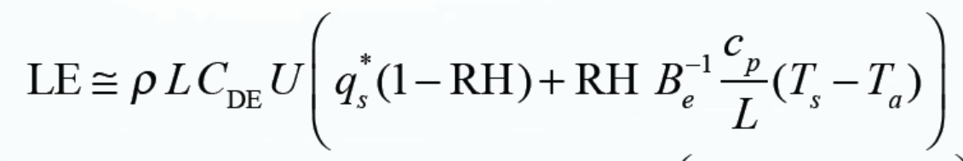
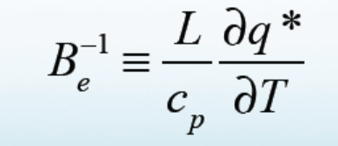
The Bowen Ratio
The Bowen Ratio is the ratio of surface sensible heat flux to the latent heat flux:
Since
Thus
where
q*_{s} is the saturation specific humidity.

Slide 34
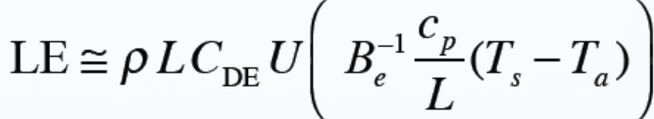
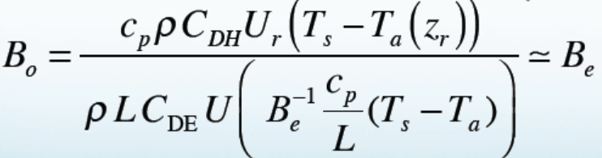
The Equilibrium Bowen Ratio
The Equilibrium Bowen Ratio (Be) refers to the Bo under equilibrium with the air being saturated (e.g., over wet surfaces).
Since LE would be higher if unsaturated → Be is the upper limit of Bo
For RH=1, CDH ≈ CDE,
Where is the Equilibrium Bowen Ratio. is the
saturation specific humidity for T=Ts

Slide 35
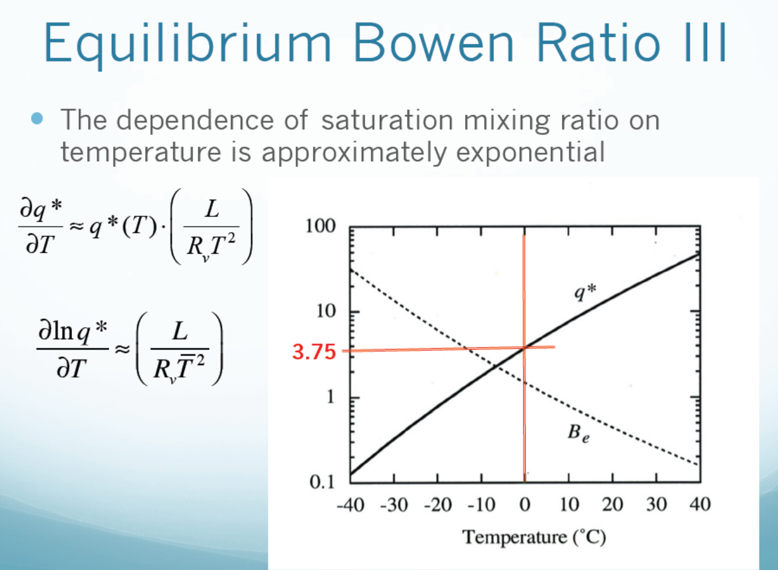
Over Wet Surface Only (g/kg for q*)

Slide 36
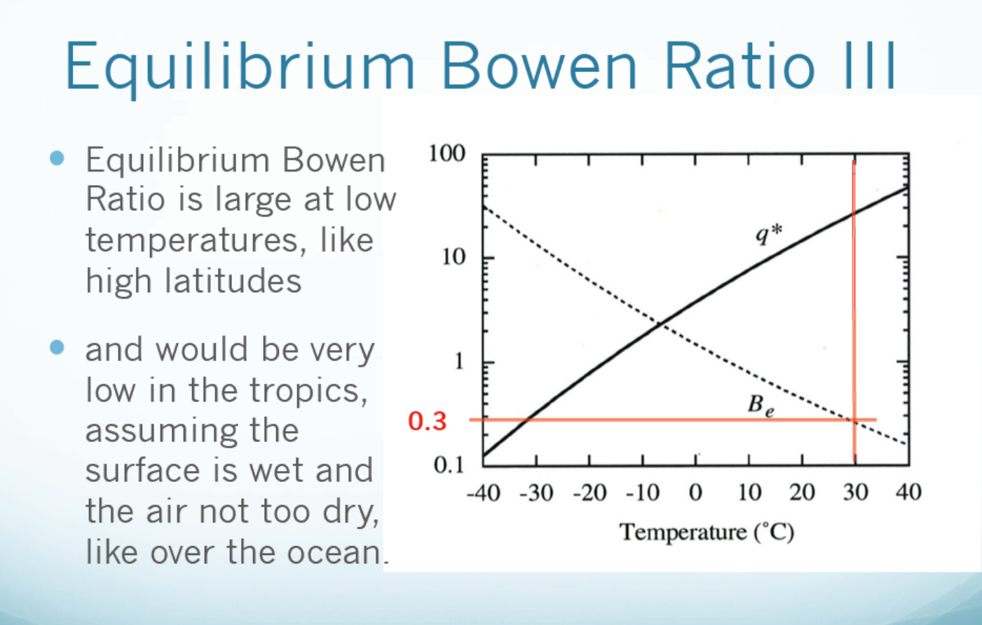
Over Wet Surface Only (g/kg for q*)
SH dominates
LH dominates

Slide 37
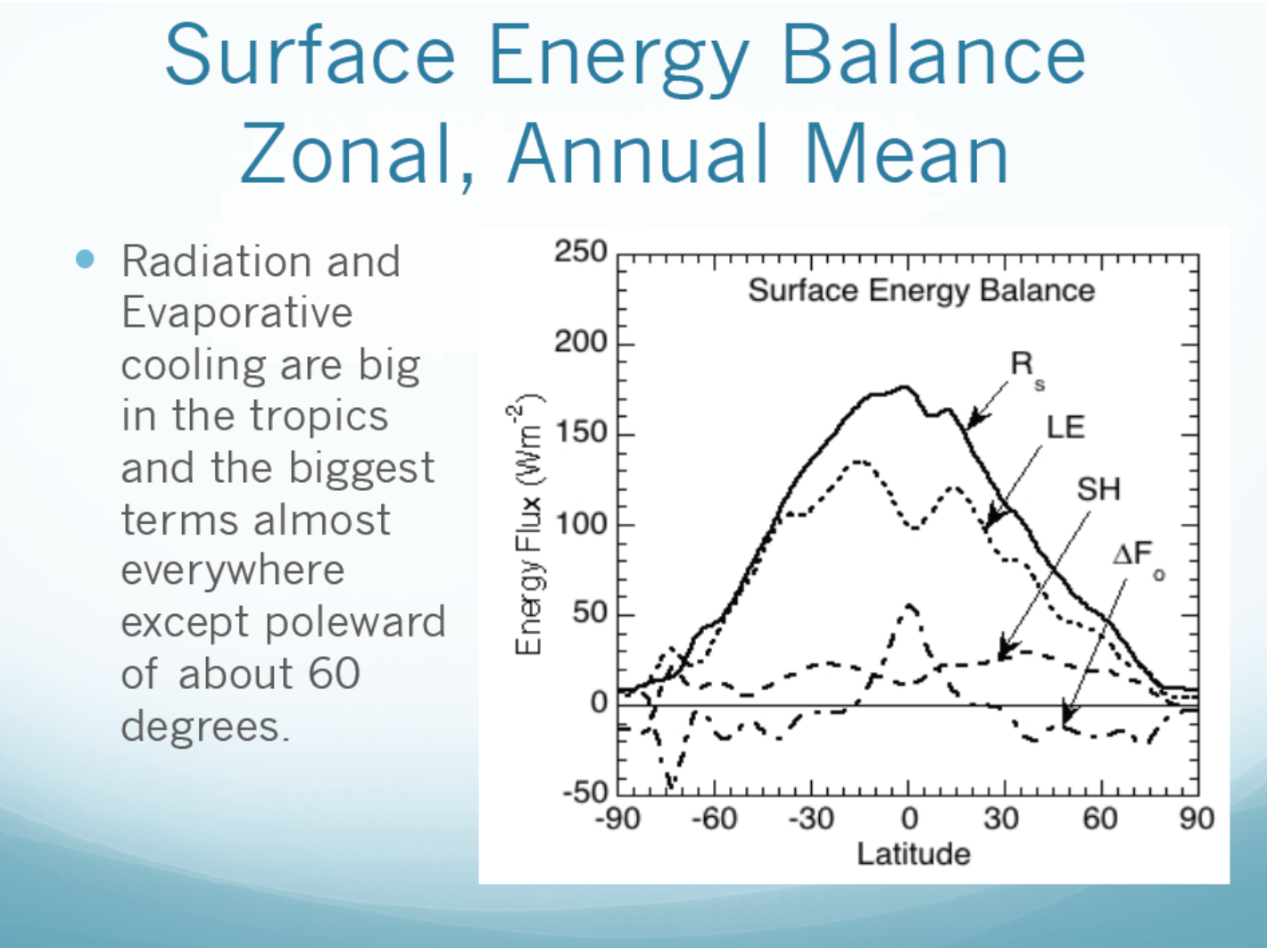
(net radiation)
=Rs-LE-SH

Slide 38
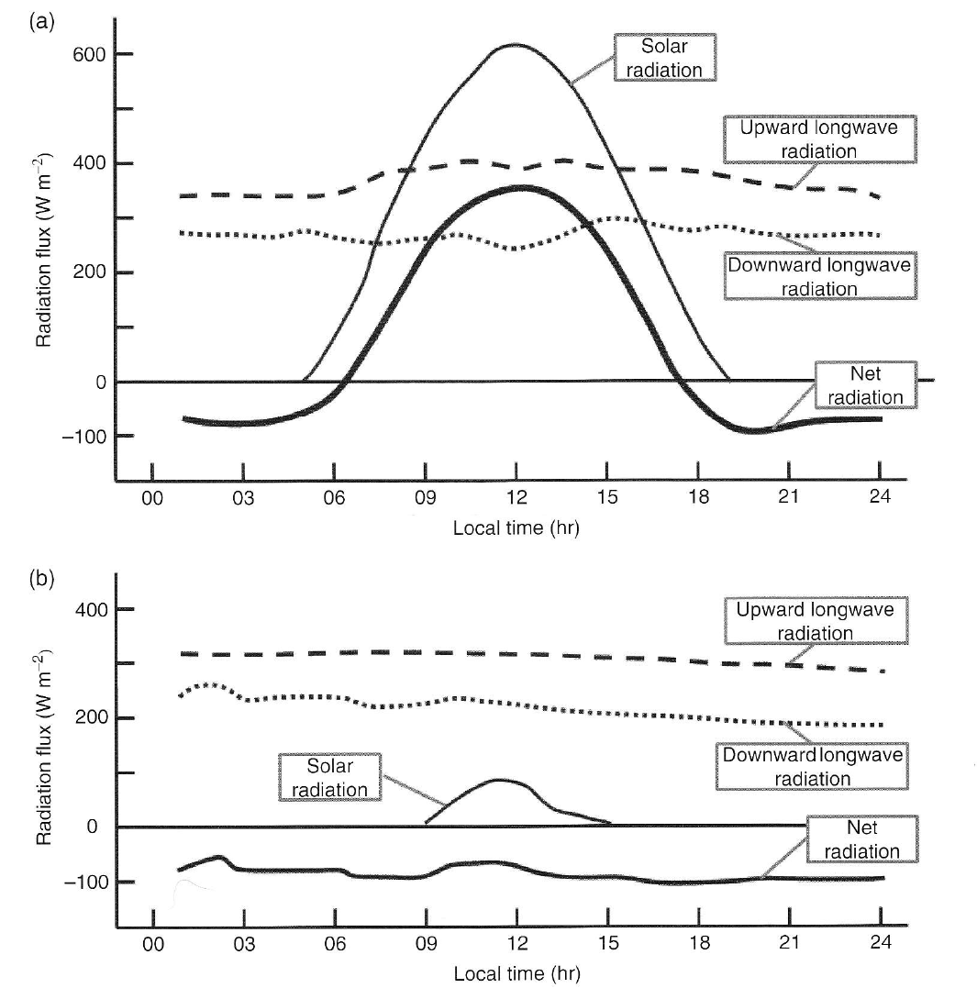
Diurnal (daily) cycle of radiation
(clear sky)
At Bergen, Norway
13 April 1968
Shuttleworth (2012)
11 January 1968

Slide 39
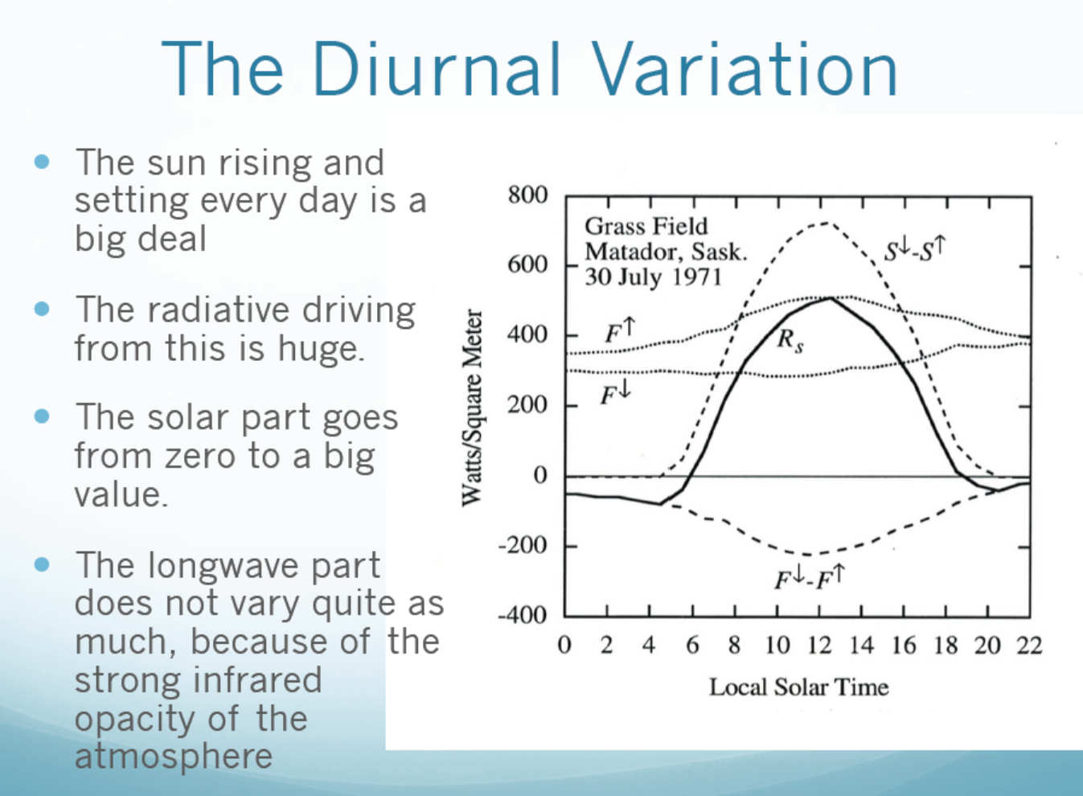

Slide 40
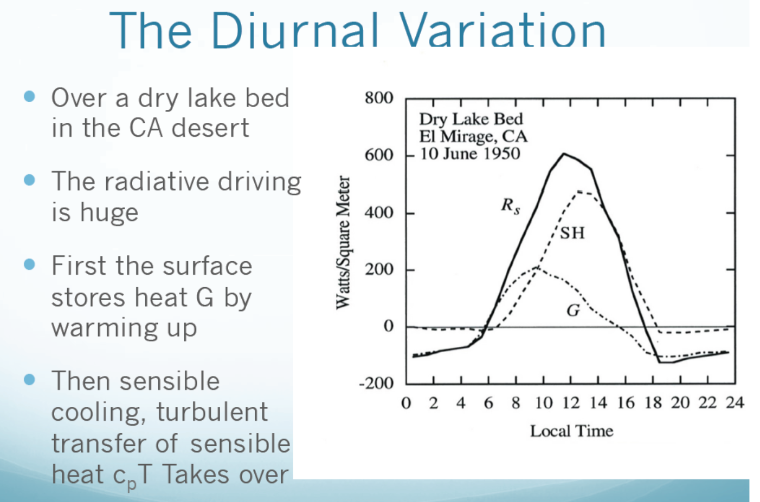

Slide 41
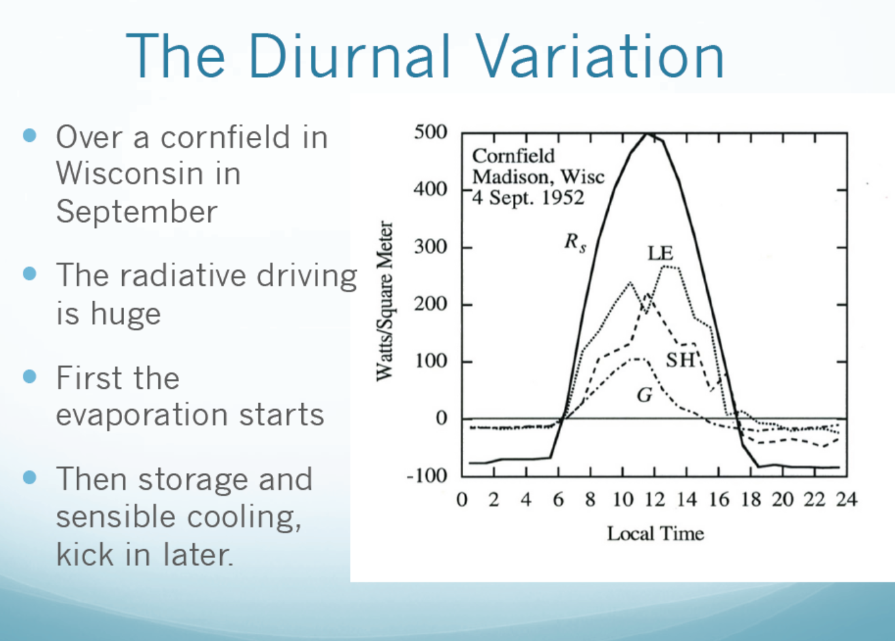

Slide 42
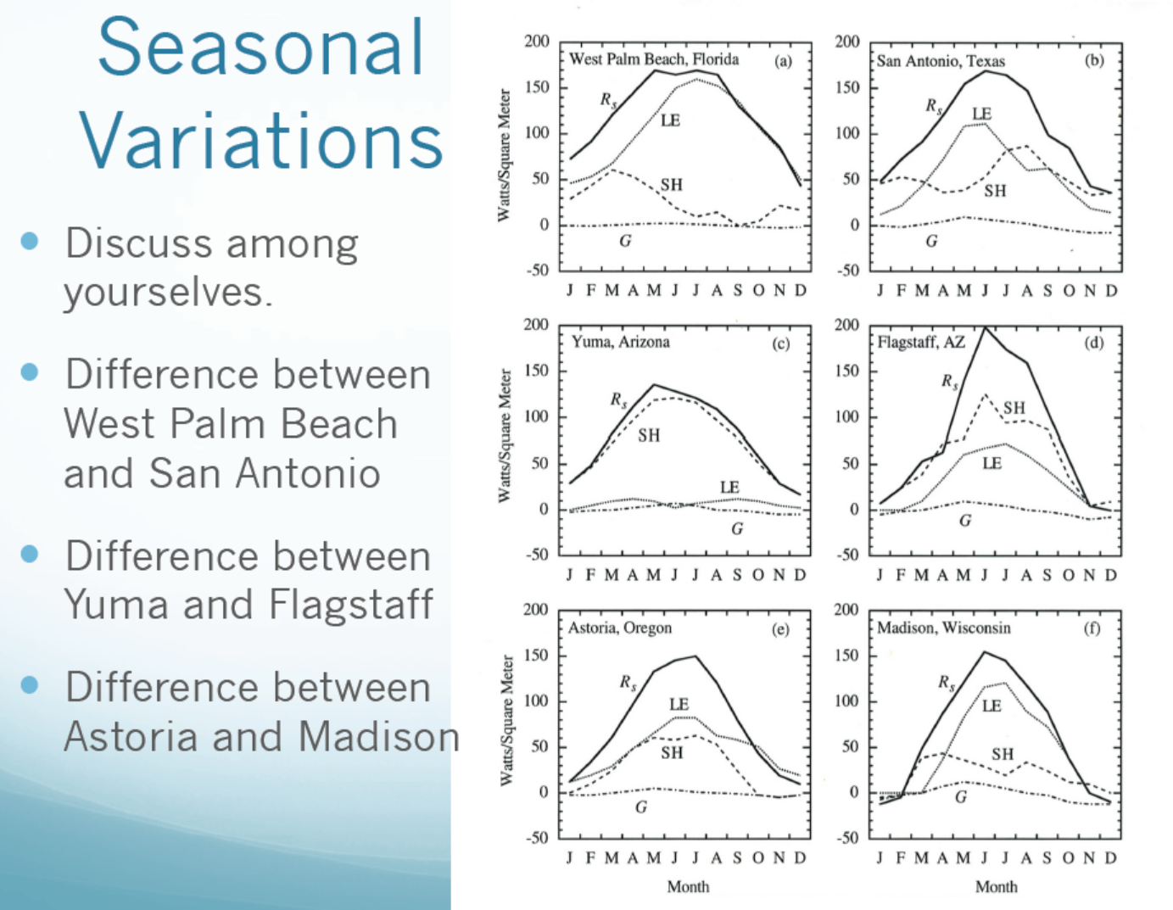
SH dominates over
dry regions (i.e. Bo >1)

Slide 43
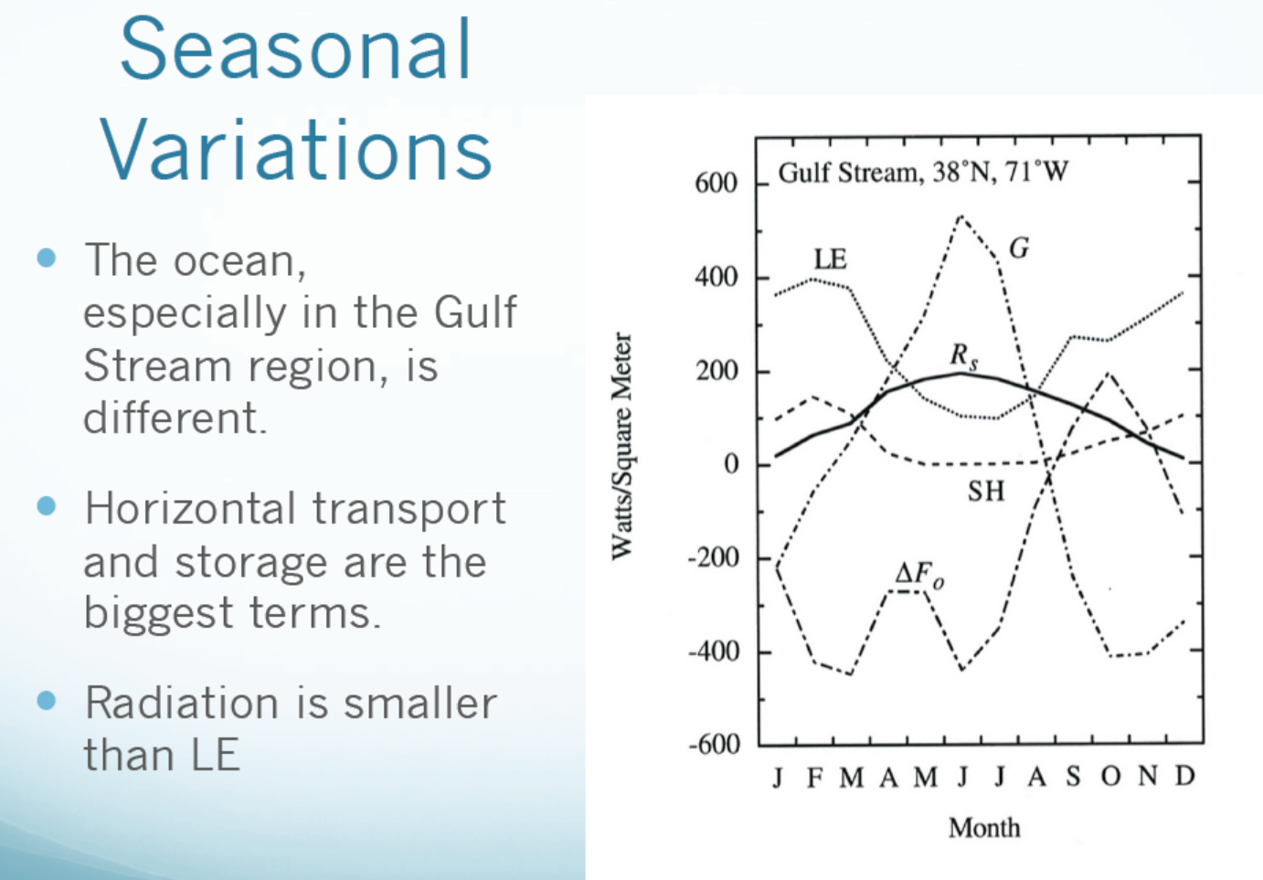

Slide 44
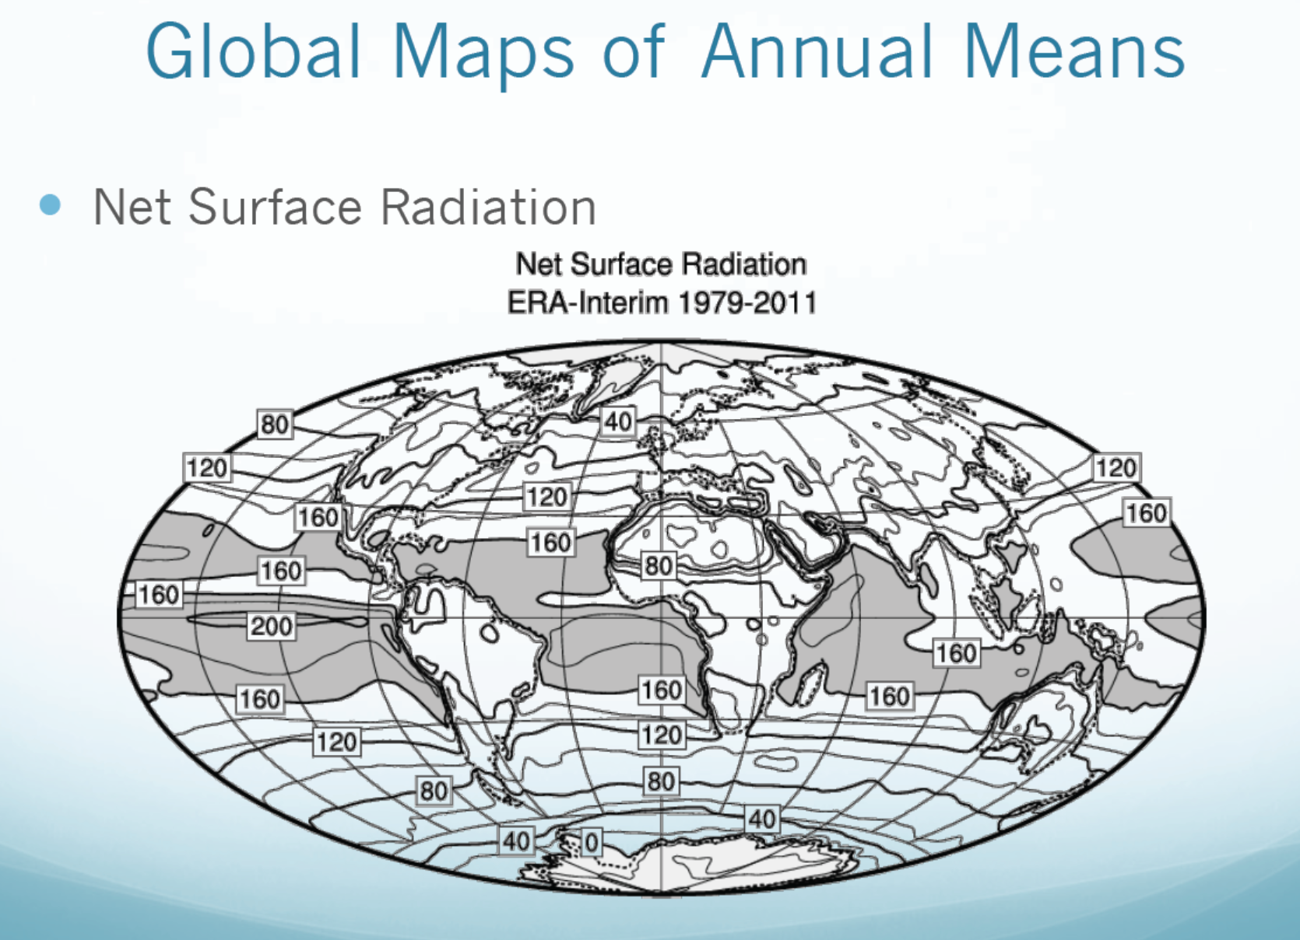
(W m⁻²)

Slide 45
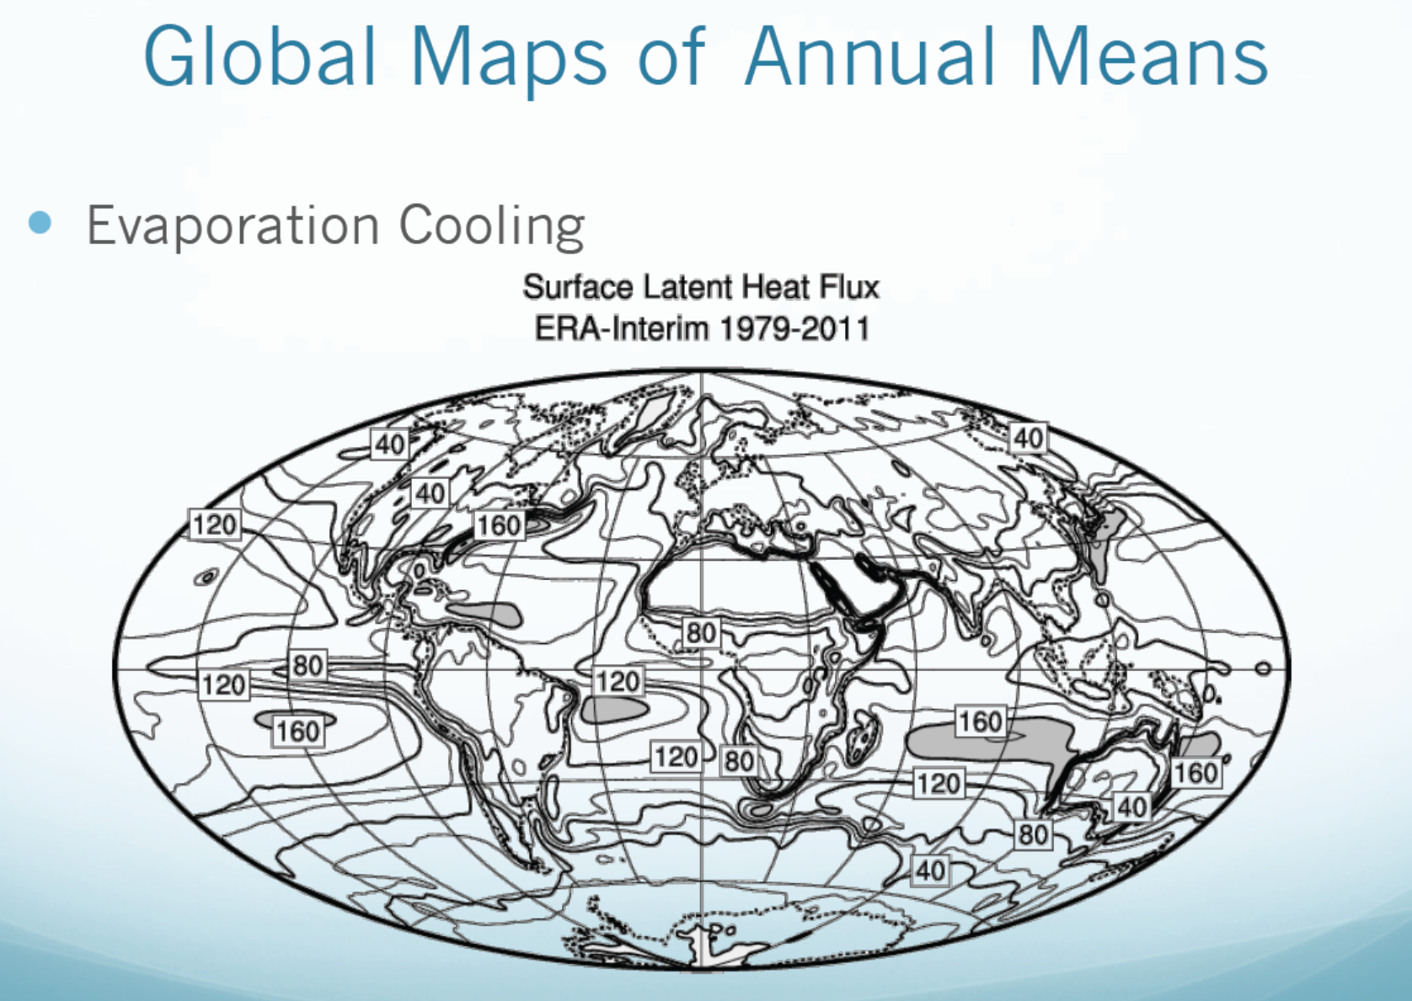
(W m⁻²)

Slide 46
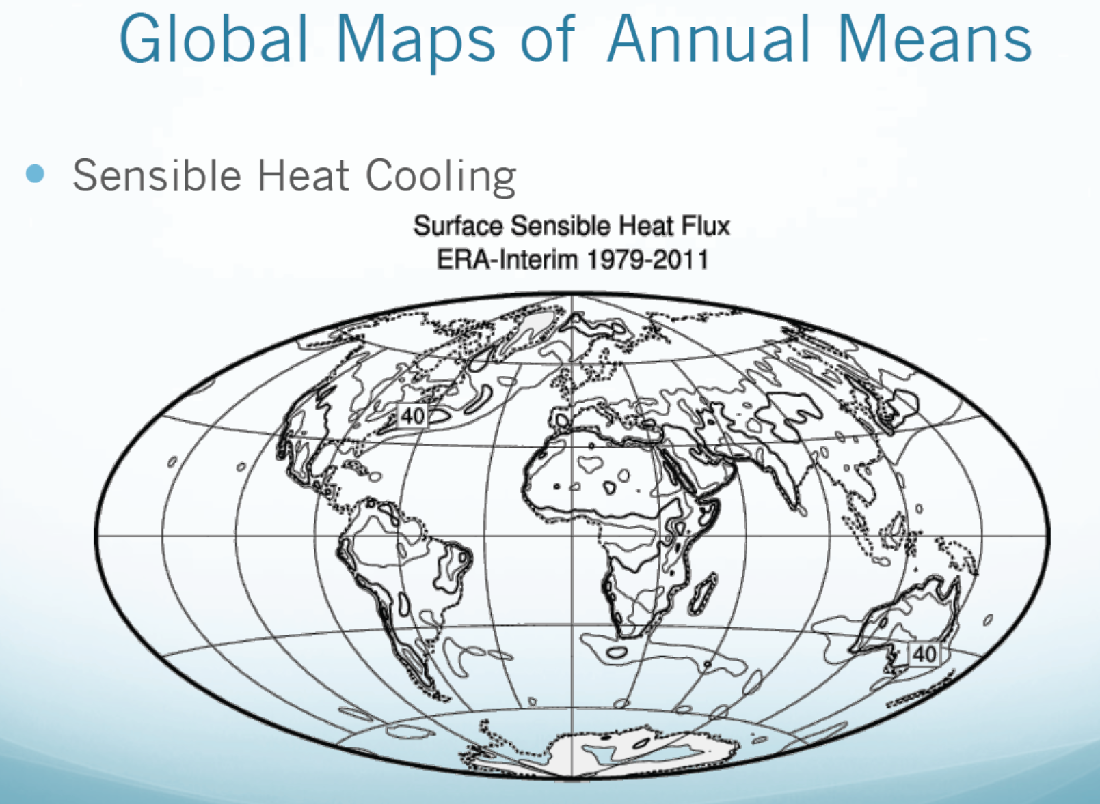
(W m⁻²)

Slide 47
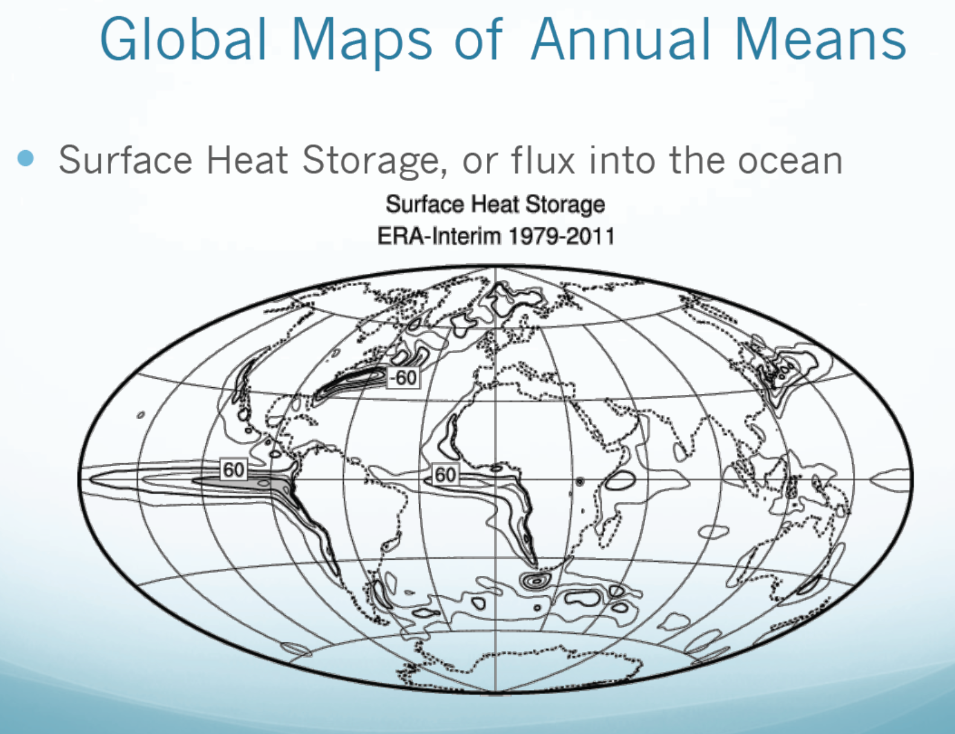
(W m⁻²)

Slide 48
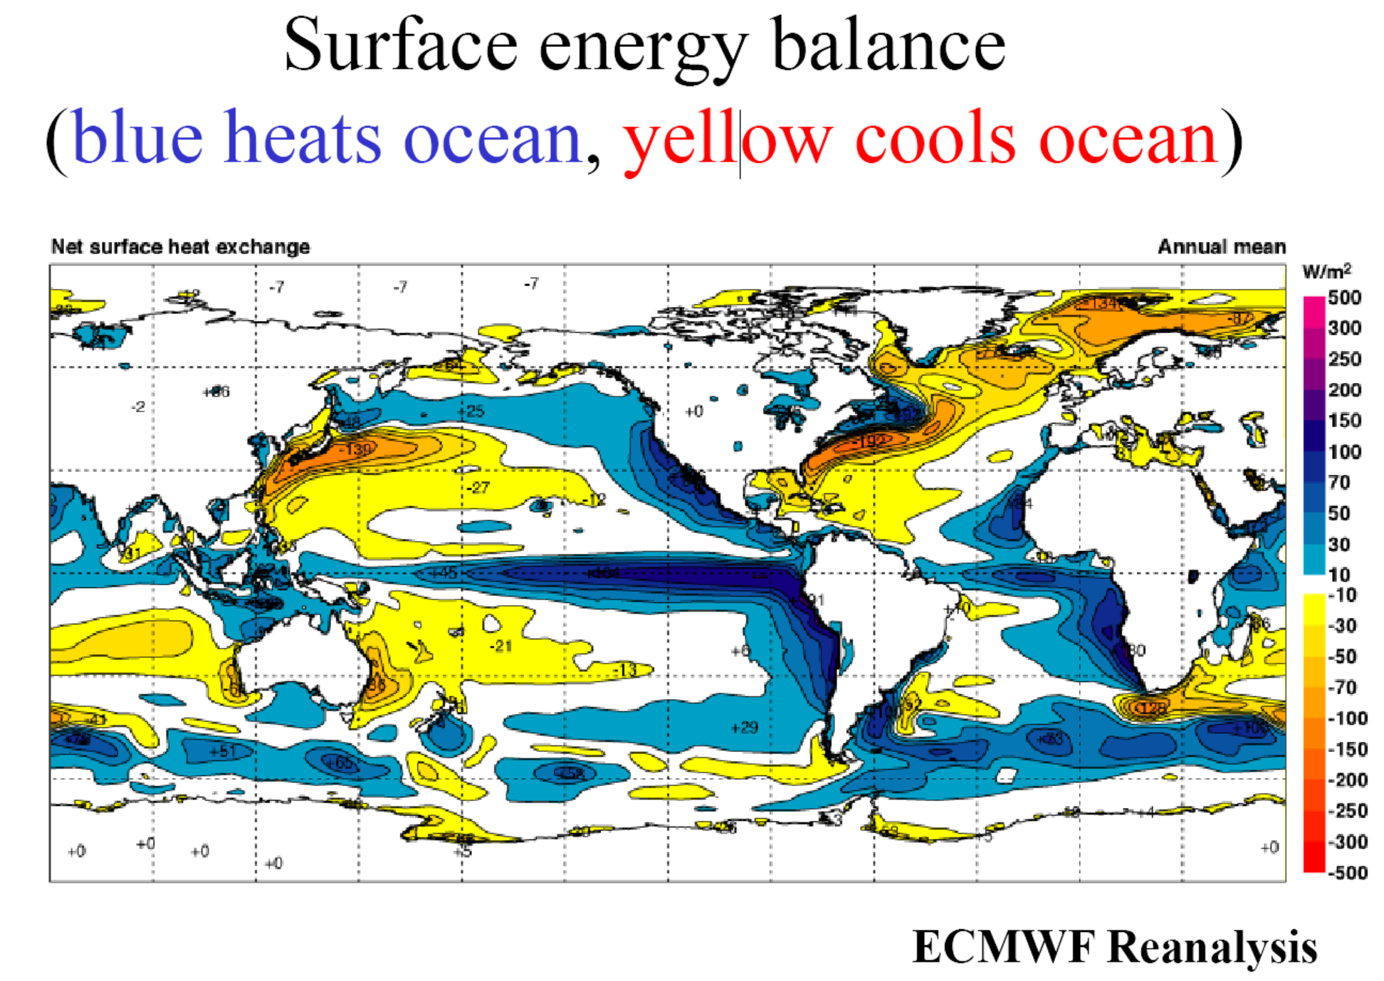

Slide 49


Slide 50
Surface Energy Balance:
λE
SH
S
L
where
ΔU/ Δt = energy storage change within the surface layer
S = net shortwave (i.e. solar) radiation into the layer (positive down)
L = net longwave (i.e. infrared) radiation into the layer (positive down)
λE = latent heat flux (positive upward), λ_{v}(MJ/kg)=2.50-2.36x10⁻³ T(ºC) is latent heat
SH = sensible heat flux (positive upward)
G = downward heat flux through conduction (often small)
A_{w} = net energy input associated with inflows and outflows of water (often ≈0)
Thus, evaporation is constrained by and can be derived using the surface energy balance.
A_{w}
G

Slide 51
Homework Assignments:
- Reading Assignments: Chapter 4 of Hartmann GPC
- Review my ppt slides

Slide 52

Next Lecture:
The Hydrological Cycle and Climate

