Slide 1
A ATM551, Lecture #6
The Hydrological Cycle and Climate
Reading Assignment:
Chapter 5 of Hartmann GPC

Slide 2
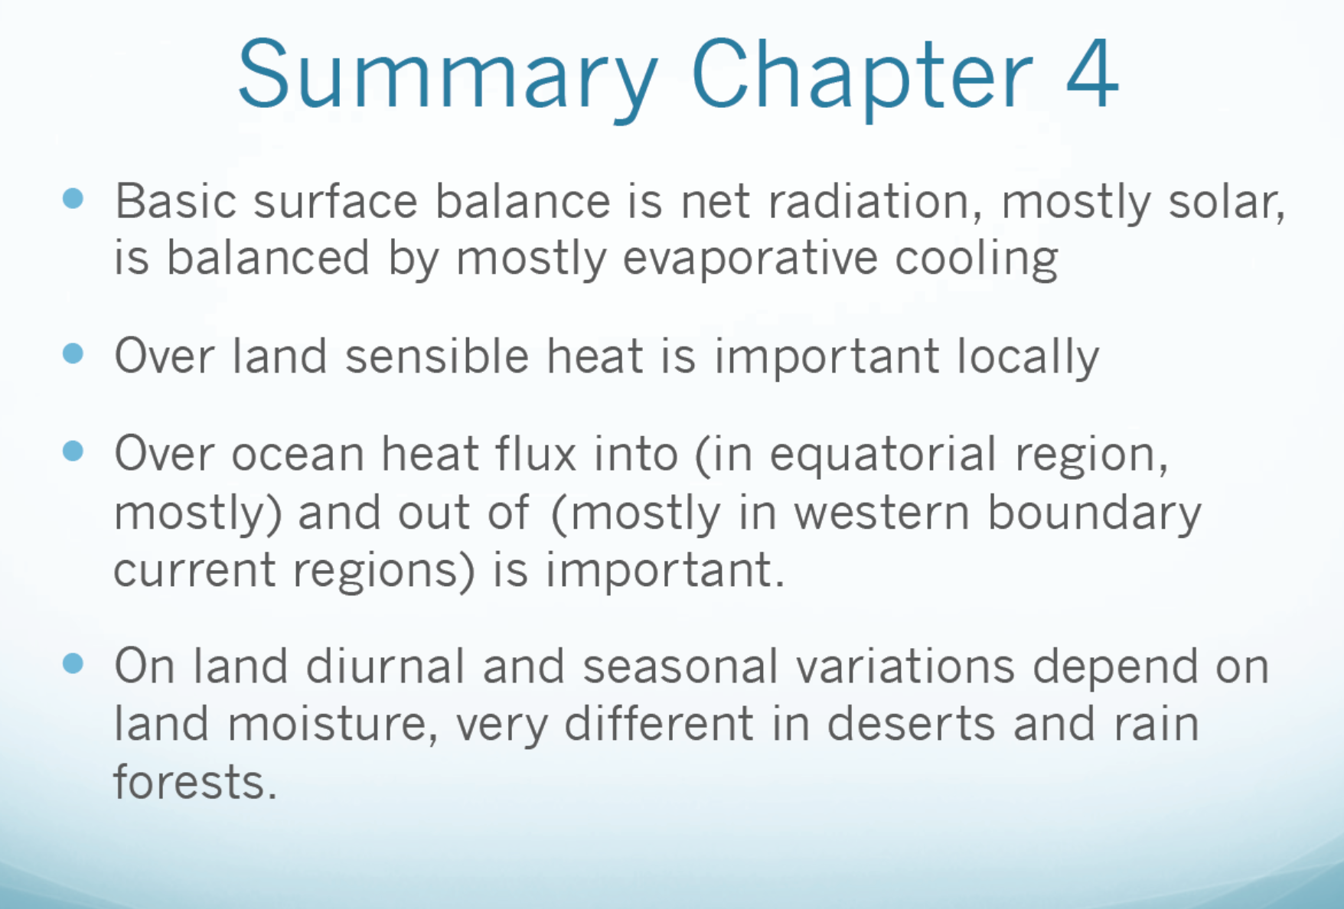
λE
SH
Summary of Surface Energy Balance
S
L
Rnet (SWnet + LWnet) = LH + SH
A_{w}
G

Slide 3
Outline of Today’s Lecture
Overview of the Global Hydrological Cycle:
Reservoirs, fluxes, and water balances – very brief.
Evapotranspiration
Precipitation
Runoff

Slide 4
The Role of Water in Climate
Water vapor provides the largest greenhouse effect
Water and ice clouds reflect sunlight and block OLR
Latent heating during precipitation is a major source of energy for the atmosphere
Surface evaporation regulates surface temperature
Surface water fluxes (E-P) affect salinity in upper oceans, and thus ocean circulation
Ice-albedo feedback is important for climate change
The water cycle affects the energy cycle
A dry atmosphere would have a very different kind of weather and climate with no clouds, no precipitation, no snow and ice.
Examples?

Slide 5
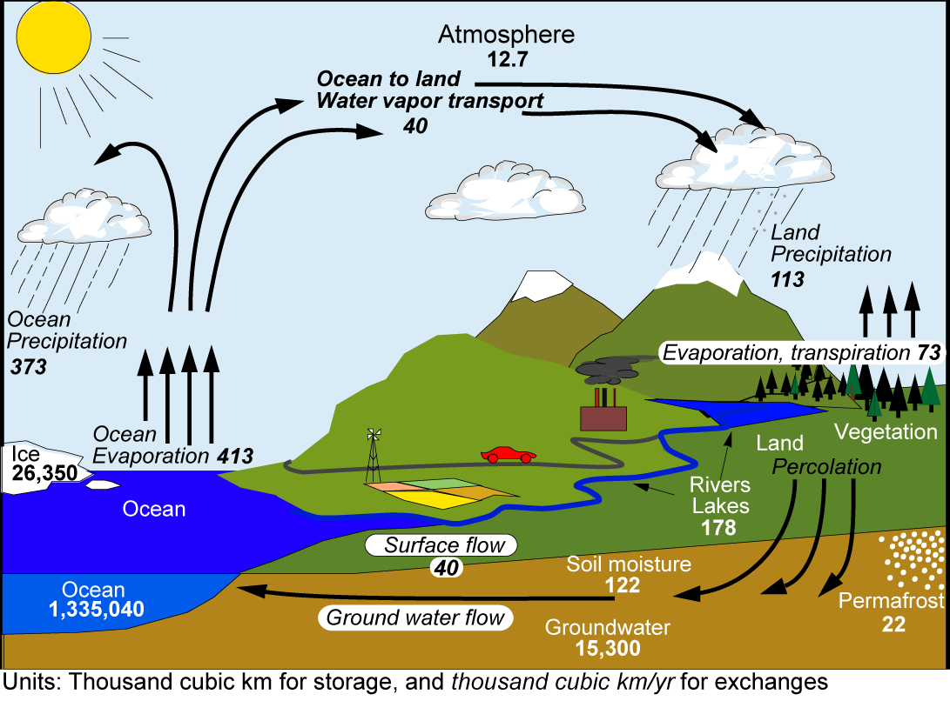
The Global Hydrologic Cycle
T=9days
35% land P comes from oceanic E.
This amount runs off into ocean.
Runoff ratio=0.35
P balances 90% oceanic E.
10% of the E transported to
land and returned by
continental runoff
T ≈ 3200yrs
(From Trenberth et al., J. Hydrometeorol., 2007)

Slide 6
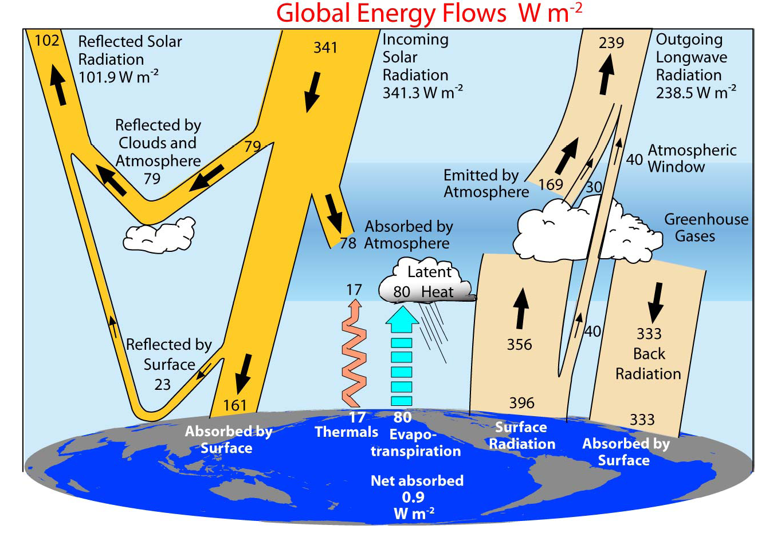
The energy and hydrologic cycles are coupled
H2O
H2O
Trenberth et al. (2009, BAMS)
It takes ~80W m⁻² energy to evaporate 1m of water in a year.
Notes:
Data used: TOA fluxes: satellite obs. Other fluxes: atmospheric reanalyses. LH: adjusted GPCP

Slide 7
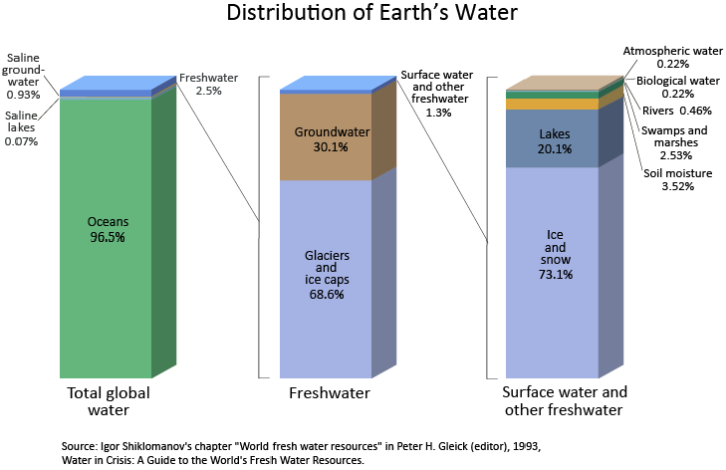
Where is the Water?
Earth’s total amount of water does not change on 10³ time scales!
From http://ga.water.usgs.gov/edu/watercyclesummary.html

Slide 8
An Estimate of the world water reservoirs. Source: MIT OpenCourseWare.
 | Surface area (million km²) | Volume (million km ³) | Volume (%) | Equivalent depth (m) | Residence time
Oceans and seas | 361 | 1,370 | 94 | 2,500 | ~4,000 years
Lakes and reservoirs | 1.55 | 0.13 | <0.01 | 0.25 | ~10 years
Swamps | <0.1 | <0.01 | <0.01 | 0.007 | 1-10 years
River channels | <0.1 | <0.01 | <0.01 | 0.003 | ~2 weeks
Soil moisture | 130 | 0.07 | <0.01 | 0.13 | 2 weeks to 50 years
Groundwater | 130 | 60 | 4 | 120 | 2 weeks to 100,000 years
Icecaps and glaciers | 17.8 | 30 | 2 | 60 | 10 to 1,000 years
Atmospheric water | 504 | 0.01 | <0.01 | 0.025 | ~10 days
Biospheric water | <0.1 | <0.01 | <0.01 | 0.001 | ~1 week

Slide 9
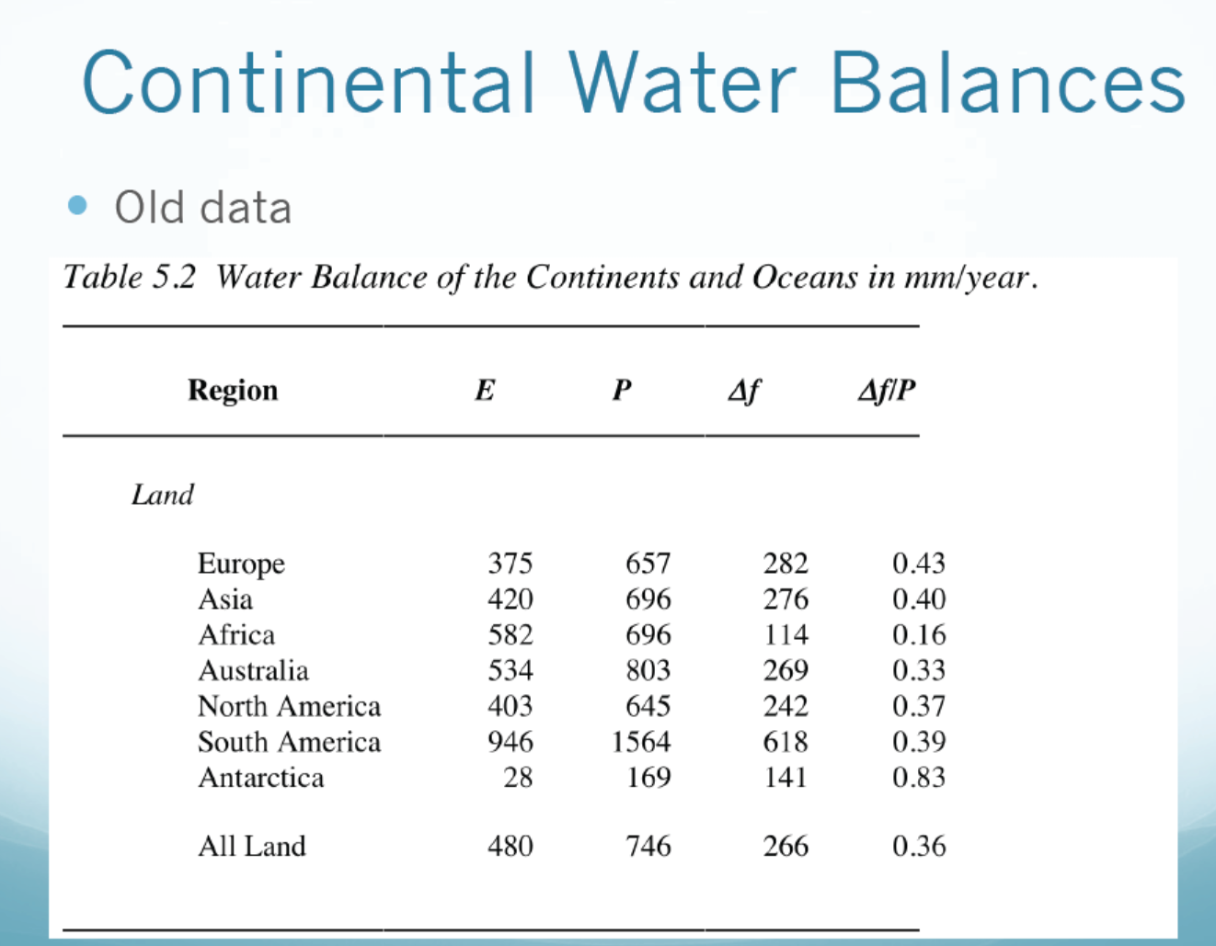
P-E
(runoff ratio)

Slide 10
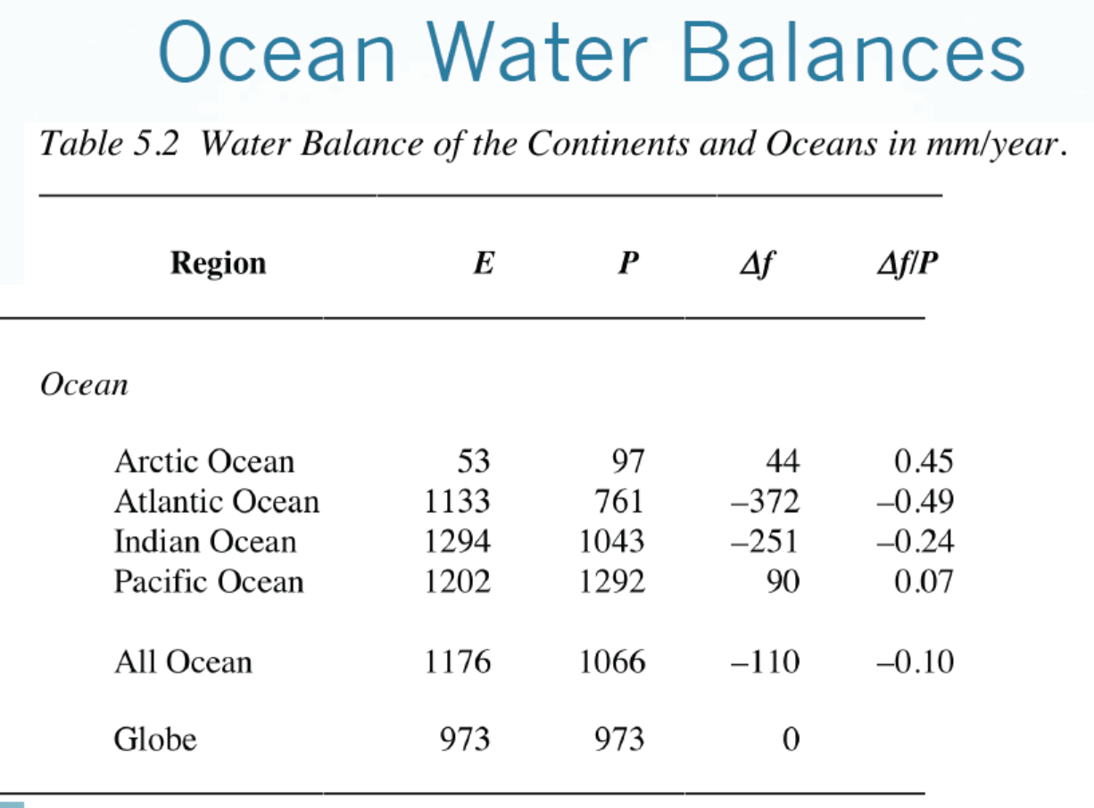
P-E

Slide 11
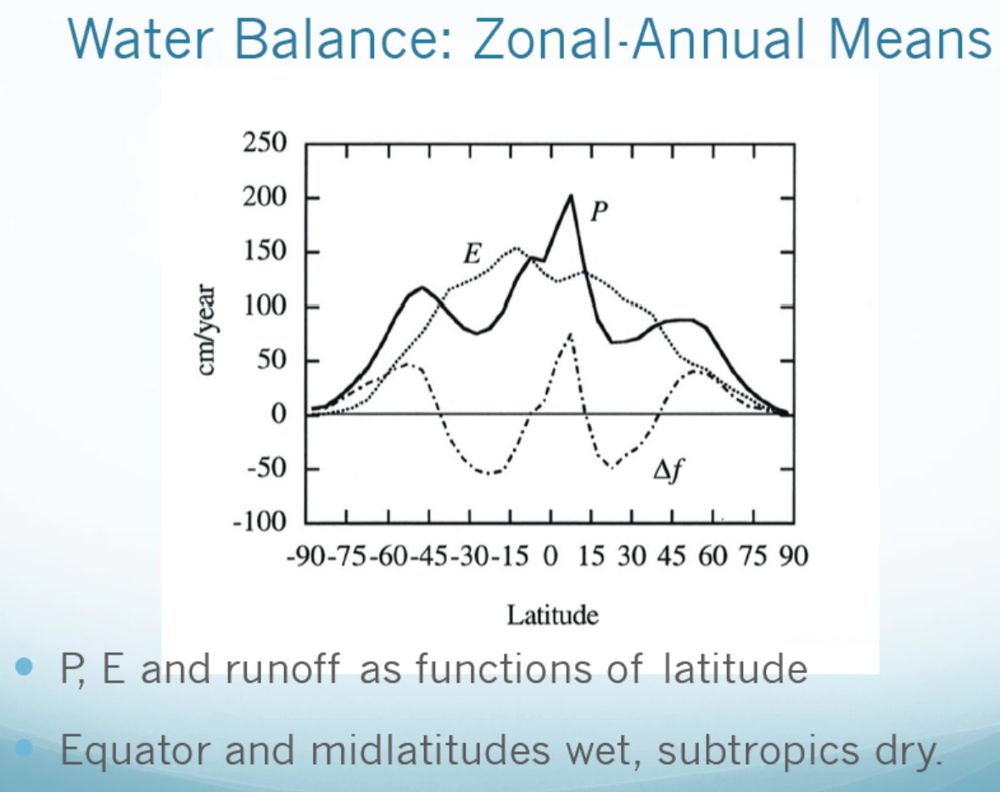
=P-E

Slide 12
Summary of the Global Water Cycle
Definition:
It refers to the movement of water on, above or below the surface of the Earth. Also known as the hydrological cycle. It helps re-distribute water and energy on Earth, greatly affects surface temperature, forms clouds and precipitation, thus playing a critical role for the weather, climate and biosphere on Earth.
Main Reservoirs:
- Oceans (96%, t∼10³yrs), freshwater on land (2.5%, t=weeks to years ), the atmosphere (<0.01%, t =10days ), the biosphere (<0.01%, t=1week)
- Freshwater: 68.6% in glaciers and ice caps, 30% in groundwater, 2.5%in surface water (ice and snow, lakes, soil moisture, etc.)
Main Fluxes:
- Surface to the atmosphere: evaporation (Ocean: 1176mm/yr; land: 480mm/yr)
- The atmosphere to the surface: precipitation (Ocean: 1066mm/yr; land: 748mm/yr)
- Atmospheric transport: Ocean to land (40,000km³/yr)
- Land to ocean runoff: 40,000km³/yr or ∼35% of land precipitation (runoff ratio=0.35).
Main Physical Processes:
- Evaporation (absorbs heat, cools the surface)
- Condensation/precipitation (releases heat, heats the air)
- Infiltration : flow of water from the surface into the ground (soils).
- Runoff : lateral movements of water on land
Linked to the global energy cycle: evaporation brings about 80W/m² of latent heat into the atmosphere. Water vapor and clouds affect atmospheric energy budgets.

Slide 13
Surface Water Balance
This applies to local, regional and global scales
For long-term mean, dW/dt≈0, so
P - E ≈ R (runoff)
How these terms may change under global warming is a major research topic.
P
E
R
W
Water Storage
dW/dt = P- E - R

Slide 14
Atmospheric Water Balance
This applies to local, regional and global scales
Global-mean Div=0 and dW/dt≈0, so P=E globally. R=-Div for steady states in a region.
Globally, how much water goes up into the air has to come down to the surface on an annual basis.
W
Water Storage
dW/dt = E- P - Div
Div
Div
P
E

Slide 15
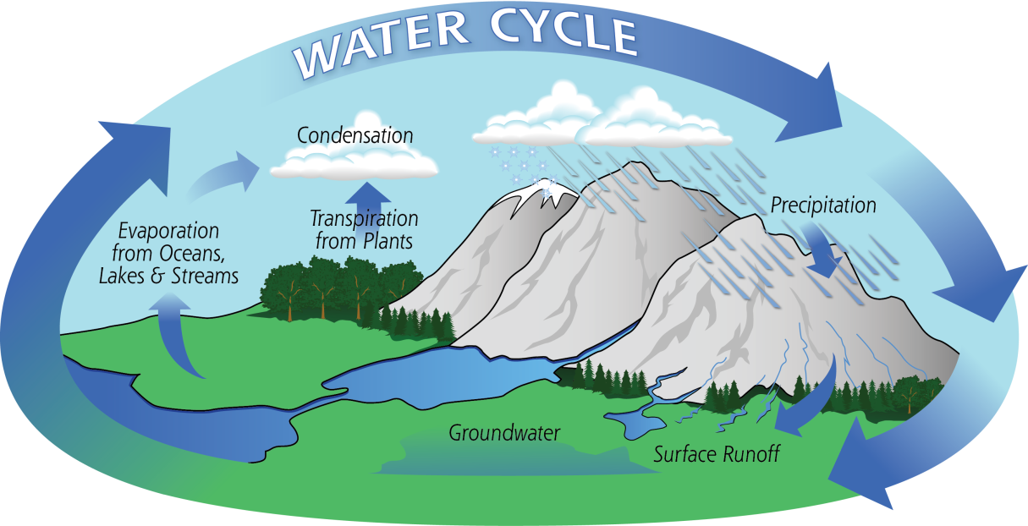
Main Water Cycle Processes:
Evaporation
Precipitation
Runoff

Slide 16
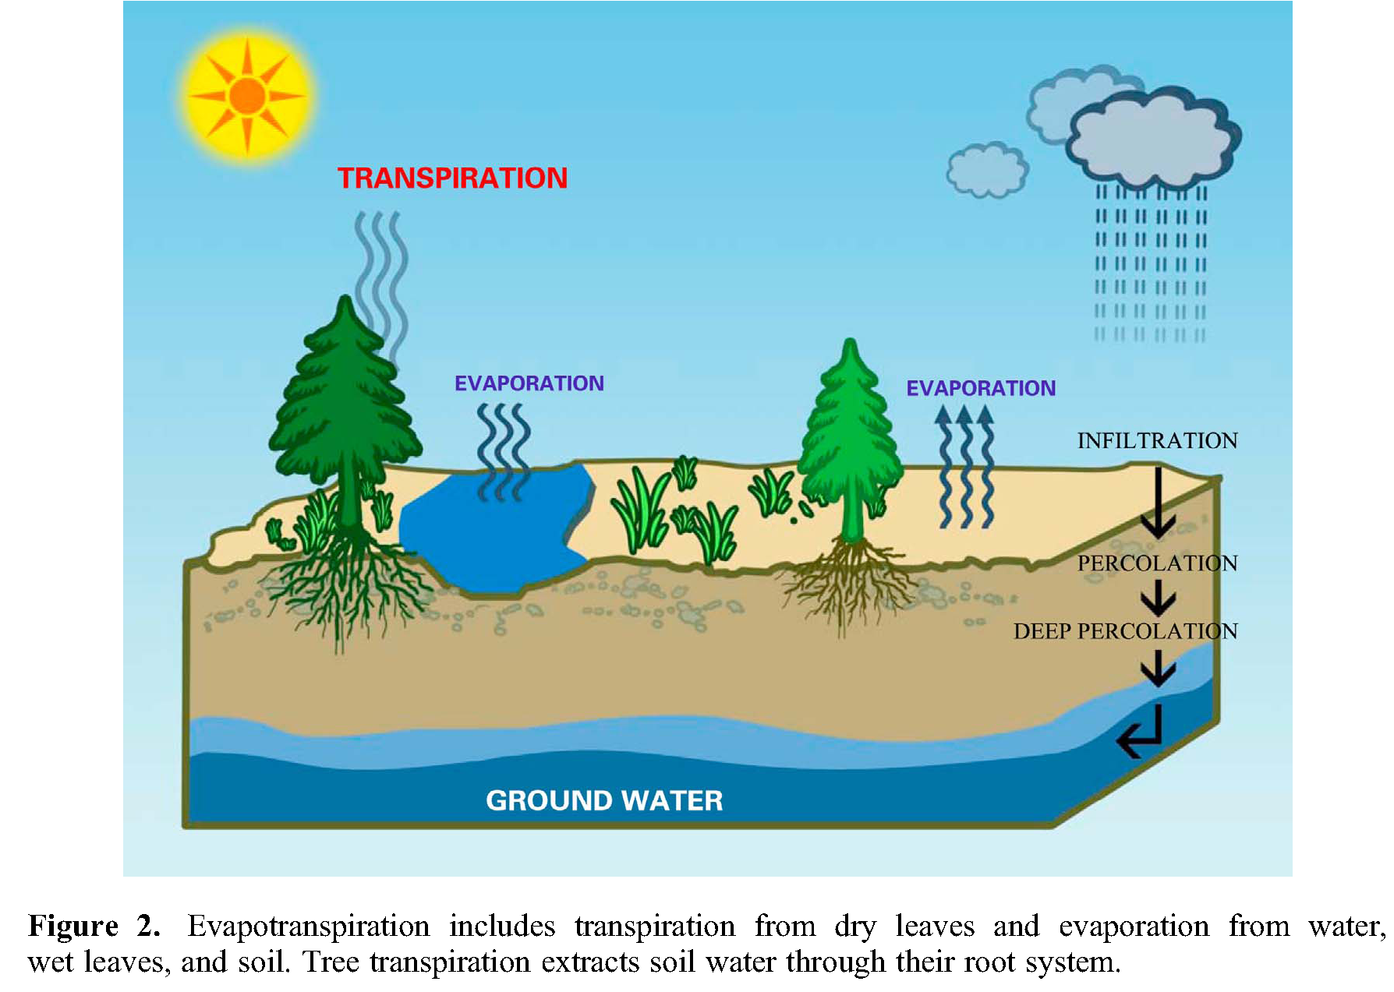
Evapotranspiration over Land
Limited by
1) water availability,
2) available energy, and
3) turbulent mixing
Evaporation
Wang and Dickinson (2012)
Notes:
Transpiration is largest contribution to total E over areas covered with vegetation.

Slide 17
Controls of E
Vegetation plays a key role by drawing water from deep soils.
Energy availability: E is large in daytime and warm seasons
Soil water availability: Dry soils reduce E
Wind speed: Strong winds increase mixing, leading to higher E
Air Temperature: higher T is associated with higher Rn and larger stomatal openings in leaves, leading to higher E.
Relative humidity: E decreases as RH increases.

Slide 18
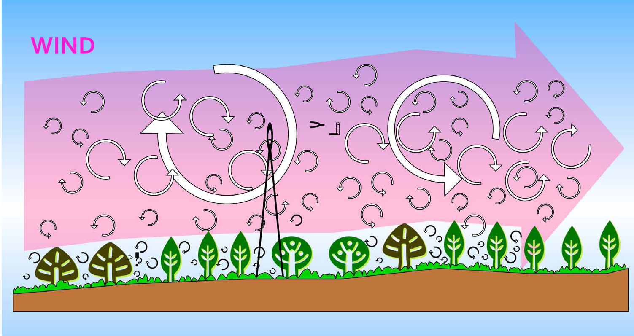
Turbulent Eddy Mixing
From http://www.instrumentalia.com.ar/pdf/Invernadero.pdf

Slide 19
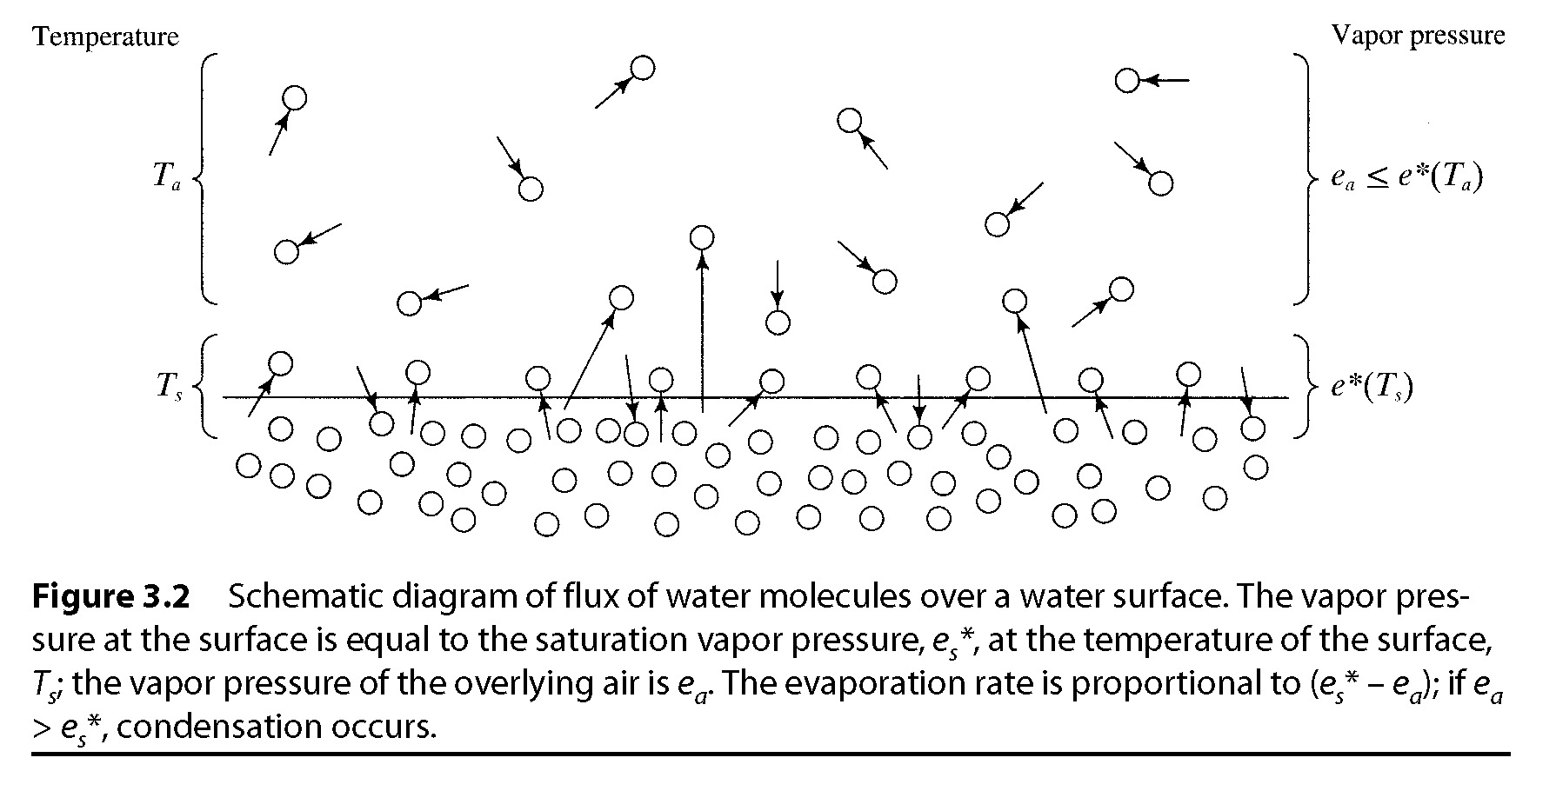
Evaporation Process: some water molecules on a water surface may have enough kinetic energy to break the hydrogen bonds and enter the thin layer of air just above the water surface. The vapor molecules are then mixed upward away from the water surface, creating a water flux called Evaporation. This evaporation process is the same over water and ice surface, soil pores, plant tissues, and cloud droplets.
E is determined by vapor pressure gradient at the interface:
If e_{s}*(Ts) > e_{a}, evaporation is occurring (it may form a fog or mist if RH=100%);
If e_{s}*(Ts) < e_{a}, water vapor is condensing on the surface; and
If e_{s}*(Ts) = e_{a}, neither evaporation nor condensation is occurring.
Note: e_{a} is determined by how quickly the water molecules are removed from the layer adjacent to the interface by turbulent mixing.
e_{s}*(Ts) = saturation vapor pressure for T = Ts
Need energy to break up
the hydrogen bonds
Air
Water

Slide 20
Evaporation Over Oceans
With enough energy, water molecules can leave ocean surfaces and enter the air as vapor, which is mixed upward and horizontally by wind turbulence.
This turbulent water flux ( ) can be estimated using various methods (see Smith et al. 1996):
- Budget methods
- Local covariance methods
- Monin-Obukhov Similarity Methods
Simplified Bulk Parameterization (Fairall et al. 2003) is commonly used in models, satellite retrievals, and climate analyses:
where C_{d} is a turbulent exchange coefficient, a function of atmospheric stability, the air-sea temperature difference, and wind speed; U is near-surface wind speed; q_{s} is the saturation specific humidity at the sea surface temperature; and q_{a} is the near-surface atmospheric specific humidity. This is the same bulk formula as for surface LH flux.
Wind
SUN

Slide 21
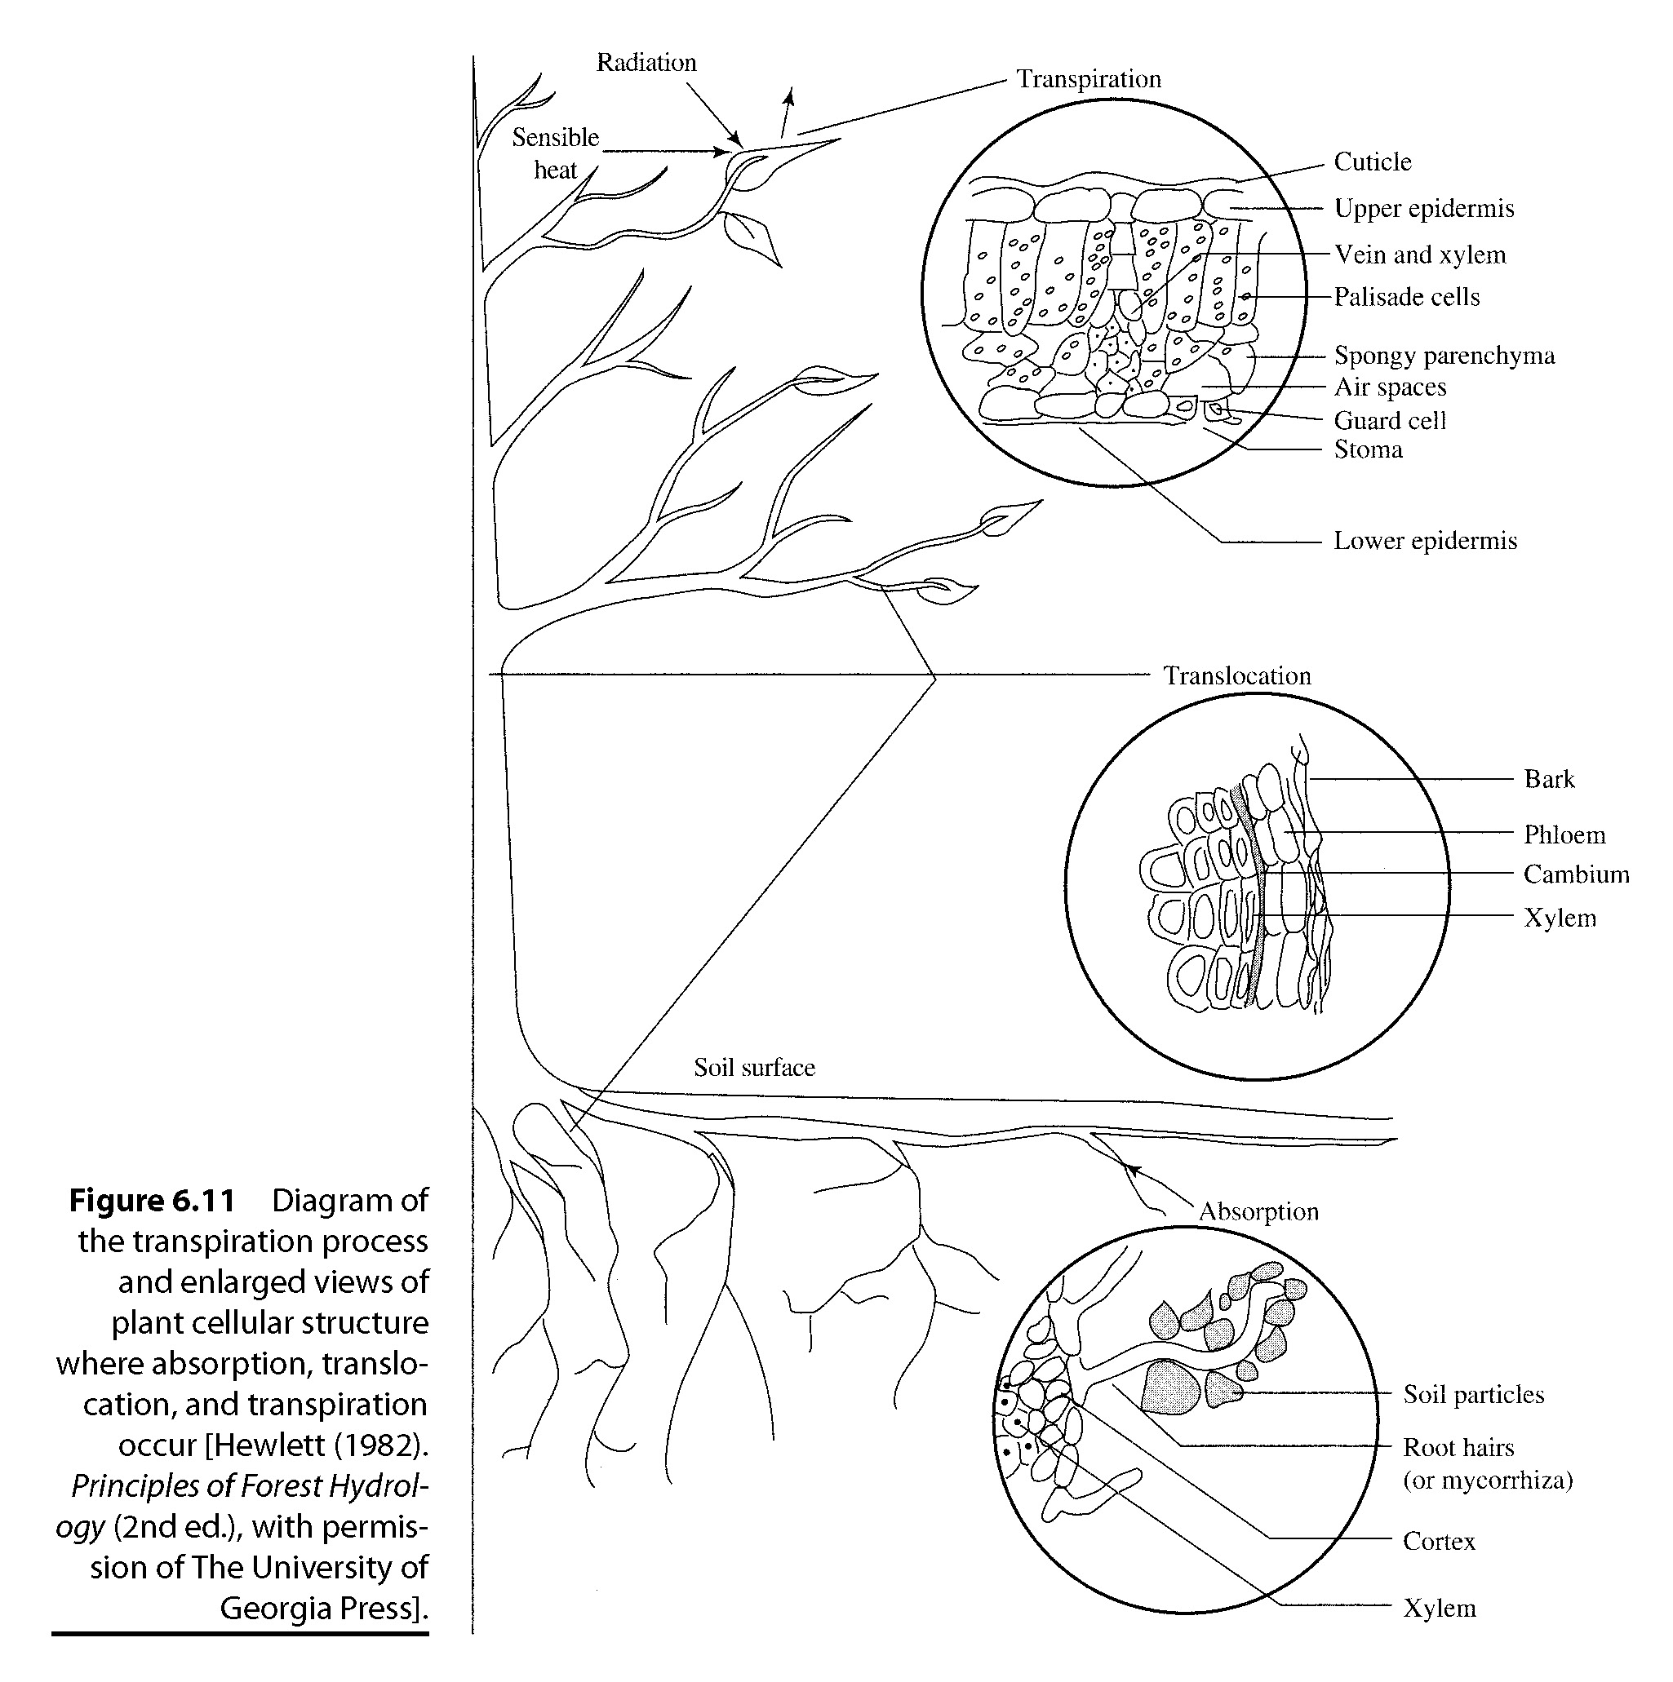
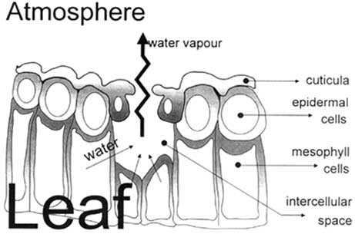
Transpiration Process
Transpiration is the evaporation of water
from the vascular system of plants into the
atmosphere
The transpiration process includes:
  absorption of soil water by plant roots;
  translocation of water through the vascular
  system of the roots, stem, and branches to
  leaves;
  movement of water through the vascular
  system of the leaf to the walls of tiny
  stomatal cavities, where evaporation
  occurs.
  The water vapor in these cavities moves
  into the ambient air through openings in
  the leaf surface called stomata.

Slide 22
Transpiration from a Lead

Slide 23
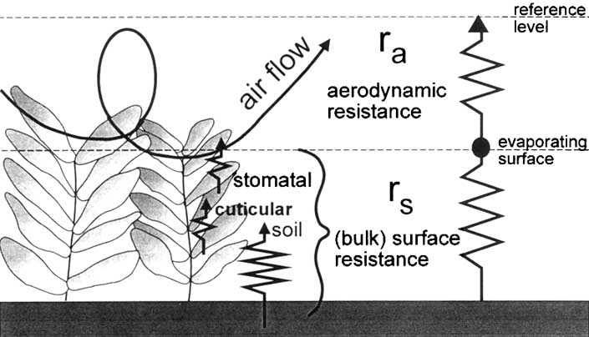
Resistance to Evapotranspiration over Land

Slide 24
Theoretical Estimates of E over Land
Monin-Obukhov Similarity Theory (MOST): Assumes a constant flux within a layer (of ~100m) above a homogeneous surface. It relates the flux to T and q vertical gradients through its universal stability function. The MOST has an error of 10-20% under ideal conditions.
The Penman-Monteith Equation: uses surface radiation, temperature, and humidity data to estimate E (see pp.125-126 of GPC for its derivation):
where λ=latent heat of vaporization, Δ=de_{s}/dT, R_{n} is net surface radiation, G is the heat flux into the ground, r_{c} and r_{h} are the canopy and aerodynamic resistance (see Wang and Dickinson 2012 for details)
The P-M Eq. is often used to estimate the E from wet surfaces (referred to as the Potential E, as the resistance from a water-stressed surface is hard to estimate.
Net heating
Dryness of air

Slide 25

Simplified Penman-Monteith Eq.
Priestley-Taylor Equation:
where α=1.2-1.3 for wet surface, but varies with soil moisture. It ignores impacts of VPD and canopy resistance, and considers the effects of R_{n} and T (through Δ).
FAO Penman-Monteith Eq. for the well-watered hypothetical grass reference crop (Allen et al. 1998): u₂=2m wind speed.

Slide 26
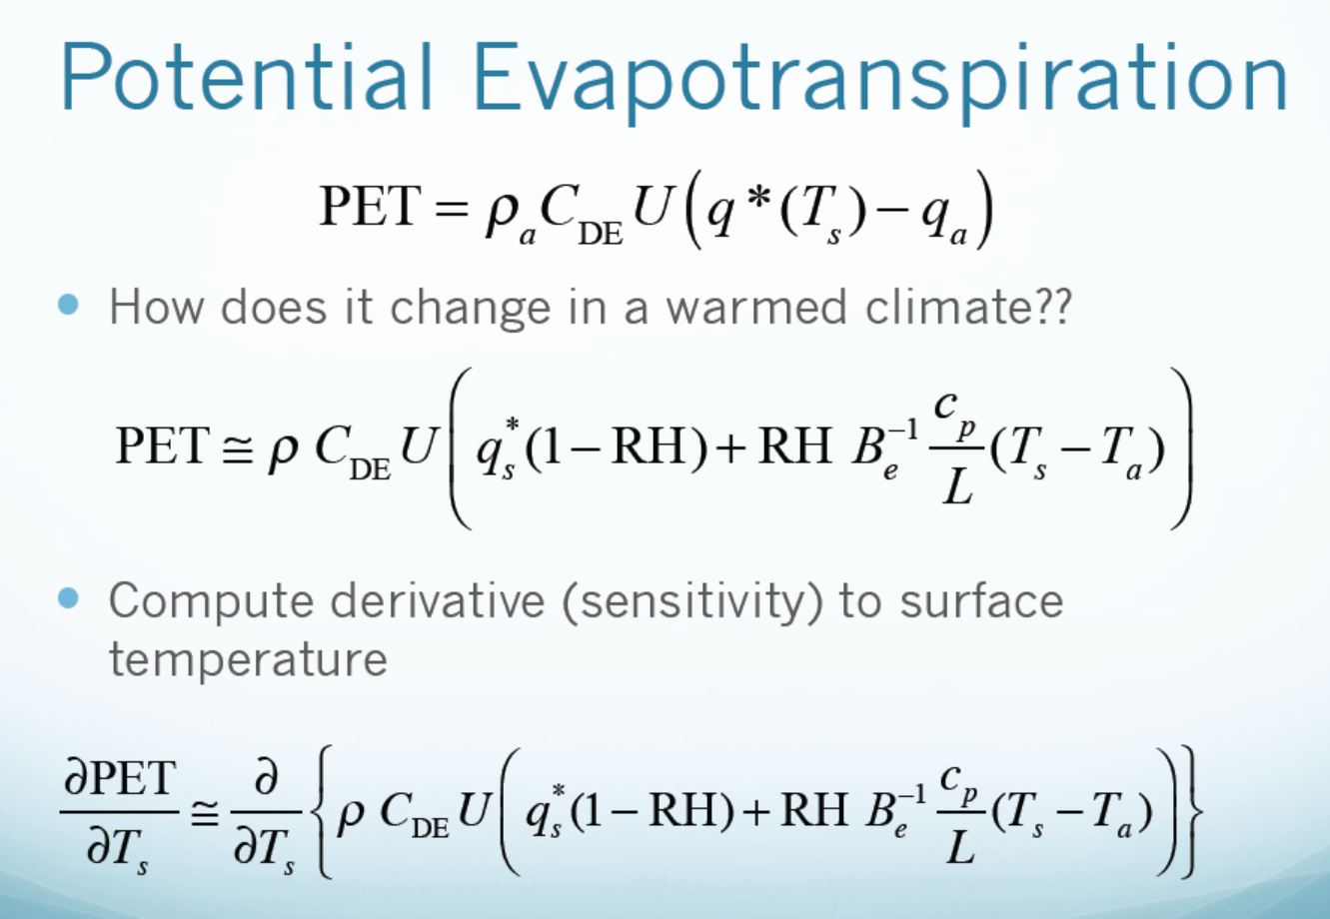
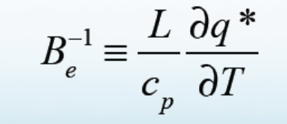
(Evapotranspiration from a wet surface with unlimited water supply)

Slide 27
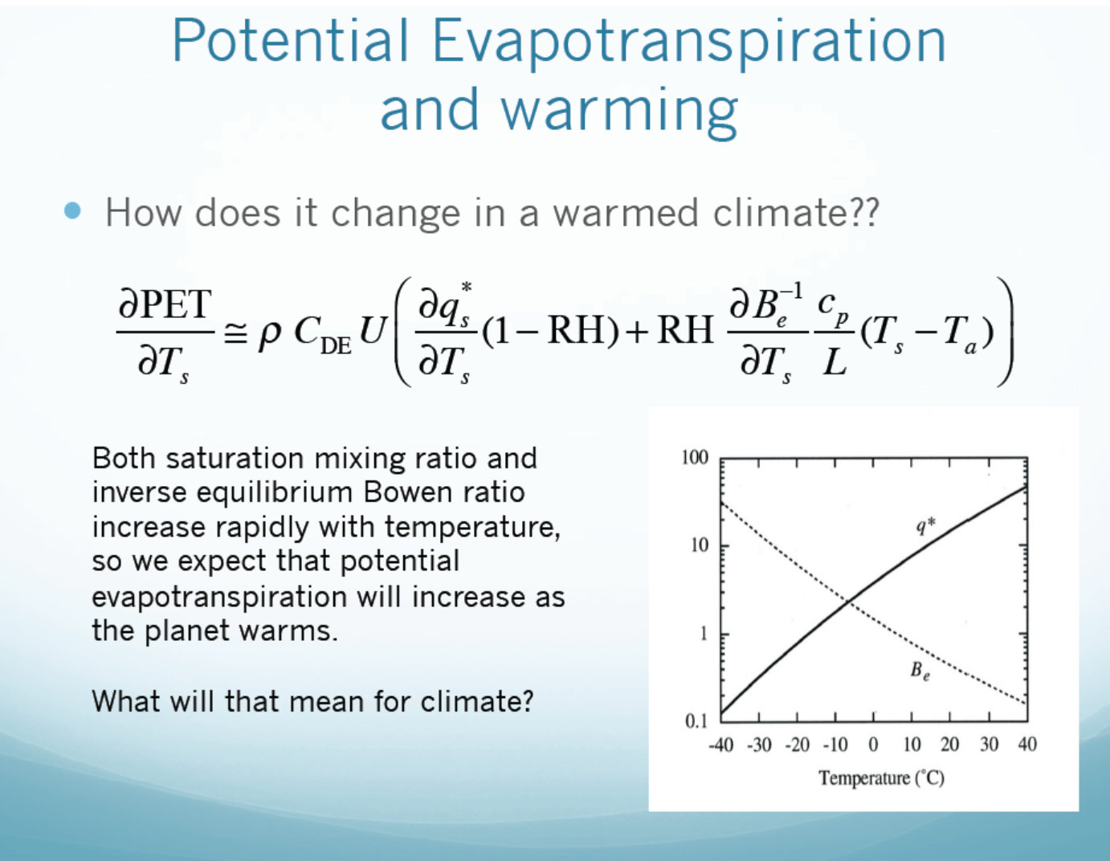
(for U and RH = constant case)
Increased atmospheric demand for
moisture → potential drying and drought

Slide 28
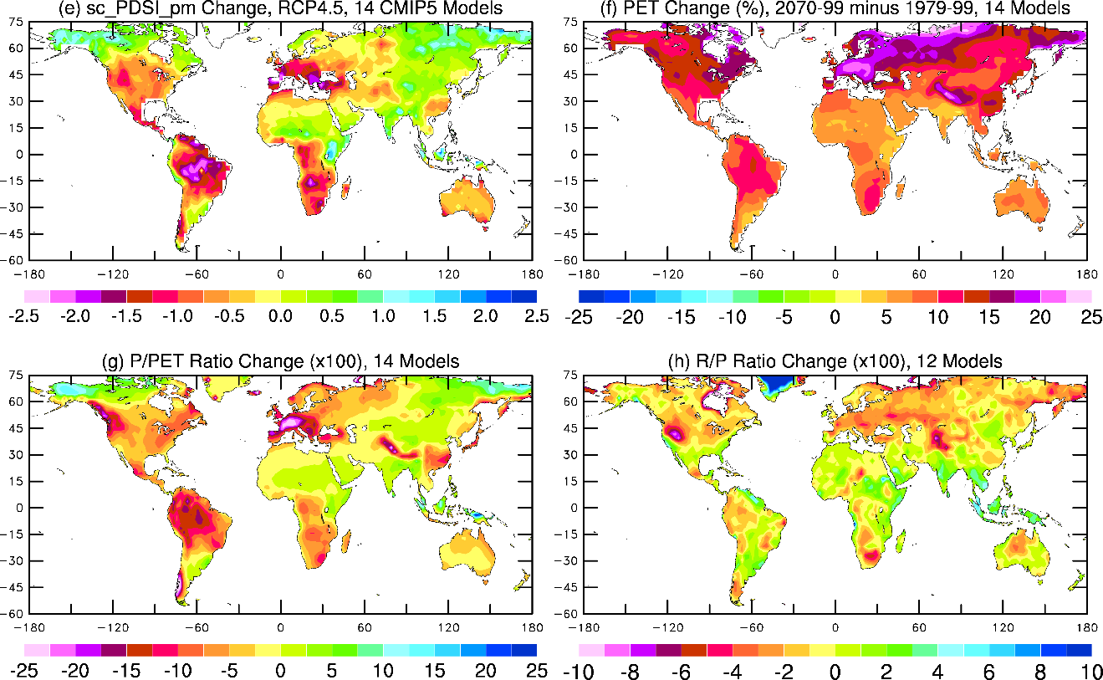
Model Projected PET Change (%)
2070-2099 minus 1970-1999, 14 CMIP5 model average, RCP4.5 scenario
Zhao and Dai (2015)

Slide 29
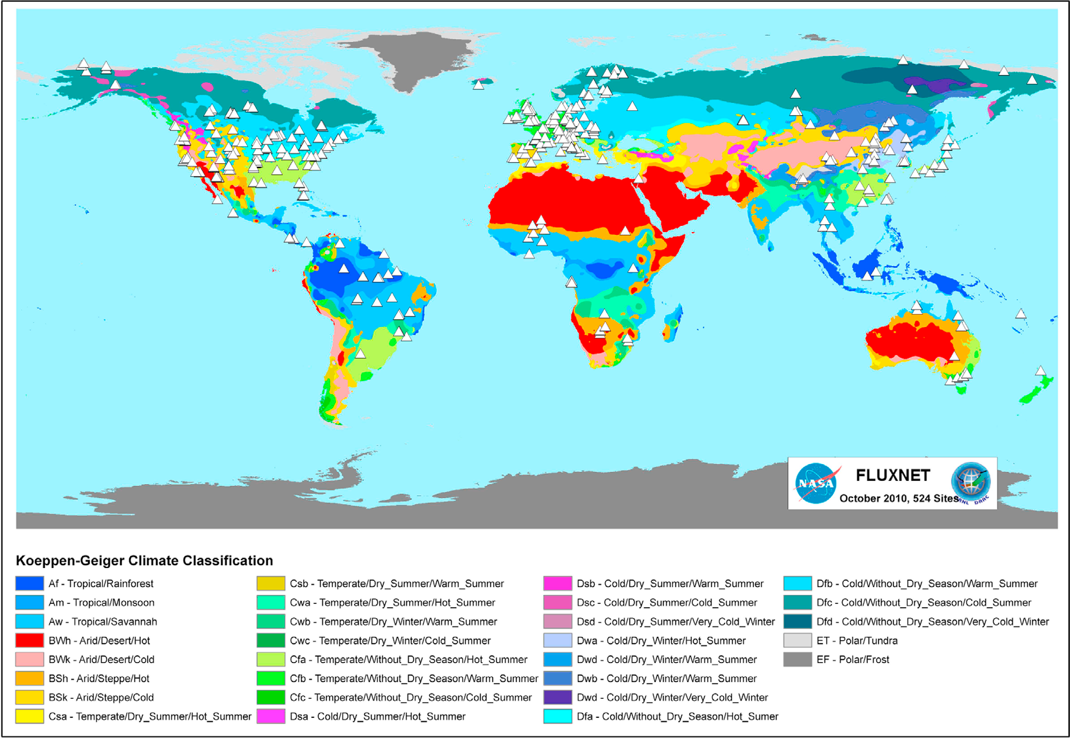
Observations of E
Eddy Covariance (EC) Method: It measures SH and LH fluxes from their covariance with vertical velocity using rapid response sensors at frequencies ≥10Hz. First used by Australian scientists in the 1950s, now used at 500+ FLUXNET sites. Error range: 5-20%.

Slide 30
Observations of E (cont’d)
Energy Balance Bowen Ratio (BR) Method: It uses measurements of vertical gradients of T and q to partition the available energy into sensible (H) and latent (λE) heat fluxes. Suitable for short vegetation.
The Bowen Ratio (Bo) is estimated as
The T and q gradients may be small, which could lead to large errors in β.
E is then estimated from the surface energy balance equation:

Slide 31
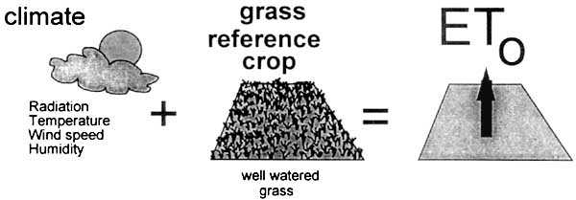
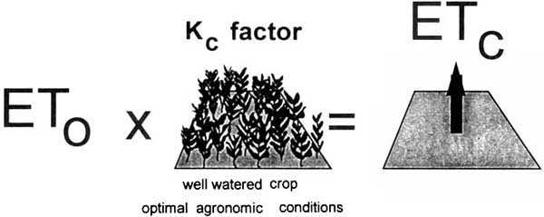
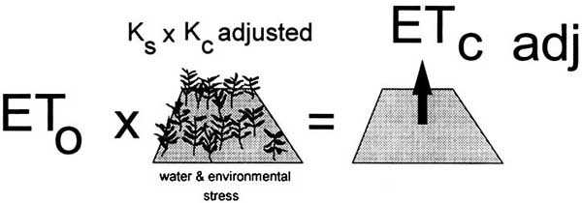
Potential vs. Actual E
PE over grass ref. crop
E over well watered crop
E over a natural land area

Slide 32
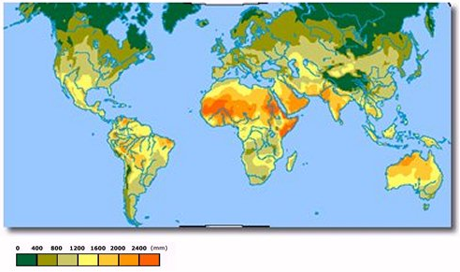
Annual Potential Evapotranspiration (mm/yr Source: UNEP)
PET represents atmospheric demand for moisture.

Slide 33
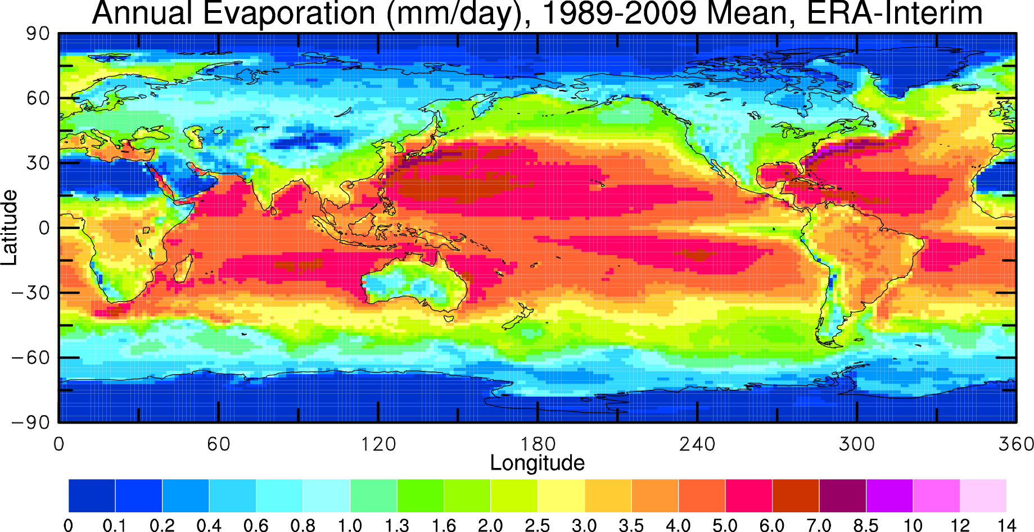
Actual Surface Evaporation Distribution

Slide 34
Movie 1: Earth: The Water Planet
Movie 2: The Water Cycle

Slide 35
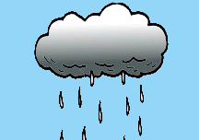
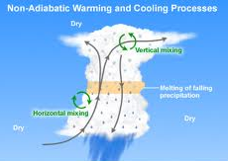
Precipitation
Formation:
When air cools (e.g., due to ascending), water vapor can become saturated and condense on tiny particles (condensation nuclei) such as dust, ice, or salt. This forms clouds
Small cloud droplets combine to form larger droplets (coalescence)
Some of the droplets collide to form even larger raindrops that can fall out of the clouds
Raindrops have sizes ranging from 0.1 mm to 9 mm in diameter.
Hail forms in storm clouds when super-cooled (T<0ºC) water droplets freeze. The storm’s updraft (a rising air plume) blows the hailstones into the upper part of the clouds. As the updraft dissipates, the hailstones fall back to the lower part of the clouds. This process can repeat many times until the hailstones become large enough (d>5mm) to fall out of the cloud.
Snowflakes form when tiny super-cooled cloud droplets (d≈10μm) freeze.

Slide 36
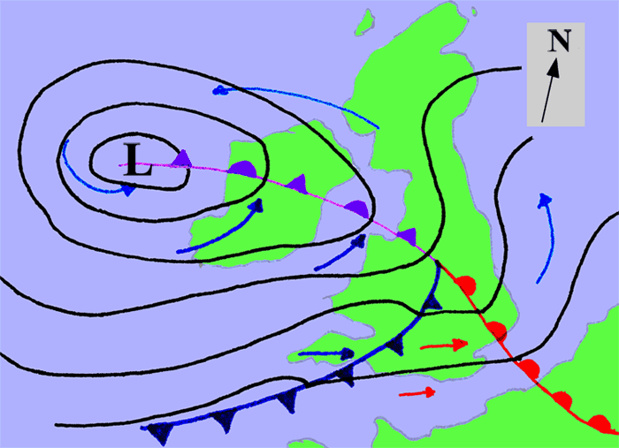
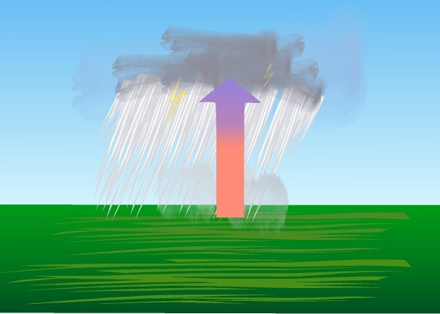
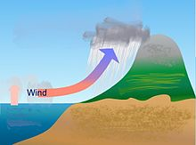
Cause of Precipitation
Frontal activity: Large-scale (≥1000km) stratiform
precipitation occurs when air ascents in a synoptic
weather system, such as over surface cold fronts,
and over or ahead of warm fronts. It can last for hours
to days. Warm air
Cold air
Convection: Convective rain, or showery precipitation
occurs during deep convection that forms tall cumulus
clouds (cumulonimbus). It usually occurs during warm
season over a few km and less than 1hr, but a storm
can travel over a long distance for many hours.
- Orographic effects: Orographic precipitation occurs on
the windward side of mountains and is caused by the
rising air motion of a large-scale flow of moist air across
the mountain ridge, resulting in adiabatic cooling and
Condensation.
Lifting of the air is the trigger!

Slide 37
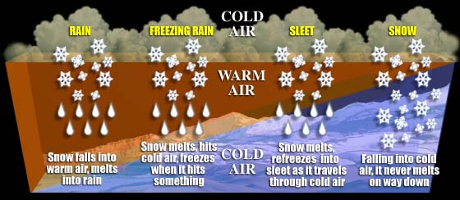
Different Phases of Precipitation

Slide 38
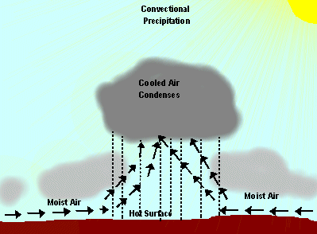
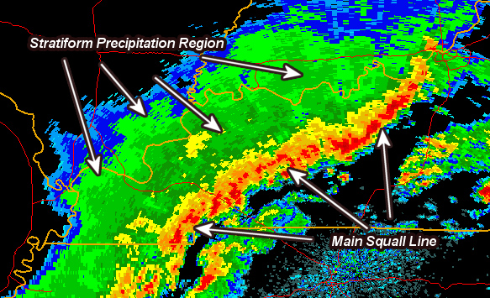
Two Types of Precipitation:
Convective precipitation
Stratiform precipitation
Needs low-level convergence and upward motion
Most of the rain comes from water in surrounding air!

Slide 39
Precipitation Characteristics
Amount (A): precipitation accumulated over a given time period ΔT (e.g., a month). A is often expressed using a mean rate = A/ΔT (= 75mm/30days = 2.5 mm/day for Station A)
Intensity (I): the rate averaged over the precipitating time Δt, i.e., I= A/Δt (=75mm/2days =37.5 mm/day for Station A). Events with I > 50mm/day is often called heavy precipitation.
Frequency (F): the fraction of the time it rains, F= Δt/ΔT (=2days/30days = 6.7% for Station A)
A = F × I → Same A can be obtained from different combinations of F and I, which is the case for station A and B and for many models!

Slide 40
Daily Precipitation at 2 stations
Monthly
Amount 75 mm
Amount 75 mm
A
B
Frequency 6.7%
Intensity 37.5 mm/day
Frequency 67%
Intensity 3.75 mm/day
drought wild fires local
wilting plants floods
soil moisture replenished
virtually no runoff
From K. E. Trenberth

Slide 41
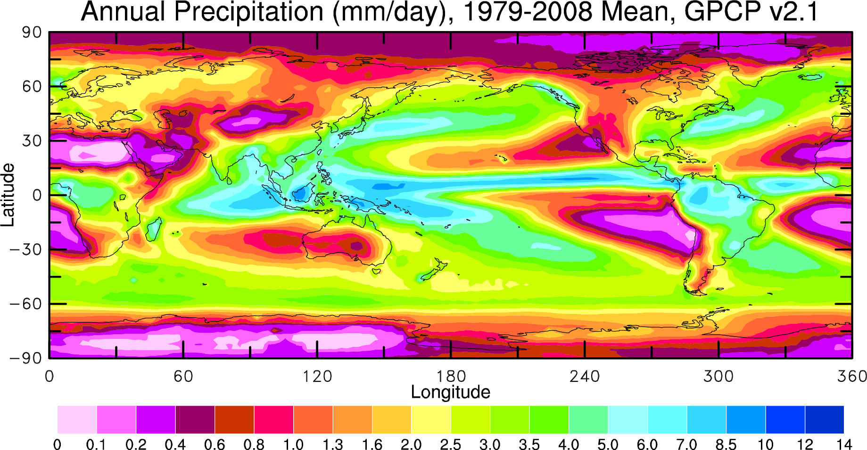
Precipitation Distribution
(Global-mean = 975mm/yr)
GPCP = Global Precipitation Climatology Project
mm/day
Questions: 1. What causes the large variations over the oceans?
2. Why deserts are located in the subtropics?

Slide 42
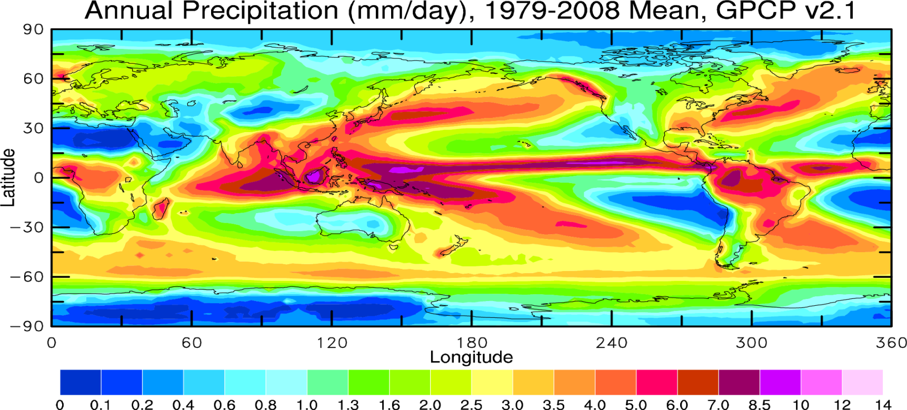
Evaporation (E) vs. Precipitation (P)

Slide 43
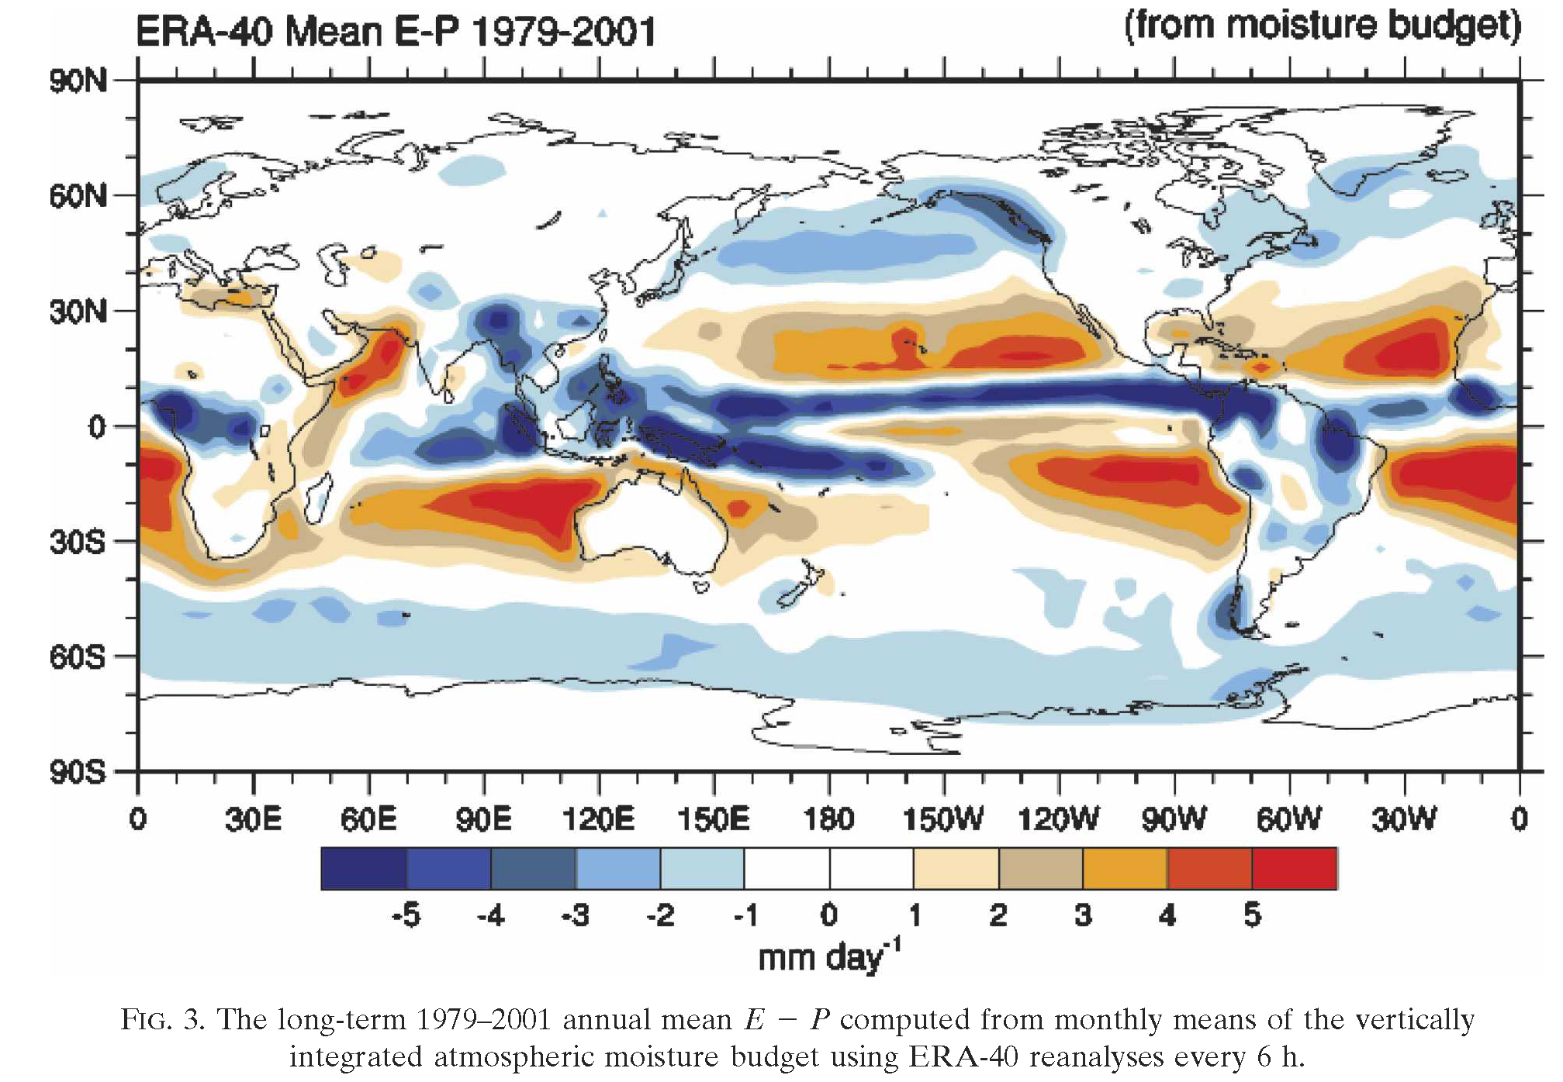
Long-term Mean E – P Difference Map
Trenberth et al. (2007, JHM)

Slide 44
Key Differences between P and E
Precipitation occurs only in a fraction of the time, while evaporation occurs all the time, albeit largest around noon;
E P
t t
Precipitation rates vary greatly in space, while evaporation rates are more uniform, especially over the oceans ;
Precipitation occurs at rates usually much larger than evaporation rates;
Evaporation cools the surface, while precipitation heats the atmosphere; and
Evaporation is controlled mainly by surface heating and wind speed, while precipitation is determined by atmospheric circulation and water vapor content.

Slide 45
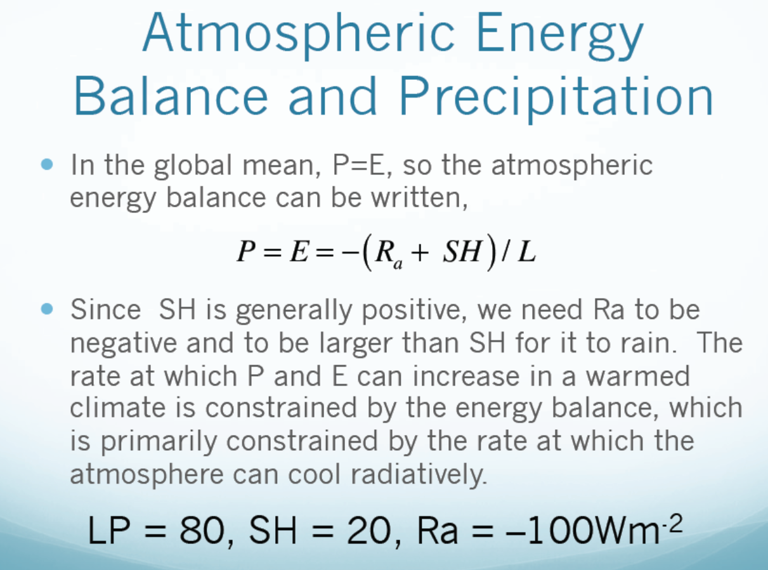
R_{a}+
R_{a}

Slide 46
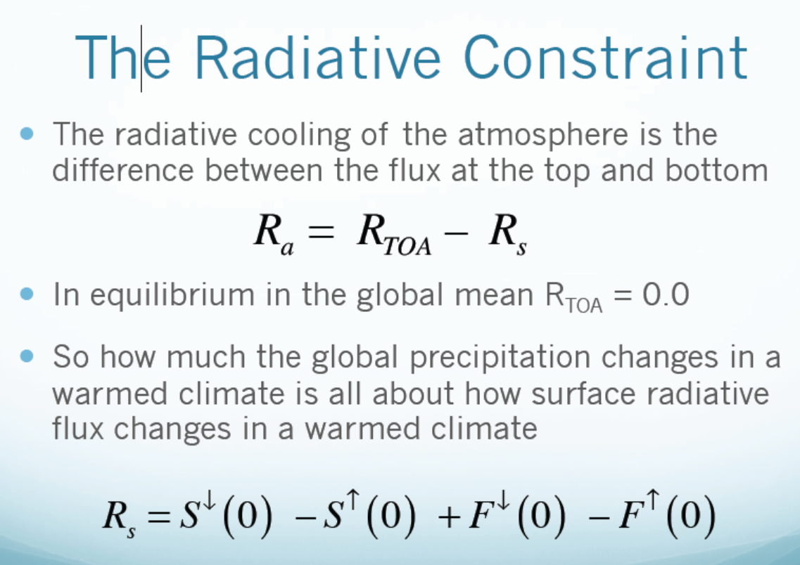
On Global-mean Precipitation Rate

Slide 47
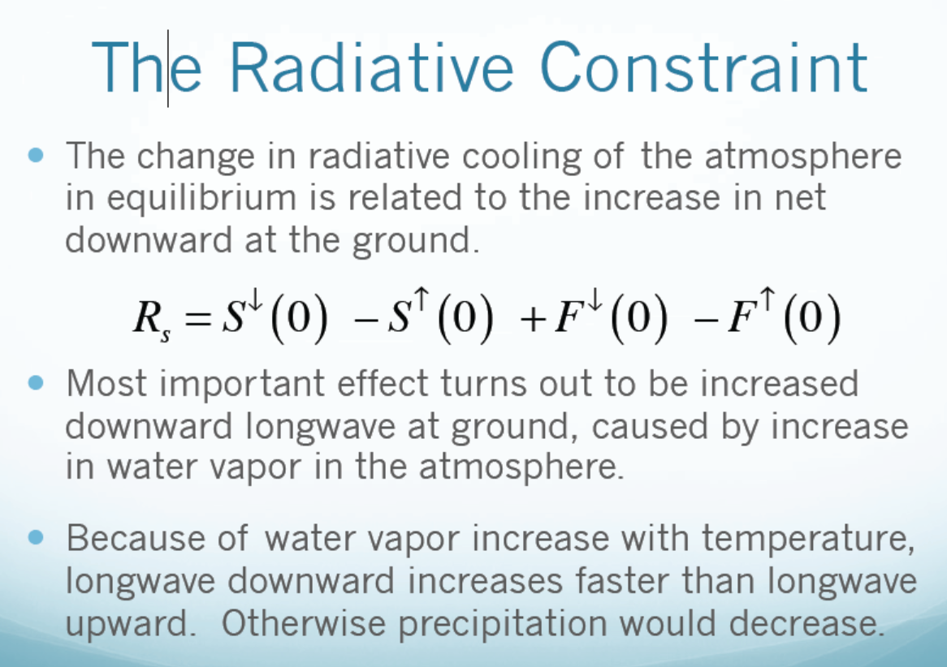
LH + SH =
Ts and Ta are tightly coupled, so Ts and Ta increase together.

Slide 48
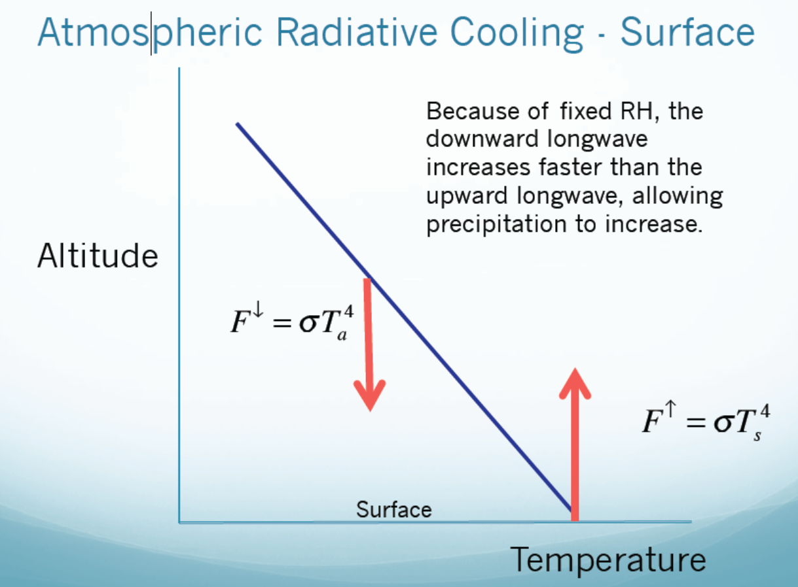
Atmospheric energy constraint on precipitation change under rising T
ε
Ta increases with Ts, but H₂O
and thus ε also increases with Ts,
leading to faster increases in F↓ ,
which allows atmospheric latent
heating or precip. to increase with Ts
in order to balance the larger F↓ increase.

Slide 49
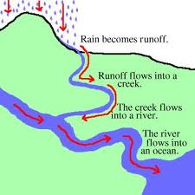
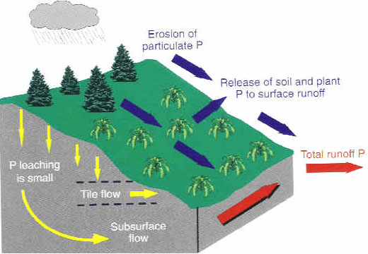
Runoff and Infiltration
Surface runoff: the water flow on earth’s surface. It occurs only when the soil is saturated or can not absorb water from rain or snow/ice melt fast enough. The flow follows the terrain into streams.
Subsurface runoff (or return flow): the lateral water flow below the earth’s surface, usually following the terrain under gravity.

Slide 50
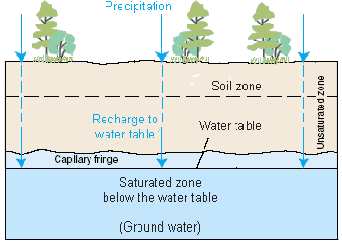
Soil and Ground Water Processes

Slide 51
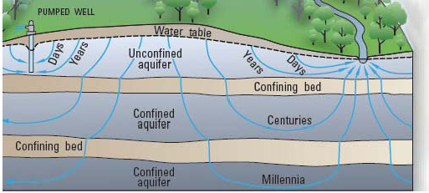
Soil and Ground Water Time Scales

Slide 52
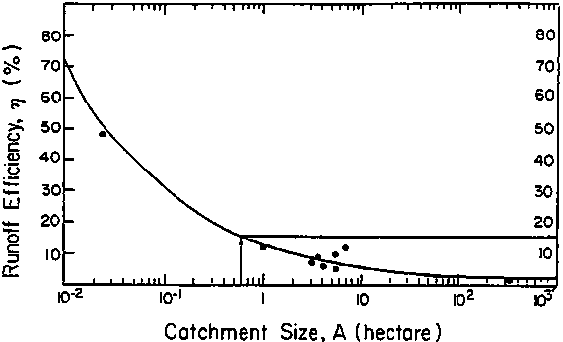
Runoff Generation
How much runoff is generated in a storm is a major topic in hydrology.
Many factors can affect runoff generation:
- soil type affects infiltration capacity
- vegetation affects how much rain is intercepted by canopy
- slope and catchment size:
steep slopes increase runoff, large size reduces the runoff per unit area.

Slide 53
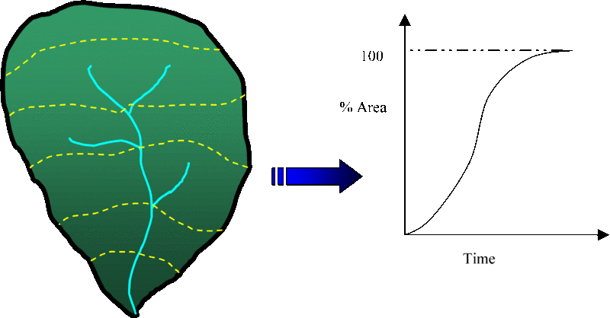
Time of Concentration
Time of concentration is a concept used in hydrology to measure the response of a watershed to a rain event. It is defined as the time needed for water to flow from the most remote point in a watershed to the watershed outlet. It is a function of the topography, geology, and land use within the watershed.
X

Slide 54
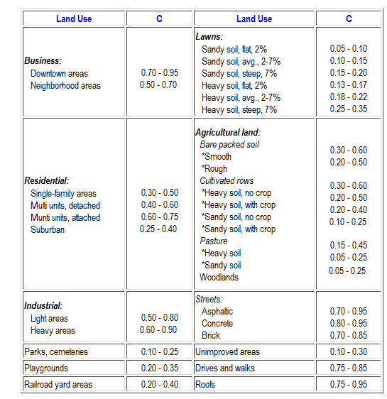
Runoff Coefficient:
Runoff Coefficient: C = Runoff/Precipitation, both in mm depth over unit area and time. C is important for flood control and in Hydrology. Also called runoff ratio on a basin scale.

Slide 55
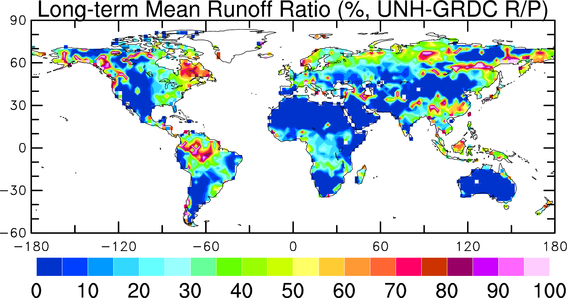
Runoff Ratio Distribution

Slide 56
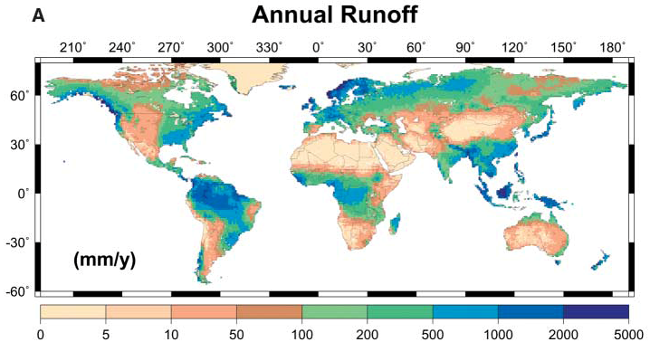
Potential Freshwater Resources
Oki & Kanae, Sci., 2006
Global Discharge: ~38,000km³/yr
= Global Potential renewable freshwater resource

Slide 57
Key points of Today’s Lecture
The Global Water Cycle:
- Main reservoirs and residence times:
Oceans (1000yrs), atmospheric water vapor (10days), soil moisture and groundwater (days-decades), the cryosphere (snowpack, ice-cap, glaciers: seasons-1000yrs)
- Main fluxes:
Evaporation, precipitation, continental discharge,
ocean-land moisture transport
- Main physical processes: (Each is a research field!)
Evaporation, precipitation, runoff
  - Water balance equations:
  At the surface: dW/dt = P – E – R; R=0 for global-mean, dW/dt=0 for long-term mean
  For an atmospheric column: dW/dt = P – E – Div; Div=0 for global-mean and dW/dt≈0 for annual mean, so P=E in this case. Div is water vapor divergence.
  - Atmospheric energy constraint on global-mean P rate:
  Latent heating is balanced by LW cooling (minus SH). Atmospheric LW cooling increases with Ts as surface downward LW flux increases faster than upward LW flux due to water vapor increases with Ts.

Slide 58
Homework Assignments:
- Reading Assignments: Chapter 5 of Hartmann GPC
- Review my ppt slides

Slide 59
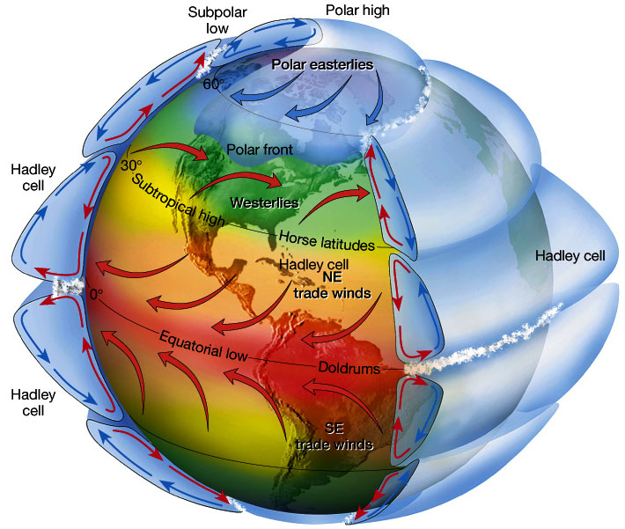
Next Lecture:
Atmospheric Circulation and Climate

