Slide 1
Summary for Water Vapor
Water vapor is the single largest greenhouse gas in the air;
RH, q, and PW are often used to quantify atmospheric humidity and water vapor content;
Surface RH varies little over the oceans (~78-82%), ranges from >82% over the Amazon to <30% over deserts. The factors that control RH are not well understood, although large-scale subsidence seems to have a major impact on upper tropospheric RH;
Water vapor feedback is a strong positive feedback that amplifies the radiative forcing by a factor of ~2;
Limited data suggest that atmospheric water vapor content increases with T, approximately following the Clausius-Clapeyron relation, which implies small changes in RH;
Models suggest global PW increases by ~9%/K, slightly above the C-C rate but consistent with the SSMI satellite data (8.9%/K);
Models suggest a slight increase (~1%) in near-surface RH and a small RH decrease (1-4%) in the sub-tropical subsidence region and 1-4% increases over the equator and mid-high latitude troposphere during the 21st century;

Slide 2
Summary of Clouds and Aerosols
Clouds are classified by shapes (cumulus, stratus, cirrus, and nimbus), formation (convective and stratiform), or height (high, middle and low clouds).
Generally, there are more clouds over oceans than over land, more clouds over the high-latitudes than the low-latitudes.
Clouds reflect and absorb sunlight (cooling effect on surface) and block out-going longwave radiation (warming effect);
SW cooling dominates over LW warming effect for low clouds, but the opposite is true for high clouds. Why?
Globally, the SW cooling effect is about 50W m⁻² and LW warming effect is about 30W m⁻², resulting in a net cooling of ~20 W m⁻², predominately over the northern mid-latitudes.
Under GHG-induced global warming, most models suggest a decrease in low and mid-level clouds, especially over the mid-latitudes and subtropics and an increase in high clouds due to enhanced tropical convection.
CMIP3 models show a CRF change from -2.2 to 1.6 W m⁻² in the 21st century, a major source of uncertainty for the future climate.
Aerosols affect climate directly through their radiative effects and indirectly through their impact on clouds albedo and lifetime.
How aerosols have contributed to the 20th century climate is still a very active research area.

Slide 3

A ATM551, Lecture #12
Atmospheric Convection
Reading Assignment:
MIT textbook by Marshall and Plumb, chapter 4
(http://paoc.mit.edu/labweb/notes/chap4.pdf)
Stevens, B., 2005: Atmospheric Moist Convection. Annu. Rev. Earth Planet. Sci. 2005. 33:605–43

Slide 4
Outline of Today’s Lecture
Atmospheric Convection:
  Definition
  Roles – Radiative-convection equilibrium
  Types
  Distributions
  Diurnal cycle
  Quantifying Convection:
  Lapse rates
  Instability
  Buoyancy
  CAPE and CIN
  Lateral mixing -- entrainment and detrainment
  Heating rates Q1 and Q2

Slide 5
Atmospheric Convection
Atmospheric convection refers to the upward motion that often occurs in an unstable column of the atmosphere. It can happen on a few km scale in cumulus convection to hundreds of km in frontal systems and squall lines.
Note: disturbance in a stable layer often leads to gravity waves, not convection.
Classification:
  Dry convection with no condensation
  Moist convection with condensation (to form clouds and sometimes precipitation)
  Shallow convection: often in the lower troposphere, form stratus clouds, little precipitation. Such as that over marine stratus-cloud regions
  Deep convection: through the whole troposphere, produces thick cumulus clouds and precipitation. Such as that in the ITCZ.
Major Roles:
  Tropical convection transports moisture and energy upward, which is crucial for the global energy and water balance. (Heat in the upper air can escape to space more easily through LW radiation).
  Produce most of the precipitation and clouds in the tropics and warm-season mid-latitudes.

Slide 6
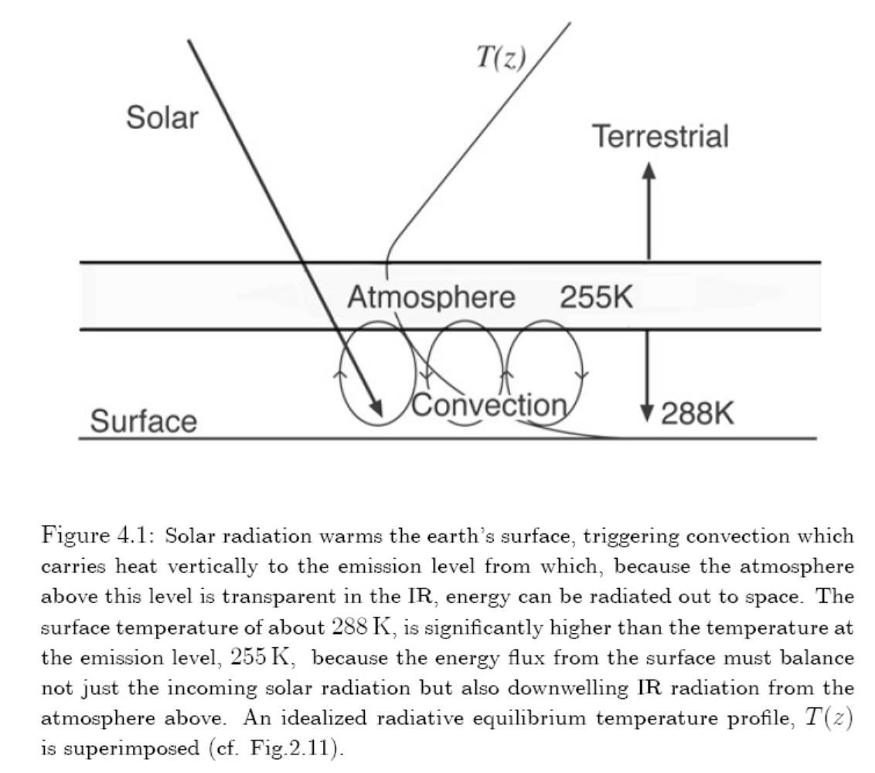
Role of Convection
PBL
Turbulent mixing

Slide 7
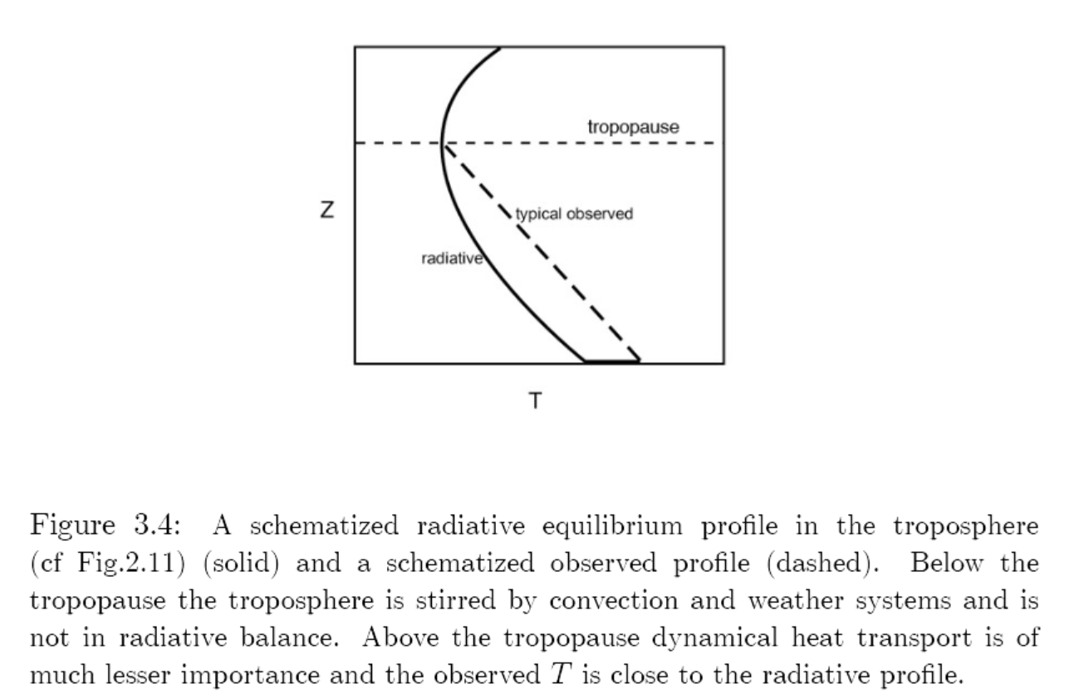
Atmospheric Radiative-Convective Equilibrium
The tropical T profile is in radiative-convective equilibrium as the observed T profile is close to neutral for moist convection. Convection transports energy from the surface to the troposphere, changing the radiative T profile to the moist adiabat.

Slide 8
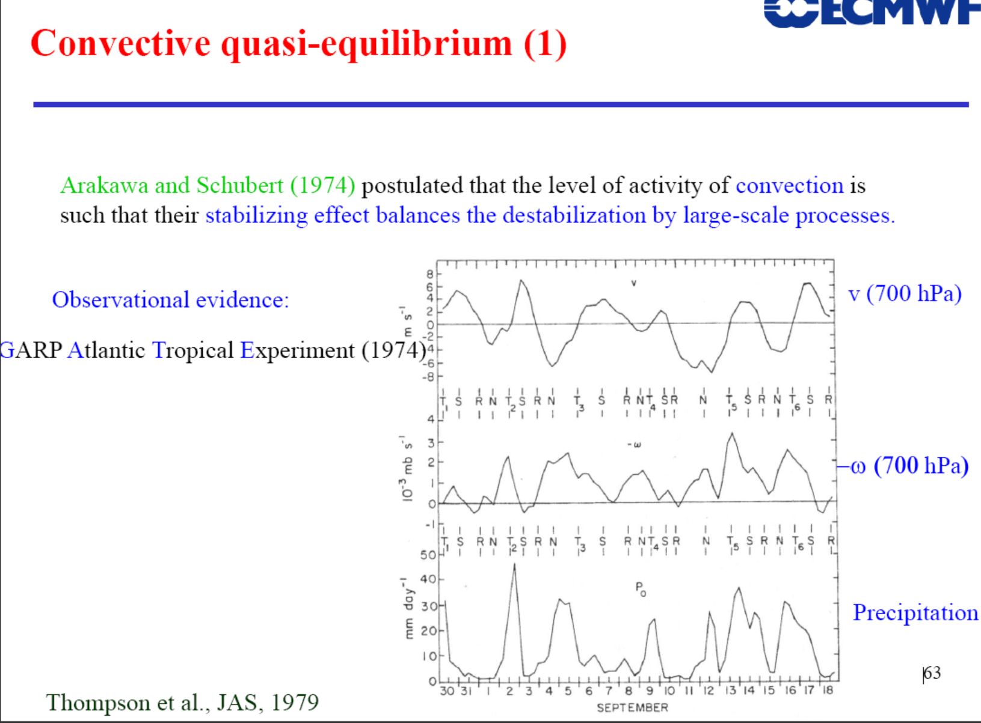
such as?
Notes:
Meridional wind (v) represents large-scale waves. The convection is highly related to the v variations.

Slide 9
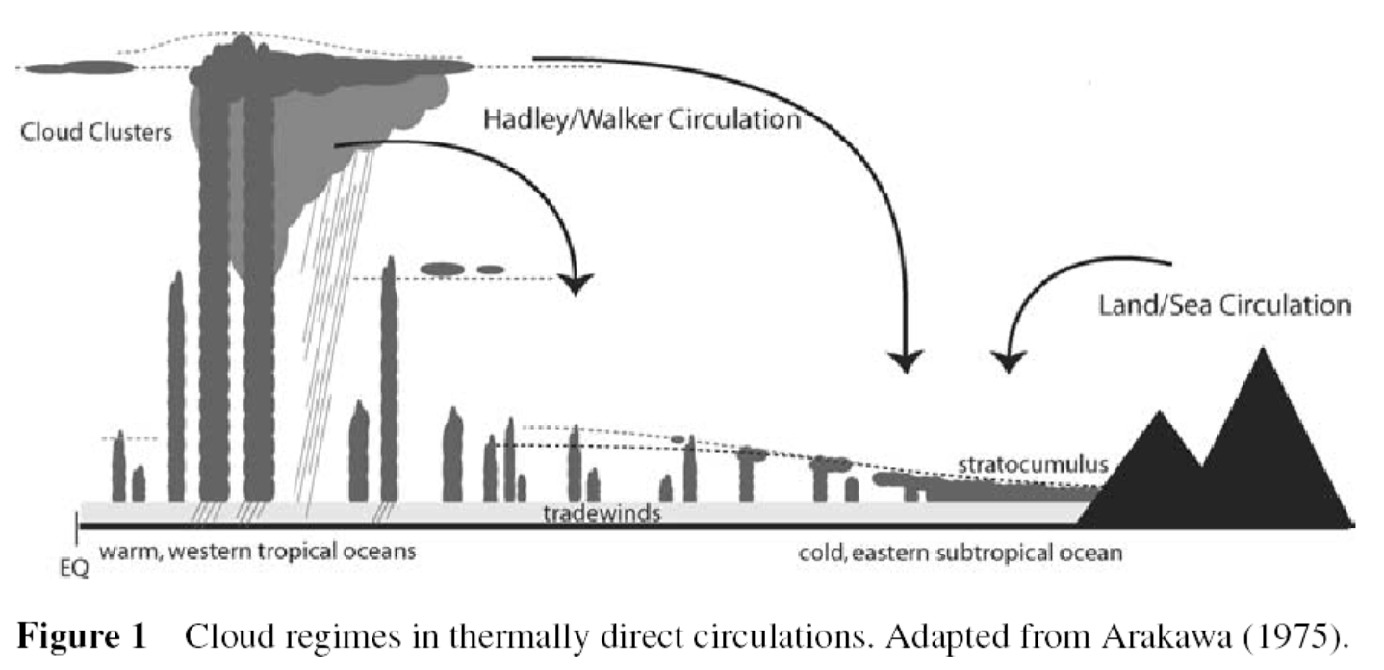
Types of Atmospheric Convection
Deep Cb
Convection
Shallow cumulus
Convection
Stratocumulus
Convection

Slide 10
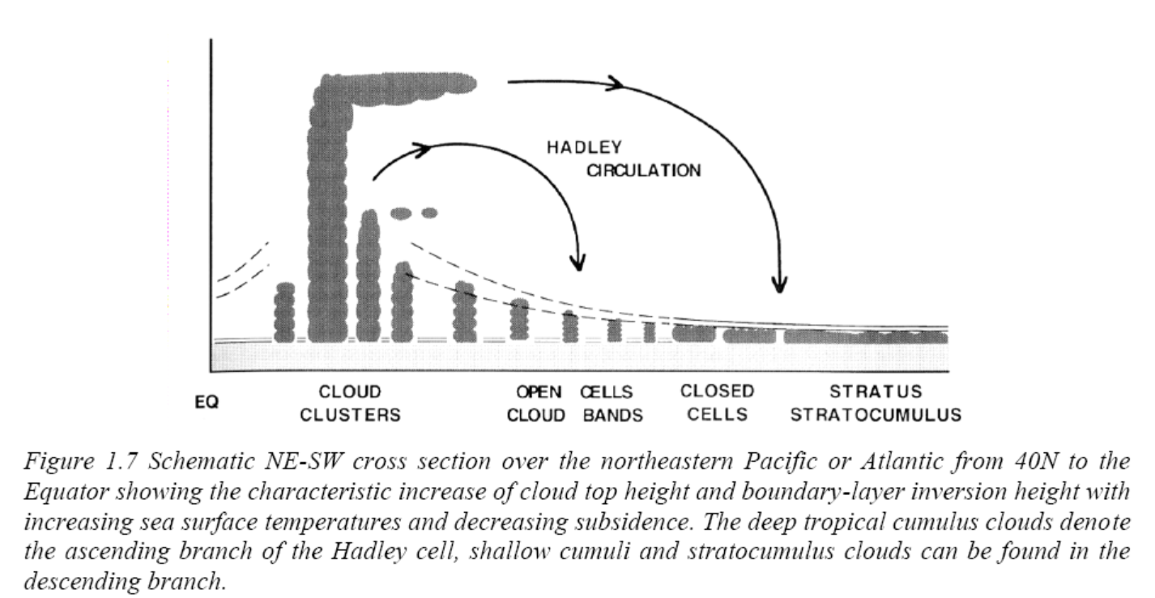
Hardly Circulation vs. Convection

Slide 11
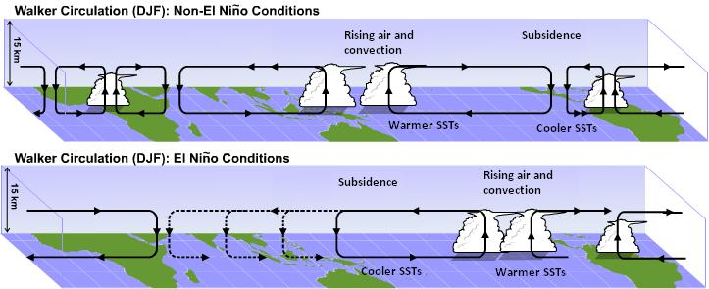

Walker Circulation vs. Convection
(Anomaly field)

Slide 12
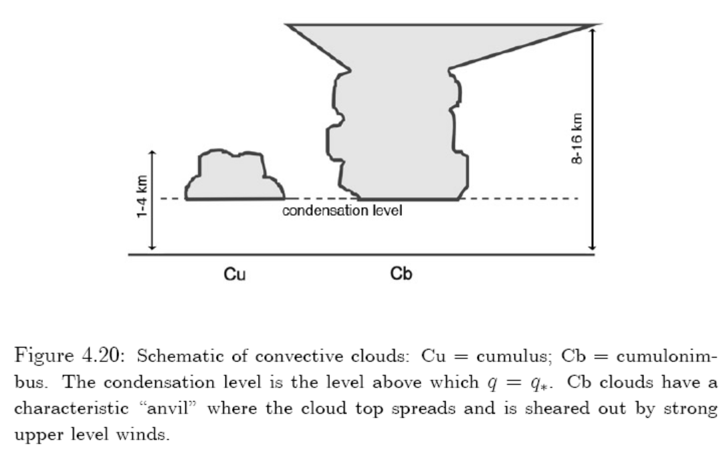
Shallow v.s. Deep Convection
Deep cumulonimbus convection
anvil
Shallow cumulus convection
1-2 km tall, T’ ~0.1K, w’~2m/s
Heat flux ~200W/s
Top reaches tropopause,
~18km in Tropics
T’ ~ 1K
w’ ~ 10m/s
Heat flux ~ 1-10 kW/s
With anvil clouds made of ice crystals
T’ and w’ are the T and vertical velocity differences between the convective cloud and the environment.
Notes:
T’ and w’ are the T and velocity differences between the convective air and the environment.

Slide 13
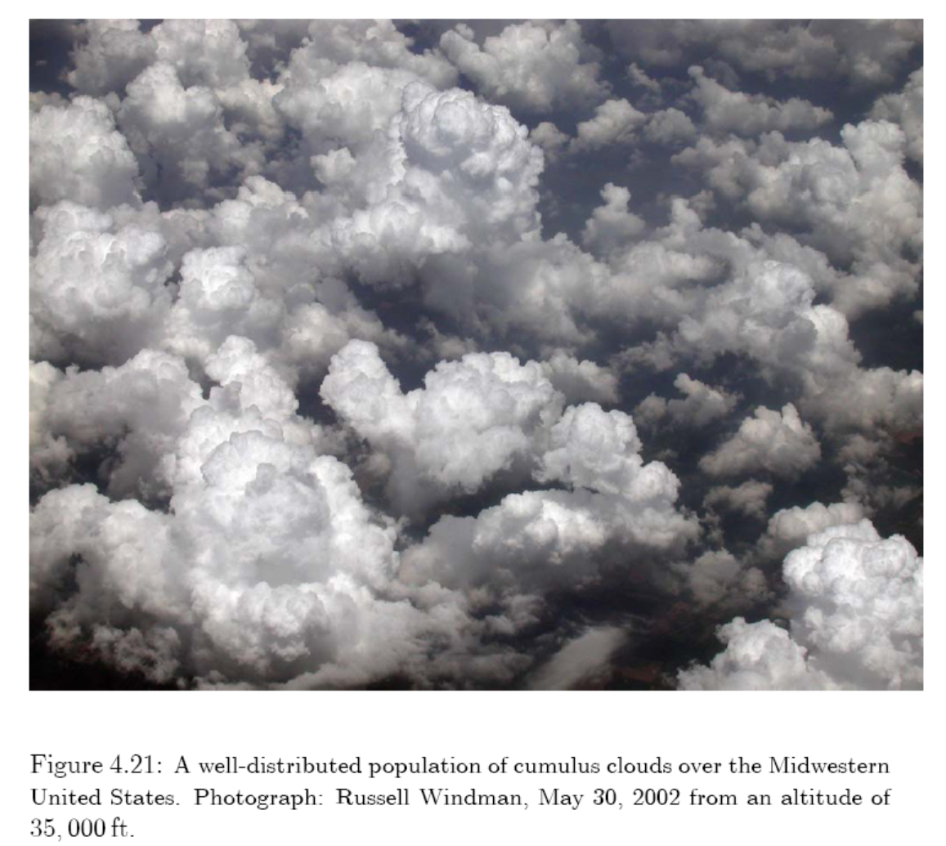
Cumulus Clouds from Shallow Convection

Slide 14
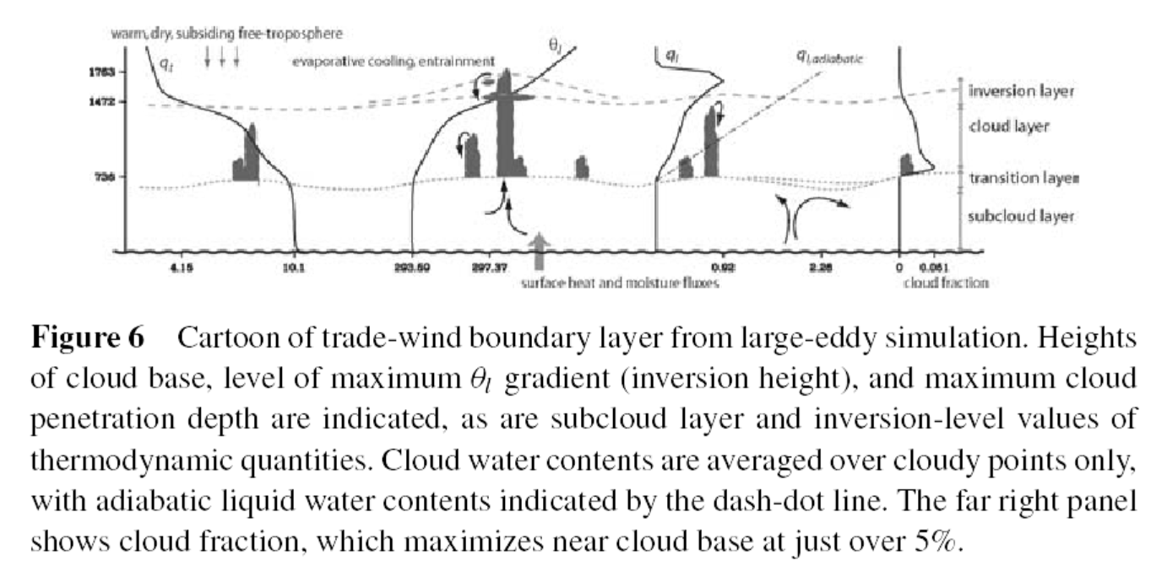
Shallow Cumulus Convection
Moist convection within shallow cumulus clouds. It is the most common moist convection in the lower troposphere over oceans and warm-season continent. It helps maintain atmospheric T and q structure in trade winds and other regions.

Slide 15

Stratocumulus Layer

Slide 16
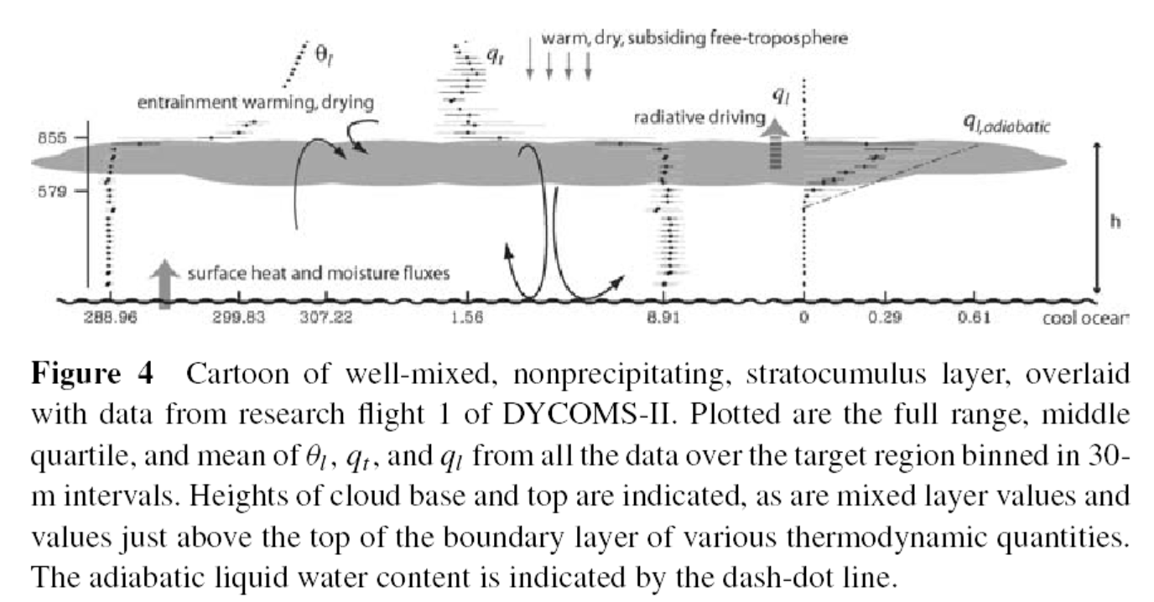
Stratocumulus Convection
Moist convection within a shallow layer of marine cumulus clouds, often over relatively cold SSTs in the eastern Pacific and Atlantic Ocean.

Slide 17
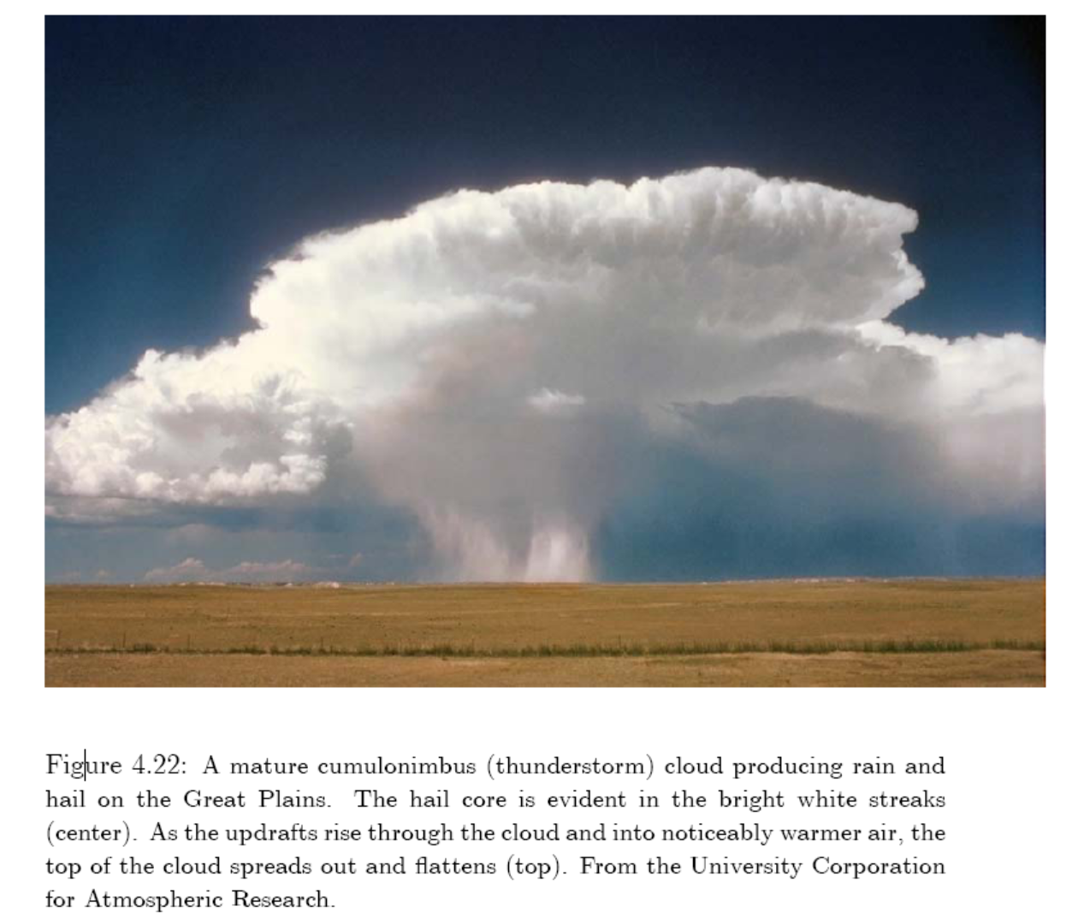
A Cumulonimbus Cloud from Deep Convection

Slide 18
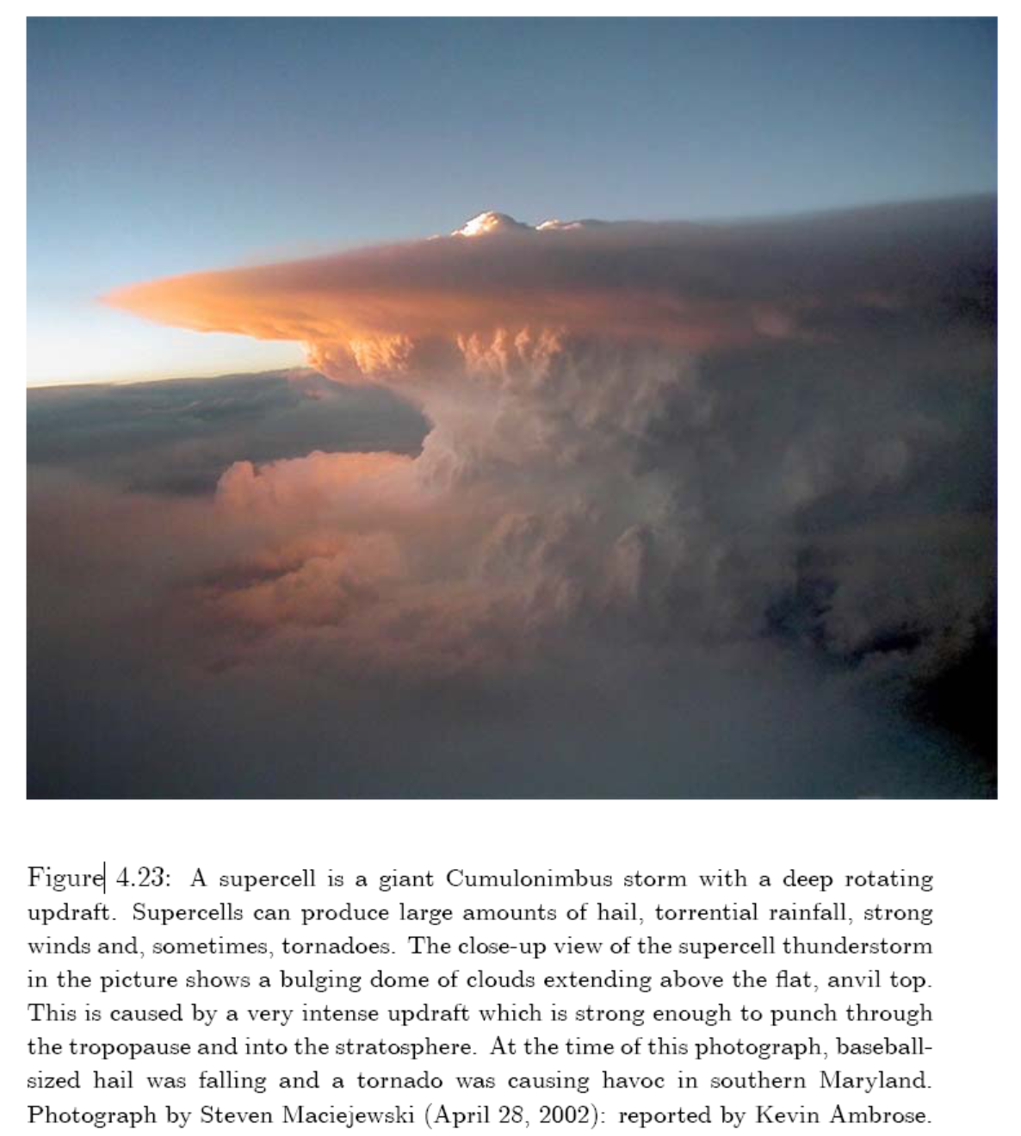
A supercell is a giant Cumulo-
nimbus storm with a deep
rotating updraft (i.e., upward
motion).

Slide 19
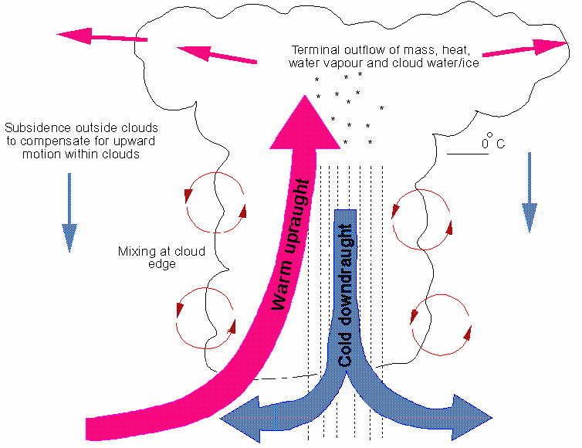
Deep Cumulonimbus Convection
Precipitating moist convection within a deep (10-18km) cumulonimbus cloud, often in the tropics and over mid-low latitude land in summer.
Entrainment
Detrainment

Slide 20
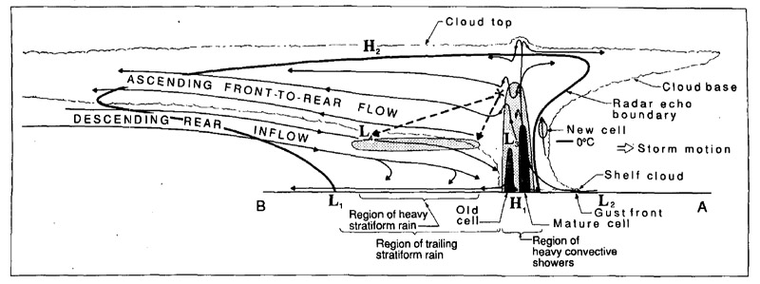
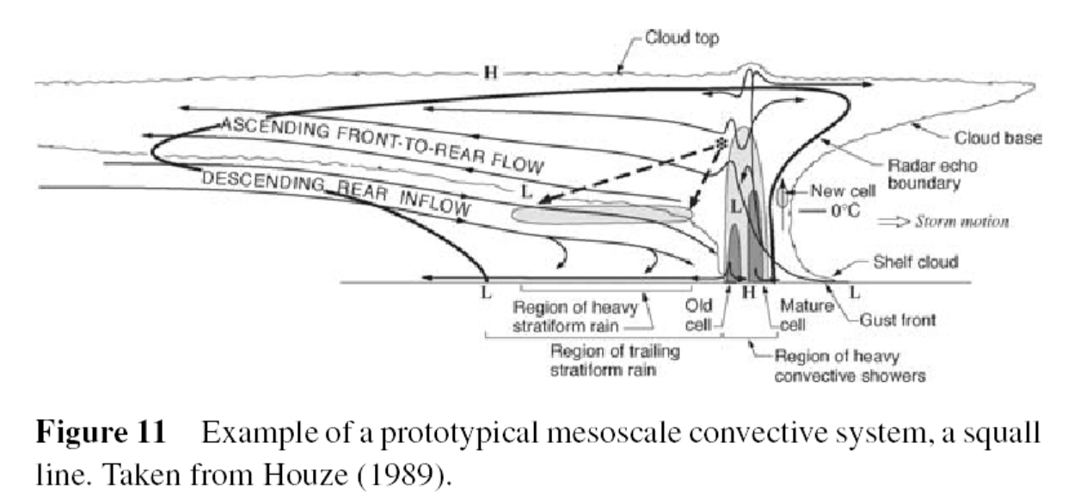
Mesoscale Convective System

Slide 21
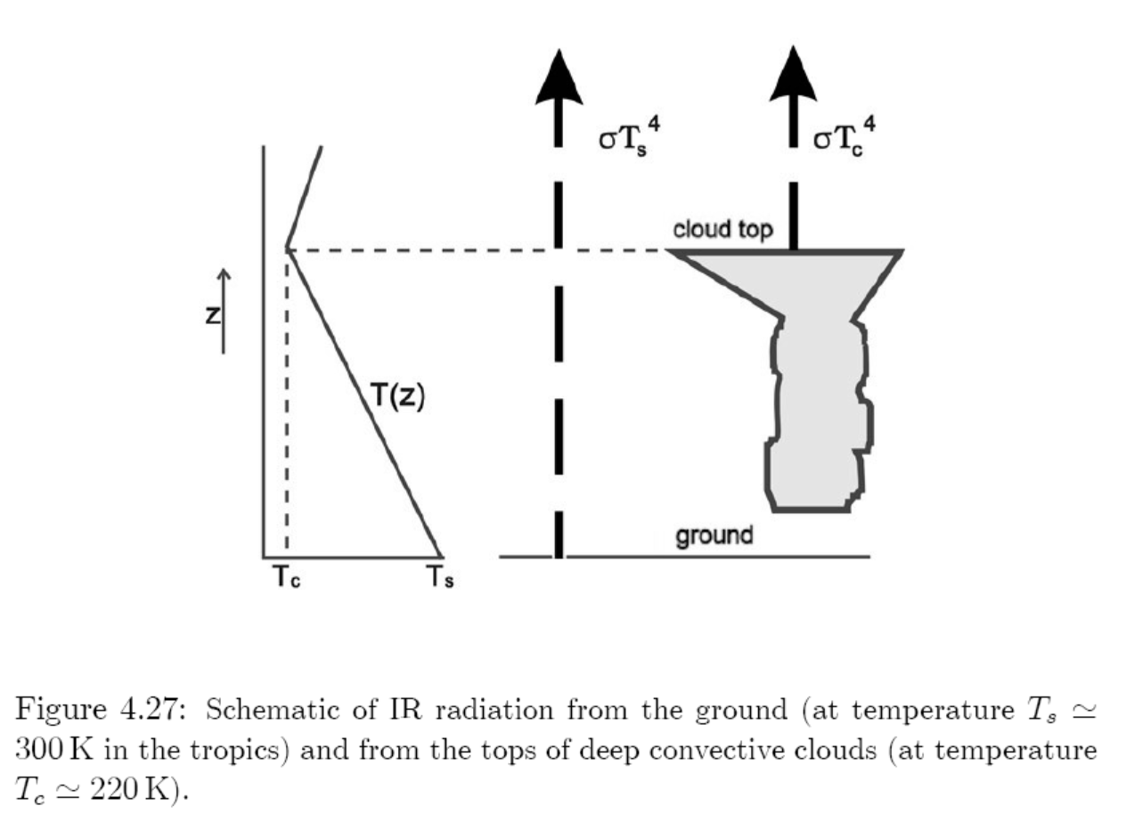
Impact of Deep Convection on OLR

Slide 22
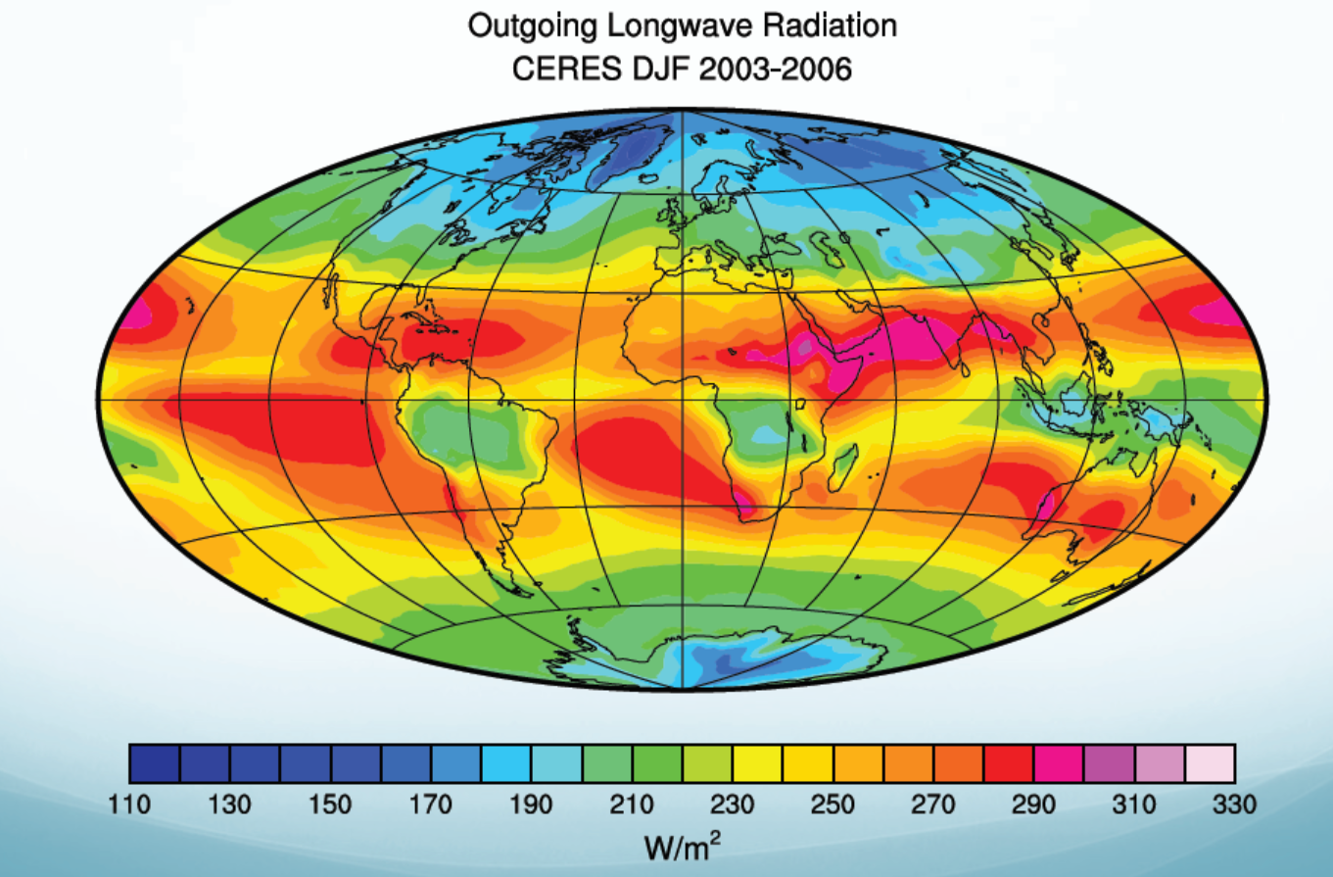
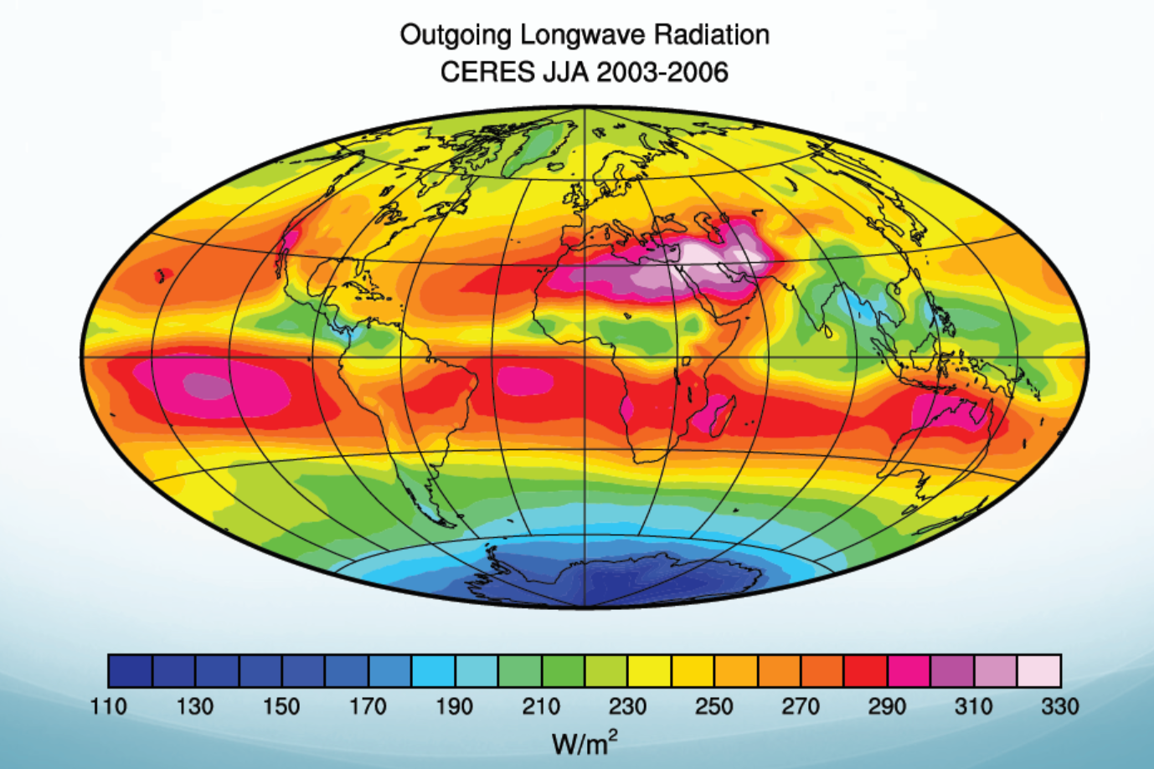
Where Does Deep Convection Occur?
DJF OLR
JJA OLR

Slide 23
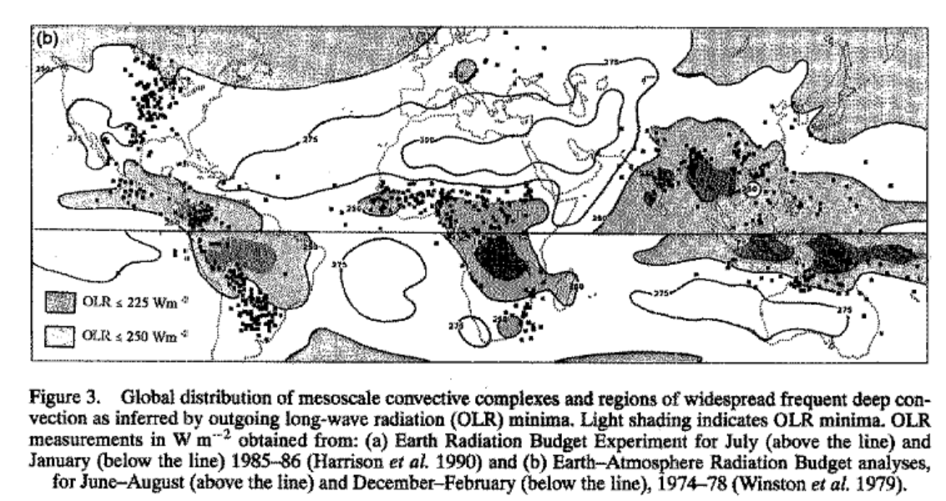
Distribution of Summer Deep Convection
(shaded areas)
Laing & Fritsch 1997

Slide 24
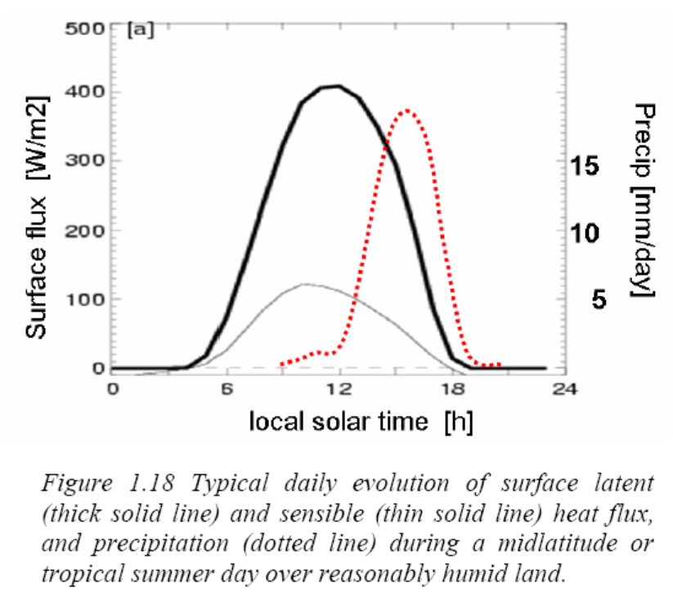
Diurnal Cycle of Summer Land LH, SH and Precip.
LH
P
SH

Slide 25
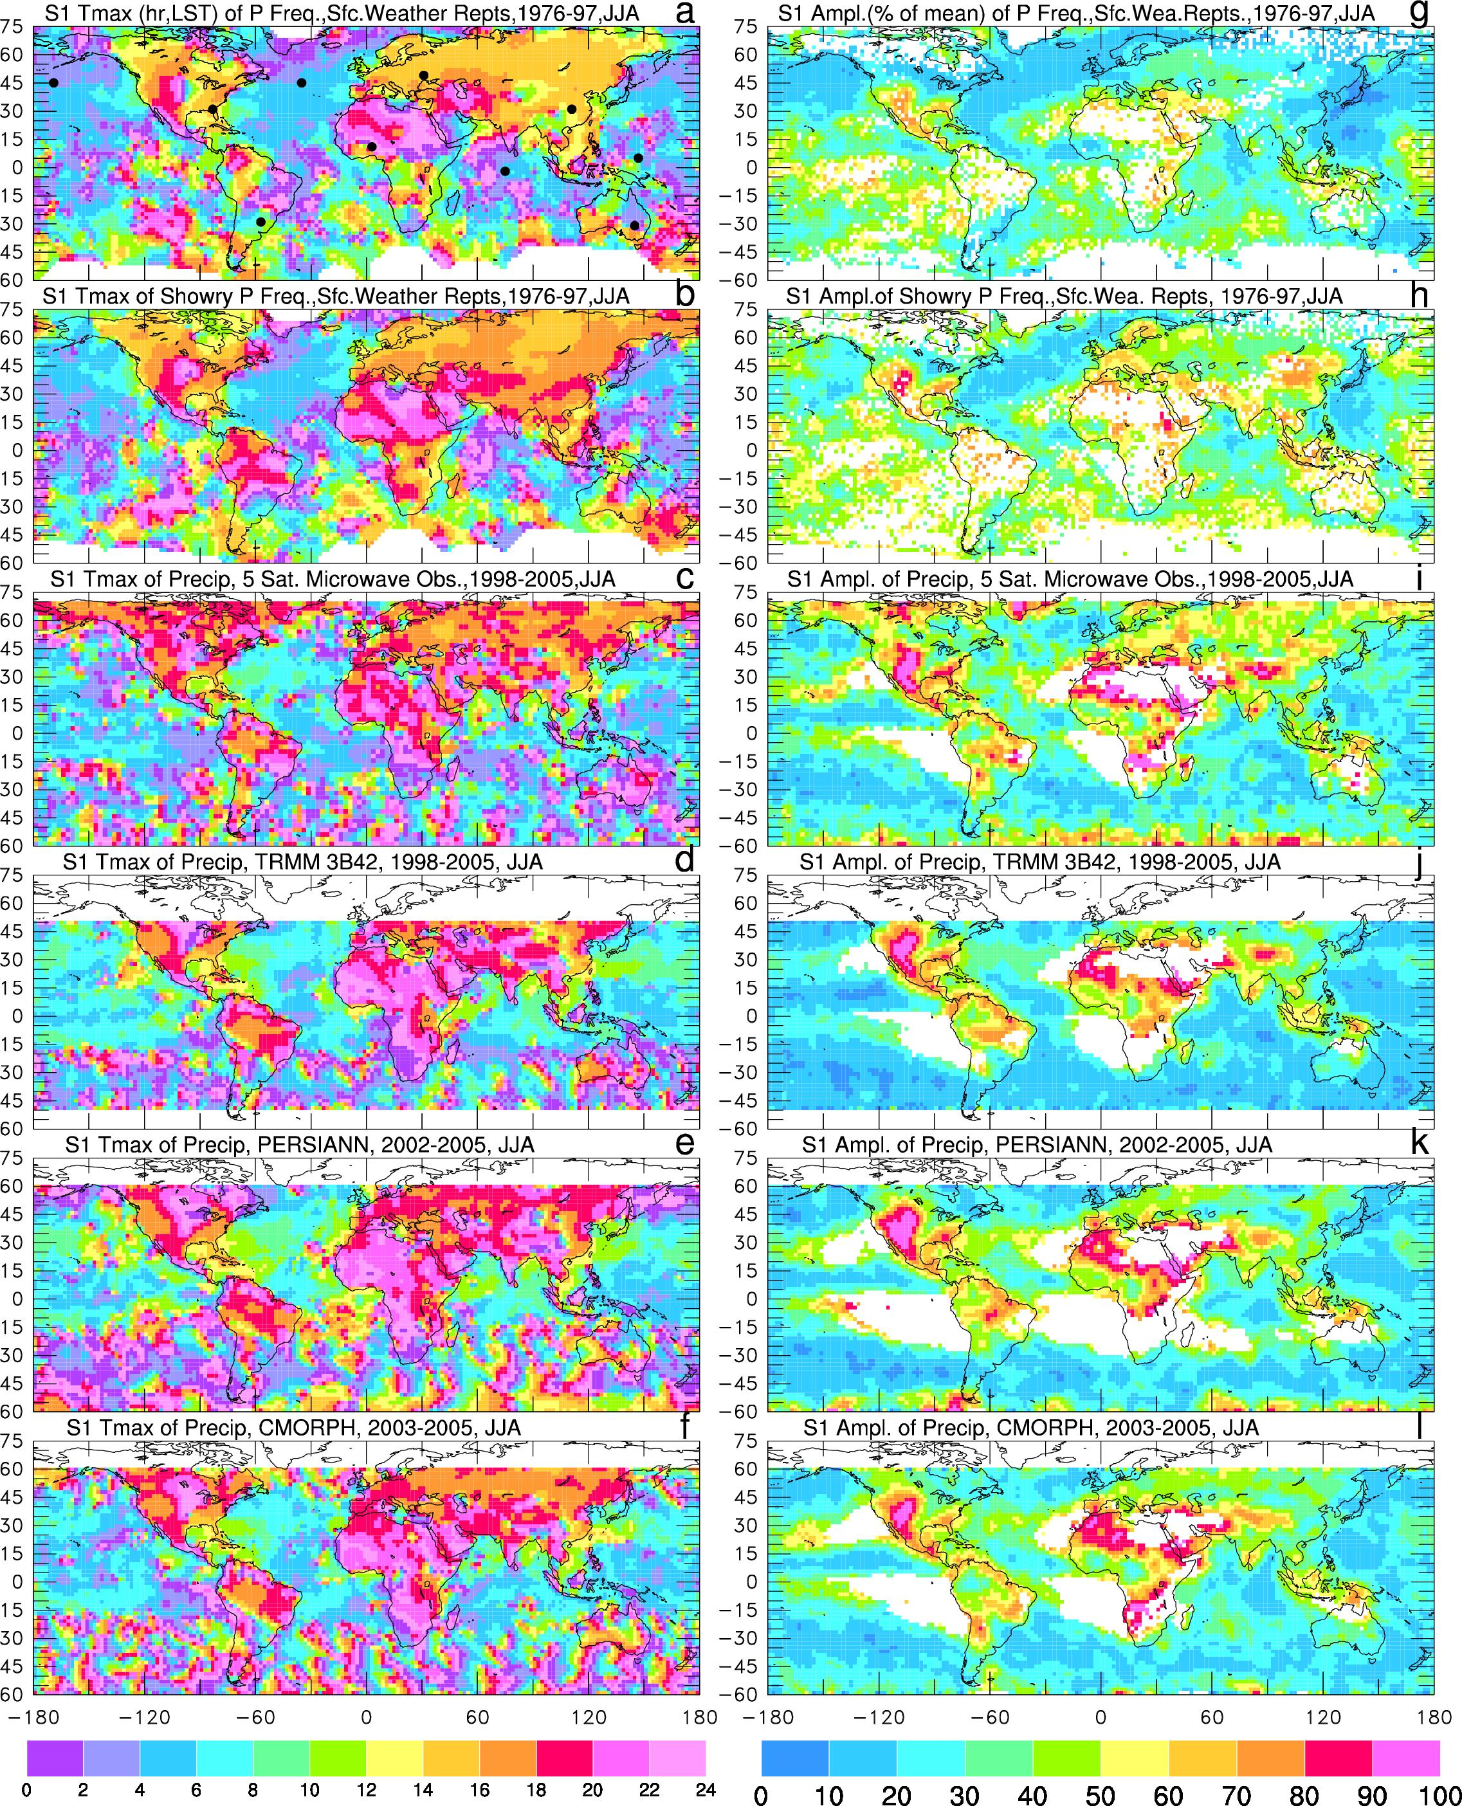
Diurnal Cycle of Convective Precipitation
(based on surface obs.)
Phase (Local Solar Time of the maximum)
Amplitude (% of daily mean)
Dai 2001

Slide 26


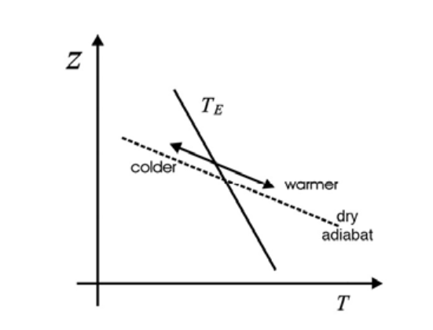
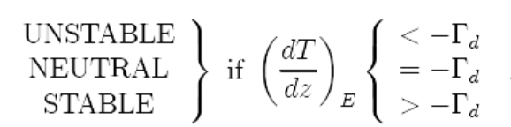
Quantifying Convection – Dry Convection
Energy change to a displaced air parcel:
For dry adiabatic convection, no latent heating and δQ=0 →
Γ_{d} is the dry adiabatic lapse rate.
stable
unstable
TE
Unstable T → convection
Stable T → oscillations →
gravity waves
Unstable if T decreases faster
than the dry adiabat. Why?

Slide 27
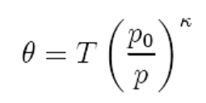
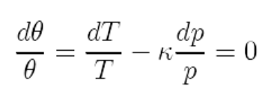
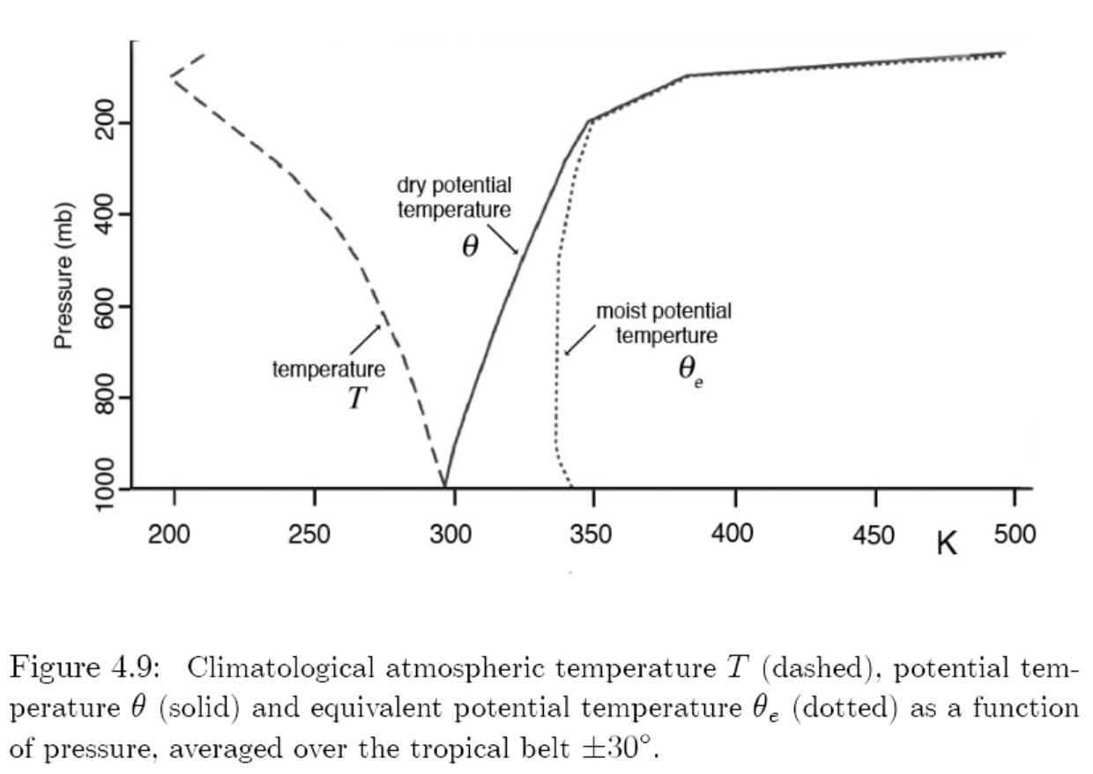
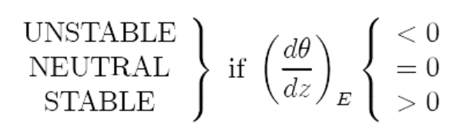
Dry Convection – Potential Temperature
Potential Temperature (θ) is the T of a parcel moved adiabatically to p_{o}=1000mb. κ = R/c_{p} = 2/7 , θ is conserved in adiabatic movements.
The atmosphere is usually stable for dry convection,
i.e., dθ/dt >0
Notes:
Mu = micrometer = E-6m nanometer (nm)=E-9m

Slide 28
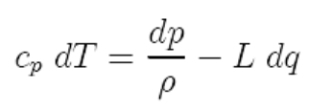
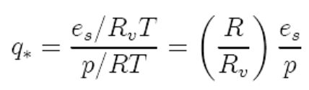

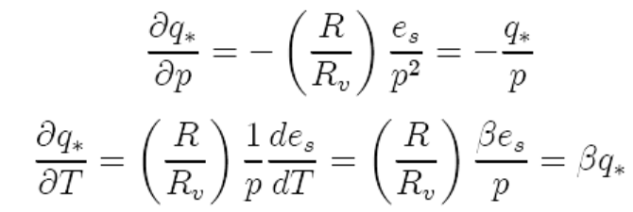
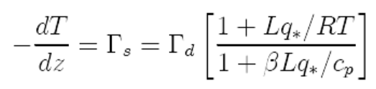
Moist Convection
The atmosphere is usually stable to dry convection (i.e., -dT/dz <9.8ºC/km)
Yet convection does occur in the atmosphere. Why?
Latent heating is important!
Energy balance of a moist air parcel with condensation:
                note: dq is negative. Assume liquid water is
                immediately removed from the parcel.
                - If q is always at saturation in the parcel, then
∼
Saturated adiabatic lapse rate
or pseudo-adiabatic lapse rate:
Γs varies with T and q. It ranges from ∼3ºC/km in the moist lower tropical troposphere to ∼9.8ºC/km in the upper troposphere.
Notes:
Note (–L dq) is positive heating to the parcel.

Slide 29
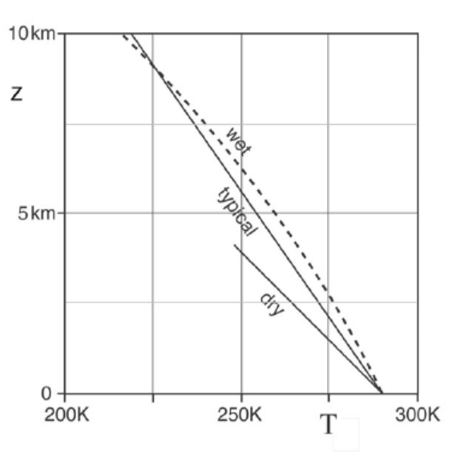
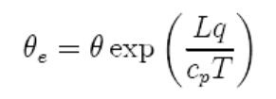
Moist Convection
Conditional instability: unstable after air parcel reaches (e.g., due to turbulence lifting) saturation level but stable for dry convection:
- Typical atmospheric T profile:
Tropical atmosphere is close to
neutral for moist convection,
i.e., dT/dz ≈ - Γs
Equivalent Potential Temp:
θe is conserved following both dry and moist adiabat.
Typical wet adiabat
Typical T profile
Dry adiabat

Slide 30
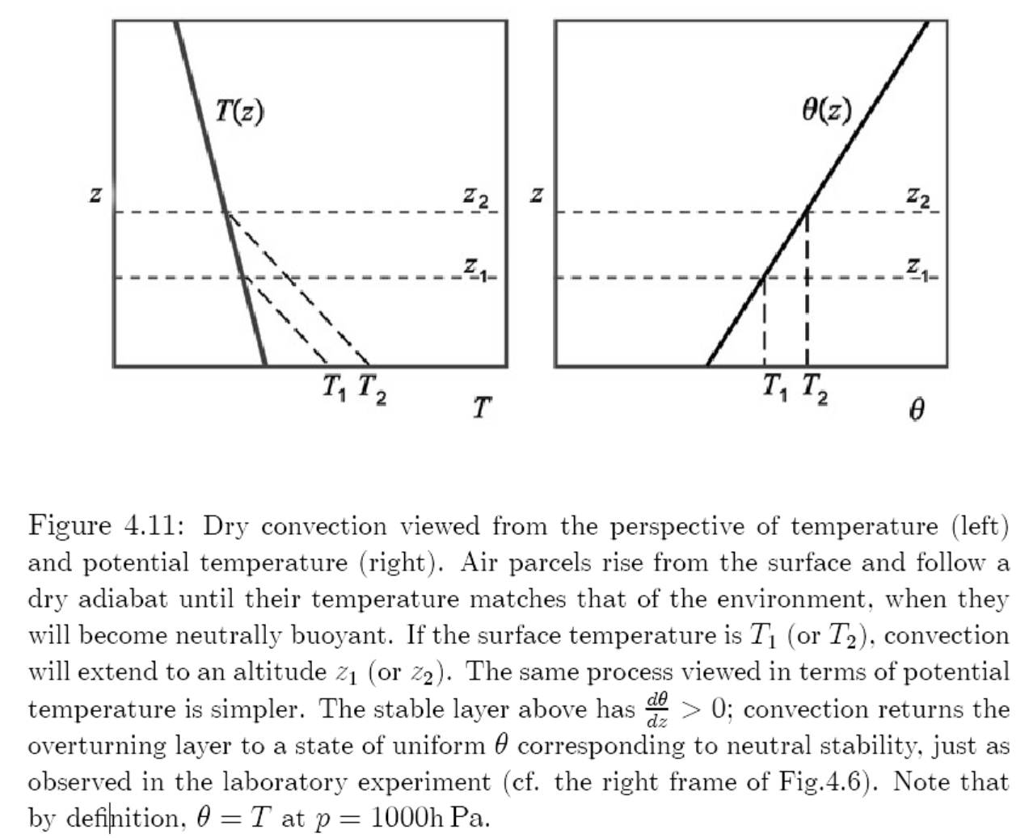
Buoyancy is negative after passing the zero buoyancy point!
Zero buoyancy
Zero buoyancy
dry adiabat
Dry Convection Path
Notes:
Buoyancy is negative after passing the zero buoyancy point!

Slide 31
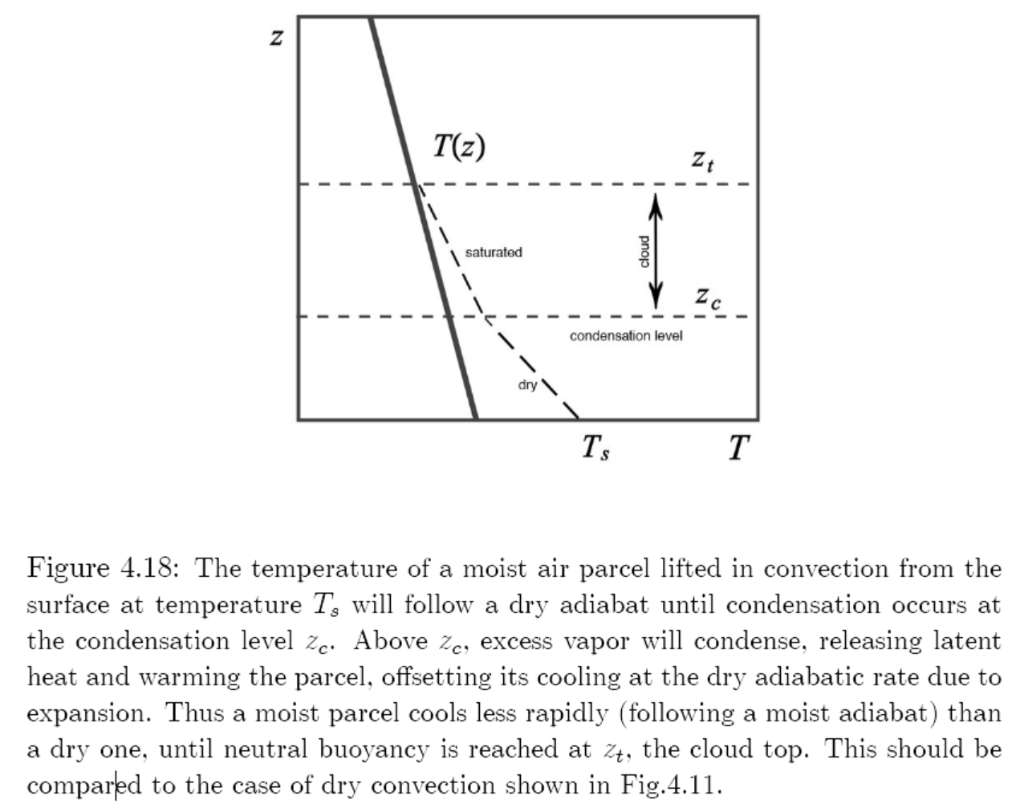
Buoyancy is negative after passing the neutral buoyancy point!
Level of Neutral Buoyancy
moist adiabat
Lifting condensation level (LCL)
dry adiabat
Moist Convection Path

Slide 32
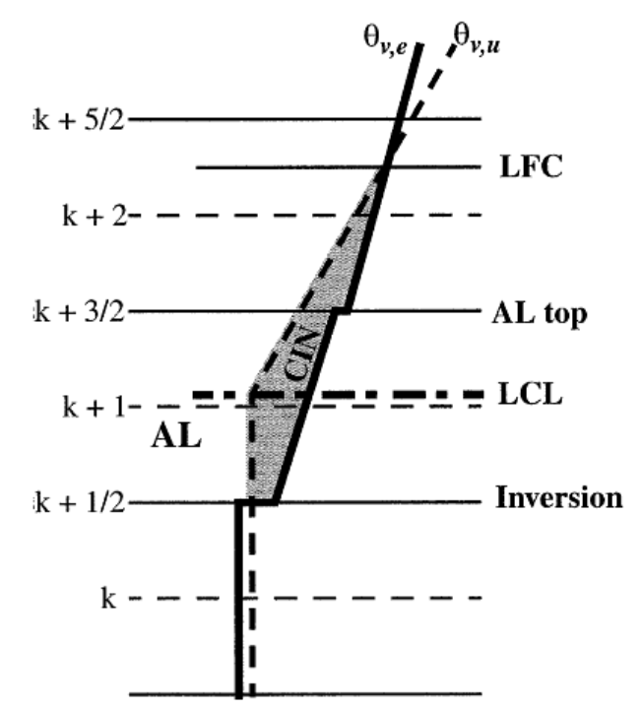

Positive Buoyancy
(≈ )
Level of free convection
Negative Buoyancy
Lifting condensation level
parcel
atmosphere
Potential Temp.

Slide 33
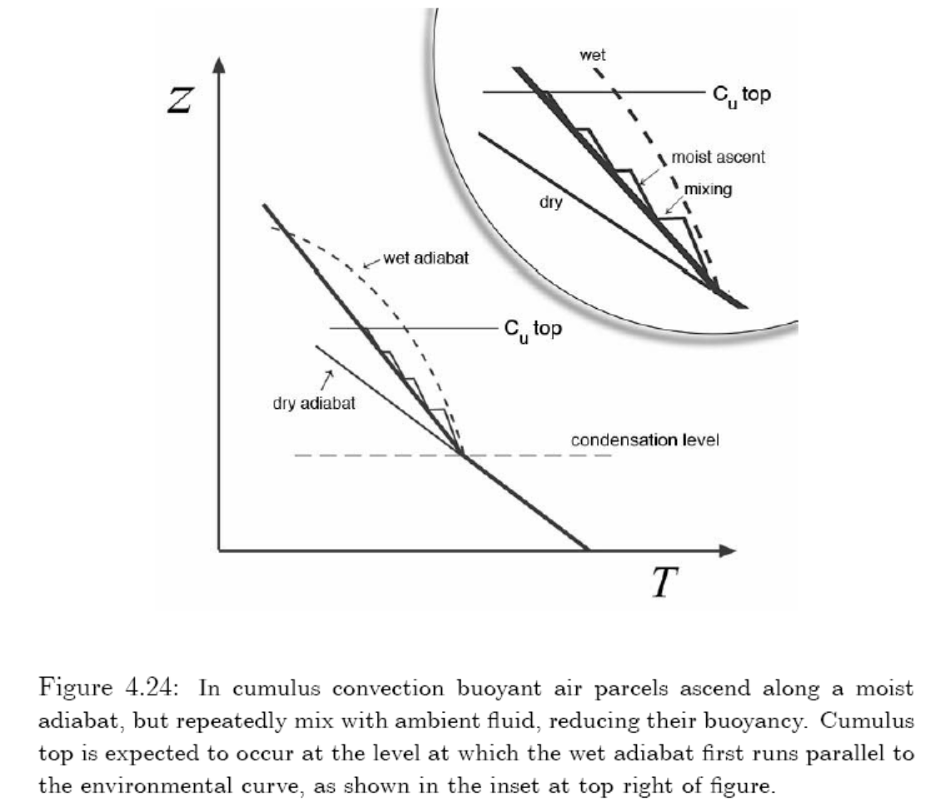
Mixing or entrainment of ambient air
into the cloud reduces
buoyancy inside the
cloud.
Mixing or detrainment of
cloudy air into the
environment shrinks
the cloudy area.
Entrainment
Detrainment

Slide 34
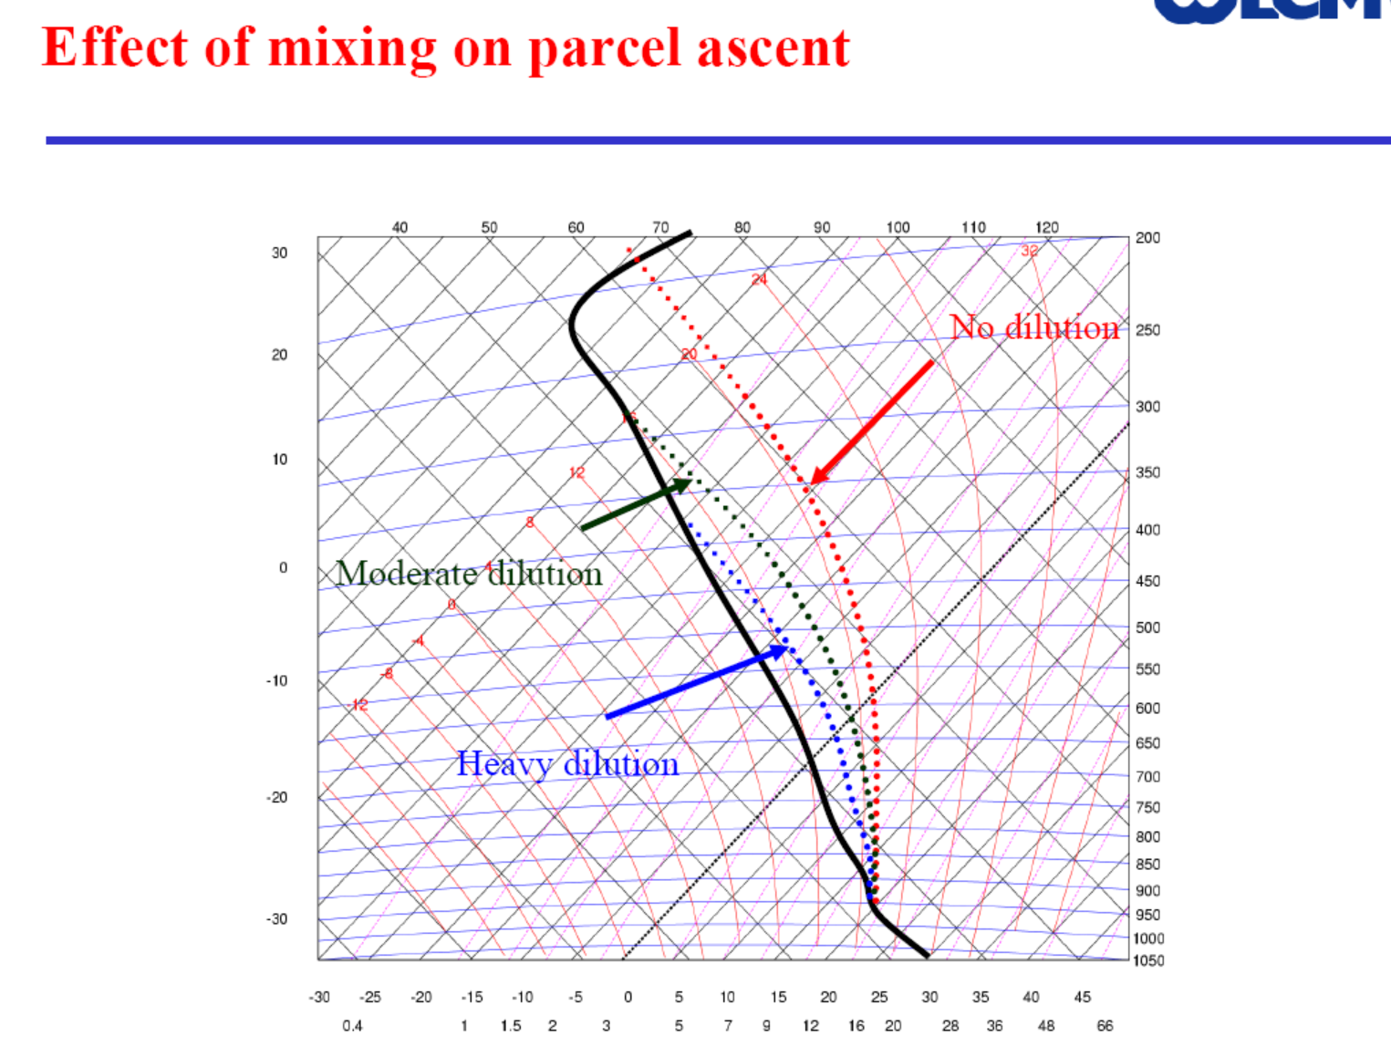
A Skew-T Diagram
Eq. Potential Temp.
Isotherms
Isobars
Environment
Dry adiabats
Notes:
A Skew-T diagram:

Slide 35
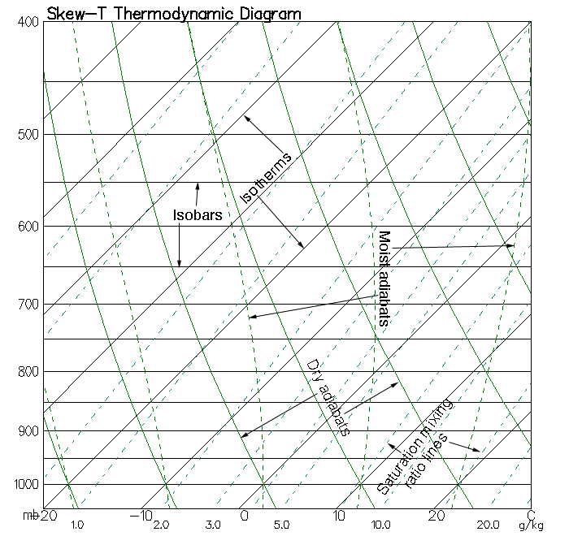
How to read a Skew-T diagram

Slide 36
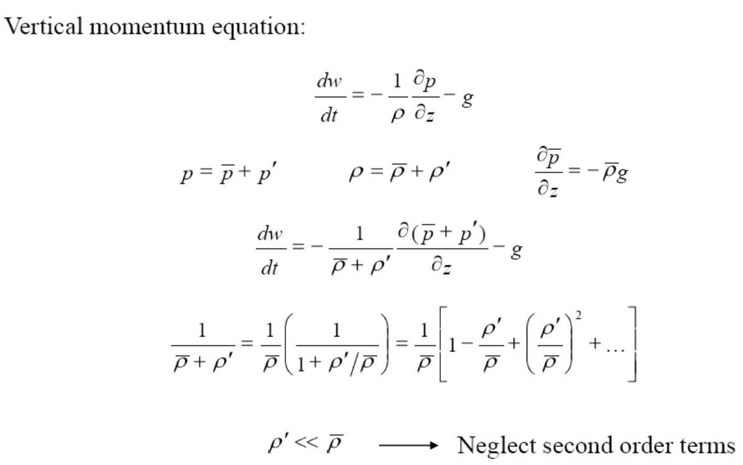
Buoyancy of A Lifted Parcel (1)
w
ρ’ and p’ can be considered as the difference between the environ. and the parcel

Slide 37
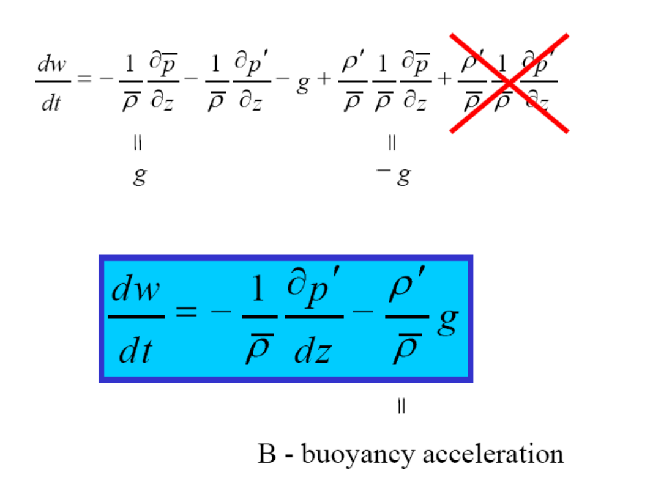
Buoyancy of A Lifted Parcel (2)
∂

Slide 38
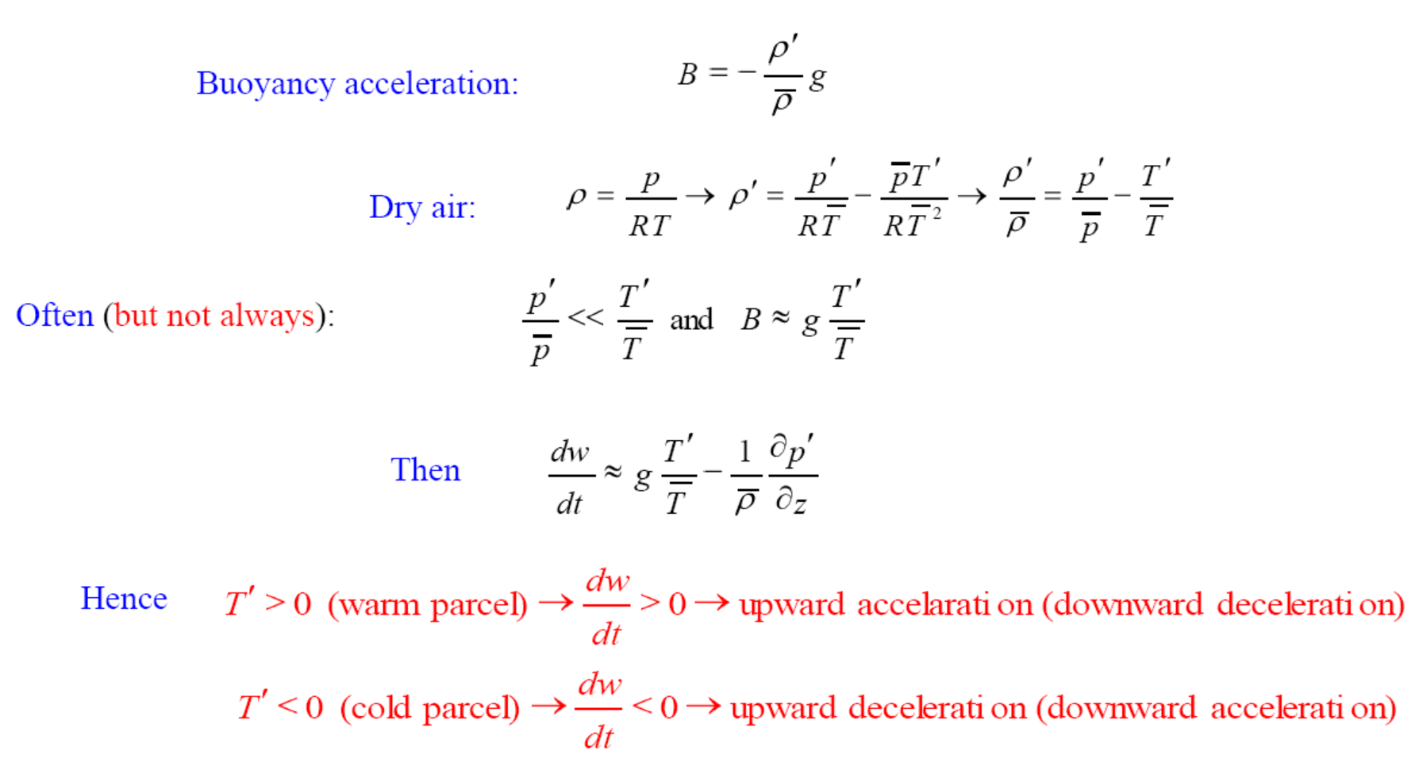
Buoyancy of A Lifted Parcel (3)
p’ and T’ can be considered as the difference between the environ. and the parcel

Slide 39
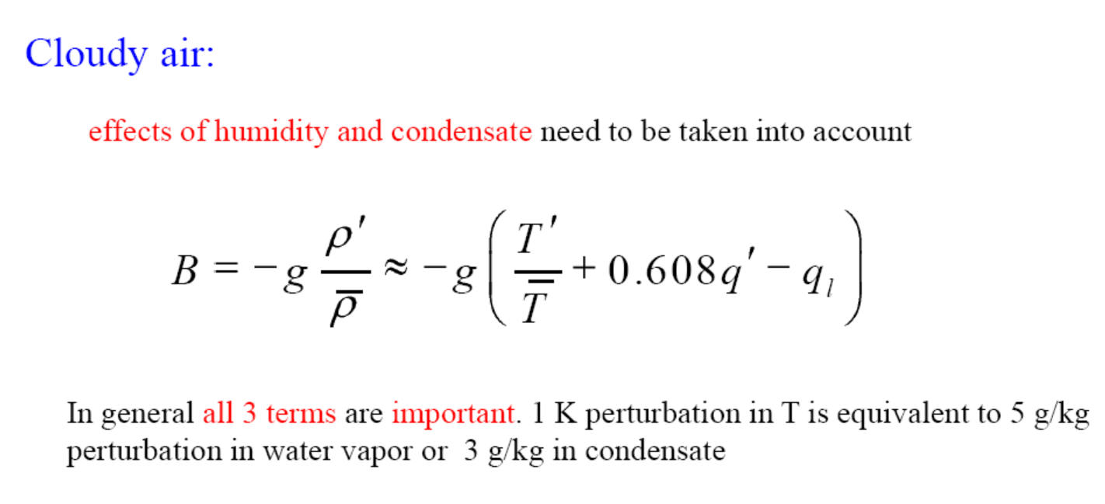
Buoyancy of A Lifted Parcel (4)
T’ and q’ can be considered as the difference between the environ. and the parcel,
q_{l} is the liquid water content in the parcel.
q’ = water vapor perturbation, q_{l}=condensate in clouds
Notes:
q’ = water vapor perturbation, q_{l}=condensate in clouds

Slide 40
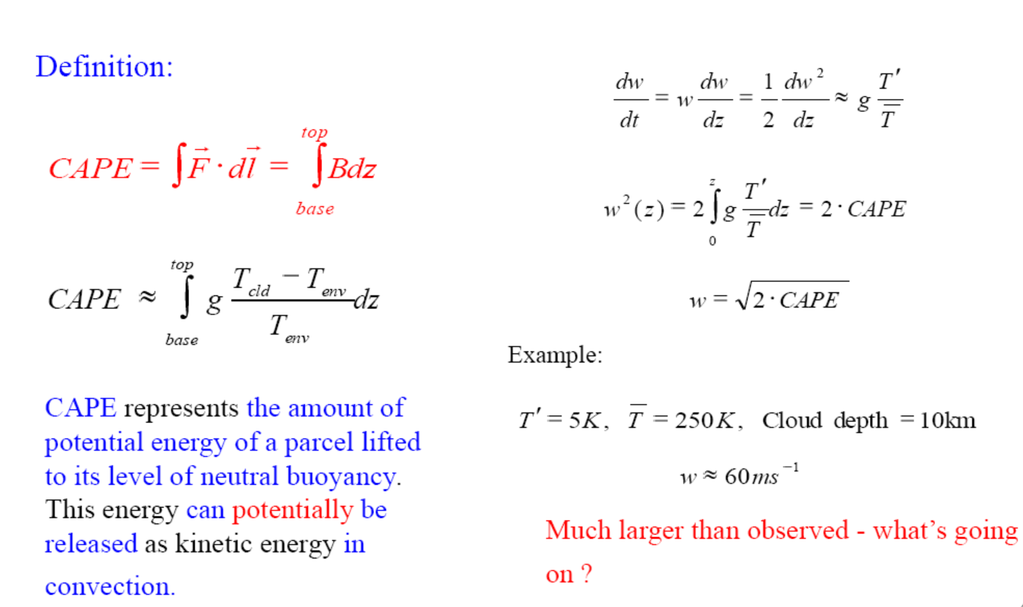
Convective Available Potential Energy (CAPE)
in m²/s²
For most applications:
R=287 J K⁻¹ kg⁻¹, T_{vp} and T_{ve} are virtual Temp(=T+0.61q) for the parcel and environ.
Notes:
Tv=T(1+0.61q)

Slide 41
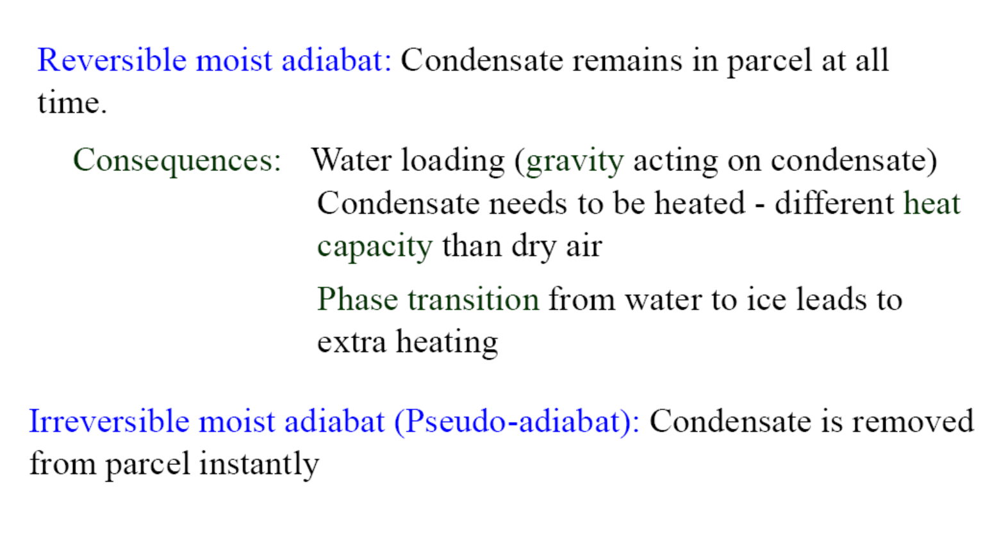
Choice of Moist Adiabat for CAPE Calculations:
→ Smallest CAPE
→ Largest CAPE
Reality is somewhere between these two extremes!

Slide 42
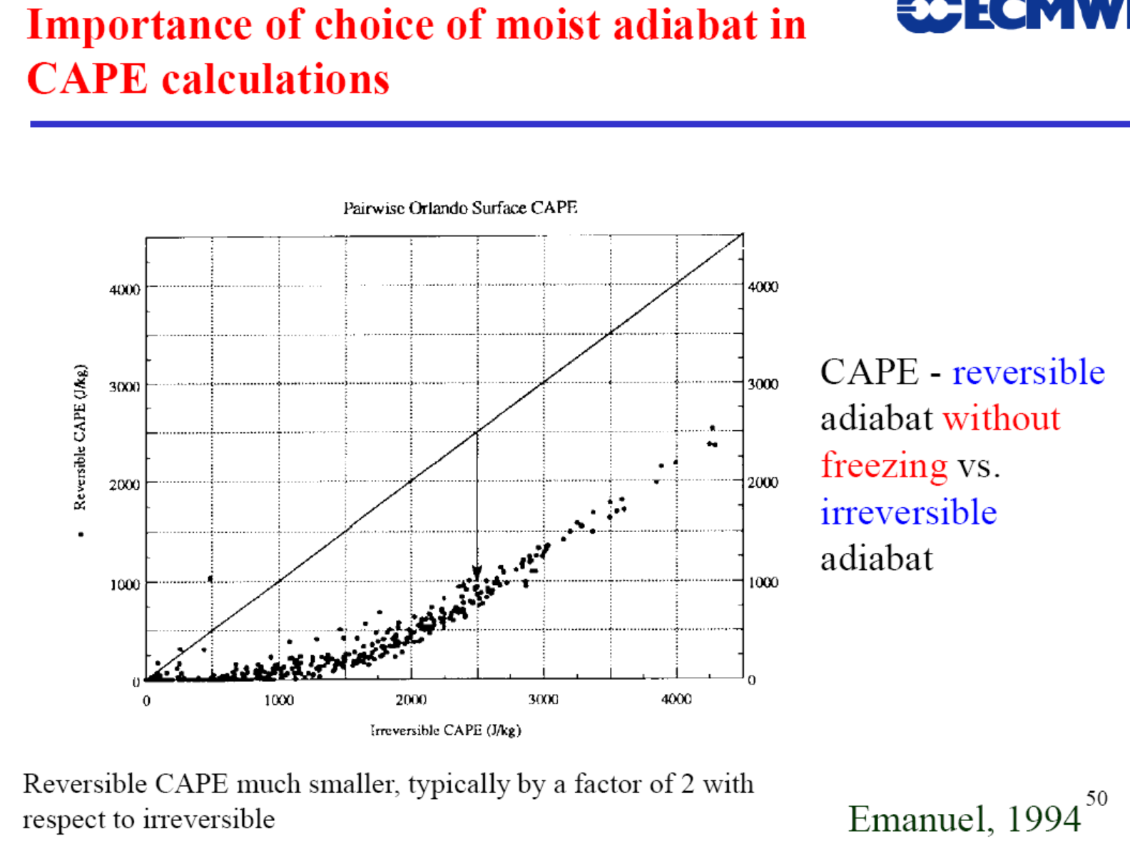
R=287 J K⁻¹ kg⁻¹, T_{vp} and T_{ve} are virtual Temp(=T+0.61q) for the parcel and environ.
Notes:
Reversible – keep the condensation inside the parcel
Irreversible – remove the condensates immediately

Slide 43
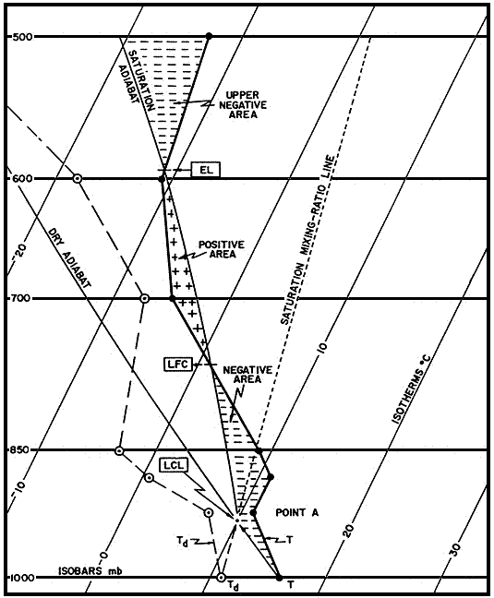
Buoyancy of A Lifted Parcel (5)
Equilibrium Level
CAPE
Level of Free Convection (LFC)
CIN
Lifting condensation level (LCL)

Slide 44
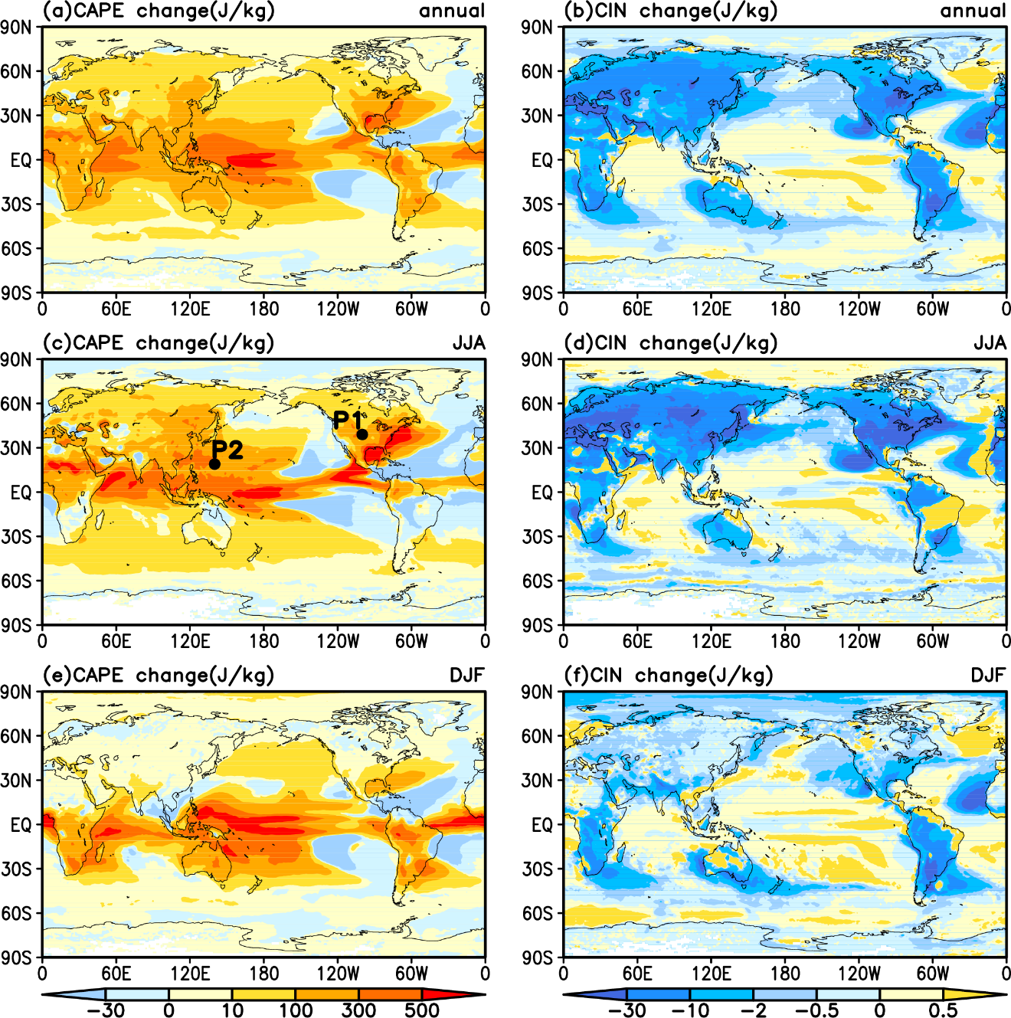
CAPE and CIN Change from 1980-1999 to 2081-2100, CCSM4, RCP8.5
Chen et al. (2020, J.Clim)
Notes:
Distributions of the annual (top), JJA (middle) and DJF (bottom) changes in CAPE (left, J/kg) and CIN (right, J/kg) from 1980-1999 to 2081-2100 with the CAPE=0 cases excluded under the RCP8.5 scenario calculated using CCSM4 6-hourly data.

Slide 45
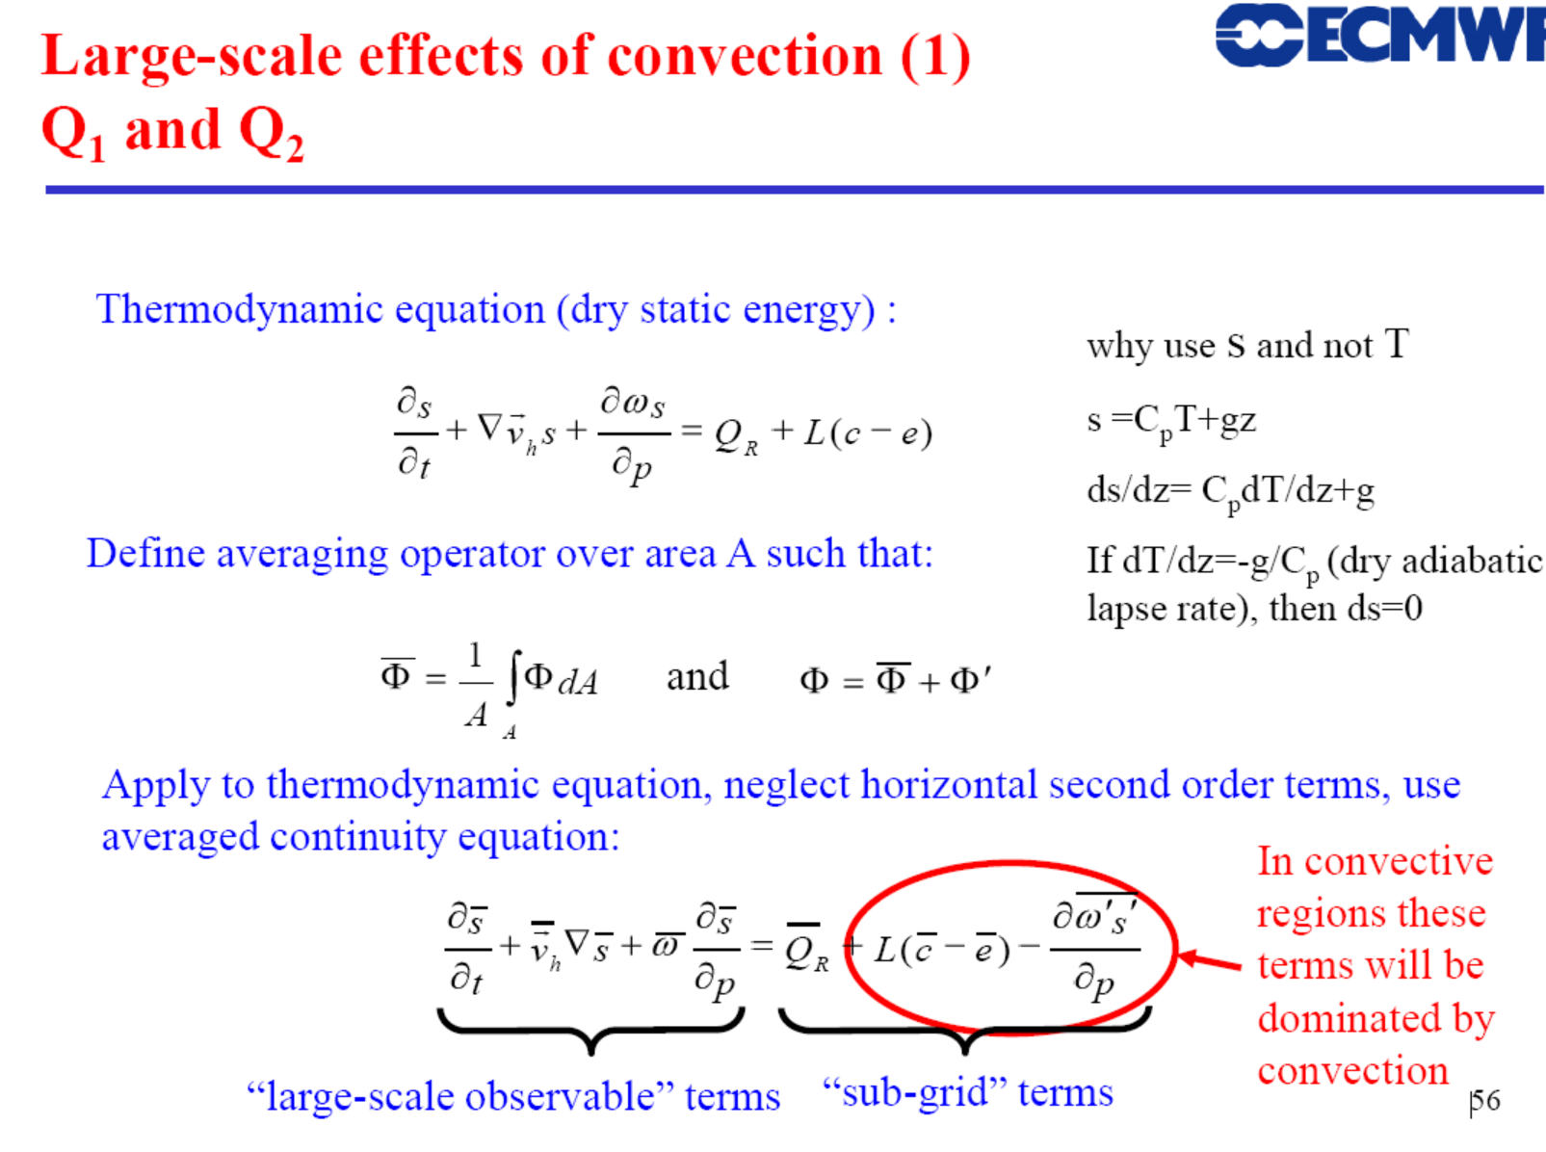
c = condensation rate
e = evaporation rate
Q_{R}=net radiative flux

Slide 46
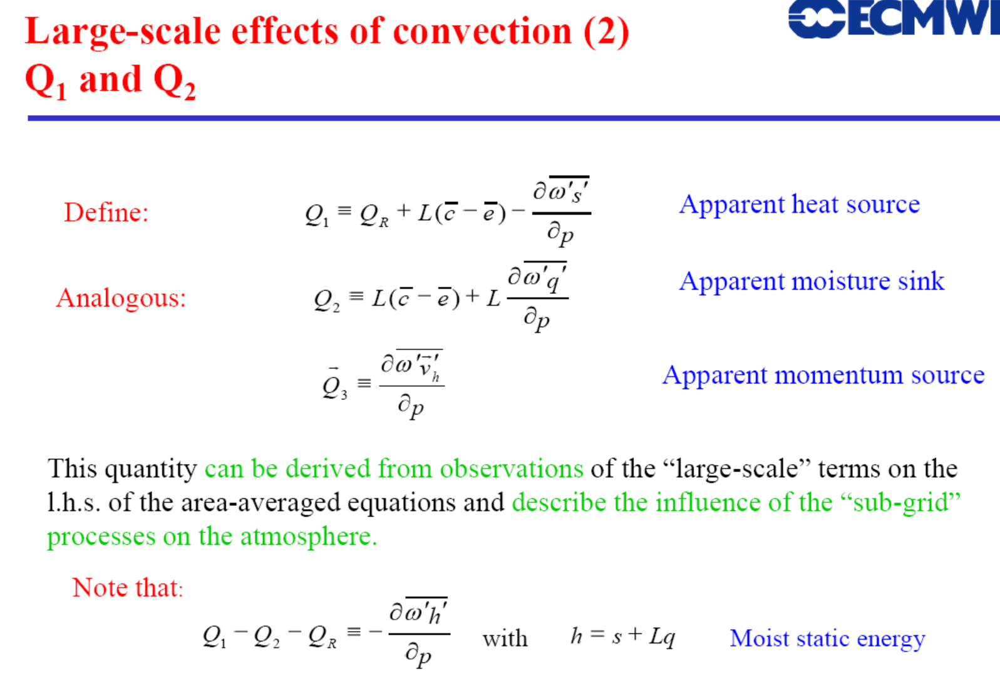
(Q_{R}=radiative flux)

Slide 47

Radiative cooling

Slide 48

due to low-level convergence

Slide 49
Summary
Convection occurs due to enhanced solar heating near the surface, which increases atmospheric instability (i.e., making T increases faster downward than a stable atmosphere).
It transports energy and moisture from the boundary layer to the middle and upper troposphere, where LW radiation can escape to space. This leads to a radiative-convective equilibrium in the tropics.
Convection affects the atmosphere through condensation, evaporation and vertical eddy transports of energy, moisture, and momentum.
The Q₁ (heating), Q₂ (moisture sink), and Q₃ (momentum transport) fluxes quantify the impacts of convection (sub-grid scale) on the environment (resolved scale in a GCM).
On a large scale, the stabilizing effect of convection balances the destabilizing effect of solar heating and other large-scale forcing.
The mean state of the atmosphere is close to the moist adiabat (i.e., neutral for moist convection); but locally and at times, conditional instability (i.e., positive buoyancy above LCL) exists in the tropics and warm-season mid-latitudes.
CAPE represents the potential energy available for convection between the Level of Free Convection and Level of Neutral Buoyancy.
Below LFC, there is often some negative buoyancy (convective inhibition or CIN) for a parcel to overcome (e.g., by turbulence lifting).
There are three common types of convection: shallow cumulus, shallow stratocumulus, and deep cumulonimbus convection. Shallow cumulus convection is most common over the oceans and warm-season land.

Slide 50
After class Assignments:
- Reading Assignments:
MIT textbook by Marshall and Plumb, chapter 4
(http://paoc.mit.edu/labweb/notes/chap4.pdf)
Stevens, B., 2005: Atmospheric Moist Convection. Annu. Rev. Earth Planet. Sci. 2005. 33:605–43
Bechtold, P., 2009: Atmospheric Moist Convection. ECMWF Lecture.
(Both are available at the course website under “OtherReadingMaterials”)
- Review my ppt slides
- Think about following questions (not a homework assignment):
Briefly describe the major types of convection in the atmosphere. (20%)
Define following: (a) dry lapse rate; (b) moist lapse rate; (c) potential temperature; and (d) CAPE. (30%)
What are the major effects of atmospheric convection on the mean state of the atmosphere? (20%)
4. Assume the atmosphere is in hydrostatic balance and isothermal with a temperature of 280K (i.e., T=280K everywhere). Determine the potential temperature at altitudes of 5km,10km, and 20km above the surface. If an air parcel were moved adiabatically from 10km to 5km, what would its temperature be on arrival? (30%)

Slide 51
Next Lecture:
Air-Sea and Land-Air Interactions

